Slide 1



Revised National Tuberculosis Control Programme
Overview - Key Priorities
Dr K S Sachdeva
Deputy Director General, Central TB Division
Revised National Tuberculosis Control Programme
Ministry of Health and Family Welfare

Slide 2
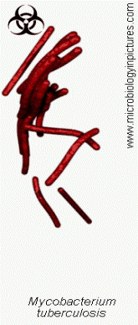
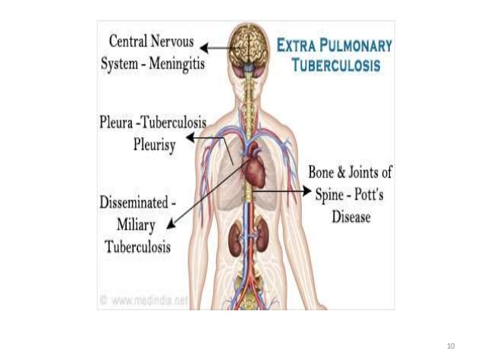
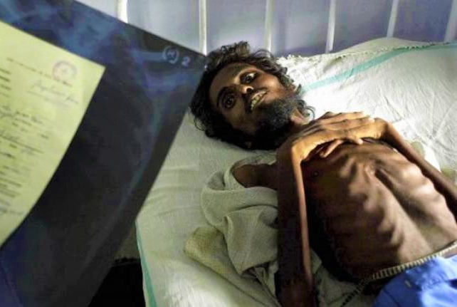
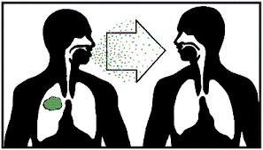
What is Tuberculosis?
Tuberculosis (TB) is an infectious disease caused by the bacterium Mycobacterium tuberculosis (MTB)
Tuberculosis generally affects the lungs, but can also affect other parts of the body
One patient with infectious pulmonary TB if untreated can infect 10-15 persons in a year

Slide 3
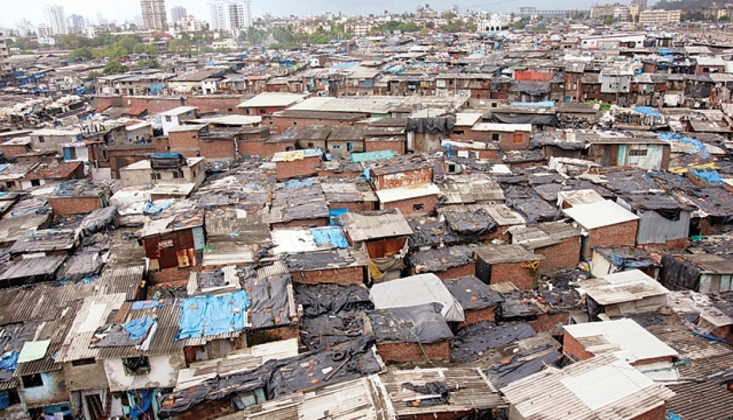
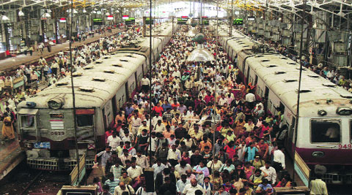
Risk factors
Medical
  Malnutrition
  Diabetes
  HIV infection
  Low body weight
  Severe kidney disease
  Other lung diseases (silicosis)
  Substance abuse etc.
Environmental
  Overcrowding
  Inadequate ventilation
  Enclosed living/working conditions
  Occupational risks
Notes:
Anyone can become infected with TB simply by breathing in the germs
Once infected, the chances of developing active disease increases when the immunity goes down due to
Babies and young children often have weak immune systems which increases their susceptibility to TB

Slide 4
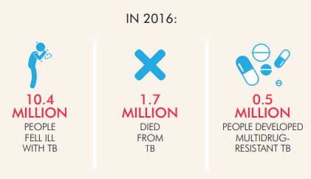
The TB threat is REAL in India
28 Lakh people fell ill from TB
4.2 Lakh people died from TB
1.4 Lakh people had drug-resistant TB
Missing million TB patients
1 patient dies every minute
Less than 50% treated successfully
WHO Global TB Report 2017

Slide 5
In India…….
40 crore infected
35 lakh estimated
TB patients annually
4.2 lakh deaths
Due to TB annually

Slide 6
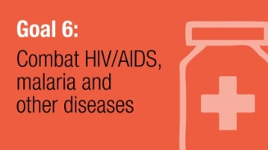
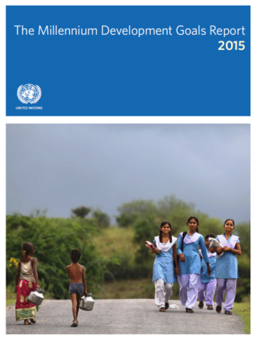
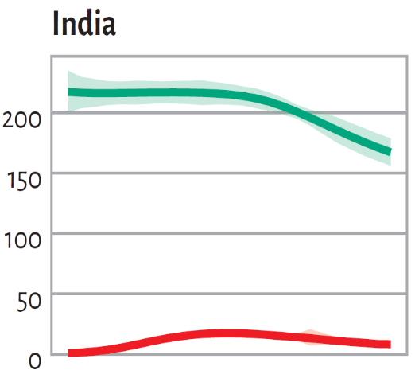

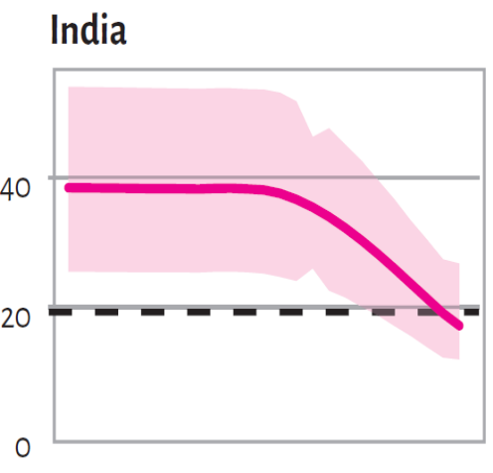


India: MDG6 TB target
TB EPIDEMIC REVERSED
50% DROP IN TB MORTALITY
50% DROP IN TB Prevalence
Rate per 100,000 population
35 lakh additional lives saved
HIV
New cases declining
All cases reduced by half
Deaths reduced by half
465 → 195 per lakh pop
(58% reduction)
Achieved
38 → 17 per lakh pop
(55% reduction)
216 → 167 per lakh pop
(23% reduction)
WHO Global TB Report 2016

Slide 7
Sustainable Development Goals (SDG)
Vision: A world free of TB
Zero TB deaths, Zero TB disease, and Zero TB suffering
Goal: End the Global TB Epidemic (<10 cases per 100,000 population)
INDICATORS | TARGETS
 | SDG 2030
Reduction in number of TB deaths compared with 2015 (%) | 90%
Reduction in TB incidence (new case) rate compared with 2015 (%) | 80%
TB-affected families facing catastrophic expenditures due to TB (%) | Zero

Slide 8
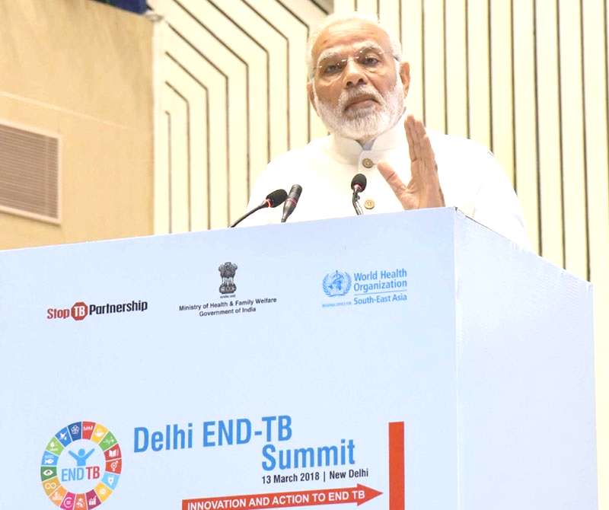

TB Free India
India has committed to End TB by 2025, 5 years ahead of the global SDG target
Prime Minister of India launched TB Free India campaign at ‘Delhi End TB Summit’ on 13th March, 2018
The campaign calls for a social movement focused on patient-centric and holistic care driven by integrated actions for TB Free India

Slide 9
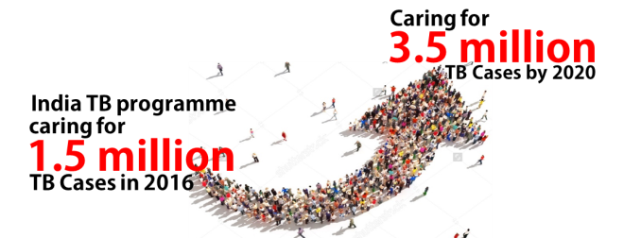
Strategies
Private sector engagement
Active Case Finding
ICT Tools for adherence and monitoring
Preventive Measures
TB
Co-morbidities
Drug Resistant TB
Multi-sectoral response
Community Engagement
National Strategic Plan (2017-25)

Slide 10

Organizational structure
Ministry of Health & Family Welfare
Central TB Division
State TB Cell
36 States / UTs
District TB Centre
733 Districts
TB Unit
One per 1.5 – 2.5 lakh population
Designated Microscopy Centre
One per 1 lakh population
Peripheral Health Institute
Supporting Facilities
National Institutes (6) National Reference Laboratories (6) Intermediate Reference Laboratories (29) State TB Training and Demonstration Centres (26) Culture and DST Laboratories (49) DR-TB Centres (148) CBNAAT Laboratories (1180)

Slide 11
Key Services
Free diagnosis and treatment for TB patient
Provision of rapid diagnostics
Testing of all TB patients for drug resistance and HIV
Management of associated diseases
Treatment adherence support
Nutrition assistance to TB patients
Preventive measures

Slide 12
Strategy to find
Active TB Case Finding
Reaching patients seeking care in Private Sector
High Sensitive Diagnostic tool

Slide 13
Treat
Treatment
Daily Regimen
Patient Centric Care
IT Enabled Adherence Support
Reduce Out-of-pocket Expenditure
Financial incentives
Direct Benefit Transfer
Shorter Regimen
Newer Drugs
Comorbidity management

Slide 14
Direct Benefit Transfer (DBT) schemes
Existing schemes:
  Honorarium to Treatment Supporters – For provision of treatment support to TB patients (Adherence, ADR monitoring, counselling @Rs.1000/- to Rs.5000/-)
  Patient Support to Tribal TB Patients (Financial Patient Support @Rs750/-)
New Schemes:
  Nutritional Support to All TB patients (Financial Support to Patients @Rs.500/-month)
  Incentives to Private Providers (Rs.500/- for Notification & Rs.500/- for Follow-up with Treatment Outcome @Rs. 500)
  Incentives to Informant (Rs. 500/- is given on diagnosis of TB among referrals from community to public sector health facility)
Notes:
In RNTCP, one of the first health programs to move to DBT, will be using it to transfer monetary benefits to eligible patients and providers. We would be using Nikshay to identify the beneficiaries and the transfer of funds will be through the Public Financial Management System or PFMS

Slide 15
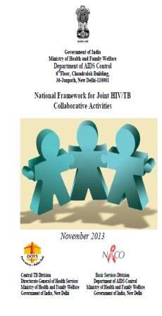
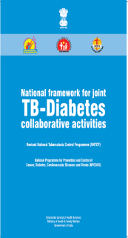


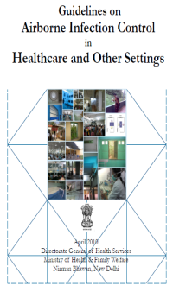
Prevent
Air borne infection control measures
Strengthen Contact Investigation
Preventive treatment in high risk groups
Manage Latent TB Infection
Address determinants of disease

Slide 16
Increased Access to Diagnostic Services
Expansion of microscopy centres to improve access
    Phase 1 - PHCs where a Laboratory Technician (LT) is available
    Phase 2 – Other PHCs
Current Status –
    16.1 lakh TB patients notified in public sector (⬆12% in 2018)
    1 microscopy centre at ~75,000 population
Microscopy Centres in 2017
Policy Update in RNTCP, 2018

Slide 17
Universal Drug Susceptibility Testing
All TB patients to be tested for Rifampicin Resistance
Current Status – 60% of target
DR-TB patients diagnosed
(⬆54% from 2017)
Testing for Rifampicin to All
Rif Resistance
Testing for INH
Mono/Poly DR-TB
Testing for Second line
FQ/SLI Resistance
XDR
MDR-TB
Policy Update in RNTCP, 2018
Notes:
Number of DR-TB diagnosed in 2017 – 38,605

Slide 18
Paradigm shift in management of Drug Resistant TB
Shorter Regimen
All MDR/RR- TB patients without resistant to addl. SLD
BDQ
MDR/RR-TB patients with resistance to addl. SLD & eligible
DLM
7 States
Children 6 to 17 years in all States
  > 20,000 patients on Shorter regimen
  > 4,600 patients on BDQ containing regimen
  62 patients on DLM containing regimen
Policy Update in RNTCP, 2018

Slide 19
Injection Free Regimen
Treatment for Previously Treated TB Patients
2HRZES
1HRZE
3HRE
Injection Free regimen for 4,20,000 patients
2HRZE
4HRE
Treatment for INH Resistant TB Patients
(3-6) Km Lfx R E Z
Injection Free regimen for ~1,00,000 patients
Lfx R E Z
Policy Update in RNTCP, 2018

Slide 20
Gazette on TB Notification
48 Cities in JEET & others
90 Cities approved in PIP
Mandatory Notification of TB patients
Public Health Actions
Provisions of Sections 269 and 270 of the Indian Penal Code (IPC)
Influence Provider
Notification
Linkage
Treatment Support
Provider
Clinics / Hospitals
Laboratories
Pharmacies
RNTCP
Patient
1
FIR
519
Notices
Policy Update in RNTCP, 2018

Slide 21
Multi-sectoral Engagement
Infection Prevention
Address Determinants
Information Education Communication
Corporate Social Responsibility
Socio-economic support & Empowerment
TB care services in health infrastructure
Prevention and Care at Work Place
Indian Post
Home Affairs
Panchayati Raj
Defence
Labour & Employment
Financial Services
Policy Update in RNTCP, 2018
TB - A social problem & needs multi-sectoral approach

Slide 22
Community Engagement
National
22 States
351 Districts
TB Patients | Community
4 lakh Treatment supporters
Transformation of TB survivors to TB champions
Capacity building and mentoring programme
Engagement of existing community groups like PRI, SHG, VHSNC, MAS, Youth Club
Grievance redressal mechanism
Involvement of community representatives in different forums

Slide 23
Call Centre
Counselling
Treatment Adherence
TB Notification
Nikshay Poshan Yojana
Follow Up
Information
Grievance Redressal
1800-11-6666
Outbound & Inbound
Time – 7 to 11
Languages – 14
100 call centre agents
Pan-India coverage
Citizen – Patient - Providers
Policy Update in RNTCP, 2018

Slide 24
Subnational Certification for TB Free District / State
Accelerate efforts
Contextual strategies
Generate healthy competition
Recognition for achieving “Disease Free” status through monetary and non-monetary awards
TB Free
Policy Update in RNTCP, 2018

Slide 25
District
Award Categories | Criteria Decline in incidence rate compared to 2015 | Monetary Award for District (in Rs.) | Non-Monetary Recognition
Bronze | 20% | 2 lakhs | Certification and Felicitation at the National Level
Silver | 40% | 3 lakhs
Gold | 60% | 5 lakhs
TB Free Status | 80% | 10 lakhs
State
Award Categories | State/Uts with population <50 lakh | State/Uts with population 50 lakh – 5 Cr | State/Uts with population >5 Cr | Non-Monetary Recognition
Bronze | 10 lakhs | 15 lakhs | 25 lakhs | Certification and Felicitation at the National Level
Silver | 20 lakhs | 35 lakhs | 50 lakhs
Gold | 40 lakhs | 60 lakhs | 75 lakhs
TB Free Status | 60 lakhs | 75 lakhs | 1 Crore

Slide 26
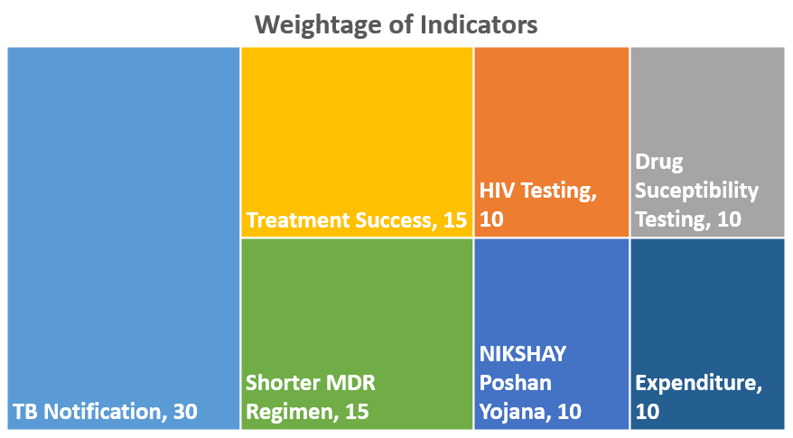
State TB Index
Policy Update in RNTCP, 2018

Slide 27
Key Challenges
Under reporting and uncertain care of TB patients in private sector
Reaching the unreached – Slums, Tribal, vulnerable
Drug Resistant TB
Co-morbidities – HIV, Diabetes
Undernutrition, overcrowding
Lack of awareness and poor health seeking behaviour lead to delay in diagnosis

Slide 28
Key Take Away
Improve TB notification rate Ensure mandatory TB notification from private sector
Active TB Case Finding to reach the unreached
Optimum utilization of CBNAAT machines
Expand Universal Drug Susceptibility Testing coverage
Expansion of newer treatment regimens (daily regimen, bedaquiline, delamanid, shorter MDR TB regimen)
NIKSHAY Poshan Yojana to every TB patients
100% reporting through NIKSHAY
Collaboration with Line Ministries to tackle social determinants of TB
Community participation for TB Elimination

Slide 29

Bending the Curve
Accelerating towards a TB free India
Thank You
Thank You

