Slide 1


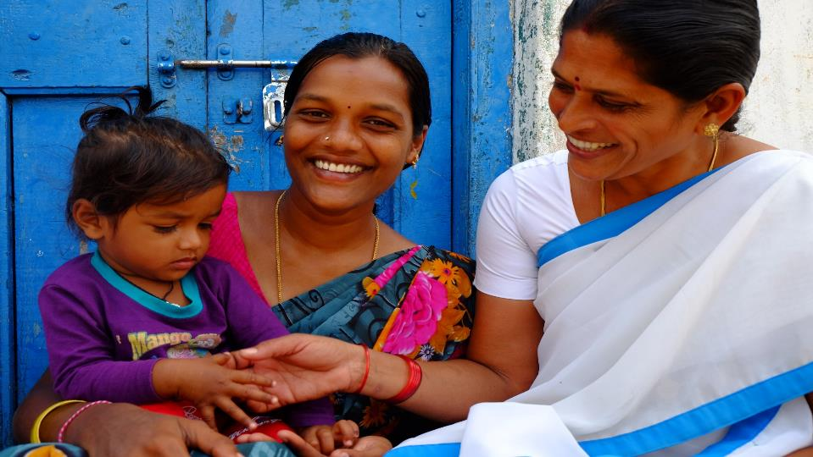
Strengthening RMNCAH+N Services
Key Focus Areas
Vandana Gurnani
JS (RCH)
Ministry of Health and Family Welfare
Government of India

Slide 2

Outline
Overview
Decoding the Unfinished RMNCAH +N agenda
RMNCAH+N Key Focus Areas
Aspirational District Approach

Slide 3
Key RMNCH+A Indicators
Maternal Mortality Ratio (MMR)
Number of maternal deaths (death of a woman while pregnant or within 42 days of termination of pregnancy) per 100000 live births
Neonatal Mortality Rate (NMR)
Number of neonatal deaths (less than 28 days of age) per 1,000 live births
Infant Mortality
Rate (IMR)
Number of infant deaths (under one year of age) per 1,000 live births
Under-Five Mortality Rate (U5MR)
Number of child deaths (dying before reaching the age of five) per 1,000 live births
Notes:
Maternal death is the death of a woman while pregnant or within 42 days of termination of pregnancy, irrespective of the duration and site of the pregnancy, from any cause related to or aggravated by the pregnancy or its management but not from accidental or incidental causes

Slide 4
Maternal Mortality Ratio
Between 1990 and 2015
India MMR Decline
Global MMR Decline
77%
44%
Compound annual rate of decline increased significantly from
5.8% to 8.01%
Between 2007-09 & 2011-13 to
2011-13 & 2014-16
Notes:
Between 1990 to 2015

Slide 5
Under- 5 Mortality Rate
For the FIRST time
India U5MR = Global U5MR
∝
Share among deaths
Share of births
Notes:
India’s U5MR has equalled the global U5MR
India’s share among deaths is now proportionate to the share of births

Slide 6

However,
the road ahead is much steeper…!!

Slide 7
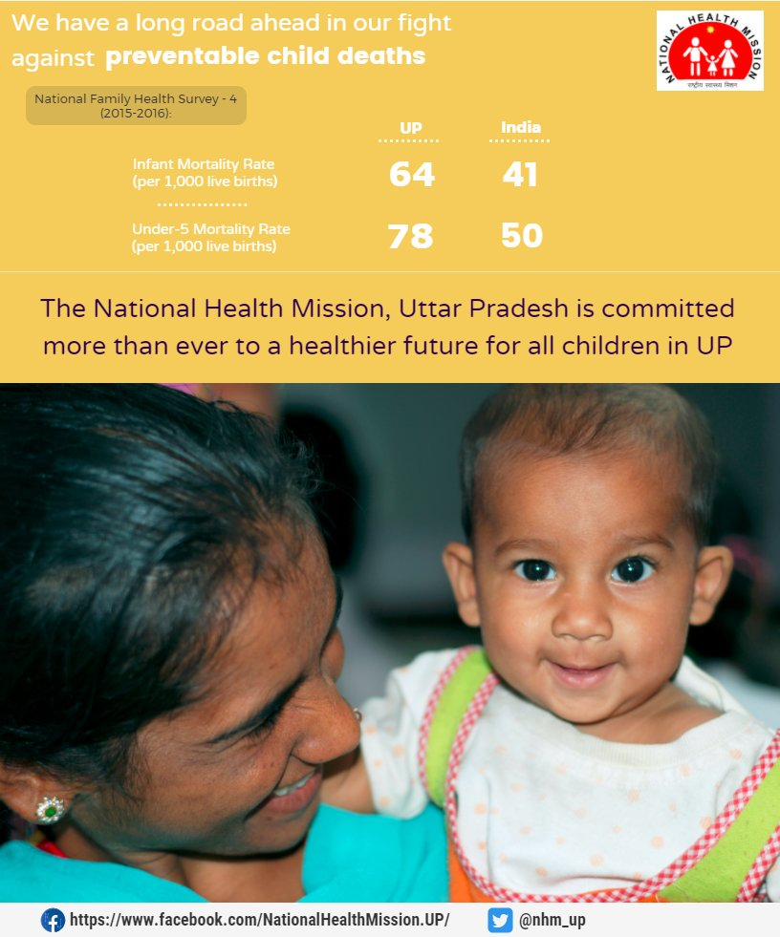
Saving Mothers and Children is in your hands!!
In India,
One pregnant woman dies every 4 hours
One child dies every 30 seconds

Slide 8
RMNCAH+N- At a Glance
Target 100 by 2020
Target 23 by 2025

Slide 9
Child Mortality Status – Uttar Pradesh
Indicators | Rate | Deaths | Contribution to U5 Deaths
Under 5 Mortality Rate (U5MR) | 39 | 9.6 Lakhs | ---
Infant Mortality Rate (IMR) | 34 | 8.4 lakhs | 87%
Neonatal Mortality Rate (NMR) | 24 | 5.9 Lakhs | 71%
Early Neo-natal Mortality Rate (ENMR) | 18 | 4.4 Lakhs | 75%
Deaths on Day of Birth | - | 1.8 Lakh | 40%

Slide 10
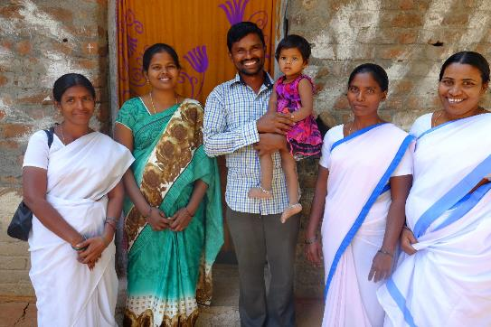
RMNCH+A- Family Planning
Towards smaller, happier, and healthier families
35%
Decline in
Total Fertility Rate
NFHS 1 (1992-93) – NFHS 4 (2015-16)
2.2
National Family Health Survey IV (2015-16)
Notes:
Nayional family health survey

Slide 11
RMNCAH+N- At a Glance
Source: NFHS 3 & 4

Slide 12

Decoding the Unfinished RMNCAH+N Agenda

Slide 13
Under 5 Deaths: Causes
Maternal deaths : Causes
Source- RGI-SRS 2001-03
Medical Causes
Source- WHO 2012
‘3 Delays’
Delay in decision to seek professional care
Delay in reaching the appropriate health facility
Delay in receiving care after arriving at a hospital
Infections 33
Prematurity 35
Asphyxia 20

Slide 14


Reproductive Maternal Newborn Child Adolescent Health + Nutrition
Reprod-uctive
Child
Adoles-cent
Maternal
New-born
RMNCAH+N
APPROACH
Reproductive
&
Child Health
RMNCH+A Links maternal and child survival to other components (family planning , adolescent health, gender & PC & PNDT)
Plus denotes inclusion of adolescence as a distinct ‘life stage’ in the overall strategy
Links community and facility based care as well as referrals between various levels of health care system
Notes:
Adolescent Health Strategy on the anvil with identified priority areas for intervention. These include SRH, Nutrition, Injuries and Violence, NCDs, Substance misuse and Mental health

Slide 15
Performance on Key Maternal Health Indicators
% Pregnant women given 180 IFA to total ANC Registration
India | 83%
Bihar | 67
Haryana | 63
Tripura | 56
Punjab | 54
Pudducherry | 52
Delhi | 51
Rajasthan | 46
Arunachal P | 44
J&K | 38
Manipur & Mizoram | 37
Meghalaya | 36
Uttarakhand | 25
Nagaland | 15
Source : HMIS (18-19)

Slide 16
Need to Ensure – Safe Delivery for Every Woman
8 out of 10 Women now deliver at health facility
Still 5 million deliver at home
Half of them in UP and Bihar
Institutional Delivery
Balrampur 30.8%
Baharich 37.3%
Siddhartnagar 45.3%
Shravasti 48.4%
Farrukhabad 52.0%
Share of Home Delivery - India

Slide 17
Performance - Postnatal Maternal and Newborn Care
Indicator | National Average (HMIS) | States/UTs Performing worse than the National Average
% Women discharged in less than 48 hours of delivery to Total Reported Deliveries at public institutions | 42% | Uttarakhand (61%), MA (65), A&N (65%), UP (65%), Haryana(67%), Arunachal Pradesh(76%), Nagaland(79%), Jharkhand(82%) and Bihar(84%)
% Newborns breast fed within 1 hour of birth to Total live birth | 89% | Punjab(79%), Lakshadweep(78%), Tamil Nadu(77%), Goa(74%), Delhi(73%), Telangana(69%), Daman & Diu(64%), Chandigarh(63%)
% of newborns received scheduled home visits out of total reported deliveries | 35% | Uttarakhand(33%), Karnataka(31%), Manipur(27%), Delhi(25%), Maharashtra(21%), Rajasthan(21%), Haryana(14%), Arunachal Pradesh(14%), Telangana(13%), Nagaland(12%), Mizoram(11%) and Daman & Diu (1%)

Slide 18
Low Caesarean Section Rates Where Need is Most
Data Source: NFHS – 4

Slide 19
Functional FRUs (HMIS)
Immunization (HMIS)
JAMMU & KASHMIR
FIC (HMIS, April’18 to Feb ‘19)
National: 78.49%
HIMACHAL PRADESH
PUNJAB
CHANDIGARH
UTTARAKHAND
HARYANA
DELHI
ARUNACHAL PR.
UTTAR PRADESH
SIKKIM
RAJASTHAN
ASSAM
NAGALAND
BIHAR
MEGHALAYA
MANIPUR
JHARKHAND
WEST BENGAL
TRIPURA
GUJARAT
MADHYA PRADESH
MIZORAM
CHHATTISGARH
DAMAN & DIU
D&N HAVELI
ODISHA
MAHARASHTRA
TELANGANA
Less than 50%
PONDICHERRY
50%-90%
GOA
ANDHRA PRADESH
More than 90%
KARNATAKA
A&N ISLANDS
KERALA
TAMIL NADU
LAKSHADWEEP

Slide 20
Performance on Key Family Planning Indicators (HMIS)
Source: HMIS 2018-19

Slide 21

Mission Indradhanush
The RMNCAH +N Strategies – Issues and Challenges
ECD
HBYC
MPV
New Contraceptives
New Vaccines
Anemia Mukt Bharat
PMSMA
LaQshya
MAA

Slide 22

Focus on Aspirational Districts
Out of 13 indicators, 8 are on RMNCAH+N
Develop special strategies and formulate annual plans
Ensure all schemes are implemented on priority in these districts
Undertake special visits Monitor ranking on NITI Dashboard
Focus on Intersectoral convergence
Quality ANC and PMSMA
Focus on 1st trimester registration and 4 ANC checkups
Focus on full ANC – screening for HIV, Syphilis, GDM, Hep B etc
Ensure High Risk Pregnancy Tracking and follow -up
Focus on Quality ANC under PMSMA

Slide 23
PMMVY, JSY & JSSK
NITI Aayog findings in a recent field study on PMMVY:
MCP cards not filled properly - cards lacked critical information like date of immunization, ANC check-up etc. causing delays in payments of PMMVY instalments.
At national level only 36% of the registered beneficiaries under PMMVY have received their 3rd and final instalment.
Focus on availability and updation of MCP cards
Raise awareness about entitlements among the beneficiaries
Ensure DBT - expedite data feeding on PMMVY-CAS in respect of JSY beneficiaries.
Clear back logs and ensure prompt payments
Ensure availability of free referral transport, drugs, diagnostics, diet etc
Village Health Sanitation and Nutrition Days
Platform to be strengthened to provide all services & counselling, not only immunization

Slide 24
FOR WOMEN, STILLBIRTHS, NEWBORNS, THE TIME OF HIGHEST RISK IS THE SAME
Notes:
9.8 lakhs

Slide 25
LaQshya
Focus on closure of gaps identified in baseline assessment and improve State & National level certifications
179 LRs & 158 OTs State Certified
2257 LaQshya Facilities
54 LRs & 38 OTs National Certified
Notes:
6 applications received by NHSRC for LR
2 certified, 1 declined and 3 pending
6 applications received by NHSRC for OT
1 certified on conditionality, 2 declined and 3 pending)

Slide 26
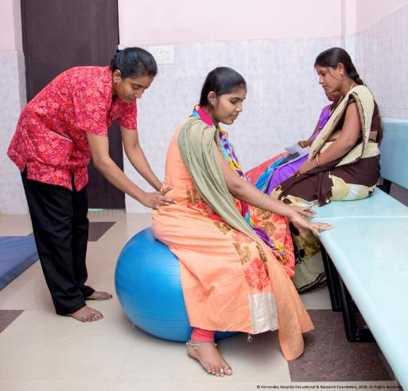
Midwifery Initiative
Lancet Series on Midwifery (2014): Safe and effective midwifery care can avert 83% of all maternal deaths, stillbirths and newborn deaths.
Strengthen BSc Nursing Colleges as State Midwifery Training Institutes
Recruit State Midwifery Educators (guidelines to be shared shortly)
Depute State Midwifery Educators for training at National Midwifery Training Institute (July onwards)
Start 18 month training of Nurse Practitioners in Midwifery – January 2020 onwards
Plan for additional Institutes and training in Supplementary PIP
  To provide access to quality maternal and newborn health services:
  Promote natural birthing by promoting positive child birthing experience
  Ensure respectful care
  Reduce over medicalization

Slide 27
Focus on supply chain management for IFA and ensure availability and generate demand
Use Anemia Mukt Bharat Dashboards for monitoring data and initiate test and treatment.
Address non nutritional causes of anemia in endemic pockets eg: Heamoglobinopathies and malaria
Anemia Mukt Bharat
Integrated Diarrhoea Control Fortnight for promotion of ORS and Zinc (28th May – 9th June 2019 – ensure availability and focus on unreached population)
National Deworming Day (NDD) – Focus on private school and out of school participation
IDCF & NDD

Slide 28
Role of PSs and MDs in implementation of IDCF 2019
(28 May – 9 June, 2019)
Review of Stock positioning of ORS/ Zinc and procurement (based on Under 5 Population, estimated diarrhoeal episodes and buffer stock)
Inter-sectoral coordination meeting at State level and Video-conference with district officials on preparation
Review of Capacity building - Stakeholders (AWW, Schools, drinking water & Sanitation, tribal, PRI, IAP –private sector, medical colleges etc.)
Launch of IDCF 2019 campaign and Visibility on Social media platforms
Review of Supportive Supervision plans (State/ Districts) and monitoring by State and District officials during fortnight (At least twice)
Advocacy and awareness generation campaign through local media, SHGs, local religious leaders and local groups (folk dance, nukad natak etc.)
Focus on Aspirational Districts/High Priority Districts- Active engagement Development Partners / Private Providers
Review of preparation, mid-level implementation (corrective measures) and at the end of fortnight

Slide 29
Focus on capacity building of labour room staff for essential newborn care and resuscitation.
Focus on use of SNCU data for ensuring quality care at SNCUs
Ensure follow-up of newborns discharged from SNCUs
Promote Mother Newborn Care Unit for developmentally supportive care of Newborn in SNCU
Expedite implementation of HBNC and HBYC programme for community-level care to newborns
Ensure supportive supervision of frontline functionaries for home visits
New Born Care
Breast Feeding (1st Vaccine)
Although institutional delivery is 78.9%, breastfeeding within one hour of birth is only 41.6%
Capacity building and accreditation on priority
Focus on complementary feeding from 6 months onwards
MAA
Programme

Slide 30

Rashtriya Bal Swasthya Karyakram and Early Childhood Development
Rashtriya Bal Swasthaya Karyakram (RBSK)
Systemic approach for early identification and management of 4Ds - Defects at birth, Deficiency, Diseases at childhood and Developmental Delays for children of 0-18 years
Improve coverage
Ensure referral and management of those identified with 4 Ds
Establish/ strengthen DEICs
Use of MCP card
Promote play and stimulation

Slide 31
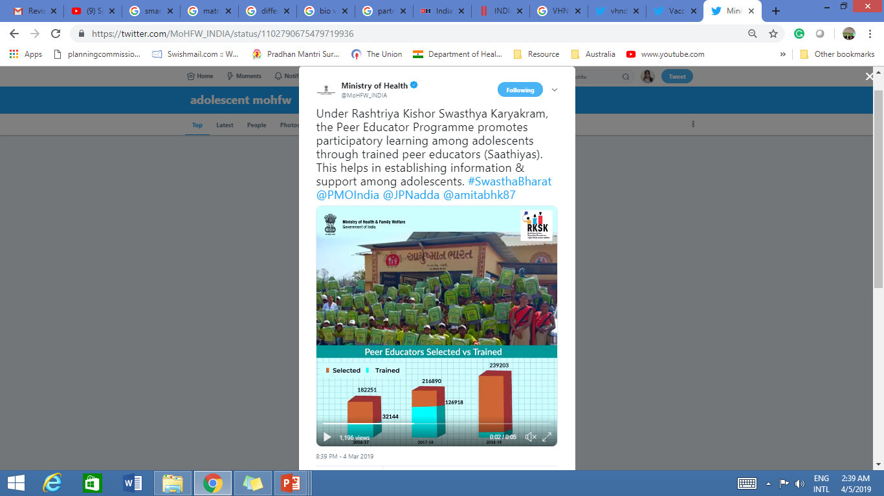

Adolescent Health - RKSK
Focus on revised guidelines for RKSK – Partnerships with NGOs to be prioritized
School Health Programme being introduced in close collaboration with MOHRD in a phased manner
Reproductive Health
Expanding the basket of choice: Injectable Contraceptive MPA (Antara Program) & Centchroman pill (Chhaya)
Mission Parivar Vikas- 146 High Fertility Districts & New Family Planning Media Campaign
Most of the states score low in FP Service provision
Programmatic reach towards male clients is limited

Slide 32
In 2018, we estimate that with the use of contraceptives:
13.9+ Crores
5.44+ Crore
18.2+ Lakhs
23,000
Unintended pregnancies
prevented
Unsafe Abortions
averted
Women were using a
Modern Method of Contraception
Maternal deaths
averted
1.1 Crore total births averted
Notes:
139,620,000
54,421,000
10,884,000

Slide 33

Immunization
Coverage Improvement- Way Forward
Key Focus Areas
Availability of updated microplans
Regular head count survey and generation of due list
Awareness generation and social mobilization
Supportive Supervision
New Vaccines - Inactivated Polio Vaccine, Rotavirus vaccine, Pneumococcal Conjugate Vaccine, Measles-Rubella (MR) vaccine
State level estimates (CES 2019)
States with FIC < 70%
States with FIC >70%
Entire State will conduct MI
Categorization of districts based on available data sources
Concurrent Monitoring data by partners in sizeable beneficiary survey
IMI Survey
FIC < 70%
Mission
Indradhanush
FIC between 70 - 90%
Intensive Monitoring
Prioritising & focussing
FIC > 90%
Sustain gains

Slide 34
Decline in Sex Ratio and PC&PNDT Act
The Pre-conception and Pre-natal Diagnostic techniques (Prohibition of Sex Selection) Act, 1994 (PC& PNDT Act) was enacted in 1996 and further amended in 2003
Prohibits sex selection before and after conception and imposes penalty.
Policy making bodies both at national and state levels-(Central/ State Supervisory Boards)
Implementation lies with the States though State and District Appropriate Authorities assisted by Advisory Committees
Monitoring mechanisms are in place at all levels- (Multidisciplinary National/ State/ District Inspection and Monitoring Committees)
Court cases have been filed, Convictions have been secured and following conviction the medical licenses of doctors have been suspended/ cancelled and ultrasound machines have been sealed for violations of the law.

Slide 35
Evaluating Performance
Web-based RCH Portal/ MCTFC
Web-based Health Management Information System for monitoring service delivery indicators
Sample Registration System : Data brought out by Registrar General of India on key outcome indicators at the national & state level
National Family Health Survey: All India data on key indicators through periodic surveys
Coverage Evaluation Survey, Rapid Survey of Children, Common Review Missions, RMNCH+A field visits

Slide 36
Pregnant Women Registration Coverage of EAG States
Child Registration Coverage of EAG States
FY 2018-19
Data as on 10th April’ 2019

Slide 37
Action Points - Improving Kilkari performance
Correct Data entry of beneficiary in RCH and MCTS with complete details such as Name, LMP/ DoB, Mobile number
IEC activity Awareness campaigns , Promotional activities to bring awareness about the schemes amongst the beneficiaries and health officials
Action plan to be prepared for all low performing districts with clear targets:
Kilkari inbox number is not being used by beneficiaries as they are not aware of the inbox number - Promote the Kilkari inbox number “1800-3010-1703” in different forums.
Ensuring data correctness in the RCH/MCTS portal
Beneficiary to be informed by ASHA about Kilkari calls
During VHND ASHA and ANM to inform beneficiary about Kilkari calls and its benefits
Kilkari toll free number to be given to beneficiary

Slide 38




Action Points for the State to improve Mobile Academy performance
Instructions for dialing and starting the MA course during ASHA monthly meeting. MA toll free number is (1800-3010-1704).
ASHAs who have not started the course to be identified and necessary instruction to be issued for completion of the course.
IEC activity Awareness campaigns , Promotional activities to bring awareness about the schemes amongst the beneficiaries and heath officials
Timely distribution of certificate on course completion by the ASHAs

Slide 39
Aspirational District Approach

Slide 40
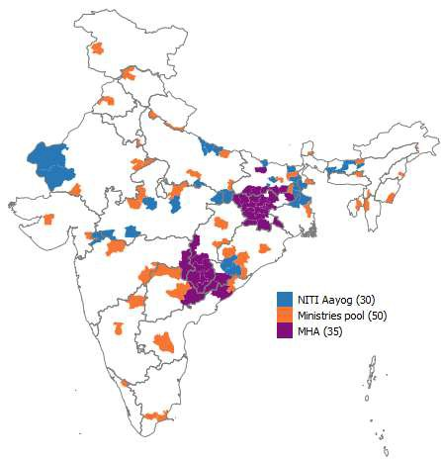
Introduction: Aspirational Districts
NITI Aayog identified 117 aspirational districts across 28 States for transformation by the year 2022
The districts have been identified based on the status of indicators related to
  Health & nutrition(30%)
  Education (30%)
  Agriculture & Water resources (20%)
  Financial Inclusion (10%)
  Basic infrastructure (10%)
A set of 13 core and 31 sub-core indicators identified for demonstrating the progress on health & nutrition in these districts

Slide 41
NITI AAYOG: 2nd DELTA RANKING REPORT
Overall Ranking
Health & Nutrition Ranking
Most Improved |  | Least Improved
District | Rank | District | Rank
Chitrakoot, Uttar Pradesh | 1 | Chatra, Jharkhand | 111
Barwani, Madhya Pradesh | 2 | Pakur, Jharkhand | 110
Vidisha, Madhya Pradesh | 3 | Hazaribagh, Jharkhand | 109
Raichur, Karnataka | 4 | Godda, Jharkhand | 108
Balrampur, Uttar Pradesh | 5 | Purbi Singhbhum, Jharkhand | 107
Most Improved |  | Least Improved
District | Rank | District | Rank
Virudhunagar, Tamil Nadu | 1 | Pakur, Jharkhand | 111
Nuapada, Odisha | 2 | Hailakandi, Assam | 110
Siddharthnagar, Uttar Pradesh | 3 | Chatra, Jharkhand | 109
Aurangabad, Bihar | 4 | Giridih, Jharkhand | 108
Koraput, Odisha | 5 | Kiphire, Nagaland | 107
Data period: June-October 2018

Slide 42
Additional Resource Availability
Rs. 974 cr sanctioned for Aspirational Districts by NITI AAYOG through ODA from JICA
  Out of this Rs. 600 cr to be provided on challenge method ( Overall ranking and sectoral ranking)
  Rs. 350 cr to be provided for new health project plan
  District administration to prepare health project plan with the help of National Mentors, NHSRC and Development Partners
60% of CSR funds of CPSE has been allocated for Health and Education in Aspirational Districts

Slide 43
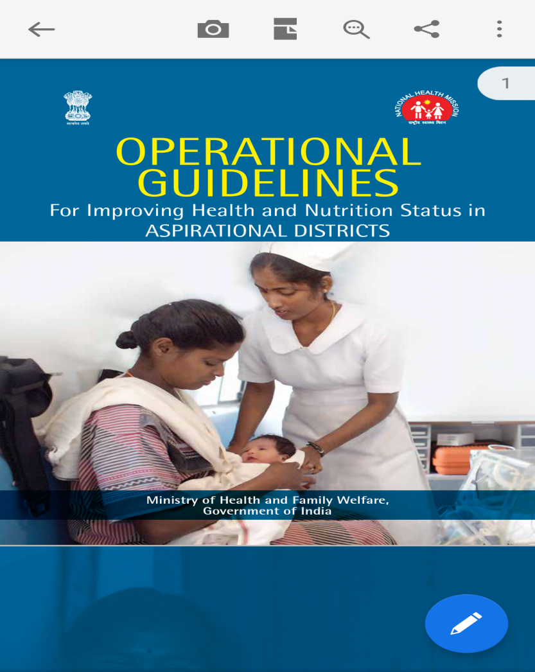

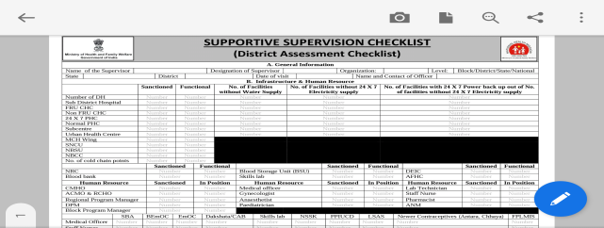
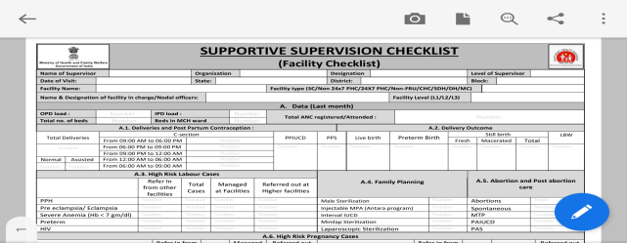
Tools for Strengthening Health and Nutrition Status in Aspirational Districts
Supportive Supervision Checklists for undertaking focused visits at District, Facility and Community level
Operational Guidelines for improving Health & Nutrition in ADs
Health Atlas as a diagnostic tool for planning and monitoring in ADs

Slide 44
Conduct a District – wise Review on all the Areas highlighted in this presentation
Institutionalize a system of Quarterly State level RMNCAH+N Reviews
Closely Monitor Aspirational Districts for Maximum Gains

Slide 45
In addition to above:
Annual Action Plans - Oversee the design and implementation of annual Plans. Use NHM flexibility to address challenges (e.g. terms of engagement of HR)
Convergence & Coordination with all concerned departments eg: WCD
Human Resource (HR): Fill up vacancies through Recruitment and Rational Deployment of HR
Essential Drugs and Diagnostics: Ensure free essential drugs and diagnostics at all government facilities
Validation of data: Check for completeness & correctness of HMIS data /data from RCH portal
Development Partner Support: Utilize technical support and monitoring from DPs.

Slide 46
Most Important- Remember that you literally have the power to change the world!!!
Reduction of Maternal and Child Deaths in Large States
Reduction of Maternal and Child Deaths in India
Reduction of Maternal and Child Deaths across the world

Slide 47

“Women are not dying because of untreatable diseases. They are dying because societies have yet to make the decision that their lives are worth saving: We have not yet valued women’s lives and health highly enough.”

