Slide 1
Quality Improvement
14th May 2019

Slide 2





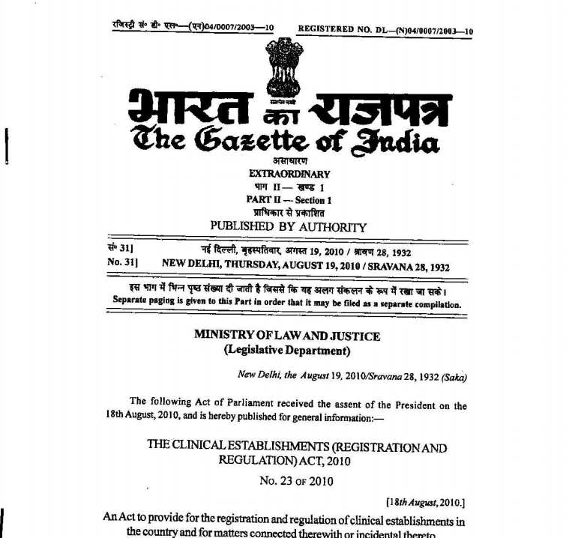







Quality Journey
Initiates –
Quality improvement in intrapartum care
Quality circles and Coaching teams
Labour Room standardization
Respectful Maternal Care
Promoted -
Sanitation and Hygiene
Infection Control
Waste Management
Peer Assessment and Cash Awards
Established-
Minimum standards and Licencing mechanism for healthcare facilities
2018
LaQshya – Labour Room QI Initiatives
Kayakalp- Clean Hospital Awards
Clinical Establishment Act
2017
2016
2015
Clinical Establishment Act
Defines
Institutional framework for
patient safety
Strategic objectives
Implementation plan
Introduced –
IT based patient feedback system
Satisfaction scores and ranking
Improvement tools
2013
Key Activities
STG Development methodology
Evidence based STGs
Clinical Pathways
Introduced
Minimum Service Guarantee
Infrastructure and Equipment
Human resource
For Public Health Facilities
CEA
Introduced -
Strategic approach and roadmap
QA committees & teams
Assessment tools & mechanism
Capacity building on Quality
Certification and Incentives
IPHS
2012
National Patient Safety
Implementation Framework
2008
Mera Aspataal- Patient Feedback
Standard Treatment Guidelines

Slide 3
Different Initiatives for Improved Quality of Care
Kayakalp
LaQshya
Mera-Aspataal
Improved QoC
National Quality Assurance Standards

Slide 4

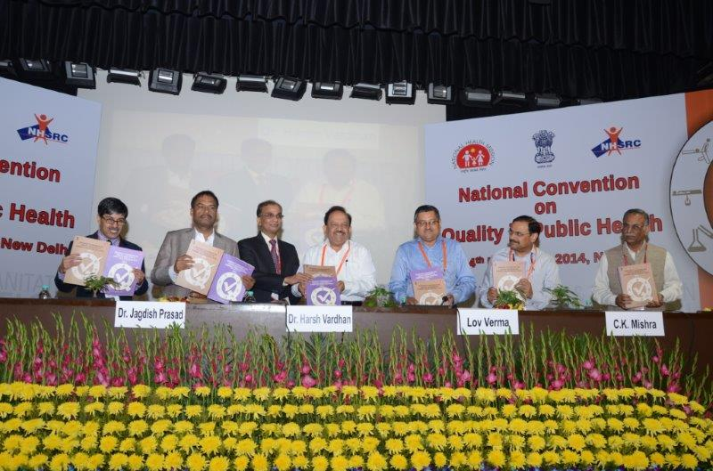

Embarking the Quality Journey……
QA Operational Guidelines & DH Standards – Nov 13
Standards for PHC & CHC – Nov 2014
Standards for U-PHC – Nov 2015
AEFI Surveillance - 2016
ISQua Accreditation Standards – 2015
Ext. Assessors (Surveyor) Trg. - 2018

Slide 5
Arrangement of Quality Standards
Area of Concern
Standards
Check point/ Check Sheet
Measurable Elements

Slide 6








Predominately Process Driven Standards
SERVICE PROVISION
Area of Concern
B
C
A
D
E
F
H
G
OUTCOME
PATIENT RIGHTS
Outcome
Outcome
Process
Quality Management
INPUTS
Process
Structure
Process
Process
INFECTION CONTROL
SUPPORT SERVICES
Process
CLINICAL SERVICES

Slide 7

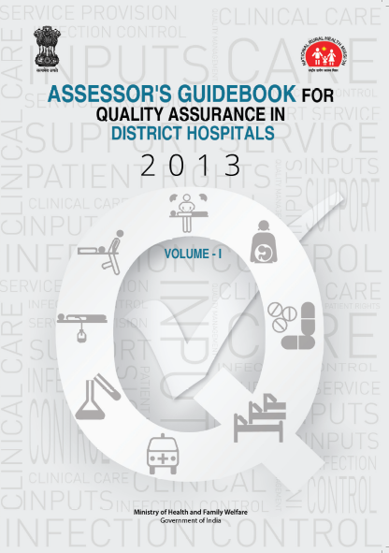
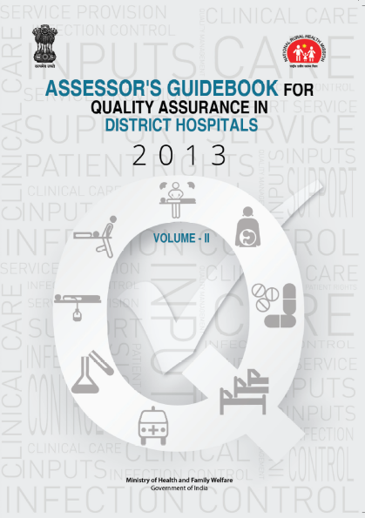


Quality Standards for Different Level of Facilities & AEFI Programme
Type of Facility/Prog. | Standards | ME | Check-lists
1. DH | 74 | 315 | 18
2. CHC | 65 | 252 | 12
3. PHC | 50 | 250 | 06
4. U-PHC | 35 | 198 | 12
5. AEFI Surveillance | 40 | 239 | 4

Slide 8



Quality Assurance Institutional Structure
State Level
District Level
National Level
Facility Level
Central Quality Supervisory Committee
State Quality Assurance Committee
State Quality Assurance Unit
District Quality Assurance Committee
District Quality Assurance Unit
Quality
Team

Slide 9
Capacity Building
Training | Duration | Level | Scope
Awareness Workshop | 1 day | State | To sensitize state level officials for quality assurance program
Internal Assessor Training | 2 Days | State / Regional | Standards , measurable elements, Internal assessment Methodology Filling up checklists and calculating scores Preparing action Plan
QA in NUHM | 2 Days | State/ Regional | Assessment, Gap Closure Action
Implementation Training | 3 Days | Regional/ District | Basic concepts of quality Standard operating procedures Patient satisfaction programs Quality improvement tools
External Assessor Training | 5 Days | National/ State | Detailed training on standard, measurable elements, assessment methodology, audit trail, code of conduct, filling formats and reporting

Slide 10
Assessments
Certification Assessment
MoHFW/ NHSRC
Internal Assessment
Continual process at Facility Level followed by PDCA
DQAU Assessment
Quarterly by DQAU
SQAU Assessment
Half yearly by SQAU
Yearly for Surveillance

Slide 11
Certification Process
App. received from State
State
submits the documents
Review of Documents by NHSRC
Documents Adequate
YES
NO
State
Result conveyed to MoHFW
Assessment
Confirmed by the state
Tentative Assessment dates are finalized

Slide 12
Criteria for National Certification (DH)
Over All Hospital Score
Department wise Score
Area of Concern wise Score
Criteria 1
70%
or More
Criteria 2
70%
or More
Criteria 3
70%
or More
Core Standards*
Standard wise Scores
Patient Satisfaction Score
Criteria 4
70%
or More
Criteria 5
50%
or More
Criteria 6
70%
or More
*A2- RMNCHA Services, B5- Free services, D10- Legal Requirements

Slide 13
Incentivisation on Quality Certification
Health Facility | Type of Certification | Norm
1. DH/ SDH/ Area Hospital/ CHC & Equivalent | Full Certification (meeting all criteria) | Rs. 10, 000 X Number of Functional Beds
2. DH/ SDH/ Area Hospital/ CHC & Equivalent | Certification with conditionality | Rs. 7,000 X Number of Functional Beds
5. PHC/ U-PHC with beds | Full Certification | Rs. 3.0 Lakh
6. PHC/ U-PHC with beds | Certification with conditionality | Rs. 2.0 Lakh
7. U-PHC/ PHC without beds | Full Certification | Rs. 2.00 Lakh
8. U-PHC/ PHC without beds | Certification with conditionality | Rs. 1.50 Lakh

Slide 14
Quality System getting established
15000+
Quality
Trained
Personnel
15000+
Facilities
Assessing Quality
3400+
Certified Internal Assessors
300+
National & 550 State QA certified facilities
1000+
Quality
Committees & Teams
700+
Dedicated Quality Professionals Working

Slide 15
Key Action Points
Recruitment of HR for State Quality Unit & District Quality Units
Base-line assessment of all facilities and prioritisation for ‘Gap-closure’ action
Monitoring of
  Gap closure (post-assessment) status
  Regulatory compliances – Fire safety, Blood bank license, Authorisation from pollution control board, etc.
  AERB
  Calibration
  Certification Status
Patients’ satisfaction – ‘Mera-Aspataal’/Manual
Quality Assurance Meetings at the State, District & Facility

Slide 16


Slide 17
Kayakalp : Rejuvenating Public Healthcare Facilities
Launched by Union Health Minister on 15 May 2015.
Aims to promote cleanliness, hygiene & sanitation of Public Healthcare Facilities
Recognition of exemplary efforts
Financial Year | Health Facilities
2015 - 16 | 10 Central Govt. Institutions DH & Equivalent
2016-17 | 16 Central Govt. Institutions DH, SDH, CHC & PHC
2017 - 18 | All above Public Health Facilities under NUHM
2018-19 | All above 24 Central Govt. Institutions

Slide 18
Institutional Arrangement
MoHFW/ NHSRC
Review and Mid-course Correction
Mobilisation of Technical Assistance & Facilitatory Support
State Award Committee
Dissemination
Training & Coordination
Constitution of External Assessment Team
Finalisation of Awards & Declaration
District Level Award Nomination Committee
Dissemination
Nomination
TA & Trainings
Finalisation of Awards for PHCs

Slide 19
Arrangement of Assessment Tools
Thematic Area | DH/CHC/U-CHC |  | PHC |  | UPHC
 | Check-points | Score | Check-points | Score | Check-points | Score
A. Up-keep | 50 | 100 | 30 | 60 | 20 | 40
B. Sanitation & hygiene | 50 | 100 | 30 | 60 | 20 | 40
C. Waste Management | 50 | 100 | 30 | 60 | 20 | 40
D. Infection Control | 50 | 100 | 30 | 60 | 20 | 40
E. Support Service | 25 | 50 | 15 | 30 | 10 | 20
F. Hygiene Promotion | 25 | 50 | 15 | 30 | 10 | 20
G. Area outside Boundary Wall | 50 | 100 | 30 | 60 | 20 | 40
Total | 300 | 600 | 180 | 360 | 120 | 240

Slide 20
3-Step Assessment
Internal Assessment
Peer Assessment
External Assessment

Slide 21
External Assessment
Three-member team (Minimum)
Trained – Internal Assessors under NQAS, Ext. Assessors & Kayakalp Ext. Assessors
As least one member should be from Non-Government Sector

Slide 22
Cash Awards
Category |  | Type of Facility | Assessment Score |  | Amount (Rs. in Lakhs)
I. Large States |  | DH | Highest (Best) |  | Rs. 50.00
 |  |  | Runner-up |  | Rs. 20.00
 |  | SDH/ CHC | Highest (Best) |  | Rs 15.00
 |  |  | Runner-up |  | Rs. 10.00
 |  | PHC | One in each District |  | Rs. 2.00
II. Small States |  | DH | Highest (Best) |  | Rs. 50.00
 |  | CHC | Highest (Best) |  | Rs. 15.00
 |  | PHC | One in each District |  | Rs. 2.00
Commendation & Cash Award
All States | DH |  |  | More than 70% Score | Rs. 3.00
 | SDH/CHC |  |  |  | Rs. 1.00
 | PHC |  |  |  | Rs 0.50

Slide 23
Kayakalp Awards: U-CHCs
S. No. | No. of Health Facilities | No. of Awards | Award (in Lakh) | Unit of Allocation
1. | 10-25 | Winner | 15.00 | 1 per state
2. | > 25 | Winner | 15.00 | 1 per state
 |  | Runner-up | 10.00
3. | U-CHCs with >70% in external assessment | Commendation Awards | 1.00 | All eligible facilities

Slide 24
Kayakalp Awards: U-PHC
S.No | No. of U-PHC | No. of Awards | Award Amount (In Lakh) | Unit of Allocation
4 | 10 – 20 | One Winner | 2.00 | For each cluster* at state/metro as the case may be
5 | >20 – 50 | One Winner | 2.00 | I per district or zone/ region of 7 metro
 |  | 1st Runner up | 1.50
6 | >50 | One Winner | 2.00 | I per district / zone or region of 7 metro
 |  | 1st Runner Up | 1.50
 |  | 2nd Runner Up | 1.0
7 | All U-PHCs scoring > 70% on External Assessment | Commendation Awards | 0.50 | All eligible facilities

Slide 25
Key Action Points
Timely Internal Assessment
At least, one peer assessment in a year
Declaration of PHC Awardee facility in each district
Extension of the scheme to urban health facilities

Slide 26
Swachh Swastha Sarvatra
A joint Initiative of Ministry of Health & Family Welfare
&
Ministry of Drinking Water & Sanitation

Slide 27
Objective of ‘SSS’
Enabling Gram Panchayat where Kayakalp awarded PHCs are located to become ODF.
Strengthening CHC in ODF blocks to achieve a high level of cleanliness to meet Kayakalp standards through a support of Rs 10 Lakhs under NHM.
Build capacity through training in water, sanitation and Hygiene (WASH) to nominees from such CHCs and PHCs.

Slide 28
Key Action Points
CHC
PHC
Priority Assessment of CHCs, located in ODF Block on ‘Kayakalp’ tools (by states) - MoHFW
Financial Allocation under National Health Mission (NHM) - MoHFW
Monitoring of CHC’s performance, supported under ‘SSS’
Training of PHC representative in WASH
Facilitation of linkage and promotion of joint action through community platform
Community & Individual level behaviour change intervention

Slide 29

Launched by the Ministry of Health & Family Welfare on 29th August 2016

Slide 30
Goal
Improving quality of care by obtaining patient feedback using technology based solutions
(Integrated with quality assurance program of Government of India)
Establish a patient-driven, responsive and accountable healthcare system

Slide 31





Multi-Channel Approach for Collecting Feedback
Short Message Service (SMS)
Interactive Voice Response
(IVR)
Mobile
Application
http://meraaspataal.nhp.gov.in
Webpage

Slide 32
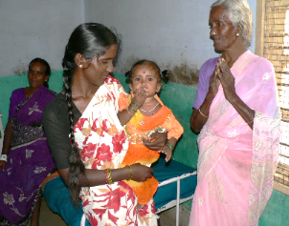



Outline and Flow of Questions
Greeting Message
Q0 (Overall Rating)
Q1 (Reasons for dissatisfaction)
Staff Behaviour
Cleanliness
Treatment Cost
Quality of Care
(Inpatients only)
Others
Q2
Q3
Q4
Q5
Q6
Dissatisfactory behaviour
(by category)
Unclean areas
Unreasonable cost
(by service)
Major quality concerns
Other Concerns

Slide 33
Mera-Aspataal Integration Status
Sr. No. | State | DH | SDH | CHC | PHC | UPHC | Others | Total
1 | Bihar | 36 |  |  |  |  | 1 | 37
2 | Chhattisgarh | 2 |  |  |  |  | 2 | 4
3 | Haryana | 18 |  |  |  |  | 5 | 23
4 | Himachal Pradesh | 11 | 7 | 1 | 1 |  |  | 20
5 | Jharkhand | 19 |  | 1 |  |  | 1 | 20
6 | J&K | 10 |  |  |  |  |  | 10
7 | Karnataka | 21 | 26 |  |  |  | 1 | 48
8 | Madhya Pradesh | 57 |  |  |  | 21 | 7 | 85
9 | Maharashtra | 26 |  |  |  |  | 2 | 28
10 | Mizoram |  |  |  |  |  |  | 0
11 | Puducherry |  |  |  |  |  | 1 | 1
12 | Rajasthan | 31 | 4 | 117 |  |  | 19 | 171
13 | Tamil Nadu | 31 |  |  |  |  | 530+19 | 580
14 | Telangana | 2 |  |  |  |  | 4 | 6

Slide 34
Key Action Points
Integration of all public health facilities
Action on feedback (regular review at each level)

Slide 35


LaQshya Launch

Slide 36
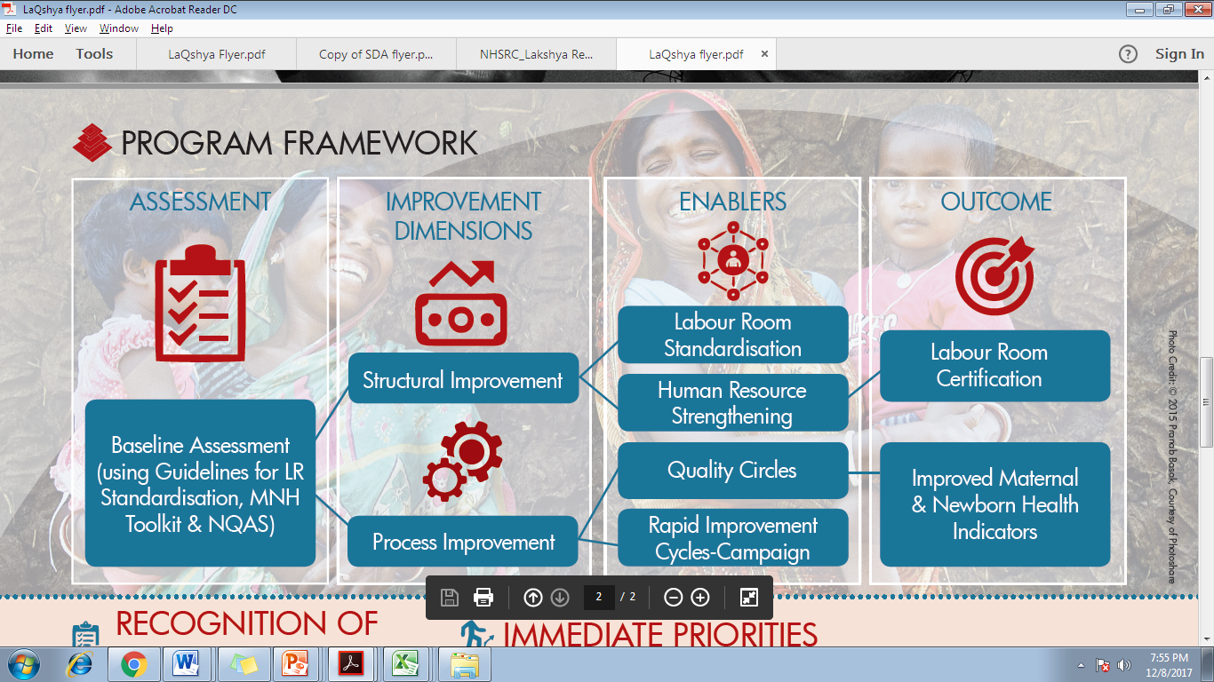
LaQshya: Interventions

Slide 37
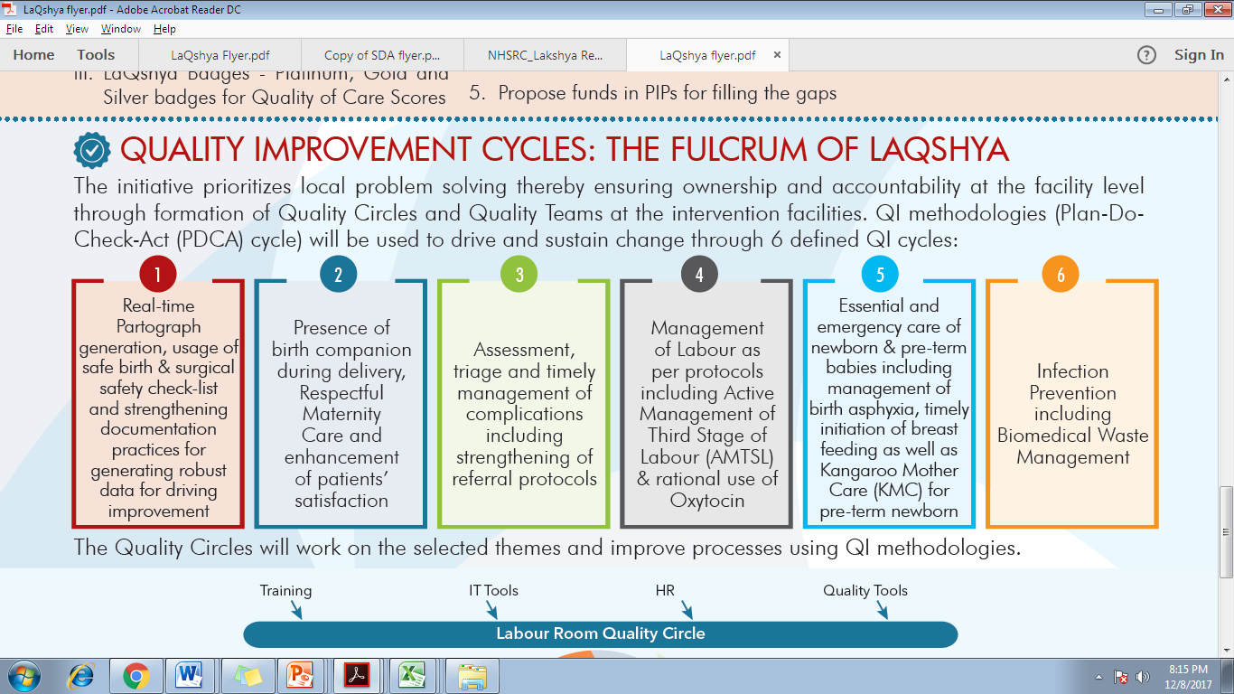
Rapid Improvement Cycles : The fulcrum of LaQshya

Slide 38




The Targets
Quality Certification of Labour Room and Maternity OT under National Quality Assurance Standards
Attainment of at least of 75% facility level targets (15 out of 20 Indicators)
80% of the beneficiaries are either satisfied or highly satisfied

Slide 39



