Slide 1
Public health administration
Dr. Himanshu Bhushan

Slide 2
Areas of work
Model Health Districts
District Hospital Strengthening and developing them as knowledge hub
Decentralized Planning
National Urban Health Mission
Support to Program divisions:
  Maternal & Child Health (MDR, CDR, BEmOC, EmOC, MCH wing, LSAS)
  Oral Health (Policy drafting)
Grievance Redressal and Health Helpline
Medico-legal Aspects
Supportive Supervision Software
Public Health Cadre
Support in Comprehensive Primary Health Care
Revision of IPHS
Family Medicine

Slide 3
Model Health Districts
District Hospital is the hub for provision of quality secondary level services.
Improvement/ decline in various program indicators of the district directly affects the state and country’s indicators.
A non- functional or partially functional District Hospital and facilities down below leads to over crowding at tertiary care facilities and also inconvenience to service seeker.
So, GoI has a commitment to make district hospitals reliable for assured and identified services
Creating districts as a role model for health
Reducing OOPEs

Slide 4
Approach
There are two parallel actions :
Improving Ambience, Protocols and assured service delivery at facility level
Improving Program Indicators of the district for morbidity and mortality

Slide 5
Model Health Districts
The Perspectives
Client
Supervisor
Service Providers
Community
Focus on
Ambience
Protocols (technical and service delivery)
Sustenance

Slide 6
Strengthening Critical Care areas
Improving ambience
Strengthening Technical Protocols
Computerized registration and drug dispensation
Strengthening Accidents and Emergency services
General and Obstetric HDU
Modern OT, LR, LDR, Lab with Zoning
Mechanized Laundry and CSSD
Modern Kitchen
Regular monitoring for improved sustenance
Programme Indicators

Slide 7
DH Strengthening
DH to be strengthened so that it can perform the following 4 major functions:
1. Provide all secondary and at least essential & critical special care services of tertiary level- so that most morbidities can be cured at DH level itself
2. Provide adequate referral support for clinical care at primary care levels
3. Act as the preferred site for skill based in-service training
4. Act as the clinical training site for:
  Paramedical education programs
  Nursing school and college

Slide 8
DH Strengthening: Core Specialties
IPHS includes 21 specialist services
At least 8 core specialities must be available at all DH:
  General Medicine Orthopedics
  General Surgery Anesthesia
  Obstetrics & Gynaecology Ophthalmology
  Pediatrics Pathology
The RKS of the DHs will be empowered for hiring of specialists, doctors, nurses to make the particular specialty functional.
They can also purchase certain critical equipment and create critical infrastructure.
DHs can be given Rs.5 crores for this and Rs. 1 crore for running paramedical/nursing courses.

Slide 9
DH as a training hub
DHs once strengthened for providing routine and basic specialist services could be upgraded as training and teaching site particularly for clinical learning.
Following programs can be implemented:
Specialty nursing programs: Neo-natal nursing, Midwifery nursing, O.T room nursing, Orthopaedic & rehabilitation nursing
Para-medical courses like MLT, X-ray/CT technicians, Renal dialysis technician, OT technician, Ophthalmic assistant
Nursing diploma program - GNM course

Slide 10
Model health districts across states
State | Intervention District | Collaborative District
Andhra Pradesh | Guntur | Visakhapatnam, Anantpur
Assam | Kamrup (Rural) | Nagaon
Bihar | Aurangabad, Jehanabad | Banka, East Champaran, Araria, Madhubani, Bhojpur, Sitamarhi, Vaishali, Saharsa
Chhattisgarh | Raipur | Jaspur, Durg, Bijapur
Himachal Pradesh | Kangra | Sirmaur
Jammu | Jammu | Kathua
Kashmir | Srinagar | Anantnag
Jharkhand | East Singhbhoom (Jamshedpur) | Gumla , West Singhbhum
M.P | Sagar | Satna
Maharashtra | Chandrapur | Sindhudurg
Manipur | Thoubal | Churachandpur
Meghalaya | West Garo Hills | West Khasi Hills
Nagaland | Mokokchung | Wokha
Odisha | Kandhamal | Gajapati, Bhubneshwar (Capital hospital), Sundargarh
Rajasthan | Udaipur | Banswara, Chittorgarh
Sikkim | Singtam | Namchi
Tamil Nadu | Krishnagiri | Pudukottai
Telangana | Medak | Mahboobnagar
Tripura | Gomati | Dhalai
U.P | Varanasi | Sonbhadra, Kannauj
Uttarakhand | Haridwar | Udham Singh Nagar

Slide 11
IPHS Revision
Detailed list of clinical services drawn up
Operational guidelines drafted
Technical guidelines for District Hospital being prepared
In comparison with the IPHS guidelines of 2012, the revised 2018 IPHS guidelines will include:
  A new guideline on urban health (specifically setting standards for UPHCs and UCHCs)
  The guideline on sub-centres is being replaced by a guideline on Health and Wellness Centres

Slide 12
IPHS- Guiding Principles
While planning and designing the health services at public facilities, health needs of the entire district should be considered as a whole.
Holistic assessment should include:
  systematic review of the burden of disease in that district
  The local epidemiology
  The specific needs and requirements of communities in different parts of the district.
All infra-structure plans and human resource requirements should be based on the range of services to be provided at that facility.
Critical and non-critical services should be offered and distributed across the district in such a way that out-of-pocket expenditure of the community is decreased,

Slide 13
IPHS- Guiding Principles
Calculation of beds: one bed per 1000 population is an ‘essential’ norm for every district while two beds per 1000 is a target they should be aspiring towards (‘desirable’).
For each district, the final number will be influenced by its population, local epidemiology and burden of disease, community requirements, the health seeking behavior of the population and the contribution of the private sector.
Optimal distribution of the total site area of a hospital complex should be the following:
  35% for total built up area including clinical, support services, residential area and knowledge hub.
  Rest should be vacant area out of which atleast 10% is reserved for landscaping/ garden.
Health systems approach for employing HR (case load, performance, accessibility, time to care) and not only on normative basis.
Addition of HR is linked with performance.

Slide 14
IPHS- Guiding Principles
The numbers of HR required at different facility levels have been developed after taking in to consideration certain clinical parameters for e.g.
  60 patients per OPD session, a 70% bed occupancy rate, at least four major surgeries per OT session of six hours, IPD rounds for at least 20 patients per day.
Numbers for nursing and para-medical staff have been developed using standard criteria (nurse : patient ratio of 1:1 for ICU settings, 1:2 for HDU and 1:6 for general wards. For pediatric cases, 1:3 for HDU(SNCU), 1:2 for ICU (PICU,NICU)
As the workload of a facility increases, the first option should be deploy existing staff in innovative ways to address the increasing footfall rather than immediately increase infra-structure.
  For example, scheduling in additional OT shifts (such as an evening or night shift) by using existing staff should be tried before proposing to build additional OTs.
Irrational deployment should be avoided. Surgeons should not be posted without an anesthetist or an obstetrician without a pediatrician and vice-versa.
Emergency and critical care tests should be available round the clock.

Slide 15
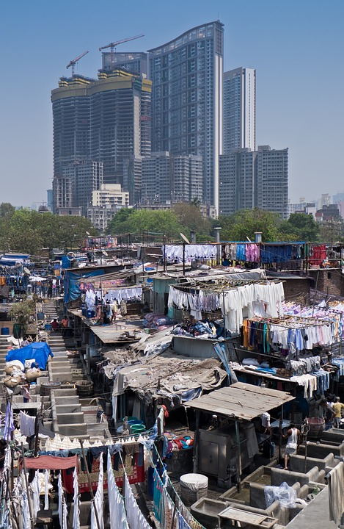
National urban health Mission: program components & action points

Slide 16
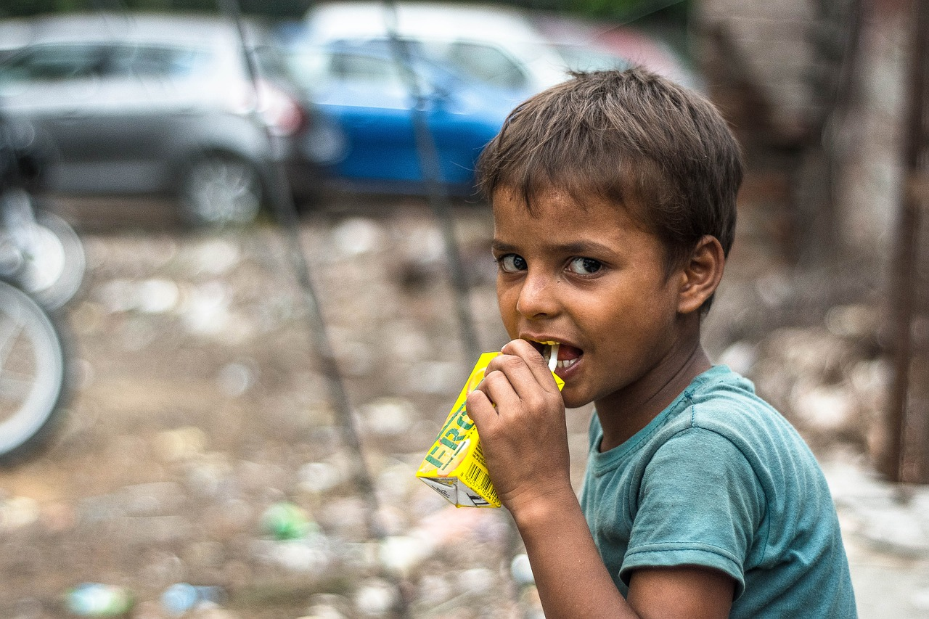
National urban health mission
Covers around 29.95 crore population
Across 1006 Cities (942 cities over 50,000 population + 64 District Headquarters with under 50,000 population)
For entire urban population, but definite focus on urban poor and vulnerable
Focus of NUHM on ‘vulnerable’ not just ‘ill’
Aims to address the interlinkage of health with social determinants
Implementation to be led by:
  State health departments
  Urban Local Bodies (in metro cities)

Slide 17










UPHC: Epicentre of primary healthcare
In-facility services under all National Health Programs
Effective and Regular Outreach
Services
Community Processes
(Community Based interventions & Home visits by ASHAs, ANMs & MAS)
The
Urban Primary Health Centre
Convergence with Urban Development, Swachh Bharat, Urban Local Body
(ULB) at
ward level
Population Based Screening
of
NCDs
Multi-directional
and Assured
Referral
Ensure effective upward (higher facility) & downward (community and ward level) linkages from the UPHC

Slide 18

Referral Services
UPHCs should identify multiple referral sites for various special needs (Multi-directional referral)
Identify focal persons at each referral centre to communicate with directly
Follow up treatment and compliance by ASHA and ANM for all referred cases
UCHC and higher tertiary centres
Substance De-addiction Centre
Mental Health Services
The Urban Primary Health
Centre
Palliative Care centre
Homeless
Shelter
Domestic Violence Help Centre
Physical Rehabilitation Centre
Nutritional Rehabilitation Centre

Slide 19
Establishing Health Advice & GR System
Health advice & GR System- Three Components
Facility based GR Helpdesk
Call centre based Health advice & GR helpline
Health advice & GR web portal
104 as a Centralized help No. can be established for all programme

Slide 20
Grievance Redressal: Time Flow
Time bound resolution
  Grievances registered at GR help desk, help line and portal compiled in web portal
  Stipulated time limit of 7 days at each level for resolution of grievances
  After 7 days, grievance automatically escalate to next higher level for resolution
  Next higher authority review the resolution provided and
  If found inappropriate, can put it for further consideration
At Facility/Block Up to 7 days
Facility Quality Team
At District Level
Up to14 days
District Quality Assurance Unit
At District Level
Up to 21 days
State Quality Assurance Unit
MOIC In-charge
BCMO
CMO
MD-NHM
PS-Health
Up to 28 days
HFM and\or CM of the State

Slide 21
Monitoring Indicators
Performance
Total Number of calls received
Total Number of calls received for reporting grievances
Number of grievances received category wise
Total number of grievances resolved till now
Number of grievances resolved category wise
% of calls where a grievances registered
% of calls service wise- health information, counselling etc.
Functioning
Average calls received per day and per month
% of calls attended by Call Operator, Medical Officer (MO) and Counselling Officer (CO).
Total average handling time (AHT) of call operator, MO and CO at the centre (suggested AHT is 3 min)
% dropped, missed, silent, abandoned, valid incomplete, noise / disturbance calls of the total calls/month.

Slide 22
Medico-legal aspects of public health
Contributed in drafting and finalizing following policies for MoHFW :
Clinical Establishment Act
Public Health Act
Comprehensive Lactation Management Centers
National Digital Health Authority of India Act (DISHA)
Policy on Rare Diseases
Medico-legal protocols

Slide 23
Guidelines and Policies
Critical Care Areas:
  Operation Theatre
  Emergency Department
  High Dependency Unit
  CSSD/ Mechanized Laundry
  Dietary Services
Comprehensive Primary Health Care:
  Architectural Design of Health & Wellness Centers
  Mental Health & Epilepsy
  Burns & Trauma
  Dental Care
  RMNCHA

Slide 24
Action Points
  Support in implementation of training courses as part of DH strengthening (DNB, CPS, nursing, paramedical)
  Strengthening secondary care facilities with comprehensive planning(OT, HDU, CSSD, Kitchen)
  Assured Emergency Care
  Implementation of Model Health Districts
  Citizen centric services- GRS and health helpline, NAS, MDSR, CDR
  Decentralized Planning including preparing DHAPs

Slide 25
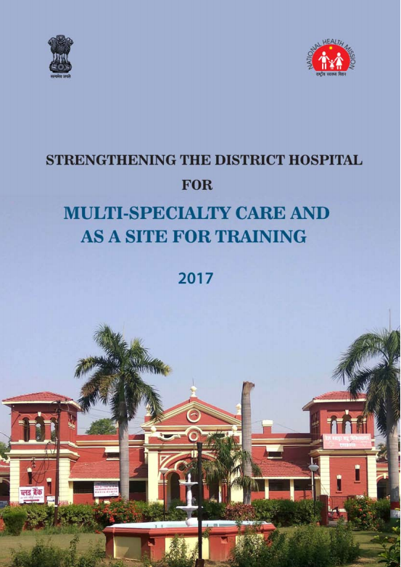
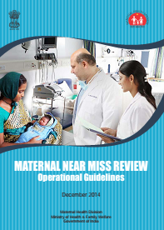

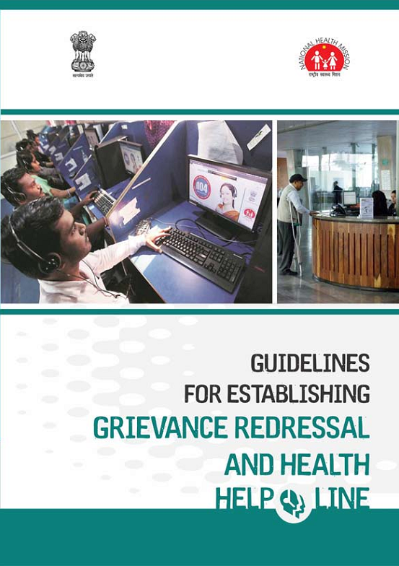
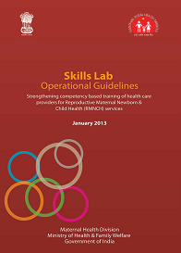

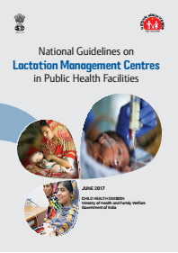
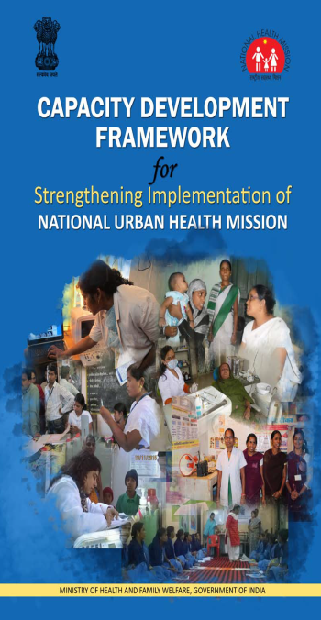
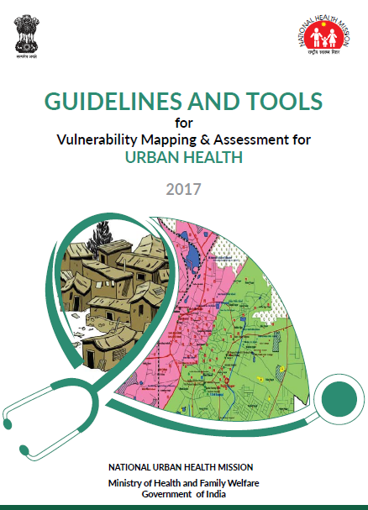
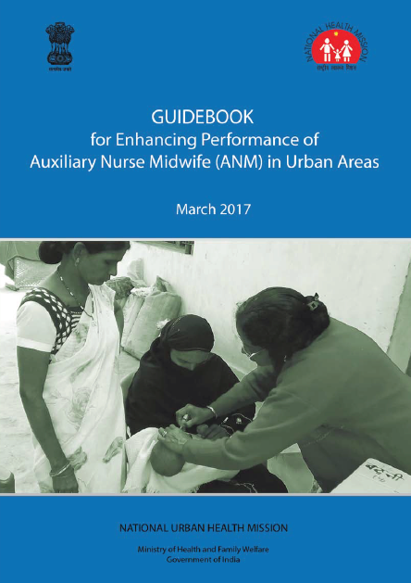
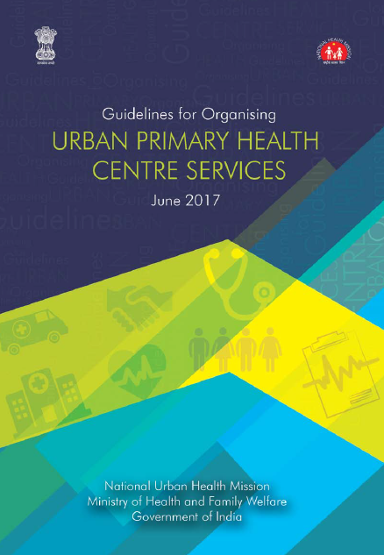
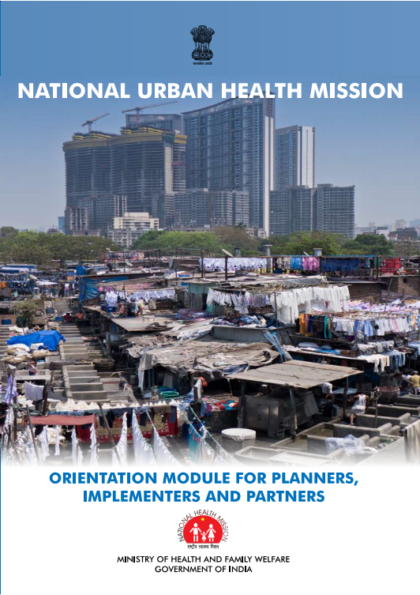
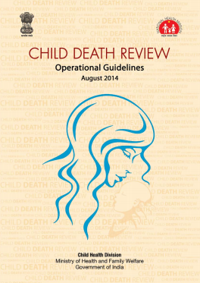
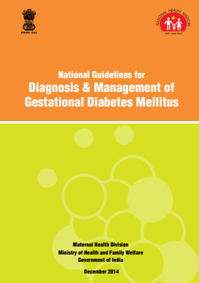
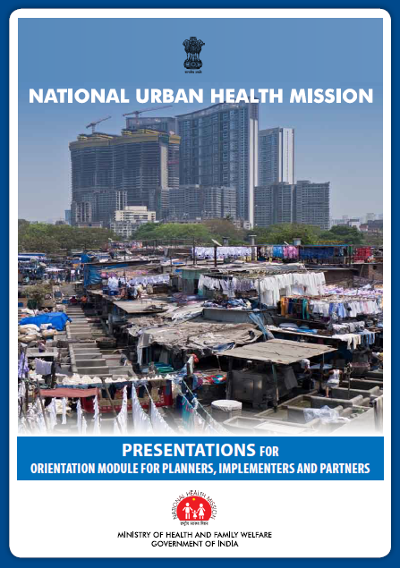
Publications

Slide 26
Our Team Members
Dr. Himanshu Bhushan, Advisor & Head
Mr. Prasanth K.S., Senior Consultant
Dr. Vinay Bothra, Senior Consultant
Mr. Ajit Kumar Singh, Senior Consultant
Ms. Shivangi Rai, Legal Consultant
Dr. Kalpana Pawalia, Consultant
Dr. Aashima Bhatnagar, Consultant

