Slide 1
PIP
MoHFW, GoI

Slide 2
Why do we need to change the budget sheet?
Far too many budget heads/lines (1761)
Inter change between budget heads not permitted. Detailed activities reflected in budget sheet under various heads could not be changed, this rigidity made implementation difficult. All the heads have now been incorporated under 18 Main heads, budget sheet has total 68 rows
FMR codes of later activities too complicated:A.9.3.7.1; A.9.5.5.2.b
    A.9 Training
    A.9.5 Child Health Training
    A.9.5.5 IMNCI training
    A.9.5.5.2 Other Child Health Training
    A.9.5.5.2.b Observership training for facility based newborn care

Slide 3
Why do we need to change the budget sheet?
Many cases of duplication under different budget heads (e.g. Drugs for Pregnant women : JSSK in MH, Also in procurement)
The system of main heads followed no logical system. Additions were as per requirement; every effort was made to keep the earlier budget heads and FMR codes unchanged which resulted in a mix of program and cross-cutting heads: MH, CH, FP… but HR, IEC, Procurement…too
Too much of verticality leading to sub-optimal utilization of resources
    Lab Technicians under many programs: RCH, NVBDCP, RNTCP, NIDDCP, AIDS Control etc.
Pro-program managers but not for implementers

Slide 4
Changes initiated in 2017-18
HR, IEC and Procurement : All the components under each of these heads were brought together
Very encouraging feedback from the states
      We know total Service delivery HR we have
      We know how much IEC budget we have under various program heads
      We know the total procurement budget and could procure all of it together
As a logical extension of this concept, in 2018-19 all the existing budget lines are clubbed and aggregated under 18 main budget heads

Slide 5
New Budget Heads
1
Service Delivery - Facility Based
11
IEC/ BCC
2
Service Delivery - Community Based
12
Printing
13
Quality Assurance
3
Community Interventions
14
Drug Warehousing & Logistics
4
Untied Funds
5
Infrastructure
15
PPP
6
Procurement
16
Program Mgt and M&E
7
Referral Transport
17
IT initiatives for SD
8
Service Delivery - HR
18
Innovations
9
Training & Capacity Building
10
Review, Research, Surveillance & Surveys

Slide 6
FEATURES OF
BUDGET SHEET 18-19

Slide 7
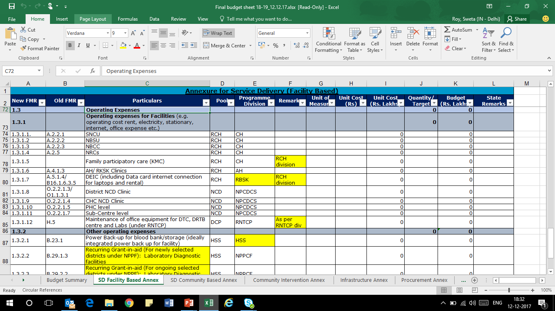
Annexure heading: for reference
For ease of reference, Old FMR, Budget Pool and programme division have been mentioned
State/ division can compare previous year activity using the old FMR codes

Slide 8
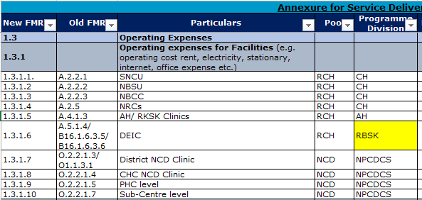
Integration of budget lines across the crosscutting components
Operational cost including electricity, rent, stationary, consumables etc. for any facility/ service delivery point have been put under one head

Slide 9
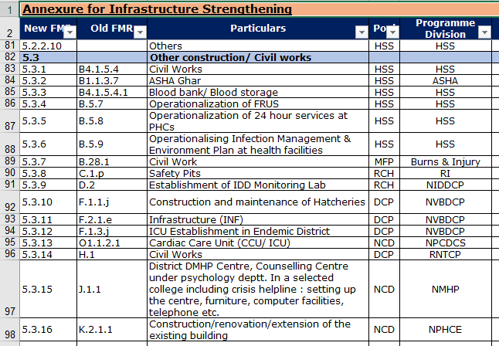
Integration of budget lines across the crosscutting components
Infrastructure strengthening/ any budget for construction budgeted under various programmes last year have been put together

Slide 10
Same Budget line under different Annexure - Examples
F.1.4.a | State Task Force, State Technical Advisory Committee meeting, District coordination meeting (Lymphatic Filariasis) | NVBDCP
New FMR | Old FMR | Particulars | New PIP Sheet
1.1.5.3 | F.1.4.a | Lymphatic Filariasis: Morbidity Management | SD – Facility Level
12.11.1 |  | Printing of forms/registers for Lymphatic Filariasis | Printing
 |  | State Task Force, State Technical Advisory Committee meeting, District coordination meeting (Lymphatic Filariasis) | Programme Management

Slide 11
Budget Sheet 2018-19
For Ease of Program Divisions : Abstracts
Use it for review and implementation

Slide 12
Abstracts – NVBDCP
New FMR | Particulars
1 | Service Delivery - Facility Based
1.1 | Service Delivery
2 | Service Delivery - Community Based
2.2 | Recurring/ Operational cost
3 | Community Interventions
3.1 | ASHA Activities
3.2 | Other Community Interventions
5 | Infrastructure
5.3 | Other construction/ Civil works
6 | Procurement
6.1 | Procurement of Equipment
6.2 | Procurement of Drugs and supplies
9 | Training
9.5 | Trainings
10 | Reviews, Research, Surveillance and Surveys
10.2 | Research & Surveys
10.3 | Surveillance
10.4 | Other Recurring cost
11 | IEC/BCC
11.11 | IEC/BCC activities under NVBDCP
12 | Printing
12.11 | Printing activities under NVBDCP
14 | Drug Warehousing and Logistics
14.2 | Other Logistics
15 | PPP
15.3 | PPP under NVBDCP

