Slide 1
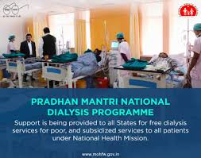




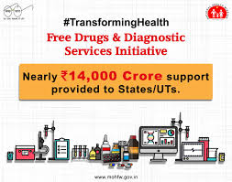


Department of Health & Family Welfare

Slide 2
Government Health Expenditure (GHE) and Out of Pocket Expenditure (OOPE) as % of Total Health Expenditure (THE)
2014
GHE as % THE - India ranks 176 out of 191 countries
OOPE as % of THE - India ranks 182 out of 191 countries

Slide 3
Tax to GDP ratio (%) (2015) in selected countries
Prioritizing Health: Health Expenditure in Total Government Expenditure (%)-2015

Slide 4
Year-Wise Health Expenditure by GOI
(Rs. in Crores)
Source: Detailed Demand of Grants, MoHFW

Slide 5
NHP 2017 Targets
Increase public health expenditure to 2.5% of GDP, in a progressive manner, by 2025.
Increase State sector health spending to more than 8% of their budget by 2020.
Primary Health Expenditure to be 2/3rd of the total health expenditure.

Slide 6
Year wise Expenditure to achieve 2.5% of GDP
 | (Rs. in Lakh Crore)
Year | Expenditure on Health as a % of GDP | GDP ( assuming growth@7.5% at current prices over baseline of 2017-18) | GDP with Rate of Inflation @4%only | Expenditure on Health | 35% of Expend. for Centre | 65% of Expend. for State
1 | 2 | 3 | 4 | 5=4*2 | 7 | 8
2018-19* | 1.4% | 178.75 | 185.90 | 2.60 | 0.91 | 1.69
2019-20* | 1.4% | 199.83 | 207.84 | 2.91 | 1.02 | 1.89
2020-21 | 1.58% | 223.42 | 232.36 | 3.67 | 1.28 | 2.39
2021-22 | 1.76% | 249.79 | 259.78 | 4.57 | 1.60 | 2.97
2022-23 | 1.98% | 279.26 | 290.43 | 5.75 | 2.01 | 3.74
2023-24 | 2.22% | 312.22 | 324.70 | 7.21 | 2.52 | 4.68
2024-25 | 2.50% | 349.06 | 363.02 | 9.07 | 3.17 | 5.90
.* Assuming that the Govt. health expenditure is 1.4% of GDP, as in 2017-18, as per Economic Survey, 2017-18
Notes:
*

Slide 7
Organization & Key Programmes of MoHFW
Support to Primary & Secondary Care | National Health Mission Ayushmaan Bharat – Health & Wellness Centres Reproductive-Maternal-Neonatal-Child - Adolescent Health & Nutrition Health System Strengthening Communicable & Non-Communicable Diseases (NCDs) National AIDS Control Programme
Tertiary Care | Ayushmaan Bharat – PMJAY PMSSY, upgradation of DHs into Medical Colleges INIs & Central Institutions Tertiary care schemes
HRH | Medical, Nursing & Allied Professionals
Institutions | Strengthening/ Establishing Health institutions including new AIIMS, CG hospitals and the CGHS
Regulation | Drugs & Food, Clinical Establishment Medical, Dental, Nursing & Pharmacy Councils Allied Health Professionals (proposed)

Slide 8


Sustainable Development Goals
- 17 Goals, 169 targets & 230 indicators
- 1 Health Goal, 13 targets & 26 indicators
Notes:
MDG Success factors: Few goals and targets, widely accepted
Some limitations: Variable progress, vertical approach ➔ Unfinished MDG agenda
SDGs: Too Many Goals= Having No Goals?
Copenhagen consensus
2 Questions: Health is well placed and What has changed- Speaking about latter first…

Slide 9







Health SDG3 is linked to other SDGs as contributor and beneficiary
Target 1.3: Implement social protection systems for all
Target 6.1: achieve universal & equitable access to safe and affordable drinking water
Target 4.2: ensure access to early childhood development, care and pre-primary education
Target 2.2: end malnutrition, achieve targets for reductions child stunting & wasting
Target 5.2: end all forms of violence against all women and girls ….
Target 16.1: reduce all forms of violence and related death rates everywhere
Other SDGs e.g. 8 (productive employment and decent work), 10 (inequality), 11 (cities) etc
Notes:
Example:
Contributor: A healthy child will attend the school and learn well………. while a sick child cannot attend the school- So health contributes to better education
Beneficiary: An educated person is more likely to take better care of his health and seek timely and appropriate care …..and vice versa- So health benefits from education

Slide 10
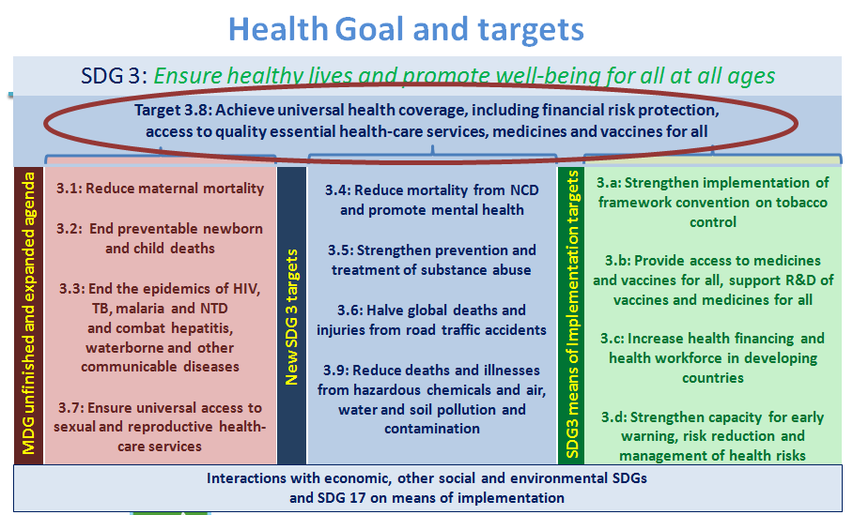

Slide 11
Initiatives taken by MoHFW

Slide 12
AYUSHMAN BHARAT – Rationale
TERTIARY
PMJAY
SECONDARY
Referral
HWCs
PRIMARY
Unmet need: NCDs/other Chronic Diseases
Preventive, Promotive, Curative, Rehabilitative & Palliative Care
Existing services: RMNCHA
CONTINUUM OF CARE – CPHC & PMJAY
Notes:
NCDs account for 62% mortality; 55% Premature, 62% OOPE of Total Health Expenditure
NSSO data (71st Round. 2014) shows 11.5% and about 4% in rural and urban areas respectively sought any form of Outpatient care - at or below the CHC (secondary health centres) (except for Childbirth).
Presently the Sub centre and Primary Health centre- currently provide preventive care mostly related to maternal and child health,
The need for primary health care is met by unqualified practitioners. particularly in the high focus states,
There is a huge unmet need for early detection and management of Non-communicable diseases and other chronic conditions. NCDs currently account for 62% mortality of which 55% is premature mortality.
Studies show that losses associated with physical NCDs is expected to be about $3.55 trillion by 2030

Slide 13
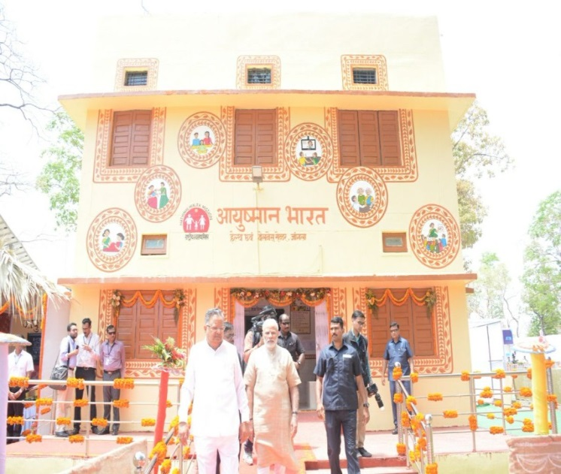
AYUSHMAN BHARAT
Aims to provide holistic care – prevention, health promotion, primary, secondary & tertiary care in an integrated manner
Operationalizing 1.5 lakh Health and Wellness Centres - To Deliver Comprehensive Primary Health Care services including prevention and health promotion
Financial protection for secondary and tertiary care hospitalisation through Pradhan Mantri Jan Arogya Yojana (PMJAY)

Slide 14


Key Milestones
Operational Guidelines on Comprehensive Primary Health Care finalized
Operationalization of 1.5 Lakh Health & Wellness Centres
Inauguration of 1st HWC and CPHC Application at Jangla, Bijapur
Budget announcement of HWCs
FY 2018-19 (Rs. 1200 Cr)
Operationalization of 18157 Health & Wellness Centres
National Consultation on Comprehensive Primary Health Care
FY 2019-20 (Rs. 1600 Cr)
Feb 2018
14th April,
2018
May
2018
July
2018
Feb
2019
May 10th 2019
2022

Slide 15

Key Elements to Roll out CPHC
Continuum of Care – Telehealth /Referral
Infrastructure
Expanded Service Delivery
Community Mobilisation and Health Promotion
Financing/
Provider Payment Reforms
Robust IT System
CPHC
through
HWC
Medicines & Expanding Diagnostics
Expanding HR - MLHP & Multiskilling
Partnership for Knowledge & Implementation

Slide 16
HWC: Paradigm Shift at multiple policy and operational levels
Focus on curative care predominant
Continuum of care only for maternal and child health
HSC led by One or two Multipurpose workers, supported by ASHAs
Supply of medicines and access to diagnostics at higher level facilities
Focus on Preventive and Promotive Health care
HWC teams to manage majority of conditions including home and community based follow up
Continuum of care for expanded range of services and linkage with PMJAY
Adding a Community Health Officer (Mid Level Health Provider) at HSC – HWCs and multiskilling of primary health care team
Dispensing of medicines including chronic care and essential diagnostics

Slide 17
HWC: Paradigm Shift at multiple policy and operational levels
Limited use of technology in consultation and capacity building
Overcrowded secondary and tertiary centres / High loss to follow up/ High OOPE
Underused network of 1,50,000 peripheral facilities, selective care
IT based application for continuum of care including linkage with PMJAY and development of electronic health record.
ECHO for regular tele mentoring and Teleconsultation to avoid patient hardship
Comprehensive care close to community, reduced OOPE, better compliance
Investment in infrastructure and branding.

Slide 18
Service Packages
Services made available at HWC
Services* being added in incremental manner
1. Care in Pregnancy and Child-birth.
2. Neonatal and Infant Health Care Services
3. Childhood and Adolescent Health Care Services.
4. Family Planning, Contraceptive Services and other Reproductive Health Care Services
5. Management of Communicable Diseases: National Health Programmes
6. General Out-patient Care for Acute Simple Illnesses and Minor Ailments
8. Basic Oral Health Care
9. Screening and Basic Management of Mental Health Ailments
10. Care for Common Ophthalmic and ENT Problem
11.Elderly and Palliative Health Care Services
12.Emergency Medical Services including Burns and Trauma
7. Screening, Prevention, Control and Management of Non-communicable Diseases and Chronic Communicable diseases like Tuberculosis and Leprosy.
*Many states in south have started adding above services

Slide 19

Roll out Plan of
Health and Wellness Centres

Slide 20
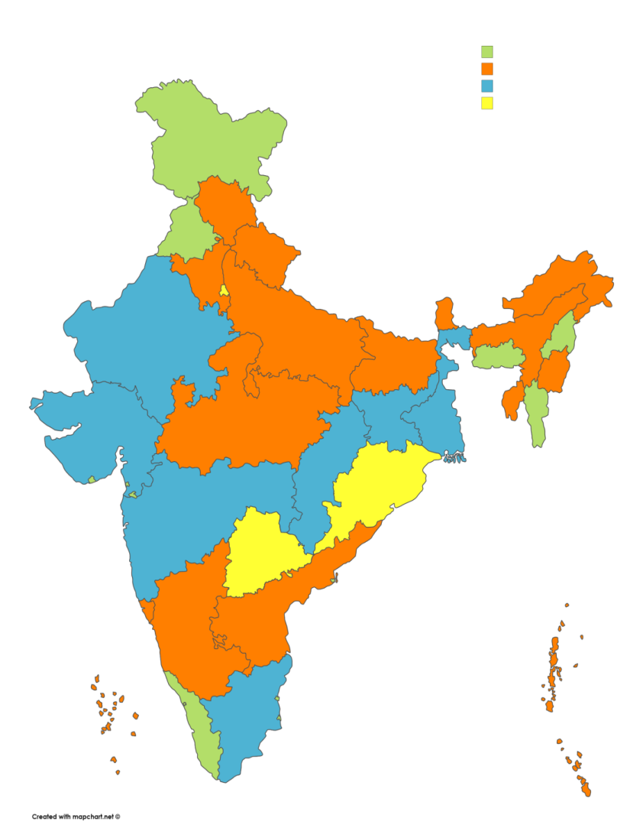
PM-JAY achievements
33
States/UTs signed MoUs
29
States/UTs implementing
18 State/UT Governments have expanded PM-JAY coverage to additional beneficiaries at their own cost
A robust IT platform has been developed
PMJAY Status till 05/05/2019
Metric | Overall
E-Cards Issued | 3,21,66,096
Beneficiaries Admitted in Hospital | 2,30,2925
Amount Authorized for Admissions | Rs.3071.5 Cr
Hospitals Empanelled | 15,075
17
Trust Mode
07
Mixed Mode
09
Insurance Mode
MoU yet to be signed
03

Slide 21
National Health Mission (NHM)
NHM
NRHM- RCH
Pool
NCDs programmes
Infrastructure Maintenance
NUHM
Communicable Disease Programme
RCH Flexipool-
RMNCH+ A - Reproductive, Maternal, Neonatal, Child & Adolescent Health.
Immunization- Routine Immunization & Pulse Polio Immunization.
Health System Strengthening
Revised National TB Control Prog (RNTCP)
National Vector Borne Disease Control Prog (NVBDCP).
National Leprosy Elimination Prog (NLEP)
Integrated Disease Surveillance Project (IDSP)
National Prog. For Prevention & Control of Cancer, Diabetes, Cardiovascular Diseases & Stroke (NPCDCS)
National Prog. for Control of Blindness (NPCB)
National Mental Health Prog.(NMHP)
National Tobacco Control Prog. (NTCP)
National Prog. for Health Care of Elderly (NPHCE)

Slide 22

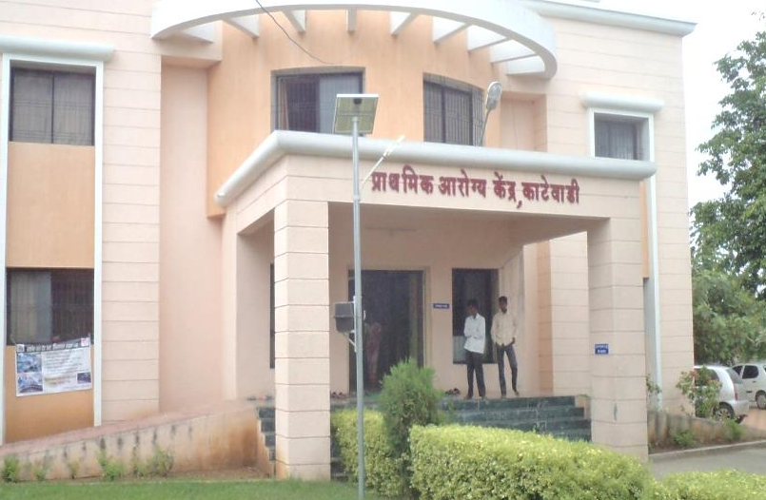
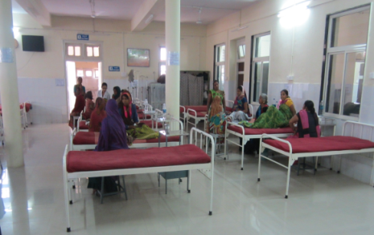
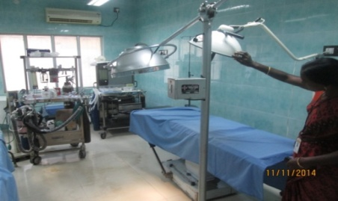
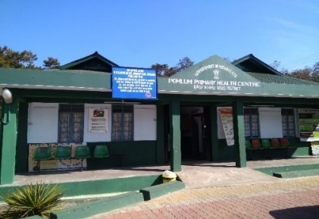
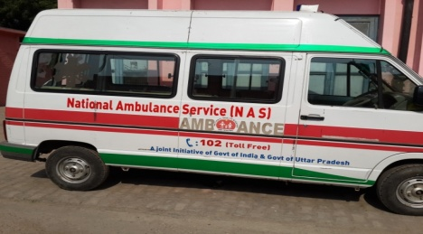
Interventions under NHM
About 2.34 lakh
Over 31811
Over 38547
Additional Human Resources excluding 10 lakh ASHAs & Mid-Wifery Cadre in 21 States
New Constructions
Renovation/ Upgradations
Over 25000
Around 3104
Around 9930
Ambulances operational
FRUs operationalized
PHCs made 24X7
3 fold increase over baseline
3 fold increase over baseline
Notes:
Source: HMIS database-June 2018

Slide 23
Free Drugs Service Initiative : Essential Medicines
Flexibility with the State / UT to increase the number of medicines in EML as per disease burden.
31 States / UTs have facility wise EML.
FDSI guidelines suggests EML to be displayed at each facility.
Type of Facility | Indicative number of Medicines / Formulations
SHC | 57
PHC | 285
CHC | 455
DH | 544

Slide 24
Number of Medicines in EML – as reported on DVDMS dashboard
Source : Central DVDMS portal as on 6.04.2019

Slide 25
As on today :
15 States have implemented DVDMS (CDAC)
3 States are in the process of implementing DVDMS -Sikkim, Arunachal Pradesh and Assam.
9 States and 1 UT have systems other than DVDMS.
  Tamil Nadu, Odisha, Karnataka, Haryana, Kerala, West Bengal and Goa are yet to integrate data with the Central DVDMS Dashboard.
One common application has been proposed for the remaining 6 UTs.
Only 2 States without an IT backed medicine supply chain system - Mizoram & Nagaland.

Slide 26
Setting up a system for Prescription Audit
14 States / UTs have initiated the process.
“Every physician should prescribe drugs with generic names legibly and preferably in capital letters and he/she shall ensure that there is a rational prescription and use of drugs .”
  Code of (Professional Conduct, Etiquette and Ethics) Regulations 2002.
Advisory issued by MoHFW to both central Government facilities/institutions and to States/UTs for compliance.

Slide 27
Grievance Redressal Systems:
19 States / UTs have a mechanism in place.
Quality Assurance:
Results of National Drug Survey 2014-16 :
Not of Standard Quality (NSQ) medicines in retail outlets : 3%.
NSQ in public health facilities : 10%.
14 States with NSQ % greater than the national average.
Quality testing by NABL accredited lab is available in 28 States / UTs.

Slide 28
Free Diagnostics Service Initiative
Type of Facility | Indicative number of Tests
SHC | 7
PHC | 19
CHC | 39
DH | 56
Gujarat, Rajasthan and Andhra Pradesh are providing all tests listed in the FDI guidelines.
Andhra Pradesh (under PPP) and Telangana (in-house) have implemented a hub and spoke model for laboratory services.
Rajasthan is also using hub and spoke model for the outsourced advanced tests.
In Gujarat, samples for few tests are transported to the district central laboratory from all health facilities.
Nagaland, Uttarakhand, Mizoram and Arunachal Pradesh are yet to implement Free Diagnostics Service Initiative.

Slide 29
All States to fast-track implementation of DVDMS – upto HWC – PHC / SC level.
States to ensure data integration with the Central DVDMS dashboard. (Tamil Nadu, Odisha, Karnataka, Haryana, Kerala, West Bengal and Goa)
Ensure Point of Care Diagnostics at HWC-PHC : 62 and HWC-SHC :15 tests – Hub and Spoke Model.
Expansion of facility level EML : Include medicines for expanded service packages.
  Same medicines to be made available at all levels of care (i.e, SHC-PHC-CHC-DH) to improve treatment compliance.
Notes:
New slide – same medicines sub point

Slide 30
BMMP :
BMMP has been implemented in 27 States/UTs: 21 States/UTs in PPP mode (Andhra Pradesh, Arunachal Pradesh, Assam, Chhattisgarh, Jammu and Kashmir, Jharkhand, Kerala, Madhya Pradesh, Maharashtra, Meghalaya, Mizoram, Nagaland, Puducherry, Punjab, Rajasthan, Telangana, Tripura, Uttar Pradesh, West Bengal, Goa and Manipur)
In-house in 6 States/UTs (Daman & Diu, Dadra &Nagar Haveli, Delhi, Gujrat, Tamil Nadu, Lakshwadeep

Slide 31
Kayakalp :
To award those facilities displaying outstanding swacchta and infection control protocols for promotion of cleanliness, hygiene and good infection control practices.
Almost 27,000 facilities assessed, 2,885 public health facilities including 271 DHs, 748 SDH/CHCs, 1,724 PHCs and 142 Urban health facilities have been awarded.

Slide 32
Swachh Swasth Sarvatra (SSS) :
Joint initiative of Ministry of Health and Family Welfare (MoHFW) and Ministry of Drinking Water and Sanitation (MDWS).
One SDH / CHC in each of the Open Defecation Free (ODF) blocks to receive additional funding of Rs. 10 lakhs.
MDWS to enable Gram Panchayats where Kayakalp awarded SDH/PHCs are located to become ODF.
Further MDWS to build capacity through training in Water, Sanitation and Hygiene (WASH) to nominees from such CHCs
and PHCs.

Slide 33
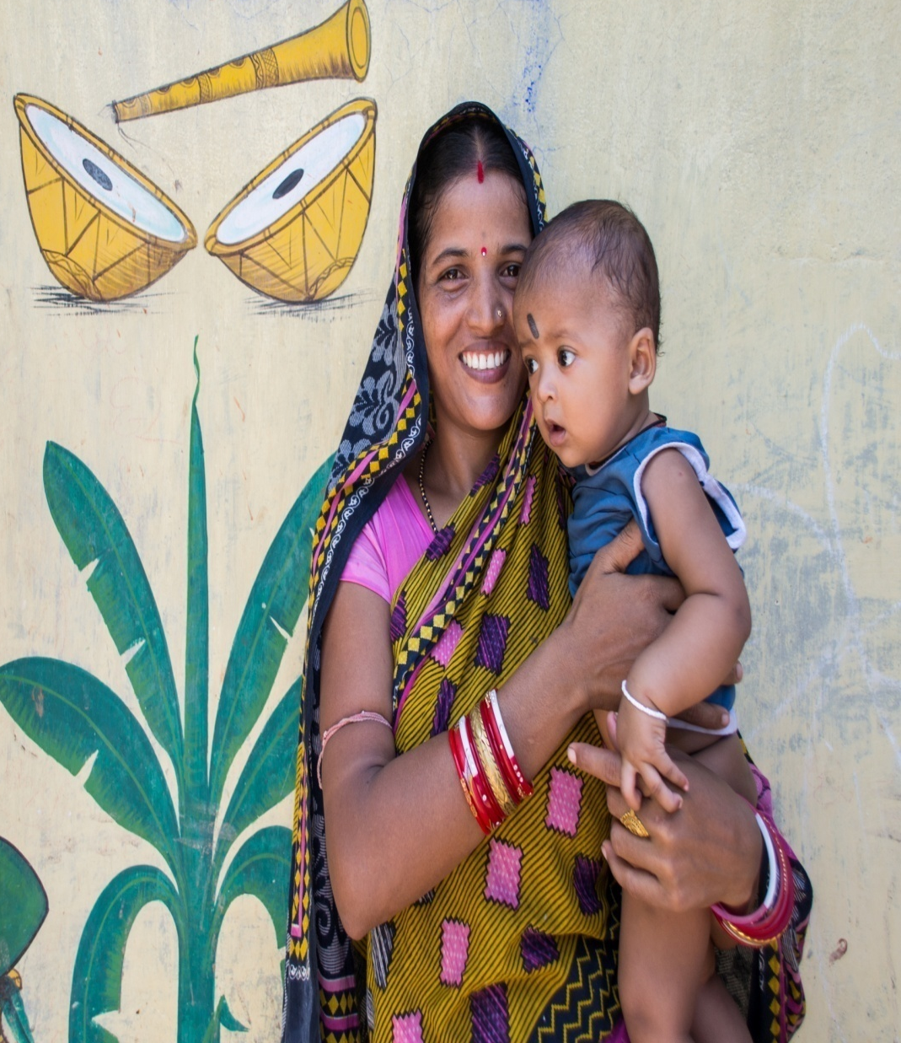


Slide 34
Programme Specific Data Sets
S no | Programmes | Indicators | Latest Available
4 | RCH | Maternal Death Surveillance and Response (MDSR) Report. Trainings report (SBA, Daksh, Dakshta, RTI/STI, EmOC, LSAS, BeMOC. Comprehensive Abortion Care . Number of JSY beneficiaries. Facility Based - SNCU, NRC Report. Community Based (HBNC etc.) Rashtriya Bal Swasthya Karyakram (RBSK). Mothers’ Absolute Affection (MAA). Peer educator selection and training Status. Menstrual Hygiene Scheme coverage. Adolescent Friendly health service trainings of MOs, ANMs, and counsellors. | Quarterly
5 |  | Infrastructure of SNCU, NBSU, NBCC, NRC. Intensified Diarrhoea Control Fortnight (IDCF). National Deworming Day (NDD) | Annual

Slide 35
Reproductive Health: Key Initiatives and Results
Expanding contraceptive basket- Injectable MPA, Centchroman and POP has been recently introduced
Mission Parivar Vikas
Strengthening Supply chain through FP-LMIS
ASHA (CHW) Schemes
Total Fertility Rate (TFR)- 2.2 in 2016 (NFHS IV).
Decadal Growth Rate- declined from 21.54% in 1991-2000 to 17.64% during 2001-11 (census India -2011).
Strategies
and
Interventions
Spacing between Births improved from 42.6% (2012) to 51.9% (2016) (SRS).
Current modern contraceptive usage is 47.8% (NFHS IV).
24 States/UTs have achieved replacement level of TFR (i.e. 2.1).

Slide 36
Maternal Health: Key Initiatives & Results
Janani Surksha Yojana (JSY)
Janani Shishu Suraksha Karyakram (JSSK)
Strengthening FRUs, Delivery Points & MCH Wings
Pradhan Mantri Surakshit Matritva Abhiyan (PMSMA)
LaQshya: Labour Room and Maternity OT Quality Improvement Initiative
MMR in India declined 59 % faster than the global MMR
MMR reduced from 556 in 1990 to 130 in 2014-15

Slide 37

Child Health: Key & Recent Initiatives
Essential Newborn Care
Mother’s Absolute Affection (MAA)
Promotional activities for Breastfeeding/ Complementary feeding.
New Initiatives
Home Based Care of Young Children (HBYC)
Home Based Newborn Care (HBNC)
Intensified Diarrhoea Control Fortnight (IDCF)
Screening and management of children with 4Ds- RBSK program
AMB Launched in April’ 2018
Preventive and curative mechanisms through a 6X6X6 strategy
National Deworming Day (NDD)
U5MR reduced from 126 in 1992 to 39 in 2015-16

Slide 38
Initiatives to Strengthen Immunization
Mission Indradhanush
New Vaccines
Inactivated Polio Vaccine (IPV)
MI launched to achieve full immunization coverage to 90% and sustain it through RI.
554 Districts covered under MI.
One of the flagship schemes under Gram Swaraj Abhiyan (GSA) & Extended GSA.
3.39 crore children and 87.2 lakh pregnant women vaccinated.
Rotavirus Vaccine (RV)
Launched in 11 States.
Measles-Rubella Vaccine (MR)
MR Campaign in 32 States.
Pneumococcal Conjugated Vaccine (PCV)
Launched in 5 States (UP and Rajasthan partially).

Slide 39
Immunization: Coverage trends
MI & IMI rounds
Average 1% increase every year from 1992 to 2014
6.7% increase within a year
Recent survey in 190 IMI districts has shown an average increase of 18.5 percentage points in FIC from NFHS-4

Slide 40
Revised National Tuberculosis Control Programme-
Achievements & Recent initiatives
Largest and the fastest expanding TB control programme in the world
Provides quality assured free diagnostics and treatment services to all TB patients
New Initiatives
National TB Prevalence Survey to determine state-wise burden of disease.
NIKSHAY Sampark – call centre services expanded to all States with counselling support and grievance redressal offered in 14 languages
Community Engagement
Working with identified Ministries
Incentives for achievement of targets
Achievements in 2018
Incidence reduced from 300(1990) to 204 (2017)
Mortality Reduced from 76 in 1990 to 31 in 2017
21.5 lakh TB cases notified - Increase of 18% over 2017
Universal Drug susceptibility testing introduced
Daily Fixed Dose Combination drugs benefiting 19.3 lakh TB patients
Treatment for 5.5 lakhs patients made more patient friendly (injection free)
Nikshay Poshan Yojana (NPY)

Slide 41
MALARIA & LEPROSY CONTROL
MALARIA
National Strategic Plan for Malaria Elimination- 2017-2022
40 Million LLINs distributed in the NE States, Odisha, Chhattisgarh & Jharkhand
+ cases reduced by 28% in 2015-17
Reported deaths reduced by 73%
58.80% reduction in the mortality rate and 42.45% reduction in the incidence of Malaria in 2015 as against 2000, further decline of 24% in 2017 & 54.44% in 2018
LEPROSY - 3 pronged strategy
Leprosy case detection
Focus Leprosy Campaign
Special Plan for Hard to reach area
Achievement - Grade II disability has started reducing.

Slide 42
HIV/AIDS
2030
End the epidemic of AIDS
SDG Goal 3, Target 3.3
2020
Reduce new HIV infections by 75% (Baseline 2010)
Achieve treatment targets of 90-90-90
Eliminate HIV-related stigma and discrimination
Eliminate Mother to Child Transmission of HIV & Syphilis
Fast Track Targets
90-90-90 By 2020
90% of all people living with HIV will know their HIV status
90% of all people with diagnosed HIV infection will receive sustained antiretroviral therapy
90% of all people receiving antiretroviral therapy will have viral suppression
80 % decline in new infections since 1995 against global average of 47%
71 % decline in AIDS related deaths since 2005 against global average of 51%

Slide 43
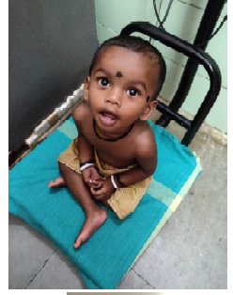


Nutrition Promotion
Facility based management of sick SAM children by Nutrition Rehabilitation Centres
39.1 million adolescents covered under WIFS programme
POSHAN Abhiyaan – India’s flagship programme to improve nutritional outcome of children, adolescent, pregnant and lactating mothers by leveraging technology, targeted approach and convergence

Slide 44
Food Regulation
Food Safety Standards (Fortification of Foods) Regulation, 2018
Formulation of standards for fortification of key staples – Edible oil ad milk (with Vitamin A & D), wheat flour and rice (with iron, folic acid and vitamin B12 and salt with iron (in addition to iodine) to address micro nutrient deficiencies
Fortified staples used Integrated Child Development Services (ICDS) and Mid-day meal scheme
Streamline licensing and registration of Food Business Operators (FBOs)

Slide 45
Drug Regulation
The Medical Device Rules, 2017- regulating manufacture, import, clinical investigation & sale of Medical devices
Provisions for improving transparency and accountability
Risk based classification criteria for medical devices.
Manufacture of high risk medical devices category – to be regulated by the Central Licensing Authority, & others will be regulated by State Licensing Authority.

Slide 46
IT Status & Plans
Vision: to create secure and interoperable Electronic Health Record (EHR) of every citizen which will facilitate continuum of care
Policy Framework
Glimpse of ongoing IT Initiatives
Global Agenda
Mother and Child Tracking System
My Health Record
Hospital Management system
Integrated Health Information Platform
NCD application
Nikshay
Drug & Vaccine Distribution Management System
eVIN
Mera Aspatal
Online Registration System
Mother and Child Tracking System
My Health Record
Hospital Management system
Integrated Health Information Platform
NCD application
Nikshay
Drug & Vaccine Distribution Management System
eVIN
Mera Aspatal
Online Registration System
A National Resource Centre for EHR standards estd.
Report of National Health StackCommittee submitted to MoHFW
A pan India Telemedicine Network established
Mother and Child Tracking System
My Health Record
Hospital Management system
Integrated Health Information Platform
NCD application
Nikshay
Drug & Vaccine Distribution Management System
eVIN
Mera Aspatal
Online Registration System
India concluded 4th Summit of Global Digital Health Partnership (GDHP) and assumed Chair of GDHP
Participation from 35 countries + Academia + Industry + Start-ups
46

Slide 47
Medical Education - Centrally Sponsored Schemes
Establishment of new Medical Colleges attached with existing district/referral hospitals
Up-gradation of existing State Government/Central Government medical colleges to increase MBBS seats in the country
Strengthening and upgradation of State Government Medical colleges for starting new PG disciplines and increasing PG seats

Slide 48



Achievements in Medical Education
118 New Medical Colleges
Increase of 15600 MBBS seats
13000 PG seats , 18635 UG seats increased
NEET examination
6 New AIIMS established with 318 PG seats and 2200 beds.
National Medical Commission Bill, 2017
Notes:
499 MEDICAL COLLEGES

Slide 49
PRADHAN MANTRI SWASTHYA SURAKSHA YOJANA (PMSSY)
22 New AIIMS being set up
  Completed / Functional : 06
  Sanctioned by cabinet : 15 (Total Cost : 20756 Cr )
  In Pipeline : 1 (in Bihar , Estimated cost : Rs. 1200 Cr )
  PMC appointed : 11 (bids invited for 3 more)
  Turnkey tender awarded : 8 ( In progress for 3 more)
  HEFA loan sanctioned : Rs. 1015 Cr (for 8 AIIMS and in
  process for 5 more)
75 GMC up-gradation projects (Total cost : 12408 Cr )
  Completed : 15 (Upto March 2018) + 16 (during 2018-19)
  Work in Progress : 44

Slide 50
Key Datasets

Slide 51
No | Data Set | Key Indicators | Latest Available
1 | SRS | CBR, CDR, IMR, NNMR, U5MR, MMR, TFR, Life Expectancy at Birth | 2012-16
2 | Rural Health Statistics | No. of PHCs, CHCs, SCs, DHs, MMUs No of Human Resources in Public Health facilities | 2018
3 | NFHS | Fertility – Birth order, birth intervals, teenage pregnancy, sex preference indicators, contraceptive use and preferences, Antenatal care indicators, Delivery and post natal care, delivery costs, maternal care indicators, ICDS services, breastfeeding practices, nutrition, TB prevalence, HIV/ AIDS, Status of Blood sugar, blood pressure, Gender issues | 2015-16
4 | HMIS | Key Demographic Indicator, Key Child Health & Maternal health indicators and Family planning and Home/institutional deliveries , Safe Abortion services related indicators | Monthly

Slide 52
Programme Specific Data Sets
S no | Programmes | Indicators | Latest Available
1 | NACO Service Delivery Epidemiological | Individual service uptake data of HIV positive clients HIV prevalence and related risk behaviour data | Monthly
2 | NVHCP | No of serological tests done for diagnosis of viral hepatitis B/C No of new patients initiated on treatment of hepatitis B/ C No of new patients completed treatment of Hepatitis C No of patients put on treatment continuing on treatment for Hepatitis B | Monthly
3 | RCH Portal | RMNCAH indicators, name wise | Realtime
4 | RCH Programmes Data | Pradhan Mantri Surakshit Matritva Abhiyan (PMSMA), LaQshya, Weekly Iron folic acid supplementation (WIFS), MDR etc | Monthly, Quarterly

Slide 53
Programme Specific Data Sets
S no | Programmes | Description | Latest Available
5 | NSSO | Consumer expenditure survey on Health | Awaited after gap of 10 yrs
6 | IDSP | Epidemic outbreak Surveillance | Daily, Monthly
7 | TB | NIKSHAY Portal | Monthly, Realtime
8 | CPHC Application | Screening Portal | Monthly
9 | Mapping of health facilities | National Health Resource Repository | Process Ongoing
10 | NHA | Health accounts – health financing sources, health expenditure | Annual

