Slide 1
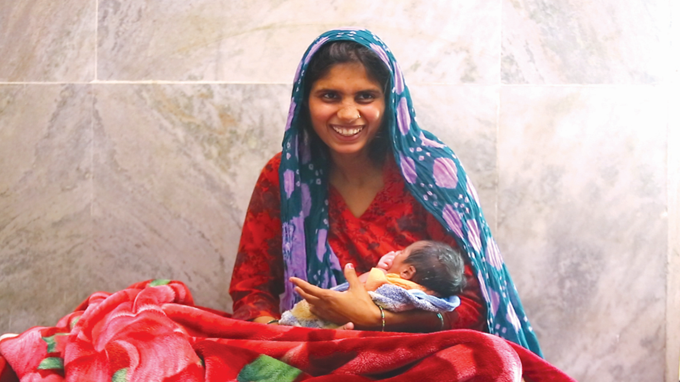

Maternal Health Scenario in India
Dr Dinesh Baswal
DC MH(I/C)

Slide 2
Background
Over the past few years, India has achieved substantial gain in health for
mothers and newborns.
India's Maternal Mortality Ratio declined by 77% from 556 per 1 lakh live births in 2000 to 130 per 1 lakh live births in 2015.
During the same period, India's newborn mortality dropped by 44% from 1.2 million newborn deaths to under 7 lakh annually.
Still we have a long way to go in terms of ‘Ensuring healthy lives and promote well being for all at all ages'.
India is committed to reduce
Maternal mortality ratio to less than 70 per 1,00,000 live births and to reduce neonatal mortality to at least as low as 12 per thousand live births by 2030 under Goal-3 of Sustainable Development Goals.
Positive birthing experience through respectful maternity care.

Slide 3
  Our Targets
National Health Policy Targets more ambitious than SDGs
Indicator | Current status | National Health Policy | SDG 2030
Maternal Mortality Ratio | 130 | 100 by 2020 | <70
Neonatal Mortality rate | 24 | 16 by 2025 | <12
Infant Mortality Rate | 34 | 28 by 2019 | -
Under 5 Mortality Rate | 39 | 23 by 2025 | ≤25
Total Fertility Rate | 2.2 | Replacement level fertility | -
National Health Policy Targets more ambitious than SDGs
Notes:
Nayional family health survey

Slide 4
Institutional Deliveries & OOPE on Child-birth
Increase in Institutional Deliveries
Reduction in Average OOPE in Child Birth in Rural areas
Source: NSSO
Source: NFHS 3 & 4

Slide 5
Maternal Health
LaQshya
2235 facilities including 179 Medical College facilities
Capacity Building of HR:
Dakshata/LSAS etc
Universal screening for
HIV and Syphilis
Janani Surksha Yojana
10.6 million beneficiaries per year
Comprehensive
Abortion Care Services
Pradhan Mantri Surakshit Matritva Abhiyan & comprehensive ANC services
16 million checkups
Janani Shishu Suraksha Karyakram
11.6 million beneficiaries per year
Strengthening FRUs, Delivery Points
FRUs 3157, DPs 20,000
MCH Wings
More than 600 MCH Wings
Obs HDU & ICU:
Approx 162 Obs HDU & ICU

Slide 6
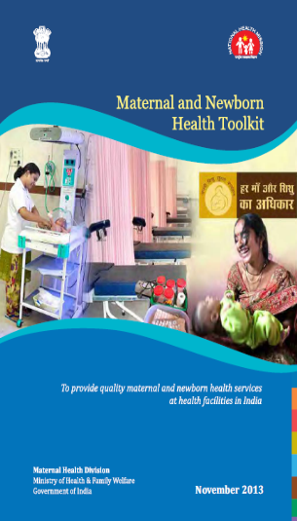
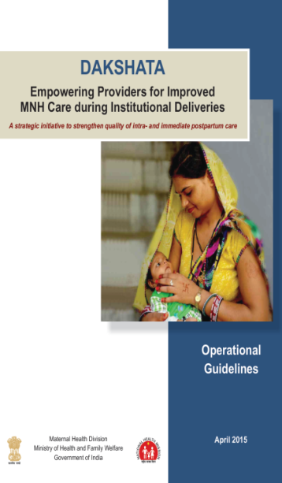
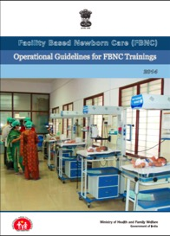

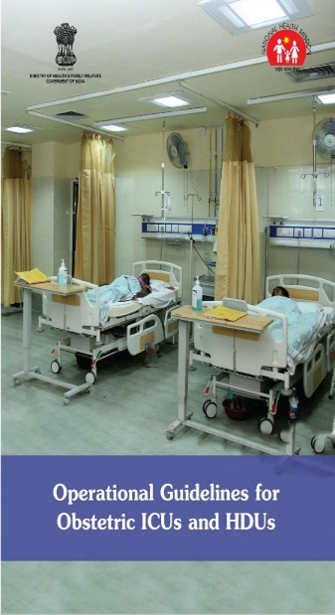
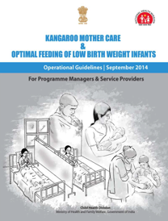
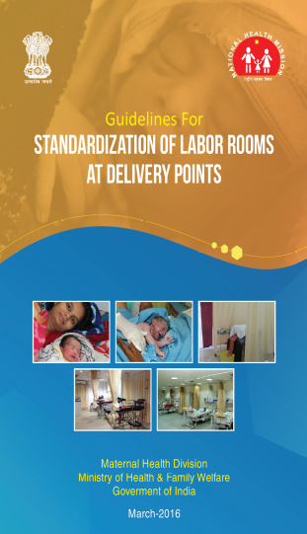
Maternal Health Guidelines

Slide 7
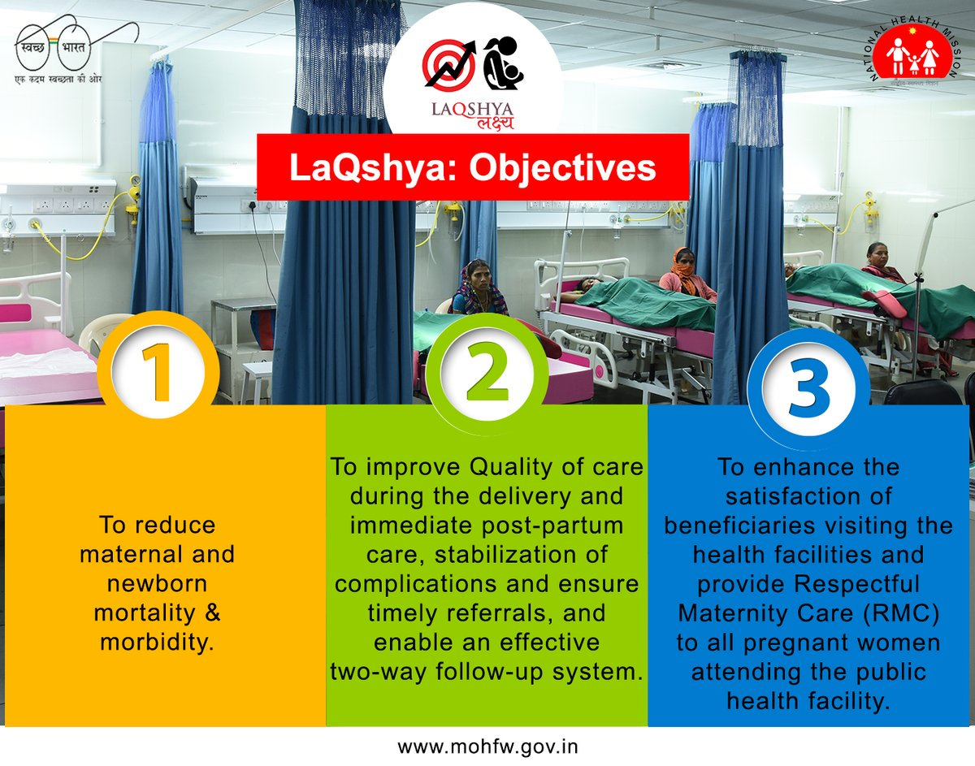

Slide 8
Key Components
LaQshya| लक्ष्य
(Labour Room & Maternity OT Quality Improvement Initiative)
Expected Outputs
LaQshya Badges – Platinum/ Gold/ Silver
Organization and standardization of Labour rooms, OTs and Obstetric HDUs/ ICUs as per national guidelines and standards
Structured Quality Improvement efforts/processes to improve adherence to critical practices around childbirth
Improved client satisfaction - “Respectful Maternity Care” (RMC).
Labour Room Certification
75% achievement of targets for quality
80% satisfaction of beneficiaries
Facility level Incentives

Slide 9
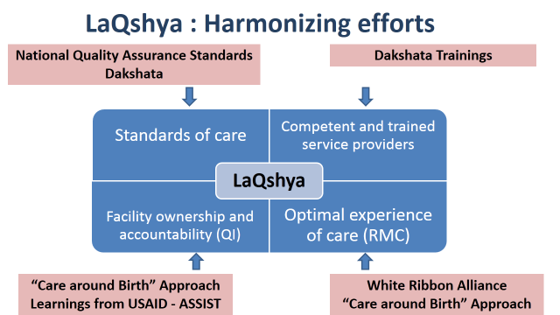

Slide 10
LaQshya Status
1 | Total LaQshya facilities | 2235 (including 179 Medical Colleges)
2 | State Certification LR | 115
3 | State Certification OT | 97
4 | National Certification LR | 54
5 | National Certification OT | 38

Slide 11
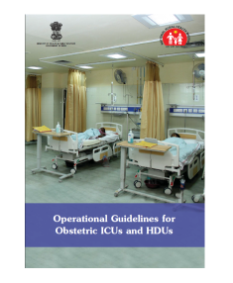
Obstetric HDU and ICU
Need for critical Care Units - More than one third of all maternal deaths are recorded either at medical college hospitals or district hospitals (MDR Software)
National Guidelines for Obstetric ICU/HDU were developed and released in 2016
Operational guidelines to complement the already existing guidelines in terms of:
  Human resource details
  Capacity Building Plan
  Equipment details
  Recording and Reporting formats etc

Slide 12
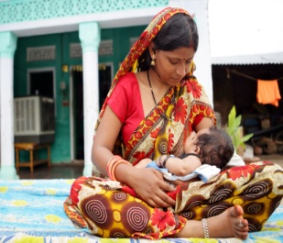
Janani Shishu Suraksha Karyakram
Launched in June 2011 to ensure service guarantees and eliminate Out of Pocket expenses
Free and Zero Expense delivery including C-section, free care in case of ante-natal & post-natal complications
Free drugs, diagnostics, blood and consumables
Free diet during stay in facilities
Free transport home to health institution, between health institutions in case of referral and drop back home
Exemption from all kinds of user charges
Similar entitlements for sick Infants (upto 1 year of age)
Extended to all antenatal & post natal complications of pregnancy
Nearly 1.3 crores women availing benefits for free entitlements every year
Notes:
12

Slide 13

Over 16 million quality antenatal checkups conducted & over 9 lakh HRPs identified – 25% checkups in HPDs
13200 facilities provide PMSMA services
Over 5500 volunteer doctors from private/ NGO sector

Slide 14
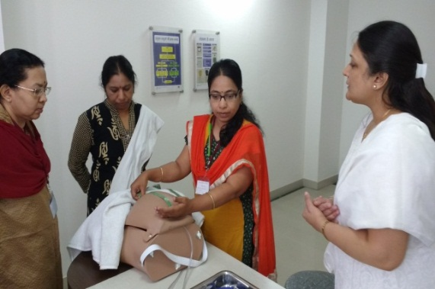
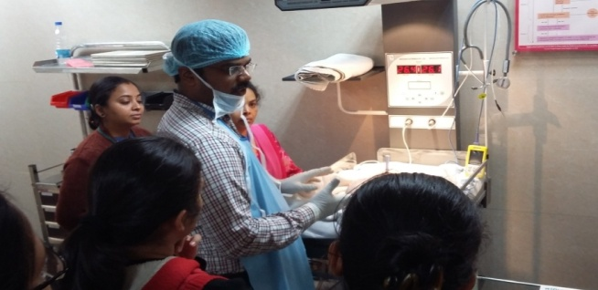
Daksh Training
^{Till date} 4907 participants trained in National and State Skills Lab
104 stand alone skill labs in States
A Lab comprising of skill stations where the trainees learn through practicing skills on mannequins, simulation exercises, demonstration videos and presentations
Lady Hardinge Medical College
5
1
Jamia Hamdard University
.
.
Five National Skills Lab
.
Safdarjung Hospital
4
2
3
Trained Nurses Association of India(TNAI)
National Institute of Health and Family Welfare (NIHFW)

Slide 15
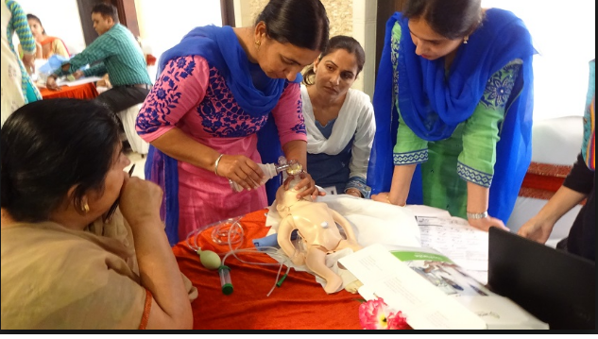
DAKSHATA - A strategic initiative to strengthen quality of intra and immediate postpartum care
Skills & Competency
16,419 providers trained till date
3119 participants sensitized in 95 DLSM meetings
928 trainers prepared in 55 ToTs
1018 training batches conducted
1548 health institutions covered
743 health institutions saturated (80% provider trained).
55 ToTs batches has been done in Rajasthan, Andhra Pradesh, Jharkhand, Maharashtra, Odisha, Madhya Pradesh, Kerala, Assam, Meghalaya, Nagaland and Jammu &Kashmir;.
.
.
4859 MSVs conducted in 738 Health facilities
Structured visit package completed in 394 facilities.

Slide 16
Other MH Trainings
EmOC
LSAS
BEmoC
SBA
2412 participants trained till date
2683 participants trained till date
More than 3 lac participants trained
17320 participants trained till date

Slide 17
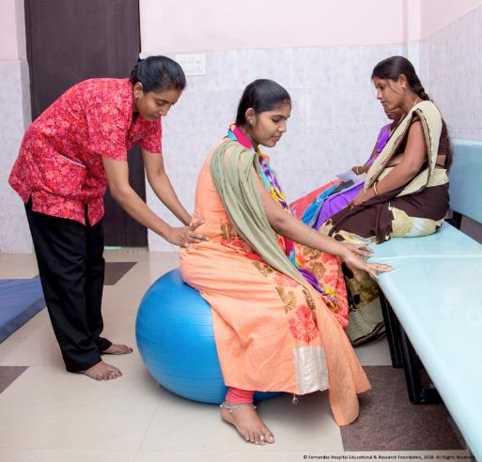
On the Anvil – Guidelines on Midwifery Services & Cadre
Cadre of Midwives skilled as per competencies prescribed by International Confederation of Midwives
Revision of current one year NPM Training curriculum to 18 months
Midwifery Led Units in Public health facilities
Career Progression for Midwives
Certification and Regulation by Indian Nursing Council
  To provide access to quality maternal and newborn health services:
  Promote natural birthing by promoting positive child birthing experience
  Ensure respectful care
  Reduce over medicalization
Lancet Series on Midwifery (2014): Safe and effective midwifery care can avert 83% of all maternal deaths, stillbirths and newborn deaths.

Slide 18

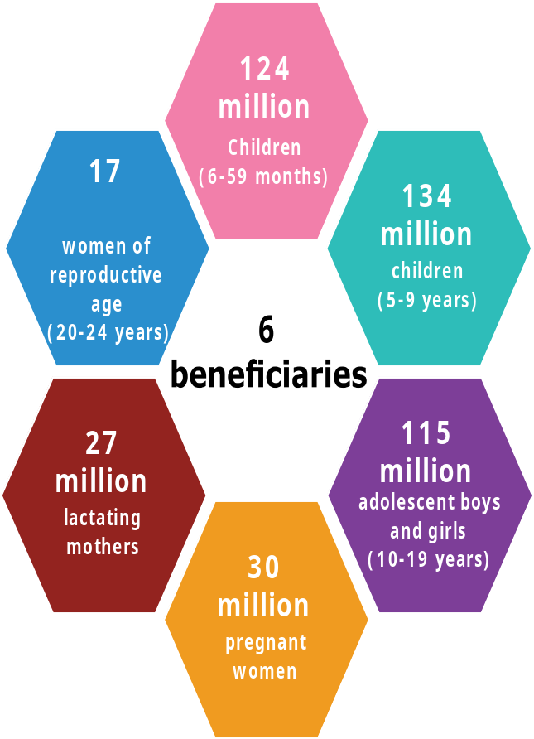
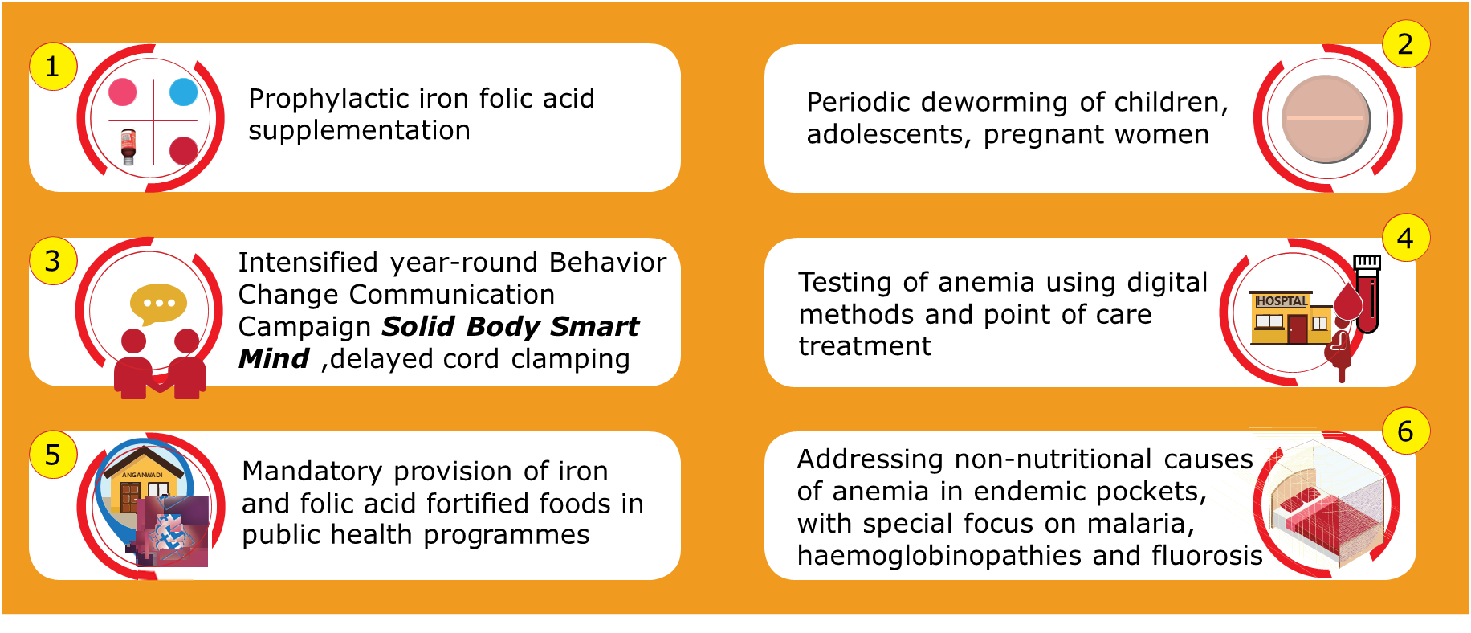
v
Anemia Mukt Bharat
Estimated 450 million beneficiaries
Reaching nearly 50% of the country’s population

Slide 19


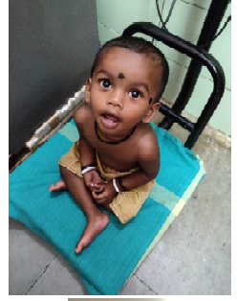
Nutrition Promotion
Enriching foods with micronutrients by fortification - to address micronutrient deficiencies - New fortification standards for rice, wheat, oil, milk and salt has been recently released by FSSAI, MoHFW
Facility based management of sick SAM children by Nutrition Rehabilitation Centres - 1151 NRCs are operational for medical management of sick SAM children – around 0.18 Million sick SAM children were admitted in FY 2017-18
34.7 million adolescents covered under WIFS programme - 62% increase in WIFS supplementation coverage during 2013-2017
POSHAN Abhiyaan – India’s flagship programme to improve nutritional outcome of children, adolescent, pregnant and lactating mothers by leveraging technology, targeted approach and convergence

Slide 20
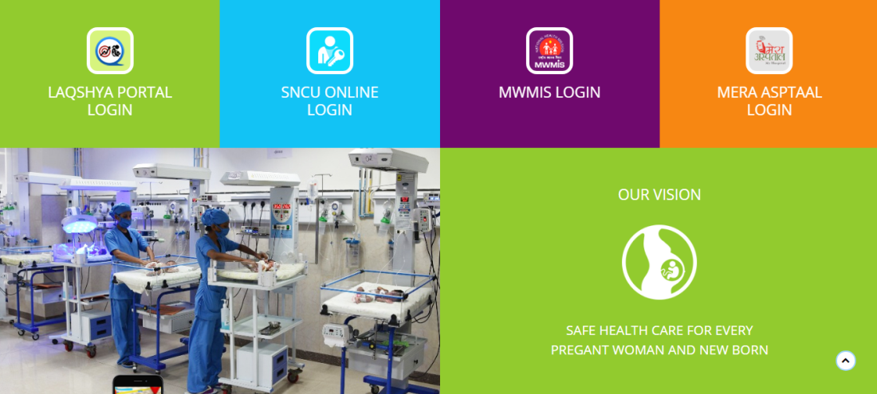



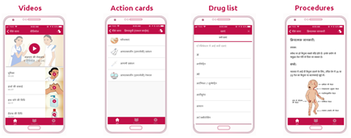

IT INITIATIVES
LaQshya Portal- Digitalization of all LaQshya related data.
All states/ UTs requested to login and Upload all LaQshya related data in portal.
4 Login Ministry, state , district and facility
RCH portal and ANMOL- 15.54 Crore & 13.32 crore children
MWMIS- Maternity Wing Management Information System
Kilkari- 72 audio messages delivered weekly
Mother and Child Tracking and Facilitation Centre
PMSMA Online portal
Mera Aspataal- beneficiary feedback and satisfaction
Safe Delivery App- job aid & certification

Slide 21
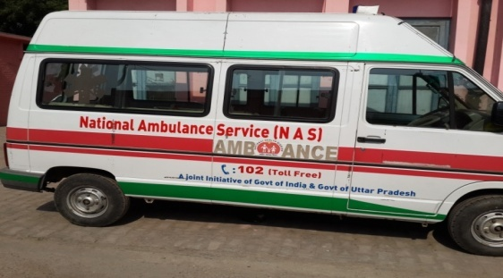
More than 25,000
Ambulances made operational

Slide 22
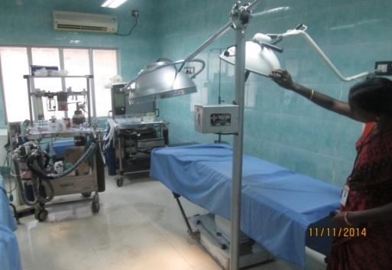
Around 3104
FRUs operationalized which is a three fold increase over baseline of 940

Slide 23
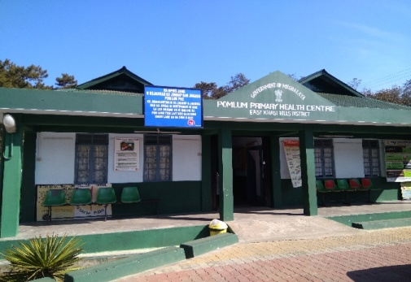
Over 17910
PHCs made 24*7

Slide 24
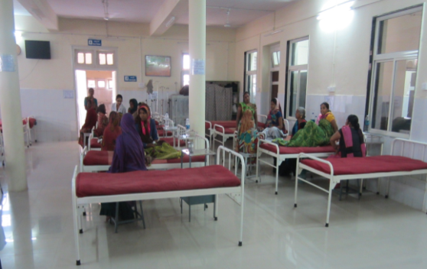
38,500+
Renovations and upgradations

Slide 25
Areas of concern
Indicator | National Average NFHS-4 | State /UT performing worse than National average
Mothers who had at least 4 antenatal care visits (%) | 51.2 % | Arunachal Pradesh (26.8), Assam( 46.5),Bihar (14.4), Haryana (45.1), Jharkhand(30.3), Madhya Pradesh(35.7), Nagaland(15), Rajasthan(38.5), Uttar Pradesh(26.4), Uttarakhand(30.9)
Institutional Birth | 78.9% | Nagaland (32.8), Meghalaya (51.4),Arunachal Pradesh(52.3), Jharkhand(61.9),Bihar(63.8) Uttar Pradesh(67.8),Uttarakhand(68.6), Manipur(69.1), Chhattisgarh(70.2),Assam(70.6)West Bengal(75.2),Himachal Pradesh(76.4)
Pregnant women age 15-49 years who are anaemic (<11.0 g/dl) (%) | 50.3 | Andhra Pradesh(52.9),Meghalaya(53.1),West Bengal(53.6),Tripura(54.4),Madhya Pradesh(54.6) Haryana (55),Bihar (58.3),Andaman and Nicobar(61.4),Jharkhand(62.6)

Slide 26
Way forward
Delayed cord clamping- Delayed cord clamping has shown improvement in Oxygen saturation in new born
ANC Guideline- Revision in ANC guideline is under process In terms of no. of ANC visits, various services provided during ANC etc.
Referral guideline- when , how and where to refer is the most critical during emergency situation and Protocol for referral is under process
Focus on Respectful Maternity care

Slide 27
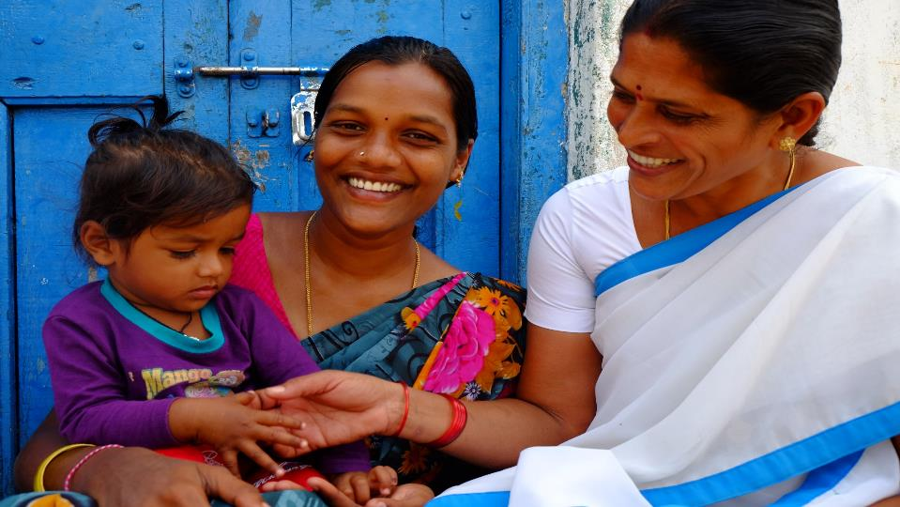
Thank You

