Slide 1
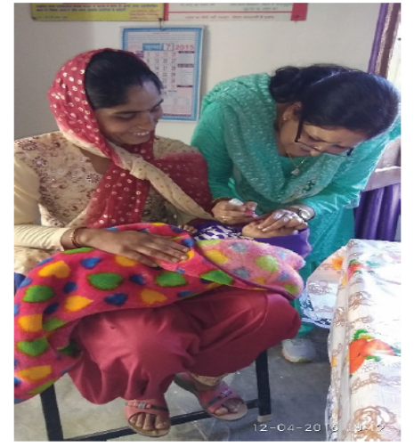

Overview of Immunization in India

Slide 2
Outline of Presentation
UIP Scope and Scale
Immunization Coverage trends
Newer Interventions & future plans in/as:
  Scaling up coverage: Mission Indradhanush
  New Vaccines introduction
Improving Quality:
  Cold chain and logistics management
  eVIN
  AEFI surveillance
Surveillance for Vaccine Preventable Diseases
Expectations from states

Slide 3
Universal Immunization Programme
(Scope and Scale)
One of the largest Public Health Programmes
Annual target
2.67 crore newborns;
2.9 crore pregnant women
Vaccine against VPDs
9 nation wide;
3 sub-nationally (JE, Rota, PCV)
≈1.2 crore sessions planned per year
~29,000 cold chain points for storage and distribution of vaccines
Make in India: Largest vaccine manufacturing capacity in the world

Slide 4
Roadmap of vaccine Introduction
2017
Since 2010 several new vaccines introduced in Country’s UIP
2016
Measles 2nd dose intro
(2010-14)
Hep. B scaled up nationwide
JE 2nd dose intro
Pentavalent
(2011-2015)
-IPV introduction
(2015-16)
Penta scaled up entire country
MR
PCV
JE
Rotavirus vaccine
Switch from tOPV to bOPV
Hep. B vaccine piloted
Vaccines against 6 VPDs- Measles, DPT, TB, Polio
2015
2013
2011
2010
2002
2006
1985
JE vaccine introduced

Slide 5
Rapidly changing landscape of Universal Immunization Programme
Milestones
2014: India declared Polio free
2015: Maternal & Neonatal Tetanus Elimination validation
New vaccines introduced
2015: Inactivated Polio Vaccine (IPV)
Improving Coverage
2015: Mission Indradhanush
2016: Rotavirus Vaccine (RVV)
2017: Measles-Rubella (MR) Vaccine and Pneumococcal Conjugate Vaccine (PCV)
2017: Intensified Mission Indradhanush
2018: Gram Swaraj Abhiyan (GSA)/Extended GSA
Improving Quality
NCCRC / NCCTC
EVM assessment
eVIN expansion
Capacity building of HR

Slide 6

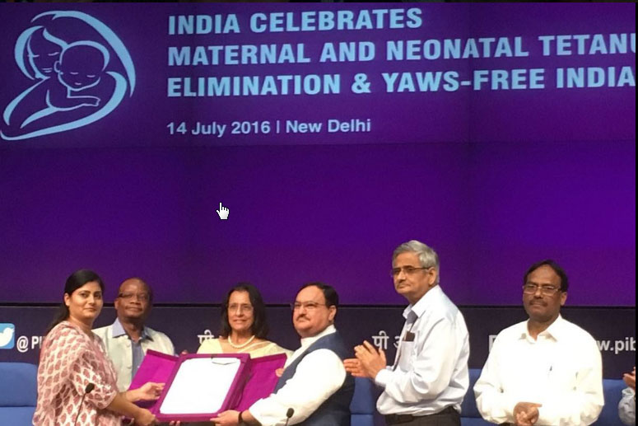
Two milestones achieved
On 27th March 2014, South-East Asia Region of WHO, including India, certified POLIO-FREE
On 14th July 2016, WHO certified India for eliminating maternal and neonatal tetanus

Slide 7
Immunization coverage
Trends

Slide 8
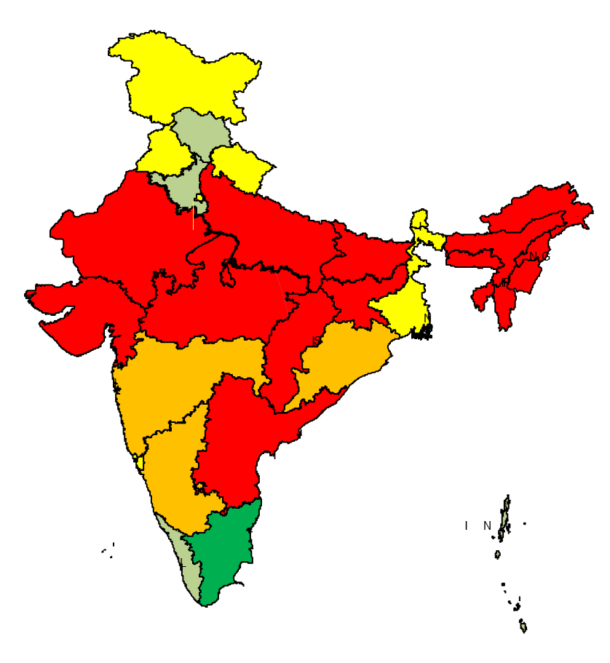
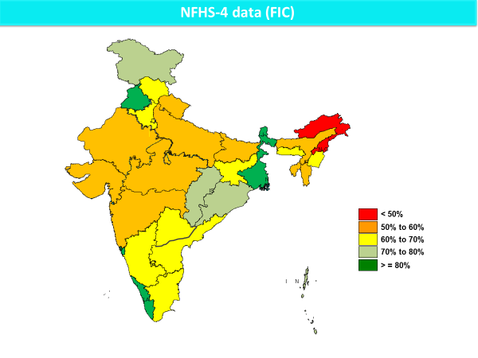
Immunization Coverage (FIC)
< 50%
50% to 60%
60% to 70%
70% to 80%
> = 80%
India: 43.5% ranging from 21% to 81%, NFHS-3, 2005-06
India: 62% ranging from 36% to 91%, NFHS-4, 2015-16

Slide 9
Inequity in Immunization
Full Immunization Coverage
Full Immunization Coverage in Urban & Rural areas
Data Source: NFHS-4 (2015-16)

Slide 10
Why are children missing their due vaccine doses?
Children aged 12-23 months, RI monitoring, India, 2018*
No immunization
1. Awareness & information gap 36%
Partial
Immunization
2. AEFI apprehension 29%
Full
immunization
Number of reasons as per caregiver = 53,599
(caregiver allowed multiple responses ; grouped under various heads)
Awareness & information gap
3. Operational gap 8%
AEFI apprehension
Operational gap
Others
Refusal
Child travelling
Number of children monitored = 344,953
Data source : Concurrent RI monitoring, Jan to Dec 2018

Slide 11
Scaling-up coverage

Slide 12
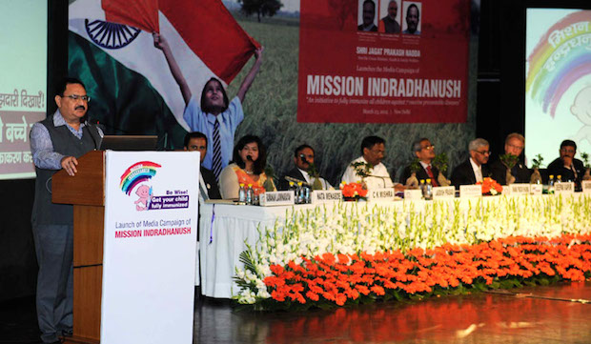
Mission Indradhanush (MI)
Reaching the unreached with all available vaccines
Increasing full immunization coverage to 90% and sustain it through RI
554 districts covered in six phases – including Intensified MI
One of the flagship schemes under Gram Swaraj Abhiyan (GSA) & Extended GSA
Launched on 25th December 2014

Slide 13
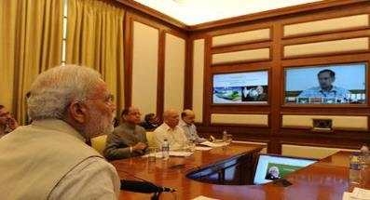
Mission Indradhanush included under PRAGATI
Reviewed by Hon’ble Prime Minister of India
Impact of MI in improving immunization coverage acknowledged
However, national coverage target of 90% not achieved
Sluggish pace of improvement in urban areas
Sustainability of achievements not planned
Target shifted from 2020 to 2018
11 ministries supporting the program
Mission Indradhanush: PM Modi calls for aggressive action plan to cover all children for immunization in a specific time-frame

Slide 14
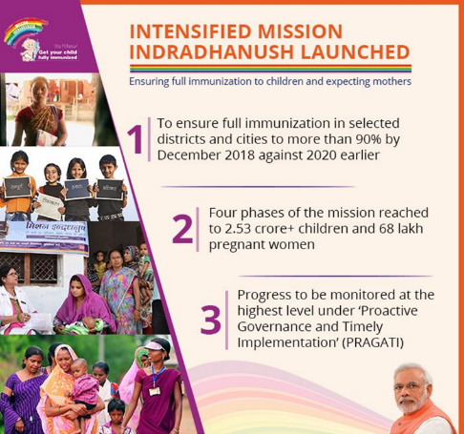
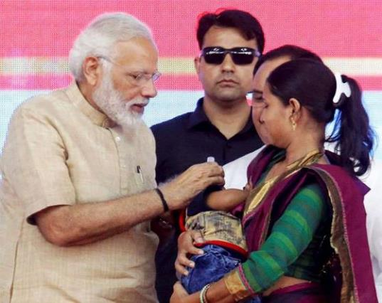
Intensified Mission Indradhanush
Hon’ble Prime Minister launched Intensified Mission Indradhanush on 8th October 2017

Slide 15


Performance: Mission Indradhanush
Figures in lakh
3.39 crore children immunized
87.18 lakh pregnant women vaccinated

Slide 16
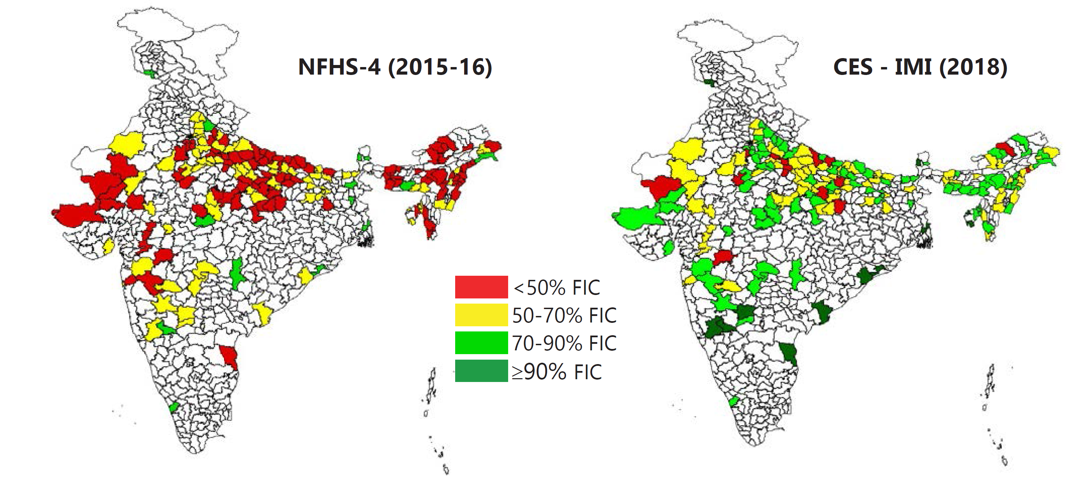
Impact of IMI in identified districts
99
77
14
00
15
75
84
16
An average 18.5% increase in full immunization coverage as compared to NFHS-4 has been reported in 190 districts covered under IMI

Slide 17
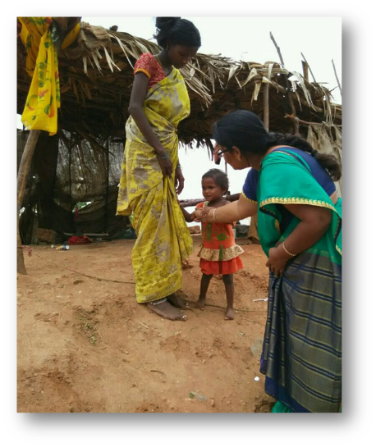
MI under Gram Swaraj Abhiyan (GSA)/Extended GSA (EGSA)
  MI under GSA - 16,850 villages across 25 states; and all UTs from Apr’18 to Jun’18
  MI – EGSA covered 48,929 villages across 117 aspirational districts. (7,408 villages in West Bengal did not participate).
During MI in GSA/EGSA :
  Children vaccinated: 20.22 lakh
  Pregnant women vaccinated: 5.41 lakh

Slide 18
New Vaccine Introduction

Slide 19
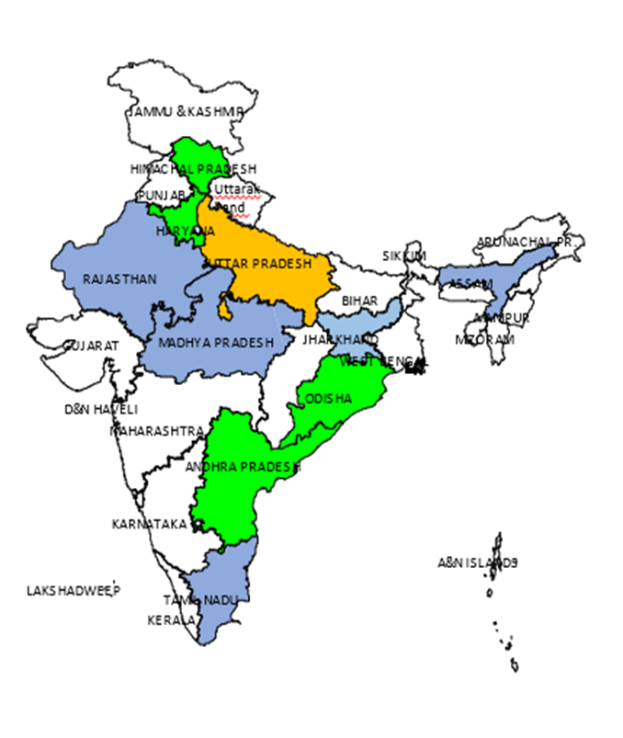
Rotavirus vaccine Expansion Plan in India
Criteria for State selection for RVV introduction
  Diarrheal disease burden
  AEFI preparedness
  Routine immunization coverage and system preparedness
  State willingness to introduce RVV
  Till March’ 19, around 6.49 crore doses of Rotavirus vaccine have been administered to children.
  Expansion of Rotavirus vaccine under ‘POSHAN Abhiyaan’ to be done in all states in 2019-20 as per the directions of PMO
Phase-1: Introduced in 2016
Phase 2: Introduced in 2017
Phase 3: Ongoing in 2018

Slide 20
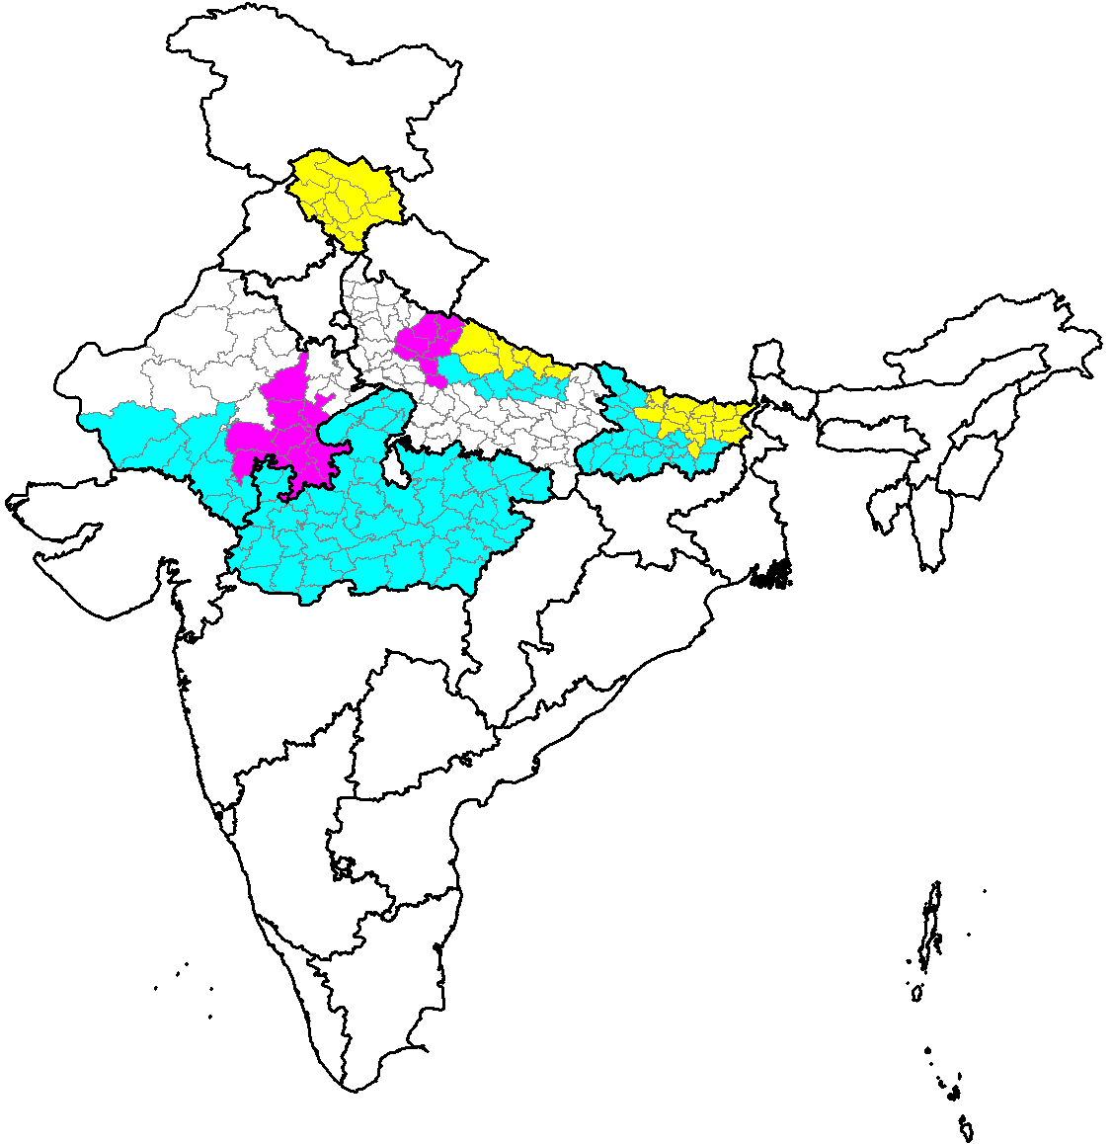
Pneumococcal Conjugate Vaccine (PCV) Expansion Plan, India
PCV has been introduced in Bihar, Himachal Pradesh, Madhya Pradesh, 19 districts of Uttar Pradesh and 18 districts of Rajasthan and Haryana (state initiative).
Till March ’19, around 116.89 lakh doses of PCV have been administered to children across above mentioned areas.
In 2019, it will be further expanded to cover 9 and 7 additional districts in Rajasthan and Uttar Pradesh respectively.
Percent birth cohort covered:
Year-1 (2017): Himachal Pradesh (100%), Bihar (50%),
Uttar Pradesh (10%)
Year-2 (2018): Bihar (100%), Madhya Pradesh (100%),
Rajasthan (25%) and Uttar Pradesh (20%)
Year-3 (2019): Rajasthan (50%) and Uttar Pradesh (30%)
2017 2018 2019
.

Slide 21
Measles Rubella (MR) Campaign
WHO-SEARO goal of achieving Measles elimination by 2020, also reiterated by Hon’ble Finance Minister in the budget speech of 2017.
Measles-Rubella vaccination campaign launched in Feb’17 targeting approx. 41 crore children aged 9 months-15 years across the country.
Campaign has been completed in 31 states/UTs and ongoing in 1 state (Meghalaya).
Subsequent to the completion of campaign, MR vaccine introduced in Routine Immunization replacing Measles vaccine at 9-12 months and 16-24 months of age.
Completed
Ongoing
Planned
>30.50 crore children vaccinated till date
Data as on 6th May’19

Slide 22
MR Campaign Timelines – Remaining States
S. No | State/UT | Proposed Timeline
1. | West Bengal | -
2. | Rajasthan | July 2019
3. | Sikkim | August 2019
4. | Delhi | -

Slide 23

Inactivated Polio Vaccine
Launched on 30th November 2015, initially in 6 states
Expanded to all states by April 2016
2 doses of fractional IPV (fIPV) given at 6 and 14 weeks of age of child
Till March ’19, around 8.89 crore doses of IPV vaccine have been administered to children across country

Slide 24
Japanese Encephalitis(JE)
JE vaccination: One time campaign strategy → single dose JE vaccine targeting all children from 1 to <15 years of age →JE vaccination is included into RI in endemic districts.
268 JE endemic districts (including 37 identified in April’18) identified across 21 states – campaigns completed in 230 districts → JE now part of RI.
Around 15.5 crore children immunized during the campaign
35 high burden districts (including 4 identified in April’18) identified in 3 states for Adult JE vaccination in endemic blocks (Assam, UP, West Bengal).
Adult JE vaccination campaign completed in 31 districts; more than 3.3 crore beneficiaries aged 15-65 years were vaccinated.

Slide 25
Tetanus & adult Diphtheria (Td) vaccine
Increase in immunization coverage in children led to shift in age-group of diphtheria cases to school going children and adults.
Tetanus and adult Diphtheria (Td) vaccine has been recommended by National Technical Advisory Group on Immunization (NTAGI) in 2016.
TT vaccine has been replaced by Td vaccine and will provide protection against both Tetanus and Diphtheria in adults.
Td vaccine will replace 2 doses of TT or single booster dose of TT given to pregnant woman and booster doses at 10 and 16 years of age.

Slide 26
Revised National Immunization Schedule
Age | Vaccines given
Birth | BCG, OPV-0, Hepatitis B Birth dose
6 Weeks | OPV-1, Pentavalent-1, fIPV-1, Rota-1 & PCV-1
10 weeks | OPV-2, Pentavalent-2 & Rota-2
14 weeks | OPV-3, Pentavalent-3, fIPV-2, Rota-3 & PCV-2
9-12 months | MR-1, JE1*, PCV-Booster
16-24 months | MR-2, JE2*, DPT-Booster 1, OPV- Booster
5-6 years | DPT-Booster 2
10 years | Td
16 years | Td
Pregnant Mother | Td1, 2 or Td Booster**
* in endemic districts only
** one dose if previously vaccinated within 3 years
Being introduced/scaled up

Slide 27
Improving Quality

Slide 28
Vaccine Logistics & Cold Chain Management
  National Cold Chain Resource Centre (NCCRC), Pune and National Cold Chain & Vaccine Management Resource Centre (NCCVMRC) -NIHFW, New Delhi established to provide technical training to cold chain technicians in repair & maintenance of cold chain equipment.
  National Cold Chain Management Information System (NCCMIS) to track cold chain equipment inventory, availability and functionality.

Slide 29
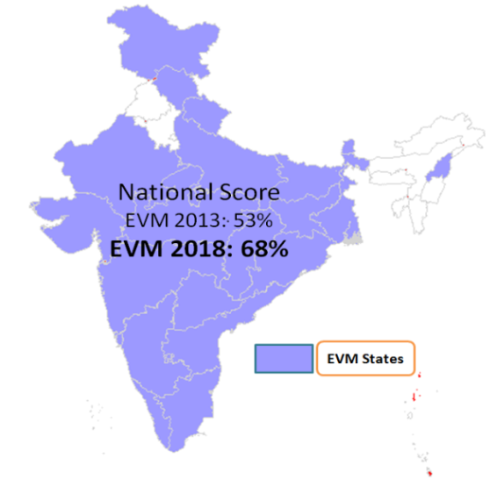
National Effective Vaccine Management (EVM) Assessment 2018
Diagnostic tool to assess and review three “P”s - Process, Practices and Policies of Efficient Immunization Supply Chain-Cold Chain – Supported by comprehensive Improvement plan
Participation by - MoHFW, Medical Colleges (16), ITSU, NCCVMRC, UNICEF, UNDP, WHO, JSI.
Status –
Data collection - May’18
Data analysis – June’18
Improvement plan workshop – July’18
Under 9 Global Criteria's
1. Vaccine Arrival Process
2. Vaccine Storage Temperature
3. Storage Capacity
4. Building, CCE & Transport
5. Maintenance & Repair
6. Stock Management
7. Distribution
8. Vaccine Management Practices
9. MIS & Supportive Functions
2018 – 23 states
What make this assessment unique – EVM 2018 is world’s largest assessment Participation by players from different domains of public health Mobile Based Paper less assessment Shortest duration (2 months) – EVM Assessment
40 teams - 74 assessors – Data collection from 145 sites

Slide 30
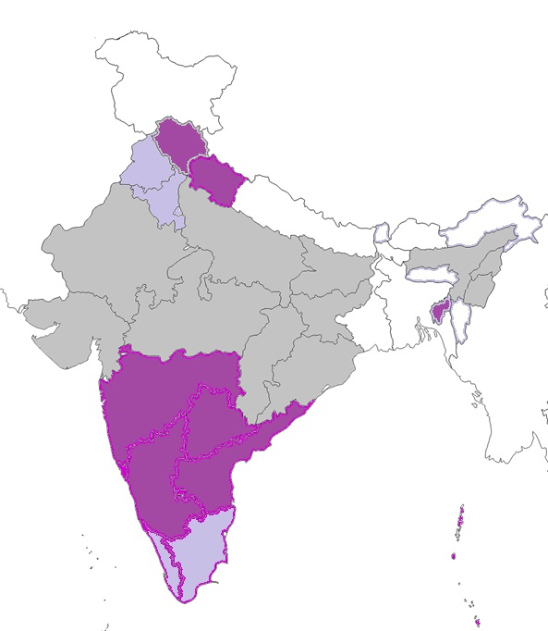
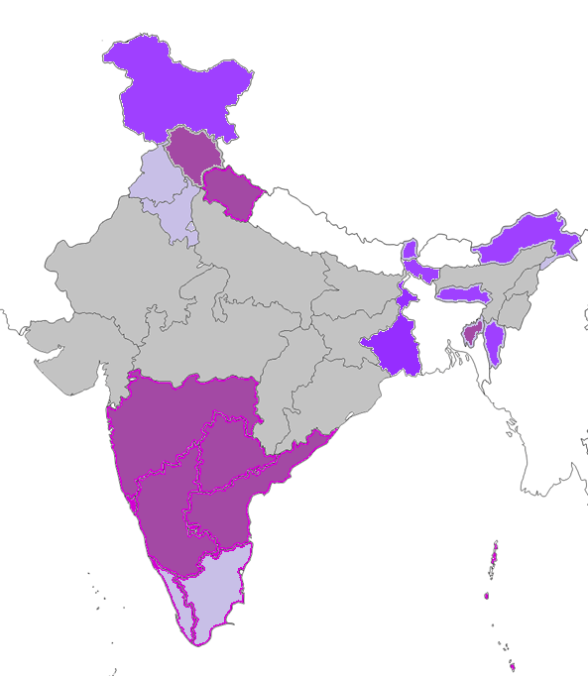
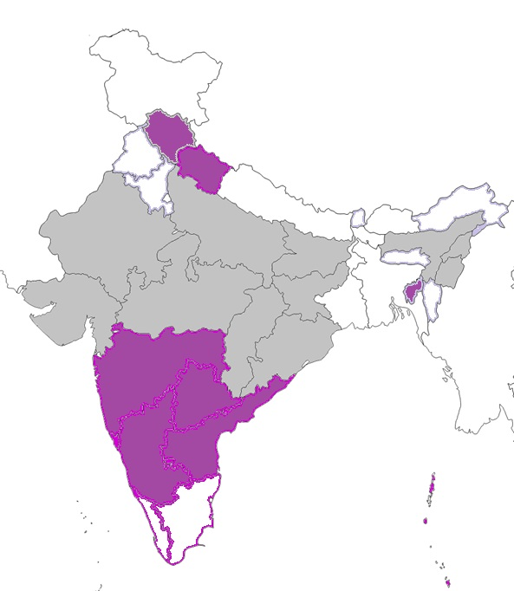
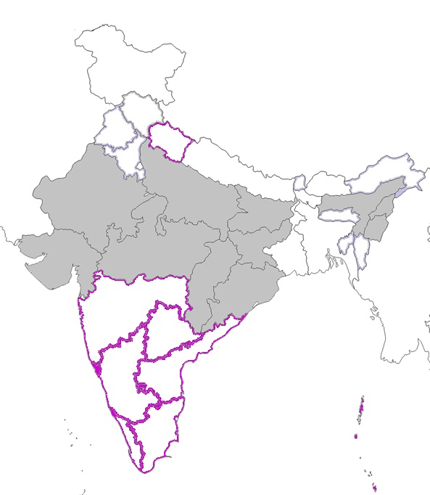
eVIN status and scale up plan
Electronic Vaccine Intelligence Network (eVIN) rollout for :
Real time stock management and Real time monitoring of cold chain temperature using mobile technology and data logger (sim based)
Phase 4, Initiation planned in July 2019
Phase 3 , Initiation planned in October 2018
Phase 2 Implementation initiated. Expected completion by June 2019
Current eVIN States

Slide 31
Adverse Event Following Immunization (AEFI) Surveillance system
Although vaccines are safe, surveillance of adverse events is required to
  Detect, correct and prevent immunization errors.
  Prevent false blame arising from coincidental adverse events.
  Maintain confidence by addressing parent/community concerns,
  and raising awareness about vaccine risks.
An Adverse Event Following Immunization (AEFI) is any untoward medical occurrence which follows immunization and which does not necessarily have a causal relationship with the usage of the vaccine.
The adverse event may be any unfavorable or unintended sign, abnormal laboratory finding, symptom or disease.

Slide 32

Types of AEFIs (for reporting)
Minor AEFIs - Minor reactions following immunization are common and self-limiting e.g. pain & swelling at the site of injection, fever, irritability, malaise, etc. Recorded in block AEFI register every week and reported monthly in HMIS
Severe AEFIs - Severity of minor AEFIs increases but not hospitalized; E.g. non-hospitalized cases of high grade fever ( >102 degree F); febrile seizure cases, anaphylaxis that has recovered; etc.
    Serious AEFIs - Any event resulting in Death, Hospitalization, Persistent or significant disability, Clustering, Community concern.
  Report all serious and severe AEFIs immediately to aefiindia@gmail.com!
  Follow National AEFI Surveillance Guidelines – 2015

Slide 33
Reporting of Serious / Severe AEFI Cases
2001-2019*
Revised National AEFI Guidelines circulated
ITSU/ AEFI Sect. Established
Revised National AEFI Guidelines circulated
Capacity building for AEFI Surveillance
National AEFI Guidelines Printed & Circulated
*Data as on 31-Mar-2019 (as per DOV)

Slide 34
AEFI surveillance – formats, timelines and stakeholders
Pharmacovigilance partners
Severe and serious AEFI
Immunization Division, MOHFW
National AEFI Committee
AEFI Secretariat, ITSU
+
4 Zonal AEFI Consultants
Natl. AEFI Technical Collaborating Centre (LHMC, New Delhi)
The DIO sends CRF within next 24 hours and PCIF in 10 days. The FCIF is submitted within next 60 days
State Immunization Office
State AEFI Committee
District Immunization Office
District AEFI Committee
Pvt Practitioner
Report AEFI within 24 hours of Notification through CRF
Health facilities and outreach sessions

Slide 35
Response to an AEFI
All ANMs/ASHAs/AWWs and MOs must
  be sensitized to recognize and notify/report AEFI promptly.
  know what to do when an AEFI occurs
  be aware of location of the nearest AEFI management centre.
Provide immediate primary management for all AEFIs.
    Minor AEFIs – provide symptomatic treatment
    Serious/severe AEFIs:
      Refer immediately to the nearest health facility/AEFI management centre, and report to the appropriate authority.
      Transportation costs may be borne through untied funds with Village Health and Sanitation Committee (VHSC) or state ambulance services (108/102).
Respond promptly and effectively in case of any serious and severe AEFIs
The district AEFI committee should
  Meet at least once a quarter
  Be prepared to support DIO in investigating serious AEFIs
  Be involved in managing media during times of crises as secondary spokesperson

Slide 36
AEFI Committees – District, State and National levels
Composition
Epidemiologist/Public Health Specialist
Representative from Drug Authority
Pediatrician, Microbiologist, Neurologist
Pathologist, Forensic Expert, Cold Chain officer
Member Infectious Disease Surveillance Program(IDSP)
Representative from local bodies like corporations
Representatives from professional bodies like IAP, IMA
Representatives from partners agencies
Terms of reference
(national/state/district)
  Meet at least once a quarter
  Strengthen and validate AEFI reporting at all levels
  Ensure implementation of uniform standards and formats.
  Prompt & thorough investigation of serious AEFIs and periodic review of non serious AEFIs
  Timely classification of cases
  Causality assessment (Brighton Classification)
  Support spokesperson for media interface and management.
Member Secretary: Immunization Programme Manager

Slide 37
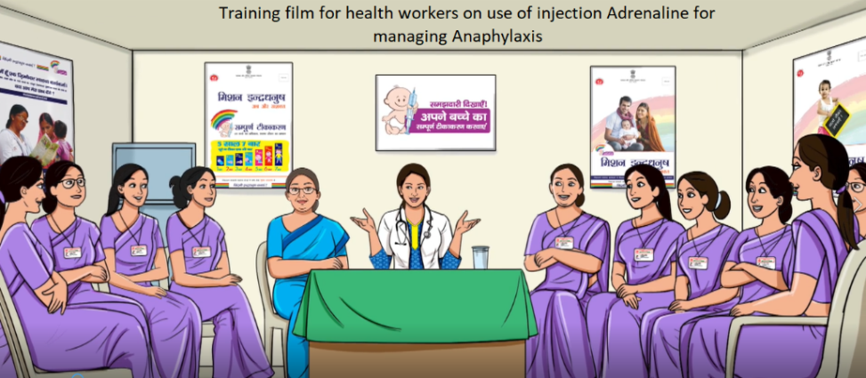
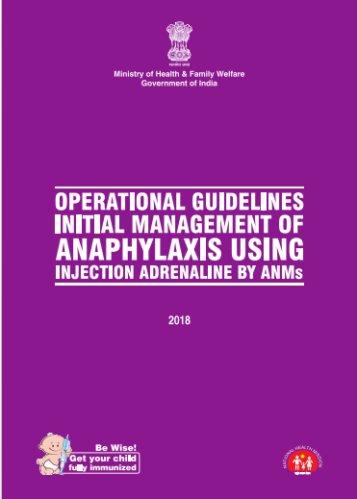


New initiatives in AEFI
Adrenaline use – operational guidelines, animation training film
Quality Management System – structures formalised and implementation underway (WB, GJ);
State Immunization and Patient Safety Associates (10) hiring initiated
Vaccine Adverse Events Information Management System: Two national TOTs, training initiated in states, migration to NHP

Slide 38
Improving AEFI surveillance
State RI cells may hire an AEFI consultant to support AEFI activities
Ensure State AEFI Committees are active and meet at least once a quarter
District AEFI Committee meetings should be tracked by state
Reporting of serious/severe AEFIs to be encouraged; Encourage reporting of non death cases
Districts not reporting a single case in a year should be encouraged to report cases
Encourage and track operationalization of AEFI registers at all planning units for recording and analysis of all AEFIs (including minor AEFIs)
Track progress of AEFI trainings of health workers, medical officers and hospital staff
Timeliness, completeness and quality of investigations are crucial for conducting causality assessment at state level
Await completion of investigations before taking action against health workers and medical officers

Slide 39
Surveillance for Vaccine Preventable Diseases

Slide 40
AFP Surveillance

Slide 41
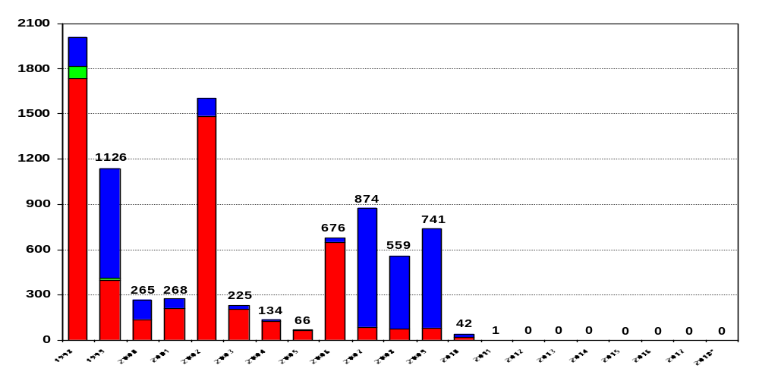
Wild Poliovirus Cases, India
1934
No WPV case since January 2011
1600
P1 wild
P2 wild
P3 wild
* data as on 25 August 2018

Slide 42
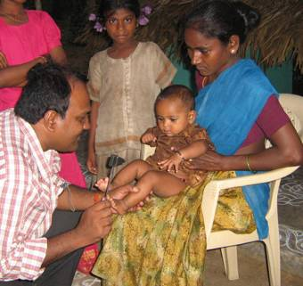
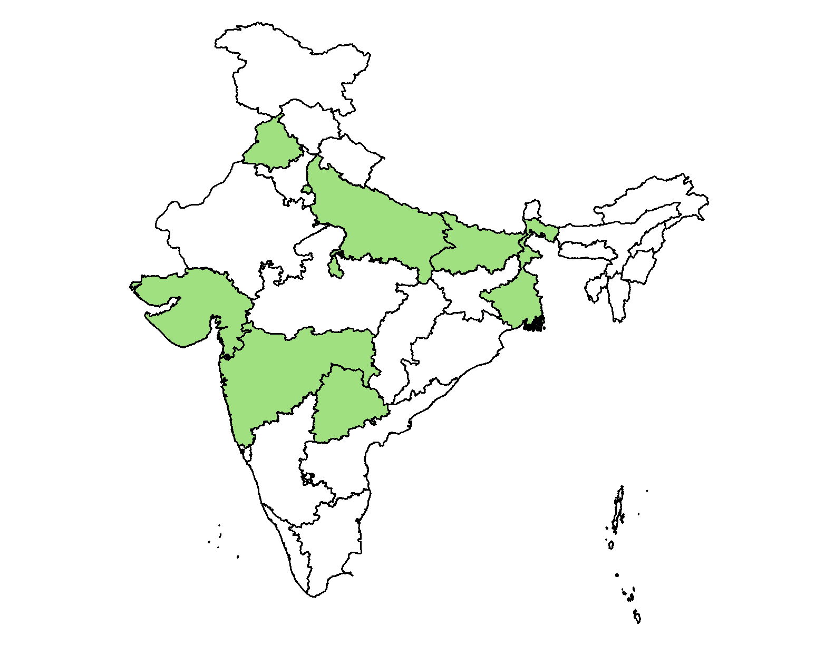
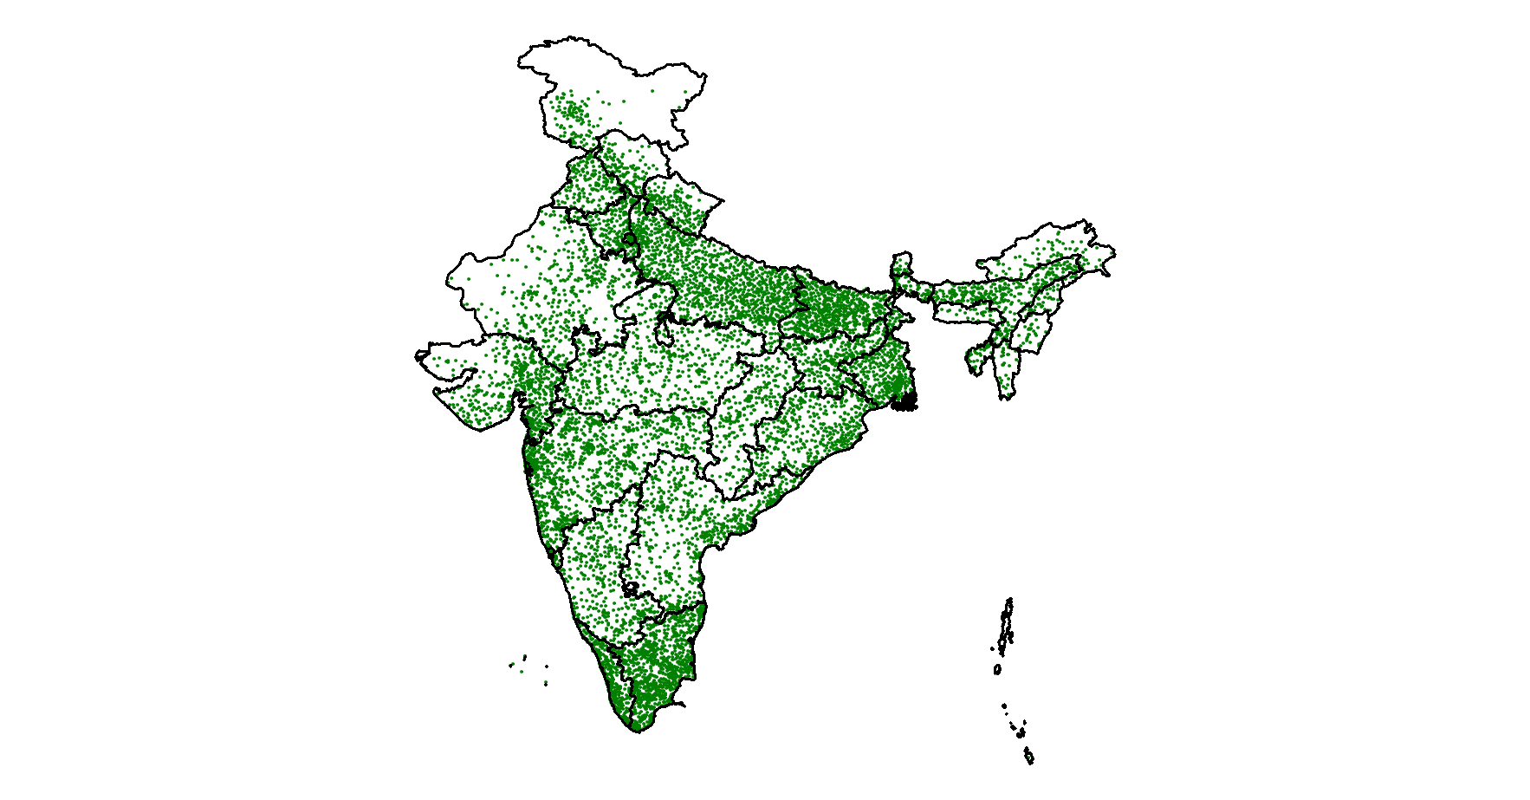
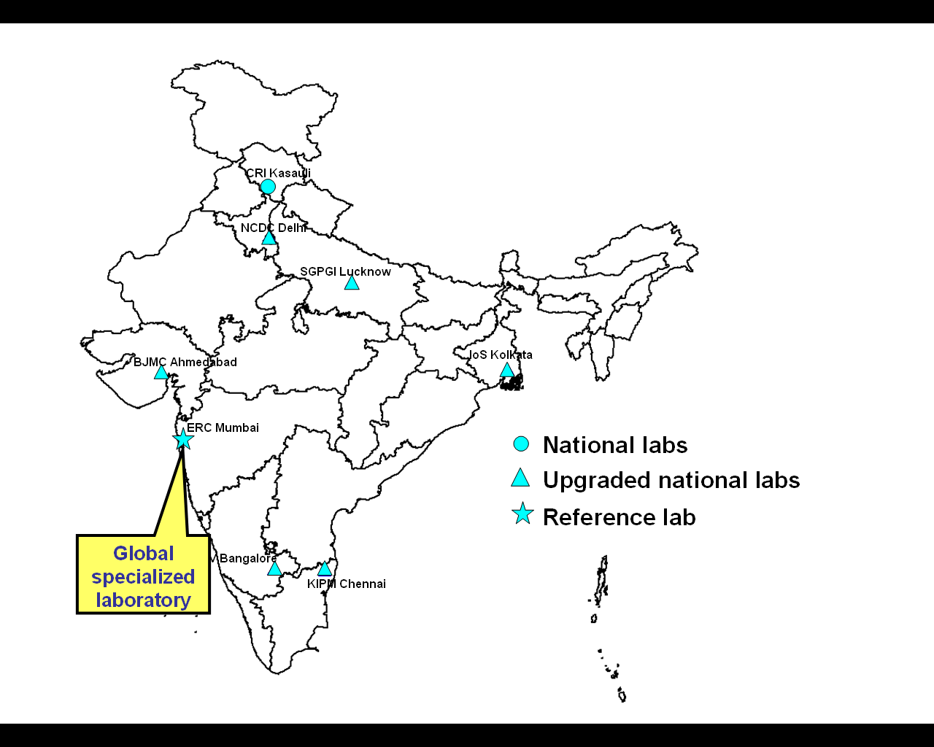
AFP Surveillance for poliovirus detection
> 40,000 health facilities enrolled as reporting sites – govt. and pvt. (including traditional healers) – report weekly
  > 75,000 active surveillance visits annually
~ 40,000 acute flaccid paralysis cases investigated annually
~ 80,000 stool specimens collected and tested in WHO accredited polio laboratories
Environmental sampling in 8 states with large migrant population

Slide 43
Measles Rubella (MR) Surveillance

Slide 44

Current MR Surveillance - India
#
STATE
Case-based Surveillance
1
A&N Islands
Outbreak Surveillance
2
Andhra Pradesh
3
Arunachal Pradesh
4
Assam
Fever Rash Surveillance
5
Chandigarh
6
Chhattisgarh
7
D&N Haveli
8
Daman & Diu
9
Goa
10
Haryana
Case based Surveillance
11
Himachal Pradesh
12
Kerala
13
Lakshadweep
14
Manipur
15
Meghalaya
16
Mizoram
17
Nagaland
18
Pondicherry
19
Punjab
20
Sikkim
21
Tamil Nadu
22
Telangana
23
Tripura
24
Uttarakhand
25
West Bengal
26
Bihar
27
Delhi
Outbreak Surveillance
28
Gujarat
Fever Rash Surveillance initiated in Karnataka and process ongoing towards initiation in Madhya Pradesh & Odisha
29
Jammu & Kashmir
30
Jharkhand
31
Maharashtra
32
Rajasthan
33
Uttar Pradesh
34
Karnataka
Fever Rash
Surveillance
35
Madhya Pradesh
36
Odisha

Slide 45
Serologically Confirmed Measles Outbreaks, India, 2017 – 18*
2017
2018
Confirmed Measles outbreaks – 786 outbreaks
Confirmed Measles outbreaks – 887 outbreaks
Confirmed Mixed outbreaks – 21 outbreaks
Confirmed Mixed outbreaks – 13 outbreaks
*: data as on 14 February 2019

Slide 46
Serologically Confirmed Rubella Outbreaks, India, 2017 – 18*
2017
2018
Confirmed Rubella outbreaks– 142 outbreaks
Confirmed Rubella outbreaks– 119 outbreak
Confirmed Mixed outbreaks – 21 outbreaks
Confirmed Mixed outbreaks – 13 outbreaks
*: data as on 14 February 2019

Slide 47
VPD Surveillance

Slide 48
VPD (Diphtheria, Pertussis and NNT*) Surveillance Expansion Plan
Number of Diphtheria, Pertussis and Neonatal Tetanus cases, 2017-18*
State | # Diphtheria cases |  | # Pertussis cases |  | # Neonatal Tetanus cases
 | 2017 | 2018 | 2017 | 2018 | 2017 | 2018
Bihar | 55 | 82 | 110 | 150 | 13 | 10
Haryana | 46 | 158 | 68 | 81 | 3 | 2
Himachal Pradesh |  | 0 |  | 7 |  | 0
Karnataka |  | 26 |  | 2 |  | 0
Kerala | 602 | 321 | 93 | 179 | 0 | 0
Madhya Pradesh | 66 | 87 | 38 | 159 | 14 | 11
Punjab |  | 9 |  | 55 |  | 1
Uttar Pradesh | 847 | 1307 | 1378 | 1349 | 30 | 28
Total | 1616 | 1990 | 1687 | 2002 | 60 | 52
*: as on March 2019
Surveillance started – 7 states
2018 – 4 states
2019 – 4 states
2020 – 4 states
2021 – 3 states
Not planned – 14 states
*NNT – Neonatal Tetanus

Slide 49
Expectations from states
Regular review of coverage/monitoring data from all sources including HMIS at all levels.
Regular meetings of State Task Force & District Task Force Meetings on Immunization with focus on inter-sectoral convergence.
Capacity building and supportive supervision of healthcare staff for Microplanning.
Focus on immunization in urban areas by utilization of NUHM structure and its review through regular meetings of City/District Task force on Urban Immunization.
Expedited transfer of funds from state treasury to State health societies

Slide 50
Summary
Polio free status and MNT elimination maintained
India committed to achieve 90% full immunization coverage
Mission Indradhanush helped in reaching unreached children
  Focus on sustaining the gains through routine immunization
Scope of vaccination expanded:
  Pneumococcal and Rotavirus vaccines being expanded in phased manner
  Nationwide introduction of Rubella-containing MR vaccine, and Td vaccine
Health system strengthening through eVIN, ANMOL and AEFI surveillance

Slide 51
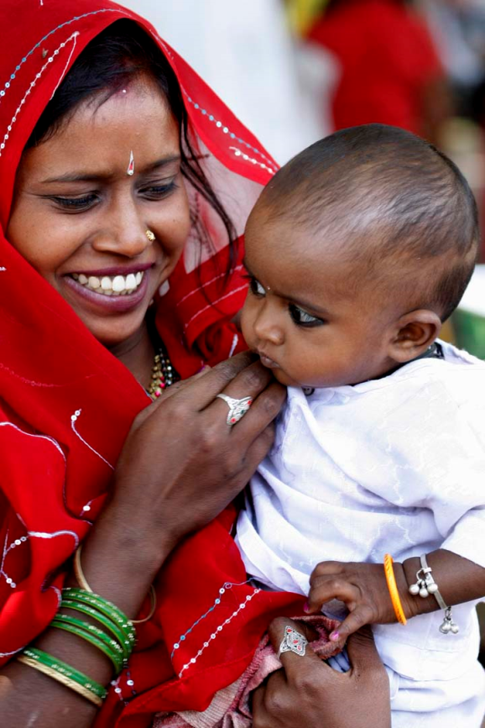
THANK YOU

