Slide 1
National Health Systems Resource Centre
HCF
Healthcare Financing

Slide 2
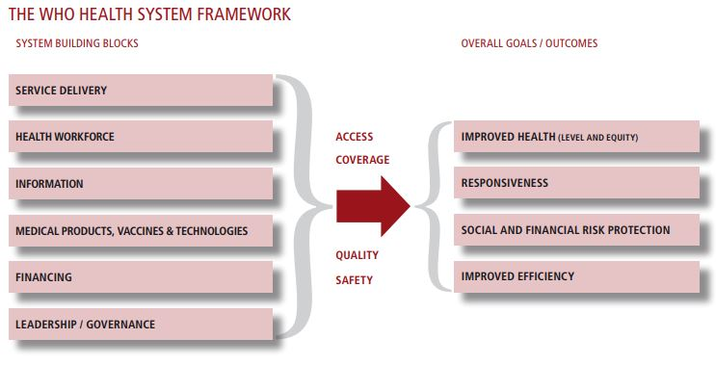
Health Financing in Health System
A health system consists of all organizations, people and actions whose primary intent is to promote, restore or maintain health.
This includes efforts to influence determinants of health as well as more direct health-improving activities.
A health system is therefore more than the pyramid of publicly owned facilities that deliver personal health services.
"Everybody's business. Strengthening health systems to improve health outcomes : WHO's framework for action" (PDF). WHO. 2007.

Slide 3
Healthcare Financing
Mobilizing & Collecting Funds
Pooling
Provisioning/Purchasing
Resource Allocation

Slide 4
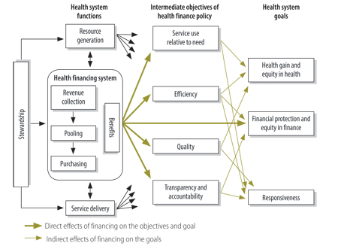
The connection between health financing and overall system goals
The health financing system does not act alone in affecting the intermediate objectives and final goals;
Co-ordinated policy and implementation across health system functions are essential for making progress on the desired objectives
Adapted from Kutzin J, 2008

Slide 5
Sources of information on Health systems financing
1. Different Sources of Health Financing:
1.1 Tools: Budget tracking, Public Expenditure Review (PER)
1.3 National Health Accounts(NHA): NHA combines expenditure data from all sources and through all types of financial agents. It answers important policy questions such as what are sources of healthcare expenditures, who manages them, who provides health care services and which services are utilised. Use of global standard frame work: System of Health Accounts 2011 (SHA 2011), facilitates comparison of estimates across countries.
Government Health Expenditure | Source of Information
Union Government | Budget Data: Health and Other Ministries
State Government | Budget Data: Health and Other Ministries
Local Governments | Budget and Annual Accounts Data
Social Health Insurance Contributions | Budget Data and Annual Reports
Private Health Expenditure
Private Health Insurance | Annual Reports and Disaggregated Insurance claim Data
Out of Pocket Expenditure | Household Surveys
Others (NGOs, Corporations, External Donors) | Survey, Existing Studies and Annual Reports

Slide 6
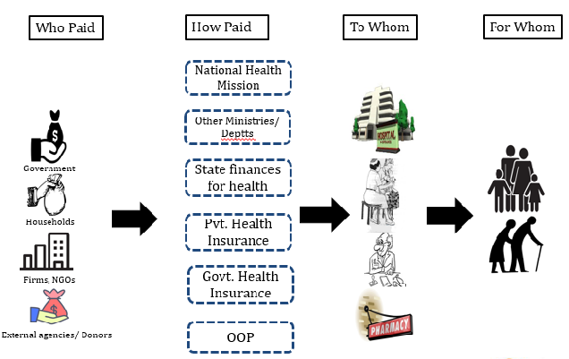
Information on health systems financing: National Health Accounts based on System of Health Accounts 2011 (SHA 2011)

Slide 7
NHA 2015-16: Healthcare Expenditure by Financing Schemes (%)

Slide 8
NHA 2015-16: Healthcare Expenditure by Healthcare Provider (%)

Slide 9
Indicators of Health Financing
Macro Aggregates: Health Exp as % of GDP.
Sources of Health Expenditure: Share of Government expenditure as a Share of total health expenditure.
Differential Allocation on Health: Share of Government Health Expenditure on Primary Health Care.
Financial Protection at Household Level: Share of Household undergoing Catastrophic Expenditure.

Slide 10
Health financing indicators based on NHA for Different Years
 | Indicator | Draft NHA 2015-16 | NHA 2014-15 | NHA 2013-14 | NHA 2004-05
1 | Total Health Expenditure (THE) as per cent of GDP | 3.8 | 3.9 | 4 | 4.2
2 | Total Health Expenditure (THE) Per capita (Rs.) | 4116 | 3826 | 3638 | 1201
3 | Current Health Expenditures (CHE) as per cent of THE | 93.7 | 93.4 | 93 | 98.9
4 | Capital Expenditures on Health as per cent of THE | 6.3 | 6.6 | 7 | 1.1
5 | Government Health Expenditure (GHE) per cent of THE | 30.6 | 29 | 28.6 | 22.5
6 | Out of Pocket Expenditures (OOPE) as per cent of THE | 60.6 | 62.6 | 64.2 | 69.4
7 | Social Security Expenditure on Health as per cent of THE | 6.3 | 6 | 6 | 4.2
8 | Private Health Insurance Expenditures as per cent of THE | 4.2 | 4 | 3.4 | 1.6
9 | External/ Donor Funding for health as per cent of THE | 0.7 | 0.7 | 0.3 | 2.3

Slide 11
Country Comparison in Healthcare Spending by Source Based on NHA
Indicators for 2015- WHO Global Health Expenditure Database,
(*Others Include – Expenditures by Private Health Insurance, Enterprises, NGOs and Donors)

Slide 12
State Health Expenditures by Source (FY2015-16)
*Others Include – Private Health Insurance, Enterprises, NGOs and Donors .
Figures may not sum up to 100 due to rounding off.

Slide 13
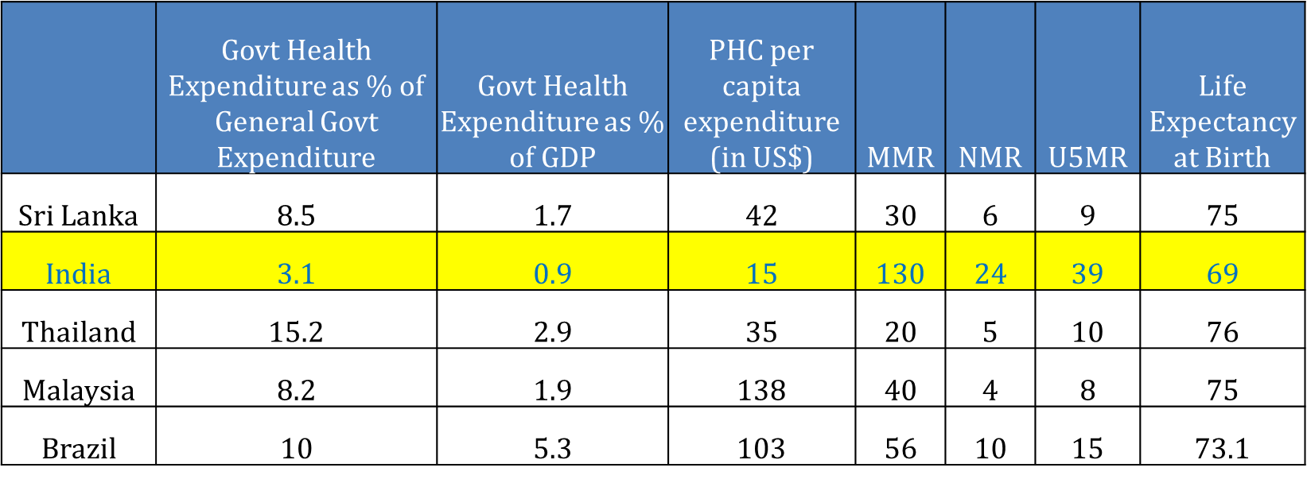
Allocation on Health

Slide 14
Catastrophic Expenditure

Slide 15
Health Account at Sub National level and why it is Important.
Federal Structure in Health Financing in India. At an aggregate more than 60 percent percent of Government health expenditure comes from the State.
Role of other agencies such as NPISH, Enterprises and Local Bodies in State.
Role of State government schemes in reducing out of pocket expenditure.
Priorities of State Government in different Health Functions.

Slide 16
Healthcare Financing (HCF): Area of Work
National Health Accounts Technical Secretariat
  Produce Annual National & State Health Accounts estimates
  Monitor financing from Union and State Government
Monitor Key Financing Indicators for SDGs & UHC
  Out of pocket expenditures
  Burden of Household payments (catastrophic and impoverishment)
Capacity building on
State Health Accounts
Health Insurance and Strategic purchasing arrangements
Public Expenditure Review of Government Health Expenditure

Slide 17
Present Engagement and Studies Planned
NHA 2016-17
State Heath Account (2017-18) Mizoram and Karnataka
Financial Protection Indicators based on NSSO, 2017-18.
Utilisation and OOP survey for ILCs.
Analysis of Public Expenditure on Health in LMIC countries using the GHED Data.
Evaluate and Monitor NHM Health financing.
Creation of Data repository of all the NHA data from 2013-14 to present.
Study based on insurance data
Evaluation of PPP Models

Slide 18
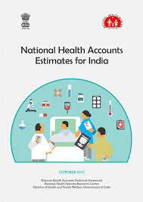
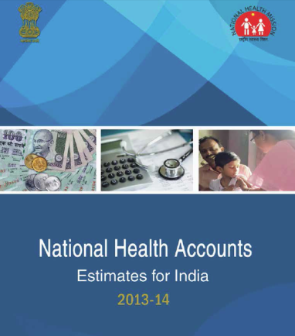
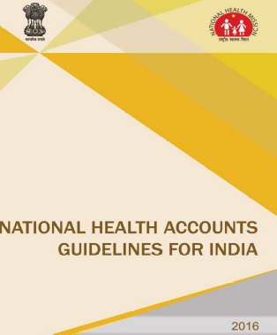
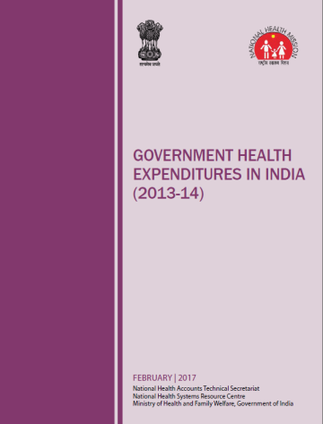
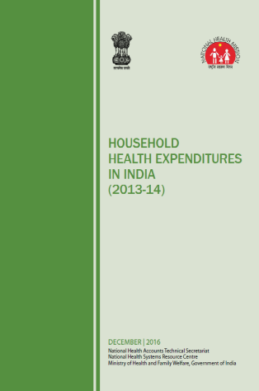
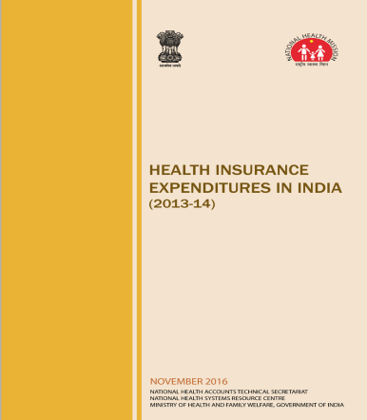
Thank You
National Health Accounts Technical Secretariat
National Health Systems Resource Centre
Ministry of Health & Family Welfare
Government of India

