Slide 1
Health Management Information System (HMIS)
Statistics Division(HMIS)
MOHFW

Slide 2
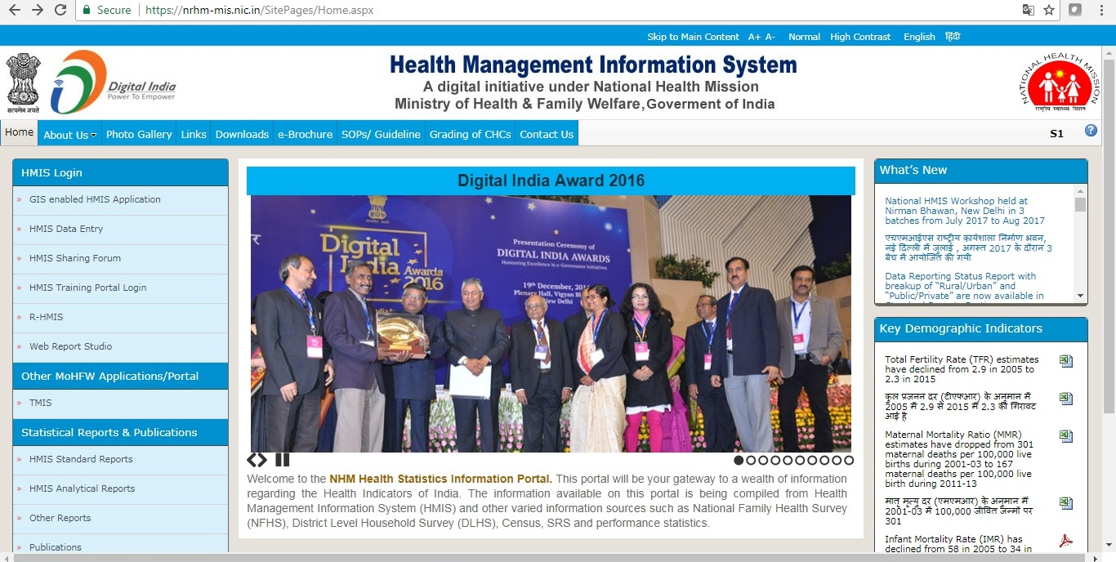
INTRODUCTION
is a web based management information system launched by MOHFW in 2008 with district level reporting
2010-11 onwards facility level reporting was initiated
Around 2,00,000 health facilities across all districts of India are uploading data every month
Data analytical & reporting capabilities using SAS platform services
GIS module of HMIS is available in Public domain
HMIS provides ready to use National, State, District and sub-district reports (available in Public domain)
Platform for evaluating the PIP on the basis of services rendered by health facilities
https://nrhm-mis.nic.in

Slide 3

OBJECTIVES OF HMIS
To Monitor the performance & quality of health care services under the National Health Mission
A tool for evidence based health planning
Repository of information on health care indicators and trends
Used for testing the effectiveness, efficiency and coverage of health programs and schemes
To improve availability and access of health care to the population
Developing and monitoring performance based health indicators

Slide 4
HMIS: Formats
Annual (Infrastructure)
SC
Quarterly (Trainings)
State
District HQ
DH
PHC
DH
SDH
CHC
PHC
SC
Monthly (Service delivery)
SDH
CHC
District

Slide 5








Flow of Data in case of Facility Level Reporting
(Case-I)
SDH
DH
DHQ
Health Worker
CHC
Enters DHQ and compiles the data to form DC
Health Worker
PHC
Data Entry Operator at Block
Enters Data for each facility
HMIS Portal
Health Worker
SC

Slide 6

Flow of Data in case of Facility Level Reporting
(Case-II)
Flow of Data in case of Facility Level Reporting
(Case-II)
SDH
DH
Enters Data
Enters Data
Enters DHQ data and compiles the data to form DC
Enters Data
Health Worker
CHC
HMIS Portal
DHQ
Enters Data
Enters Data
Health Worker
PHC
Health Worker
SC

Slide 7
CURRENT COVERAGE OF HMIS
Sub-Centre
157413
Primary Health Centre
5839
Community Health Centre
11762
4567
Sub-District Hospital
1072
1207
District Hospital
0
1197
Urban
Facility Type
/No*.
Total
Public
Private
160894
160814
80
448
30802
30354
7195
5631
6131
2276
1350
926
1200
1008
192
Rural
3481
24963
Total
15094
206934
199157
7777
191840
* Equivalent facilities as mapped in HMIS

Slide 8
DATA QUALITY DIMENSIONS & HMIS
Data Quality Dimensions
Technical Checks and Dimensions in built in the HMIS System
All Facility Types have
  Separate Formats
  Variable content
  Data items to suit their categories
Completeness mainly focus - Under Coverage, Over coverage, Redundancy, Missing values- Data status report and % filling report
Accuracy/correctness through validation rules
Consistency of data reporting though comparability with previous month data
The timeliness- Each facility is supposed to enter the data by 5th of month for the previous month in case of monthly MIS data and by 30th April in case of Annual Infrastructure data.
Relevance
Accuracy
Timeliness & Punctuality
Accessibility & Clarity
Comparability
Coherence
Completeness

Slide 9
HMIS Reports
Analytical reports
Scorecard & Dashboard
Standard reports
Live reports
Data reporting Status
Factsheet: State & District
Key indicator reports
Data Quality reports ( validation & outlier report)
Data comparison reports (& others)
Facility monitoring reports: Range wise & Min-Max
Data item reports
Master’s reports
Log reports (& others)
Data item reports
Drill Down report
RCH performance reports
CHC Grading
PHC Grading

Slide 10
Uses of HMIS Data
      HMIS data is widely used by States in preparing Program Implementation Plans (PIPs) under NHM.
      Indicators from HMIS (like Institutional Deliveries, C -Section deliveries, Immunization, IPD, OPD, Surgeries, etc.) are used to evaluate the States’ performance during National Programme Coordination Committee (NPCC) meetings
      Facility wise data of PHCs is used for grading the facilities (Grading of PHCs). This grading is also a conditionality for incentivisation/decentivisation of funds under NHM
      Further, CHC Grading & DH Ranking is also being done
Notes:
The above graph is taken from Grading of CHCs for Telangana Apr-Dec 2016-17

Slide 11
HMIS- Strengths & Constraints
Strengths
Data Flow
Usability
Well conversant
Over the 10 years major improvements
Rationalization of formats
Easy to use & upload data (offline as well)
Acceptance
Facility Level Data Entry
Constraints
No API
Daily Reporting not available
No Automation of Analytical reports(Grading/Score Cards/Factsheets)
Dashboard not available
Outdated Software and Hardware Technology
Envisioned Requirements for HMIS Revamping
Further strengthening the current HMIS System which should include our strengths by overcoming constraints

Slide 12
WAY FORWARD
New HMIS is being developed with technical support from WHO
Real time data entry features
It will have APIs to ensure direct linkages of HMIS portal with Programme –specific information systems at state and national level
Standard DASHBAORD for real-time monitoring
Alerts
Analytics

Slide 13
Thanks

