Slide 1
Implementation of of Blood services & Blood Disorders interventions (Haemoglobinopathies & Hemophilia )
Vinita Srivastava, Blood Cell, MoHFW

Slide 2


Slide 3
Introduction
Blood, an intrinsic requirement for proper functioning of the health system, is regulated as a “drug” under Section 3 (b) of the Drugs and Cosmetics Act - having a direct impact on the blood services.
Developing countries, which account for nearly 80% of the population, contributes meagerely to only 40% of the global blood supply.
More than 60 % of the blood supply in developing countries is collected from family/replacement donors and paid blood donors

Slide 4
THE INCALCULABLE COST OF UNSAFE & INADEQUATE BLOOD
Shortfalls in blood supply majorly impacts women and victims with life threatening anemia
Globally, up to 150 000 pregnancy-related deaths could be avoided each year through access to safe blood.
Victims from road accidents can be saved
Also, as per the NFHS surveys , almost half the women in the reproductive age group are moderate to severe anemic.
Its an essential part of Health care systems
Notes:
Morbidity and mortality resulting from the transfusion of infected blood have far-reaching consequences, not only for the recipients themselves, but also their families,
Onus of the blood services lies on the state health .

Slide 5
BLOOD & ITS RELATED DISORDERS - A PRESSING CONCERN OF OUR SOCIETY
Blood Disorders (Haemoglobinopathies & haemophilia) impose a heavy burden on families and the health sector in India - a big cause of morbidity and mortality.
10 – 15 thousands babies with thalassemia major are born every year.
Sickle cell disease, which primarily affects the tribals, is seen to be present in some other communities of central ,Western and southern part of India
The incidence of Hemophilia is estimated to be around 1,00,000 people. Approx 75% of affected people still receive inadequate treatment.

Slide 6
GLOBAL POTRAIT - A BRIEF SYNOPSIS
An increase of 10.7 million blood donations from voluntary unpaid donors has been reported from 2008 to 2013.
In total-
  74 countries collect over 90% of their blood supply from voluntary unpaid blood donors
  71 countries collect more than 50% of their blood supply from family/replacement or paid donors.
Only 51 of 180 reporting countries produce plasma-derived medicinal products (PDMP) through the fractionation of plasma collected in the reporting country.
A total of 96 countries reported that all PDMP are imported, 17 countries reported that no PDMP were used during the reporting period, and 16 countries did not respond to the question.
Notes:
Blood transfusion saves lives and improves health, but. Providing safe and adequate blood should be an integral part of state health care system

Slide 7
GLOBAL PORTRAIT - AN OVERALL COMPARISON
PARAMETERS MEASURED | HIGH INCOME COUNTRIES | LOW INCOME COUNTRIES
1. Category of Most frequestly transfused patients | > 65 years of age, accounting for up to 76% of all transfusions. | > 5 years - up to 65% of blood transfusions
2. Blood donation rate | High-income countries- 32.1 donations Upper-middle-income countries -14.9 donations | lower-middle-income countries - 7.8 low-income countries - 4.6
3. Capacity to provide patients with the different blood components | 92% in upper-middle-income countries, and 97% in high-income countries. | 59% in lower-middle-income countries 50% of the blood collected in low-income countries is separated into components
Notes:
Of the 112.5 million blood donations collected globally, approximately half of these are collected in high-income countries, home to 19% of the world’s population.

Slide 8
STEPS IN THE RIGHT DIRECTION -AN INTERNATIONAL PICTURE
COUNTRY | STEPS TAKEN | OBSERVED EFFECTS
Italy (Sardinia) | Introduction of the voluntary carrier screening programme (1975) | Reduced the incidence of β-thalassemia from 1:250 to 1:4000.
Italy ( Latium) | voluntary screening programme for secondary school children and young adults (>3 decade) | Brought down the incidence of affected births to zero
Canada ( Montreal) | voluntary screening programme in high schools for Thalassemia ( 1980) | 95% decrease in the incidence of β-thalassemia
Cyprus | Prevention and control programme alng with an augmented health care programme | Brought down the birth rate to almost zero (lack of such steps would have resulted in an increase in prevalence of affected births from 1:1000 to 1:138, leading to a 600 % increase in blood requirement over a period of 20 years)
Israel |  | Cost of treatment of 1 patient for average life expectancy - $2 million Cost of running a thalassemia control programme for 1 year - $4 million

Slide 9
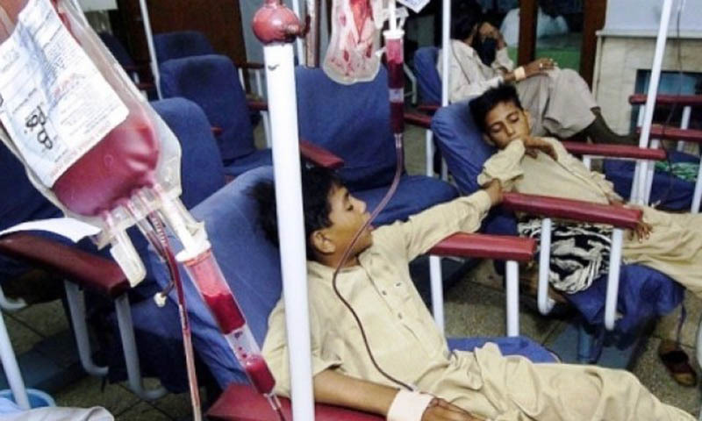
Indian Scenario- Challenges -Bad blood: 2,234 get HIV after transfusion-Hindu

Slide 10
CHALLENGES
In blood disorders India has the largest birth cohort
Globally, with 27 million new births in 2010, the country has the second largest global population of 1.21 billion and a high birth rate of 21.8.
India has around 1,00,000 people with hemophilia(PWH). Only 20% of them have been diagnosed so far.
Untimely access to safe blood
The health care costs of caring for these chronically ill patients is substantial.

Slide 11
A Focus on the Intervention itself is Not Sufficient
The use of effective interventions without implementation strategies is like serum without a syringe
The cure is available, but the delivery system for using it is not

Slide 12
Knowledge - key to Implement a New Program
Details on implementation
Resources that are required, priming Health economics
How setting clinicians, and patients are selected. Who are excluded?
Adaptation- what changes will be needed to the protocol in order to adapt to new setting?
Differences across settings

Slide 13
Mission of Blood cell -NHM (GOI)
Ensure access to safe blood to far flung areas of the country
To lower the prevalence of Hemoglobinopathies & Hemophilia by reducing the number of births of children affected .
To provide a better future for all Thalassemia Sickle Cell Disease & Hemophilia patients and their families

Slide 14
Reaching the Aspirations
A gap analysis was executed for blood services & for blood disorders interventions and the following observations were found:
  Unavailability of blood - cost lives
  TTI put a big burden on health systems
  Wastage of blood
  Transportation of blood - challenge
  Optimum usage of blood
  Unavailability of plasma products which are mostly imported In India,
  Prevention was not focused
  Unavailability of facilities for the patients suffering with the disease of hemoglobinopathies & hemophilia
  Transfusion reactions
  Mortality rate was quite High

Slide 15
HEALTH ECONOMICS
The cost of transfusing and chelating a 30 kg body weight child for one year was estimated to be Rs. 2 lakhs/year, compared with Per Capita Income of India, which is Rs. 1.65 Lacs
With an estimated birth of 12 thousands children with Thalassemia Major every year, and average survival for 50 years, we have around 5 lakhs affected children
The cost of managing 5 lakhs children works out to Rs.10 thousands crores (5 lakhs x 2 lakhs), and Rs.100 crores if only 1% were to survive to 50 years. (Roshan Colah)

Slide 16
Cost Estimates Treatment v/s Screening
 | Beta Thalassemia | SCD | Hemophilia
# of new cases/year | 12000 | 20000 | 1000
Treatment cost/individual | 2 Lacs | 2 Lacs | 4 Lacs
Total treatment cost/year | 240 Crores | 400 Crores | 40 Crores
Screening Cost (CBC + HPLC + Prenatal Genetic) | 6 Crores | 10 Crores | 50 lacs

Slide 17
STEPS TAKEN
Focus was given to strengthen the existing Health systems for improvements in blood services & Blood Disorders while :
Establishing Blood banks in districts with out blood banks
Setting 24*7 functional blood banks at FRUs
Establishing blood storages
Augmentation Voluntary blood donation
Transportation of blood
Training
Processing of blood units for safe blood
Centralized blood bank data management system
Creating Donors Registry

Slide 18
AN INTEGRATED Approach for under Health systems
Screening:
  Cost effective screening programmes at PHC level and upwards. (CBC, solubility test, electrophoresis, Point of care device, Genetic screening, HPLC, etc)
  Culture sensitive screening programmes
Newborn screening
  Detection of abnormal Hb Variants (carriers and diseased state)
Establishing Prenatal diagnosis
  Where both partners are carriers
  With the option of termination in case of an affected fetus
  Extended family screening of all known, detected carriers and patients
  Establishment of Day care centres:
  Day care centres in District hospitals focusing in endemic areas
  Referral centres at Medical colleges
Counseling:
    Avoiding marriage between two carriers
    Genetic counseling

Slide 19
  Community education and awareness: about appropriate treatment and management options and making these available through public health facilities
  Training
    Universal training module for Hemoglobinopathies & hemophilia With focus on prevention & management
    Financial support for obtaining treatment regimen
    Support from NHM and state funds
    Universal treatment cost across the country
  Monitoring and evaluation
    A system of surveillance and registry is being established to track and evaluate outcomes such as (patients registered, number of carrier couples opting for prenatal diagnosis, number of carriers detected in school or at premarital stage avoiding marriage with another carrier, BMT etc)

Slide 20
Thalassemia Bal Sewa Yojna
(A project for under privileged Thalassemics patients )
    Primarily benefit underprivileged Thalassemia patients who are eligible for bone marrow transplantation but do not have the financial resources to cover the cost of procedure.
    CIL is one of the first PSUs to take up CSR activities in this area
    Being pursued since April, 2017 in collaboration with Coal India for Bone Marrow Transplant (BMTs)
    Financial support at the rate of Rs.10.00 lakhs or actual expenditure of the HSCT procedure whichever is lower.
Application are invited from the states

Slide 21
Bal sewa Yojna (contd)
Implementation Through
  6 hospitals nominated by Ministry of Family Health and Welfare. –AIIMS Delhi , CMC Vellore , Tata Medical Centre Kolkatta, PGIMER Chandigarh, Rajeev Gandhi Cancer Institute Delhi , SGPGI Luknow
Standard operational procedures
  Screening committee shortlists patients eligible for assistance based on the eligibility criteria.
  Financial assistance provided by CIL , would be directly transferred from CIL to the institutions performing HSCT and the institutions submit the Utilization Certificate for the amount utilized.
MoHFW is a implementing agency for the same

Slide 22
    Sarthakta
    (Synergy of efforts from 4 different sectors for social welfare)
Govt
MoHFW
Coal India
Civil society
Health care sector
Coal India Ltd.
Civil Society
Healthcare sector

Slide 23
Outcomes of the Thalassemia Bal Sewa Yojna
FACTORING SCALABILITY
  Started with 3 hospitals. Now partnering with 6 hospitals
  Hospitals selected are spread across India to avoid excessive or deficient focus in one region and to create a facility near to the patients to
IMPACT ANALYSIS
Beneficiaries Thalassemia patients from poor background, their family. A one time cure for lifelong joy.
Advantages
      Model is a successful synergy of efforts from 4 different sectors for social welfare
      Pan India presence
      Collaborated with coal India and a NGO called (Thalassemics India) which has 30 years experience in the field.
      The model has been successful & it is requested to be replicated in other inherited diseases.(sickle , hemophilia)
      96 BMTs have ben done so far.

Slide 24
Achievements ( state blood cell at NHM and state Health Departments) –
58 blood banks have been established in the districts without blood banks
987 blood banks have been made functional , around 150 blood component units has been establihed
1646 Blood storages has been made operational
Antenatal and new born screening has been initiated in some states
Day care centres are being established, availability of drugs
Awareness programmes
initiation of BMT

Slide 25
OUTCOMES
Reduced maternal and child mortality rate
Decreased incidence of Haemophilic people living with disabilities
Increased survival rate among the hemoglobinopathies patients
Reduced burden on health resources ,
Lower prevalence of Hemoglobinopathies etc

Slide 26
WAY FORWARD
Effective strategies for improving health-related processes & outcomes
Refined implementation frameworks ,interventions and measures
  Strengthening laboratory facilities for testing and confirmation of hemoglobinopathy carriers at DH
  Establishing regional centers, COE in States with facilities for prenatal diagnosis and laboratory facilities for DNA analysis.
  Provide optimal care to all thalassemia , sickle cell and Hemophilia patients at the district level, ensuring the blood bank facilities, and establishing the day care units

Slide 27
WAY FORWARD
Political Will and Advocacy:
  A strong administrative and political support is required as observed in countries like Cyprus, Greece and Italy
  Success examples even in developing countries, e.g. in Iran, Maldives, Sri Lanka and Pakistan.
Collaboration More PSUs are required to direct thier CSR activities towards preventions and cure of these blood disorders like BMT project of Coal India
  Sustenance of preventive programmes for long periods of time extending to decades with changing dynamics is required to achieve expected outcomes.

Slide 28
Still Miles to go: Further Objectives
Functionality of blood banks and blood storages
Quality Processing of blood units for safe supply of blood
Day care centres having all the necessary facilities to cater patients needs
Comprehensive care and management at the tertiary care level including rehabilitation)
Establish Hematopoietic stem cell transplant (HSCT) centers in states
  Augment facilities for stem cell collection and storage
  Initiation of Stem Cell Donor registry

Slide 29
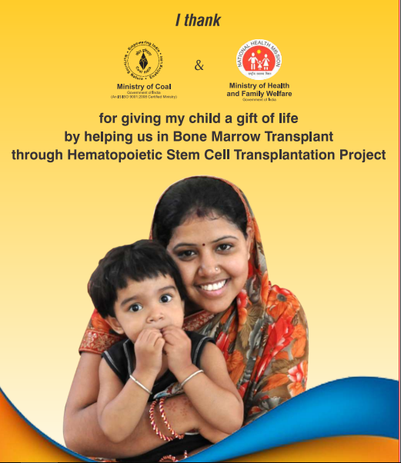

Slide 30
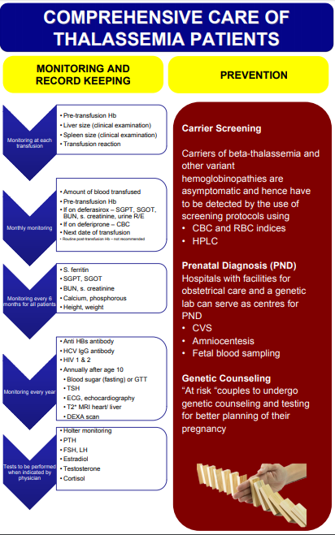

Slide 31
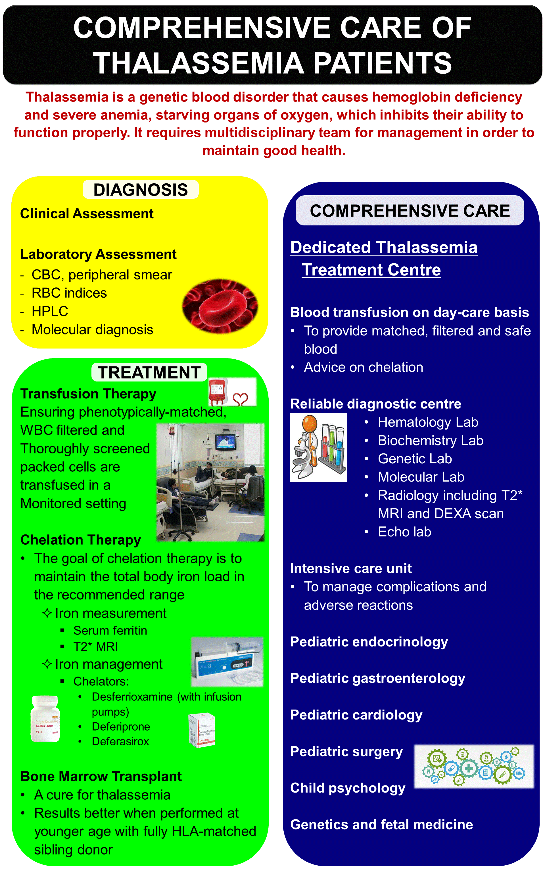

Slide 32

We all can work but together we win

