Slide 1
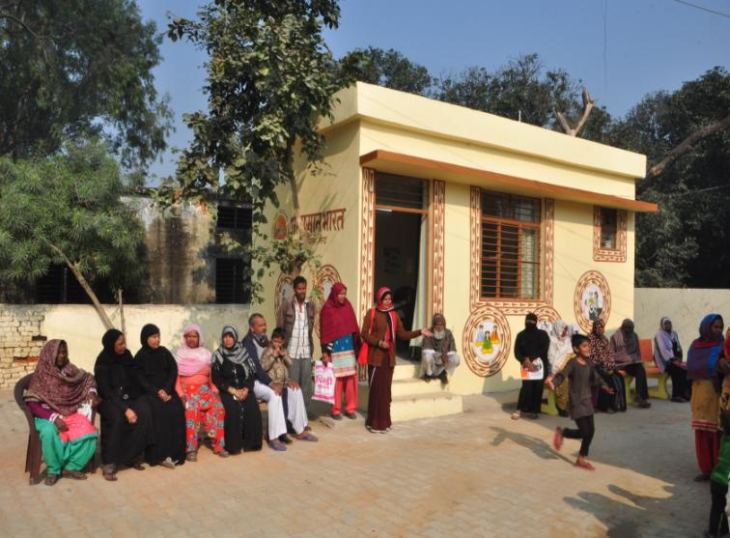
“Delivering Comprehensive Primary Health Care by Strengthening Health and Wellness Centers in Uttar Pradesh”
REGIONAL WORKSHOP , GOA- 19th – 20th AUGUST 2019

Slide 2
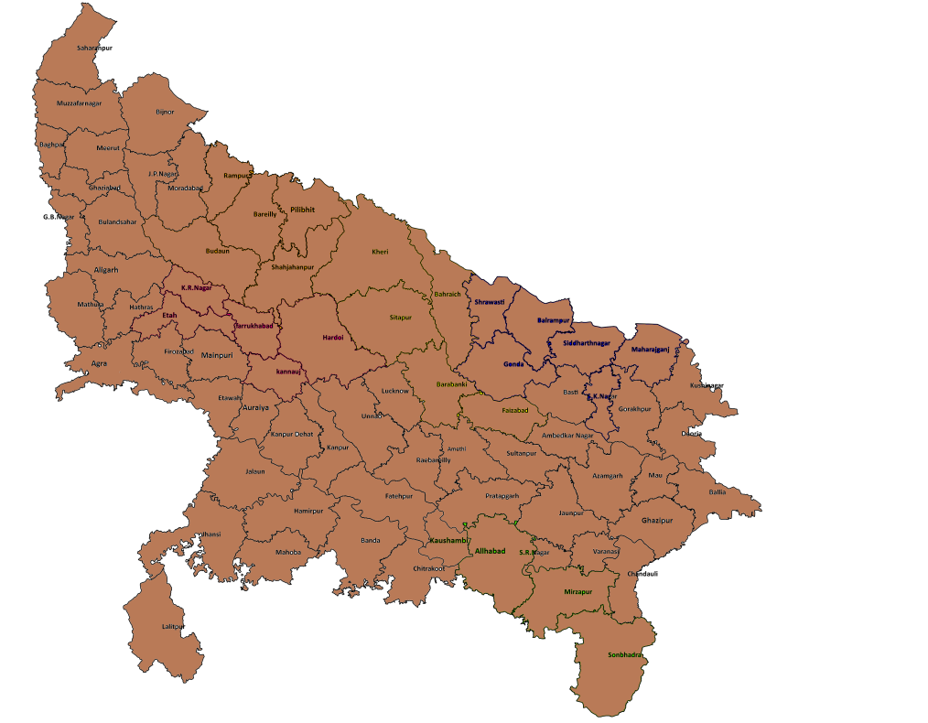
Uttar Pradesh at a Glance
Status of Health in UP:
Maternal Mortality Ratio: 201 per 100,000 live births
Infant Mortality Rate: 43 per 1,000 live births
Total Fertility Rate (NFHS 4): 2.7
Geography:
18 divisions, 75 districts,
312 tehsils, 820 blocks,
648 statutory towns,
267 census towns, and
106,000 villages
Demography:
~200 million accounting for 16% of India’s total population
Equivalent to 5th highest populated country of the world
78% of state population is rural
Health Infrastructure in UP:
# of Facilities Operational HWC
DH 171 -
CHC 958 -
PHC 2727 960
UPHC 592 391
SC 20573 768
Frontline force in UP (#):
ASHA :152601
AWW :173797
ANM :23500
VHSNC :62871

Slide 3
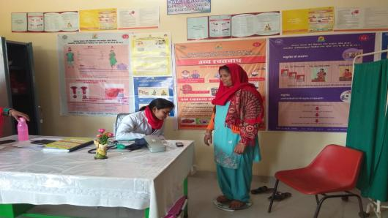
Current Status
Total target for 2019-20 – 7570
2119 HWC (768 SC, 960 PHC, 391 UPHC) are operational in
the state against the total approval of 4120 (SC 2329, 1386 PHC, 405 UPHC) FY 2018-19.
1121 CHOs completed training and given interim posting.
5000 HWC-SC and 400 HWC-PHC approved for FY 19-20.
3005 CHOs will be trained in Jul- Dec 19 batch out of which 2400 HWC-SC are likely to be operationalized by Feb 20.

Slide 4
HWC Operationalization Plan
Months | HWC- SHC | HWC- PHC | HWC- UPHC | Total
August – September 2019 | 1779* | 1086 | 395 | 3260
Total upto March 2020 | 4183* | 1586 | 405 | 6174**
*Considering 80% pass out rate in the bridge course examination
**As per conditionality target for operationalization of HWC is 25% of 23890= 5973

Slide 5


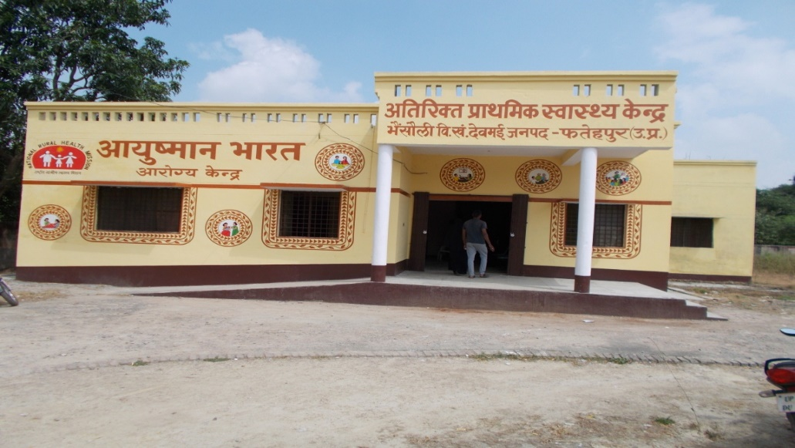


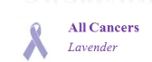
Key Service’s Delivered by HWC (April to July 2019)
Screening: 469392
Newly diagnosed: 66193
7285829
On Treatment: 51569
Screening: 353739
350201
Newly diagnosed: 44930
On Treatment: 33994
Individuals Empaneled
787365
Oral Cancer Screening: 36436
Breast Cancer Screening: 8788

Slide 6
Drugs & Diagnostics
EDL :
  SC – 43 (184)
  PHC – 98 (248)
  UPHC – 156
Diagnostics :
  SC - 07 (14)
  PHC - 12 (63)

Slide 7
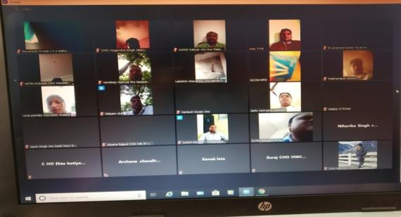
Capacity Building of FLW’s and CHO
13736 ASHA and 3010 ANM trained on NCD
CHO’s trained on performance based Incentives through ZOOM Platform.
ECHO sessions for MO and CHO

Slide 8
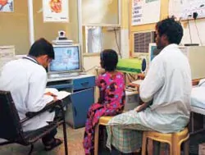
Tele Medicine
  Five tele medicine Hub approved in RoP 19-20.
  Initial meeting Conducted with CDAC team and Nodal officers from SGPGI, BHU, KGMU, MLB Jhansi, BRD medical college Gorakhpur.
  CDAC will start a pilot project with KGMC and SGPGI

Slide 9
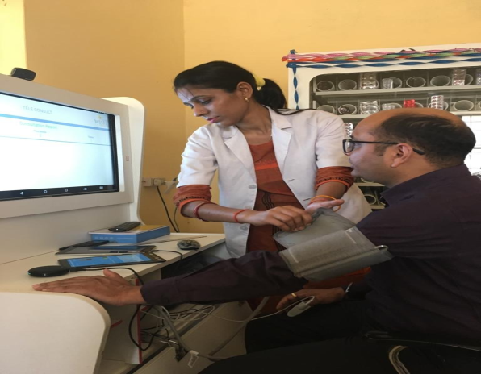
Tele Consultation
  Tele Consultation started in 9 HWCs of Shrawasti and Fatehpur with support from Wish Foundation.
  1817 tele consolation conducted from 1st Feb to 15th Jul, 2019.

Slide 10
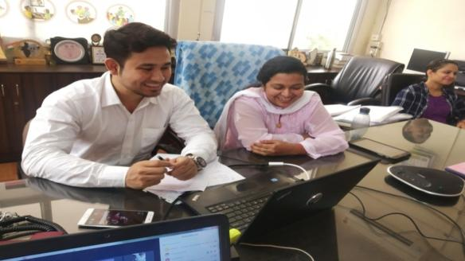
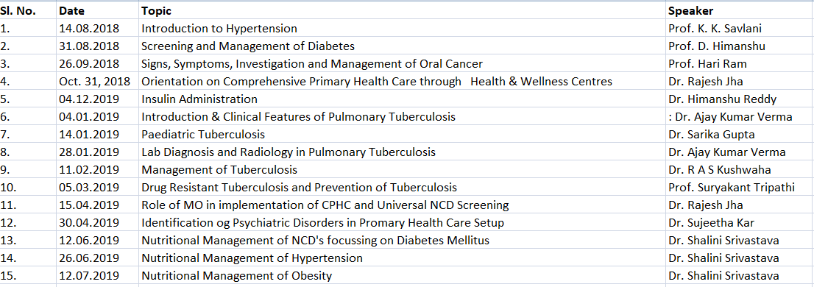
ECHO Platform
ECHO platform is operational from PSM department of KGMU.
Four ECHO Hub will be proposed in SPIP 19-20.
15 ECHO sessions were conducted.
Following 15 topics were covered so far.

Slide 11
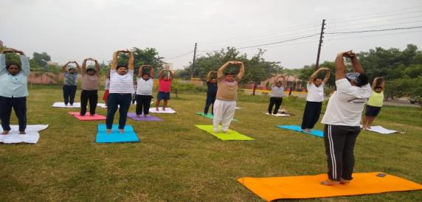
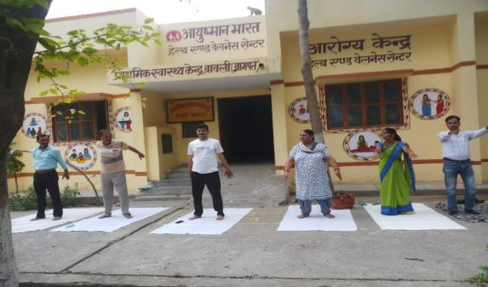
Yoga at HWC
In 1373 HWC Wellness activities started as per the portal.
Resource pool of Yoga instructors along with guidelines shared with the districts.
Faizabad University agreed to facilitate Yoga training for CHOs and certify them.
The university will send comprehensive training plan in next 15 days.

Slide 12
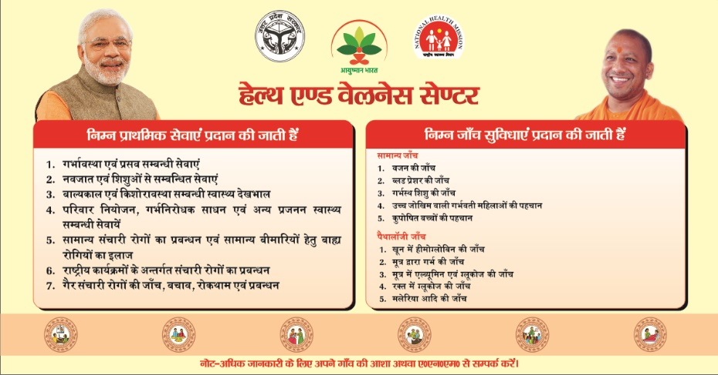
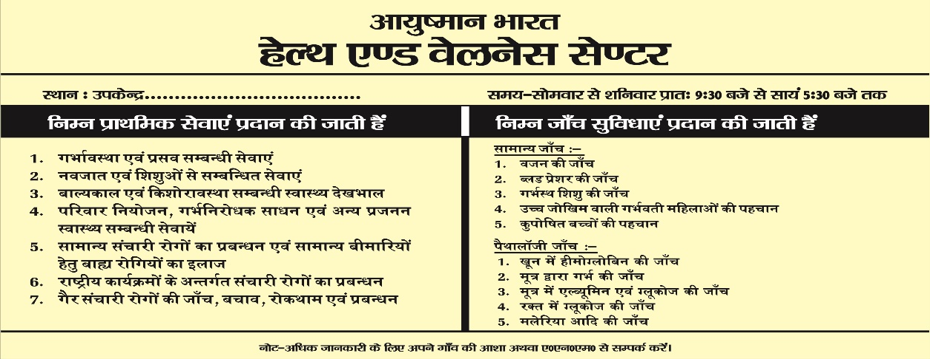


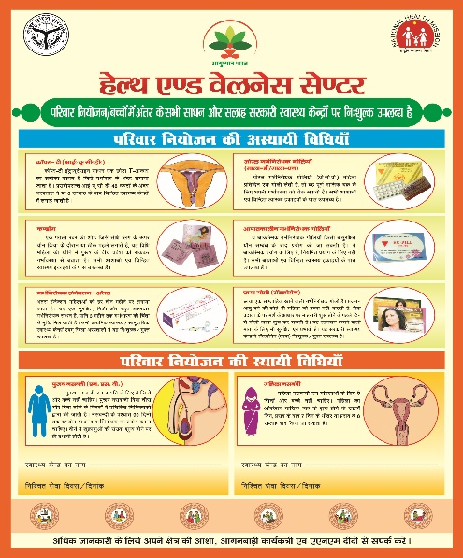
Information, Education and Communication Initiatives
Wall Writing
Patient Card
Posters

Slide 13
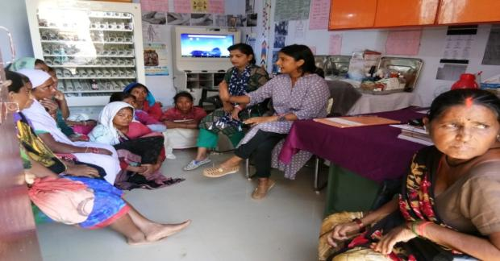
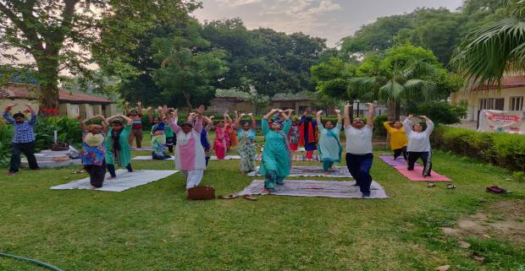
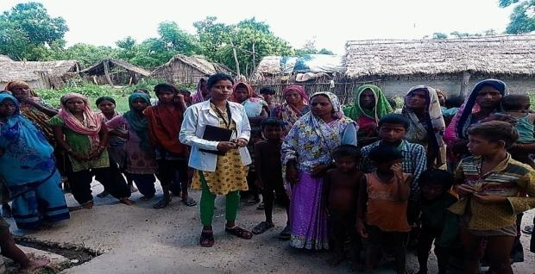
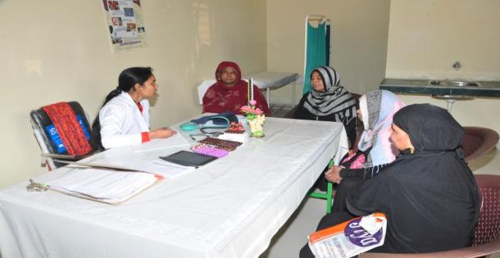
Health Promotion Days
World Hepatitis Day at HWC-SC, Shravasti
World Yoga Diwas HWC, Meerut
World Hepatitis Day at HWC-SC, Bhagwanpur
HWC- SC, Meerut

Slide 14
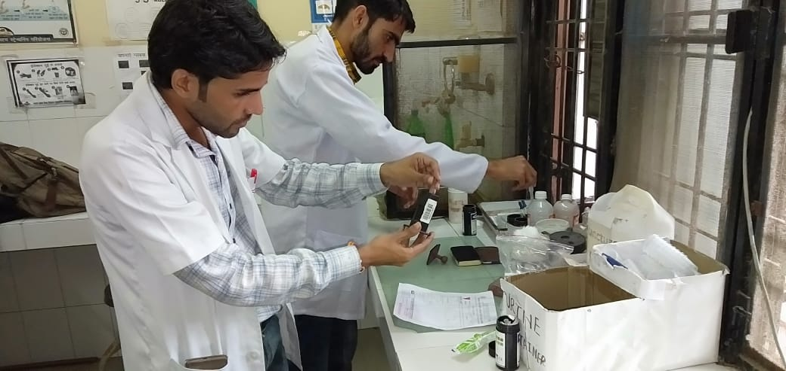
Scale-up of CHO Training: Experiences of Uttar Pradesh

Slide 15
The Task
20573 sub-centres , 3319 PHCs (PHC-2727 and UPHC-592) into Health & Wellness Centres by 2022
01
Operationalization of HWC (SHCs) would requires incremental addition of human resource
02
56 Program study centres to be operationalized in a phased manner by 2019 to ensure adequate number of CHOs
03
Adopted six‐months Certificate Course in Community Health developed by IGNOU for developing the cadre of CHOs
04

Slide 16
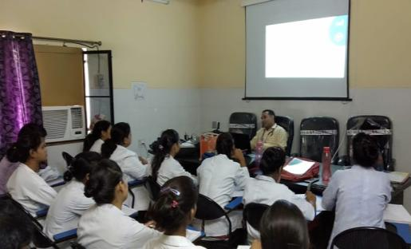
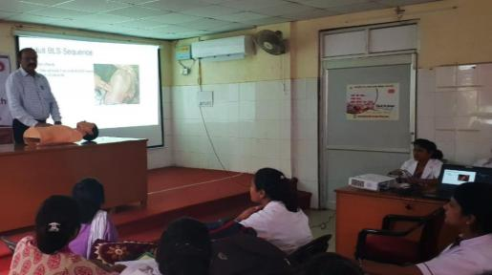
CCHN Training’s/ CHOs
Program Study Centre (PSC)
Operational PSC– 33
New PSC identified/Assessed – 23/23 ,
Notified – 10
CHO Trainings
CHO working/passed – 803/881
Result awaited – 1121 (Provisional posting issued)
Written test conducted for 6000 CHOs (16.6.2019)
For July 2019 - 2805 candidates
For Jan 2020 - 3195 candidates
Alternate Strategy for CHO training
In collaboration with KGMU and SIHFW
200 CHO would be trained at 5 RHFWTCs
using virtual classroom technology.
MoU singed between all stakeholders

Slide 17
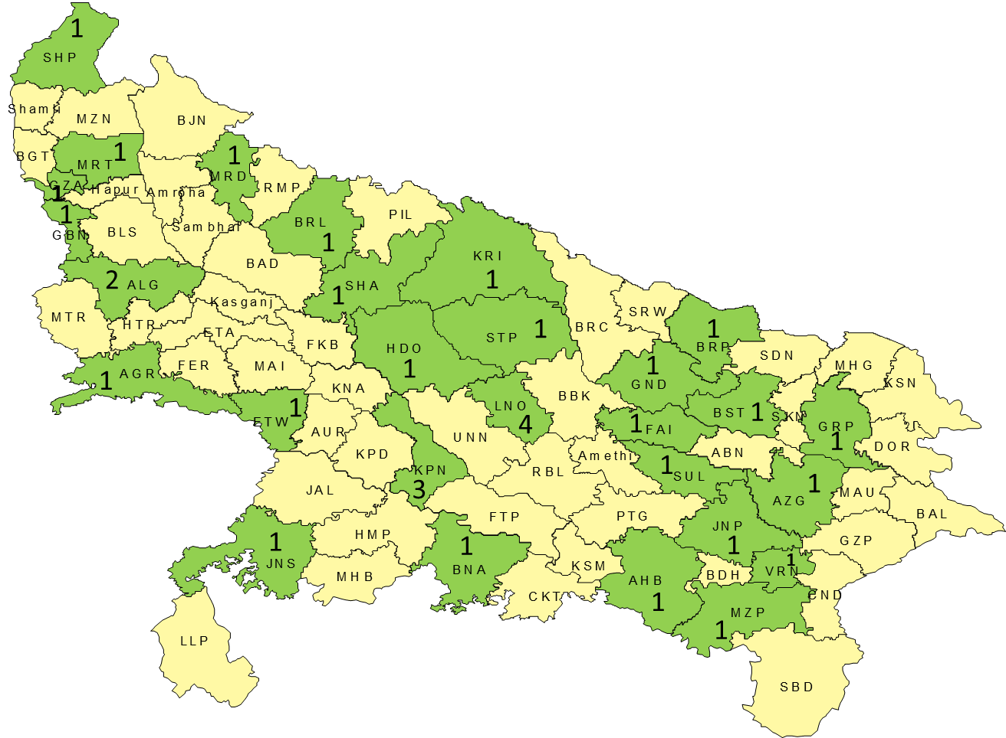
Geographical Spread and Achievements
Number of PSCs upto March 2019
Institutions | Targeted (Mar 19) | Notified
DH,DWH & DCH | 27 | 27
Medical University/Institute | 2 | 2
College of Nursing | 3 | 3
School of Nursing (GNMTC) | 1 | 1
Total | 33 | 33
Proposed 23 New PSCs FY 2019-20
DH,DWH & DCH | 12 | 8
Medical University/Institute | 10 | 1
School of Nursing (GNMTC) | 1 | 1
Total | 23 | 10

Slide 18
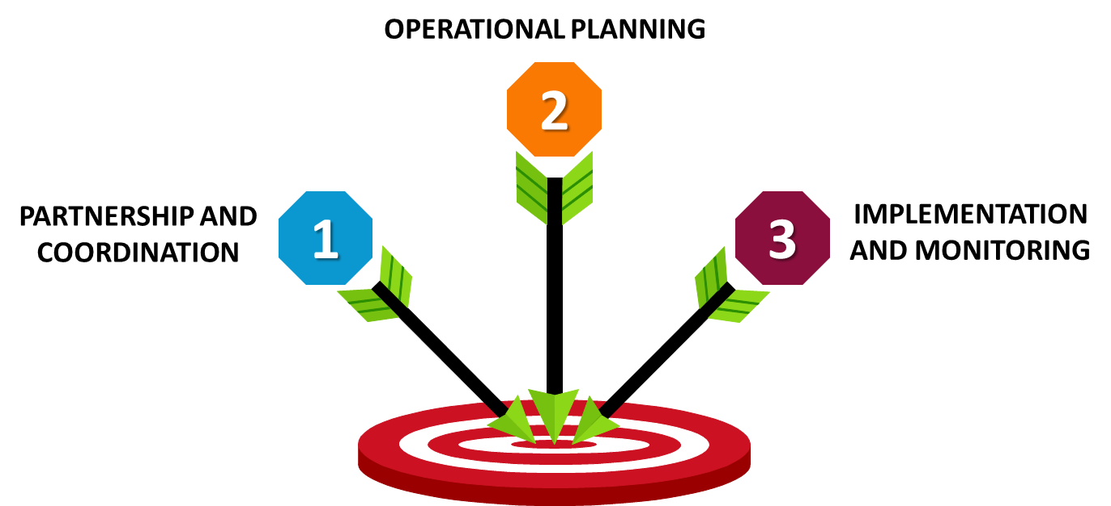
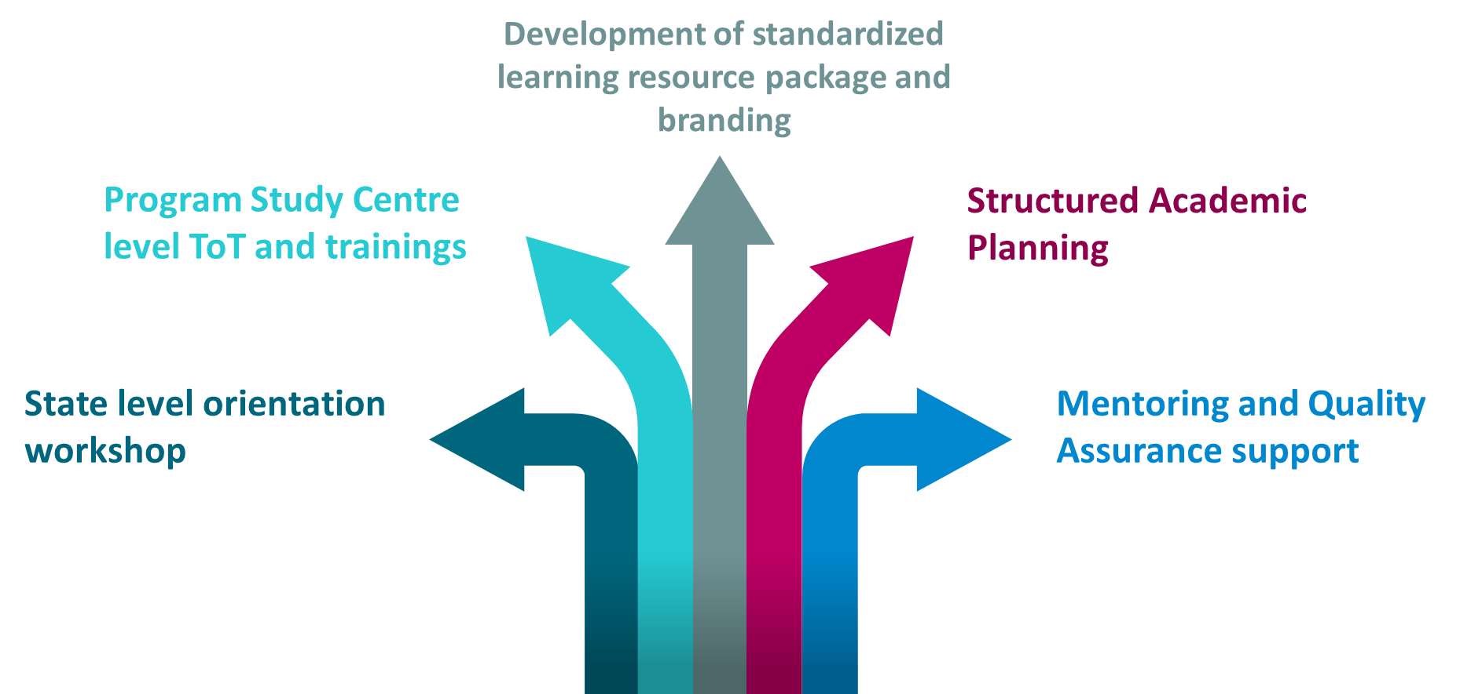
CHO Training - Conceptual Framework and Operational Strategy
Comprehensive roll out strategy developed with technical support of Jhpiego
Notes:
© Copyright PresentationGO.com – The free PowerPoint template library

Slide 19
Strategies That Worked For Us..
CHO Selection and Training
Open Market candidates
No domicile restrictions
Non-residential training
Training Approach & Quality Assurance
  Use of Learning Resource Package and facilitators guide developed with support of Jhpiego
  Creating pool of trainers through PSC level ToTs
  Mid-term examination (Mock Test)
  Mentoring & quality assurance visits
Counselling and retention
  Allocation of final posting prior to joining course
  Bond signing prior to joining the course

Slide 20
Measuring Success: Increased applicants and Term End Examination Results
191/217
643/798

Slide 21
Alternate strategy to increase availability of CHOs for operationalization of Health & Wellness Centres
UP Initiative………
A collaborative innovation of King George's Medical University (KGMU), Lucknow, State Institute for Health and Family Welfare (SIHFW) and National Health Mission to roll out the certificate course in community health for nurses by using Virtual classroom technology .
Notes:
© Copyright PresentationGo.com – The free PowerPoint library

Slide 22
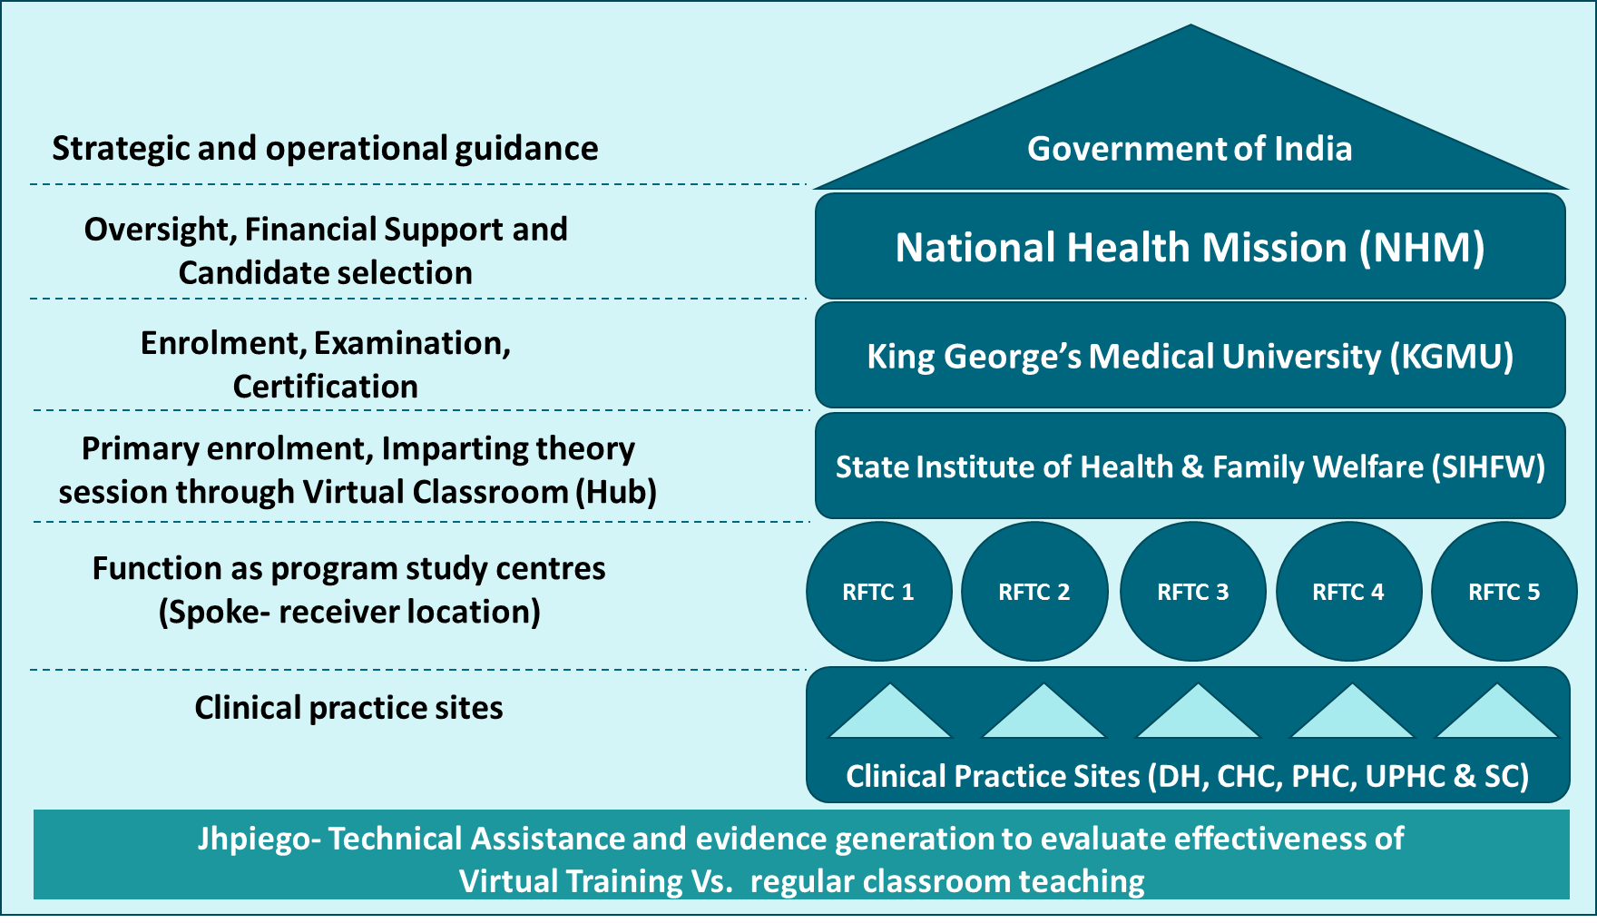
Piloting State Led Alternate Strategy
To Boost CHO Output- virtual classroom technology
Pilot to start with July-Dec 2019 batch
Will initially add approx. 400 CHO annually
Once successful, to be scaled up to 10 RHFWTCs.

Slide 23




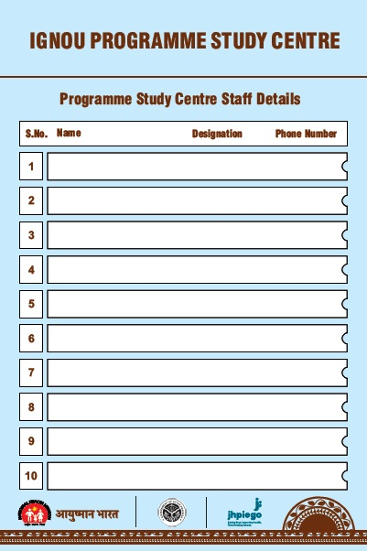
Branding of Program Study Centre

Slide 24
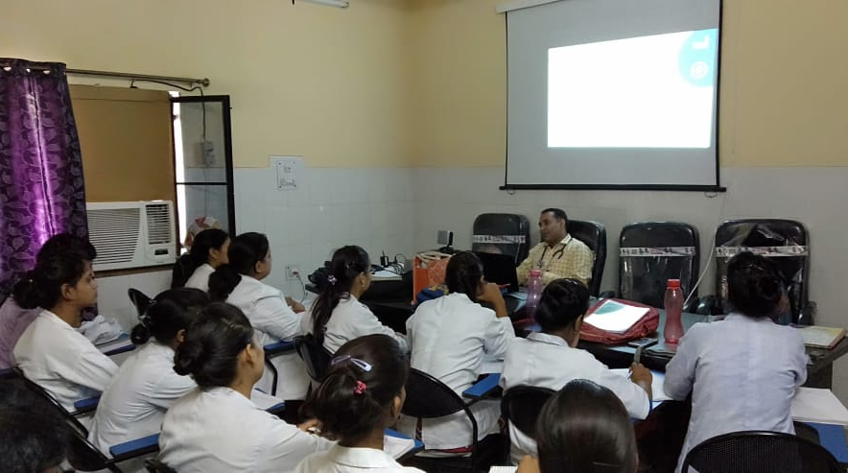
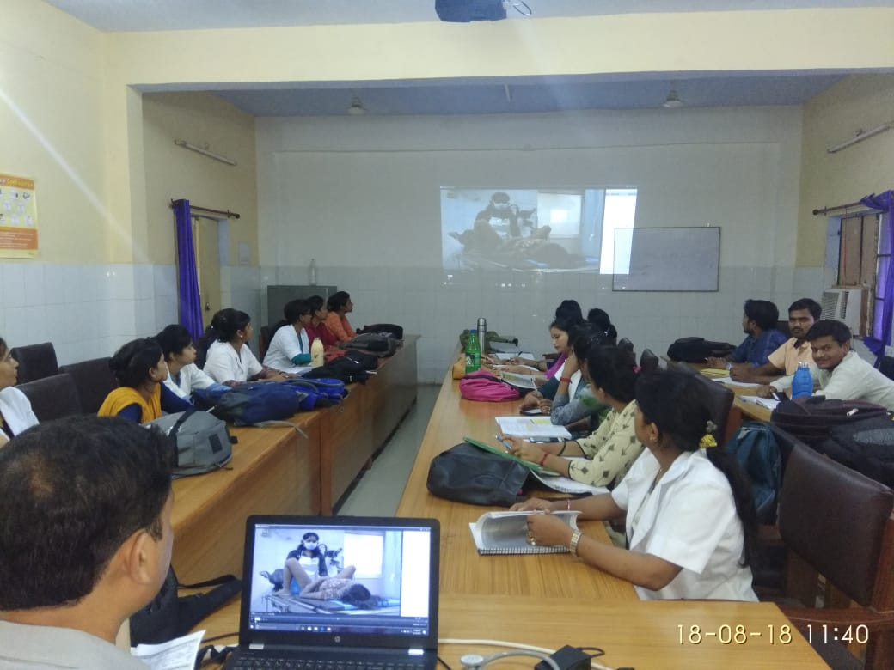
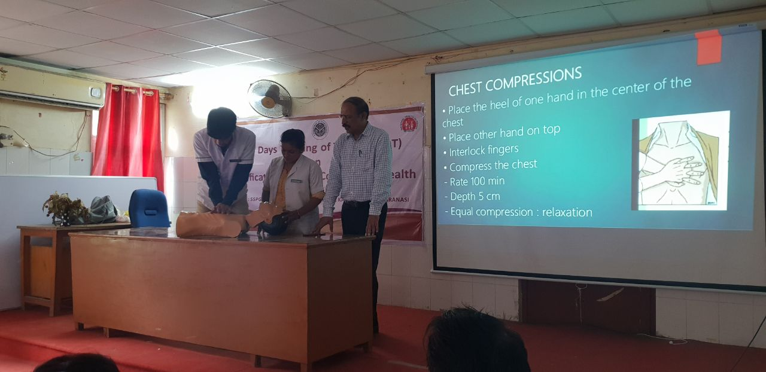
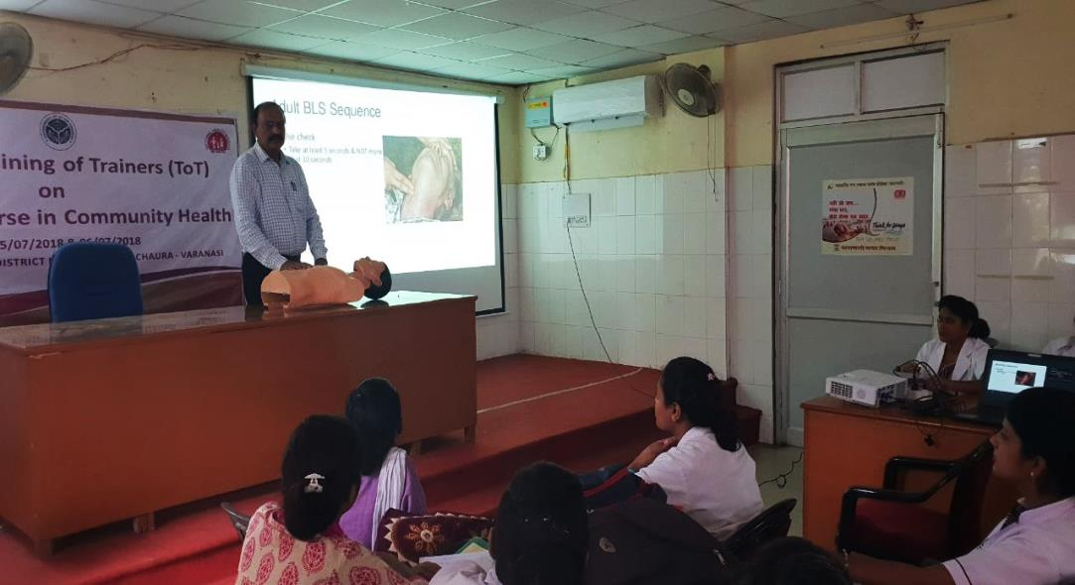
Theory Sessions using LRPs and Skills demonstration
Theory session using Standard LRPs
Classroom teaching using AV aid at DWH Basti
Skills demonstration at PSC Varanasi

Slide 25
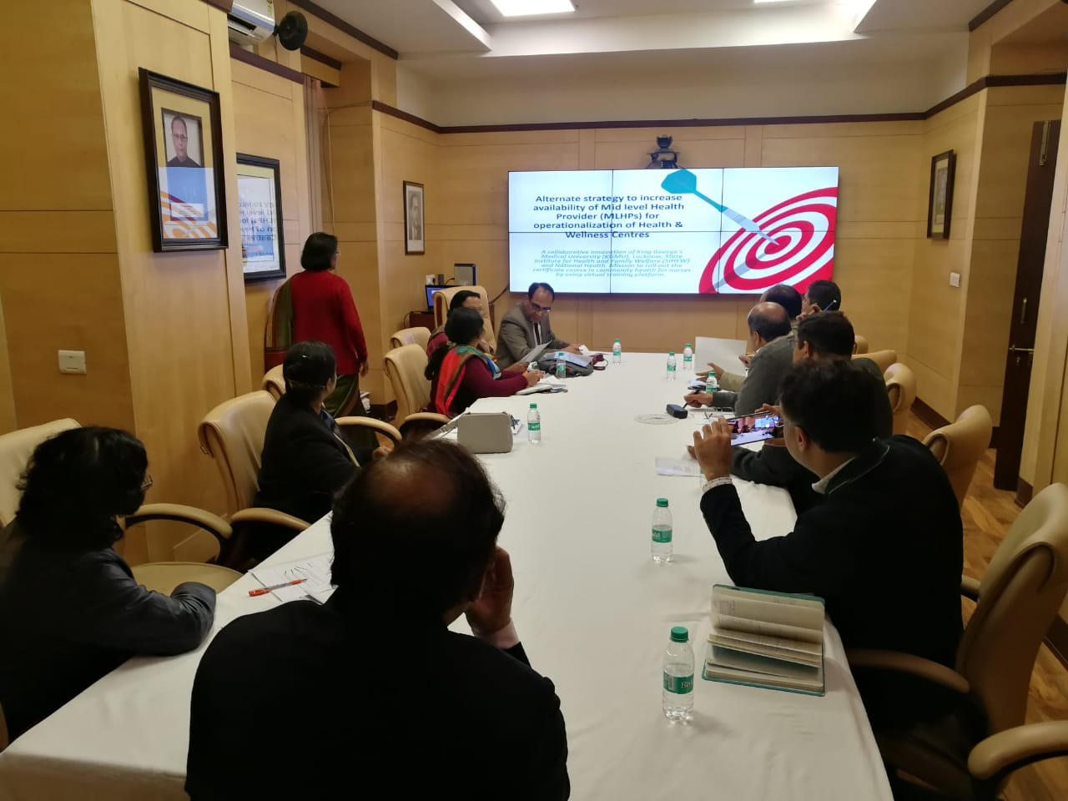
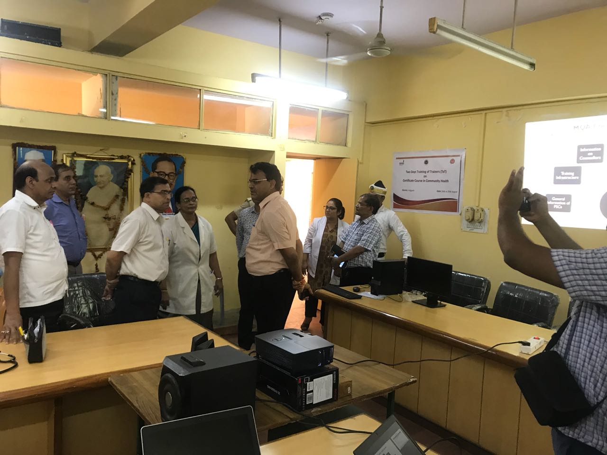
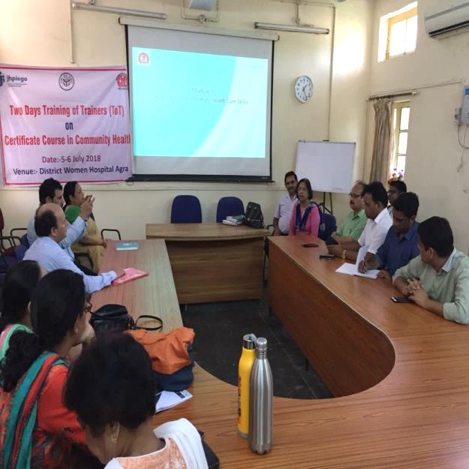
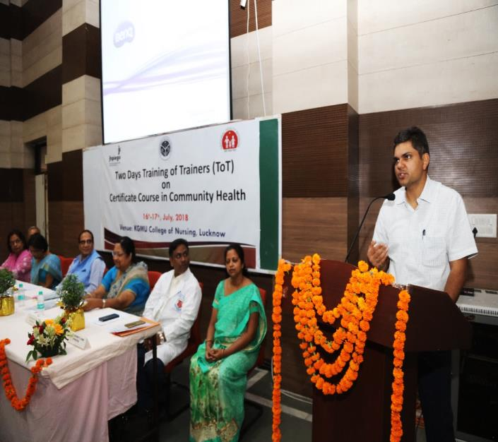
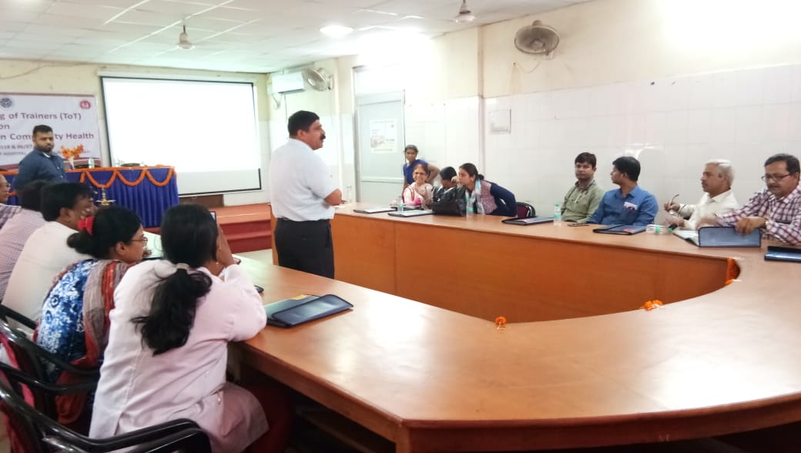
Glimpses of PSC level ToTs
Discussion on Alternate Strategy with VC-KGMU
DM Aligarh visited During ToT
Dr Madhu sharma GM Planning during ToT
MD NHM at ToT KGMC
Mr. Devesh Tripathi (SNO-N) briefing guideline during ToT Varanasi

Slide 26
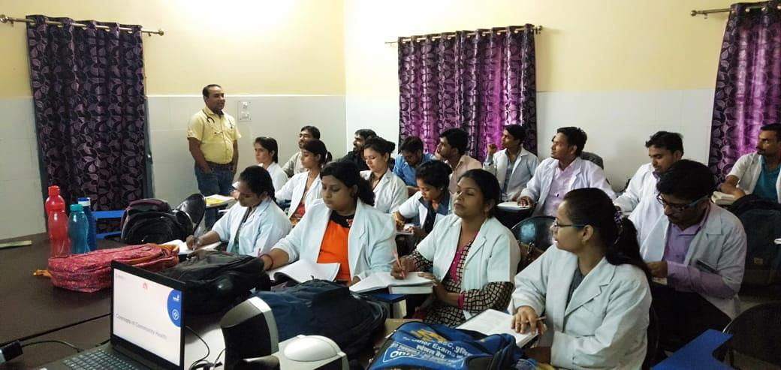
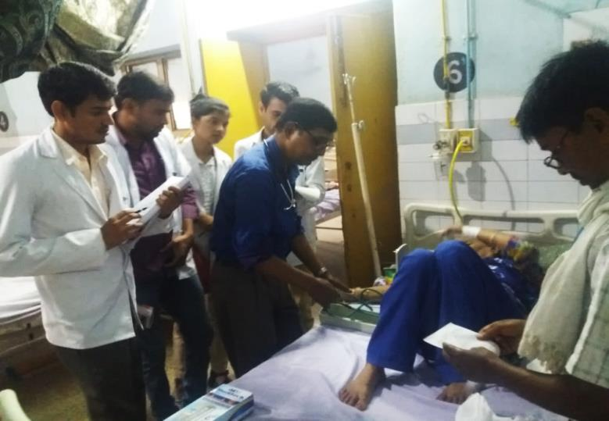
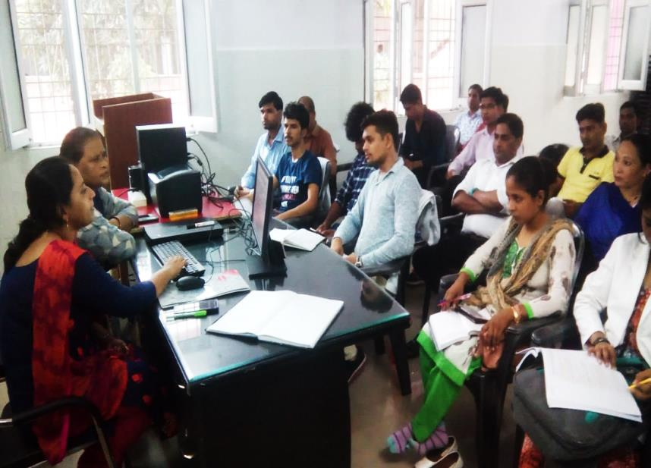
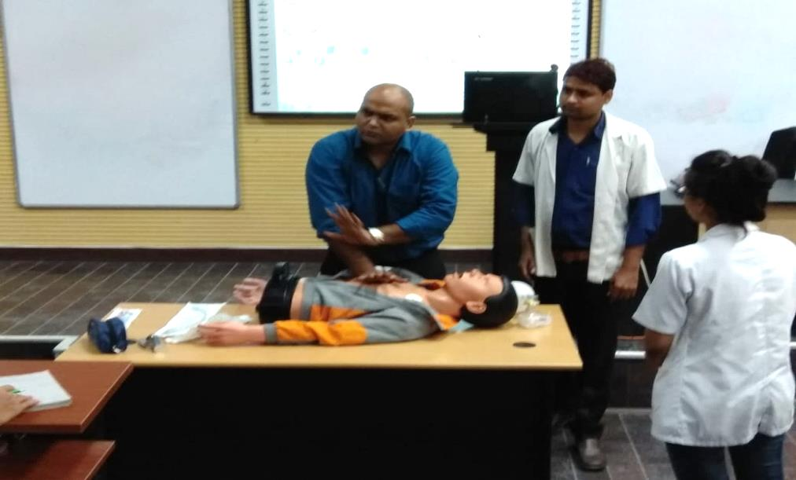
Theory and Practical Sessions at PSCs
Classroom teaching at DWH Aligarh
Clinical postings at DH Baharaich
Sexual Health Education Counseling class at DWH Kheri
Basic Life Support class at RMLIMS Lucknow

Slide 27
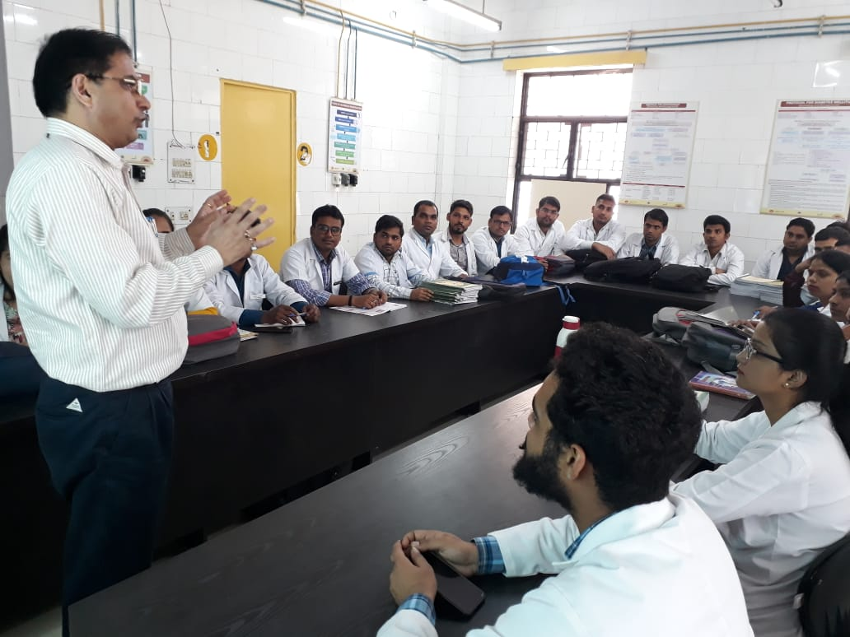
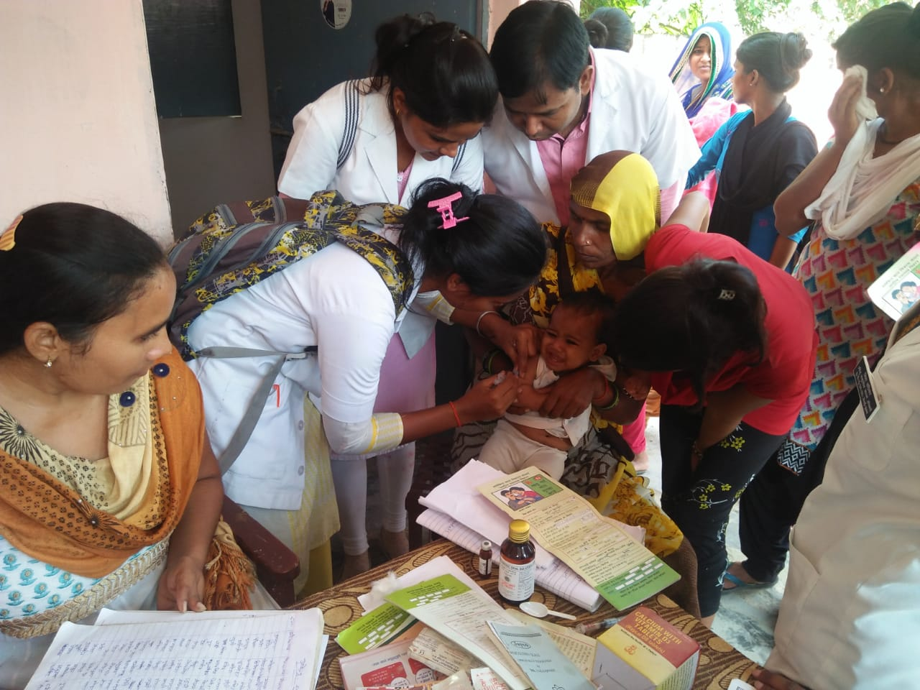
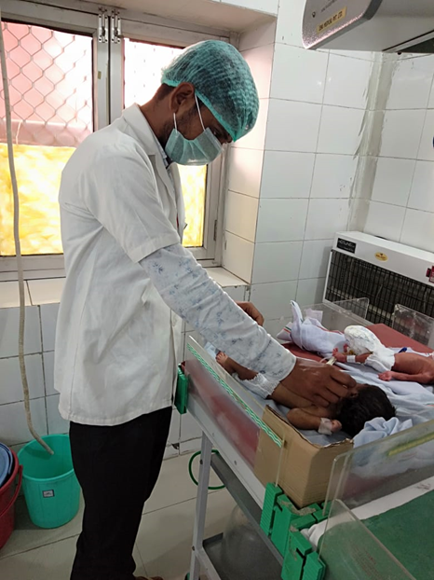
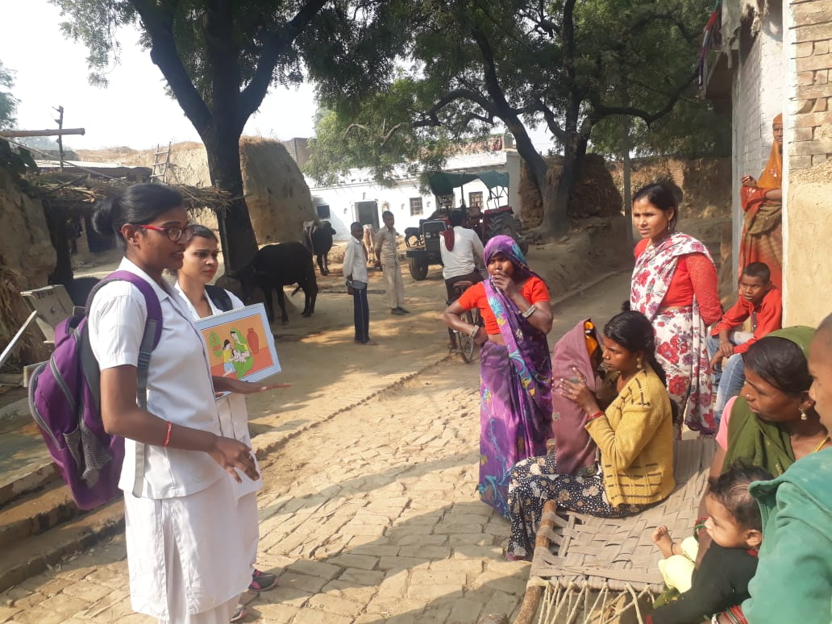
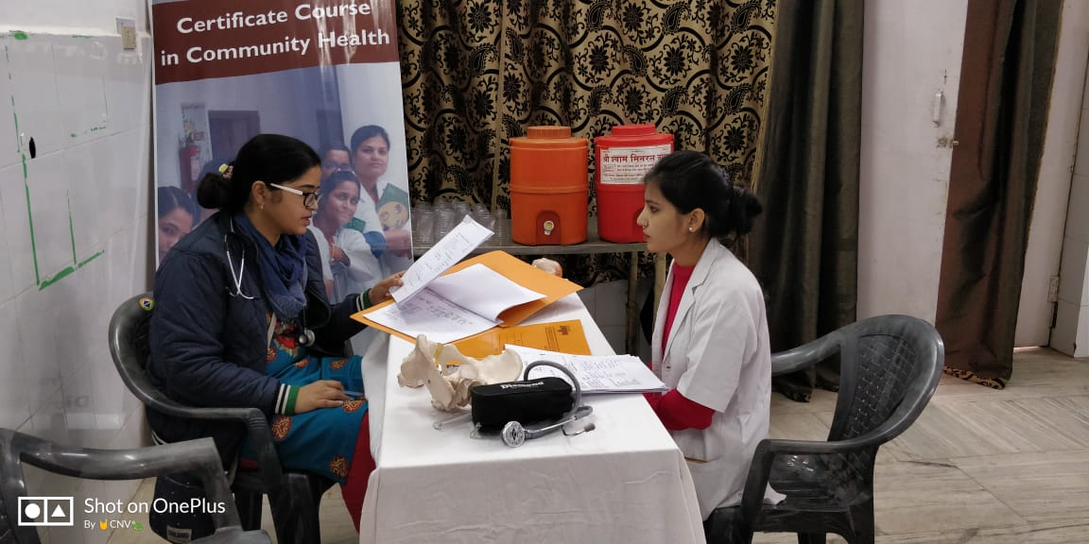

Slide 28
Challenges & Way Ahead :
Urban PHC HWC : Training and Implementation
PHC HWC : LT, Staff Nurse & ANM
Cadre Management : Integration into the health system
MPW Male : Recruitment and expansion of the existing cadre
Diagnostics : Hub and Spoke model
Drugs : EDL revision and DVDMS portal usage
Training Capacity : New PSC and alternative measures
CHO : July Batch – HC Stay and its impact on the planned HR

Slide 29
THANK YOU….

