Slide 1
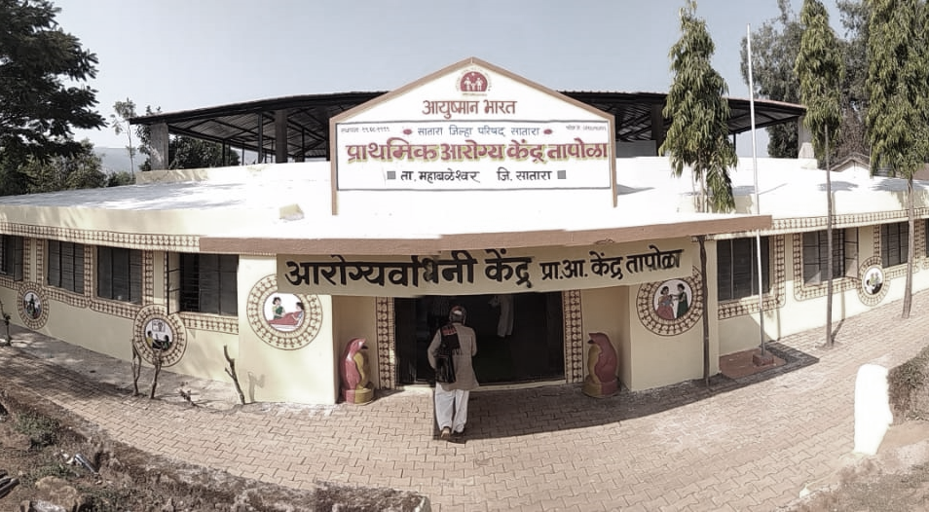
Best Practices in Health and Wellness Centres
MAHARASHTRA

Slide 2
HWC Maharashtra: Present status
Type | Total no. In State | Approved – 2018-19 | Functional as on 15/08/19 | Approved – 2019-20 | Remarks
HWC-PHC | 1828 | 495 | 1128 | 1349 | Branding and training of remaining PHCs in Process
HWC-UPHC | 605 | 0 | 429 | 400
HWC-SC | 10668 | 1591 | 1111 | 5200 | Entrance exam complete and training program started from 1st August 2019
Total | 13101 | 2086 | 2668 | 6949

Slide 3
Infrastructure, HR, Drugs and Diagnostics
Branding of 1128 PHCs, 429 UPHCs and 1111 SC completed
Two MO available in one PHC – at least one MBBS MO is posted in each HWC-PHC
Minimum One CHO, one ANM and one MPW male with 5-6 ASHA in all HWC-SC
Revised EDL prepared for SHC- HWC (108) and HWC-PHC (443). Medicines are being made available as per revised list. State working with CDAC for expansion up to HWC-SC level.
In HWC PHC, 11 in-house tests and 25 outsourced tests are available. However, MO can prescribe higher tests available for Hospital package as per need.
At HWC-SC, 7 tests done in-house and plan is to outsource rest of tests to HLL

Slide 4




Course conducted by Maharashtra University of Health Sciences (MUHS)
Duration: BAMS & BSc Nursing – 6 months, BUMS – 8 months
Total Program Study Centres : 106 (DH- 23, GH/SDH- 37, Trust Hosp- 17, Corporation Hosp – 22, ESIS Hosp -7 )
Total Capacity – 6300 candidates per batch
Curriculum designed jointly by MUHS and NHM as per IGNOU/GoI syllabus
Responsibility of the training centre monitoring is given to PHI Nagpur and all HFWTC in the state
Every 15 days the training centre are being monitored by HFWTC observers as per the checklist designed by state
Training in the form of Lectures (386), bedside clinics (121), field visits (15 days) and care of 30 families for 66 months
Request has been done to the MMC for getting credit points for our teachers
HWC – Bridge Course Plan

Slide 5
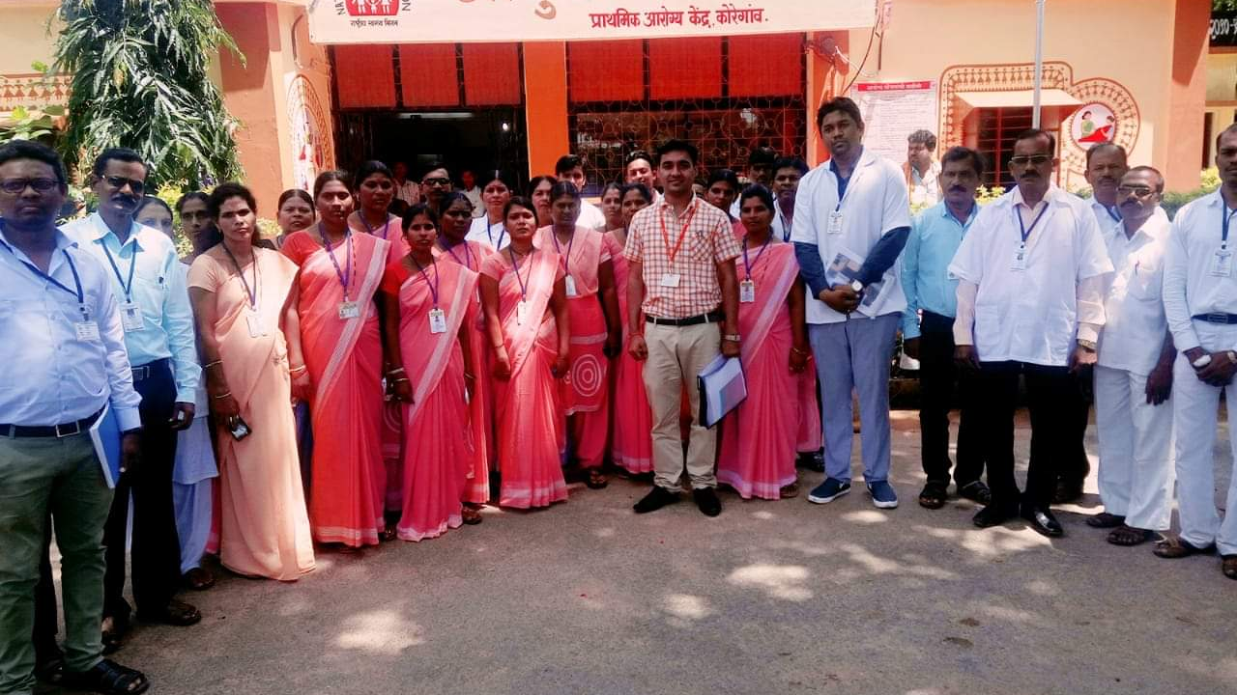



Services Provided
Out patients: 61,47,197
Inpatients: 4,20,715
Deliveries: 25,624
NCD Screening
No enlisted : 6189645
CBAC forms filled: 2617959
Persons examined for BP : 1116433
Persons examined for Bl. Sugar : 1032246
No diagnosed : 14080
No under treatment : 4044
Yoga sessions: 12,072
IT training: 6315 ANM

Slide 6
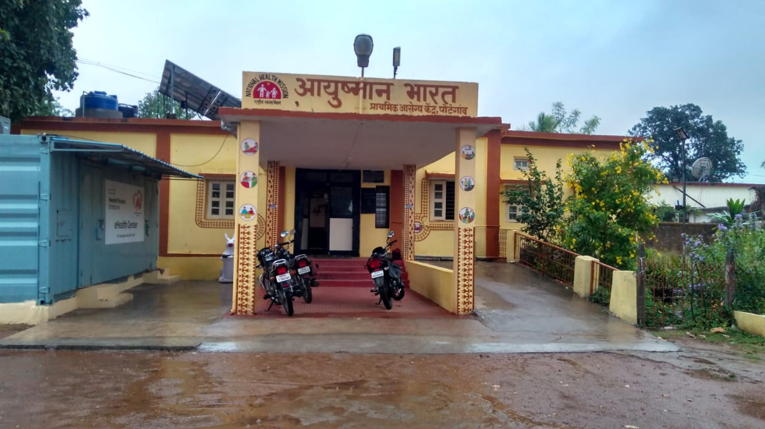

HWC Best practices in Maharashtra
BEST PRACTICE I: Healthcare of Elderly

Slide 7
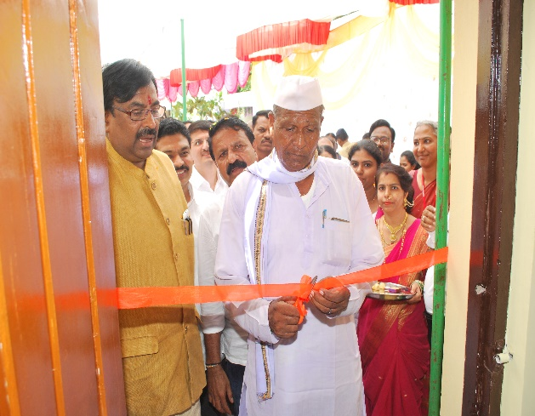
Health Care Services to Elderly in HWC-PHCs Chandrapur project
Once a week the geriatric clinics in 4 HWC-PHCs from Mul Block
Team of one Medical Officer, ANM’s and ASHA trained in Geriatric Care
Team conduct Geriatric OPD at the PHC’s
Physiotherapy unit established
HWC-PHC team supported by Specialists, Physiotherapist and Staff Nurses from District Hospital
Training and implementation support by Tata Trusts.

Slide 8
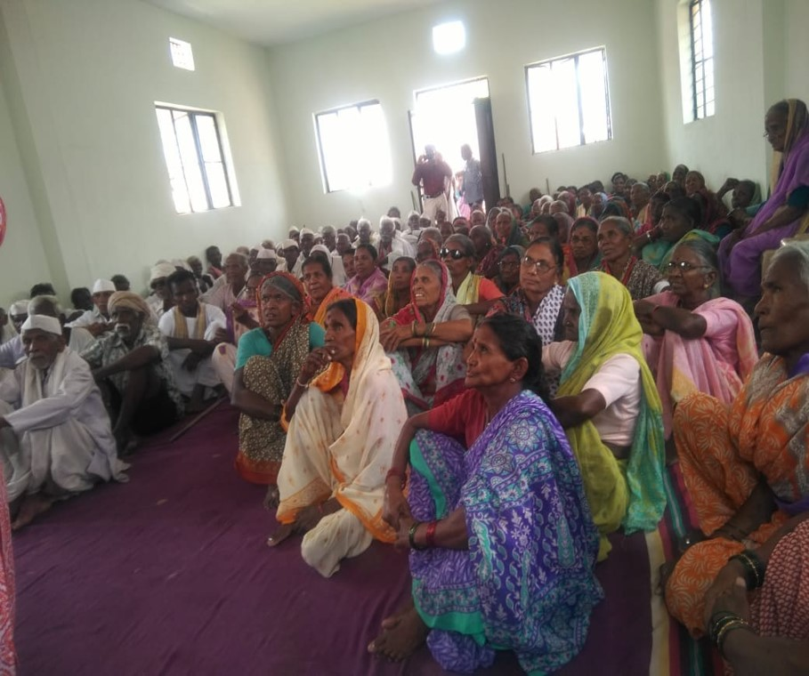
Services provided from June 2018 to July 2019
S. No. | Services provided | Total
1 | Number of clinics conducted at PHCs | 181
2 | Elderly persons provided OPD care during weekly clinics | 11,456
3 | Lab tests undertaken on elderly people | 765
4 | Elderly screened and provided health card | 3,537
5 | Elderly referred to CHC/DH | 160
6 | Number of activity centres started | 10
7 | Number of activity sessions conducted | 716

Slide 9
HWC Best practices in Maharashtra
BEST PRACTICE II: Model HWC Layout

Slide 10
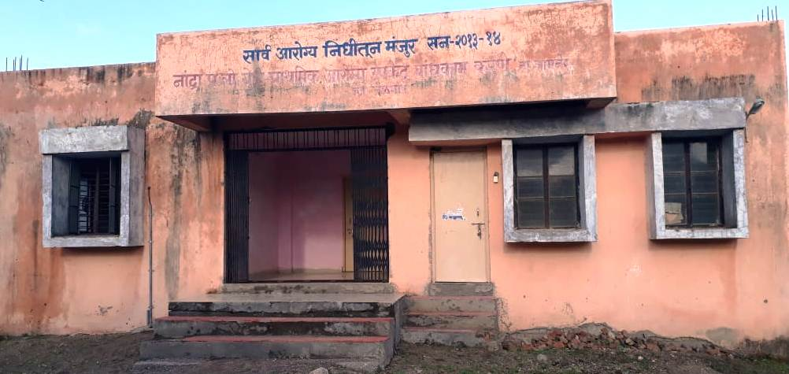
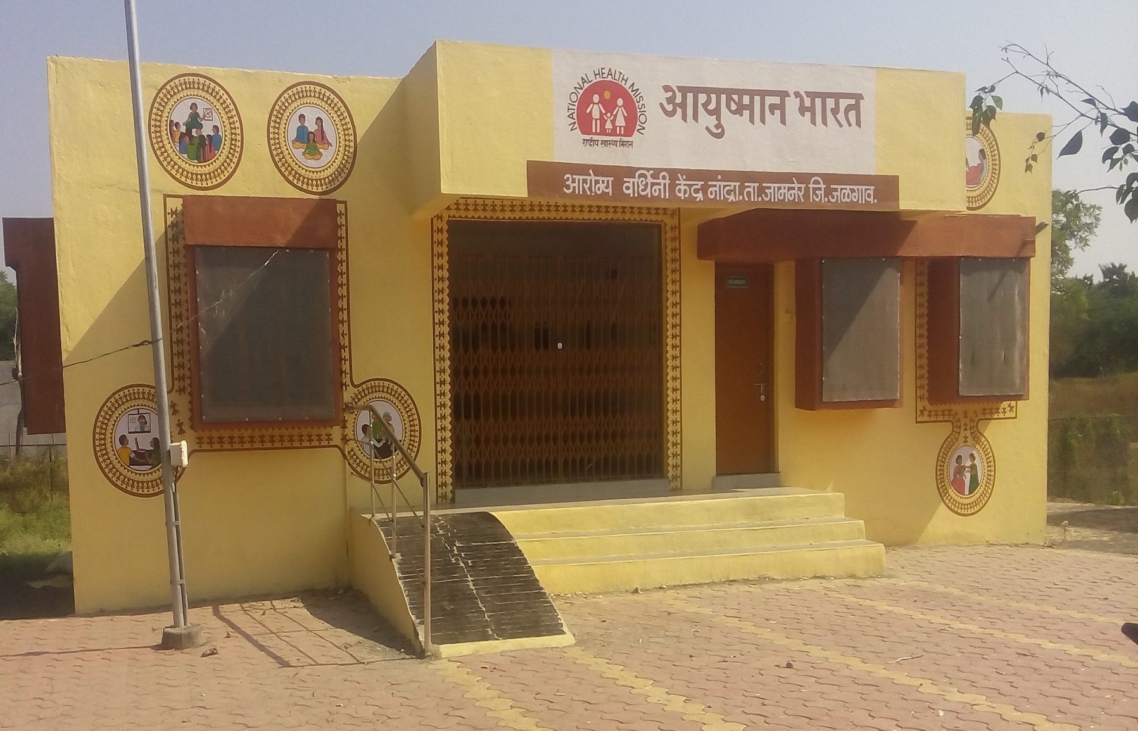
Aim is to make HWCs ready to provide CPHC
Activity conducted to maintain uniformity across all the HWCs in State.
In Maharashtra there are total 4 types of layouts for sub center, from these 3 types of model layouts prepared and pilot conducted in Jamner block of Jalgaon district.
Orientation Work shop and onsite training given to all Engineers & Architects of State to have uniform patient friendly design.
This resulted into uniform designs and patient friendly buildings, it also saved budget.
Model HWC Layout

Slide 11
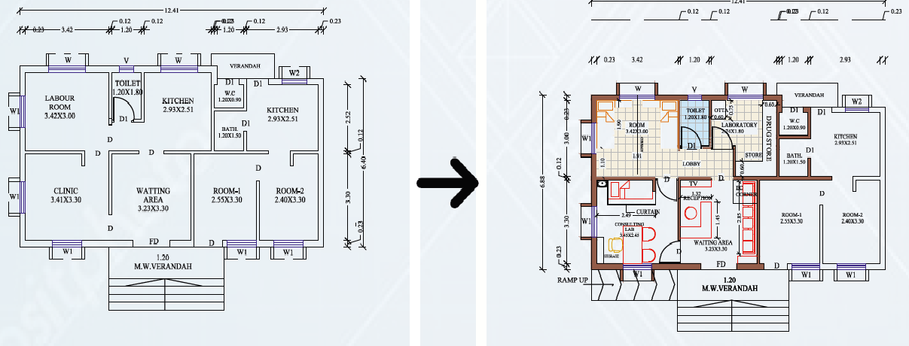
Box Type

Slide 12
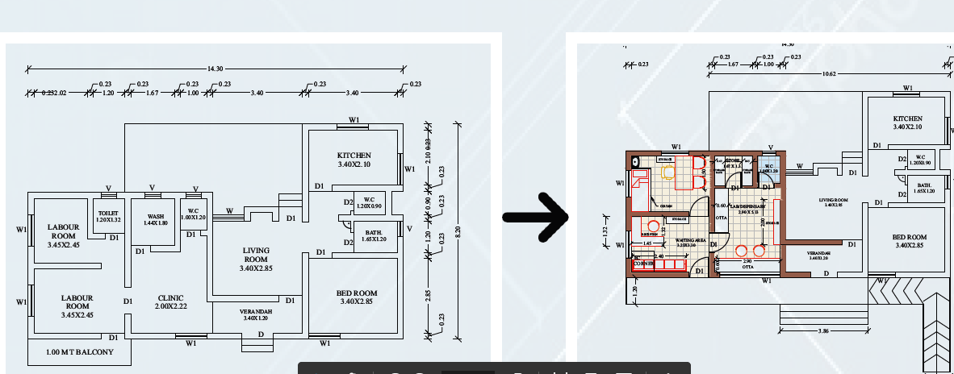
Sloping type

Slide 13
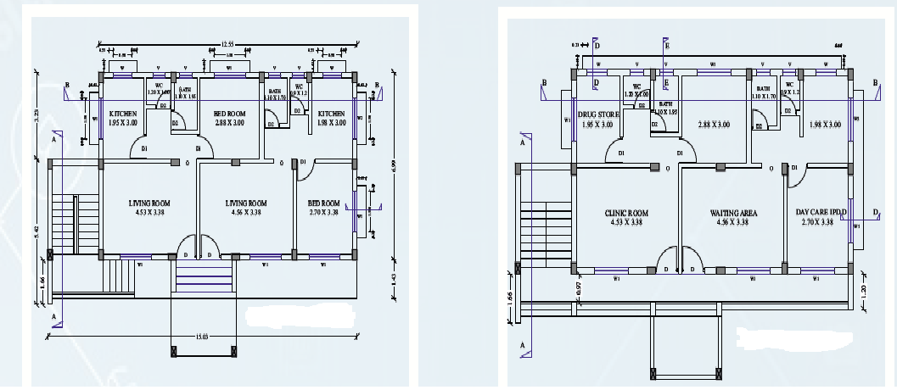
Ground plus One

Slide 14
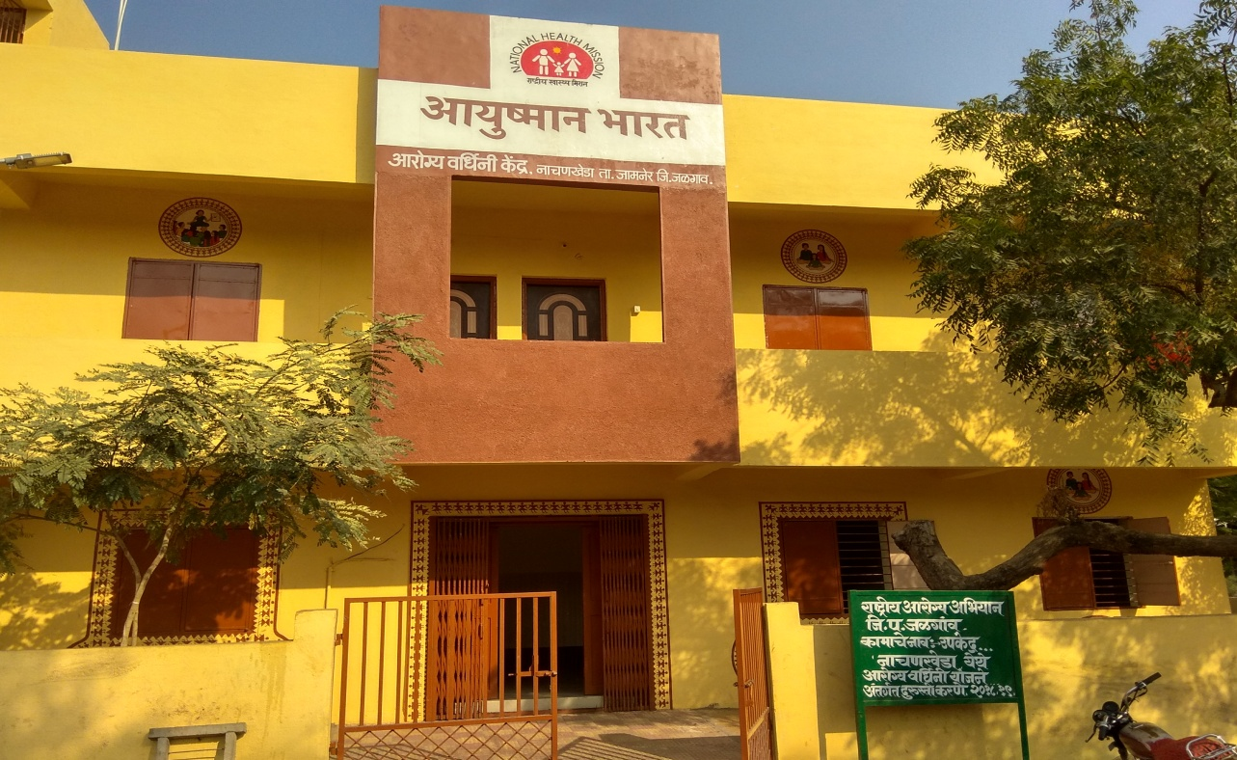
Advantages
Uniformity about coloring and signage maintained across the State for all the facilities.
Existing structures remodeled with minimal changes.
Required space for drug storage as per norm is 6.25 sq. mt. and the storage space in new plan is 10.25 sq.mt. or more.
Adherence to NQAS standard for illumination, drainage, facing of examination tables, fridge etc.
Making disability friendly as far as possible
Ensuring facilities
  Examination room with adequate privacy.
  Ease in performing diagnostic & dispensing medicine.
  Waiting area with facility fro IEC.
  Citizen charter to empower people about their rights.
  Adequate space to conduct tele-health services and other IT initiatives.

Slide 15
HWC Best practices in Maharashtra
BEST PRACTICE III: Anaemia Control-Therapeutic Management of Anaemia

Slide 16
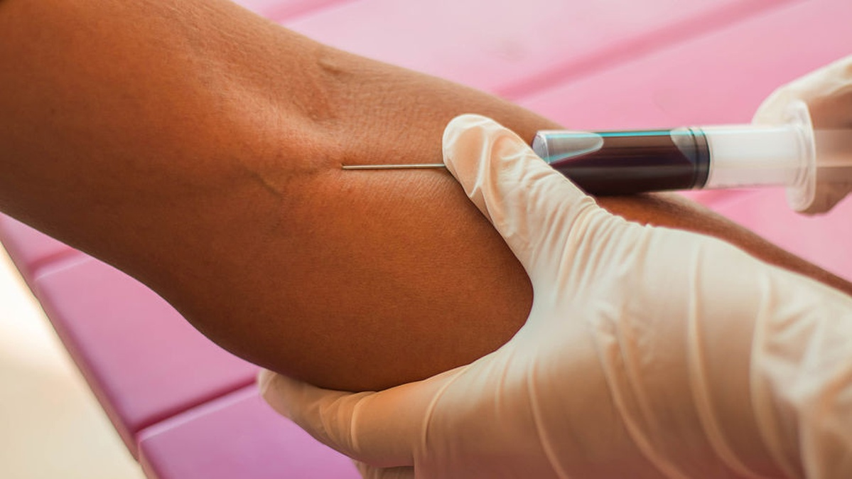
Anaemia Control-Therapeutic Management of Anaemia
Area covered is HWCs of Raigad district, 6 blocks
Population covered – 17,345 school going children in the age group of 5-16 years
Methodology adopted:
  Awareness Creation and Behavioral Change Communication
  Screenings for Haemoglobin levels amongst students between 5-16 yrs. of age were conducted by using HemoCue -Hb 201 Analyser/Emacure at schools by RBSK teams
  Students given a daily dose, as per GoI guidelines and administered by the school teachers and monitored fortnightly by Swadesh Co-ordinators to track consumption of their daily dose, to assess adherence and address adverse effects, if any

Slide 17
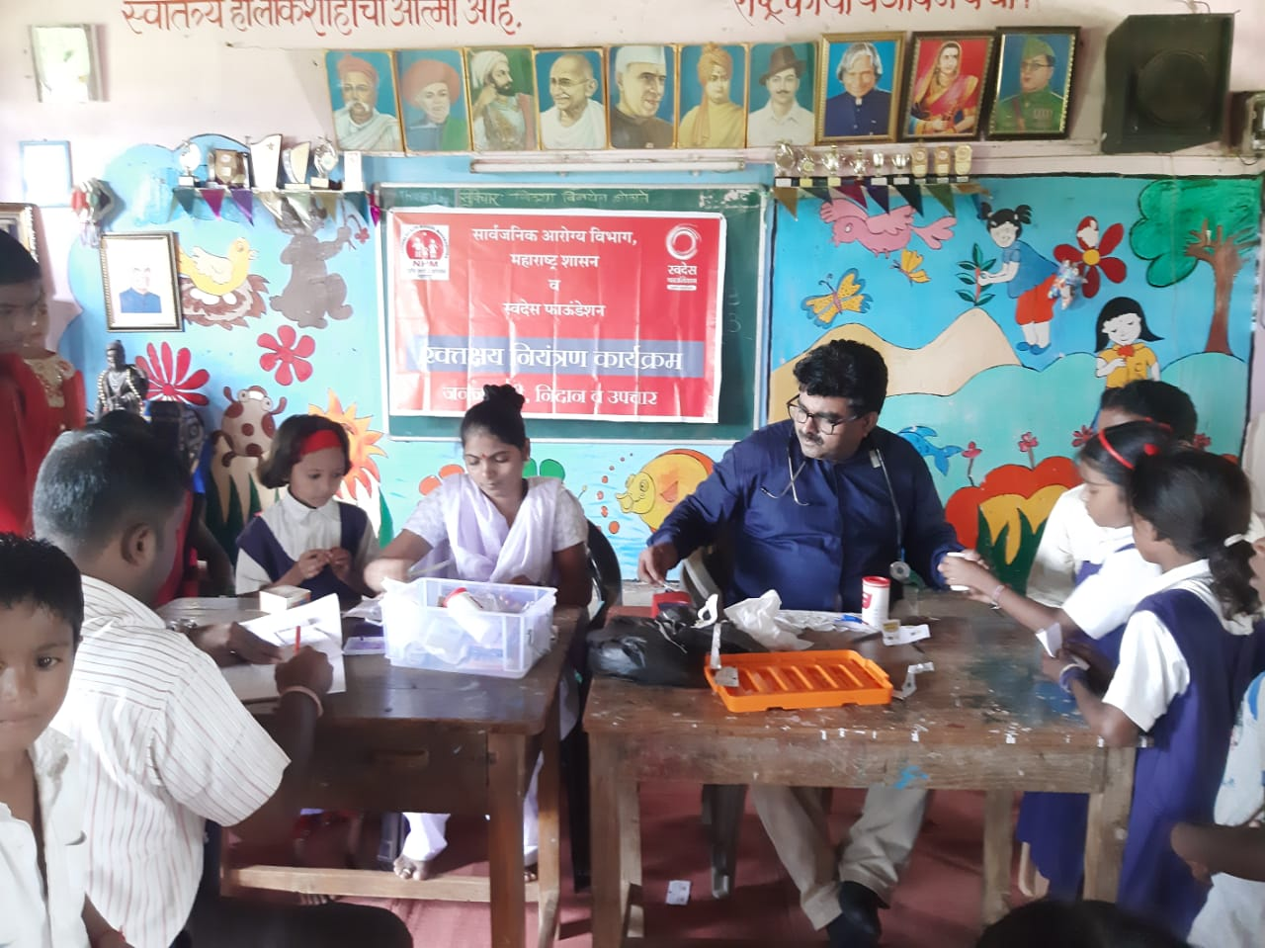
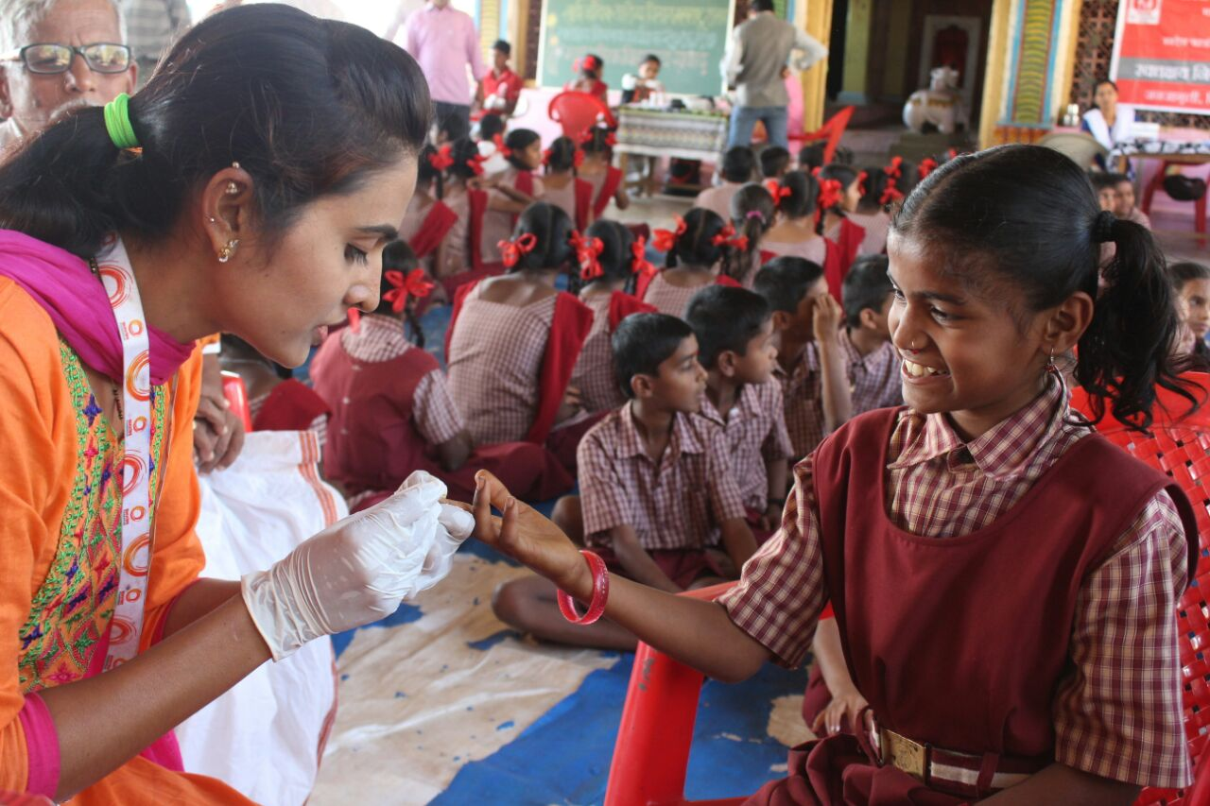
Anaemia Control: Therapeutic Management of Anaemia
Screenings for Haemoglobin levels amongst students between 5-16 yrs. of age at Schools in intervention Blocks, Raigad

Slide 18
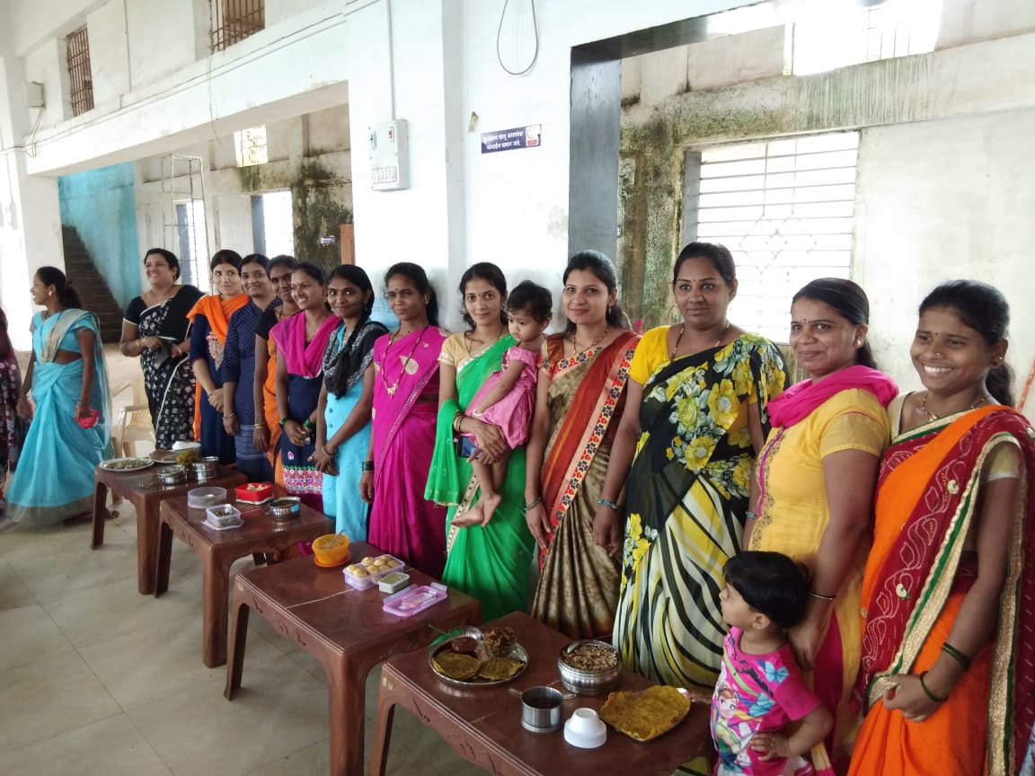
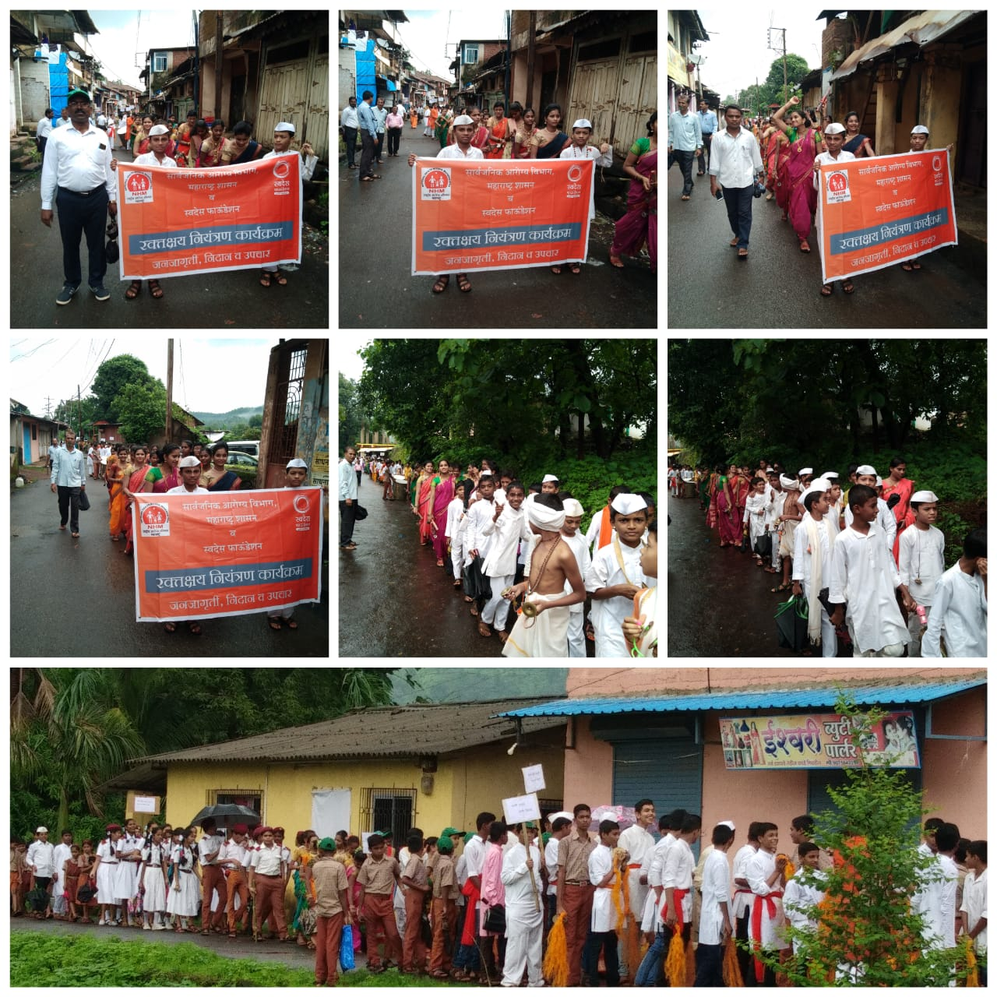
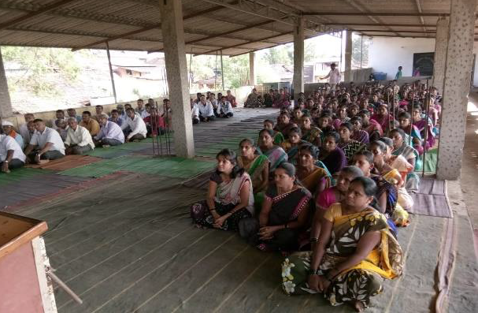
Anaemia Control: Therapeutic Management of Anaemia
Awareness on Nutrition and Cooking competition for Mothers
Awareness rallies on Anaemia, Diet and Hygiene

Slide 19

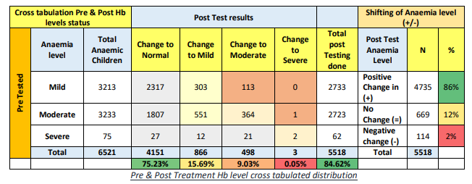
Evaluation results
Impact - Positive shifting of Haemoglobin level is reported in 5156 (93.9%) of cases
Majority of cases (88.5%) Haemoglobin level was increased by 1 to 3 gm/dl
Prevalence of Anaemia reduced by 79% (from 38% to 8%)

Slide 20
HWC Best practices in Maharashtra
BEST PRACTICE IV: Expanded range of services in HWC-PHC
a. Eye care, b. Menstrual Hygiene, c. Elderly care, d. Token System

Slide 21

After upgrading PHC as HWC, services such as Ophthalmic services, health care of elderly added to PHC with the help of Private partners.
Netradhan trust extended help to address ophthalmic problems.
MO PHC and field staff, identify persons with ophthalmic problems in OPD, HWC-SC clinics and field visit
Specialists and technicians from Netradhan Trust visit PHC once a month – 2nd Saturday.
Patients requiring surgical intervention are checked for fitness at HWC-PHC and referred to Netradan Trust Hospital for further treatment every Tuesday (4-5 patients/Tuesday)
Expanded range of services under CPHC

Slide 22
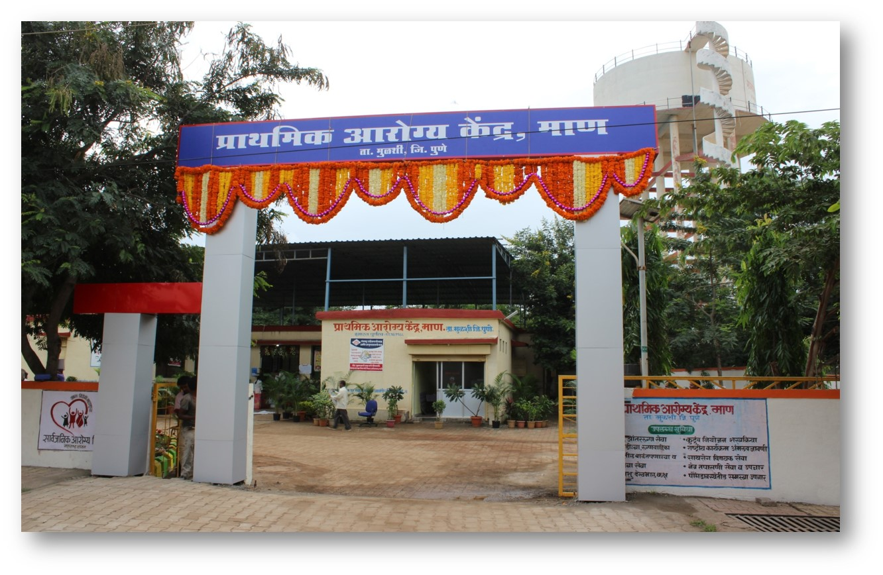
Vision Testing Corner
 | Camps | Checked Patients | Cataract Surgery | Other Surgeries
Ophthalmic checkup with the help of Pvt Sector | 4 | 1045 | 201 | 19

Slide 23
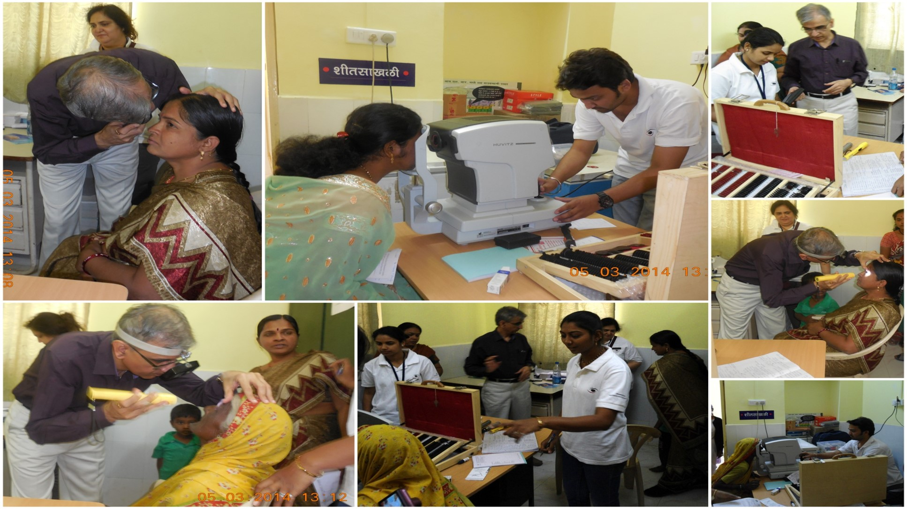

Slide 24
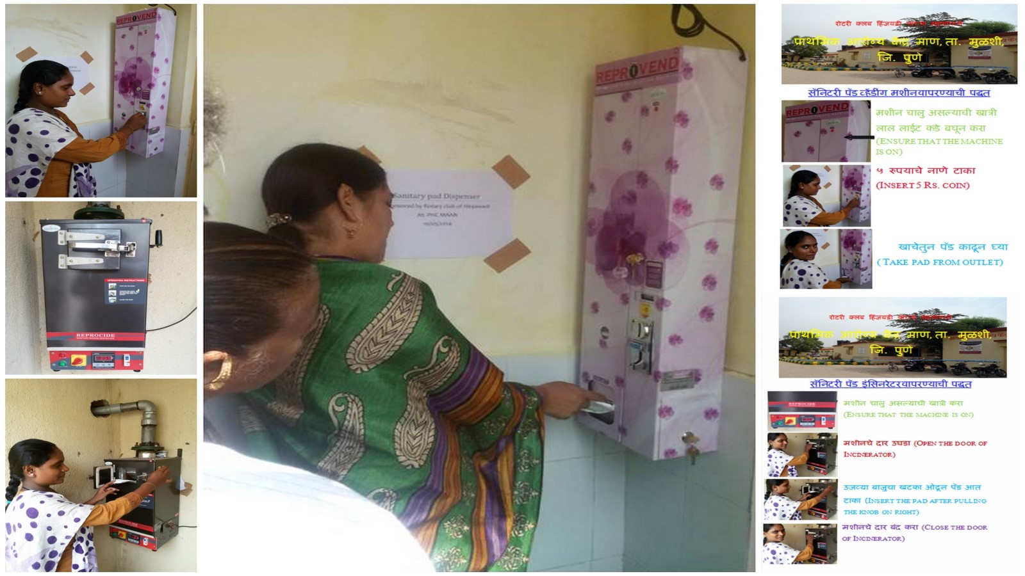
Sanitary pad dispenser and incinerator

Slide 25
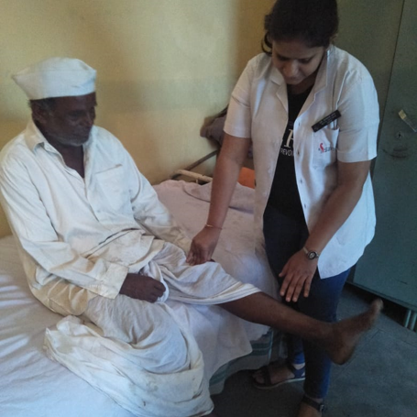
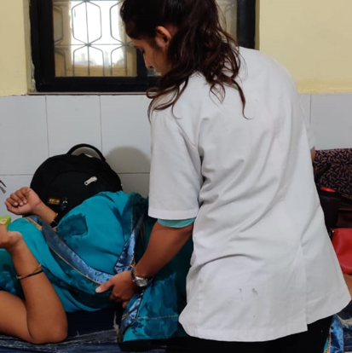
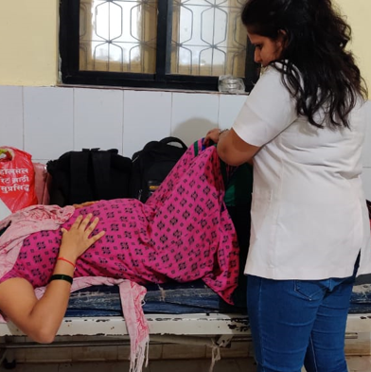
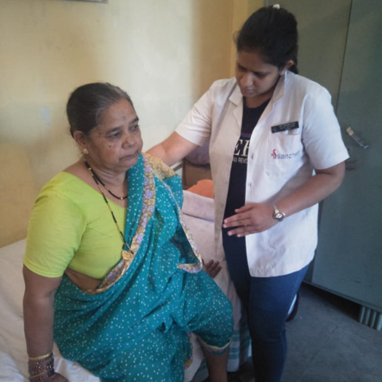
Physiotherapy services to elderly and pregnant mothers

Slide 26
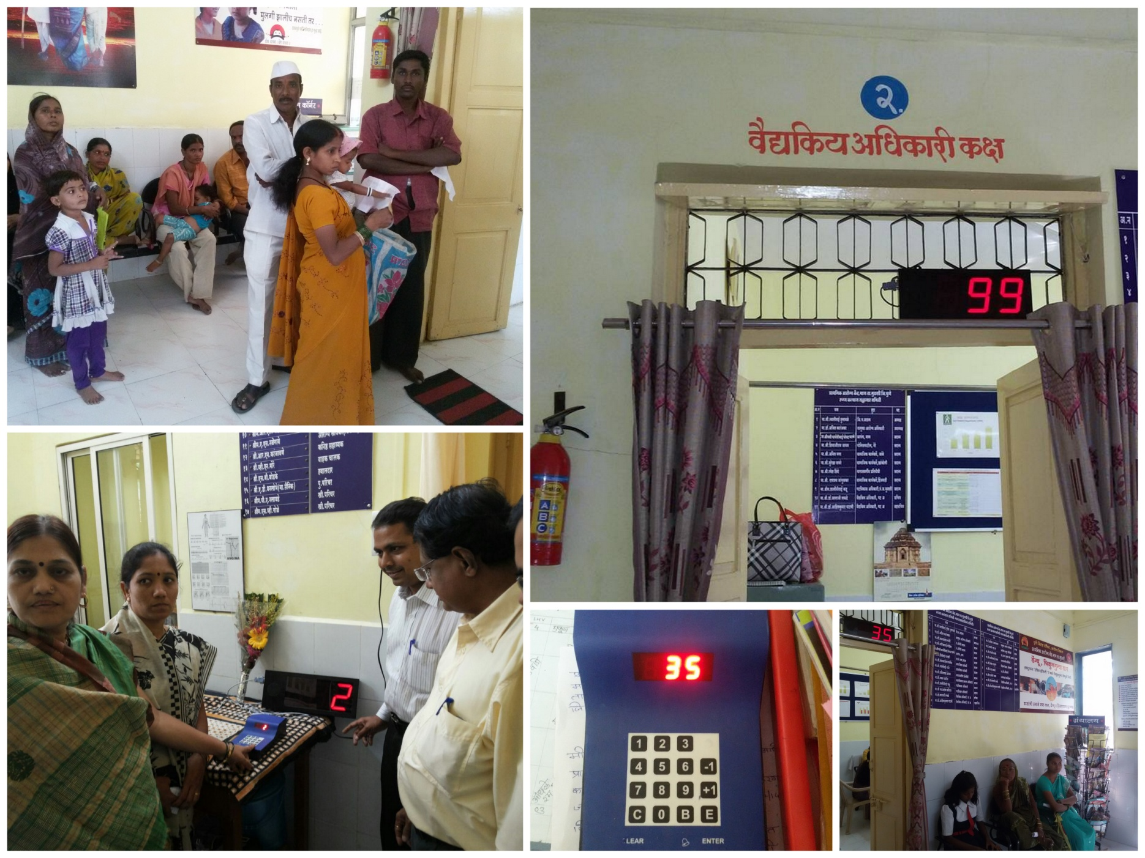


Token machine system for OPD

Slide 27
HWC Best practices in Maharashtra
BEST PRACTICE V: Healthy Parents Healthy Child Initiative: Pre-conception care for preventing maternal mortality, morbidity and adverse birth outcomes

Slide 28
Pre-conception care for preventing maternal mortality, morbidity and adverse birth outcomes
Project implemented in HWCs of Nashik and Sinnar Blocks of Nashik district.
Beneficiaries were all eligible married women in the reproductive age group of 15-49 years planning to become pregnant
Implementing Partners - NHM, Maharashtra, UNICEF and Bharati Vidyapeeth Pune
Implementation started in April 2018
Implementation strategy:
  ASHAs visit each house of the village and enrol those women who are planning pregnancies.
  Investigations; Blood group both ABO and Rh, Hb, solubility test for sickle cell anaemia, blood sugar by glucometer, HIV, VDRL, TSH
  Nutritional advice to all women with special emphasis to women with BMI <18.5 and >25
  IFA, deworming every six months
  Daily Folic acid supplementation to those planning to conceive.

Slide 29
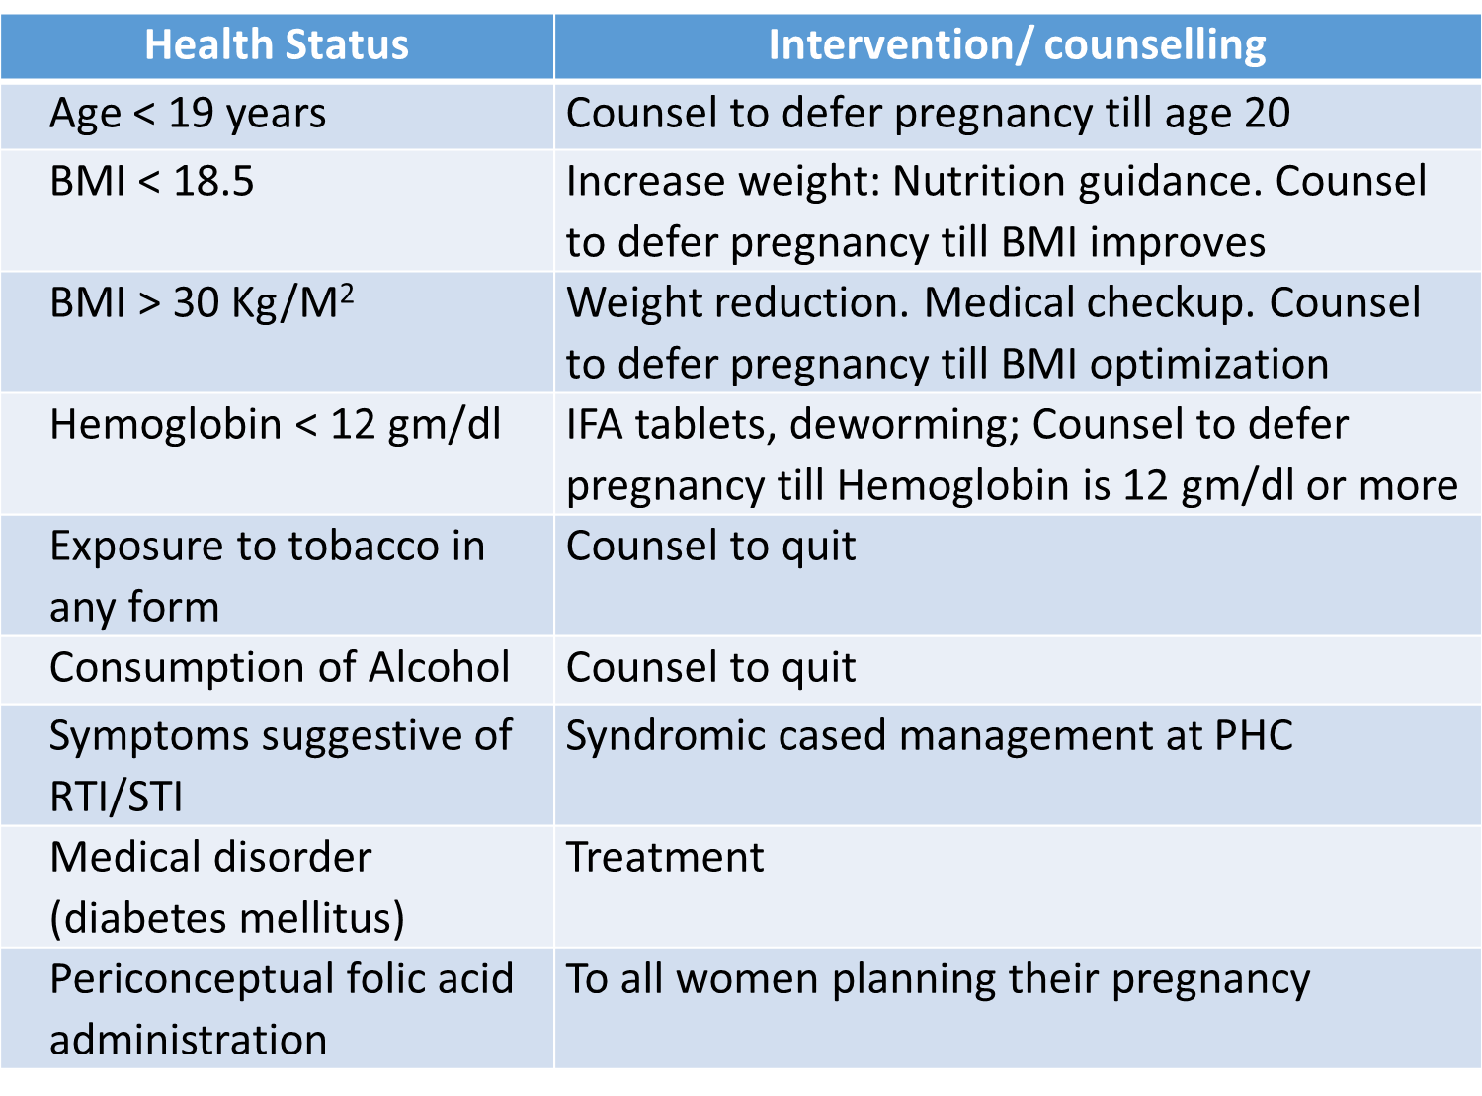
Interventions

Slide 30
Impact
  1. Improvement in BMI nine months follow ups
  Proportion of women with extremely low BMI (less than 16) reduced from 9.9% to 3.9%
  Low BMI (16.01 to 18.5 reduced from 30.8% to 21.1% (p-value < 0.001)
  2. Significant increase in Hb% at seven months follow ups.
  3. Other improvements
  Evidence of delaying first pregnancy in adolescent married women
  Treatment of RTI and chronic diseases like diabetes mellitus
  Compliance of IFA and peri-conceptual folic acid consumption.
  Reduction in tobacco use
  Reduction in alcohol consumption
  Management of Diabetes and Hypertension.

Slide 31
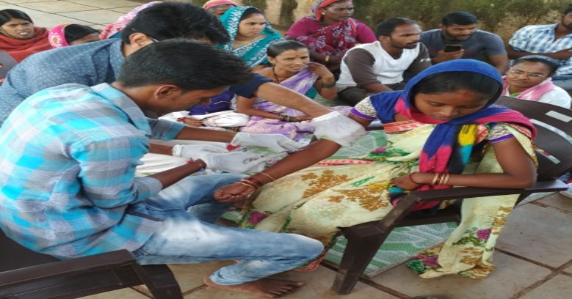
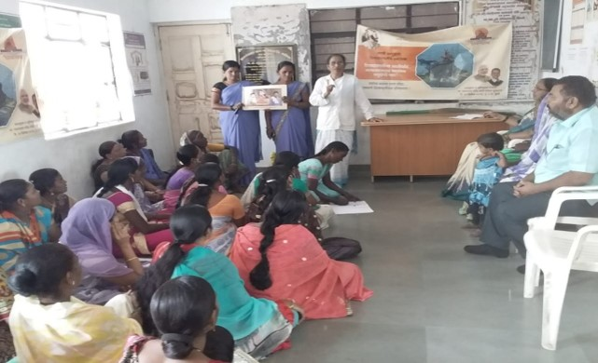
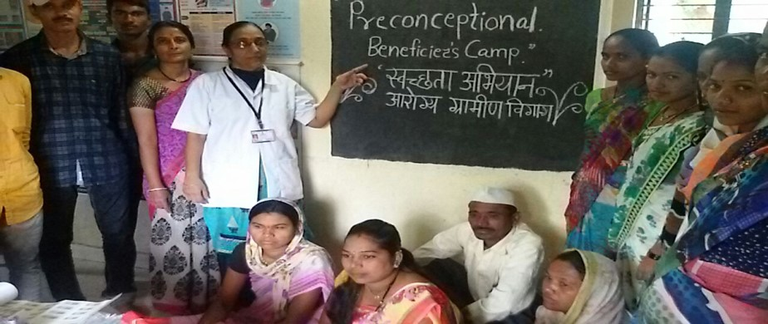
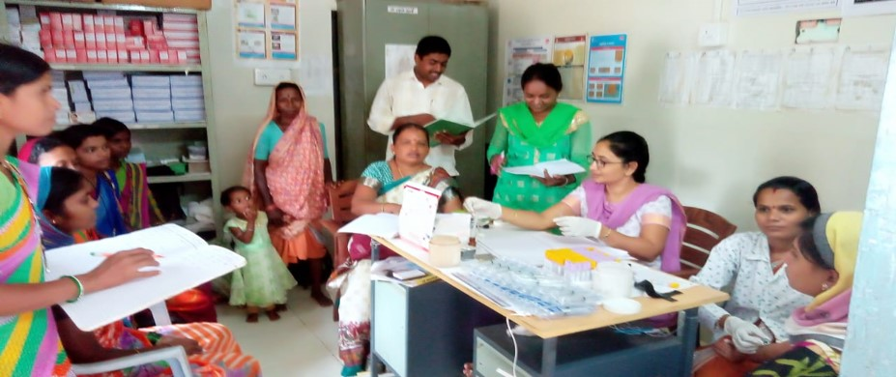
Healthy Parents Healthy Child Initiative: Pre-conception care for preventing maternal mortality, morbidity and adverse birth outcomes
Eligible women who want to conceive completed and nine month follow up of these women in two intervention blocks
Mobilization of the women to VHSNDs for health checkup, laboratory tests and treatment

Slide 32
THANK YOU

