Slide 1
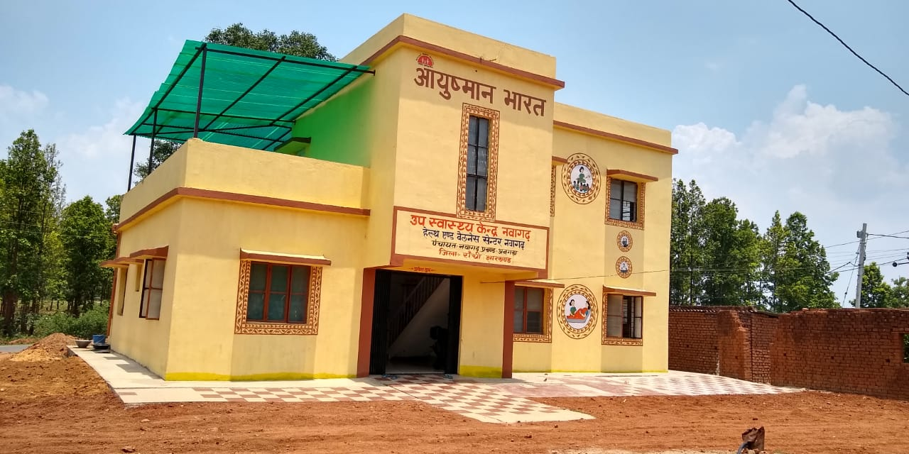





Ayushman Bharat- Health & Wellness Centre
Best Practices, Jharkhand

Slide 2
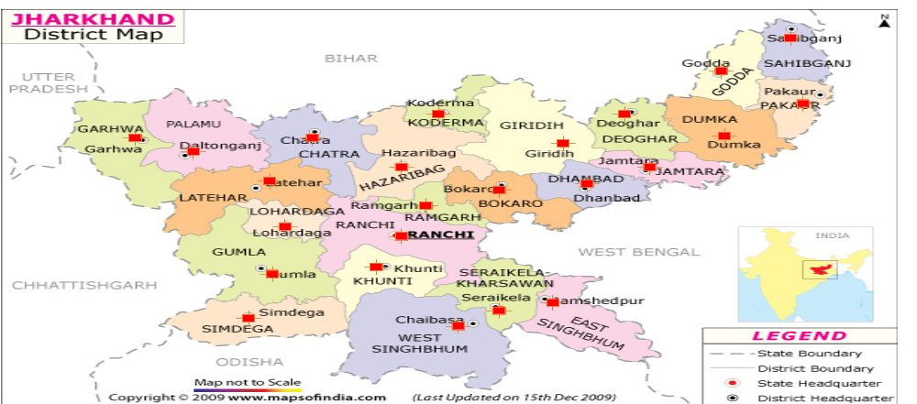
Geographical Coverage - HWC, Jharkhand
HWC
Program Study Centre

Slide 3
Annual Plan to convert all primary health care facilities into HWCs by 2022.
Financial Year | Sub Centre (3550) | PHCs (298) | UPHCs (59) | Cumulative Total
FY- 2018-19 | 711 | 33 | 32 | 776
FY-2019-2020 | 741 | 258 | 22 | 1797
FY 2020-2021 | 1092 | 7 | 5 | 2901
FY 2021-2022 | 1006 | 00 | 00 | 3907
FY 2022-2023 | May consider adding new HWCs as per IPHS guidelines.
Implementation Partner: USAID MCSP/ Jhpiego

Slide 4
Financial Approval and current status HWC for FY 2018-19 & 19-20.
Type of Facility | Target | Functional
HSC | 1452 | 203
PHC | 291 | 99
UPHC | 54 | 52
TOTAL | 1797 | 354

Slide 5
Population based NCD Screening in HWC.
Indicators | No of Person Screened
30+ population enumerated | 61593
30+ population screened for HTN | 48192
30+ population screened for Diabetes | 30700
30+ population screened for Oral Cancer | 13678
30+ women’s screened for breast cancer. | 8488
30+ women’s screened for breast cancer. | 4175
As per HWC Portal.

Slide 6
Best Practices
Issues
Innovations
Population Based NCD screening (PBS)
  NCD Trainer - No master trainers at district level for scale up in all districts
  Equipments for NCD screening- No supply of complete list of equipments and consumables by districts
  NCD Screening was opportunistic rather than population based
  NCD positive case follow up- No specific tracking/registers for positive case follow up.
Population Based NCD screening
  Created Pool of Master trainers for all districts.
  Concept of NCD Kit
  Fixed Day, Village wise, NCD screening mechanism
  Developed and implemented format for NCD positive case follow up

Slide 7
Best Practices
Issues
Innovations
Tablet Procurement with given specification- Delay in tablet procurement by districts and specification of tablet was not followed, this led to problem with NCD app use
Infrastructure upgradation layout plan- Demand from field for layout plan for converting existing HSC building to HWC to ensure key component of HWCs.
IEC and facility branding- No specific IEC packages for community awareness
District Resource Envelop (DRE)- Under utilization of HWC fund
State level procurement with required specification
Developed layout plans for existing Health Sub-Centre building
Developed IEC and facility branding package for HWCs.
Prepared and disseminated DRE with detailed guidelines on fund availability and utilization for HWC component

Slide 8
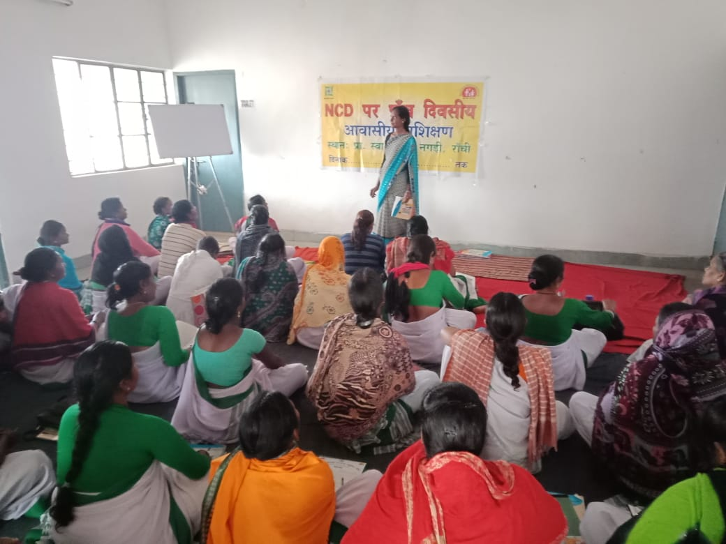
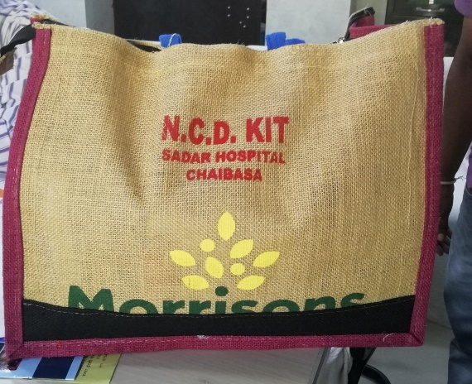
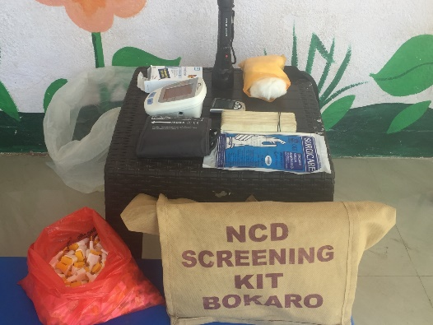
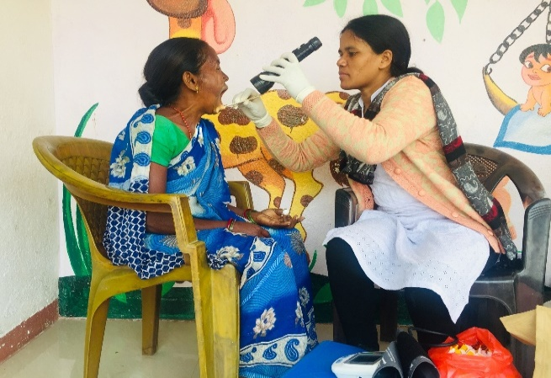
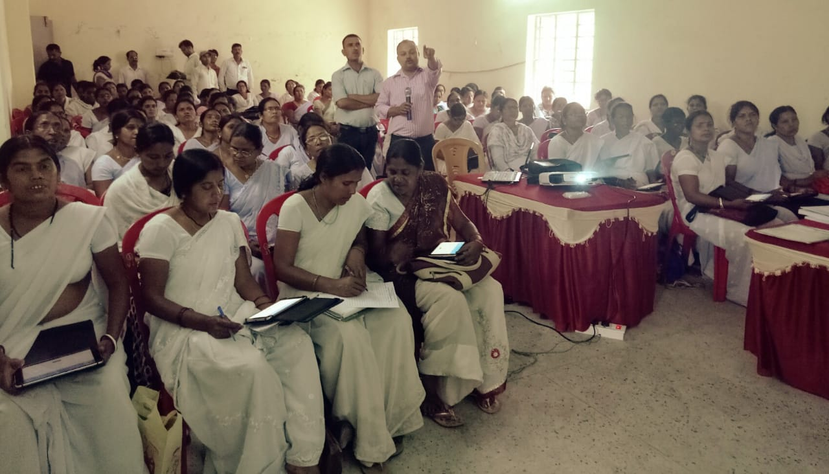
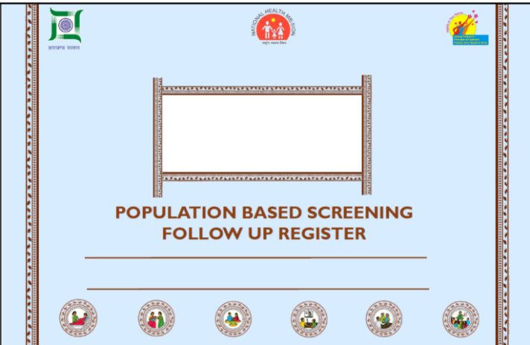
Population Based Screening
Training of HR
Provision of NCD Kits
Sustainable mechanism for PBS Screening
Form 1
National Programme on Prevention & Control of Cancer, Diabetes, CVDs & Stroke (NPCDCS)
Reporting performa for Sub Centre
Name of the Sub-centre_______________ PHC _______________ Block/ Mandal ________________ District_____________ State______________
Month____________________ Year ________________________
Part A: Hypertension and Diabetes Screening
Monthly Reporting
Use of IT Application
Follow Up

Slide 9
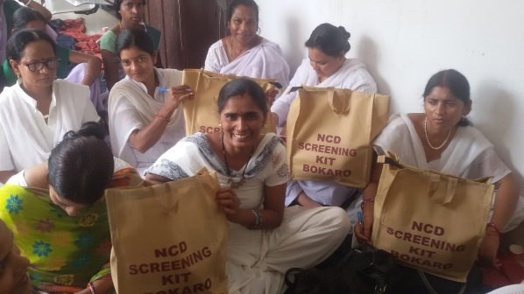
Concept of NCD Kit
  List of equipment required for NCD with simple zip bag to carry all necessary equipment to field for screening.
  Ideally it should be one per MPW, but started with 1 Kit / HSC-HWC and ensured one per MPW in one of PBS district (Bokaro).
  Makes districts to provide complete list of equipment
  Easy to carry to the village without missing any single equipment.
  Concept of NCD kit developed and implemented with support from MCSP USAID/Jhpiego

Slide 10
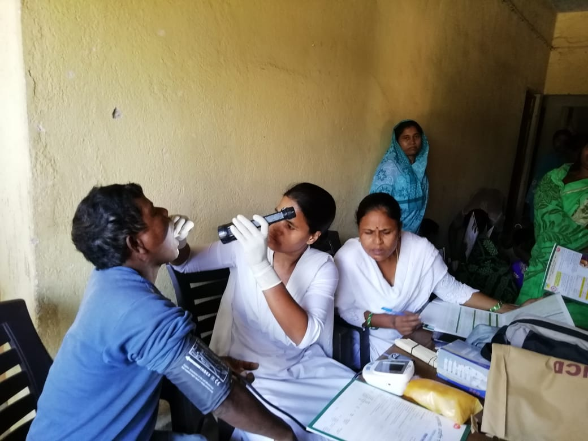
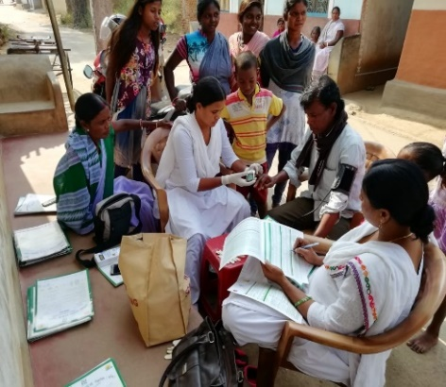
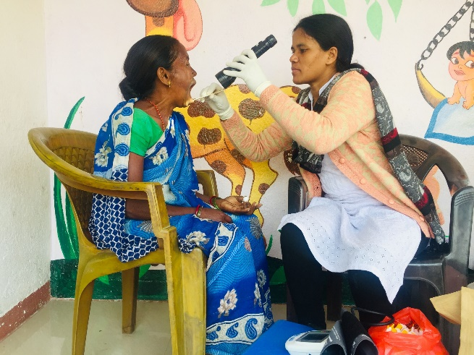
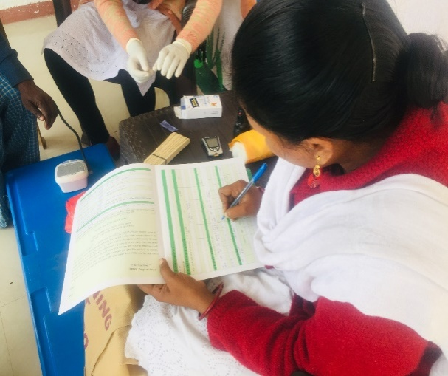
Fixed day village wise NCD screening
Mechanism-
Microplanning of fixed day village wise visit, except immunization day
MPW visit particular village with NCD kit for screening & Sahiya (ASHA) mobilize eligible population.
Advantages
It follows the principle of no individual should need to travel more than half an hour for screening.
Easy to mobilize eligible population
Sustainable approach, need less follow up at HWC level.

Slide 11
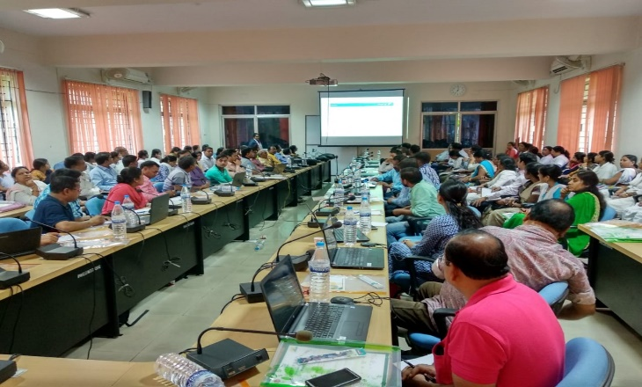
Follow up and IT equipment for NCD services
Follow up positive cases
Prepared follow up register with support from USAID MCSP/Jhpiego to track Hypertensive and Diabetic patient tracking, regular check up and drug distribution.
IT equipment for NCD app
Procurement has been done at state level in order to ensure timely supply with required specification.
Currently supplied 1 tablet / MPW in all HWCs for online data entry.
Held two batch TOT at state level for NCD app training.
Follow up Register
NCD app training

Slide 12
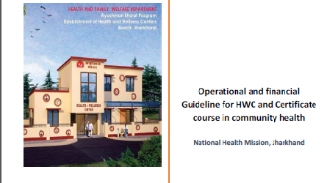
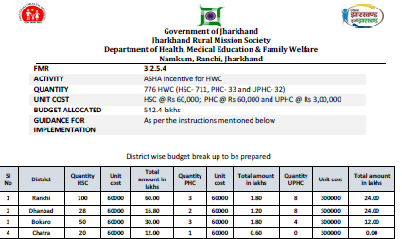
District Resource Envelop (DRE)
With support of MCSP USAID/Jhpiego DRE was Prepared and disseminated with detail guidelines on fund availability for different component of HWCs and its utilization.
Guidelines contains
  MD, NHM letter issued for HWC guidelines & utilization of fund.
  Summary sheet for fund available for various component of HWC with FMR code and list of annexure.
  Budget allocated under every FMR code includes- Budget activity, Quantity, unit cost, total budget allocated and relevant guidelines and check list.

Slide 13
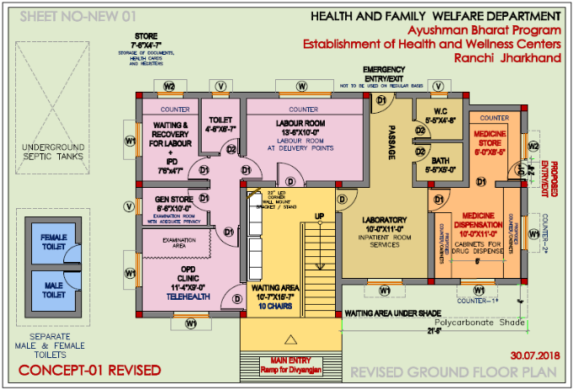
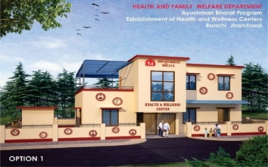
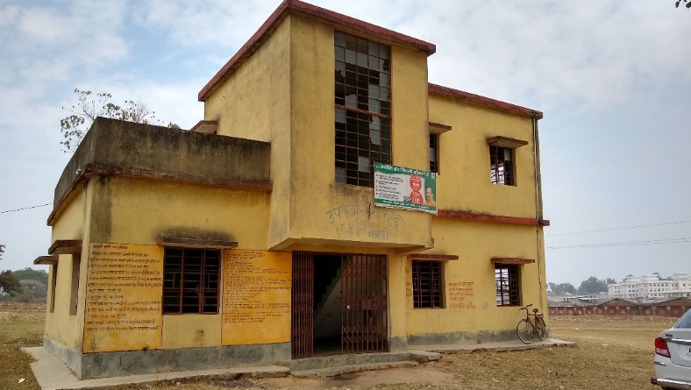
Infrastructure Layout Plan – Health Sub Centre
Existing HSC buildings have been customized as per requirements of HWCs
Gives clear image of how infrastructure should be upgraded
Infrastructure upgradation would be similar in all districts.
Is helpful in budget estimation for its upgradation.
Clarity in how to use available space as a HWC.
MCSP USAID/Jhpiego team supported in development of architectural layouts for upgradation of SHCs
Layout for HWCs
Existing building
Upgraded HWC

Slide 14


IEC and Facility Branding
Prepared IEC and facility branding package for HWCs with support from MCSP USAID/Jhpiego
Package includes IEC materials for all service delivery at HWC
Purpose is to create health awareness among community about health and service delivery at HWCs.

Slide 15
Challenges
Physical and app based reporting for NCD Screening to be streamlined;
Currently opportunistic screening being done under NPCDCS and Population Based NCD Screening through PBS districts & Operational HWC’s.
Performance based incentives not initiated - Incentive’s could be auto calculated as per entries in the portal, even the entries could be incentivized for proper & complete reporting
The Civil works are time consuming & the amount approved for renovation is insufficient- For quicker compliance, prefabricated structures could be a better short term option.
With the increasing number of HWC’s, HWC State/District level consultants are dire necessity
Detail Issues

Slide 16
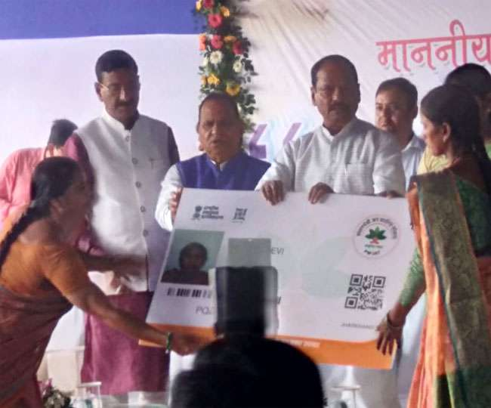
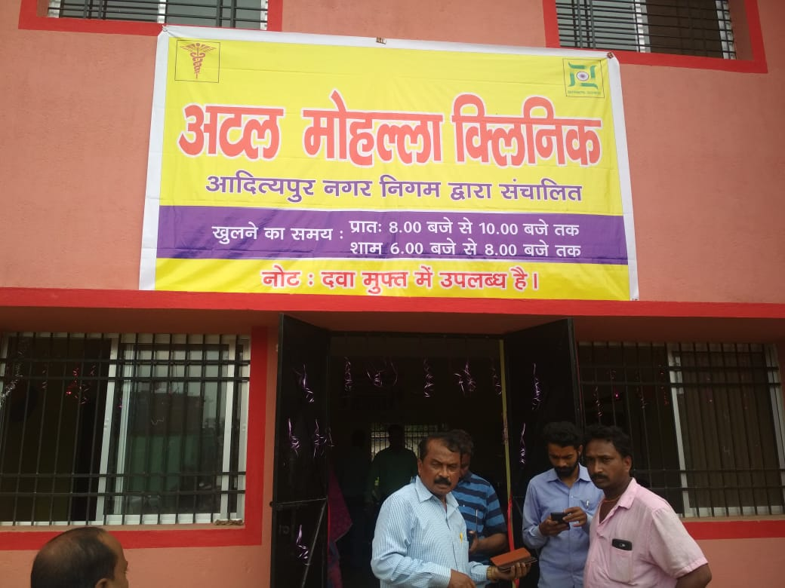
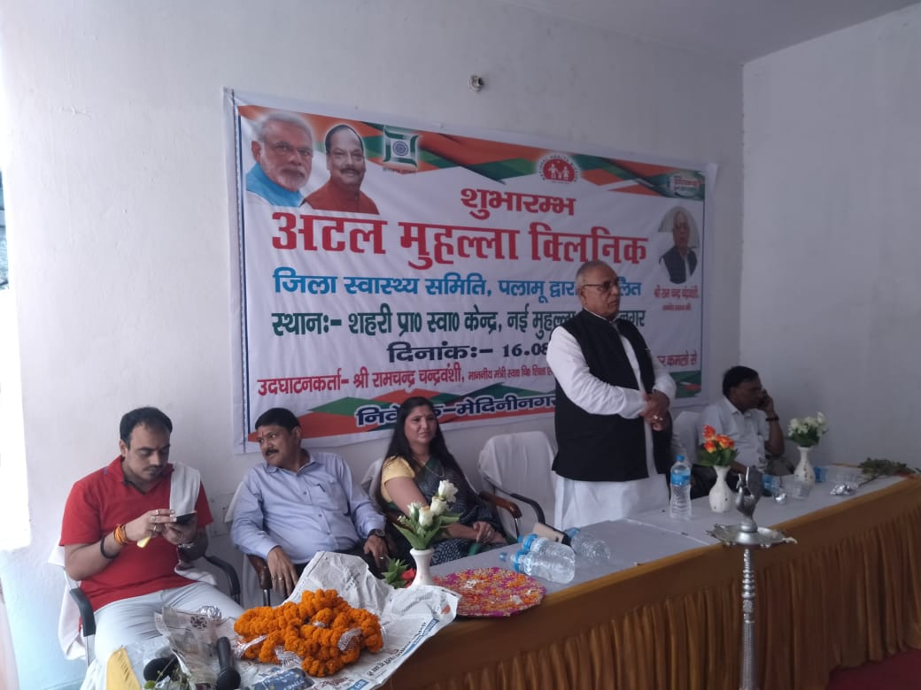
झारखंड में शुरू हुआ “अटल क्लिनिक”, CM रघुवर दास ने रांची के मलिन बस्तियों को दी सौगात
State Urban Initiative – “Atal Clinic” , where NCD Screening Services apart from other Health Services to be imparted to Slum Dwellers, inaugurated by Hon. CM on 16-08-2017

Slide 17
Way Forward
Upgrading all primary health care centres (HSC, PHC & UPHCs) into HWC as per state Road map
Formation of state level CPHC cell with dedicated consultants
Ensuring regular supply of drugs and diagnostics as per CPHC Guidelines
Capability building of CHOs and MPW workers to ensure quality service.(eg. Induction training and Multiskilling training)
Extending Teleconsultation service to HSC-HWC by connecting with medical colleges as a Hub

Slide 18
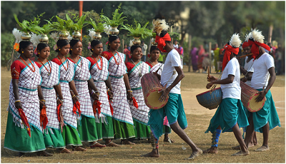
Thanks
THANK YOU

