Slide 1
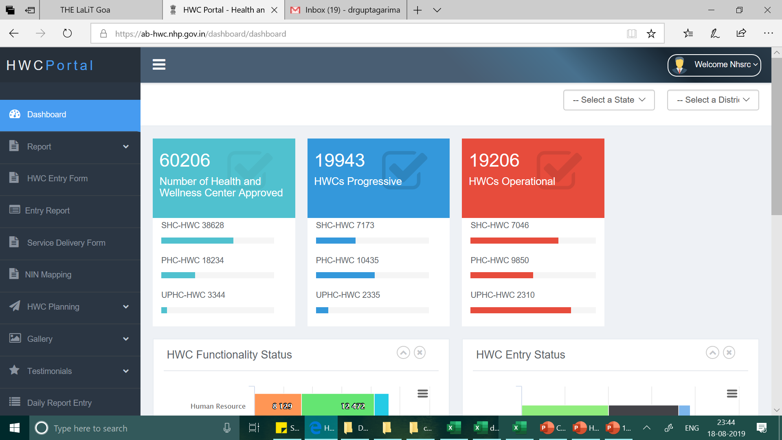
HWC Portal (https://ab-hwc.nhp.gov.in/)
Key Features
Facility wise information on all functionality criteria
Daily Reporting on service utilization
Monthly Servicer Delivery Reporting Format
HWC and CPCH planning sheet
NIN and RCH Code mapping
HWC – CHO / MO Directory
Platform to upload photos, videos and testimonials

Slide 2
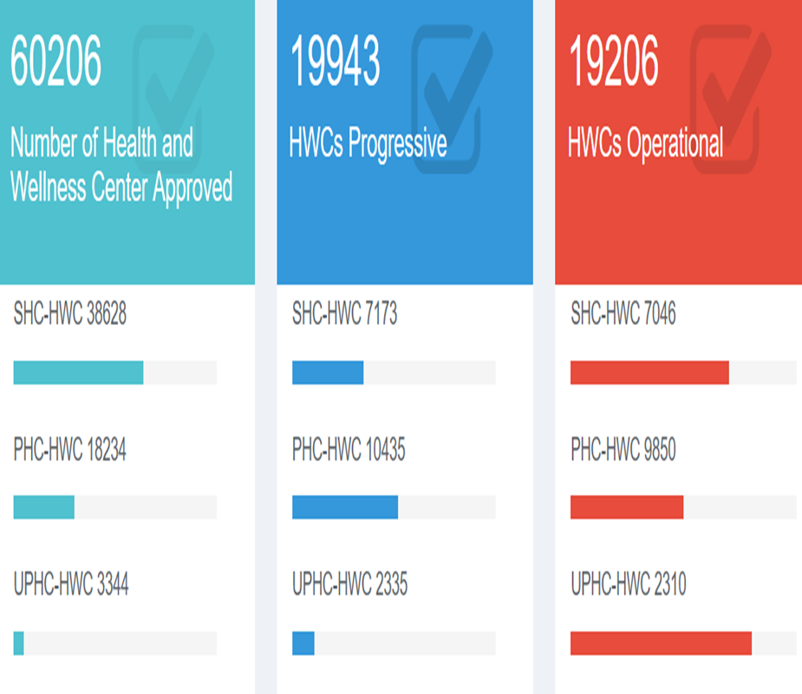
Functionality Criteria
Criteria for SHC-HWC:
CHO in position+
Training on NCD completed for MPW(F) and ASHA+
Diagnostics available +
Medicines available+
Branding completed + Screening of NCDs- Hypertension + Diabetes+ Oral Cancer + Breast Cancer started
Criteria for PHC-HWC & UPHC- HWC:
MBBS MO in position +
Training on NCD completed for MO or Staff Nurse+
Diagnostics available +
Medicines available +
Branding completed +
Screening of NCDs- Hypertension + Diabetes + Oral Cancer + Breast Cancer started
Criteria for SHC-HWC:
CHO in position +
Training on NCD completed for MPW(F) and ASHA + Diagnostics available +
Medicines available +
Branding completed if the facility is in Government Building
Criteria for PHC-HWC & UPHC- HWC:
MBBS MO in position +
Training on NCD completed for MO or Staff Nurse +
Diagnostics available +
Medicines available +
Branding completed if the facility is in Government Building

Slide 3






HWC portal data entry status
AYUSHMAN BHARAT-HEALTH AND WELLNESS CENTRES

Slide 4
HWC portal data entry status
Service delivery reporting status
April – July, 2019
State Name | HWC | April, 2019 | % | May, 2019 | % | June, 2019 | % | July, 2019 | %
Bihar | 599 | 252 | 42 | 161 | 27 | 182 | 30 | 50 | 8
Dadra & Nagar Haveli | 31 | 18 | 58 | 19 | 61 | 24 | 77 | 21 | 68
Daman & Diu | 23 | 23 | 100 | 23 | 100 | 23 | 100 | 6 | 26
Goa | 28 | 9 | 32 | 8 | 29 | 9 | 32 | 0 | 0
Gujarat | 1602 | 1343 | 84 | 1335 | 83 | 1362 | 85 | 1282 | 80
Jharkhand | 363 | 249 | 69 | 221 | 61 | 200 | 55 | 86 | 24
Maharashtra | 2669 | 723 | 27 | 603 | 23 | 513 | 19 | 232 | 9
Uttar Pradesh | 2119 | 1557 | 73 | 1454 | 69 | 1607 | 76 | 417 | 20
Total (All Sates) | 19943 | 11780 | 59 | 10803 | 54 | 10576 | 53 | 5074 | 25
AYUSHMAN BHARAT-HEALTH AND WELLNESS CENTRES

Slide 5
Use of IT application
 | Operational HWCs | Use of IT app as per HWC Portal
Bihar | 599 | 100 (17%)
Dadra & Nagar Haveli | 31 | 0
Daman & Diu | 23 | 0
Goa | 28 | 31
Gujarat | 1602 | 173 (11%)
Jharkhand | 363 | 399
Maharashtra | 2669 | 921 (35%)
Uttar Pradesh | 2119 | 439 (21%)
Total (All Sates) | 19943 | 10290 (52%)
AYUSHMAN BHARAT-HEALTH AND WELLNESS CENTRES

Slide 6
NCD Screening status as per AB- HWC Portal
 | State Name | Bihar | DNH | D&D | Goa | Gujarat | Jharkhand | Maharashtra | UP | Total (All states)
Community Outreach | Individuals Empaneled | 53542 | 19130 | 14275 | 3083 | 2566381 | 21131 | 6255530 | 1980721 | 2,43,01,255
 | CBAC Filled | 34407 | 19130 | 313 | 6943 | 924163 | 56311 | 2821784 | 594767 | 1,59,89,930
Hypertension | Screening | 23985 | 6893 | 17003 | 2230 | 663553 | 43374 | 1161929 | 573911 | 1,54,40,445
 | Newly diagnosed | 3820 | 227 | 761 | 219 | 38963 | 6861 | 59820 | 80732 | 1279294
 | On Treatment | 3481 | 237 | 2897 | 511 | 65666 | 6563 | 68504 | 64795 | 7058852
Diabetes | Screening | 14756 | 6095 | 16292 | 2233 | 1877593 | 27855 | 1075558 | 425101 | 1,44,56,811
 | Newly diagnosed | 2035 | 186 | 520 | 214 | 39857 | 4142 | 39293 | 53658 | 1572479
 | On Treatment | 1954 | 188 | 2340 | 462 | 51634 | 4374 | 62959 | 40411 | 31,27,345
Oral Cancer | Screening | 4937 | 5852 | 14588 | 2158 | 408329 | 12291 | 956339 | 193620 | 76,80,756
 | Newly diagnosed | 17 | 4 | 0 | 7 | 1334 | 81 | 3250 | 3499 | 15128
 | On Treatment | 5 | 4 | 2 | 0 | 1202 | 10 | 755 | 1957 | 10218
Breast Cancer | Screening | 2667 | 3552 | 6426 | 1103 | 206997 | 7559 | 409168 | 52537 | 52,93,008
 | Newly diagnosed | 0 | 0 | 1 | 0 | 472 | 70 | 1358 | 3244 | 20408
 | On Treatment | 1 | 0 | 1 | 1 | 344 | 3 | 1068 | 1304 | 9742
Cervical Cancer | Screening | 2567 | 3221 | 3375 | 724 | 171271 | 3943 | 222867 | 25416 | 37,30,142
 | Newly diagnosed | 4 | 0 | 0 | 0 | 655 | 28 | 700 | 1461 | 17785
 | On Treatment | 2 | 0 | 38 | 0 | 302 | 5 | 452 | 544 | 10075
AYUSHMAN BHARAT-HEALTH AND WELLNESS CENTRES

Slide 7
NCD Screening status as per NCD Dashboard – Total
PBS + HWC |  | Bihar | DNH | D&D | Goa | Gujarat | Jharkhand | Maharashtra | UP | Total (All states)
 | Enrollment | 15987 | 1 | 5 | 9519 | 39518942 | 37987 | 161972 | 753751 | 6,09,57,480
 | Over 30 | 10982 | 1 | 5 | 6912 | 581980 | 34705 | 155569 | 356706 | 1,55,43,701
Hypertension | Screening | 1001 | 0 | 0 | 4078 | 339222 | 4611 | 86246 | 29911 | 1,00,65,287
 | Diagnosed | 0 | 0 | 0 | 17 | 0 | 1 | 859 | 11 | 3,91,989
Diabetes | Screening | 955 | 0 | 0 | 4052 | 337567 | 4540 | 84734 | 26868 | 94,48,473
 | Diagnosed | 0 | 0 | 0 | 16 | 0 | 3 | 363 | 5 | 1,58,192
Oral Cancer | Screening | 871 | 0 | 0 | 3313 | 338581 | 4292 | 82552 | 28681 | 90,99,482
 | Diagnosed | 0 | 0 | 0 | 0 | 11 | 0 | 0 | 0 | 145
Breast Cancer | Screening | 392 | 0 | 0 | 1822 | 178809 | 2487 | 42151 | 10839 | 49,38,577
 | Diagnosed | 0 | 0 | 0 | 0 | 2 | 0 | 0 | 0 | 63
Cervical Cancer | Screening | 92 | 0 | 0 | 664 | 177534 | 528 | 26679 | 3751 | 29,93,896
 | Diagnosed | 0 | 0 | 0 | 0 | 9 | 0 | 0 | 0 | 87
AYUSHMAN BHARAT-HEALTH AND WELLNESS CENTRES

Slide 8
NCD Screening status from HWCs as per NCD Dashboard
HWC |  | Bihar | Goa | Maharashtra | UP | Total (All states)
 | Enrollment | 2318 | 7412 | 94468 | 110093 | 23,90,221
 | Over 30 | 1239 | 5105 | 89778 | 79964 | 19,08,006
Hypertension | Screening | 246 | 3399 | 41963 | 17752 | 8,30,065
 | Diagnosed | 0 | 7 | 558 | 7 | 13,819
Diabetes | Screening | 234 | 3396 | 41513 | 14880 | 8,22,278
 | Diagnosed | 0 | 4 | 262 | 5 | 8097
Oral Cancer | Screening | 236 | 2831 | 39587 | 16725 | 8,15,630
 | Diagnosed | 0 | 0 | 0 | 0 | 5
Breast Cancer | Screening | 108 | 1522 | 20046 | 5194 | 4,19,328
 | Diagnosed | 0 | 0 | 0 | 0 | 2
Cervical Cancer | Screening | 10 | 584 | 12442 | 1664 | 1,90,838
 | Diagnosed | 0 | 0 | 0 | 0 | 12
AYUSHMAN BHARAT-HEALTH AND WELLNESS CENTRES

Slide 9
Daily Reporting Status

Slide 10
28%
20%

Slide 11
82%

Slide 12
Jharkhand - 363
Maharashtra -2669
4%
8.2%

Slide 13
9%

Slide 14
Key issues
About 50% verification of data done by state nodal teams – affects quality of data entered
No regular updation of HWC – suggestive frequency was quarterly
Slow pace of data entry

Slide 15
Next phase
Integration with NCD- CPHC IT application for –
Sharing of daily service utilization data (for estimation of Performance Linked Payments for HWCs)
Pulling data for NCD screening
Create Hierarchy of SHC and PHCs for planning of strengthening Primary health care units

