Slide 1






AYUSHMAN BHARAT
Health and Wellness Centres,
UT Administration of
Daman & Diu
and
Dadra & Nagar Haveli

Slide 2
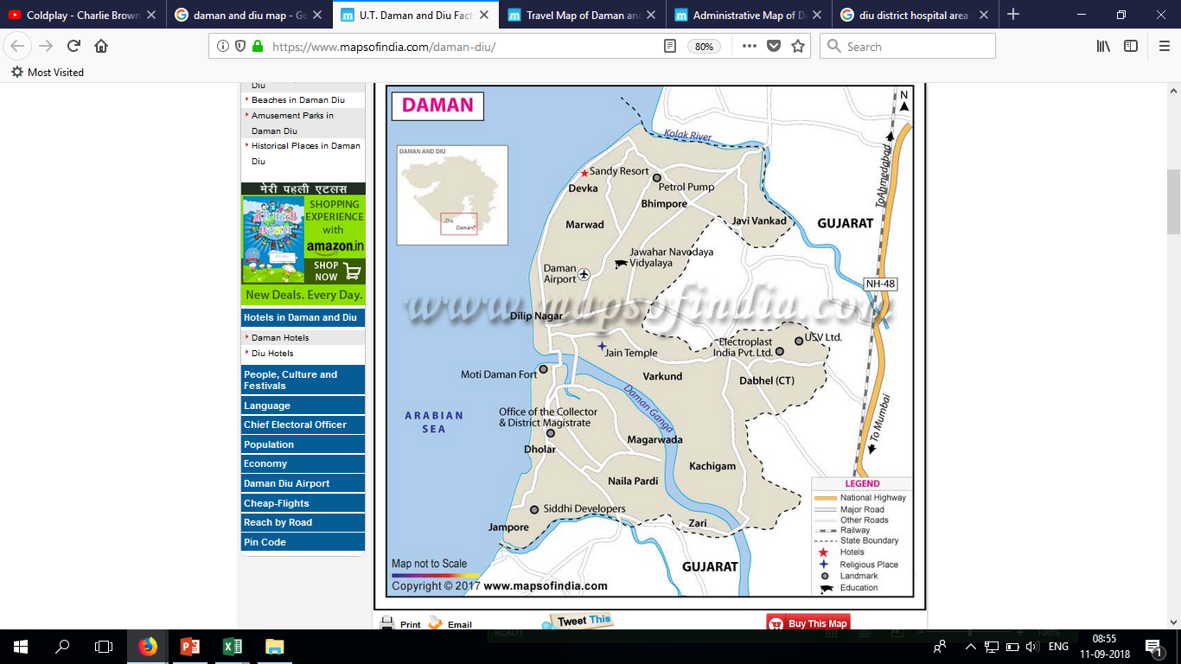
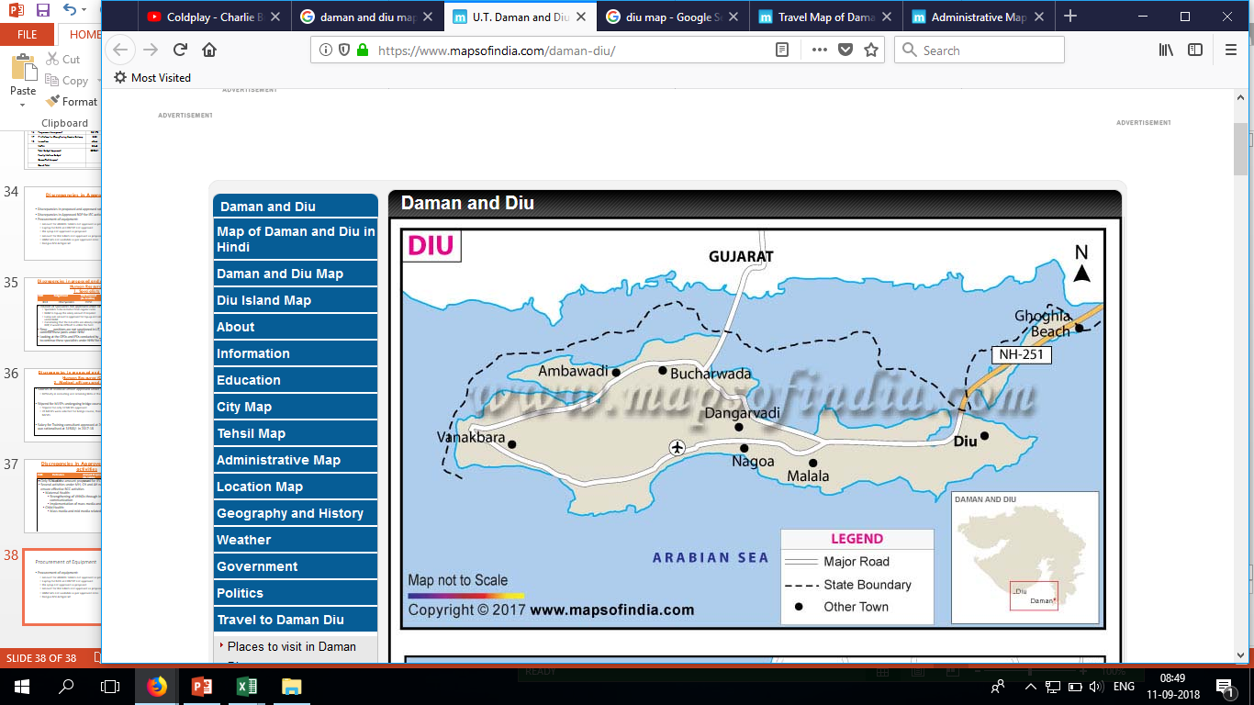
UT of Daman and Diu
Daman and Diu, a union territory in West India, consists of two districts, namely Daman and Diu with a total area of 112 sq kms. Diu is a small island and a mainland village. The districts are about 700 kms apart.
P PHC
CHC
DH
P PHC
CHC
DH

Slide 3
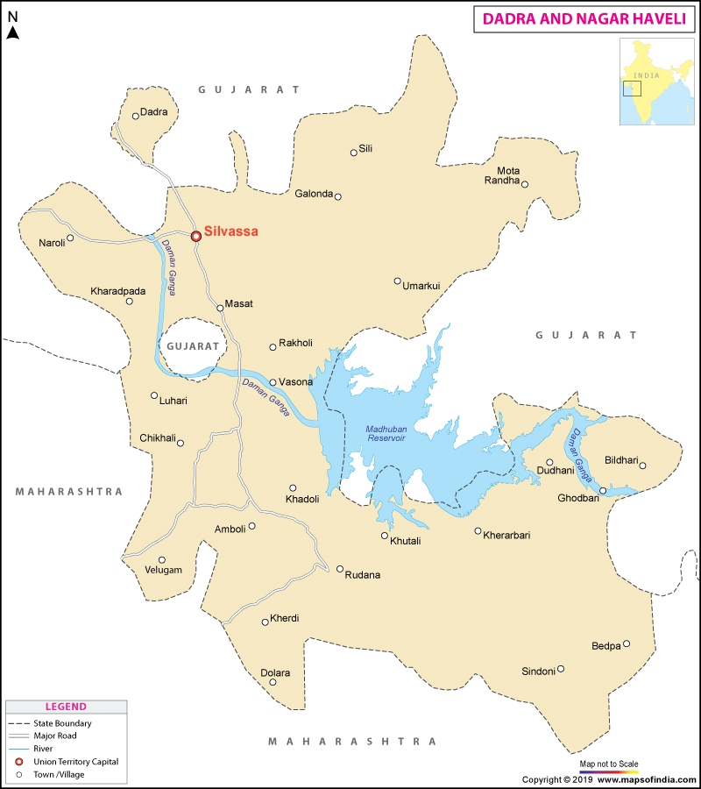
UT of Dadra and Nagar Haveli
Dadra and Nagar Haveli is a UT in Western India. It has 2 separate geographical entities namely the smaller enclave of Dadra surrounded by Gujarat and Nagar Haveli wedged between Maharashtra and Gujarat with a total 491sq km area.

Slide 4
Existing - Health Infrastructure
 | Daman | Diu | DNH
District Hospital | 1 (176 beds) | 1 (60 beds) | 1 (316)
SDH | - | - | 1 (100)
CHC | 1 (45 beds) | 1(30 beds) | 2 (60)
PHC | 3 (32) | 1 (6) | 9 (153)
UPHC (Collocated) | 1 | - | 2
Health & Wellness Centres | 20 | 6 | 52 HWC (71 SC)
AYUSH Unit | 3 | 3 | 1
Blood Bank (with BCSU) | 1 | 1 | 1
MMU | 1 | - | 4

Slide 5
Health and Wellness centres, UT of Daman and Diu
All the Primary Health centres and subcentres in the UT of Daman and Diu are being operationalised as Health and wellness centres.
A total of 20 Mid level service providers are posted in the respective HWCs in the year 2018-19. (14 at Daman and 6 at Diu districts)
6 MLSPS (For the remaining subcentres) are undergoing Bridge course under IGNOU at Dadra and Nagar Haveli

Slide 6
Health and Wellness centres, UT of Dadra & Nagar Haveli
24 subcentres in the UT of DNH are being operationalised as Health and wellness centres.
A total of 23 Mid level service providers are posted in the respective HWCs in the year 2018-19.
28 MLSPS (For the remaining subcentres) are undergoing Bridge course under IGNOU at Dadra and Nagar Haveli

Slide 7
Health Facilities for up gradation to HWCs
Sr. No. | Year | PHCs upgraded into HWCs | Sub Health Centres upgraded in to HWCs DD | Total Eligible Facilities in DD
1 | 2018-19 | 4 | 20 | 26
2 | 2019-20 | - | 6
3 | Total | 4 | 26
Sr. No. | Year | PHCs upgraded into HWCs | Sub Health Centres upgraded in to HWCs DNH | Total Eligible Facilities in DNH
1 | 2018-19 | 3 | 24 | 52
2 | 2019-20 | 4 | 28
3 | Total | 7 | 52

Slide 8
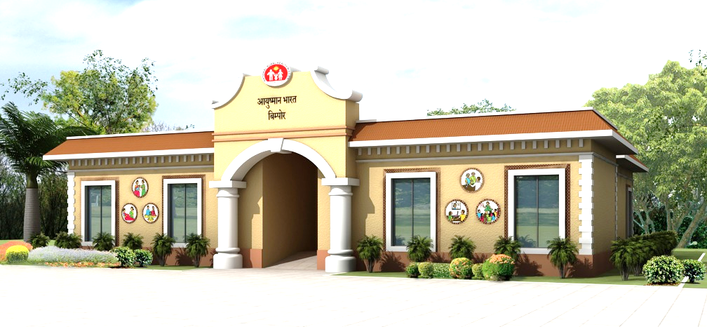
Infrastructure design of HWCs finalised by UT Administration

Slide 9
Best Practices
Infrastructure development of HWCs through CSR and MPLad Funds
Technology based citizen centric service delivery through e - Aarogya
Capacity building of Mid Level Service Providers
Daily Monitoring of activities undertaken by Mid Level Service Providers

Slide 10
Infrastructure Up-gradation of Health Facilities to Health and Wellness Centres through CSR
The upgradation of 13 subcentres in the UT of DD has been under Corporate and Social Responsibility (CSR).
Further upgradation of 7 subcentres at Daman and 1 at Diu has been carried out through MP-LAD Funds.
The cost of Civil Infrastructure is approximately 15cr. which is borne by the industries under CSR and from funds under MPLAD scheme thus, bringing about reduction in the overall expenditure borne by the Government.
The expenditure on purchase of equipment (approximately Rs. 3cr) and manpower including the training cost of CHOs (approximately Rs. 20lakhs) is being borne by the UT Administration.

Slide 11
Infrastructure Up-gradation of Health Facilities to Health and Wellness Centres through CSR
The upgradation of 5 subcentres in the UT of DNH has been under Corporate and Social Responsibility (CSR).
The expenditure on purchase of equipment (approximately Rs. 9 cr) and manpower including the training cost of CHOs (approximately Rs. 80lakhs) is being borne by the UT Administration.

Slide 12
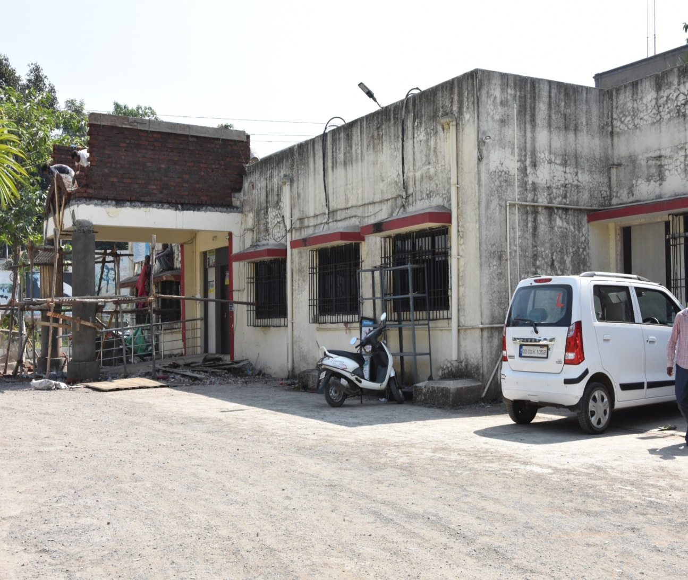
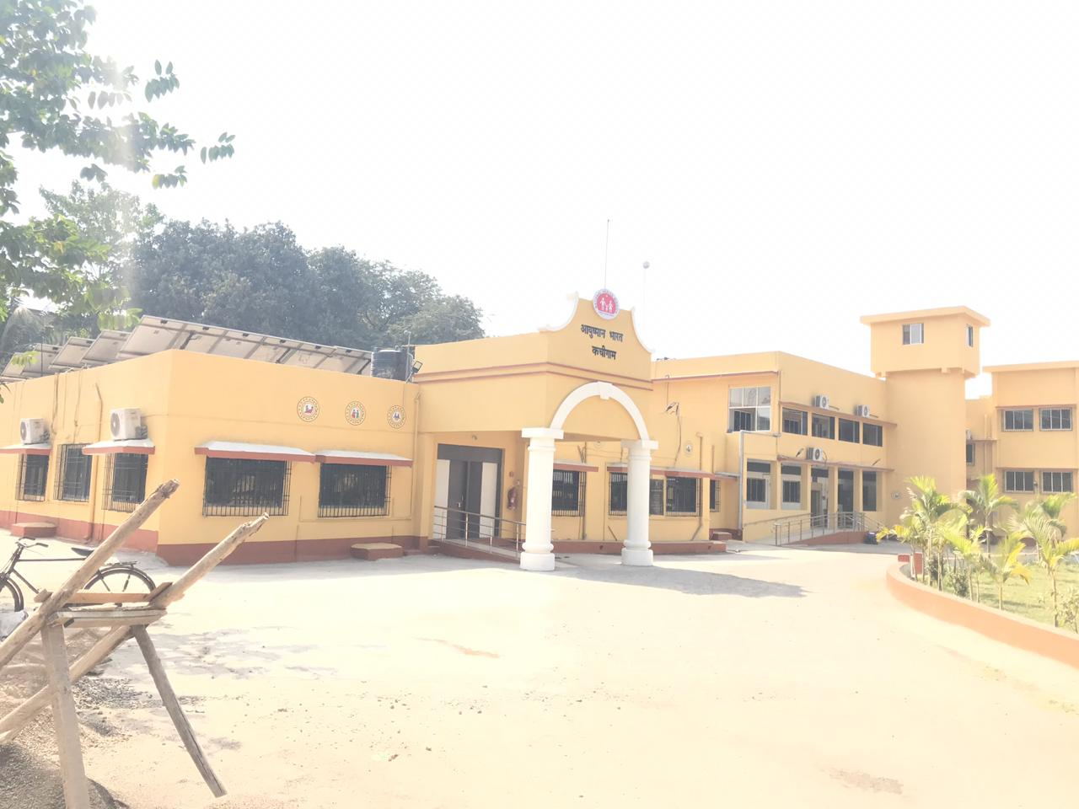
HWC Kachigam (PHC)
Before
After

Slide 13
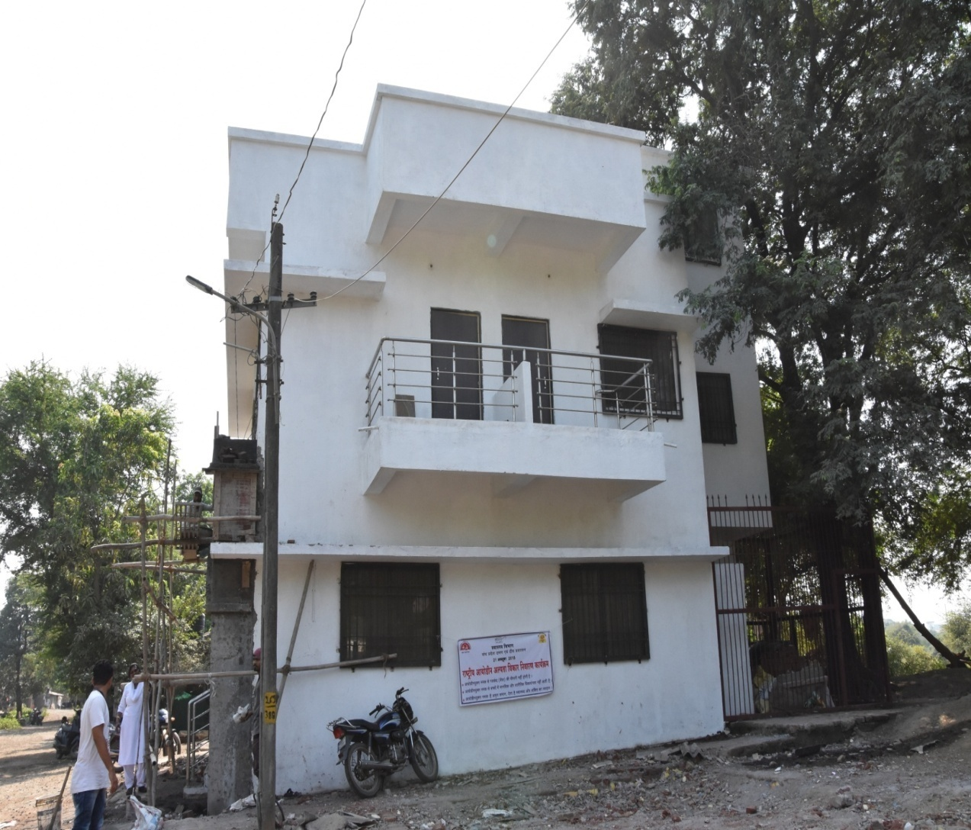
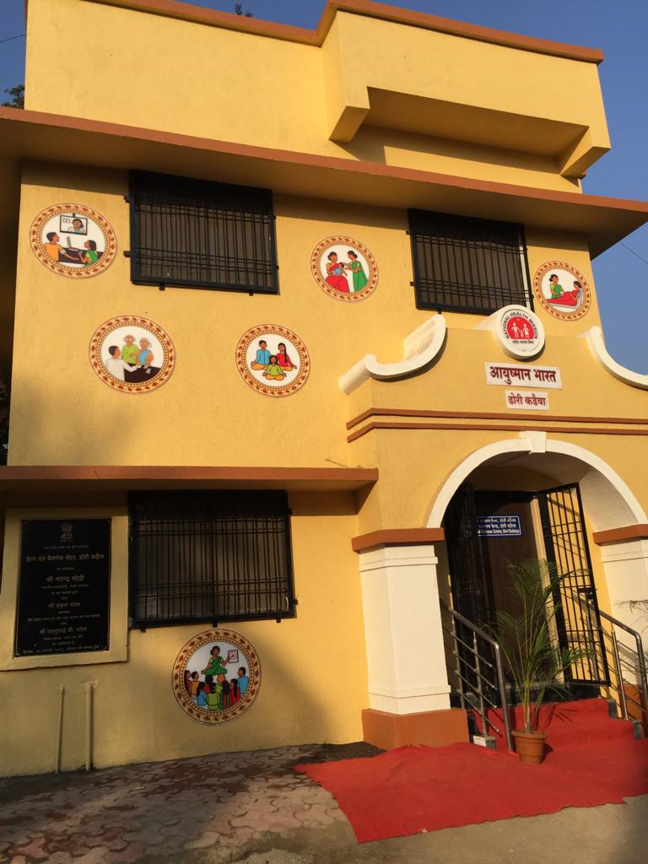
HWC Dori Kadaiya
Before
After

Slide 14
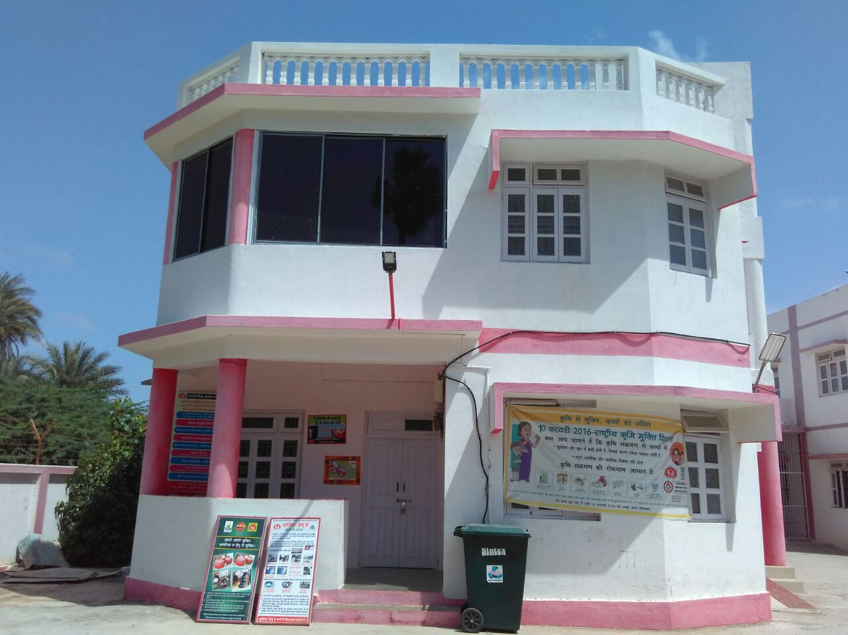
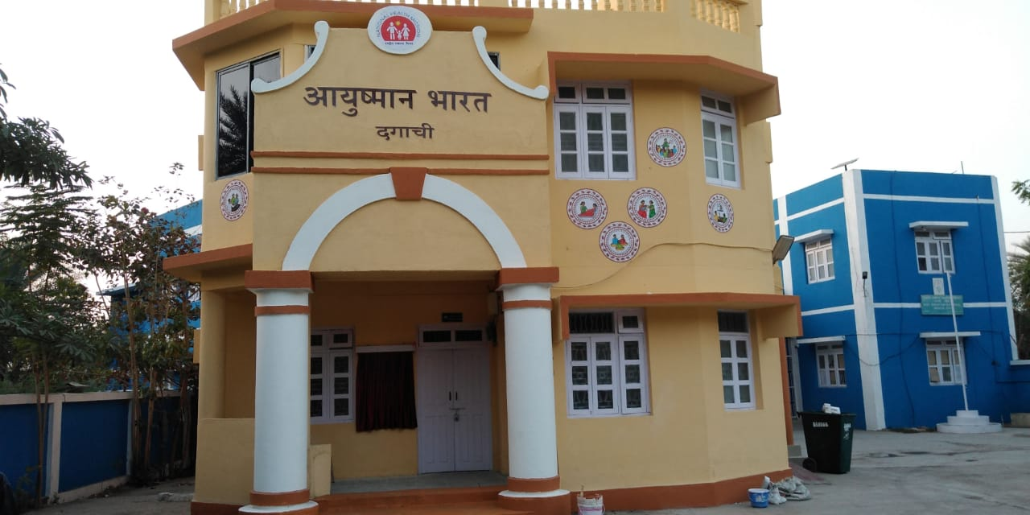
HWC Dagachi
Before
After

Slide 15
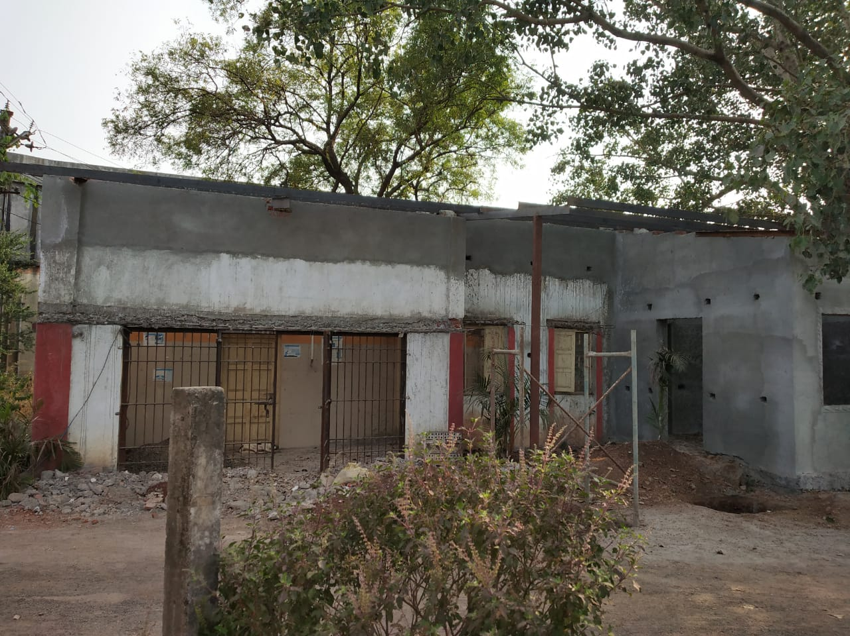
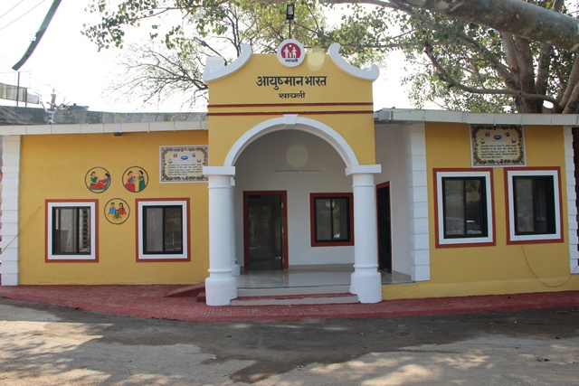
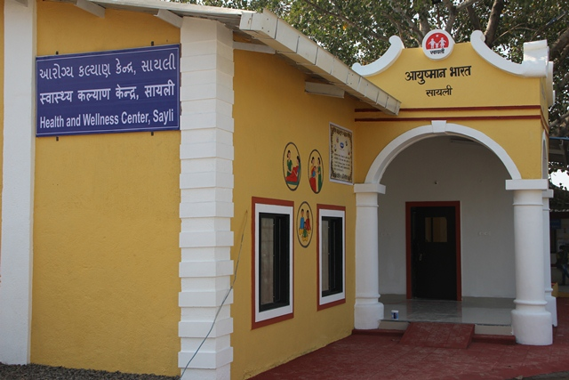
HWC Sayli
Before
After

Slide 16

Unique Citizen Centric Service Delivery Initiative
“e - Aarogya”
Purpose
Efficient Inventory Management
Doorstep delivery through health workers
Effective Disease Surveillance
“Womb to Tomb” comprehensive medical records
Electronic Patient Folder, accessible from anywhere, anytime
Integration of Diagnostic Services - Imaging and Lab
Integration with ICD-10
To deliver Hassle free healthcare services

Slide 17
Challenges faced for record management & patient services
100% dependence on paper based system
High turn around time, busting queues in turn lead to increased risk of cross infections
Problems in record keeping and retrieval
Zero linkage with public health services
Absence of Inter-health facility transfer of records
Absence of patient access to his/her medical records history

Slide 18
Open Source, cloud based solution
Multiple locations backup for failsafe operations
Store and Inventory Management
Pan-UT Coverage, contains record of entire population
Covers both clinical and public health
Interface with Laboratory and PACS for Imaging Services
Integrated with Ayushman Bharat Scheme
E-Aarogya Wallet System
Follows
MDDS, LOINC, DICOM, HL-7
SNOMED-CT
Features of E-aarogya

Slide 19
Services rendered under e - Aarogya
A Cloud based health care eco system, that helps health care providers to utilize the technology for delivering their services effectively.
Implemented at all the public health facilities in the UT.
Ensures paperless data at all the facilities
Availability of patient records on click of a button!

Slide 20

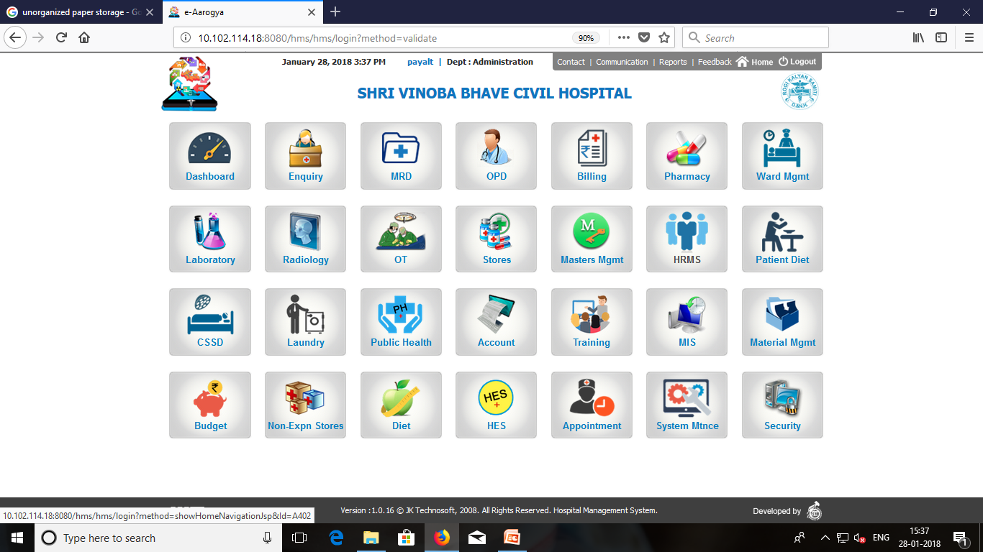
Services rendered under e - Aarogya

Slide 21
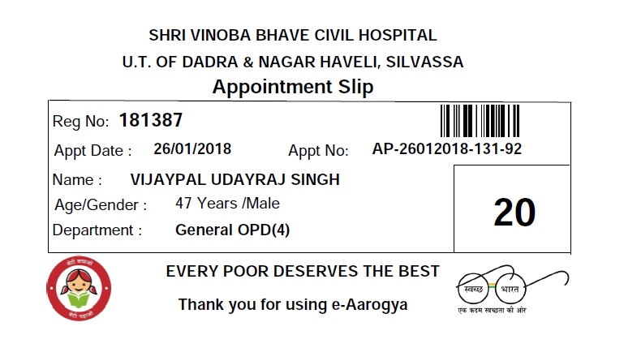
Hassle Free Registration and Appointment
Patients
OPD Rooms
Web Portal
Kiosk
Mobile access
Registration Counter

Slide 22
Capacity Building of Mid Level Service Providers
Hands on training of CHOs regarding:
  Slide collection
  Preparation and examination under microscope for Malaria, Filaria, Tuberculosis etc.
  Operating of various equipments like TENS
Regular Yoga sessions in all HWCs on rotational basis
Digital data entry for OPD & NCD screening in e-Aarogya
Registration of Family folder in e-Aarogya in Tablets
Additional postings at DH & SDH for Suture removal, Diabetic foot dressing with aseptic precautions, Emergency response & First Aid for Snake Bite, Poisoning & other emergencies.

Slide 23
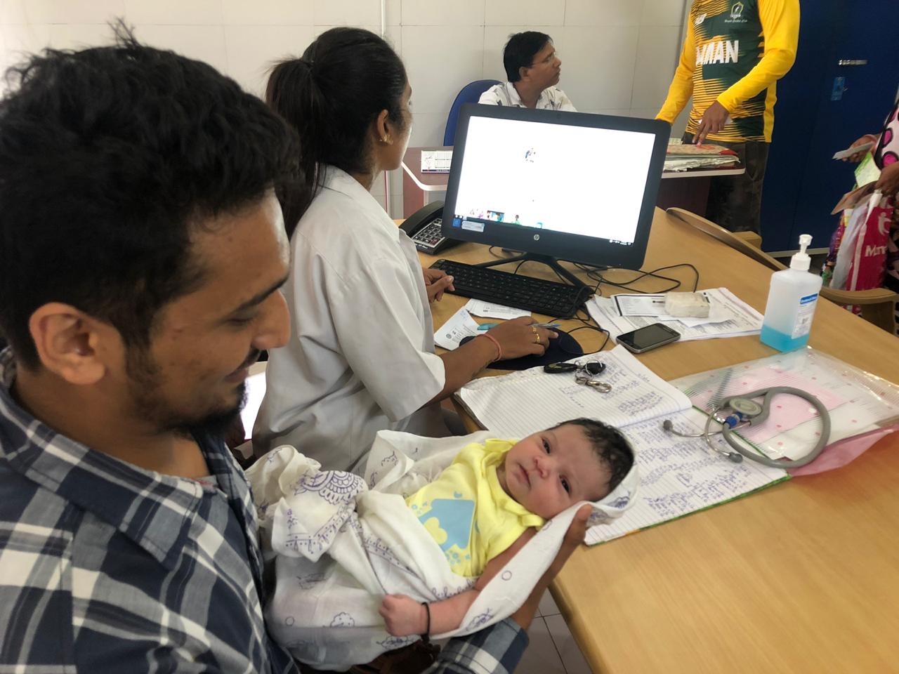
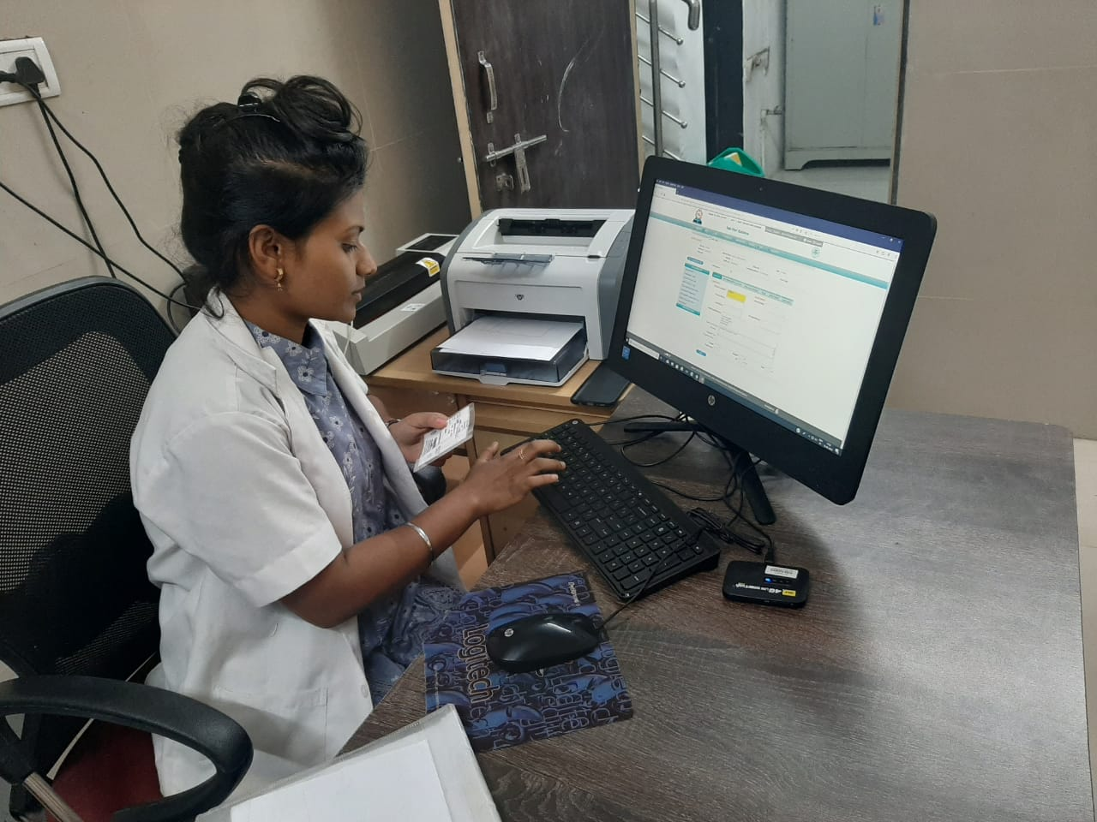
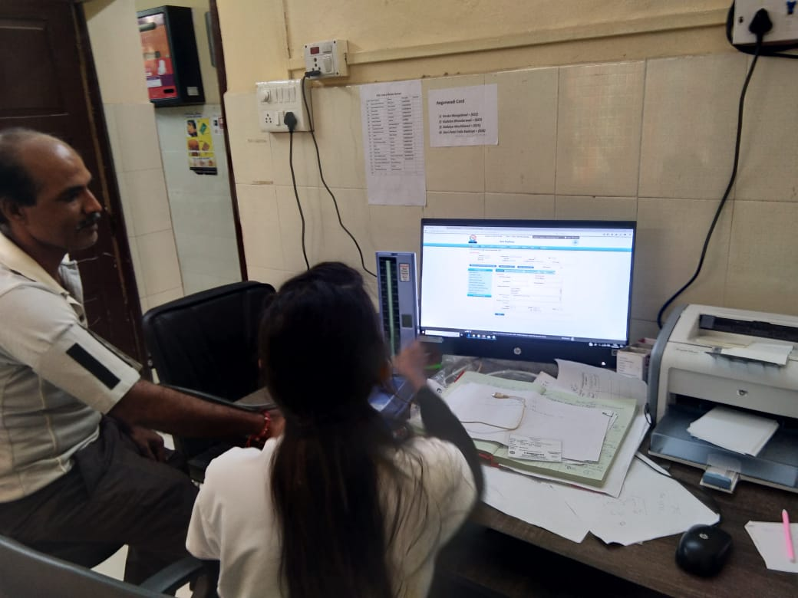
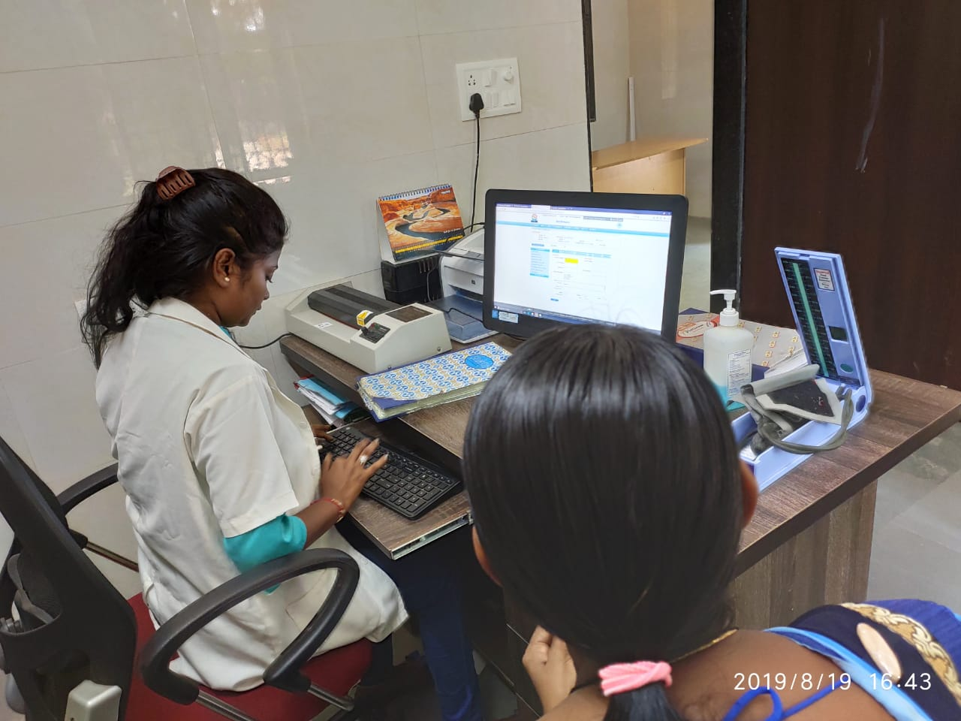

Slide 24
Daily Monitoring of MLSPs
Daily Reporting:
  Daily reports received through whatsapp and a compiled report shared on a daily basis
  Weekly monitoring by the PHC Medical Officers

Slide 25
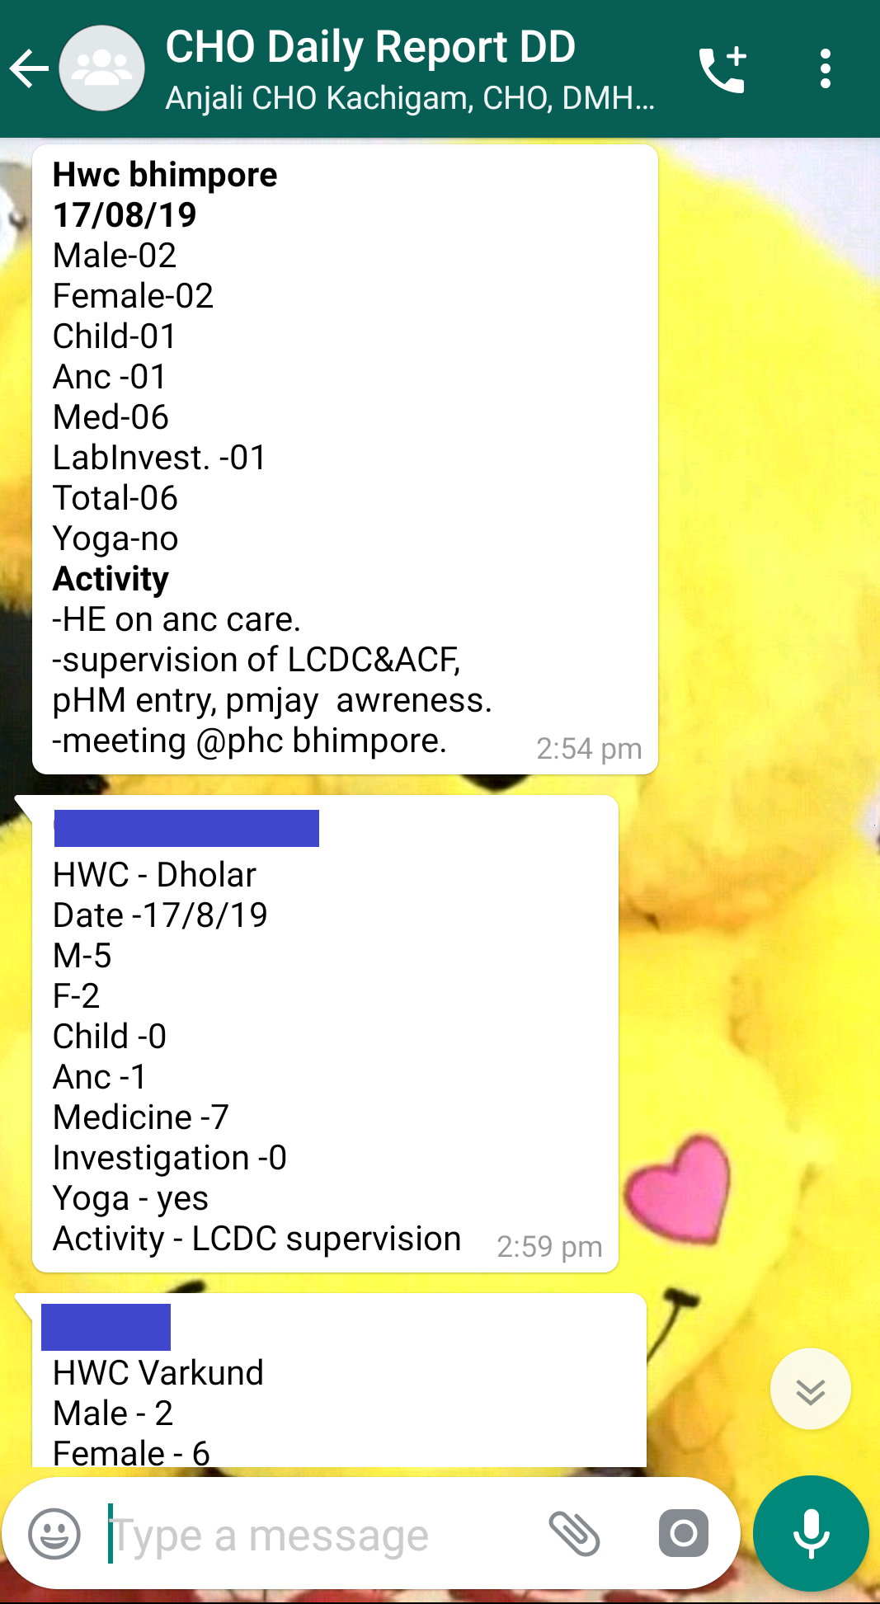
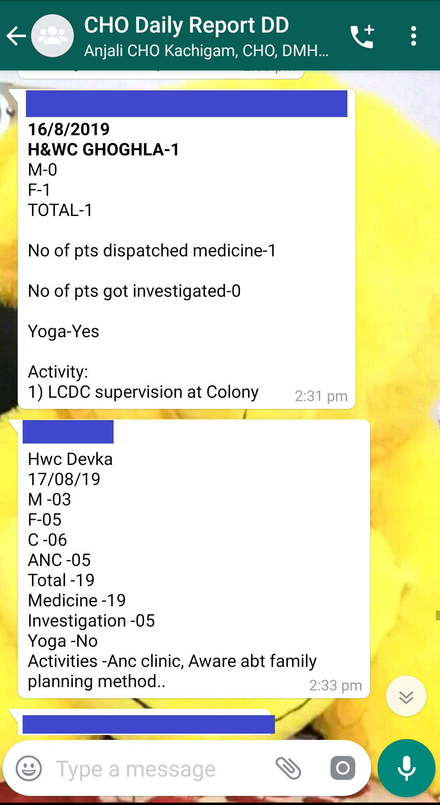

Slide 26
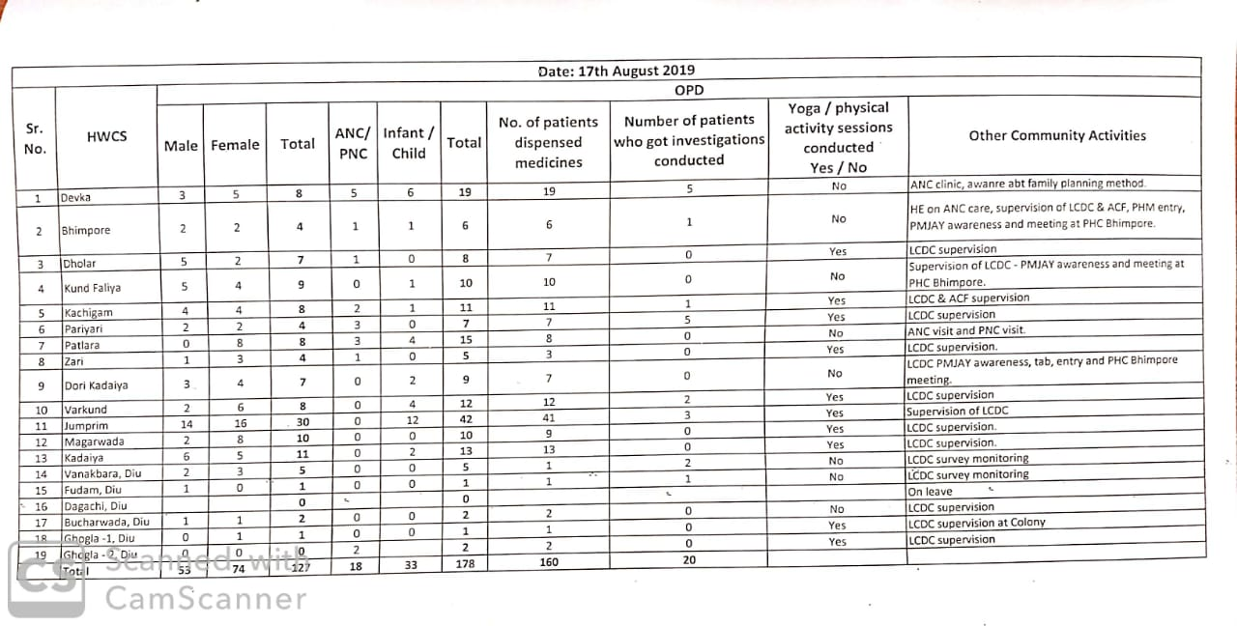

Slide 27
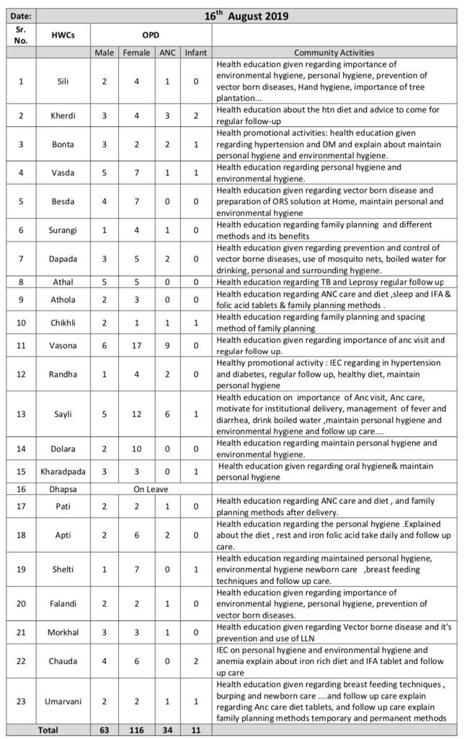

Slide 28
Services provided at Health and Wellness Centres:
Antenatal, Postnatal care and check-up
Neonatal ,Childhood and Adolescent Health Care Services.
Family Planning, Contraceptive Services and other Reproductive Health Care Services
Implementation of National Health Programmes
General OPDs
Screening, Prevention, Control and Management of Non-communicable Diseases
Community Outreach activities like VHNDs, Counselling, sensitization of beneficiaries for various health programmes
Implementation of UMANG, UDAI and other UT initiated programmes

Slide 29
Benefits to the Community through operationalization of HWC
Increase in OPD Services:
  With the deployment of a Community Health Officer at each HWC, the accessibility to health services in the community area has increased tremendously.
  The time taken by a common man to avail healthcare services has reduced drastically.
  On an average the monthly OPD at HWC has increased from 150 patients per month to around 800 patients per month.
Digitization of family records:

Slide 30
Benefits to the Community through operationalization of HWC
Timely referral of patients from the field level:
  With implementation of e-aarogya, on an average around 100 patients are referred to higher public health facilities for further diagnosis and treatment.
  Their records are now accessible at any facility at the click of a button and thus enhancing digitization of records and easy retrieval
Improvement in overall screening of Non communicable diseases and service delivery.
  The screening of the population for NCDs has intensified with the active involvement of well trained CHOs. Further, an expanded range of services is being focussed on.
  Also, availability of essential drugs and diagnostics at HWC level, dispensed through the CHOs has improved the coverage and service delivery throughout the villages in the UT.

Slide 31
Benefits to the Community through operationalization of HWC
Strengthening of RMNCH+A services
  The posting of Mid Level Service Providers has strengthened the service delivery of RMNCH+A services like early registration of ANC, registration of ANC in e-aarogya helps in monitoring the beneficiary through the entire duration of pregnancy with the help of e-aarogya
  Follow-up and Facility based new-born care data available at the click of a button
  Routine laboratory check-up during ANC has become more accessible to the beneficiaries by operationalization of HWCs
  Effective counselling and awareness by MLSPs on Family Planning thereby increasing
  Timely identification of High Risk pregnancies and early referral

Slide 32
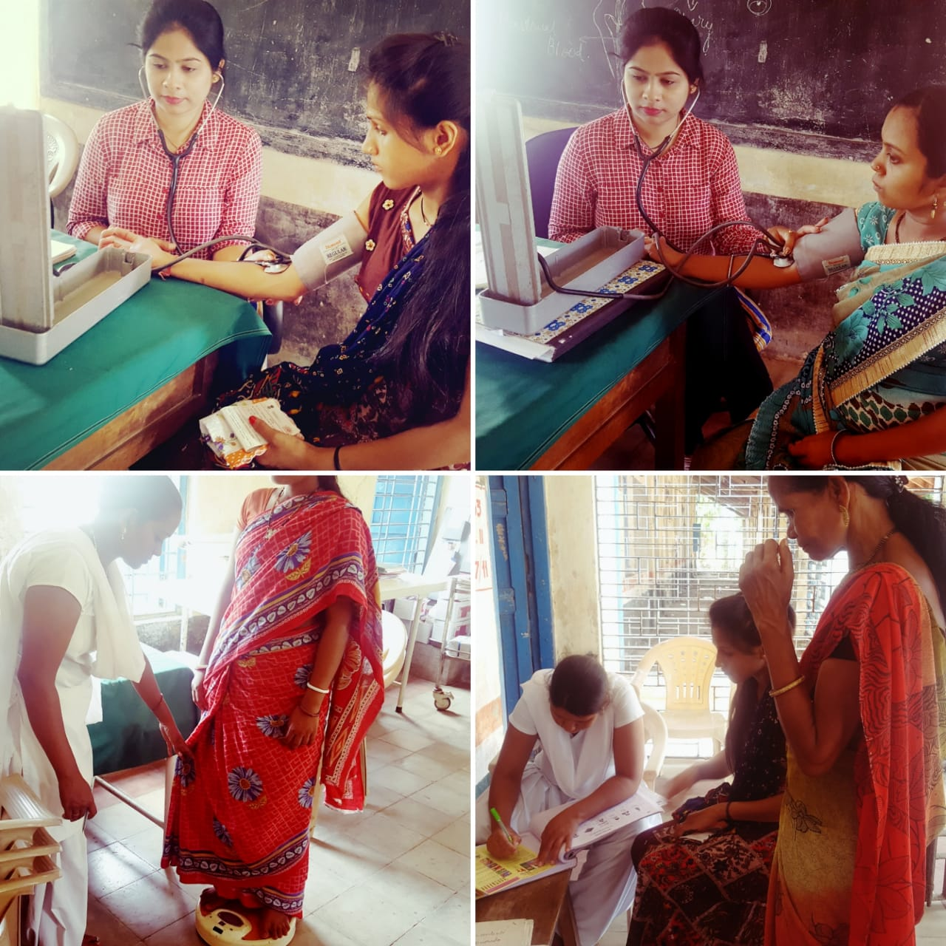
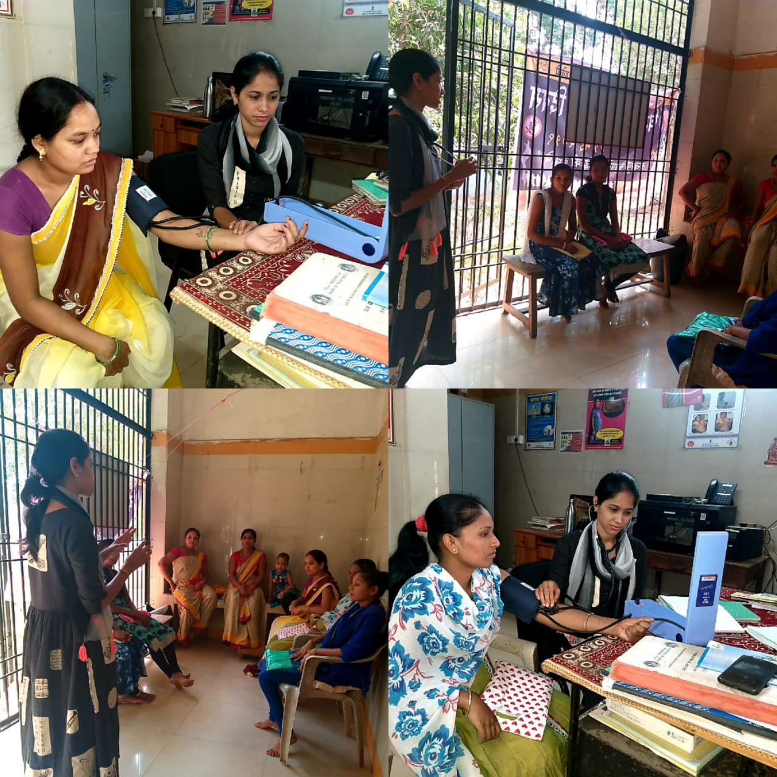
ANC Check up at HWCs

Slide 33
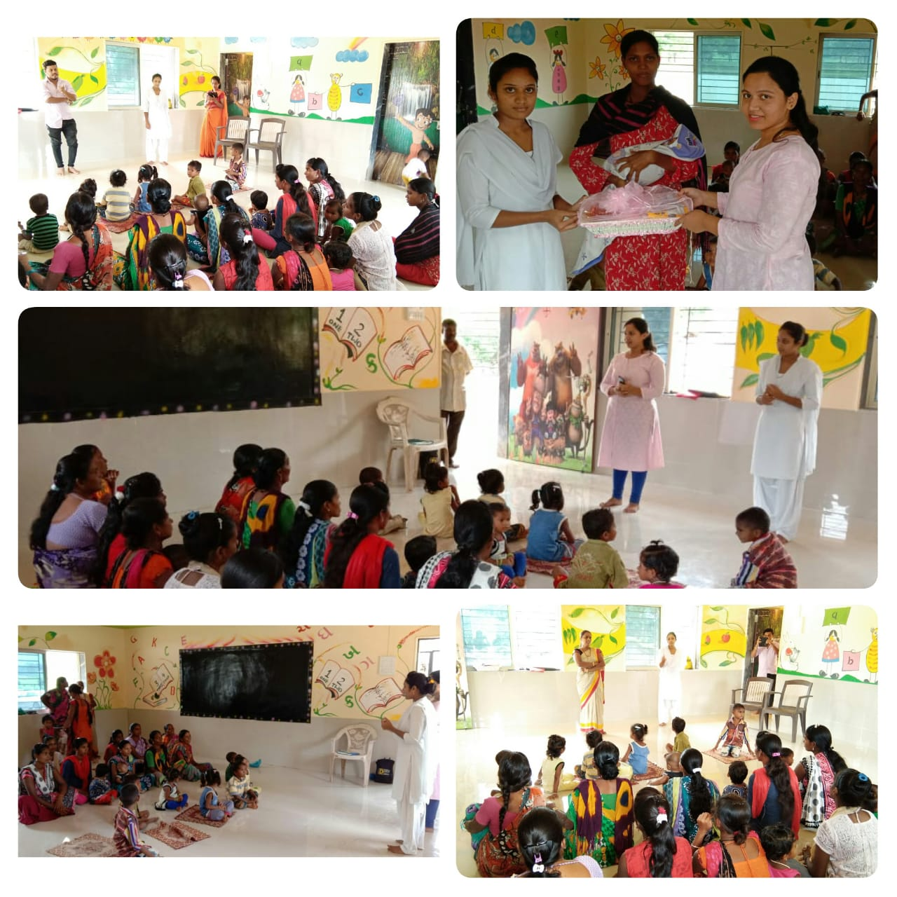
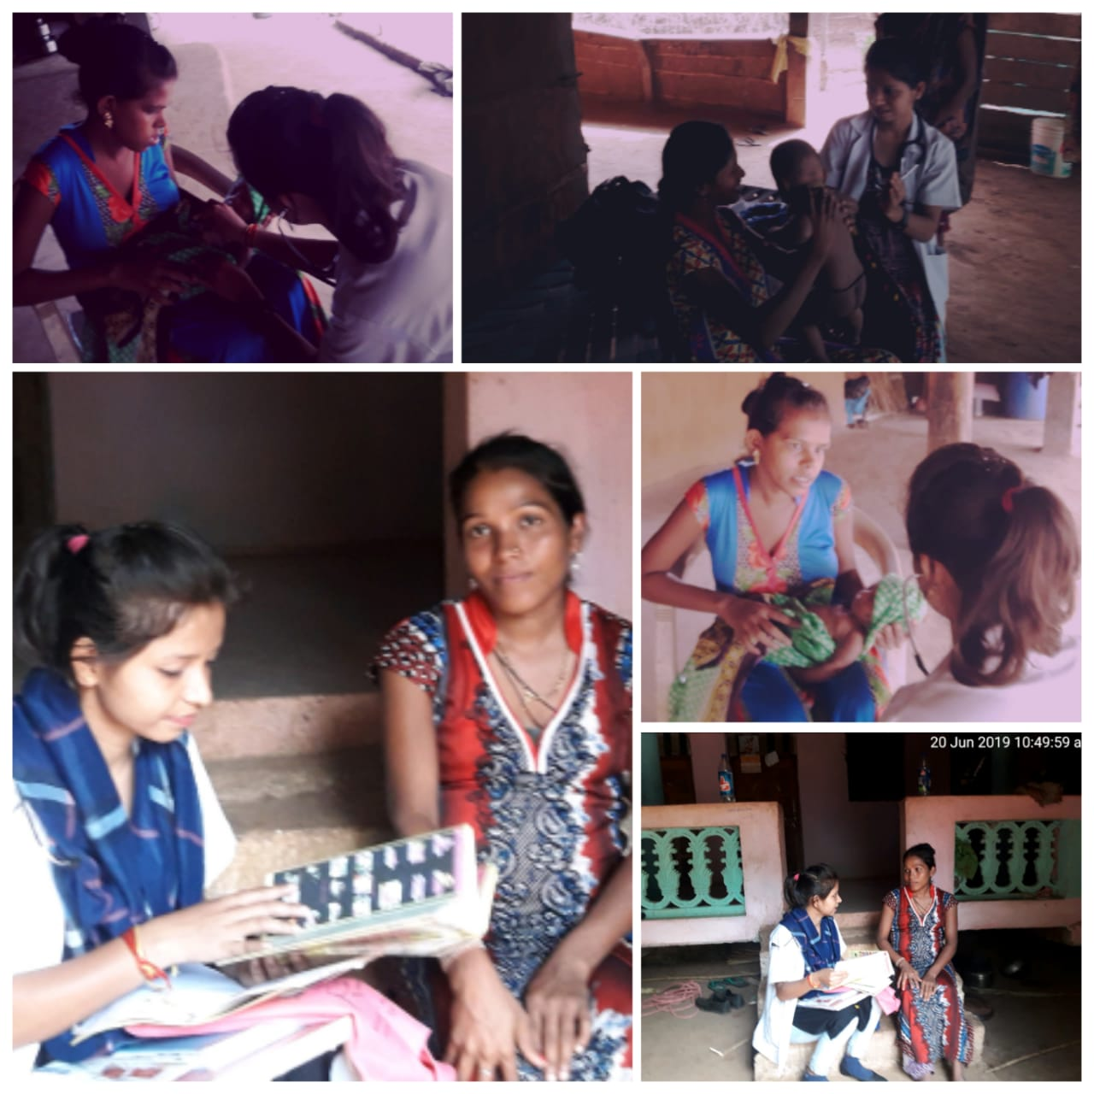
HBNC / PNC care at HWCs

Slide 34
Benefits to the Community through operationalization of HWC
Strengthening of service delivery of Communicable Diseases:
  Effective follow up of TB patients and Leprosy patients
  With slide collection and testing being conducted at HWCs, early diagnosis and treatment of Vector Borne Diseases take place
Rigorous monitoring of field level activities conducted by ASHA and ANM by MLSPs leading to effective service delivery in the field level

Slide 35
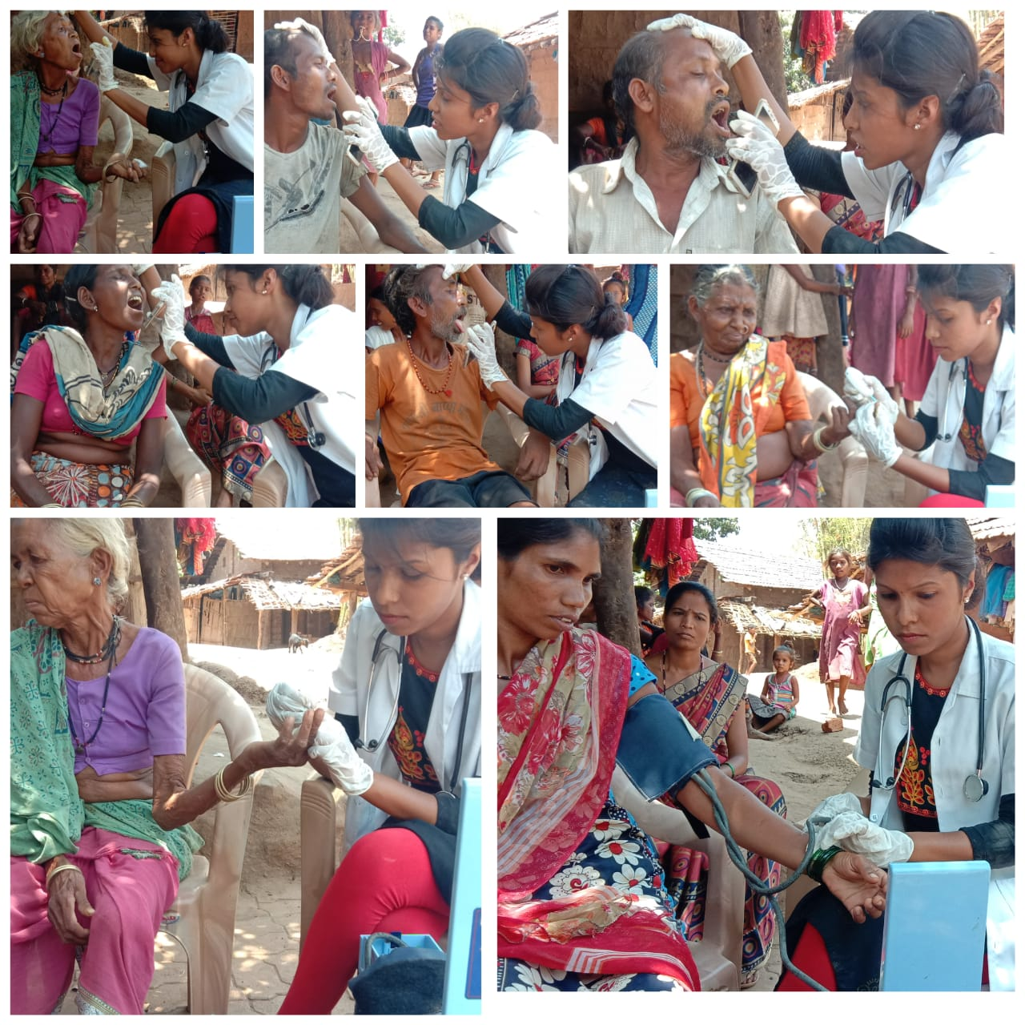
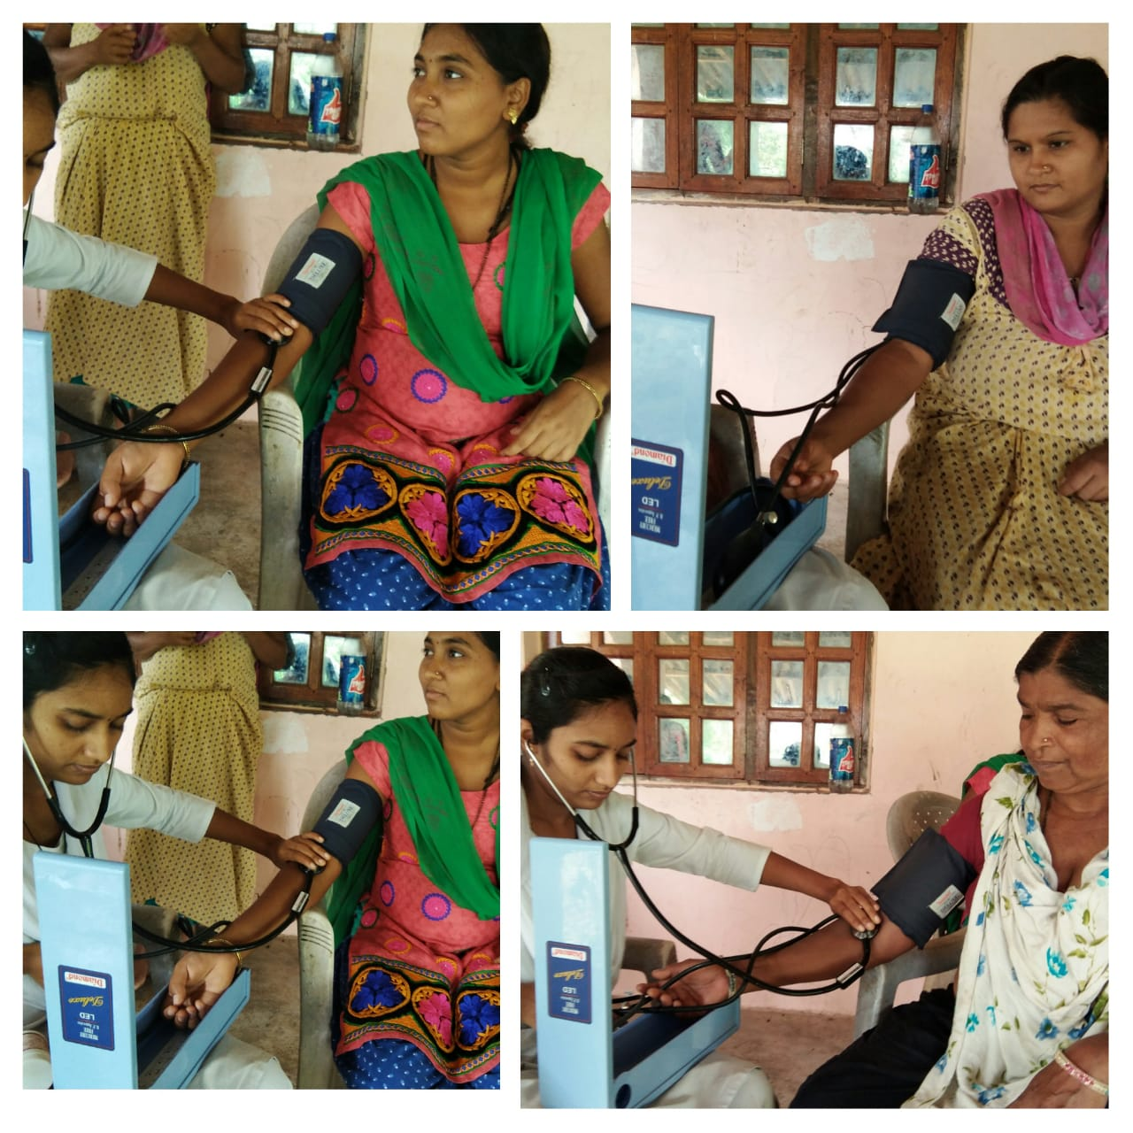
NCDs Screening by CHOs

Slide 36
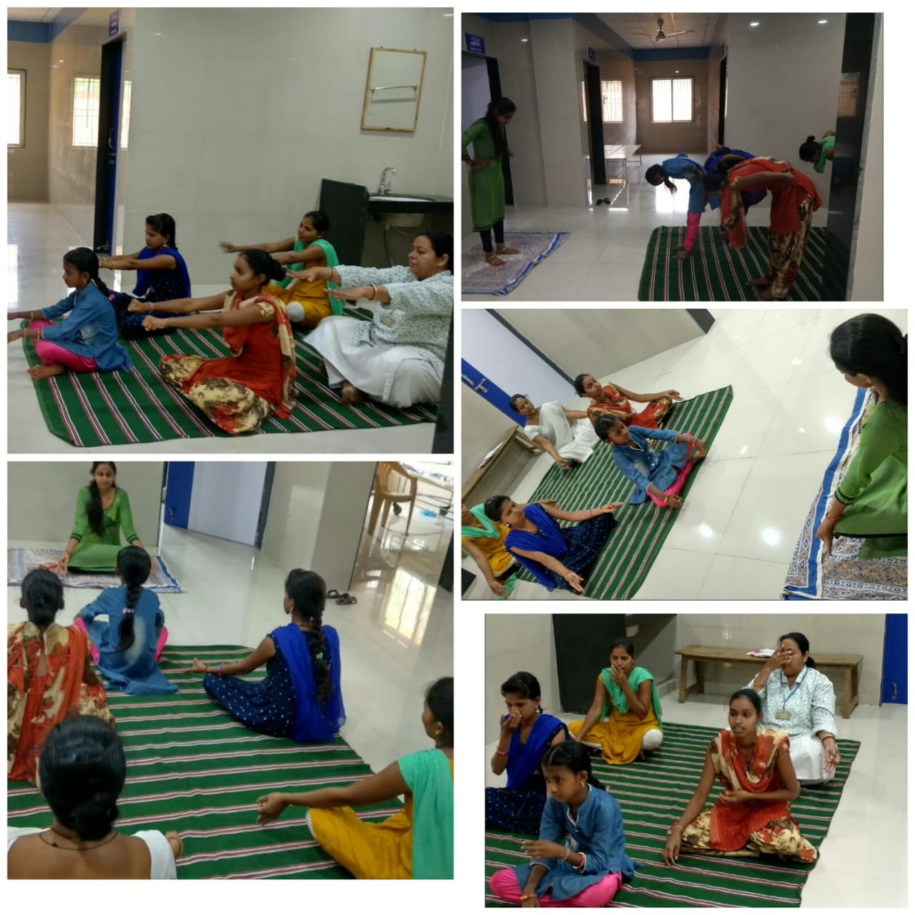
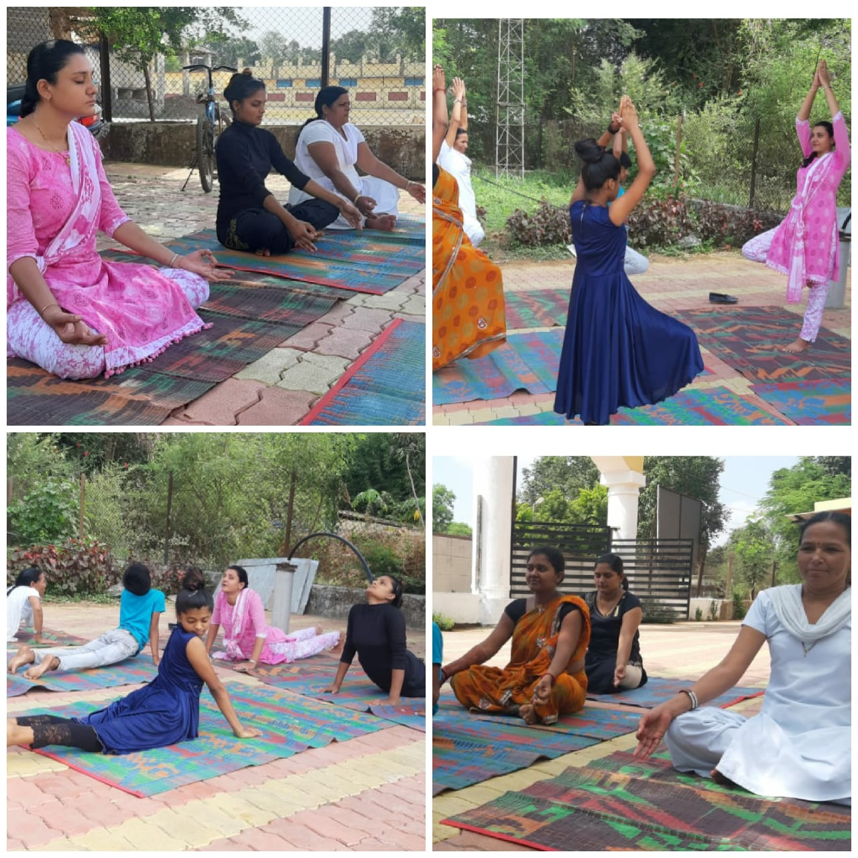
Yoga session at HWCs

Slide 37
Thank You

