Slide 1






AYUSHMAN BHARAT
Health and Wellness Centres
Goa

Slide 2
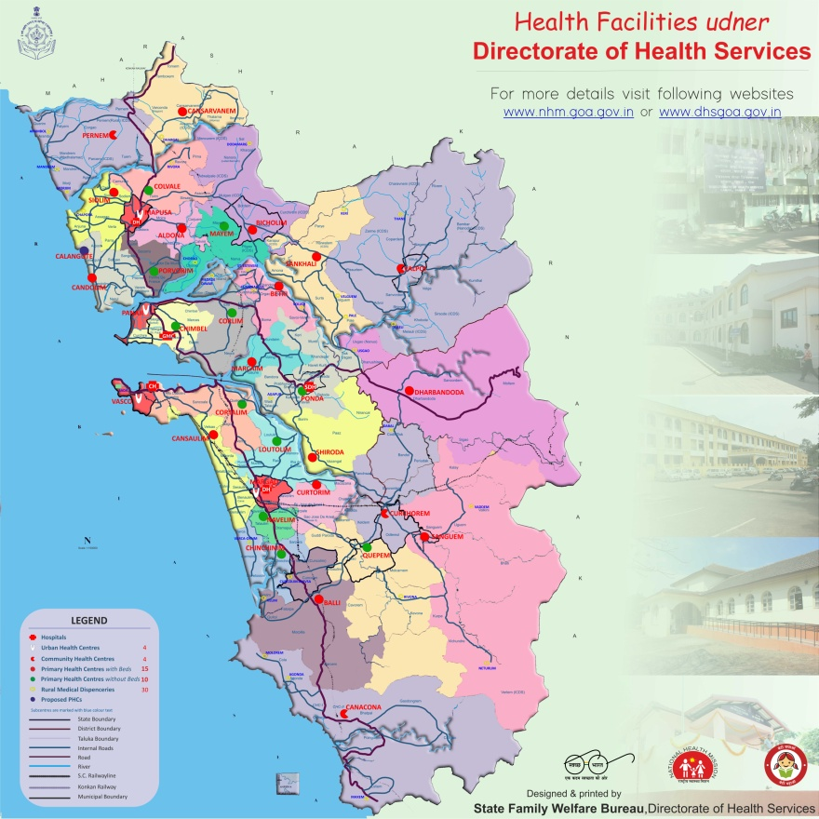

Slide 3
HWCs in Goa
In the State of Goa, all 24 Primary Health Centres, 30 Rural Medical Dispensaries, 4 Urban Health Centres, 1 RHTC and 1 UHTC have been converted to Health and Wellness Centres. (Total = 60)
There are 32 HWCs in North Goa and 28 HWCs in South Goa.

Slide 4
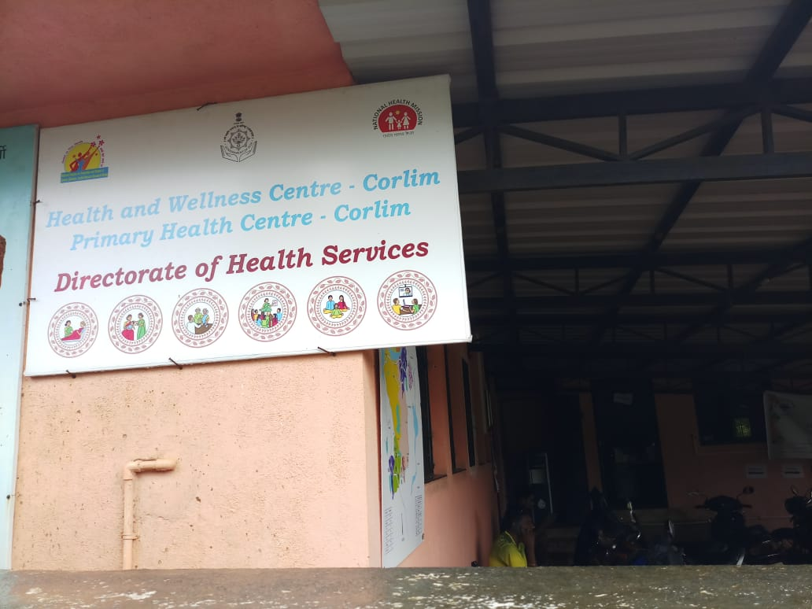
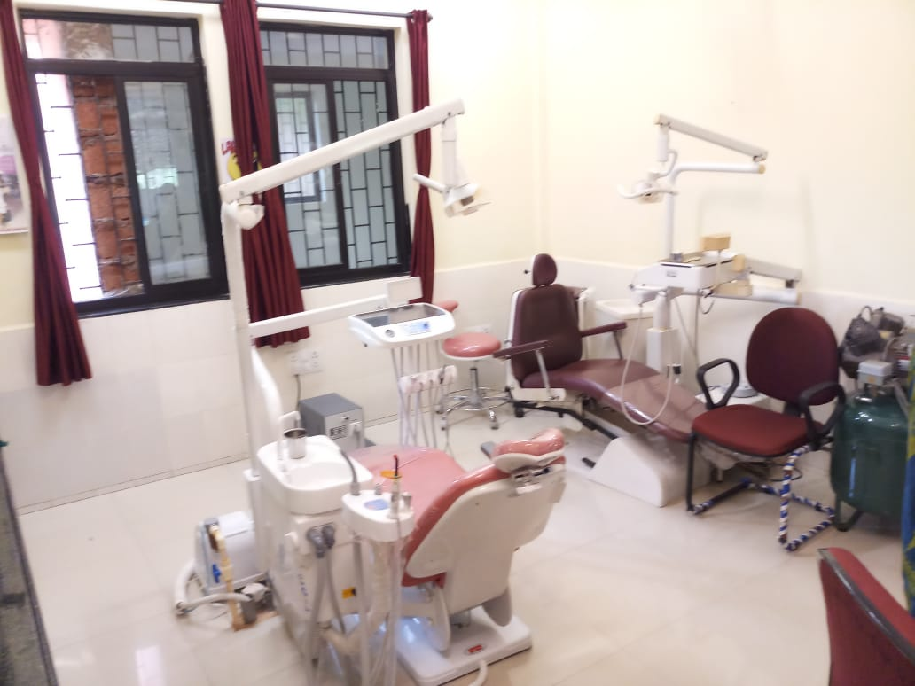
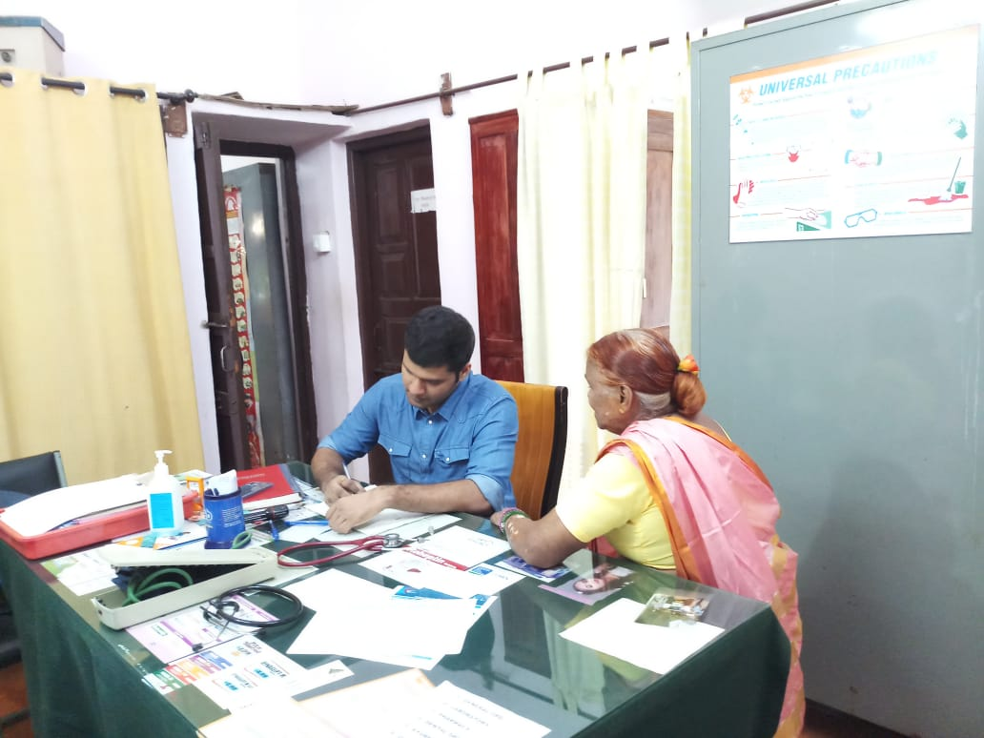
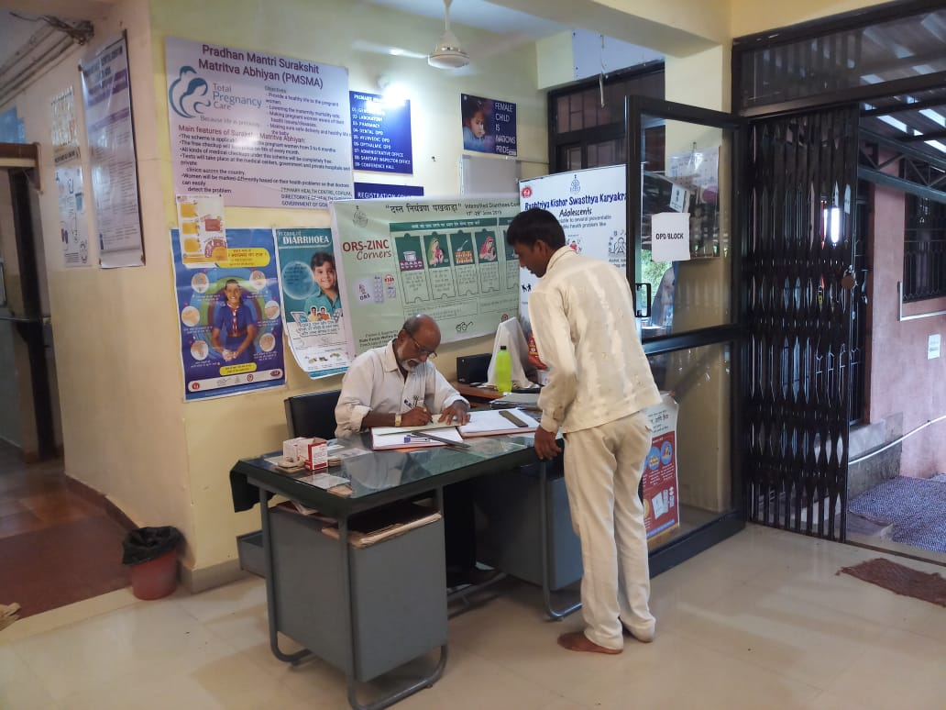
Branding has been undertaken for all new HWCs. IEC Material has been distributed to all HWCs and placed at strategic location.

Slide 5
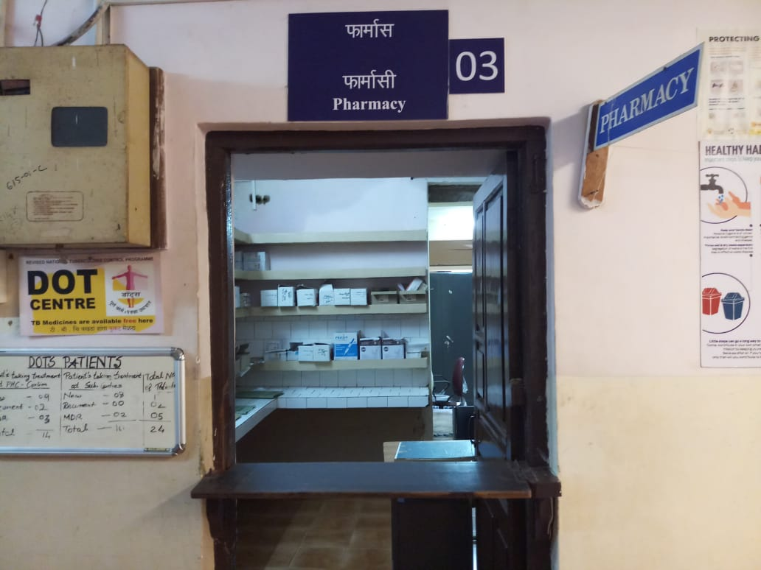
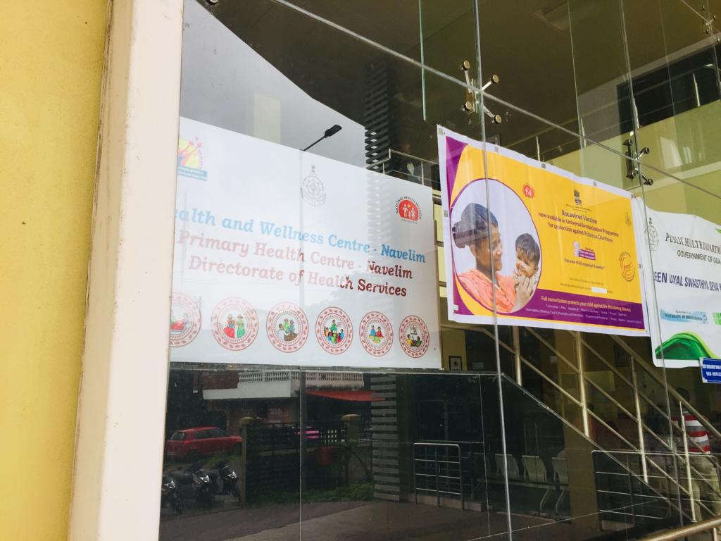
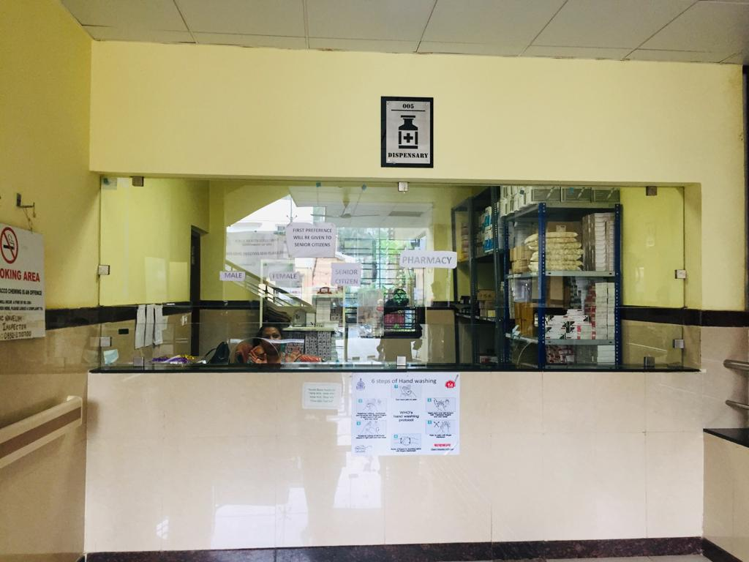
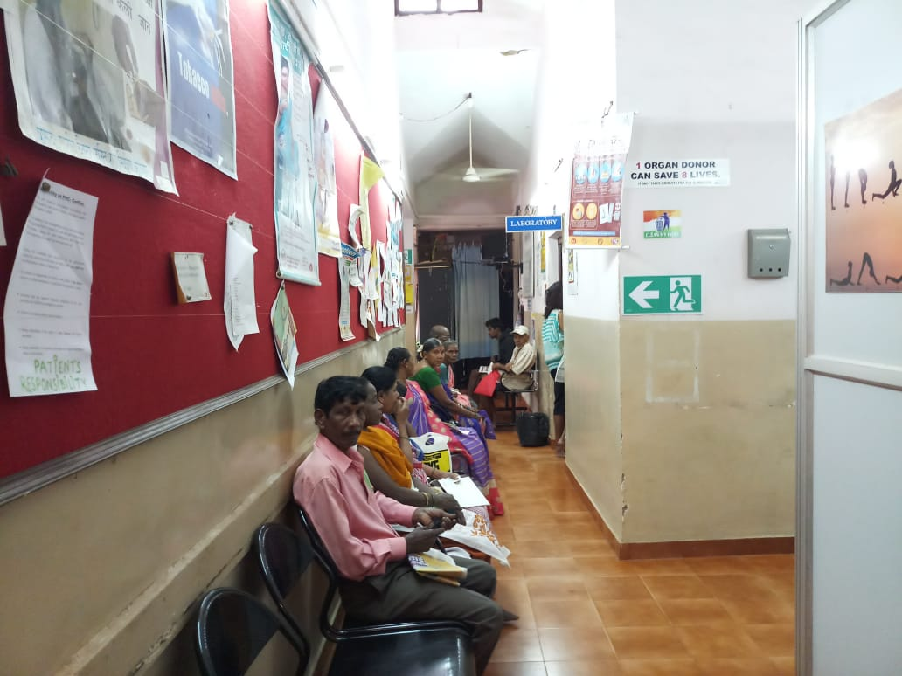

Slide 6
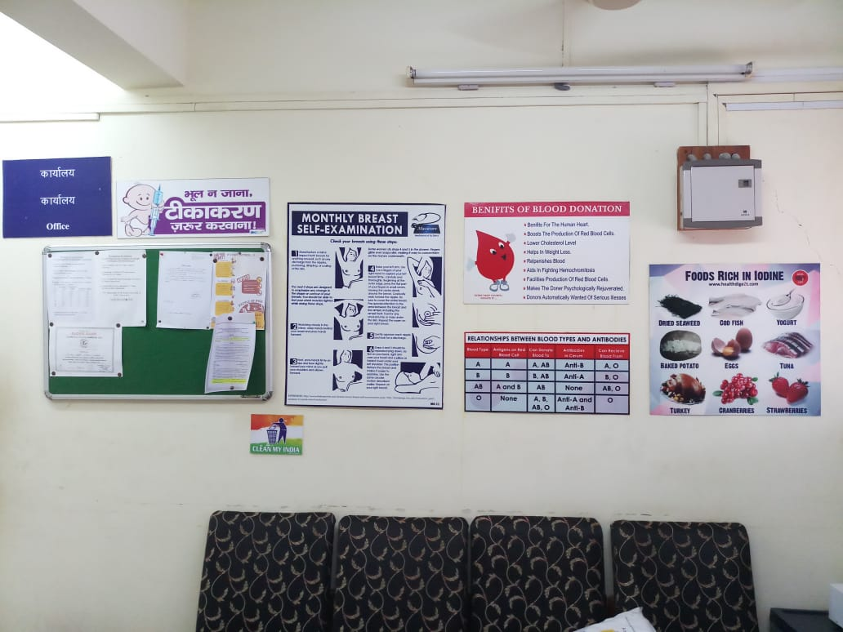
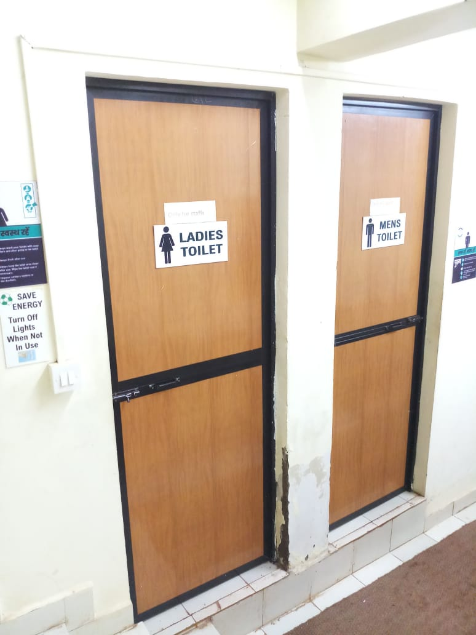
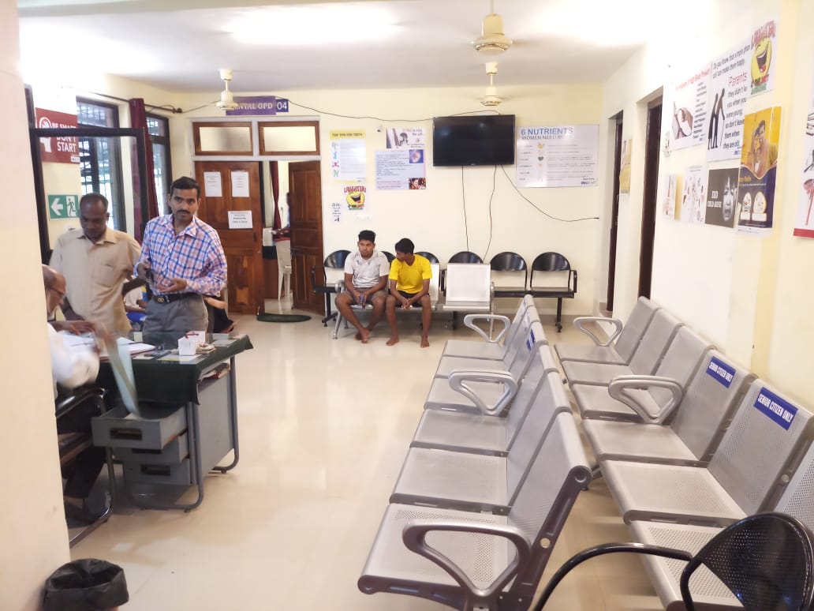
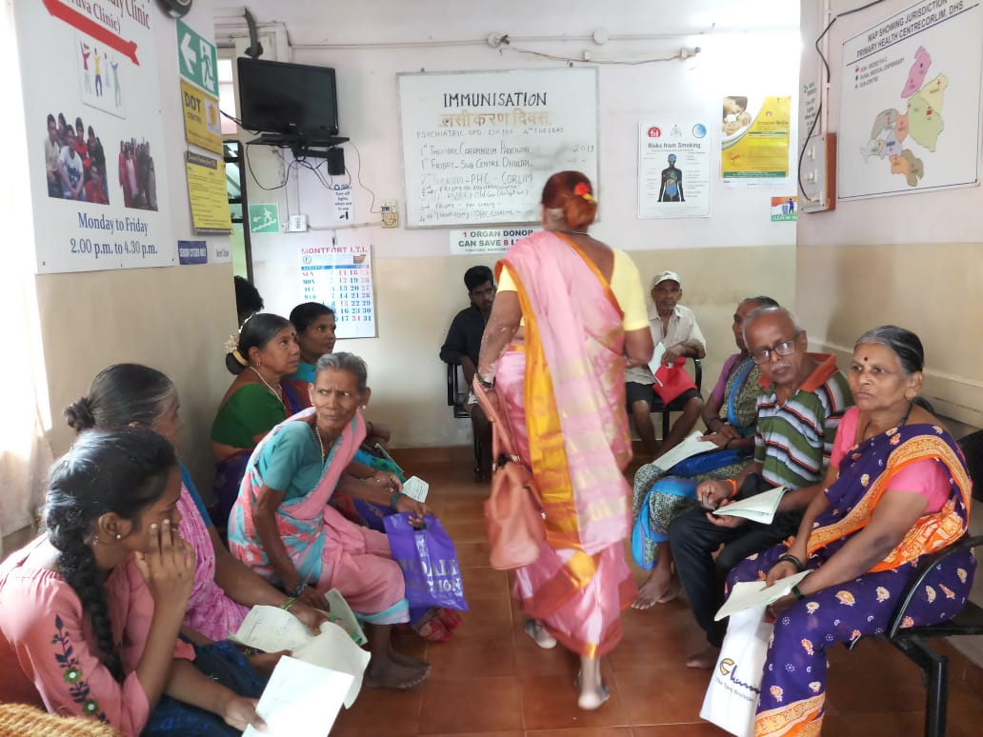

Slide 7
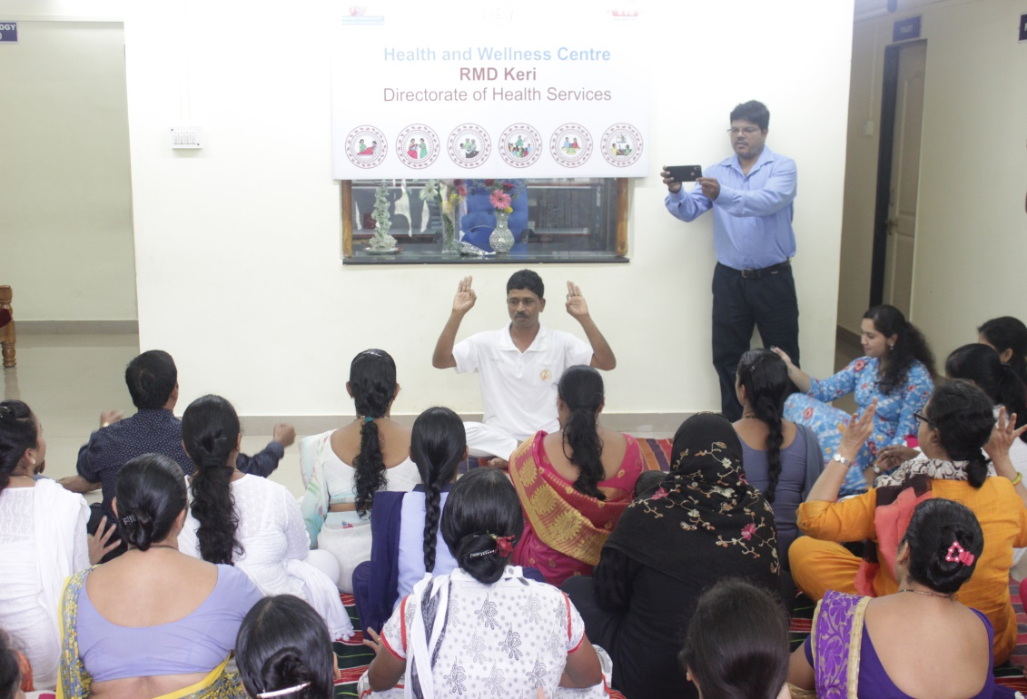
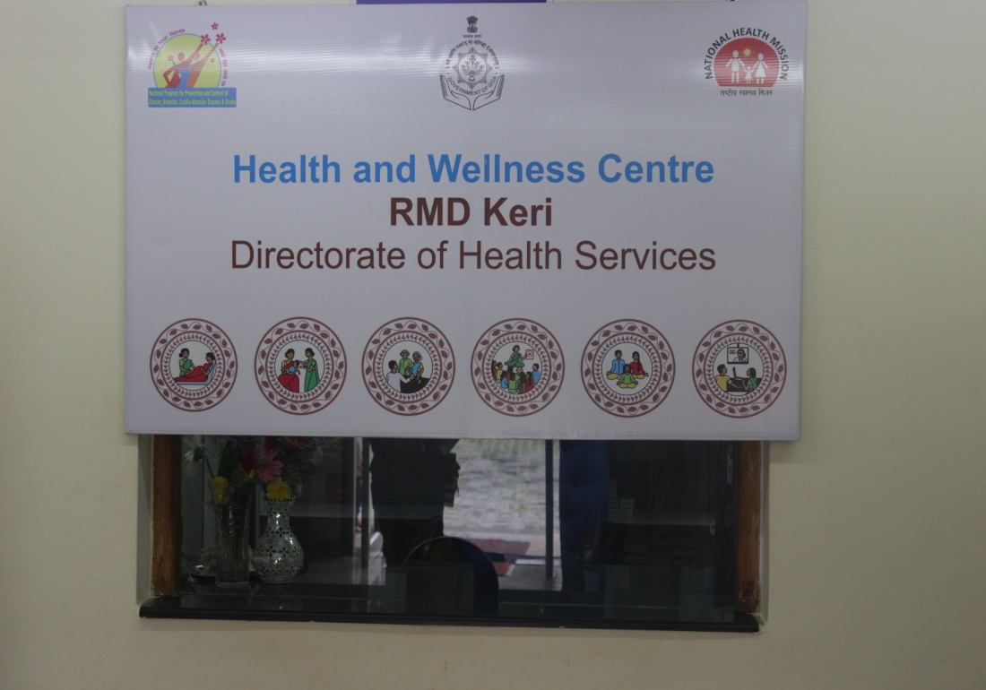
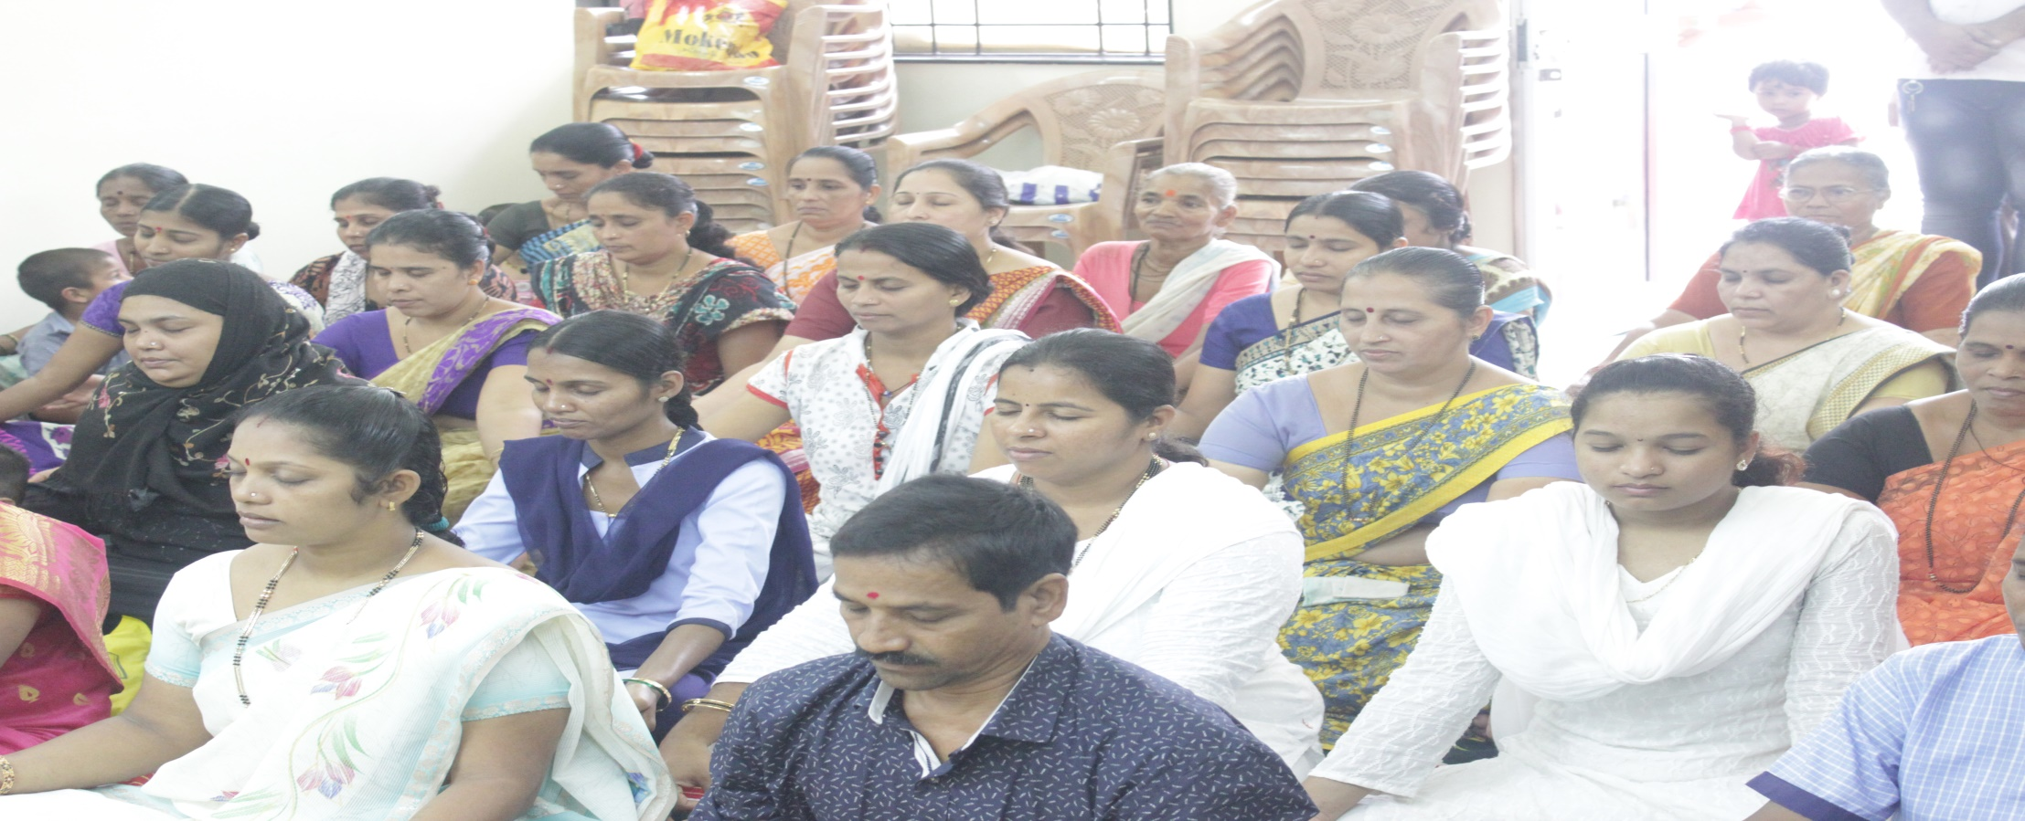

Slide 8
IT Infrastructure
Computers along with Printers have been procured and installed at all the HWCs.
A letter has been sent to Department of Information Technology for providing additional Broadband Connection to PHC-HWCs and new Internet connection for RMD-HWCs.
Procurement of 222 Tablets for ANMs for data entry in NCD Application is under process and is expected to be complete by September 2019. The hands on training for the ANMs is planned October 2019 onwards.

Slide 9
NCD MO portal Training
Hands on Training for online entry on PHC-MO portal conducted for 7 batches in the month of April-May 2019.
Total Staff trained = 308
Staff trained | No. of staff
Medical Officers | 49
AYUSH Medical Officers | 29
Staff Nurses | 49
Pharmacists | 44
ANMs | 80
Health Educators/ IEC Officers | 21
DEOs | 36
Refresher training for NCD MO Portal is planned on 26th & 27th August 2019 to sort out the issues pertaining to the MO NCD Portal

Slide 10
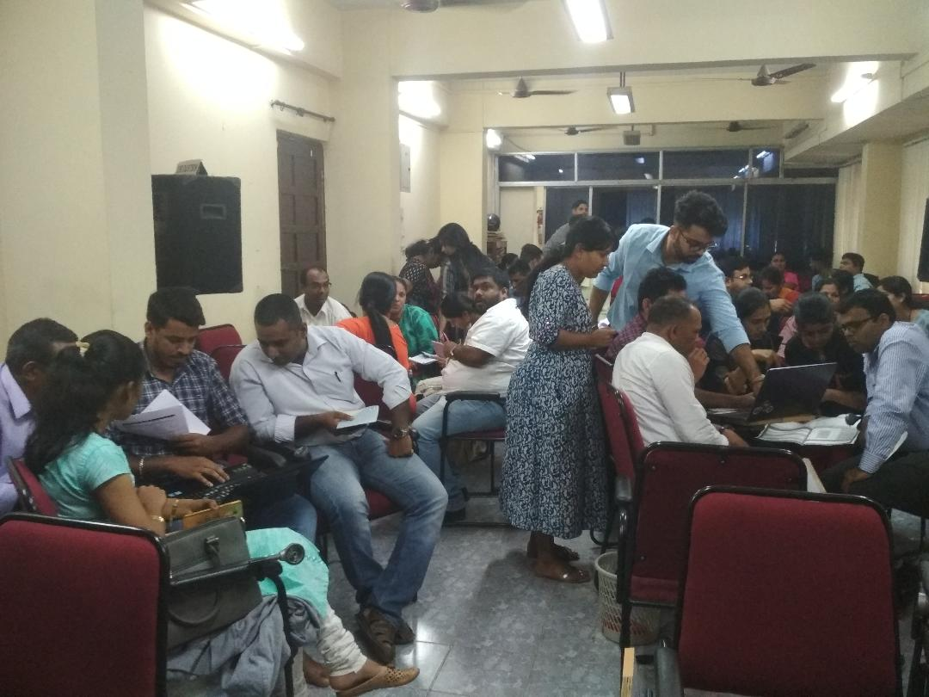
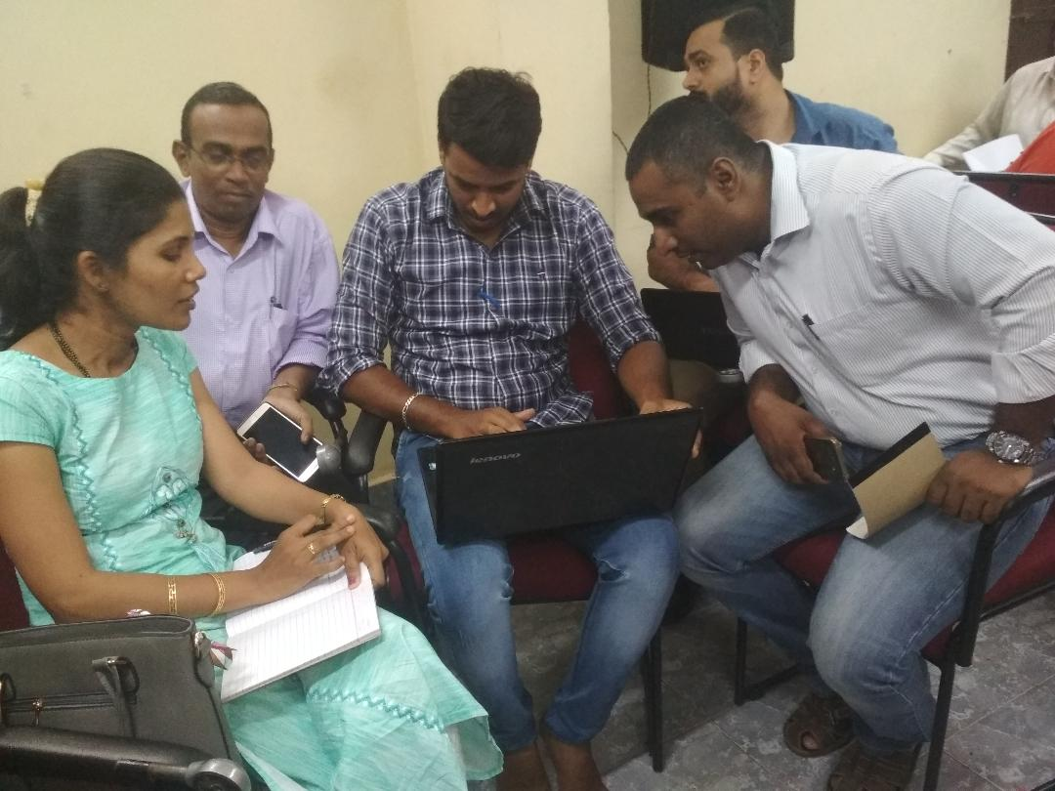
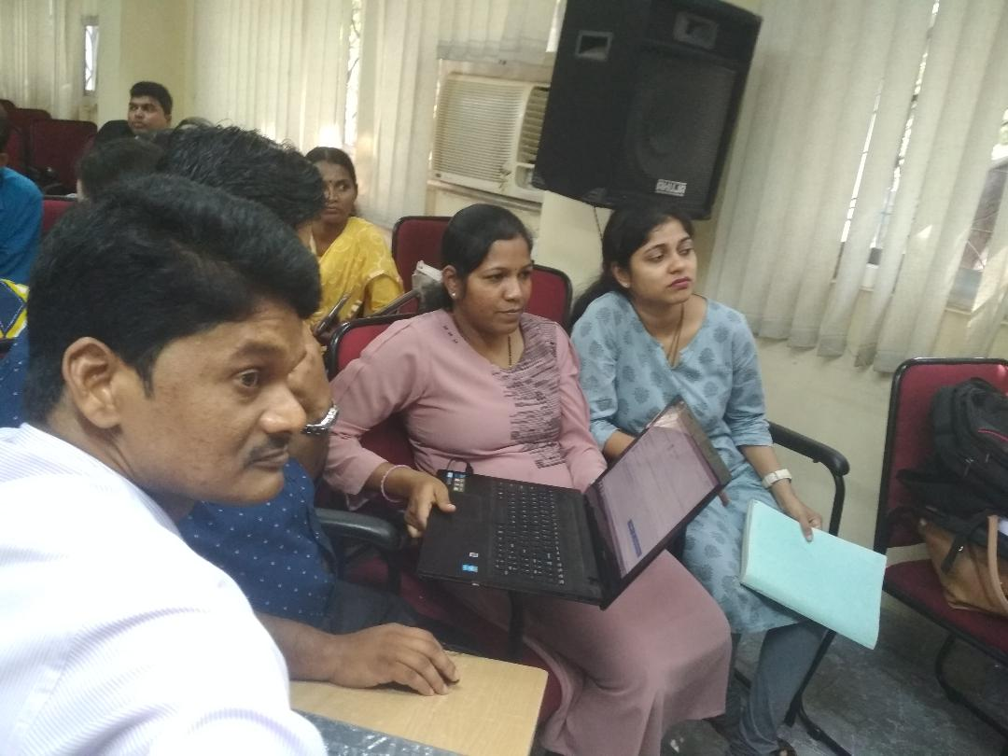
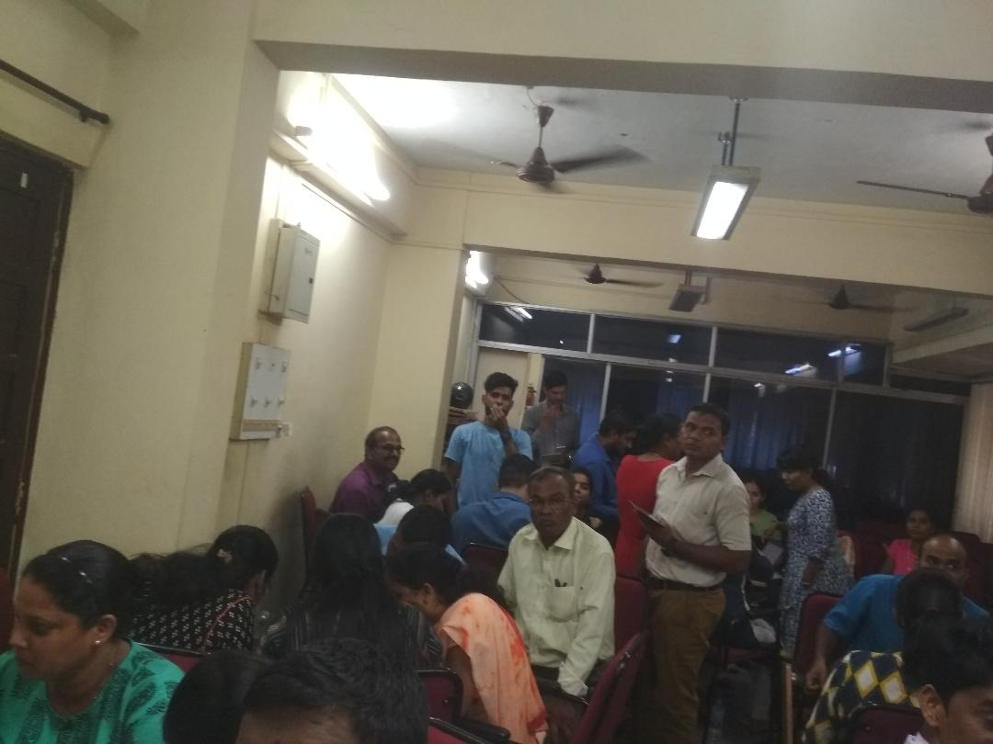

Slide 11
Human Resource
Health services are provided by MBBS Medical Officers. MO In charge/ Health Officers (qualified MBBS) in each HWCs are designated as a Community Health Officer.
The existing HR from the State are part of HWC – Pharmacists, Lab Technicians, etc
The ANMs are recruited under State as well as NHM. Additional ANMs are proposed for PHCs/UHCs in supplementary PIP as ASHAs are not available in the State of Goa. Additional ANMs (32) are required in urban areas under NUHM.

Slide 12
Services Provided
  General OPD services
  Dental OPD services
  AYUSH OPD services
  Yoga at selected HWCs on fixed days
  Ophthalmic OPD on selected days
  Laboratory services
  Pharmacy
  Obstetrics and Gynaecology, ENT, Psychiatry, and services are provided in selected HWCs on fixed days
  Ultrasound facilities and X ray facilities are available in selected HWCs

Slide 13
Drugs & Diagnostics
Pharmacy Inventory Management System is used at all HWCs. The supplies are provided from State Medical Store Depot.
In case of shortage of supplies funds are released for local purchase.
Some HWCs have semi-auto Analyzers / fully automated Analyzers.
Xray machines and USG machines are also available at selected Health Facilities.
Most Rural Medical Dispensaries/ Sub-Centres are in close proximity of PHCs/ CHCs and the samples are collected and sent to these PHCs/CHCs or the patients are referred to these Health Facilities for investigations.

Slide 14
Reducing OOPE
Free diagnostics and medicines are available at all the Health Facilities. The patients are referred to higher centres where diagnostics are available for further evaluation and management. Some private diagnostic centres have been identified where patients are referred for investigations as and when the need arises and the bills are settled by the State Government.
The residents of Goa are covered under the State Insurance Policy under Deen Dayal Swasthya Seva Yojana (DDSSY). The insurance is also available under Pradhan Mantri Jan Aarogya Yojana (PMJAY) and also under State Mediclaim Scheme.
In case the drugs are stocked out, full powers are delegated to all In charges of hospitals/ CHCs/ PHCs/ UHCs to make local purchase under NHM.

Slide 15
NCD –HWC data April 2018 – Mar 2019
Health Condition | No. newly diagnosed patients | Total no. of patients initiated on t/t | No. of pts referred to higher centre
A. Diabetes Only | 8548 | 8431 | 1704
B. Hypertension Only | 7302 | 7215 | 1523
C. HTN & DM (Both) | 5586 | 5521 | 1019
D. CVDs | 1526 | 1378 | 311
E. Stroke | 1510 | 1500 | 214
F. COPD | 267 | 234 | 81
G. CKD | 79 | 78 | 78
H.Oral Cancer | 15 | - | 15
I. Breast cancer | 24 | - | 23
J. Cervical cancer | 31 | - | 30

Slide 16
NCD- HWC data from April 2019 till date
Health Condition | No. newly diagnosed patients | Total no. of patients initiated on t/t | No. of pts referred to higher centre
A. Diabetes Only | 3635 | 3635 | 363
B.Hypertension Only | 3224 | 3224 | 431
C. HTN & DM (Both) | 3273 | 3273 | 426
D. CVDs | 758 | 758 | 148
E. Stroke | 840 | 837 | 124
F. COPD | 670 | 670 | 79
G. CKD | 389 | 389 | 25
H.Oral Cancer | 5 | - | 5
I. Breast cancer | 16 | - | 16
J. Cervical cancer | 17 | - | 17

Slide 17
Health Promotion activities in all HWCs
Minimum two health promotion activities (Health Days) in a month for all operational Health & Wellness Centres shall be undertaken .
Awareness and IEC activities carried out in the community
All India Radio/ FM and Doordarshan/ Private channels/ Print media are utilised to give health awareness talks.
Awareness activities are carried out in school by RBSK doctors.

Slide 18
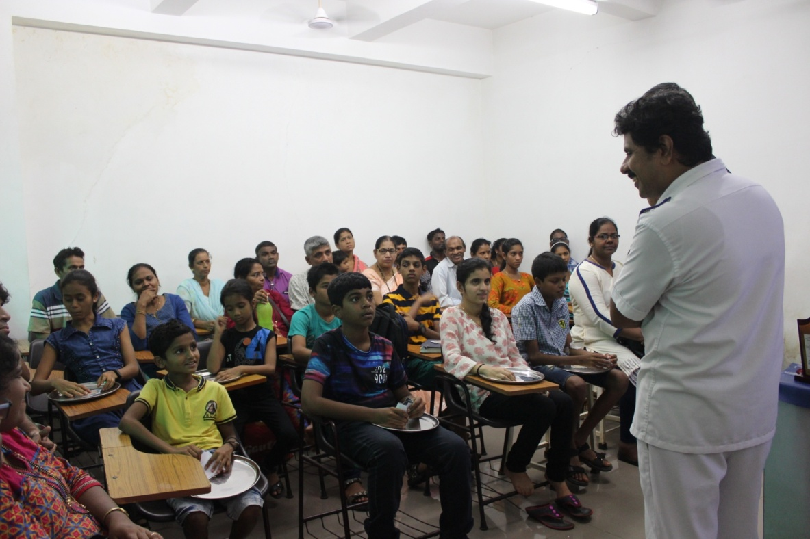
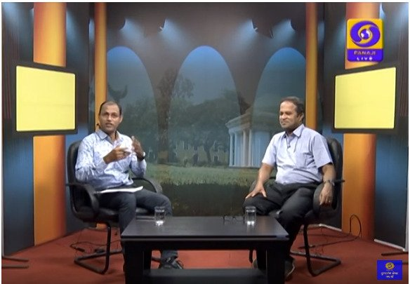
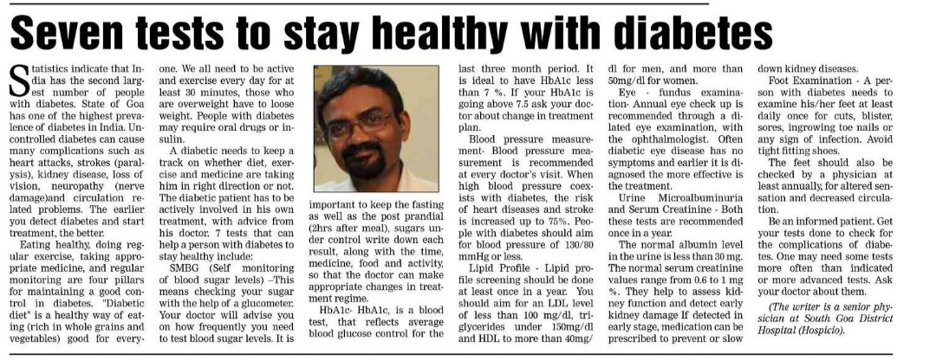
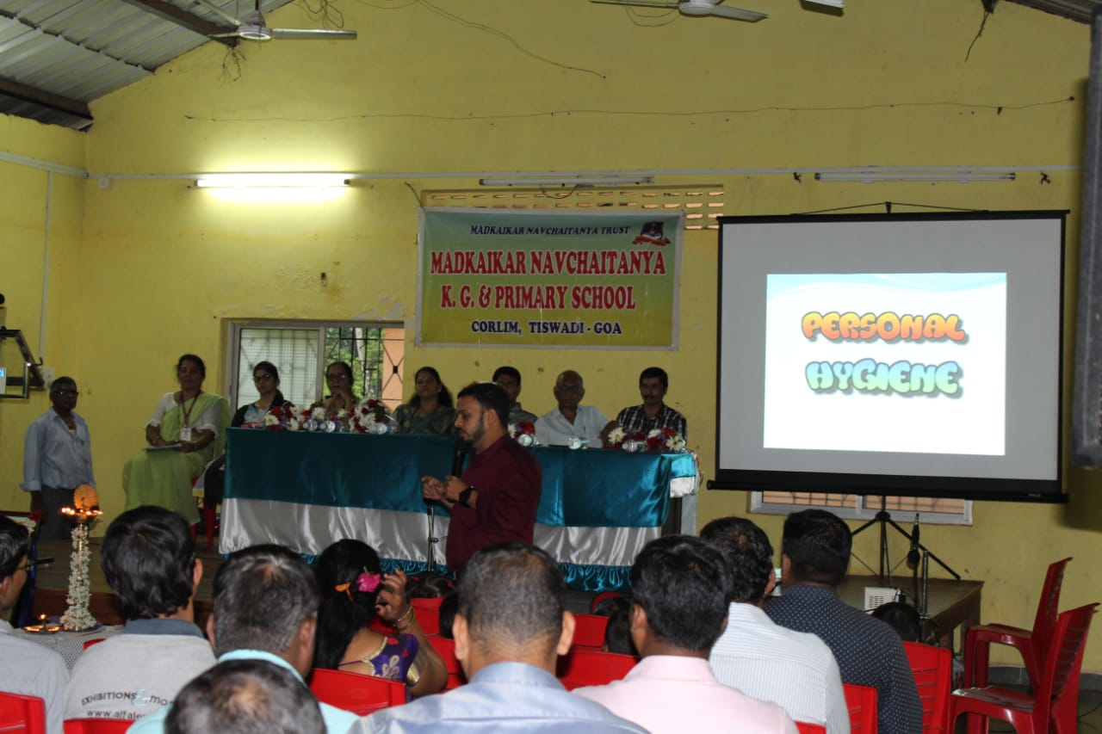

Slide 19
STATE INITITATIVES – BEST PRACTICES

Slide 20
The STEMI-Goa Project
Aims of the STEMI-Goa project:
To reduce mortality from STEMI in the state of Goa
To reduce morbidity resulting from STEMI in the state of Goa
Keeping in line with the objectives of Ayushman Bharat, the STEMI-Goa project aims at taking the best health practices and modern technology to all parts of the state and benefit the rich and the poor alike.
The project was launched in Goa in December 2018.
HUB: Goa Medical College & Hospital
1. Asilo Hospital, Mapusa
2. Hospicio Hospital, Margao
4. Sub-district Hospital, Chicalim
5.CHC Valpoi
3. Sub-District Hospital, Ponda
6. CHC Sakhali
7. CHC Pernem
8. CHC Canacona
9. CHC Curchorem
10. PHC Dharbandora
11. PHC Aldona
12. UHC Panaji
spokes

Slide 21
PROGRAM DESCRIPTION
Tele-ECG machine (Tricog Health Services, Pvt Ltd., Bengaluru)
Reporting in record time (< 5 minutes) + ECG alerts via SMS/ Email / App/ Call. (Median turnaround time from Dec’18- Jun’19: 1 m 48 sec)
Newer thrombolytic agents: Reteplase (to District Hospitals)/ Tenecteplase (to other spokes)
Defibrillator to all spoke centres & Non-invasive ventilators to district hospitals
Specialized Cardiac/ALS equipped ambulances (in association with 108 GVK- EMRI) manned by doctor, EMT & driver.
Strengthening of the ‘Hub’ Centre- i.e. the Department of Cardiology, Goa Medical College
Training of all medical officers.
All services under this project are provided free of cost to all people from Goa.

Slide 22
SUPPORTIVE MEASURES
A dedicated mobile phone with android OS to send and receive ECG related alerts and for communicating with Hub doctors using Cardionet App
Wireless Printers for printing ECG reports received from Tricog Health Services Pvt Ltd.
Setting up of Emergency Care Centres (ECCs) in selected spoke centres in partnership with 108 GVK EMRI
STEMI management protocols, drug information, cardiac monitor placement charts, etc. are displayed in the casualties. A desk reference manual prepared as a part of training of Medical Officers is also given to each medical officer and kept for reference in the casualty.
A STEMI kit
Till date 457 STEMIs have been diagnosed and 326 thrombolyzed under STEMI-GOA Project.

Slide 23
FINANCIAL IMPLICATIONS
CAPEX
Sr. No. |  | Particulars |  |  | Amount (INR)
1 |  | TELE ECG Machine |  |  | CSR Funding
2 |  | External Defibrillator/pacemaker |  |  | 1592910
3 |  | Ventilator |  |  | 1422400
4 |  | Resuscitation Kit |  |  | 86490
a |  | Adult Silicon Resuscitator
b |  | Laryngoscope Set
c |  | Guedel Airways
d |  | Silicon Mask
5 |  | Printers |  |  | 237428
6 |  | Phones |  |  | 149850
7 |  | STEMI Kits |  |  | 2772
Total |  |  |  |  | 3491850
OPEX
Sr. No. | Particulars | Amount (INR)
1 | Trainings | 600000
2 | Mobile Recharge | 108000
3 | IEC Material (STEMI Modules, spoke forms,etc) | 40000
4 | Electrodes | 65800
6 | ECG rolls | 619500
7 | Adult Pacer Electrodes (AED Pads) for DG – 400 Defibrillator | 150450
8 | Inj Tenecteplase / Inj Reteplase | 9000000
Total |  | 10583750
Grand Total |  | 14075600

Slide 24
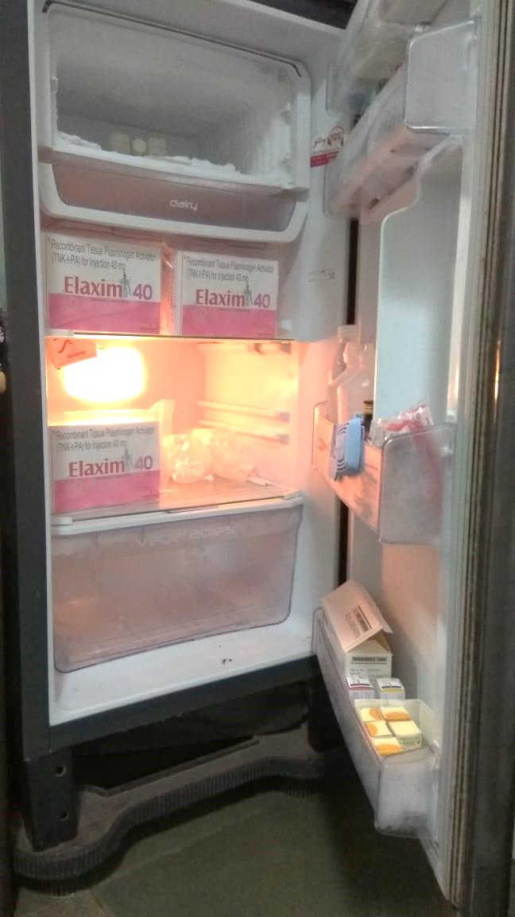
Utilization of thrombolytics under STEMI-Goa project from December 2018- June 2019
No. | Name of drug | Unit Cost | Consumption
1. | Inj. Tenecteplase | Rs. 23,237 + taxes | 119
2. | Inj. Reteplase | Rs. 14,350 + taxes | 285

Slide 25
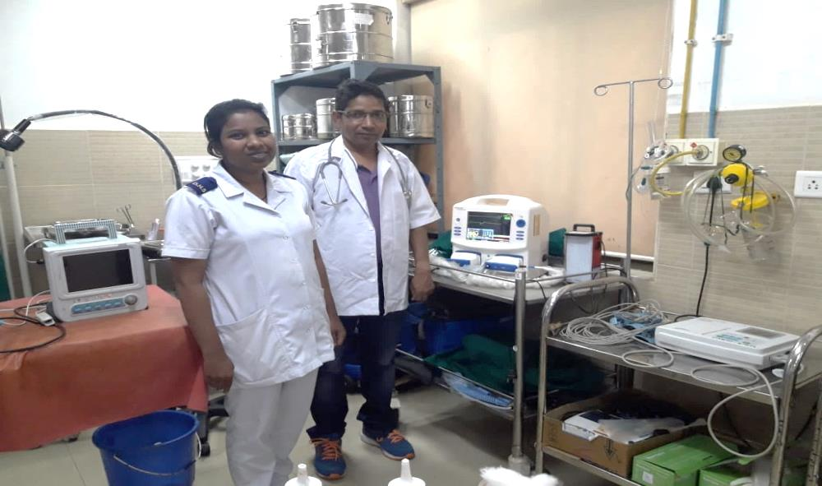
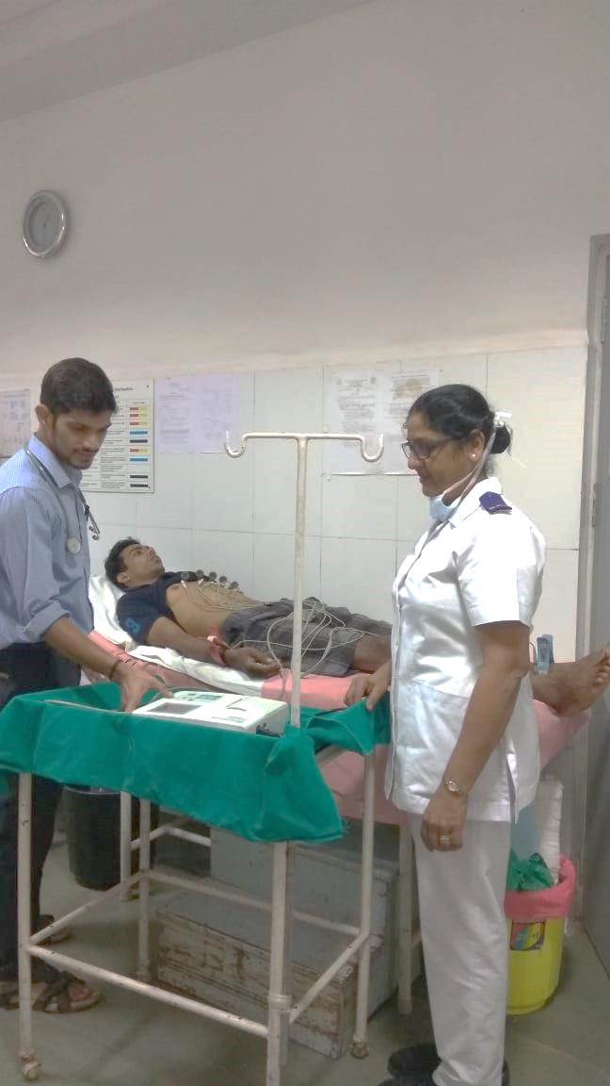
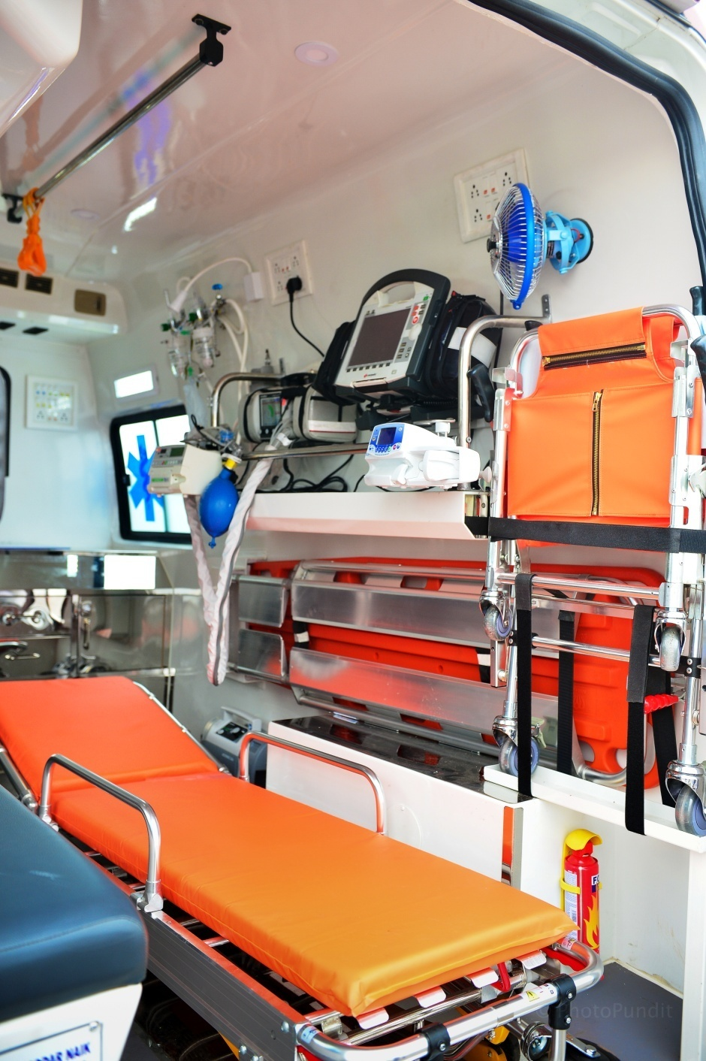
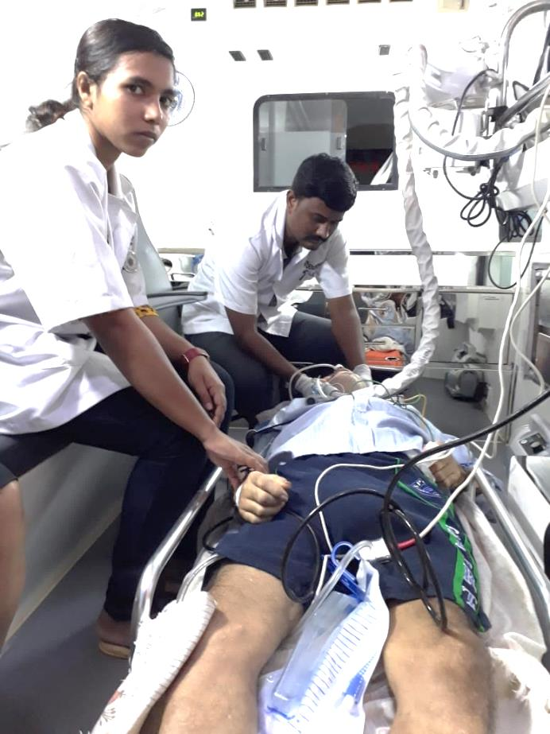

Slide 26



CHANGING DIABETES BAROMETER
An innovation by Government of Goa
In partnership with Novo Nordisk Education Foundation

Slide 27
COMPONENTS UNDER CDB PROJECT
CHANGING DIABETES BAROMETER
15 COMMUNITY DIABETES CENTRES (CDCS)
FREE TREATMENT for all Goans with diabetes, including provision of insulins
IN-DEPTH TRAINING based on latest international curriculum for Govt. doctors and healthcare workers
At-home counseling for people with diabetes by dedicated DIABETES EDUCATORS
Launch of a DIGITAL DIABETES REGISTRY to track patient progress

Slide 28
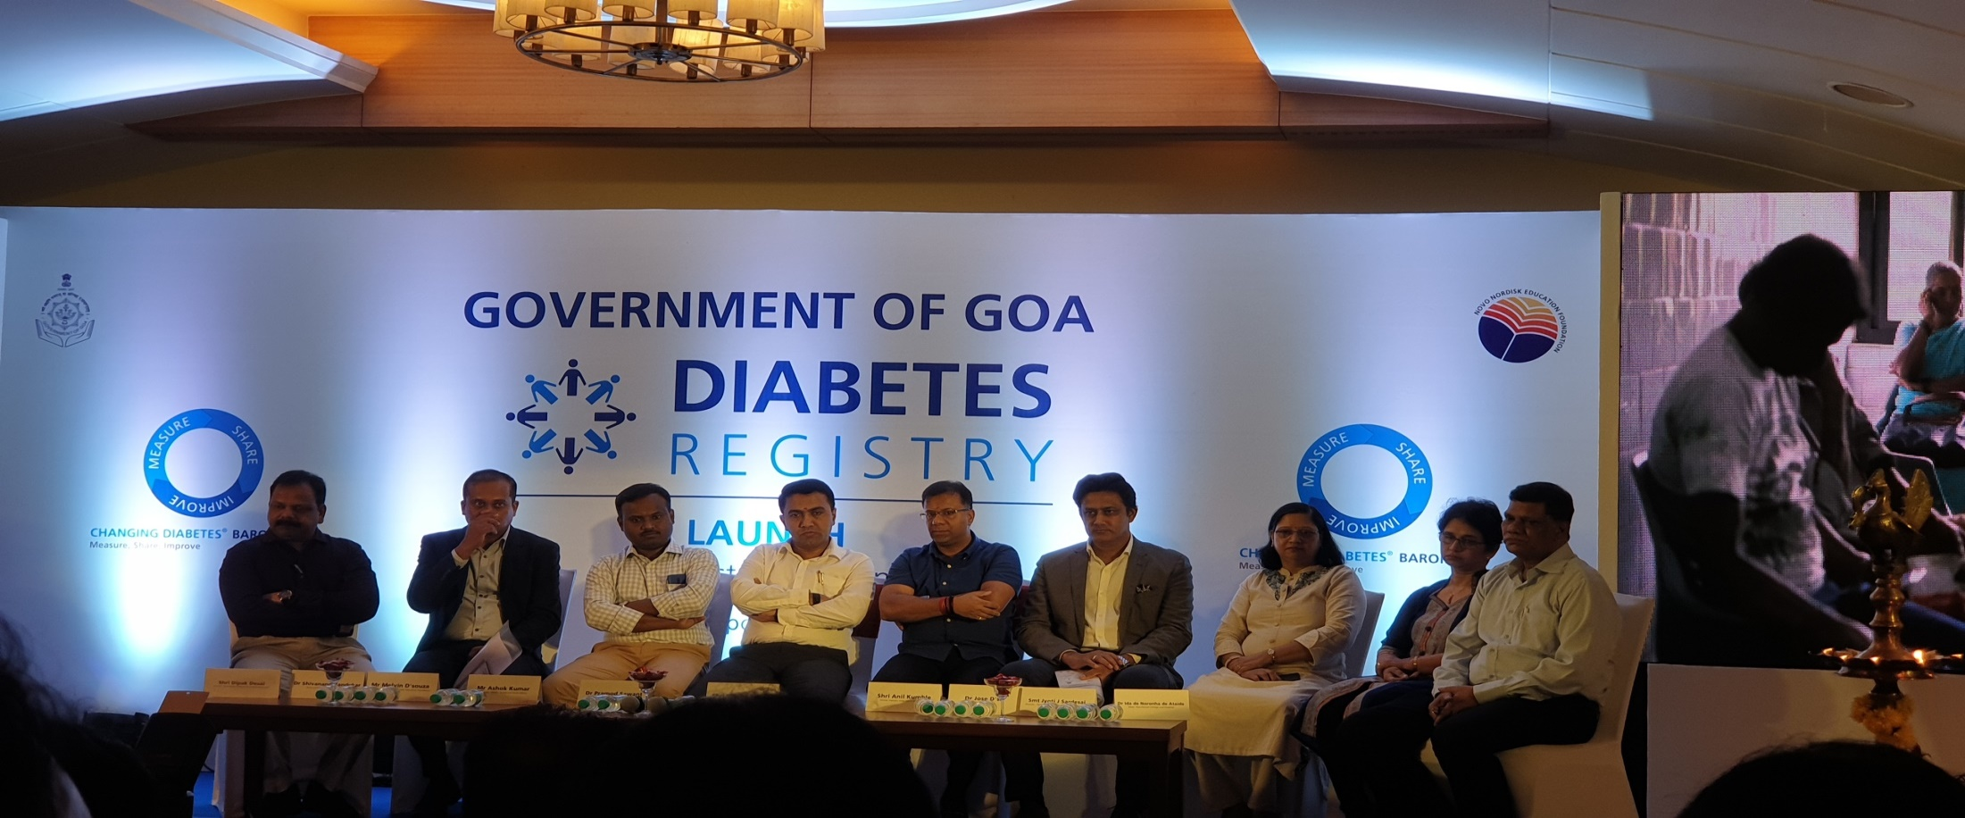
About 12000 Type II Diabetes patients have been benefited from CDB.
Over 100 patients of Type I Diabetes Mellitus are also receiving free treatment.
Linked with Diabetic Retinopathy Project.

Slide 29
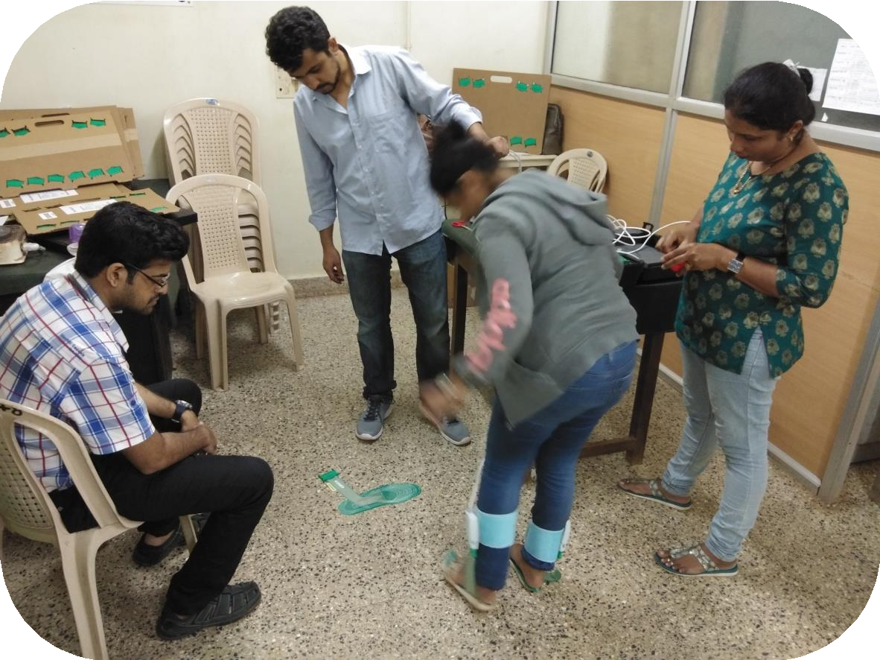
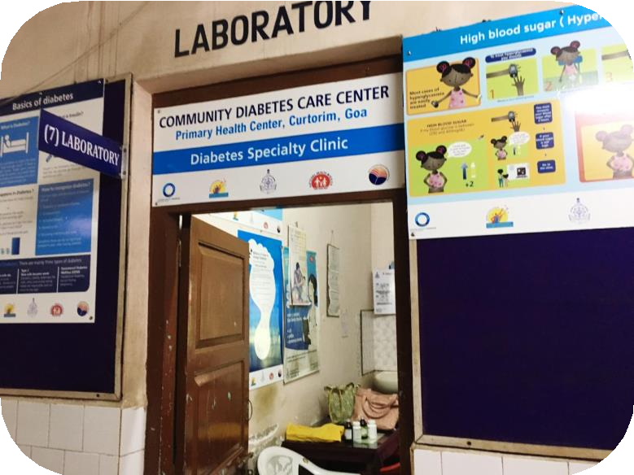
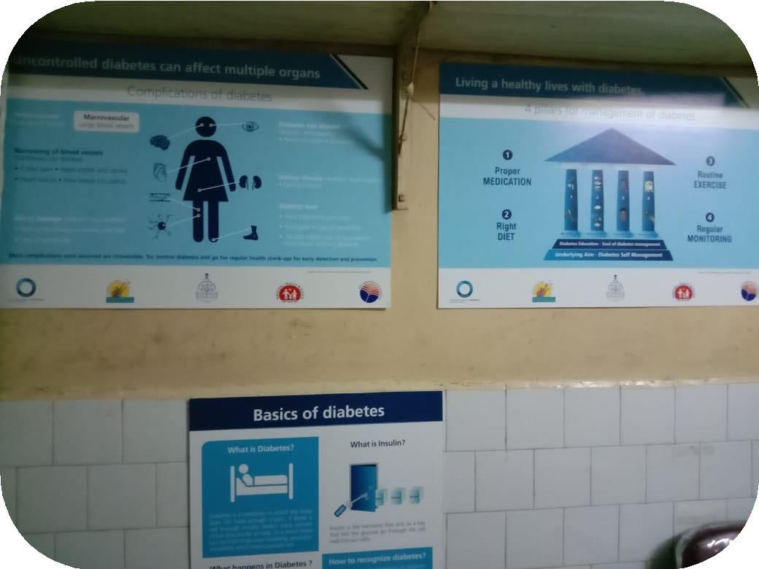
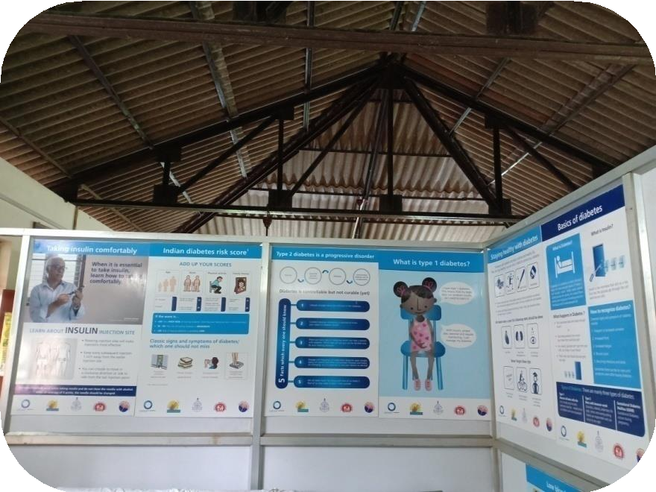

Slide 30
Mega Medical Camps
Unique to the State of Goa
Services provided are:
  Screening of common NCDs like Hypertension, Diabetes Mellitus, Ca Oral, Ca Breast, Ca Cervix is done by trained and expert staff
  Physicians, Surgeons, OBGY, Neurologist, Nephrologist, Pediatricians, Ophthalmologists, Orthopedician, ENT Surgeons, etc from GMC are part of the Mega Medical Camp
  Mobile Dental Van in collaboration with Goa Dental College.
  Free medications & Laboratory investigations
  IEC activities on lifestyle management of NCD
  Counseling services
  Yoga demonstration

Slide 31
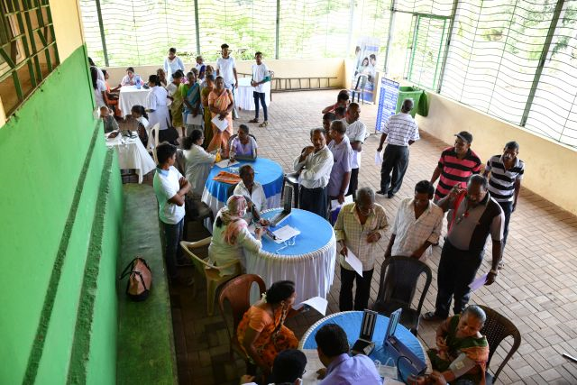
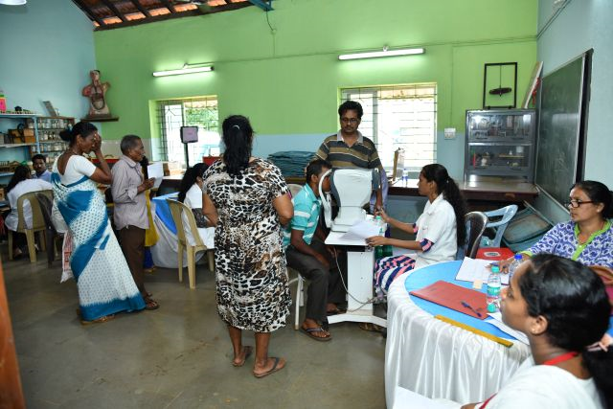
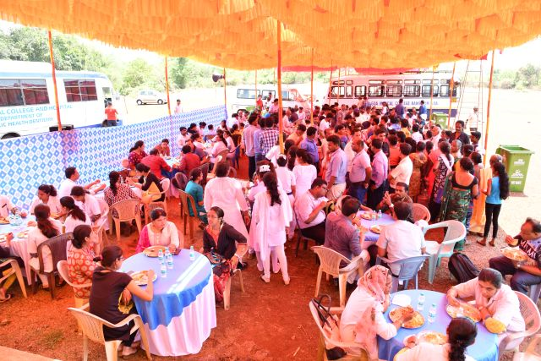
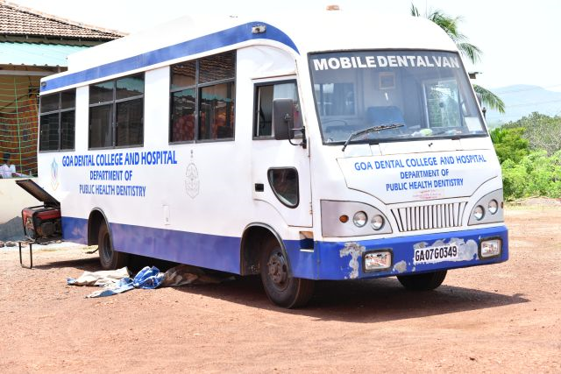

Slide 32
Mega Camp Data
24 Mega Medical Camps have been held across Goa till date.
Patients identified during these camps are given priority for Evaluation and Management at higher facilities.
Total No. Patients Screened for common NCDs = 14,750.
3563 patients referred from camps to higher centres.

Slide 33
NCD Camps
Outreach programme conducted monthly under each Health Facility
ANMs screen the population for the risk factors and presence of Non communicable diseases like Anemia, Hypertension, Diabetes Mellitus, COPDs, Oral Cancer, Breast Cancer, Cervical Cancer
Pap Smears done by Gynecologists during the camp.
Focus of action is on health promotion, early diagnosis, prompt initiation of treatment as well as complication screening and referral.

Slide 34
Till date Total NCD Camps held is 684.
6 cases of Breast Cancer & Cervical Cancer detected & are being treated for the same at Goa Medical College.
2 cases of Oral Cancer are being treated at Goa Dental College.
Health Condition | Total screened | Suspected | Confirmed
Anaemia | 18739 | - | 5906
Diabetes | 19826 | - | 4784
Hypertension | 19808 | - | 2311
COPD | 19551 | - | 38
Cancer Breast | 22386 | 22 | 6
Cancer Cervix | 6999 | 72 | 6
Oral Cancer | 19808 | 154 | 2

Slide 35
Collaboration with Sanofi India and DHS Goa
Sanofi has a 3-year partnership for capacity building of the State’s healthcare personnel and also educate children on the benefits of a healthy lifestyle and diabetes education.
Focus on training RBSK doctors, Counselors, Nutritionists and IEC officers and MBBS doctors and ANMS.
Implemented in cooperation with local health centers in a phase wise manner.
To increase awareness and health literacy within the rural population on diabetes, hypertension through schools.

Slide 36
KiDS Programme
Sanofi co-created the Kids and Diabetes in School (KiDS) project with the International Diabetes Federation (IDF) and the International Society for Pediatric and Adolescent Diabetes (ISPAD) and Public Health Foundation of India (PHFI)
support children with Type 1 diabetes manage their disease and avoid discrimination in a school setting and
raise awareness of the benefits of healthy diets and physical activity among school children.
Activities conducted
Trainings conducted from 24th June -to 28th June 2019 for the school teachers of North and South Goa.
69 Doctors rained who in turn will train , conduct activities and awareness in the community .
Total 381 teachers were trained.
IEC activities are being conducted at schools and other educational institutions

Slide 37
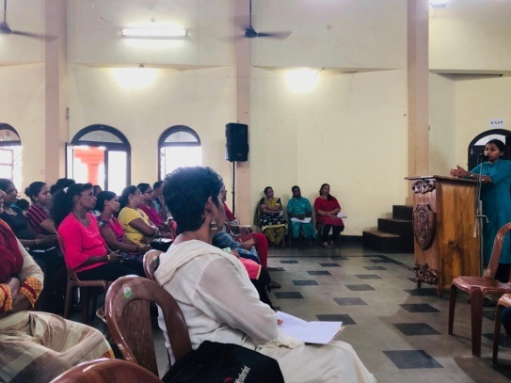
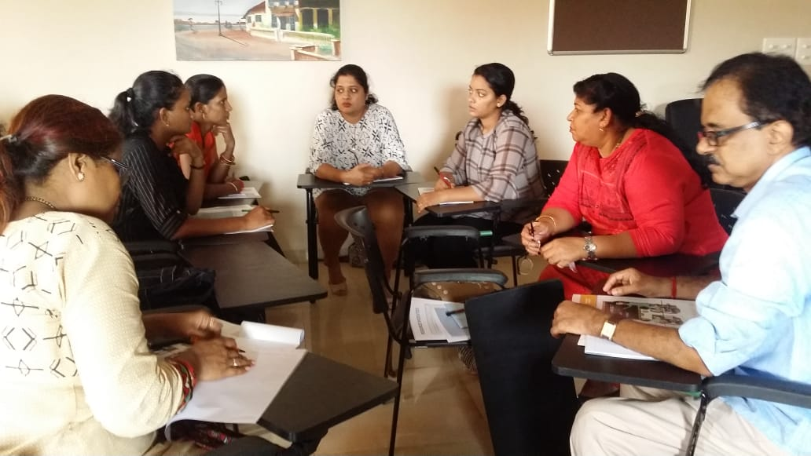
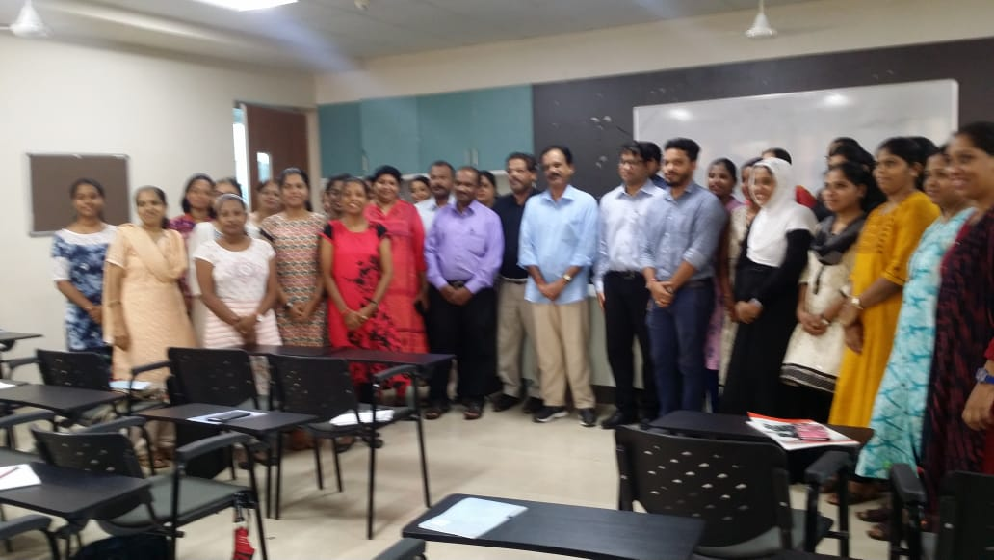
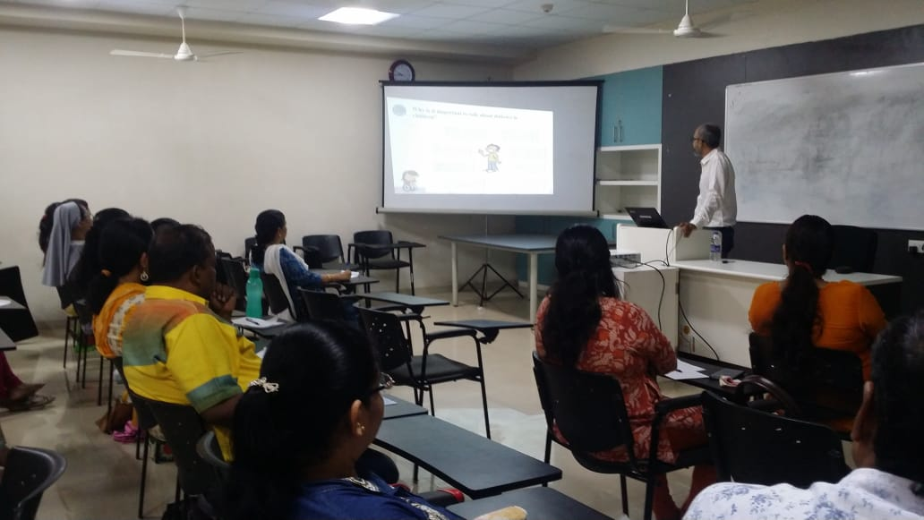
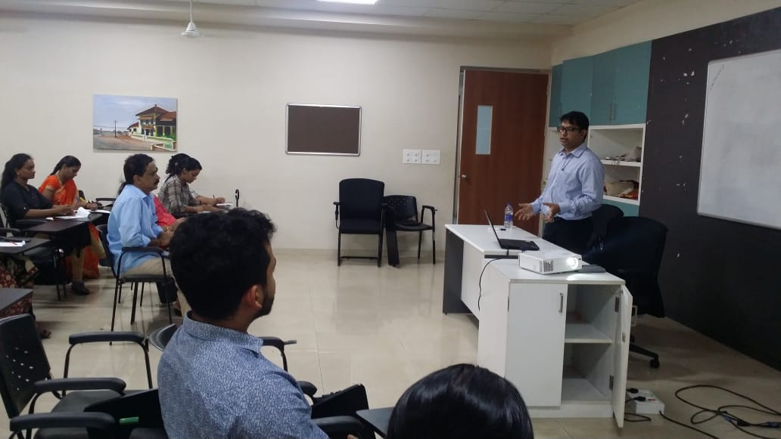
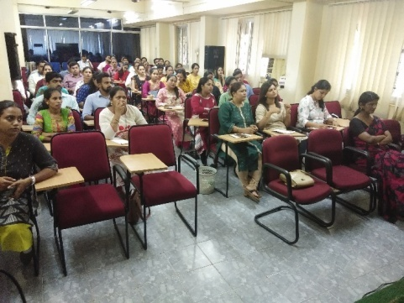
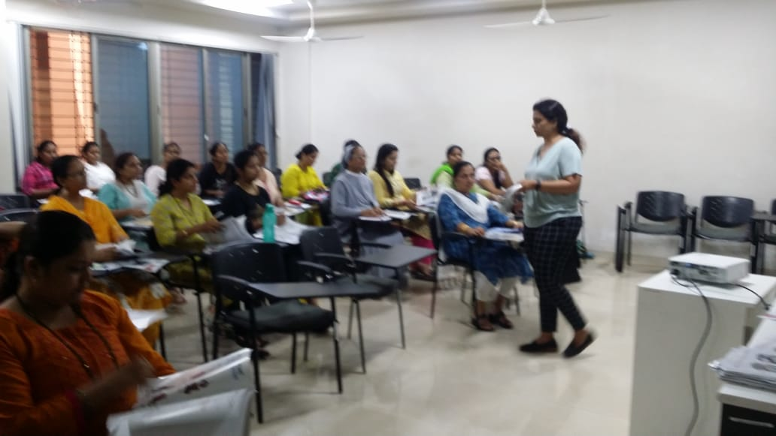
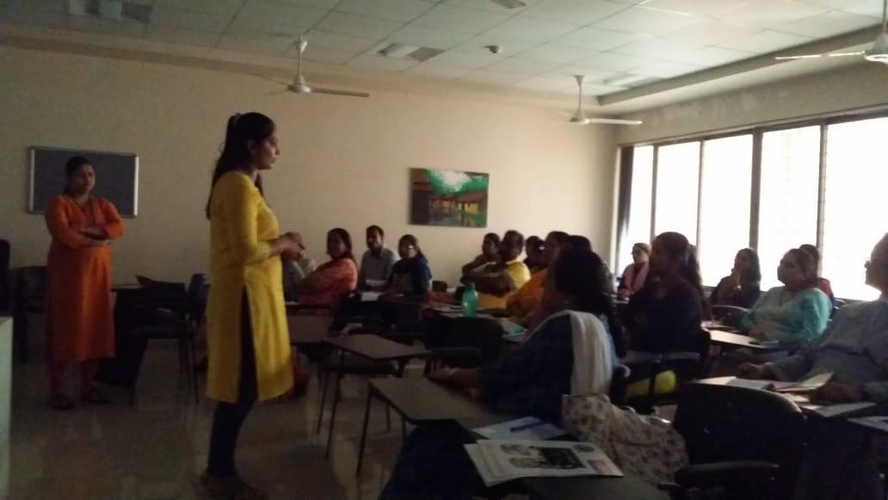
Training sessions for school teachers

Slide 38
Collaboration With Cipla
Trainings and Awareness activities within the state.
Survey was conducted for all the 12 Talukas all the talukas will be targeted for interventions for mission tobacco free Goa.
The main objective of the programme is to target Sal Panchayat in PHC Bicholim in North block and declare it as smoke free.
Similarly, Target Colva Beach in PHC Cansaulim in South block and Declare it as smoke free.

Slide 39
Trainings And Awareness Activities
Dentist, Ayush Doctors, RBSK Doctors, Health Educator, Extension Educator, IEC Officers, Medical Officers, From various Health Facilities including Anaganwadi workers, ANMs etc.
Trainings for Law Enforcement Agencies such as municipality officers, sanitary inspectors, Jt. Mamlatdar, additional collector, police officers, officials from legal metrology, FDA, information and publicity, civil supply, panchayati raj, excise dept. were conducted along with Field visits and Challaning for Compliance of COTPA act 2003.

Slide 40
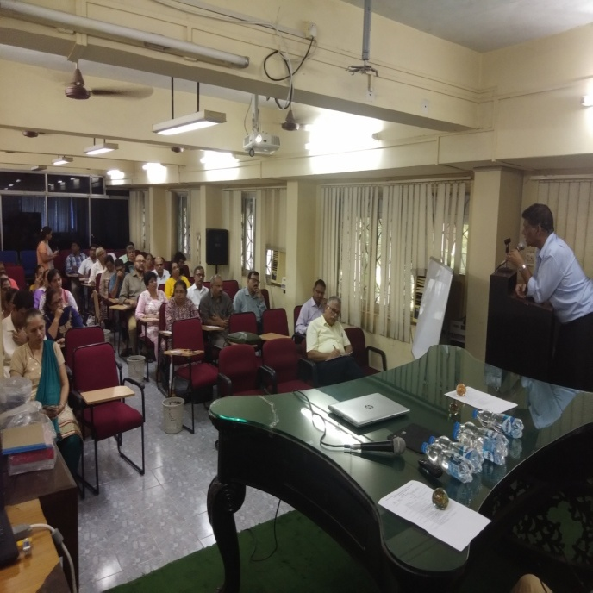
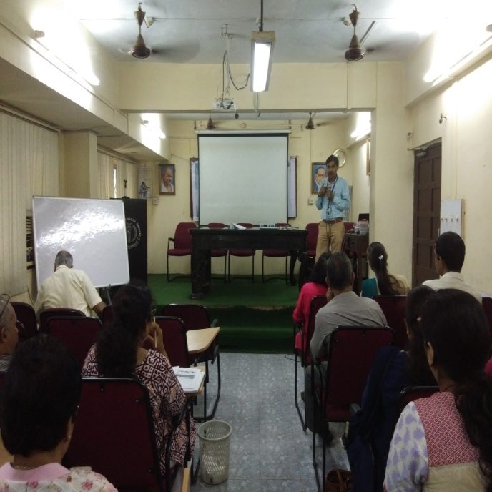
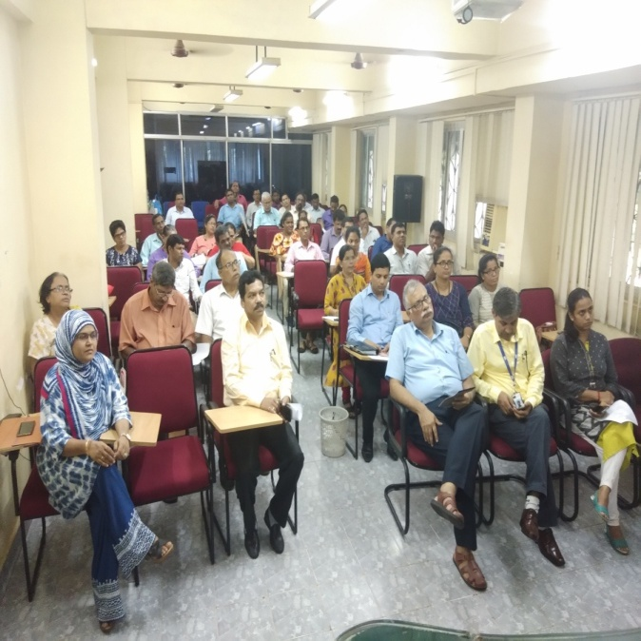
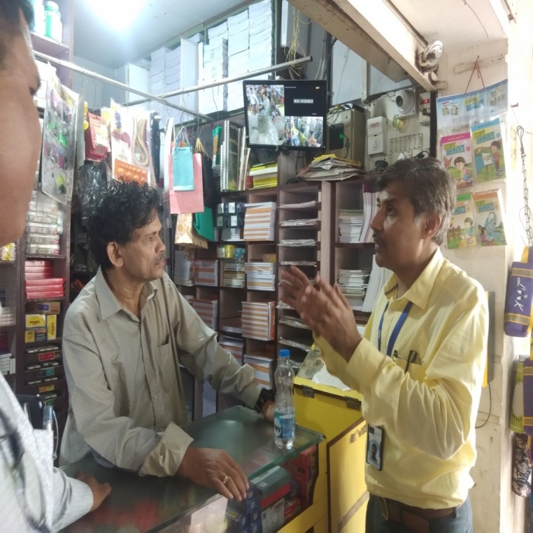



Slide 41
District Mental Health Programme
Regular Psychiatric OPD conducted at both District Hospitals.
Outreach Psychiatric OPD at Health Centres by District Mental Health Team.
Camps are conducted by District Mental Health Team at Schools.
Medical Officers and RBSK Doctors are trained for prevention, early detection and referral of common mental health illnesses at IPHB, Bambolim – Goa.
Detoxification Centre is functional in both the District Hospitals under Senior Psychiatrist
Health Awareness on harmful use of alcohol & substance abuse at Educational Institutes, Panchayats, VHNSC, Construction sites is conducted.

Slide 42

National Programme for Palliative Care
Under the NPPC, Pain & Palliative Care OPD is inititated at South Goa District Hospital on every Tuesday.
The training of the selected staff from both the District Hospitals on Palliative care was conducted at 10 day workshop on Foundation course on Palliative Care in collaboration with NGO Dilasa.

Slide 43
Narayana Hrudayalaya
Three consecutive OPD’s every second week of month with speciality as Liver Transplant, Nephrology, Neurology and Paediatric Cardiology, Oncology.
Specialist OPDs are conducted regularly at Asilo Hospital, Hospicio Hospital, SDH Ponda, SDH Chicalim

Slide 44
NH OPD from March 2019 onwards
Super Speciality | Total no. of patients
Paediatric Cardiology | 219
Gynae-onco | 08
Surgical / Gastro Onco | 46
Liver transplant | 30
Neurology | 90

Slide 45
Issues in Goa
Human Resource:
  As Goa does not have ASHAs and all urban area population ranges between 60,000 to 10,0000, additional ANMs required to cater the urban population
  As RMDs have been designated as HWCs, provision has to be made for Lab Technicians under NHM
2. Infrastructure:
- Rs. 1 crores have been proposed in supplementary PIP for upgrading infrastructure and additional room for Lab facilities.

Slide 46
Issues in Goa contd..
3. IT issues:
- RMDs are not mapped in the NCD and AB-HWC Portal. So provision has to be made by NHSRC for the same.
- Some PHCs have been shifted from North Goa District to South Goa District. New PHCs have been created. Similarly, Subcentres have been transferred from one to another PHCs. All these Health Facilities need to be mapped correctly.
- Population more than 9999 cannot be uploaded on NCD App used by ANMs in urban areas.

Slide 47


