Slide 1
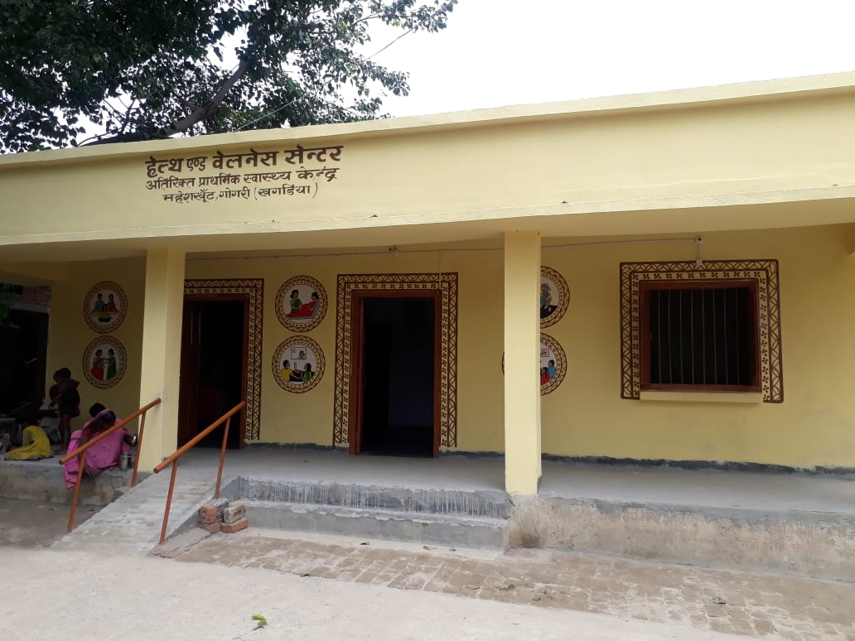
Developing
Health & Wellness Centre
State Health Society Bihar

Slide 2
STATE PLANNING TO DEVELOP HWCs
Total in FY 2018-19 | 598
Total in FY 2019-20 | 2250
By Dec 2019 | 814

Slide 3
DISTRICT PLANNING TO DEVELOP HEALTH AND WELLNESS CENTRE TILL DECEMBER IN FY 2019-20

Slide 4
Tele-Medicine Service

Slide 5
MCH IDENTIFIED AS HUBS
AIIMS,
PATNA
IGIMS,
PATNA
DMCH,
DARBHANGA
ALL DISTRICT HOSPITALS TO SERVE AS HUBS FOR HWCs (SPOKES)

Slide 6
IDENTIFIED DISTRICTS AS HUBS
AIIMS (15)
Arwal
Bhojpur
Buxar
Aurangabad
Gaya
Jehanabad
Kaimur
Nalanda
Nawada
Patna
Rohtas
Saran
Sheikhpura
Siwan
Vaishali
DISTRICT NAME UNDER HUB

Slide 7
IDENTIFIED DISTRICTS AS HUBS
DMCH (12)
Darbhanga
Gopalganj
Madhepura
Madhubani
Muzaffarpur
Paschim Champaran
Purba Champaram
Saharsa
Samastipur
Sheohar
Sitamarhi
Supaul
DISTRICT NAME UNDER HUB

Slide 8
IDENTIFIED DISTRICTS AS HUBS
IGIMS,
PATNA
(11)
Araria
Banka
Begusarai
Bhagalpur
Jamui
Katihar
Khagaria
Kishanganj
Lakhisarai
Munger
Purnea
DISTRICT NAME UNDER HUB

Slide 9
Starting Telemedicine Services
Funds for same sought in SPIP
  HUBS - Desktop, HD Web Camera, Headphone, Microphone & Net connectivity for two systems per HUB
  Spokes – Laptops are being procured, some minor procurement like headphone, Internet Connection required

Slide 10
Certificate Course in Community Health for Ayurveda Practitioners & Nurses
1. Nineteen (19) Program Study Centres (PSCs) accrediated for Certificate Course in Community Health by IGNOU
2. 47 CHO’s already working in Health & Wellness Centres
3. IGNOU Course completed for 58 Ayurveda Practitioners of January 2019 batch. Results awaited.
4. For non inclusion of Homoeopath, litigation with CWJC No. 13410/2019 in Hon’ble Patna High Court with vacation of GNM /B.SC. Nurses entrance exams .
Only Nurses have been allowed to appear at the examinations for 400 positions. Admission expected to be completed before 31st Aug 2019.

Slide 11
ACCREDIATION OF PROGRAM STUDY CENTRE FOR CERTIFICATE COURSE IN COMMUNITY HEALTH
SL No. | Name of Regional Centre, IGNOU | District Name | Hospital Name
01 | PATNA | Patna | GGS Hospital, Patna City
02 |  | Vaishali | District Hospital, Hajipur
03 |  | Nalanda | District Hospital, Biharsharief
04 |  | Aurangabad | District Hospital, Aurangabad
05 |  | Buxar | District Hospital, Buxar
06 |  | Kaimur | District Hospital, Bhabhua
07 |  | Rohtas | District Hospital, Sasaram
08 |  | Sheikhpura | District Hospital, Sheikhpura
09 |  | Jamui | District Hospital, Jamui
10 |  | Saran | District Hospital, Chapra
11 | DARBHANGA | Gopalganj | Sub-Divisional Hospital, Hathua, Gopalganj
12 |  | Madhubani | District Hospital, Madhubani
13 |  | Muzaffarpur | District Hospital, Muzaffarpur
14 |  | Samastipur | District Hospital, Samastipur
15 | BHAGALPUR | Banka | District Hospital, Banka
16 |  | Bhagalpur | District Hospital, Bhagalpur
17 | SAHARSA | Khagaria | District Hospital, Khagaria
18 |  | Supaul | District Hospital, Supaul
19 |  | Purnea | District Hospital, Purnea

Slide 12
Daily Reporting Status on HWC Portal
State Daily Report filled in HWC Portal Status
Date | 30/7/2019 | 1/8/2019 | 9/8/2019 | 10/8/2019 | 12/8/2019 | 13/8/2019 | 14/8/2019 | 16/8/2019
opd_male | 14 | 2 | 138 | 147 | 299 | 446 | 660 | 778
opd_ female | 10 | 3 | 93 | 113 | 216 | 326 | 526 | 605
opd_total | 24 | 5 | 231 | 260 | 515 | 772 | 1186 | 1383
opd_medicines | 24 | 5 | 228 | 258 | 510 | 772 | 1136 | 1366
opd_ patients_ investigation | 24 | 0 | 27 | 39 | 90 | 46 | 69 | 76
opd_yoga | 2 | 0 | 0 | 0 | 2 | 0 | 0 | 0
16 Districts reporting already started
Rest to be started soon

Slide 13
Districtwise M.O Training of Trainers (ToT)on CPHC
Sl. No. | District | No. of MBBS doctor Trained | Sl. No. | District | No. of MBBS doctor Trained
1 | Araria | 5 | 21 | Madhubani | 3
2 | Arwal | 3 | 22 | Munger | 5
3 | Aurangabad | 1 | 23 | Muzaffarpur | 5
4 | Banka | 4 | 24 | Nalanda | 5
5 | Begusarai | 5 | 25 | Nawada | 5
6 | Bhagalpur | 5 | 26 | Patna | 3
7 | Bhojpur | 3 | 27 | Purnea | 6
8 | Buxar | 4 | 28 | Rohtas | 4
9 | Darbhanga | 4 | 29 | Samastipur | 3
10 | Purba Champaran | 3 | 30 | Saran | 5
11 | Gaya | 5 | 31 | Sheikhpura | 2
12 | Gopalganj | 4 | 32 | Sitamarhi | 5
13 | Jamui | 4 | 33 | Siwan | 3
14 | Jehanabad | 4 | 34 | Supaul | 4
15 | Kaimur | 3 | 35 | Vaishali | 4
16 | Katihar | 6 | 36 | Paschim Champaran | 4
17 | Khagaria | 4 | 37 | Saharsa | Training being held
18 | Kishanganj | 1 | 38 | Sheohar | Training being held
19 | Lakhisarai | 3 |  | Grand Total | 140
20 | Madhepura | 3
These
trained MOs
are District
trainers

Slide 14
Screening of NCDs (NCD Portal) 18.08.2019
Total Enrollments |  | Total Patients Screened |  | Referred to PHCs
All | > 30 years | Partial | All diseases
16189 | 11171 | 506 | 530 | 382
Total Tablets available with ANMs: 147

Slide 15
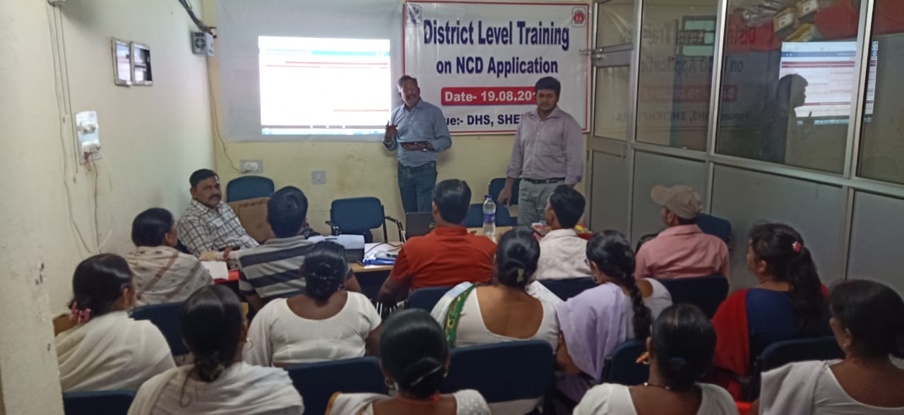
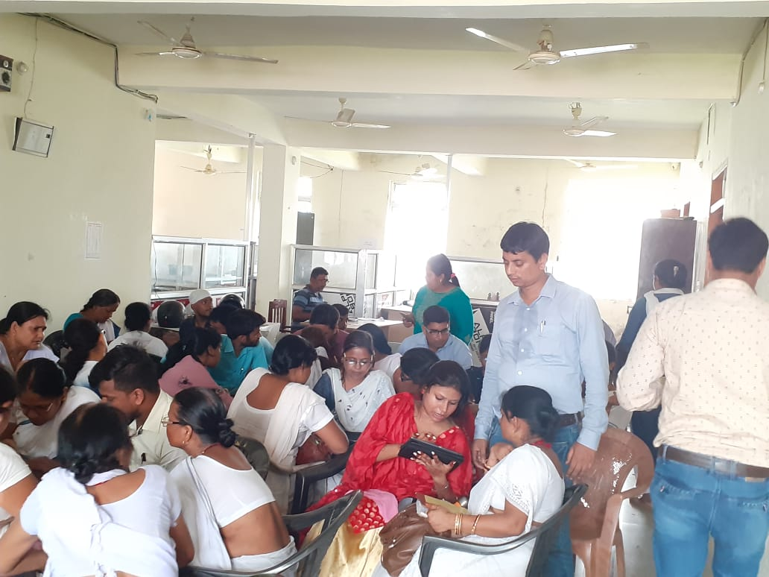
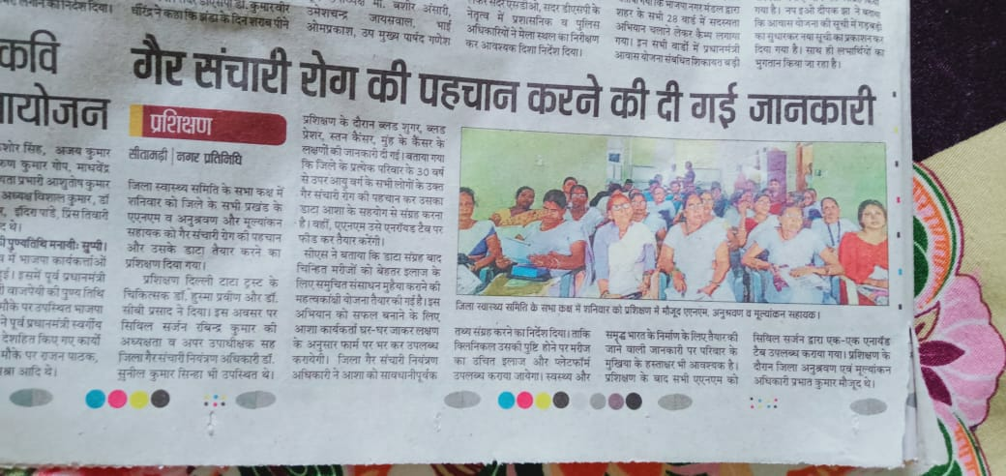


Slide 16
TRAINING ON NCD APPLICATION
147 android tablets procured. All 147 ANMs trained
3799 ANMOL tablets distributed to ANMs of Aspirational districts. Training under process
Approximately 14,000 tablets being procured by BMSICL
District Monitoring & Evaluation Officers - District trainers on NCD App
Block Monitoring and Evaluation Assistants - Block level Trainers on NCD app
Training on NCD Portal ongoing in 13 Aspirational Districts. More than 3800 Android Tablets to start reporting on NCD Portal from 1st September 2019

Slide 17
A OVERVIEW ON
INFRASTRUCTURE
&
BRANDING
OF FACILITIES

Slide 18
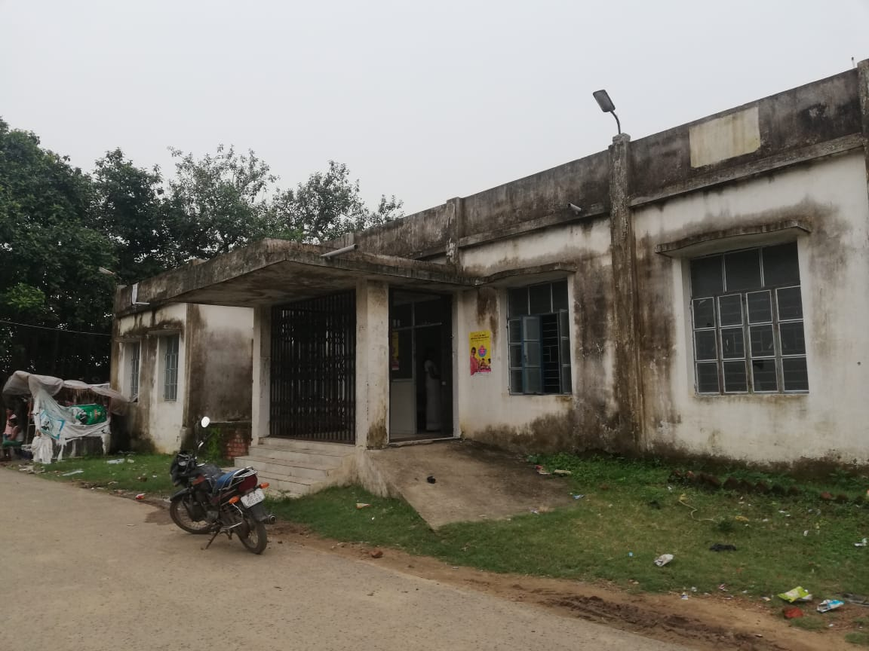
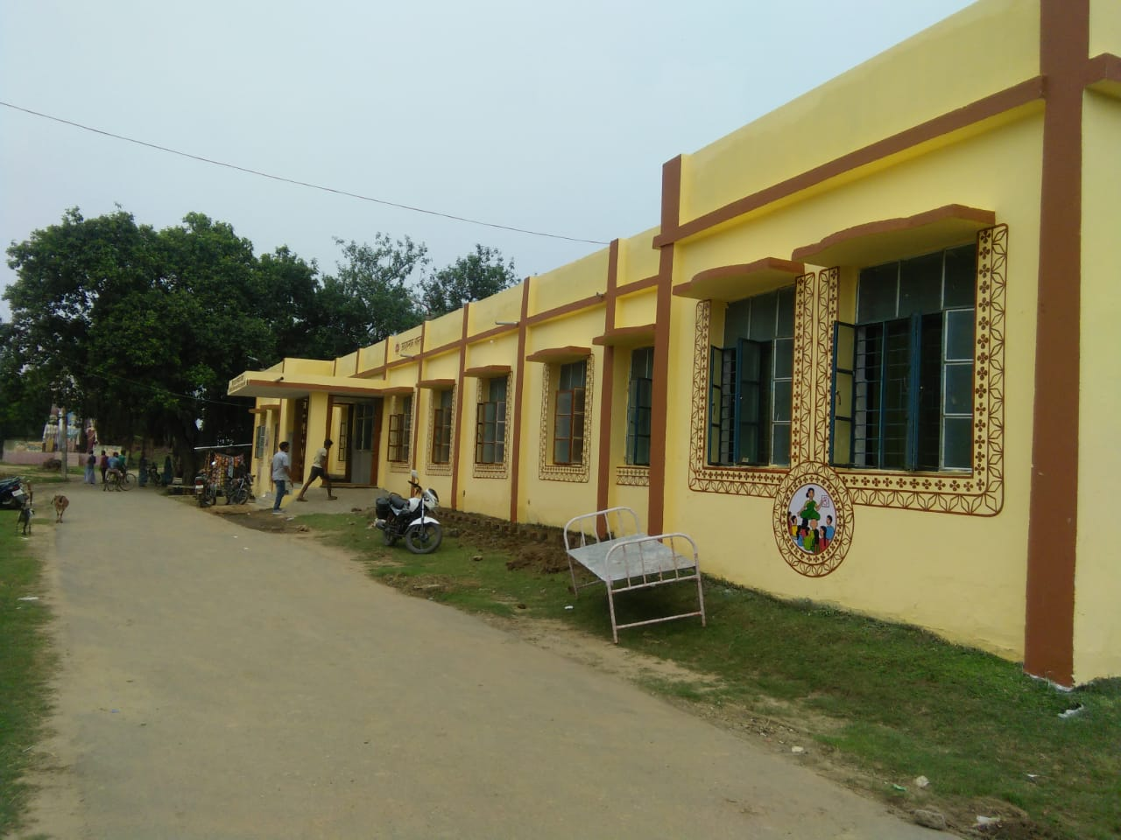
NALANDA- APHC GOKUL MATH
Before
After

Slide 19
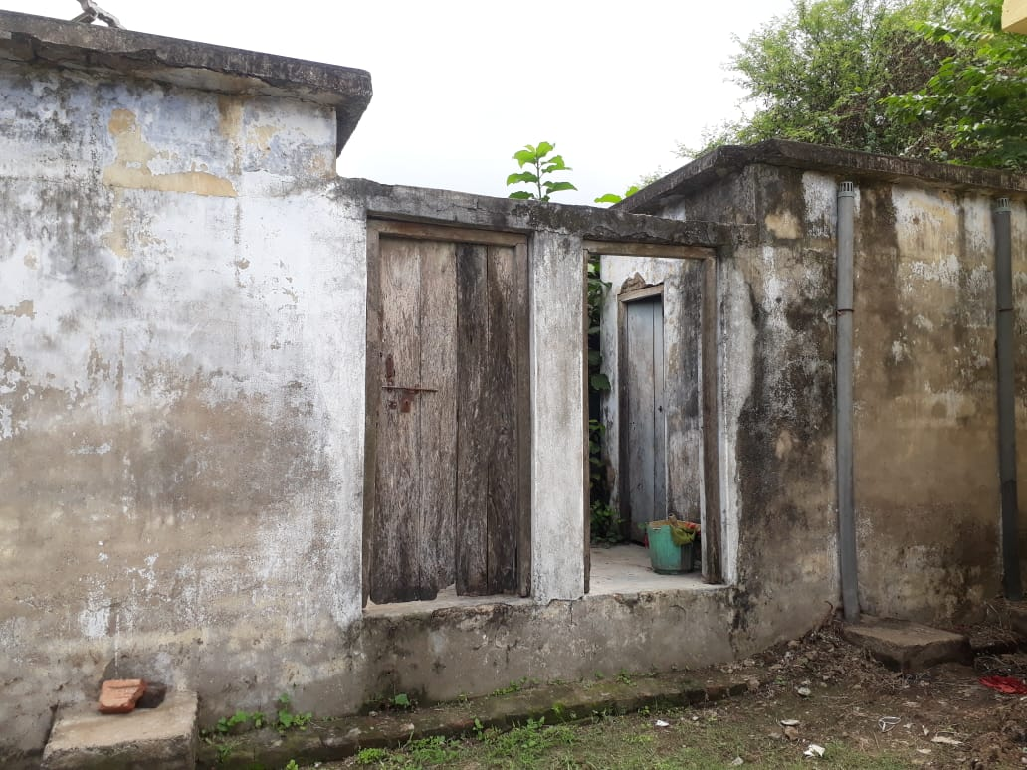
KHAGARIA- APHC MAHESHKHUNT
Before
After

Slide 20
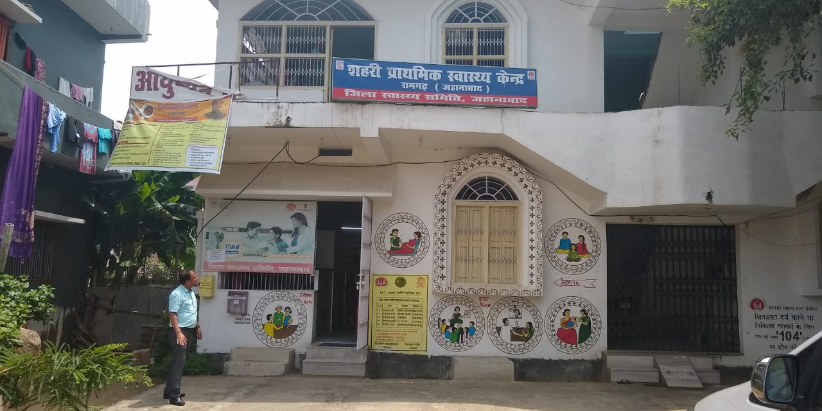
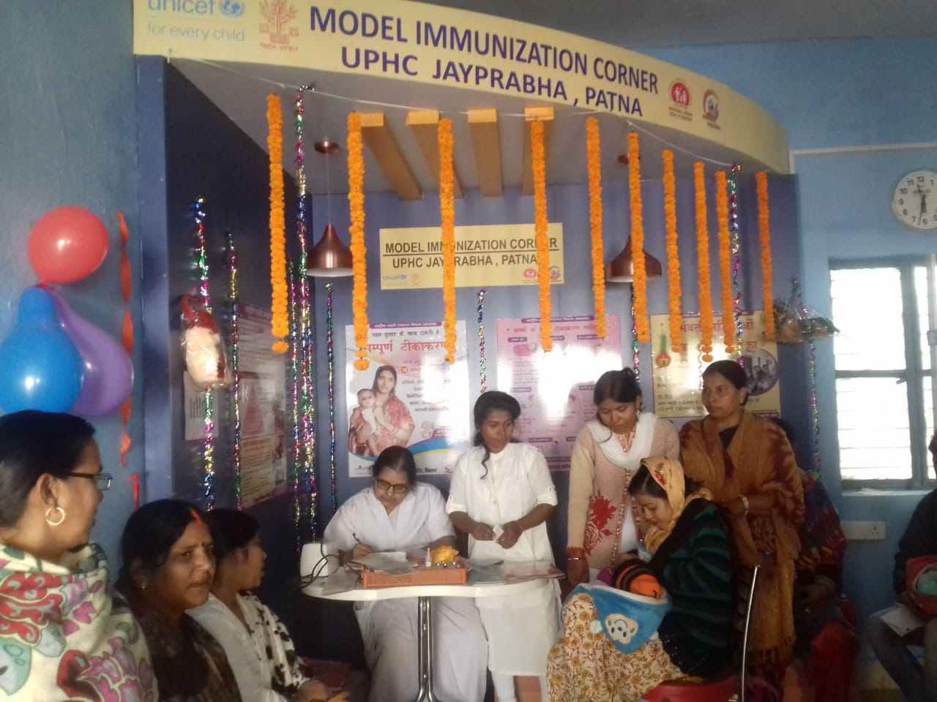
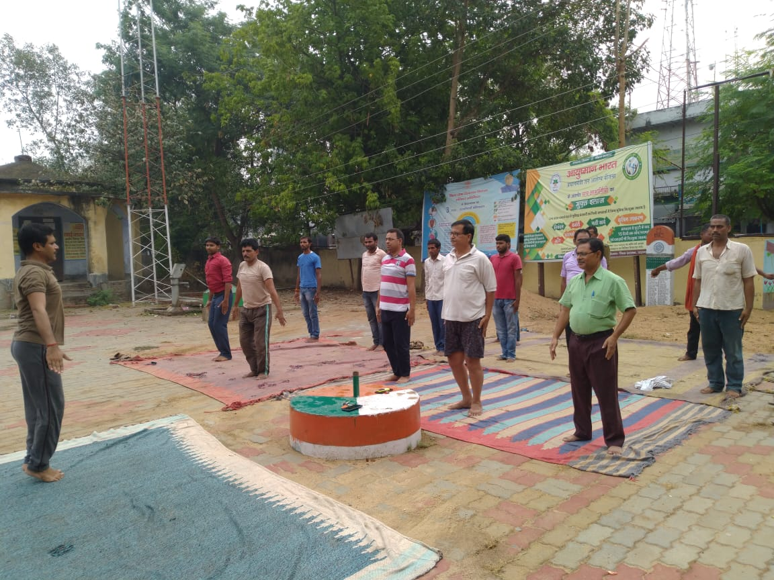

Slide 21
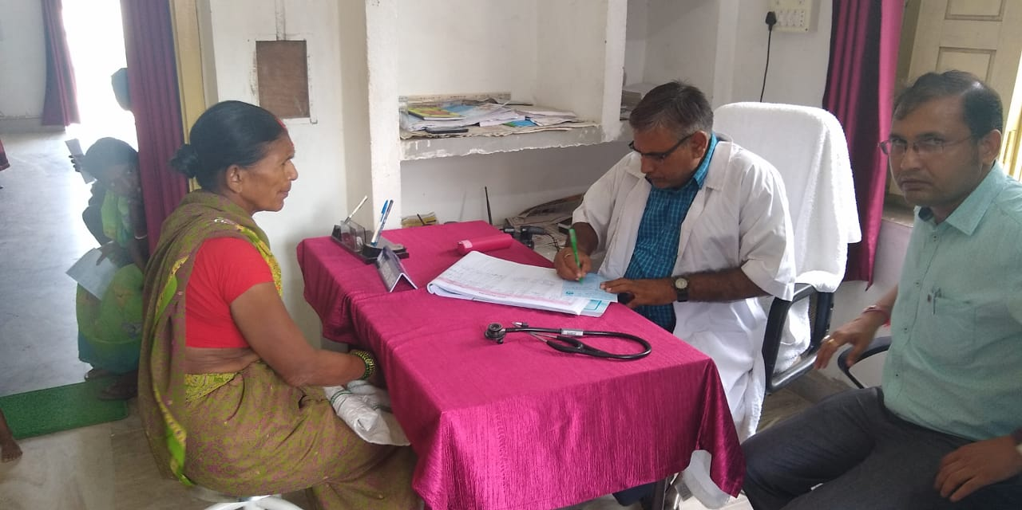
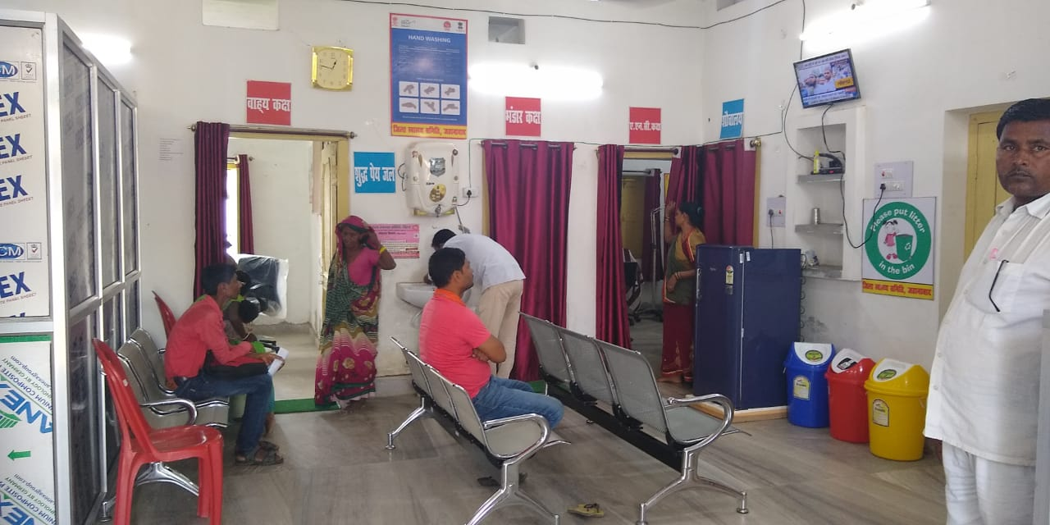

Slide 22
Challenges
Shortage of HR – MOs, Lab Technicians, Pharmacists, Staff Nurses
Relatively high attrition of MO
Quality training and skill up gradation of HR especially staff nurse in use of various IT applications
Delay in procurement of android tablets, laptops & other IT equipment
Infrastructure at places requiring more funds for refurbishments
Litigation in Hon’ble Patna High Court resulting in stay on entrance test for CHO. Stay for Staff Nurses vacated.
Procurement of Drugs and consumables through BMSICL need to be strengthened

Slide 23
Way Forward…
Telemedicine facilities expected to start in this Financial Year 2019-2020.
Filling HR gap at the earliest. HR agency has been identified
In house Pathological tests at APHCs & UPHCs
ANM kit for basic pathological strip based test being procured
Pathological Tests on Hub & Spoke Model for higher pathological tests

Slide 24
Way Forward…
EDL revised. 91 (earlier 50 OPD/34 IPD) EDL Drugs & 27 medical consumables for HWCs approved by EDL Committee
DVDMs (e-Aushadhi) to be extended to HWCs in phase wise manner
Streamlining procurement & indenting of drugs

Slide 25
Achievement
ASHA training has been completed.
140 MO posted at APHC have been trained about HWC functions and various IT application.
Family Folder & CBAC Forms are being filled. Screening for Breast, Oral Cancer and TB/ Leprosy cases being identified regularly.
Annual Calendar of Wellness Activities shared by GOI disseminated to all districts. Fund allocated. Materials disseminated
Yoga activities started being scaled up in all HWCs. Physical Instructors of Sarv Shiksha Abhiyaan involved after State level Officials convergence meeting. More than 2000 instructors available with 114 specially trained in Yoga
Posting of pharmacist and lab technician is completed for UPHCs
5 Model Immunization centre operational. Target to operationalize total 100 MIC by December ’19

Slide 26
Thank You…

