Slide 1

DIGITAL HEALTH INITIATIVES
Ministry Of Health & Family Welfare
Government of India

Slide 2
Vision of Digital Health
Create EHR of 1.3 billion people with Pan-India exchange in secured manner
Set-up pan-nation Telemedicine Network
Optimal use of IT for pan-nation surveillance & monitoring of programs
Efficient use of IT tools for capacity building & training
Wide-scale deployment of IT tools for governance & information dissemination
India undertook various initiatives in digital domain for efficient health service delivery

Slide 3
Institutional Framework eHealth
eHealth
Centre for Health Informatics (CHI), NIHFW
National Resource Centre for EHR standards (NRCeS)
National Resource Centre for Telemedicine
Established in 2013 by The National Institute of Health and Family Welfare (NIHFW)
Work as the secretariat for managing the activities of the National Health Portal and other eHealth initiatives of MoHFW.
Established in 2014 at C-DAC ,Pune
Facilitate adoption and promotion of standards
National release centre for providing free of cost SNOMED license and tool kits
Providing assistance in developing, implementing and using EHR standards effectively in healthcare IT applications across country
Established in 2011 at SGPGI Lucknow & supported by 7 Regional Resource Centres (RRCs)
To develop and strengthen Telemedicine technologies
To provide necessary technical assistance and handholding to State governments.
Act as implementation wing for tele education and tele medicine initiatives

Slide 4
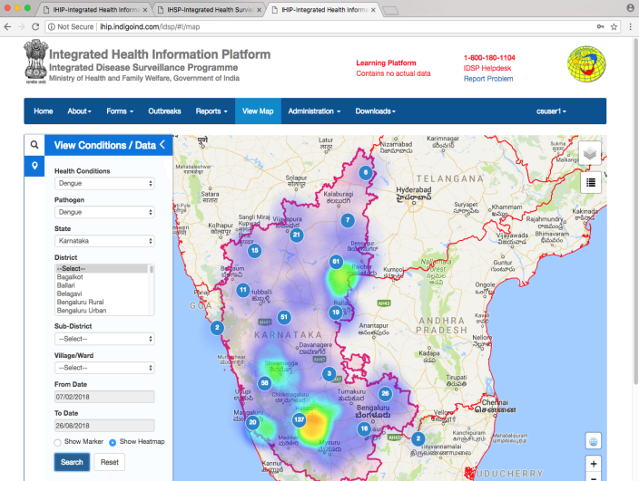
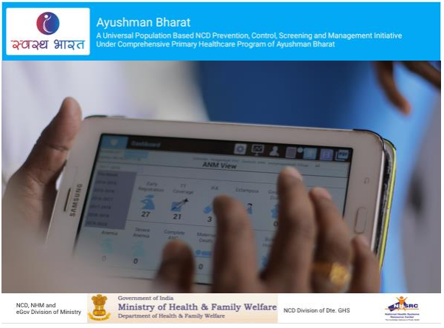
Digital Health Initiatives
Integrated Health Information Platform (IHIP)
Web-enabled nation-wide near-real-time electronic information system
Data entry envisaged from more than 200,000 Health facilities
covering 33 epidemic prone diseases
predicting early outbreaks with advanced GIS mapping
30% of the Population covered
Comprehensive Primary Healthcare Program (CPHC-NCD)
Name based population based screening
5 Non-Communicable Diseases - Hypertension, Diabetes, 3 common cancer (Oral, Breast and Cervical)
Operational in 20 states
80 million enrolments done and close to 13 million screened

Slide 5

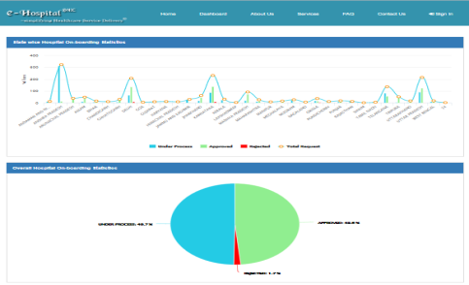


Digital Health Initiatives
Hospital Information System (HIS)
A workflow based HL7 compliant and ISO/IEC 9126 certified end-to-end solution
An Integrated HMIS Suite consists of HIS, LIS, RIS, PACS, Blood Bank and Telemedicine Suit
Built on Open Source Software tools and technologies
Implemented in more than 400 Hospitals
171. 3 million OPD registrations
National Medical College Network (NMCN)
50 Govt. Medical Colleges interconnected on NKN networked
Collaboration network for Doctors/Students
Tele-Education, Remote learning, live surgery, CME
Operational since January 2019
More than 2000 sessions conducted so far
Tele-Radiology (CORS)
Providing remote Radiology services to PHC/CHC/DH from State/Central Medical Colleges
Web based access for Radiologists and Medical Officers
Implemented in 90+ HFs

Slide 6



Digital Health Initiatives
My Health Record System – PHRMS
Enable the citizens to manage their own medical records in a centralized way
Facilitate the storage, access and sharing of personal health data.
Alerts for medications, appointments and other wellness parameters
Provision to add discharge summary and lab report
Storage linked with Digital Locker
Online Registration System (ORS)
Facilitate online registration & appointment in public hospitals
Online viewing of test reports, blood bank availability
Currently more than 200 hospitals on-boarded
340,000 appointments availed
Mera Aspataal – My Hospital
IT based patient feedback system
multi-channel approach to collect information on patients’ level of satisfaction- Short Message Service (SMS), Outbound Dialling, Web Portal, Mobile App
Currently, more than 6,000 hospitals are covered

Slide 7



Digital Health Initiatives
Reproductive Child Healthcare (RCH)
Facilitating care and support to the mother, children and eligible couples for reproductive and child health service
Eligible couples : 206 million
Pregnant women- around 140 millions
Children – over 120 millions
Kilkari
A mobile service to deliver audio messages on pregnancy, child birth & child care
Currently covering around 19 million mothers/ would-be mothers
~280 million outbound voice messages sent
Mobile Academy
Mobile training course on maternal & Child health
Aimed at improving the knowledge & communication skills of ASHA workers
Around 133,000 field health workers covered

Slide 8



Digital Health Initiatives
TB Patient Monitoring System “Nikshay”
A Web-based application for monitoring TB Patients
>95% coverage in public sector
>11 million patients notified so far
e-RaktKosh
Centralized Blood Bank Management System
Biometric Donor Management System for identifying, tracking and blocking donors
Track of the blood stock across numerous blood banks – Web / App based
>2,500 e-blood banks on-board
mCessation
A SMS based initiative to help tobacco users quit tobacco
Collaboration with WHO
Currently more than 150,000 users registered

Slide 9


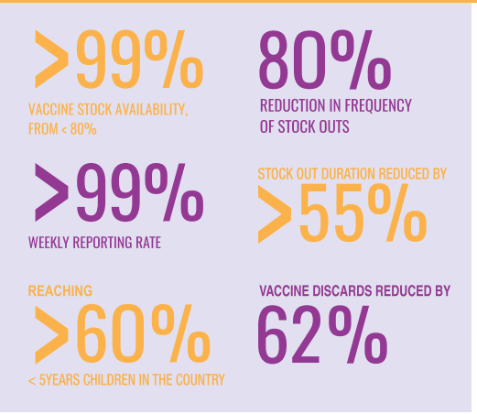
Digital Health Initiatives
Drug & Vaccine Distribution Management System (DVDMS)
Automating workflow of supply chain of drugs, sutures, surgical items etc.
To achieve reliable, accurate information for demand forecasting, ordering
Centrally hosted web based application
Implemented in 18 States
eVIN
Digitizes vaccine stocks & monitors the temperature of the cold chain through a smartphone application
providing real-time information on vaccine stocks & flows, and storage temperatures across all cold chain
Over 26,500 cold chain points digitized across 32 states
Over 4.5 million online transactions every month

Slide 10



Digital Health Initiatives
Standards:
Notified revised Electronics Health Record (EHR) Standards 2016 (initially in 2013)
Procured country license of SNOMED CT
Notified Health Metadata & Data Standards (MDDS) in August 2018
National Resource Centre for EHR standards (NRCeS) established by MoHFW for adoption and promotion of standards.
National Health Resource Repository (NHRR)
With vision to create a comprehensive & robust registry with details on Infrastructure, Services, Patient Load, GIS, manpower, equipment for all public and private health facilities
~ 25 Lakh health facilities to be covered across country; Currently 60% health facilities successfully verified with over 1400 data sets per facility.
National Identification Number (NIN)
a unique identification number & key requirement for achieving inter-operability and creation of EHRs
~ 99 % of Public Health Facilities allocated NIN

Slide 11



Digital Health Initiatives
Mobile Apps : for citizen services, health promotion, directory services:
Immunization Tracker,
Healthy India
India Fights Dengue
Directory Services
Stress Management
Mera Astptaal
Pradhan Mantri Surakshit Matritva Abhiyan- PMSMA
Cyber Security
Appointed Chief information Security Officer (CISO)
Conducted sensitization workshop in Ministry and issued advisories for best practices implementation to counter the cyber attacks
eOffice
transitioning to a "Less Paper Office" , to reduce processing delays and to establish transparency and accountability.
Over 75% of the work in the Ministry has been shifted to electronic mode.
Support for digitization of old physical file, hand holding support to the staff, allocation of DSCs/ e-Sign and bug fixing

Slide 12
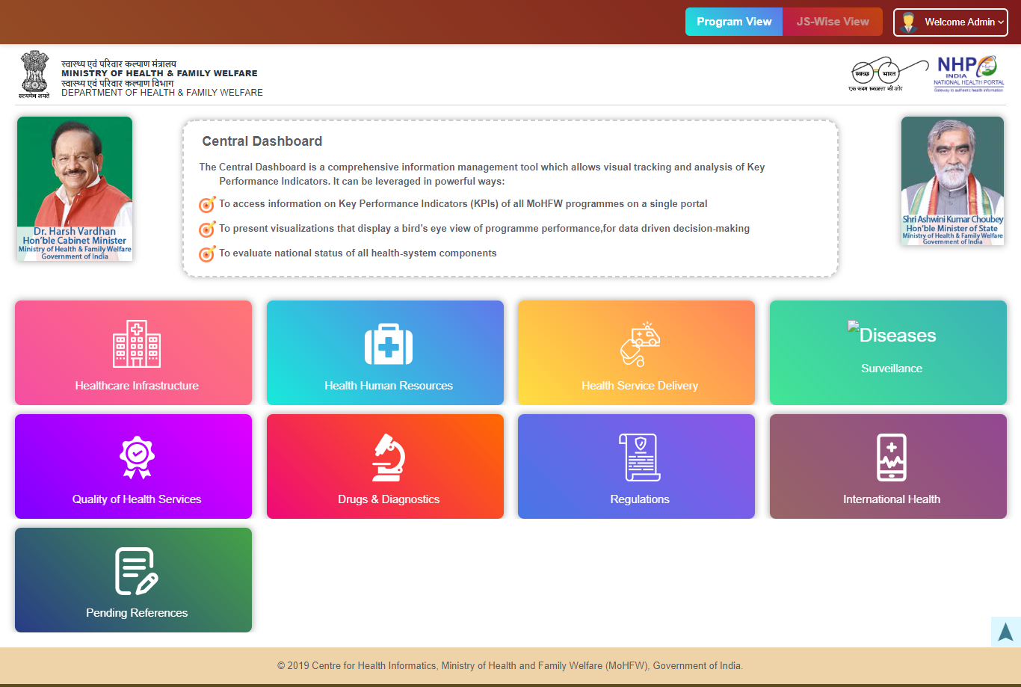
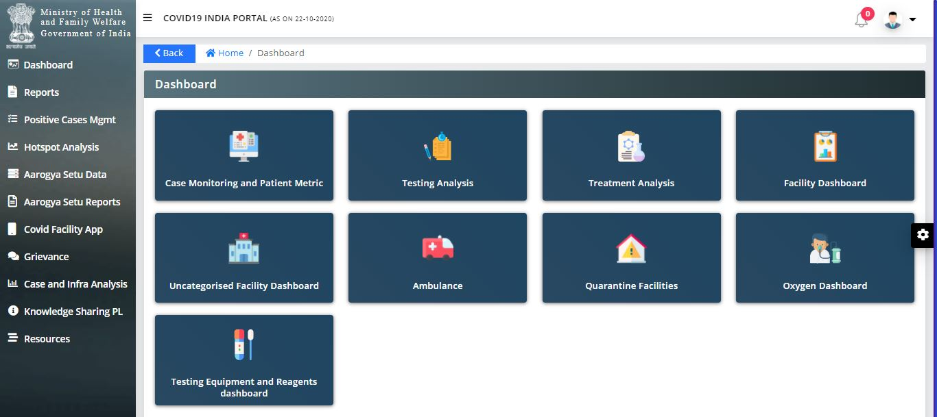
Digital Health Initiatives
Dashboards/Portal
COVID Dashboard
Central Dashboard
Health and Wellness Centers (HWC)
Laqshya
National Programme for Health Care of Elderly (NPHCE)
Mental Health website and Dashboard
Emergency Medical Response (EMR) website and Dashboard
MoHFW Budget.
National Health Policy-2017
International Health (IH/IC)
Pradhan Mantri Swasthya Suraksha Yojana

Slide 13


eSanjeevani Telemedicine Platform
Telemedicine in Health & Wellness Centres (HWCs)
    Doctor to Doctor consultation
    11 States have actively rolled out services
    70+ Doctor HUBs created by States linked with 3,500+ HWCs
    More than 100,000+ Consultations rendered
    More than 12,000 professionals trained
Telemedicine OPD for COVID Management
Patient to Doctor consultation
Board of Governors (BoG) released ‘Telemedicine Practice Guidelines’
Allowing Registered Medical Practitioners (RMPs) to provide Healthcare services through Telemedicine
eSanjeevani application modified for providing Online consultation to patients directly

Slide 14
eSanjeevani Telemedicine
Coverage
Consultations
Capacity
  28 States
  75% of Population
  5,00,000+ Consultations
  7,000 Consultation/day
  5,00,000 consultations/day
Infrastructure
Skill Enhancement
  15,000 Users trained
  70+ Dedicated HUBs
  3500+ HWCs

Slide 15

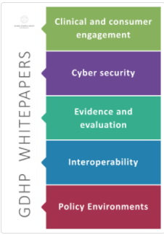
Global Agenda on Digital Health
India moved the Resolution of Digital Health in 71st World Health Assembly, 2018 to prioritize Digital Health in Global arena which was agreed unanimously.
Global Digital Health Partnership
A collaboration of governments, territories, government agencies and the World Health Organization.
Provide an international forum to facilitate global collaboration and co-operation and to share policy insights and evidence of best practice in the implementation of digital health services
Members: Currently, 25 countries and World Health Organization (WHO)
Achievements:
India concluded 4th Summit of Global Digital Health Partnership (GDHP) in New Delhi.
Participation from 35 countries + Academia + Industry + Start-ups
Adoption of Delhi Declaration on Digital Health for Sustainable Development
India got the chairmanship for GDHP to extend the GDHP Secretariat services.
Paved the way for GDHP & WHO Countries to adopt Digital Health at Policy Level

Slide 16
Current challenges in Health IT
Fragmented information streams/systems
  Digital interventions captures patient data but operates in siloes
Data is inaccessible, improperly formatted/not standardised and hence not interoperable
Duplication of data collection – Data Redundancy due to non-communication between various application
No Health Information Exchange – due to lack of unique identifiers for patients, providers & health facilities across systems
Lack of common data analytics platform.
India moved towards a comprehensive digital health framework for all existing as well as upcoming initiatives

Slide 17
Journey – National Digital Health Blueprint (NDHB)
National Health Policy
Extensive deployment of digital tools for improving the efficiency and outcome of the healthcare system.
Ensure Continuum of care
Citizen centricity, quality of care, better access, universal health coverage, and inclusiveness Integrated health information system
Inclusive - stake-holders
Focuses on improving transparency & citizen experience.
National Digital Health Blueprint (NDHB)
India recognized the need for creating a framework for the evolution of a National Digital Health Eco-system (NDHE)
A committee got constituted with all stakeholders
National Digital Health Blueprint (NDHB) finalized as an Architectural Framework for Digital Health in India
Specific guidance on Digital Health implementation across the country

Slide 18
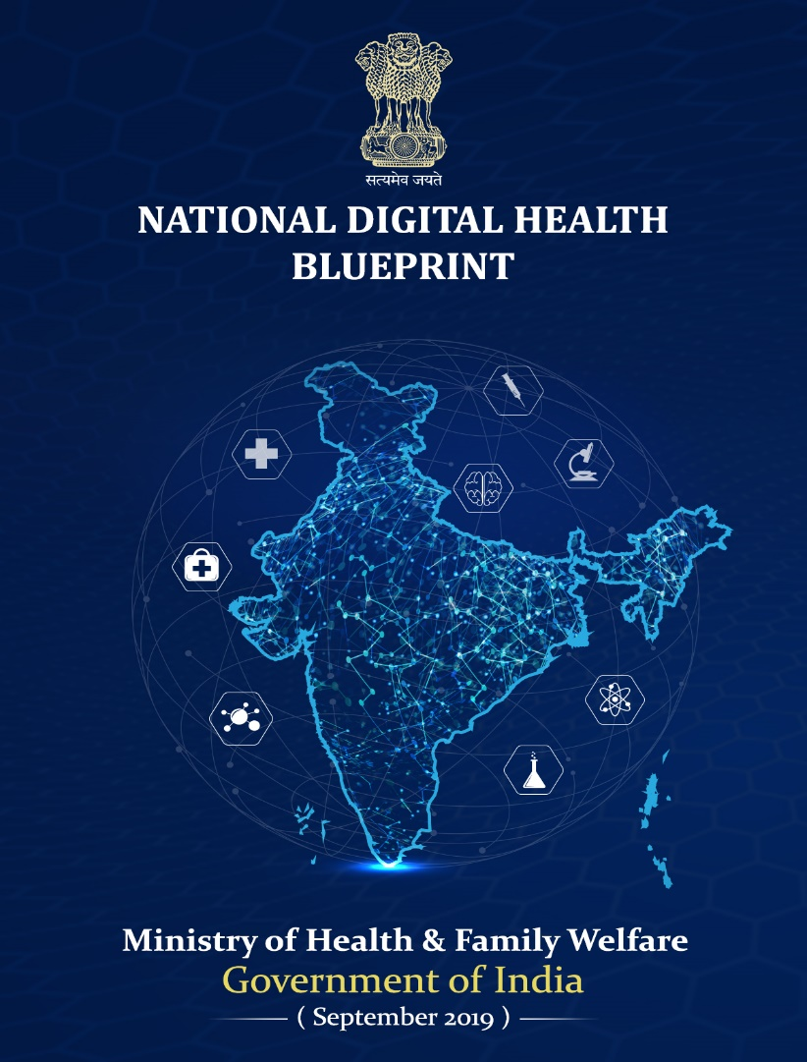
National Digital Health Blueprint (NDHB)
  National Architectural Framework
  Converging disparate health information systems
  Federated architecture, open standards
  5-layered system of architectural building blocks
  Unique Health Identifier (UHID)
  Privacy and consent management
  National portability
  EHR, applicable standards and regulations
  Health Analytics, proposing AI/ML/Blockchain technologies
  Multiple access channels like web, mobile, call centre, telemedicine, Digital Health India portal and MyHealth app
  NDHB proposed to setup National Digital Health Mission (NDHM) as implementation mechanism

Slide 19
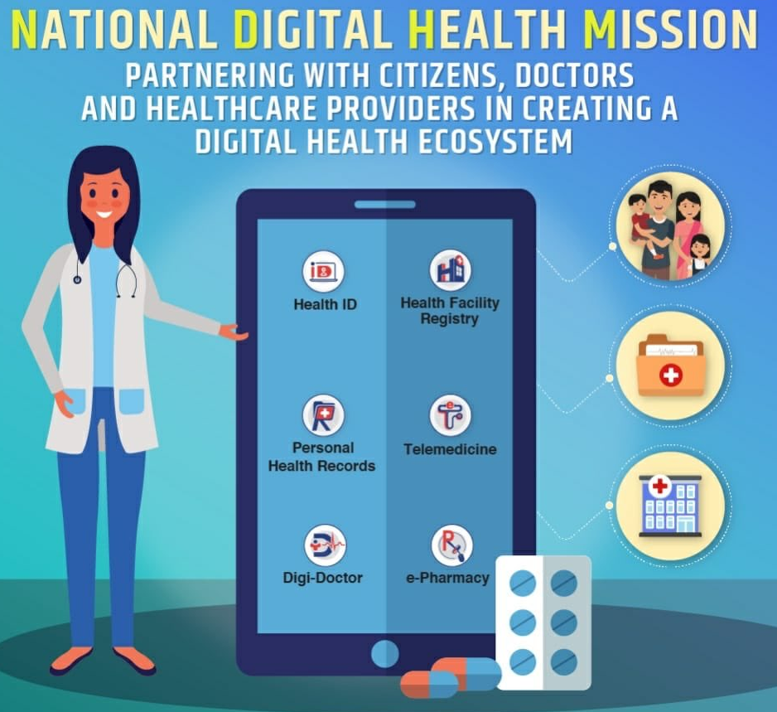
National Digital Health Mission (NDHM)
15th August 2020, the Hon'ble Prime Minister announced the launch of
National Digital Health Mission (NDHM)
VISION
To create a national digital health ecosystem that supports universal health coverage in an efficient, accessible, inclusive, affordable, timely and safe manner and a seamless online platform through the provision of a wide range of data, information and infrastructure services, duly leveraging open, interoperable, standards-based digital systems, and ensures the security, confidentiality and privacy of health-related personal information.

Slide 20
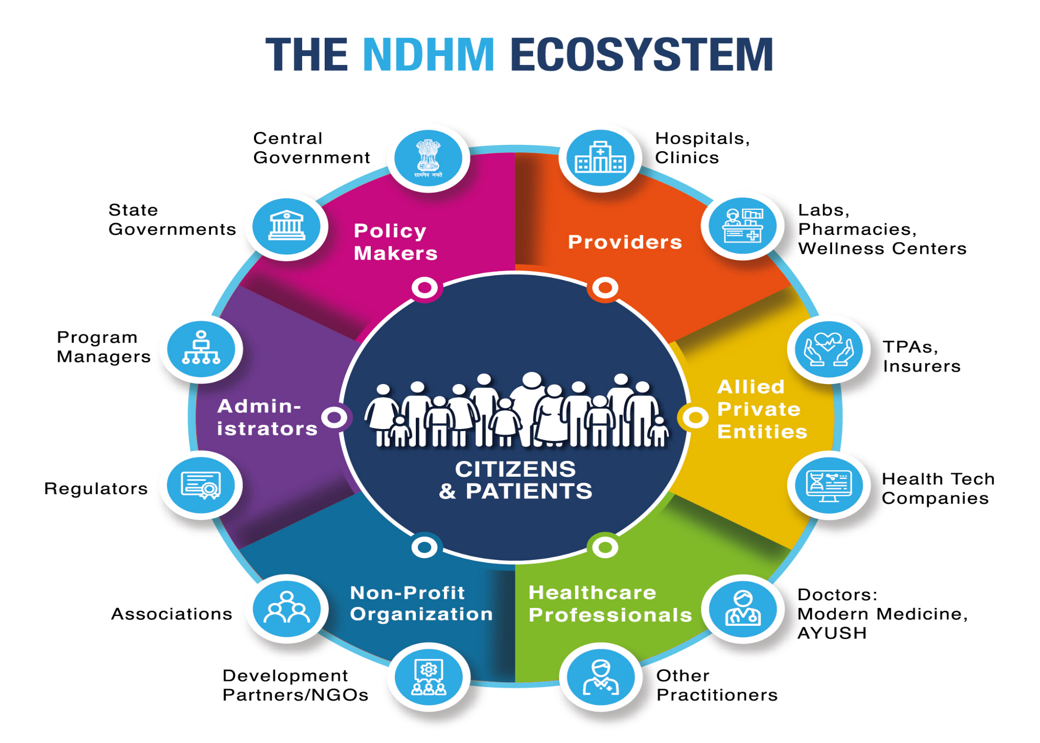
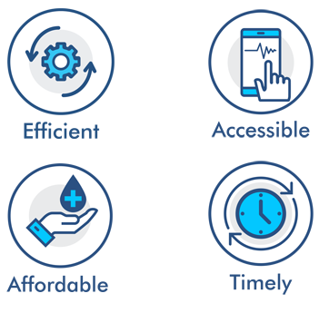


National Digital Health Mission (NDHM)- Ecosystem

Slide 21







National Digital Health Mission (NDHM)- Architecture
Universal Immunization Program
Organ Retrieval & Banking
RBSK
Single Window for Healthcare
MCTS / RCH
e-Aushadhi
Health ID/ Facility / Provider Registry
Citizen Interface
Healthcare for All
eRaktkosh
Unifying Platform
EHR & PHR
E-Sushrut
Open API
Enabling Regulatory Framework & Regulation
One Platform
AI/ML/Deep Learning
E-Hospital
and ORS
IndEA*
Data Analytics
Ayush Sanjivani
Blockchain / Augmented Reality/ VR/ 3D imaging
PMJAY
Multiple Agencies
(Govt. at all levels, Industry, Peer to Peer)
Health & Wellness Centers
Mera Aspataal
Vaccine Distribution System
Disease Surveillance
*IndEA: India Enterprise Architecture- notified by MeitY

Slide 22
National Digital Health Mission (NDHM)-Status
National Digital Health Strategy Issued
Guidelines for Health Information Provider and Health Information User released
NDHM Sandbox environment open to test and integrate applications
PMU setup is under process
The NDHM is envisaged to be implemented in phase wise manner:
  Phase 1 to cover 6 UTs on pilot basis is under implementation
  Phase 2 will cover additional States with expansion of the services.
  Phase 3 will target nation-wide roll-out, operationalizing and converging with all health schemes across India along with promotion, on-boarding, and acceptance of NDHM across the country.
Implementation Strategy

Slide 23





National Digital Health Mission (NDHM) – Pilot Phase
Health ID based on Aadhaar/Mobile number of patient
More than 100,000 IDs issued
Voluntary service to be availed by citizens
Registry for Health Workforce
More than 1500 application received by professionals
Voluntary service
Existing programs like National Health Resource Repository (NHRR) leveraged
More than 400 facilities opted to be part of NDHM ecosystem
Voluntary for hospitals to join NDHM
Electronic record of health-related information on an individual
Conforms to nationally recognized interoperability standards
Individual to manage his/her info
Electronic medical record (EMR) web app
Longitudinal health record in linkage with Health ID
Following interoperability standards , EHR standards
Citizen centricity

Slide 24


National Digital Health Mission (NDHM)
Sandbox environment created as a closed ecosystem to test applications with NDHM Building blocks
Healthcare Service Providers, Hospitals, Healthcare Software Vendors, Startups and innovators
API level integration with NDHM
Assessment of solution by NDHM team for nationwide adoption
National programs in process of integration
Promotes participation, innovation and built trust within ecosystem

Slide 25
Way Forward
Establishment of National Digital Health Ecosystem in country
Integration of National and State programs in a common framework under NDHM
Ensuring longitudinal health record of patient across healthcare spectrum
Establishment of Telemedicine system covering every health facility
Position India as the World leader in Digital Health
Ensuring appropriate inclusion of disruptive technologies in health programs
Move from silos towards a more citizen centric health service delivery for ensuring Continuum of Care

Slide 26
THANKS

