Slide 1
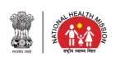
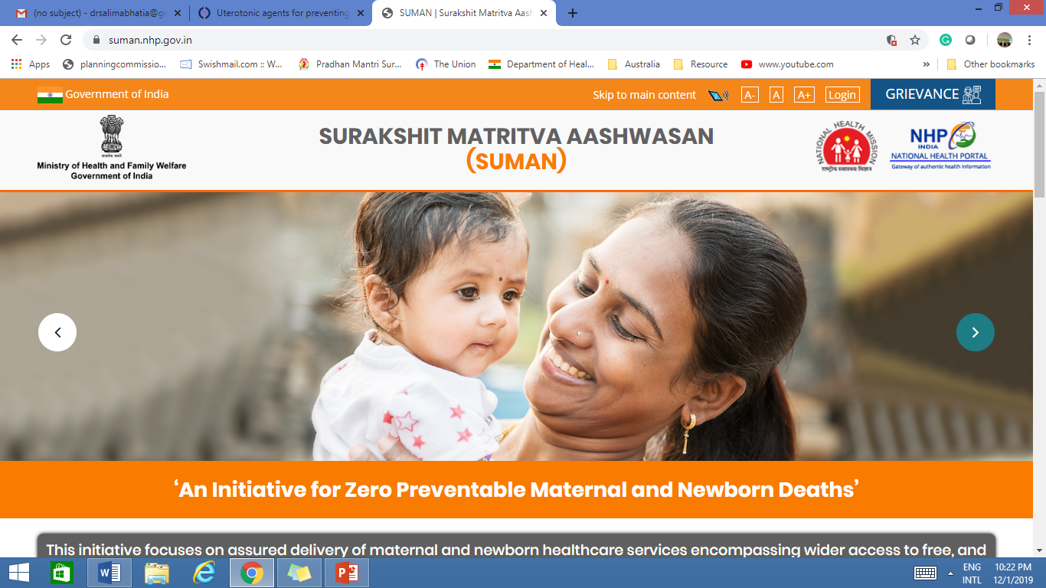
Reproductive Maternal Newborn Child Adolescent Health Plus Nutrition (RMNCAH+N)

Slide 2
Our Targets
National Health Policy Targets more ambitious than SDGs
Indicator | National Health Policy | SDG 2030
Maternal Mortality Ratio | 100 by 2020 | <70
Neonatal Mortality rate | 16 by 2025 | <12
Infant Mortality Rate | 28 by 2019 | -
Under 5 Mortality Rate | 23 by 2025 | ≤25
Total Fertility Rate | Replacement level fertility | -
National Health Policy Targets more ambitious than SDGs
Notes:
National family health survey

Slide 3
Maternal Mortality Ratio (MMR)
Between 1990 and 2017
India MMR Decline
Global MMR Decline
80%
45%
* 113 as per SRS 2016-18
Considering the compound annual rate of decline in last ten years, India is likely to achieve SDG goal of MMR (i.e. MMR 70 by 2030) by 2025.
As per SRS 2016-18, five States have already attained SDG target of MMR (i.e. 70 by 2030): Kerala (43), Maharashtra (46), Tamil Nadu (60), Telengana (63) & Andhra Pradesh (65)

Slide 4
Under 5 Mortality Rate (U5MR)
For the First Time - India’s U5MR (36/ 1000 live births) less than the global U5MR
India U5MR Decline
Global U5MR Decline
71%
58%
Considering the compound annual rate of decline over the past ten years, India is likely to achieve SDG goal of U5MR (≤25) by 2022.
As per SRS 2018, seven States have already attained SDGs target of U5MR: Kerala (10), Tamil Nadu (17), Delhi (19), Maharashtra (22), J&K (23), Punjab (23) & Himachal Pradesh (23)

Slide 5
Infant Mortality Rate (IMR)
India IMR Decline since 1990
60%

Slide 6
Neonatal Mortality Rate (NMR)
Neonatal Mortality Rate (NMR)
India NMR Decline
Global NMR Decline
60%
51%
since 1990

Slide 7
Key Initiatives under RMNCAH+N
R
Basket of Choices, Home Delivery of Contraceptives, Enhanced Compensation Scheme , MPV etc.
Reproductive
M
JSY, JSSK, FRUs, LaQshya PMSMA, MCH Wings, Midwifery etc.
Nutrition
Maternal
N
Facility & Home Based Newborn Care, HBYC, Immunization, Promotion of Breast Feeding etc.
Continuum of care
C
Immunization, RBSK, Diarrhoea control, SAANS, NDD etc.
Adolescent
Newborn
AH
RKSK, WIFS, AFHS, MHS , School Health & Wellness Ambassador Initiative etc.
Child
+N
MAA,CLMC, AMB, Poshan Abhiyan, NDD, HBYC, NRC, Vit A etc.

Slide 8
Overview of Key Maternal Health Interventions
Janani Suraksha Yojana (JSY)
Janani Shishu Suraksha Karyakram (JSSK)
Pradhan Mantri Surakshit Matritva Abhiyan (PMSMA)
Midwifery Initiative
Surakshit Matritva Aashwashan (SUMAN)
Comprehensive Abortion Care Services (CAC)
Universal screening for HIV and Syphilis
Strengthening First Referral Units (FRUs) & Delivery Points (DP)
Maternal Death Surveillance & Response (MDSR)
LaQshya – Labor Room & Maternity OT
MCH Wings and Obstetric HDUs/ ICUs
Capacity Building of Human Resource: Dakshata, CEmONC, LSAS, SBA etc.

Slide 9
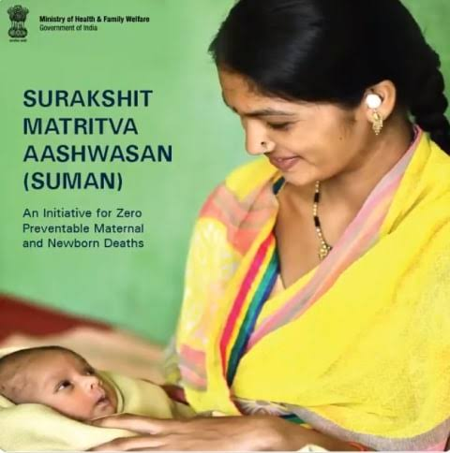
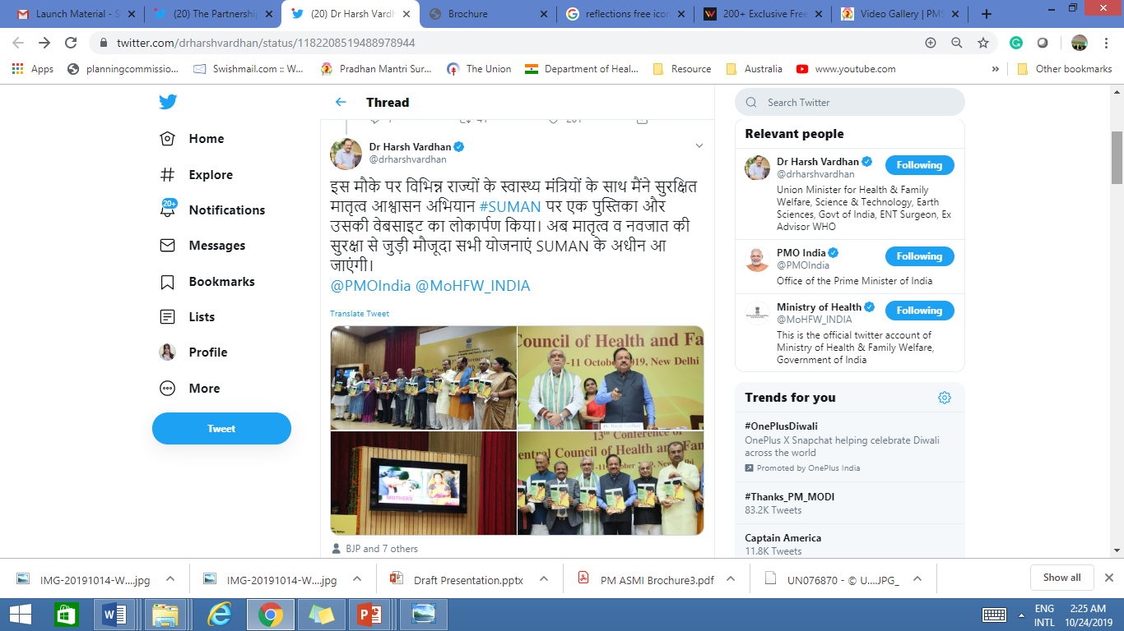
SURAKSHIT MATRITVA AASHWASAN
(SUMAN)
Assured, dignified, respectful and quality healthcare at no cost and zero tolerance for denial of services for every woman and newborn visiting the public health facility to end all preventable maternal and newborn deaths and morbidities and provide a positive birthing experience.
Making every effort to realize the aspirations and dreams of each and every mother in the country

Slide 10
OBJECTIVES
To provide high quality medical, surgical and emergency care services in a dignified and respectful manner as per SUMAN service package at no cost to the beneficiaries
To leverage institutional and community based platforms to help create awareness in the community on the entitlements under SUMAN
To strengthen Grievance Redressal Mechanism by incorporating client feedback
To orient service providers and build their capacity for delivering SUMAN
To ensure reporting and review of all Maternal and Infant deaths

Slide 11

Pradhan Mantri Surakshit Matritva Abhiyan (PMSMA)
Launched in 2016 to provide comprehensive and quality ANC to pregnant women on the 9th of every month.
Doctors from private sector also encouraged to volunteer for the campaign and provide services at nearby Government health facilities.
Antenatal Care to pregnant women in 2nd/ 3rd trimesters of pregnancy
Over 2.43 Crore antenatal checkups conducted & over 12 lakh HRPs identified
Over 17,200 facilities provide PMSMA services
Over 6000 volunteer doctors from private/ NGO sector

Slide 12
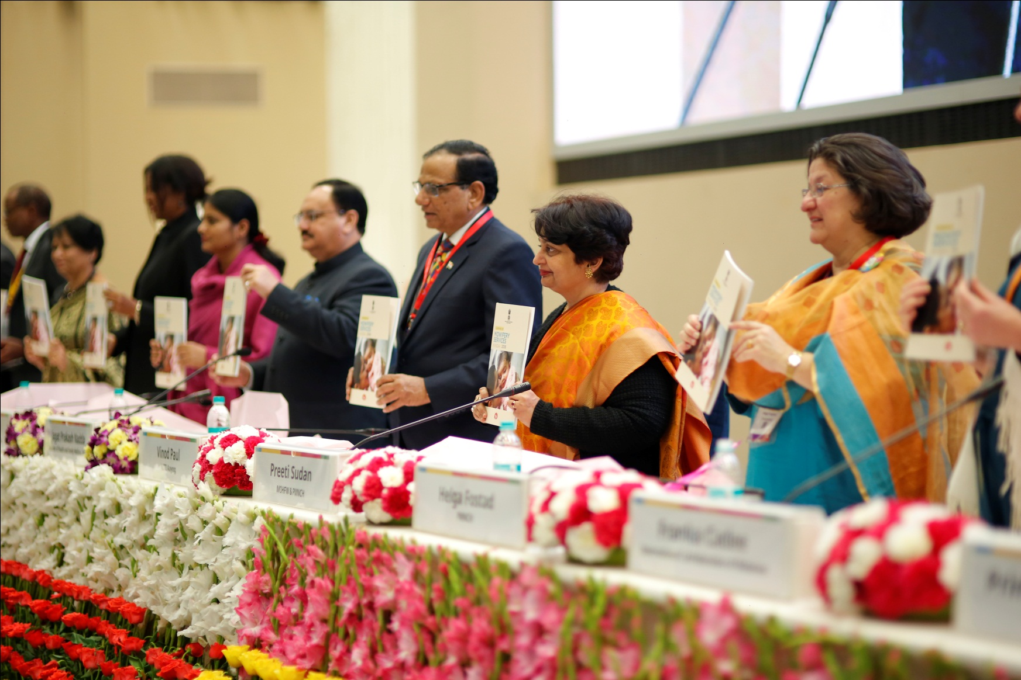
Midwifery Initiatives
Launch of Guidelines on Midwifery Services in India – Partners Forum 2018
Global evidence highlights that investment in high quality of midwifery can prevent about two thirds of all maternal and newborn deaths—saving millions of lives every year.
Objectives
  To provide access to quality maternal and newborn health services
  Promote natural birthing by promoting positive child birthing experience
  Ensure respectful care
  Reduce over medicalization
Midwifery Led Units in Public health facilities

Slide 13

Key Components
LaQshya| लक्ष्य
(Labour Room Quality Improvement Initiative)
Expected Outcomes
LaQshya Badges – Platinum/ Gold/ Silver
Organization and standardization of Labour rooms, OTs and Obstetric HDUs/ ICUs as per national guidelines and standards
Structured Quality Improvement efforts/processes to improve adherence to critical practices around childbirth
Improved client satisfaction - “Respectful Maternity Care” (RMC).
Labour Room Certification
75% achievement of targets for quality
Facility level Incentives
80% satisfaction of beneficiaries
Total LaQshya facilities: 2444 National Certification: LR-262 OT- 229
Notes:
Platinum Badge: Achieving more than 90% score.
Gold Badge: Achieving More than 80% Score.
Silver Badge: Achieving more than 70% Score.
SN
Facility Level Indicators
1 At least 90% deliveries are conducted using safe birth and Safe Surgery checklist in Labour Room and Maternity OT
2 No case of APH/PPH related mortality or at least 25% reduction from baseline
3 80%and more OSCE scores or at least increment of 30% from baseline
4 No case of pre-eclampsia, eclampsia & PIH related mortality or at least 25% reduction from baseline
5 Achieved 80% or more antenatal corticosteroid administration rate in case in preterm labour or at least increment of 30% from baseline

Slide 14
Newborn & Child Health Interventions
Newborn Health
Nutrition related intervention
Pneumonia and diarrhea related intervention
RBSK
Essential Newborn Care
Nutrition Rehabilitation Centres (NRCs)
IMNCI and F-IMNCI
Screening at delivery points for birth defects
Facility Based Newborn Care-SNCU/NBSU/NBCC
IYCF promotion / MAA Program/ CLMCs
IDCF/ Defeat Diarrhea (D2) Campaign
Screening at AWC and Schools for 4 Ds
Home Based Newborn Care (HBNC) &
Home Based Care for Young Children (HBYC)
Anaemia Mukt Bharat (AMB) and Vitamin A suppl.
Promotion of ORS and Zinc use by ASHA
DEICs establishment
SAANS
Deworming
Child Death Reviews

Slide 15
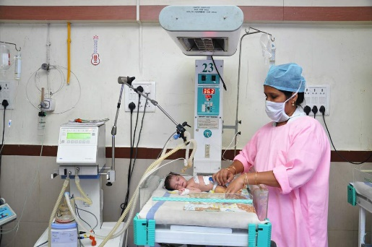
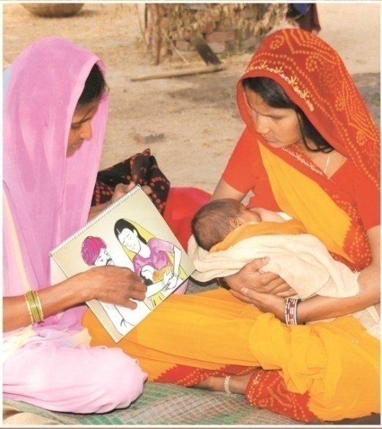
Newborn & Child Health
Facility Based Newborn Care- 894 SNCUs treating 11 lakh newborns, 2571 NBSUs & 20,337 NBCCs
Home based newborn care – more than 1.42 crore newborns visited every year
Mother’ s Absolute Affection (MAA) Programme: Promote, Protect & Support breastfeeding at facility and community levels.
Nutrition Rehabilitation Centers (NRC) – 1072 centres operational; nearly 2.0 lakh annual admissions
National Deworming Day (NDD) –
11.02 crore children in 25 States/UTs in 10th Round (February 2020)
Notes:
NDD:
NDD program was launched in 2015, since then nine successful NDD rounds have been conducted across the country in which approximately 184.73 crores of Albendazole tablets were administered to the children and adolescents (1-19 years) of age across all States/UTs. NDD is the world’s largest single-day public health intervention.
The 10th round of National Deworming Day (NDD) has been conducted in the month of February, 2020 in 25 States/UTs with a target to reach 12.79 crore children. Report compilation of February 2020 round is in progress.

Slide 16
Activities to address Diarrhoea and Pneumonia
Potential Impact of ORS, Zinc and IMNCI interventions
Intensified Diarrhoea Control Fortnight (IDCF) observed during 28th May- 8th June, with the ultimate aim of ‘zero deaths due to childhood diarrhoea’
ORS | 93% reduction in diarrhoeal mortality with 100% coverage
Zinc | 23% reduction in diarrhoeal mortality
Increasing access to community-based case management | 35% reduction in child pneumonia mortality with 100% coverage 93% childhood diarrhoeal mortality reduction with 100% coverage
Promotion of Integrated Management of Neonatal and Childhood Illnesses (IMNCI) for early diagnosis and case management and F-IMNCI at facility level
‘SAANS’ initiative for Management of Childhood
Pneumonia at facility and community level
10.01 crore under five children covered during IDCF 2019
Notes:
ORS Use Rate is 50.6% and Zinc use rate <25%
Source: Lancet

Slide 17
Rashtriya Bal Swasthaya Karyakram (RBSK)
Systemic approach for early identification and management of 4Ds - Defects at birth, Deficiency, Diseases and Developmental Delays for children of 0-18 years.
Referral
  Newborn Screening for defects at birth
  Screening of children at AWCs and in schools
  Free of cost management of children identified with ailment in District Early Intervention Centre and referral at pre-identified tertiary level institutions for surgery
  Early Intervention Centre (DEIC) at District hospital for confirmation, further assessment and as referral linkage to appropriate health facility
Screening
Management

Slide 18

Focus on Early Childhood Development
1000 day Booklet released
Messages integrated in MCP Card
HBYC Platform to be leveraged
Ayushman Bhava app developed
Call Centre approach

Slide 19
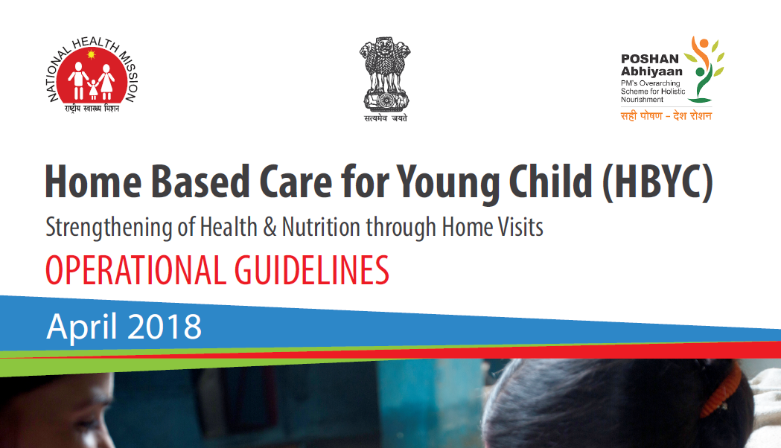

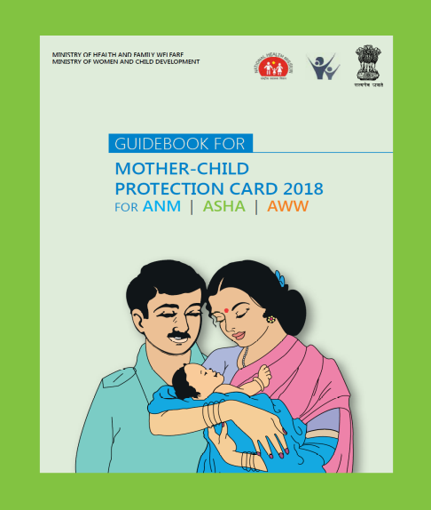
Implementation of Revised MCP Card
Focusing first 1000 days
Counselling and awareness generation tool for caregivers as responsible & active partners
HBYC through ASHA till 15 months of age with actions across four domains:
  Nutrition
  Health
  Child development
  Wash
Notes:
Early Childhood Development (ECD) is a continuum of care process that begins with planning for pregnancy and must continue for at least the first two years of a child’s life. To make this information available for within the every family and caregiver, the Maternal and Child Protection (MCP) card which targets every pregnant woman and the child till the age of first 2 years of age has been revised to include information in an age appropriate pictorial description. ASHAs would use this card to support families in the 5 visits at 3, 6,9,12 and 15 months of the child under the Home Based Young Child Care and qualitatively using the MCP cards as ready reckoner. The card now specifically included information on what the child does by a specific age, what the parents should do to stimulate the child and engage with the child and red flag signs in child development as guidance when to seek help.

Slide 20
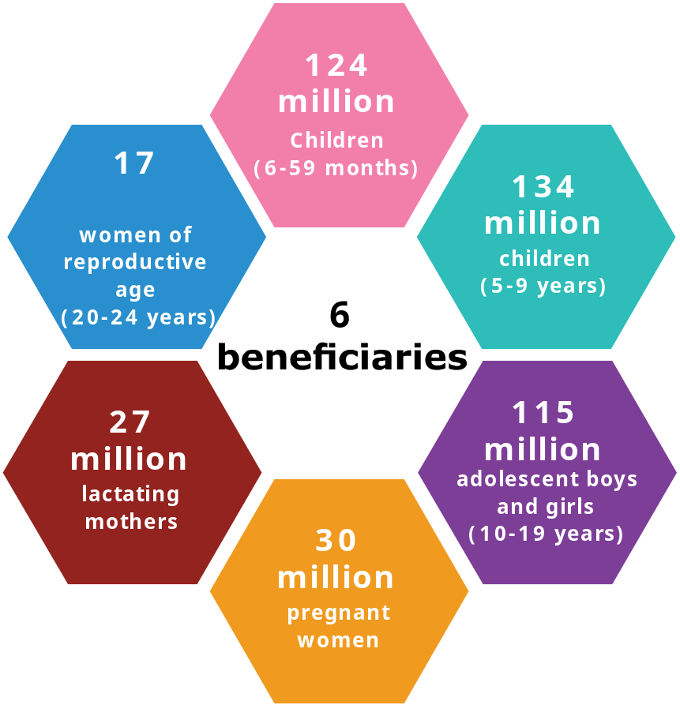
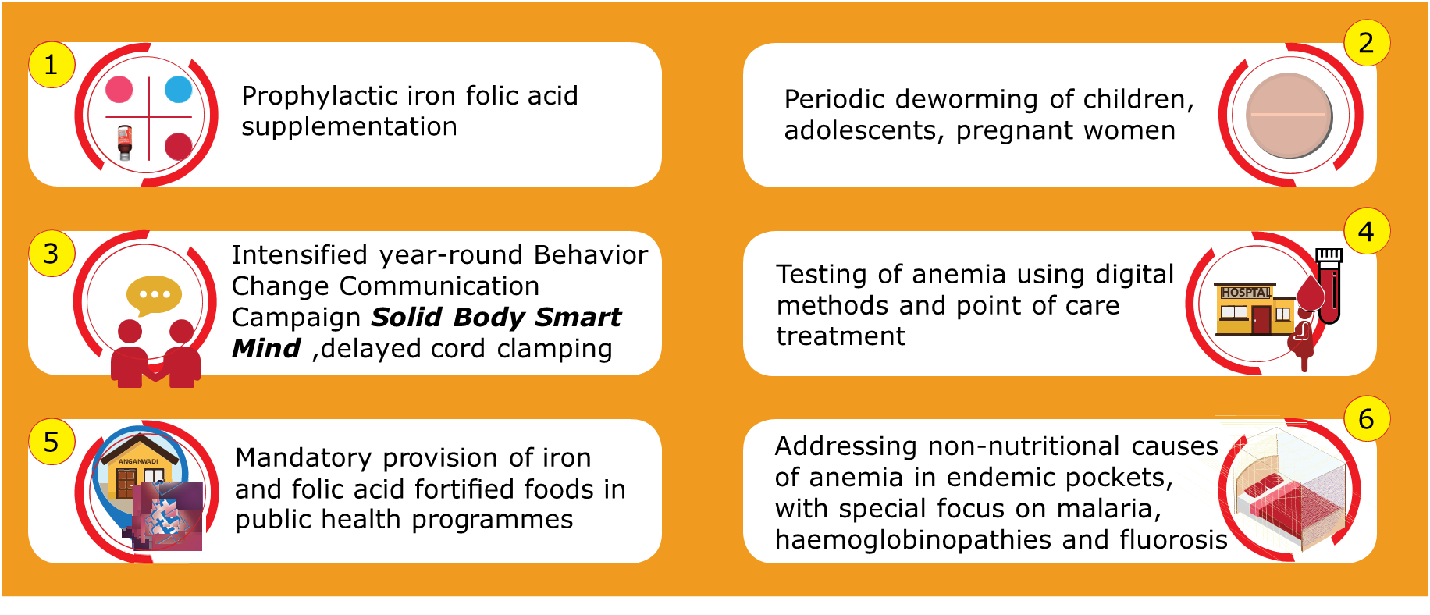
Anemia Mukt Bharat (AMB)
Estimated 450 million beneficiaries
Reaching nearly 50% of the country’s population
Notes:
The Anemia Mukt Bharat strategy- Intensified Iron Plus Initiative and aims to strengthen the existing mechanisms and foster newer strategies of tackle anemia, focused on six target beneficiary groups, through six interventions and six institutional mechanisms; to achieve the envisaged target under the POSHAN Abhiyaan. The strategy focuses on testing & treatment of anemia in school going adolescents & pregnant women using newer technologies, establishing institutional mechanisms for advanced research in anemia, and a comprehensive communication strategy including mass/mid media communication material (Radio spots, TVCs, posters, job-aids, IPC materials, etc).

Slide 21
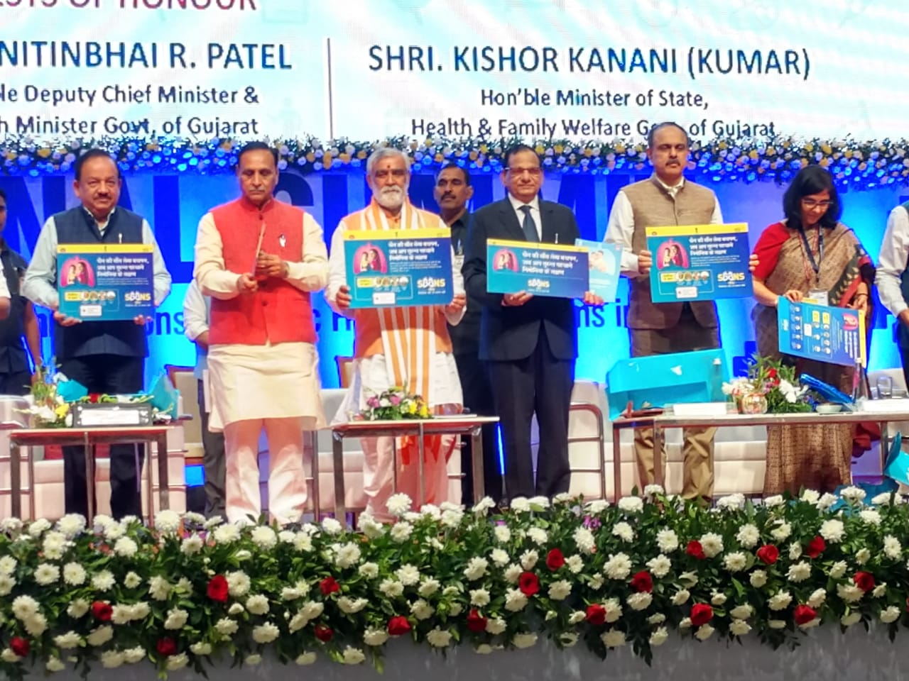
SAANS INITIATIVE launched on 16th November 2019
Prevent and Control Child Deaths due to Pneumonia
SAANS (Social Awareness & Action to Neutralize Pneumonia Successfully)
To prevent and control child deaths due to pneumonia :
Revised National Childhood Pneumonia Management Guidelines 2019
Skilled based capacity building of MOs/CHOs/ANMs and ASHAs
360 degree Communication Campaign
Notes:
www.worldpneumoniaday.org

Slide 22
Universal Immunization Programme (Scope & Scale)
One of the largest Public Health Programmes
Annual target
-2.6 crore newborns;
-2.9 crore pregnant women
Vaccine against 12 Vaccine Preventable Diseases
-10 nation wide;
-2 sub-nationally
[PCV: under expansion; JE: endemic districts]
Approx. 1.2 crore sessions planned per year (Source: HMIS*)
Approx. 29,000 cold chain points for storage and distribution of vaccines
(Source: NCCMIS*)
All vaccines, cold chain equipment (CCE) and syringes are procured centrally
HMIS: Data uploaded by states/ UTs in Health Management Information System portal; NCCMIS: National Cold Chain Management Information System

Slide 23
Roadmap of UIP
RVV scale up as per 100 days agenda
Tetanus and adult diphtheria vaccine
2019
Six new vaccines added under UIP in last 5 years
MR, PCV, Adult JE
2017
tOPV to bOPV switch
RVV
Rotavirus vaccine
2016
Inactivated Polio Vaccine
Some text here
2015-16
2014
India and South East Asia Region certified POLIO- FREE
JE 2nd dose and Open PV
2013
Pentavalent vaccine
2011-15
Measles 2nd dose
2010
JE vaccine
2006
Hep. B vaccine
2002
Vaccine Vial Monitor
1997
Polio NID
1995
4 Vaccines against 6 VPDs- Measles, DPT, TB, Polio
1985

Slide 24
Immunization System Strengthening
01
Improving Cold chain and vaccine logistics management
04
Demand generation and Social mobilization
    Robust procurement and supply chain management
    Electronic Vaccine Intelligence Network (eVIN)
    Effective Vaccine Management assessment
    Strengthening institutional capacity (NCCVMRC, NCCRC)
02
Strengthening Vaccine Preventable Disease (VPD) surveillance
  Polio surveillance (through AFP surveillance)
  Measles Rubella surveillance
  Diphtheria Pertussis and Neonatal Tetanus (DPnT) surveillance
05
Capacity building of human resources
03
Strengthening Adverse Events Following Immunization (AEFI) surveillance

Slide 25
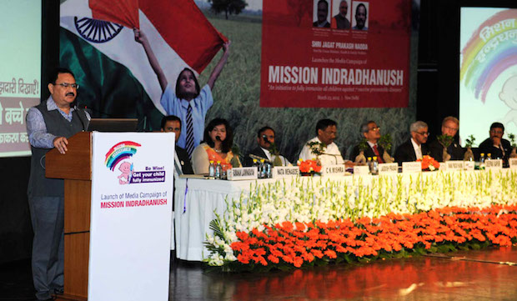
Mission Indradhanush (MI)
Reaching the unreached with all available vaccines
Increasing full immunization coverage to 90% and sustain it through RI.
690 districts covered in various phases – including Intensified MI.
One of the flagship schemes under Gram Swaraj Abhiyan (GSA) & Extended GSA.
Launched on 25th December 2014

Slide 26


Performance of Mission Indradhanush
3.76 crore children vaccinated
94.60 lakh pregnant women vaccinated
* IMI 2.0 data is provisional

Slide 27
Key Interventions : Reproductive Health
Mission Parivar Vikas: launched in 146 high fertility districts (TFR > 3.0) in seven high focus states
New Contraceptive Choices: Injectable contraceptives (under Antara programme) and Centchroman (Chhaya)
Family Planning Logistics Management Information System
(FP-LMIS)
Quality Assurance Committees at State and District levels to monitor the quality of Family Planning services including adverse events.
National Family Planning Indemnity Scheme (NFPIS)
Enhanced Compensation scheme
Scheme for Home delivery of contraceptives by ASHAs at doorstep of beneficiaries.
Vasectomy Fortnight
World Population Day campaign

Slide 28
Impact of efforts of Family Planning
139+ Million
53+ Million
1.82+ Million
22,000
In 2019 alone, it is estimated that with the use of contraceptives:
Unintended pregnancies were
prevented
Unsafe Abortions were
averted
Women were using a
Modern Method of Contraception
Maternal deaths were
averted
Source:- TRACK 20 Estimates

Slide 29
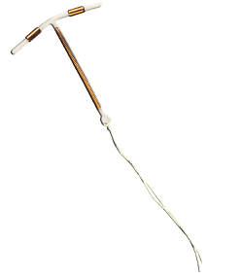




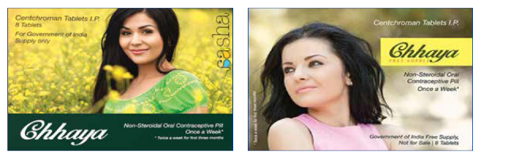


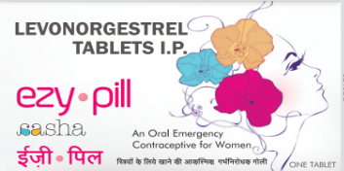



Contraceptive Basket of Choice
Injectable MPA and Centchroman has been recently introduced in contraceptive basket
Temporary Methods
Condoms (Nirodh)
Oral Contraceptive Pills-
  Combined Oral Contraceptives (Mala N)
  Centchroman (Chhaya)
  Emergency Contraceptive Pills (Ezy Pill)
IUCD-380A, 375
Injectable MPA (Antara Program)
Permanent Methods
Male Sterilization (Conventional Vasectomy/NSV)
Female Sterilization (Minilap/Laparoscopic)
IUCD 380 A
IUCD 375

Slide 30
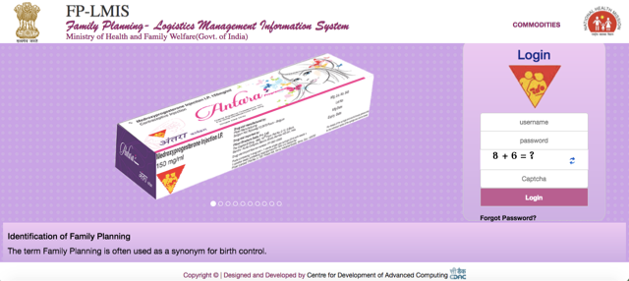
Strengthening Supply Chain- FPLMIS
Family Planning Logistics Management Information System (FPLMIS)
Unified Software for FP logistics to streamline FP logistics and supply chain management
Web based, App based and SMS based application
Instant access to stock information from National level to ASHA level
Auto forecasting of contraceptives
SMS alerts for key indicators
Auto generated reports for program review

Slide 31



RKSK: Key Implementation Approach
School Based Approach
Facility Based Approach
Community Based Approach
Screening of Adolescents for 4 Ds (RBSK)
Weekly Iron Folic Acid Supplementation (WIFS) Program
Deworming during National Deworming Day (NDD)
Provision of sanitary napkins
Health promotion and prevention activities- Ayushman Bharat School Health & Wellness Ambassador Initiative
Adolescent Friendly Health Clinics (AFHCs) providing counselling and clinical services
Adolescent Health Resource Centre at District Hospital
Weekly Iron Folic Acid Supplementation (WIFS) Program
Deworming during National Deworming Day (NDD)
Provision of sanitary napkins
Peer Educator (Saathiya) program for out of school/vulnerable adolescent groups
Quarterly Adolescent Health Day (AHD)
Adolescent Friendly Clubs (AFCs)

Slide 32

Ayushman Bharat School Health & Wellness Ambassador Initiative
Age appropriate, skill-oriented, theme based, graded curriculum for the teachers to implement the activities at school level launched on 12th Feb, 2020.
Two teachers in every school designated as “Health and Wellness Ambassadors”, will be trained to transact health promotion and disease prevention information in the form of interesting activities for one hour every week
Every Tuesday may be dedicated as Health and Wellness Day in the schools
24 hour sessions will be delivered through weekly structured interactive classroom-based activities
These health promotion messages will also have bearing on improving health practices in the country and students will act as Health and Wellness Messengers in the society.

Slide 33
Eleven Themes of Curriculum: Ayushman Bharat School Health & Wellness Ambassador Initiative
Growing Up Healthy
Emotional Well-being and Mental Health
Gender Equality
Interpersonal Relationships
Nutrition, Health and Sanitation
Prevention and Management of Substance Misuse
Promotion of Healthy Life Style
Reproductive Health and HIV Prevention
Safety and Security Against Violence and Injuries
Values and Responsible Citizenship
Promotion of Safe Use of Internet and Social Media Behaviors

Slide 34
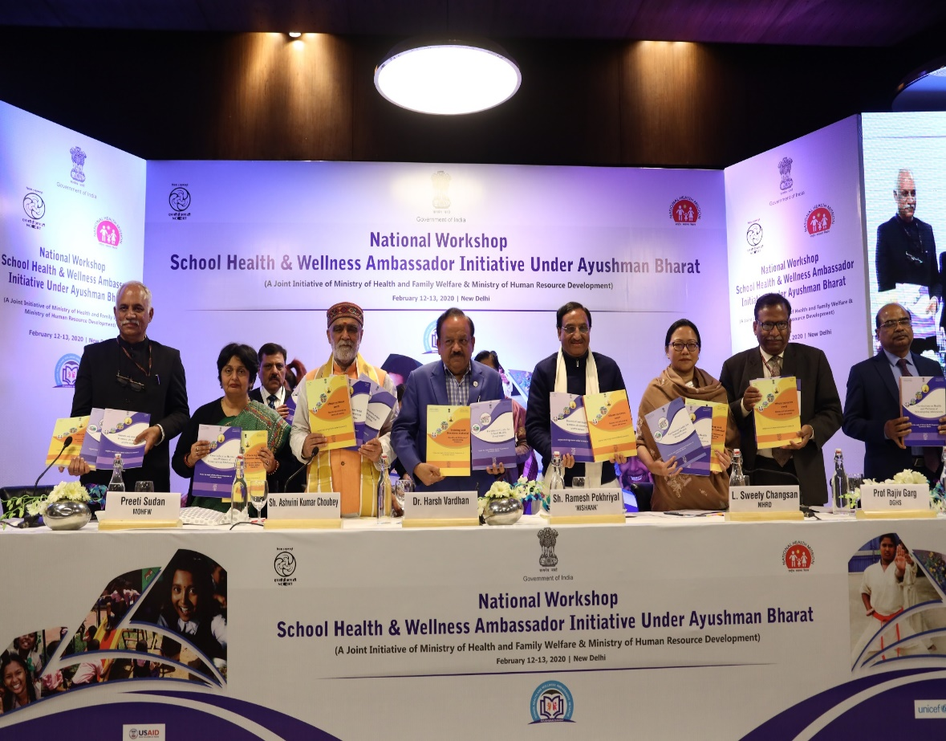
Ayushman Bharat School Health & Wellness Ambassador Initiative
  Operational Guidelines released by the Prime Minister on April 14, 2018
  Resource material released by Hon’ble Ministers of Health and Family Welfare and Human Resource Development on Feb 12, 2020
  National Resource Group (NRG) members have been identified and trained
  1800 State Resource Group (SRG) members have been trained through virtual sessions
  In first phase, 191 districts have been covered targeting more than a lakh Government and Government aided schools (upper primary and above)
  More than two lakh teachers will be trained as Health and Wellness Ambassadors in FY 2020-21
Release of Resource Material by Hon’ble Ministers of HRD and Health on 12th Feb 2020

Slide 35
Key RMNCAH+N Issues
Large inter-state and intra- district variations
Persistent Urban-Rural differential and Gender differential in Child Mortality
46% of all maternal deaths, 40% stillbirths and 20% of under-five deaths occur on the day of birth
Under nutrition underlying cause of nearly 50% of child deaths
Quality of Care & Respectful Maternity Care
Poor Civil Registration System- Birth and Death
Persistent high level of anemia in children, pregnant women and women of reproductive age (15-49 yrs)
Suboptimal C Section Rates
Early Childhood Development

Slide 36
THANK YOU !

