Slide 1
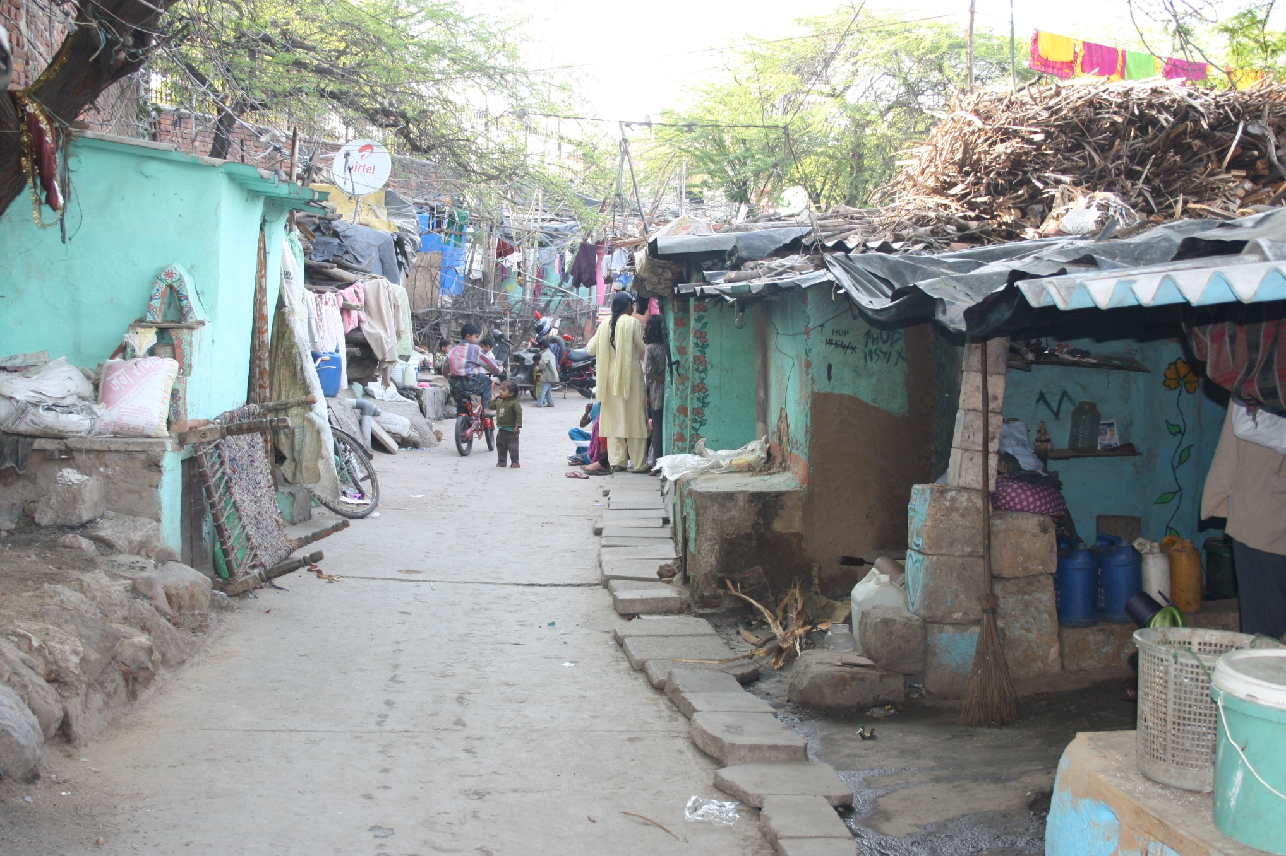
National Urban Health Mission (NUHM)
Orientation workshop for ACS/PS/Sec (Health) & MD (NHM)
Date- 27.10.2020

Slide 2
About NUHM
Approved in 2013 to address health issues of urban poor and marginalized population
  Burgeoning population :In 2018, 461 million Indian population living in cities- second largest urban population in world- The World Bank, 2015, World Development Indicators 2015 (database)
  Mobility dynamics and demographic profile remain unpredictable
  Health indices (IMR, Immunization Coverage) of urban poor worse than rural population
  Inadequate health promotion & health seeking behaviour
Covers cities/ towns with population above 50,000 & District and State Head Quarters above 30,000 population
After NUHM, about 5,000 UPHCs and180 U-CHCs added. Latest RHS (2018-19) estimated Mid year population (2019) shows shortfall of 4026 UPHCs
So far, 3607 U-PHCs converted into HWCs providing Preventive, Promotive and Curative care
Notes:
Health indices - Full Immunization (12–23 months)- urban poor- 57.7% ; rural areas- 61.3% ; Anaemic children- urban poor - 62.7% ; rural areas -59.5%
Inadequate health protection & promotion affecting productivity of individual and society

Slide 3
Service Delivery/Implementation Mechanism- NUHM
Service Delivery Mechanism
Implementation Mechanism
Urban-CHC
30-50 bedded in cities with 2.5lakh population
Urban-PHC
For every 50,000 urban population
Outreach Sessions
For slum and vulnerable population, routine UHNDs
ASHA &Mahila Arogya Samiti
1 ASHA per 1000-2500 urban population (200-500 households)
100 bedded for every 5 lakh population in Metro cities
Provision of Comprehensive primary healthcare services
Special outreach sessions
1 MAS per 250 – 500 population (50 – 100 households)
Implementation through Health Department - Rest of the State
Implementation through ULBs- 7 Metro cities

Slide 4
Shortfall in Primary health Centres- RHS data (2018-19)
Health Facilities | Required as per RHS (2018-19) (no.) | In-Position (no.) | Shortfall (no.) | %
U-PHC | 9072 | 5190 | 4026 | 44%
U-CHC | 1814 | 350 | 1464 | 81%
Urban Population- Census 2011 - 28.6 cr; Census 2011 - 37.7 cr
Estimated Mid-year urban Population (as on 1st July 2019)- 45.36 cr
Approx. urban population growth- 20%

Slide 5
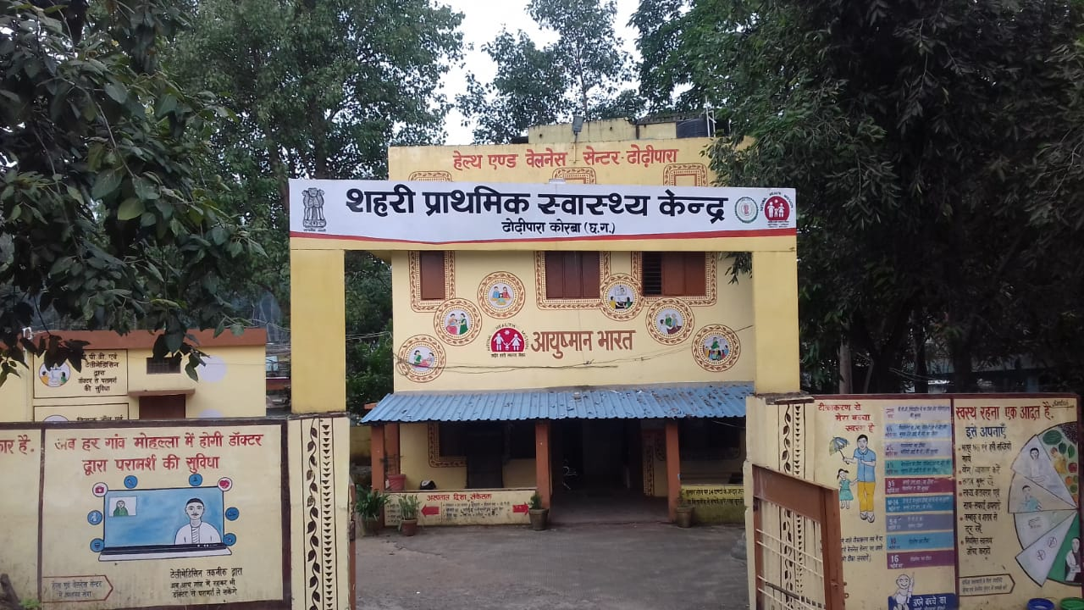
NUHM Approvals/Progress since 2013
39044 HR approved | 4870 U-PHCs approved
74468 ASHA approved | 92993 MAS approved
HR increased from 24% to 74%
Operationalization of U-PHCs increased from 72% to 95%
ASHAs engagement increased from 41% to 88%
MAS formation increased from 22% to 83%
3607 (75%) HWCs made operational against 4752 approved
U-PHC, Korba, Chhatisgarh

Slide 6
Physical Progress- State wise
Source: NHM MIS/QPR for period ending June, 2020

Slide 7
% Approvals (UPHC, HR, ASHA, MAS ) in Metros & Rest of the State

Slide 8
Health Service Delivery Models
Public Private Partnerships-
Andhra Pradesh – e-UPHCs on PPP mode (244)
  HR, Tele-consultation, IT, Diagnostic services: Supported by Agency
  Building, Drugs: Provided by State Health Department
Maharashtra - U-PHCs as Model centres in Nagpur corporation in Partnership with TATA Trust- (26)
  Infrastructure, IT, investigations through Hub & Spoke model : Supported by Agency
  Building, Drugs: Provided by State Health Department

Slide 9
Contd…
Tamil Nadu- Specialist services at Polyclinics ; weekly roster of services (96)
Telangana - Basti Dawakhana functional in GHMC. Buildings provided by ULBs in slum & similar habitations (350)
Roster of services-
  Monday – General Medicine & Dermatology
  Tuesday – Obs/ Gynae & Dental
  Wednesday – Pediatrics and Ophthalmology
  Thursday – Ortho and Physiotherapy
  Friday – ENT and Dental
  Saturday - Psychiatry

Slide 10
Service Delivery reported in HMIS portal
Immunization focused in 14 cities supported by WHO- Guwahati, Gaya, Muzzafarpur, Patna, Bangalore, BBMP, Bhopal, Indore, Agra, Allahabad, Ghaziabad, Kanpur, Varanasi and Lucknow.
Source: NHM HMIS Portal

Slide 11
Financial Progress- Year wise central allocation, fund releases and expenditure
Central Allocation – Rs. 7837 crore till FY 2019-20
Central Releases - Rs. 5715 crore till F.Y. 2019-20
Expenditure Reported – Rs. 6802 crore till F.Y. 2019-20
Notes:
As evident in the graph, the central allocation of funds is very high during the initial three years from F.Y. 2013-14 to 2015-16 and the absorption capacity was low, however, later on the position improves over the years from 2016-17 to 2019-20 when the pace of utilization of NUHM funds has improved.

Slide 12
Year wise trend- Utilization of funds
Notes:
The graph represents the improvement in the overall absorption capacity of funds which has improved from 1% in FY 2013-14 to 79% in FY 2019-20 due to better implementation of the NUHM activities and streamlined booking of expenditure

Slide 13
Major components of NUHM expenditure (FY 2019-20)
Notes:
The slides shows the major activities under which utilization is reported by the states under NUHM Flexible Pool. These are
1. HR (47.04%)
2. Community Processes (9.97%)
3. Procurement – Drugs and Supplies (7%)
4. Other Activities (Increment, EPF, Incentives etc) – 11.51%)

Slide 14
Focus Areas- NUHM
AB-HWCs- Operationalizing all UPHCs as HWCs :
Budgeting for HR, drugs & diagnostics, IT systems etc. in State PIPs
Planning &implementation of HWCs in Metro cities- in collaboration with ULB Nodal officers
Daily reporting and Monthly reporting at AB-HWC portal
Prioritizing NCD screening- Population enumeration, filling up of CBAC formats etc.
Planning for UPHCs to address the shortfalls

Slide 15
Contd…..
Others-
Strengthening Drugs and Diagnostics- expanding EML list, adopting diagnostics models like in house/ outsourcing/ hub and spoke models
Achieving NQAS for urban health facilities
Strengthening IT system- Tablets, Smart phones, Laptops, Computers, internet connectivity availablity at health facilities
Integration of health facilities in ‘Mera-Aspataal’ portal for seeking patient satisfaction and experience

Slide 16
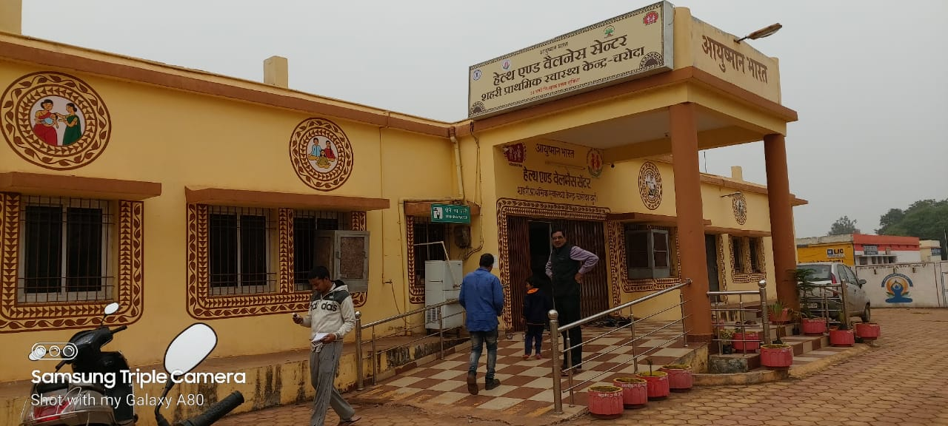
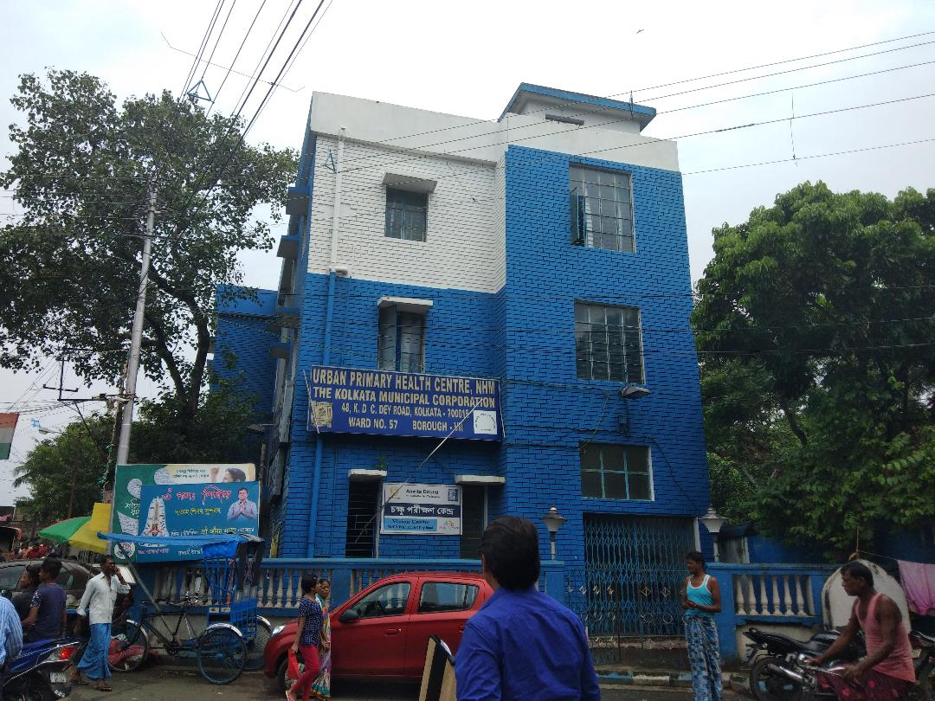
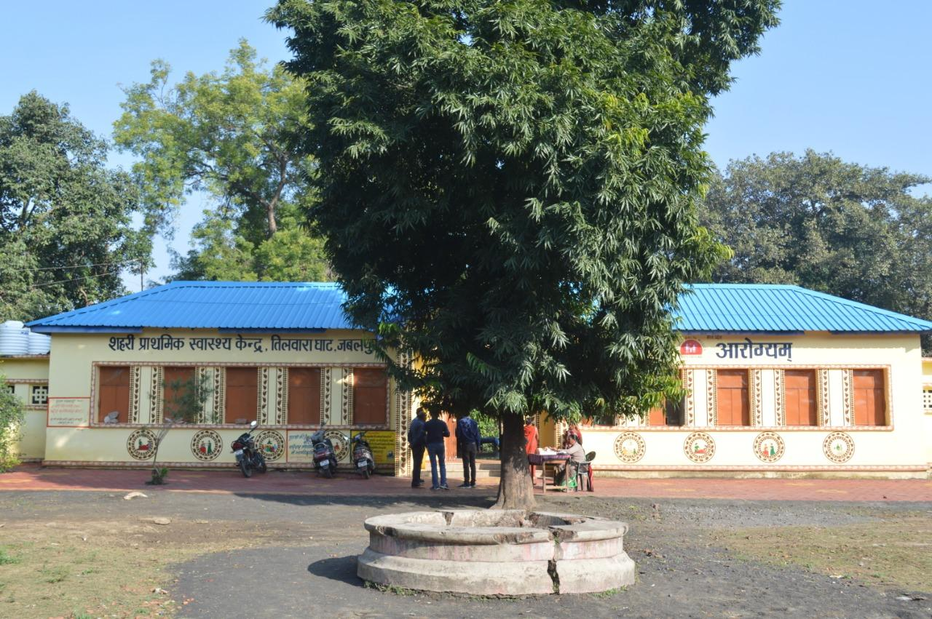
Thank you

Slide 17
Out Put/Outcome Indicators
OUTPUTS 2020-21 |  |  | OUTCOMES 2020-21
Output | Indicator(s) | Target 2020-21 | Outcome | Indicator(s) | Target 2020-21
1. Improving access to Healthcare in Urban India | No. of UPHCs and UCHCs providing CPHC services with adequate staff | 25000 PHCs including urban PHCs & Sub Centres to be providing CPHC services. | Improving access to Healthcare in Urban India | - | -
 | No. of OPDs carried out at Public health facilities in urban India | 5% increase from the previous financial year (As per HMIS as on 31.03.2020) | Increased utilization of public health facilities. | % increase in annual OPD in public health facilities | 5% increase from the previous financial year (As per HMIS as on 31.03.2020)

Slide 18
OutPut/Outcome Indicators
OUTPUTS 2020-21 |  |  | OUTCOMES 2020-21
Output | Indicator(s) | Target 2020-21 | Outcome | Indicator(s) | Target 2020-21
2. Providing quality healthcare services in Urban India | 2.1 No. of pregnant women getting at least 4 ANCs at all urban health facilities | 2% increase from the previous year as per HMIS | Reduction in Maternal Mortality Ratio (MMR) | Maternal Mortality Ratio (MMR) | As under NHM
 | 2.2 No. of children getting full immunization at all Urban Health Facilities | 2% increase from the previous year as per HMIS | Reduction in Infant Mortality Rate (IMR) | Infant Mortality Rate (IMR) | As under NHM
 | 2.3 No. of UHNDs/ Special Outreach conducted by UPHCs) | 2% increase from the previous year as per HMIS | Improving access to Health care in Urban India | - | -

