Slide 1


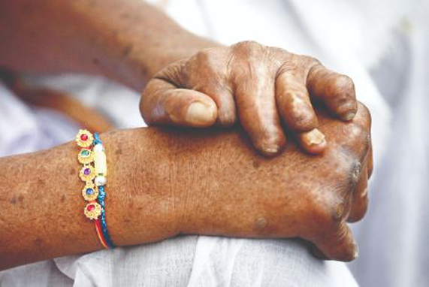
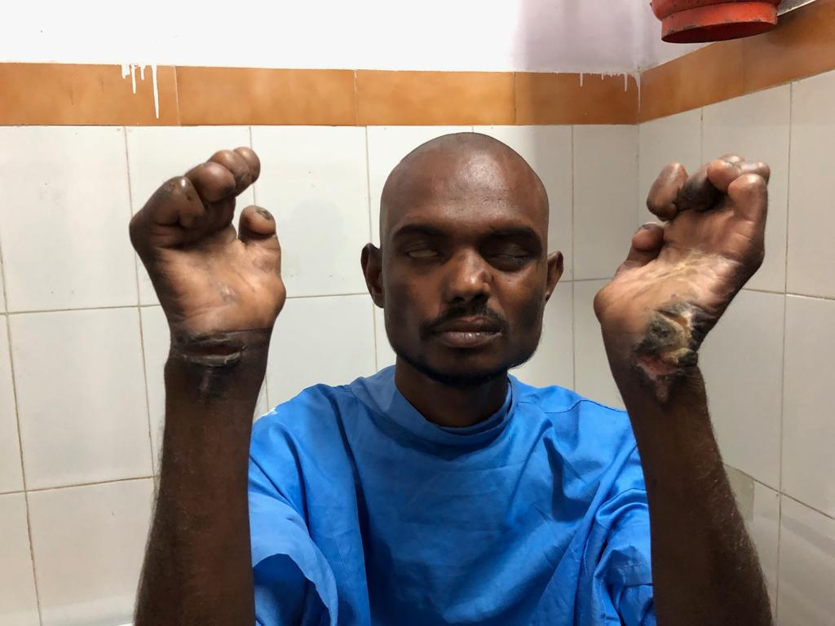
National Leprosy Eradication Programme
India is highest leprosy burdened (58% of new cases) country in the world.
Leprosy, if not detected in time and treated, is a serious disease, causes Grade II disability.
No. of G2D cases in 2019-20 – 2761
G2D % among new cases detected is 2.41%

Slide 2
Goals- NLEP
To reduce Prevalence rate less than 1/10,000 population at sub national and district level.
To reduce Grade II disability % < 1 among new cases at National level
To reduce Grade II disability cases < 1 case per million population at National level.
Zero disabilities among new pediatric cases.
Zero stigma and discrimination against persons affected by leprosy.

Slide 3
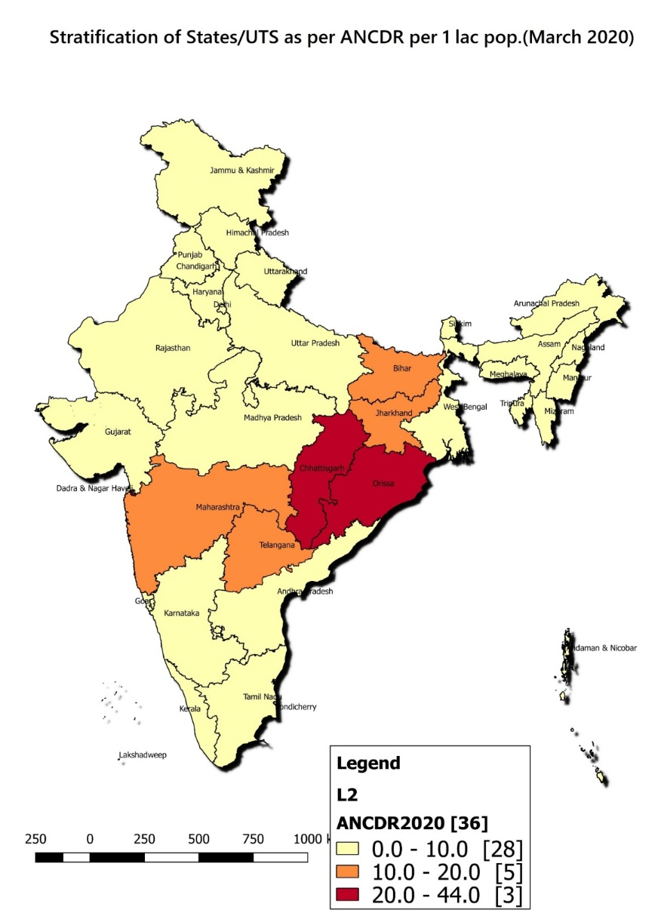
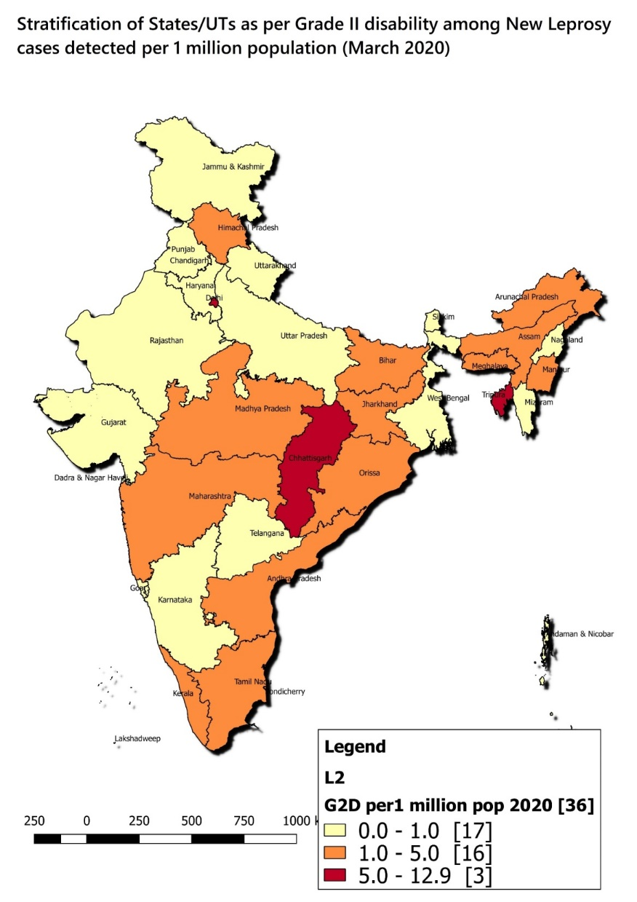
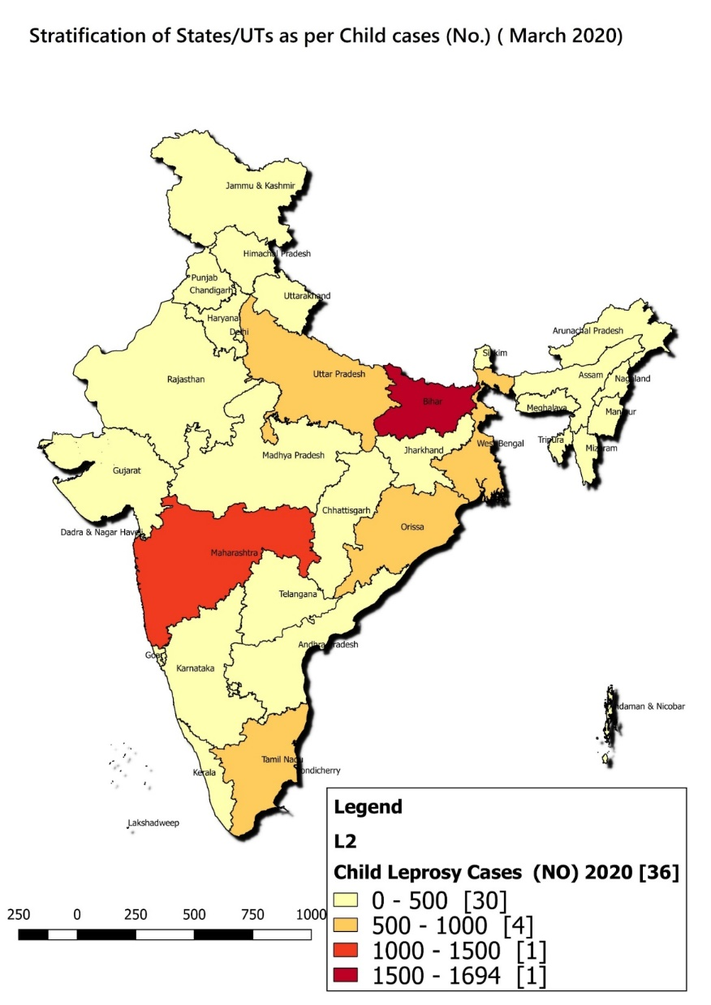
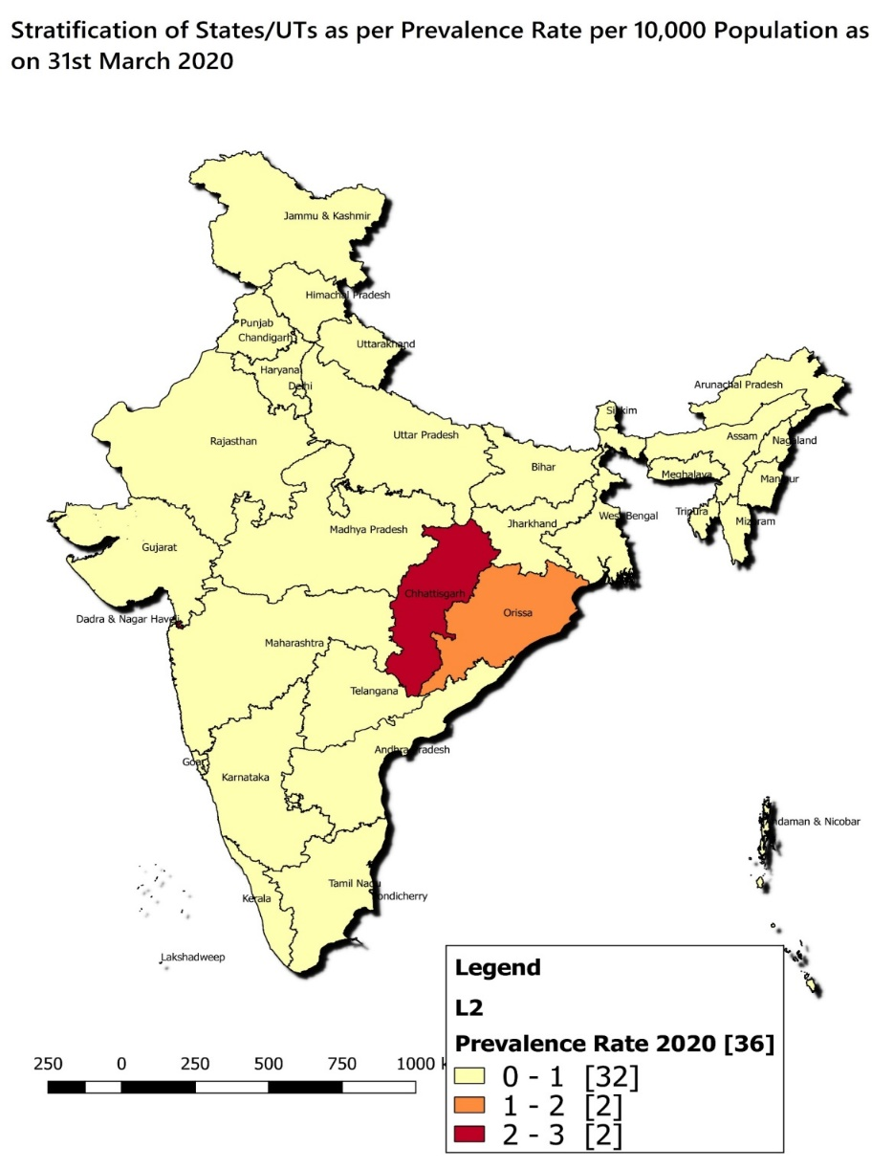
National Leprosy Status-India
ANCDR - 8.13 per 100,000 popn.
Prevalence Rate (PR) - 0.57 per 10,000 popn.
Child proportion - 6.87 %
Grade 2 Disability proportion- 2.41%
G2D rate- 1.96 / million population.

Slide 4
Activities under NLEP
Enhanced active and early case detection
Convergence of leprosy screening under RBSK (for 0-18 yrs), RKSK (13-19 yrs), CBAC (above 30+ yrs population) and NUHM (to cover peri-urban, slums, colonies and migratory population).
Timely referral and follow up for treatment completion on time through Multi Drug Therapy (MDT) available free of cost in all public health facilities.
Disability prevention and Medical Rehabilitation (DPMR): Reaction management, provision of Self Care kits, MCR footwear and Aids & Appliance, and re-constructive Surgeries (RCS) at DH and medial colleges
Sparsh Leprosy Awareness Campaigns.

