Slide 1
Health Management Information System (HMIS)

Slide 2
INTRODUCTION
HMIS is a web based management information system launched by MOHFW in 2008 with district level reporting
2010-11 onwards facility level reporting was initiated
Around 2,00,000 health facilities across all districts of India are uploading data every month
Data analytical & reporting capabilities using SAS platform services
GIS module of HMIS is available in Public domain
HMIS provides ready to use National, State, District and sub-district reports (available in Public domain)
Information for evaluating the PIP on the basis of services rendered by health facilities
https://nrhm-mis.nic.in

Slide 3
OBJECTIVES OF HMIS
To Monitor the performance & quality of health care services under the National Health Mission
A tool for evidence based health planning and monitoring
Repository of information on health care indicators and trends
Used for testing the effectiveness, efficiency and coverage
of health programs and schemes
To improve availability and access of health care to the population
Developing and monitoring performance based health indicators

Slide 4
DATA CAPTURED UNDER HMIS
HMIS capture Service Delivery data through monthly and Infrastructure & HR on Annual basis, Service Delivery and Infrastructure & HR data on monthly basis and 5 data items on daily basis.
Service Delivery : Reproductive health which includes Ante Natal Care, Deliveries, Post Natal Care; Child Health which includes immunization, Adolescent Health; Family Planning, Vector Borne Disease, Patient Services including Allopathic and AYUSH OPD, Emergency Services, IPD Services, Surgeries, Nutritional Rehabilitation Centre (NRC), Lab Services, Morbidity and Mortality, Rashtriya Bal Swasthaya Karyakram (RBSK), Janani Shishu Suraksha Karyakram (JSSK), etc. data).
Infrastructure & HR: The data items collected annually. physical infrastructure which includes building status, functioning of different Departments/Clinics, Pharmacy, Equipment, Cleanliness, Availability of Medical Services such as Surgery etc., Super Specialties services such as Cardiology etc., Diagnostics; availability of Doctor, Specialist Doctor, Para Medicals and Support Services, Investigative & Laboratory Services including Clinical Pathology, etc. data
In new HMIS, five data items are also collected on daily basis which are mainly linked to COVID19.
Total number of outpatients (OPD), Total number of inpatients (IPD), Total SARI - Severe Acute Respiratory Infection (OPD + IPD), Total ILI - Influenza Like Illness (OPD + IPD) & Total fever cases >= 7 Days (OPD + IPD)

Slide 5








FLOW OF DATA
(Case I- At Block Level & Case II- Directly from Facility)
SDH
DH
DHQ
Health Worker
CHC
Enters DHQ and compiles the data to form DC
Health Worker
PHC
Data Entry Operator at Block
Enters Data for each facility
HMIS Portal
Health Worker
SC

Slide 6
SALIENT FEATURES OF NEW HMIS
Person Specific User Credentials (mapped to an Individual)
Provision for Daily/ Monthly data entry
Flexible : Multiple facilities to one credentials, one facility to one credentials
Compatibility with multiple devices (Mobile, Tab etc.)
Integration with other MoHFW software’s- Linking through API
DASHBAORD for real-time monitoring,
Alerts,
GIS Integration with layers up to road, village boundary etc.
NIN/ LGD compatible
Infrastructure data to be entered only once in the new system, later to be auto populated and monthly basis updated.

Slide 7
USES OF HMIS DATA
In monitoring and evaluations of achievements and progress on key deliverables under National Health Mission
20% of NHM resources are tied to the conditionalities which include NITI Aayog ranking of States, operationalization of HWCs, implementation of DVDMS or similar logistic management IT systems upto PHC level, Implementation of mental Health Programme etc.
HMIS data is extensively used in NITI Aayog ranking of States, Grading of PHC, Ranking of District Hospital, Immunization coverage, State Health index etc.
Monitoring of aspirational districts
Monitoring visits like CRM, Supportive supervision visits, etc.

Slide 8
Important points for consideraton
Facility based data entry
  Availability of basic infrastructure
  Data centers at DH\CHC – DEOs vs. outsourcing
  Connectivity – Broadband connection and WiFi hotspots
Completeness
Timeliness
SUPPORT AVAILABLE IN PROGRAMMES AND HSS Pool.

Slide 9
CPHC-NCD Updates
MoHFW
Oct 24th, 2020
Dell, Tata Trusts, NIC,NHSRC, CHI

Slide 10
State onboarding and
Deployment updates
NCD status, Tamil Nadu, West Bengal, CDSS-Punjab. Guidance to other States

Slide 11

State NCD Deployment Status
Geography | Enrollment | Partial Screening | Total Screening | Referred to PHC | Examined at PHC | Diagnosed-DM | Diagnosed-HTN
India | 6,52,39,051 | 60,36,540 | 2,52,78,291 | 82,75,855 | 20,11,752 | 4,86,782 | 9,41,712
Telangana | 1,31,27,060 | 15,15,469 | 89,95,249 | 21,13,885 | 8,04,399 | 2,42,584 | 4,79,715
Madhya Pradesh | 1,10,20,884 | 10,06,990 | 44,28,800 | 15,90,505 | 7,10,983 | 1,66,443 | 3,04,049
Orissa | 95,38,007 | 15,11,658 | 54,88,495 | 22,41,429 | 85,778 | 14,081 | 35,330
Maharashtra | 82,25,279 | 5,00,613 | 21,71,528 | 8,06,622 | 78,513 | 21,767 | 51,601
Uttar Pradesh | 59,07,227 | 7,98,039 | 18,29,374 | 7,02,415 | 612 | 33 | 114
Karnataka | 56,54,603 | 1,31,260 | 4,36,201 | 1,15,662 | 93,766 | 17,278 | 26,778
Punjab | 31,23,050 | 21,833 | 88,604 | 34,848 | 548 | 214 | 346
Rajasthan | 23,58,326 | 210 | 211 | 2,817 | 10,555 | 834 | 2,372
Haryana | 22,38,357 | 48,232 | 1,45,763 | 73,428 | 53 | 0 | 6
Chhattisgarh | 16,86,812 | 3,37,546 | 11,61,605 | 3,95,798 | 2,11,936 | 18,515 | 33,372

Slide 12
State NCD Deployment Status
Geography | Enrollment | Partial Screening | Total Screening | Referred to PHC | Examined at PHC | Diagnosed-DM | Diagnosed- HTN
Bihar | 13,42,334 | 83,513 | 3,55,697 | 1,10,857 | 1 | 0 | 0
Meghalaya | 2,60,509 | 8,677 | 13,379 | 8,862 | 104 | 28 | 65
Manipur | 1,89,010 | 9,236 | 23,705 | 5,499 | 3,850 | 796 | 1,616
Jharkhand | 1,20,140 | 14,075 | 28,418 | 11,221 | 11 | 3 | 1
Goa | 1,11,885 | 17,036 | 31,815 | 26,681 | 9,409 | 3,967 | 5,474
Mizoram | 1,00,278 | 9,694 | 23,652 | 10,185 | 1 | 1 | 0
Sikkim | 67,162 | 3,681 | 17,549 | 4,418 | 302 | 55 | 211
Uttarakhand | 65,175 | 7,933 | 12,759 | 11,118 | 0 | 0 | 0
Arunachal Pradesh | 27,112 | 2,647 | 4,735 | 1,489 | 2 | 0 | 0
Chandigarh | 18,547 | 3,846 | 8,853 | 3,955 | 0 | 0 | 0

Slide 13
Empower States to manage GOI-NCD
Empower States to manage GOI-NCD
Phase | Status | Next Steps
Phase-1 Download Line listing report from BSNL data center | 11 states have downloaded UP, MH, RJ,PB, OR,MP,UK, MH, KA, CG,TG | Telangana and Punjab States want to generate custom reports and have requested Database Architecture and schema training Dell team, with NIC ready to conduct the training in first week of November Request Ministry to send official communication for training
Phase-II GOI-NCD hosting in SDC and integrating with states application | Telangana, West Bengal & Tamil Nadu are interested to host GOI-NCD in SDC and have sent letters to Ministry | SOP and Guideline document prepared by Dell and reviewed by NIC and CHI NIC has sent final document to Ministry on 20-Oct-20 Request Ministry to send SOP and Guideline document to States Additionally, for easy on-boarding Dell has prepared detail On-boarding Kit Dell team in collaboration with NIC ready to conduct “Hosting GOINCD in SDC” training in first week of December Request Ministry help for official communication for training
Phase-III GOI-NCD code access, and customize for states workflow | Telangana and Tamil Nadu are ready to do customization after hosting in SDC | Dell team in consultation with NIC will prepare Customization Guidelines (workflow or protocol) and Technical Governance Structure to be followed Institutional Governance structure and model is required to ensure states adhere to published guidelines. Request Ministry help to setup Institutional Governance structure

Slide 14
SOPs for State Data Centre

Slide 15
Proposed State Workshops
IT Workshop - 1
Data Base Walkthrough
IT Workshop - 2
Hosting GOI-NCD in SDC
  Proposed 2 days workshop
  Target Audience: Will be conducted to the states IT teams who have access to line listing data, to understand NCD Data Flows and Database structures.
  Agenda is to make the State IT teams comfortable to understand the database structure and with continuous practice they can pull their own custom reports
  Workshop material preparation is in progress will be completed by mid of next week and will have a final revision with NIC
  Proposed 2 days workshop
  Targeted Audience: State IT teams
  Agenda is to help interested states in Hosting GOI-NCD in SDC
  For easy on-boarding Dell has prepared detail On-boarding Kit and will get it reviewed with NIC Team.

Slide 16
State Customization

Slide 17
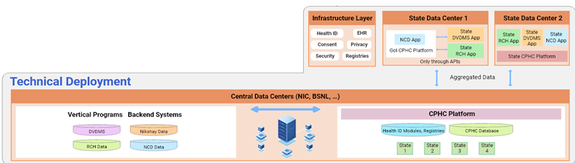
States Customization
Option 1: Using GoI CPHC Platform as is
  GoI CPHC platform is hosted at State Data Center
  All programs can leverage platform APIs to use common functional & system modules
  GoI CPHC platform is linked with central system to send aggregated data.
Option 2: Using Customized CPHC Platform
  Aggregate data module will ensure required aggregated data is shared with central system
  Core CPHC platform and database schema cannot be modified
  Periodic software checks & during upgrades to ensure software binaries are not updated or changed

Slide 18
States Customization
States can do limited customization in GoI-NCD software when hosting in State Data Centre
State IT Team will be responsible for any customizations done on standard GoI-NCD software
To ensure integrity and security of the GOI-NCD system, the following will be enforced in customization:
States can
States can not
Customize using configurations provided e.g. SMS templates, Email
Use state specific master data adhering to standards required for sending aggregates to central dashboard
Integrate with state specific software using APIs
Build custom UI using the existing APIs which can be deployed independently
Customized report using existing GoI-NCD APIs e.g. line listing
Develop reports by building read-only APIs on aggregate dataset
Modify database schema & current production API
Customize or change core modules
Remove / undeploy any binaries packaged as part of GoI-NCD software
Change any deployment related scripts
Any of these changes can result in failure to upgrade to new versions of GoI-NCD software

Slide 19
State Requests
Tamil Nadu, West Bengal, Telangana

Slide 20
Program Update - Telangana
State request:
  State got access to line listing data; state has sent request to Ministry to conduct a training for understanding the data/database structure, so that state IT team can generate custom reports
  Request Ministry to send official communication for training.
  State is interested in setting up NCD in State Datacenter and sent letters/mail to Ministry for approvals.
  Pending ministry approval/reply with guidelines.
Technical dependency:
  State is requesting for state specific customizations on the NCD system.
  State wants to integrate all state health apps – KCR Kit, Basti Dawakhana, Kanti Velugu with NCD for single EHR
  State is very interested in the data as they want to utilize Aadhaar. Ministry guidance awaited on communication to states on the same.
  State wants to start the PHC Mobile App pilot from Nov-01-2020 in Hyderabad area.

Slide 21
Program Update - Tamil Nadu
State request:
  State is interested in setting up NCD in state datacenter.
  State has sent letters/mail to ministry for approvals. Pending ministry approval/reply with guidelines.
  Requested sharing of complete source code for further customization as per State needs
  Technical dependency
  Request for screening data from MO portal to be included in dashboard
  Feature to Search for any individual within the State
  Master Data needs to be cleaned (Master data to be shared along with admin login)
  Migration plan for existing data (Villages are open text which need to be mapped to village ids)
  State already has citizen database which they would like to use in GOI-NCD system so enrollment effort is reduced.
  Unique ID for existing enrolments
  Pilot in select locations (Ramnad/Villupuram)

Slide 22
Program Update - West Bengal
State request:
  State is interested in setting up NCD in State Datacenter.
  State has sent letters/mail to ministry for approvals. Pending ministry approval/reply with guidelines.
Technical dependency:
  Need UI Customizations
  Bilingual with English and Bengali
  Gap analysis yet to be completed

Slide 23
THANKS

Slide 26
Agenda
Finalizing requests from Three States such as Telangana, WB and TN for rolling out Central NCD App in these States and arriving at the procedure for the same
Decision on customization requested by these States
Finalizing the SoPs for State Data Centre
Buidling Technical Capacity inside NIC/CHI

Slide 28
Backup Slides

Slide 29
Infrastructure Updates
Data Access to States
Building capacity inside NIC/CHI
Infrastructure upgrade
ANM and ASHA Mobile App in Playstore
BSNL Data Center Challenges

Slide 30
Data Access to States
Solution | Status
3(b) Phase- I Immediate Data Access to all 28 states with 24-hour delay | Access enabled and credentials communicated to all states Eight states (Karnataka, Rajasthan, Punjab, Orissa, Madya Pradesh, Haryana, Uttaranchal and Maharashtra) have downloaded data
3(b) Phase- II Atomic database per state. i.e. States Data in Central IT Infrastructure (Temporarily provisioned by Centre) | · Approach and Design validated by NIC · Dell team developed software in July & Aug · Demo provided to NIC in Staging environment Software changes rolled out to production – Aug 24th · For deploying(atomic database) the first state, data backup is necessary to ensure there is no data loss Currently it is not working. CHI is working with BSNL to resolve this. For create more states database, additional infrastructure required
3(a) States Hosting Data locally in State Data Centre (SDC) | Few states have sent request to NIC for infrastructure requirement Infrastructure Sizing for Small and Large states prepared by Dell in consultation with NIC

Slide 31
Building Technical Capacity inside CHI/NIC
Shared Microservice, Architecture and Database Design Documents to NIC and CHI
Provide Application demo, Completed Architecture and design walkthrough to NIC
Container orchestration from Docker to Kubernetes
  NIC asked for the migration
  Dell team has completed and ready for rollout in Production
  Not rolled out in production due to limited human resources capacity in TSU (Technical support unit)
Data sharding (Option 3B) in Central Data center requires additional human resources in TSU
Waiting for new team members from CHI to start hand-holding

Slide 32
Infrastructure Upgrade
Current infrastructure is minimal, and infrastructure upgrade is required for below reasons.
  For activating atomic databases for all States in Central data center, additional infrastructure is required.
  GOI-NCD deployed in Central data center can handle approx. 4Crore enrollments.
  Currently 6.4Crore+ are enrolled. By end of this year, it may reach 8Crore enrollments.
  States are asking for reports which can help in effective program administration. Dell developed feature but could not be rolled out as it requires infrastructure upgrade
  States have also written letter to Ministry about application performance and all details shared with NIC.
Prepared proposal in consultation with NIC and file is under review

Slide 33
Building Technical Capacity inside CHI/NIC
Shared Microservice, Architecture and Database Design Documents to NIC and CHI
Provide Application demo, Completed Architecture and design walkthrough to NIC
Working with NIC team to setup GOI-NCD Test environment in NIC data center
First state Telangana Data sharding (Atomic specific database) to be completed on 1-Nov-20
More states data sharding requires additional human resources in CHI
Container orchestration from Docker to Kubernetes completed. Not rolled out in production due to limited human resources capacity in TSU (Technical support unit)
Waiting for new team members from CHI and NIC to start hand-holding

Slide 34
ANM and ASHA Mobile App in Playstore
CHI shortlisted AAA technologies as Security Auditor for GOI-NCD Application
Mobile Application Security audit is complete and requires approval on below issues
Issue Details | Dell & AAA Technologies | NIC/CHI
External Storage is assigned for Data Storage | there is no alternative for that either restrict these permissions | Requires division approval about risk acceptance
Dangerous Permissions are allowed in the app | there is no alternative for that either restrict these permissions | Requires division approval about risk acceptance
Improper Export of Android Application Components | there is no alternative that for third party broadcast receiver | Requires division approval about risk acceptance
Dangerous Http Methods are Enabled in the application (OPTIONS) | AAA--> Disabled OPTIONS method Dell --> Explained why there is no risk. | NIC is reviewing it
Path Disclosure is possible in the app | Dell agreed to fix next release | NIC is reviewing it
Java hash code is used in the app | AAA--> Remove third party files. Dell--> Not possible as it is opensource code | NIC is reviewing it

Slide 35
BSNL Data Center Challenges
Ticket # | Date Raised | Description | Remarks
CS061197 | 13th August - 2020 | Database Backup | Blocker for Karantaka Data sharding Informed BSNL 1 month
CS061185 | 13th August - 2020 | Merging of resources | Required for better performance
CS061556 | 17th August - 2020 | Resource Inventory allocated to NCD | Requested through mail on 13th August – 2020
CS061504 | 16th August - 2020 | Storage IOPS Speed confirmation
CS060844/CS060822 | 10th August - 2020 | Network Latency | Temporary solution provided. Issue can occur anytime and impacts deployment

Slide 36
Objectives for NCD Dashboard Redesign
NCD DASHBOARD REDESIGN
Provide visibility, in aggregate form, of data already being captured
Better User Interface with more Filter criterion
Turning available data into actionable insights
Draw comparison across Locations/Facilities for an indicator, parameter or disease

Slide 37
PHC Mobile App
Status
Version 1 Features
Completed
Pilot with Tata Trusts Volunteers and PHC Doctors.
User Interviews were conducted & the feedback was looped in back as improvements
Upcoming
Version 1 launch in October
Login & Search
PHC Dashboard & Subcenter wise Indicators
Quick Enrolment
Initial Assessment – Vitals, History, Medication, Symptoms, Physical Examination
Disease Sections - Hypertension, Diabetes, Oral, Cervical & Breast Cancers

Slide 38
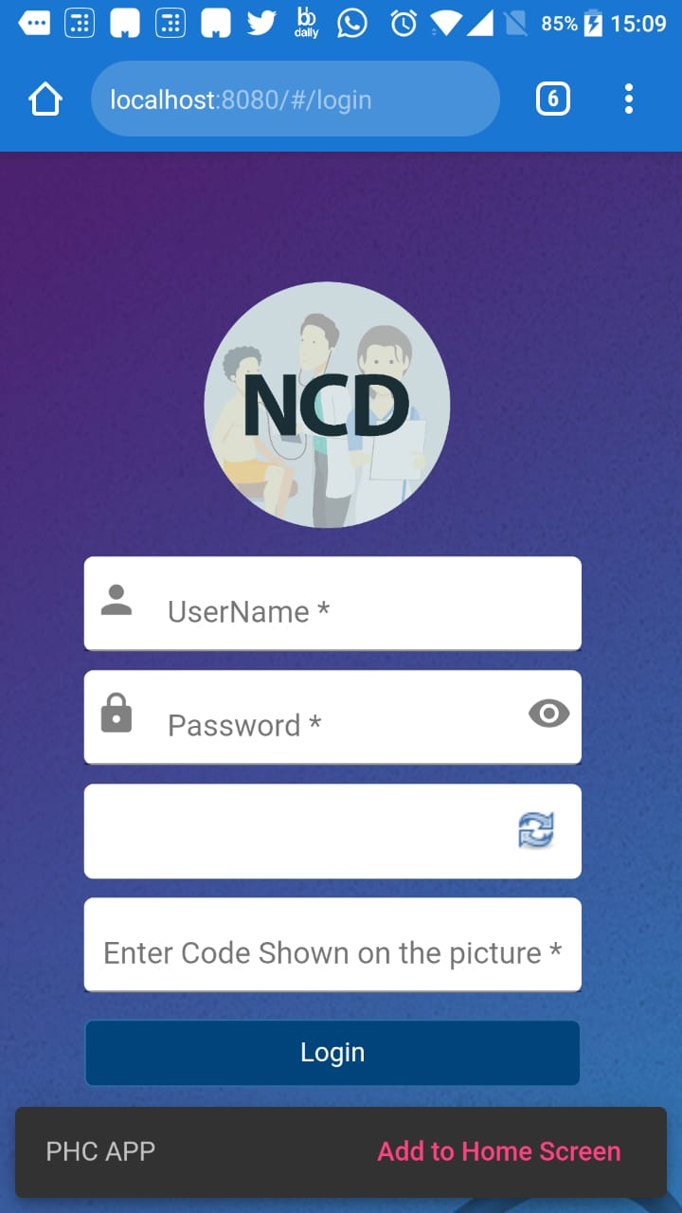
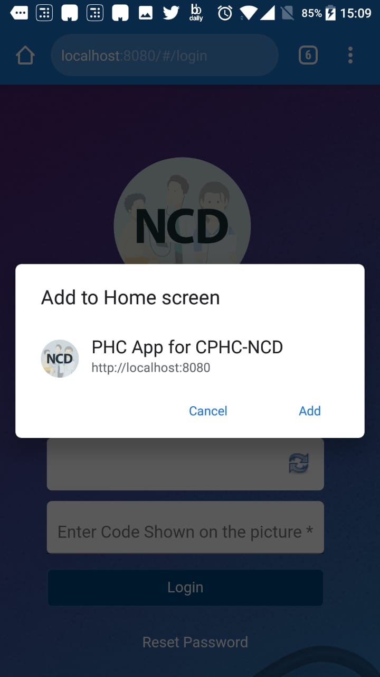

PHC Mobile App – Progressive Web App
A Progressive Web App (PWA) is a web app that uses modern web capabilities to deliver an app-like experience to users.
No need of heavy APKs.
  Easily share via URL and not require complex installation.
  Will be updated automatically.
You can either download it as an app and keep it on your home-screen or use it as browser.
It will work across browsers and is responsive on all devices - desktop, mobile, tablet.
Requires lesser storage on the device as compared to an app
Currently its an online only app.
1. Open url https://ncd.nhp.gov.in/#/login in the mobile browser
2. Add to home screen
3. Use like any other app on your phone. No URL required.
Notes:
Mention a few examples

Slide 39
Identify facilities as HWCs in NCD system​
NCD metadata is inherited from RCH in 2018 & extended over the years, where only some facilities were marked as HWC. This data has been manually updated last year by taking a dump from HWC team. Today in our system we have ~ 15 K HWCs.​
Regular update to this information is essential to pull out performance of the HWC’s, which are running the NCD Program.​
Plan of Action:​
API Integration with HWC Portal to get regular updates about facilities identified as HWCs​
Send NCD indicators to HWC portal for Daily reporting​
Instead of Facilities doing Daily reporting in HWC portal , wherein the aggregates reported are not validated (not backed​
by data) , HWC portal to pull the required Indicators from NCD portal.​
Benefits:​
Avoid manual entry from Facilities and reducing the data entry burden​
Reporting validated data ​

