Slide 1
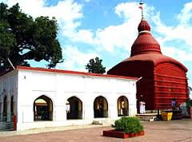



TRIPURA
Review of
Comprehensive Primary Health Care
Date: 3rd & 4th Oct’2019 Guwahati

Slide 2
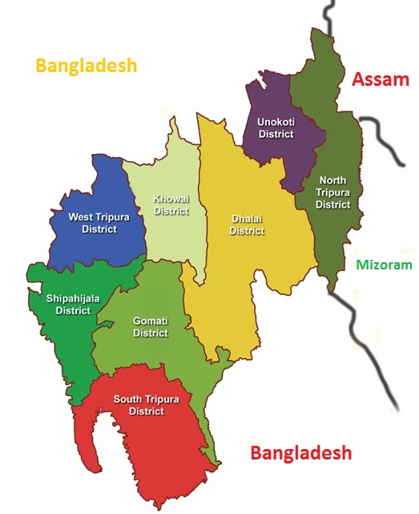
State Profile
SL | Item | Number
1 | Projected Population | 4132121
2 | Density/km2 | 350
3 | Sex Ratio | 961
4 | Literacy | 87.75%
5 | District | 08
6 | Sub-Division | 23
7 | Block | 58
8 | Village | 1038
9 | SC | 1005
10 | PHC | 108
11 | UPHC | 07
12 | CHC | 22
13 | SDH | 12
14 | DH | 06

Slide 3
Health Indicators
Indicators | Unit | Present Status
 |  | India | Tripura
IMR | Per thousand | 33 | 29
Birth Rate | Percentage | 20 | 13
Death Rate | Percentage | 6.3 | 5.2
Natural Growth rate | Percentage | 13.9 | 7.8
Total Fertility Rate (TFR) | Per productive couple | 2.2 | 1.7
Sex Ratio | Per thousand | 943 | 961
Source: Sample Registration System (SRS) / National Family Health Survey (NFHS)

Slide 4
Health Indices : RMNCH+A
No | Indicator | 2017-18 | 2018-19 | 2019-20 (as on August)
1 | Institutional births | 79.9% | 93% | 93%
2 | 4 ANC | 53% | 56.4% | 57%
3 | Anaemia among ever married women (15-49 yrs) | ---- | 43% | 40%
4 | PW consumed IFA for 100 days | 13.4% | 56% | 53%
5 | Children age 0 - 12 months fully immunized | 54.5% | 84% | 84%
6 | Infants Breast Fed within 1 hr of Birth | 44.4% | 87% | 93%
7 | Male Sterilization | 28 | 49 nos. | 19 nos.
8 | Female Sterilization | 2614 | 1294 nos. | 977 nos.
9 | PPIUCD /PAIUCD / IUCD | 2285 | 821 nos. | 246 nos.
Sl No. | OPD/IPD Patients (HMIS) | 2017-18 | 2018-19 | 2019-20
1. | OPD | 44,31,571 | 4766223 | 2077095
2. | IPD | 4,37,362 | 445590 | 205565

Slide 5
Situation : Vector Borne Disease
Name of Vector Borne Disease | Parameter | Year
 |  | 2018 | 2019 as on July
Malaria: API-2.68 (2016), 1.74 (2017) 0.99 (2018) | No. cases | 13079 | 7860
 | No. death | 13 | 01
Dengue | No. cases | 100 | 62
 | No. death | 0 | 0
Chikungunya | No. cases | 75 | 64
 | No. death | 0 | 0
Japanese Encephalitis | No. cases | 59 | 40
 | No. death | 00 | 0
Source : State MIS of NVBDCP

Slide 6
AB- PMJAY
Sl | Name of Component | Target | Achieve FY 2018-19 |  | Achievement in FY 2019-20
1 | Hospital Empanelment | 64 | Public: 62 + Private: 02 |  | NA
2 | e-Card Generation | Approximately 498520 nos. of eligible families with about 2056819 nos. of individuals | Family | Beneficiary | Family |  | Beneficiary
 |  |  | 160459 | 351148 | 84687 |  | 202174
3 | No. of Patients Registered | N.A | Private | Public | Private |  | Public
 |  |  | 29 | 9140 | 173 |  | 25638
4 | Total No. Of Claims Submitted | N.A. | Private | Public | Private |  | Public
 |  |  | 27 | 7747 | 87 |  | 24769
5 | Claim Settled Amount in Rs. | N.A | Private | Public | Private |  | Public
 |  |  | 145620 | 20159446 | 3974693 |  | 83867977
6 | Hospital Audit | 64 | 10 |  | 15 | Remarks
 |  |  |  |  |  | Remainder should be undertaken shortly. To be undertaken twice yearly for 64 hospitals
7 | Medical Audit | 2% Direct Audit of all cases + 2% of audits done by ISA | 10 |  | 17 | Remainder should be undertaken shortly.
8 | Beneficiary Audit (post discharge – through telephone) | 5% direct audits of all cases + 10% of audits done by ISA | 10 cases |  | 5 cases | Remainder should be undertaken shortly
9 | Beneficiary Audit (post discharge – through home visit) | 2% direct audit of all cases + 2% of the audits done by the ISA | 5 cases |  | 5 cases | Remainder should be undertaken shortly

Slide 7

Health & Wellness Centre: Road Map
1
SL | Year | Sub Centres | PHCs | UPHCs | Total
1 | 2018-19 | 40 | 26 | 5 | 71
2 | 2019-20 | 317 | 82 | 1 | 400
3 | 2020-21 | 360 | 0 | 2 | 362
4 | 2021-22 | 288 | 0 | 0 | 287
Total |  | 1005 | 108 | 08 | 1120
2
3
Technical Partner: USAID MCSP/ Jhpiego

Slide 8
Essential Package of Services
Before HWCs intervention
After intervention
Care in Pregnancy and Child-birth
Neonatal and Infant Health Care Services
Childhood and Adolescent Health Care Services
Family Planning, Contraceptive Services and other Reproductive Health Care Services
Management of Communicable Diseases: National Health Programmes
General Out-patient Care for Acute Simple Illnesses and Minor Ailments
Screening, Prevention, Control and Management of Non-communicable Diseases
Care for Common Ophthalmic and ENT Problems
Basic Oral Health Care
Elderly and Palliative Health Care Services
Emergency Medical Services including Burns and Trauma
Screening and Basic Management of Mental Health Ailments
Care in Pregnancy and Child-birth
Neonatal and Infant Health Care Services
Childhood and Adolescent Health Care Services
Family Planning, Contraceptive Services and other Reproductive Health Care Services
Management of Communicable Diseases: National Health Programmes
General Out-patient Care for Acute Simple Illnesses and Minor Ailments
Screening, Prevention, Control and Management of Non-communicable Diseases
Care for Common Ophthalmic and ENT Problems
Basic Oral Health Care
Elderly and Palliative Health Care Services
Emergency Medical Services including Burns and Trauma
Screening and Basic Management of Mental Health Ailments
Wellness

Slide 9
HWC Functional Status (Service Delivery)
40% OPD attendance increased in last 6 months across 39 functional SC-HWCs
NCD Service particularly Population Based NCD Screening initiated
NCD Screening – 180,365 patients in FY 2018-19 and 124,662 patients in FY 2019-20 (till August, 2019)
Elderly and Palliative Health Care Services started by every CHOs
Disease |  | HTN | DM | DM & HTN(Both) | CVDs | COPD | Oral Cancer | Breast Cancer | Cervical Cancer
Confirmed Case | 2018-19 | 38395 | 9843 | 8190 | 172 | 513 | 23 | 3 | 0
 | 2019-20(August, 2019) | 20634 | 6687 | 3202 | 154 | 454 | 10 | 17 | 1
Data Reference – NCD Clinic – EDSS Component, UPBS – CBAC Component, Non-NCD Clinic hospital.

Slide 10
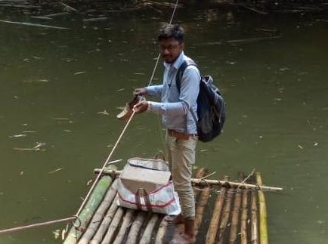
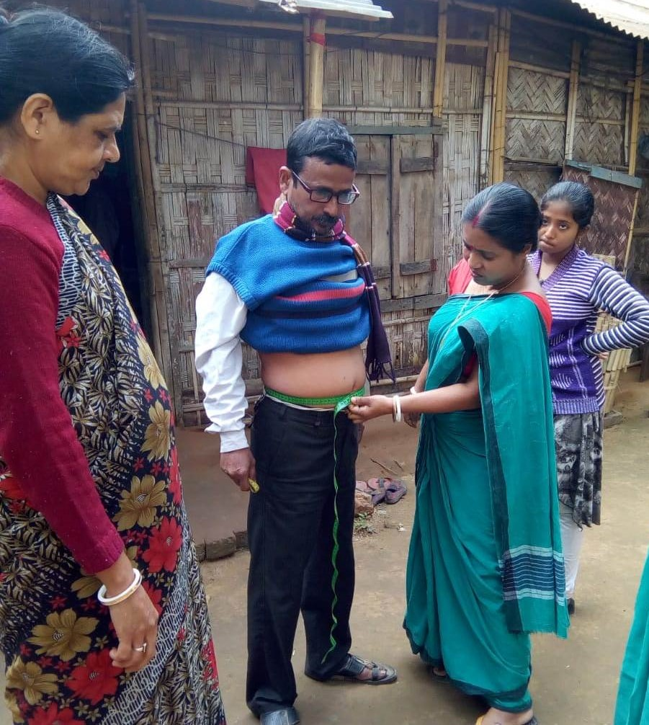
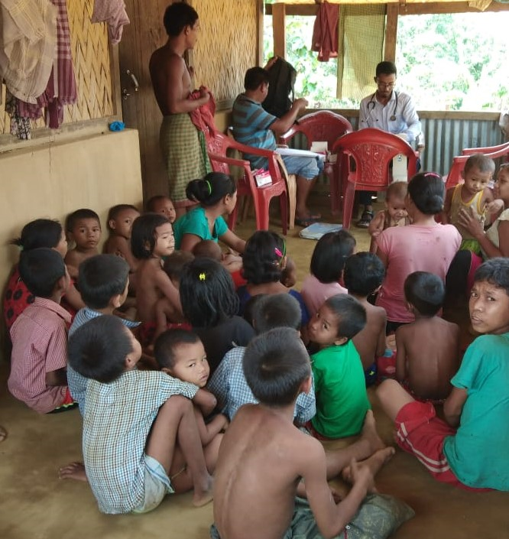
Expansion of services through HWCs

Slide 11
HWC Functional Status (Human Resources )
HR availability
85% of PHCs have 02 Doctors, 03 Staff Nurses, 01 Pharmacist & 01 Lab Tech
65% of SCs manned by MPW (F) & MPW (M)
35% of SCs manned with MPW (M) or MPW(F)
Till date, CHOs posted across 170 SC-HWCs
03 Program Study Centres (PSCs) functional for Certificate Course on Community Health with capacity of 60 candidates per PSC
Regular Supportive Supervision for HWCs and mentoring support for Certificate Course in Community Health by USAID MCSP/ Jhpiego

Slide 12
HWC Functional Status (Medicines and Diagnostics )
Online supply chain management system expanded till PHCs
Free Drugs Services:
  As per EDL, drugs made available in all HWC – PHCs / UPHCs & SCs
Free Diagnostics Services :
  Out of 14 mandatory Tests, 7 (PKT, HB, Blood Sugar, Malaria Slide, Sputum Collection, RD kit, Urine Albumin) are available in all SC HWCs
  Out of 63 mandatory Tests, 24 tests are available in PHC HWCs & UPHC HWCs
  Training on VIA completed for South District, ToT formed for Unakoti District
  Funds will be proposed in Supplementary PIP 2019-20 for West District for VIA training
PHC / UPHC tests: VDRL, Hep- B, C, BTCT, Blood Group, Blood Sugar, HIV, Urine – Albumin / pregnancy / Sugar, HB, Malaria, Sputum, HBSAG, HCB, Urine Routine tests, TSR Lipid Profile, Uric Acid.)

Slide 13
HWC Functional Status (Information Technology)
Tab Procurement for ANMOL App is under process
Laptop / Desktop for 357 CHOs procurement is under process
  Tendering Process initiated to Out Source (due to huge shortage of Specialists) the Tele – Medicine service component as per Hub & Spoke Model
71 facilities are reporting in the HWC portal on daily / monthly basis. Another, 134 HWC SCs & 82 PHCs are in pipeline

Slide 14
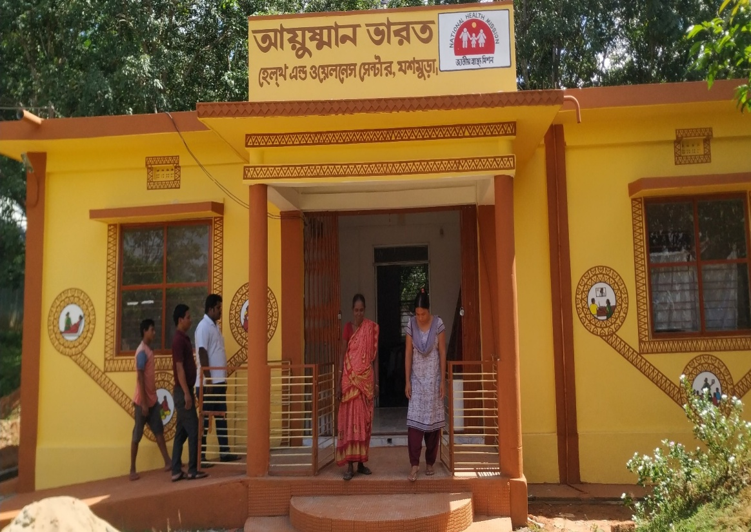
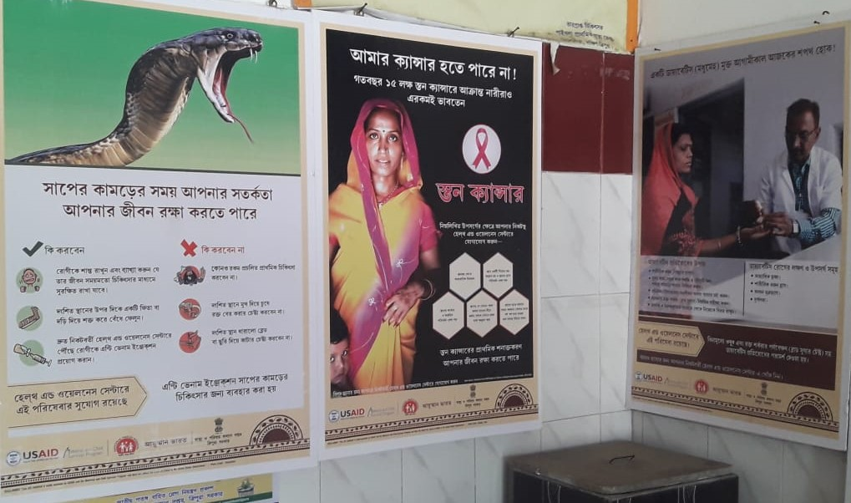
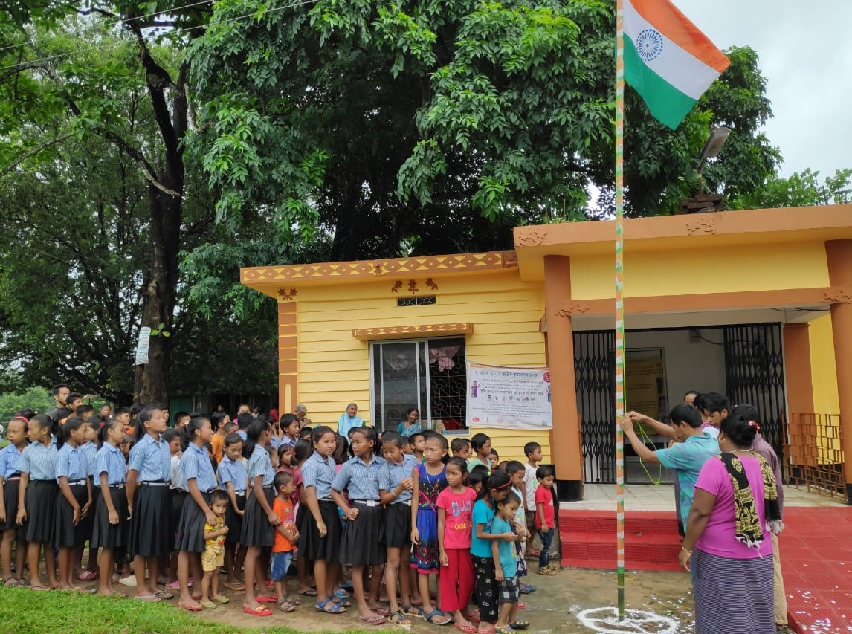
HWC Functional Status (IEC)
External Branding completed in 40 HWC and 317 is under process
External branding covered 12 services
Customized package for internal branding and IEC materials developed by USAID MCSP/ Jhpiego
Mega VHNDs conducted after joining of CHOs in SC-HWCs
Health Days celebrated in all functional HWCs

Slide 15
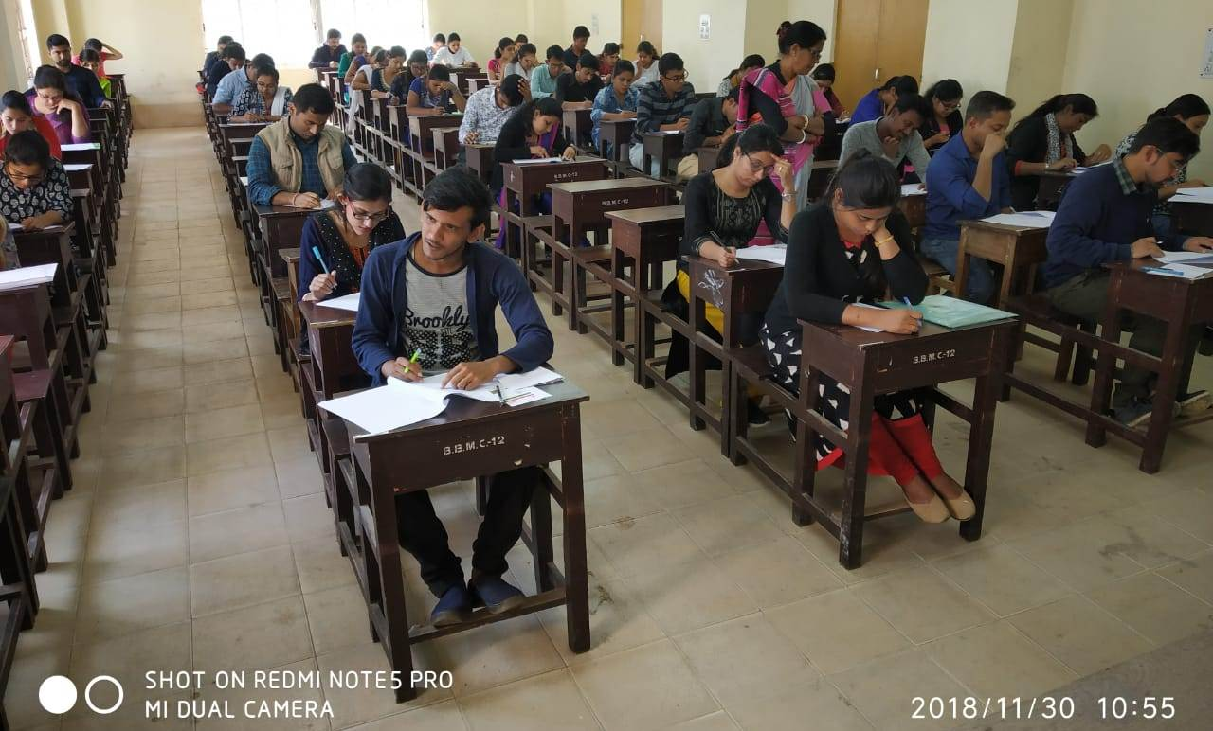
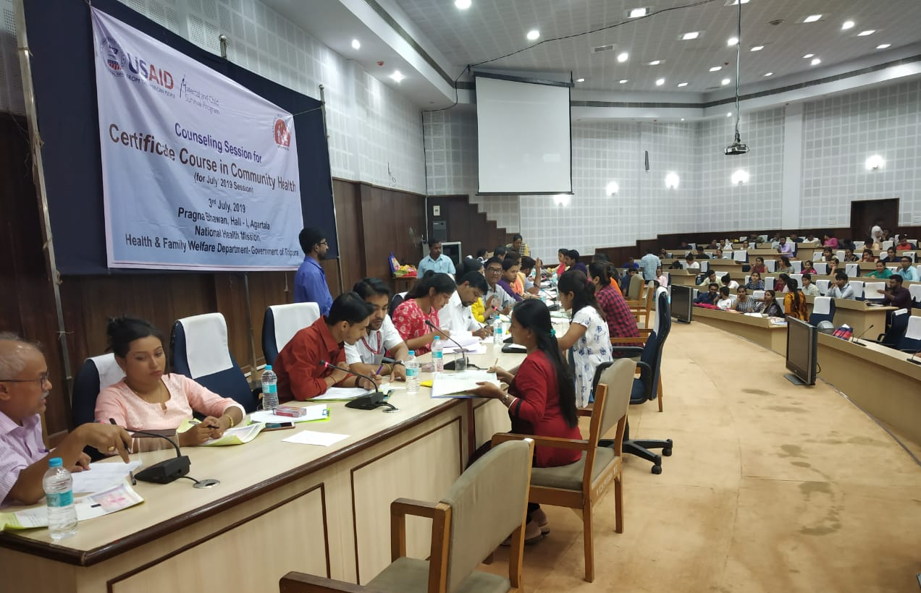
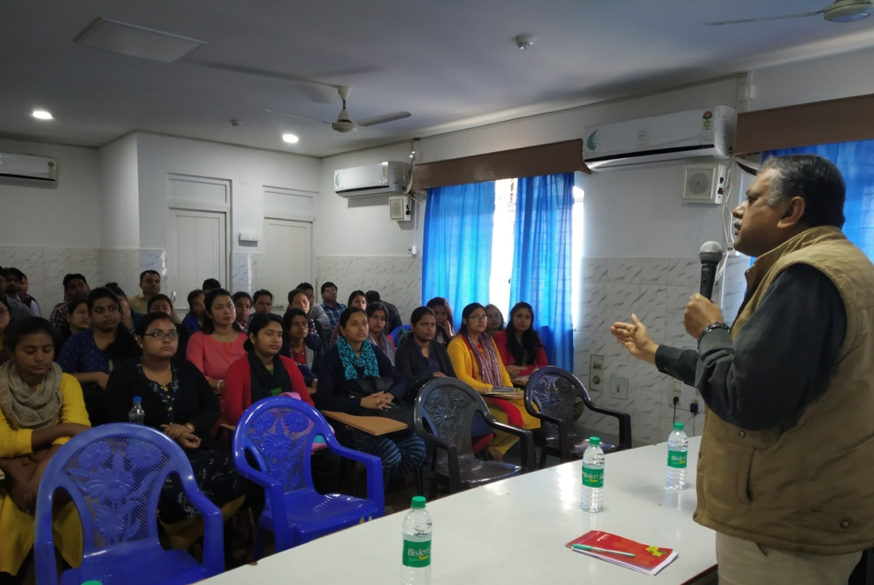
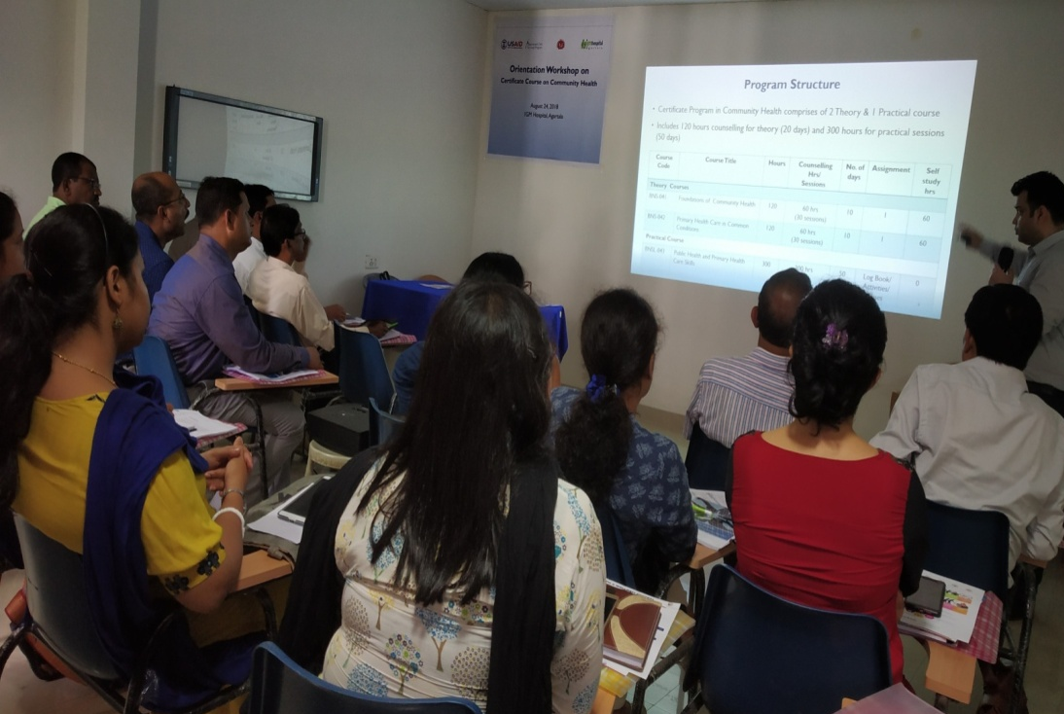
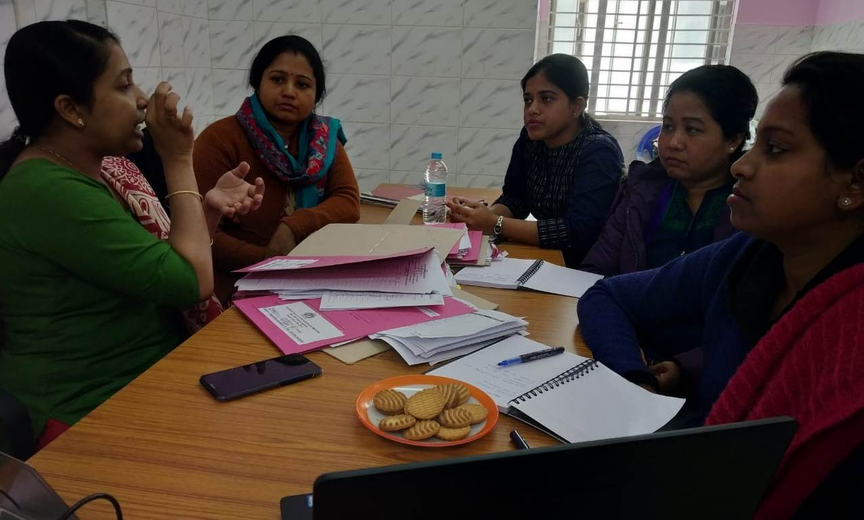
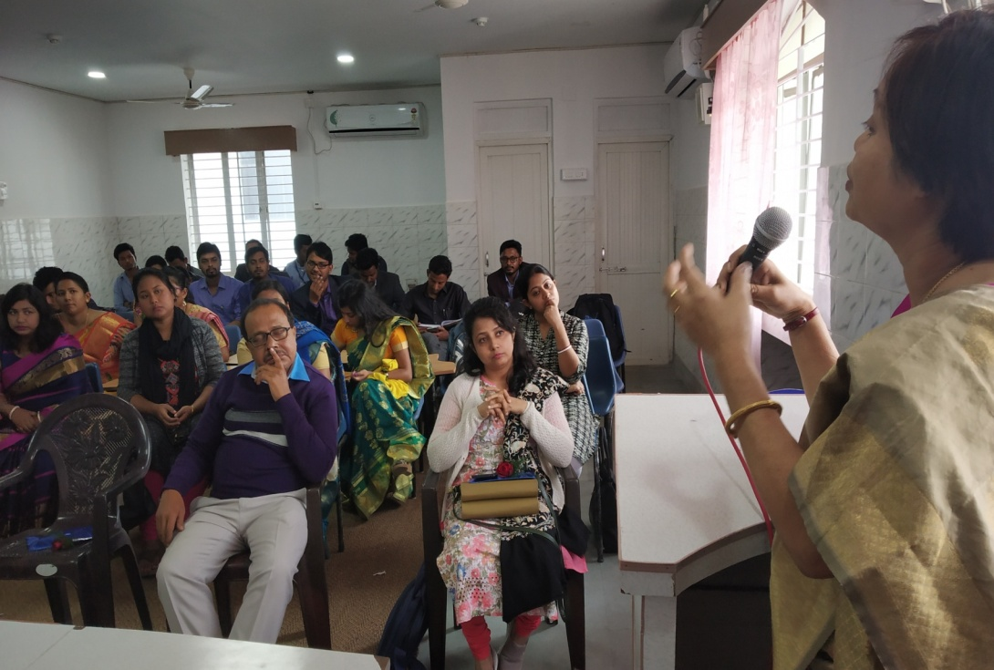
Good Practice: Selection Process of CHOs
Entrance Exam
Student Counselling
RD-IGNOU with CHOs
ToT for counselors
Course planning with Jhpiego team
Welcome address by Hospital Head

Slide 16
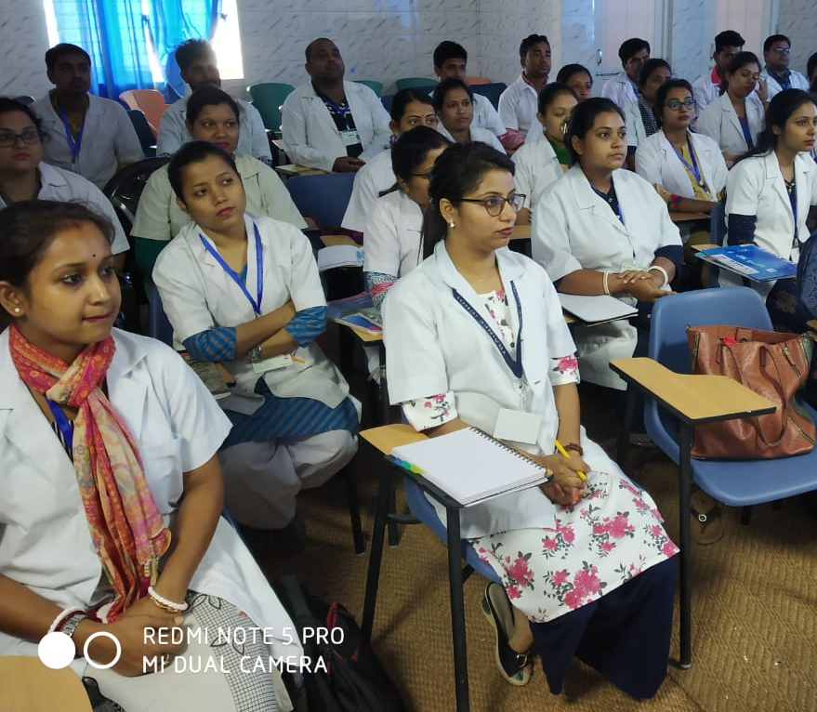
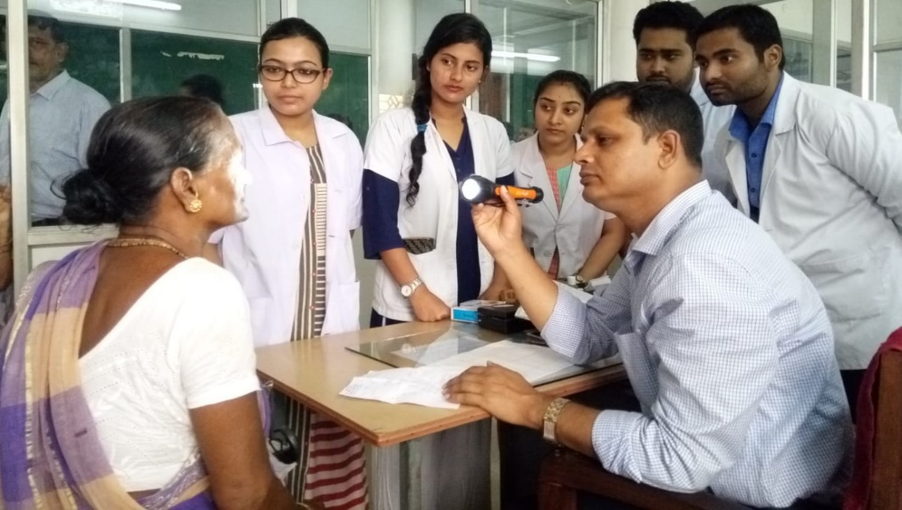
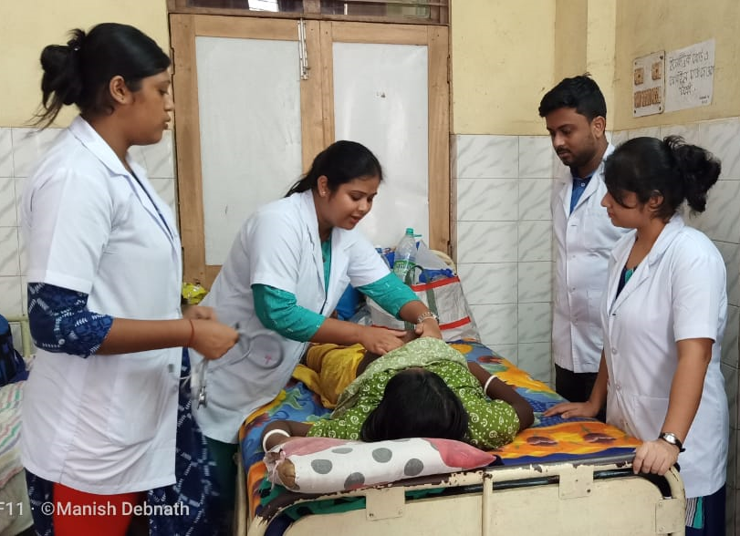
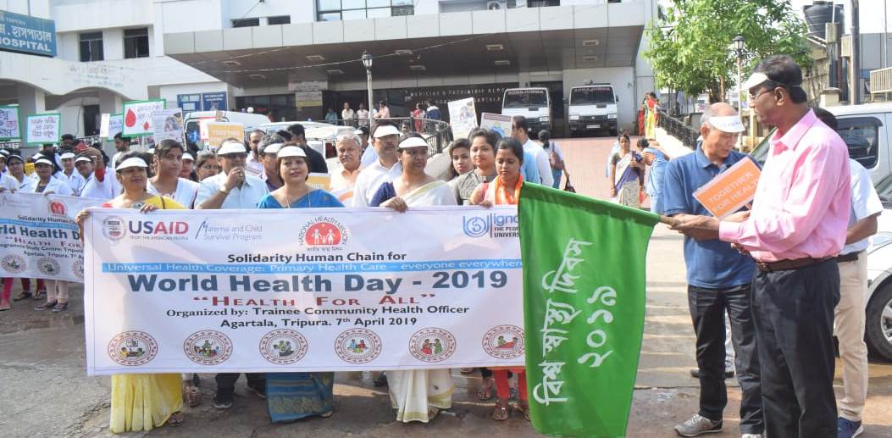
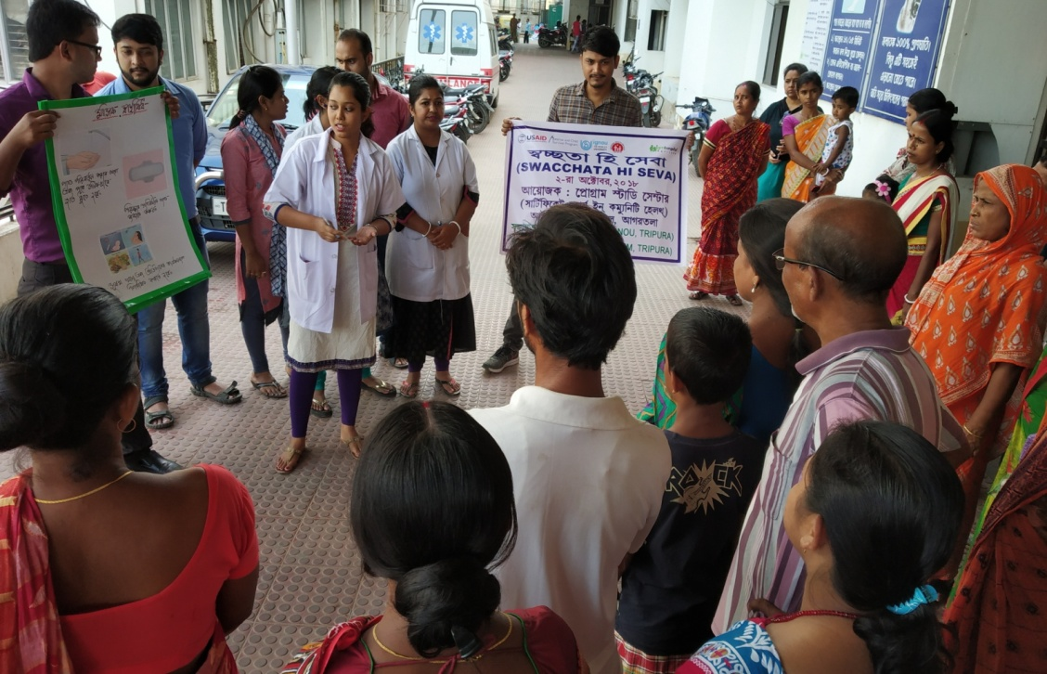
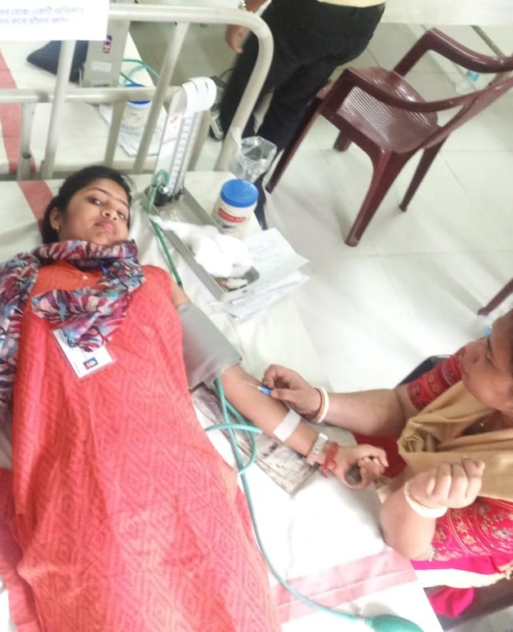
Good Practice: CCH Course period
Theory Class
CHOs at OPD
CHOs at Ward
Days observation
Awareness prog. by CHO
Blood donation camp by CHOs

Slide 17



Best Practice: Induction Training of CHOs
Solution
Key challenges faced
Limited information of CHOs on implementation processes
Lack of understanding on vertical programmes
7 days induction package for CHOs on National Health Programmes before their deployment to SC-HWCs designed with support
Mechanism
Resource persons mobilized from NHM – State Programme Officers, Consultants & Managers
Study material (in presentation mode ) finalized – in-house
No additional budget for this activity – as all the things were done in-house
Training imparted after Term end examination & before deputation

Slide 18
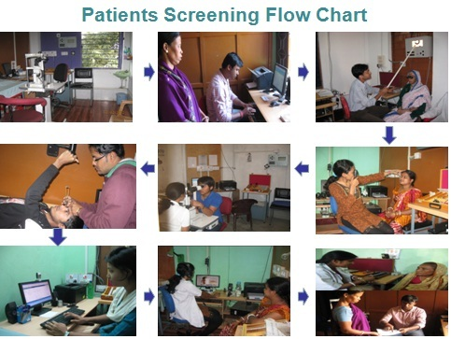
Innovation: Tele-Ophthalmology
Aims to provide preventive and primary eye care to beneficiaries
Uses ICT platform for specialist consultations –linkages with IGM Medical College & Hospital
44 functional centres in state with:
  HR: 01 / 02 ophthalmic assistants
  Equipment:
  Furniture
  Computer with printer
Trial box (prism set) Trial frame Near vision chart Streak Retinoscope Ophthalmoscope | Vision drum 14 Digital camera with clamp Schiozt Tonometer Slit lamp Edging machine
Average monthly OPD – 260 (approx.)

Slide 19
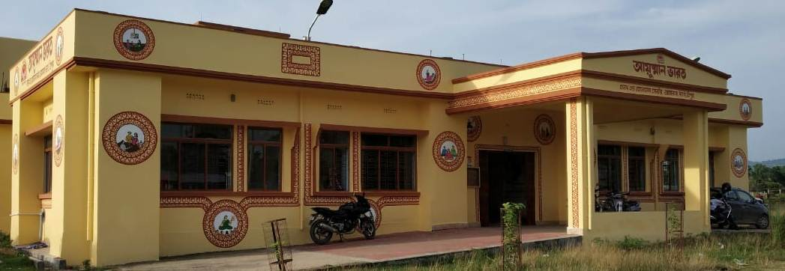
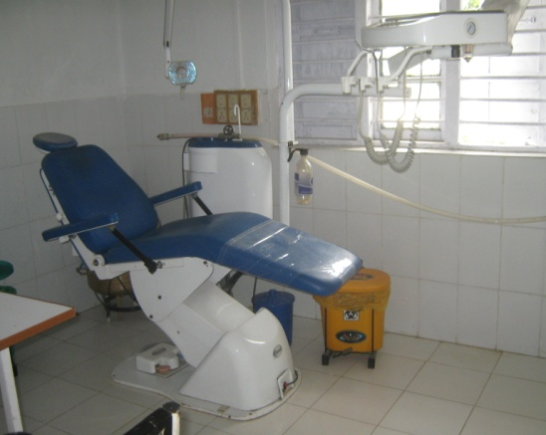
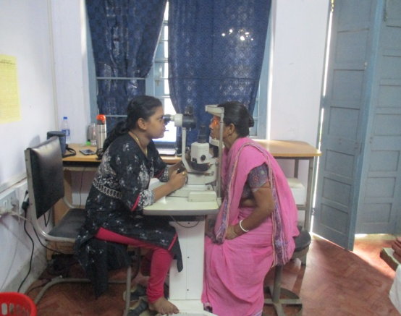
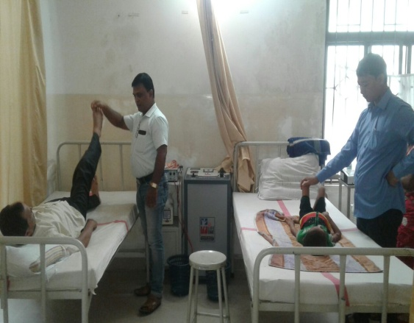
Additional services introduced at HWCs
Screening and Management of NCDs
Dental OPD
Eye OPD
Earmarked beds for elderly care
Provision of basic mental health services
Adolescent Clinic
Expansion of diagnostic services
Physiotherapy
Yoga

Slide 20
Scope of further strengthening
Regular Tele-consultation and scheduling of sessions
Capacity building of HR
Challenges…..
Fund ceiling for Infrastructure Strengthening
Transfer policy & Career progression of CHOs
Clarification on Prescription right of CHOs
Residential Facility for CHOs are highly required
Approval of 180 new CHOs for December 2019 session though RE exhausted
Shortage of specialists & skilled manpower & Inadequate skill training centres
High referral due to unavailability of specialists at DH / SDH level
Contractual HR – sense of insecurity & lack of ownership

Slide 21
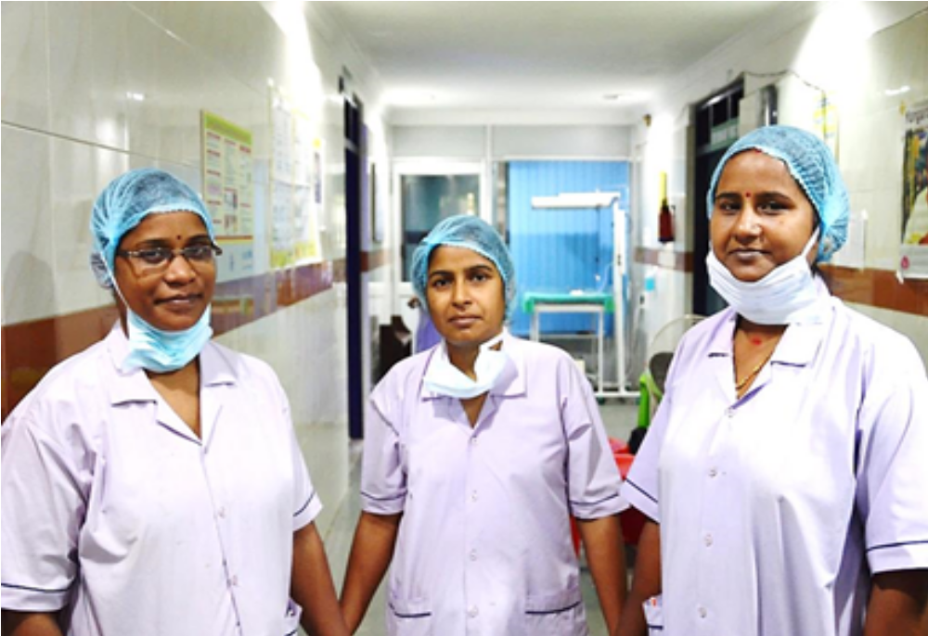
THANK YOU

