Slide 1
Good replicable Practices of
Sikkim

Slide 2




SIKKIM: HEALTHY, BEAUTIFUL, PROSPOROUS, SIKKIM IS OUR DREAM & SIKKIM IS WORKING TOWARDS UNIVERSAL HEALTH COVERAGE .

Slide 3
Good replicable Practices of
Sikkim
Strengthening the certificate course
Wellness Activities.
Mental Health Program Initiatives
TOT on ‘Saksham’
Concerns
Way forward

Slide 4
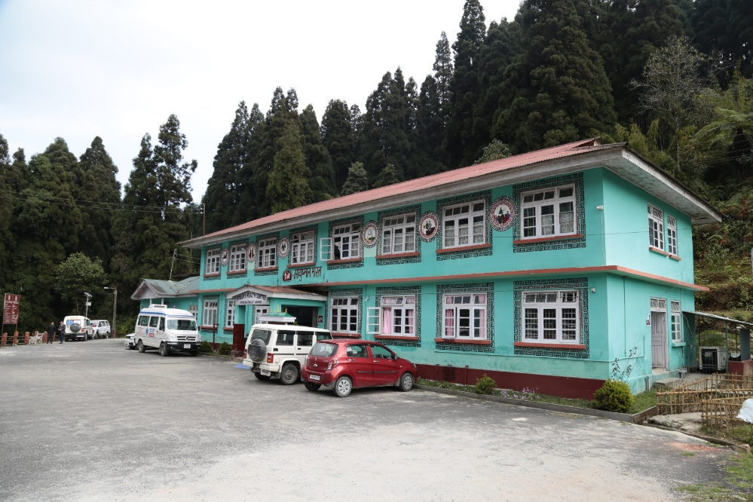
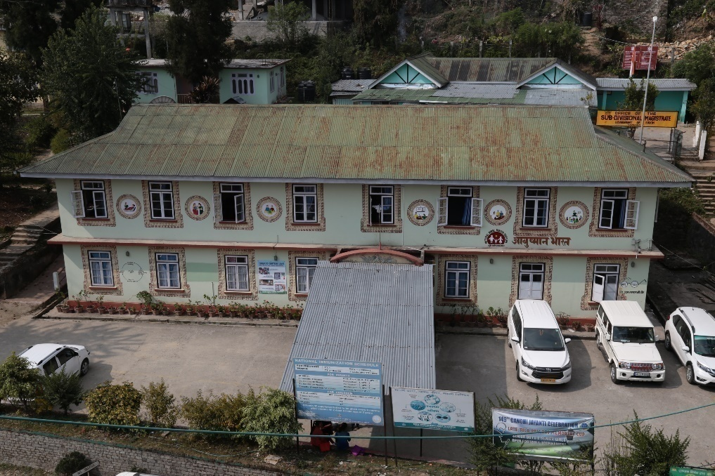
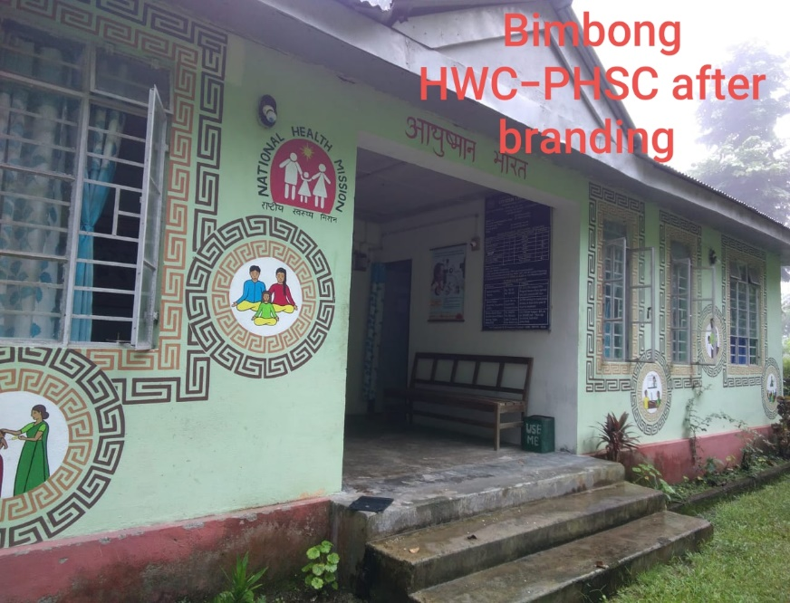
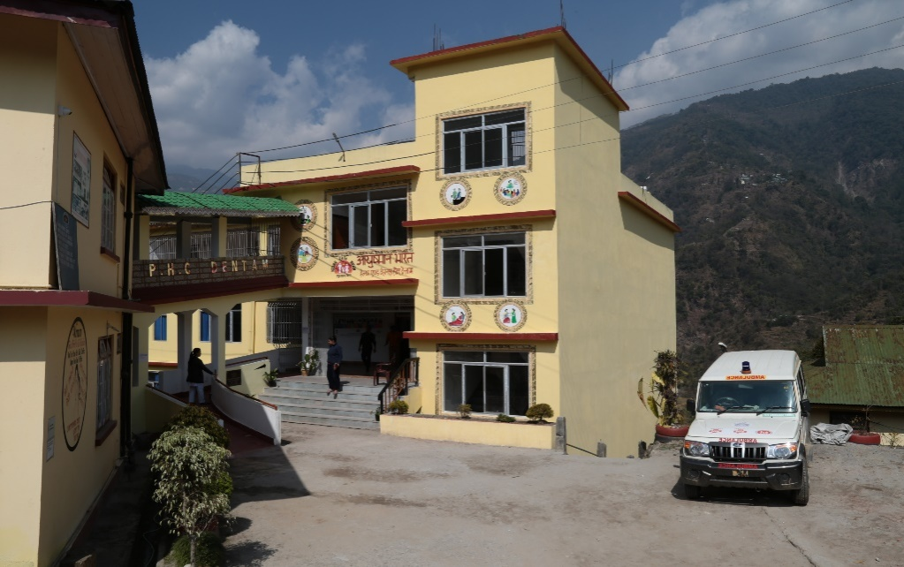
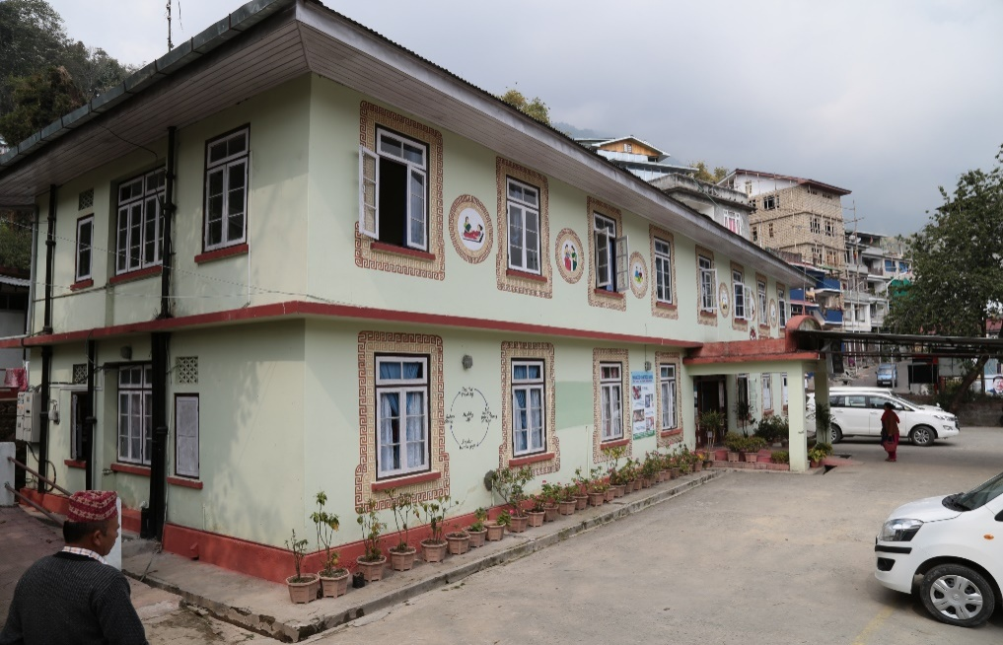

IMPRESSIVE GOOD HEALTH & WELLNESS CENTER IS BEGINNING OF MAKING HEALTH & WELLNESS REAL.
SOME GLIMPSE OF HEALTH & WELLNESS CENTERS

Slide 5
Strengthening the certificate course
6 months Certificate course for Community Health
20 days Basic Yoga Training
7 days orientation on NHPs
3days VIA hands on Training
Implementation of TOT “Saksham”

Slide 6
Strengthening wellness activities through Basic Yoga Training
Under Ayushman Bharat, Wellness activities is one of the most important component.
In coordination with the AYUSH Mission conducted 20 days basic yoga training
The training has been incorporated in 6 month certificate course.

Slide 7
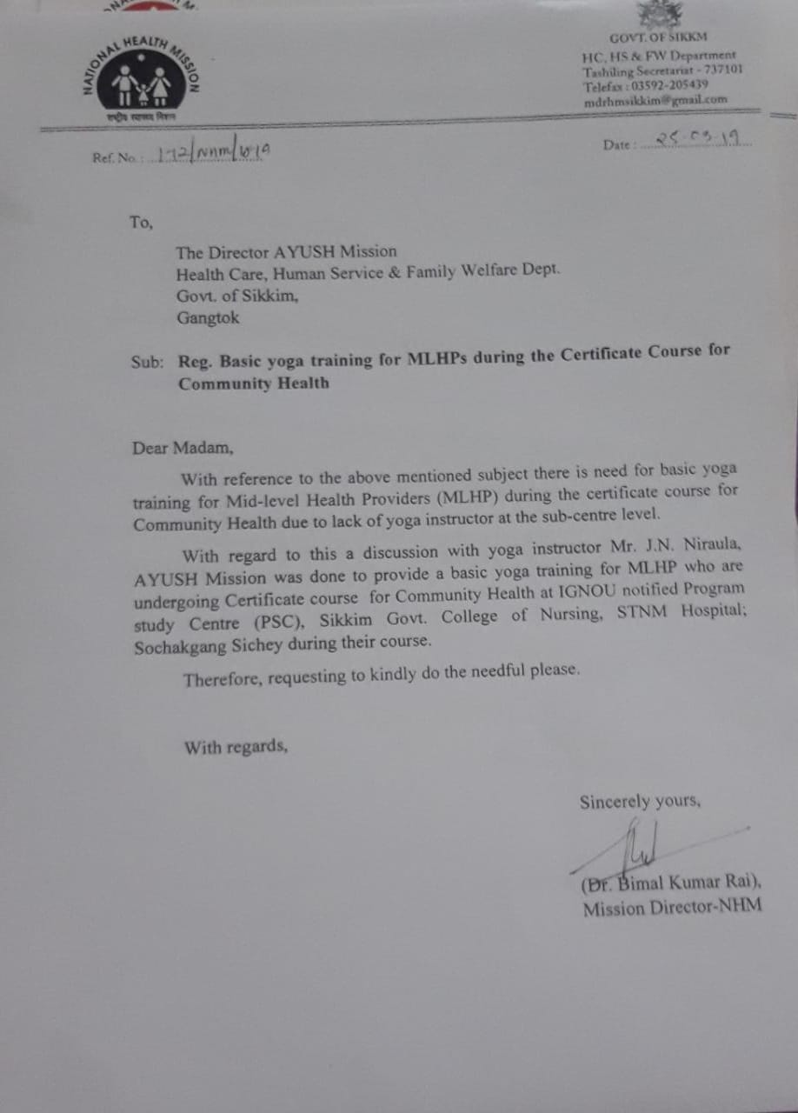
Issue of Letter to AYUSH Mission for Yoga Training

Slide 8
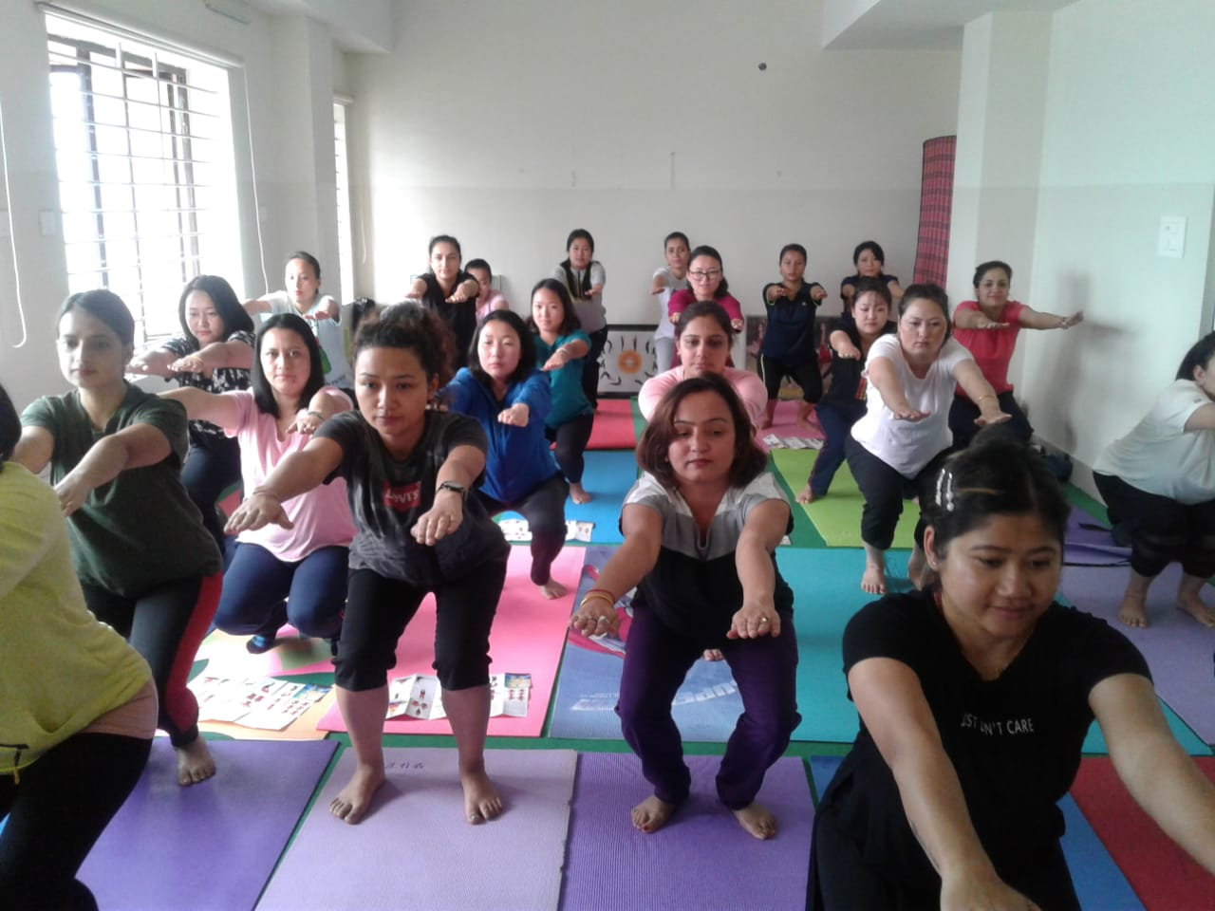
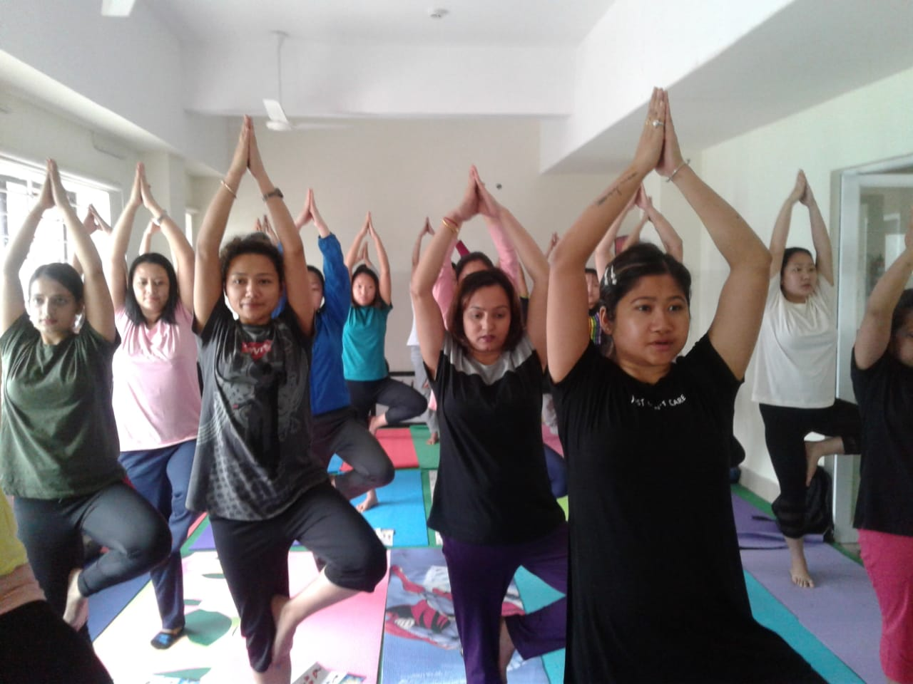
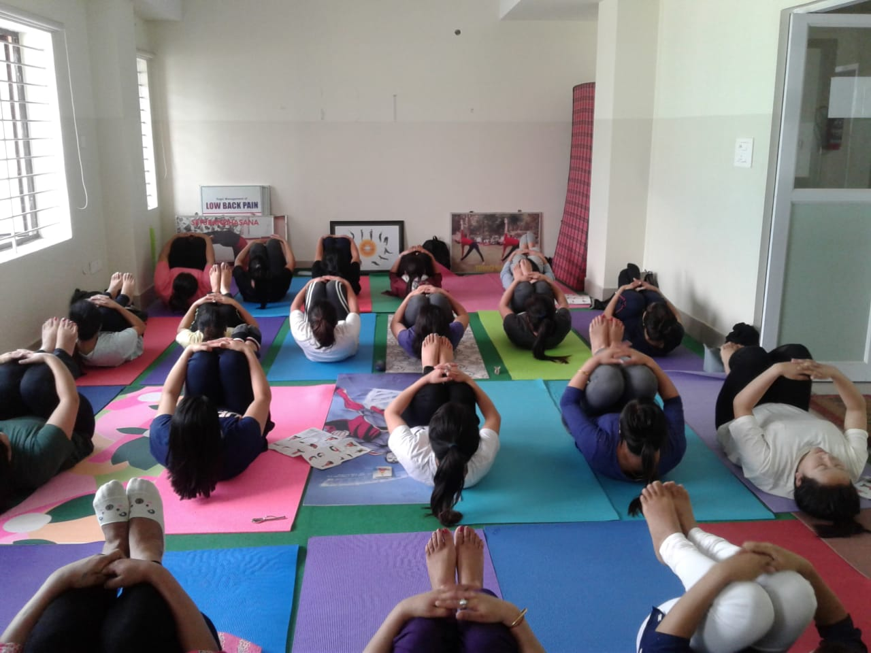
Photographs of Yoga Session from 7am to 9am

Slide 9
Benefits
Self development of MLHPs
Availability of pool of yoga trainers at HWCs
Economical & time saving

Slide 10
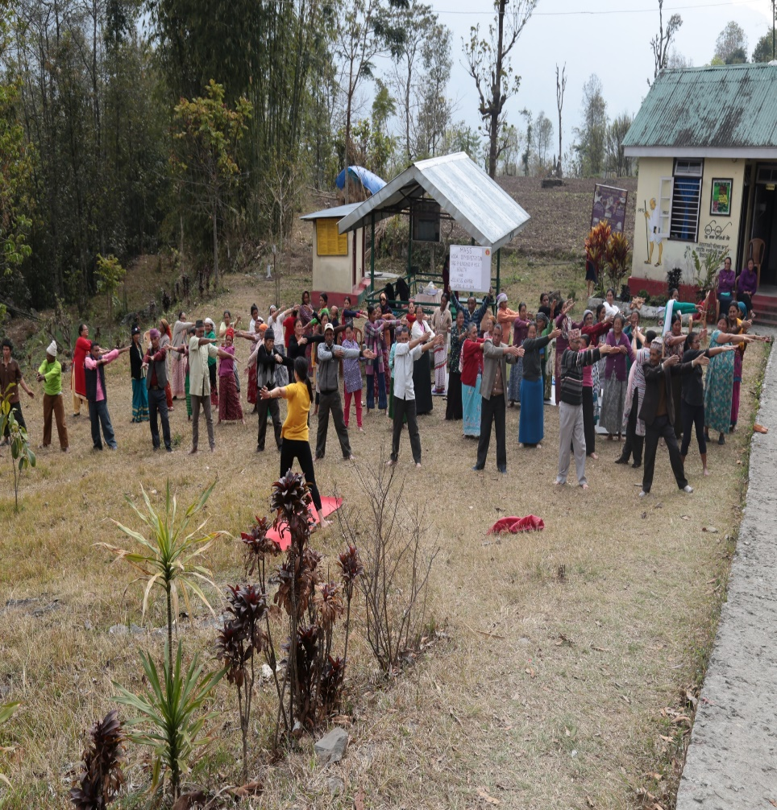
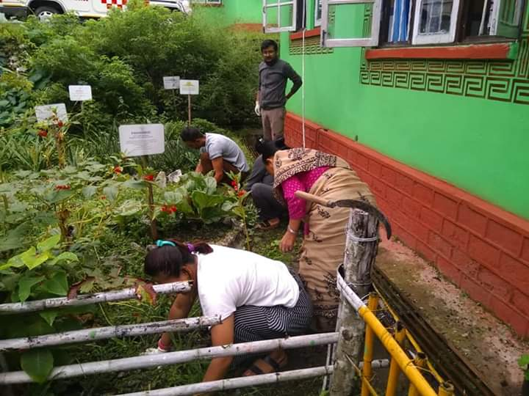
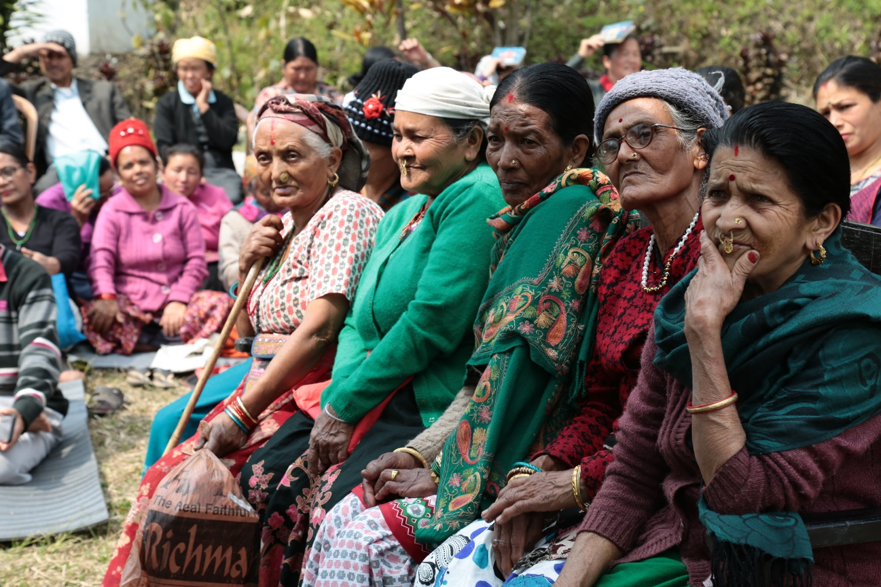
Wellness activities other than Yoga at HWCs
Aerobic exercises
Herbal Gardening
Peer Group counselling

Slide 11
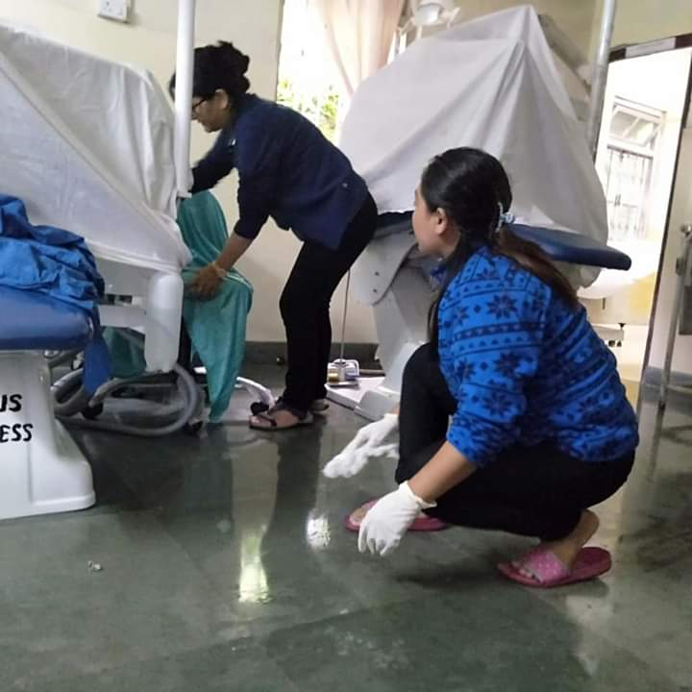
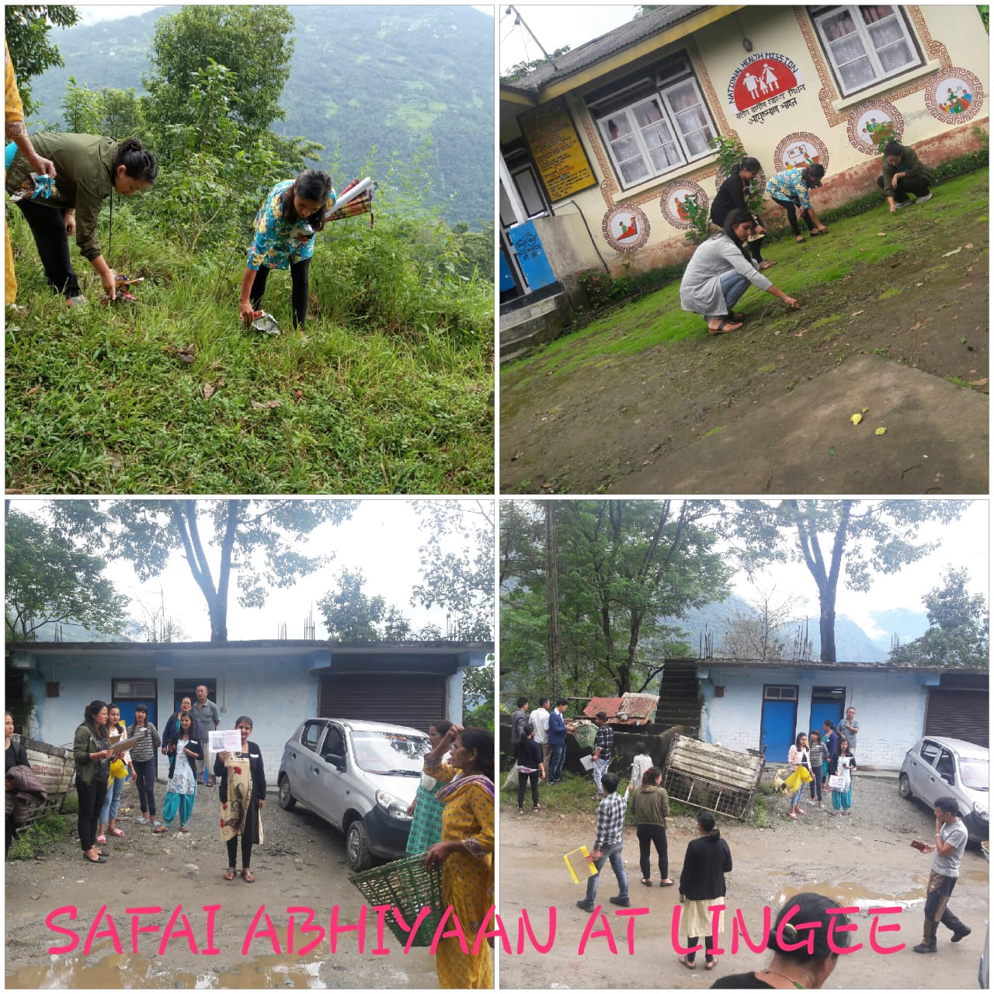
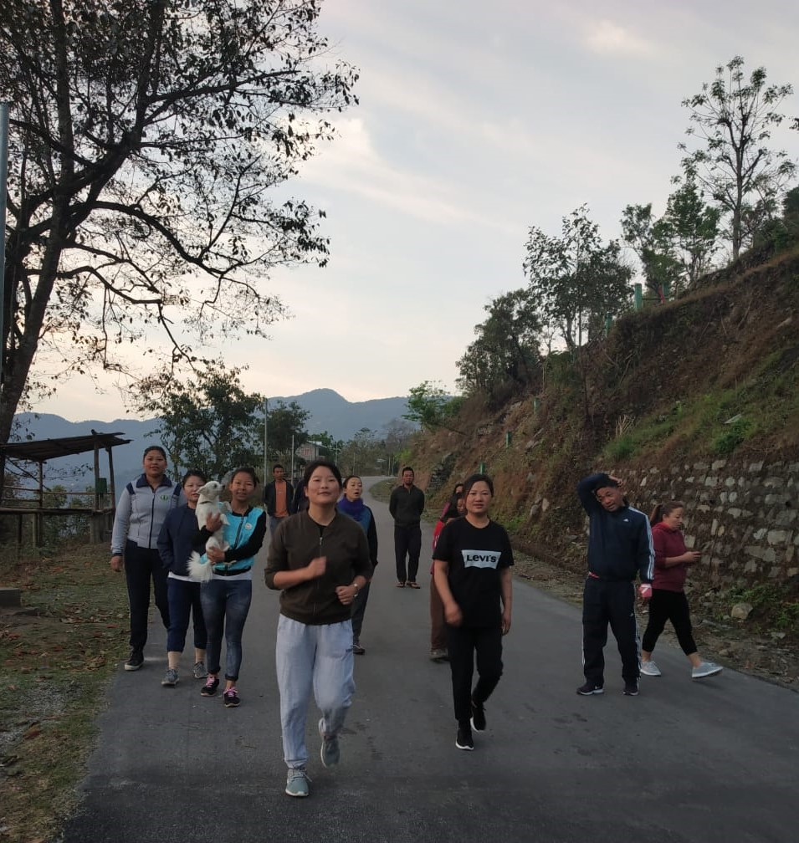
Cleanliness Drive at HWCs
Morning Walk initiated at HWCs

Slide 12
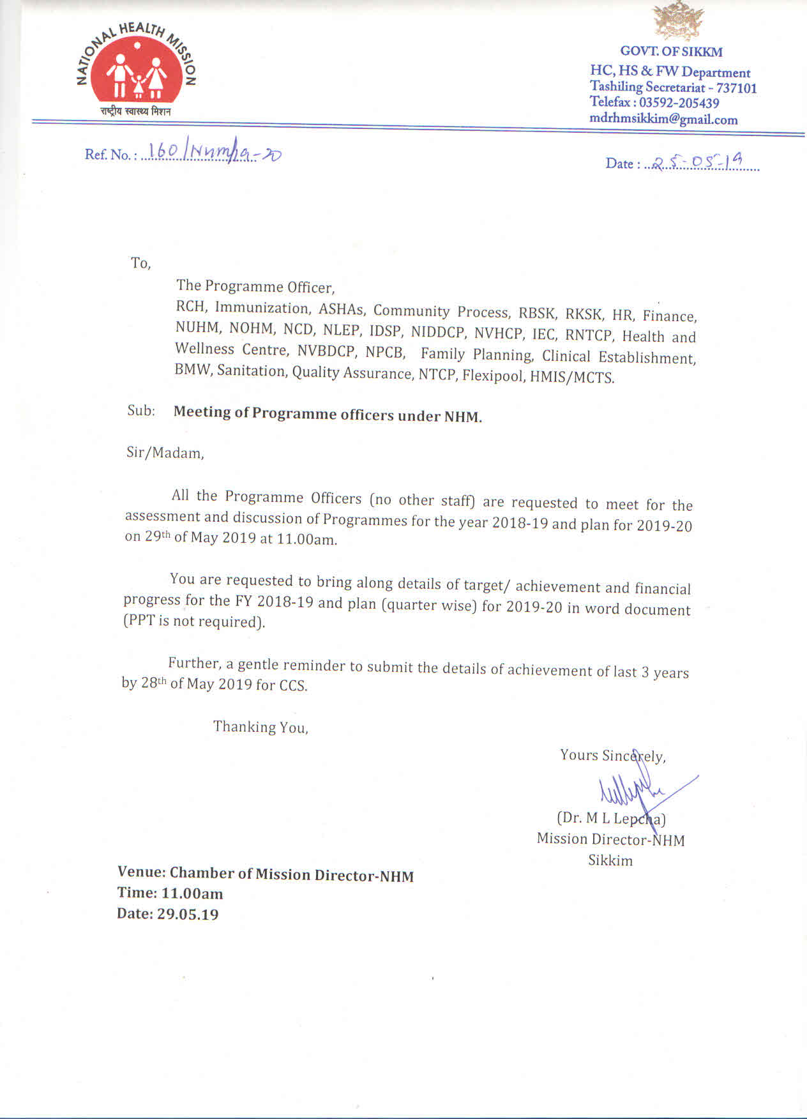
7 days Orientation on National Health Programs
All the Program Officers were directed to take orientation classes and further they took classes as and when required as part of Continuing Education for CHN.

Slide 13
List of NHPs to orient & train on as part of Continuing Education
NLEP (National Leprosy Eradication Program)
RMNCHA (Reproductive, Maternal, Newborn, Child and Adolescent Health)
Ayushman Bharat: Health and wellnesss and PMJAY
IDSP (Integrated Disease Surveillance Programme)
NIDDCP (National Iodine Deficiency Disorders Control Programme)
IEC
NVBDCP & NBCP (National Program for control of Blindness)
RBSK (Rashtriya Bal Swasthya Karyakram) & RKSK (Rashtriya Kishor Swasthya Karyakram )
NCD (Non Communicable disease)
CP (Community Process)
AYUSH/ Wellness activities
RNTCP (Revised National Tuberculosis Control Programme)
Quality Assurance
NHM (National Health Mission) & flexi pool
UIP (Universal Immunization Program)
HMIS (Health Management Information System)
Mental Health Program
CHSO (Central Health Stores organization)
CATCH & other state Programme towards UHC in Sikkim.

Slide 14
Weekly Schedule for Orientation on National Health programs
STNM Hospital, Program Study Centers Certificate Course for Community Health, weekly time table (November 2018)
TIME | 23/11/18 | 24/11/18 | 26/11/18 | 27/11/18 | 28/11/18 | 29/11/18
9:00 AM to 11:00 AM | General Discussion on Clinical Posting findings and Partograph | NLEP (National Leprosy Eradication Program) | RMNCHA (Reproductive, Maternal, Newborn, Child and Adolescent Health) | Ayushman Bharat: Health and wellnesss and PMJAY | IDSP (Integrated Disease Surveillance Programme) | NIDDCP (National Iodine Deficiency Disorders Control Programme)
 | Ms Lalita Rai | Dr. Raj Prabha Moktan | Dr. N. Shenga | Dr M.L. Lepcha | Dr. Y. Changapa | Dr. Y. Changapa
11:00 AM to 01:00 PM | IEC (Information Education and Communication) | NVBDCP (National Vector Borne Disease Control Program) & NBCP (National Program for control of Blindness) | RBSK (Rashtriya Bal Swasthya Karyakram) & RKSK (Rashtriya Kishor Swasthya Karyakram ) | NCD (Non Communicable disease) | CP (Community Process) | AYUSH/ Wellness activities
 | Mrs. Diki Lhamu Lepcha | Dr. Ganita Thapa | Dr. Indira Chettri | Dr. Rinzing Lhamu | Dr. M.L Lepcha | Dr. Keshri Rai
2:00PM to 4:00PM | RNTCP (Revised National Tuberculosis Control Programme) | Quality Assurance | NHM (National Health Mission) & flexi pool | UIP (Universal Immunization Program) | CHSO (Central Health Stores organization) | HMIS (Health Management Information System)
 | Dr. D.S. Kerongi | Ms. Madhu Mishra | Dr. Namita H. Subba | Dr. Phumzay Denzongpa | Dr. Jigmee | Dr. Anita /Mr. Sanjay

Slide 15
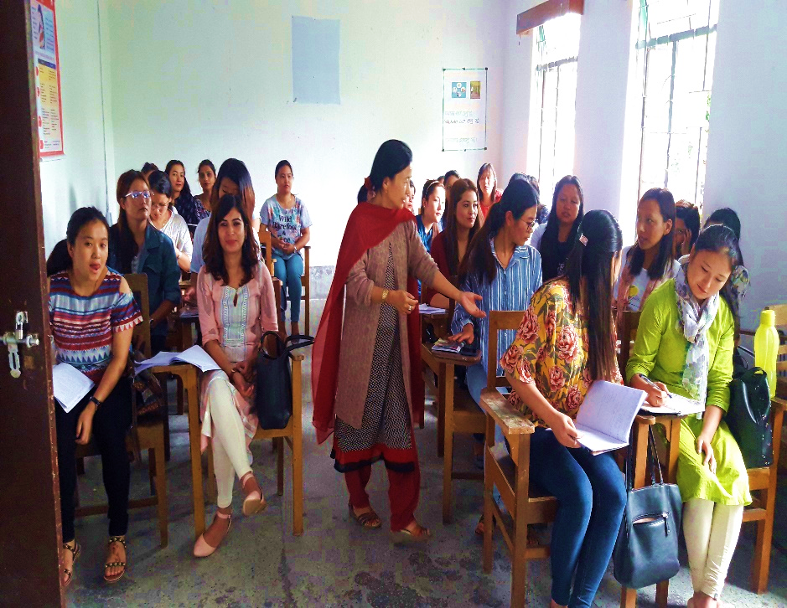
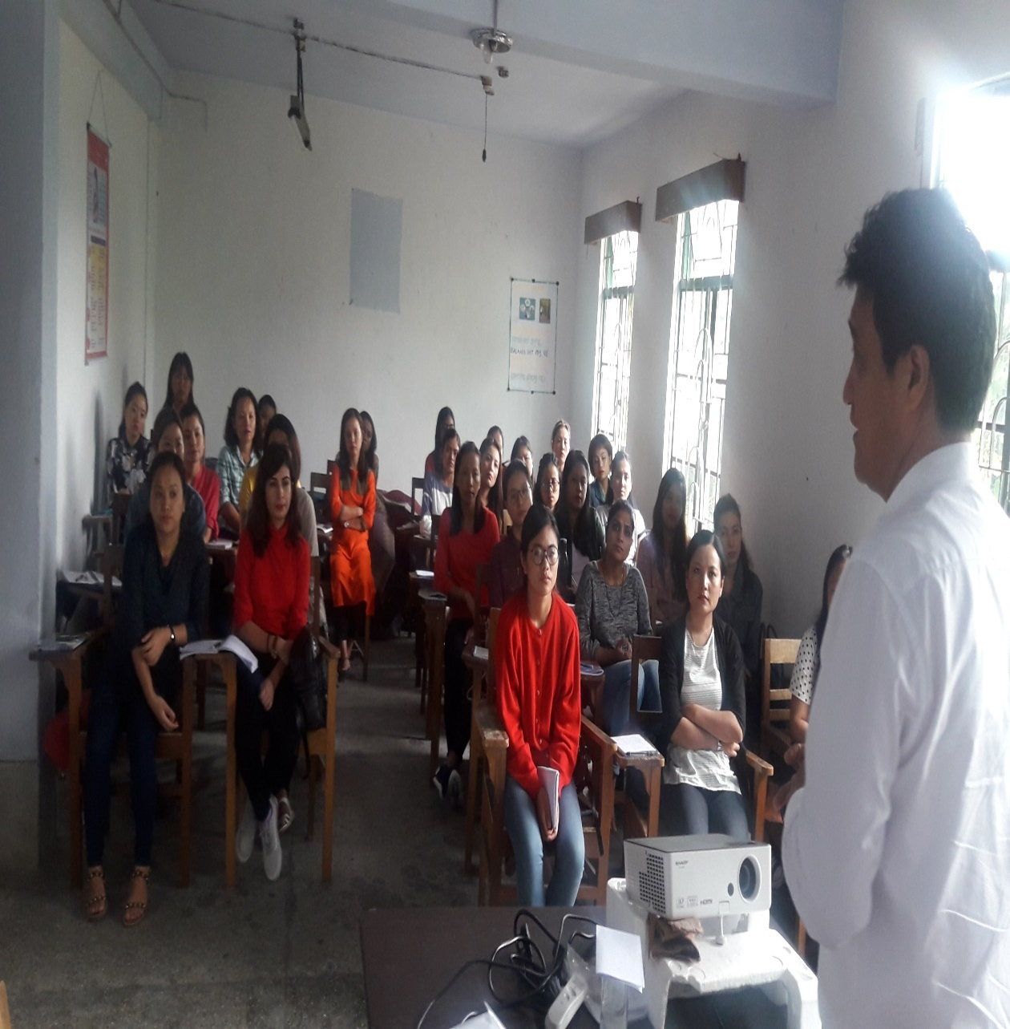
Orientation on National Health Programs

Slide 16
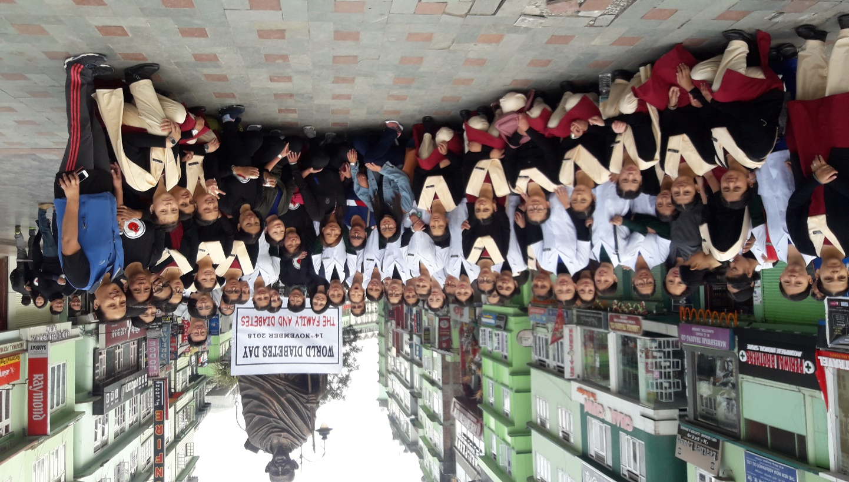
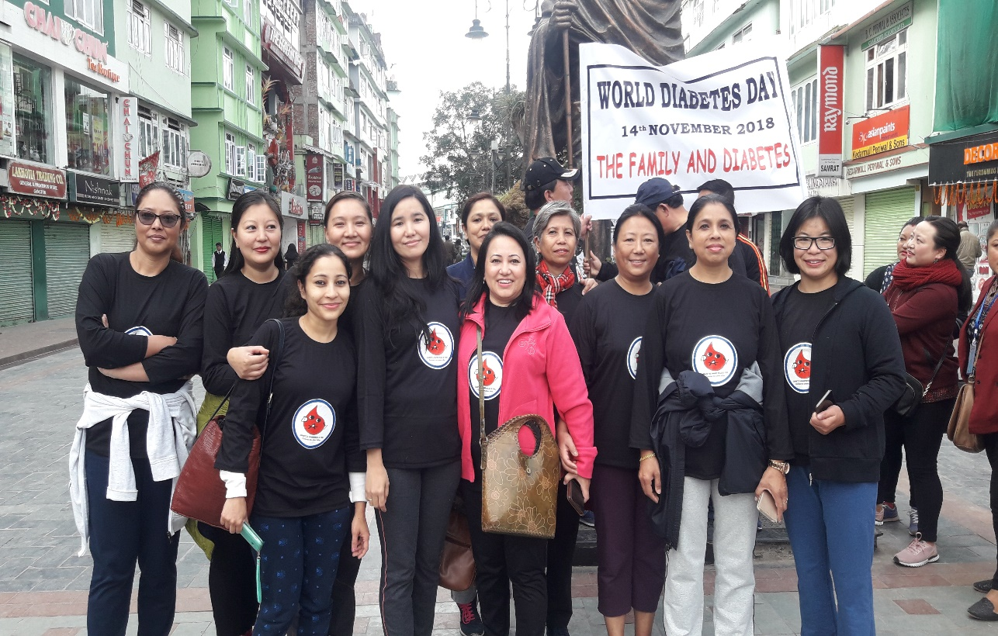
MLHPs participation in World Diabetic Day (NCD Screening)

Slide 17
Benefits
Created a platform to involve all the concerned Program officials to take ownership on HWCs
It has found that the orientation of NHP is effective for the future MLHP to deliver quality services at HWCs.
Economical & time saving

Slide 18
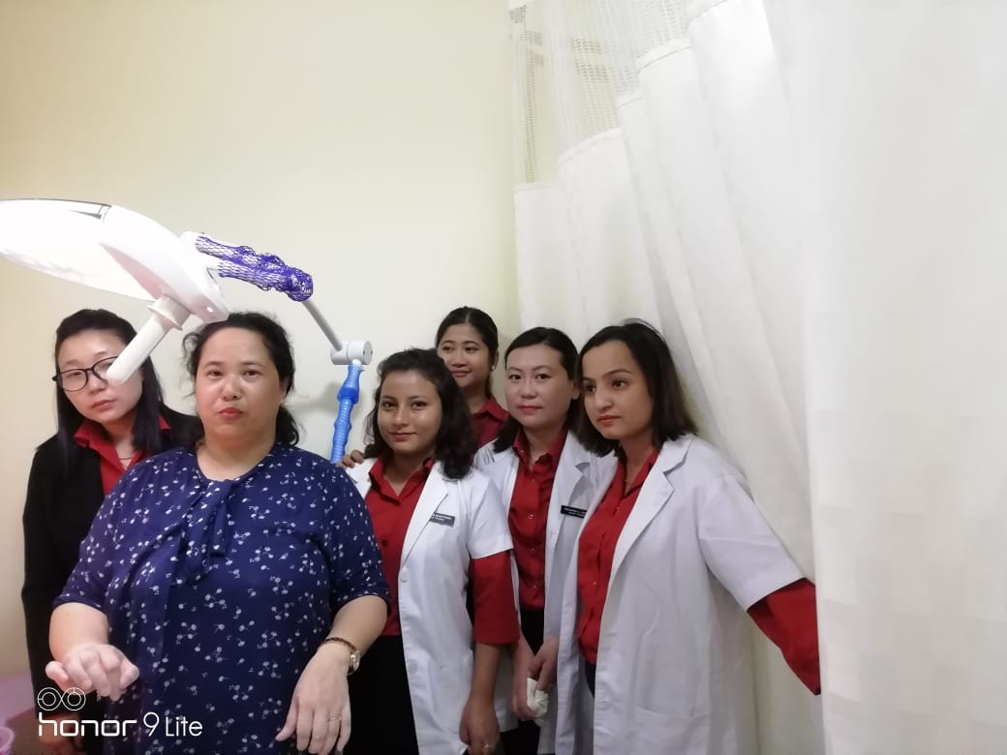
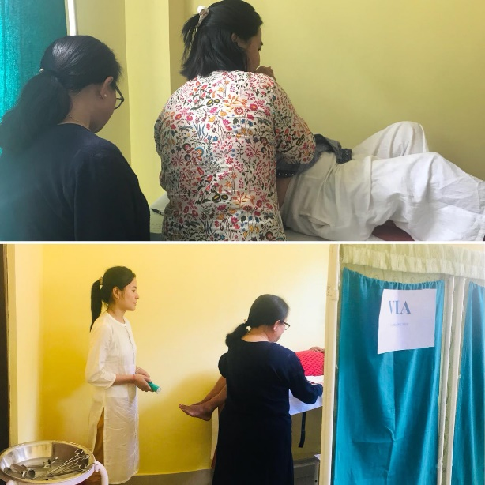
VIA Training at New STNM Multispecialty Hospital & conduction of VIA tests in some H& W Centers.

Slide 19
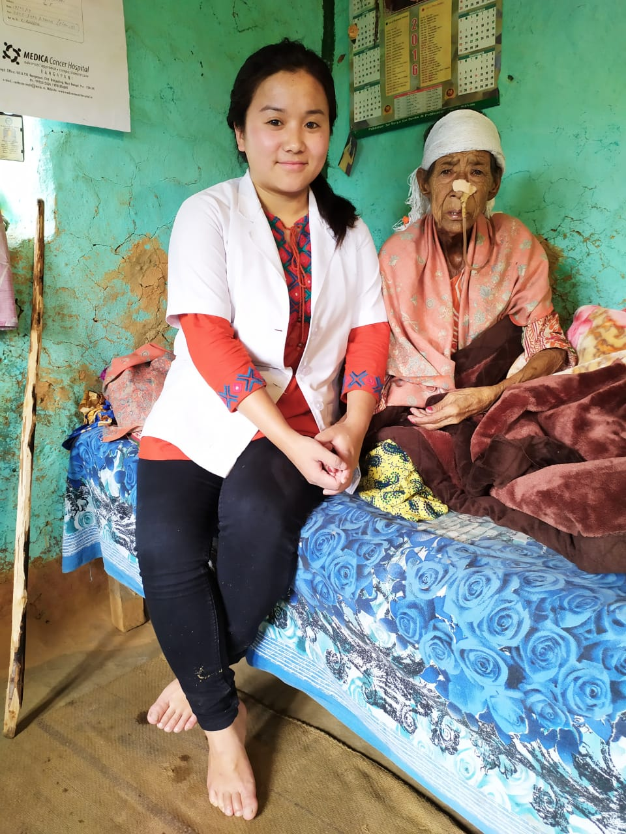
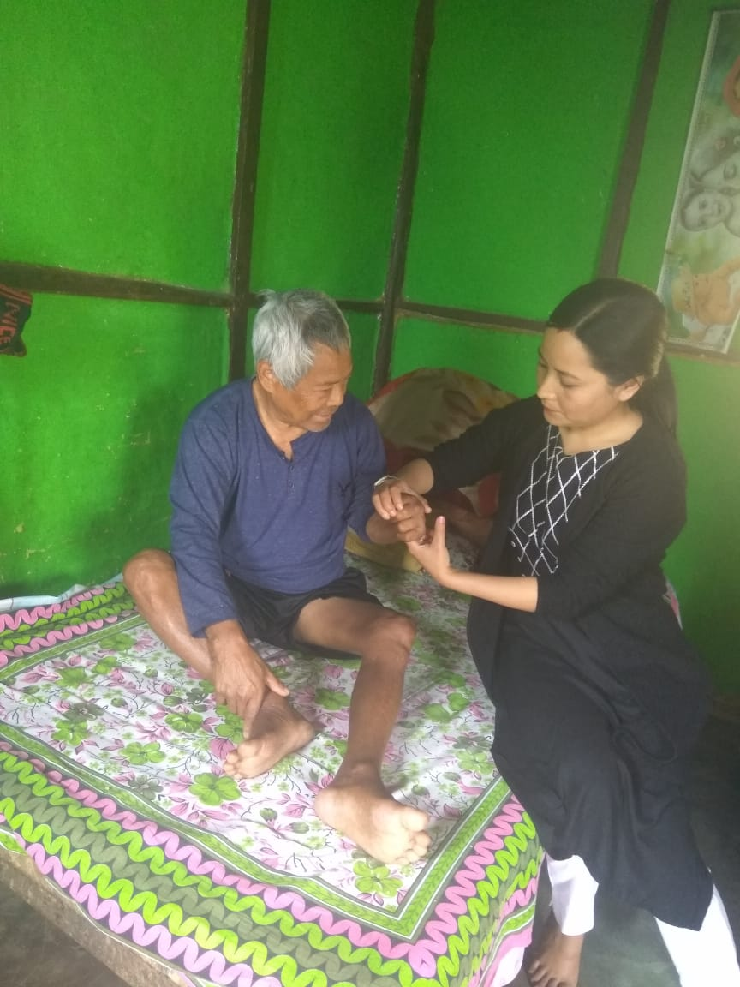
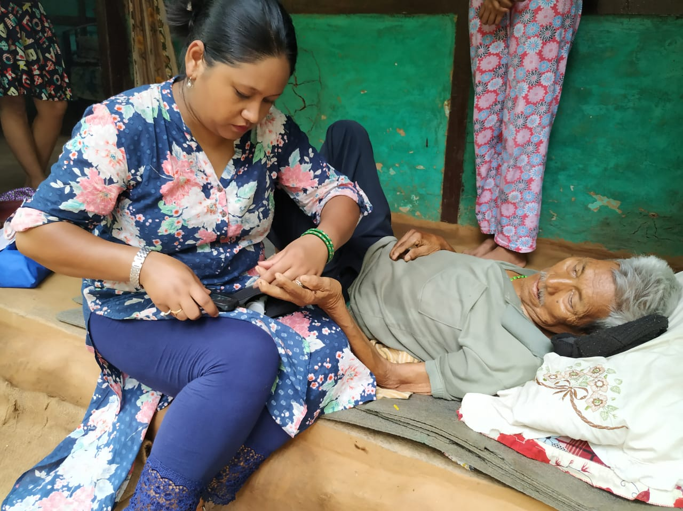
Home based Elderly care by CHN (MLHP)

Slide 20
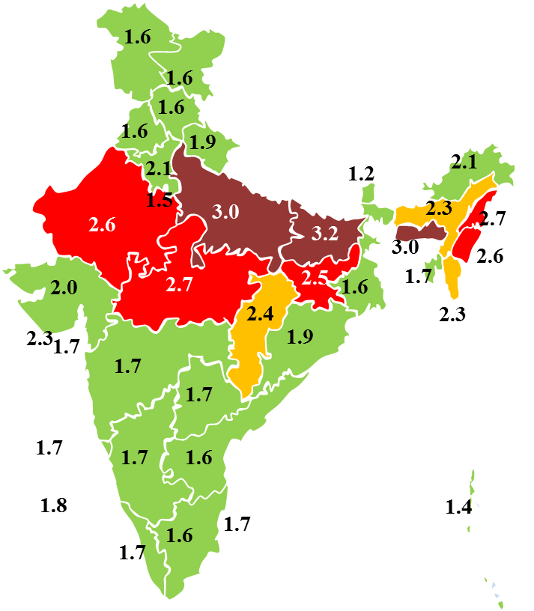
State specific program: Proud Mother Scheme
TFR of Sikkim is 1.2 lowest in the country.
State specific programme called proud mother scheme has been launched along with other initiatives.
1st baby Rs. 7000 (one time payment) + Nutritional support of Rs. 500 per month (till 5 years)
2nd baby –Rs. 10000 (one time payment) + Nutritional support of Rs. 500/month (till 5 years).
CHN (MLHP) has been oriented & playing important role in implementation along with other initiatives to promote fertility.

Slide 21
Mental Health Program Initiatives
Sikkim since one decade has second highest suicide rate.
MOU was signed in between Health & Family Welfare and NIMHANS.
Suicide Prevention Action Network (SPAN) in collaboration with NIMHANS at Sikkim
- 3 month online Diploma in Mental Health for Medical Officers, MLHPs/ Staff nurse & Counsellors.
SUICIDE prevention Helpline No: 18003453225/ 03592202111 has been introduced and displayed in the HWCs.

Slide 22
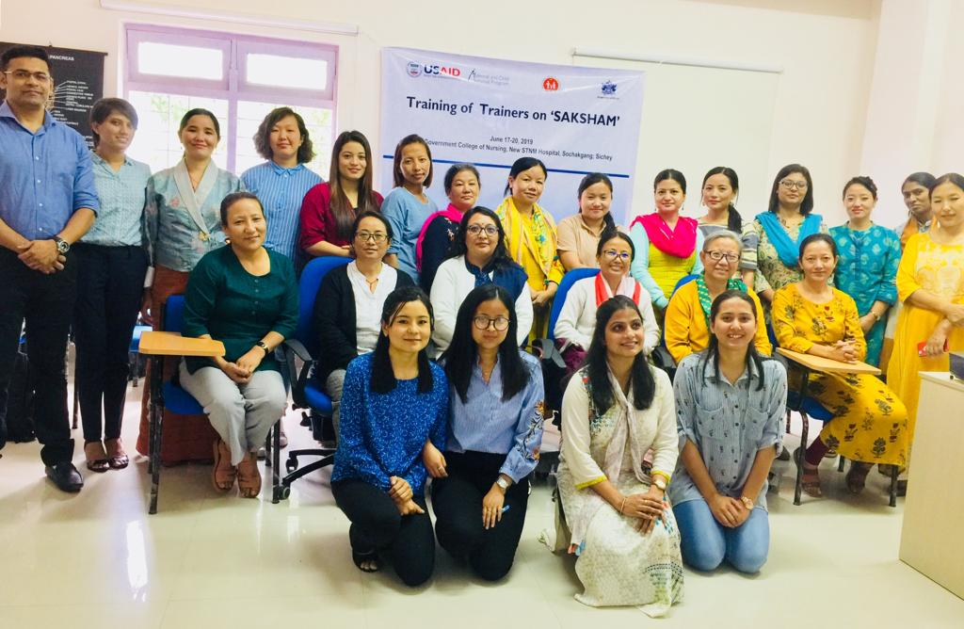
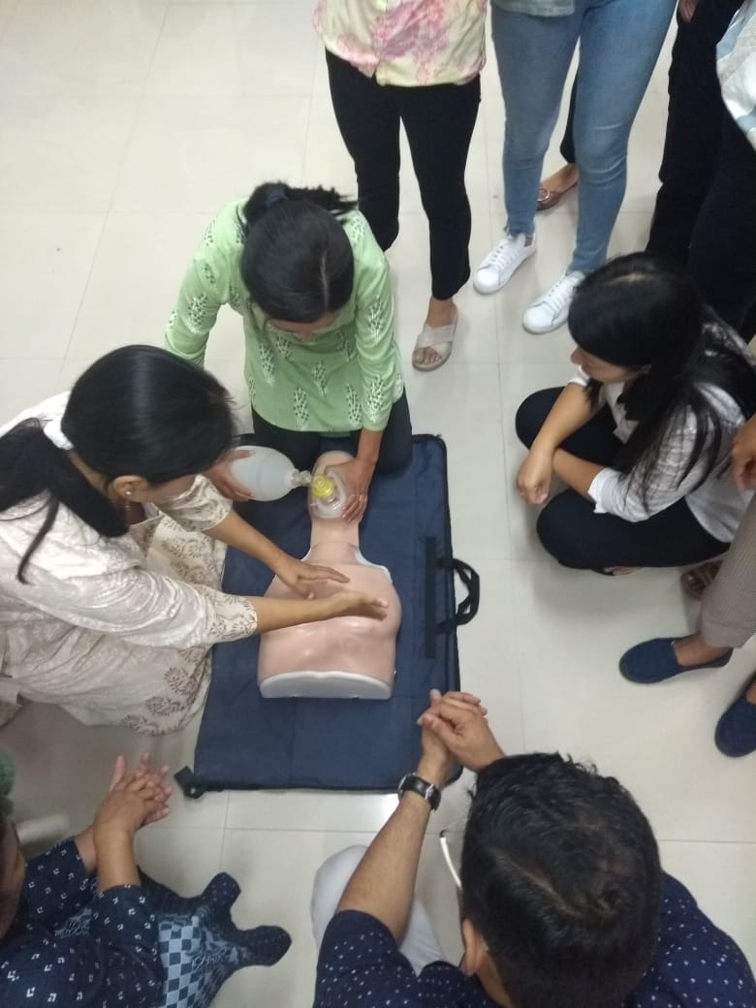
TOT on ‘Saksham’ supported by Jhpiego

Slide 23
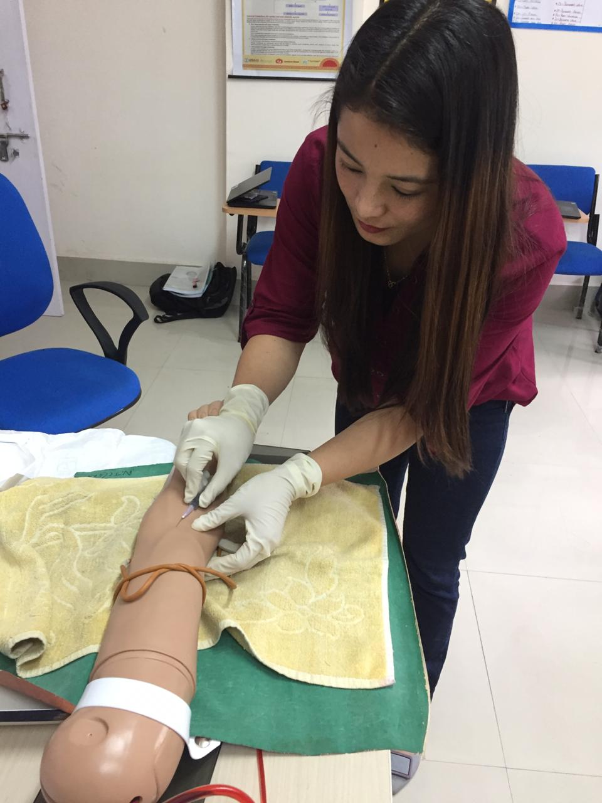
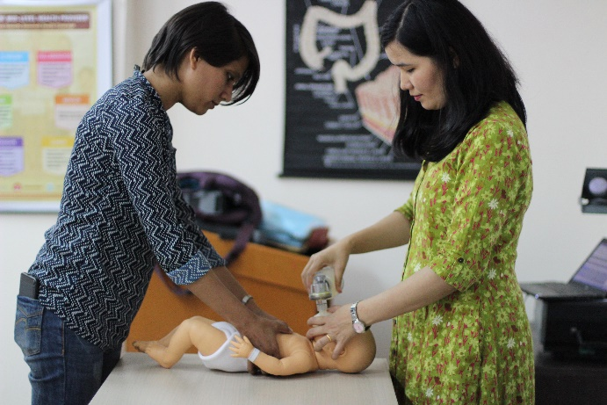
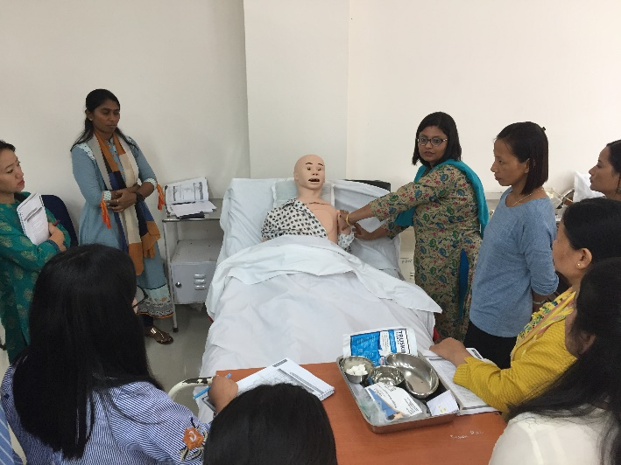
5 Academic counsellors & 10 MLHPs were trained

Slide 24
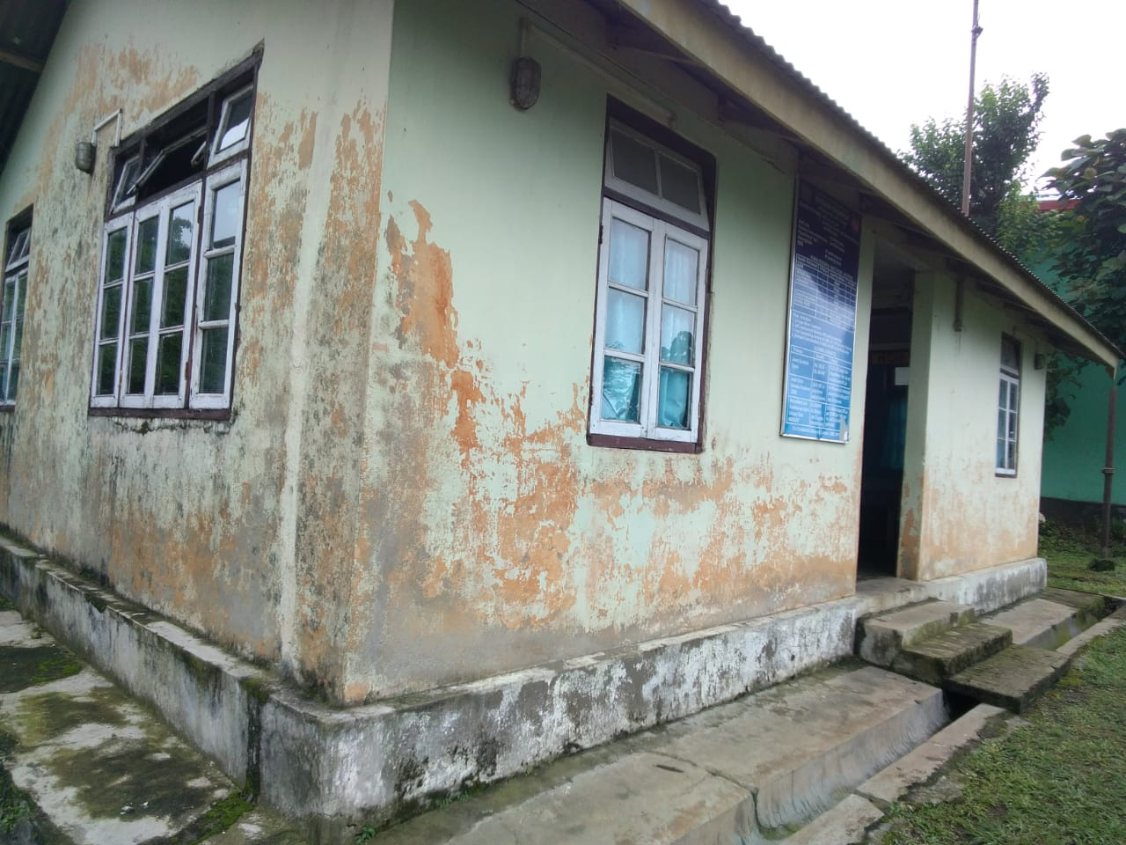
CONCERNS ON INFRASTRUCTURE FOR HEALTH & WELLNESS CENTERS PERHAPS IN ALL NE STATES & OTHER HILLY STATES
CONCERNS
PICTURES OF SOME SUB CENTERS
Most of the PHCs & SHC were constructed in 1980s. SHC constructed in 1980s are very small (3 rooms of size 10X8 ft. ) e.g. For South District , out of 33/39 SHCs were constructed in 1980s, 4 in 1990s & 2 of them after 2000.
Per unit cost for Construction or modification and repair of Health & Wellness Centers is high in hilly areas. Therefore, capping of Rs7 Lakhs & 4 Lakhs for Sub Centers & PHC may be reviewed for NE & Hilly areas of course with higher Resource Envelop which is shrinking now. This may be allowed to put in PIP mode as per requirement.

Slide 25
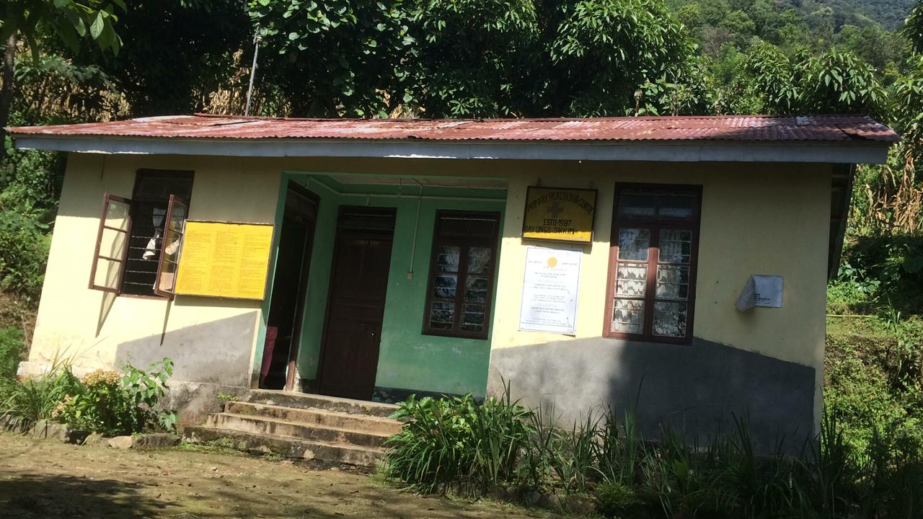
Rayong PHSC, South Sikkim

Slide 26
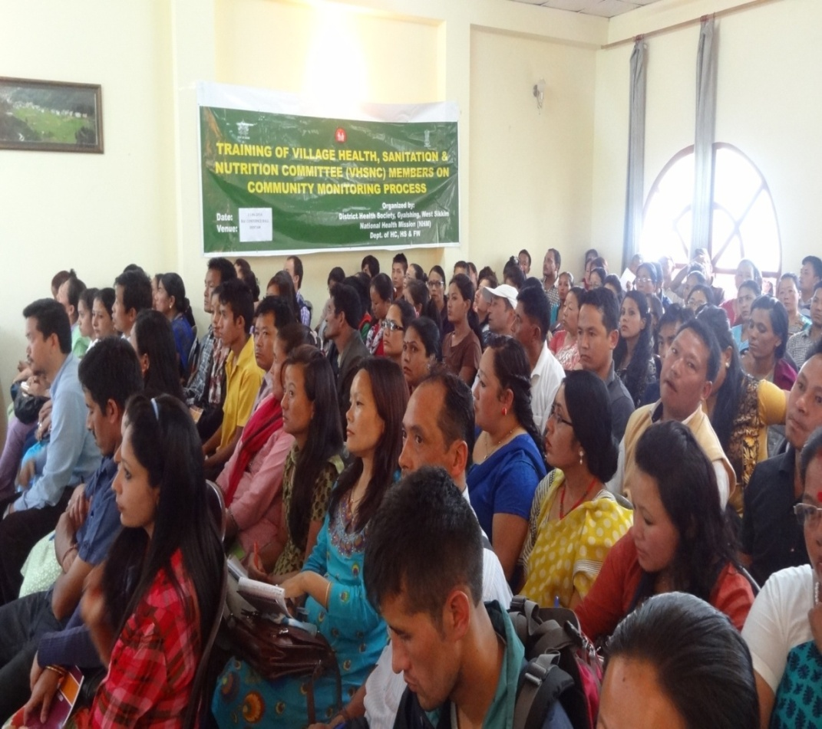
SIKKIM STATE TOWARDS UINVERSAL HEALTH COVERAGE
SIKKIM INITIATIVES
Sikkim had given maximum focus on Primary Health care owing to which our Primary Care facilities are relatively better equipped compared to Secondary and Tertiary Care.
Our PHCs and Sub Centres were one of the better functioning institutions among all states of India.
In addition to continued focus on RMNCHA, since one decade Sikkim has been working towards Universal Health Coverage and focus on Health Promotion and prevention of Non Communicable Diseases (NCDs) through Universal Annual Health Check up, Tobacco Smoke Free Policies implementation, Integrated Mental Health, Non Communicable Diseases, Health Care for the Elderly along with CATCH Programme.
Some glimpse of meeting with Civil society towards Healthy Sikkim Initiative .

Slide 27
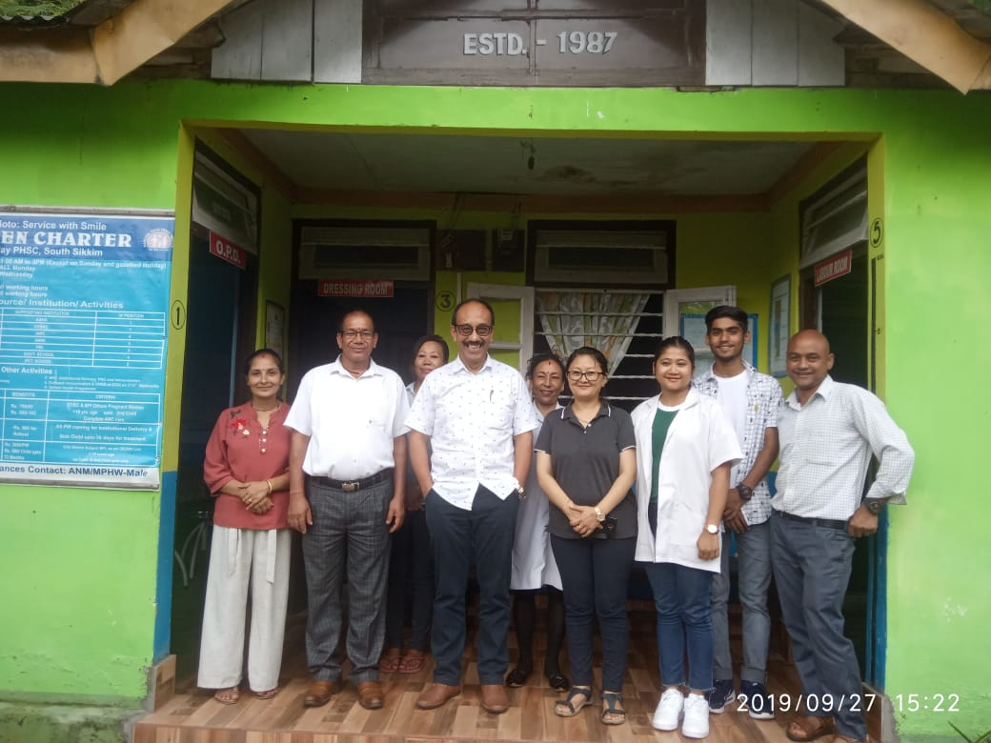
CHN (MLHP) AS KEY MEMBERS TOWARDS UHC IN SIKKIM
MD NHM, MO of PHC in Sub Health Centre H& WC team.
However, provision of Mid Level Health Provider at the Sub Centre is one of the most important member for UHC in Sikkim.
Sikkim is taking tremendous advantage in reemphasizing the focus on Comprehensive Primary Health Care and provide better linkage of all activities undertaken earlier for movement towards UHC.

Slide 28
Challenges
Drugs & Continuum of Care is area of concern
High Prevalence of Suicide
Continuing focus on NCDs as per latest Nutritional Survey had shown Children and adolescents showed very High level of cholesterol, Triglycerides and Deranged Kidney Function Test (KFT).
WAY FORWARD
New data to be used for PMJAY to cover 40% of Population of Sikkim which can be great support to provide Universal Health Coverage in Sikkim State.
Sikkim State Health Policy 2019 to address newer development and newer challenges.
Linking CATCH & other programmes towards UHC in Sikkim.
Orientation of Training of Health manpower till MPHW Male & Female on Ayushman Bharat & CPHC Services and towards Universal Health Coverage.

Slide 29
GATS
Initiatives for Tobacco free village, alcohol free village

Slide 30
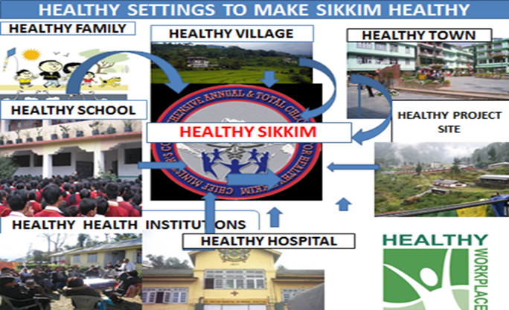

Slide 31

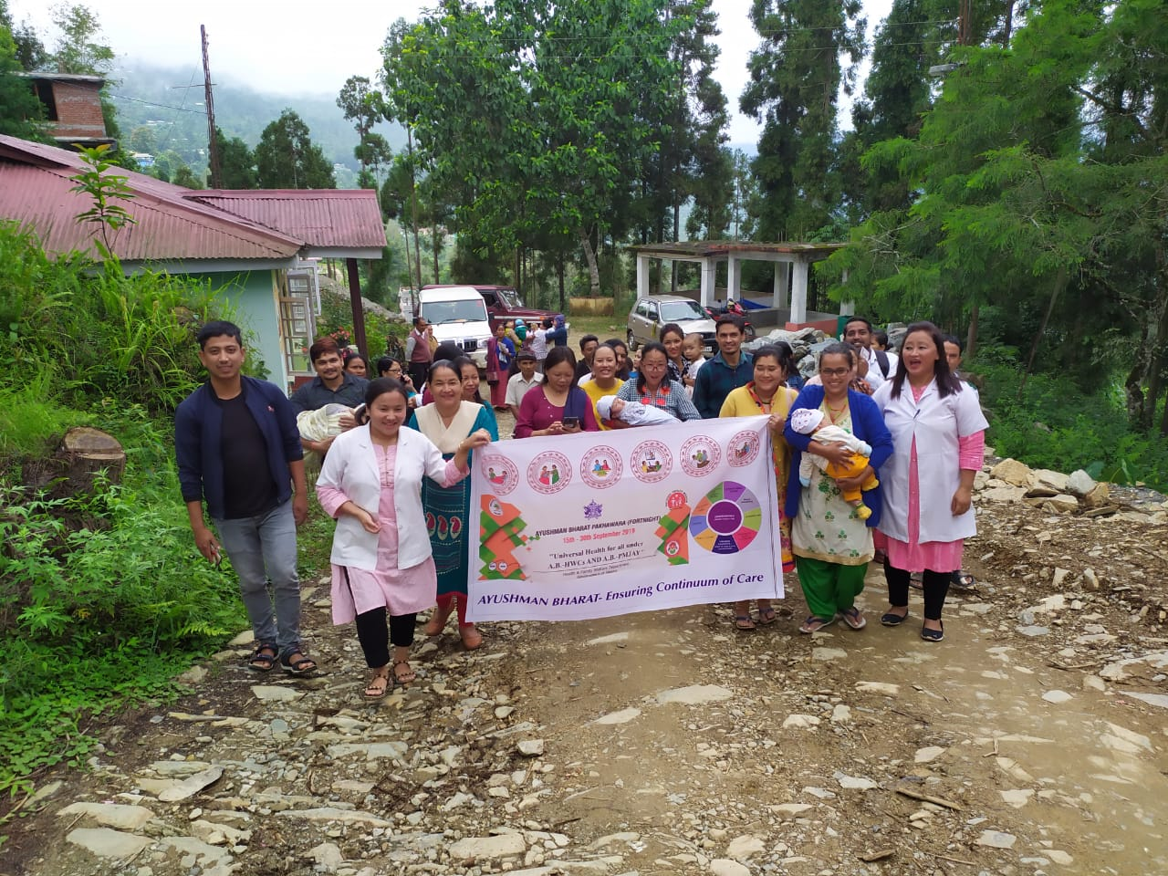
Thank You

