Slide 1

Regional Workshop on
Operationalization of AB-HWC
3rd– 4th October, 2019
Arunachal Pradesh
                Shri P. Parthiban, IAS
                Secretary (HFW) and MD NHM
                Govt. of Arunachal Pradesh

Slide 2
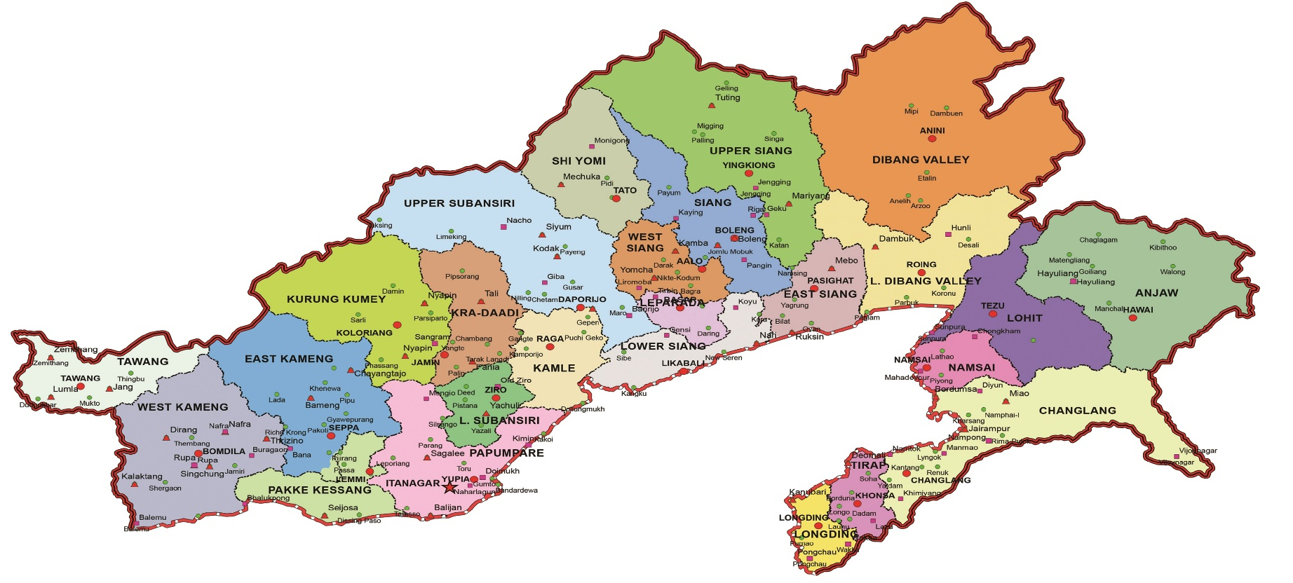
ARUNACHAL PRADESH
Target of Operationalization of HWCs
Facilities | Total
SHCs | 332
PHCs | 143
UPHCs | 4
Total | 479
Implementation Partner - USAID-MCSP/Jhpiego

Slide 3
Road-map for HWCs upgradation
Financial Year | Sub Centers | PHC | UPHC | Total
FY 2017-18 | - | - | - | -
FY 2018-19 | 78 | 38 | 4 | 120
FY 2019-20 | 52 | 50 (17 approved , proposed for additionally 33 in SPIP) | 0 | 102
Sub : Total | 130 | 88 | 4 | 222
FY 2020-21 | 101 | 28 | 0 | 129
FY 2021-22 | 101 | 27 | 0 | 128
Total | 332 | 143 | 4 | 479

Slide 4
HWC Operationalization Status FY 2018-19
Sl. No | District | Target FY 2018-19 | Operational as HWC
 |  |  | PHC-HWC | UPHC-HWC | SC-HWC | Total
1 | Papum Pare | 38 | 9 | 3 | 18 | 30
2 | East Siang | 24 | 8 | 1 | 15 | 24
3 | Namsai | 19 | 4 | - | 12 | 16
4 | Tawang | 18 | 6 | - | 7 | 13
5 | Tirap | 6 | 3 | - | - | 3
6 | East Kameng | 11 | 5 | - | 3 | 8
7 | Upper Siang | 4 | 1 | - | 2 | 3
Total |  | 120 | 36 | 4 | 57 | 97

Slide 5
Best Practices

Slide 6
Best practices in HWCs of Arunachal Pradesh
District level
Namsai district - Fixed (Dedicated )day services and HWC Bags in HWCs
Papum Pare / Itanagar Capital Complex districts-Customized IEC materials & HWC monitoring team
East Kameng District - Bike ambulance in HWC
Tawang District - Wellness activities and Quality branding works at HWCs
State level
Integrated Monitoring and Supervision of Health Facilities

Slide 7
Fixed Day Services – Namsai District
Fixed Day Services
Rationale To address the gap in equity of service provision for all the major components of CPHC Dedicated /Fixed day schedule: Monday – VHND / Outreach Sessions/ PBS for NCD Tuesday- Routine Immunization (RI), ANC and Family Planning Wednesday – VHND / Outreach Sessions/ PBS for NCD Thursday – NCD Screening day Friday- Wellness / Health Promotion activities Saturday - Routine Immunization, ANC and Family Planning Expected Outcomes: Increased in OPD attendance NCD screening prioritized and expected to cover the targeted population Complete ANC and Immunization coverage VHND as scheduled Mapping/ Line listing of ANC and RI beneficiaries
Notes:
VHND= Village Health and Nutrition Day
PBS= Population Based Screening
NCD= Non-Communicable Disease
ANC= Ante-Natal Check up

Slide 8
HWC Field Bags - Namsai district
HWC Field Bags in HWCs
Rationale To improve availability of logistics/diagnostics for field activities of HWC-SCs ASHA Kits(149 sets) & Bicycles to all ASHAs HWC –SC field kits ( 15 Sets) Expected Outcomes : Basic Diagnostic tests available Quality VHND Better Screening of PW and NCDs Improvement in Identification of High Risk PWs and Monitoring of Child Growth
Kit Bag | Digital stop Watch | Umbrella | Cord Clamp | Blades | Dettol
Digital Weigh Machine | Measuring Tape | Pregnancy Test Kits | Surgical Gloves | Head Cap | ORS Sachets
Digital Thermometer | Torch Light | Wash Proof adhesive plaster | Nylon Thread | Tab IFA | Oint. Betadine
Kit Bag | Digital Weigh Scale, Digital | BP Instrument | Stethoscope | Digital Thermometer
Sahlis’ Haemocheck | MUAC Tape | Blood Grouping Reagent | Torch Light | Glucometer (Monitor + Test Strip)
Notes:
PW= Pregnant Women

Slide 9
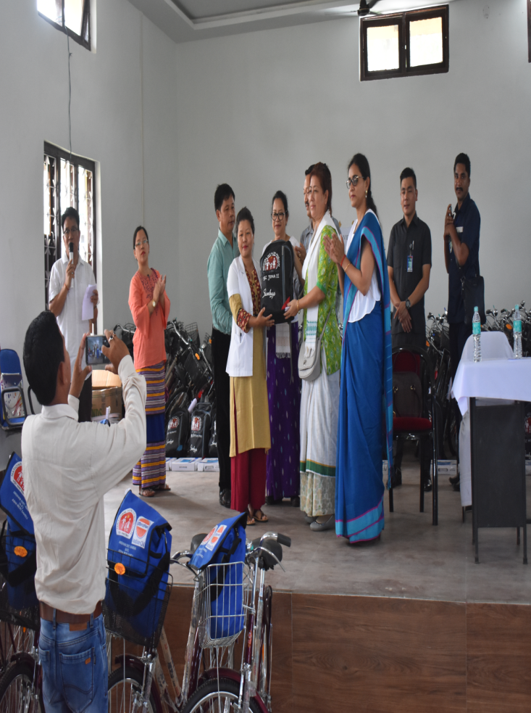
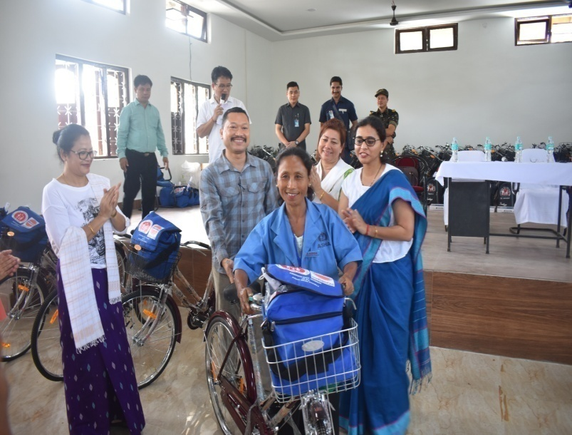
Field Bag Distribution at Namsai District
Bicycle and Field bag distributions to ASHAs and HWOs of Namsai district
Support for the Best Practice in Namsai district
District Administration
USAID-MCSP/Jhpiego
UNICEF
CSR funds
https://arunachalobserver.org/2019/07/06/namsai-district-innovation-anm-asha-given-kits-bicycle/
https://thedawnlitpost.com/kits-with-bicycles-distributed-to-anms-ashas/

Slide 10
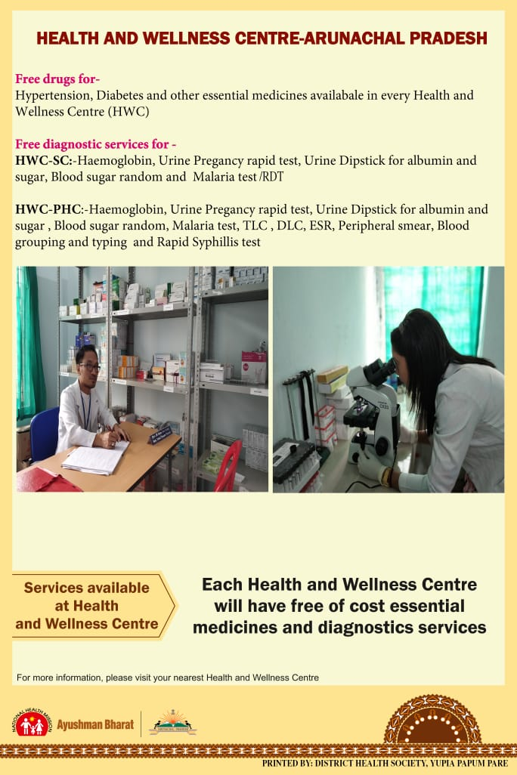
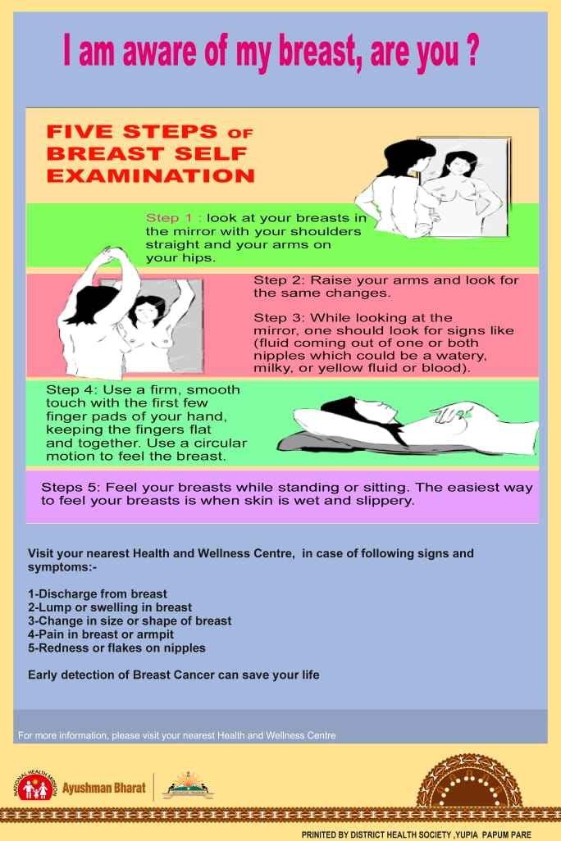

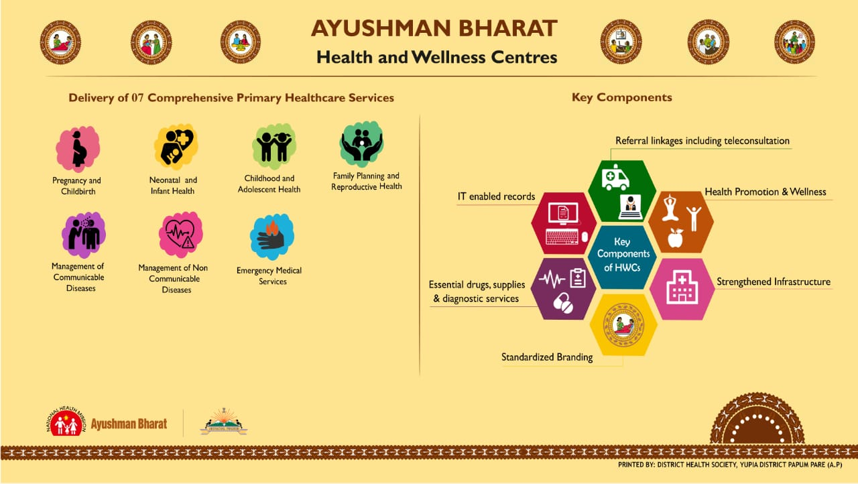
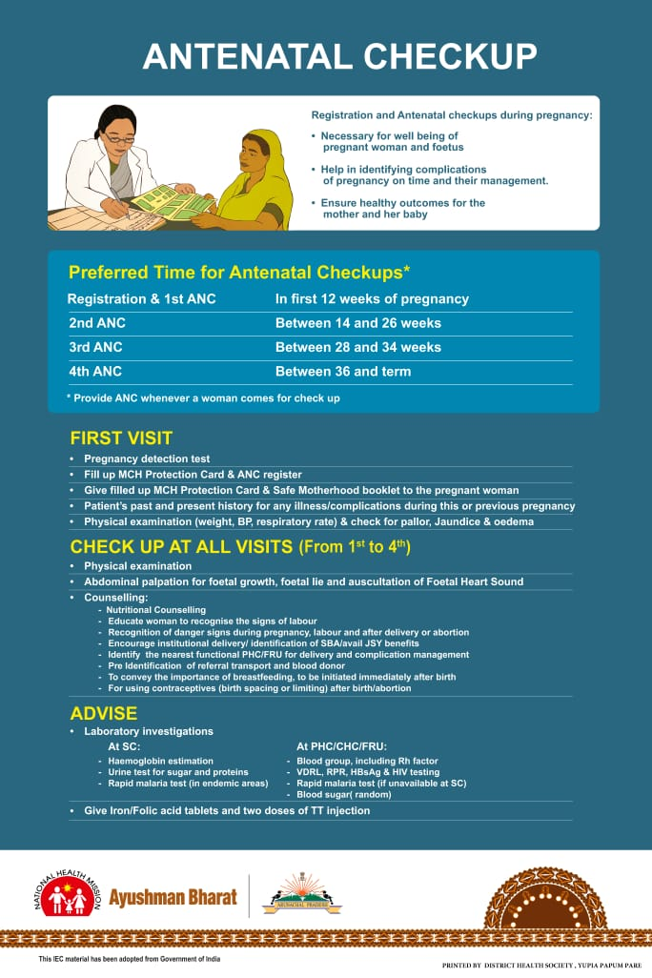
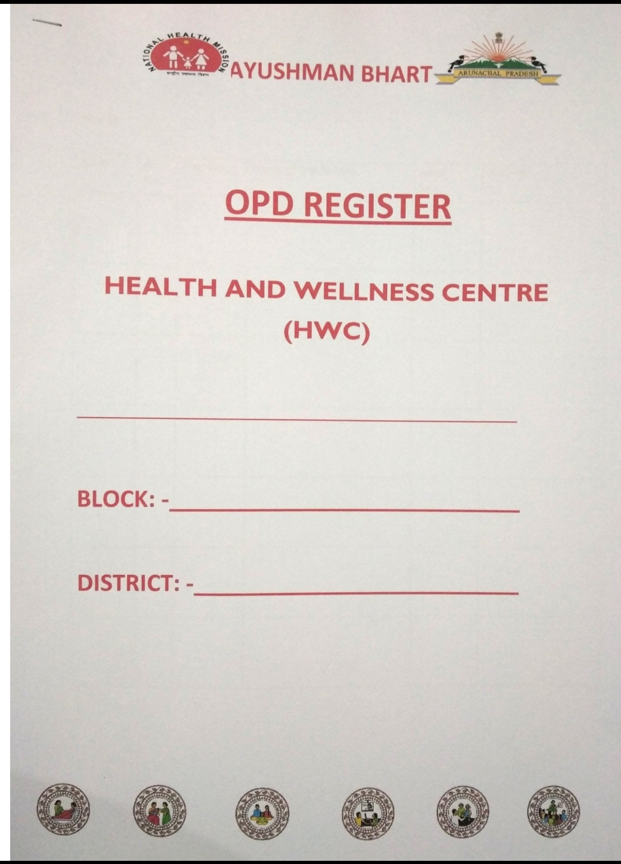
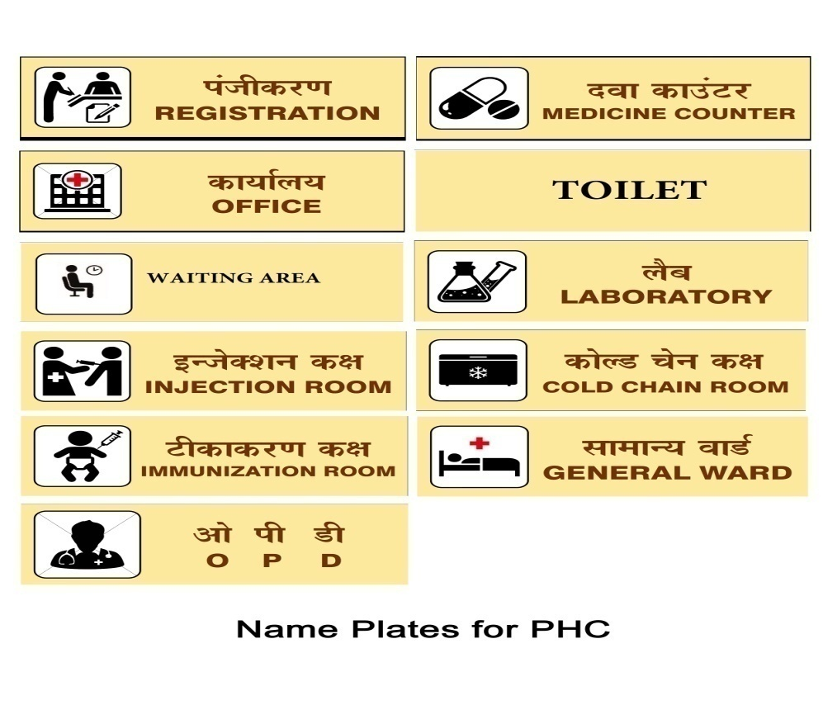

Customized IEC Materials (Papum Pare)
10
USAID-MCSP/Jhpiego supported for developing IECs materials

Slide 11
HWC Monitoring Team (Papum Pare)
HWC District level Monitoring team
  District Administration
  DMO , DRCHO, DANO,DPO and DPM
  Executing Agency, WRD department involved 12 AEs & JEs area wise
  Medical Officer I/C of respective blocks
  WRD Itanagar / Yupia Division for GEO Tagging
  Jhpiego representative
  This monitoring team formulated for monitoring HWC upgradation activities . This team conducted gap analysis, follow up during upgradation works and planning to visit after completion of HWC works

Slide 12
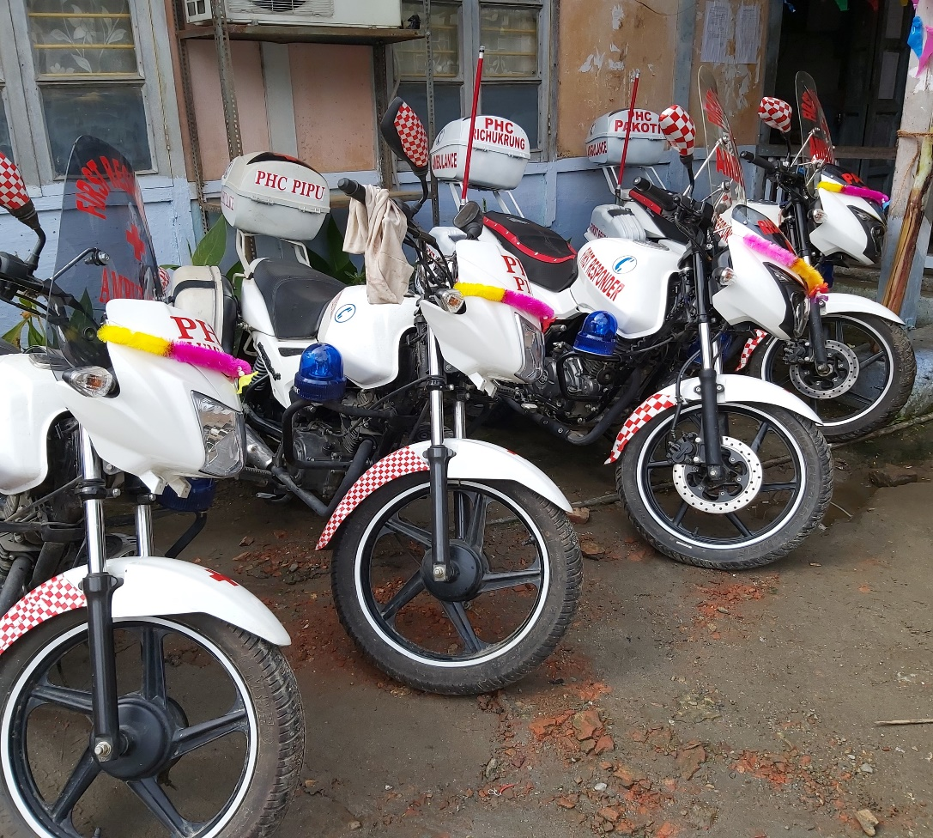
Bike Ambulance in HWC- East Kameng District
Bike ambulance “First Responder” is presently being used in Khenewa , Pipu and Pakoti HWC-PHC for:-
Patient from villages who required support
Referrals
Vaccine delivery for RI
Medicine , Diagnostics and other logistic delivery at SC
VHND and other community activities
Notes:
Background: East Kameng district is situated in the Western part of Arunachal Pradesh surrounded by West Kameng in the west, Papum Pare in the East, Part of Lower Subansiri and McMahon (International Boundary) line in the North and Sonitpur District of Assam in the South covering an area of 4134 sq. kms.
The entire district barring a small area on the southernmost tip of Assam is mountainous.
The District Hqr, Seppa lies on the bank of River Kameng. Important tributaries of river Kameng which are turbulent and high speed rivers are Para, Pachi, Pachok, Pakoti, Keya Bichom, Pacha, Pakke, Papu, Passa, Narmorah and Dikalmukh.
The rugged terrains of the district make transport and communication extremely difficult. There are few surface roads, which remain cut off during summer seasons due to flood and landslide. To bridge these gaps, the introduction of First Responder (Ambulance Bike) was initiated by Sri Gourav Singh Rajawat (IAS), Deputy Commissioner Seppa and implemented by Department of Health & Family Welfare, East Kameng District.
Objective:
1. To lift patients including pregnant mothers where regular ambulance cannot perform
2. To deliver vaccines and emergency medicines in inaccessible areas and in difficult road conditions.
3. To provide First Aid services at door step
Funding:
The funding was done from MLA LAD
Outcome:
Referral cases from inaccessible areas like Pipu and R/krung areas are increasing after introduction of First Responder.
The immunization coverage in those inaccessible areas are improving rapidly.
There is improvement in the performance of HWCs
Issues and Limitations:
1. Recurring cost
2. Difficult to carry seriously ill patients and Pregnant mothers due to the road conditions and the original structure of the motorcycle.

Slide 13
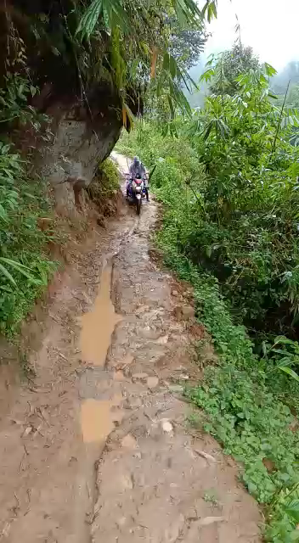
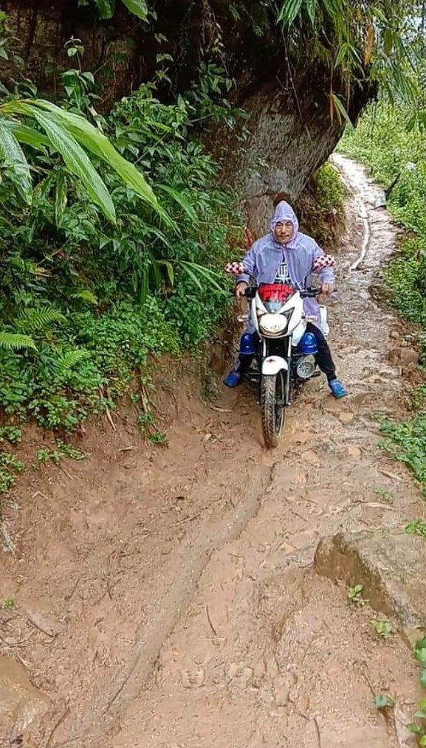
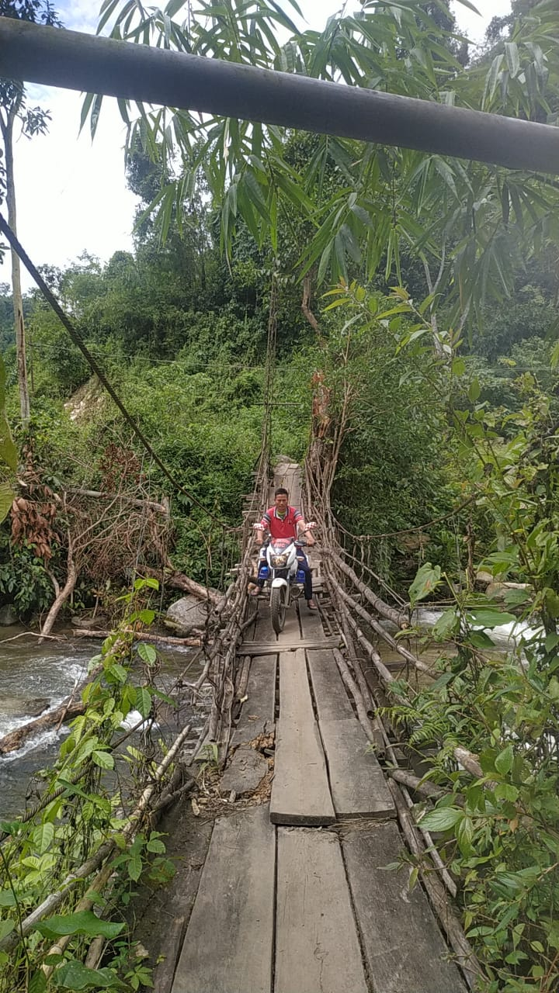
Bike Ambulance in HWC- East Kameng District
Video Click Here
Notes:
Background: East Kameng district is situated in the Western part of Arunachal Pradesh surrounded by West Kameng in the west, Papum Pare in the East, Part of Lower Subansiri and McMahon (International Boundary) line in the North and Sonitpur District of Assam in the South covering an area of 4134 sq. kms.
The entire district barring a small area on the southernmost tip of Assam is mountainous.
The District Hqr, Seppa lies on the bank of River Kameng. Important tributaries of river Kameng which are turbulent and high speed rivers are Para, Pachi, Pachok, Pakoti, Keya Bichom, Pacha, Pakke, Papu, Passa, Narmorah and Dikalmukh.
The rugged terrains of the district make transport and communication extremely difficult. There are few surface roads, which remain cut off during summer seasons due to flood and landslide. To bridge these gaps, the introduction of First Responder (Ambulance Bike) was initiated by Sri Gourav Singh Rajawat (IAS), Deputy Commissioner Seppa and implemented by Department of Health & Family Welfare, East Kameng District.
Objective:
1. To lift patients including pregnant mothers where regular ambulance cannot perform
2. To deliver vaccines and emergency medicines in inaccessible areas and in difficult road conditions.
3. To provide First Aid services at door step
Funding:
The funding was done from MLA LAD
Outcome:
Referral cases from inaccessible areas like Pipu and R/krung areas are increasing after introduction of First Responder.
The immunization coverage in those inaccessible areas are improving rapidly.
There is improvement in the performance of HWCs
Issues and Limitations:
1. Recurring cost
2. Difficult to carry seriously ill patients and Pregnant mothers due to the road conditions and the original structure of the motorcycle.

Slide 14
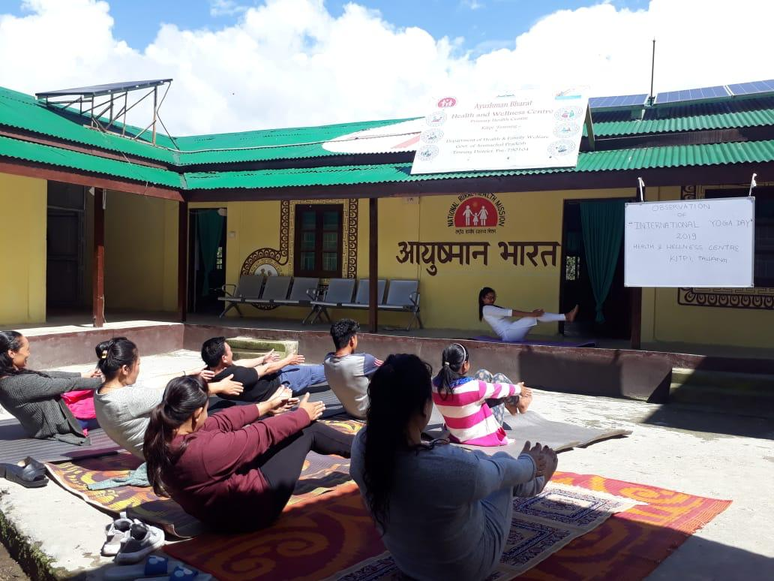
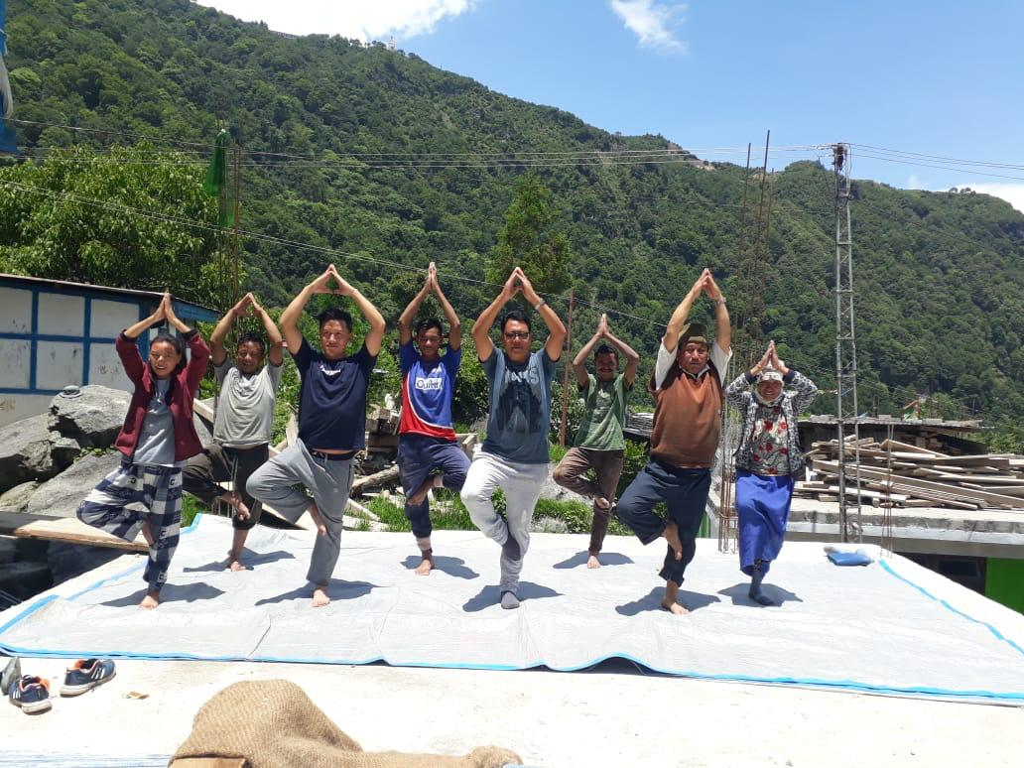
Tawang District Initiated Weekly Wellness Activities in 5 PHC-HWCs through Yoga Instructors (Locally identified )
Wellness activities
Wellness activities at Kipti PHC-HWC
Wellness activities at Seru SC-HWC

Slide 15
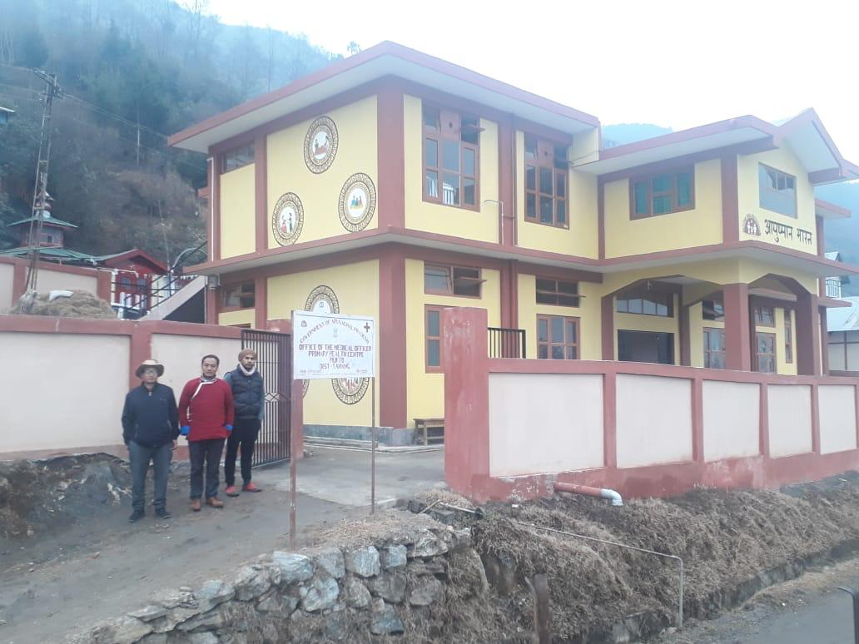
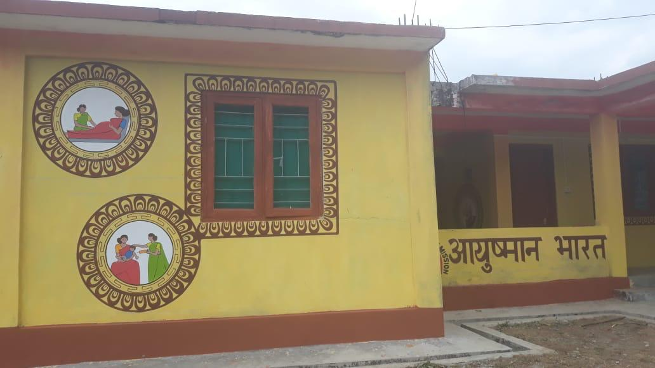
Quality branding works at HWCs in Tawang District
Quality Branding of the HWCs
Mukto PHC-HWC
Bongleng PHC-HWC

Slide 16
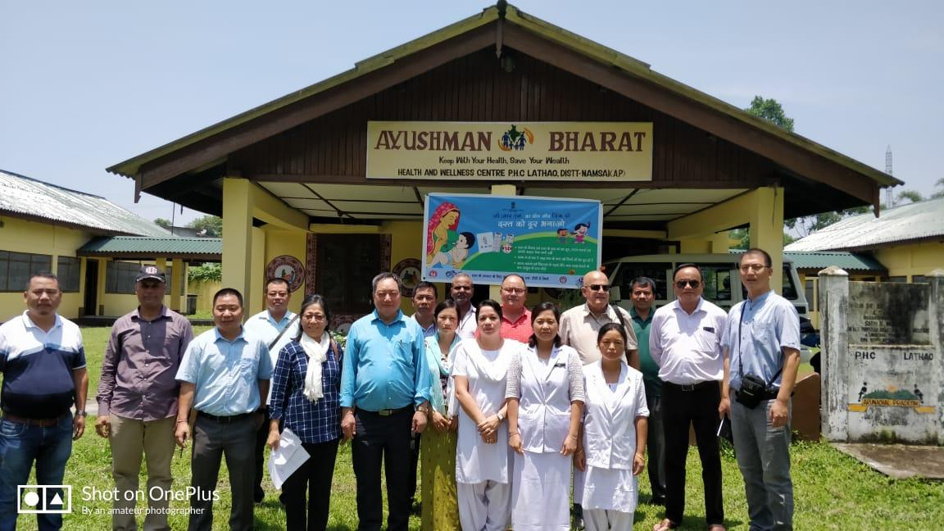
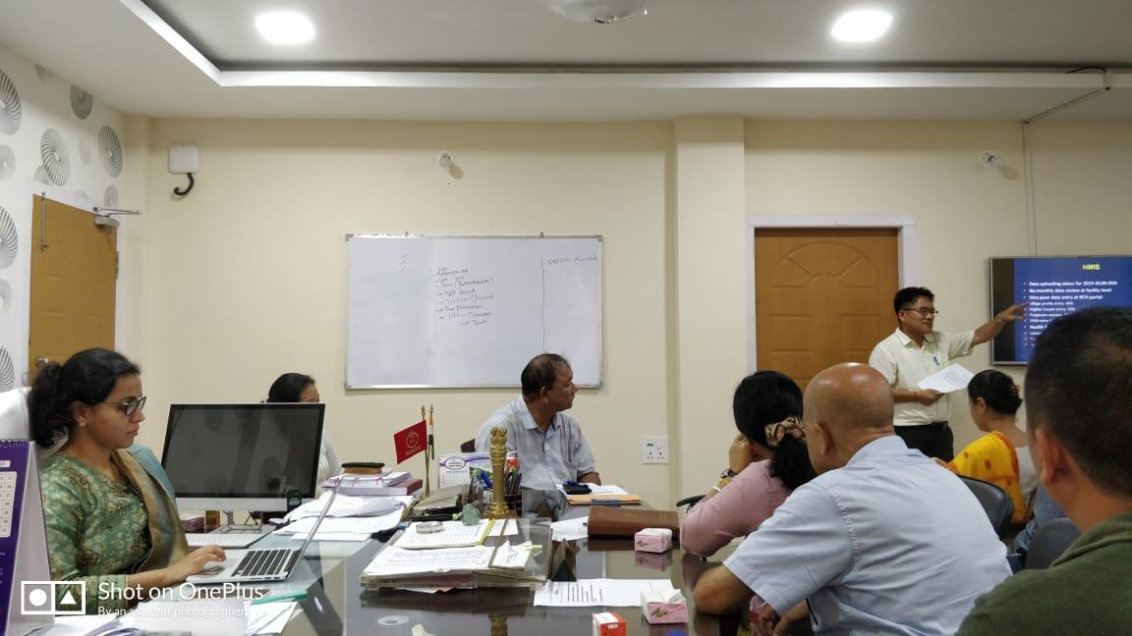
Integrated Monitoring and Supervision
Monitoring team
Directors, Joint Directors & Deputy Directors of Department of Family Welfare
Nodal officers of NHM and other vertical program
State Epidemiologist
Representative from Jhpiego and UNICEF
Activity :
Joint visit in all the district once in a year and evaluation of all the component of CPHC services
Debriefing meeting with district administration and preparation of report with action points
Picture
Notes:
CPHC=Comprehensive Primary Health Care

Slide 17
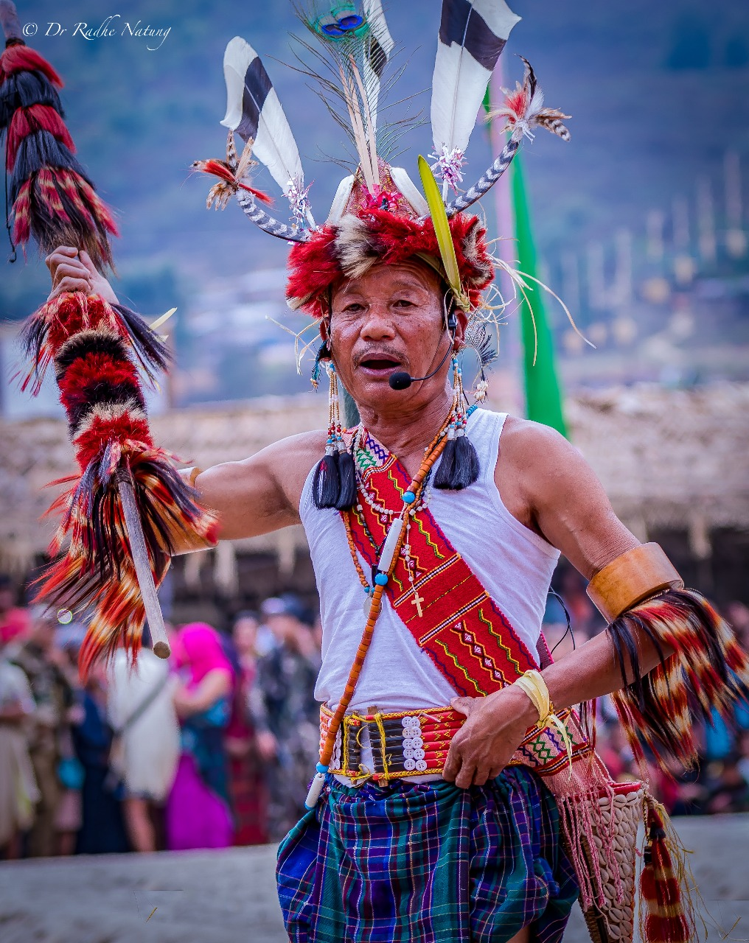
Thank You
Notes:
The Noctes!!!!!

