Slide 1
Joining hands with Community for Quality Health Services at Health and Wellness Centers
By: Dr. Kevichusa Medikhru
MD NHM Nagaland

Slide 2
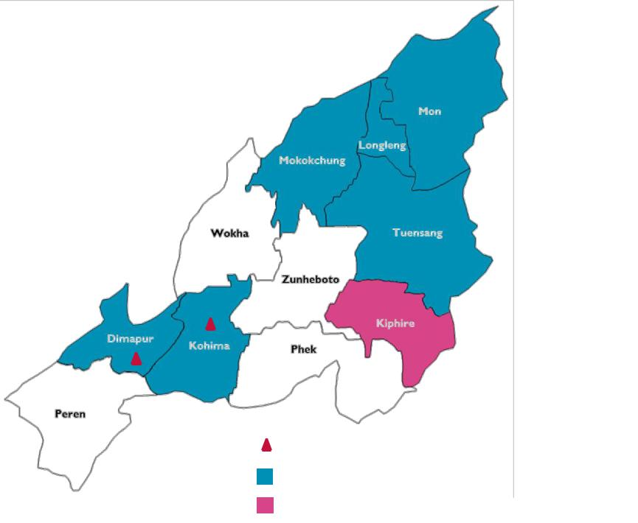
Background
Reach: 7 districts (all proposed HWCs)
PSCs: 2 (NHAK, DH-Dimapur)
`
Program Study Centres (PSCs)
HWC Intervention districts
Aspirational district
Will be taken up in FY2019-20
Poor Infrastructure- not conducive for institutional delivery
No skilled manpower to delivery quality health care
Strong embedded community practice of home delivery
Poor Health Seeking behavior
Solution
Joining hands with Community

Slide 3
Strategies adopted
Accountability
Integrated
Institutionalization
Funding system
Work closely with NHP, Village council for upgrading SC to HWC
Established HWC cell at State/district levels
2
4
1
3
5
Sensitization
Ownership
State-district-till VHC level and other stake holder sensitized on CPHC
Nagaland Communitization Act
Technical Partner: USAID MCSP/ Jhpiego

Slide 4
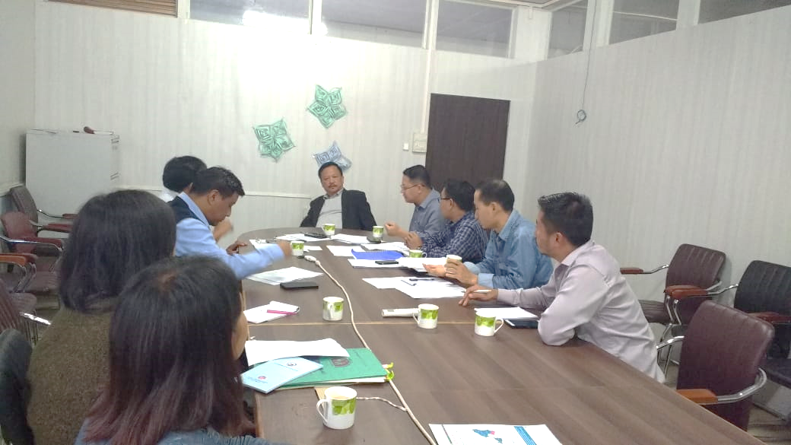
Institutionalization
HWC cells established at State and district level for regular planning and monitoring
HWC cell chaired by Principal Secretary and Deputy Commissioner at state & district respectively
Committee takes policy decisions related to CPHC-HWCs
Meeting held every once in a month in first 3 months and held quarterly thereafter
HWCs Cell meeting

Slide 5
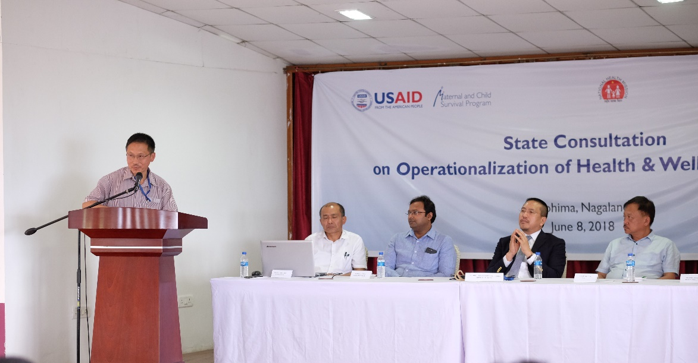
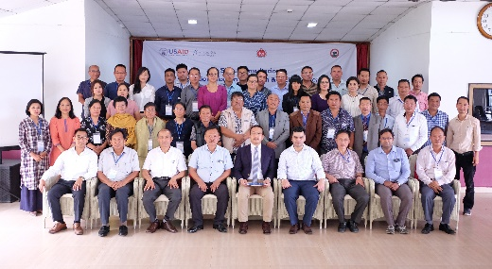
Regular Sensitization on CPHC concept
First State Sensitization workshop with technical Support from USAID MCSP/ Jhpiego on 8th June 2018
Thereafter state level orientation conducted for District Officials
District Health authority took over to sensitize the district team including the Village Health Committee (VHC)
Developed robust IEC materials in local context

Slide 6
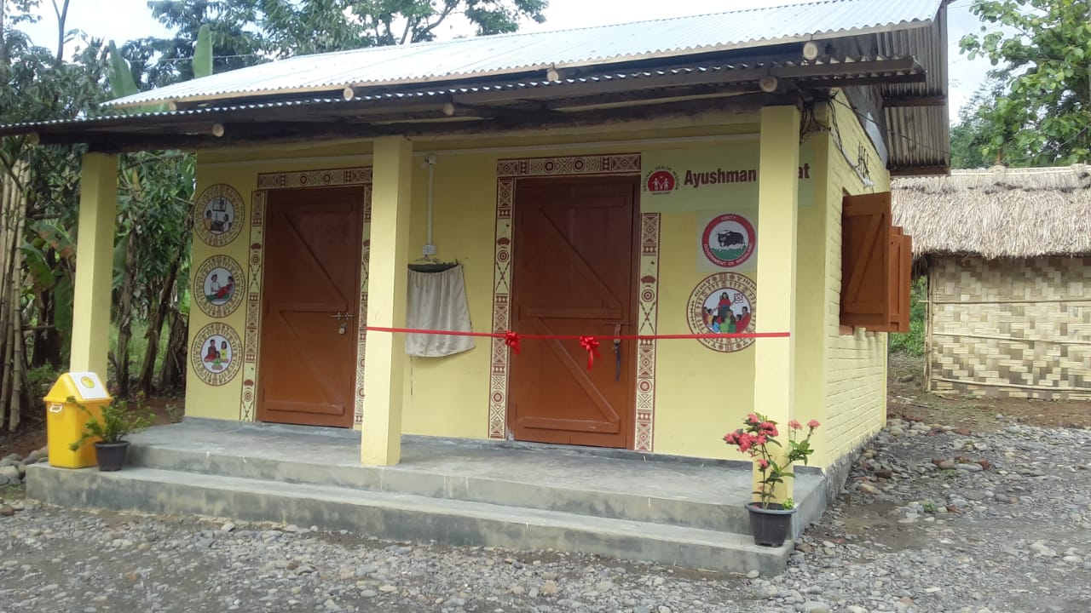
Accountability:
Funding rooted through VHC account
Transparency of the work order
More community ownership
Ownership:
Nagaland Communitization Act
Integrated:
Nagaland Health Project funded by World bank helps in establishing Labour room/waste management/ power back up and water supply
Community awareness activities are carried out with Social Welfare dept.
Village councils help in monitoring of upgrading SCs-HWC
HWCs being constructed through Engaging Local Communities

Slide 7
Results
All the 56 HWCs construction work done by VHCs
Community donated the construction of community kitchen in most of the Operationalized HWC
Enhanced community participation and ownership for HWCs
Most of the Civil work carried out was very transparent
Community ensures stay and accommodation arrangements for CHOs
Community participate in taking up activity to create awareness on Healthy living

Slide 8
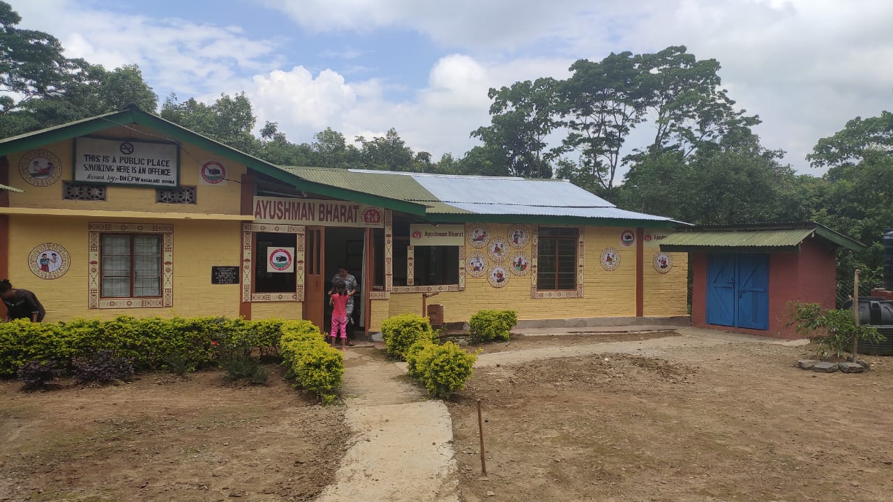
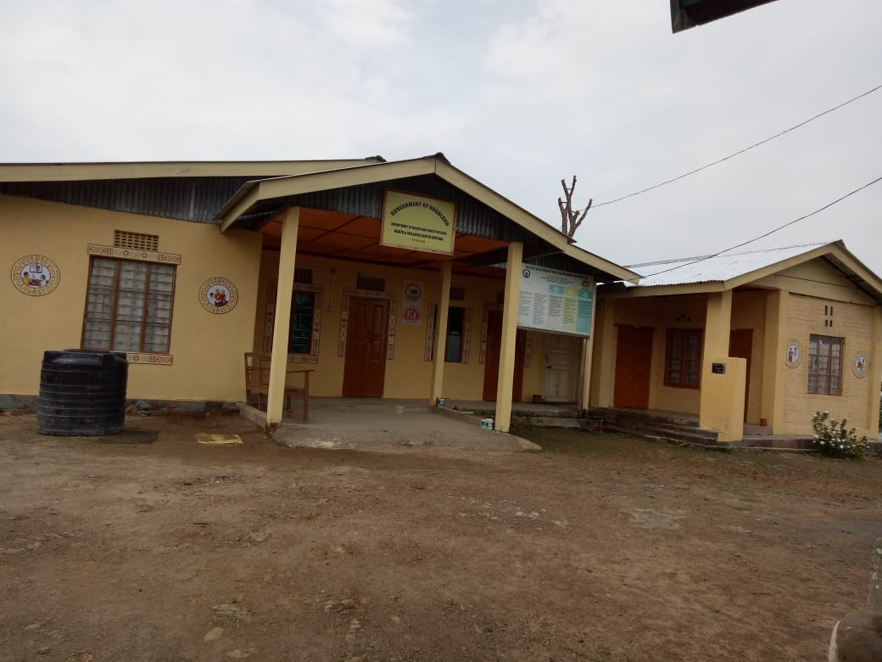
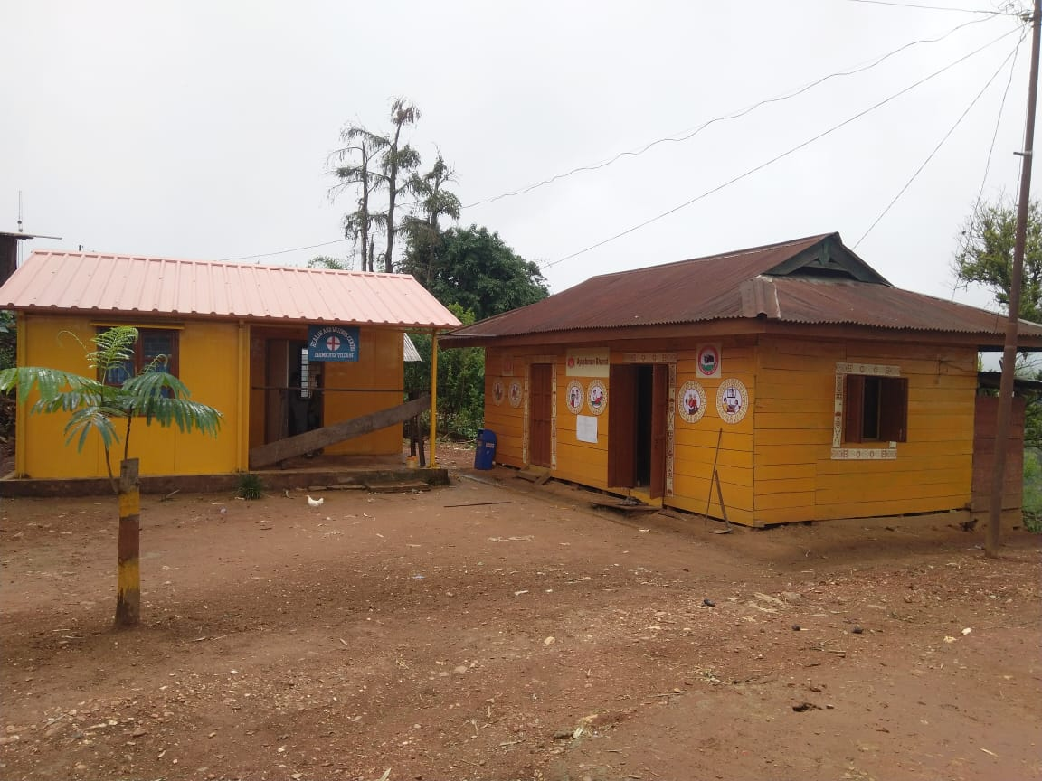
HWCs constructed by VHCs

Slide 9
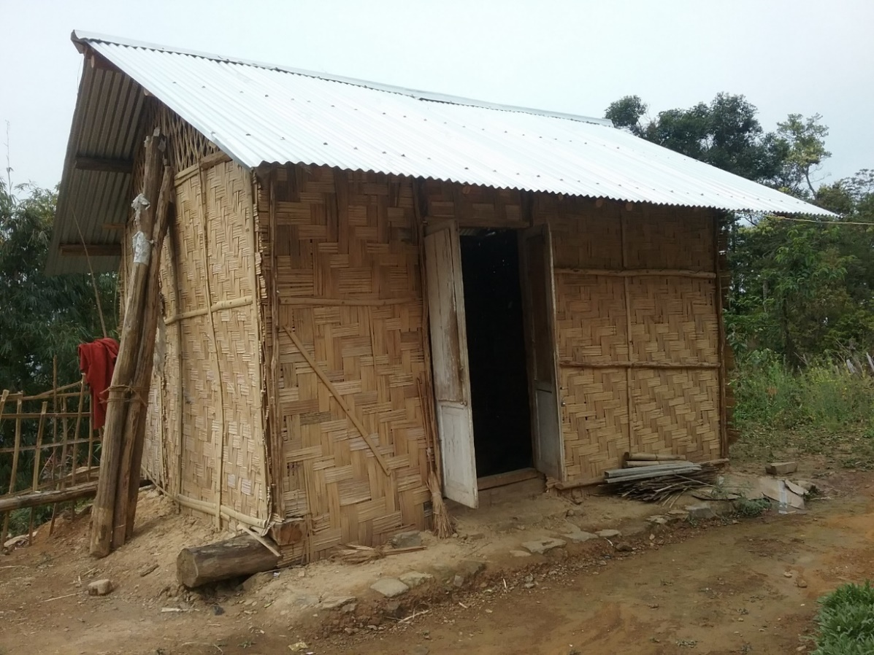
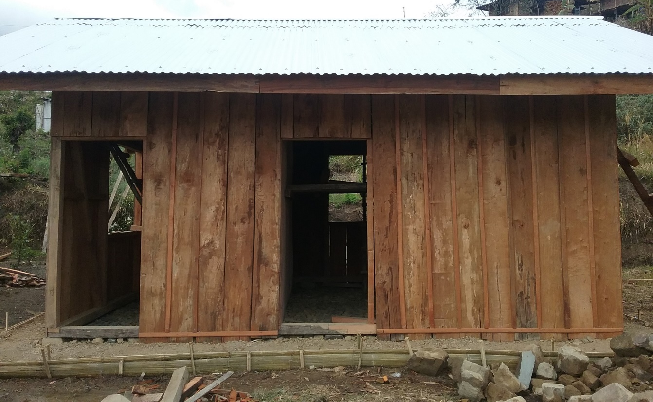
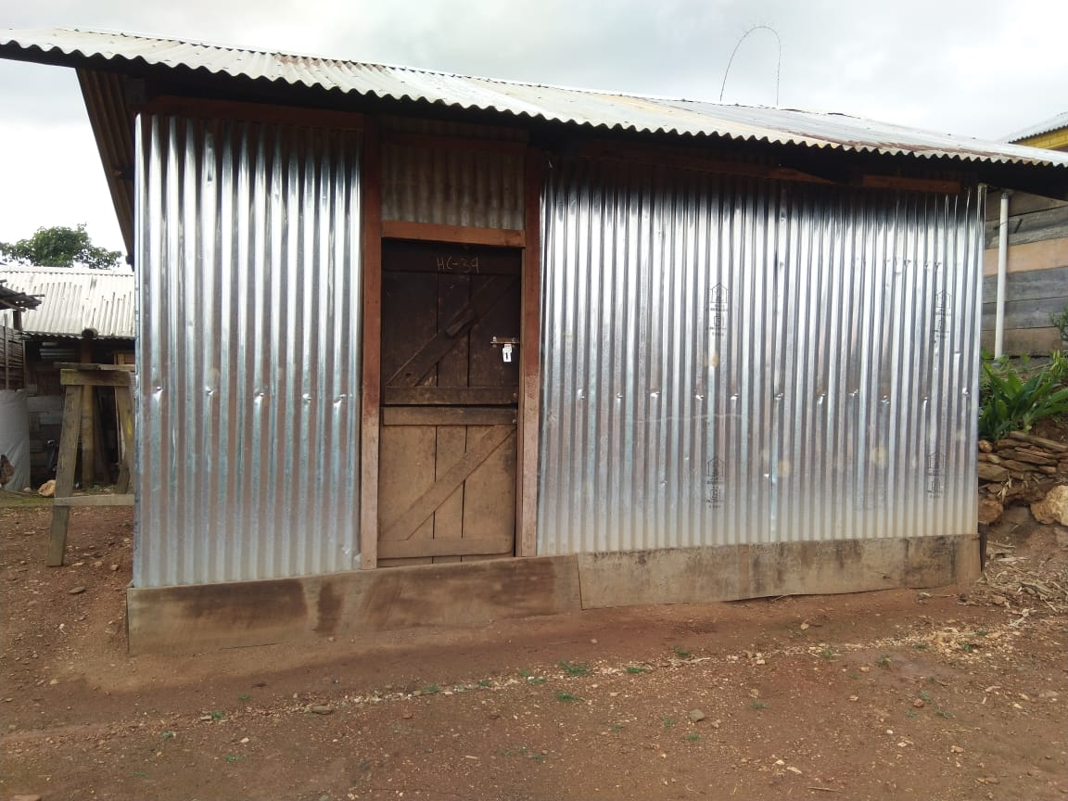
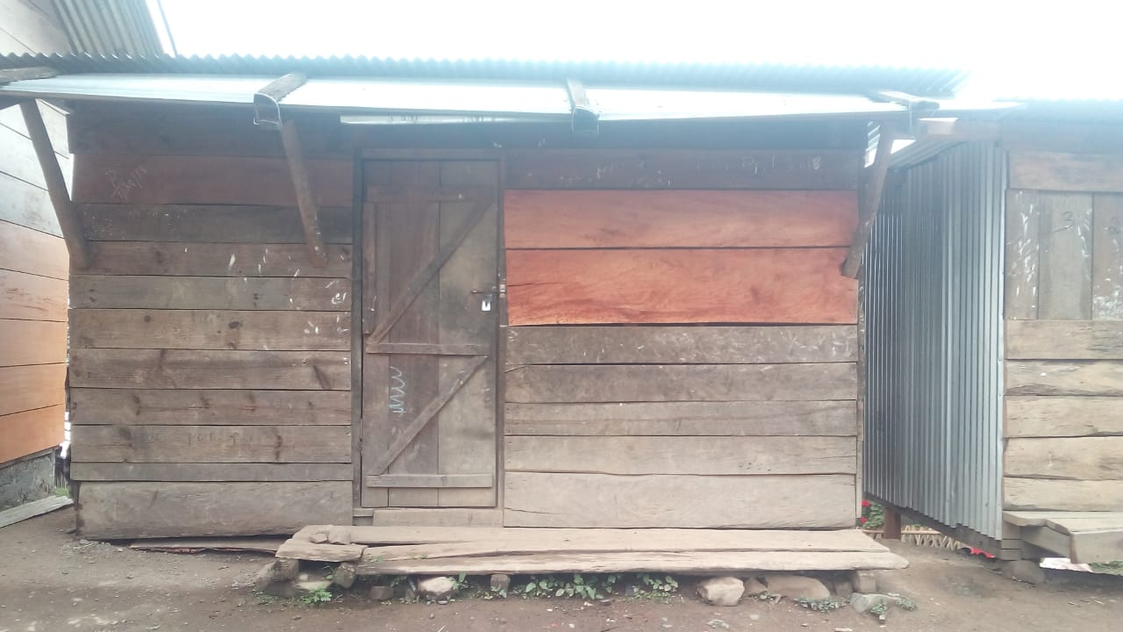
HWC Kitchens constructed by the Community

Slide 10
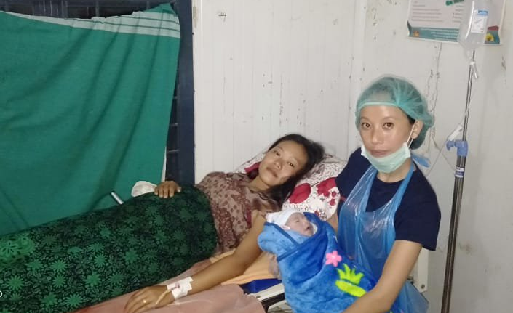
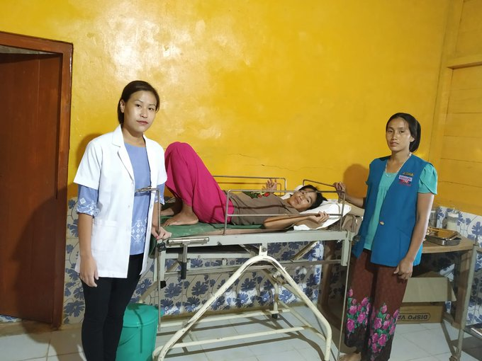
Key Achievements
20 HWCs SCs in hard to reach areas of Nagaland have started conducting institutional deliveries
Till date, 51 institutional deliveries conducted by CHOs
IUCD insertion initiated for the first time at the SCs by CHOs
Wellness Activities initiated
Institutional delivery at SC-HWC, Kisetong (Kiphire)
IUCD insertion at SC-HWC by CHO, Anatonger

Slide 11
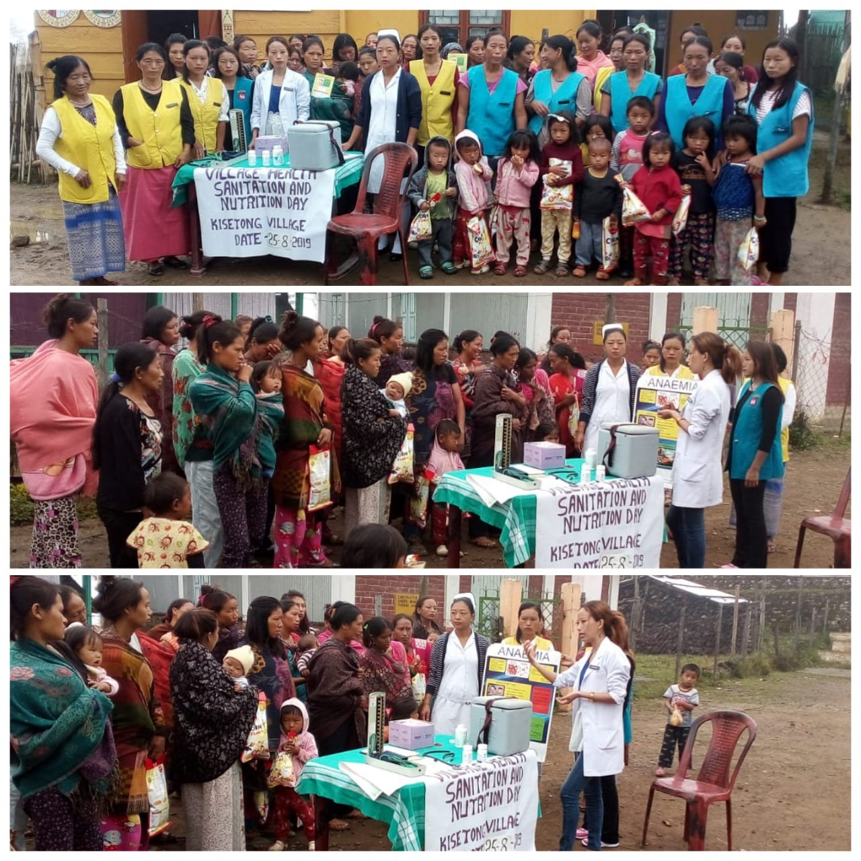
VHND strengthening
Home based Elderly care within the community
Enhanced services at Village Health and Nutrition Days
Community participation and ownership through involvement of Village Health Communities
Village Health and Nutrition Days in Nagaland

Slide 12
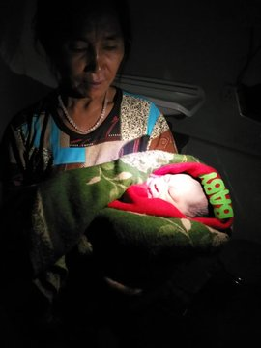
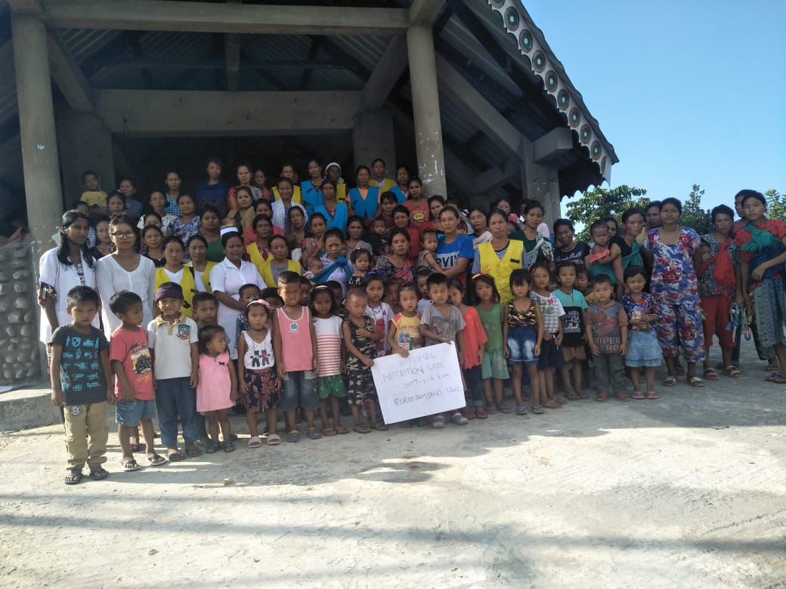
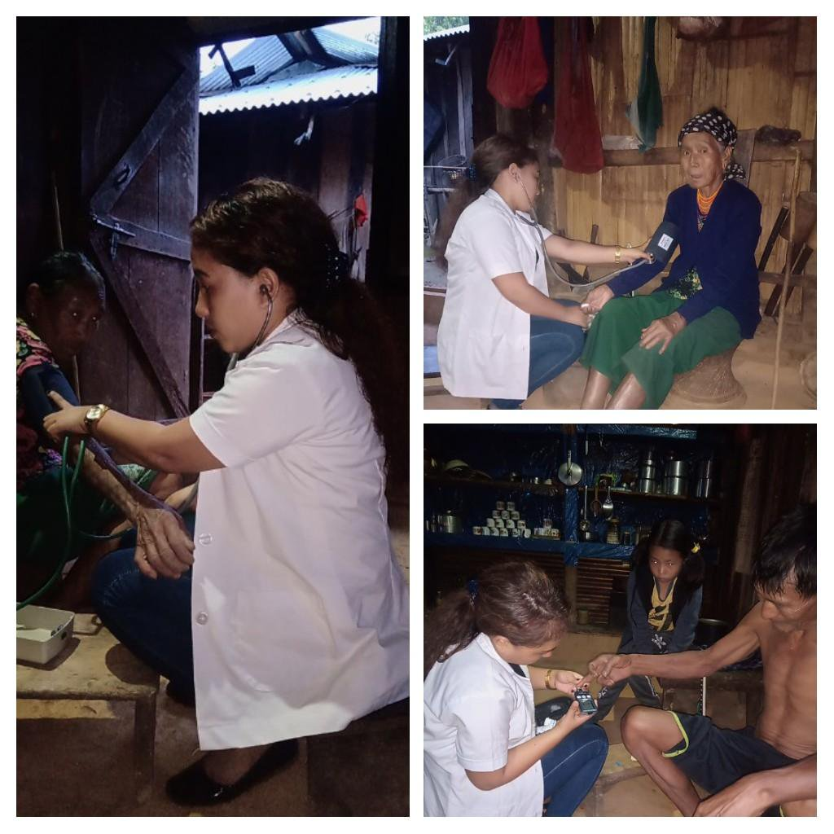
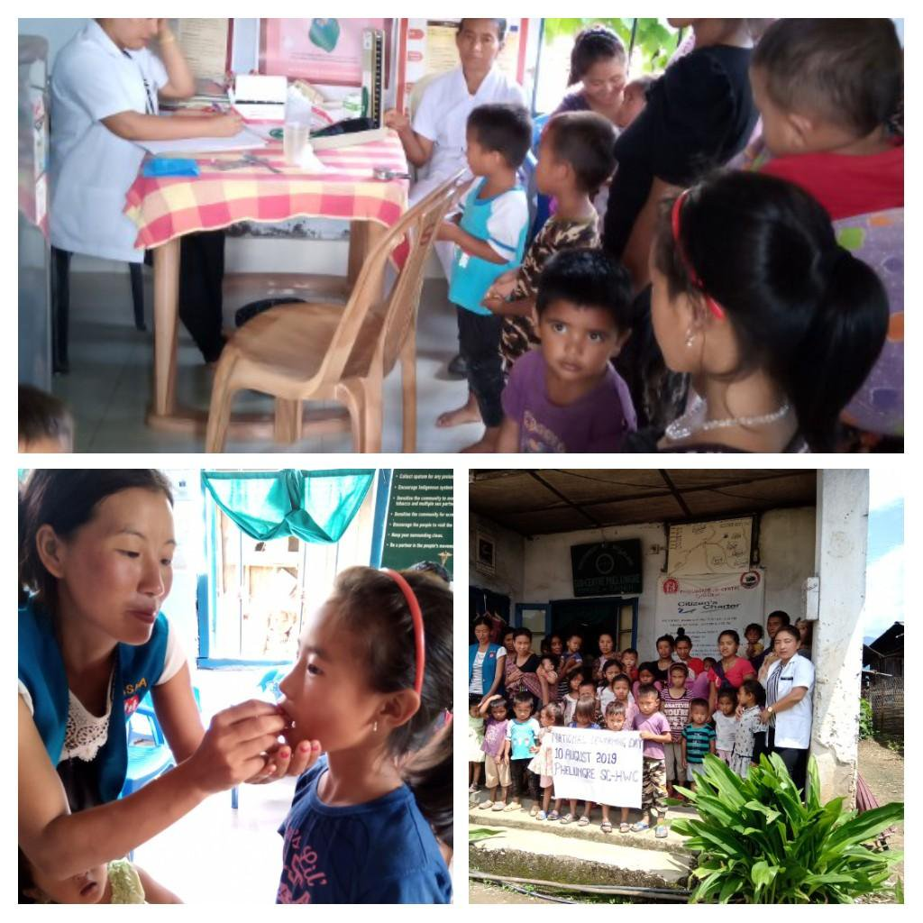
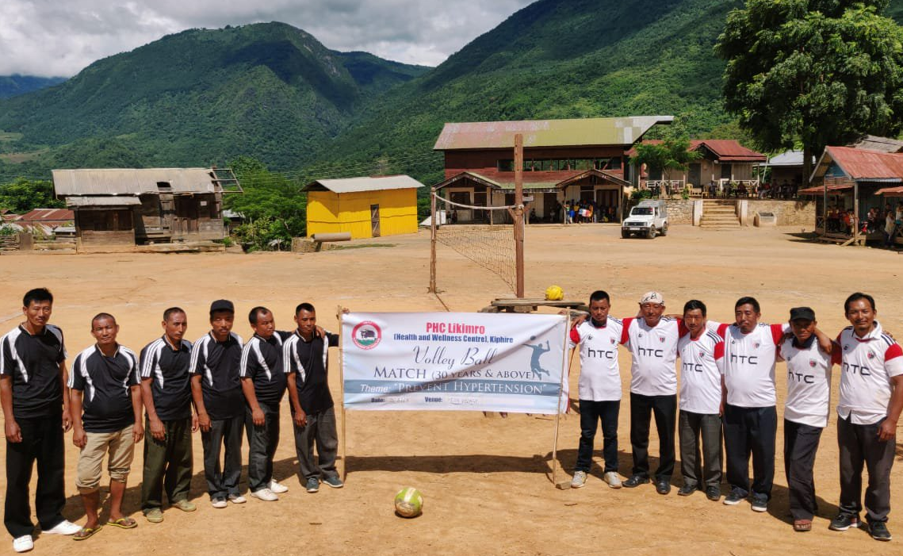
Strengthening CPHC services through HWCs
Institutional Delivery at HWC
Nutrition Week at HWC
Elderly Care by CHO
Deworming Day at HWC
Wellness Activities at HWC
Elderly Care by CHO

Slide 13
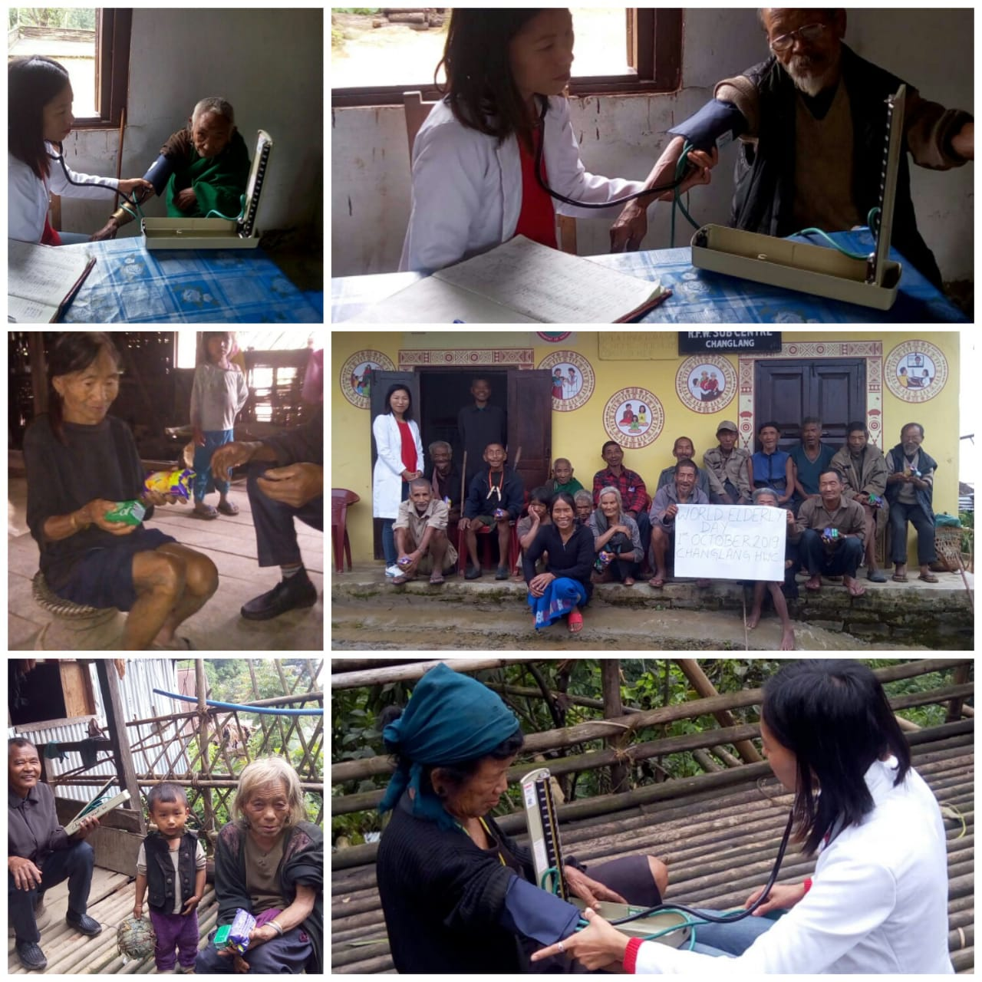
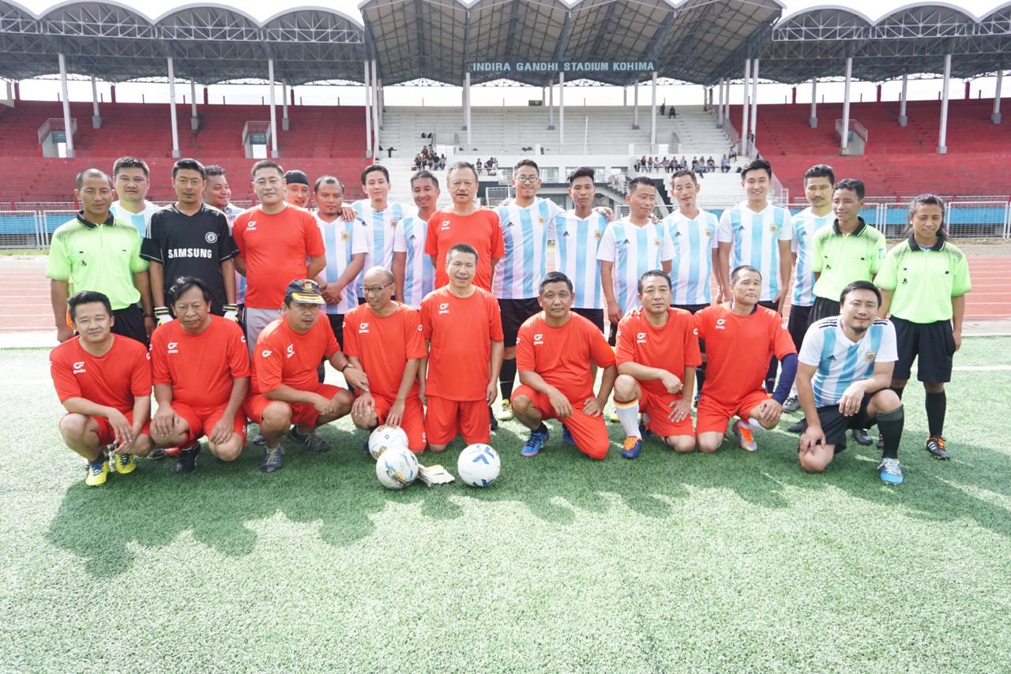
Wellness activities at HWCs
Engagement of youth for wellness activities
Health days calendar developed and it is celebrated in all the important Health day
Wellness activities at HWCs
Recent football match at Directorate to promote Physical Wellness
World elderly Day observed at HWC

Slide 14
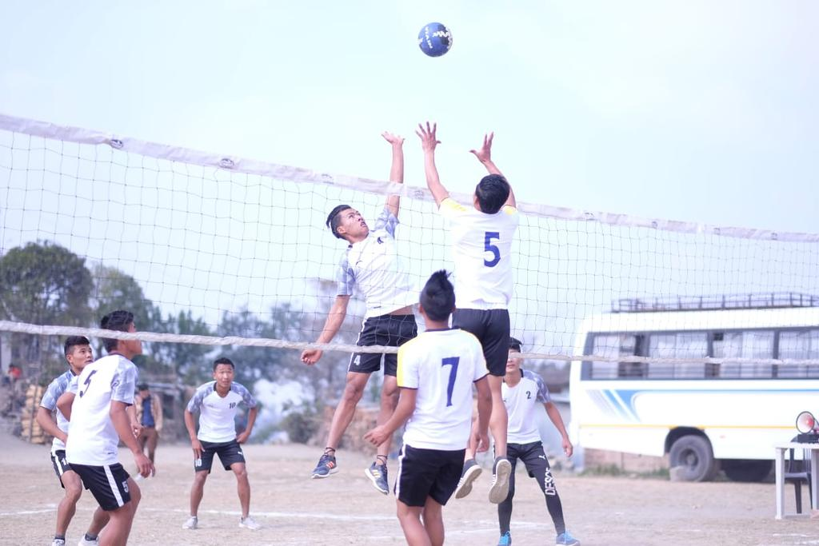
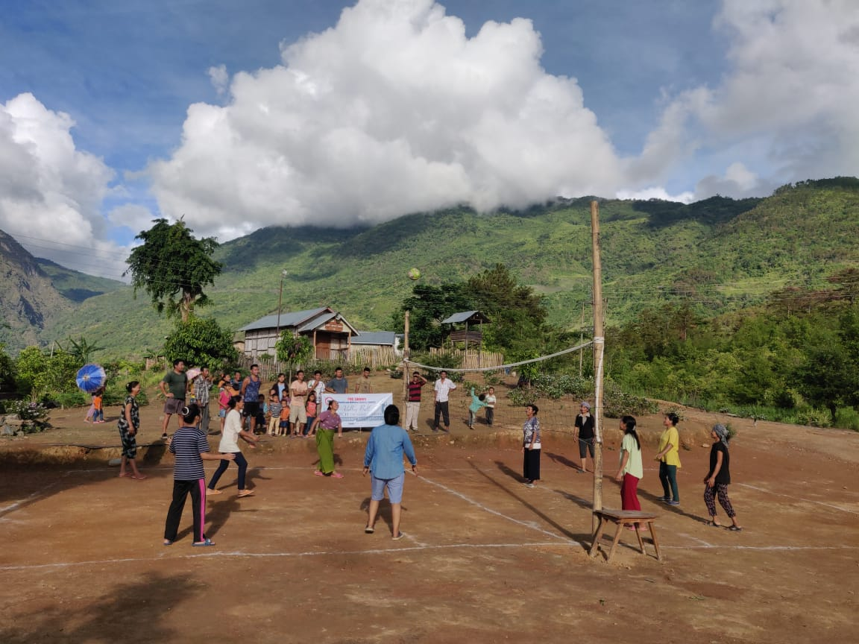
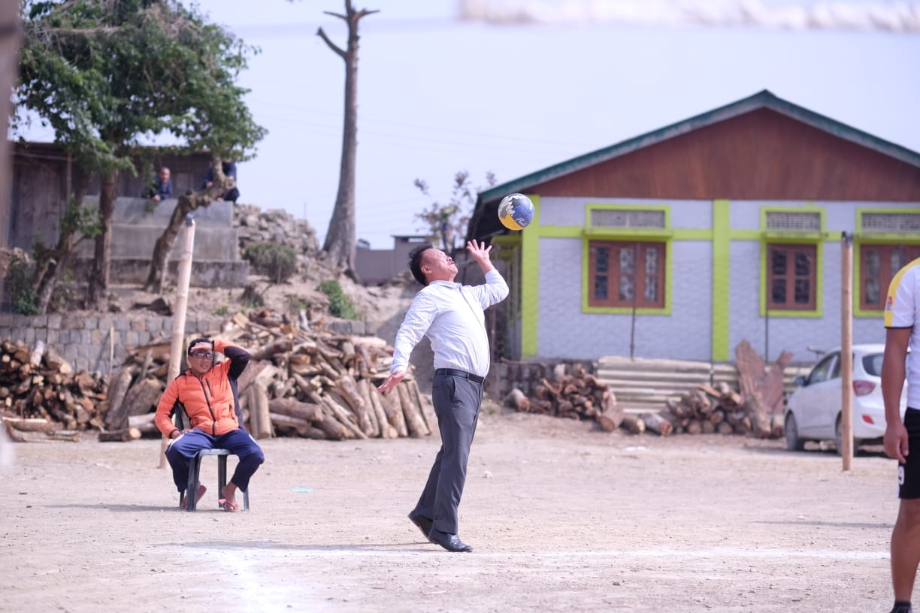
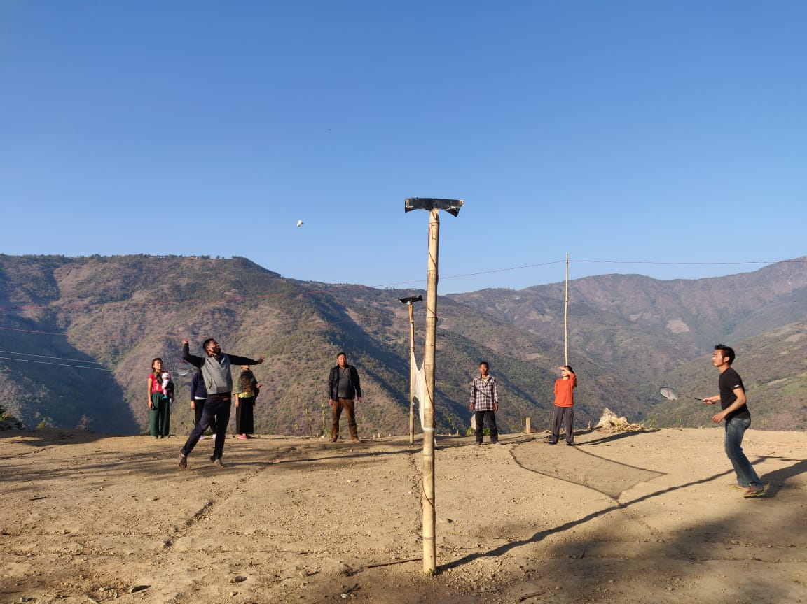
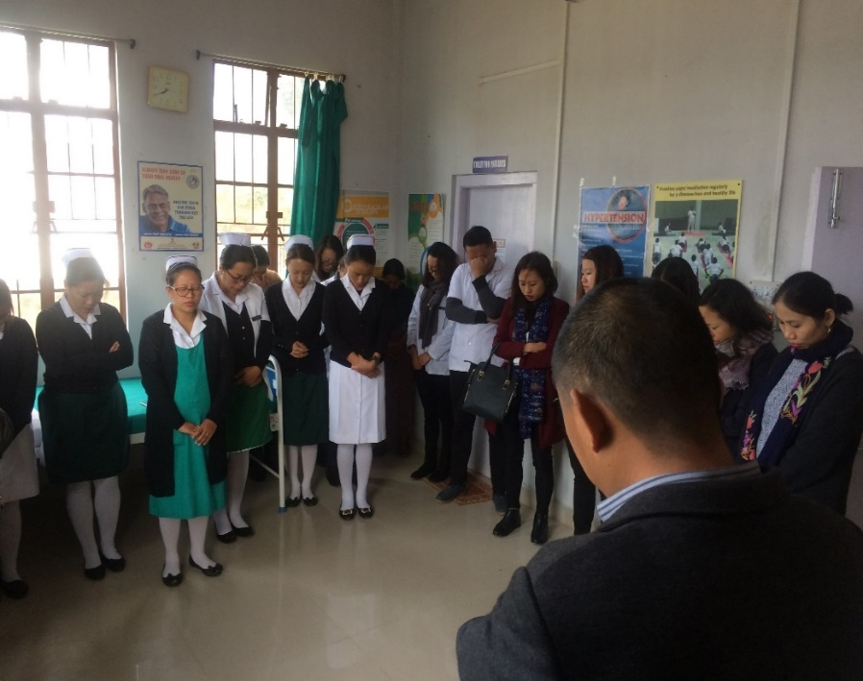
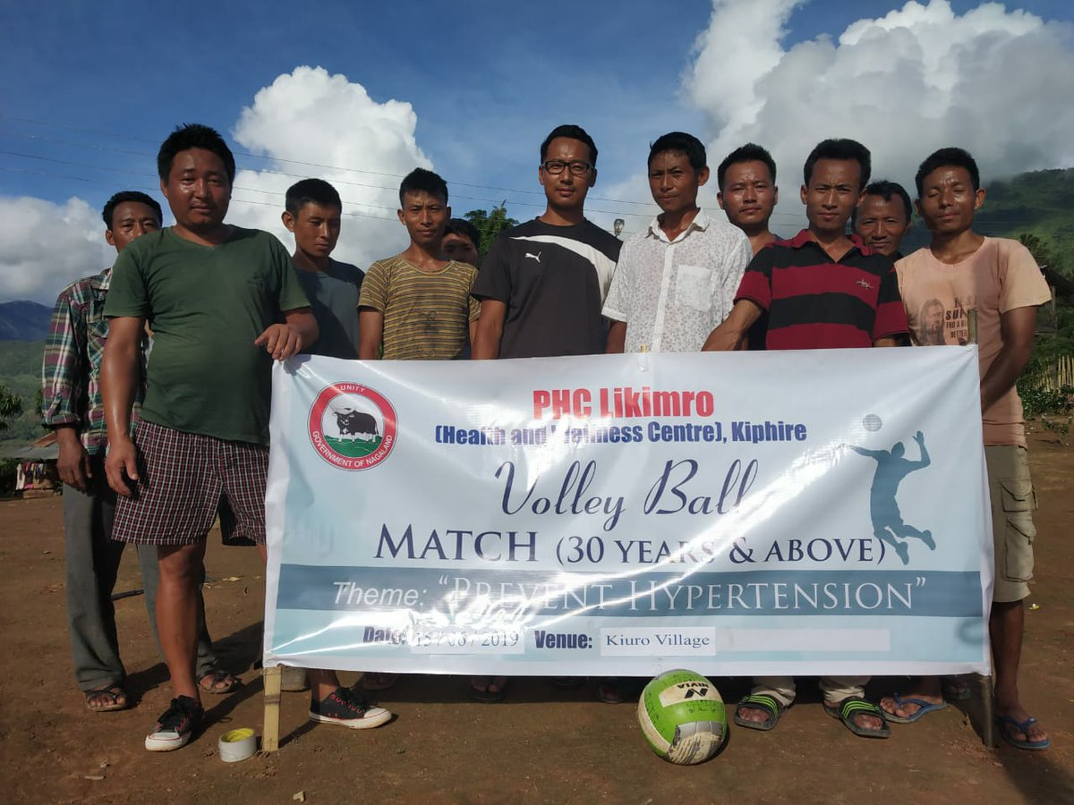
Volley Ball match as wellness activity
Women’s Volley Ball
Mission Director Promoting Sport as wellness Activity
Badminton as wellness activity
Morning meditation as part of Wellness
Screening Hypertension through sport
Notes:
Sport as activity beyond Yoga

Slide 15
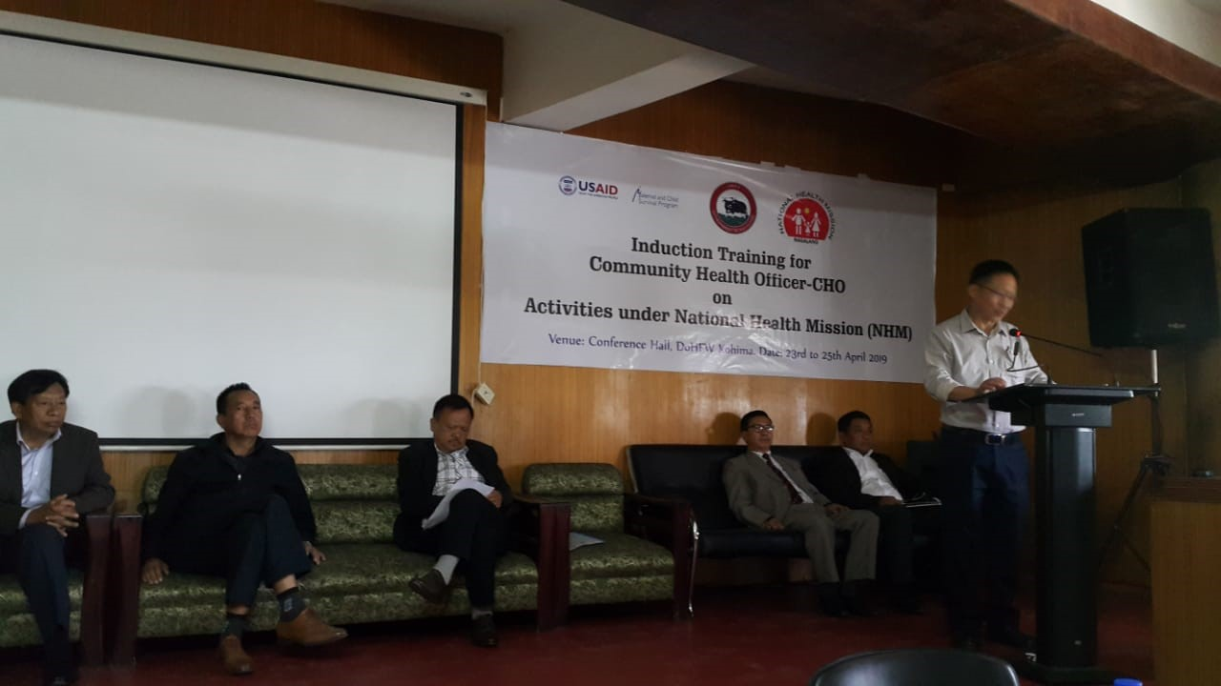
Regular Joint Supportive Supervision with State team and Jhpiego
Some of the key finding results to key implementation-
  Developing CHOS weekly Schedule
  3 days induction training for CHOs on various national Vertical program
  Ensuring quality of wellness room construction
  Continuous hands on support during the visit
CHOs Weekly Schedule
Principal Director addressing CHOs during 3 days induction training
DAY | 09:00AM- 1:00 PM | 02:00- 4:00 PM
Monday | Regular OPD | ARSH Clinic/Health Promotion activities
Tuesday | Regular OPD | NCD Clinic at HWC
Wednesday | Community Outreach –VHND, Palliative care, CBAC-NCD camp, Immunization day, School Health, Health Promotion activities, NHM Vertical Program activities etc.
Thursday | OPD- Special focus on High Risk ANC/PNC and follow up | Home visit
Friday | Regular OPD | Review & Coordination meeting
Saturday | Wellness activity

Slide 16
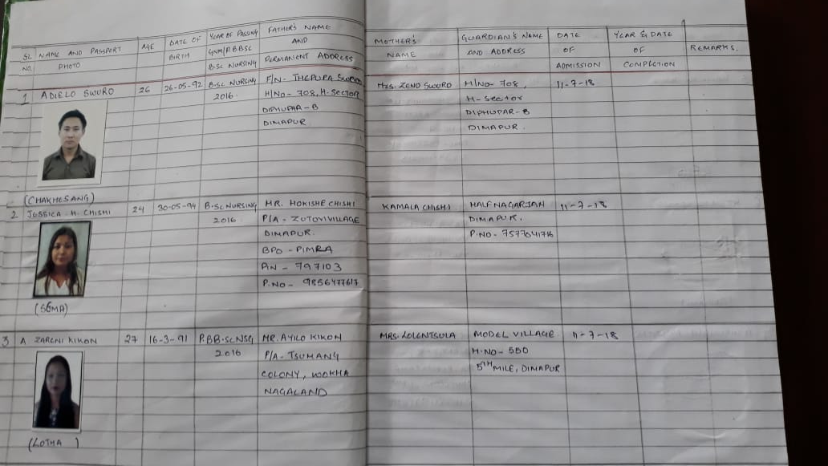
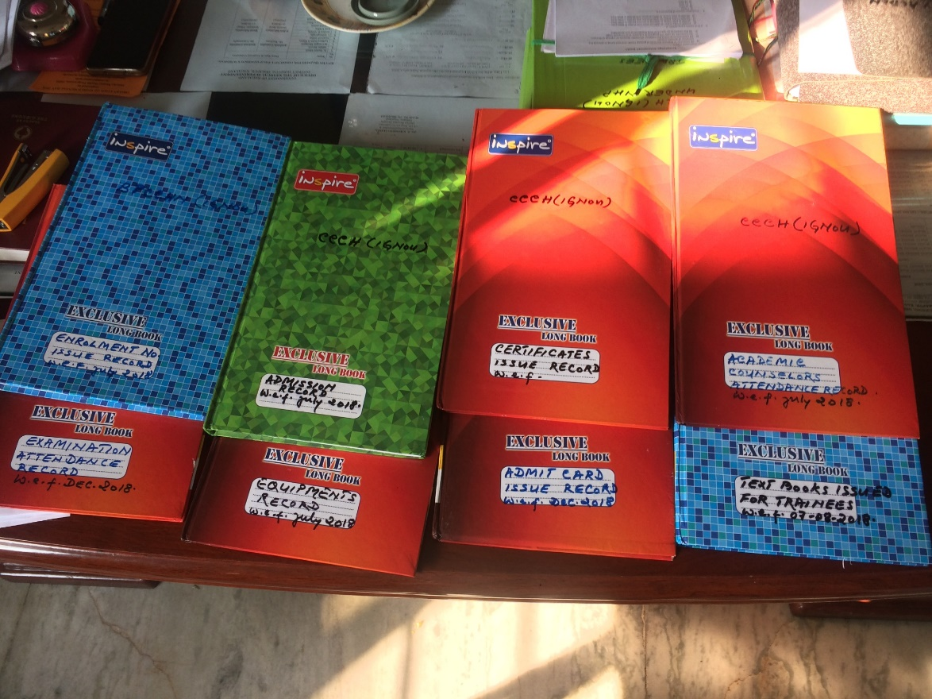
Certificate Course
Capacity: 30 each in each batch
  ToT are conducted for counsellors before the course begins
  Regular Mentoring Quality Assurance visit ( MQA) and Knowledge assessment Test (KAT) are conducted with technical support from Jhpiego to ensure quality of training
  Till date, we have produce 95 CHOs ( 49 in first batch, 46 pass in second batch, final score card awaited)
  3rd batch classes are going on now (total of 60)
  Master Rotation Plan(MRP,) Clinical Rotation Plan (CRP) are developed and strictly adhere to the schedule
Record neatly maintained at PSC
Number of PSCs
Targeted=2 | Operational=2

Slide 17
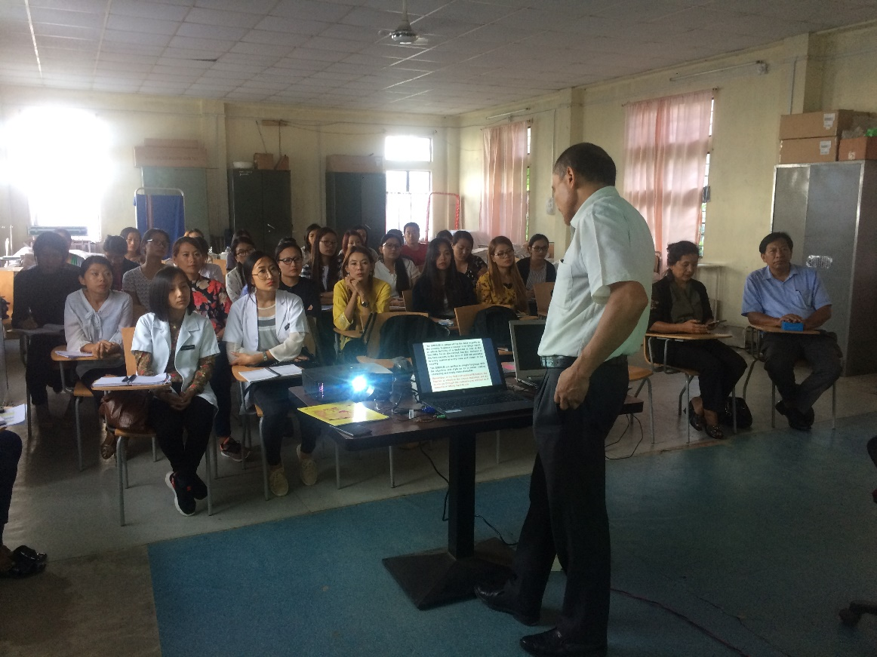
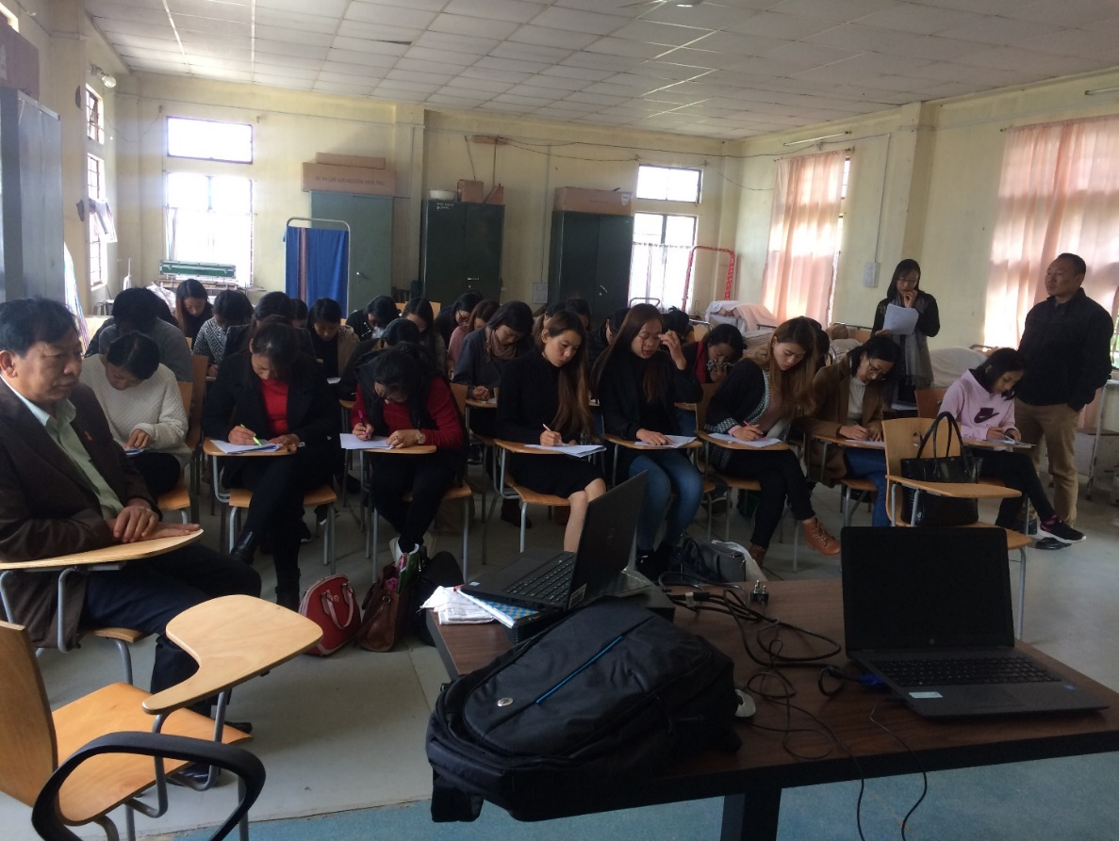
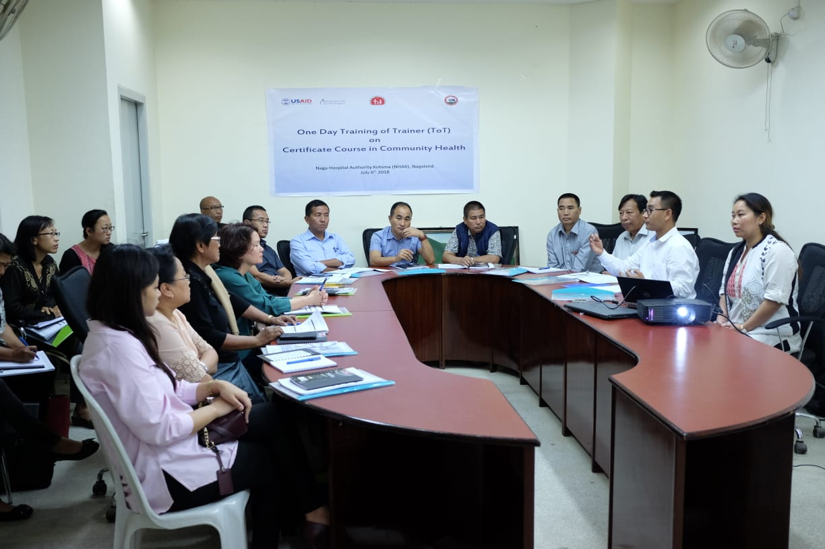
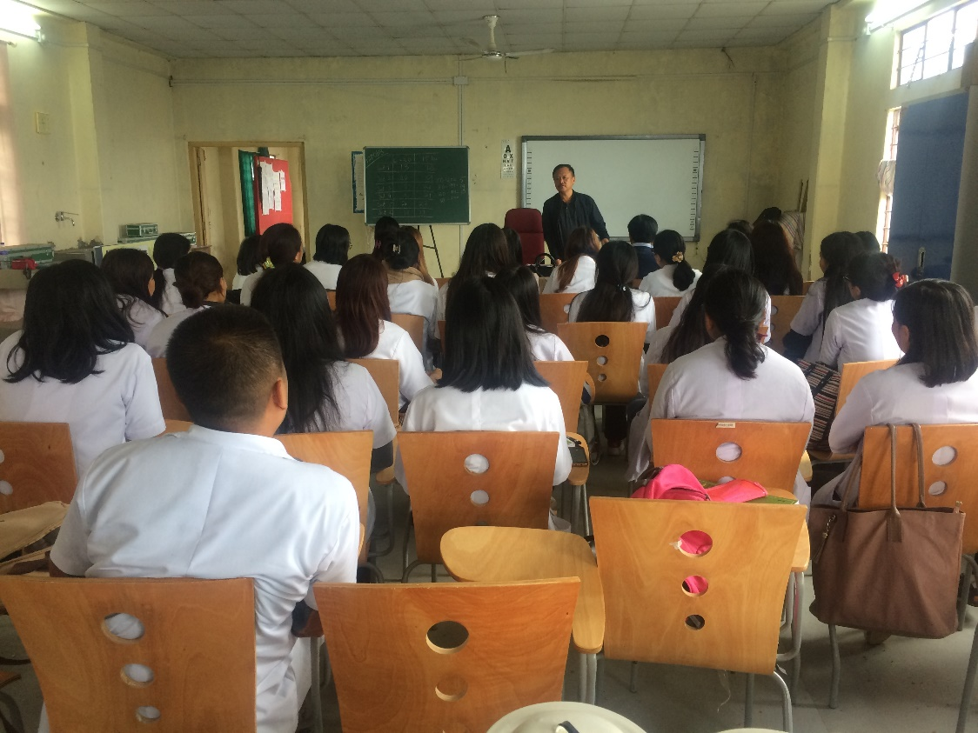
Glimpses at Program Study Center
Conducting Knowledge assessment Test
IGNOU Director orientating the MLHP candidate
ToT training for Counsellor with Jhpiego support
Joint MQA visit-MD-NHM

Slide 18
Delayed in fund transfer from State treasury
Poor Health seeking Behavior
Challenges
Allocation for Infrastructure is less to provide quality Infra in remote areas
Frequent change of VHCs members

Slide 19
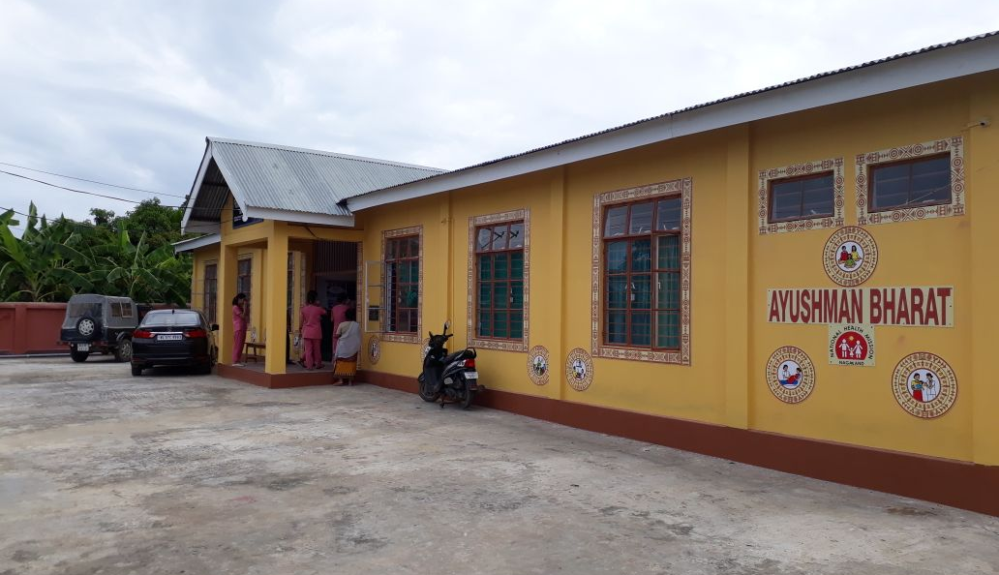
Strong Community Engagement: VHCs constructed HWCs
Thank you!

