Slide 1







Mainstreaming of Induction training package on NHM programs within IGNOU Curriculum
Meghalaya

Slide 2
Major Achievements of Meghalaya under HWCs

Slide 3
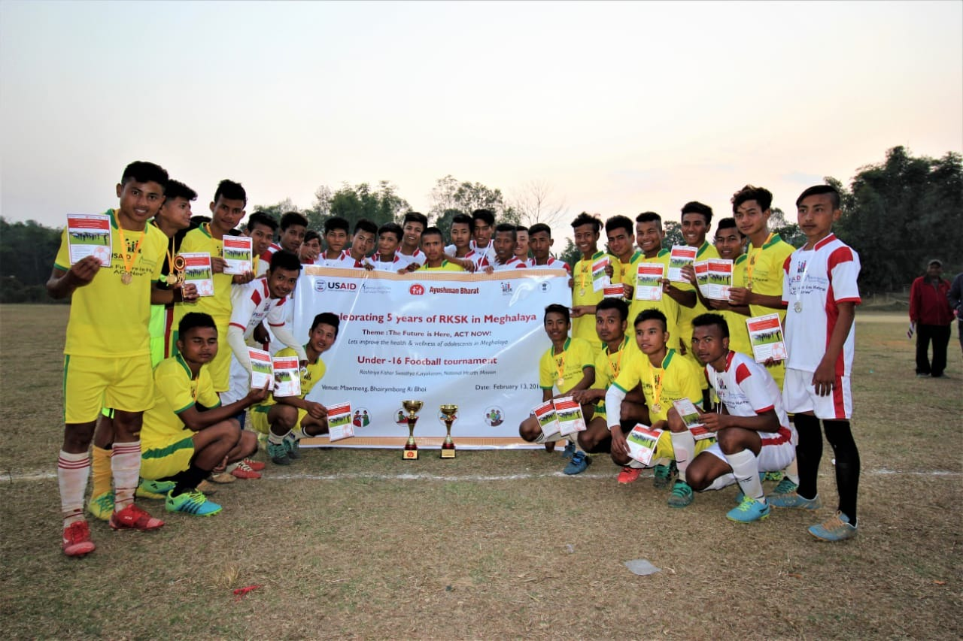
Engaging the adolescents for Improving the Health and Wellness of the people!
The Month long Celebration of five years of RKSK in Meghalaya”
“Future is here, Act Now”
Health Promotion through screening, Sports (Football), Marathon, Yoga etc.

Slide 4
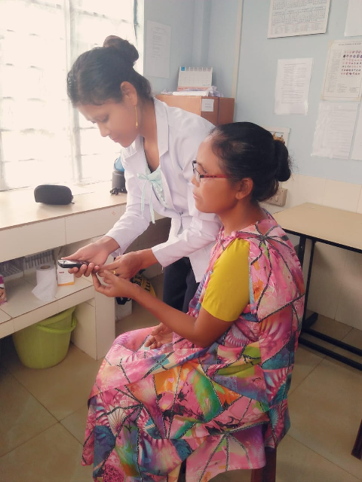
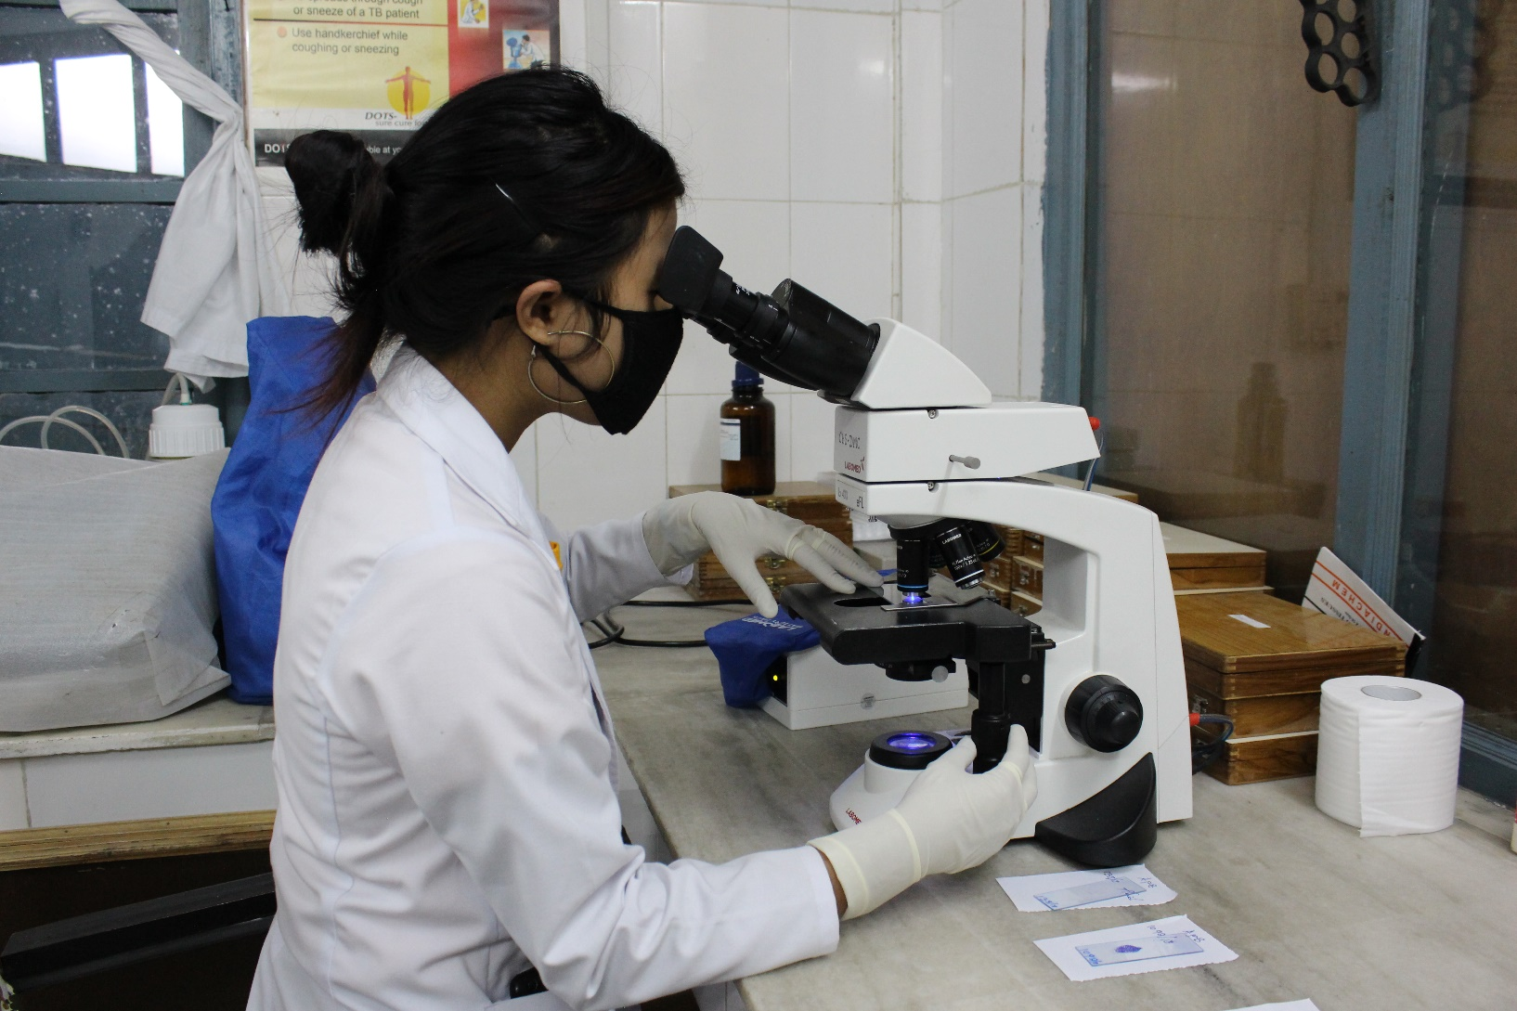
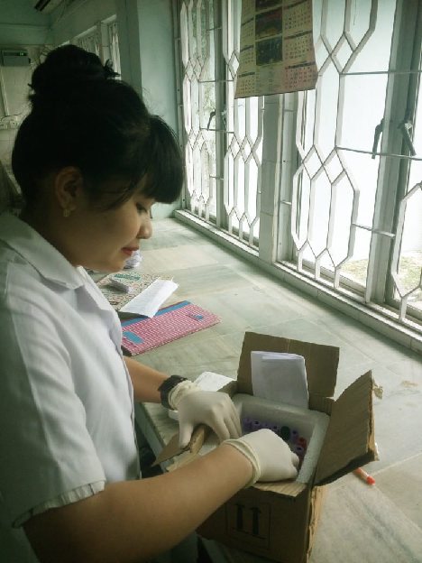
Meghalaya-conducting 51 diagnostic tests at HWCs/PHC along with Special parameter test & Cancers markers through PPP

Slide 5
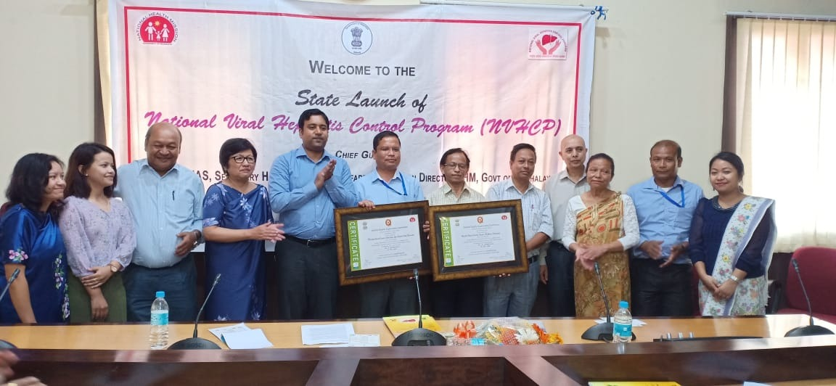
National Quality assurance award
PHC UMDEN-First Health & Wellness center to get NQAS Award

Slide 6
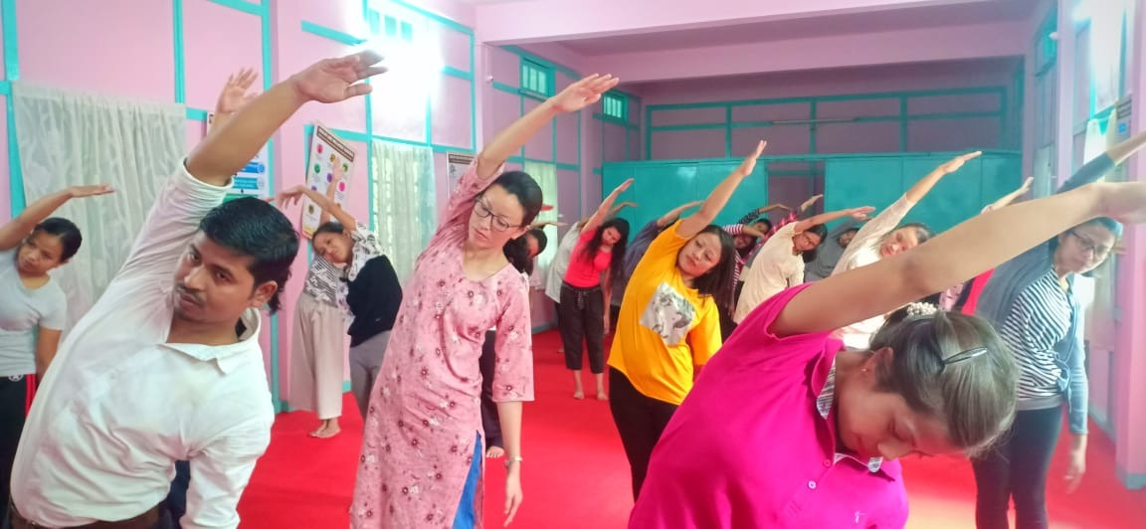
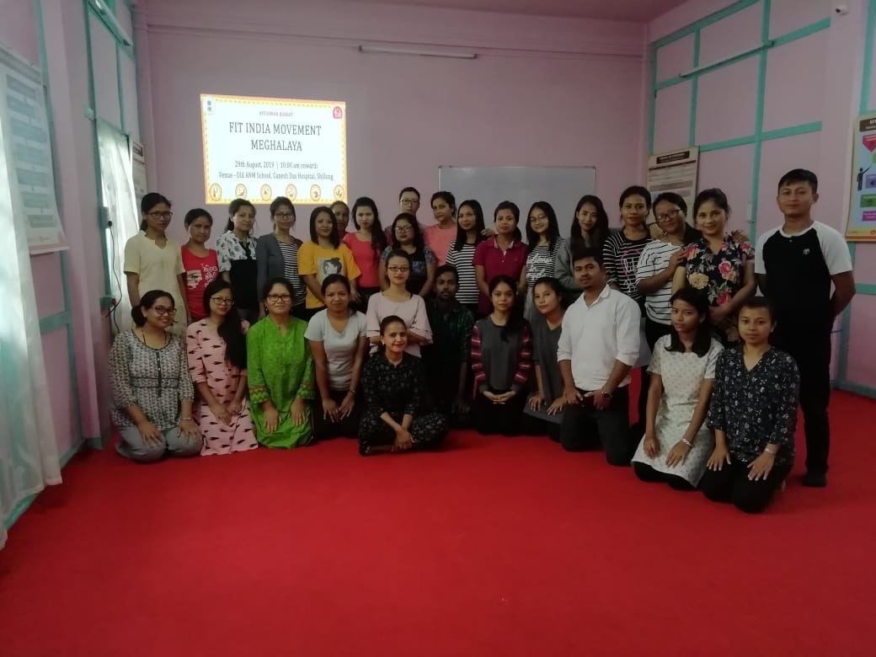
Mainstreaming Basic Yoga skills training in IGNOU Curriculum
Certified Community Health Course

Slide 7
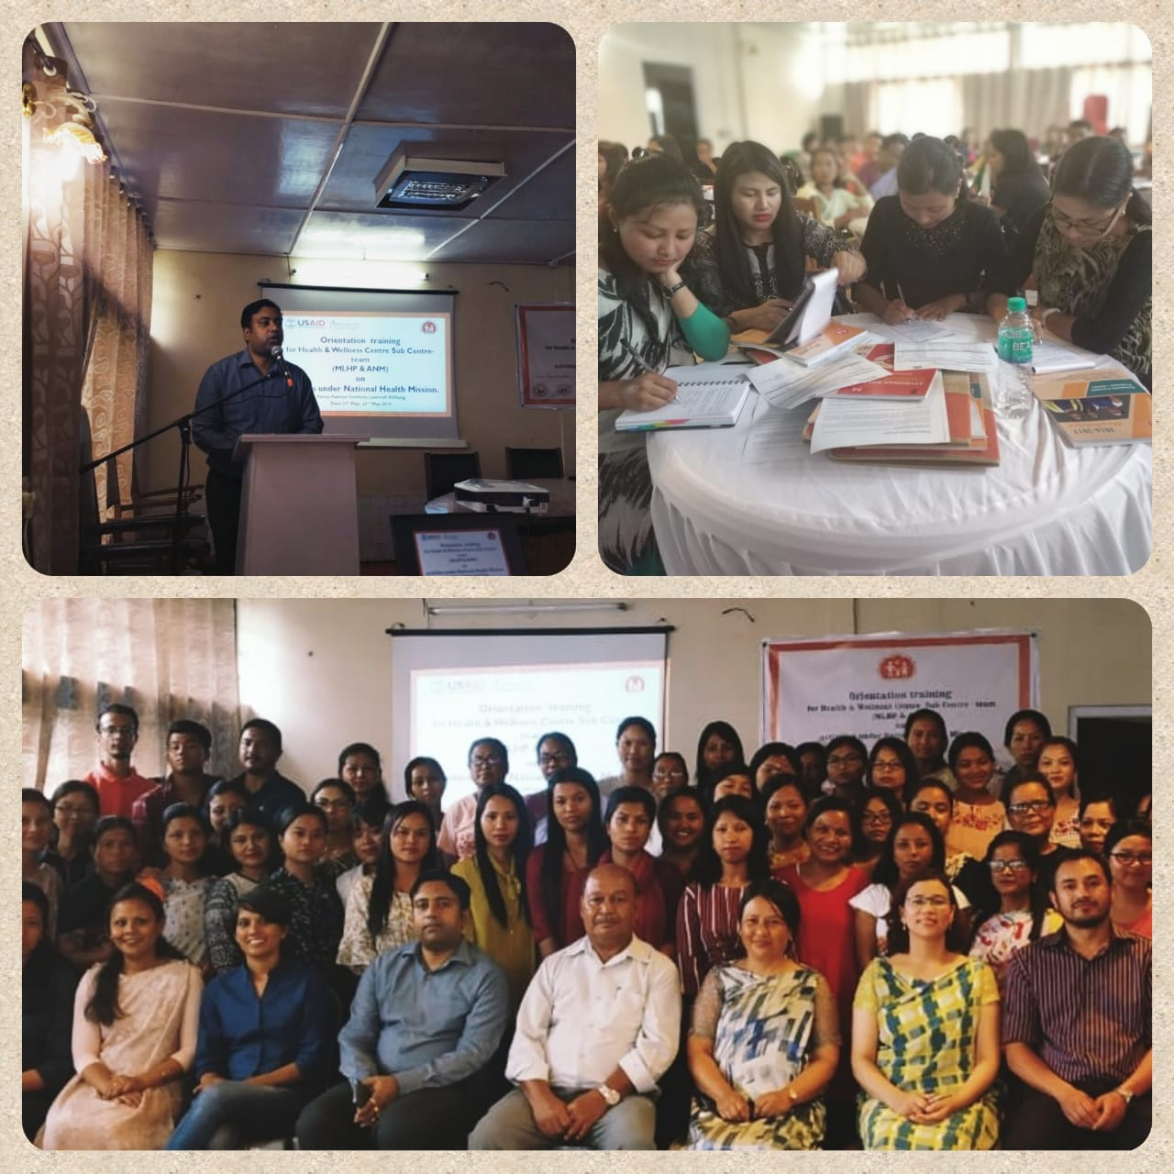
State conducted Induction training for Both ANM & MLHP together

Slide 8
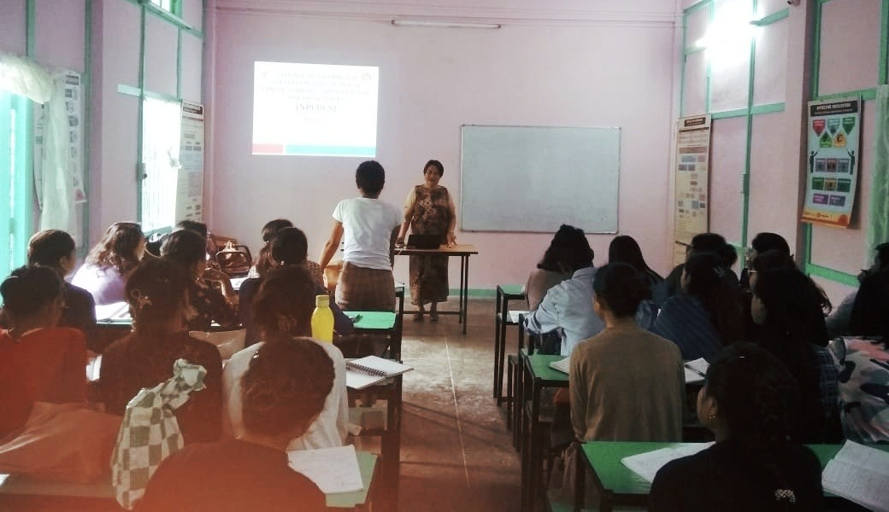
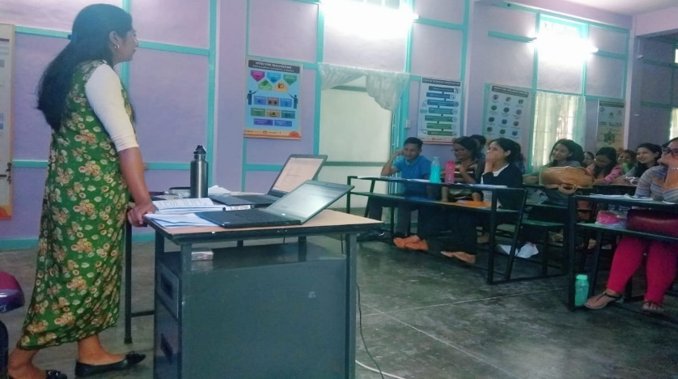
Mainstreaming of Induction training package on NHM programs within IGNOU Curriculum.

Slide 9


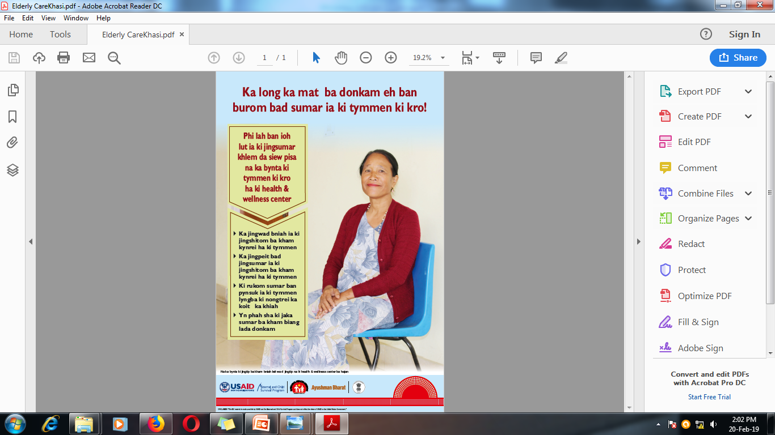
Developed 15 HWC posters in Khasi & Garo Language with Jhpiego support

Slide 10
Mainstreaming of Induction training package on NHM programs within IGNOU Curriculum
Mainstreaming Basic Yoga Skills within IGNOU Curriculum
Certified Community Health Course PSC Meghalaya

Slide 11
Rationale
Six-month Certificate course in ‘Community Health’ prepares CHOs on various aspects of Comprehensive Primary Health Care, however, this curriculum lacs few important components under National Health Mission like HMIS, NQAS & Kayakalp etc. Being a new program & a new role of CHOs, it was a felt need to conduct the induction training

Slide 12
Objectives
To strengthen the capacities of CHO/MLHP on NHM programs.
To orient MLHPs on modalities of CPHC to ensure successful implementation of the Program through induction training.

Slide 13
Process Flow
MLHP, MOIC & Counsellor identified the need to have an Induction training
State took the decision to conduct an Induction training for MLHP
State finalized an induction package (3 days) In consultation with Jhpiego
In CPHC meeting State decided to have a cost effective & sustainable approach in induction training
Conducted 3 days Induction training for MLHP along with ANM
Discussed induction package & Financial norms with Program in charge & RD IGNOU
Package included in IGNOU curriculum
Now the Induction training is part of Certified Community Health Course at PSC
State finalized 6 days packages on NHM program

Slide 14
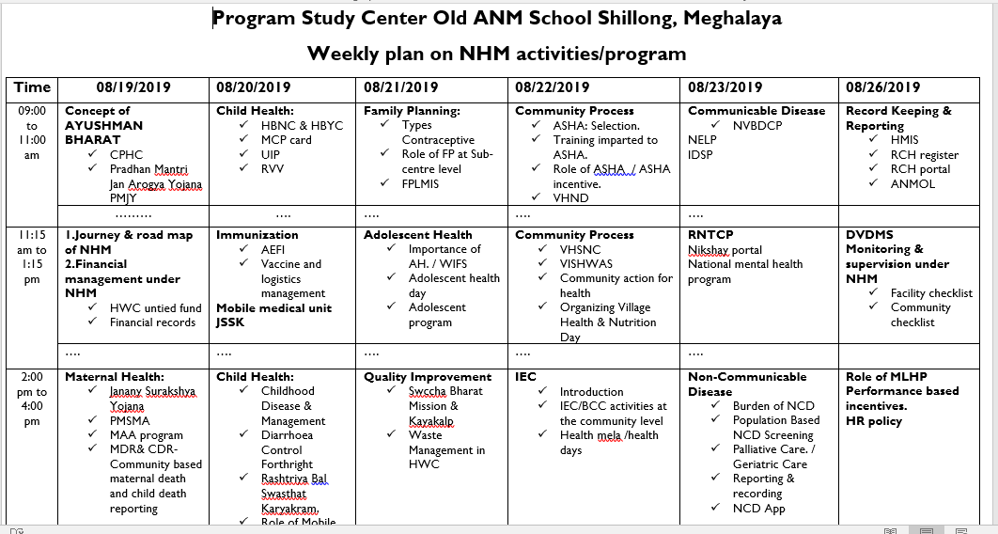

Slide 15
Programme Outcome
This package enabled the enrolled students at Program Study Center to get familiar with
Various concepts of Comprehensive Primary Health Care
Roles and responsibilities in imparting HWC services
Healthcare delivery system and understanding the population needs in Meghalaya before their formal posting at HWCs

Slide 16
Financing Mechanism
Miscellaneous funds approved & sanctioned for the program study center.
RCH norms are followed for the payment of resource person/trainers fees.

Slide 17
Scalability
Previously the induction training was not the part of “Certificate Course in Community Health”, now State has included this package in certificate course itself from Jul 2019 batch.

Slide 18
Glimpse

Slide 19
Mainstreaming Basic Yoga skill training in IGNOU Curriculum
Certified Community Health Course
Rationale- Due to lack of Yoga trainers (Only 2) in the state & at the Sub health Center, there was a felt need for imparting basic yoga training to staff to promote wellness activities at HWCs
Objectives-
To initiate Wellness activities through skilled staff
To streamline the wellness activities at HWCs
Opportunity- 6 Months Certified Community Health course at PSC
Intervention-
In support with Ayush Department, appointed a Yoga instructor at Program Study center.
Duration – 30 days basic Yoga skills
Financial Norms- Miscellaneous funds approved & sanctioned for the program study center.

Slide 20
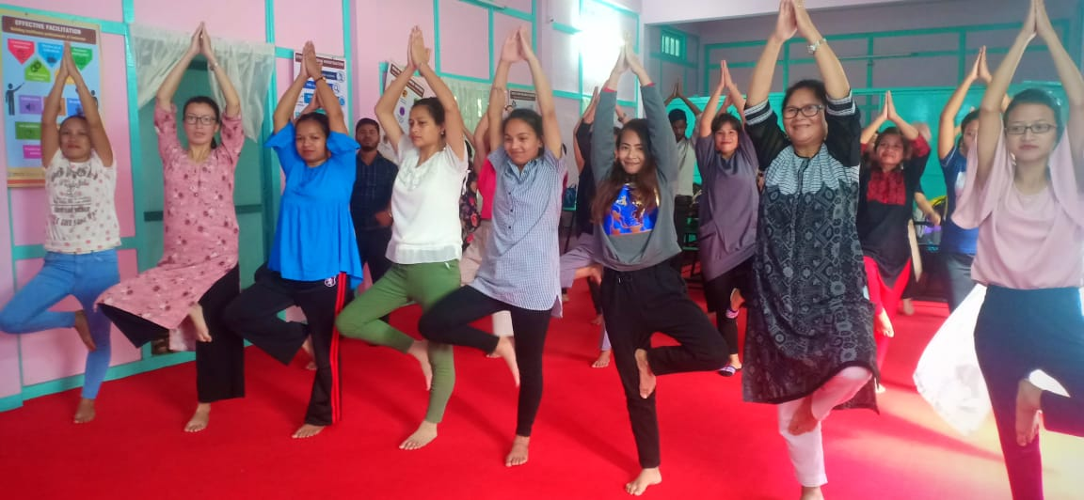
Glimpse

