Slide 1
Regional Review on CPHC
Guwahati
3rd – 4th October 2019
By: V. Vumlunmang, IAS
Principal Secretary, Manipur

Slide 2
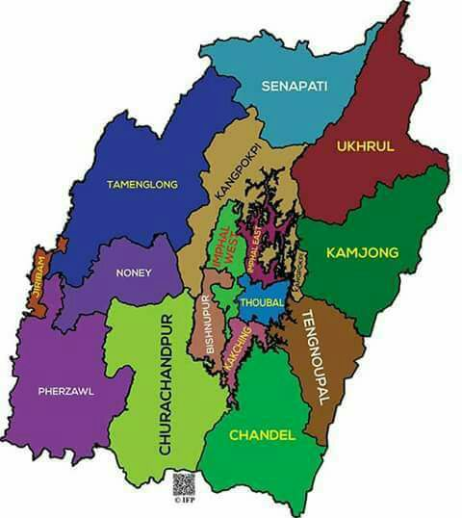
Outline of the presentation
Status of the HWCs
Best Practices
  Traditional Healthy Practice
  Making Communities – a part of HWCs initiative
  Home Based Care of Palliative Services under HWCs
  Regular monitoring, training & hand holding on NCD App
  Sustainable Yoga through community engagement
  Infrastructural layouts
Coverage: CPHC is implemented in all 16 districts from 2nd phase of 2018-19

Slide 3
Progress of HWCs so far..
Technical Partner: USAID MCSP/ Jhpiego

Slide 4
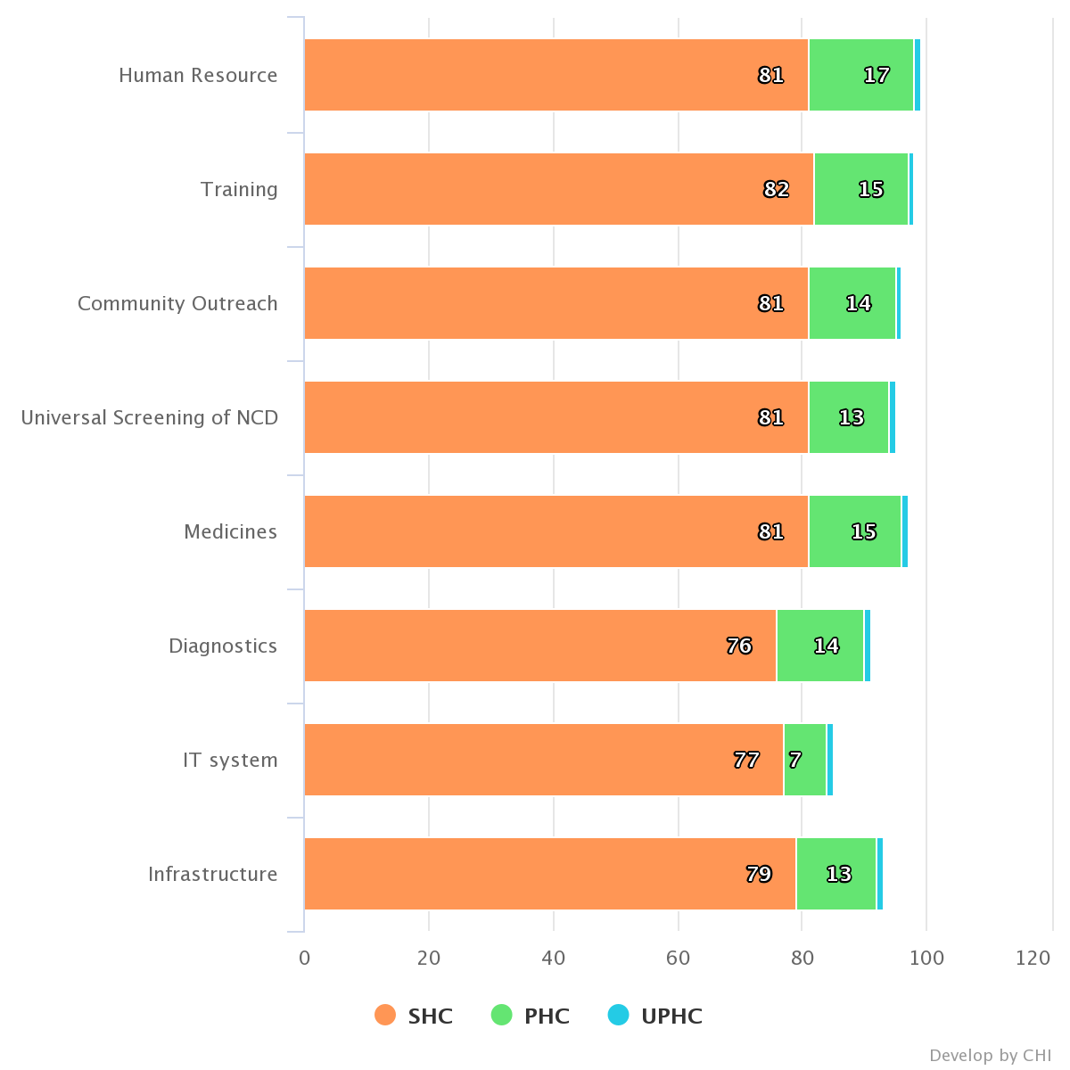
Snapshot from portal
Status of HWC as on 29th Sept 2019: 81
SHC-HWC Operational = 67
PHC-HWC Operational = 13
UPHC-HWC Operational = 1

Slide 5




Additional Services at HWCs
Basic Oral Health Hygiene through Monthly Dental surgeon visits in HWC of four districts – IW ,Thoubal ,Chandel and Ccpur
ENT and Eye services available in camp mode at HWCs
Seven compulsory packages (RMNCHA+, Communicable and NCDs) are available in all HWCs
Mental Health Screening in Thoubal HWCs
Home Based Elderly and palliative Care services

Slide 6
TRADITIONAL HEALTHY PRACTICE

Slide 7
Cultural and Traditional Practice
When women is in her 6-8th month of pregnancy, family members, friends and relatives start organizing schedules for inviting her to their homes for special lunch or dinner. During such gatherings a first time would be mother is advised or taught on child birth lessons, what to expect, what signs to be checked for or inform elders for a delivery etc.
Mandatory initiation of breastfeeding within 1 hour(Colostrum)
In Meitei community, locally called ritual named “Chak Umba” where infant is not given any form of semi solid food, water etc. till 6 months
Very good practice of exclusive breastfeeding (73.6%- NFHS 4)

Slide 8
Contd…
Keeping the baby warmth through local practice of wrapping the infants and holding the infant either in the back or by the chest
Diet rich in high protein/Iron intake by the community across state. Fish “Ngamu” (Scientific Name: “Channa Gachua” with vegetable diet (“Yendem – (Colocasia)” - highly rich in Iron) in valley areas and high consumption of meat in the hill districts). Trunk of banana tree and “Chakwai” also consumed locally to enhance breast milk production
Deliveries are generally conducted by skilled birth attendants only. Even if the institutional delivery is reported 69.1% (NFHS 4). Private institutions in the valley districts also contributes high institutional deliveries.

Slide 9
Demography and HR Ratio:
Region | Area (Sq. Km.) | No. of Districts | Population (2011 census) in lacs | Density of population | % of Rural Population
Hill | 20089 | 5(10) | 12.22 | 61 | 92.7
Valley | 2238 | 4(6) | 16.34 | 730 | 54.4
Total | 22327 | 9(16) | 28.56 | 128 | 70.8
Indicators | Status | National Average | Remarks
Doctor Population Ratio | 1:1135 | 1:1596 | 1 per 921 with AYUSH Doctors/MCI
Nurse Population Ratio | 1:250 | 1:475 | Medical Directorate/State Nursing Registry
Bed Population Ratio | 1:747 | 1:1110 | Excluding PHC beds (AHPI)

Slide 10
Trend of IMR (NFHS & SRS)

Slide 11
Making Communities – a part of HWCs initiative

Slide 12
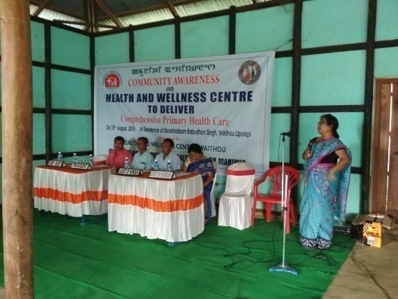
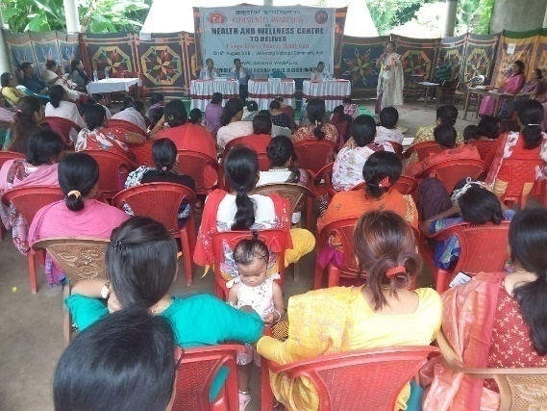
Enhanced Community Participation
Key challenges faced
A new intervention – Health & Wellness Centre
Limited awareness about additional services in community through HWCs
Perceived MCH centric care at SCs
Limited community ownership
Solutions Devised
Community Awareness Program in Manipur
Conduct community awareness program at every SC-HWCs before inauguration through newly posted CHOs
Engaging village chiefs and local PRI members
Held under every identified SHC-HWCs through the newly posted CHOs
Conducted before the inauguration or launching of the HWCs
Informed about the program and services which are to be rendered under HWCs
Gathering ranges from 30-80 people

Slide 13
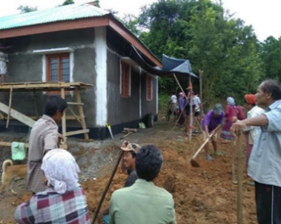
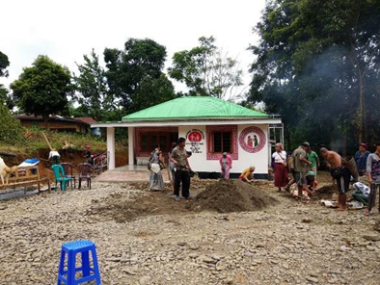
Results
Platform helps in team building and communication with the community –
Creates the responsibility among the villagers and help them in taking ownership of the HWCs.
Helps in monitoring of the ongoing infrastructural development works – feedback given to concerned Mo/c, CMO of the district for status, help in organizing inauguration program also
Ensured timely completion & operationalization of the facilities
Increase in availing health care - regular check-up increases epecially on NCDs
Scale up in 2nd phase too with fund from IEC activities
The villagers or the workers under NREGA conduct social service

Slide 14
Home Based Care of Palliative Services under HWCs

Slide 15
Stakeholders
Palliative care at HWCs
Karunashraya bangalore & NIMHANS
Palliative care Society,
Imphal
RIMS palliative Unit
IPM calicut
RIMS Palliative unit
Home based Model through HWCs
DH palliative ward (10 bedded)

Slide 16
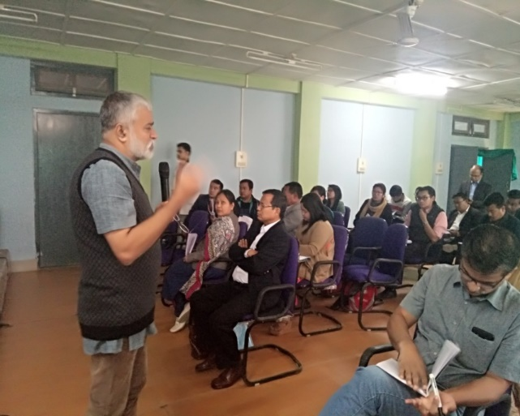
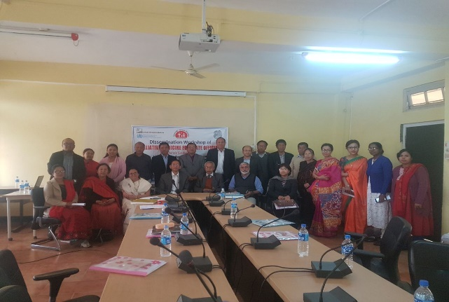
TRAINING & DISSEMINATION
Foundation Course In Palliative Medicine for 96 Medical Officers and specialist Doctors done under the aegies of WHO collaborating Institute -Institute of Palliative medicine Calicut at SAT and RIMS in 16-25 February 2018 and 28 jan –1st Feb 2019
Foundation Course in Palliative care : For 27 Community Health officers ,50 Staff Nurse , 28 ANM . Physiotherapist and Counsellors held simultaneously

Slide 17
District Wise HWC having home based palliative care

Slide 18
Process for Home Based Palliative Care
FIELD VISIT BY ASHA & ANM
TO FIND OUT PATIENTS WHO NEED HOME BASED PALLIATIVE CARE
CHO PUT UP PROPOSAL TO MO ic & CMO
MO and CMO CONFIRM THE CASE FOR WEEKLY HOME VISIT

Slide 19
DISTRICT WISE Patient (NEW &OLD)
PERIOD | IMPHAL EAST | IMPHAL WEST | THOUBAL | CHANDEL | CCPUR | BPR | KPI | Total
July- Sept 2018 | NIL | 3 | 2 | Nil | Nil | NIl | Nil
Oct- Dec | NIL | 3 | 2 | Nil | Nil | Nil | NIL
Jan- march | 41 | 6 | 8 | Nil | Nil | 12 | NIL
April -June | 41 | 40 | 16 | 27 | 12 | 14 | 03
July-sept | 41 | 40 | 16 | 27 | 22 | 39 | 03
Total | 41 | 40 | 16 | 27 | 22 | 39 | 03 | 188

Slide 20
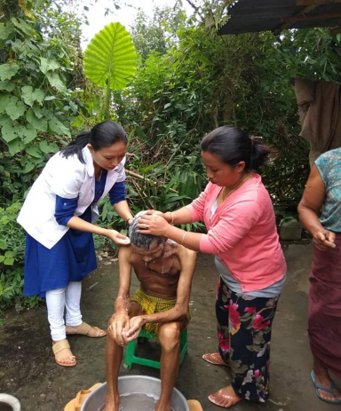
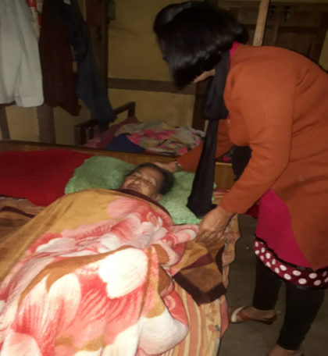
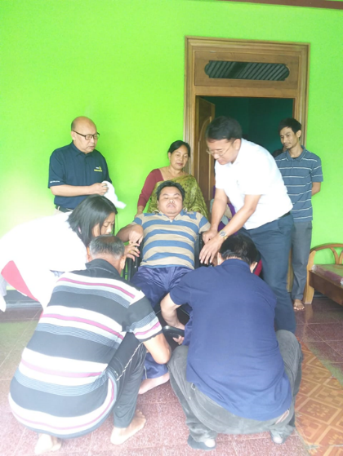
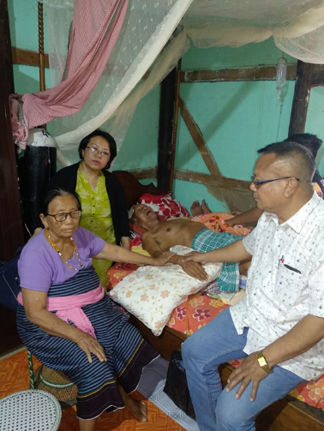
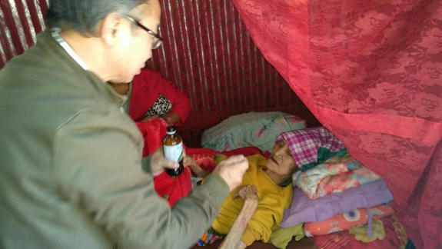

At a Glance - Palliative care
Wheelchair & air mattresses under HWC
With church leaders

Slide 21
Active Enrollment in GoI NCD Dashboard Manipur (till August 2019)
Leveraging CSR support with focus on
  hands-on training
  handholding support
Total Enrolled
101997
Issued - 150 Tab. April 2019
Issued - 3 Tab. July
Issued - 61 Tablets. August 2018
Cumulative - 214 Tab
Cumulative - 211 Tab.
Cumulative - 61
Direct Handholding support at the Facility level (MOs,CHOs and ANMs for data enrolment and enrolment camp )

Slide 22
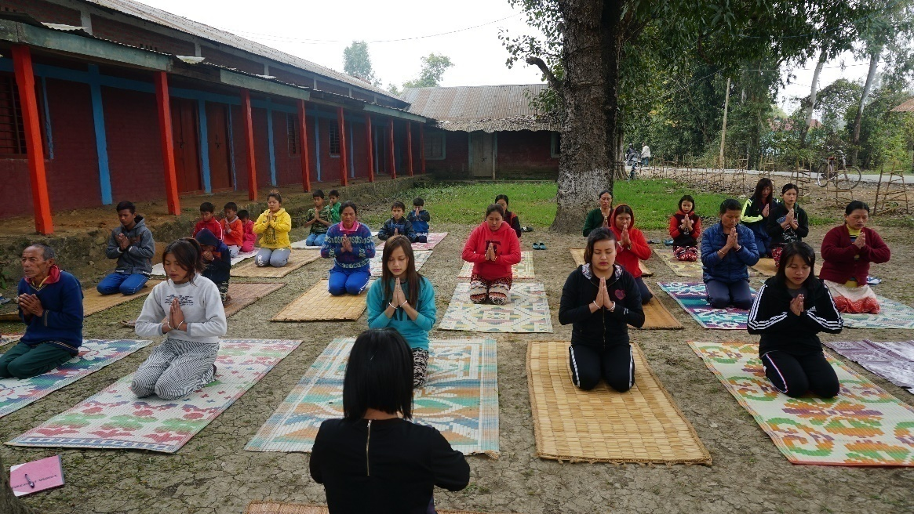
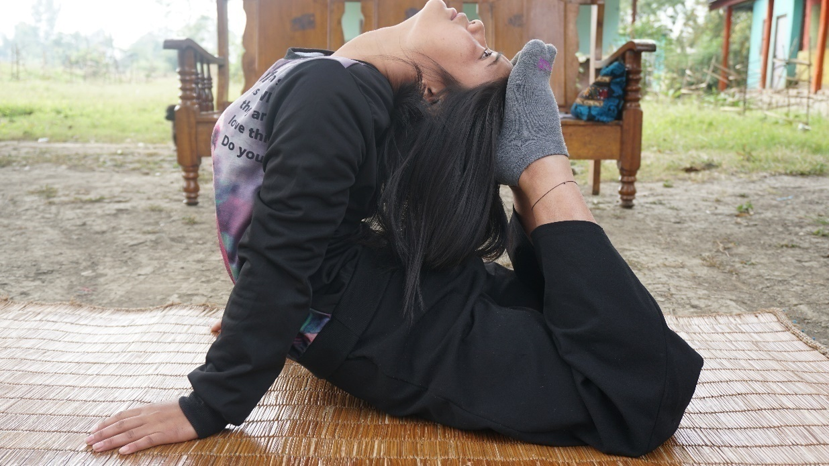
Sustainable Yoga through Community Engagement
Key challenges faced
Limited knowledge and expertise of Yoga at local level
Limited availability of Yoga trainers and instructors
Lack of knowledge about benefits of Yoga in the community
Solutions Devised
Training of Yoga to local community person
Identification of staff for regular capacity building on Yoga for 2 - 3 months
Posting of trained Yoga instructor in HWCs on rotational basis
Identify local people in the community for their training and capacity building on Yoga
Local trained people to continue Yoga in community on sustainable basis
Output: 42 HWCs across 6 districts (CDL, CCP, BPR, TBL, IE, IW) sustaining Yoga activities

Slide 23
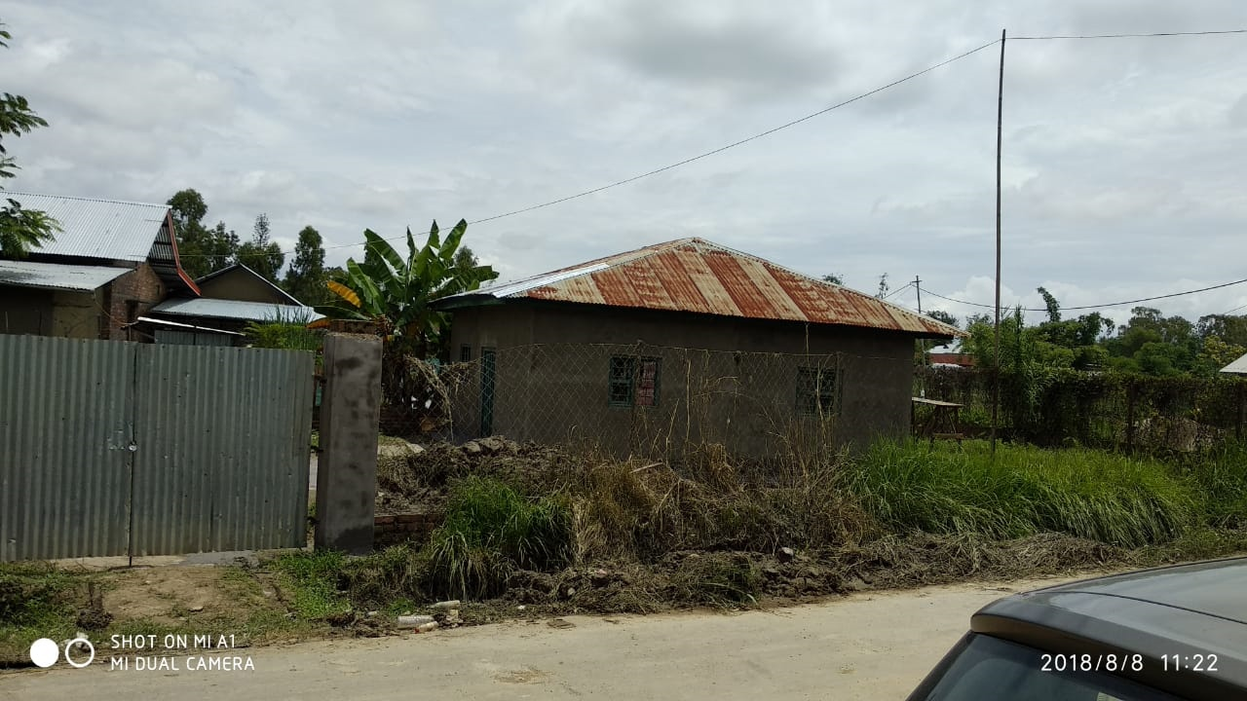
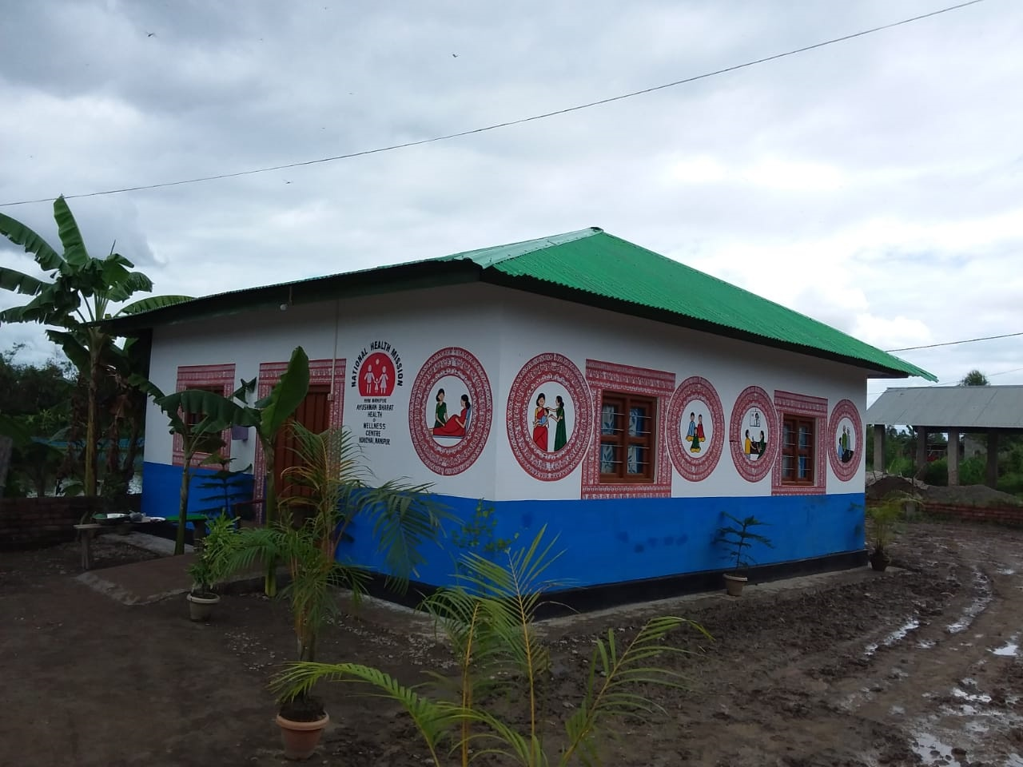
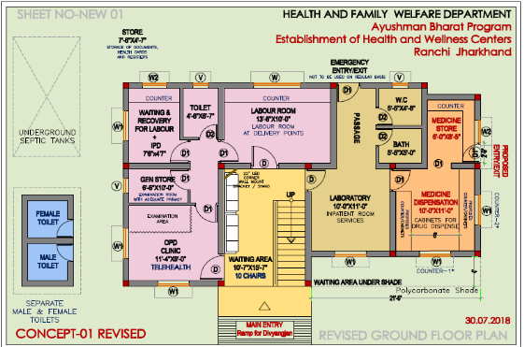
Infrastructural Layouts – Manipur
Before Upgradation
After Upgraded to HWC
Layout for HWCs

Slide 24
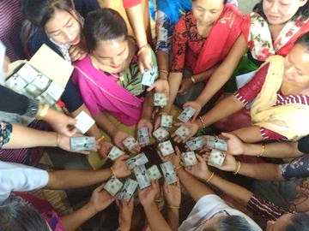
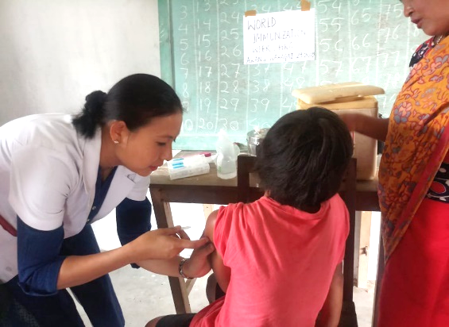
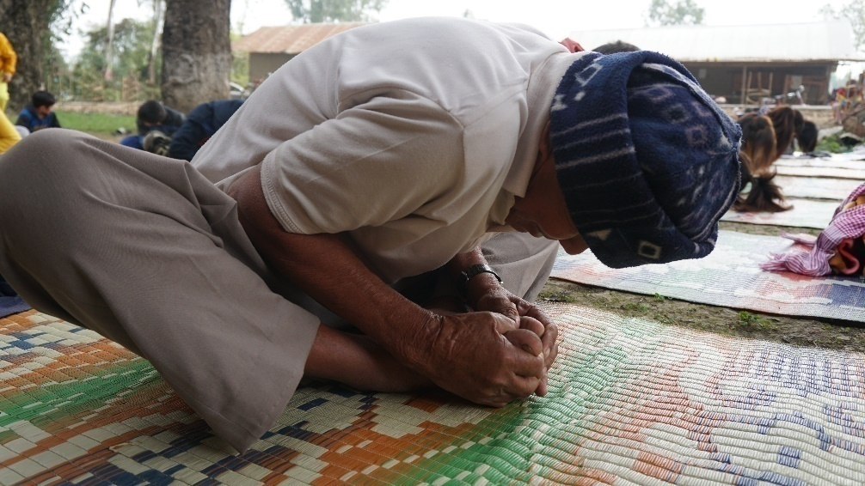
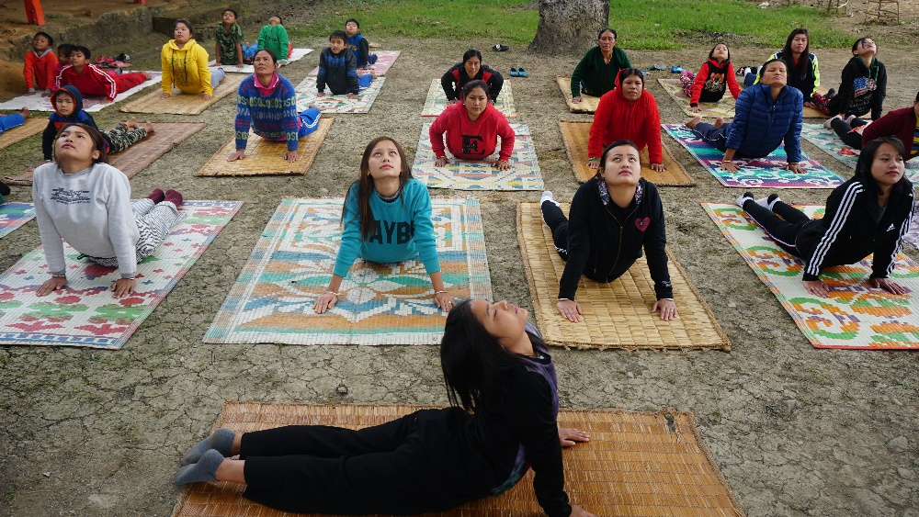
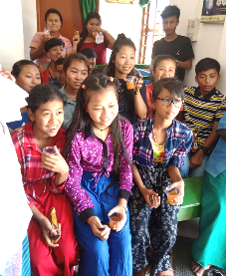
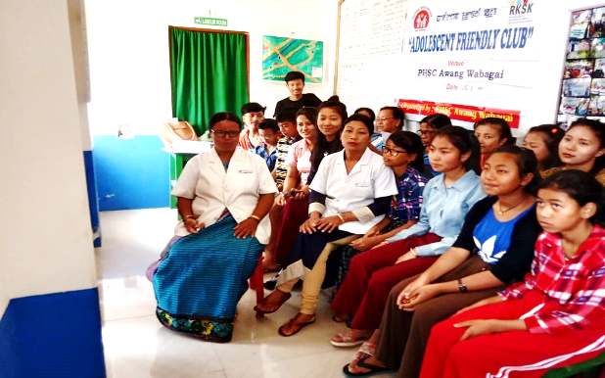
Celebration of Prevention and Promotion Activities
World Population Day in Manipur
Immunization Week in Manipur
Yoga Activities
Yoga as Wellness Activity
Adolescent Friendly Clubs in Manipur

Slide 25
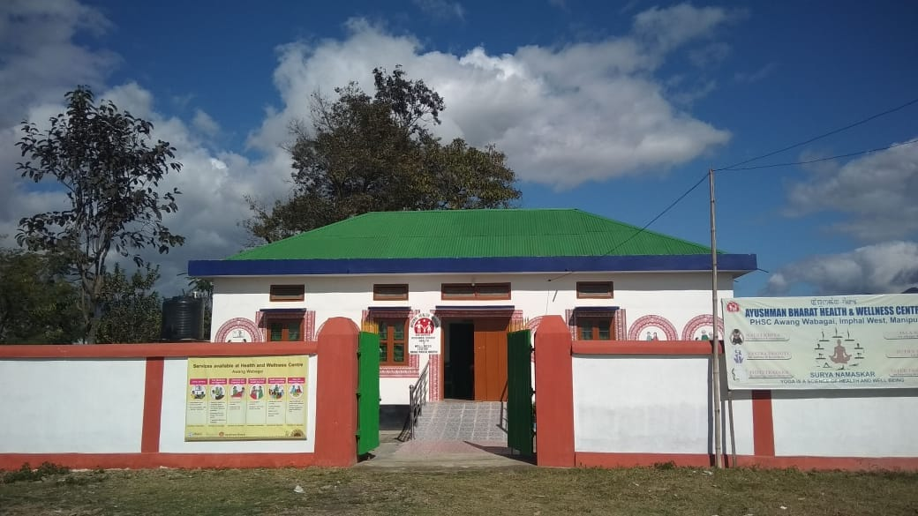
Thank You

Slide 26
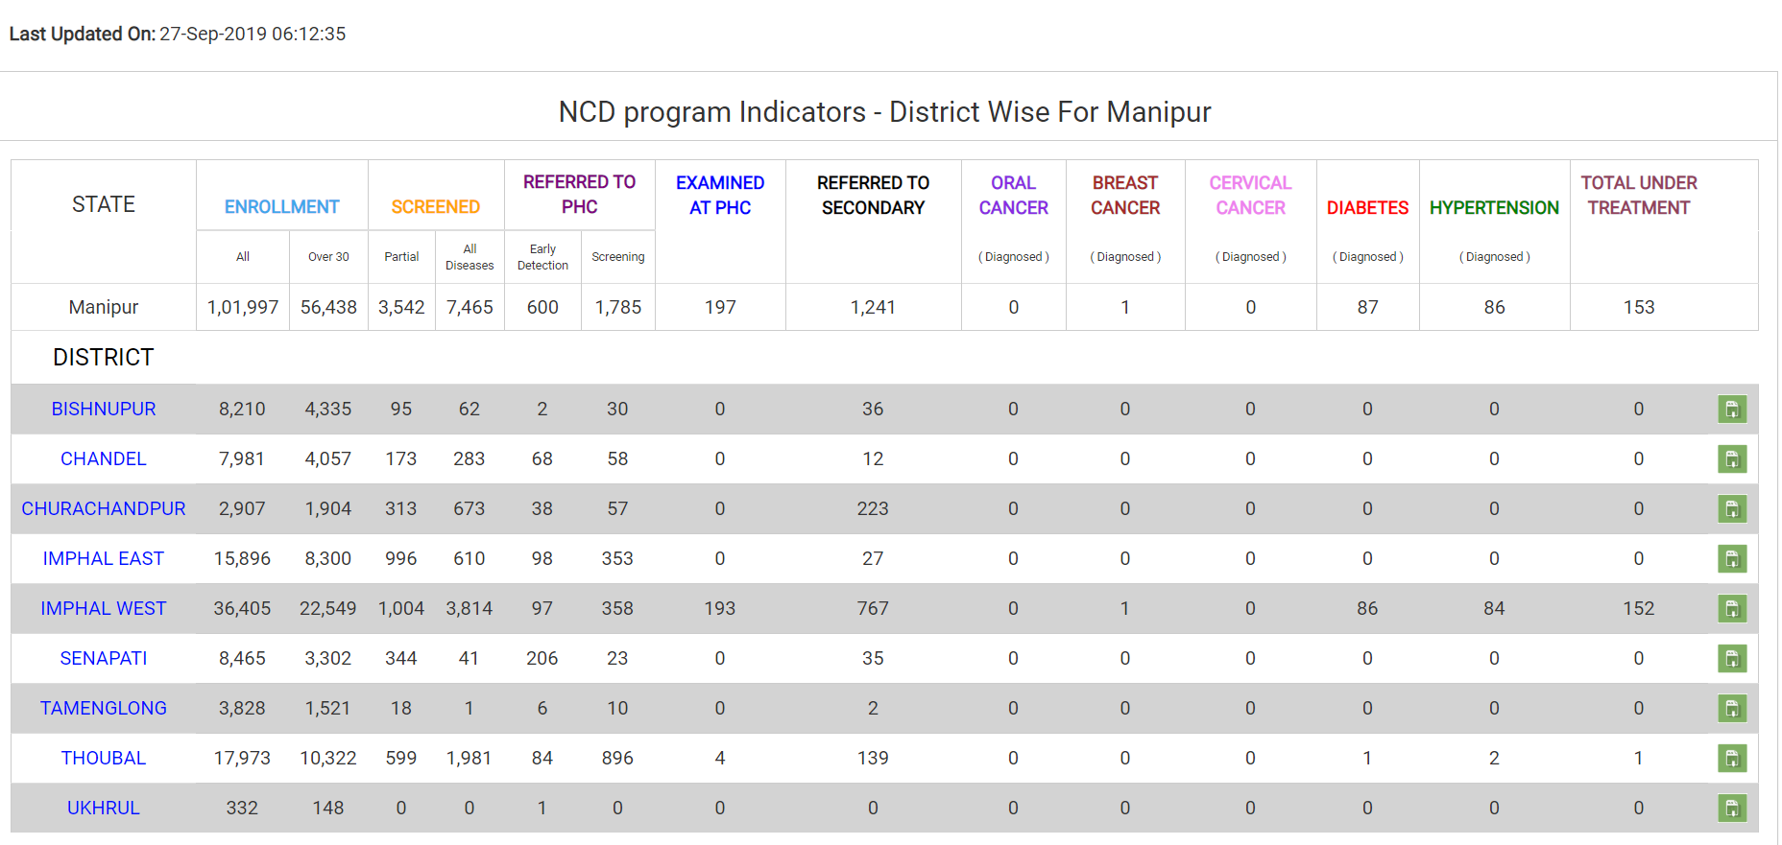
NCD App Portal Data as 27th September 2019

