Slide 1






Ayushman bharat – health and wellness centres
Regional Workshop , GUWAHATI, assam 3rd – 4th October 2019

Slide 2
Ayushman Bharat – Health and Wellness Centres a Platform to integrate service delivery – provide comprehensive care
Preventive and Promotive
Comprehensive Primary Health Care – Oral, Mental, Geriatric etc.
Moving towards Universal Health Coverage
RMNCHA+N
Communicable Diseases
Non Communicable Diseases
Notes:
RMNCHA +N

Slide 3
Universal Health Coverage
PMJAY empanelled Public & Private Healthcare facilities
CHCs/SDHs/District Hospitals/Medical Colleges
TERTIARY
SECONDARY
Referral/Return
Gatekeeping
PRIMARY
Preventive, Promotive, Curative, Rehabilitative & Palliative Care
CPHC through AB-HWCs
Unmet needs: NCDs/other Chronic Diseases
Existing services: RMNCH+A
CONTINUUM OF CARE

Slide 4

AB-HWC Regional Workshops
  4 Regional Workshops conducted in :
  6th – 7th August : Hyderabad, Telangana
  19th – 20th : Panjim , Goa
  5th – 6th September : Amritsar, Punjab
  3th – 4th : Guwahati , Assam

Slide 5
AB-HWCs - What has changed?
Up to an extent only!!!
Improved infrastructure including branding
Human Resources
Strengthening of existing services – RMNCHA+N
Availability of essential medicines
Availability of essential diagnostic services
Population Based Screening for 30+ (NCD – diabetes/hypertension, 3 Common Cancers)
Emergence of IT – AB-HWC portal and NCD Application
Wellness activity – YOGA and others

Slide 6
Field findings suggest
We need to move away from Adhocism to
Comprehensive thinking & planning…
Request to have a Vision Document on it…

Slide 7
Vision Document for AB-HWCs by December 2019
Assigning population to the AB-HWCs
Mapping for Bidirectional referral and return
Continuum of Care
Human Resource for Health as per IPHS
Infrastructure strengthening
Ensuring availability of Free Essential Drugs & Strengthening of DVDMS
Expansion of essential Diagnostic services
Wellness Activities
Expanded package of services
Financial planning – NHP 2017 (2/3rd allocation to Primary Care)

Slide 8
Assigning Population to AB-HWCs
Rural areas:
  Area under the SHCs which are upgraded as AB-HWCs.
  As first port of call, Entire Service area of PHC for referred cases from SHC level AB-HWCs
Urban areas:
  Demarcation and mapping of area under urban AB-HWCs to be done on the basis of Ward (with a special focus on slum areas) and to be followed by enumeration of population.

Slide 9
Enrolment / Family Folder / Health Diary
Every household to be linked to the nearest AB-HWC and Family folders created for each HH.
This folder will have
      demographic,
      socio-economic information and
      information about chronic diseases: TB, leprosy, diabetes, epilepsy, hypertension, COPD, cancers, heart ailments, HIV/AIDS, disabilities, inherited blood disorders, SAM children, etc.
In addition to the family folder, each member to be issued a health diary which will be used to update treatment given at the AB-HWC.

Slide 10
Enrolment Process of Households & Updation
Registration by ASHAs with support of the AB-HWC team.
  Other Modalities to be explored for Urban Areas
IT enabled Patient Unique Health Identifier will be created for each member of Household with a provision for Family Folders.
SECC database / PDS / Electoral Roll data base or any other database which is largely representative of the population can be used as the base database.
The missing HHs can be additionally added by the AB-HWC team/ASHA annually to ensure that no HH is left out.
Verification of the data to be done through a survey by AB-HWC team.

Slide 11
Enrolment of Households & Members
Family folder and health diary to be digitalised at the earliest.
Information in each folder to be updated once a year through surveys.
Family folders to be kept at AB-HWCs and health diary will be available with the members of the enrolled HHs.
Non-availability of health diary not be a barrier for seeking treatment.
AB-HWCs should be the first port of call for all OPD treatment for every person seeking care through the public system.
The nearest AB-HWC could be found through by calling toll free telephone number (can be integrated with 104 service) and on Google maps.

Slide 12
Principles of Referral and Return linkages
Mapping of the AB-HWC and all public health facilities (along with the service delivery)
From AB-HWCs, Patients will be referred to the First Referral Unit of the Public Healthcare System i.e. either Community Health Centres/Sub District Hospitals/District Hospitals (CHCs / SDHs / DHs)
Specialists / Doctors at CHCs / DHs will refer the patients to either Public Healthcare Services or PMJAY empanelled Hospitals for Secondary / Tertiary level.
Sharing of patients’ information on discharge from AB-PMJAY empanelled hospitals with CMHOs
Individuals discharged from AB-PMJAY services will approach DHs / CMHOs for getting continuous (Rehabilitative or palliative) treatment from appropriate AB-HWCs.

Slide 13
AB-HWC Conditionality
State | Total facilities (NUHM + RHS 2018) | Approvals Accorded Till date | FUNCTIONAL HWC as on 17.09.19 |  |  | 25% of Total facilities | TOTAL AB-HWC FUNCTIONAL as on 03.10.19
 |  |  | SHC | PHC | UPHC
Tripura | 1027 | 485 | 40 | 26 | 5 | 257 | 71
West Bengal | 10816 | 3230 | 143 | 256 | 0 | 2704 | 399
Meghalaya | 462 | 113 | 29 | 9 | 1 | 116 | 40
Nagaland | 401 | 327 | 49 | 2 | 3 | 100 | 54
Arunachal Pradesh | 316 | 222 | 34 | 34 | 4 | 79 | 77
Manipur | 438 | 352 | 57 | 6 | 1 | 109 | 81
Assam | 4683 | 1720 | 628 | 252 | 49 | 1171 | 926
Sikkim | 153 | 20 | 22 | 8 | 0 | 38 | 20
Mizoram | 378 | 198 | 0 | 2 | 2 | 95 | 4

Slide 14
Addressing the HR Gaps : Community Health Officers
Sr. No. | States | Number of SHCs approved for 2018-20 | Total CHO available | DEFICIT CHO based on Total SHCs approvals | Induction training completed
1 | Arunachal Pradesh | 130 | 135 | NIL | No
2 | Assam | 1233 | 1047 | 186 | Yes
3 | Manipur | 220 | 177 | 43 | No
4 | Meghalaya | 132 | 172 | NIL | Yes
5 | Mizoram | 120 | 57 | 63 | No
6 | Nagaland | 152 | 145 | 7 | No
7 | Sikkim | 60 | 101 | NIL | Yes
8 | Tripura | 332 | 291 | 41 | Yes

Slide 15
Key Issues for Community Health Officers
  Role & Responsibilities of CHO – work distribution (including community out-reach, not just VHND)
  Local recruitment and placement of CHOs – preference postings
  Constant Supportive Monitoring and Mentoring
  Induction module for CHOs
  Performance Linked Payments for Primary Healthcare Team
  Career pathway
  GNM – SN ; 6 month training would be required
  What bothers:
    Regular vs Contractual
    Prescription by CHOs?
    Referral to private practitioners – consultations / medical prescriptions / diagnostics – to be curtailed at the Start!

Slide 16
Medical Officers at PHCs – Status
RHS 2018
State/UT | (As on 31st March, 2017) |  | (As on 31st March, 2018)
 | Required | Shortfall | Required | Shortfall
Arunachal Pradesh | 143 | 21 | 143 | 18
Assam | 1014 | * | 946 | *
Manipur | 85 | * | 91 | *
Meghalaya | 109 | * | 108 | *
Mizoram | 57 | 1 | 57 | *
Nagaland | 126 | 4 | 126 | 8
Sikkim | 24 | * | 24 | 0
Tripura | 93 | * | 108 | *
West Bengal | 914 | * | 913 | *

Slide 17
Addressing the Infrastructure Gaps
Data Source: RHS 2018
State/UT | Number of SHCs |  |  | Number of PHCs
 | Total Facilities | % Without Water supply | % Without electricity | Total Facilities | % Without Water supply | % Without electricity
Arunachal Pradesh | 312 | 42.9 | 46.2 | 143 | 16.8 | 10.5
Assam | 4644 | 11.8 | 56.8 | 946 | 2.2 | 1.5
Manipur | 429 | 79.7 | 46.2 | 91 | 42.9 | 12.1
Meghalaya | 443 | 59.8 | 36.8 | 108 | 13.9 | 0.0
Mizoram | 370 | 62.2 | 0 | 57 | 17.5 | 3.5
Nagaland | 396 | 54 | 39.6 | 126 | 44.4 | 11.9
Sikkim | 147 | 10.2 | 0.7 | 24 | 0.0 | 0.0
Tripura | 1020 | 35.2 | 30.7 | 108 | 15.7 | 0.0
West Bengal | 10357 | 6.6 | 22.1 | 913 | 2.3 | 4.8

Slide 18
Building Position of Sub Centres
Data Source RHS 2018
State | Total Number of Sub Centers functioning | Sub-Centres functioning in |  |  | Buildings Under Construction | Buildings required to be constructed
 |  | Govt. Buildings | Rented Buildings | Rent Free Panchayat / Vol. Society Buildings
Arunachal Pradesh | 312 | 312 | 0 | 0 | 0 | 0
Assam | 4644 | 3916 | 683 | 45 | 603 | 125
Manipur | 429 | 358 | 71 | 0 | 98 | *
Meghalaya | 443 | 435 | 1 | 7 | 2 | 6
Mizoram | 370 | 370 | 0 | 0 | 0 | 0
Nagaland | 396 | 334 | 1 | 61 | 2 | 60
Tripura | 1020 | 859 | 38 | 123 | 14 | 147
West Bengal | 10357 | 7482 | 1960 | 915 | 419 | 2456
Sikkim | 147 | 142 | 5 | 0 | 3 | 2

Slide 19
Infrastructure Strengthening
  Gap analysis as per population Norms
  Gap analysis w.r.t essentials of Regular supply of water and electricity
  Construction of additional room & toilets
  Space for medicine dispensing, conducting lab tests, patient waiting areas - draft layout plan has been shared.
  Infrastructure: Revised (7 to 10L for SHCs / 4 to 7L for PHCs / 1 to 2L for UPHCs)
  Resources Mobilization
    MPLADS
    Support from Gram Panchayats / ULBs
    Donors from the Community

Slide 20
Medicine and Diagnostics
  Drugs and Diagnostics foundation for providing primary health care through AB-HWCs! Go ALL-OUT to Strengthen these two.
  Continuous supply of generic medicine at all the facility – buffer stock of at-least 2 months.
  14 diagnostic tests at AB-HWC-SHCs and 63 diagnostic tests at AB-HWC-PHC as per the revised
  Free essential drugs will be communicated shortly

Slide 21
Wellness: Preventive and Promotive Healthcare
1. Community Involvement
2. YOGA – the only activity being focused on – can CHOs be trained as Yoga instructors?
3. Different options:
  Open Gyms – in collaboration with the local panchayats
  Sahi Bhojan, Behtar Jeevan – Eat Right Campaign
  Nutrition Counselling – expanded to adolescents, patients suffering with chronic conditions, awareness building (BMI), lifestyle modifications – less salt, less sugar
  Food adulteration kits
  Health Talks / Discussions / Counselling / Laughter Clubs
  Health Calendar / Planning of Events
  Cycling / Zumba/ Cyclathons Activities
  4. School Health and Wellness Ambassadors
  5. Tobacco free public health institutions

Slide 22
Expanded Package of Services
  States can role out packages as per capacity e.g. palliative, oral, elderly etc.
  2. Medicines / Diagnostics need to be made available as per the additional packages being introduced.
  3. Additional indicators for performance linked payment may be added once the additional packages are rolled out at all the AB-HWCs.

Slide 23
Financial planning
Gap analysis and planning
  Infrastructure
  HR
  Training
  Untied Funds
  Resources for Medicines and Diagnostics / IT – tablets / laptops / training / telemedicine / IEC, etc.
Mobilize Additional Resources
  Kayakalp of AB-HWC-SHCs
  Intersectoral convergence with MNREGA (for maintaining the gardens / open spaces), using the facilities of ULBs etc.
  Utilization of MPLADS / MLADAS / CSR funding

Slide 24
Community action for Ayushman Bharat HWCs
To achieve Comprehensive PHC, Community action is central and absolutely essential
Community Action for Health is showing concrete improvement in health indicators in some states with intensive processes under NHM
  Needs upscaling, generalisation in conjunction with AB-HWCs
Objective is reaching the last person with quality care:
  supply side push must be combined with demand side pull and active feedback from health care users

Slide 25
Community action and Social Audits
Structures Key Actors Processes
PRI Members
.Quarterly meetings of RKS Monitoring committee
.Annual social audit with collection of community feedback
.Report cards for each AB-HWC
.Jan samvad covering all AB-HWCs
District Mentoring and Resource Group
Social auditors
AB-HWC-
RKS Monitoring committee
ASHAs
VHSNC and Gram Sabha
VHSNC members
Involvement of activated
Health care users, Patients groups,
Women’s groups, Civil society groups,
COMMUNITY

Slide 26
Vision Document for AB-HWCs in Urban areas
Criteria for establishing AB-HWCs ?
  Population based / Ward based / Restricted to slum population
Infrastructure (Buildings) - Community Halls of Urban Local Bodies / Corporation / existing health facilities can be utilized
Facility based services - Specialty Services- Model ? (Facility based / Tele-consultation)
Outreach – Can we have a different Model ?
  Role of Self Help Groups , RWAs
        Basti Dawa Khana , Telangana – thinking for performance linked payments for outreach activities ?
        In areas where there are no ASHAs, existing community volunteers, SHGs, NGOs, Nursing students etc may be identified to undertake population enumeration and risk assessment (using CBAC) under Universal Screening of common NCDs.

Slide 27
Evaluation of AB-HWCs for NITI Aayog’s State Health Index
  An independent authority to conduct an evaluation of least 2 % of the functional AB-HWCs in each State / UT is to be conducted.
  Planned for Q4 – January 2020-March 2020
  AB-HWCs made functional Dec 2019 will be covered
  ToRs will be finalized in consultation with States shortly
  IIT / IIM / AIIMS / ICMR / State specific CSOs / DPs would be coopted
  During this process VHSNCs / MAS / SHGs / PRI would also get oriented on Social Audit.

Slide 28
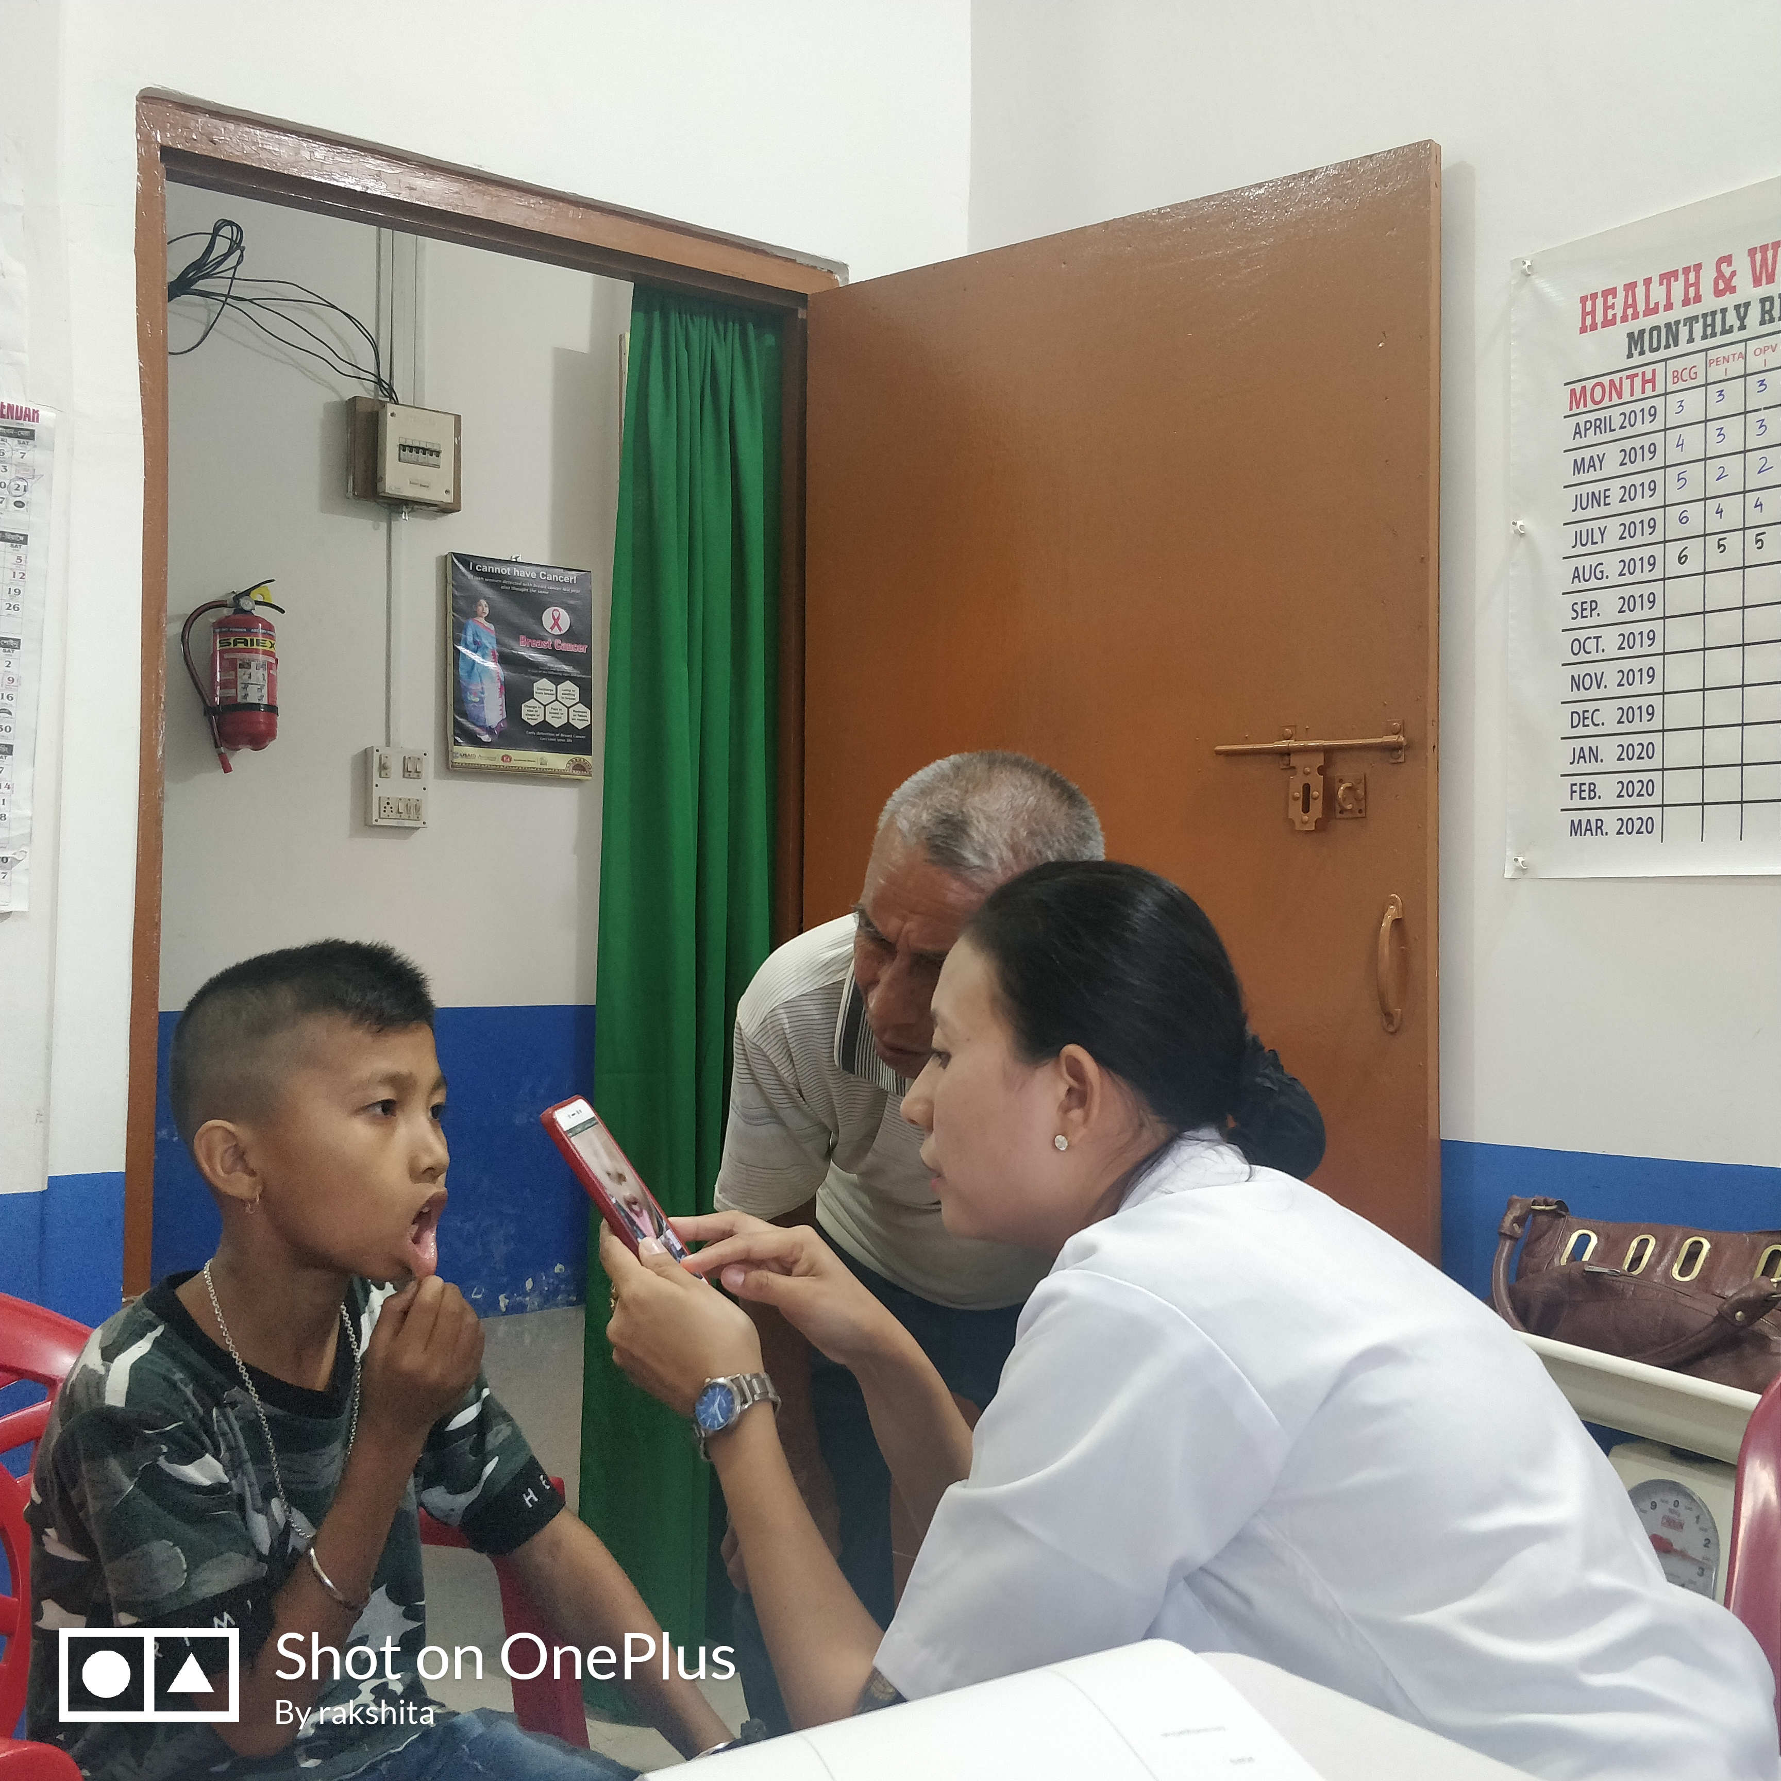
The greatest Wealth is Health !
- CHO – Ranita at Awang Wabagai AB-HWC, Imphal West, Manipur

Slide 29
AB-HWCs- Good practices observed
Andhra Pradesh:
  Safe Delivery Calendar
Karnataka:
  Streamlined recruitment process and Performance Linked Payments of CHOs
Kerala:
  PRI Involvement in Palliative Care
  SN designated for NCD screening, also working as Ophthalmic Assistant, ECG technician- UPHC-HWC
  Arogya Sena / Health Ambassadors
Odisha:
  Population Based Screening – Campaign mode
  Yoga and Meditation – for pregnant women
  Mahila Aarogya Samitis (SHG) actively involved for in house profiling, IEC and health promotional activities – urban areas
  Weekly Specialist services in UPHCs
  Mental Health Services provided by trained MO and SN through NIMHANS (R/U)

Slide 30
AB-HWCs- Good practices observed
Tamil Nadu:
  3 months of buffer stock of medicines at SHC, PHC
  Population being served is defined with SHC – PHC linkages
  96 Poly clinics providing Specialist services in UPHCs
  SN designated for NCD screening- UPHC-HWC
Telangana:
  Basti Dawa Khanas in Urban Areas
  State run diagnostic hub
  Streamlined collection of samples and reporting
Maharashtra:
  Model AB-HWCs – SHC layout-3 Designs
  Certificate Course in Community Health through MUHS (6300 candidates/batch)
  Netradan trust – NGO collaboration for diagnosis and treatment for cataract etc.
  Jharkhand:
  ATAL Clinic (Community Clinic) to cater to health care needs of urban marginalised population by Nagar Nigam

Slide 31
AB-HWCs- Good practices observed
Gujarat:
  Arogya Samanwaya – Integration of Ayurvedic and Yogic practices with Allopathy
  Yoga at SHC/PHCs - daily by trained CHO/MPW-M/ANM, twice weekly by trained ANMs at UPHCs
  Meditation and Saptdhara
Uttar Pradesh:
  Community Health Officer – Virtual Classrooms
  Curriculum for CHOs improvised.
Himachal Pradesh:
  Expansion of Population based NCD screening to 18-30 yrs age group
  Alcohol Cess
  Goa:
  Linkages with School Health Programs - Identified Health & Wellness Ambassadors
  Expanded Wellness Activities – laughter clubs etc.

Slide 32
AB-HWCs- Good practices observed
  Dadra & Nagar Haveli:
  Upgradation of Infrastructure using MPLAD / CSR funds
Daman & Diu:
  e-Arogya (Cloud based health ecosystem) at all public health facilities
  Haryana:
  VIA screening started at PHCs by trained staff nurses.
  CSR leveraging – TATA Steel and Indian Oil
  Eye Camps in Urban Areas for Drivers to reduce accident cases
Chhattisgarh:
  NCD Suraksha Maah
  Attractive & Informative Internal branding for AB-HWCs
  Collaboration with Govt. Medical Colleges for community outreach and service delivery in urban areas.
  Mental Health Services provided by trained MO and SN through NIMHANS (R/U)

Slide 33
AB-HWCs- Good practices observed
  West Bengal:
Saturday Review Meetings
  1st : RCH MIES (Block HQ)
  2nd : 1st Half: Public Health, 2nd Half: ASHA Meeting (Block HQ)
  3rd : ICDS Convergence Meeting (Block HQ)
  4th : Gram Panchayat HQ Meeting
Mothers Picnic : Monthly once, ANC Care, talk on nutrition, anemia prevention, family planning, etc.
Orders issued that CHO would be he nodal officer of Su-Swasthya Kendra (Health & Wellness Centre)
Entire urban health system would be regulated / controlled by Health Ministry.
Nagaland:
  e-Arogya (Cloud based health ecosystem) at all public health facilities
  Sikkim:
  VIA screening started at PHCs by trained staff nurses.
  CSR leveraging – TATA Steel and Indian Oil
  Eye Camps in Urban Areas for Drivers to reduce accident cases

Slide 34
AB-HWCs- Good practices observed
  West Bengal:
  Sikkim:
  VIA screening started at PHCs by trained staff nurses.
  CSR leveraging – TATA Steel and Indian Oil
  Eye Camps in Urban Areas for Drivers to reduce accident cases
  Manipur
    Char Umba
    Kangaroo Mother Care
    Nagamu – Vegetable Diet
  Tripura
Induction course of CHOs
Palliative Care Services being provided by CHOs for bed ridden patients via home visits (after two day special training on palliative care during CCCH course)
Yoga training for 450 ASHAs for 2 days at PHC level by Diploma Trainers at Dhalai & South districts

Slide 35
AB-HWCs- Good practices observed
Arunachal Pradesh
Incentivization of Rs. 1000 for achieving full immunization to parents of children below 1 year of age
Intensified NCD screening conducted on 23rd September celebrating as Ayushman Bharat divas during Ayushman Bharat Pakhwada
Meghalaya
Included Induction training on NHM activities in IGNOU (CCHC) curriculum for better understanding of MLHP on NHM program.
Distribution of Walker and Walking Stick at HWCs to the elderly patients on World Elderly Day.
Other Wellness activity – Zumba, Herbal garden at PHCs.

Slide 36
Building on RMNCHA+N ; continuing our focus !
  Performance linked payment are aligned to service delivery parameter
  90% Immunization to achieve the amount for the conditionality for FY 2019-20.
  Nutrition – local food rich in iron, vitamins etc.
  First 1000 days – linked with the local / tribal practices
  Wellness activities need to be emphasized – e.g. Yoga / Aerobics / Exercise for pregnant women.

