Slide 1
GROUP 3: HWC-UPHC
U | Urbanization
R | Rapid
B | Boom - Population
A | Ayushman Bharat
N | Nation (Healthy Individuals, Healthy Families, Healthy Cities)

Slide 2
Teams Visited NE States and West Bengal
States where NUHM field visit conducted | Teams visited
Assam | DC (UH) – Dr. Jyoti Rawat Adil Shafie
Manipur | Dr. Honey Arora
Tripura | Abhishek Gupta
Nagaland | Nisha Kadyan
West Bengal | AC (UH) – Dr. Sushil Kumar Vimal Rajni Tomar,
Meghalaya | Seema Pati
Field visits not conducted for States – Sikkim, Arunachal Pradesh and Mizoram

Slide 3
Functionality Status of HWCs
State | No. of UPHCs-HWCs approved till date | No. of U-PHCs-HWCs operational
Assam | 56 | 50
Manipur | 7 | 1
Mizoram | 8 | 2
Meghalaya | 19 | 1
Tripura | 7 | 6
Nagaland | 5 | 5
Arunachal Pradesh | 4 | 4
Sikkim | 2 | 1
West Bengal | 75 | 0
Total | 183 | 70
Source:

Slide 4
Human Resource at AB-HWCs
Adequate HR (regular and contractual) available in all States except few States
  West Bengal- there is Acute shortage of ANMs and SNs. First tier Supervisors (FTS) are performing immunization activities in field.
  Manipur- Pharmacists vacant in all 9 UPHCs. SNs dispensing medicines in place of Pharmacists. 1 MPW-M was found in 1 UPHCs.
  Assam – SNs are posted in UPHCs but deputed to District Hospital.
1 AYUSH doctor is available at U-PHCs along with 2 MOs - Manipur
ASHAs and MAS available and found active in all States-
  West Bengal- Honorary Health Workers (HHWs) engaged as an ASHAs (covering entire urban 5000-6000) population getting fixed honorarium. Not yet trained on Module 6 &7 due to which performance based incentives are not being paid. MAS co-opted from SHGs of NULM. No MAS formed in Kolkata Municipal Corporation (KMC).
  Assam- Involved in distributed dustbins from untied funds, counselling on de-addiction, mobilizing diabetic patients, propagating “No Plastic use”
  Tripura- MAS in outreach activities such as street plays, handwashing, JSY polio mobilization, cleaning of public toilets etc.

Slide 5
Essential Medicines Availability
State | No. of Drugs available | EML displayed | Procurement system
Assam | 140 drugs including NCDs drugs. NCD given for 1 month | Yes | Manual indenting in forms of Debit and Credit kind of format. Look alike and sound alike medicines available
Manipur | 60 drugs including NCD drugs | No | Manual indenting done. Buffer stock maintained for 1 month
Mizoram | 50 drugs including NCD (both first and second line treatment drugs) | No | Manual indenting done. Drugs nearing expiry were found which were being used for dispensing
Meghalaya | 70 drugs | Process of revision | Online indenting done. Buffer stock maintained for 1 month.
Tripura | 55-60 drugs including NCDs |  | Online indenting. One month buffer stock maintained. Supply from CMS is slow and hence drugs purchased from Jan Aushadhi store
Nagaland | 170 drugs including NCD and anti-epileptic drugs | Yes | Manual indenting.
West Bengal | 156 drugs including NCD drugs | Yes | Online indenting through SIMC except KMC (manual indenting). Stock management poorly maintained, no records maintained since last 6 months.
Drug availability varies from State to State. On an average 50-170 drugs available at U-PHCs with minimum in Mizoram and maximum in Nagaland

Slide 6
Essential Diagnostics
State | No. of Diagnostics available | In-house / PPP | User Charges | Remarks
Assam | 5-19 | In-house | Nominal charges
Manipur | 7 | In-house | No | RDK kits available
Mizoram | 15-20 | In-house | No | Out of 8 only 2 UPHCs have semi-auto-analyzers. Strips for Glucometer was not available
Meghalaya | 10 | In-house | Nominal charges | Outsourced model from KRSNA yet to be initiated.
Tripura | 18-20 | In-house | No | User charges are chargeable when patients are referred to high facilities (SDH, DH, MC) eg. Hb – Rs. 21
Nagaland | 23 | In-house | No | Semi-autoanalyzer available.
West Bengal | 20-25 | In-house | No | KMC has 15 dengue detection centers (10 centres supported from GOI) which is mapped (100-120 dengue tests are done daily).
Diagnostics also varies from State to State. On an average 7-25 tests done at U-PHCs with minimum in Manipur and maximum in West Bengal

Slide 7
Population based screening (including filling up of CBAC) /
AB-HWC Portal reporting – mechanisms available
Population Enumeration and Family folder - not initiated in States except Assam where Family folder is being maintained by ASHA
CBAC forms
  Assam – filled by ASHA, checked by ANMs and counter checked by Medical Officer, this is the basis of ASHAs receiving incentives on CBAC.
  Tripura – filled by ASHAs (both slum and non-slum areas)
  Mizoram –Co-located centres have initiated CBAC to be filled by ASHAs.
Population based NCD screening not initiated in Manipur, Mizoram, Nagaland, Tripura, West Bengal.
Mostly Opportunistic screening is being done in most of the states except West Bengal.
NCD Training-
  Not yet initiated in Manipur, Mizoram, West Bengal
  Tripura, Nagaland, Assam, Meghalaya – NCD training conducted but NCD application training is pending. In Tripura – ASHAs and ANMs are self screened during NCD training.
  VIA training has not been initiated in any of the states.
Daily AB-HWCs is not being done at the UPHCs in all states except Assam (by Accountant / MIS) and Tripura (by DEO).

Slide 8
Branding of AB-HWCs / Wellness Activities (Yoga & beyond)
Branding (internal and external) done in Manipur, Tripura, Assam and Meghalaya, Nagaland except West Bengal
State specific branding observed in Meghalaya
IEC materials including citizen charter displayed in all the states except Manipur, Tripura and West Bengal
Wellness Activities being done in Nagaland (Physiotherapist visit to U-PHCs), Assam (in few UPHCs and Schools), except Manipur, West Bengal, Tripura

Slide 9
Provision of expanded range of services
Dental and Mental health – Tripura ( MO trained for 7 days)
Nagaland – Mental health (MO trained for 3 days)
Mizoram- Deliveries are being conducted at U-PHCs
Meghalaya- Dental services being provided at one HWC. Dentist posted by State at U-PHCs
West Bengal- eye care services provided through Mission Vision and Susrat in Kolkata Municipal Corporation and in few U-PHCs of RoWB through ULBs initiative
Tripura –CHOs are being trained on 7 days (posted at Sub Centers-Urban kiosks) in urban areas. Tele-ophthalmology services are also being provided at U-PHCs on PPP mode

Slide 10
Best Practices
West Bengal
  15 Dengue Detection Centres (DDC) in Kolkata Municipal Corporation located at U-PHCs and each DDC covering 9-10 U-PHCs
Manipur
  Kitchen Garden established in UPHCs visited with plants with green leafy vegetables.
  UPHCs visited has herbal gardens with plants of medicinal value.
  Chlorination: liquid waste treatment is being done at the UPHCs visited
Assam, Meghalaya
  Strong Referral mechanism maintained at the level of UPHCs by Medical Officers
Nagaland
  Strong community participation through voluntary support in the construction of UPHCs

Slide 11
Way Forward
Prioritization and Planning of HWCs in urban areas
  Assigning Population to the HWC-UPHC- for entire coverage
  Referral linkages Mechanisms to be created to higher facilities
Provision of Specialty Services at facilities (Evening OPDs/Part-time weekly) - ensure expanded range of services
Strengthening Outreach services-
  In Campaign mode
  Engagement of community volunteers, SHGs, NGOs, Nursing students etc. be utilized/ Additional ANM deployment- In areas where there are no ASHAs
  Performance linked payments for outreach activities
Wellness Activities- Yoga instructors/teachers/volunteers. Zumba/Laughter clubs/gym can be initiated in urban areas. Municipal schools/ Parks can be used for such activities.

Slide 12
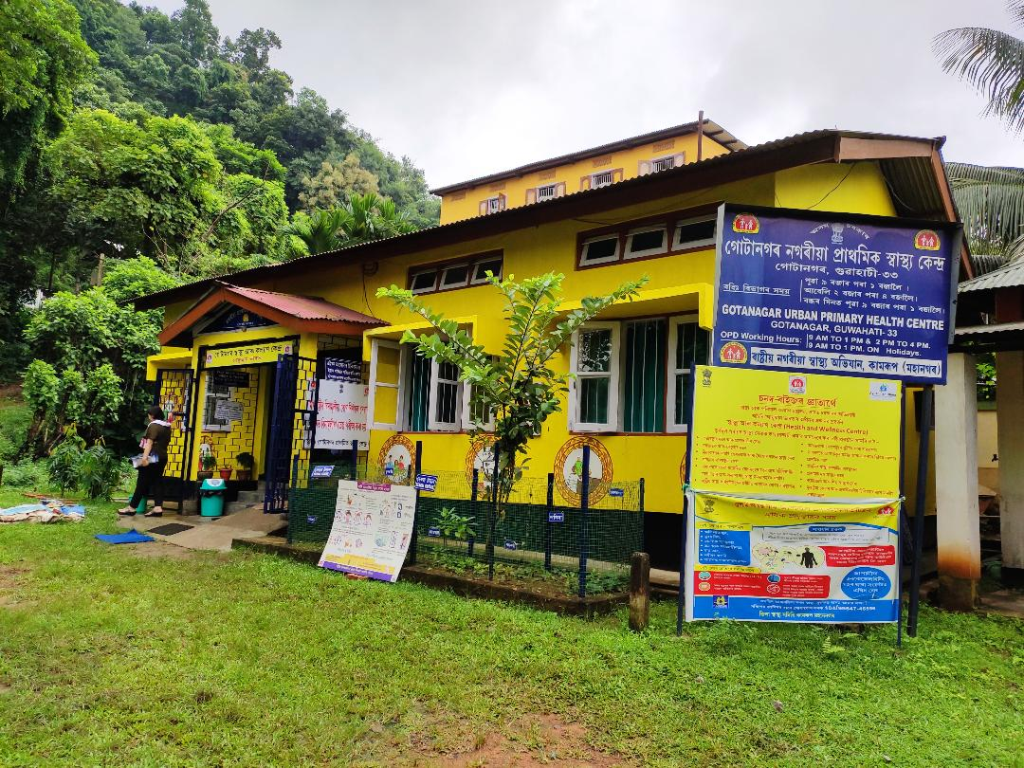
THANK YOU

