Slide 1
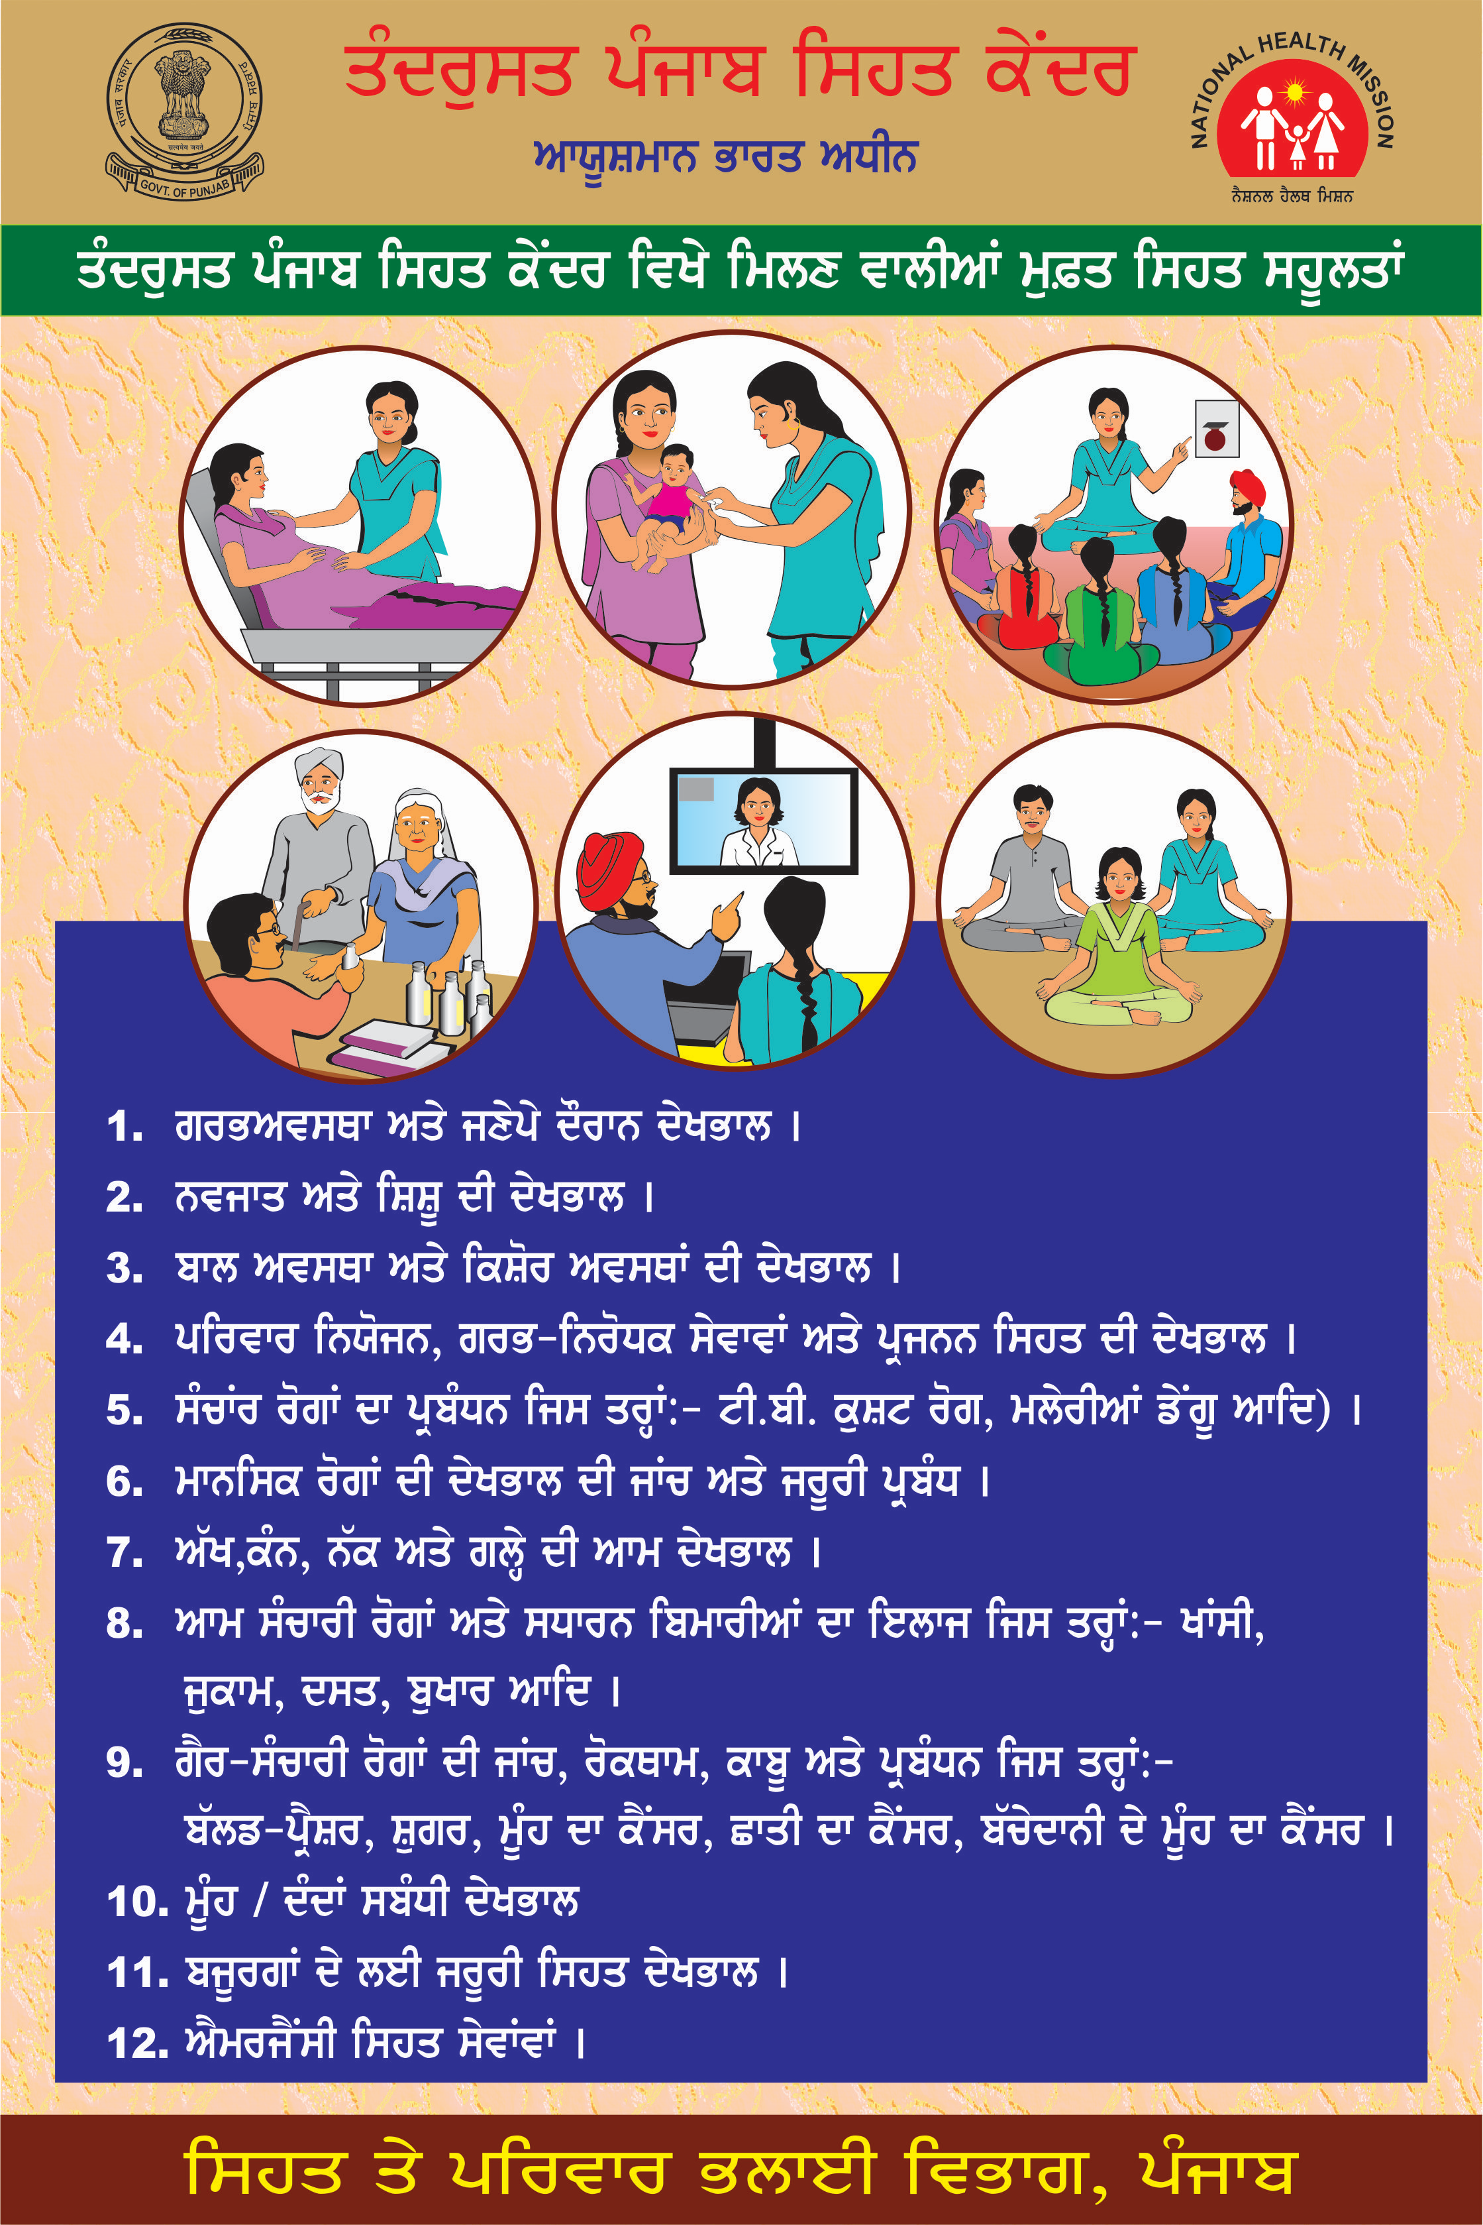
AYUSHMAN BHARAT
Operationalizing Health and Wellness Centres
To Deliver
Comprehensive Primary Health Care

Slide 2
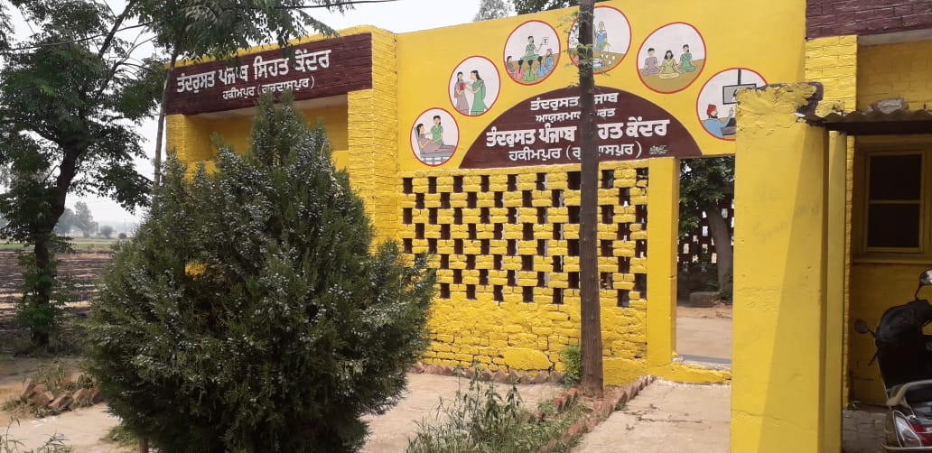
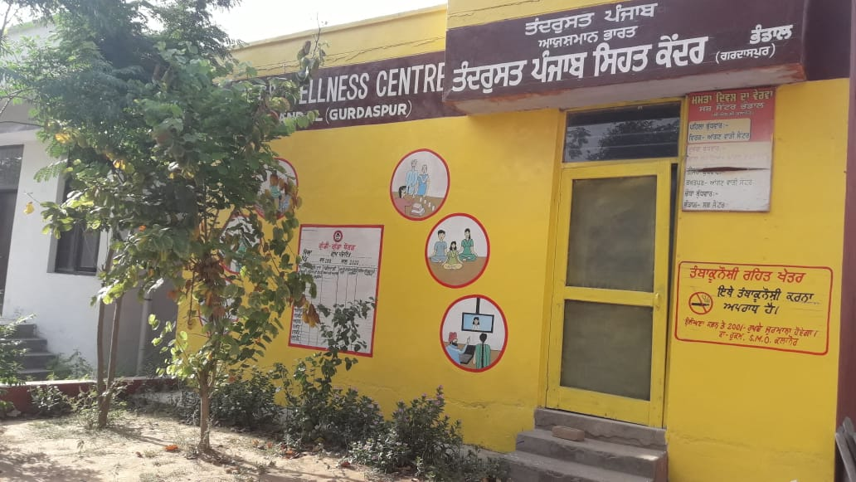
Health and Wellness Centers
Operational HWCs
859

Slide 3
Status of Implementation of H&WCs
859 H&WCs have been opreationalized-421 Sub Centre, 348 PHCs and 90 UPHCs
By March 2020, 1600 Sub centres out of 2662 Sub Centres will be operationalized as H&WC
17 IGNOU Study Centres are operational
Wellness Activities-Yoga has been started-once a week.

Slide 4
Health issues in the State
As per Disease Burden Study major health risk factors are High Blood Pressure (15.3%), Dietary Risks (14.6%) High fasting plasma glucose (10%) .
Major cause of death & disability are Ischaemic Heart Disease (17.1%),Road Injuries (4.2%) Diabetes (3.9%) and stroke (2.9%).
Maternal Mortality Ratio-122
High Prevalence of Anaemia-Anaemia- 53.5% Women of reproductive age group, 42% PW, 56.6% Children in age group 6-59 months are anaemic – NFHS-IV (2015-16)
High Out of Pocket Expenditure on Health

Slide 5
Initiatives taken/being taken
All H&WCs has been provided with Desktops
Implementation of Telemedicine in process
Anaemia Mukt Punjab- Screening of all Pregnant Women & Adolescent Girls and management of moderate anaemic cases and referral of severe anaemic cases.
Population Based Screening, Screening of Common Cancers
A Brochure in Punjabi has been prepared for community

Slide 6
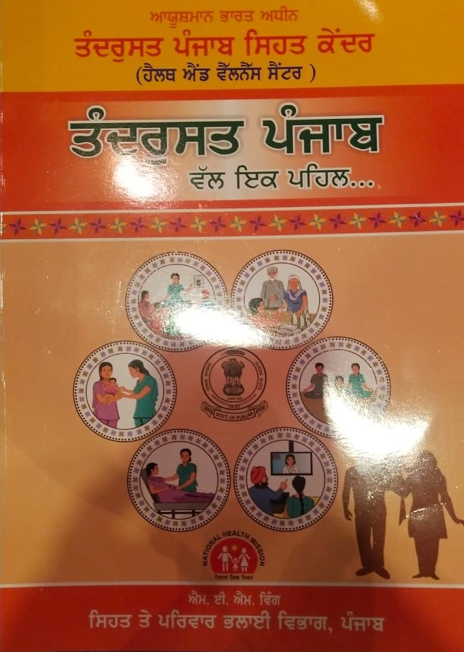
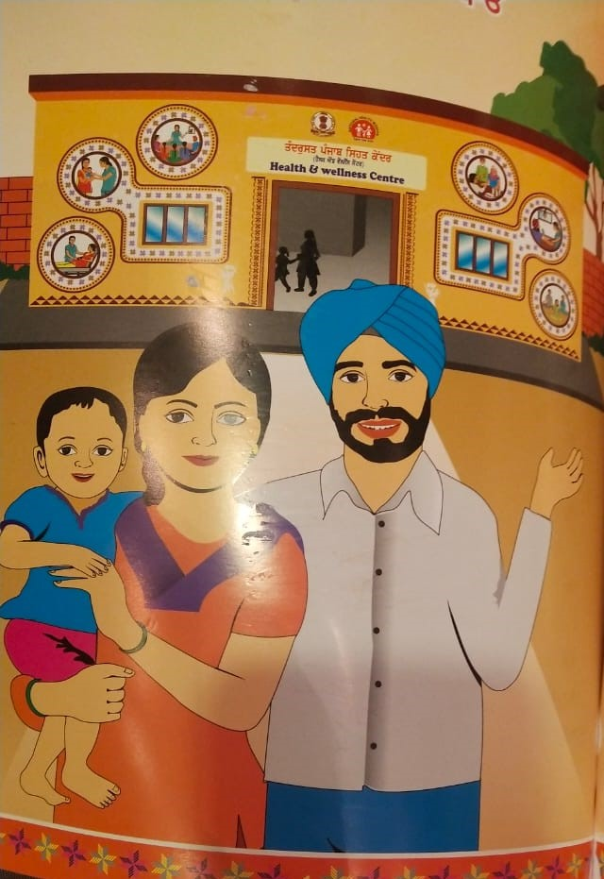

Slide 7
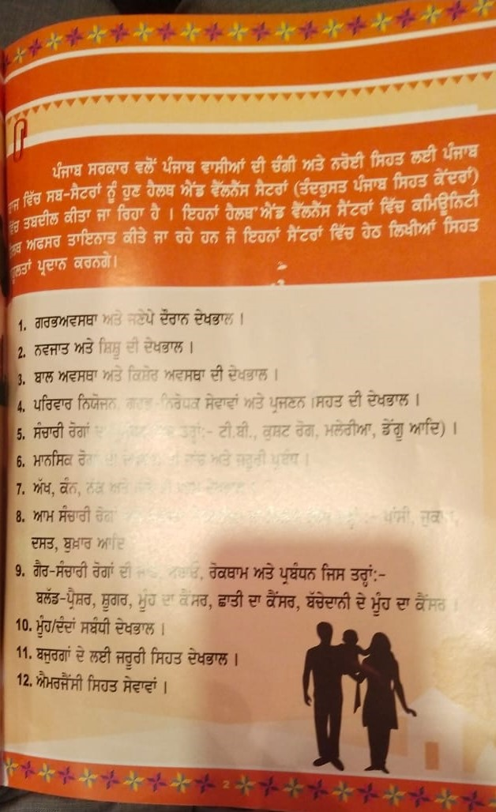
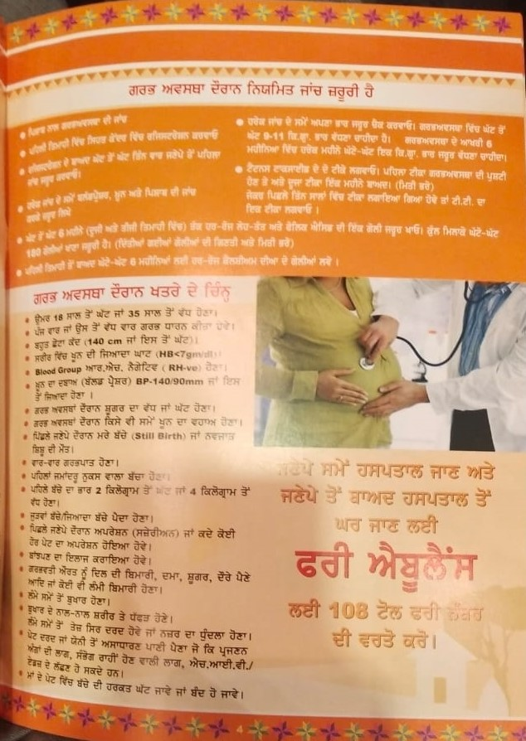

Slide 8
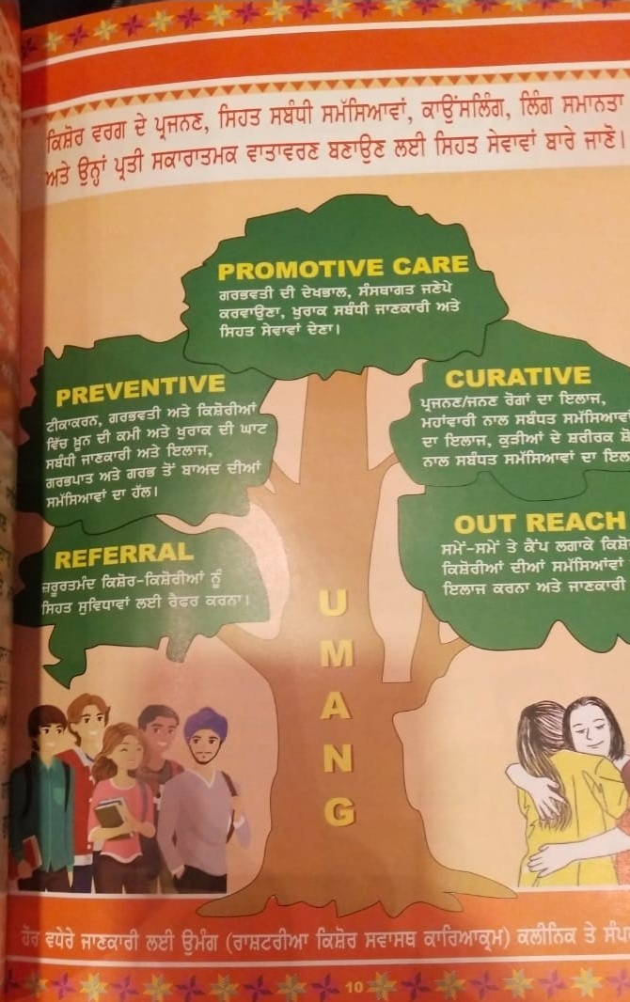

Slide 9
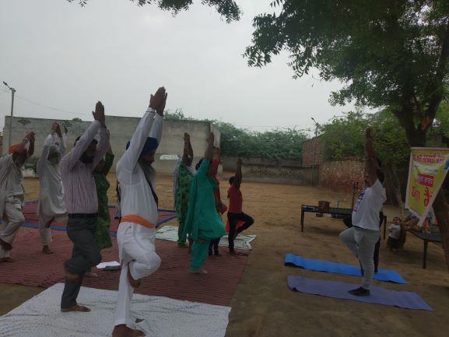
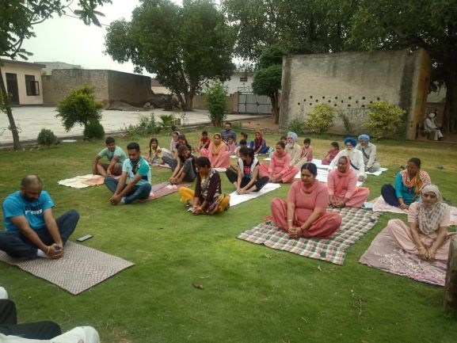

Slide 10
Integration of HWC with other National Programmes:-
National Programme for Control of Blindness & Visual Impairment (NPCB&VI)
and
National Programme for Prevention and Control of Cancer, Diabetes, Cardiovascular diseases and Stroke.( NPCDCS)

Slide 11
Burden of Diabetes in India
72 million diabetics amongst 1.3 billion population
7.3% average prevalence among adults >20 years
10.3 % in Punjab
Diabetic retinopathy (DR) which is a vision threatening complication of disease is present in 10-20% of diabetic patients.

Slide 12

Objectives
To implement the protocol at primary, secondary and tertiary levels to train health care providers treating people with DM and DR to improve their decisions regarding appropriate DR referral, treatment and Health outcomes
To establish the linkage between the HWCs-SC and higher centres for DR treatment and management

Slide 13
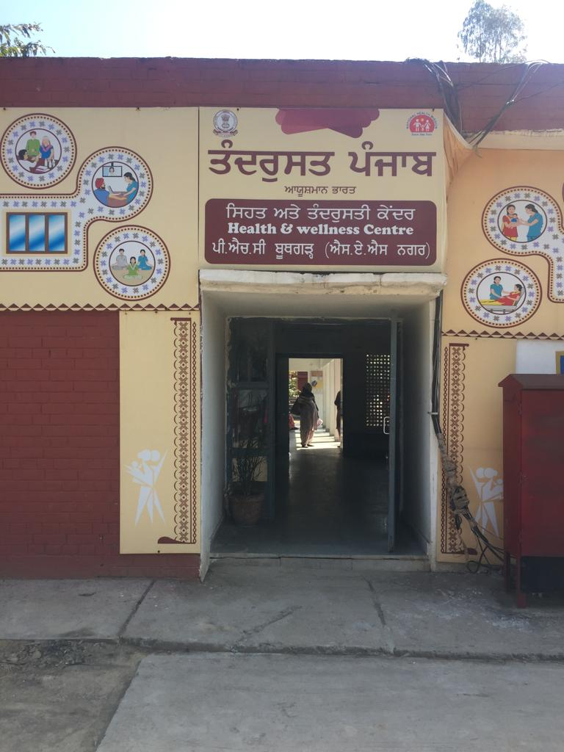
Case Study of Boothgarh and Gharuan Block, District Mohali
Early screening, detection and management of Diabetic Retinopathy

Slide 14
Service Delivery Framework
Currently, a population-based screening for hypertension, diabetes and common cancers (cervical, breast and oral) is being implemented under National Programme for Prevention and Control of Cancer, Diabetes, Cardiovascular Diseases and Stroke (NPCDCS)
At Village level (ASHAs & ANMs)
  Community Based Screening for population age 30 years and above for diabetes
  ASHA to complete Community Based Assessment Checklist (CBAC)

Slide 15
Service Delivery Framework
HWC-SCs
(Screening of DM, Referral to the PHCs/CHCs )
PHCs/CHCs
(Referral of DM patient to Ophthalmic officers for visual acuity)
Treatment with Glasses
Can't be Treated with Glasses
Refer to NCD Clinic for the management of DM
Refer to Ophthalmologist:- Screening & Diagnosis of DR
HWC-Diet Counseling, Management of Blood Sugar levels and Timely referral
PGIMER for Laser treatment

Slide 16
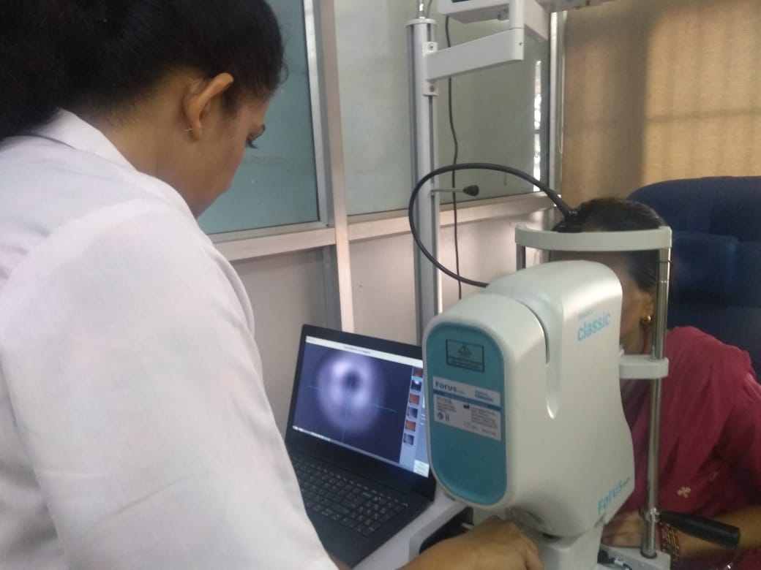
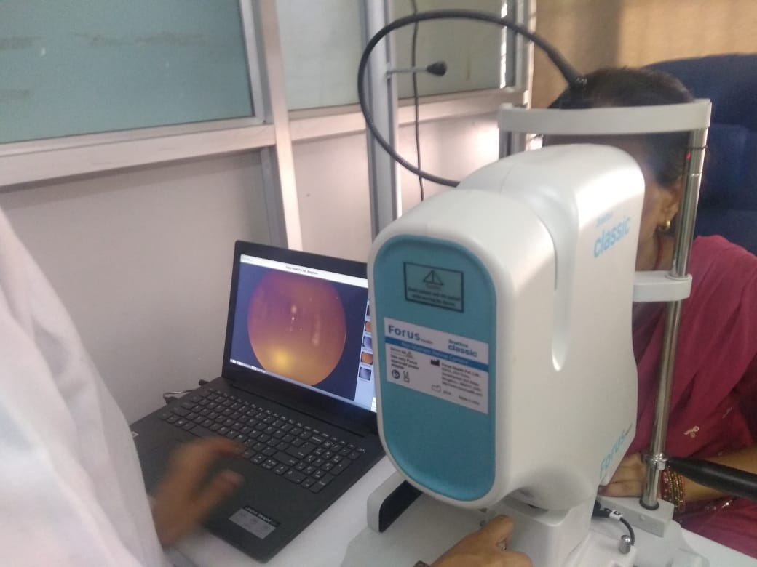
Civil Hospital Mohali

Slide 17
Trainings
Health system service delivery level | Primary Health Care | Secondary Care | Tertiary Care | Specialist Care
Health Facility | ASHA- house screening ANM-Civil dispensaries (urban) or Primary health centre (rural) | CHC: Community Health Centre | DISTRICT HOSPITAL (DH) | PGIMER
Cadre | ASHA/ANM/CHO | Physicians / Ophthalmic Officer | Comprehensive Ophthalmologist/General physician /Ophthalmic Officer | Retina Specialist

Slide 18
Results
Report of the Block Boothgarh & Gharaun for the month of July, 2019
Sr. No | Particulars | Number
 |  | Male | Female
1 | No. of Patients screened for Diabetes (33 Sub Centers) | 207 | 468
2 | No. of Patient Diagnosed (33 Sub Centers) | 87 | 130
3 | No. of Patient reporting at PHC Boothgarh & Gharaun after referral from SCs | 64 | 95
4 | No. of patient referred by Ophthalmic officer to Ophthalmologist (DH Mohali) | 37 | 24
5 | No. of patient screened for DR in DH Mohali | 18 | 11
6 | No. of DR patient referred to PGIMER for Laser Treatment | 1 | 0

Slide 19
Conclusion
Hence a protocol is established to link the HWCs-SC and higher centers for early detection , treatment and management of Diabetic Eye disease from the list of patients screened at village level.

Slide 20
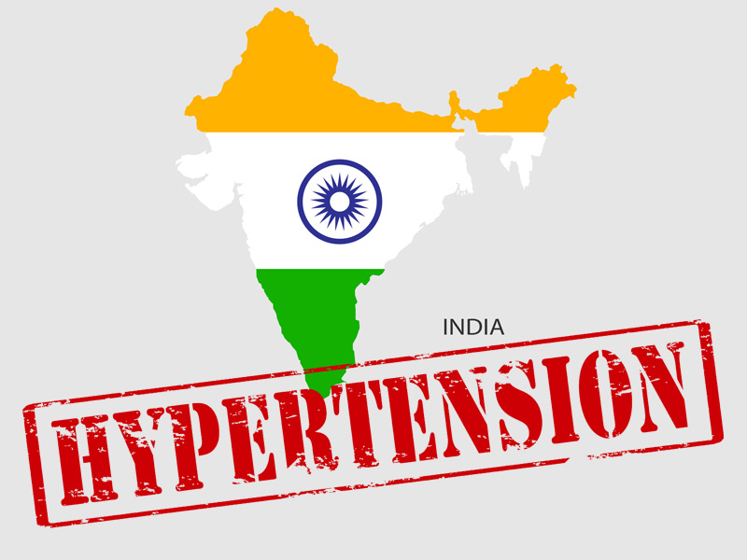
Integration of IHMI (India Hypertension Management Initiative) at HWC level
A Case study from Block Kalanaur
(District Gurdaspur)

Slide 21
Prevalence of hypertension in various Indian states : DLHS- 4 survey 2012-14

Slide 22
Five Projected Districts in Punjab
Pathankot
Gurdaspur
Hoshiarpur
Bathinda
Mansa
A case study from Block Kalanaur District Gurdaspur

Slide 23
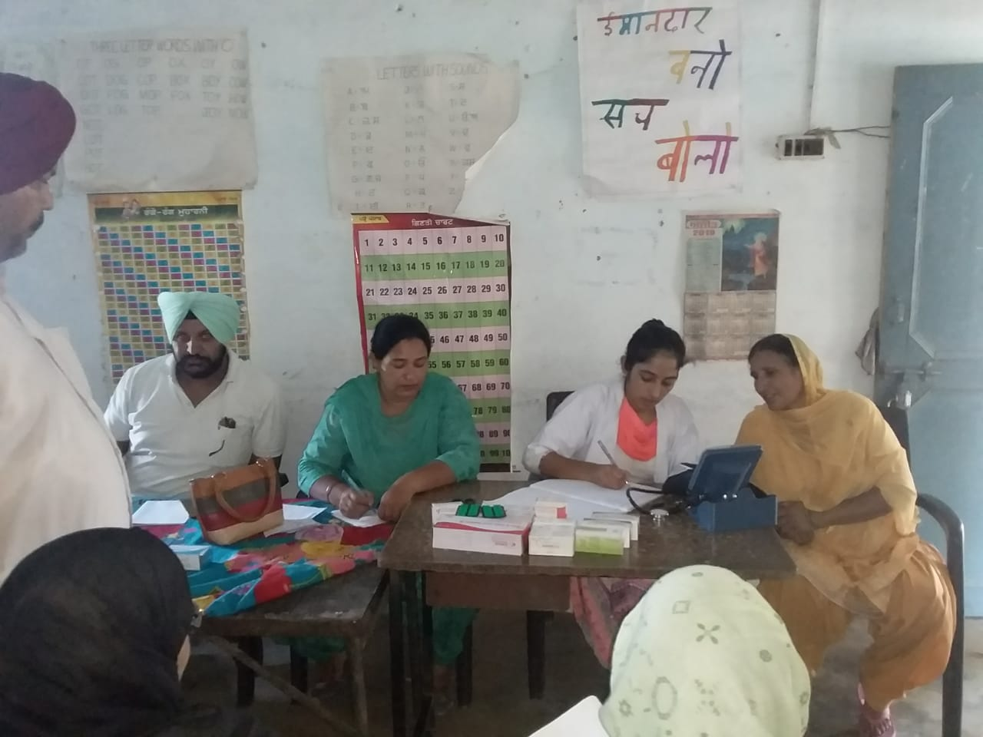
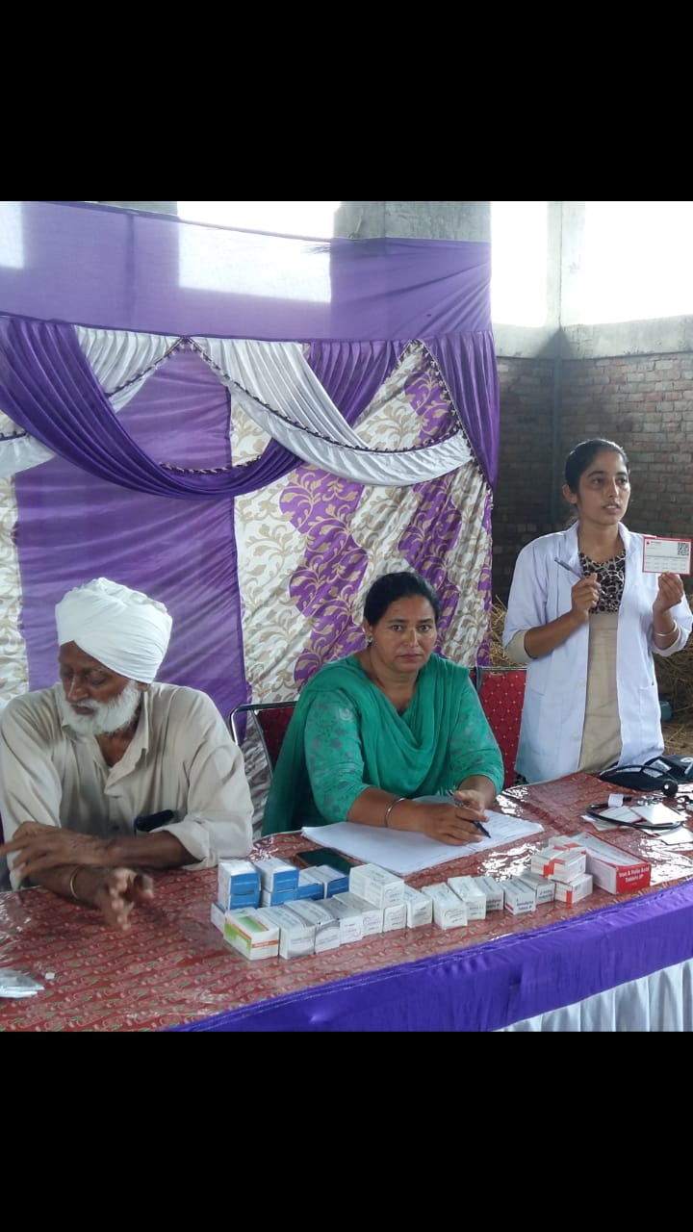
NCD Screening Camps
NCD Screening:- CBAC By ASHAs under supervision of CHOs
CBAC Score more than 4 were identified by the CHO.
Village wise camps are being organized by the team comprising Medical officers, CHOs, ANMs and ASHAs
Micro plans of the camps are being prepared by CHOs every month
ASHAs make sure to bring all the persons having score more than 4 to the camps

Slide 24
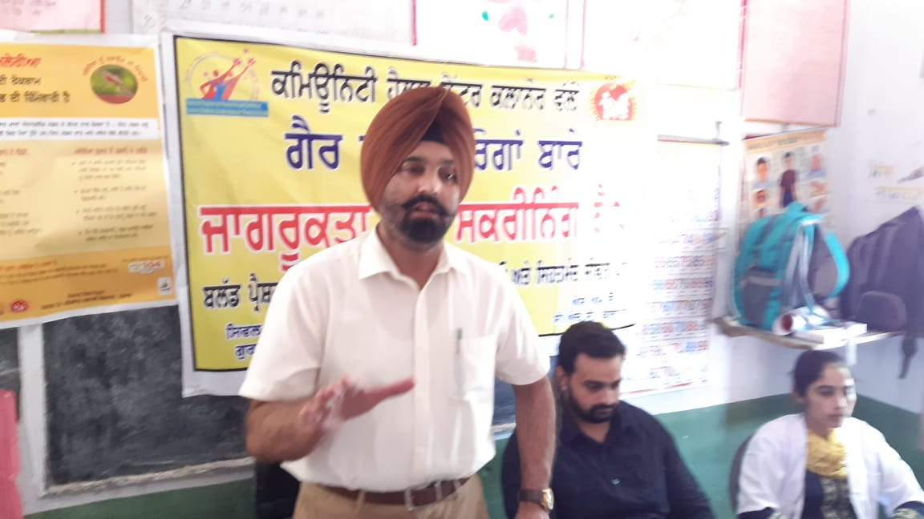
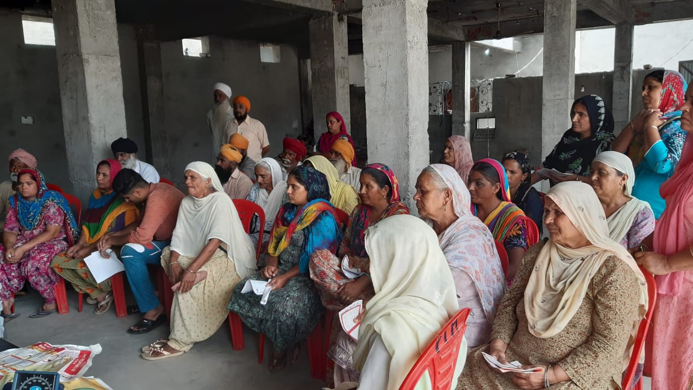
IHMI Integration at HWC level
Screening for NCDs is being done at the camp by assessing the blood pressure and blood sugars levels.
Treatment of hypertension:- medicines for 10 days given on the spot
All the hypertensive patients are uploaded on IHMI App by CHOs and regular follow up of the patients is being done
Village wise list of NCD patients are prepared and given to ASHA by CHO for follow up.

Slide 25
Report from April – July 2019
Block - Kalanaur
Sr. no. | HWC | No. of persons screened | No. of persons diagnosed with Hypertension | Under Control during Follow Up
1 | Hardochanni | 958 | 85 | 61
2 | Kalanaur | 1733 | 393 | 279
3 | Bhandal | 1530 | 74 | 59
4 | Naranwali | 60 | 27 | 25
5 | Wadala Bangar | 1436 | 65 | 62
6 | Hakimpur | 1200 | 112 | 109
Total |  | 6917 | 756 | 595

Slide 26
Conclusion
Community level camps may be organised for the diagnosed patients of Hypertension/DM/other NCD.
Medical Officer can examine these diagnosed patients, prescribe the required tests and medicines at one point
IHMI programme is thus integrated in the community at HWC level.

Slide 27

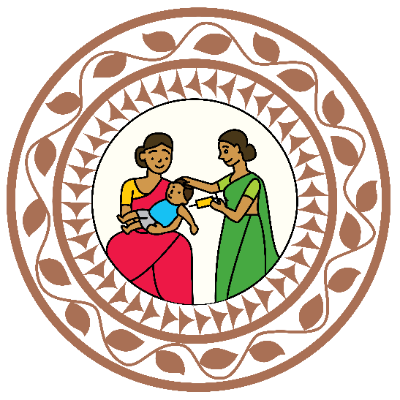

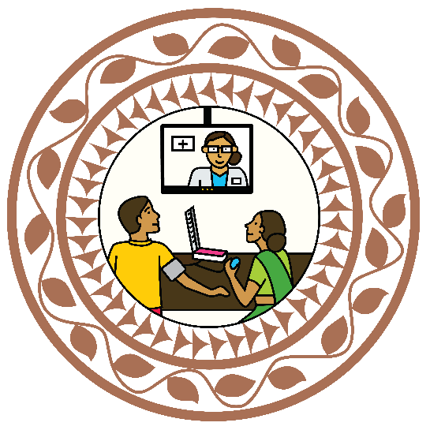


Thank You

