Slide 1



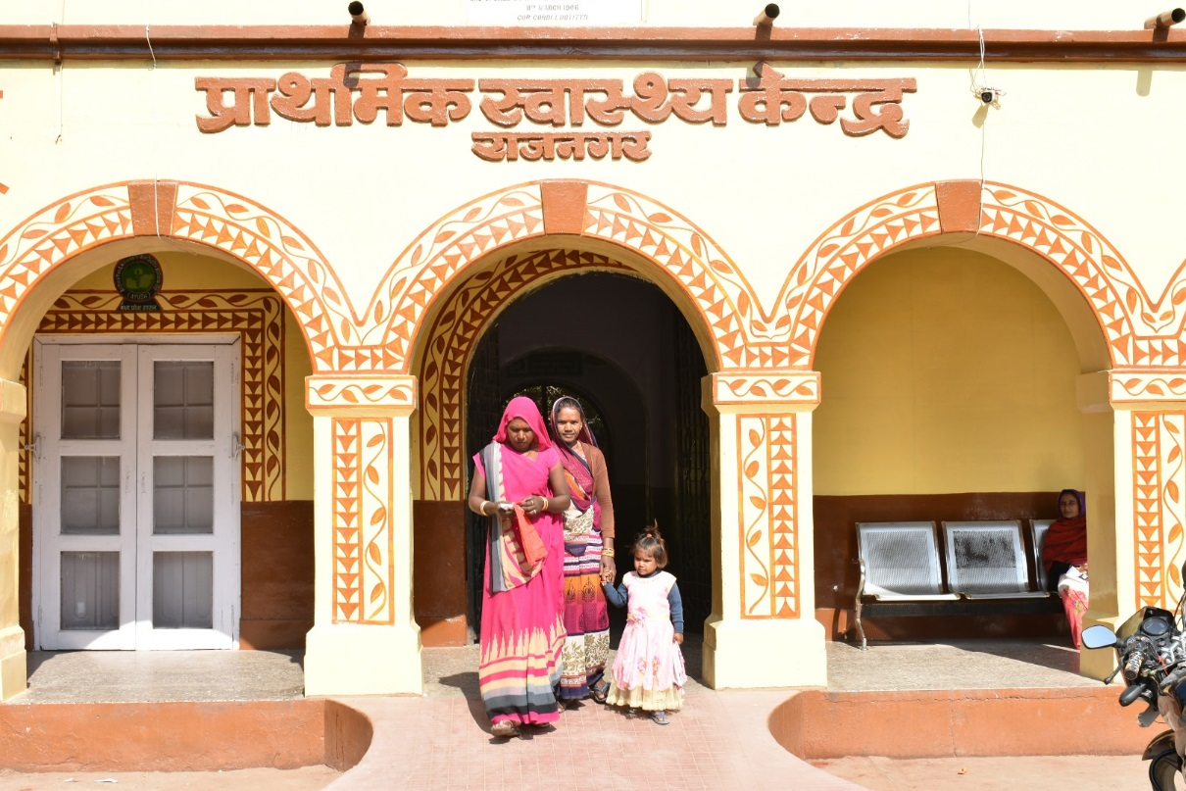
Comprehensive Primary Health Care
through
Health and Wellness Centers (HWC)
Mission Director
NHM- MP

Slide 2
HWC Coverage in Madhya Pradesh
 | FY 2018-19 | FY 2019-20 | Total | Operational
Number of HWCs to be established | 690 | 2177 | 2867 | 760
SHCs | 0 | 1450 | 1450 | 0
PHCs | 612 | 560 | 1172 | 666
Urban PHCs | 78 | 167 | 245 | 94
*As on 4th September, 2019 at 09:00 am
 | FY 2018-19 | FY 2019-20 | Total
Program Study Centers (PSCs) | 8 | 14 | 22

Slide 3
Operational planning - Development of roadmaps
FY 2018-19
Total target to be upgraded by December 2022
10020 SHCs
1172 PHCs
245 UPHCs
FY 2019-20
612 PHCs
78 UPHCs
FY 2020-21
560 PHCs
167 UPHCs
1450 SHCs
Total: 2177
FY 2021-22
3370 SHCs
FY 2022-23
3370 SHCs
1830 SHCs
264 CHOs in
FY 2018-19
(PSCs – 08)
1320 CHOs in
FY 2019-20
(PSCs – 22)
3660 CHOs in
FY 2020-21
(PSCs – 33)
3660 CHOs in
FY 2021-22
(PSCs – 33)
1830 CHOs in
FY 2022-23
(PSCs – 33)
Cumulative
690
2867
6237
9607
11437
Production of adequate number of CHOs
Direct Deployment of B.SC Nursing candidates +Private GNM Candidates

Slide 4
Roadmap for Operationalization of HWCs
Ensuring HR availability - MO, CHO, SN, LT, MPW(M) and (F)
Availability of drugs and diagnostics - hub and spoke model, OPD application (line lists of referrals ,tracing follow-up and backtracking referrals)
Training
Organization - Regular NCD screening and hierarchy of referrals
Telemedicine
Activating wellness component
Civil infrastructure and 2 MBps connectivity

Slide 5
Human Resource Availability
CHOs
  266 SNs trained as CHOs to be posted at HWCs - September
  1300 candidates undergoing training as CHOs (Jul-December 2019)
  Counselling for MOs of 270 AYUSH dispensaries co-located with HWCs - September
Medical Officers
  Posting of MOs at vacant HWCs –divisional walk in interviews every Wednesday
  MOs deputed every Thursday for NCD clinic at HWC(SHC)
  MOs deputed every Wednesday for NCD clinic at HWC(PHC)
  Mobilization support for MOs

Slide 6
Drugs, Diagnostics and Referral Hierarchy
Village level screening on Wednesdays by MPW(F) and MPW(M) – tablets given and training completed
Referrals from village/SHC to HWC supported out of VHSNC funds
Data uploading on NCD App portal every Saturday during sector meetings
Team of MO-Pharmacist-Lab Technician with 2 months medicine stock for NCD clinic at HWC(SHC)
NCD clinic on Wednesdays on all HWC(PHCs) and UPHCs

Slide 7
Drugs and Diagnostics
OPD tracking application under development to track
  Cases across referral facilities
  NCD OPDs/ HWC – Retention of patients
  Availability of drugs
  Diagnostics
Hub and Spoke model operationalized for 311 PHCs with no LTs
Telemedicine RFP floated - all 1172 HWC(PHC)s covered, 5 regional hubs @ 20-spokes/seat

Slide 8


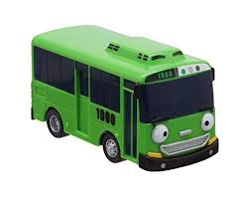

Hub and Spoke Model
Samples are collected from Staff Nurse from the PHCs during OPD hours from 9:00 AM to 1:OOPM
Samples are then transported to the nearest hub in a vaccine carrier by Identified field workers or staff – (compounder/Supervisor)
Rs. 300/ per day for the transporter for the time being by utilising free pathological services funds to ensure sustainability
The reports are delivered to the facility after 5:00 PM or the day after, by any personnel available at the facility (Spoke)

Slide 9
BEST PRACTICE – NCD Campaign
AIM:
Expediting NCD screening and management
Generation of line lists of referred cases, category-wise, HWC-wise
Tracking referrals up to DH-NCD clinic and follow-up
Activity | Timelines
NCD Module and Application Training | July - August 2019
NCD Campaign | September – October 2019
Campaign Calendar
Days | Campaign Level | Responsibility | Community Mobilization
Wednesday | Village Level NCD Day | MPW (M) and (F) | ASHA
 | PHC Level NCD Day | Medical Officers | MPW (M) and (F)
Thursday | SHC Level NCD Day | Medical Officers | MPW (M) and (F)

Slide 10
Putting in place an organization, hierarchy of referrals
NCD Campaign – Sept-October 2019
Survey Tool
CBAC form and family folder
Population Survey
ASHA training on NCD Screening
Enrolment
Training of MPW(F) and MPW(M) on NCD application
Line listing format
Survey by ASHA as per guidelines & target
Line listing of village
Data upload in NCD app by MPW(M)
Printed and supplied from state
NCD Screening by MPW(F) and MPW(M) at SHC
NCD Screening by MO at PHC level
Data uploading in NCD application and
Referral to PHC/CHC/DH as per findings
Diagnosis, treatment and referral by Medical Officer at PHC/CHC/DH

Slide 11
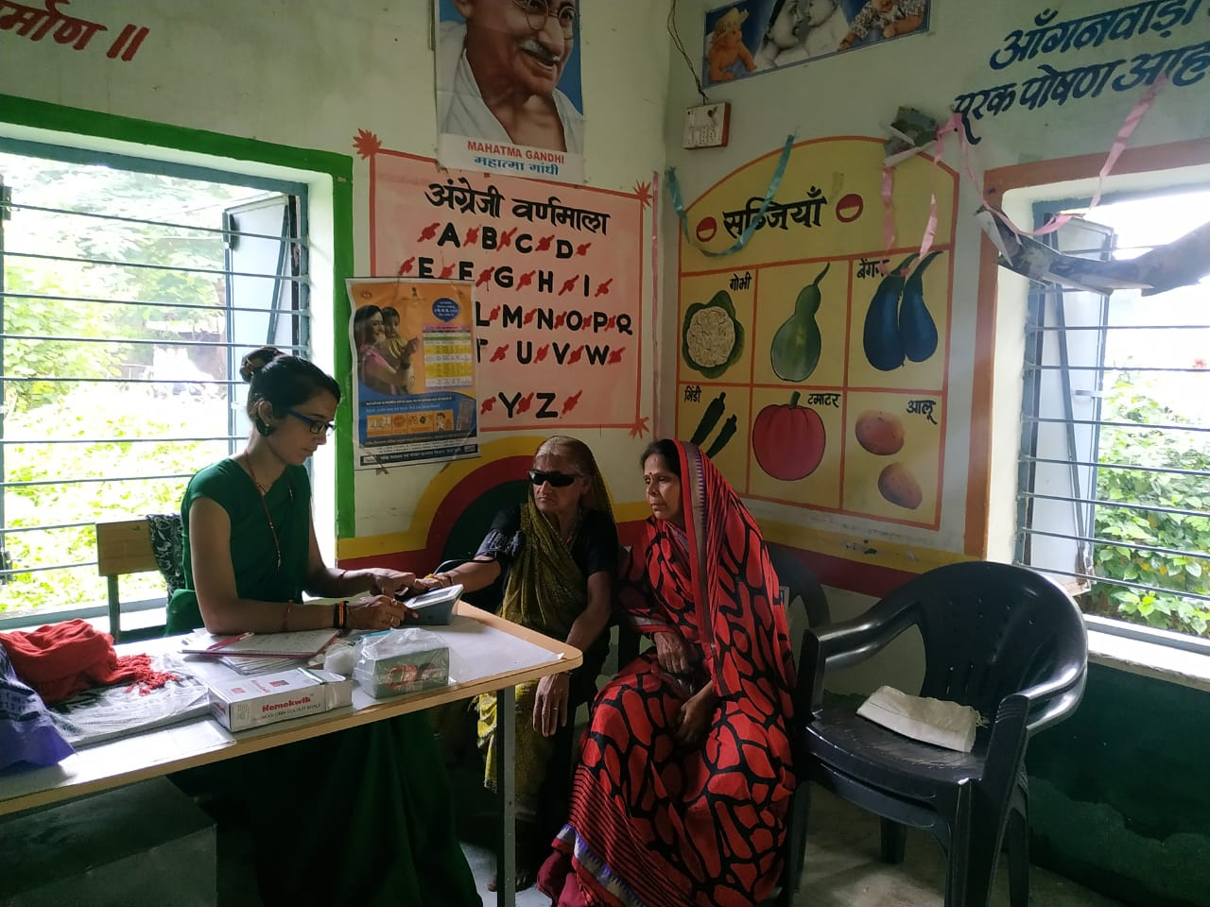
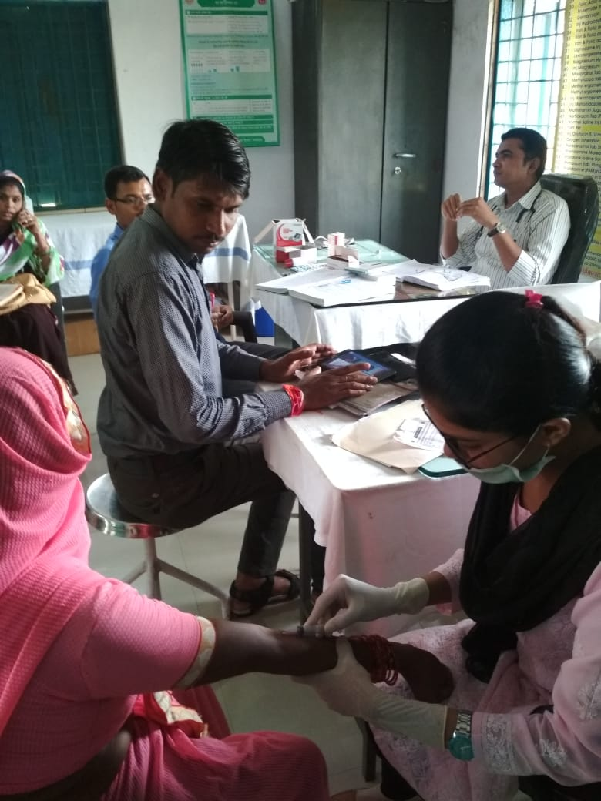
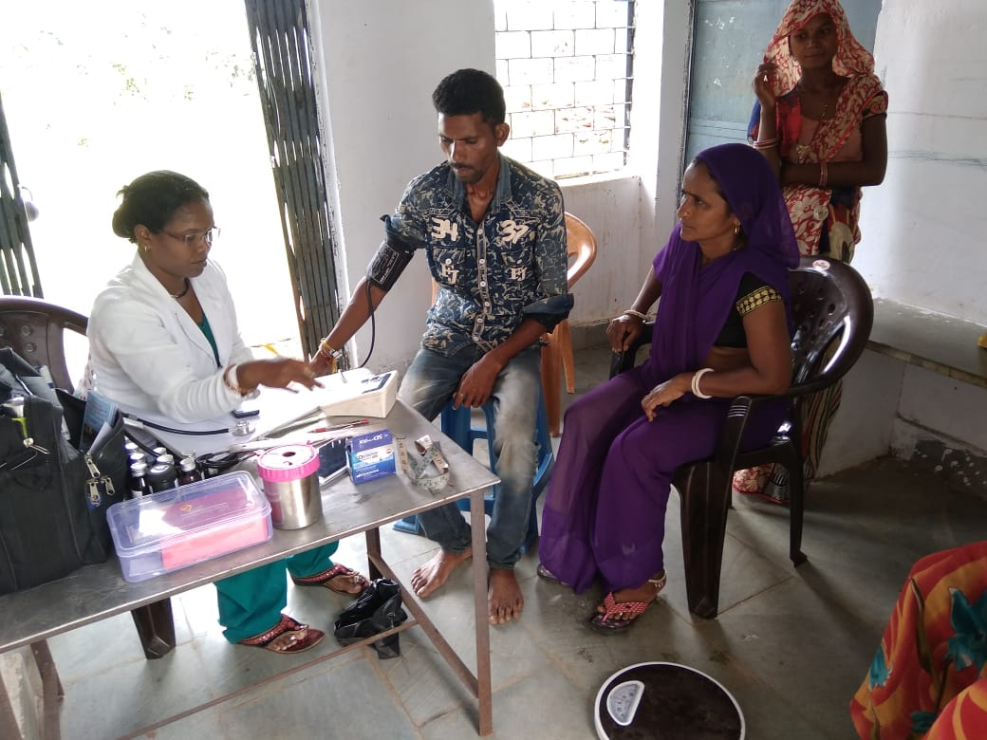
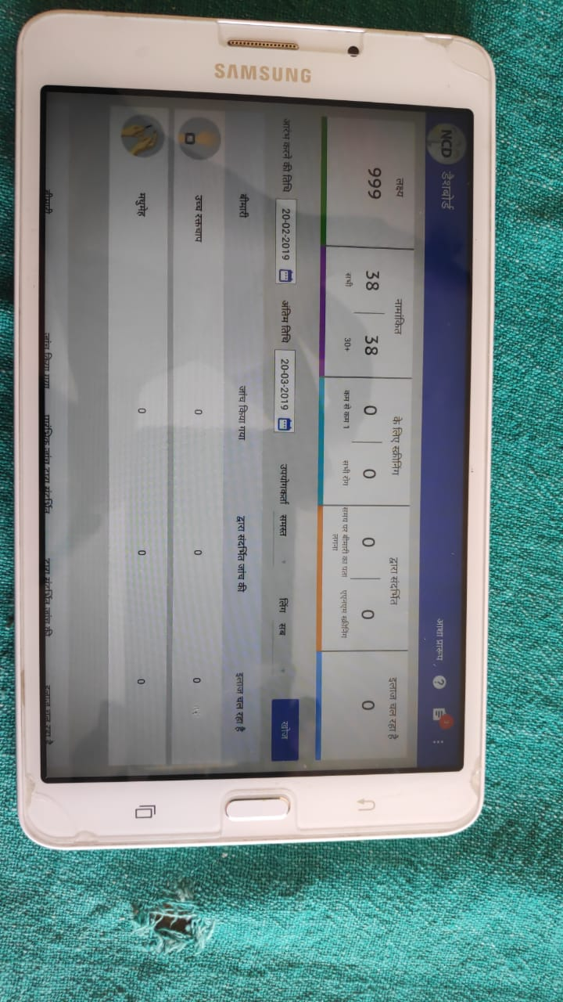
Population based Screening: NCD Screening Sessions

Slide 12
Utilization/Recruitment of MPW(Male)
Revival of MPW(Male) regular cadre
3707 MPWs(Male) redeployed for NCD program at SHCs along with MPW(Female)
Proposal to recruit 6932 MPW(Male) for gap-filling
Development of training module on CPHC for MPW (Male)
MPW(M) rechristened as Community Level NCD worker for active population screening in community

Slide 13
RMNCH+A services
Grading performance of all HWCs on key 16 indicators
RCH mirror portal for monitoring outreach services and HRPW/HRI management
HRPW and HRI identification, referral and follow-up, tagging with MPW(F), gynaecologist-obstetrician and delivery facility
Mandatory ANC check-up in 3rd and 4th trimester by MO at HWC(PHC)

Slide 14
CAPACITY BUILDING
Mentoring and hand-holding of 10 HWCs per Medical College – credit points for interns and Community medicine PG students - draft MOU under discussion
MCSP-USAID/Jhpiego – CHO program - creating pool of mentors and monitors, regular appraisals, supervision and handholding
PHFI - Training on Hypertension and Diabetes for MOs
CHAI/WISH - Drug supply logistics and management of cancer
Training of ASHA, MPW(F), MPW(M), MOs, M&E officers completed

Slide 15



Mentoring of PSCs
State Level mentors to provide mentoring and supportive supervision to newly established PSCs
  Preparation of MRP/CRP for each institution
  Preparation of registers (Admission register, Attendance register etc)
  Ensure soft copy/hard copy of IGNOU modules is available
  Financial planning
  Ensuring quality teaching during sessions
  Mentoring and periodic appraisals
Newly Identified Program Study Centres
Pool of Mentors
Ensuring quality training and session planning

Slide 16

BEST PRACTICE – SAKSHAM Roll Out
Competency enhancement of CHOs on expanded range of services to
  Perform clinical skills directly on clients during clinical practice
  Competently provide services related to all domains of CPHC at HWCs
Training Methodology includes
  Demonstration on Mannequins
  Simulation
  96 Standard Checklists

Slide 17
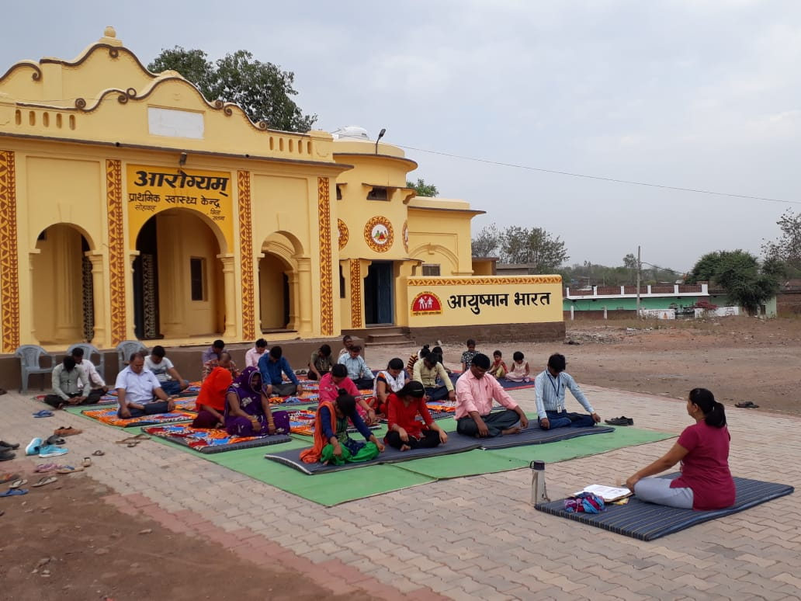
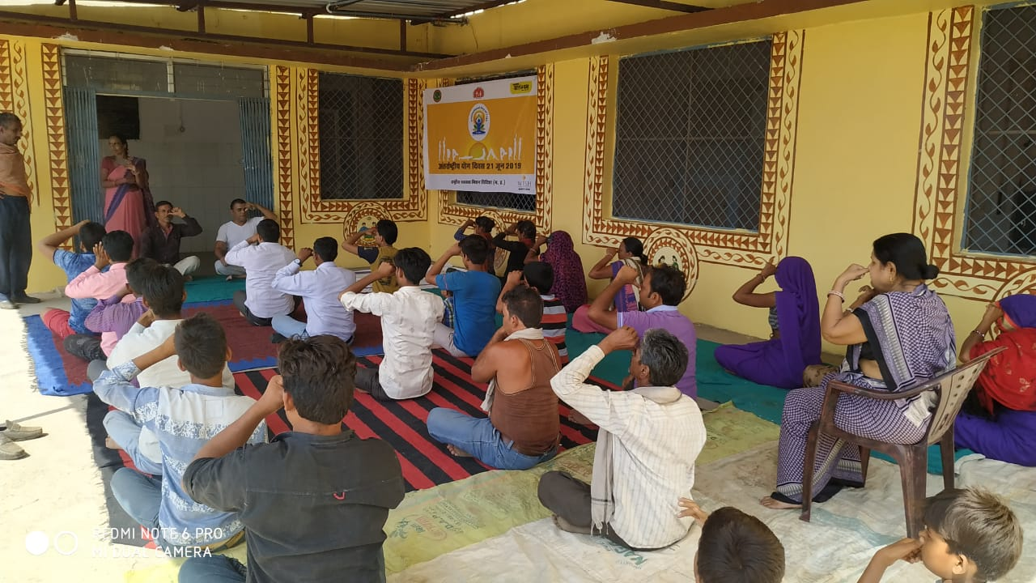
Activating Wellness Component
HWCs providing YOGA & Wellness Sessions | Number of Sessions held | Number of beneficiaries
65 | 453 | 1795
Inclusion of YOGA instructors and trainers from AYUSH Deptt, Education Deptt, Govt. Institutions and colleges – Standard RFP issued
Incentives to yoga instructor @ Rs 250/ session for conducting three sessions/week
Presently, 65 PHC-HWCs are providing YOGA and wellness sessions to community on regular basis

Slide 18
Formation of Civil Committees for Infrastructure and HWC Award
District Civil Committee
Medical Officer, BMO, Sub-engineer and DHO-1
Basic facilities and amenities as per the CPHC guidelines
Seven Divisional Workshops on Infrastructure Strengthening conducted
Prioritization of facilities for branding
Pooled fund allotted to districts under DHS
Monitoring and review in DHS
BEST HWC AWARD
Competition at district, division and state level on best developed and upgraded HWCs
Focus on External green development, YOGA space and use of solar energy
Divisional Civil Committee
RJD, CMHOs, and Divisional Engineer
State Civil Committee
Mission Director, HWC Nodal Officer, Urban Nodal Officer and Civil Department

Slide 19
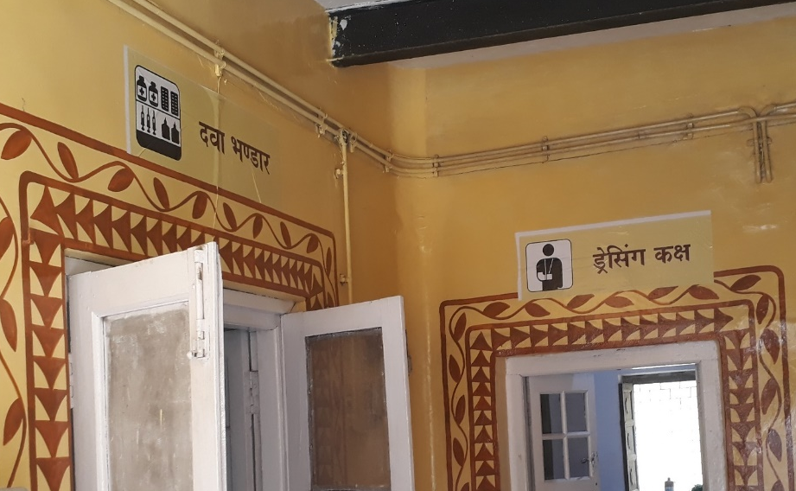
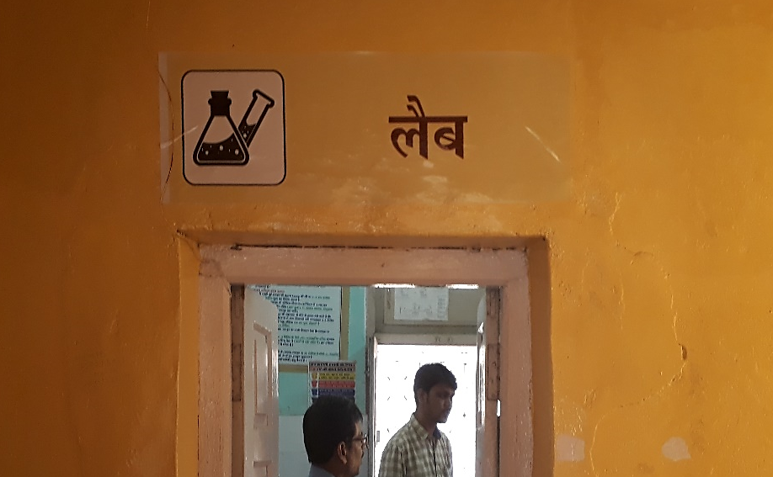
BEST PRACTICE - Internal Branding Package
Standardized Internal Branding package used at HWCs
Comprises of-
Posters
Signage
Citizen Charter
Designs of Sign Board
Banner and posters

Slide 20
Challenges and Way Forward
HR issues: Lack of Medical Officers, staff nurses and lab technicians at PHC level
Lack of well defined career pathway for CHOs
Need to increase number of PSCs (to meet CHO requirement)
Hiring CHO recruitment agency
Entrenching mentorship and quality of teaching at PSCs
Utilizing MCs for mentorship of HWCs
Recruitment of MPW(Male) in matching numbers
Handholding MOs via Telemedicine facility

Slide 21
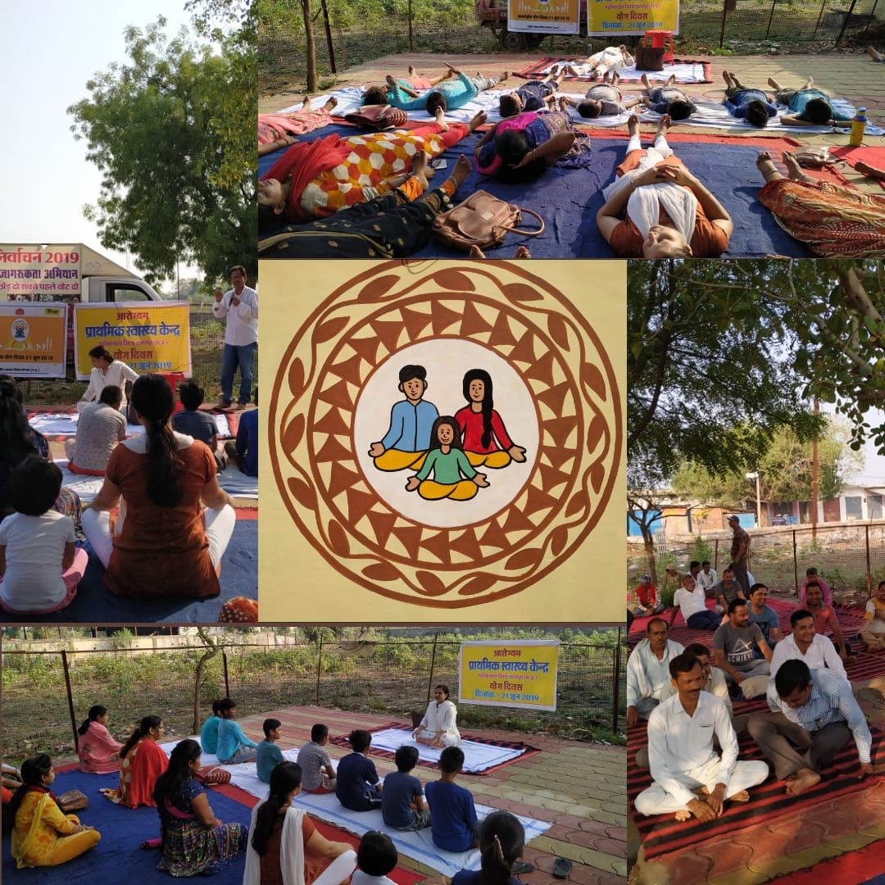
Thank You

