Slide 1
MCSP Health and Wellness Centers Program
Lessons Learnt and Experiences from Intervention States

Slide 2





The Reach
Arunachal Pradesh
Assam
Chhattisgarh
Jharkhand
Madhya Pradesh
Manipur
Meghalaya
Mizoram
Nagaland
Odisha
Sikkim
Tripura
Uttar Pradesh
3921 facilities upgraded to HWCs
13
States (12 USAID + 1 UPTSU)
111
Training sites established
Districts
(including 24 Aspirational Districts)
65.3 Million Population

Slide 3








Technical Assistance in Operationalization of HWCs
Strengthening Institutional Mechanisms
Capacity Building
Operational Planning
IEC and Facility Branding
Facilitate Infrastructural Strengthening
Community mobilization and Demand Generation
Leveraging Funds through non-conventional Health sources
Supportive Supervision and Feedback

Slide 4






TA for Roll out of Certificate Course
Establishment of Training Sites
Creating a Resource Pool
Academic Planning
Stakeholder coordination
Standardized Teaching Learning Materials
Mentoring and Quality Assurance

Slide 5
Supportive Supervision Mechanism – HWCs
Mentoring & Quality Assurance- PSCs

Slide 6
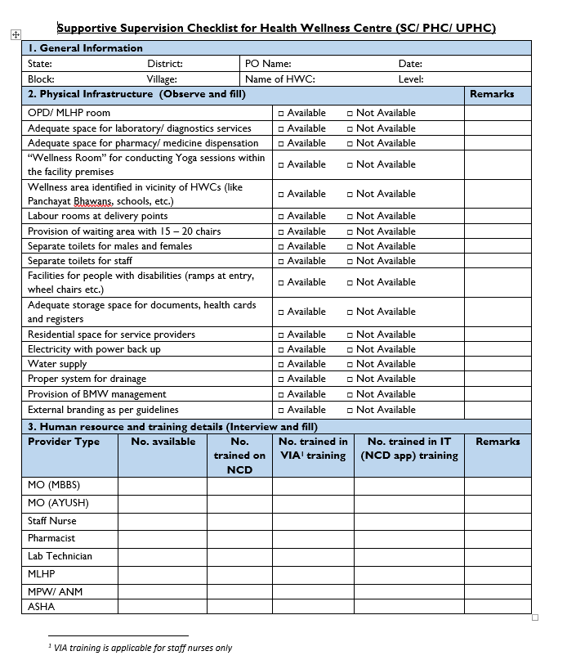
Supportive supervision visits
Purpose: To assess the functionality of HWCs in terms of availability of physical infrastructure, human resources, drugs & diagnostics, IT services and wellness activities etc.
Data Collection Tool: SSV checklist
Collection Frequency: Quarterly (Program Officers are visiting all the targeted facility at-least once in a quarter)

Slide 7
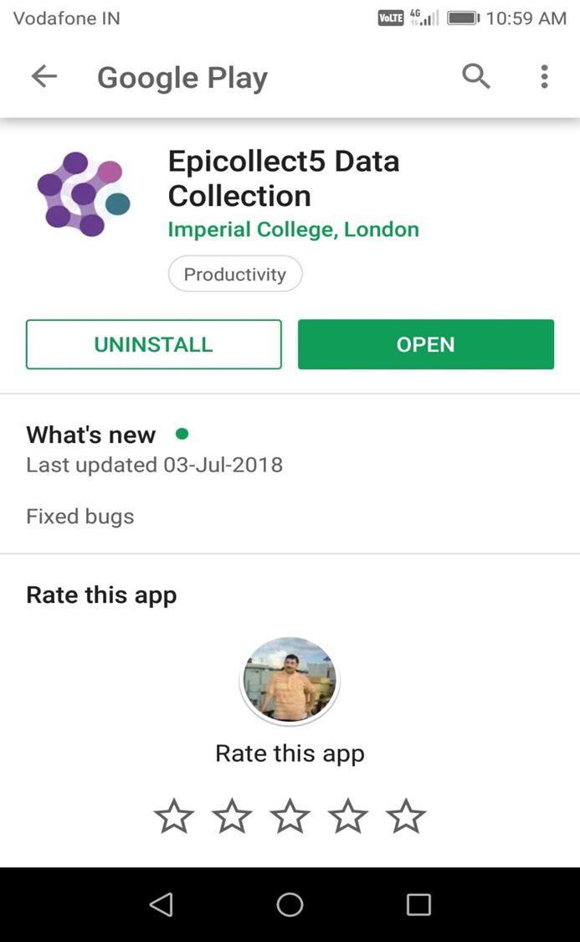
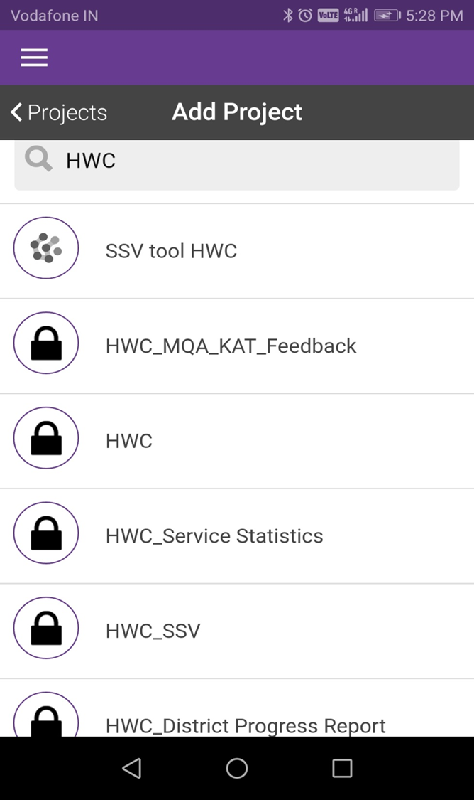
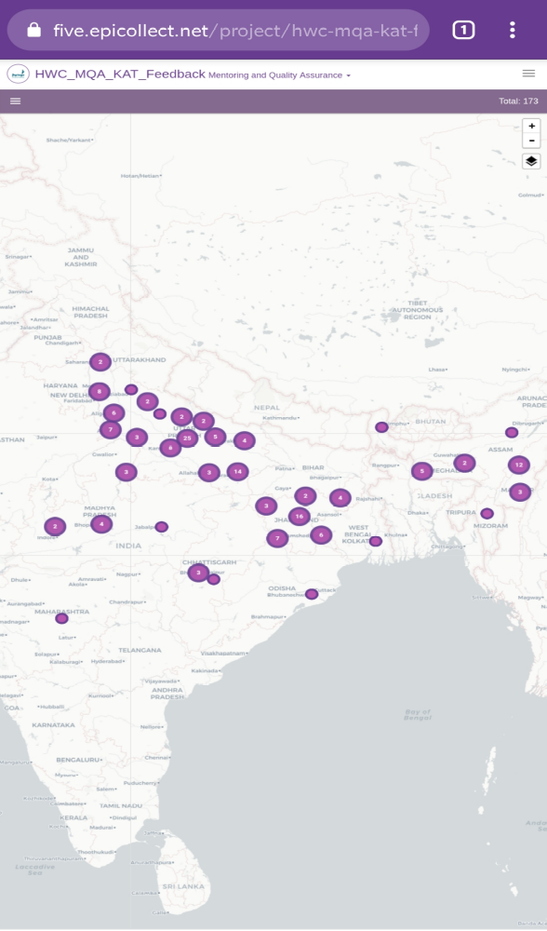
Capturing real time SSV data through open source mobile application

Slide 8
Supportive Supervision – Key areas
General Information
Physical Infrastructure
Drugs & Supplies
Diagnostics
IT Services
Wellness activities
HR & Training
IEC
Service Delivery

Slide 9

Data flow
Data collection from HWCs & entry into mobile software by POs
Report shared with stakeholders at State and District level
Data quality assurance, compilation, analysis and state level reporting – State level
Sharing of data/report to state level

Slide 10
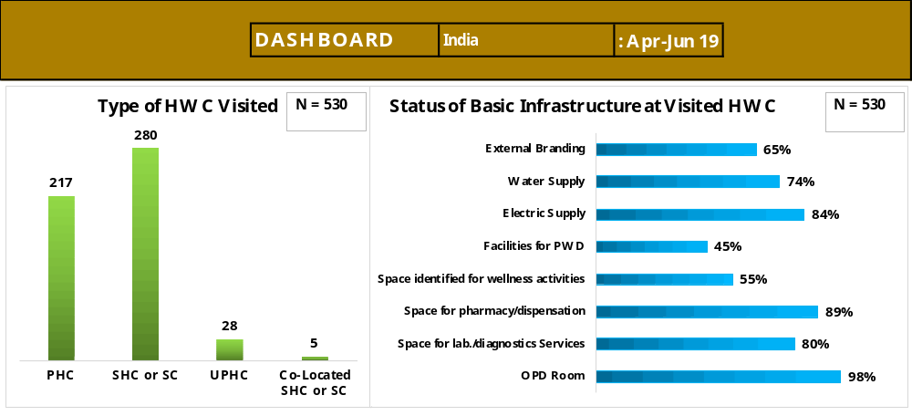
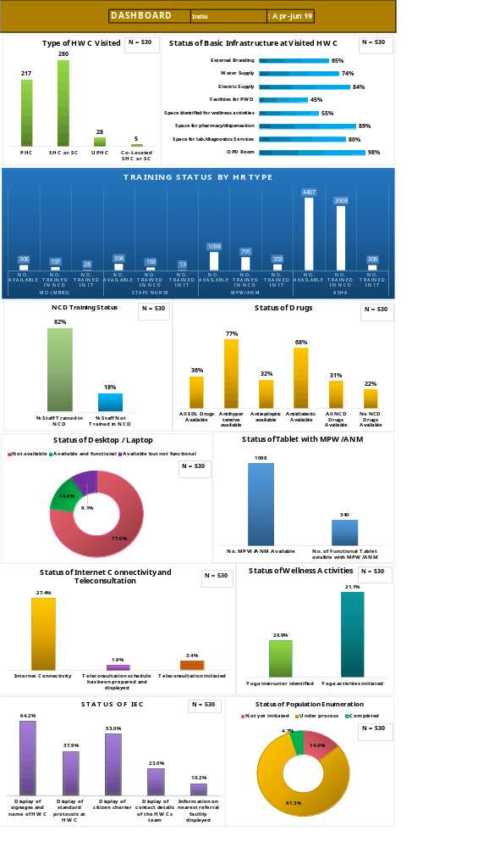
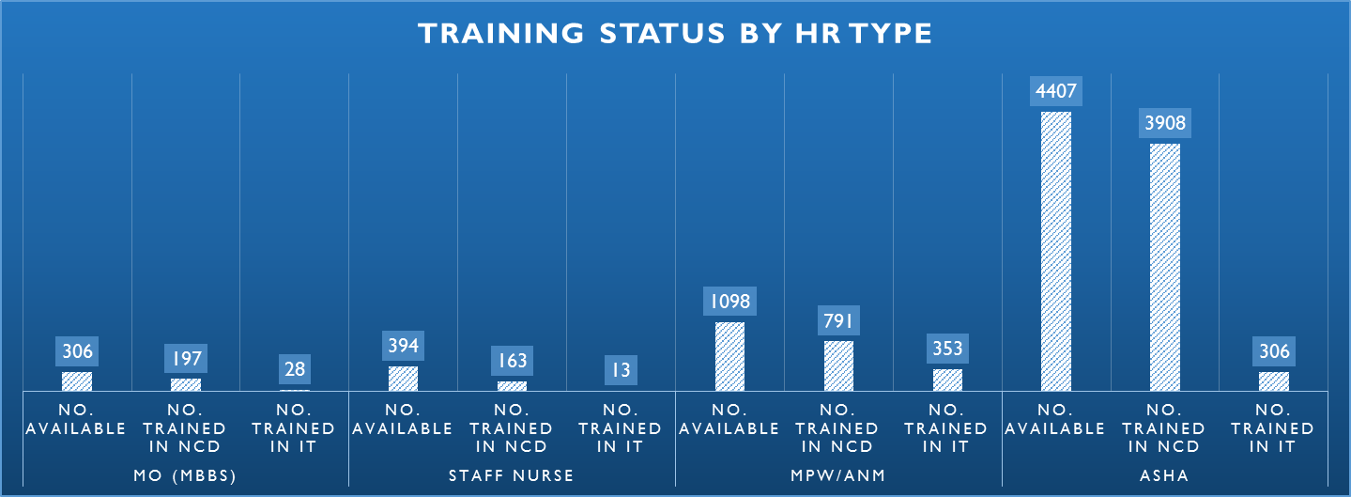
Supportive Supervision– Dashboard

Slide 11
Results of Supportive Supervision
SS Visits supported in improving in HWC Infrastructure

Slide 12
Results of Supportive Supervision
SS Visits supported in improving availability of trained HR and IT logistics at HWCs
Status of NCD Training of HR
Availability of IT equipment

Slide 13
Results of Supportive Supervision
Improvement in availability of Drugs

Slide 14
Improvement in Availability of IEC Materials
Results of Supportive Supervision

Slide 15

Mentoring & Quality Assurance (MQA) model
Key components
MQA Checklist
Student’s Feedback Questionnaire
Knowledge Assessment Tool

Slide 16
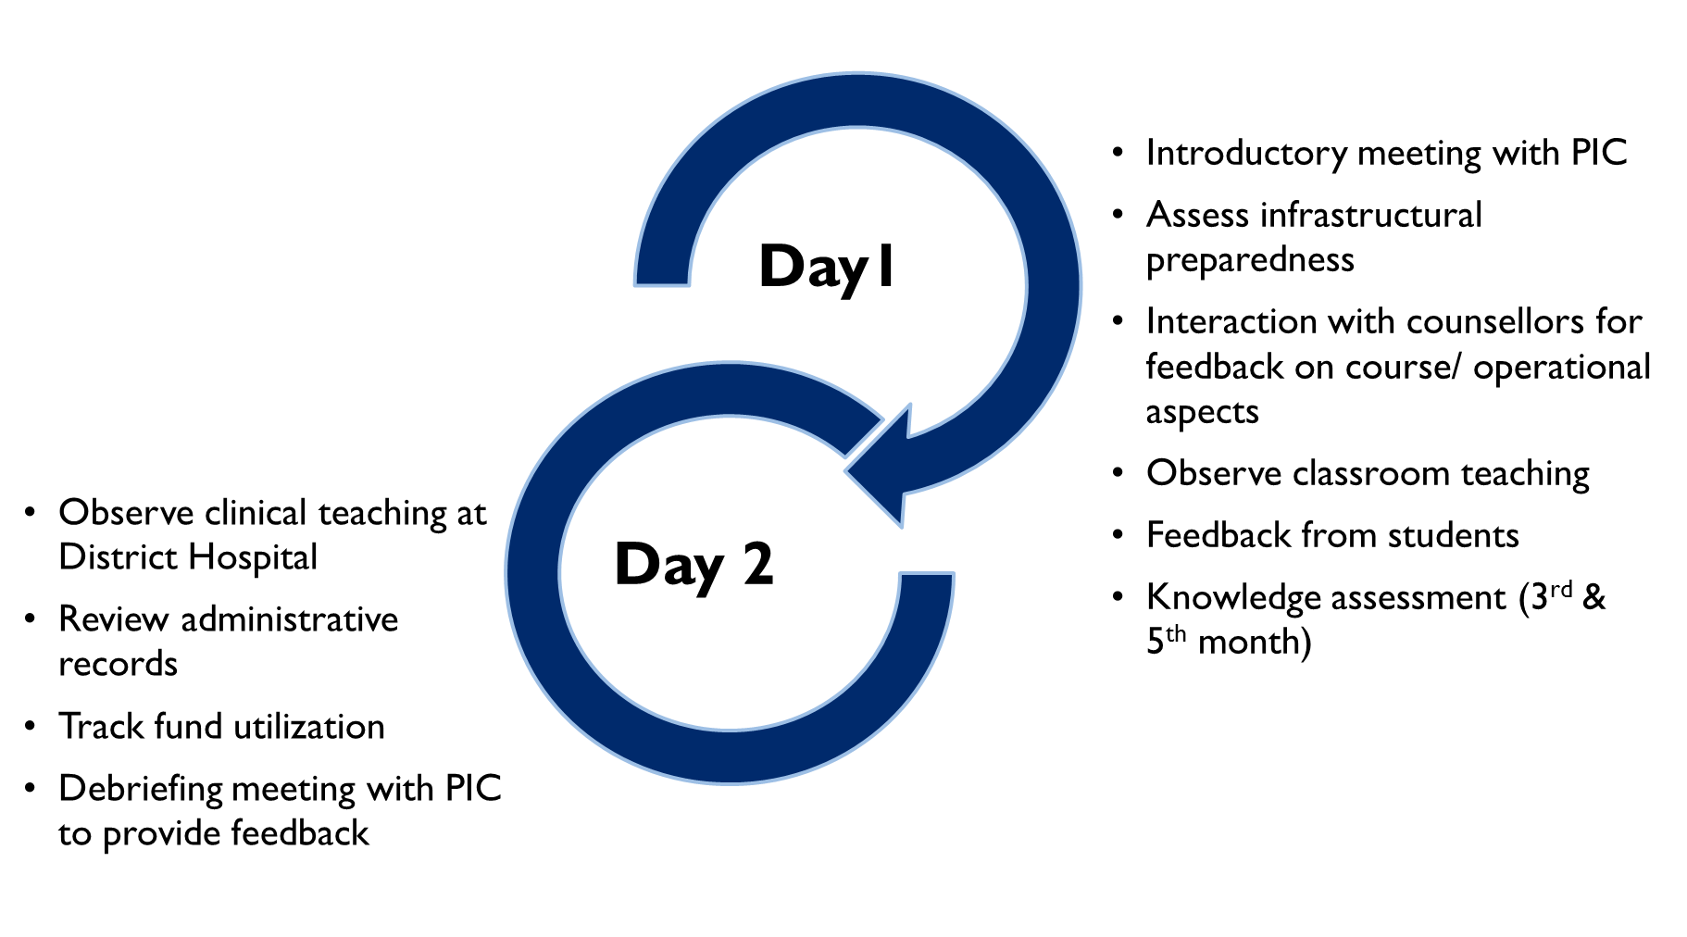
Operational Aspects of MQA
The Team:
State Nodal Officers (HWC/CCCH)
DPMU Team members
Jhpiego representatives

Slide 17
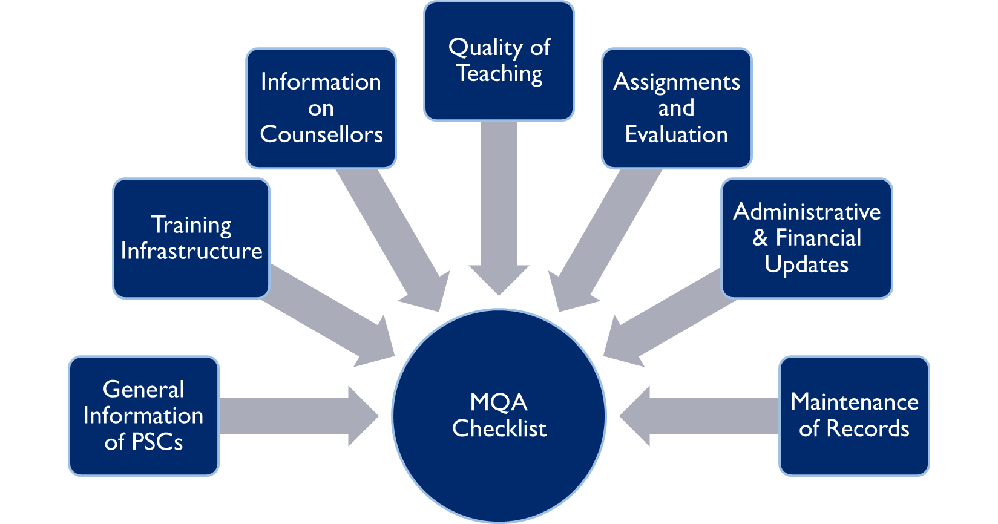
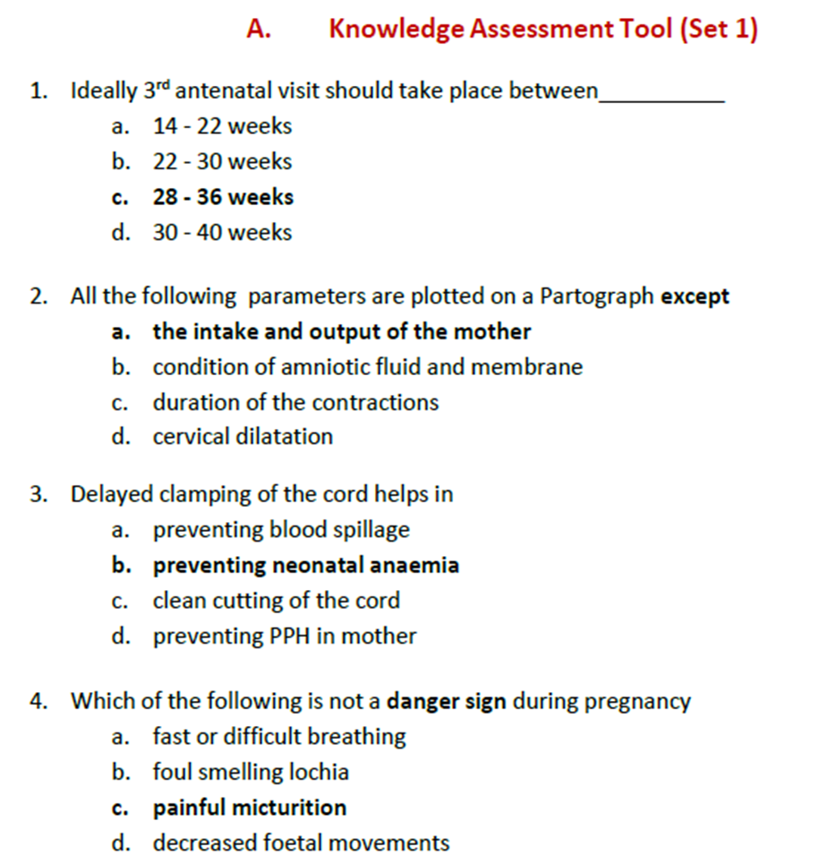
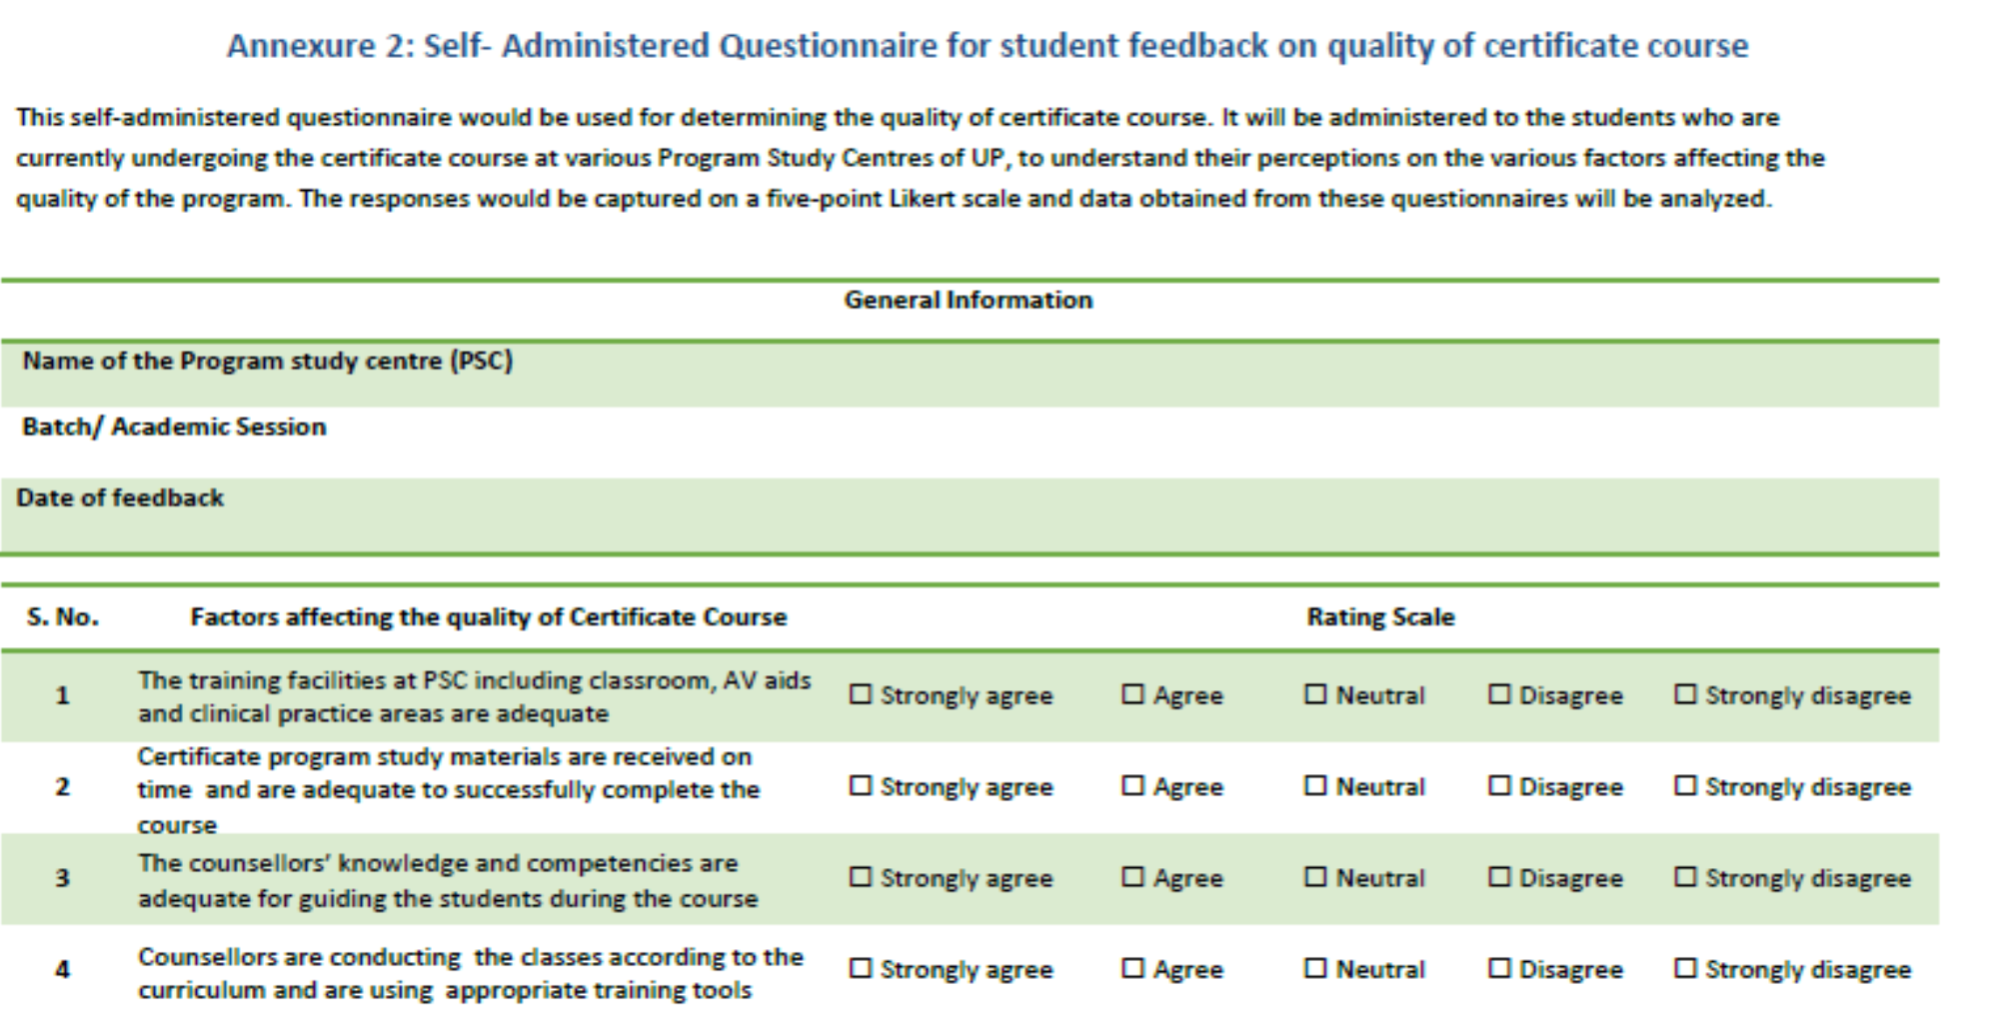
MQA- Toolkit

Slide 18

Summarizing MQA visit Report
Status of dashboard indicators: 14 dashboard indicators reflecting upon infrastructural preparedness, quality of education (theory & practical) and management practices
Key highlights: Includes a summary of best practices, innovative approaches being used by PSCs
Areas of concern: Issues at PSCs which need immediate attention

Slide 19
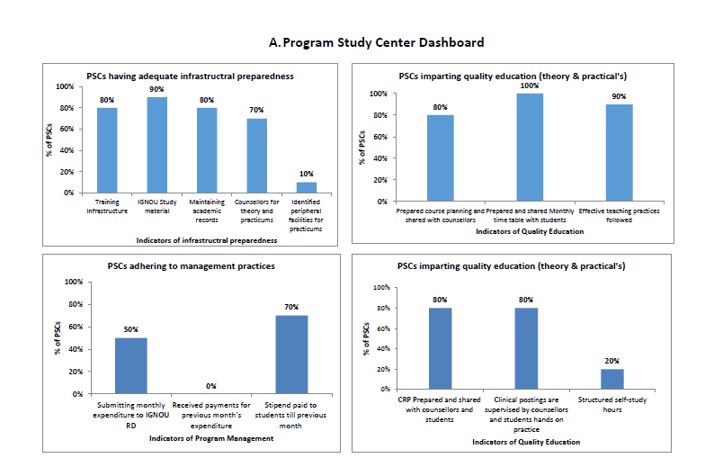
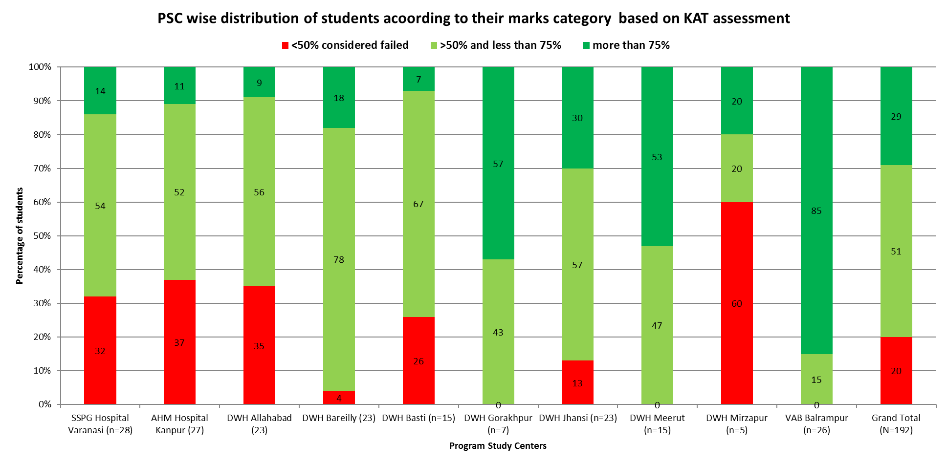
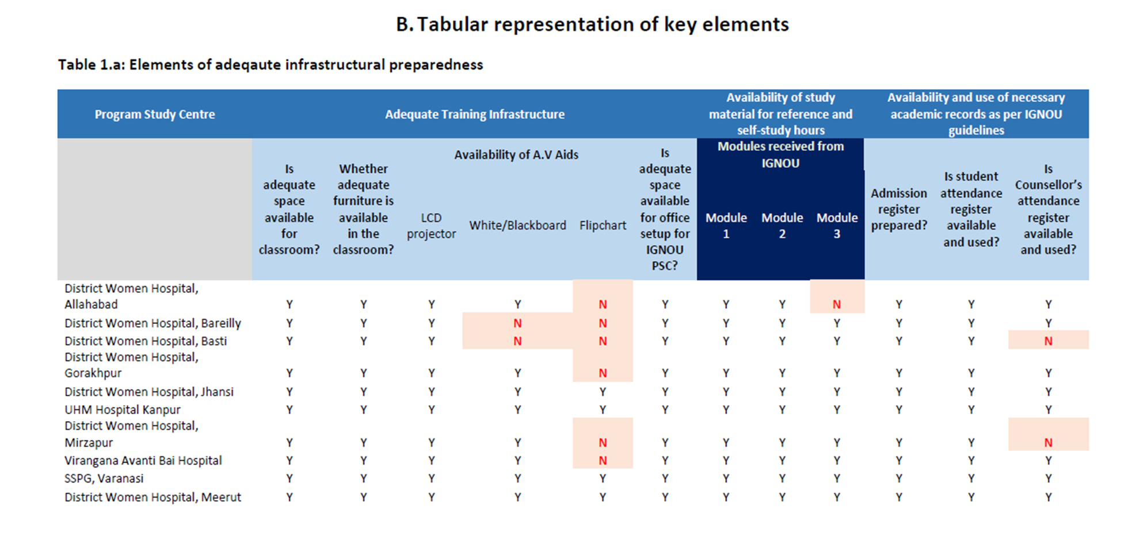
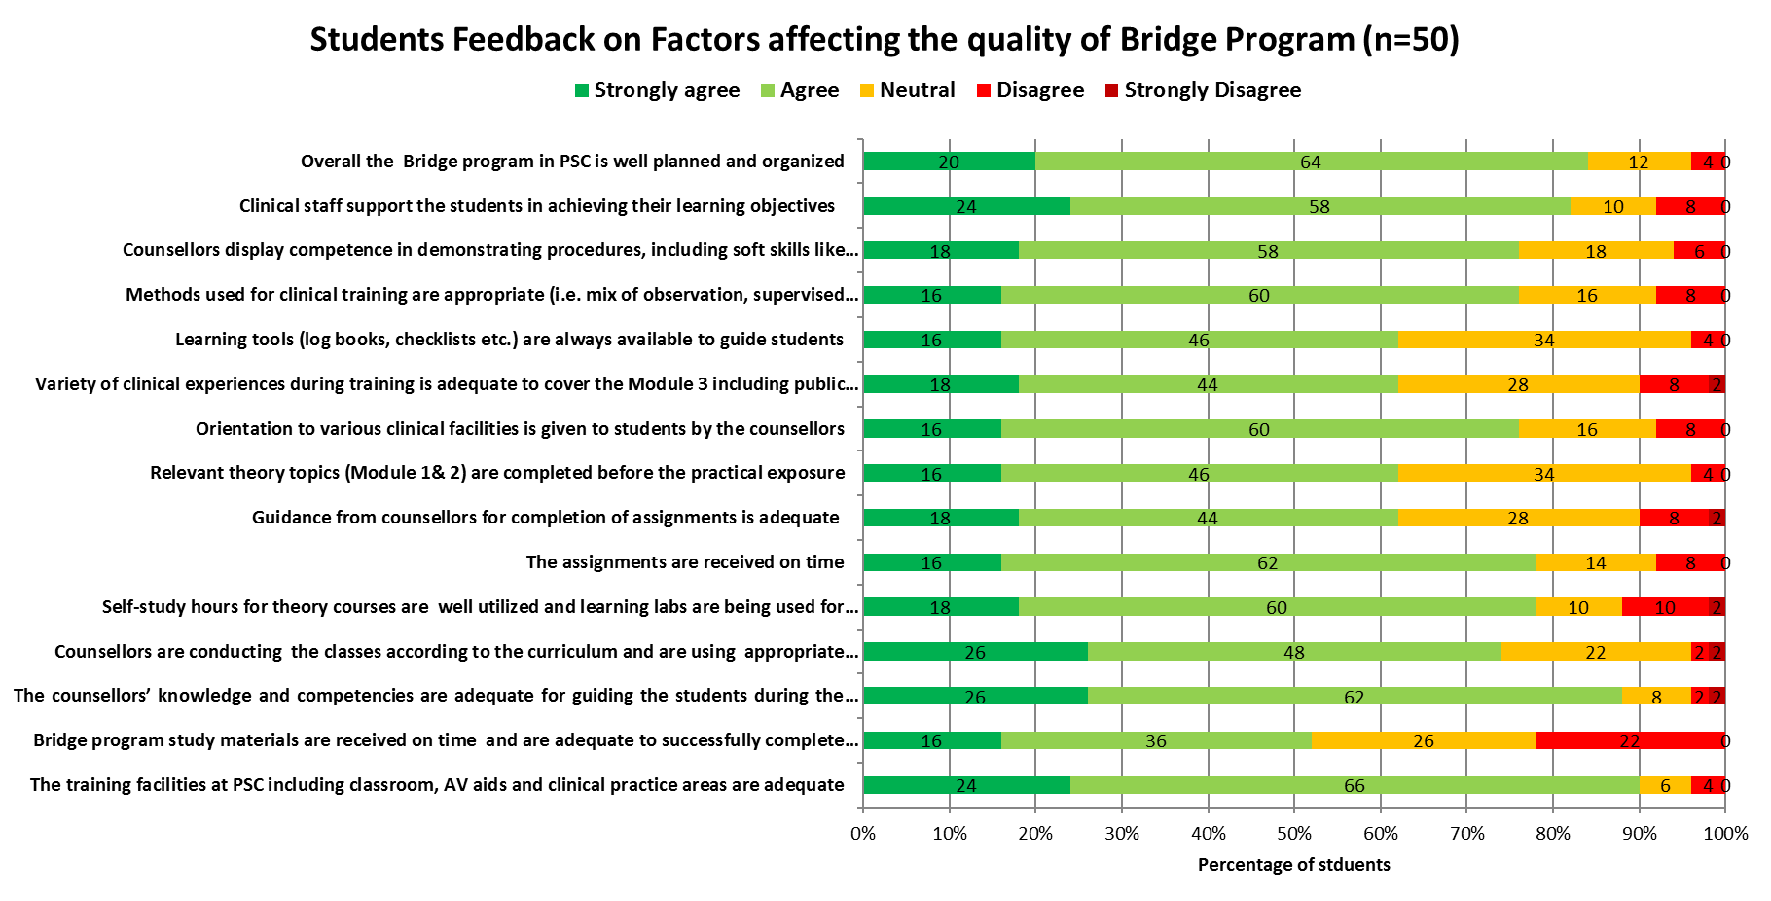
Mentoring and Quality Assurance – Dashboard

Slide 20
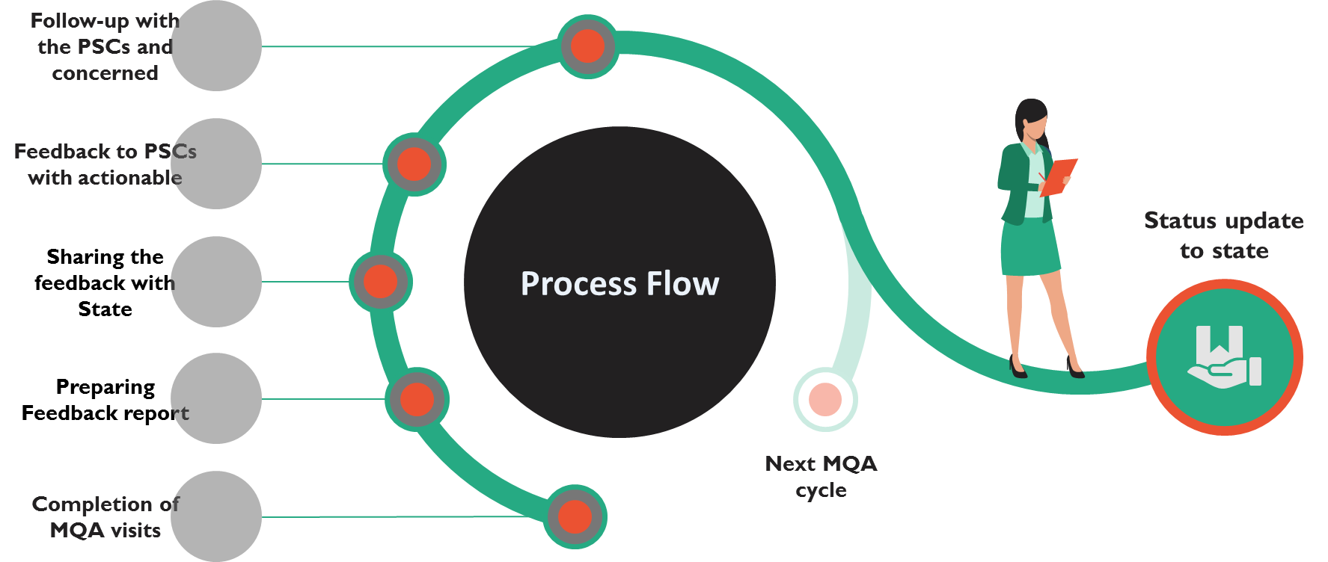
The Process: closing the loop

Slide 21
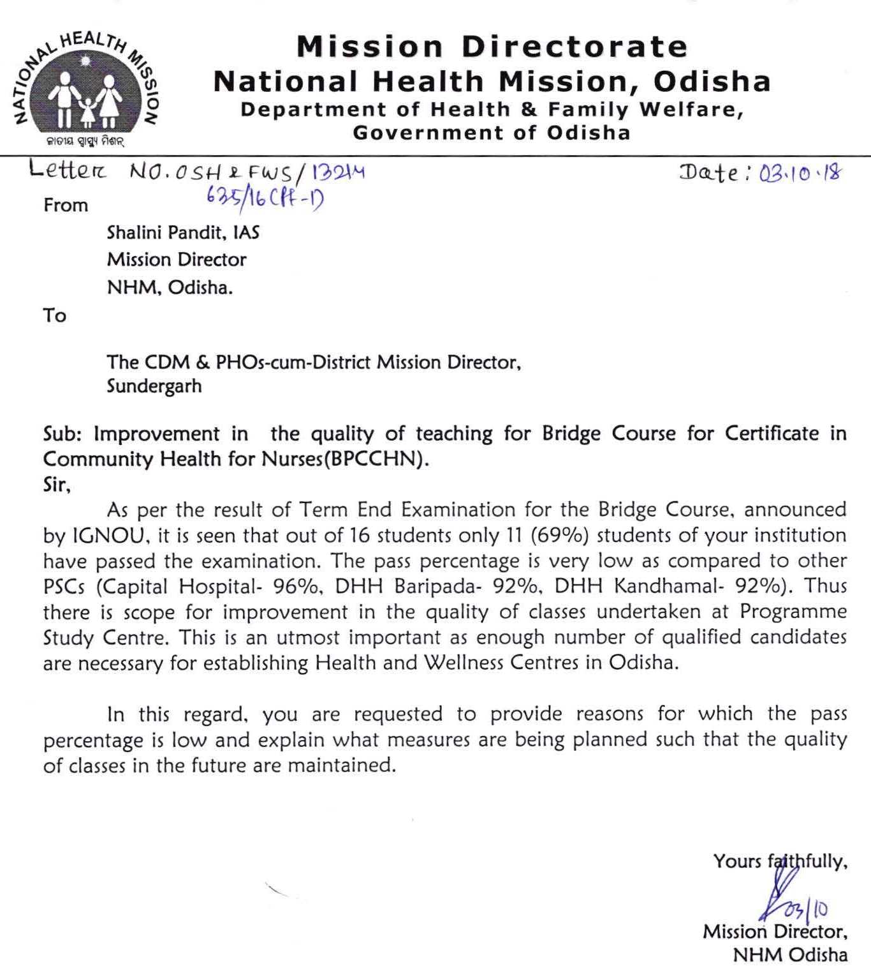
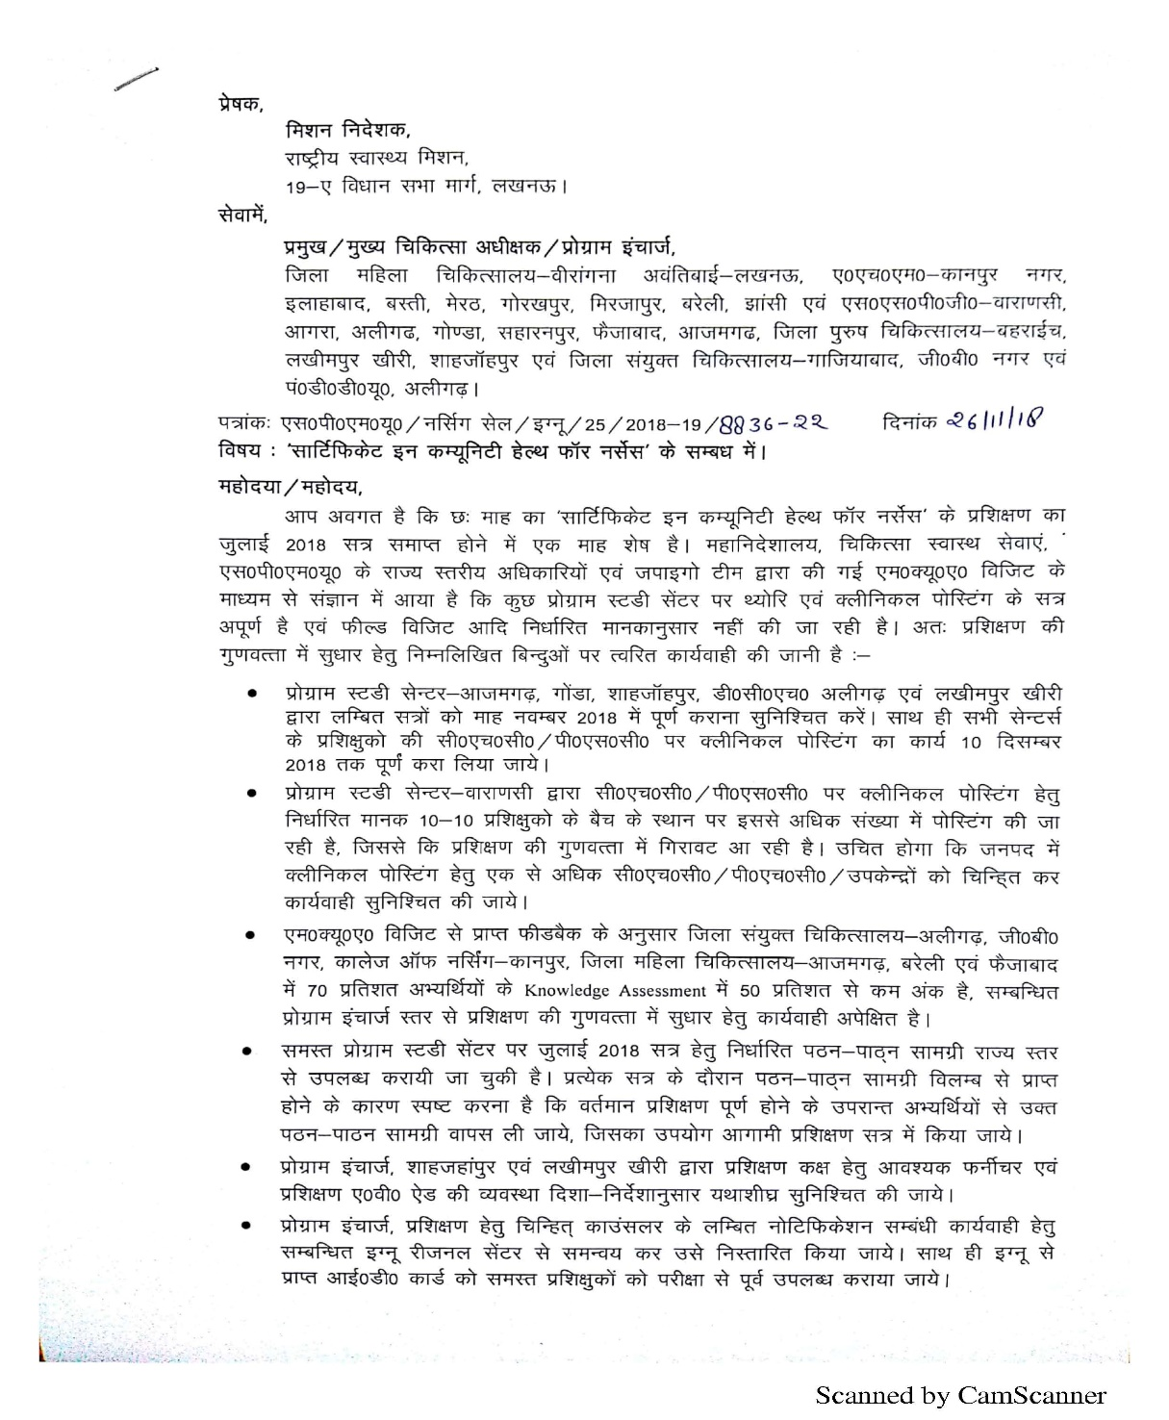
Promoting evidence based actions and accountability
Initiation of clinical posting of JAN 2018 batch at Sundergarh PSC
State feedback to PSCs with clearly delineated actionable

Slide 22
Effectiveness of MQA Model
Improvement in Training Infrastructure
Availability of Study Materials

Slide 23
Participants feedback during MQA
Level of Satisfaction with Quality of Clinical Training
Level of Satisfaction with learning Environment

Slide 24
Priority Areas for Support in next phase
Setting up a Rapid Response Unit for providing need-based, quality soft TA to additional states beyond direct intervention areas
Strengthening preventive, promotive and wellness component within HWCs
Institutionalize a system for Supportive Supervision
Recognizing and rewarding high-performing HWCs and CHOs, to ensure that staff are motivated and the momentum is accelerated
Integration of School Health Program within HWC initiative
Ensuring unfinished agenda of RMNCH+A and TB-free India through HWCs
Work together for transforming India’s healthcare service delivery and ensuring the ultimate goal of providing quality, accessible and affordable healthcare for all

Slide 25
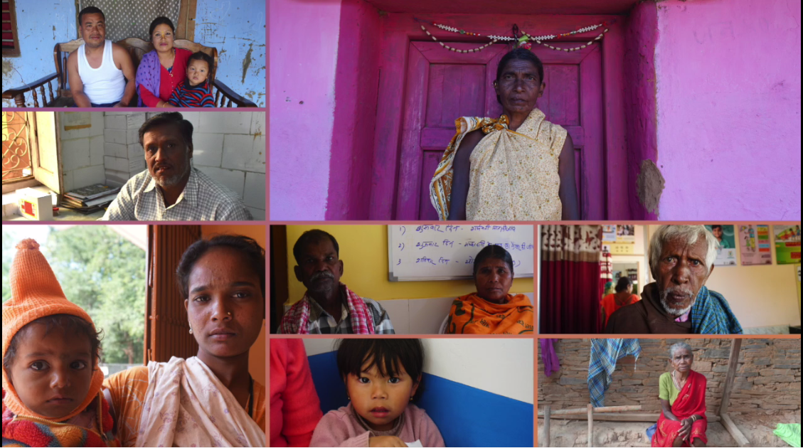
Thank You

