Slide 1






AYUSHMAN BHARAT
3rd Regional Workshop on AB-HWC
5th & 6th September 2019
Presented by: MD,NHM,J&K

Slide 2
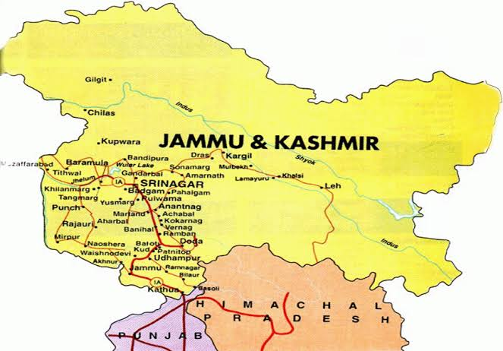
J&K State profile
Jammu & Kashmir comprises of 22 districts.
10 districts in Jammu and 10 in Kashmir and 2 in Ladakh.
Mostly hilly/ mountainous terrain except some areas of Jammu/ Kathua and Samba districts in Jammu Division and Srinagar, Kulgam, Anantnag, Budgam, Pulwama, Ganderbal in Kashmir Division.
Extreme climatic conditions-harsh winters.

Slide 3
J&K State profile Cont...
Total population is about 1.3 Crores.
Most of population is rural, sparse, difficult terrain
Health Infrastructure-
23-District Hospitals, 84 CHCs, 398 PHCs, 49 UPHCs, 239 NTPHCs, 3025 Sub Centres.
7- Government Medical Colleges, 3- more sanctioned by GoI,
2-Govt. Dental Colleges,
1-Sher-i-Kashmir Institute of Medical Sciences, Soura Srinagar,
1-Private Medical College and 1-Private Dental College.

Slide 4
Health Indicators-comparison
S. No | Health Indicator | State of J&K | National
1 | Infant Mortality Rate (IMR) | 23 | 33
2 | Neonatal Mortality Rate (NMR) | 17 | 23
3 | Early Neonatal Mortality Rate (ENMR) | 15 | 18
4 | Under 5 Mortality Rate | 24 | 37
5 | Total Fertility Rate (TFR) | 1.7 | 2.2
Source: SRS-2017

Slide 5
Number of HWCs Approved
Sl. No | Director Health Services | HWC-PHCs/ NTPHCs/ UPHCs | HWC-SCs | Total
1 | Jammu | 46 | 120 | 166
2 | Kashmir | 94 | 81 | 175
Total |  | 140 | 201 | 341
FY-2019-20 Approved |  | 291 | 480 | 771
Target by March 2020 |  | 431 | 681 | 1112

Slide 6
Current Status of HWCs
Total Target for FY-2019-20 is 1112 HWCs.
240 HWCs (126-SCs, 100-PHC, 14-UPHCs) are operational in the State against the total approval of 1112.
Infrastructure and Façade Branding completed in 310 HWCs.
Drugs and diagnostics are being provided as per state government decision and GoI guidelines (19 drugs & 07 diagnostics at HWC-SC; and 71 drugs and 19 diagnostics at HWC-PHC having Lab. Technician.)

Slide 7
Current Status of HWCs-cont.
Local Health authorities authorized to purchase drugs from Jan Aushadi incase of non availability from JKMSCL.
MPWs of HWCs provided hands on training for 3-5 days at nearest Laboratory of CHC/ DH for basic tests.
Existing services like-Ante Natal care, Family Planning services, immunization, VHNDs, OPD, health promotions are also being strengthened.
Universal Screening for Common NCDs are being conducted on fixed day i.e. (every Saturday).

Slide 8
Current Status of HWCs Cont.
140 MLHPs are trained and posted at HWC-SCs, and Results of 102 candidates of January 2019 session are awaited.
500 MLHPs selected, to be trained in July- Dec. 2019 session out of which 300 MLHPs through IGNOU and 200 through University of Kashmir.
IEC material of CPHC is being printed and shall be available in HWCs.

Slide 9
Current Status of HWCs Cont.
Wellness Activities at HWC-SCs- State has organised International Yoga Day at most of the HWCs, Yoga sessions are being conducted by MLHPs, in addition to Yoga, other wellness activities are being carried out in form of exercise/ physical activities, Health Promotion and modification in food habits etc.
Shortage of trained Yoga Instructors in State.

Slide 10
Drugs & Diagnostics
Drugs & Diagnostics
Essential Drug List : State has approved 23 Drugs including Anti hypertensive and Anti Diabetic drugs for HWC-Sub Centres; and 71 Drugs for HWC-Primary Health Centres and UPHC. Funds available under Free Drugs Policy have been utilized for providing essential drugs at HWCs.
Diagnostics Services : at HWC-Sub-Centre - 07 Diagnostics; and at PHC/ NTPHC/ UPHC- HWCs 17 Diagnostics (available at PHCs where Laboratory Technicians are available)

Slide 11
Status of Programme Study Centres
FY | Approved | Established | REMARKS
2017-18 | 4 | 4 | Enhancement of intake by PSC Govt. Hospital Gandhi Nagar, Jammu, PSC DH Udhampur, PSC- DH Baramulla & PSC- DH Anantnag with intake capacity 30 candidates per PSC
2018-19 | 4 | 4 | 2 PSC-Kashmir University (50 candidates per PSC), BUMS only JLNM Hospital, Srinagar and District Hospital Pulwama 2 PSC through –IGNOU, DH Rajouri, DH Kathua (30 Seats)
2019-20 | 4 | 2 | 2 PSC- Kashmir University (50 Per PSC), BUMS only District Hospital, Ganderbal and District Hospital Kulgam. 2 PSCs through IGNOU- Planned at DH Poonch and CHC/ Nursing College Akhnoor
TOTAL | 12 | 10 | Total 6 PSC through IGNOU and 4 PSC through University of Kashmir.

Slide 12
Establishment of Programme Study Centres (BPCCHN) through IGNOU
S. No | Programme Study Centres | Intake capacity per session
1 | District Hospital - Anantnag | 60
2 | District Hospital - Baramulla | 60
3 | District Hospital -Udhampur | 60
4 | Govt. Hospital Gandhi Nagar, Jammu | 60
5 | District Hospital -Kathua | 30
6 | District Hospital - Rajouri | 30
 | Total | 300

Slide 13
Alternate strategy to increase availability of MLHPs for operationalization of Health & Wellness Centres
J&K Initiative………
A collaborative innovation of University of Kashmir, Directorate of Life-Long learning and National Health Mission to roll out the six months certificate course in community health for Unani Graduates.
Notes:
© Copyright PresentationGo.com – The free PowerPoint library

Slide 14
Establishment of Programme Study Centres (BPCCHN) through University of Kashmir for Unani Graduates
S. No | Programme Study Centres | Intake capacity per session
1 | JLNM Hospital, Rainawari, Srinagar | 50
2 | District Hospital Pulwama | 50
3 | District Hospital Kulgam | 50
4 | District Hospital Ganderbal | 50
 | Total | 200
 | Grand total (IGNOU + Kashmir University) | 500

Slide 15
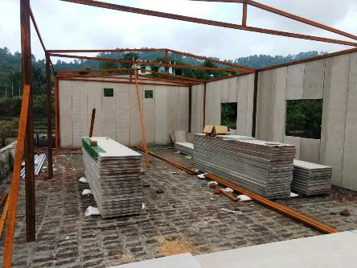
Alternate strategy for development of Space for Health & Wellness Centre
J&K Initiative Cont……
Additional space being created using Pre fabricated materials, helping in reducing the cost and timely completion.
Notes:
© Copyright PresentationGo.com – The free PowerPoint library

Slide 16
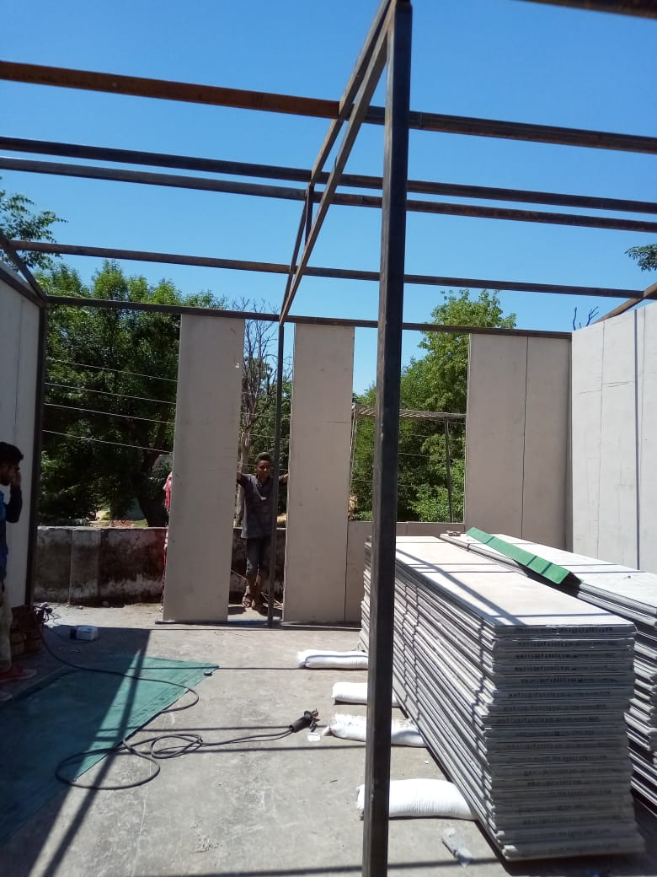
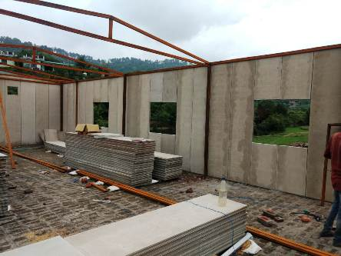
Pre Fabricated Structure of HWC
Notes:
© Copyright PresentationGo.com – The free PowerPoint library

Slide 17
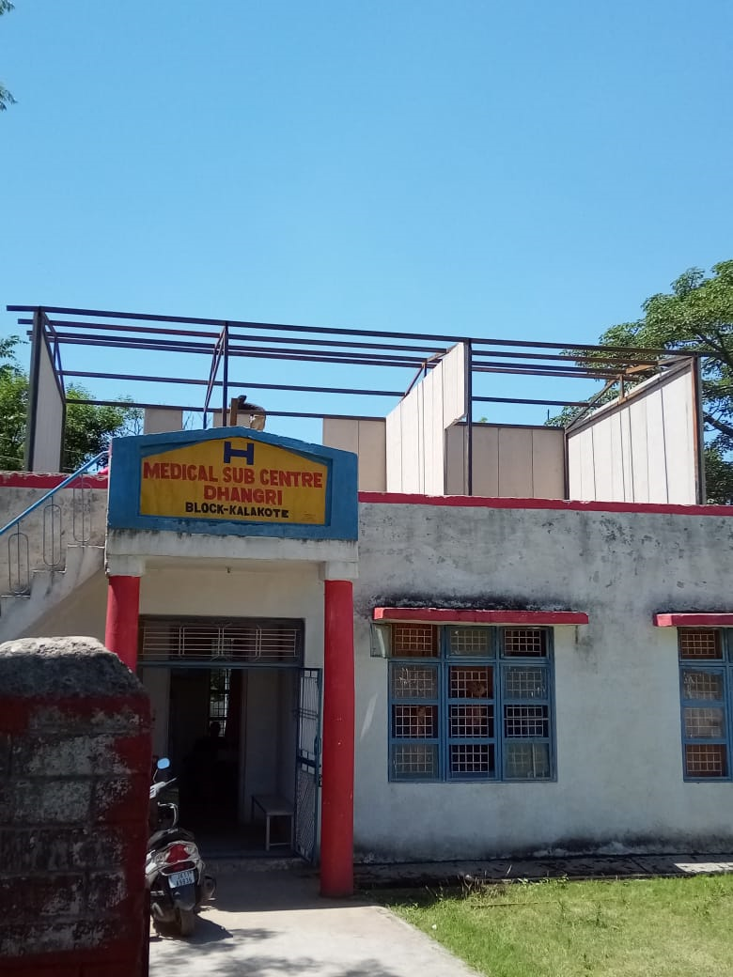
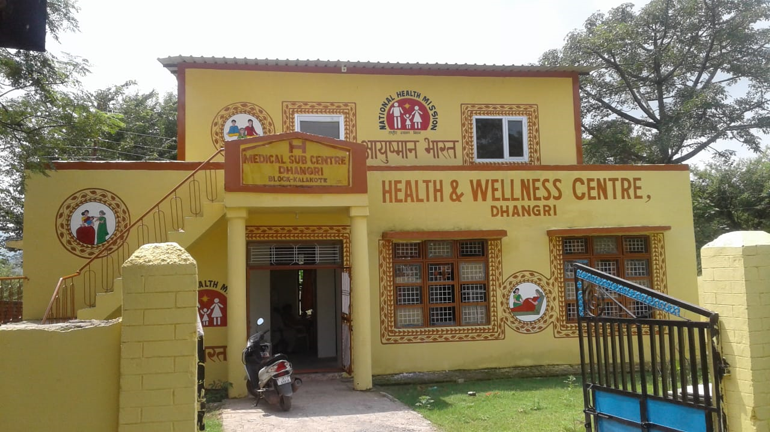
Pre Fabricated Structure of HWC- SC
Before
After
Notes:
© Copyright PresentationGo.com – The free PowerPoint library

Slide 18
Status of Population Based Screening for Common NCDs FY-2018-19
Name of District | Total 30-Plus Population Screened for common NCDs |  |  | Suspected
 | Male | Female | Total | Normal | Hypertension | Diabetes | Oral | Breast | Cervical
Kupwara | 67765 | 60495 | 128260 | 105697 | 18776 | 3777 | 7 | 2 | 1
Baramulla | 97724 | 109383 | 207107 | 176887 | 17227 | 12926 | 25 | 30 | 12
Anantnag | 58920 | 68305 | 127225 | 114603 | 8045 | 4572 | 1 | 4 | 0
Doda | 42698 | 33994 | 76692 | 65184 | 6631 | 3520 | 1281 | 76 | 0
Udhampur | 33699 | 37735 | 71434 | 67326 | 2360 | 1501 | 100 | 147 | 0
Jammu | 75315 | 71253 | 146568 | 125996 | 19253 | 1294 | 20 | 2 | 3
State Total | 376121 | 381165 | 757286 | 655693 | 72292 | 27590 | 1434 | 261 | 16
Target | 696000 (as per 2011 census) |  | 757286 (till 31st March 2019)
Number of Hypertension Cases confirmed is 31638 and on treatment is 27232 Number of Diabetes cases confirmed is 19550 and on treatment is 17149 Number of oral cancer cases confirmed is 44 and on treatment is 44. Number of Breast Cancer cases confirmed is 40 and on treatment is 35. Number of Cervical Cancer cases confirmed is 9 and on treatment is 9. Note: Cervical Cancer Screening is being done under NPCDCs Programme at CHC/ DH level. For confirmation of diagnosis and treatment of suspected Cancer cases are being referred to Medical Colleges and territory care centres for further management.

Slide 19
Training Status
Training on Universal Screening for common NCDs of District trainers (ToTs) for ASHAs and ANMs are completed.
Training of ASHAs (5 days) & ANMs (4 days) and Medical Officers (2 days) of six districts where Population Based Screening is rolled out.
3 days Induction/ orientation training regarding Comprehensive Primary Health Care (CPHC) conducted for 126 MLHPs/ CHOs.

Slide 20
Training Status Cont….
2-days Orientation of CMOs/ DHOs/ BMOs & 1 Male & 1 Female MBBS M.O from each block & DPMU of PBS districts regarding CPHC & operationalization of HWCs conducted.
2-days Training on software NCD application for District Trainers completed with the support of Tata Trust.
ANMs/ ASHAs/ Medical Officers and CHOs have been provided printed material shared by MoH&FW, GoI. for references.

Slide 21
Challenges
Infrastructure not available as per guidelines, most of NTPHCs/ UPHCs and Sub Centres are in private, rented accommodation with limited space and scope for extension or additional space.
Non availability of Laboratory Technician (LT’s) in NTPHC/ UPHCs, State has proposed 288 LT’s in Supplementary PIP for FY-2019-20.
Non availability of dedicated DEOs for HWCs in Health Blocks- State has proposed 50 DEOs in Supplementary PIP for FY-2019-20.
Non availability of Helper in HWCs- State has proposed 1112 helper/Sweeper in Supplementary PIP for FY-2019-20.

Slide 22
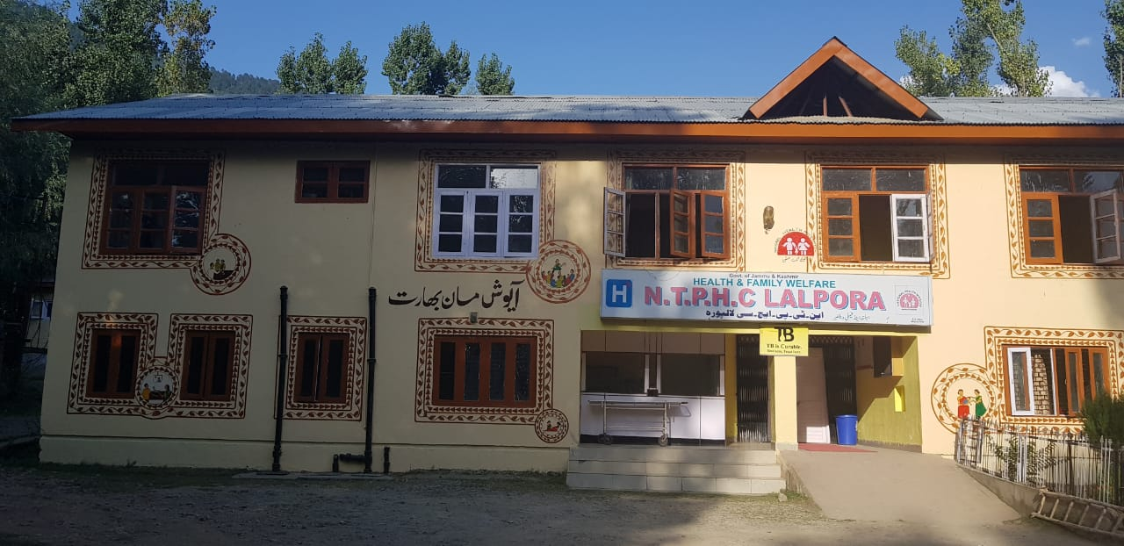
HWC- NTPHC Lalpora District Kupwara

Slide 23
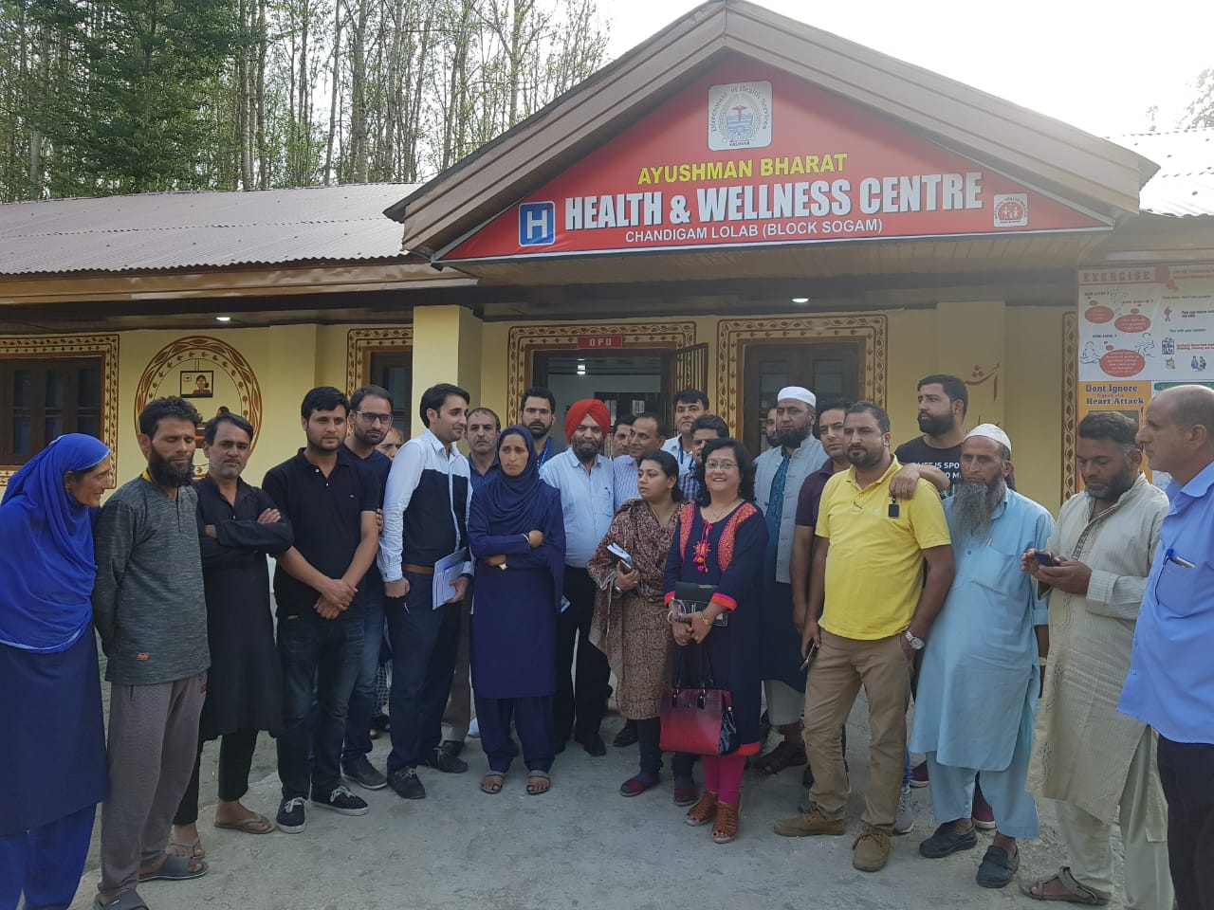
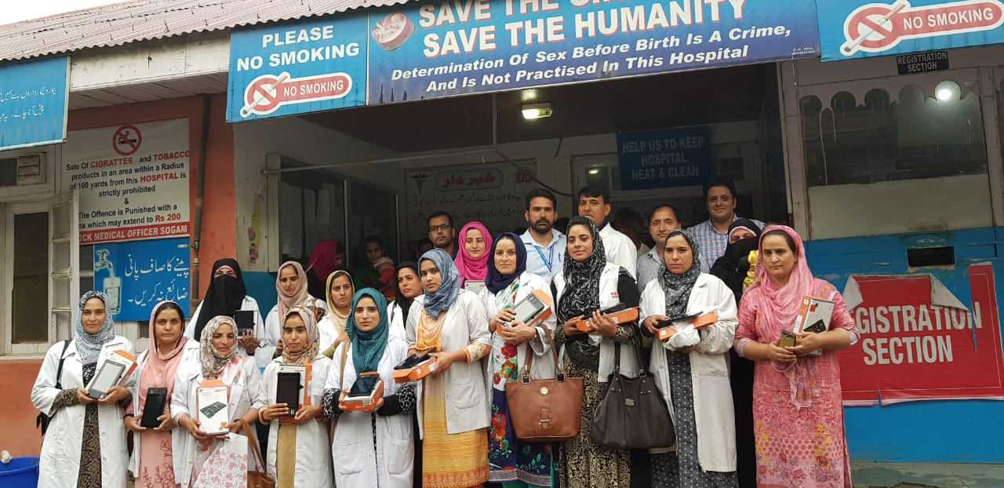
CRM team Visited to HWCs of Block Sogam District Kupwara
Tablet distribution for HWCs- Block Sogam District Kupwara

Slide 24
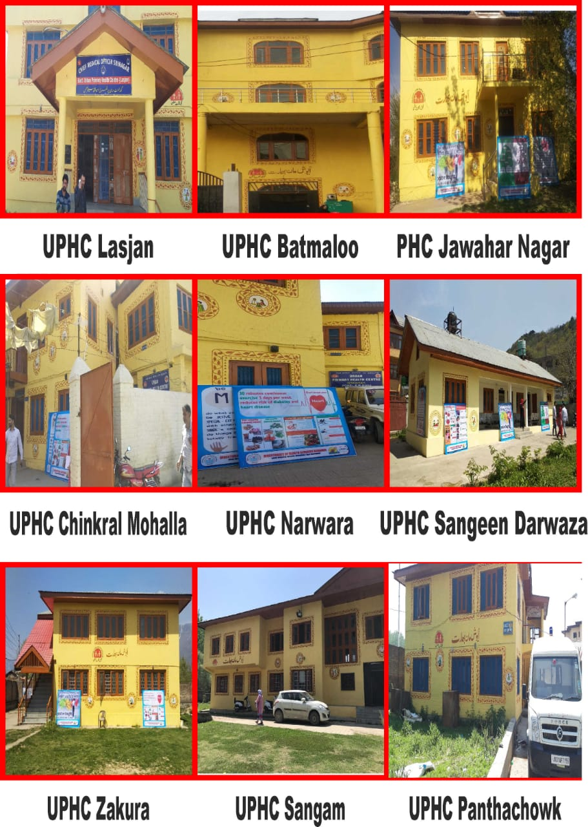
HWCs of District Srinagar

Slide 25
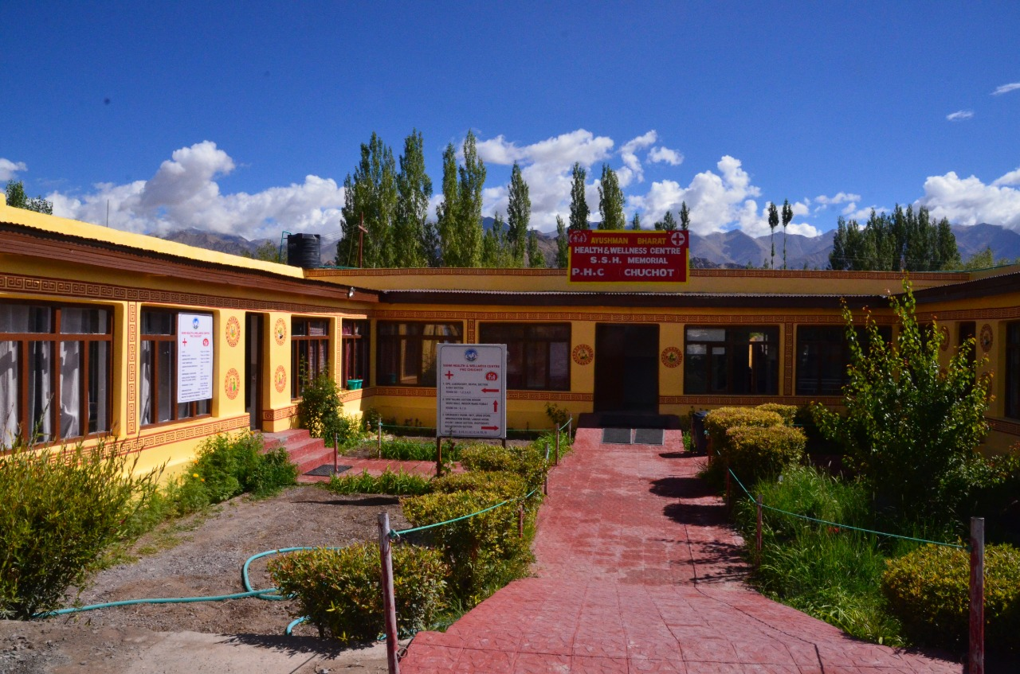
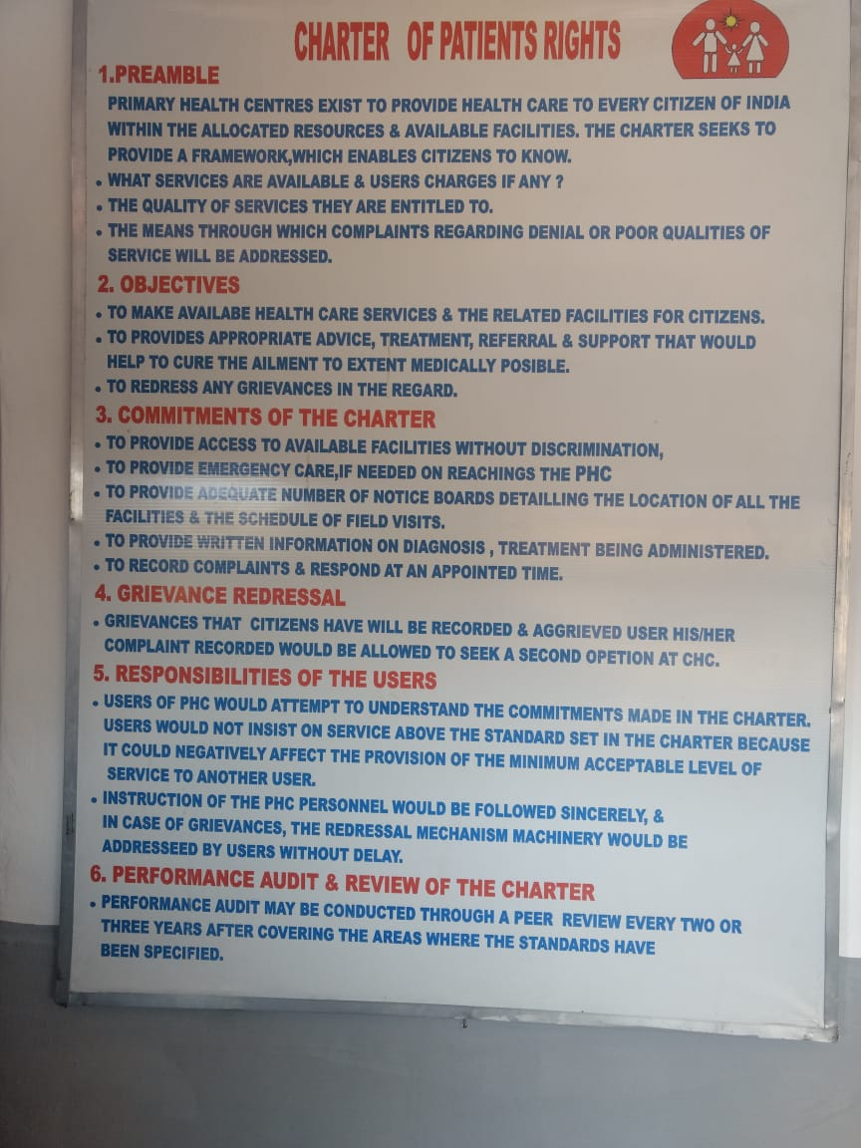
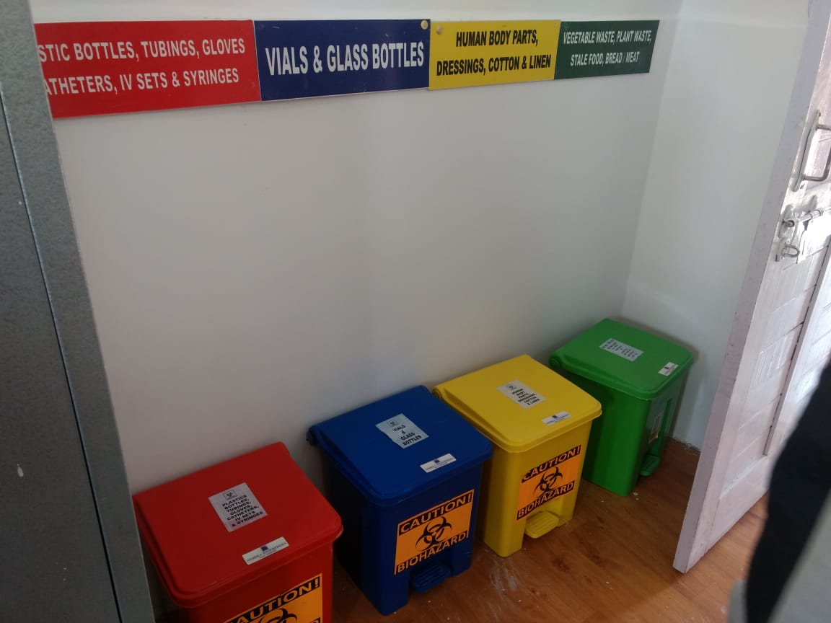
Glimpse of HWC-PHC Chuchot in District Leh

Slide 26
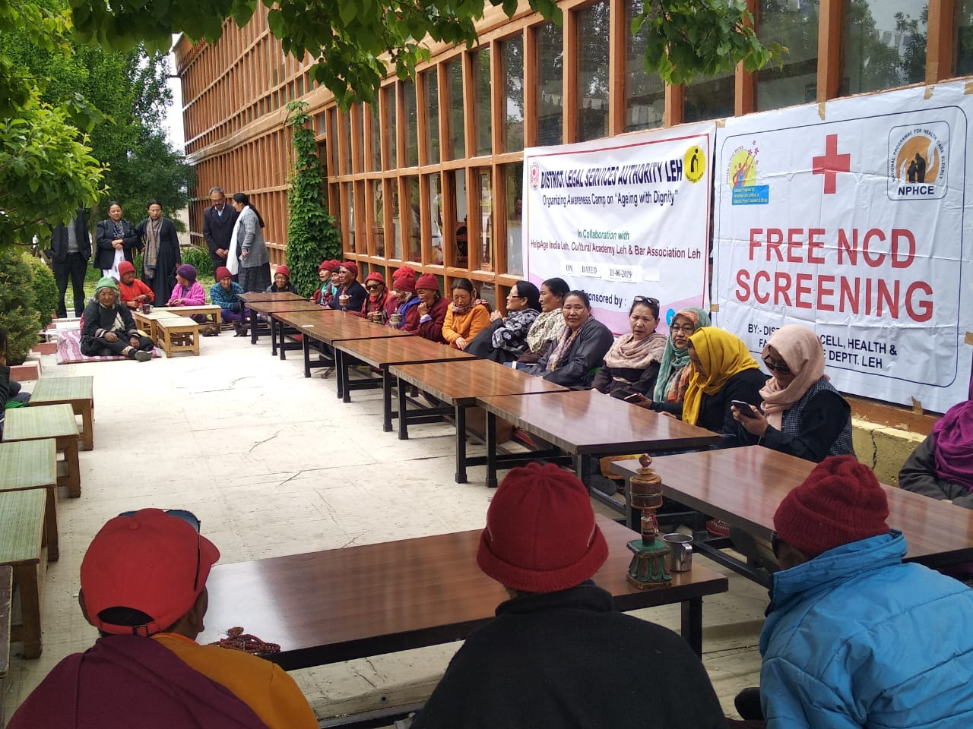
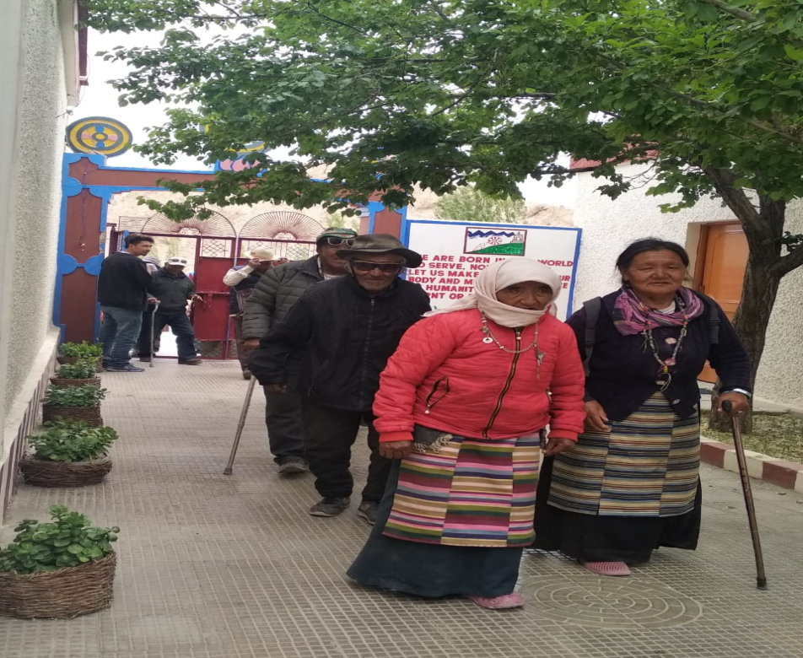
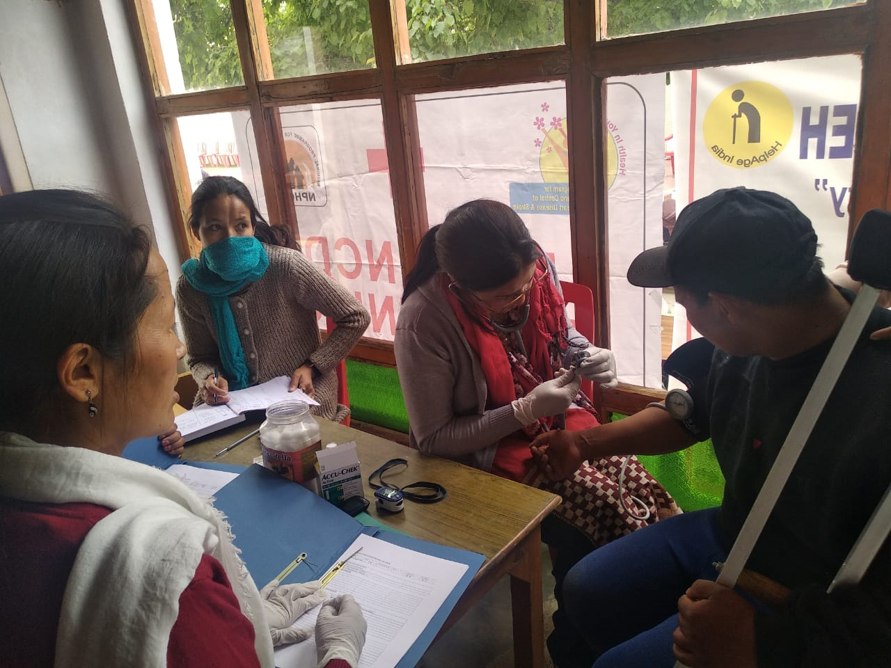
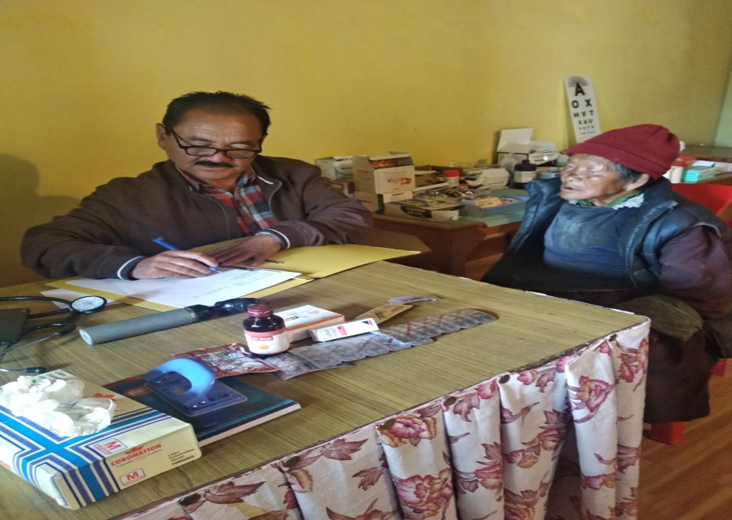
NCD Screening conducted on fixed day (Saturday) at HWC- SC

Slide 27
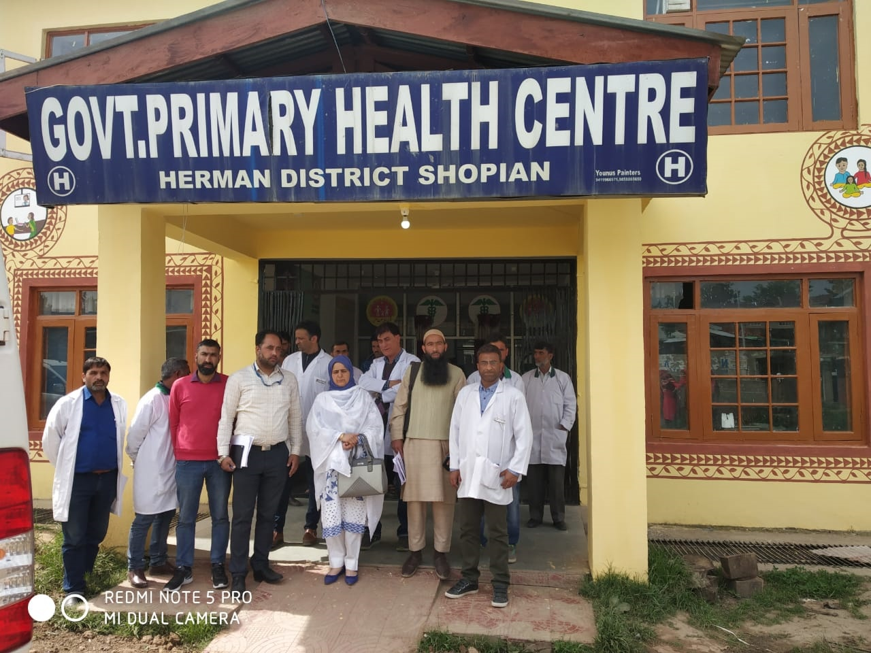
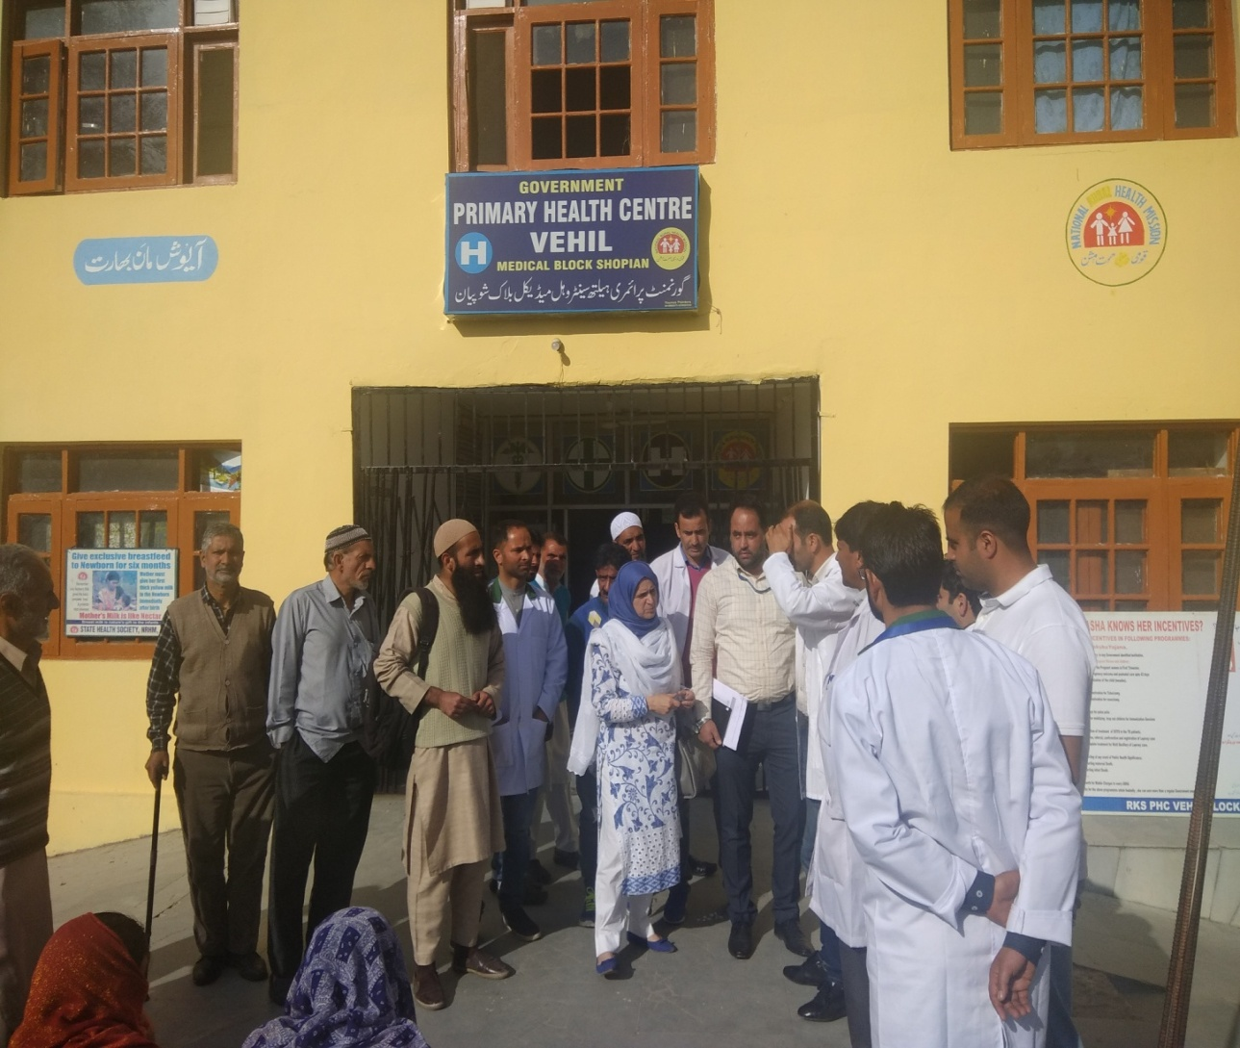
PHC- HWCs of Kashmir Division

Slide 28
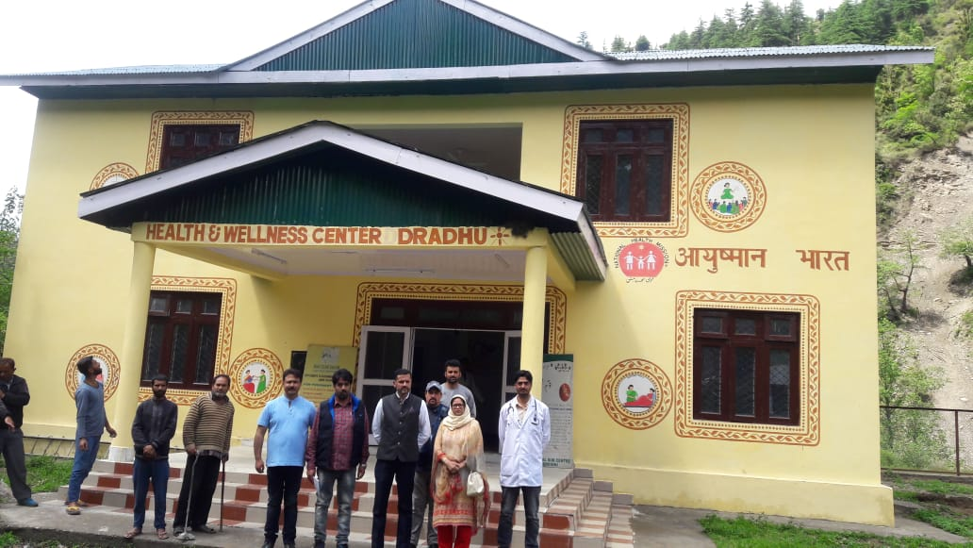
HWC- SC- Dradhu District Doda

Slide 29
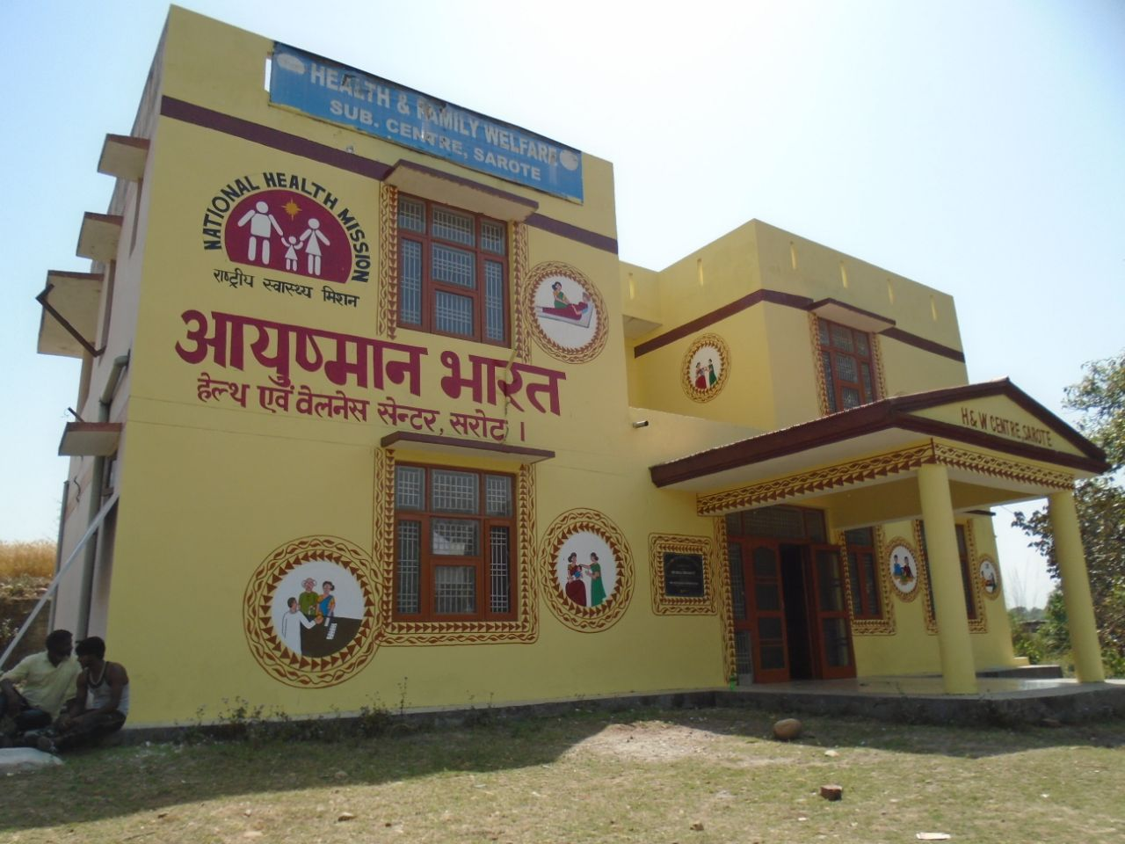
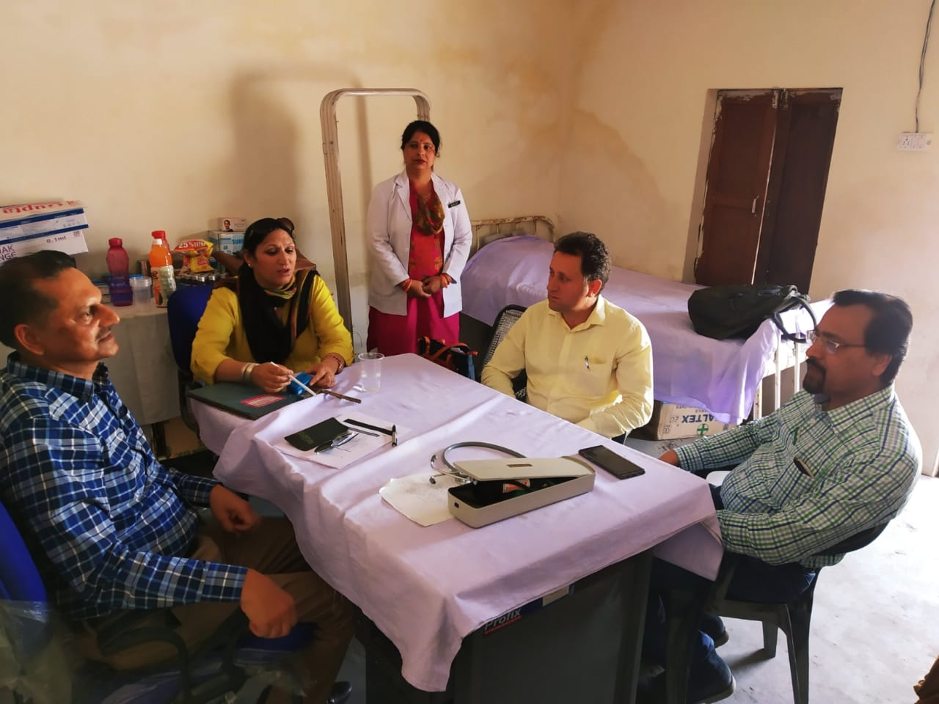
HWC- SC- Sarote District Jammu
Monitoring team at HWCs of Jammu Division

Slide 30
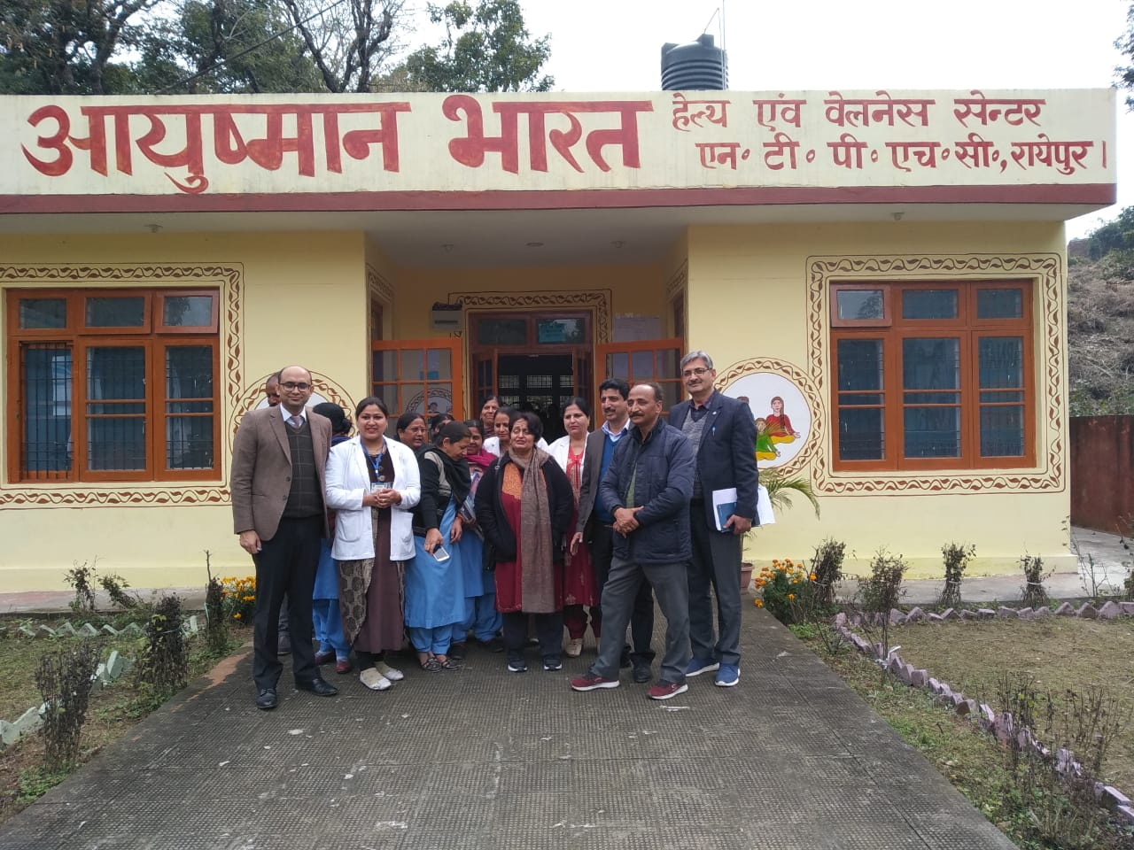
Secretary MoH&FW, GoI. visited HWC-SC- Raipur District Jammu

Slide 31
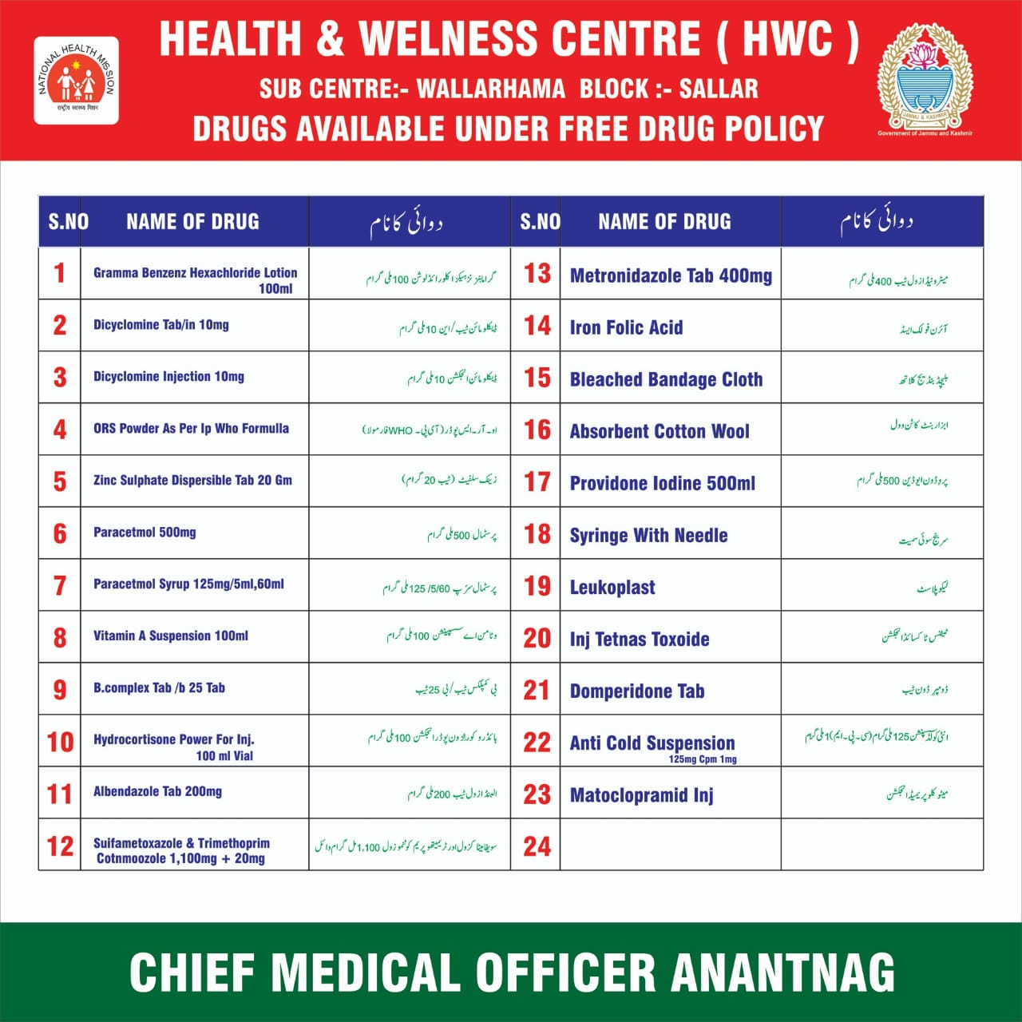
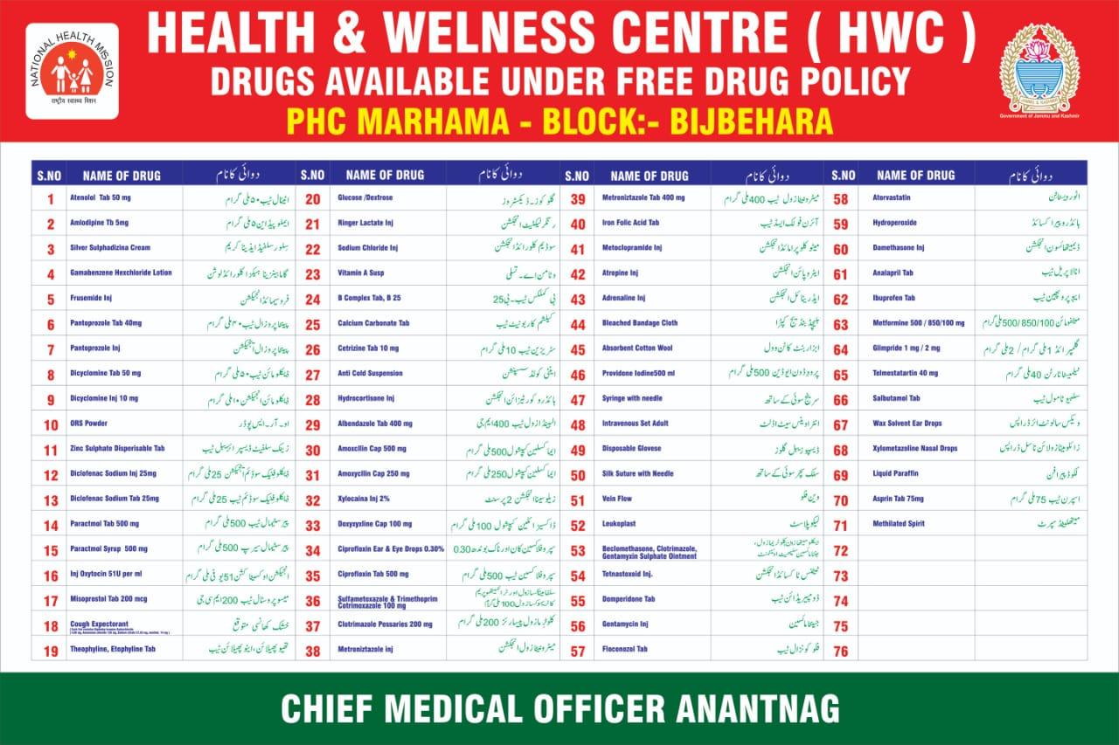
List of Drugs available at HWC- SCs and HWC- PHCs

Slide 32
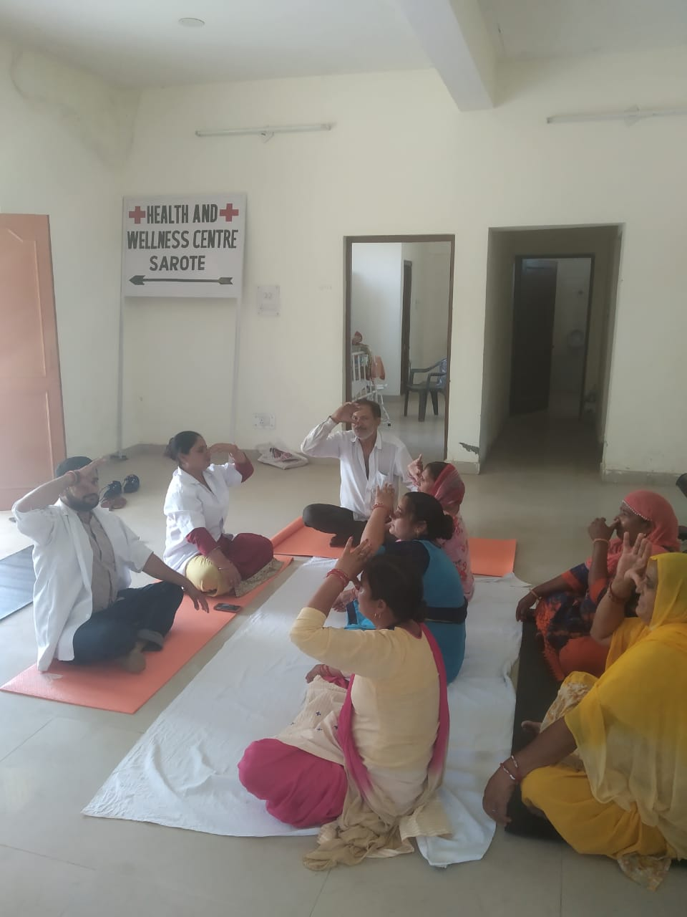
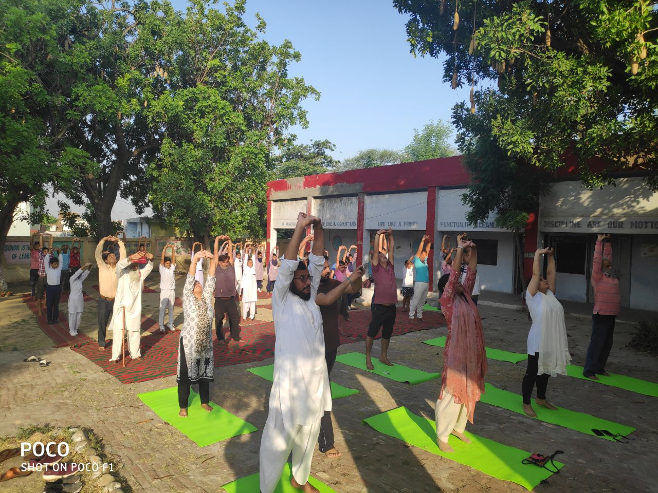
MLHPs conducting Yoga Session at HWC-SC- Sarote

Slide 33
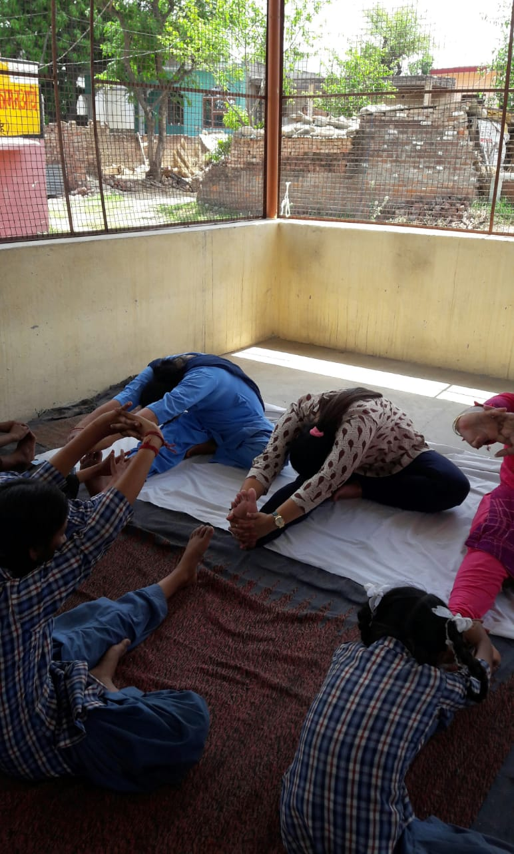
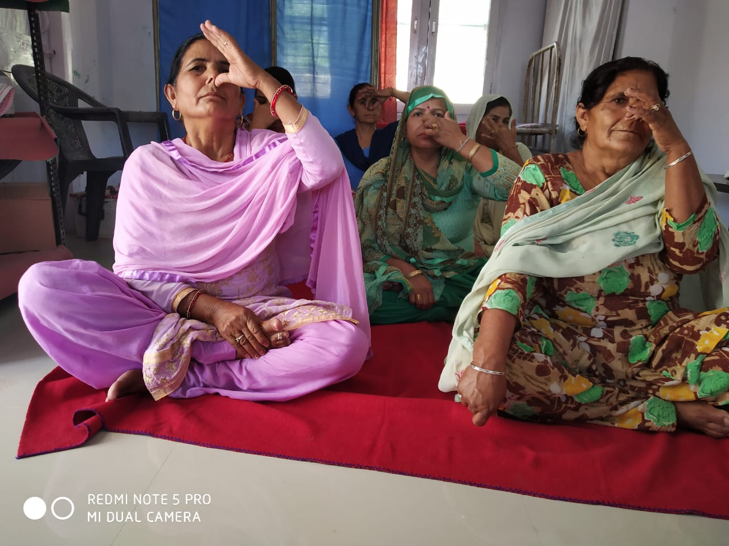
MLHPs conducting Yoga Session cont....

Slide 34
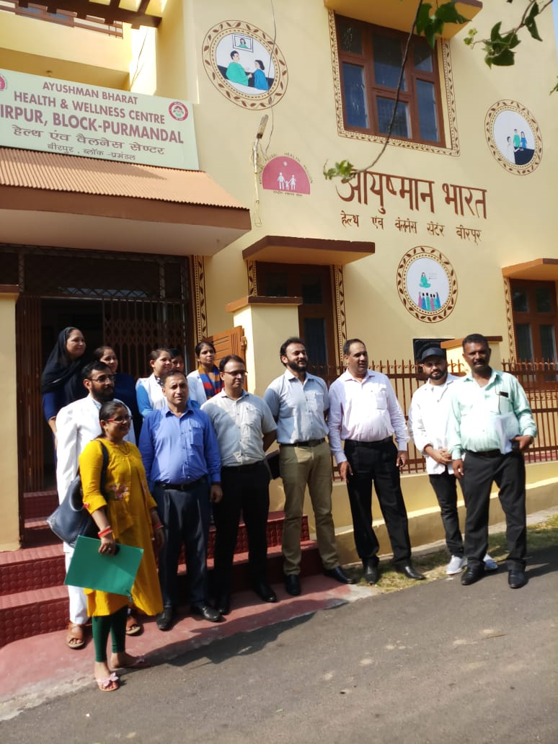
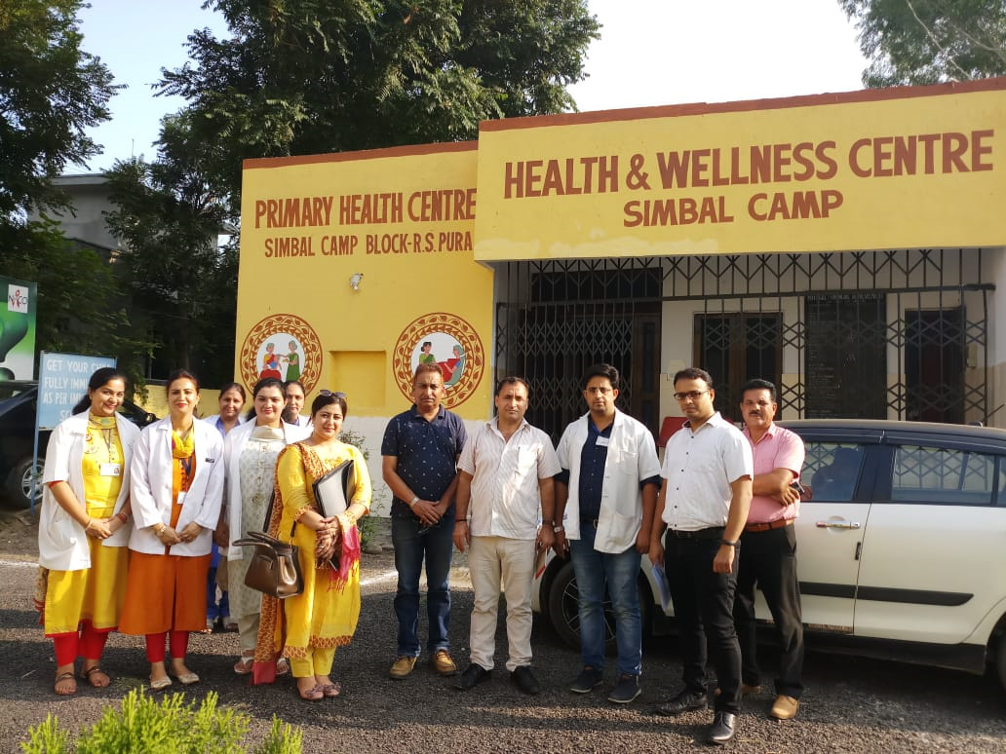
Visit of Team from MoHFW, GoI.

Slide 35
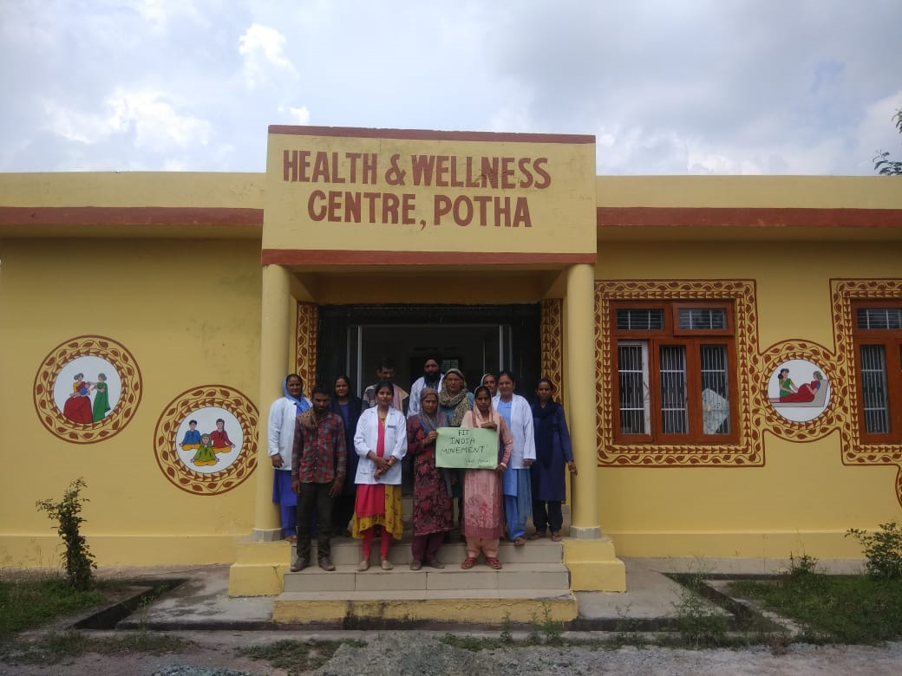
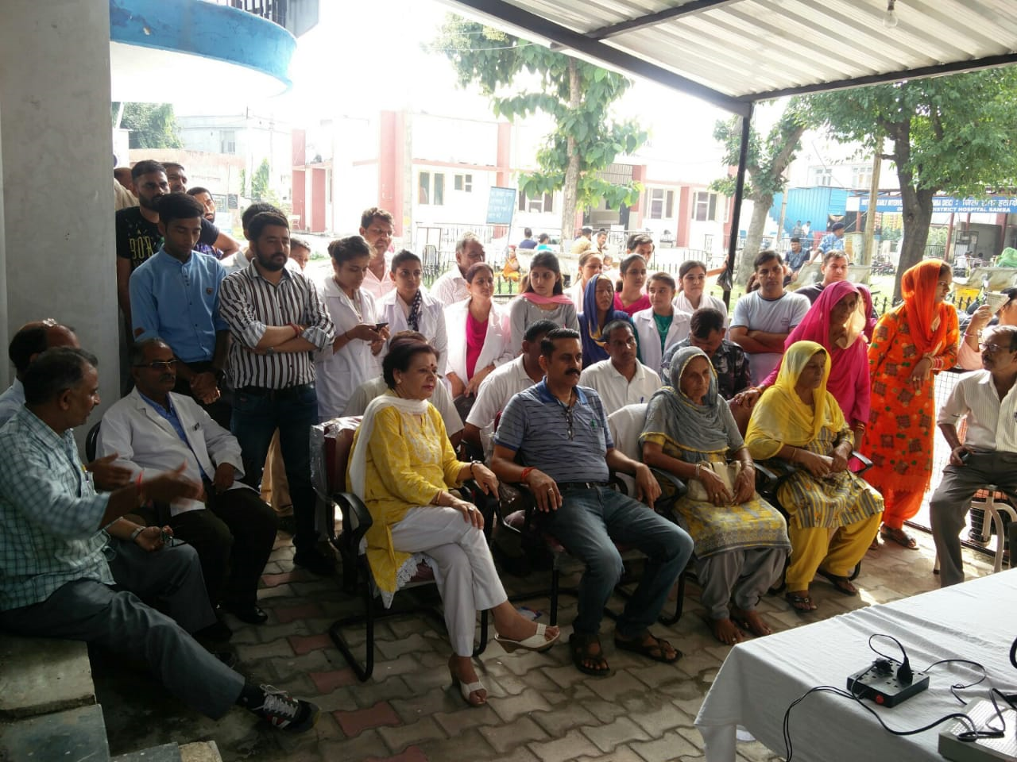
Fit India movement Celebrated in most of the HWCs
Awareness about Fit India movement by CHO at HWC- Potha

Slide 36
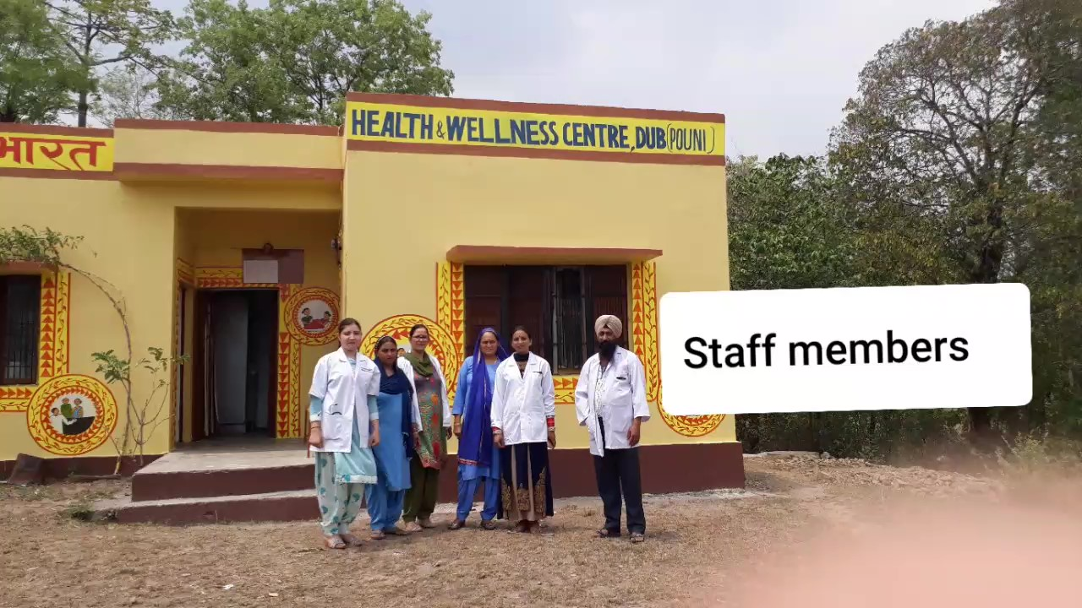
Availability of Services at HWC-SCs- Dub HWC-SC-DUB.mp4

Slide 37
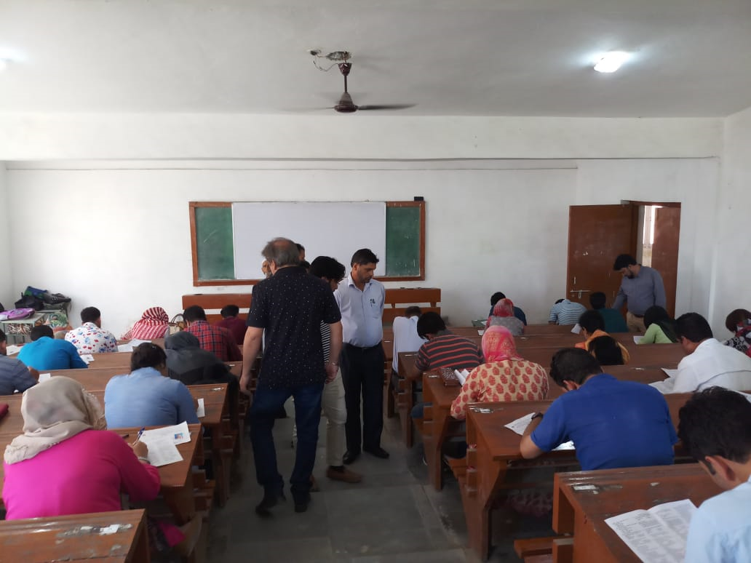
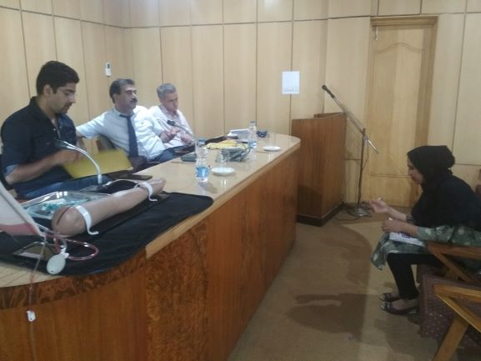
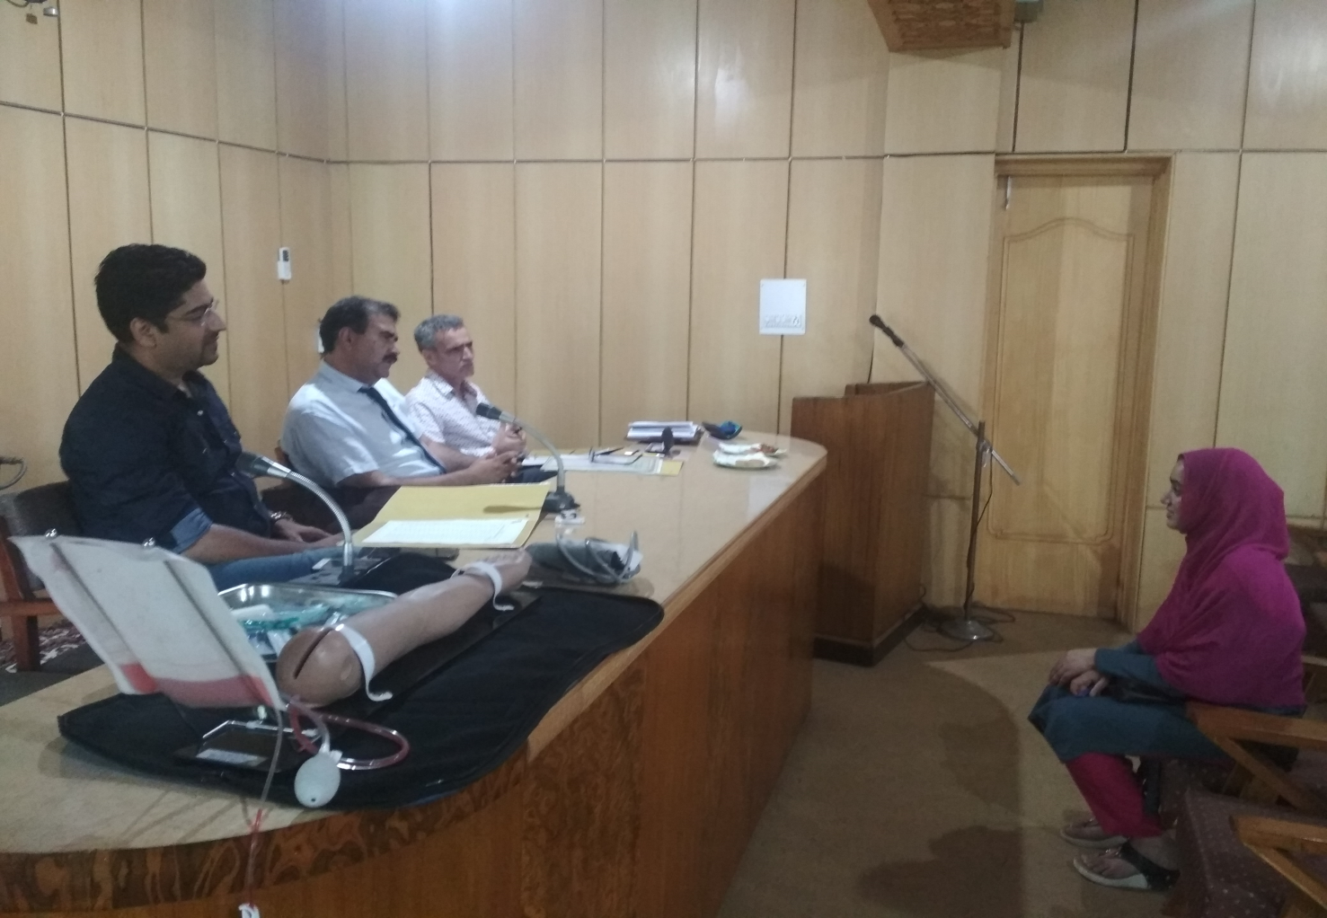
Screening test for selection of CHOs
Written Test for selection of CHOs
Skill Assessment/ interview of CHOs

Slide 38


