Slide 1






Comprehensive Primary Health Care through
Health & Wellness Centres
HIMACHAL PRADESH

Slide 2
Progress at a glance - Notification
* The state opted to up-grade PHCs instead of HSCs in 2018-19
** The state notified 250 HSCs as per target of 2019-20 + 104 left out of 2018-19
 | Target |  |  | Notification
 | PHC | UPHC | HSC | PHC | UPHC | HSC
2018-19 | 0 | 8 | 104 | 125 * | 8 | 0
2019-20 | 400 | 5 | 250 | 400 | 5 | 354 *

Slide 3

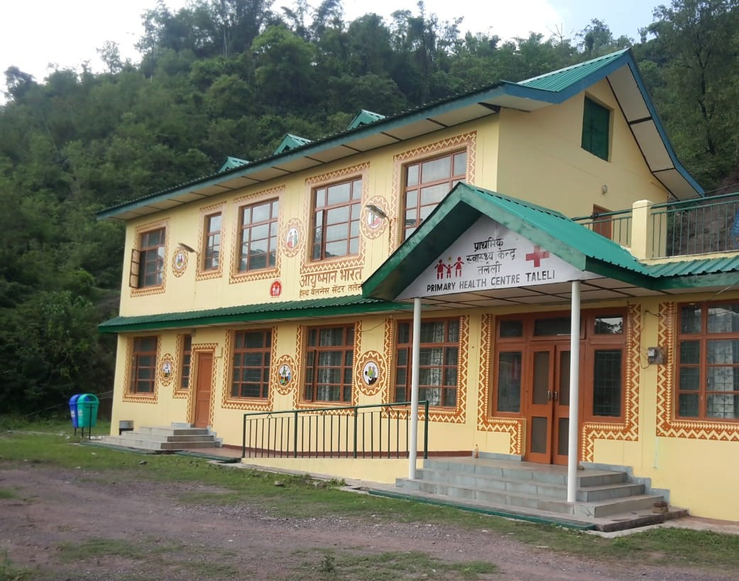
Up-Gradation and Branding
Being conducted through HLL
As per the GOI guidelines

Slide 4
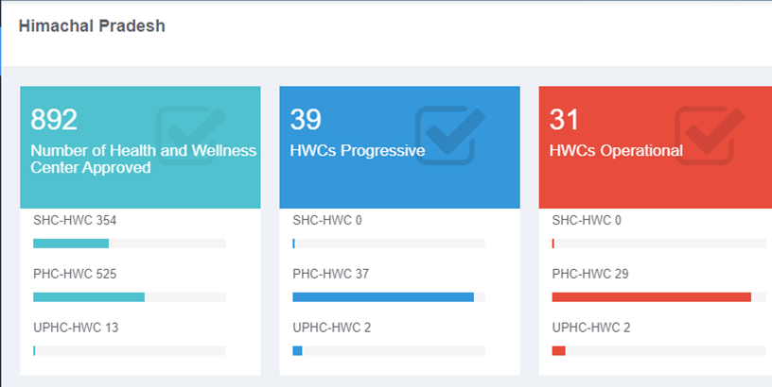

Slide 5
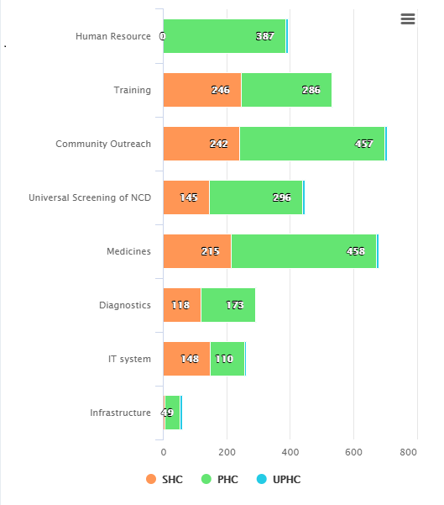
Functionalisation of HWCs

Slide 6
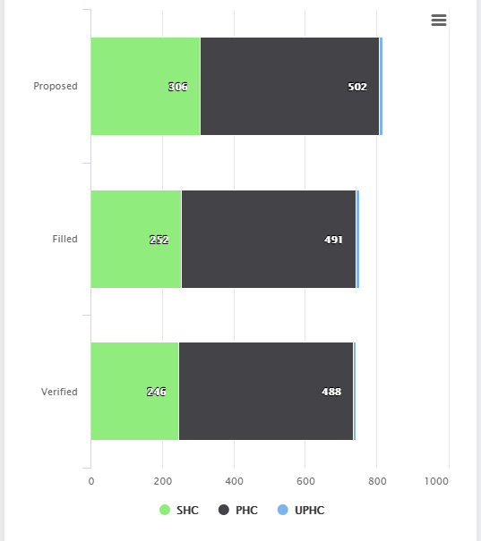
Daily Reporting

Slide 7
NCDs
Screening
Treatment & follow up
Risk Reduction

Slide 8
Risk Reduction
Organisation of wellness activities
Comprehensive IEC pamphlet (IEC) being distributed to all beneficiaries by ASHA during home visits
Health cess on alcohol @Rs 1 per bottle
Tobacco control activities – School Health activities, constitution of Tobacco Control Committees

Slide 9

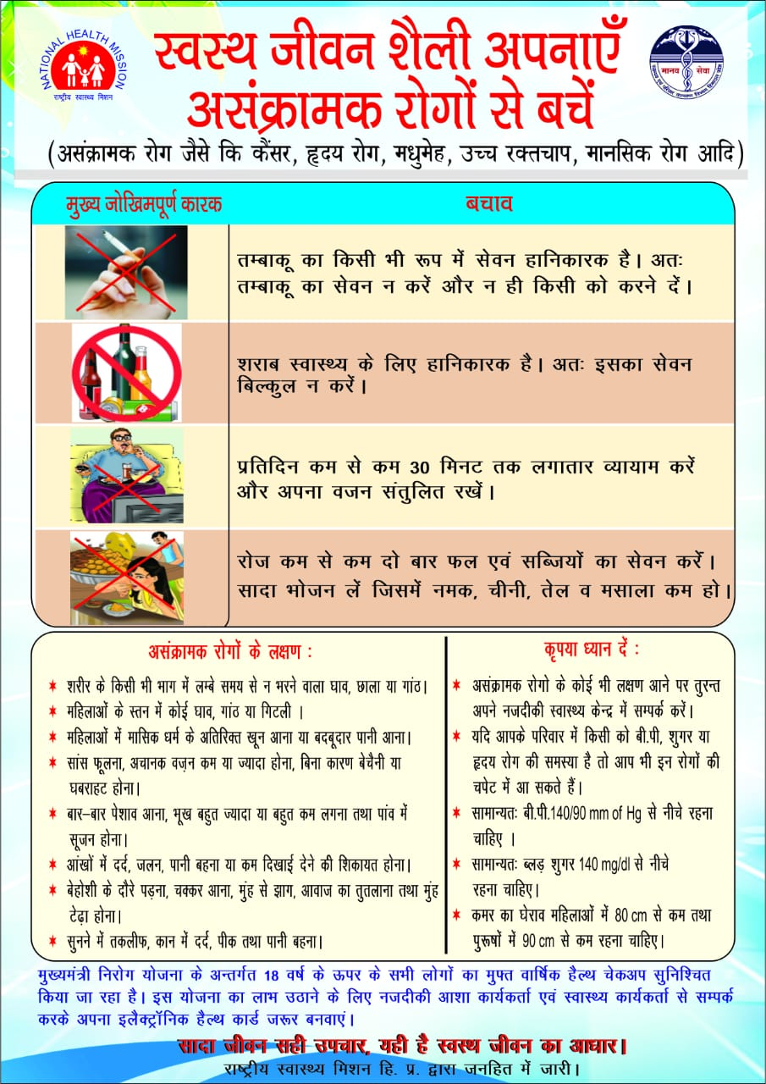

Slide 10
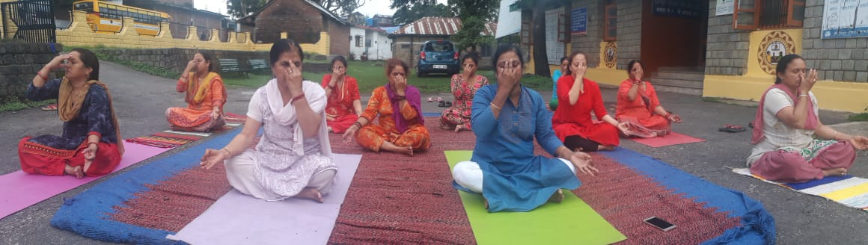
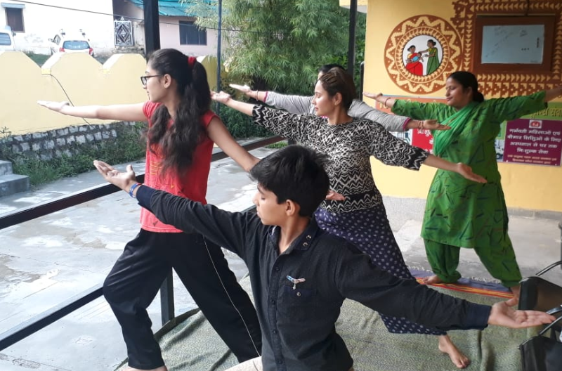

Slide 11
Risk Reduction
Rs. 8 Crore additional resource mobilisation through alcohol cess in last Financial year.
24% reduction in tobacco use from 2010-2016 (GATS).

Slide 12
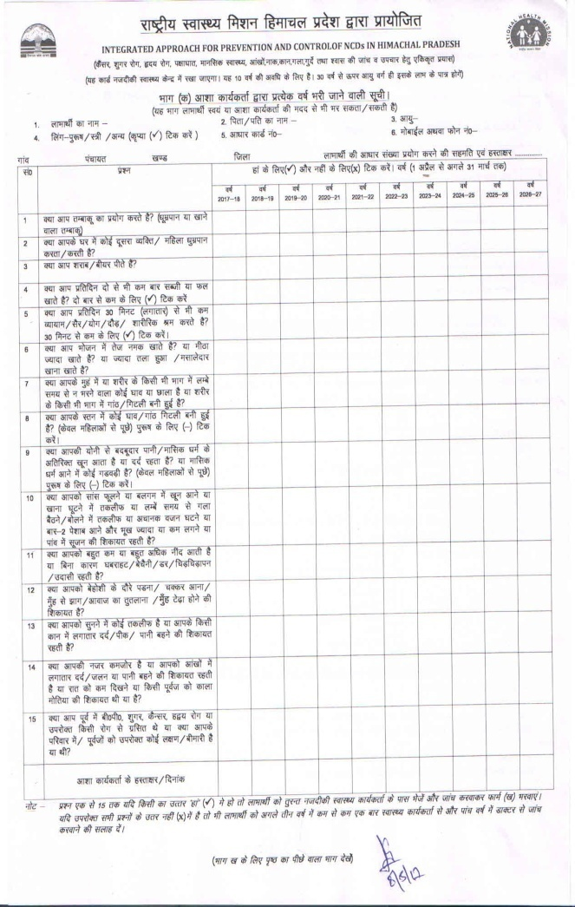
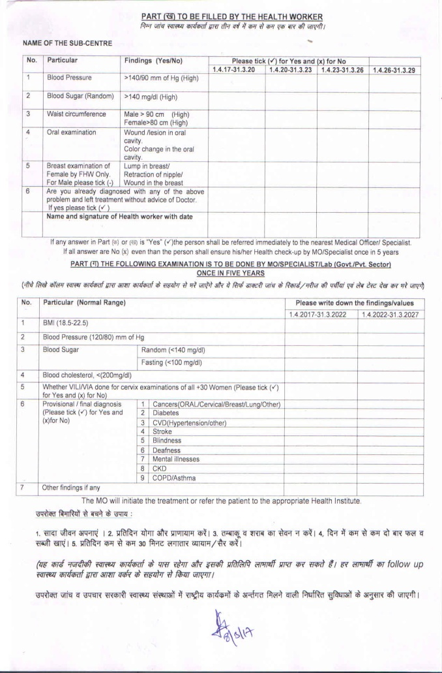
Screening
15 risk factors and 10 NCDs through a expanded CBAC

Slide 13
Screening
Mukhya Mantri Nirog Yojana – expanding the screening base to 18-30 years of population as well.
Population based enumeration –ongoing
Digital Health Record – E-Health card
Special outreach camps

Slide 14
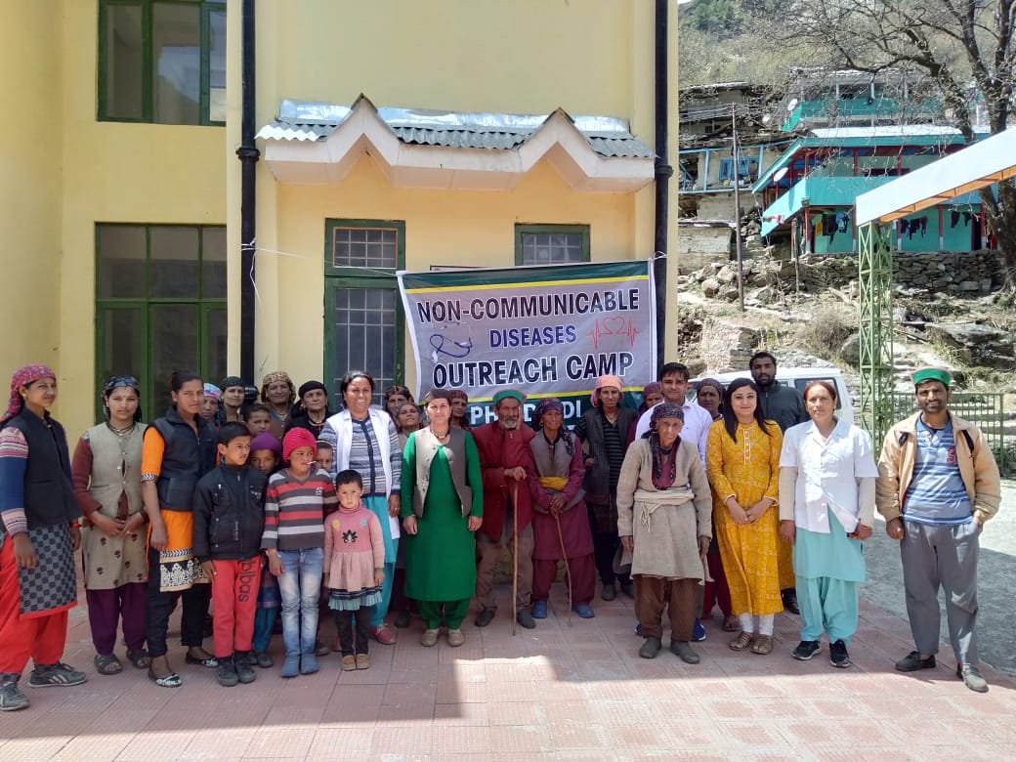

Slide 15
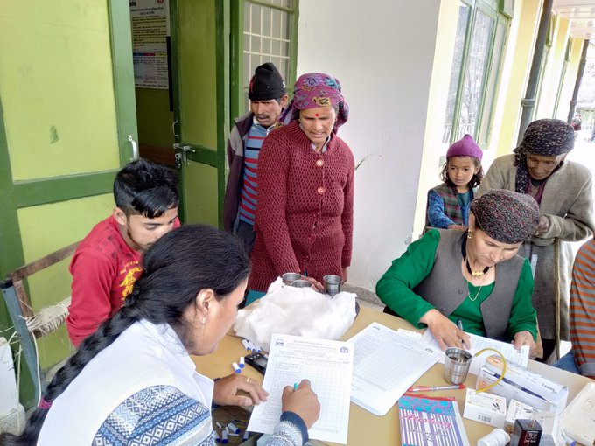
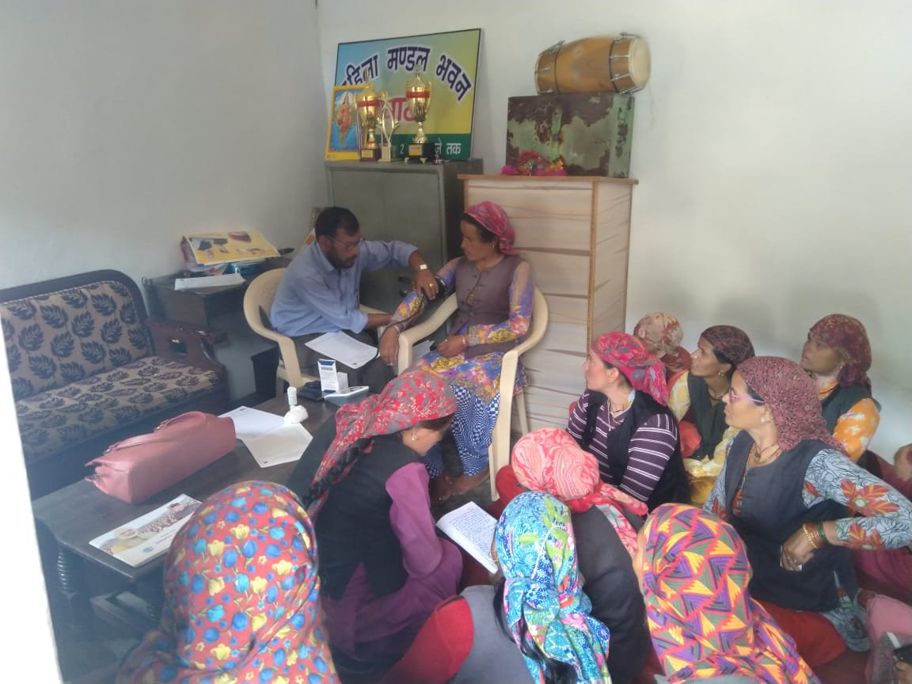
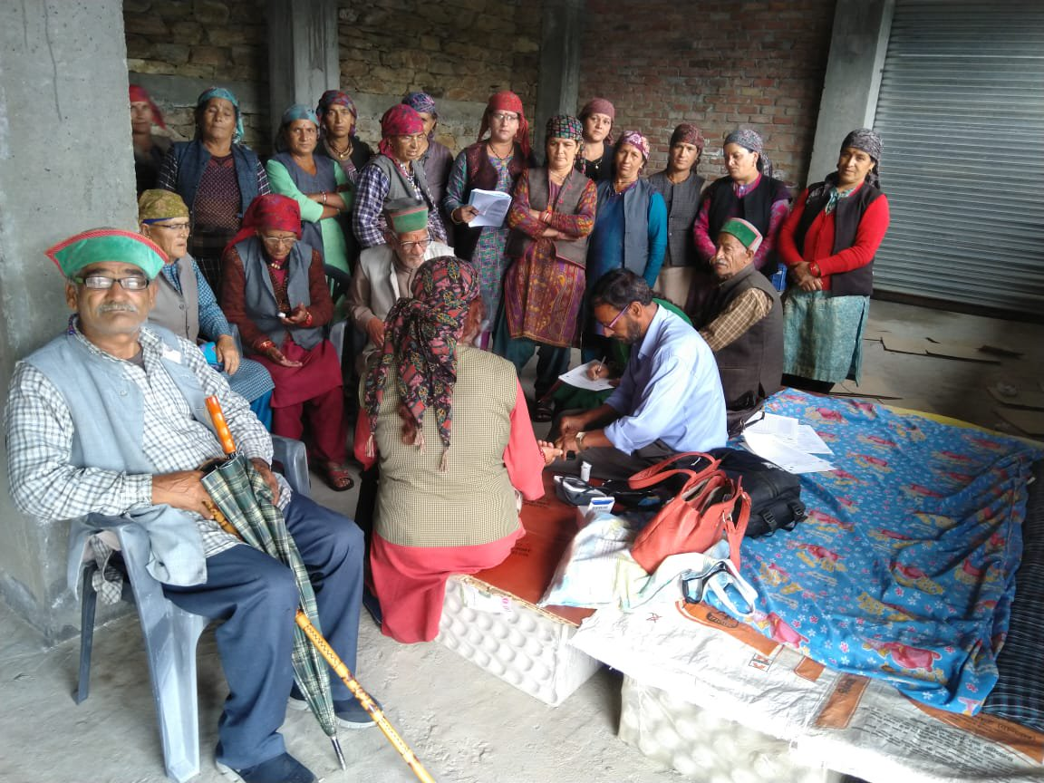
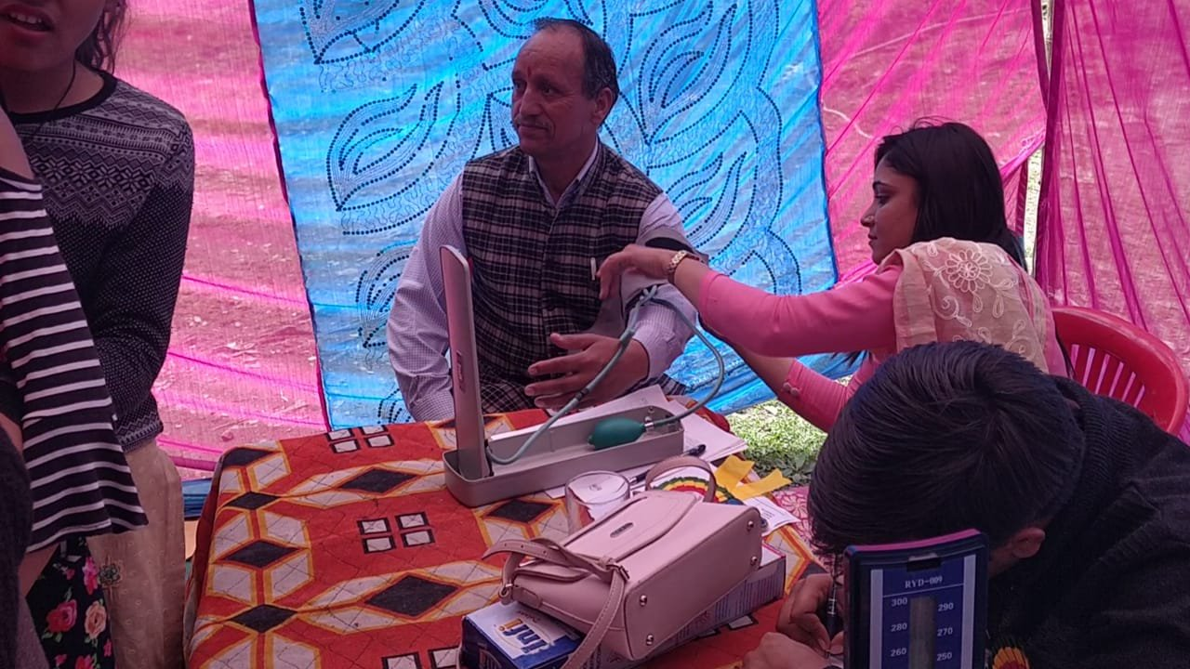

Slide 16
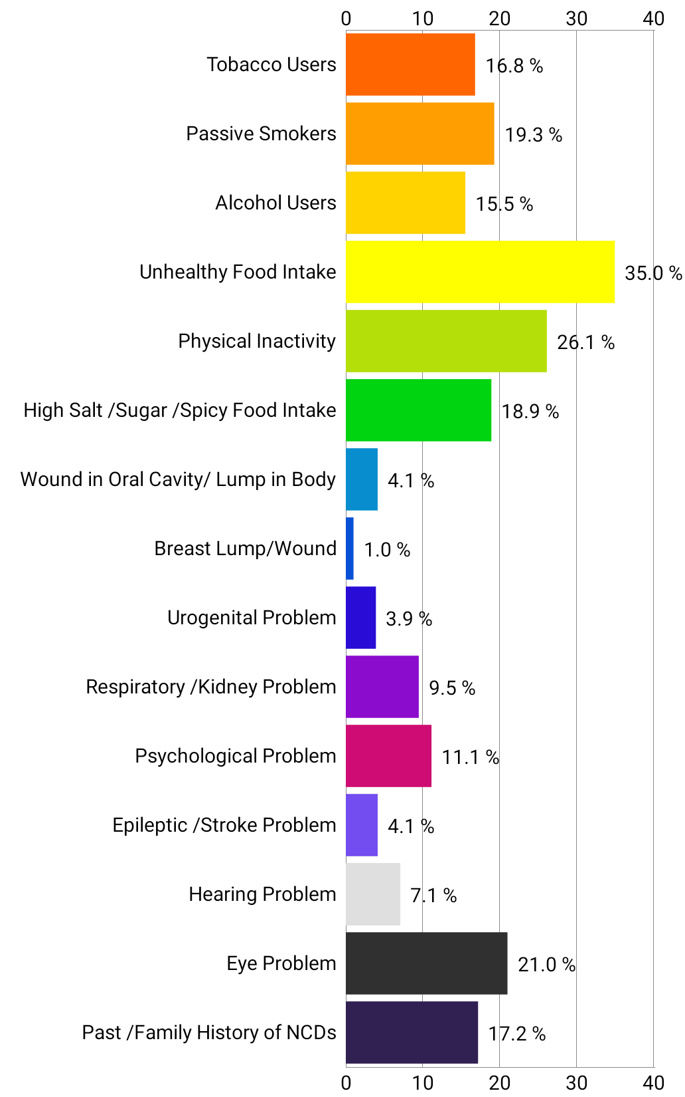
1063392 18+ population assessed by ASHA for risk factors

Slide 17
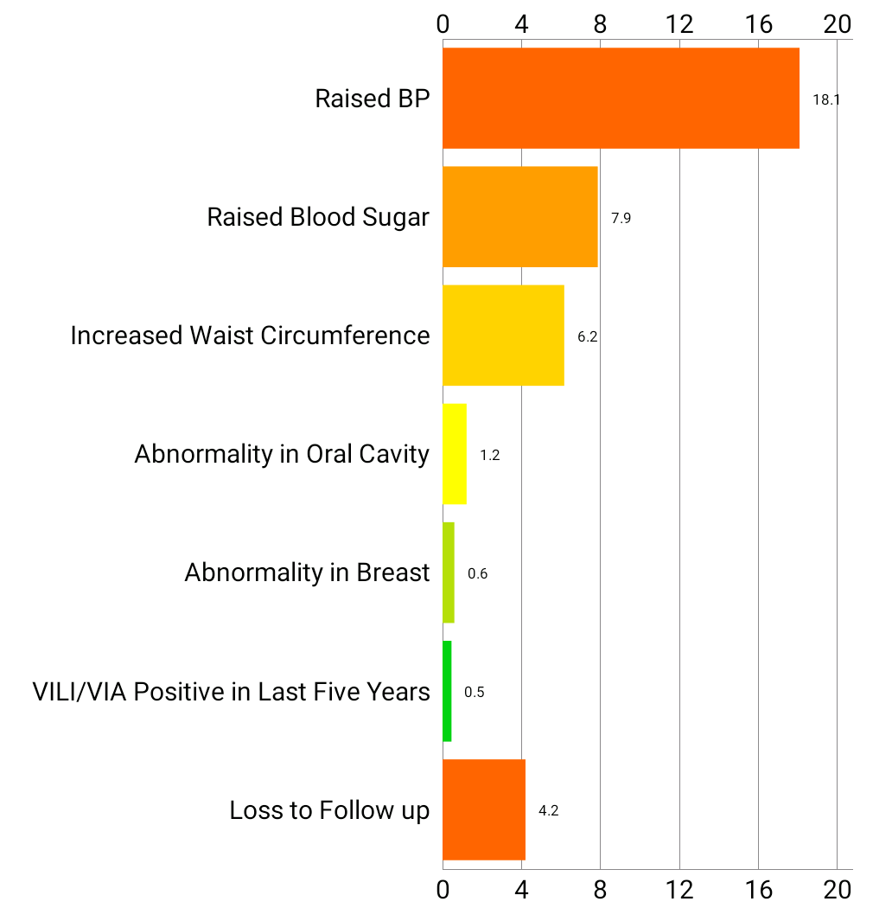
214970 18+ population screened by ANM

Slide 18
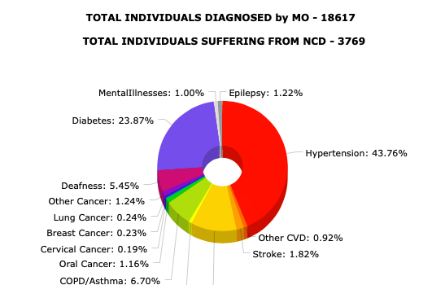

Slide 19
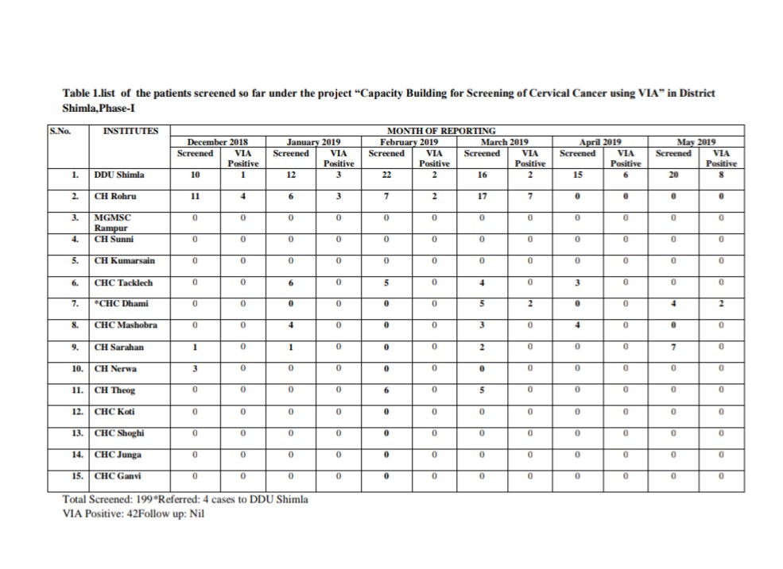
Cervical Cancer
Health facility based screening – pilot in Shimla District

Slide 20
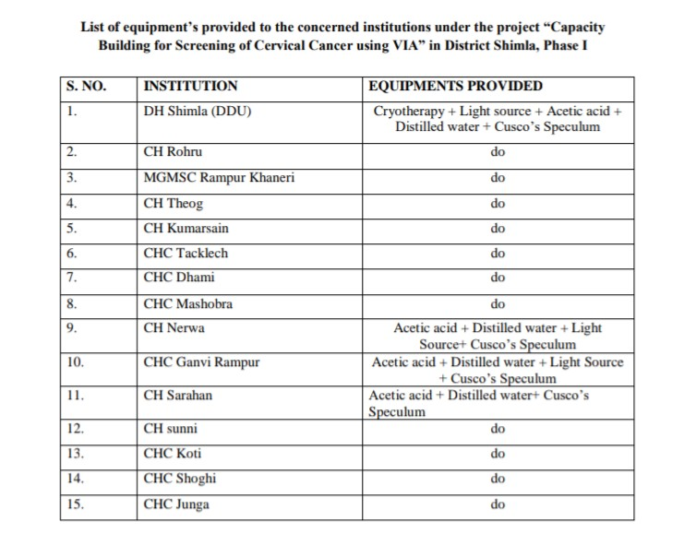
Cervical Cancer

Slide 21
Treatment and Follow up
Cardiac Care Units in 11/12 Districts
Day care cancer centers x 10 (1987 + chemo given)
Dialysis units 13/13 functional – 67858 session
HP telestroke project (364+ thrombolysis so far)
Palliative care started in 8/11 hospitals
COPD Clinics being opened in 10 Hospitals before November 2019
To provide the last mile delivery – capacity of Tertiary Institutions being enhanced

Slide 22
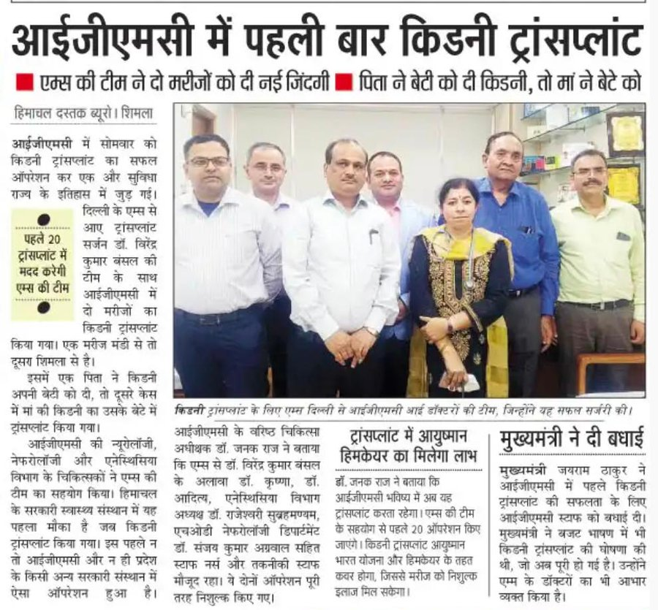

Slide 23
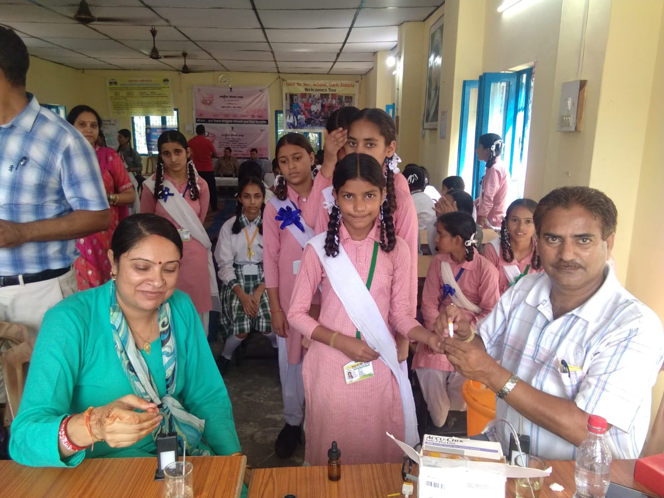

Slide 24
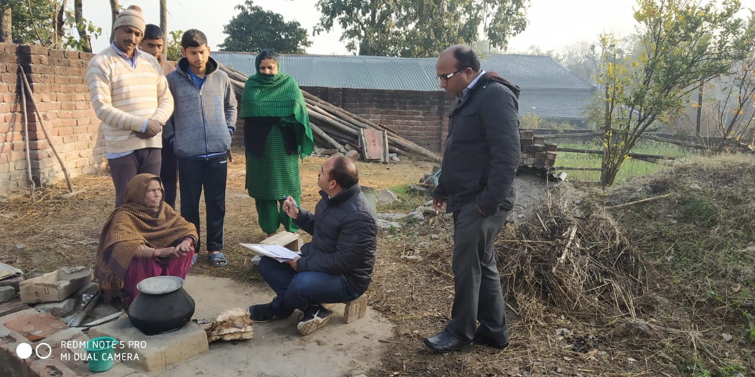
Annualised TB case notification – 226/lakh/annum
500 new TB cases detected in first round of TB Mukt Abhiyan
State registered 61% increase in TB case notification from private sector

Slide 25
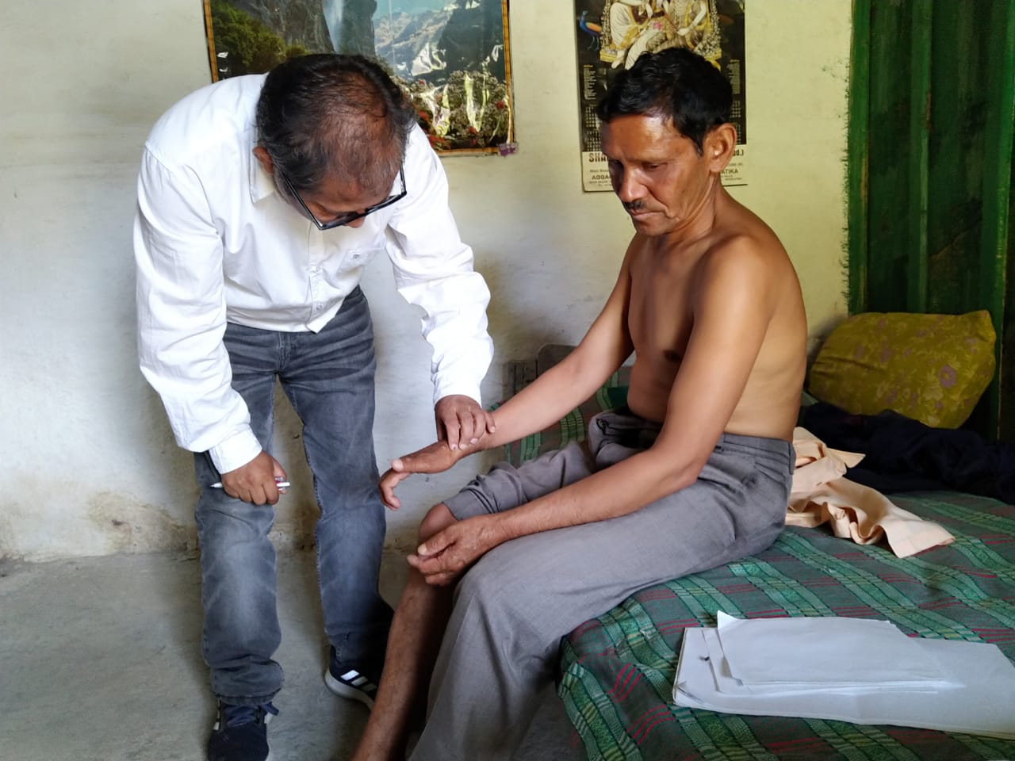

Slide 26
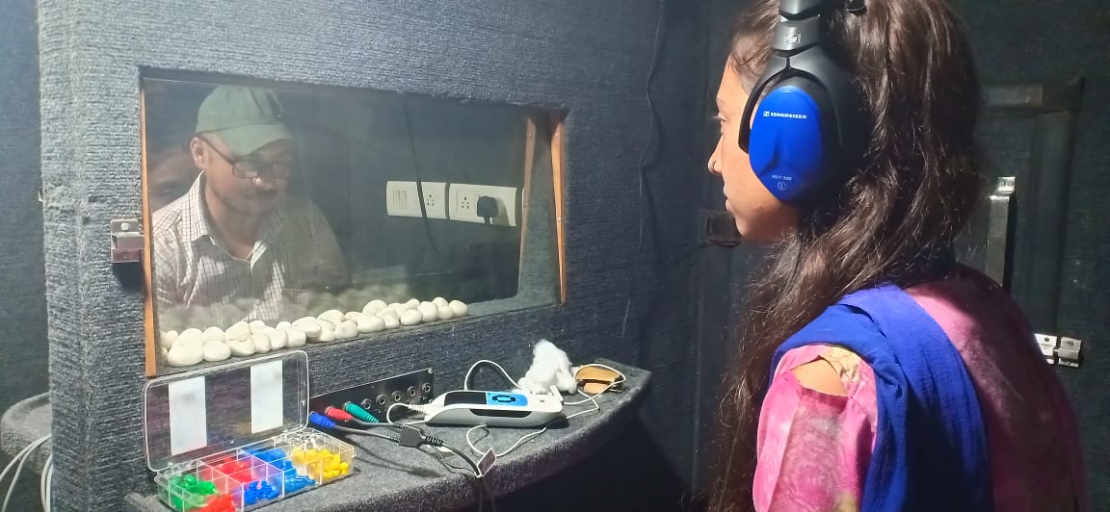
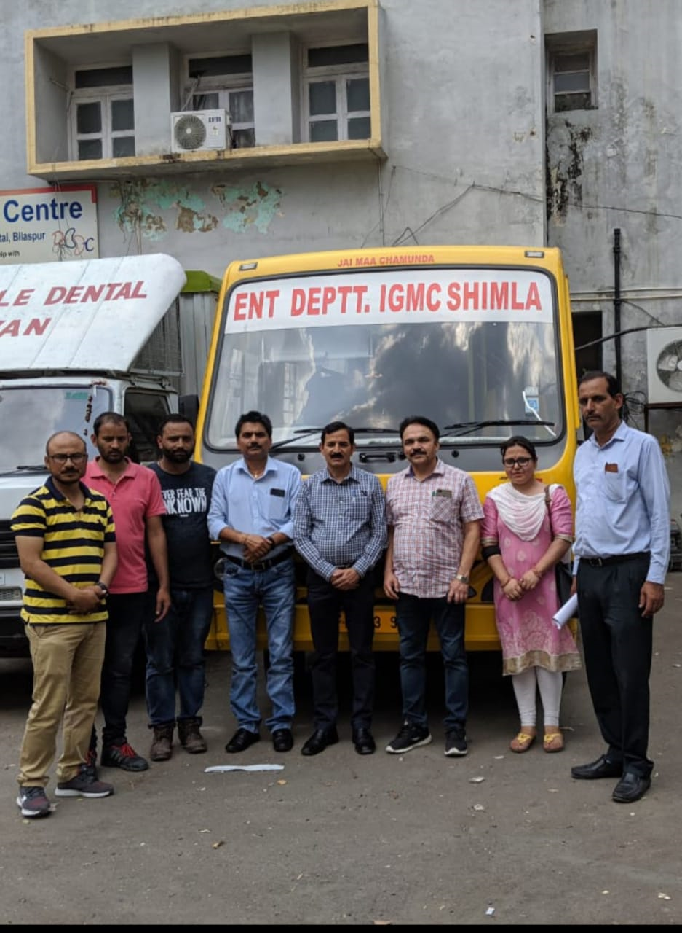
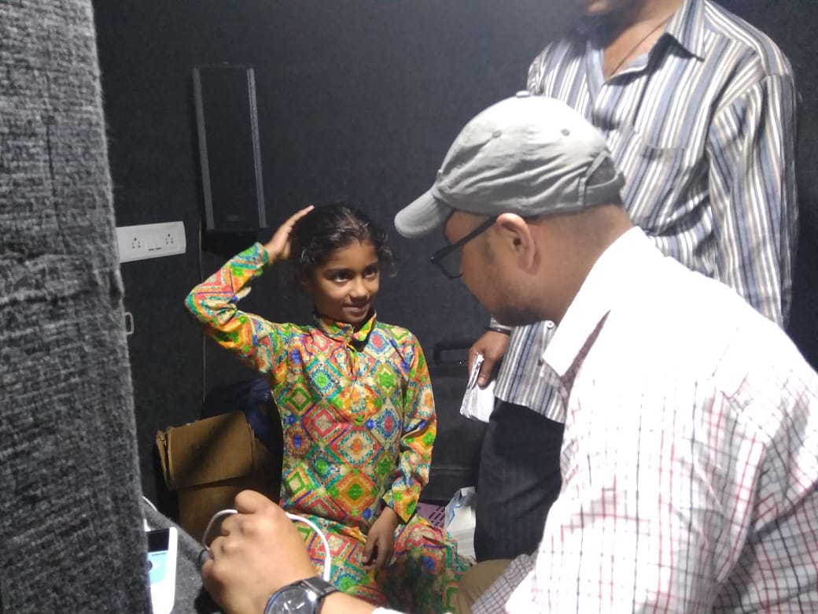
Van based outreach BERA for RBSK screened children in 7 medical blocks, June 2019

Slide 27


Slide 28

MUKHYAMANTRI CHIKITSA SAHAYTA KOSH
For expenditure incurred on OPD/miscellaneous
Launched on 2oth October, 2018
Rs. 3.24 Crore spent on 137 beneficiaries
SAHARA
Rs. 2000 per month DBT to patients afflicted with chronic and debilitating conditions like Parkinsonism, Renal failure, malignant cancers etc.
Till date more than 4000 patients enrolled

Slide 29
GAPS
CHOs – first batch starting from 16th September in 7 IGNOU certified PSCs – 342 CHOs
Diagnostics – Hub and Spoke under process, expanded tests still not available
Training issues – As per the prescribed norms, District TOTs scheduled on 17-19th September

Slide 30

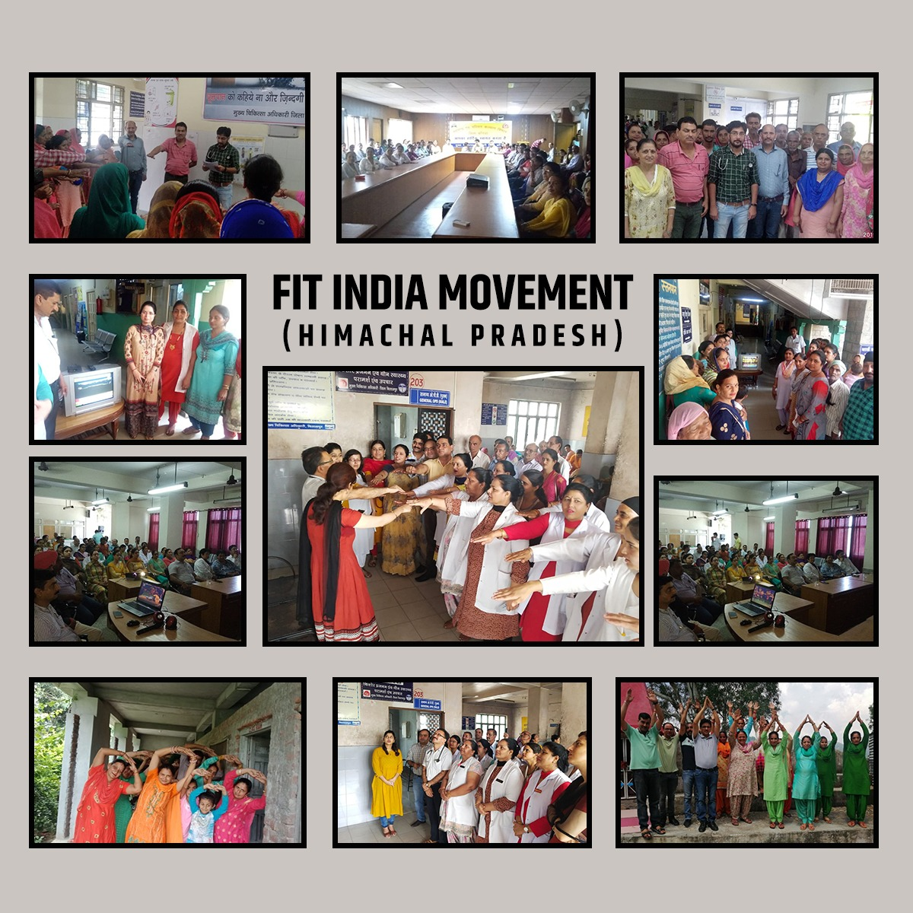

Thanks!

