Slide 1


Slide 2
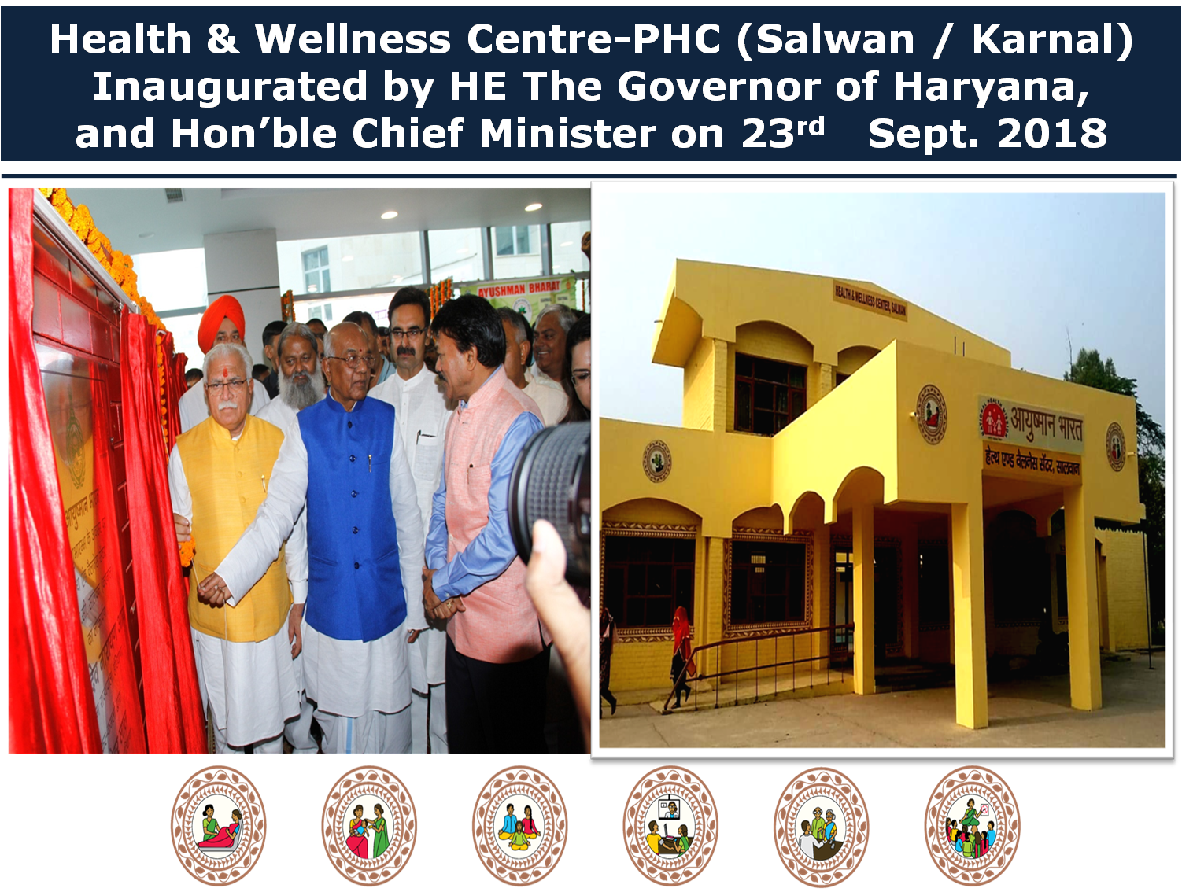

Slide 3
AB-HWC Conditionality Framework Targets, Planning, Achievements in Haryana (2018-19 and 2019-20)
Total Standalone Health Facilities to be covered by FY 2022-23* |  | Already Covered (as on 31/8/2019) | Planned For FY 2019-20 | Target by FY 2019-20
 |  |  |  | No. | %
Total | 2803 | 463 | 487 | 950 | 34%
Sub Centres | 2328 | 169 | 307
Rural-PHCs | 375 | 208 | 167
Urban-PHCs | 100 | 86 | 14
Source: Rural Health Statistics, GoI Data 2018

Slide 4
AB-HWC Conditionality Framework Saturations of Health Facilities and Districts
As per GoI Conditionality Framework, Haryana will be able to cover 34% of its total Health Facilities (i.e. Standalone Sub Centres, Rural PHCs, & Urban PHCs) 100% Rural PHCs, 100% Urban PHCs and approx 29% Sub Centres will be transformed into HWCs by end of FY 2019-20 100% health facilities of Mewat (Aspirational District) will also be covered by the end of FY 2019-20 Apart from Mewat (Aspirational District), 06 more Districts will be saturated by the end of FY 2019-20.

Slide 5
Health & Wellness Centres
Target & Progress FY 2018-19 & 2019-20
(Source: HWC GoI Portal)
Financial Year | Targets as per RoPs | No. of Operational HWCs
 |  | Total | Rural-PHC | Urban-PHC | Sub Centre
2018-19 | 408 | 432 | 196 | 72 | 164
2019-20 | 542 | 31 | 12 | 14 | 05
Total | 950 | 463 | 208 | 86 | 169
Source: GoI HWC Portal, as on 31/08/2019 at 3:00pm

Slide 6
Functionality Status of Health & Wellness Centers in Haryana
(Source: GoI HWC Portal: As on 31/08/2019)
Type & No. of Operational HWCs |  | HWCs Meeting Functionality Criteria
 |  | Human Resource | NCD Training | Community Outreach | Universal Screening | Medicines | Diagnostic Services | Information Technology | Facade Designing
Rural-PHCs | 208 | 208 | 208 | 187 | 208 | 208 | 208 | 104 | 208
 |  | 100% | 100% | 90% | 100% | 100% | 100% | 50% | 100%
Urban-PHCs | 86 | 86 | 86 | 83 | 86 | 86 | 86 | 56 | 85
 |  | 100% | 100% | 96% | 100% | 100% | 100% | 64% | 99%
Sub Centers | 169 | 169 | 169 | 169 | 169 | 169 | 169 | 119 | 169
 |  | 100% | 100% | 100% | 100% | 100% | 100% | 70% | 100%
Total | 463 | 463 | 463 | 439 | 463 | 463 | 463 | 279 | 459
 |  | 100% | 100% | 95% | 100% | 100% | 100% | 60% | 98%

Slide 7
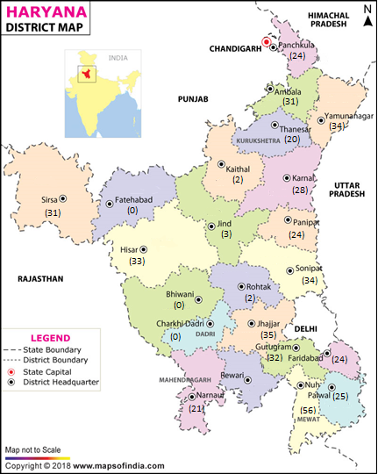
District-wise Target & Progress of HWCs (FYs 2018-19 & 2019-20:) Source: GOI HWC Portal
Sr. No. | Name of Districts | Total No. of Standalone SCs, PHCs | FY 2018-19 |  | FY 2019-20
 |  |  | Target | Achievement as on 31/03/2019 | Target | Achievement as on 31/08/2019
1 | Ambala | 112 | 25 | 31 | 56 | 0
2 | Bhiwani | 164 | 0 | 0 | 25 | 0
3 | Ch. Dadri | 87 | 0 | 0 | 12 | 0
4 | Faridabad | 72 | 17 | 24 | 11 | 0
5 | Fatehabad | 152 | 0 | 0 | 21 | 0
6 | Gurugram | 101 | 18 | 32 | 48 | 0
7 | Hisar | 202 | 30 | 33 | 07 | 0
8 | Jhajjar | 135 | 25 | 24 | 15 | 0
9 | Jind | 165 | 19 | 01 | 12 | 21
10 | Kaithal | 164 | 0 | 0 | 04 | 2
11 | Karnal | 151 | 24 | 28 | 82 | 2
12 | Kurukshetra | 119 | 24 | 20 | 03 | 0
13 | Mewat | 94 | 57 | 56 | 26 | 0
14 | Narnual | 136 | 21 | 21 | 08 | 0
15 | Palwal | 98 | 23 | 25 | 08 | 0
16 | Panchkula | 47 | 15 | 16 | 11 | 0
17 | Panipat | 95 | 22 | 24 | 15 | 0
18 | Rewari | 128 | 0 | 0 | 16 | 2
19 | Rohtak | 136 | 0 | 0 | 13 | 2
20 | Sirsa | 160 | 28 | 31 | 81 | 0
21 | Sonepat | 165 | 31 | 32 | 11 | 2
22 | Y. Nagar | 120 | 29 | 34 | 57 | 0
Total |  | 2803 | 408 | 432 | 542 | 31

Slide 8
Status of MLHP-cum-CHOs &
Programme Study Centres in Haryana
Total 184 Community Health Officers (i.e. 45 BAMS + 139 BSc Nursing) engaged in FY 2018-19; out of which 169 now posted at Sub Centre level HWCs after completion of their 6 month Course in Community Health through IGNOU, as per GoI norms. All CHOs have been trained in induction module with technical Support of NHSRC.
Processes has already been initiated for engagement of 328 more Community Health Officers (i.e. BAMS).
Total 09 Programme Study Centres have been accredited by the IGNOU for Haryana.
05 more Programme Study Centres at District Hospital have been processed and the accreditation is pending with the IGNOU.

Slide 9
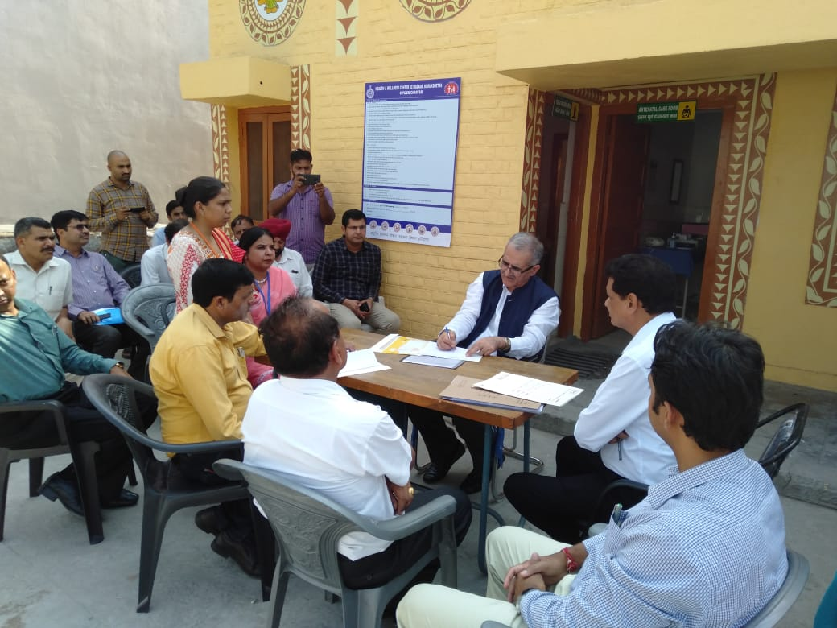
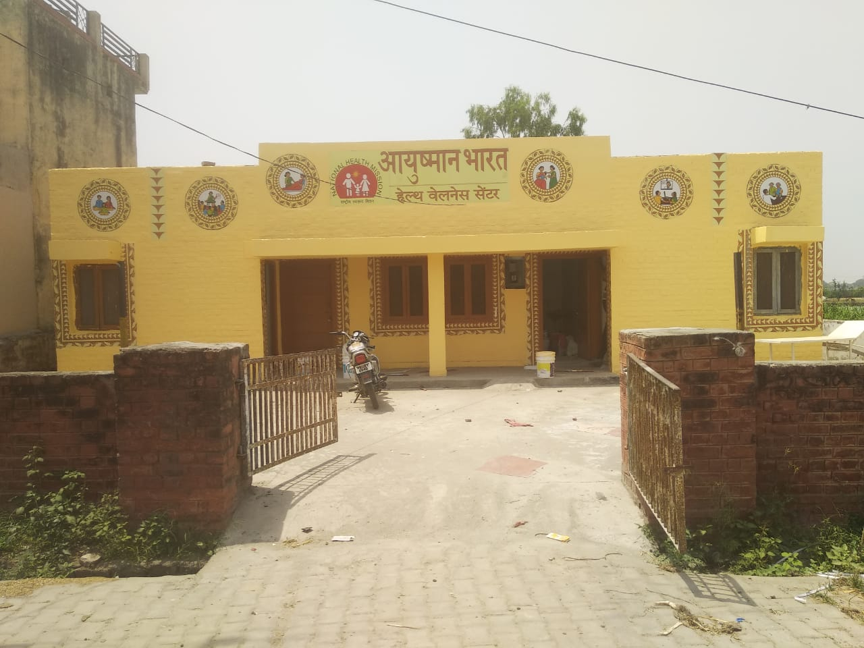






Chief Secretary to Govt. Haryana visited Health & Wellness Centre, Masana (Kurukshetra) on 20/06/2019 ; Reviewed its activities with the local People and PRI Members , Dy. Commissioner and Civil Surgeon

Slide 10








Transformation of
Health & Wellness Centres in Aspirational District
Nuh / Mewat (Haryana)
NATIONAL HEALTH MISSION (HARYANA)

Slide 11
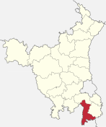
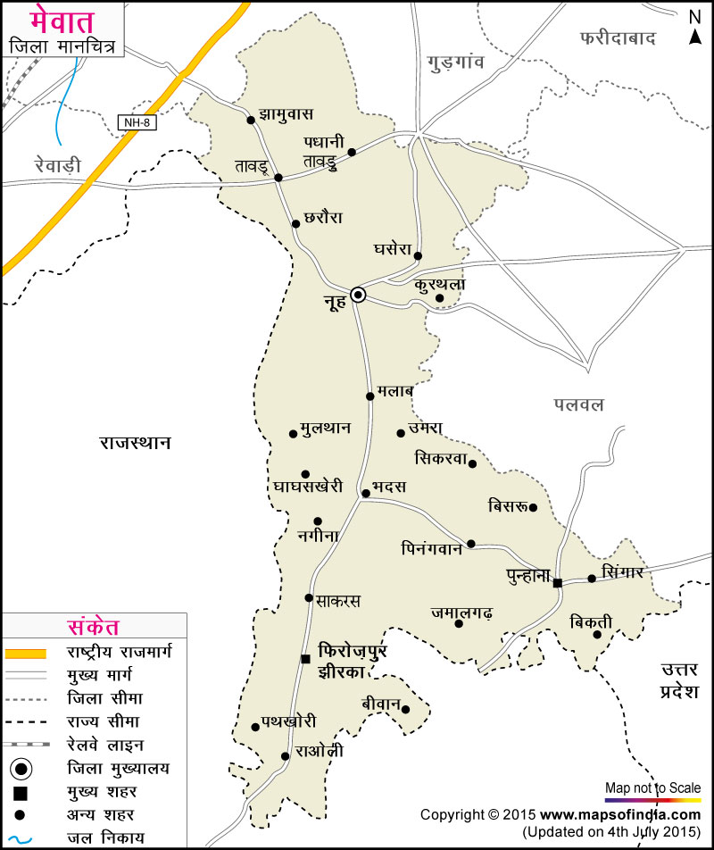
Location of Nuh/Mewat in Haryana
(Aspirational District)

Slide 12
Status of HWCs in Nuh/Mewat
(Aspirational District: 2018-19 & 2019-20)
Description | No. of Health Facilities
 | PHCs | SCs | Total
Targeted Health Facilities to be Transformed into HWCs in Nuh (As per RHS 2018) | 18 | 76 | 94
Health Facilities Already Transformed in Nuh into HWCs in 2018-19 | 12 (67%) | 44 (58%) | 56 (60%)
Health Facilities Processed for Transformation into HWCs in FY 2019-20 | 06 | 20 | 26
Health Facilities to be Transformed into HWCs by the FY 2019-20 | 18 (100%) | 74 (97%) | 92 (97%)
Remaining 02 Sub Centres just sanctioned and buildings to be constructed.

Slide 13
Functionality Status of Health & Wellness Centers in Nuh/Mewat
(Source: GoI HWC Portal: As on 31/08/2019)
Type & No. of Operational HWCs |  | HWCs Meeting Functionality Criteria
 |  | Human Recourse | NCD Training | Community Outreach | Universal Screening | Medicines | Diagnostic Services | Information Technology | Facade Designing
Rural-PHCs | 12 | 12 | 12 | 12 | 12 | 12 | 12 | 12 | 12
 |  | 100% | 100% | 90% | 100% | 100% | 100% | 100% | 100%
Sub Centers | 44 | 44 | 44 | 44 | 44 | 44 | 44 | 44 | 44
 |  | 100% | 100% | 100% | 100% | 100% | 100% | 100% | 100%
Total | 56 | 56 | 56 | 56 | 56 | 56 | 56 | 56 | 56
 |  | 100% | 100% | 100% | 100% | 100% | 100% | 100% | 100%

Slide 14
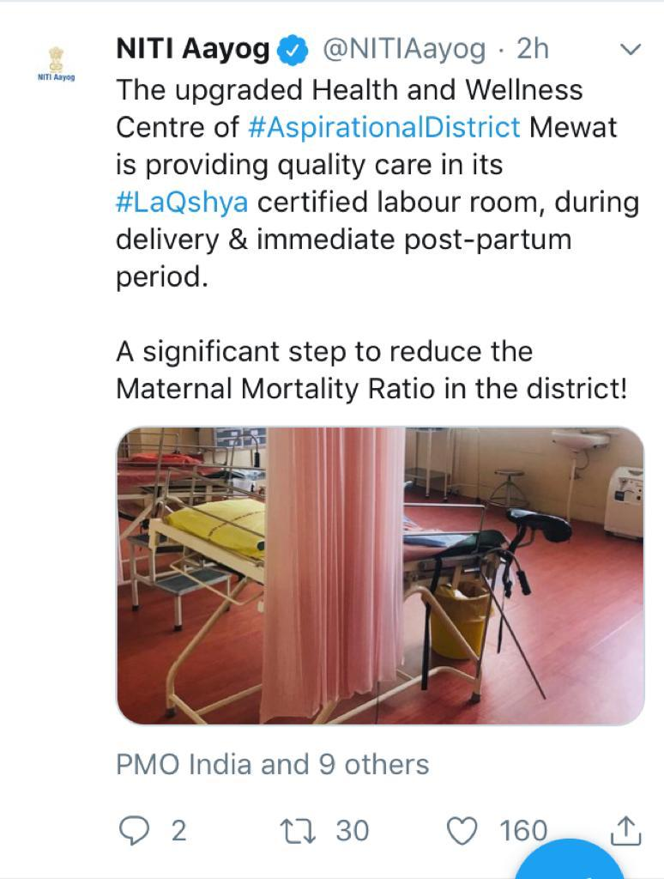








PHC-HWC Tigaon in Mewat
Commanded on
NITI Aayog Portal
Success Story: PHC-HWC Tigaon (Nuh/Mewat)
PHC-HWC Tigaon was dilapidated and non-functional since many years
Earnest efforts of State & District Teams resulted this transformed into a HWC, NQAS Certified and Ready for LaQshya Certification…

Slide 15
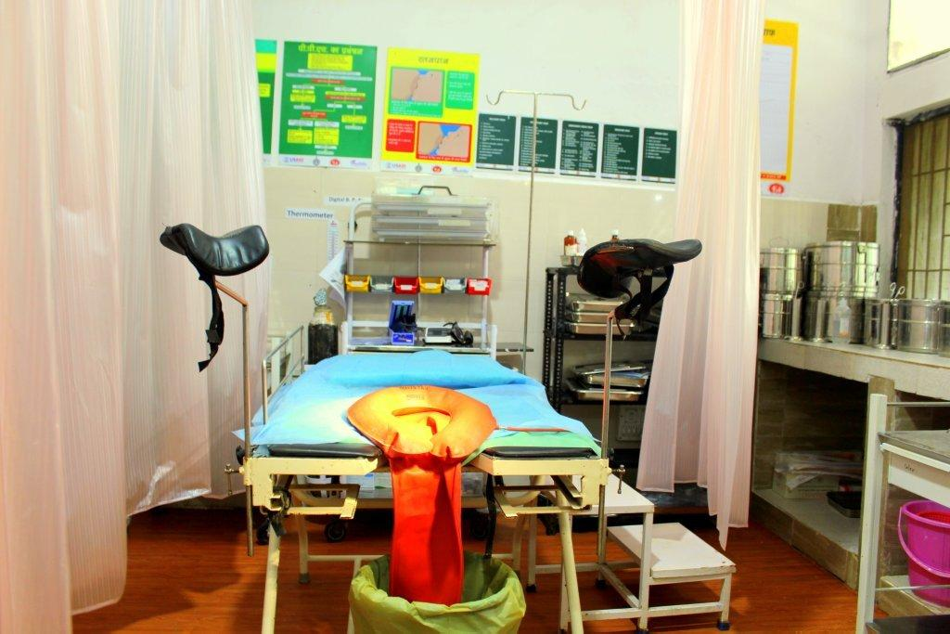
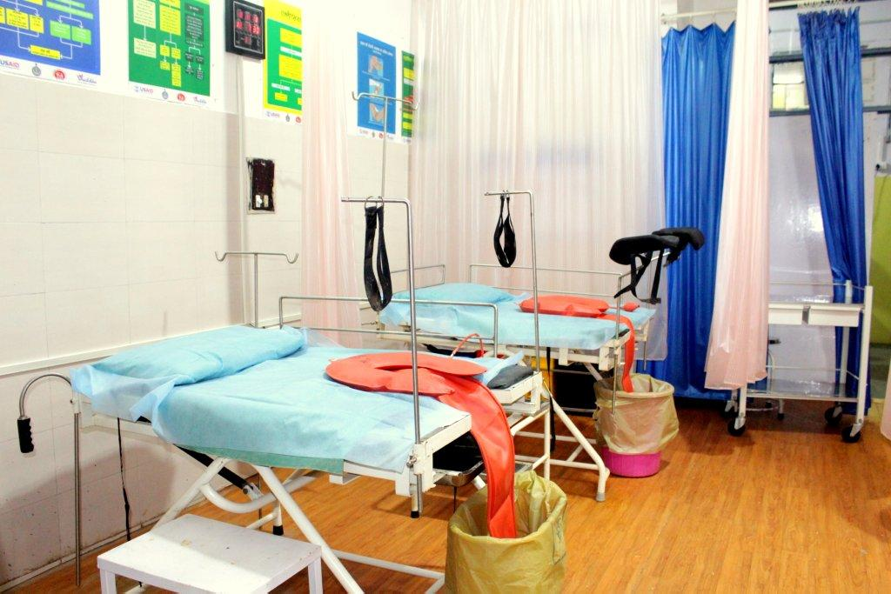
Initiatives under NHM for strengthening MCH services in Nuh
Facility up-gradation:
Out of 20 Govt. health facilities (CH, CHCs and PHCs) in Mewat, 18 health facilities have been strengthened as 24x7 for round the clock delivery care services.
Designation of 1 more FRU – CHC Nuh for provision of obstetric and newborn care services.
Blood Storage Units established at all the three CHCs.
Human resource: for Civil Hospital and all 3 CHCs, sanction given under NHM for MCH services:
  22 Specialists
  134 Staff Nurses
  94 ANMs
  Labour room of CH Mandikhera is National certified under LaQshya.
  Increase in institutional deliveries : by 28.55 % since 2014 (CRS)i.e. from 42.35% in 2014 to 70.9% in 2018 .

Slide 16
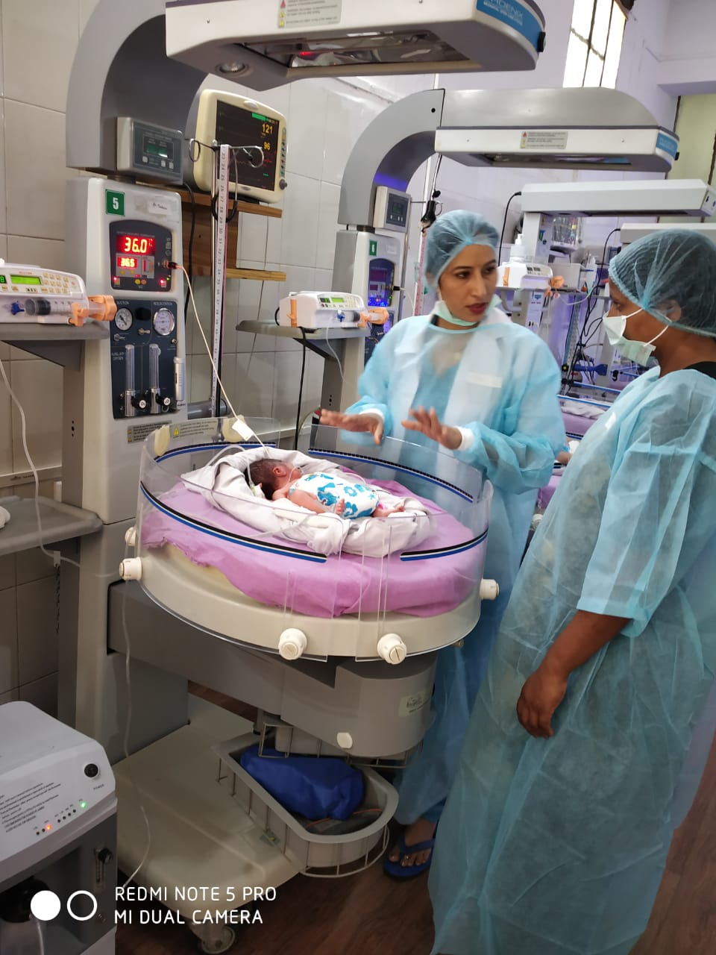
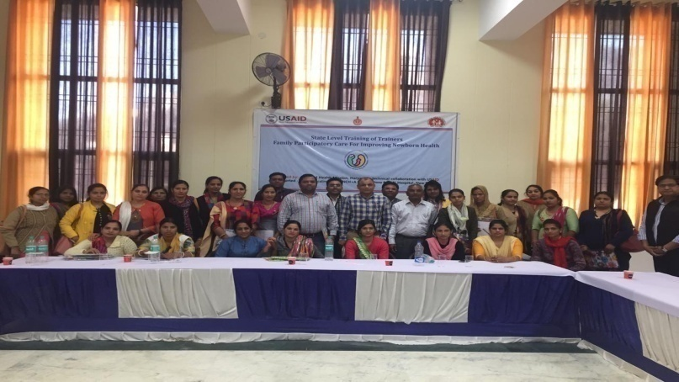
Strengthening of MCH services at GMC Nalhar, Nuh under NHM-ensuring continuum of Care
  Establishment of separate 100 bedded MCH wing and 8 bedded Obstetric HDU-ICU is in process.
  Sanction of 10 Specialists accorded to Medical College.
  Nalhar Medical College has five bedded SNCU with six ventilators and cater to population of 3-4 nearby districts.
  To expand child care services, state has planned to establish Regional SNCU at Nalhar Medical college.
  It will decongest the premium institute like PGIMS Rohtak, AIIMS and will increase the quality of services given to patients.

Slide 17
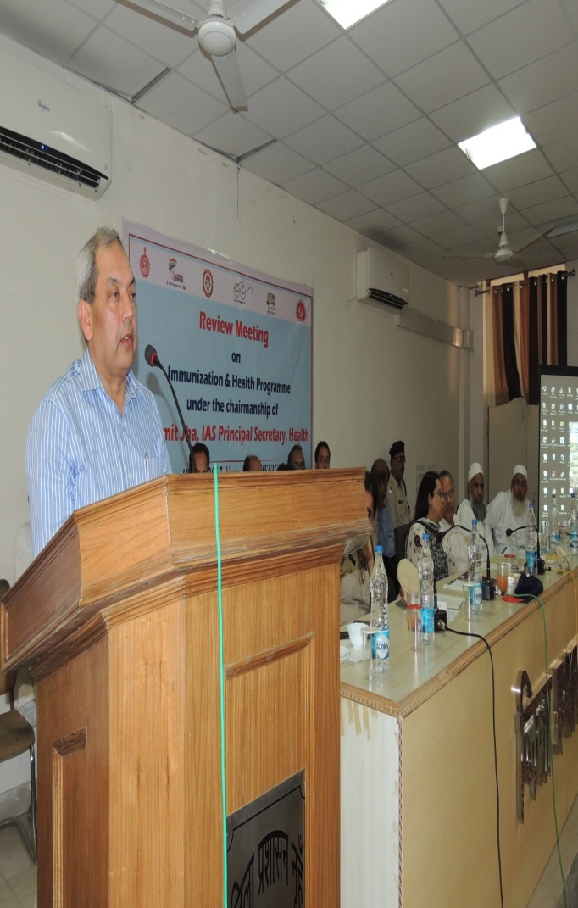
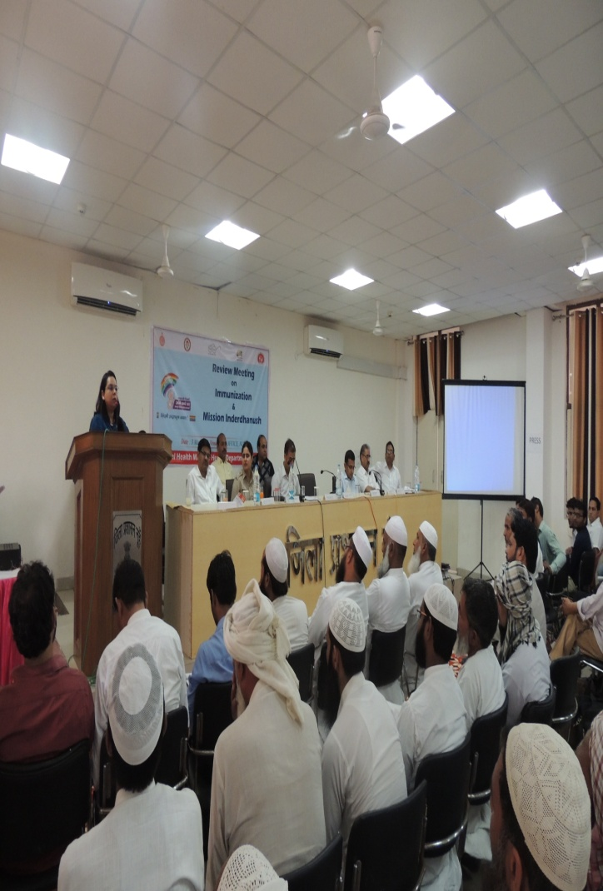
Review & Orientation Meeting with Health Department, Religious Leaders, Frontline Workers etc. also being conducted by Worthy Principal Secretary/Health, and Mission Director/ NHM in Mewat

Slide 18
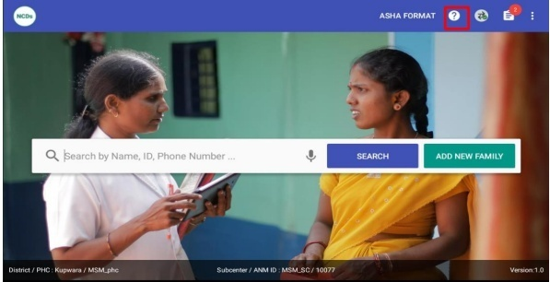
NPCDCS -PBS
Modular training Health staff (ASHAs, ANMs, SN and MO) completed in 13 districts (ASHA-12622, ANM-2871, SN-755, MO-574)
F.Y 2019-20- initiated in remaining 9 districts for Operationalization of HWCs pool of ToTs for ASHAs/ANMs/SNs/MOs –created, Printing/Trainings under Process
Screening activity Status:
Enumerated: 4863800
CBAC -2095467
Screened- 13,14,615
Suspected for DM- 1,24,233 (9.4 2%)
Suspected for HT- 1, 72,242 (13.1%)
CPHC NCD App Training:
Completed in 5 districts and under process in 5 more districts following completion of Modular trainings.
Data uploaded: Enumeration – 4,05,889
CBAC -2,15,322

Slide 19
NCD Training Status of ASHA,ANM,SN & MO
Sr. No. | District | ASHA |  | ANM |  | SN |  | MO
 |  | Target | Trained | Target | Trained | Target | Trained | Target | Trained
1 | Faridabad | 1023 | 908 | 186 | 268 | 58 | 53 | 58 | 55
2 | Hisar | 1341 | 1341 | 396 | 365 | 100 | 85 | 100 | 75
3 | Jind | 1095 | 1095 | 322 | 330 | 78 | 76 | 78 | 31
4 | Karnal | 1100 | 1099 | 294 | 221 | 62 | 40 | 62 | 18
5 | Kurukshetra | 750 | 750 | 234 | 155 | 50 | 60 | 50 | 59
6 | Mewat | 1043 | 1027 | 170 | 130 | 44 | 36 | 44 | 43
7 | Narnaul | 865 | 865 | 270 | 240 | 60 | 70 | 60 | 30
8 | Sonipat | 1270 | 1270 | 328 | 370 | 80 | 101 | 80 | 73
9 | Gurugram | 1016 | 1005 | 285 | 233 | 51 | 51 | 45 | 45
10 | Panchkula | 342 | 341 | 116 | 125 | 22 | 22 | 40 | 40
11 | Sirsa | 923 | 923 | 234 | 172 | 29 | 29 | 27 | 27
12 | Yamunanagar | 978 | 978 | 182 | 156 | 35 | 35 | 48 | 48
13 | Ambala | 832 | 826 | 189 | 106 | 97 | 97 | 30 | 30
14 | Jhajjar | 860 | 860 | 253 | 288 | 203 | 29 | 173 | 30
15 | Palwal | 1025 | 1015 | 179 | 125 | 102 | 85 | 72 | 25
16 | Panipat | 932 | 932 | 217 | 60 | 120 | 60 | 87 | 0
17 | Rewari | 812 | 740
18 | Fatehabad | 832 | 650
19 | Kaithal | 935 | 630
20 | Rohtak
21 | Bhiwani
22 | Charkhi Dadri
Total |  | 17974 | 17255 | 3855 | 3344 | 1191 | 929 | 1054 | 629

Slide 20
District wise PBS
S.No. | Name of District | Total Population of the district | 30 years & above Population (37% of the total Population) | # persons enumerated | % | # CBAC forms filled | % | NO. of persons screened by ANM/SN
1 | Sonipat | 1450001 | 536500 | 1206887 | 225 | 444260 | 83 | 3192
2 | Gurugram | 1514432 | 560340 | 1597961 | 285 | 361148 | 64 | 149187
3 | Ambala | 1271337 | 470395 | 513436 | 109 | 248204 | 53 | 446170
4 | Sirsa | 1295189 | 479220 | 533348 | 111 | 242302 | 51 | 178821
5 | Panchkula | 558890 | 206789 | 406352 | 197 | 222350 | 108 | 101537
6 | Yamunanagar | 1214162 | 449240 | 242035 | 54 | 210973 | 47 | 261949
7 | Narnaul | 922088 | 341173 | 88258 | 26 | 154729 | 45 | 107016
8 | Mewat | 1089263 | 403027 | 77668 | 19 | 67546 | 17 | 36052
9 | Karnal | 1505324 | 556970 | 71326 | 13 | 44187 | 8 | 13450
10 | Kurukshetra | 964655 | 356922 | 39577 | 11 | 39577 | 11 | 1338
11 | Hisar | 1743931 | 645254 | 41369 | 6 | 39008 | 6 | 2610
12 | Faridabad | 2383918 | 882050 | 33399 | 4 | 13881 | 2 | 569
13 | Palwal | 1227058 | 454011 | 12184 | 3 | 7302 | 2 | 477
 | Total | 17140248 | 6341892 | 4863800 | 68 | 2095467 | 33 | 1314615

Slide 21
STATUS OF SUSPECTED CASES
S.No | District | DM |  |  | HT |  |  | Oral Cancer |  |  | Breast Cancer | Cervical Cancer
 |  | Male | Female | Total | Male | Female | Total | Male | Female | Total
1 | Ambala | 35992 | 43220 | 79212 | 40182 | 52266 | 92448 | 227 | 141 | 368 | 265 | 461
2 | Faridabad | 61 | 216 | 277 | 66 | 185 | 251 | 2 | 1 | 3 | 9 | 4
3 | Gurugram | 2890 | 4855 | 7745 | 3786 | 5694 | 9480 | 22 | 34 | 56 | 28 | 167
4 | Hisar | 221 | 165 | 386 | 282 | 247 | 529 | 3 | 0 | 3 | 3 | 7
5 | Panchkula | 7702 | 9984 | 17686 | 10613 | 13253 | 23866 | 161 | 24 | 185 | 72 | 125
6 | Sirsa | 2612 | 3242 | 5854 | 5195 | 6380 | 11575 | 153 | 117 | 270 | 102 | 234
7 | Karnal | 104 | 330 | 434 | 175 | 539 | 714 | 5 | 5 | 10 | 8 | 6
8 | Mewat | 348 | 376 | 724 | 429 | 330 | 759 | 23 | 19 | 42 | 1 | 0
9 | Narnaul | 808 | 782 | 1590 | 632 | 596 | 1228 | 32 | 4 | 36 | 36 | 2
10 | Sonipat | 93 | 103 | 196 | 105 | 91 | 196 | 30 | 34 | 64 | 10 | 54
11 | Jind | 0 | 0 | 0 | 0 | 0 | 0 | 0 | 0 | 0 | 0 | 0
12 | Kurukshetra | 0 | 0 | 0 | 0 | 0 | 0 | 0 | 0 | 0 | 0 | 0
13 | Yamunanagar | 3924 | 5601 | 9525 | 14092 | 16390 | 30482 | 186 | 162 | 348 | 255 | 215
14 | Jhajjar | 215 | 378 | 593 | 227 | 434 | 661 | 18 | 8 | 26 | 12 | 12
15 | Palwal | 7 | 4 | 11 | 34 | 21 | 55 | 0 | 0 | 0 | 0 | 0
Total |  | 54977 | 69256 | 124233 | 75818 | 96426 | 172244 | 862 | 549 | 1411 | 801 | 1287

Slide 22
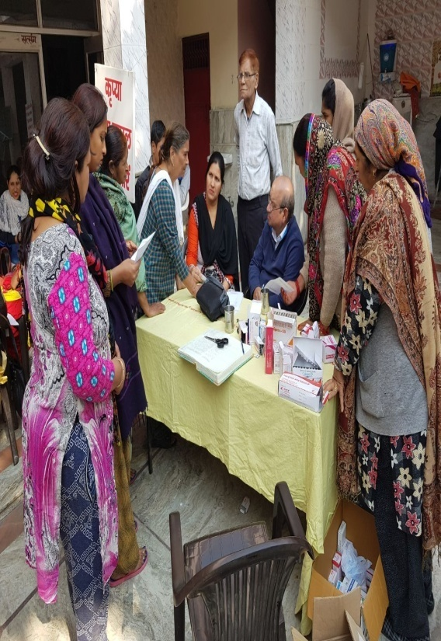
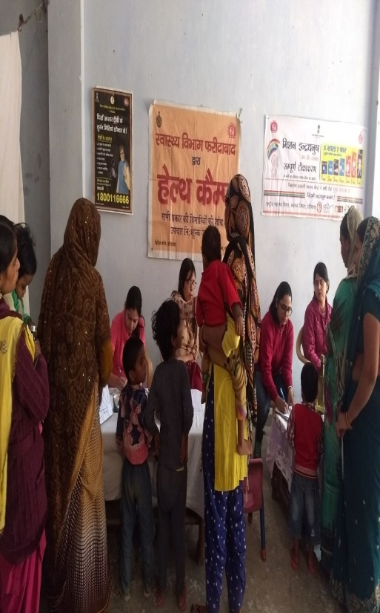
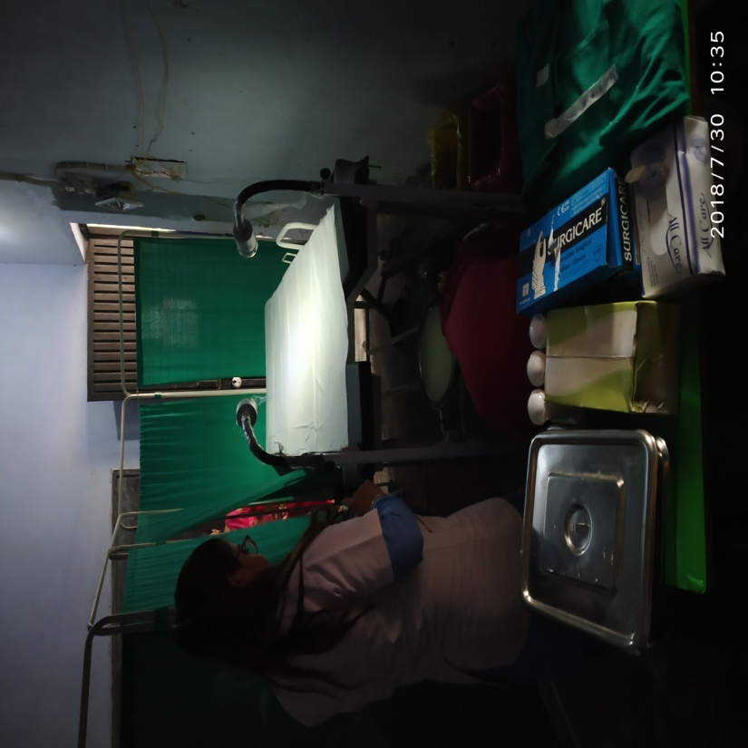
Mega Outreach Camps for NCDs screening - NUHM
VIA being done in camps
Notes:
RMNCH A stretegy

Slide 23
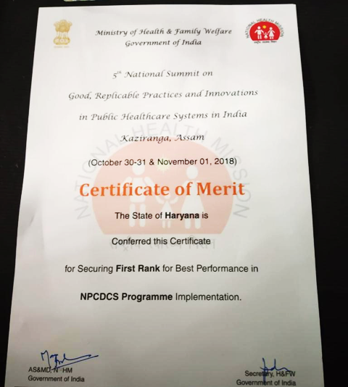
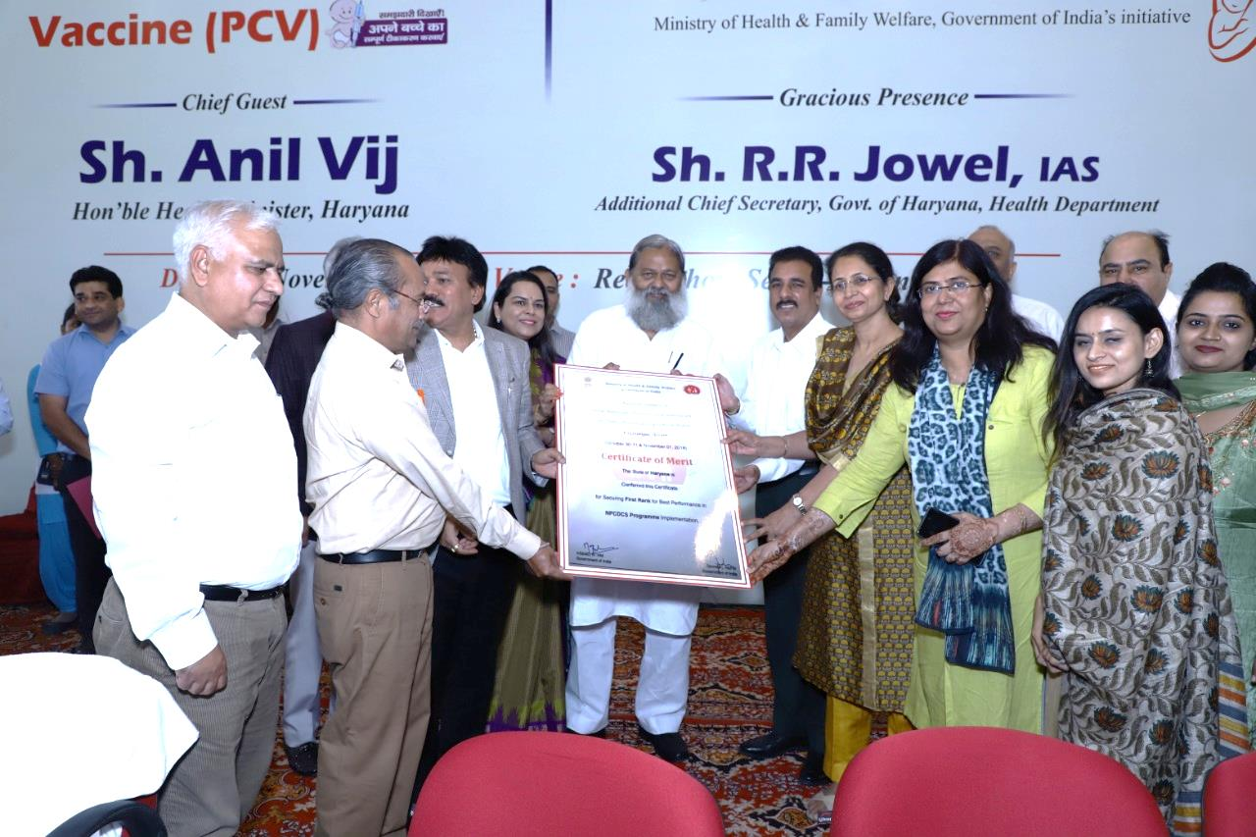
Haryana State secured first Rank in the Country in implementation of NPCDCS during 2018-19

Slide 24
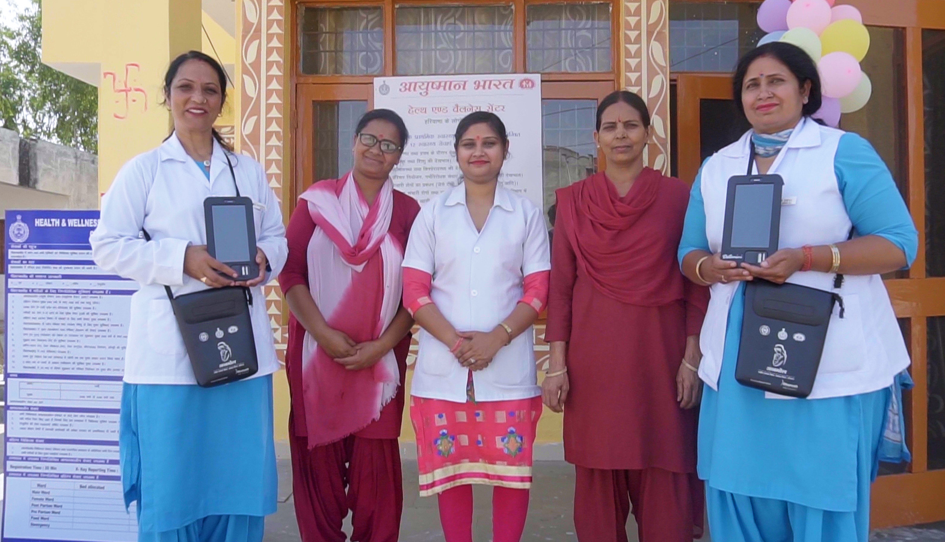



ANMOL IT INNOVATION
NHM, Haryana

Slide 25
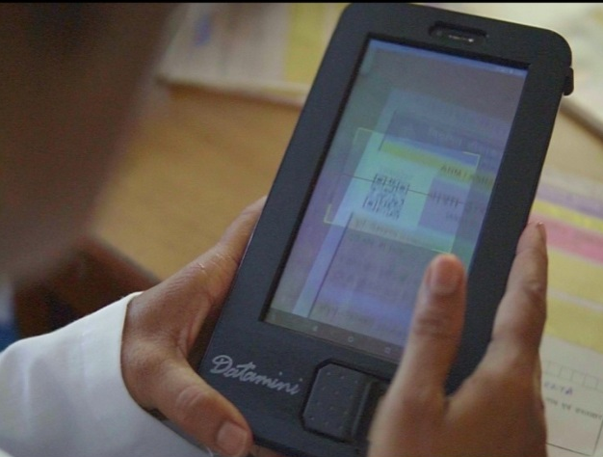
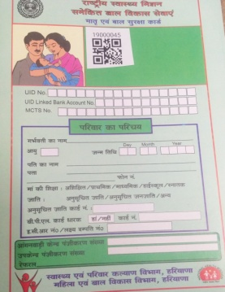

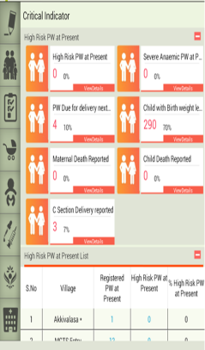
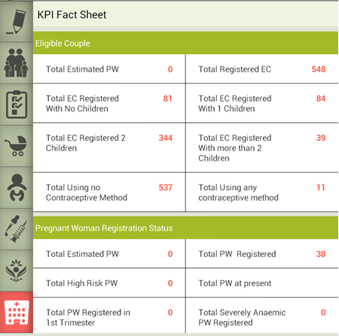
ANMOL - MCP QR Code integration
ANMOL Currently implemented in 12 districts in 1st Phase and is being scaled up to rest of 10 districts.
All ANMs (2735 ANMs ) are provided with Integrated Tablets with Biometric Finger Print Device
After introducing ANMOL , Data Entry Coverage for Eligible Couples improved from 45% to 84% , Pregnant Women 36% to 58% and Children from 30% to 40% in RCH Portal.
MCP Cards with preprinted unique QR Codes
At point of registration the beneficiaries data is linked with QR Code of MCP card
Service delivery data can be updated by scanning the QR code on MCP Card with the tablet.
Ensures real-time service updating at point of care
Patient’s Community healthcare episodes with ANMs will be integrated with Hospital EMR System in ensuring continuum of care through QR Code scanning

Slide 26
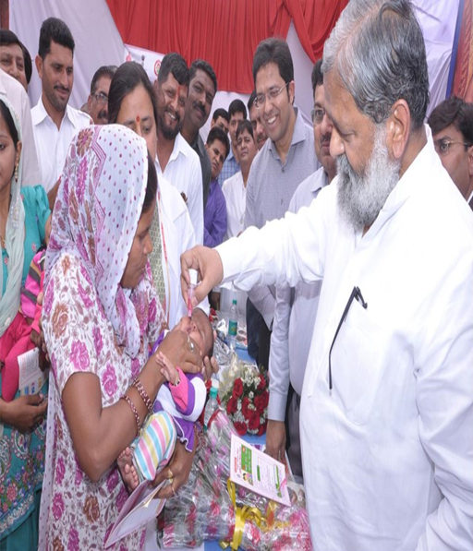
PCV Vaccine QR Code
Pneumococcal Conjugate Vaccine (PCV) launched as Atal Teekakaran Yojana Under Swaran Jayanti celebration.
Total 3,66,619 children have received PCV doses till April 2019
At Immunization session ANM is scanning QR Code pre-printed in PCV Vial
Batch number of PCV Vaccine can be identified immediately in case of any AEFI
Real-time service updation of vaccine during immunization session
PCV Vaccines administrated and wastage can be derived from data and published on dashboard.
No additional cost component involved

Slide 27
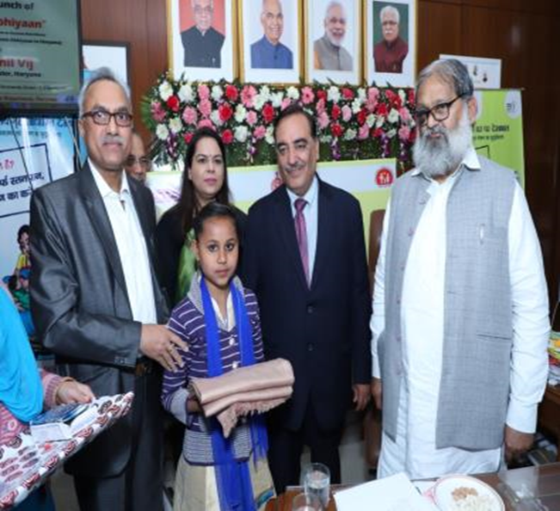
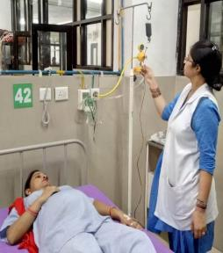
Pregnancy and child care initiatives
  Launch of ATAL ABHIYAAN (Assuring Total Anemia Limit Abhiyaan) by Hon’ble Health Minister Haryana on 8th March 2019
  Inclusion of Injection Iron Sucrose for treating Severely Anaemic Pregnant and Lactating Women in State’s EDL upto PHC level
  Distribution of Welcome kit to Private doctors and Refreshment to pregnant women in PMSMA
  Provision of ultrasound services to pregnant women through public-private partnership (PPP) mode.
  Formulation of State specific Standard Operating Protocols (SOPs).
  Inclusion of 75 gm glucose in State essential drugs list (EDL) for ensuring screening of Gestational Diabetes Mellitus (GDM).

Slide 28
Trends –Institutional deliveries (2014-2019, upto April) CRS
Increase in Institutional Deliveries from 85.9% in 2014 to 93% in 2019 (CRS).
    Launch of “Zero Home Delivery Campaign” with aim of achieving 100% institutional deliveries in the state

Slide 29
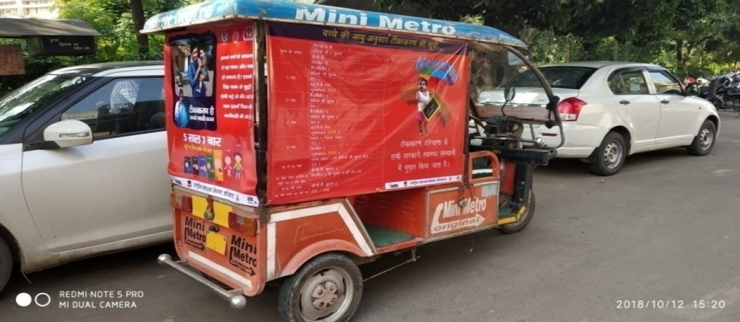
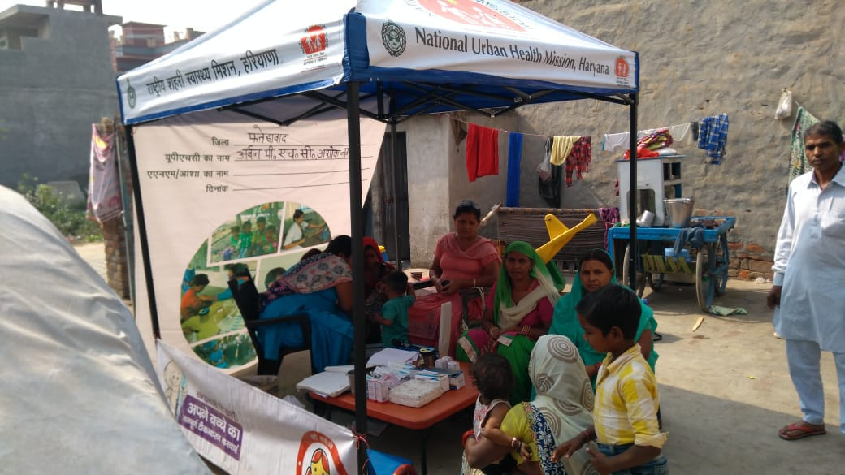
Innovative model: To increase immunization in Urban Slums
  E-Rickshaw: To increase immunization coverage in urban slums, e -rickshaw project implemented in all districts.
  Canopy tents also provided for immunisation sessions in urban slums.
  Rollout of Boosting Routine Immunization Demand Generation (BRIDGE) trainings in May 2019, for enhancing Inter-personnel communication (IPC) skills of Frontline workers (ANMs, ASHAs & AWW)

Slide 30
Immunization Achievements (FY 2018-19)
State has achieved 96% total Full Immunization Coverage in FY 2018-19 as compare to 62% in NFHS-4 (2015-16)

Slide 31
Comprehensive Incentive Package for ASHA under State Plan Budget
Monthly fixed incentive @Rs. 4000/- (w.e.f. Jan. 2018) 50% added incentive of the monthly earning under NHM (Contd. from Feb. 2014) Ex-gratia grant of Rs. Three Lakh to the family of deceased ASHA Additional Incentive of Rs. 750/- for following 06 Major Activities:
Sr. No. | 06 Major Activities | GoI Rates | State Rates | Additional Amount
1 | Facilitation of Institutional Deliveries (other than JSY cases) @ Rs. 200/- per case w.e.f. Feb. 2014 | - | - | Rs. 300/-
2 | Facilitation of JSY Cases for Institutional Deliveries (Rural/Urban) | Rs. 300/200 | Rs. 400/300 | Rs. 100/-
3 | Routine Immunization of Children | Rs. 150/- | Rs. 250/- | Rs. 100/-
4 | ANC Check-up of Pregnant Women | Rs. 250/- | Rs. 350/- | Rs. 100/-
5 | HBNC of Newborn & Mothers | Rs. 250/- | Rs. 350/- | Rs. 100/-
6 | Promoting Spacing between Births | Rs. 500/- | Rs. 550/- | Rs. 50/-
Now each ASHA would be able to earn minimum Rs. 9000/- per month after implementation of the enhanced incentive

Slide 32
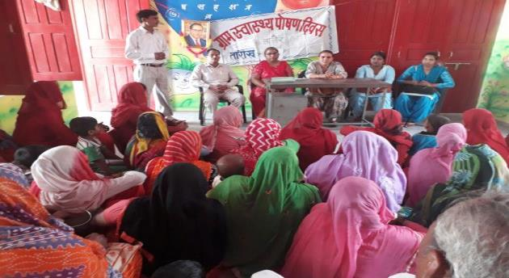
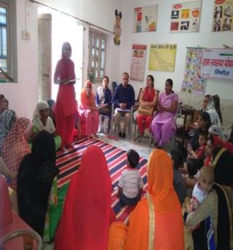
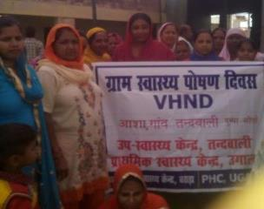
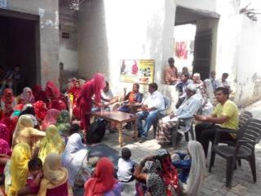
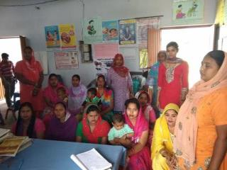
Total 18007 Special VHND Celebrated by ASHAs in Haryana under Gram Swaraj Abhiyaan

Slide 33
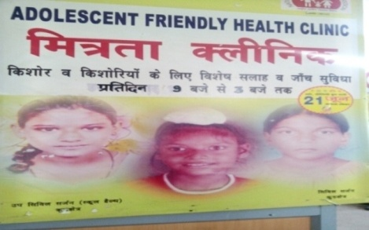
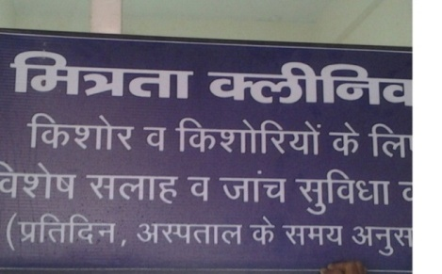
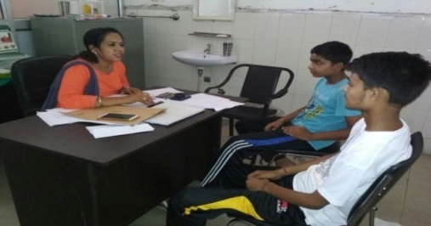
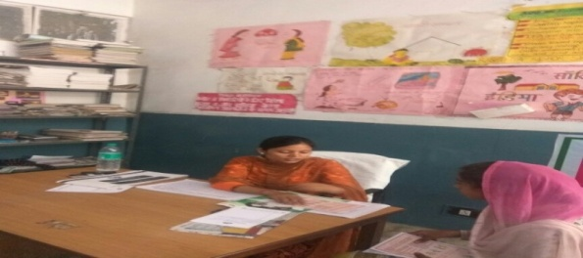
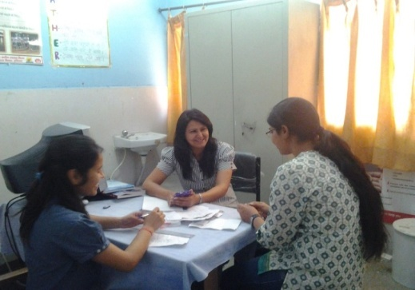
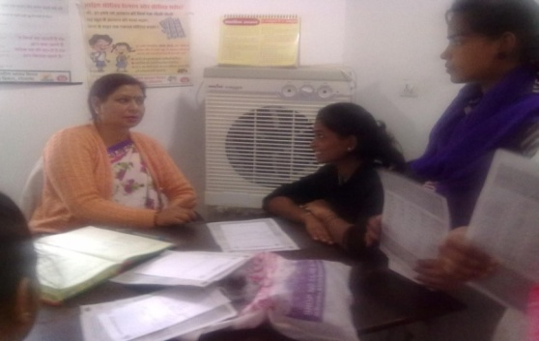
Adolescent Friendly Health Clinics
(AFHCs)
Branded as Mitrata Clinics in State. Functional in 126 PHCs and 76 uphcs upgraded as HWCs with trained manpower.
Service Providers: Trained Adolescent Health Counselors, Trained AYUSH Doctors/Dental Surgeons.
Sources of demand generation for AFHCs:
- Referrals from OPDs.
- Walk in clients.
- Through outreach visits to schools , Community, Bal Bhawans, ITIs, Nehru Yuva Kendras etc.
- Daily 15-20 adolescents visits AFHCs.
SIGNBOARDS OF AFHCs
INTERACTIVE SESSIONS BY DOCTORS AND COUNSELOR

Slide 34
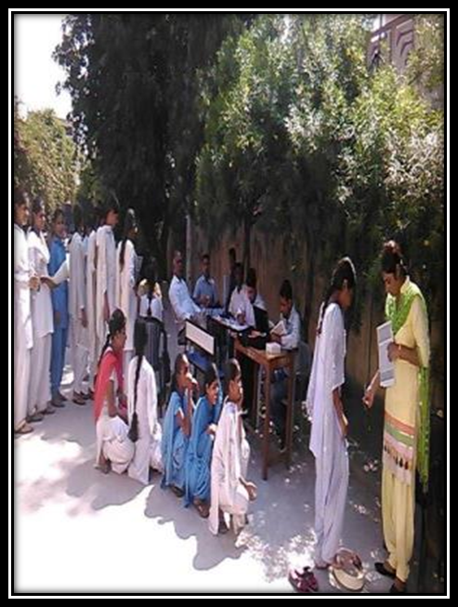
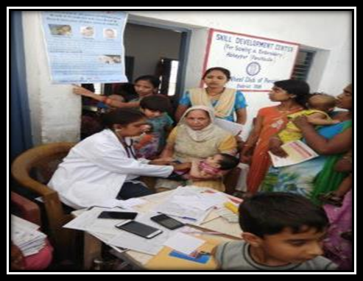
Rashtriya Bal Swasthya Karyakaram RBSK
Theme based and disease specific screening every month under RBSK across all districts.
Dental Camps are being organized every week at CHC and PHC/UPHC level and every month at DEIC.
2712 no of Spectacles have been distributed in the first quarter to children with refractive errors.

Slide 35
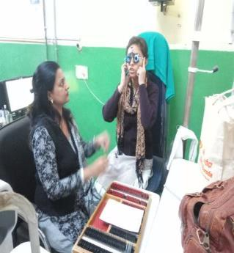
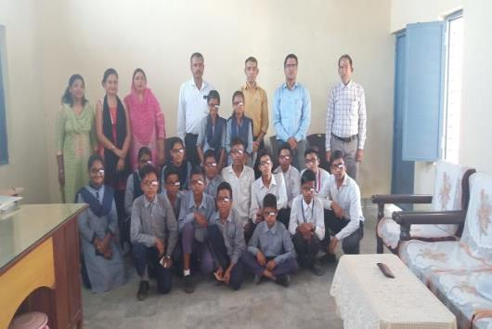
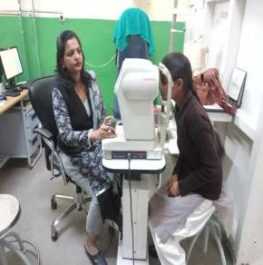
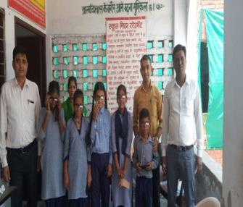
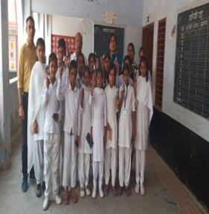
FREE OF COST SPECTACLES DISTRIBUTION TO CHILDREN WITH REFRACTIVE ERRORS

Slide 36
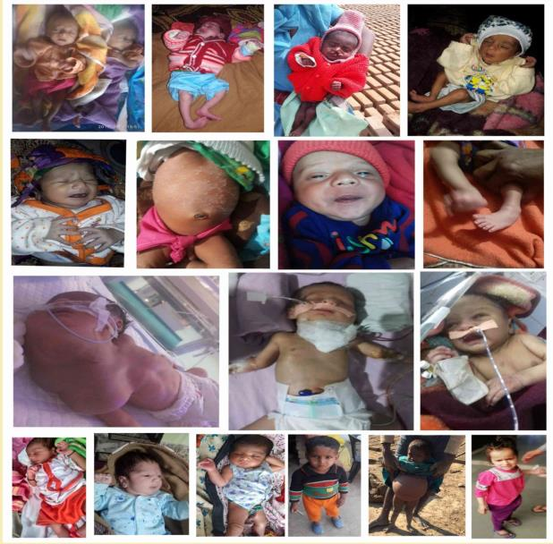

Newborn/Infants/Children Facilitated through HWCs for Management of Critical illness
IEC Material Displayed at all
Health & Wellness Centers for BCC & Awareness Generation

Slide 37
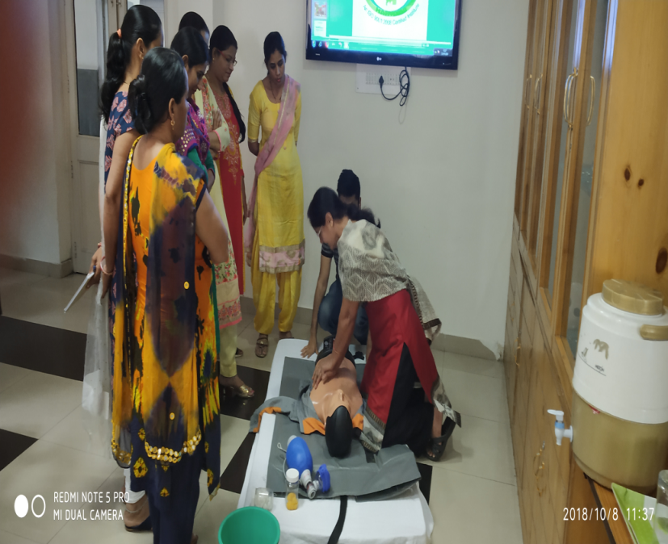
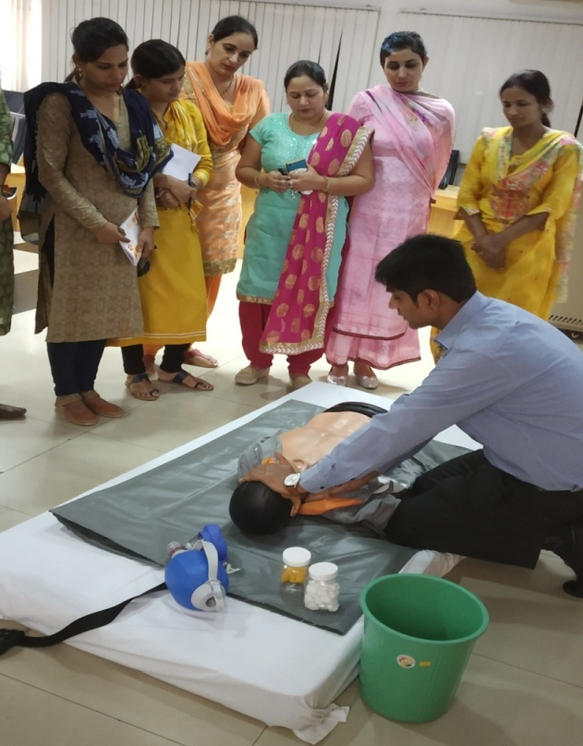

Staff Nurses and MOs trained in BLS to provide Emergency Medical Services in UPHCs
Notes:
RMNCH A stretegy

Slide 38




Yoga and Wellness Activity in HWCs
Notes:
RMNCH A stretegy

Slide 39


Outreach Activities for Community Mobilization through HWCs

Slide 40


Mega Health Camps for Universal Health Coverage
Organized by Health & Wellness Centers

Slide 41


Health & Wellness Centre
Govt. Dispensary, Haryana Bhawan, New Delhi
Before
After

Slide 42




Health & Wellness Centres
Rural-PHCs Kunjpura and Salwan (Karnal)
Before
After

Slide 43




Health & Wellness Centres
Rural-PHC Samlerhi & Nahoni (Ambala)
Before
After

Slide 44


