Slide 1
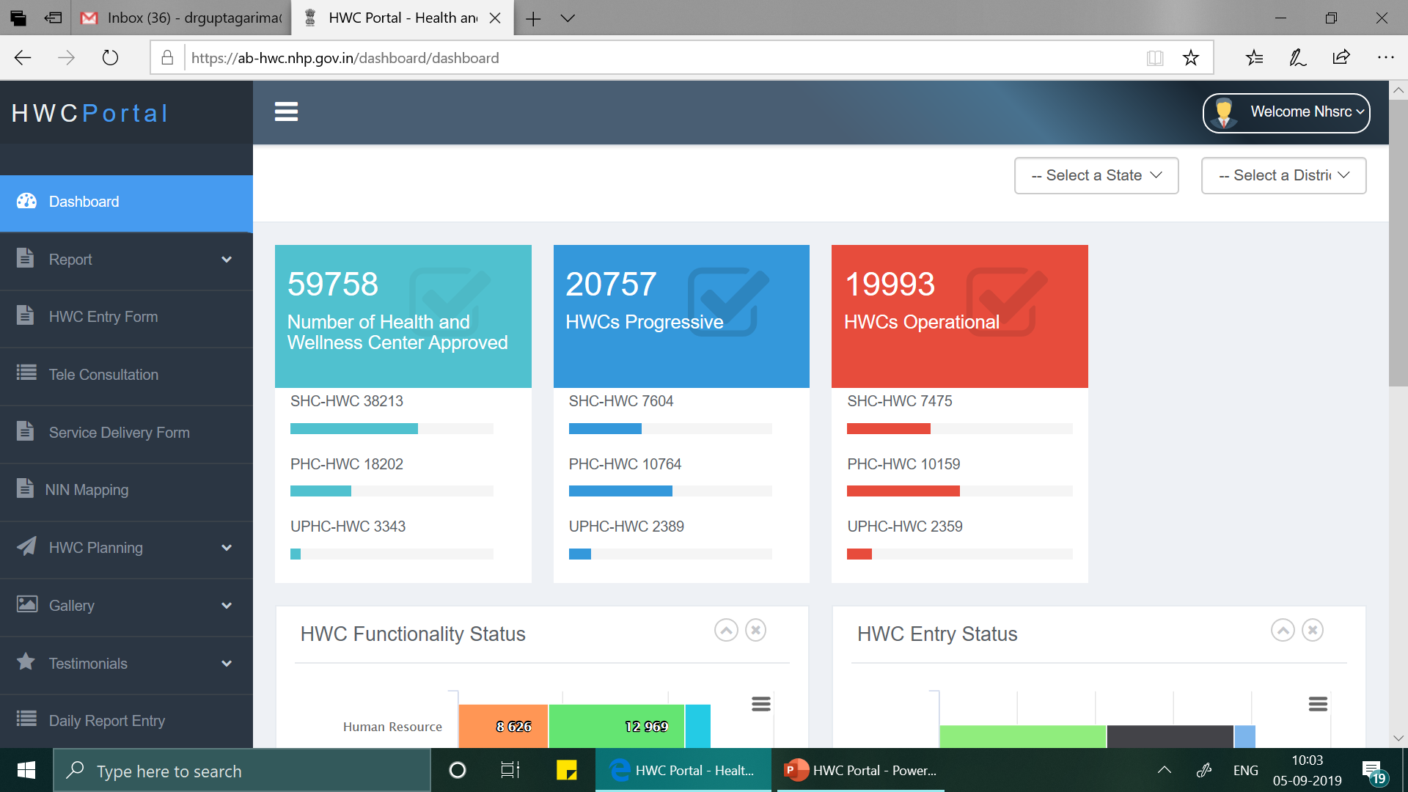
HWC Portal (https://ab-hwc.nhp.gov.in/)
Key Features
Facility wise information on all functionality criteria
Daily Reporting on service utilization
Monthly Servicer Delivery Reporting Format
HWC and CPCH planning sheet
NIN and RCH Code mapping
HWC – CHO / MO Directory
Platform to upload photos, videos and testimonials

Slide 2
Functionality Criteria
Criteria for SHC-HWC:
CHO in position+
Training on NCD completed for MPW(F) and ASHA+
Diagnostics available +
Medicines available+
Branding completed + Screening of NCDs- Hypertension + Diabetes+ Oral Cancer + Breast Cancer started
Criteria for PHC-HWC & UPHC- HWC:
MBBS MO in position +
Training on NCD completed for MO or Staff Nurse+
Diagnostics available +
Medicines available +
Branding completed +
Screening of NCDs- Hypertension + Diabetes + Oral Cancer + Breast Cancer started
Criteria for SHC-HWC:
CHO in position +
Training on NCD completed for MPW(F) and ASHA + Diagnostics available +
Medicines available +
Branding completed if the facility is in Government Building
Criteria for PHC-HWC & UPHC- HWC:
MBBS MO in position +
Training on NCD completed for MO or Staff Nurse +
Diagnostics available +
Medicines available +
Branding completed if the facility is in Government Building

Slide 3






HWC portal data entry status
Service delivery reporting status
May- August, 2019
State Name | HWC Operational | May, 2019 | % | June, 2019 | % | July, 2019 | % | Aug, 2019 | %
Chandigarh | 10 | 7 | 70 | 9 | 90 | 9 | 90 | 9 | 90
Chhattisgarh | 808 | 742 | 92 | 744 | 92 | 761 | 94 | 191 | 24
Haryana | 463 | 144 | 31 | 144 | 31 | 135 | 29 | 91 | 20
HP* | 31 | 71 | 229 | 133 | 429 | 192 | 619 | 38 | 123
J &K | 229 | 49 | 21 | 41 | 18 | 9 | 4 | 9 | 4
MP | 744 | 189 | 25 | 210 | 28 | 176 | 24 | 71 | 10
Punjab | 859 | 829 | 97 | 808 | 94 | 784 | 91 | 286 | 33
Rajasthan | 580 | 259 | 45 | 217 | 37 | 180 | 31 | 15 | 3
Uttarakhand | 184 | 36 | 20 | 189 | 103 | 207 | 113 | 39 | 21
Total | 19993 | 11377 | 57 | 11206 | 56 | 10480 | 52 | 2732 | 14
* Entries also include data from proposed HWCs which are yet to become progressive
AYUSHMAN BHARAT-HEALTH AND WELLNESS CENTRES

Slide 4
Use of IT application
State Name | HWC Operational | Use of IT app as per HWC Portal
Chandigarh | 10 | 10
Chhattisgarh | 808 | 872
Haryana | 463 | 279
HP | 31 | 261
J &K | 229 | 19
MP | 744 | 498
Punjab | 859 | 150
Rajasthan | 580 | 474
Uttarakhand | 184 | 5
Total | 19993 | 10818
AYUSHMAN BHARAT-HEALTH AND WELLNESS CENTRES

Slide 5
NCD Screening status as per AB- HWC Portal
 | State Name | Chandigarh | Chhattisgarh | Haryana | HP | J&K | MP | Punjab | Rajasthan | UK | Total- all states
Community Outreach | Individuals Empanelled | 0 | 469949 | 425657 | 124997 | 13395 | 78062 | 86480 | 16246 | 157741 | 24301255
 | CBAC Filled | 0 | 652359 | 155963 | 67303 | 17699 | 114717 | 589909 | 30121 | 60393 | 15989930
Hypertension | Screening | 3038 | 833194 | 44180 | 149607 | 18443 | 31169 | 262494 | 37934 | 23555 | 15440445
 | Newly Diagnosed | 10 | 83626 | 4198 | 15926 | 1619 | 5525 | 55115 | 2624 | 3284 | 1279294
 | On Treatment | 0 | 354353 | 7584 | 30374 | 2060 | 8052 | 76767 | 4520 | 2464 | 7058852
Diabetes | Screening | 1336 | 717611 | 37889 | 82970 | 17297 | 19551 | 151105 | 28131 | 19824 | 14456811
 | Newly Diagnosed | 7 | 62910 | 3138 | 9983 | 782 | 3915 | 27666 | 1299 | 2352 | 1572479
 | On Treatment | 0 | 70729 | 5676 | 16926 | 1114 | 5569 | 50003 | 2134 | 1813 | 3127345
Oral Cancer | Screening | 1101 | 455983 | 19816 | 28210 | 11979 | 3021 | 59313 | 17506 | 7451 | 7680756
 | Newly Diagnosed |  | 3264 | 8 | 9 | 0 | 41 | 131 | 4 | 10 | 15128
 | On Treatment | 0 | 2753 | 45 | 43 | 0 | 42 | 735 | 3 | 10 | 10218
Breast Cancer | Screening | 605 | 214964 | 10013 | 7532 | 4198 | 1323 | 44163 | 8620 | 5821 | 5293008
 | Newly Diagnosed | 0 | 1733 | 57 | 3 | 0 | 24 | 232 | 3 | 6 | 20408
 | On Treatment | 0 | 1653 | 17 | 4 | 0 | 19 | 538 | 4 | 6 | 9742
Cervical Cancer | Screening | 386 | 109174 | 2923 | 3169 | 1054 | 954 | 15858 | 2874 | 235 | 3730142
 | Newly Diagnosed | 0 | 692 | 60 | 1 | 1 | 1 | 146 | 87 | 4 | 17785
 | On Treatment | 0 | 587 | 7 | 3 | 1 | 3 | 416 | 0 | 3 | 10075
AYUSHMAN BHARAT-HEALTH AND WELLNESS CENTRES

Slide 6
NCD Screening status as per NCD Dashboard – Total
PBS+ HWC – All | State Name | Chandigarh | Chhattisgarh | Haryana | HP | J&K | MP | Punjab | Rajasthan | UK | Total- all states
Community Outreach | Individuals Empanelled | 3917 | 834800 | 477046 | 1042905 | 3491 | 540178 | 113685 | 595744 | 820430 | 63682732
Hypertension | Screening | 1208 | 591258 | 11112 | 0 | 463 | 9222 | 2135 | 0 | 29 | 10582474
 | Diagnosed | 0 | 16659 | 0 | 2230 | 0 | 23 | 0 | 197 | 0 | 433931
Diabetes | Screening | 1203 | 588919 | 10956 | 0 | 440 | 8781 | 2082 | 0 | 30 | 9896891
 | Newly Diagnosed | 0 | 10145 | 0 | 1205 | 0 | 4 | 0 | 69 | 0 | 172860
Oral Cancer | Screening | 1198 | 584728 | 10616 | 0 | 433 | 8457 | 2065 | 0 | 27 | 9510927
 | Newly Diagnosed | 0 | 5 | 0 | 56 | 0 | 0 | 0 | 0 | 0 | 147
Breast Cancer | Screening | 697 | 305050 | 5512 | 0 | 224 | 3568 | 1191 | 0 | 20 | 5173560
 | Newly Diagnosed | 0 |  | 0 | 12 | 2 | 0 | 0 | 0 | 0 | 67
Cervical Cancer | Screening | 93 | 129683 | 1925 | 0 | 28 | 1878 | 942 | 0 | 1 | 3160550
 | Newly Diagnosed | 0 | 15 | 0 | 10 | 0 | 0 | 0 | 116 | 0 | 97
AYUSHMAN BHARAT-HEALTH AND WELLNESS CENTRES

Slide 7
NCD Screening status from HWCs as per NCD Dashboard
HWC | State Name | Chhattisgarh | Haryana | J&K | MP | Punjab | Rajasthan | UK | Total- all states
Community Outreach | Individuals Empanelled | 699797 | 213345 | 3213 | 441195 | 51161 | 286762 | 162 | 2733428
Hypertension | Screening | 521153 | 3334 | 420 | 7275 | 1643 | 0 | 29 | 874471
 | Diagnosed | 11665 | 0 | 0 | 20 | 0 | 94 | 0 | 14934
Diabetes | Screening | 518969 | 3305 | 400 | 6949 | 1595 | 0 | 28 | 865647
 | Newly Diagnosed | 6838 | 0 | 0 | 2 | 0 | 43 | 0 | 8579
Oral Cancer | Screening | 516153 | 3164 | 395 | 6691 | 1587 | 0 | 26 | 858145
 | Newly Diagnosed | 5 | 0 | 0 | 0 | 0 | 0 | 0 | 5
Breast Cancer | Screening | 268737 | 1617 | 207 | 2813 | 896 | 0 | 20 | 440559
 | Newly Diagnosed | 1 | 0 | 0 | 0 | 0 | 0 | 0 | 2
Cervical Cancer | Screening | 113374 | 413 | 26 | 1523 | 850 | 0 | 1 | 201490
 | Newly Diagnosed | 12 | 0 | 0 | 0 | 0 | 0 | 0 | 12
AYUSHMAN BHARAT-HEALTH AND WELLNESS CENTRES

Slide 8
Daily Reporting Status

Slide 13
Key issues
About 50% verification of data done by state nodal teams – affects quality of data entered
No regular updation of HWC – suggestive frequency was quarterly
Slow pace of data entry

Slide 14
Next phase
Integration with NCD- CPHC IT application for –
Sharing of daily service utilization data (for estimation of Performance Linked Payments for HWCs)
Pulling data for NCD screening
Create Hierarchy of SHC and PHCs for planning of strengthening Primary health care units

