Slide 1
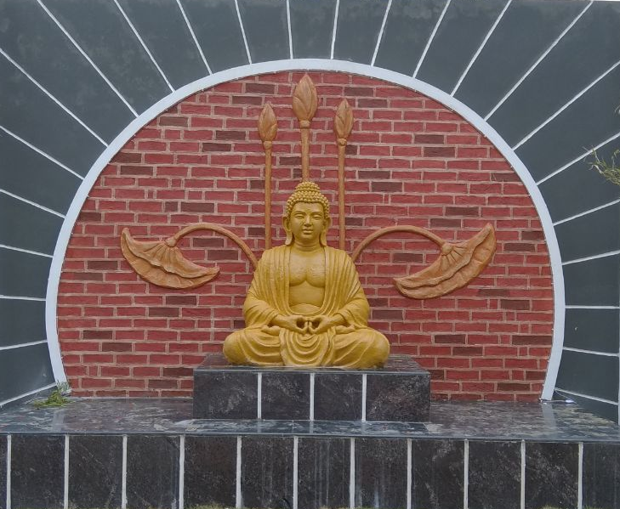
AB-HWC Best Practices,
Chhattisgarh
Presentation by :
Dr. Priyanka Shukla
MD-NHM CG
UPHC-HWC Burha Mahadev, Kawardha

Slide 2
HWC in Chhattisgarh: Current Status
Target | Achieved | Remark
1900 HWC (Conditionality Target = 1309) | 810 (1200 Functionally Active in terms of Service Delivery) | 1500 HWCs planned to be operationalized by Nov 2019, 1900 by February 2020
CHO Status
July 2018 Batch – 68 passed and posted in HWC-SC
January 2019 Batch - 278 CHO result awaited
July 2019 Batch – 300 selected and training started
* Passing Percentage of Student is > 90%
Programme study Centre
Total 9 PSC has been started with the capacity of 480
2 proposals submitted, 6 new PSCs proposed in the FY 2019-20, annual capacity = 1400
228 LTs, 900 SNs have been recruited recently, 700 SN more to be recruited this year

Slide 3
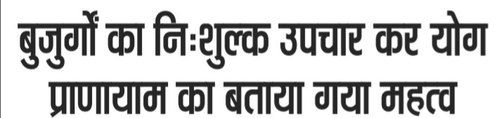
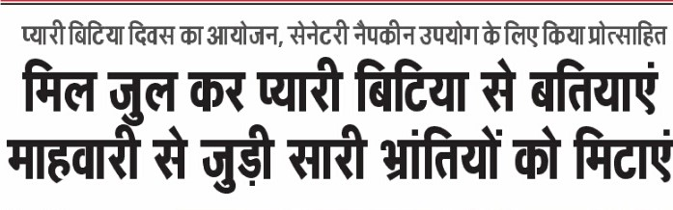
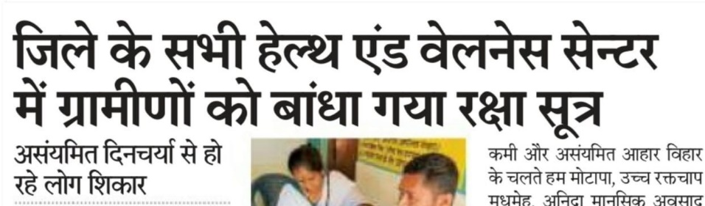
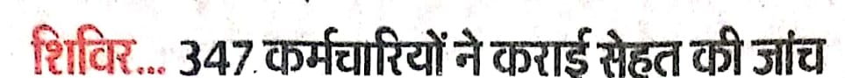
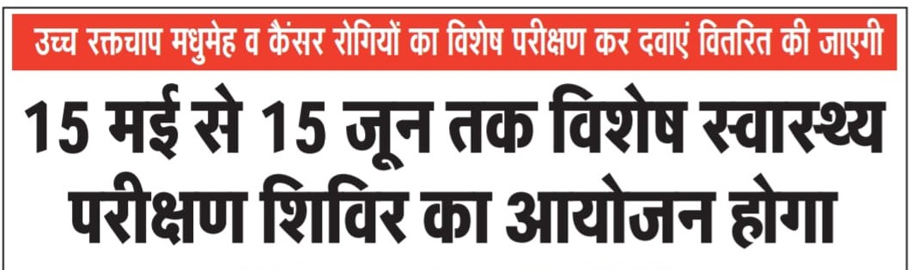
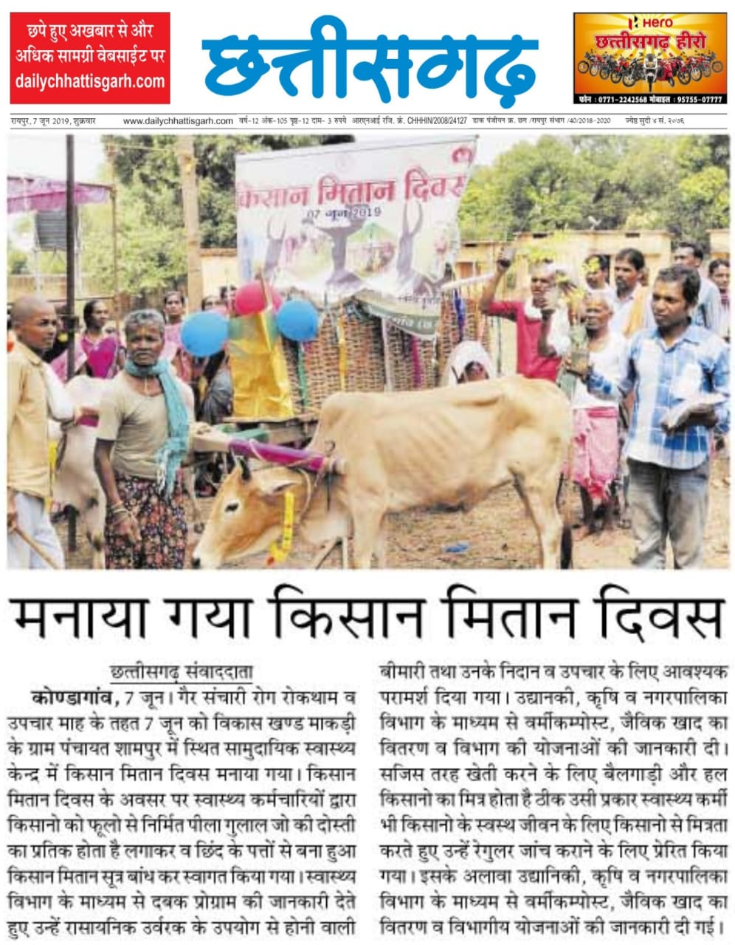
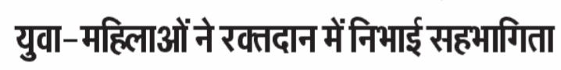
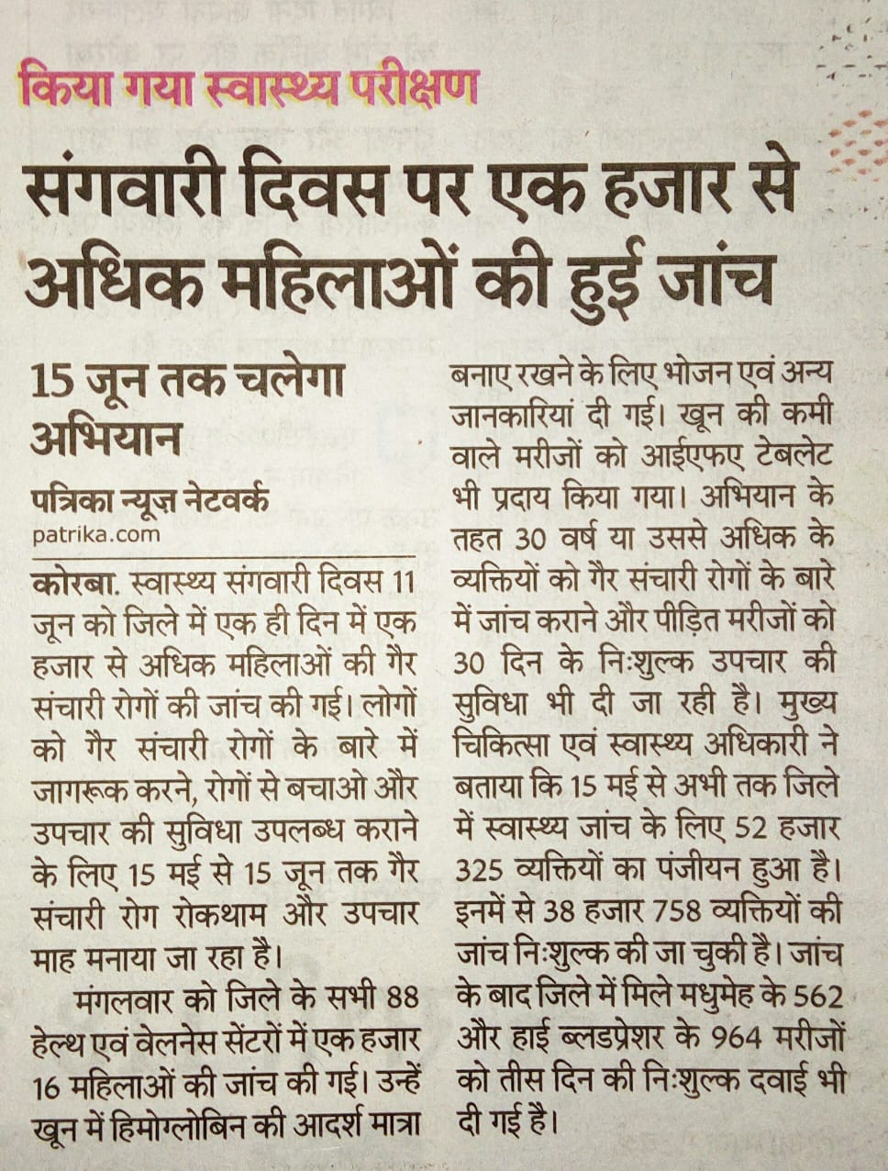
Best Practice 1 - NCD Suraksha Maah

Slide 4
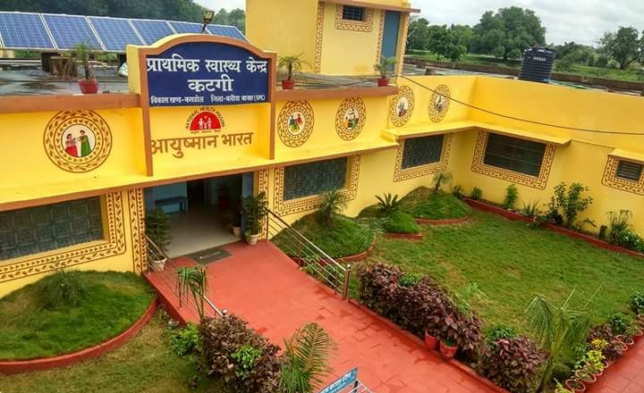
Increased Mortality and Morbidity in CG from NCDs –60% of deaths-Epidemiological Transition in Burden of Disease
69% of OOP expenditure due to NCDs
- Catastrophic expenditure
Low pace of NCD screening at the
field level
  CBAC filling by Mitanins
  Universal screening of NCDs at
  HWCs based on scoring in CBAC
  Proper treatment and timely referral
  of NCD identified cases
Need for Massive awareness generation reg. NCDs, concept of wellness & healthy lifestyle
Rationale
Need to re-invigorate the HWC field staff
NUDGE
NEEDED

Slide 5
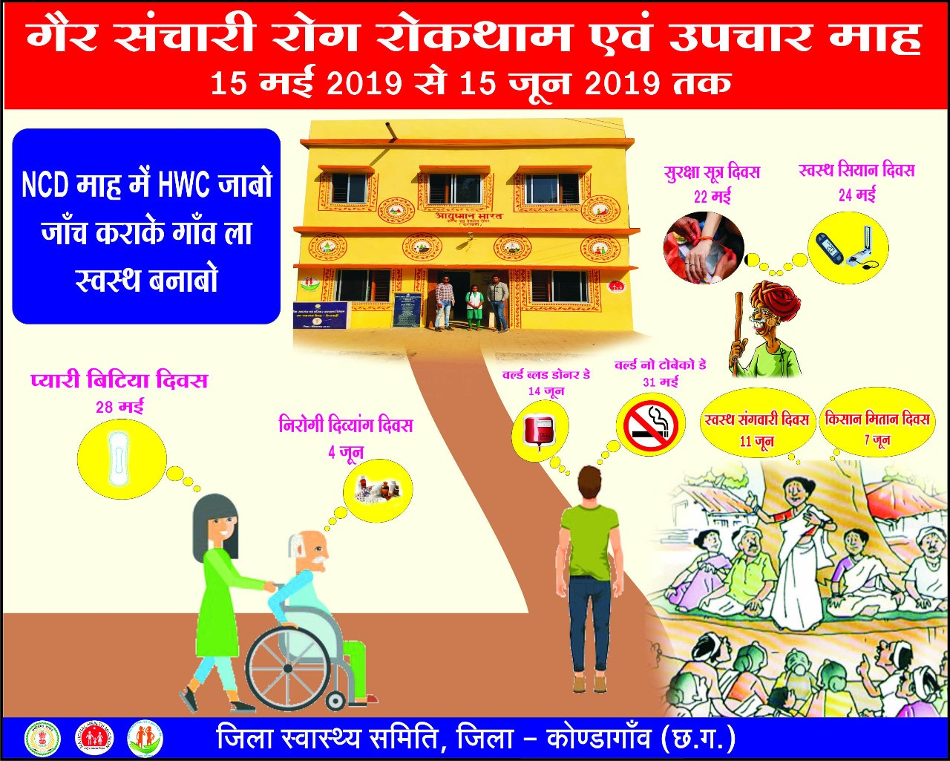
NCD Suraksha Maah
Organized in 900 SHC, PHCs & UPHCs upgraded as HWCs in all 27 districts
(As on 15th May)

Slide 6
THE STRATEGY
Robust Planning
  State level orientation cum consultation organized for all state & dist officials on 10th May in collaboration with USAID MCSP / Jhpiego
  Detailed guidelines prepared for implementation
  Daily / weekly reporting, monitoring formats developed
  Microplanning to ensure logistics (CBAC formats, family folders, Drugs, Diagnostics, consumables, equipment, instruments, referral cards etc.) at all HWCs
  Attractive, informative NCD Card developed for everyone to be screened to ensure effective follow-up
Intensive Follow-up
  Nodal officers at state level for each division/distt
  24*7 follow up thru Whats app group
  Weekly VC with district officials
  Continuous follow-up with district collectors, CMHOs and other district officials
  Daily compilation of district level progress and sharing with districts- Relative performance shared in group
  State officials & DPs involved in district level orientation and monitoring of NCD month

Slide 7
THE EXECUTION
Ensuring Effective Execution
  100% Compliance Of Guidelines & Action Plans Ensured thru District and block level orientation
  Supportive Supervision by CMHOs and others thru VC, meetings etc.
  Technical issues related to NCD app were solved on daily basis in collaboration with Tata Trust & Dell
  Ensured population enumeration, universal screening of NCDs, treatment, referral and entry of the data in NCD app and MO portal at all 900 HWCs of the state
Innovative Mechanism
  Massive Mobilization ensured through Special health days organized at all HWCs involving the target population of all age groups
  Leveraged various social events
  Special screening of various target groups including farmers, MNREGA workers, Swachhatakarmis, elderly .
  Extensive IEC on various media platforms- quiz competition
  Wellness innovations

Slide 8
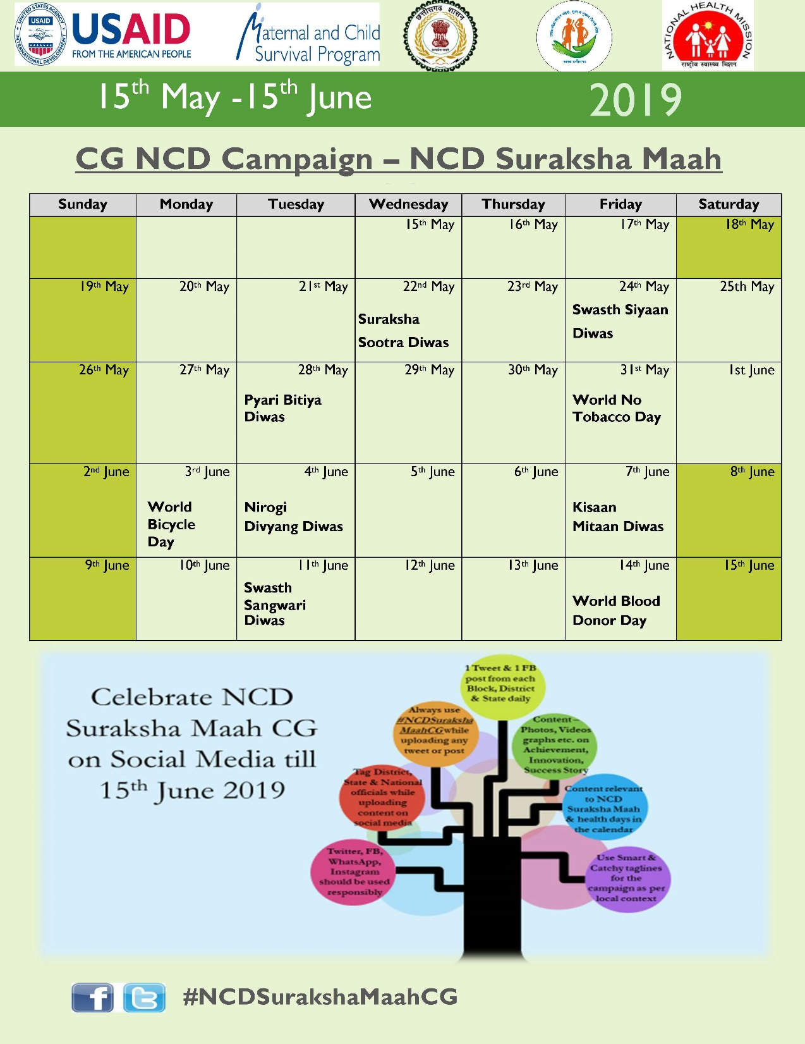
Intensive Social Mobilization Plan
&
Consistent engagement of field teams

Slide 9
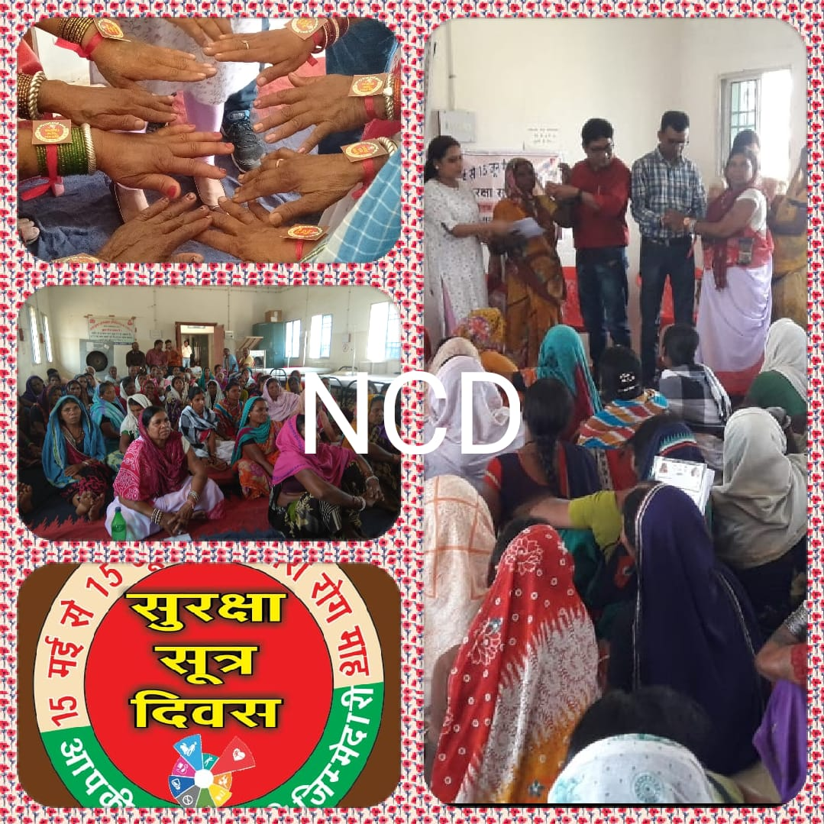
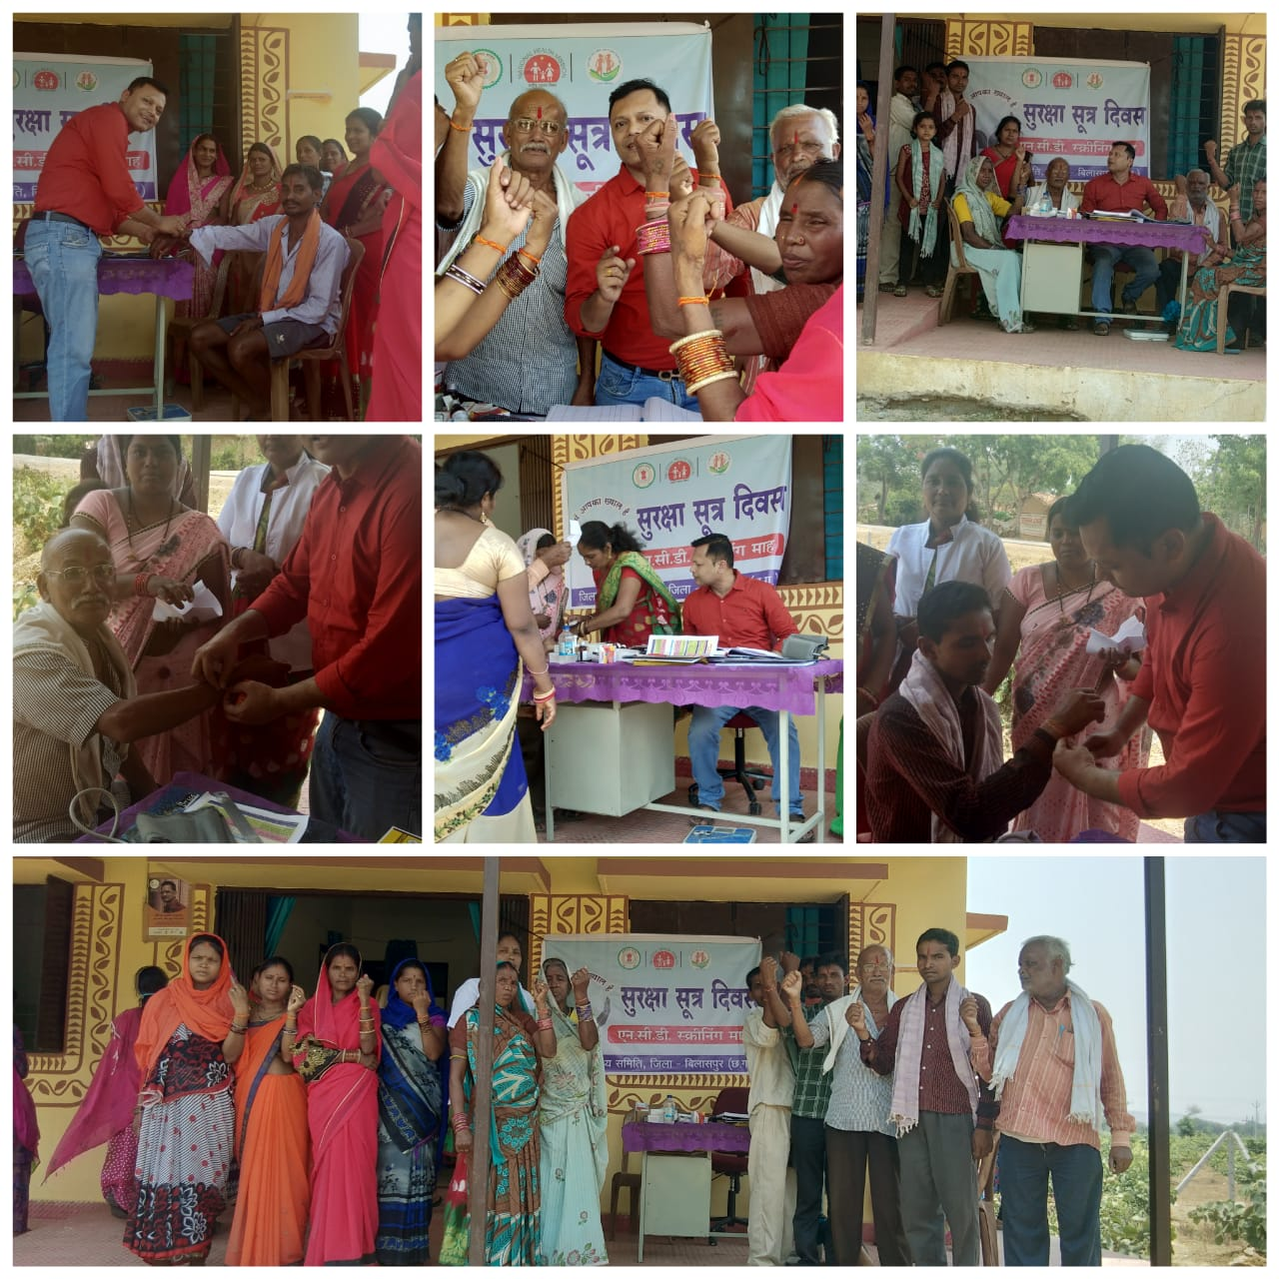
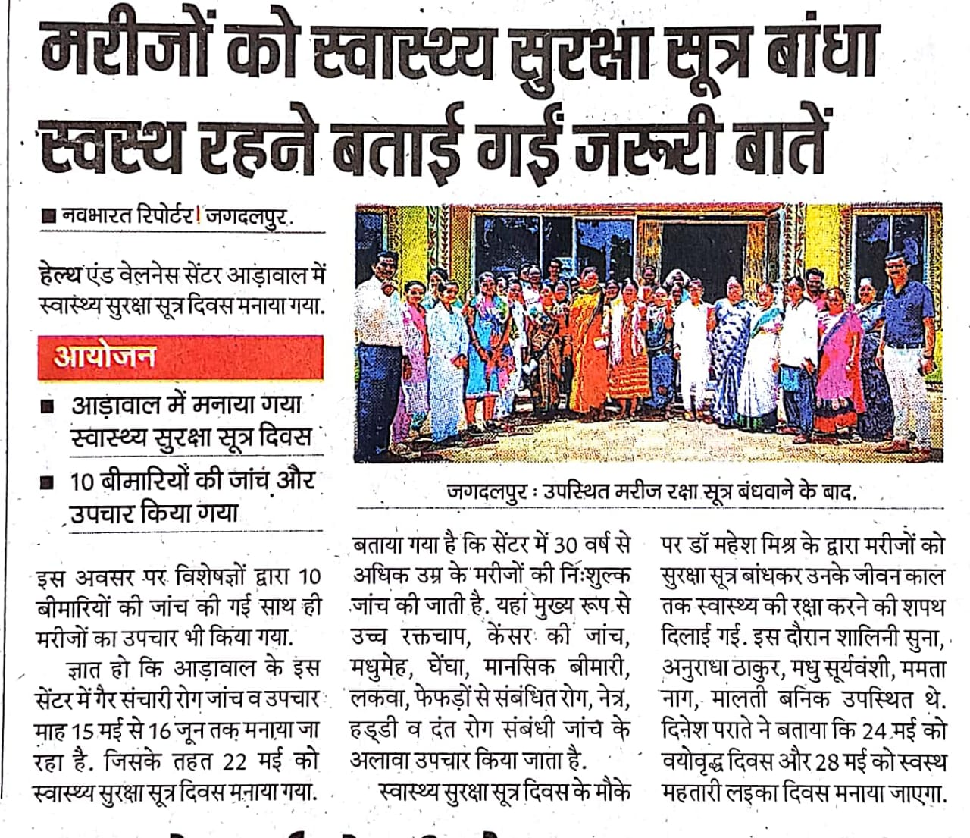
Suraksha Sootra Diwas

Slide 10
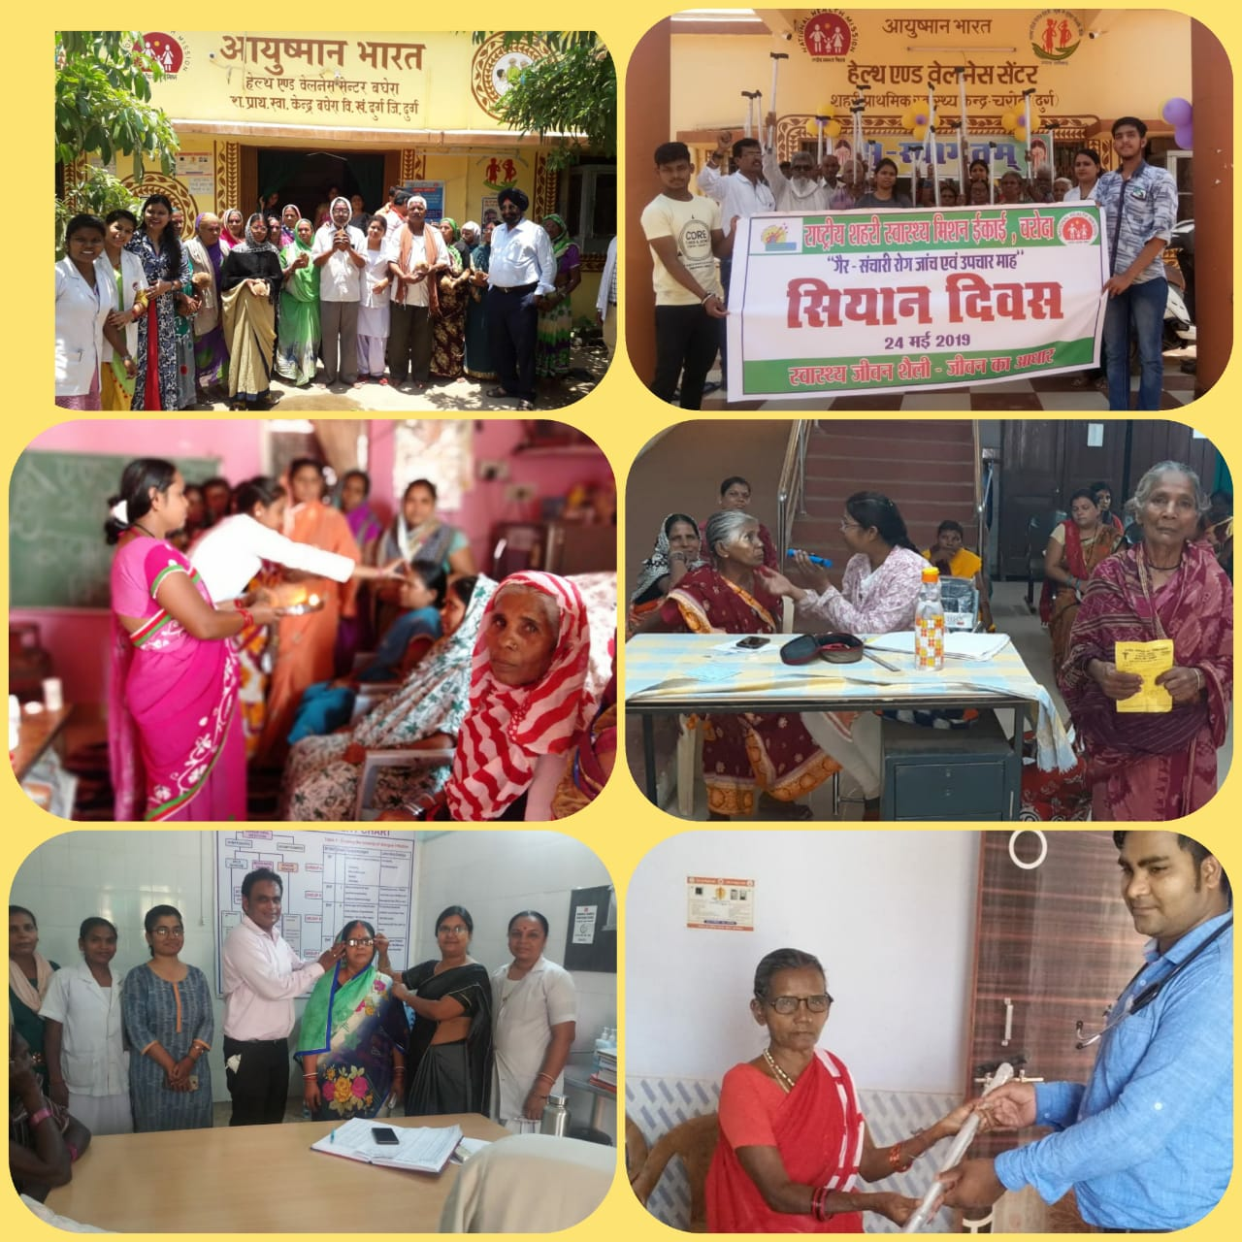
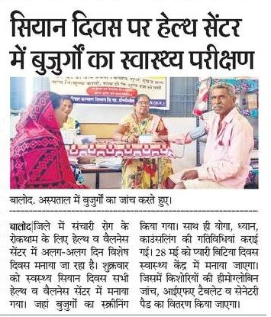
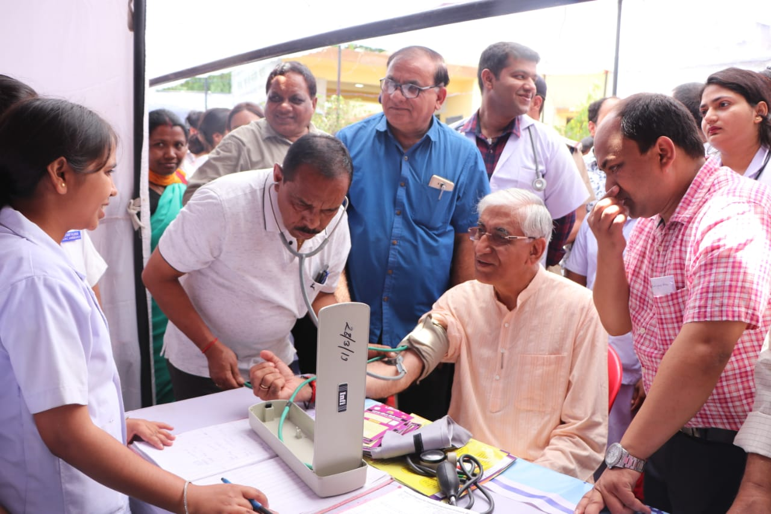
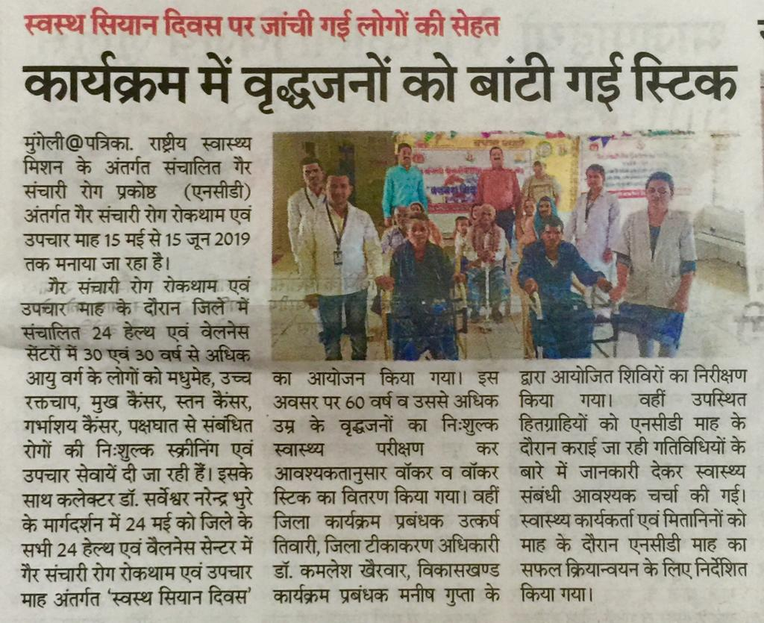
Swasth Siyan Diwas
Health Minister being Screened

Slide 11
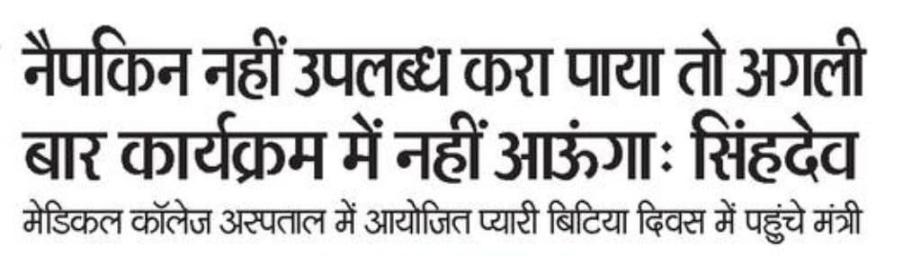
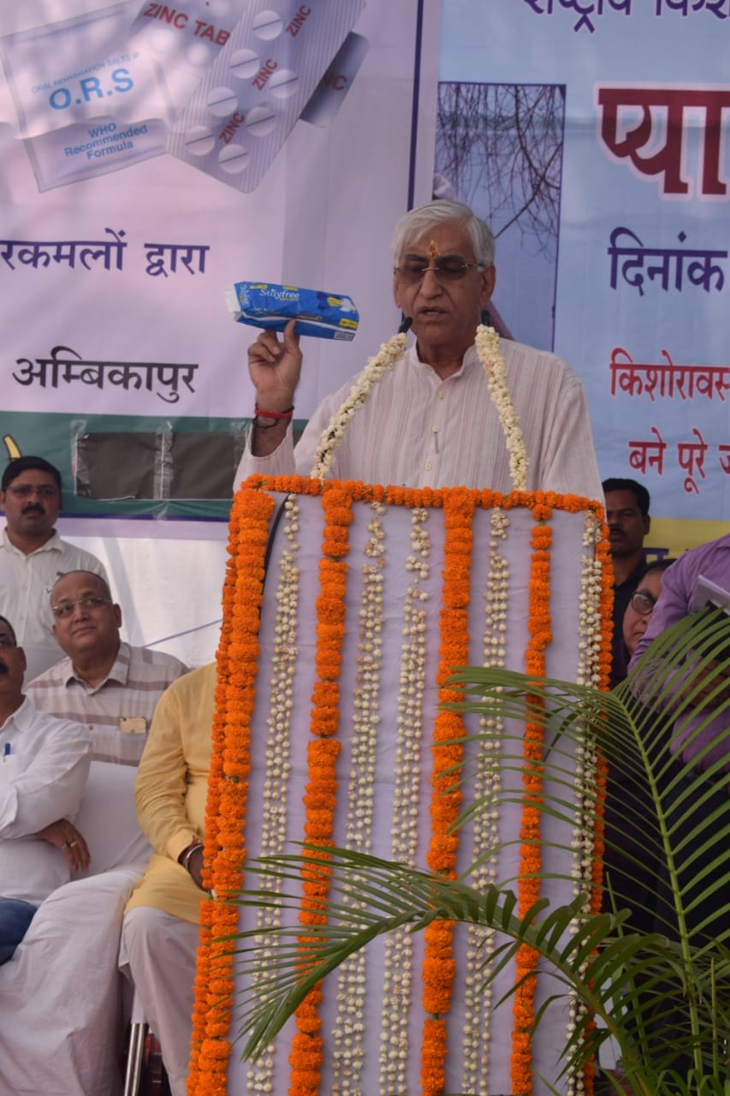
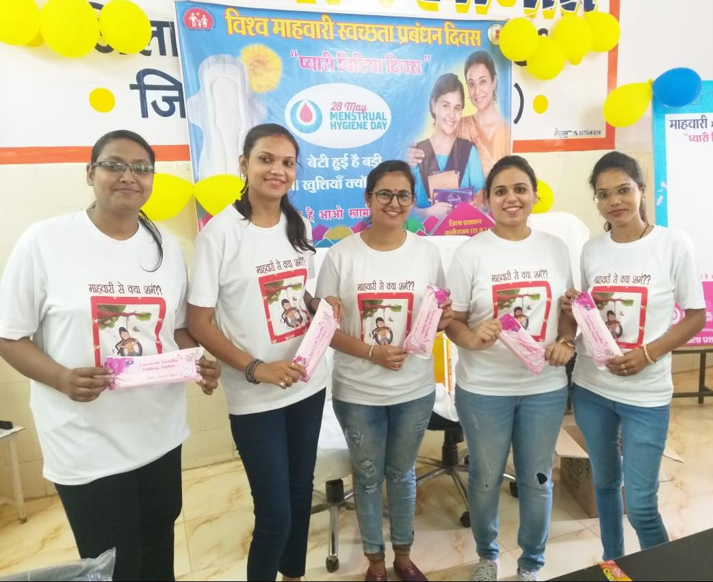
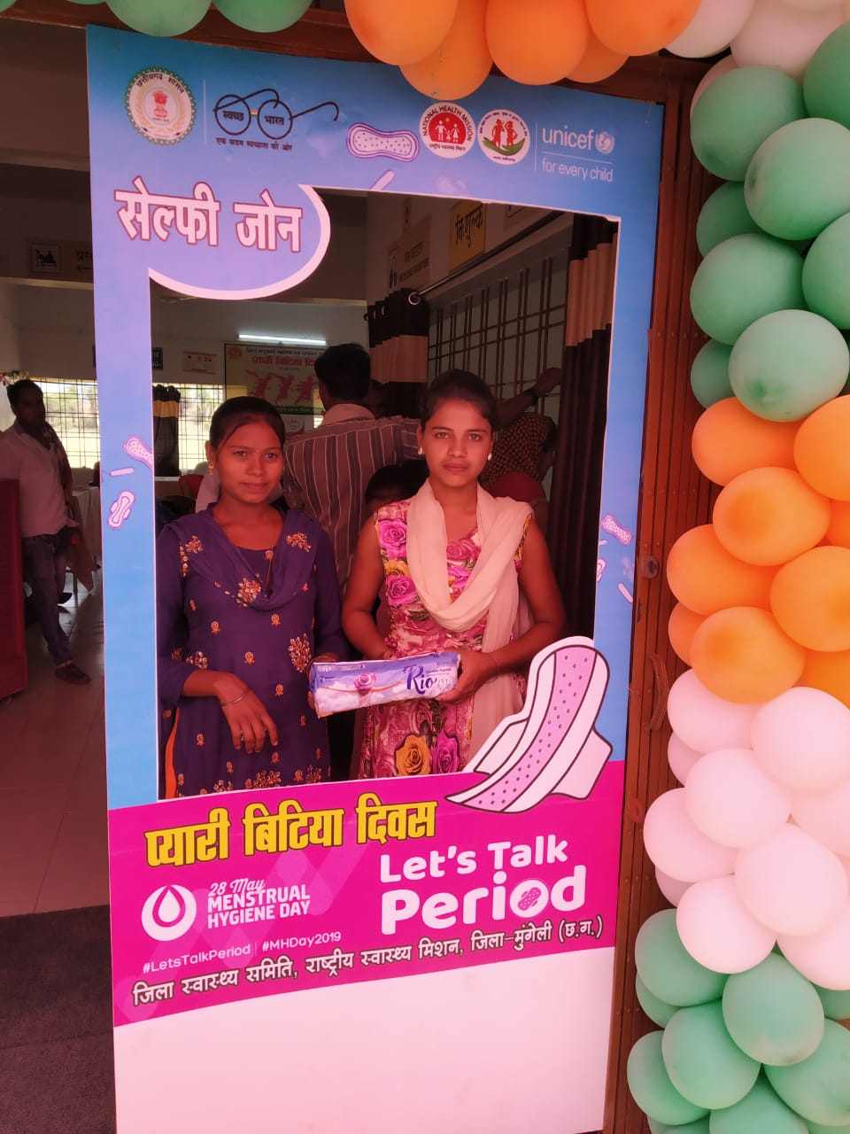
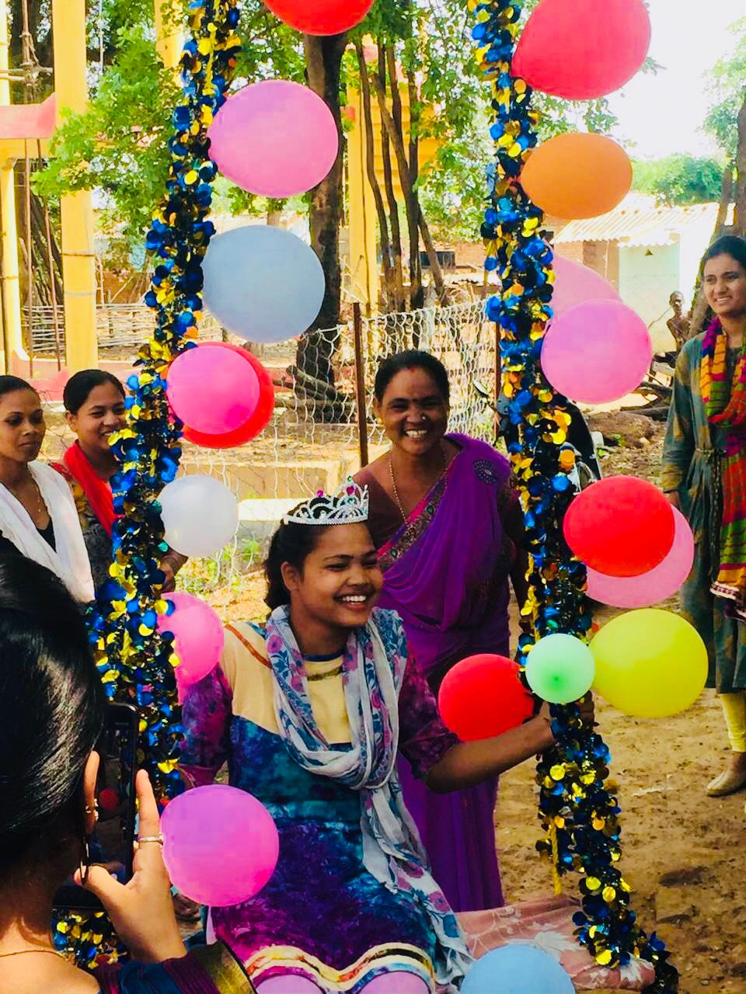
Pyari Bitiya Diwas

Slide 12
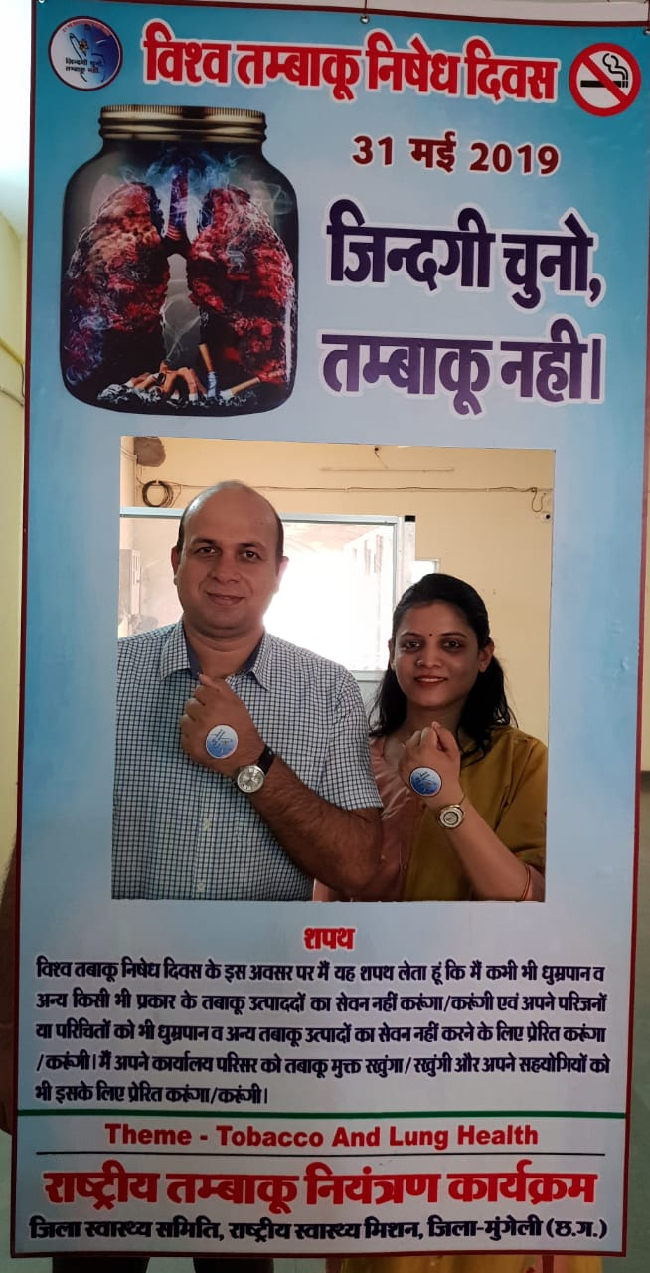
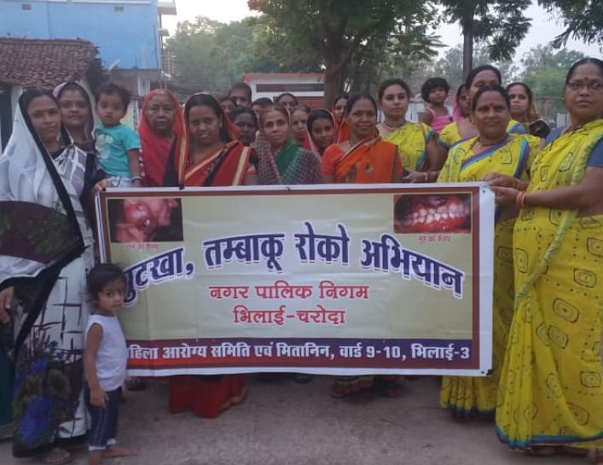
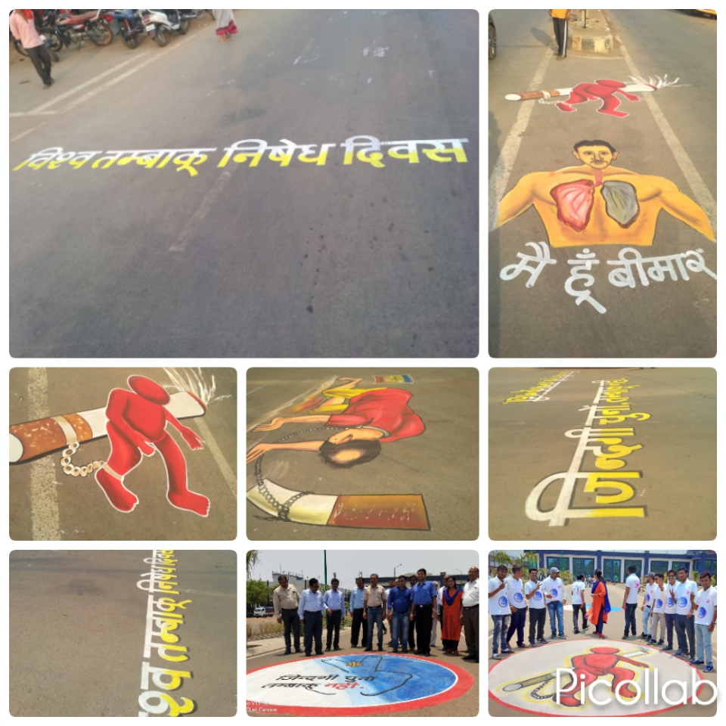
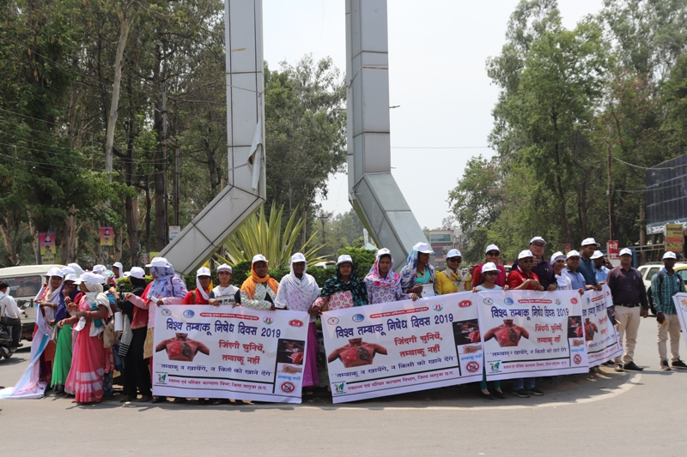
World No-Tobacco Day
935 Challan
Rs. 1.38 Lac Collection
Ex MD – DR Bhure

Slide 13
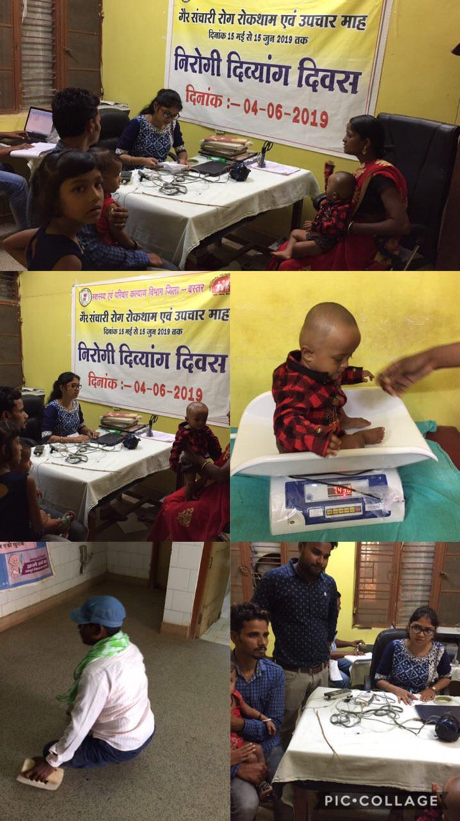
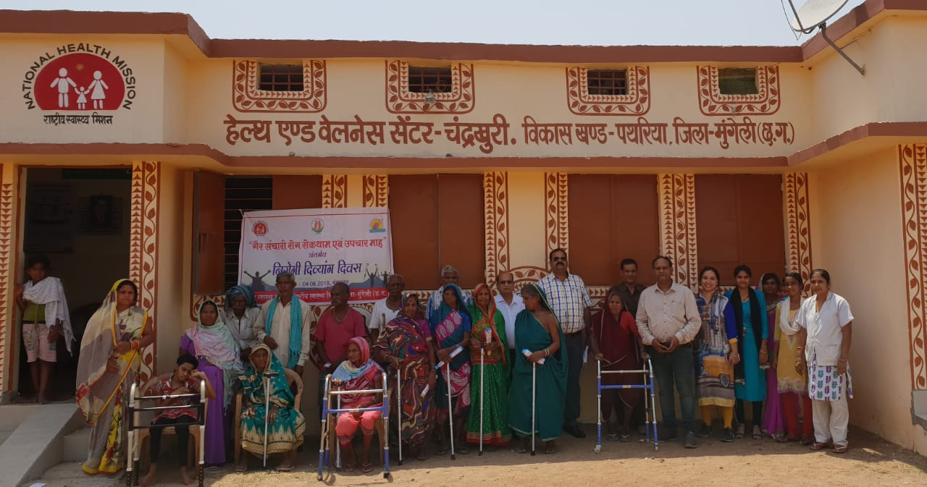
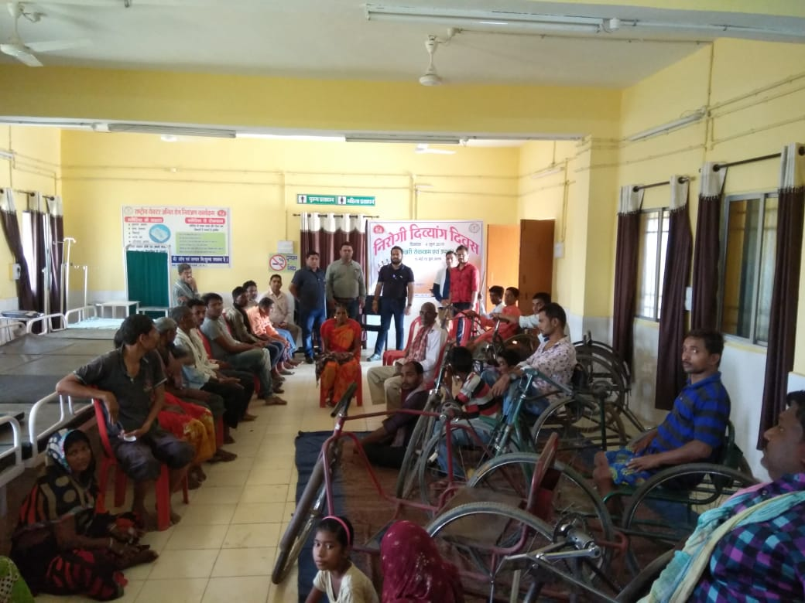
Nirogi Divyang Diwas

Slide 14
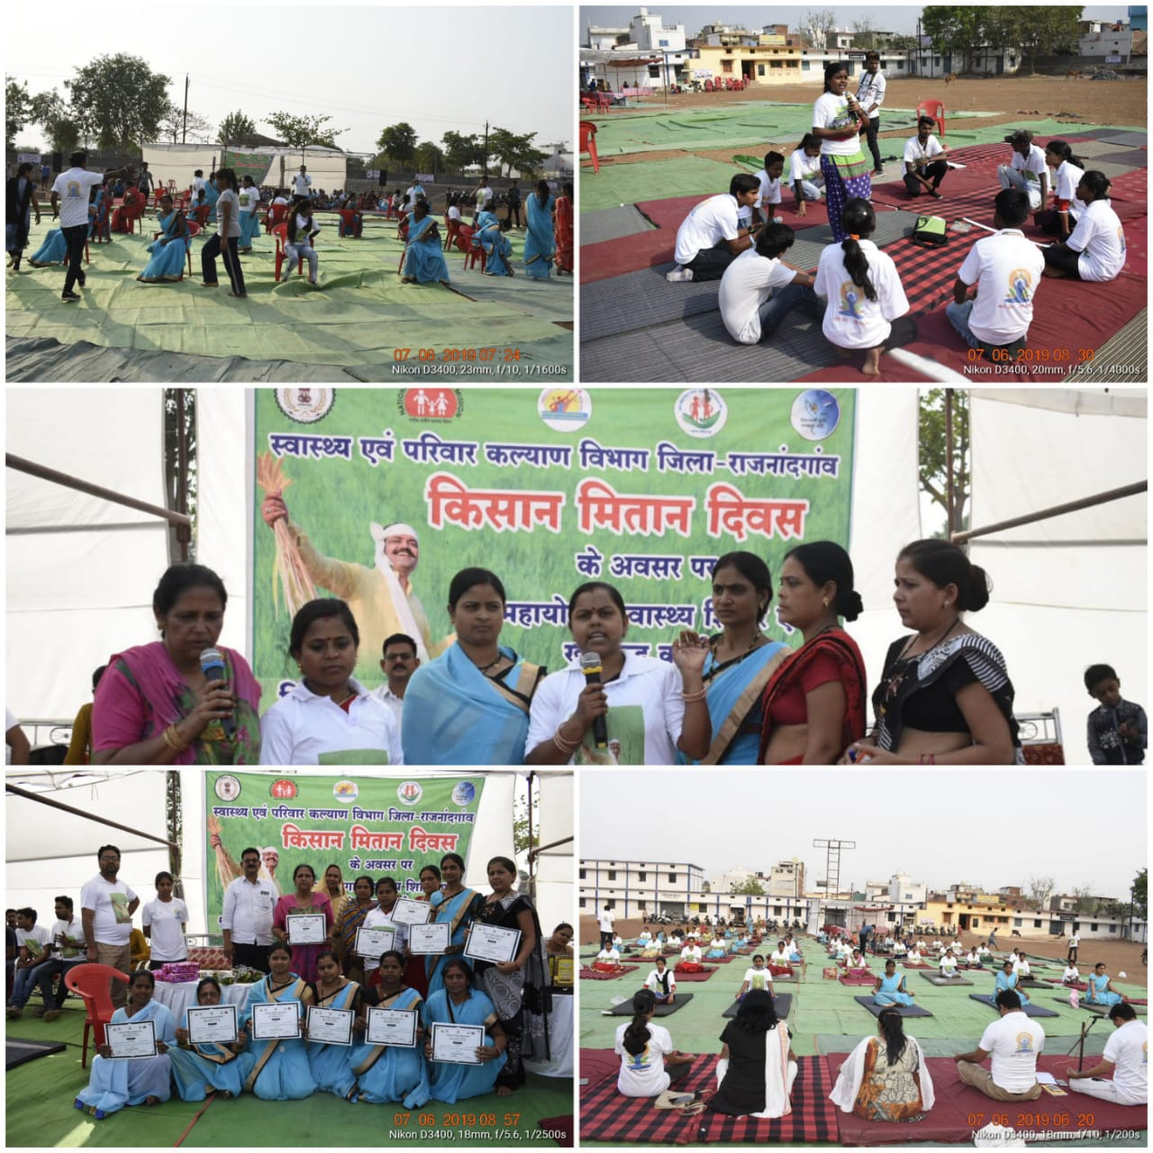
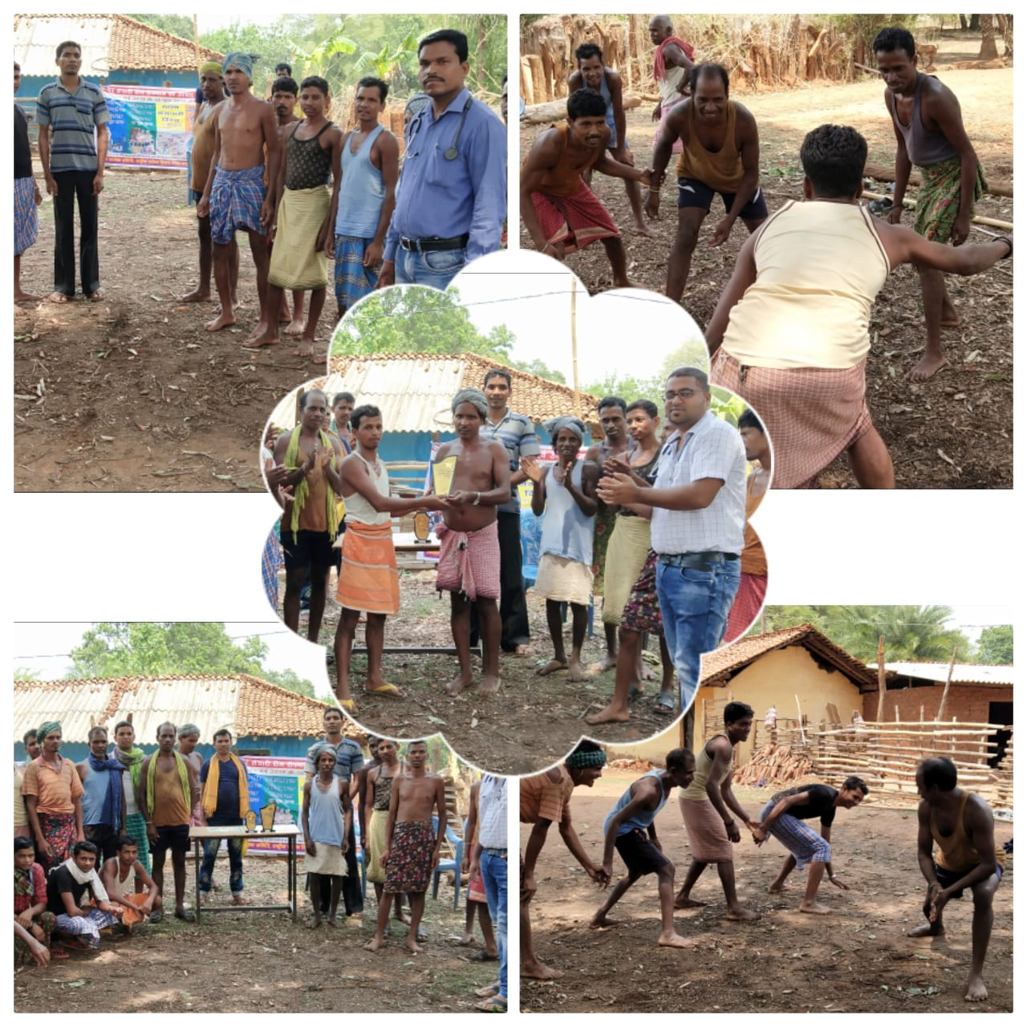
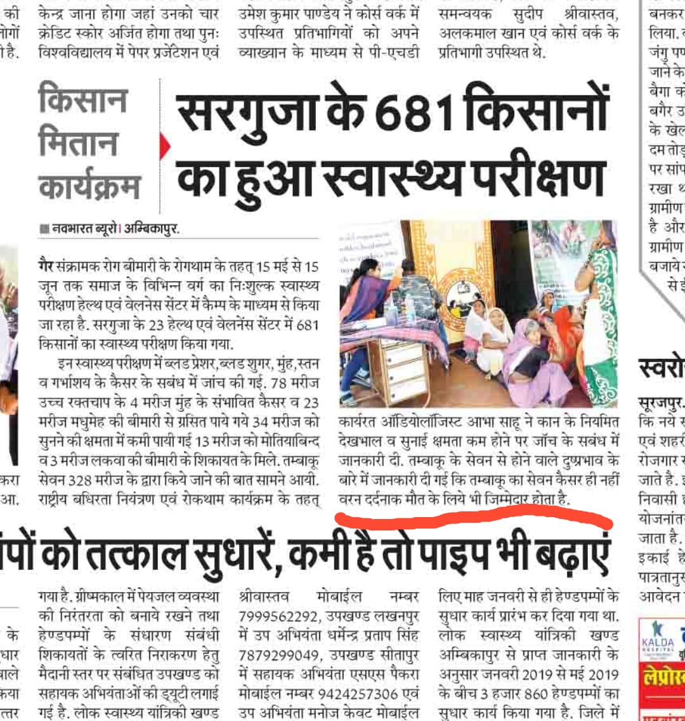
Kisaan Mitaan Diwas

Slide 15
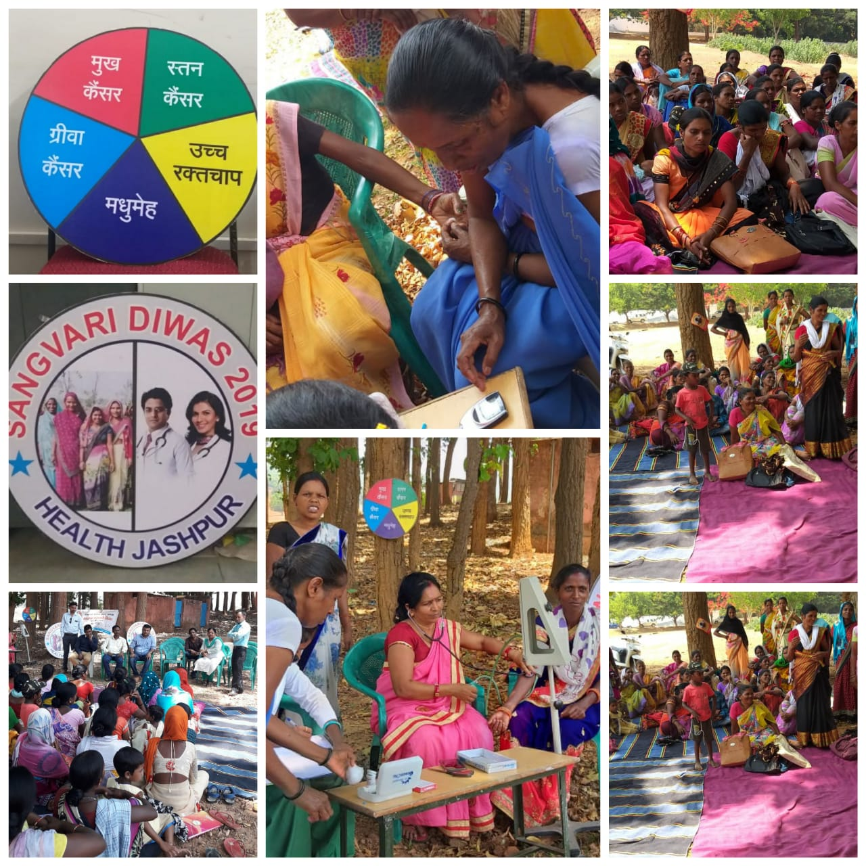
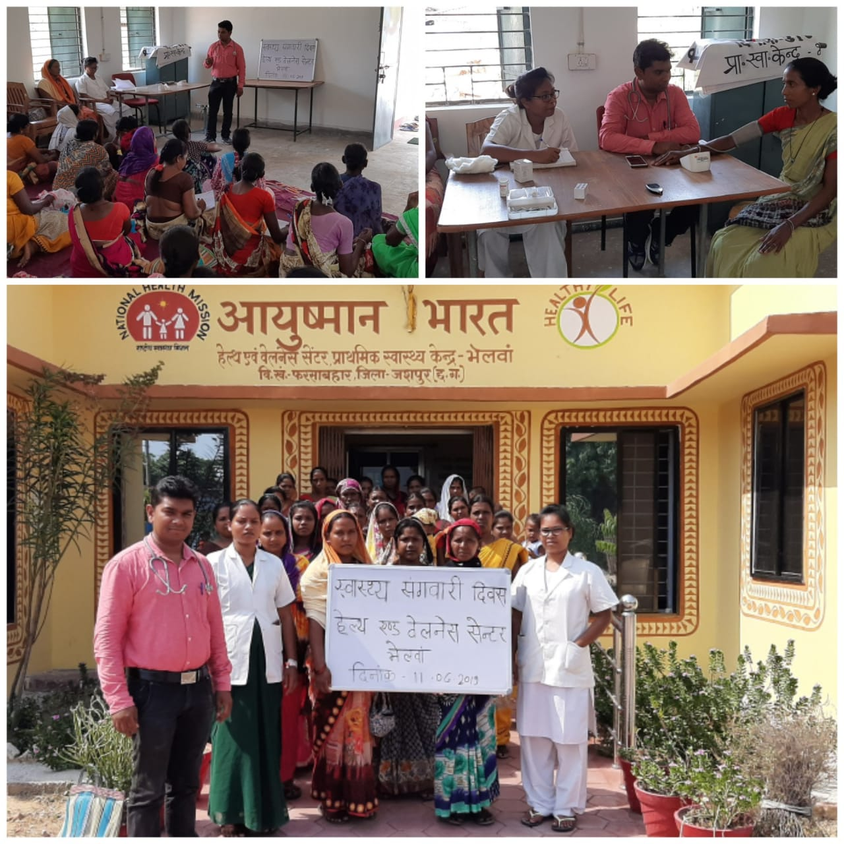
Swasth Sangwari Diwas

Slide 16
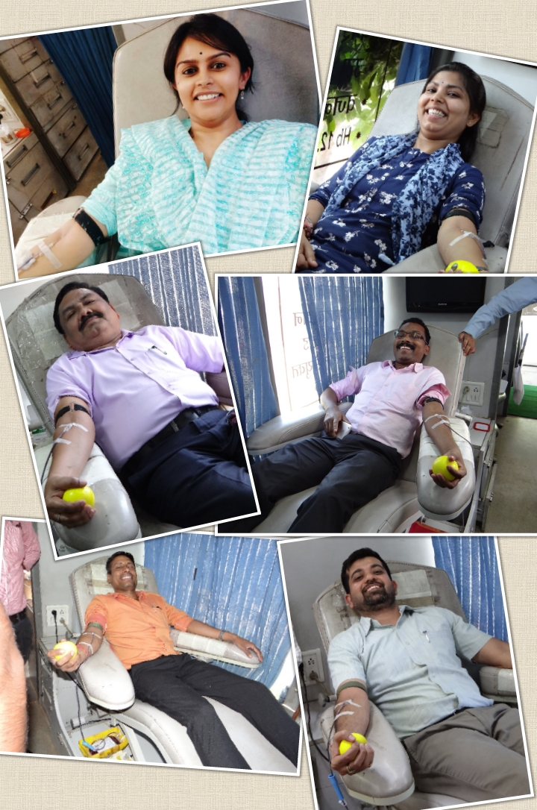
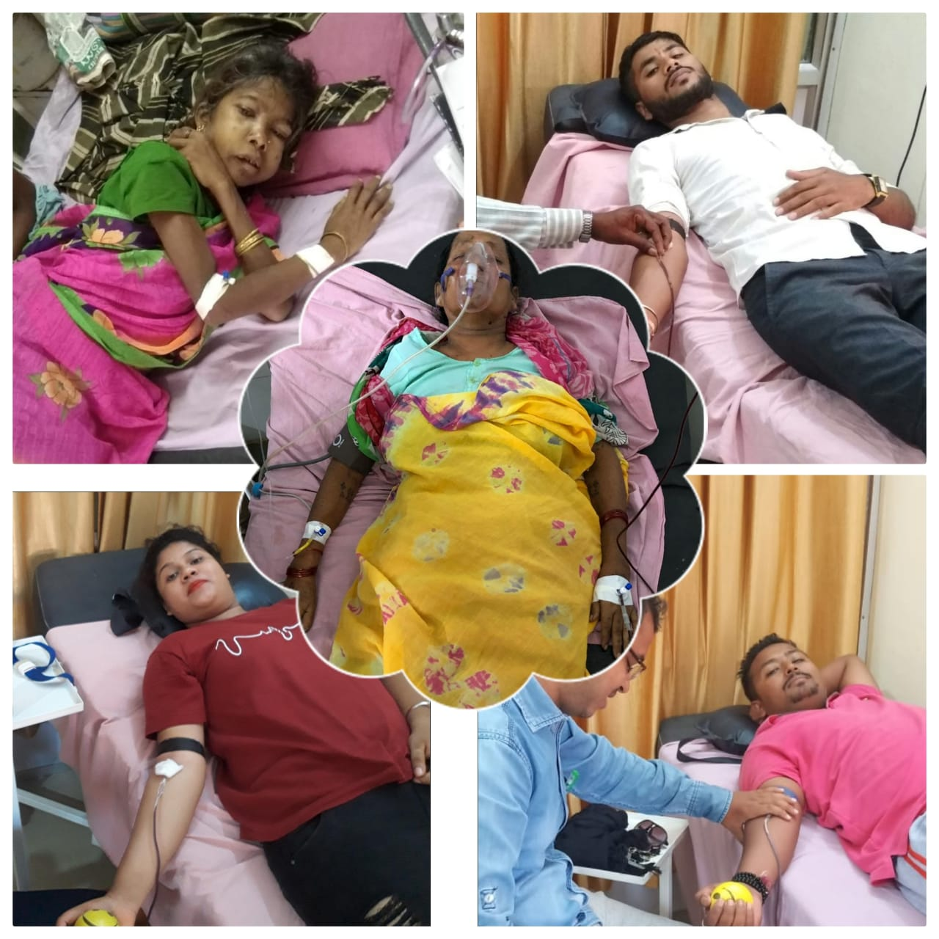
World Blood Donor Day

Slide 17
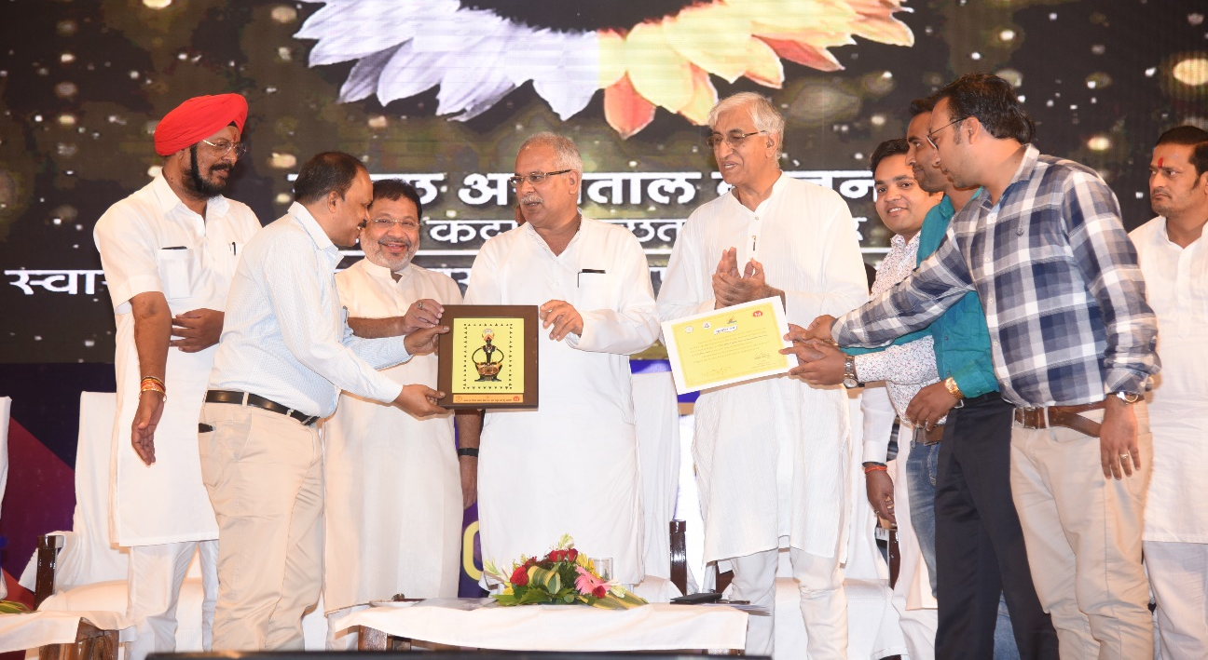
THE RESULT
Enumerated = 6,86,972
Screened = 6,76,761
Suspected:
  Diabetes = 34,952
  Hypertension = 39,450
Diagnosed & T/t initiated
  Diabetes = 19,527
  Hypertension = 25,021
  Population screened (till date) - 8,33,194
District Dhamtari was awarded by Hon’ble CM for ensuring best continuum of care

Slide 18
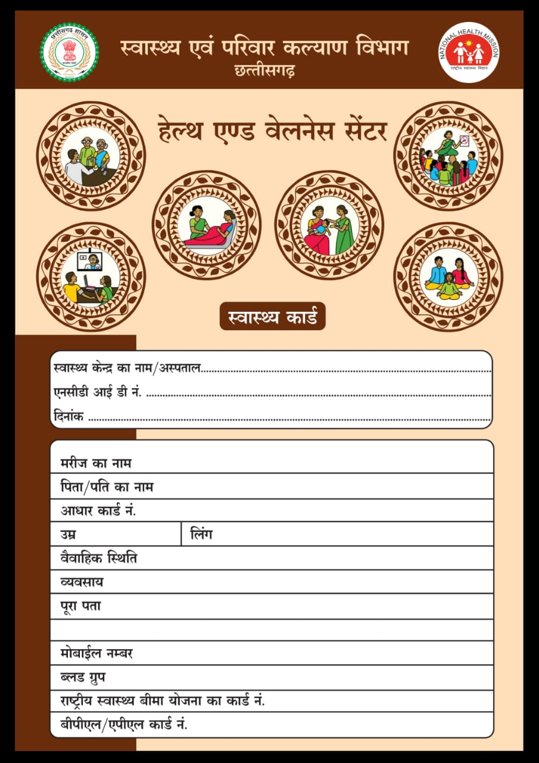
THE ACHIEVEMENT
Reach of “wellness” was ensured to more than 8.5 lakh people
NCD App entry increased 119 times when compared to pre- NCD Suraksha maah figures

Slide 19
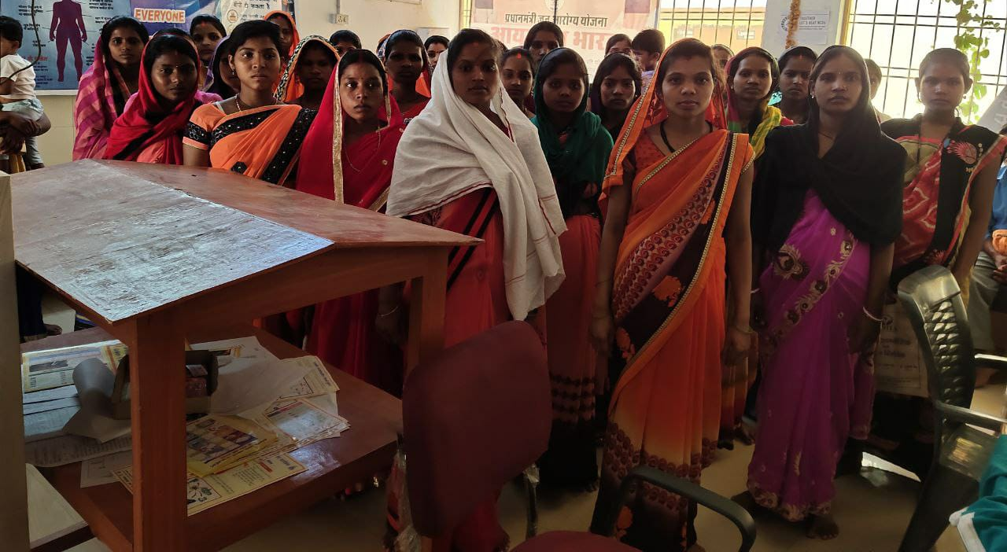
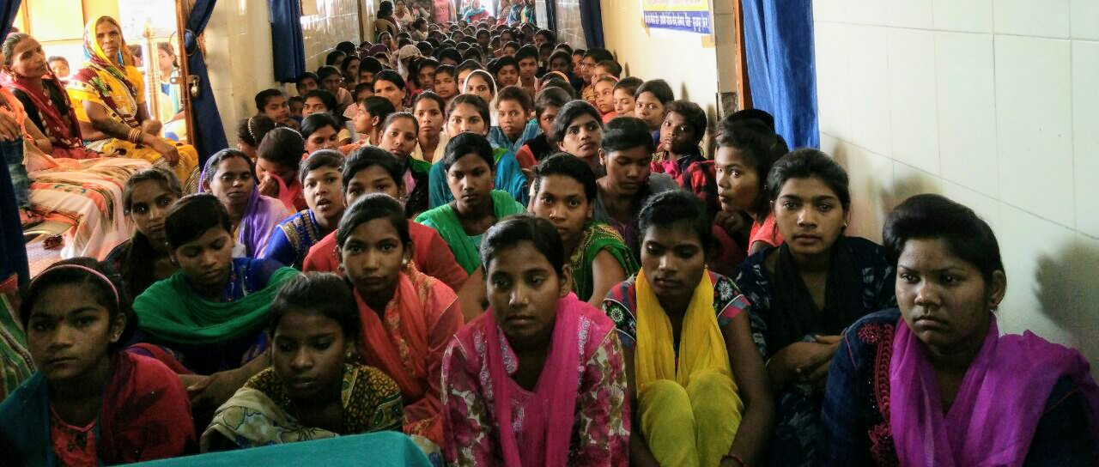
THE IMPACT

Slide 20
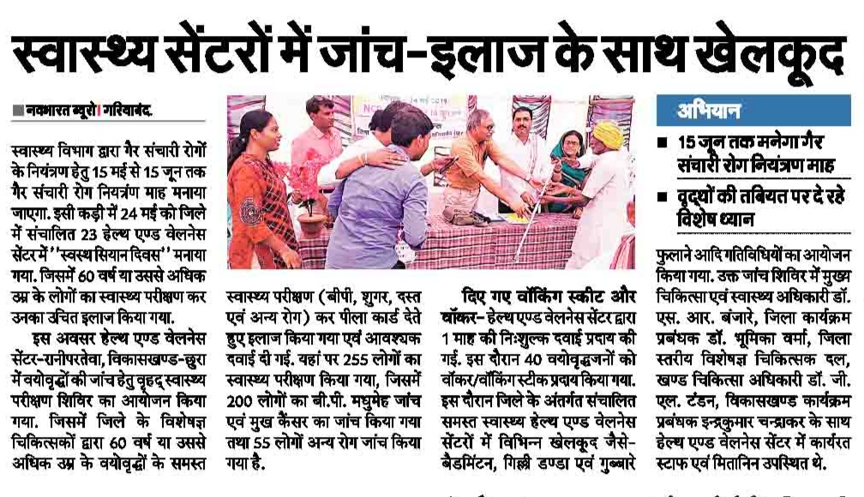
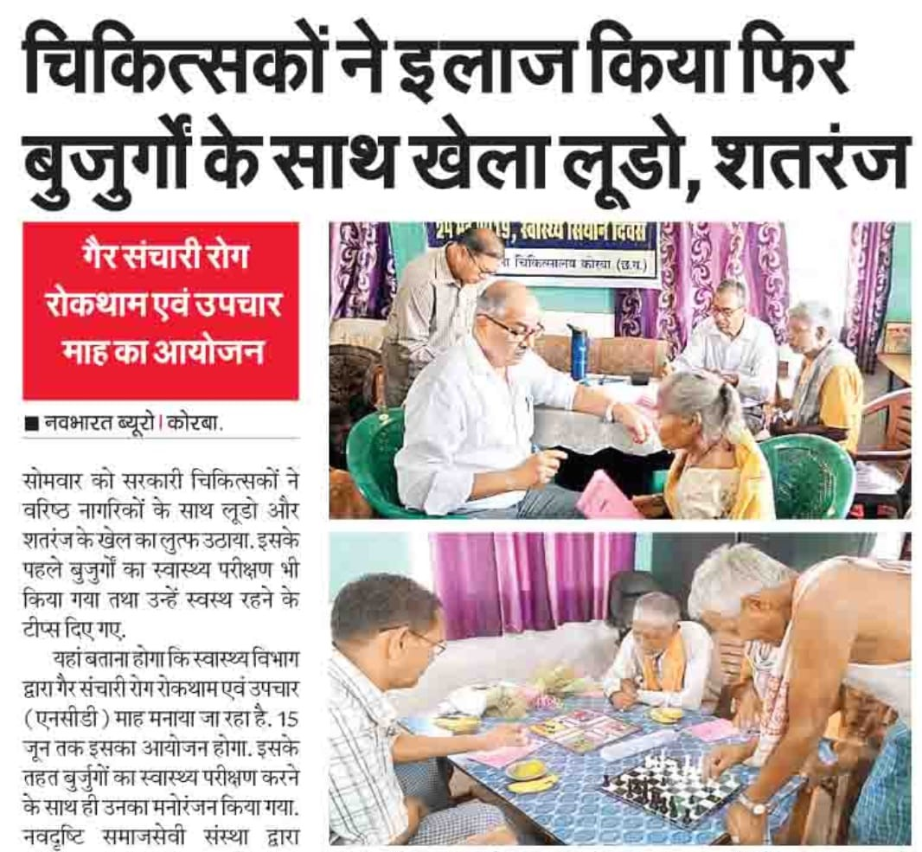

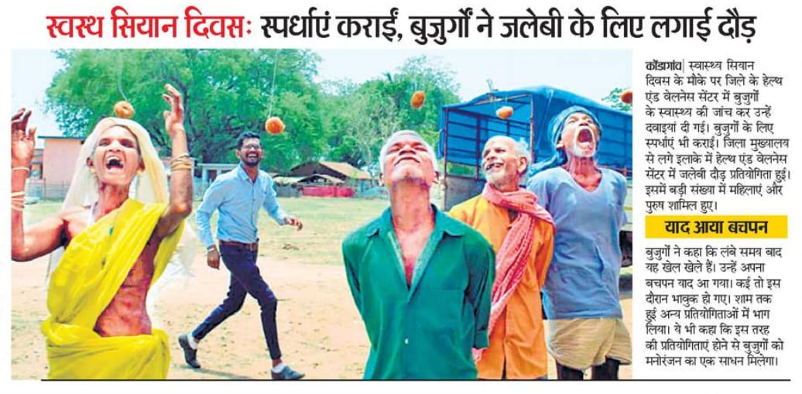
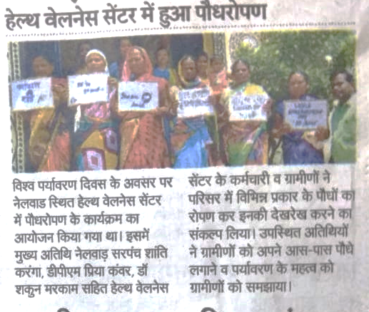
WELLNESS BEYOND YOGA

Slide 21
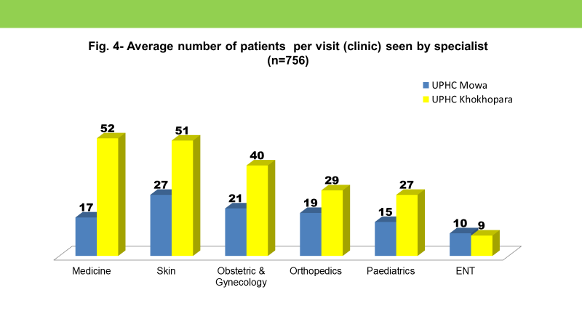
Best Practice 2 - Specialist services at UPHC-HWCs
Fixed day specialist services made available at 2 UPHC-HWCs of Raipur city in collaboration with Govt Medical College, Raipur

Slide 22
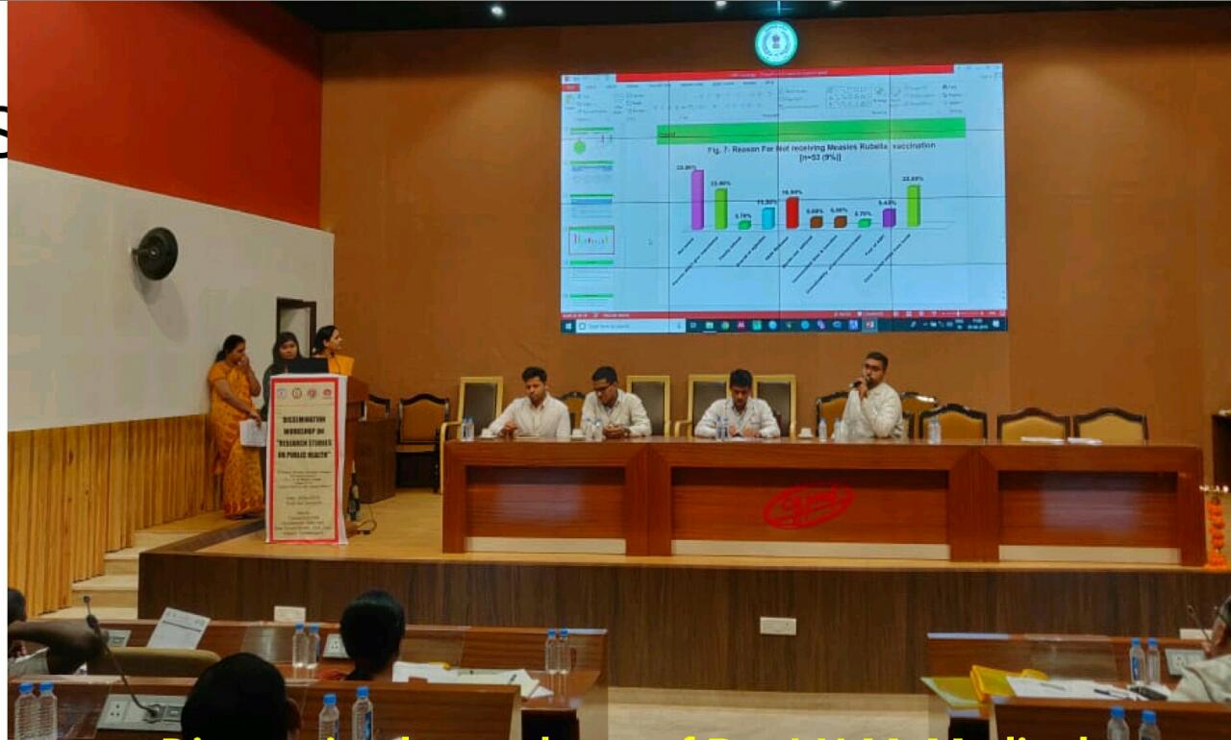
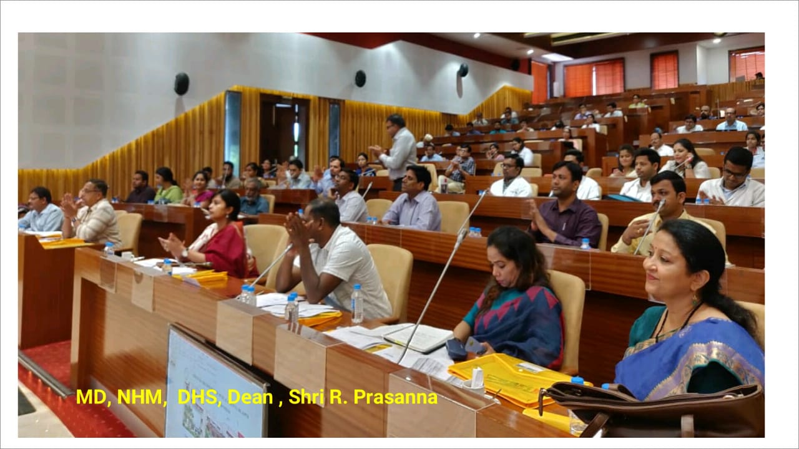
UPHC-HWC: Best Practices
Presentation by Medical College students to improve the implementation of National Programmes in Urban area-
Increased range of services- RMNCHA+N, Poshan Maah, 2 days in Week NMA for leprosy, DMC for TB, 2 days-Ophthalmic services with the integration of RBSK, Geriatric Care and NPCB.
Mental Health services with the help of NIMHANS
Online indent of drugs through DPDMIS
Free camp for ULB Swachhta Karmis

Slide 23

Best Practice 3 - Internal Branding
Why Internal Branding?
To extend the standardization of branding of HWCs beyond the
exteriors by including the interiors.
USAID MCSP / Jhpiego supported the Govt. of Chhattisgarh in developing a comprehensive Internal Branding Package.
Objectives
To raise awareness among beneficiaries and service providers
To ensure uniformity in interiors of the HWCs
To enable service providers to follow standardized treatment protocols

Slide 24

Contents
The package included:
Facility internal branding materials for SHCs, UPHCs, and PHCs
New IEC materials on the additional services of HWCs
Adaptation of existing RMNCHA IEC materials with the Ayushman
Bharat branding
A detailed guidebook highlighting the internal branding components and IEC components, area and room-wise
Each component further described in terms of design sample, dimensions, material used for developing, location for placement, target audience and uses

Slide 25
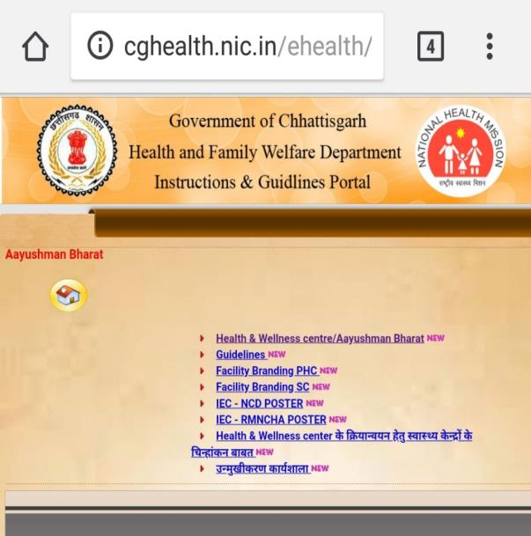
Outcome
Internal Branding was one of the Best practices presented by CG in GOI workshop at Guwahati.
It is rolled out in HWCs of all 27 districts.
The internal branding package was shared with GoI by Chhattisgarh for scale-up, many other state have taken up this package

Slide 26




Road Signage
Waiting area
Waiting area
OPD

Slide 27

Best Practice 4 - MPWs (M&F) trained as Yoga Instructors
Why train Multi-purpose Workers?
To ensure regular wellness activities.
Ensuring wellness activities, like yoga many cadres were involved - school teachers, local yoga trainers etc.; but initiation and sustenance of regular wellness activities WAS NOT HAPPENING!
As an alternative 5 districts Bemetara, Jashpur, Surguja, Surajpur and Balrampur in collaboration with USAID MCSP / Jhpiego decided to train its ANMs & MPWs from within the system as Yoga Trainers

Slide 28
Action taken!
Bemetera
Fresh recruitment of additional or 2nd MPW (F) were done. Among them, 14 ANMs were trained on basic Yoga for four days
Surguja, Balrampur, Surajpur and Jashpur
All 3 cadres of MPWs [MPW (M) and 2 MPW (F)] along with the male MPW) were trained in basic Yoga clubbed with their 4-day NCD training at district
ANMs were asked to make a schedule for Yoga at their respective HWCs and conduct Yoga sessions

Slide 29

Outcomes
From only 2 HWCs, now Yoga activities were initiated at 14 HWCs for 2-3 days a week in Bemetara
In Surguja, Surajpur, Balrampur and Jashpur, yoga activities are carried out every Saturday or Monday across all HWCs
Average number of participants: 10-30
District administration have now included this activity as a part of MPWs daily activities
Benefits
No additional cost
Yoga training can be clubbed with NCD training
Can be scaled up to all HWCs which have at least 2 MPWs

Slide 30





Slide 31
Best Practice 5 - Monthly Fixed Day Indenting
The Goal
To ensure uninterrupted availability of Drugs & Consumables at the HWC including maintenance of the buffer stock
Situation
  Sometimes states have all systems in place from supply side such as Centralized procurement agency, DVDMS, Quality assurance mechanism, District Drug ware houses etc.
  Still there is unavailability of drugs & consumables at the HWCs from the demand side due to erratic indenting behaviour of staff at HWCs
  Incomplete / Irregular / Inconsistent Indenting from the HWCs leading to :
    Unavailability of Drugs & Consumables at the HWCs
    Non maintenance of Buffer Stock
    Leads to loss in service demand at the HWC

Slide 32
The Solution
Monthly Fixed day indents to be generated by every HWC even if it is NIL
  Under DPDMIS
  Or Manual
  Action to be taken
    Finalization of EDL for HWCs (SHC/PHC)
    Training of facility staff on inventory management & fixed day indenting
    Fix the date of the month till which indents should be generated from HWCs
    If the State is big, divisions can be given different dates for indenting, to reduce the burden on procurement corporation

Slide 33


Pilot – CG Experience
Key Findings :
Earlier Indents were generated after a gap of 2-3 months
After pilot at Kondagaon district with support of USAID MCSP / Jhpiego, Availability of Drugs & Consumables improved drastically
Buffer stock was maintained
SSV findings say that most of the consumable and drugs available at PHC were available at SHC of same sector
Improved quality of indenting
Pre - intervention indent
Post intervention indent

Slide 34





Best Practice 6 - Learning Resource Package for PSCs
The Learning Resource Package has come as a boon for us. It helps us ensure we do not miss any topic or material while teaching. This is especially useful as time is short and we have so many additional responsibilities so it is difficult to go through this vast syllabus and provide quality training within the limited time. However, thanks to the learning package developed by USAID MCSP / Jhpiego team, we are able to save time and also deliver quality training.
Academic Counsellor, PSC

Slide 35



Best Practice 7 - Mentoring & Quality Assurance (MQA) Model
MQA Checklist
Student Feedback Questionnaire
Knowledge Assessment Tool
MQA has helped in improving quality of CCCH program, through addressing challenges faced by academic counselors / PSCs / students. Few decisions like additional theory classes, realignment of peripheral posting and smooth flow of fund from IGNOU and NHM etc were taken based on MQA findings

Slide 36
Other Best Practices
Institutional structures to review HWCs – State level working group, District HWC Committees- Quarterly Intensive District-wise review by MD NHM
Regular supportive supervision visits at HWCs on standard checklist developed by USAID MCSP / Jhpiego
Standard documentation at HWCs – OPD register, MPR, NCD Health Card
Fixed day health services – Piloted posting of MBBS MO /Ophthalmic Assistant / Lab Technician /Dental Surgeon at HWC to provide fixed day services
  Pilot Suitcase labs at HWCs in Bilaspur
  Utilizing PRI, DMF funds for Infra developments
  Division-wise selection of candidates for CCCH program to ensure the operationalization of SHC-HWCs in tribal districts

Slide 37
WAY FORWARD : Kyunki Picture abhi baki hai mere dost!!
  CPHC Control room at NHM Office to monitor drugs & Diagnostics
  Pictorial Manuals for Lab Technicians
  District-wise HWC Report Cards
  Valediction & Felicitation ceremony for CCCH pass out students
  Ensuring10 Assured Minimum Facilities (AMFs) at all HWCs
  Model UPHCs: 3 UPHC-HWCs at Raipur to ensure 16 hours OPD services; PPP with Tata Trust
  Sangwari Clubs – at every HWC ; Nutrition Ambassadors in schools
  HWCs with Positive Deviance – model HWCs for exposure visits
  Wellness beyond Yoga : Aerobics, Zumba classes in UPHCs

Slide 38
WAY FORWARD : Kyunki Picture abhi baki hai mere dost!!
Training of ANMs & MPWs on Multiskilling package
Convergence with Chhattisgarh Yoga Aayog to ensure Yoga at HWCs through 21,000 trained Yoga instructors
Refresher Trainings for CHOs
Skill lab being developed for training of CHOs at PSCs
ECHO/ Zoom based continuing education of MLHPs
Monthly Fixed day indenting across the state
Development of Community mobilization material in collaboration with USAID MCSP / Jhpiego
Telemedicine being initiated from District Gariyaband

Slide 39
THANKS TO OUR TECHNICAL PARTNERS!!
USAID MCSP / Jhpiego – 13 Districts, Innovations & Management of Program Study Centres
SHRC – 10 Districts & Community Process
Tata Trust – NCD App
WHO – 3 Districts
Unicef – 1 District

Slide 40

THE CHALLENGES THAT REMAIN
Unavailability of HR - MBBS MOs for PHCs
Availability of CHOs in remote tribal areas
Issues in LWE affected areas
Drugs and Diagnostics related issues
Quality of filled CBAC forms
Slow progress of Infra works, HWC Branding
Ensuring persistence of enthusiasm in
the field teams
Ensuring continuous voluntary Community involvement
Internet connectivity related issues hampering data entries, shall affect teleconsultation in future

Slide 41



Slide 42
10 Assured Minimum Facilities
1. Drinking Water
2. Clean Linen, Clean Premises & Clean toilets with running water
3. Regular Supply of Electricity
4. Proper Seating arrangement for patients and attendants
5. Sheds for patient waiting outside
6. Wheel-chairs and ramps for differently abled
7. Signages to aid patient and attendants
8. Display of essential services, drugs & diagnostics available at all center
9. Patient help desk at HWC
10. Level-wise uniform branding of all health centres
BACK

