Slide 1
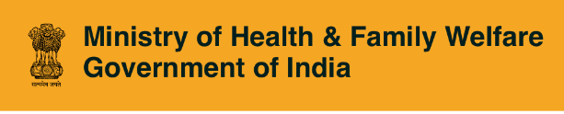


Ayushman Bharat
Comprehensive Primary Healthcare
Population-based NCD Screening Program

Slide 2
Ayushman Bharat CPHC- NCD Solution
Hypertension, Diabetes, Oral, Breast and Cervical Cancers
Population based screening and management for everyone over 30
6 Apps on CPHC Platform
ASHA App
ANM / MLHP App
PHC Portal
Admin Portal
CHC, DH, TCC Portal
Dash boards
CPHC Platform

Slide 3
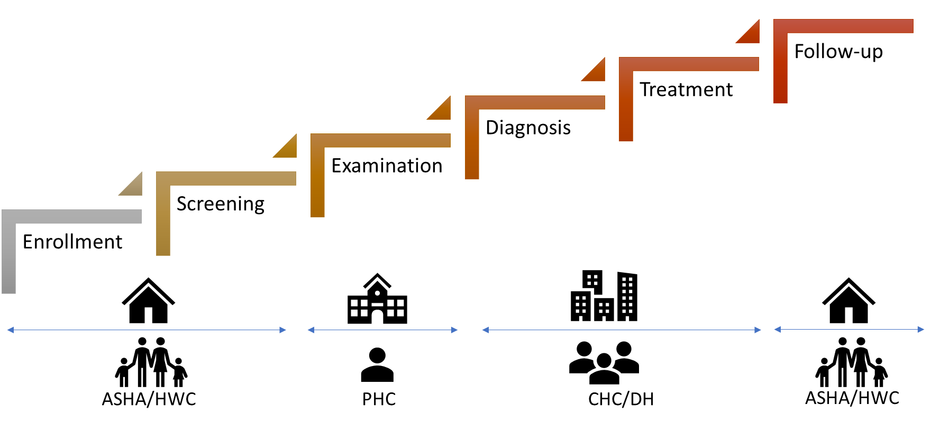




Continuum of Care
Enrolment
Screening
Examination
Treatment
Diagnosis
Village
SC / HWC
PHC
CHC/DH
TCCC

Slide 4
Continuum of Care – Application Features
Unique Health ID – linked with Aadhaar.
Enrollment, Family Folder, CBAC. Health Record for each individual.
Enter CBAC paper formats directly into PHC portal
Workplans, Dashboards, Incentives, Awareness material for Health workers
CDSS (pilot), Examination, Investigations, Diagnosis, Treatment – Doctors
Auto-populated drug-list. Drug stock dispensed
Referral workflow for patient moving from SC, PHC, CHC and DH
Standard Disease GOI protocols support for MO and ANM, Initial Assessment by Nurse
Administrator - Manage User Logins, Transfers, Master Data Changes. Real-time dashboards
Security – 2 factor authentication. Login protocols. Role-based access; performance for scale

Slide 5
State NCD Deployment Status
State/UT | Enrolment | Partial. Screening | Total Screening | Referred to PHC | Examined at PHC | Diagnosed- DM | Diagnosed-HTN
Himachal (Non-NCD) | 10,42,905 | NA | 5,89,263 | 3,45,006 | 15,416 | 1,205 | 2,230
Chhattisgarh | 8,34,800 | 2,33,064 | 6,31,199 | 85,998 | 1,13,227 | 10,145 | 16,659
Rajasthan | 5,95,744 | 360 | 360 | 406 | 1,237 | 69 | 197
Madhya Pradesh | 5,40,178 | 2,849 | 9,393 | 3,716 | 106 | 4 | 23
Haryana | 4,77,046 | 4,177 | 11,176 | 1,846 | 0 | 0 | 0
Punjab | 1,13,685 | 378 | 2,162 | 1,028 | 0 | 0 | 0
Chandigarh | 3,917 | 628 | 1,212 | 368 | 0 | 0 | 0
Jammu & Kashmir | 3,491 | 239 | 469 | 113 | 0 | 0 | 0
Uttarakhand | 177 | 26 | 32 | 22 | 0 | 0 | 0

Slide 6
Himachal Pradesh – Snapshot (Non NCDGOI Apps)
State Performance
State | Enrolment | Partial. Screening | Total Screening | Referred to PHC | Examined at PHC | Diagnosed- DM | Diagnosed-HTN
Himachal Pradesh | 10,42,905 | NA | 5,89,263 | 3,45,006 | 15,416 | 1,205 | 2,230
Top three dist | Enrolment | Partial Screening | Total Screening | Referred to PHC | Examined at PHC | Diagnosed- DM | Diagnosed-HTN
Mandi | 4,98,390 | NA | 2,38,660 | 2,11,807 | 4,287 | 487 | 773
Shimla | 1,00,846 | NA | 75,471 | 22,727 | 1,837 | 128 | 174
Kangra | 71,342 | NA | 53,787 | 10,133 | 237 | 30 | 32
Close to 60% of enrolments in Mandi and Shimla
Very low activity in Lahaul

Slide 7
Himachal Pradesh – Dist. updates
Dist | Enrolment | Partial Screening | Total Screening | Referred to PHC | Examined at PHC | Diagnosed- DM | Diagnosed-HTN
Mandi | 4,98,390 | NA | 2,38,660 | 2,11,807 | 4,287 | 487 | 773
Shimla | 1,00,846 | NA | 75,471 | 22,727 | 1,837 | 128 | 174
Kangra | 71,342 | NA | 53,787 | 10,133 | 237 | 30 | 32
Una | 67,852 | NA | 35,504 | 12,245 | 894 | 18 | 28
Bilaspur | 62,959 | NA | 29,460 | 24,133 | 3,024 | 87 | 195
Hamirpur | 53,795 | NA | 26,695 | 16,741 | 601 | 38 | 36
Sirmour | 52,978 | NA | 35,157 | 8,260 | 149 | 15 | 11
Kullu | 52,385 | NA | 35,757 | 2,846 | 201 | 52 | 62
Solan | 40,421 | NA | 26,968 | 8,629 | 652 | 75 | 188
Chamba | 20,939 | NA | 14,922 | 7,417 | 811 | 34 | 92
Kinnaur | 20,087 | NA | 16,392 | 19,378 | 2,492 | 230 | 620
Lahaul | 911 | NA | 490 | 690 | 231 | 11 | 19

Slide 8
Chhattisgarh – Snapshot
State Performance
State | Enrolment | Partial. Screening | Total Screening | Referred to PHC | Examined at PHC | Diagnosed- DM | Diagnosed-HTN
Chhattisgarh | 8,34,800 | 2,33,064 | 6,31,199 | 85,998 | 1,13,227 | 10,145 | 16,659
Top three dist | Enrolment | Partial Screening | Total Screening | Referred to PHC | Examined at PHC | Diagnosed- DM | Diagnosed-HTN
Korba | 71,299 | 17,328 | 53,300 | 8,166 | 9,395 | 817 | 1,494
Rajnandgaon | 66,633 | 16,617 | 55,624 | 9,466 | 2,437 | 419 | 897
Dhamtari | 65,456 | 23,624 | 51,301 | 8,484 | 14,759 | 1,550 | 2,792
Comparatively slower after campaign
Yet to procure more tablets

Slide 9
Chhattisgarh– District-wise updates
Dist | Enrolment | Partial. Screening | Total Screening | Referred to PHC | Examined at PHC | Diagnosed- DM | Diagnosed-HTN
Korba | 71,299 | 17,328 | 53,300 | 8,166 | 9,395 | 817 | 1,494
Rajnandgaon | 66,633 | 16,617 | 55,624 | 9,466 | 2,437 | 419 | 897
Dhamtari | 65,456 | 23,624 | 51,301 | 8,484 | 14,759 | 1,550 | 2,792
Kanker | 62,048 | 11,170 | 51,727 | 6,090 | 4,659 | 848 | 1,355
Bemetara | 45,960 | 8,951 | 17,576 | 3,685 | 2,852 | 353 | 290
Raipur | 41,084 | 10,415 | 27,298 | 2,188 | 10,609 | 565 | 694
Durg | 35,960 | 14,466 | 28,503 | 4,753 | 1,882 | 178 | 190
Bilaspur | 32,536 | 9,755 | 27,577 | 3,302 | 2,786 | 918 | 1,006
Mungeli | 32,532 | 8,659 | 25,218 | 3,660 | 2,977 | 745 | 1,106
Bijapur | 31,292 | 7,705 | 16,277 | 1,908 | 552 | 87 | 104
Kabeerdham | 30,889 | 9,005 | 26,712 | 5,642 | 1,994 | 574 | 814
Mahasamund | 30,688 | 9,407 | 25,186 | 2,707 | 1,481 | 103 | 175
Surguja | 30,565 | 9,733 | 23,346 | 981 | 8,235 | 39 | 201
Baloda Bajar | 24,823 | 5,890 | 21,456 | 4,850 | 1,088 | 212 | 276
Bastar | 23,310 | 6,935 | 18,388 | 2,898 | 4,602 | 344 | 487
Jashpur | 22,048 | 5,490 | 20,575 | 1,521 | 1,340 | 114 | 451
Surajpur | 20,753 | 4,537 | 14,886 | 1,452 | 5,192 | 166 | 477
Dantewada | 19,285 | 4,888 | 17,582 | 817 | 178 | 22 | 54
Balod | 19,084 | 8,495 | 15,036 | 2,323 | 3,699 | 162 | 290
Koriya | 18,918 | 2,751 | 11,802 | 245 | 3,586 | 28 | 159
Raigarh | 18,327 | 7,187 | 14,617 | 2,083 | 7,158 | 469 | 792
Janjgir - Champa | 18,145 | 5,141 | 11,163 | 2,431 | 6,140 | 976 | 1,247
Gariyabandh | 17,698 | 4,163 | 10,937 | 1,571 | 3,641 | 272 | 755
Sukma | 16,798 | 7,104 | 12,476 | 510 | 8,074 | 64 | 181
Kondagaon | 16,482 | 7,901 | 14,371 | 1,217 | 1,431 | 48 | 138
Balrampur | 14,651 | 3,116 | 12,232 | 2,377 | 859 | 56 | 142
Narayanpur | 7,536 | 2,631 | 6,033 | 671 | 1,621 | 16 | 92
** Dist. With enrolment less than 100 are not included

Slide 10
Rajasthan – Snapshot
State Performance
State | Enrolment | Partial. Screening | Total Screening | Referred to PHC | Examined at PHC | Diagnosed- DM | Diagnosed-HTN
Rajasthan | 5,95,744 | 360 | 360 | 406 | 1,237 | 69 | 197
Top three dist | Enrolment | Partial Screening | Total Screening | Referred to PHC | Examined at PHC | Diagnosed- DM | Diagnosed-HTN
Churu | 1,33,968 | 0 | 0 | 32 | 1 | 0 | 0
Bikaner | 82,388 | 0 | 0 | 12 | 9 | 0 | 0
Jodhpur | 65,390 | 0 | 0 | 15 | 2 | 0 | 0
All enrolments done through PHC Portal
Tablets are not available

Slide 11
Rajasthan – Dist. updates
Dist | Enrolment | Partial Screening | Total Screening | Referred to PHC | Examined at PHC | Diagnosed- DM | Diagnosed-HTN
Churu | 1,33,968 | 0 | 0 | 32 | 1 | 0 | 0
Bikaner | 82,388 | 0 | 0 | 12 | 9 | 0 | 0
Jodhpur | 65,390 | 0 | 0 | 15 | 2 | 0 | 0
Sikar | 31,132 | 0 | 0 | 3 | 25 | 0 | 4
Baran | 24,394 | 0 | 0 | 12 | 2 | 0 | 0
Ajmer | 23,127 | 303 | 303 | 4 | 603 | 1 | 11
Pali | 22,209 | 0 | 0 | 8 | 5 | 1 | 0
Hanumangarh | 20,181 | 0 | 0 | 10 | 0 | 0 | 0
Jhunjhunun | 18,923 | 1 | 1 | 5 | 6 | 0 | 1
Jaipur | 15,785 | 3 | 3 | 55 | 12 | 1 | 4
Jhalawar | 15,520 | 0 | 0 | 6 | 2 | 0 | 1
Chittaurgarh | 15,312 | 0 | 0 | 1 | 24 | 1 | 0
Ganganagar | 14,497 | 2 | 2 | 17 | 245 | 45 | 145
Nagaur | 13,748 | 0 | 0 | 7 | 5 | 0 | 1
Banswara | 11,533 | 1 | 1 | 65 | 69 | 5 | 2
Barmer | 11,037 | 0 | 0 | 2 | 2 | 0 | 0
Jalor | 8,572 | 1 | 1 | 20 | 1 | 0 | 0
Bhilwara | 8,255 | 0 | 0 | 2 | 3 | 0 | 0
Kota | 6,833 | 0 | 0 | 0 | 1 | 0 | 0
Sawai Madhopur | 6,083 | 0 | 0 | 8 | 0 | 0 | 0
Dausa | 5,867 | 3 | 3 | 6 | 39 | 7 | 17
Bundi | 5,830 | 0 | 0 | 3 | 33 | 8 | 9
Alwar | 5,540 | 0 | 0 | 9 | 1 | 0 | 0
Pratapgarh | 5,023 | 0 | 0 | 1 | 1 | 0 | 0
Udaipur | 4,502 | 46 | 46 | 10 | 138 | 0 | 0
Karauli | 3,942 | 0 | 0 | 42 | 0 | 0 | 0
Tonk | 3,798 | 0 | 0 | 2 | 2 | 0 | 0
Rajsamand | 3,212 | 0 | 0 | 0 | 1 | 0 | 0
Jaisalmer | 2,209 | 0 | 0 | 2 | 1 | 0 | 0
Bharatpur | 2,176 | 0 | 0 | 43 | 0 | 0 | 0
Sirohi | 2,006 | 0 | 0 | 1 | 4 | 0 | 2
Dhaulpur | 1,482 | 0 | 0 | 1 | 0 | 0 | 0
Dungarpur | 1,270 | 0 | 0 | 2 | 0 | 0 | 0
** Dist. With enrolment less than 100 are not included

Slide 12
Madhya Pradesh – Snapshot
State Performance
State | Enrolment | Partial. Screening | Total Screening | Referred to PHC | Examined at PHC | Diagnosed- DM | Diagnosed-HTN
Madhya Pradesh | 5,40,178 | 2,849 | 9,393 | 3,716 | 106 | 4 | 23
Top three dist | Enrolment | Partial Screening | Total Screening | Referred to PHC | Examined at PHC | Diagnosed- DM | Diagnosed-HTN
Jabalpur | 56,636 | 321 | 775 | 514 | 73 | 1 | 7
Sehore | 48,509 | 54 | 111 | 219 | 0 | 0 | 0
Chhindwara | 43,915 | 221 | 508 | 171 | 0 | 0 | 0
On mission mode in September and October. Ambitious training program launched
M&E officers made NCD nodal officers, 20 Tata Trust consultants supporting implementation on ground
100+ member WhatsApp group working well in monitoring and disseminating information; 3 Train the trainers sessions completed and 26 Dist. trainings planned

Slide 13
Madhya Pradesh – Dist. updates
Dist | Enrolment | Partial Screening | Total Screening | Referred to PHC | Examined at PHC | Diagnosed- DM | Diagnosed-HTN
Jabalpur | 56,636 | 321 | 775 | 514 | 73 | 1 | 7
Sehore | 48,509 | 54 | 111 | 219 | 0 | 0 | 0
Chhindwara | 43,915 | 221 | 508 | 171 | 0 | 0 | 0
Betul | 32,125 | 161 | 627 | 253 | 1 | 0 | 0
Ujjain | 26,493 | 10 | 14 | 82 | 0 | 0 | 0
Raisen | 24,568 | 128 | 285 | 249 | 0 | 0 | 0
Dewas | 22,014 | 8 | 11 | 101 | 0 | 0 | 0
Satna | 19,489 | 5 | 11 | 111 | 0 | 0 | 0
Shahdol | 19,468 | 557 | 3,079 | 326 | 0 | 0 | 0
Sheopur | 18,891 | 11 | 27 | 39 | 0 | 0 | 0
Barwani | 18,830 | 167 | 611 | 126 | 1 | 0 | 1
Dindori | 17,704 | 30 | 209 | 57 | 0 | 0 | 0
Balaghat | 17,248 | 137 | 628 | 203 | 0 | 0 | 0
Anuppur | 16,965 | 15 | 60 | 82 | 0 | 0 | 0
Guna | 16,883 | 59 | 176 | 56 | 0 | 0 | 0
Seoni | 16,841 | 2 | 2 | 82 | 3 | 0 | 0
Bhind | 16,369 | 1 | 13 | 33 | 0 | 0 | 0
Indore | 15,397 | 42 | 60 | 35 | 1 | 0 | 0
Chhatarpur | 14,894 | 341 | 825 | 142 | 0 | 0 | 0
Ashoknagar | 10,747 | 43 | 125 | 177 | 1 | 0 | 0
Damoh | 9,855 | 22 | 35 | 52 | 0 | 0 | 0
Rajgarh | 8,268 | 45 | 125 | 87 | 13 | 1 | 12
East Nimar (Khandwa) | 6,466 | 60 | 133 | 81 | 0 | 0 | 0
Jhabua | 5,441 | 0 | 1 | 16 | 1 | 0 | 0
** Dist. With enrolment less than 100 are not included

Slide 14
Madhya Pradesh – Dist. Updates (Contd)
Dist | Enrolment | Partial Screening | Total Screening | Referred to PHC | Examined at PHC | Diagnosed- DM | Diagnosed-HTN
Hoshangabad | 5,217 | 27 | 75 | 74 | 0 | 0 | 0
Panna | 3,973 | 64 | 173 | 15 | 0 | 0 | 0
Vidisha | 3,196 | 118 | 284 | 54 | 0 | 0 | 0
Katni | 2,930 | 8 | 27 | 16 | 0 | 0 | 0
Dhar | 2,371 | 9 | 22 | 20 | 0 | 0 | 0
Umaria | 2,048 | 14 | 34 | 15 | 0 | 0 | 0
Singrauli | 1,976 | 0 | 3 | 27 | 0 | 0 | 0
Shivpuri | 1,658 | 18 | 36 | 32 | 0 | 0 | 0
Burhanpur | 1,657 | 75 | 126 | 21 | 0 | 0 | 0
Alirajpur | 1,517 | 4 | 5 | 15 | 0 | 0 | 0
Mandla | 1,393 | 0 | 1 | 8 | 0 | 0 | 0
West Nimar (Khargone) | 1,251 | 19 | 44 | 34 | 1 | 0 | 1
Shajapur | 1,157 | 0 | 0 | 8 | 0 | 0 | 0
Harda | 964 | 2 | 6 | 15 | 0 | 0 | 0
Morena | 762 | 0 | 0 | 0 | 0 | 0 | 0
Gwalior | 748 | 1 | 1 | 2 | 0 | 0 | 0
Neemuch | 620 | 7 | 10 | 6 | 10 | 1 | 2
Rewa | 561 | 3 | 10 | 2 | 0 | 0 | 0
Narsinghpur | 506 | 0 | 2 | 1 | 0 | 0 | 0
Tikamgarh | 476 | 0 | 0 | 0 | 0 | 0 | 0
Ratlam | 443 | 9 | 19 | 12 | 0 | 0 | 0
Agar Malwa | 258 | 10 | 18 | 13 | 0 | 0 | 0
Mandsaur | 200 | 10 | 24 | 7 | 0 | 0 | 0
Datia | 101 | 8 | 16 | 15 | 1 | 1 | 0
Sidhi | 95 | 1 | 3 | 3 | 0 | 0 | 0
Sagar | 51 | 0 | 0 | 0 | 0 | 0 | 0
Bhopal | 33 | 2 | 3 | 7 | 0 | 0 | 0
** Dist. With enrolment less than 100 are not included

Slide 15
Haryana – Snapshot
State Performance
State | Enrolment | Partial. Screening | Total Screening | Referred to PHC | Examined at PHC | Diagnosed- DM | Diagnosed-HTN
Haryana | 4,77,046 | 4,177 | 11,176 | 1,846 | 0 | 0 | 0
Top three dist | Enrolment | Partial Screening | Total Screening | Referred to PHC | Examined at PHC | Diagnosed- DM | Diagnosed-HTN
Yamunanagar | 2,48,245 | 270 | 480 | 280 | 0 | 0 | 0
Sirsa | 92,692 | 2,541 | 6,413 | 666 | 0 | 0 | 0
Ambala | 55,181 | 647 | 2,429 | 344 | 0 | 0 | 0
Yamunanagar is driving most of the enrolments

Slide 16
Haryana – Dist. updates
Dist | Enrolment | Partial Screening | Total Screening | Referred to PHC | Examined at PHC | Diagnosed- DM | Diagnosed-HTN
Yamunanagar | 2,48,245 | 270 | 480 | 280 | 0 | 0 | 0
Sirsa | 92,692 | 2,541 | 6,413 | 666 | 0 | 0 | 0
Ambala | 55,181 | 647 | 2,429 | 344 | 0 | 0 | 0
Gurgaon | 39,005 | 169 | 538 | 107 | 0 | 0 | 0
Karnal | 29,611 | 424 | 1,046 | 321 | 0 | 0 | 0
Panchkula | 10,738 | 100 | 210 | 102 | 0 | 0 | 0
Mewat | 1,065 | 9 | 17 | 18 | 0 | 0 | 0
Hisar | 337 | 16 | 39 | 5 | 0 | 0 | 0
Jind | 109 | 0 | 0 | 0 | 0 | 0 | 0
** Dist. With enrolment less than 100 are not included

Slide 17
Punjab– Snapshot
State Performance
State | Enrolment | Partial. Screening | Total Screening | Referred to PHC | Examined at PHC | Diagnosed- DM | Diagnosed-HTN
Punjab | 1,13,685 | 378 | 2,162 | 1,028 | 0 | 0 | 0
Top three dist | Enrolment | Partial Screening | Total Screening | Referred to PHC | Examined at PHC | Diagnosed- DM | Diagnosed-HTN
Barnala | 19,646 | 0 | 0 | 238 | 0 | 0 | 0
Sahibzada Ajit Singh Nagar | 17,887 | 13 | 29 | 98 | 0 | 0 | 0
Moga | 16,798 | 9 | 23 | 51 | 0 | 0 | 0
Punjab has restarted enrolment after gap of a few months

Slide 18
Punjab- Dist. updates
Dist | Enrolment | Partial Screening | Total Screening | Referred to PHC | Examined at PHC | Diagnosed- DM | Diagnosed-HTN
Barnala | 19,646 | 0 | 0 | 238 | 0 | 0 | 0
Sahibzada Ajit Singh Nagar | 17,887 | 13 | 29 | 98 | 0 | 0 | 0
Moga | 16,798 | 9 | 23 | 51 | 0 | 0 | 0
Gurdaspur | 10,813 | 8 | 12 | 25 | 0 | 0 | 0
Faridkot | 10,208 | 126 | 191 | 45 | 0 | 0 | 0
Hoshiarpur | 7,947 | 2 | 8 | 19 | 0 | 0 | 0
Ludhiana | 7,364 | 102 | 149 | 148 | 0 | 0 | 0
Fatehgarh Sahib | 4,587 | 12 | 14 | 39 | 0 | 0 | 0
Sangrur | 3,748 | 2 | 3 | 130 | 0 | 0 | 0
Bathinda | 3,154 | 6 | 11 | 23 | 0 | 0 | 0
Jalandhar | 2,974 | 63 | 628 | 86 | 0 | 0 | 0
Patiala | 2,335 | 17 | 1,037 | 47 | 0 | 0 | 0
Amritsar | 1,548 | 1 | 1 | 8 | 0 | 0 | 0
Firozpur | 1,234 | 12 | 24 | 18 | 0 | 0 | 0
Fazilka | 945 | 3 | 6 | 11 | 0 | 0 | 0
Muktsar | 890 | 1 | 5 | 14 | 0 | 0 | 0
Rupnagar | 477 | 1 | 8 | 17 | 0 | 0 | 0
Kapurthala | 448 | 0 | 2 | 2 | 0 | 0 | 0
Mansa | 426 | 0 | 2 | 1 | 0 | 0 | 0
Shahid Bhagat Singh Nagar | 129 | 0 | 4 | 3 | 0 | 0 | 0
** Dist. With enrolment less than 100 are not included

Slide 19
Chandigarh– Snapshot
State Performance
UT | Enrolment | Partial. Screening | Total Screening | Referred to PHC | Examined at PHC | Diagnosed- DM | Diagnosed-HTN
Chandigarh | 3,917 | 628 | 1,212 | 368 | 0 | 0 | 0
Top three dist | Enrolment | Partial Screening | Total Screening | Referred to PHC | Examined at PHC | Diagnosed- DM | Diagnosed-HTN
Chandigarh | 3,917 | 628 | 1,212 | 368 | 0 | 0 | 0
Not much movement in the last few months
Need to procure remaining tablets and restart enrolments

Slide 20
J&K– Snapshot
State Performance
UT | Enrolment | Partial. Screening | Total Screening | Referred to PHC | Examined at PHC | Diagnosed- DM | Diagnosed-HTN
J&K | 3,491 | 239 | 469 | 113 | 0 | 0 | 0
Top three dist | Enrolment | Partial Screening | Total Screening | Referred to PHC | Examined at PHC | Diagnosed- DM | Diagnosed-HTN
Rajauri | 674 | 77 | 152 | 229 | 0 | 0 | 0
Kulgam | 635 | 35 | 50 | 85 | 0 | 0 | 0
Ramban | 511 | 1 | 8 | 9 | 0 | 0 | 0
On standstill now
Need to procure remaining tablets

Slide 21
J&K- Dist. updates
Dist | Enrolment | Partial Screening | Total Screening | Referred to PHC | Examined at PHC | Diagnosed- DM | Diagnosed-HTN
Rajauri | 674 | 77 | 152 | 229 | 0 | 0 | 0
Kulgam | 635 | 35 | 50 | 85 | 0 | 0 | 0
Ramban | 511 | 1 | 8 | 9 | 0 | 0 | 0
Doda | 495 | 21 | 69 | 90 | 0 | 0 | 0
Punch | 492 | 30 | 50 | 80 | 0 | 0 | 0
Reasi | 390 | 28 | 53 | 81 | 0 | 0 | 0
Baramula | 80 | 7 | 9 | 16 | 0 | 0 | 0
Kathua | 63 | 0 | 0 | 0 | 0 | 0 | 0
Anantnag | 56 | 16 | 38 | 54 | 0 | 0 | 0
Kupwara | 26 | 13 | 18 | 31 | 0 | 0 | 0
Srinagar | 25 | 4 | 9 | 13 | 0 | 0 | 0
Badgam | 21 | 2 | 8 | 10 | 0 | 0 | 0
Ganderbal | 10 | 3 | 3 | 6 | 0 | 0 | 0
Jammu | 9 | 2 | 2 | 4 | 0 | 0 | 0
Kishtwar | 4 | 0 | 0 | 0 | 0 | 0 | 0
Bandipore | 0 | 0 | 0 | 0 | 0 | 0 | 0
Kargil | 0 | 0 | 0 | 0 | 0 | 0 | 0
Leh (Ladakh) | 0 | 0 | 0 | 0 | 0 | 0 | 0
Pulwama | 0 | 0 | 0 | 0 | 0 | 0 | 0
Samba | 0 | 0 | 0 | 0 | 0 | 0 | 0
Shopian | 0 | 0 | 0 | 0 | 0 | 0 | 0
Udhampur | 0 | 0 | 0 | 0 | 0 | 0 | 0
** Dist. With enrolment less than 100 are not included

Slide 22
Uttarakhand– Snapshot
State Performance
State | Enrolment | Partial. Screening | Total Screening | Referred to PHC | Examined at PHC | Diagnosed- DM | Diagnosed-HTN
Uttarakhand | 177 | 26 | 32 | 22 | 0 | 0 | 0
Top three dist | Enrolment | Partial Screening | Total Screening | Referred to PHC | Examined at PHC | Diagnosed- DM | Diagnosed-HTN
Udham Singh Nagar | 151 | 14 | 19 | 4 | 0 | 0 | 0
Dehradun | 15 | 3 | 3 | 8 | 0 | 0 | 0
Hardwar | 11 | 9 | 10 | 10 | 0 | 0 | 0
Enrolment initiated very recently
Tablets available only in two districts

Slide 23
Uttarakhand- Dist. updates
Dist | Enrolment | Partial Screening | Total Screening | Referred to PHC | Examined at PHC | Diagnosed- DM | Diagnosed-HTN
Udham Singh Nagar | 151 | 14 | 19 | 4 | 0 | 0 | 0
** Dist. With enrolment less than 100 are not included

Slide 24
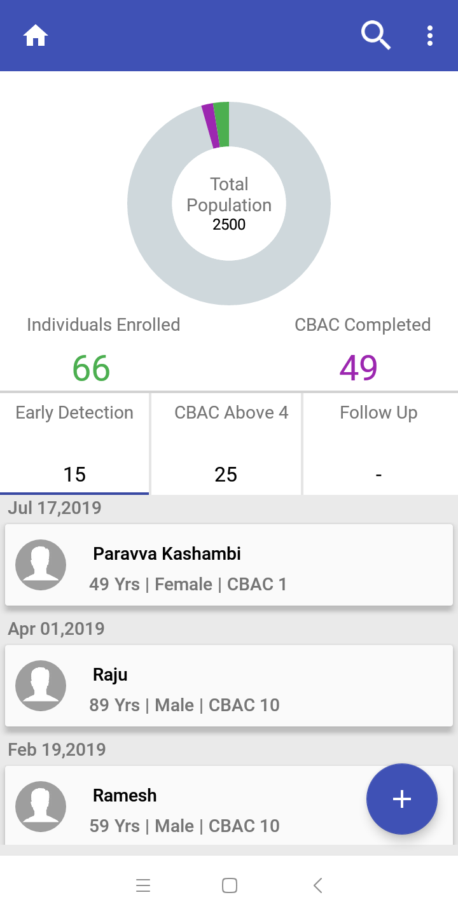
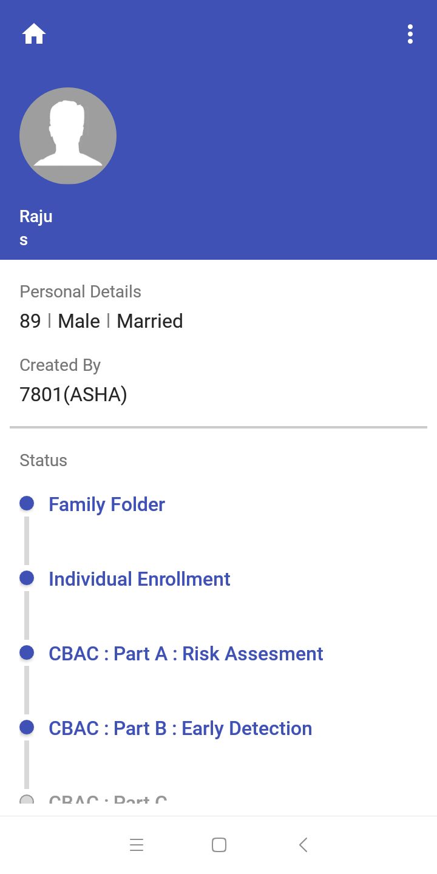
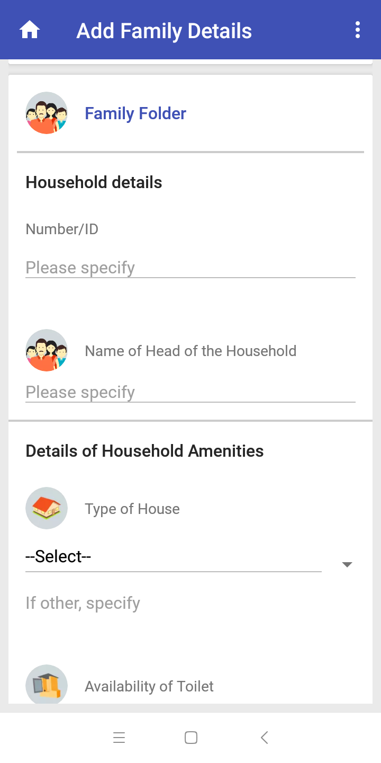
ASHA App Smart phone - Family Folder, CBAC, Dashboard

Slide 25
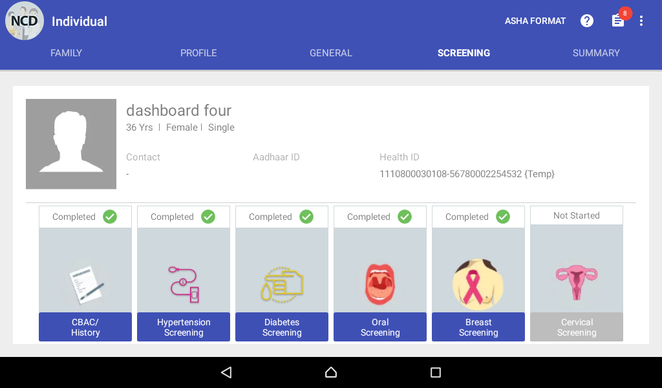
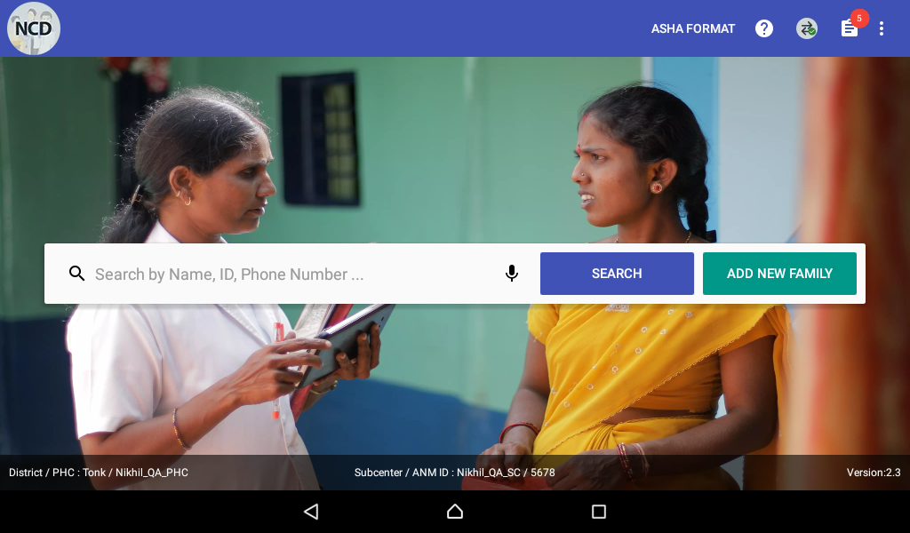
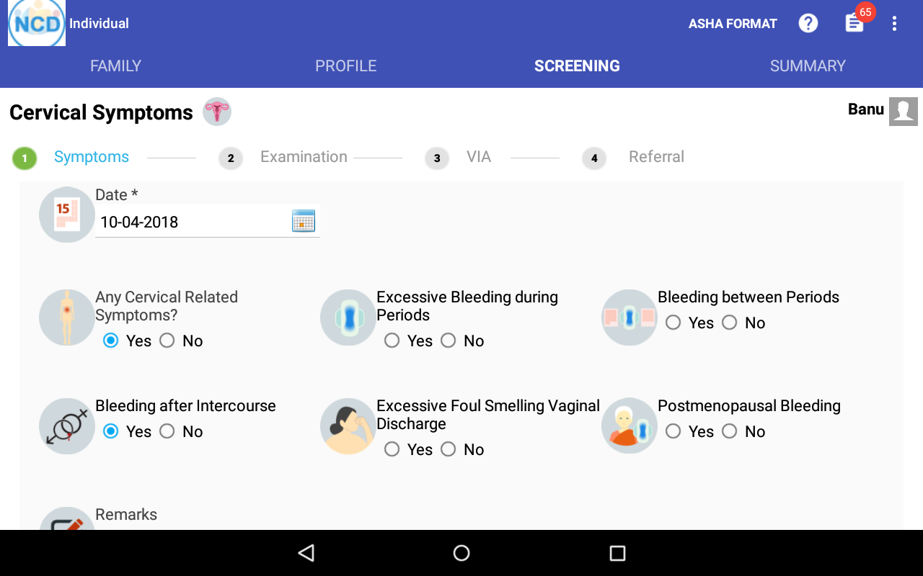
ANM App

Slide 26
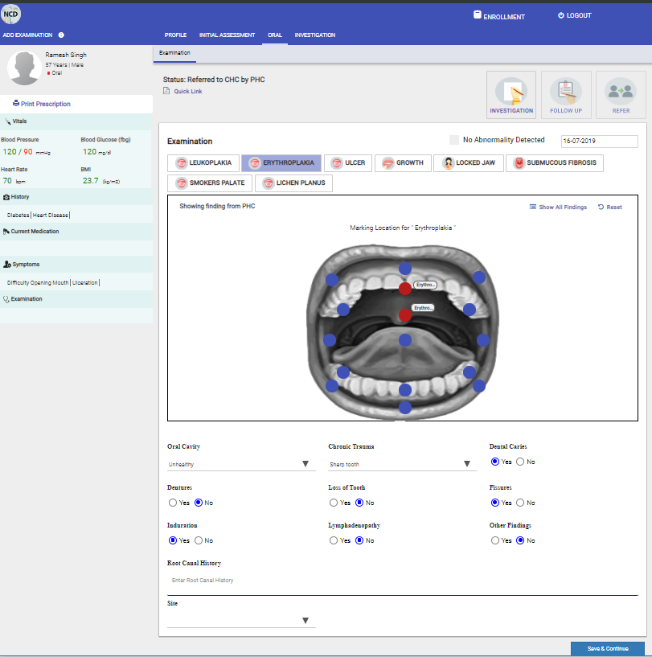
PHC Portal
Findings
Leukoplakia
Erythroplakia
Submucous fibrosis
Smoker’s palate
Lichen Planus
Ulcer
Growth
Locked Jaw
Oral Cavity
Chronic trauma
Dental Caries
Dentures
Loss of tooth
Fissures
Induration
Other findings
Lymphadenopathy
Root Canal History
Site
No Abnormality Detected (NAD)

Slide 27
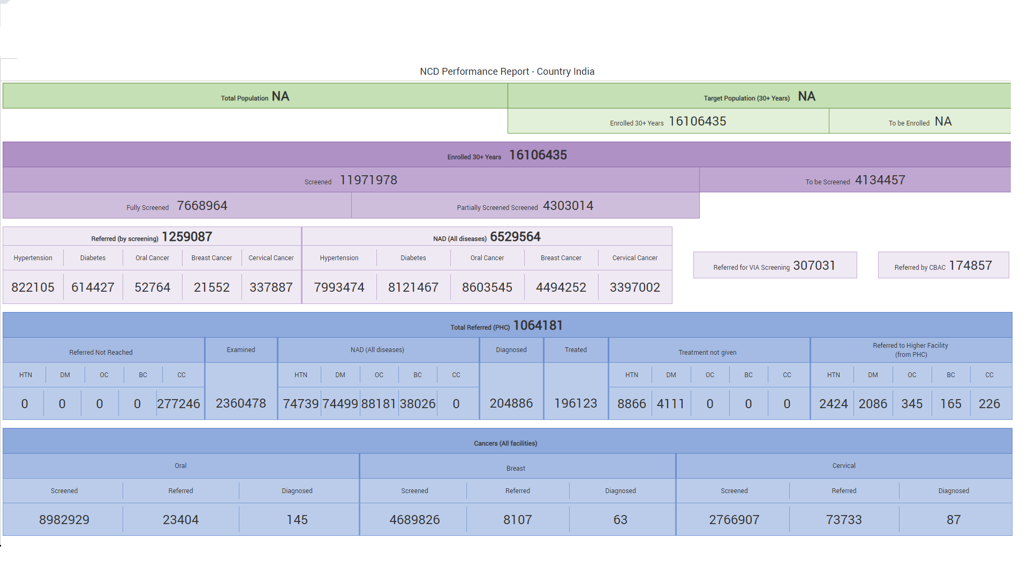
NCD Performance Dashboard

Slide 28
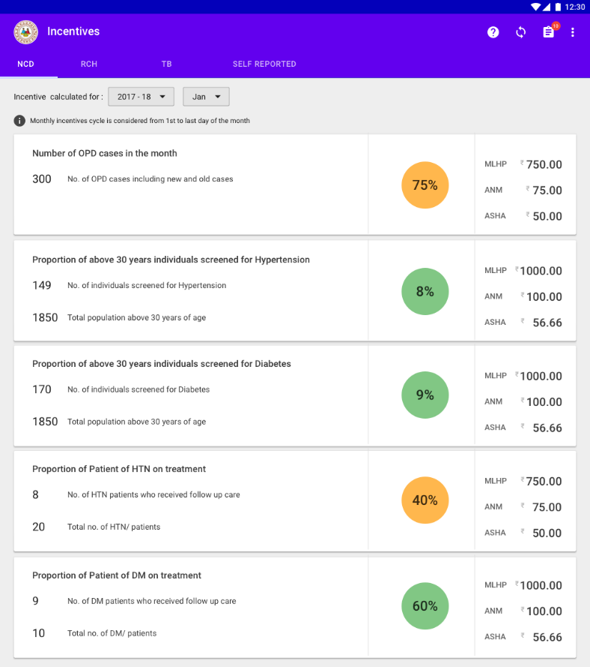
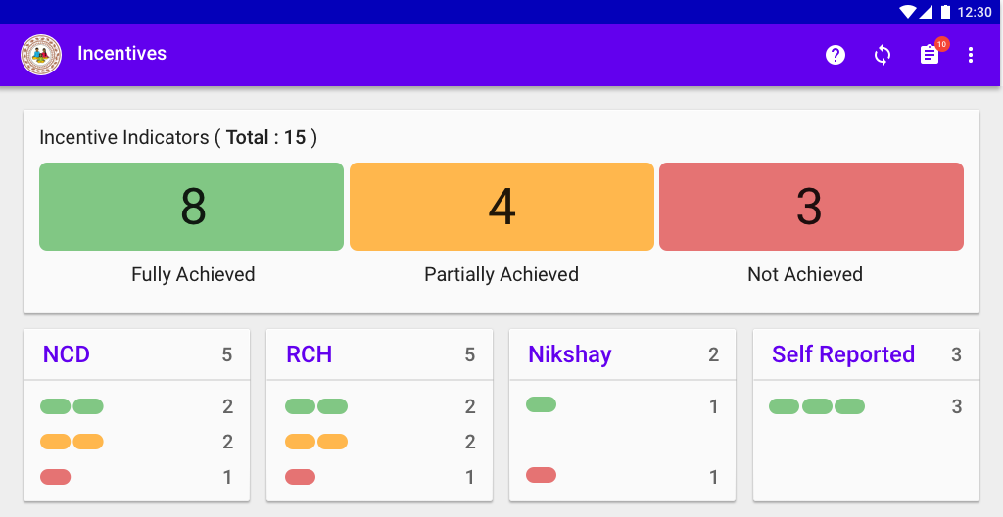
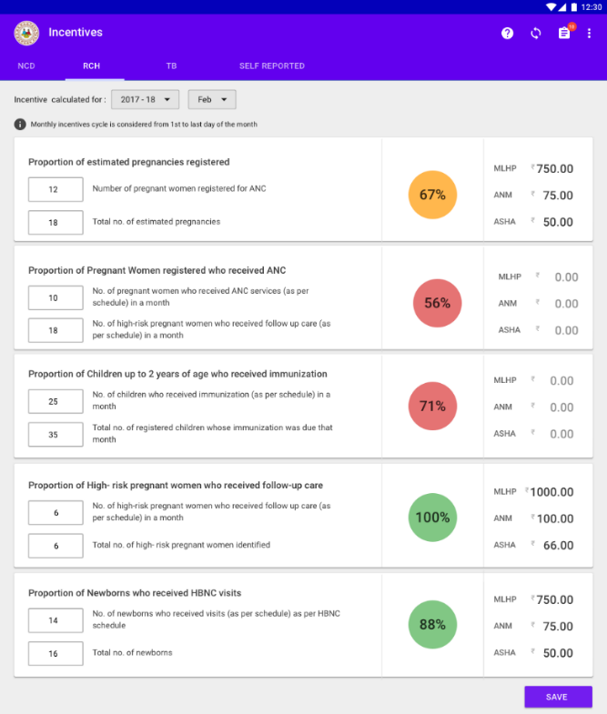
CPHC Incentives (coming shortly)
NCD Indicators
RCH Indicators

Slide 29
CBAC – Sample Analysis
CBAC Score >=4 and Age group mapping

Slide 30
Smoking, Drinking, Family History – CBAC >4

Slide 31
Training Model- Cascade
Model applied in Odisha, Punjab, Karnataka, Madhya Pradesh, Chhattisgarh
Master
trainers
District level trainers
Healthcare workers (ANMs & MOs)
Identify trainers from state and district. Conduct two day hands-on training on ASHA app,
ANM app, MO, Admin and Dashboard portal
Master trainers to identify trainers from district and block.
One day hands on training on ASHA & ANM app
Master trainers from district / block imparting training to end users.
One day hands-on training for ANMs and MO’s respectively

Slide 32
Best Practice- Training
Ensure participants have undergone PBS training
Availability of MDM, tablets, Laptops/desktops, internet etc
State/District readiness in terms of training
  One day hands-on training for ANMs and MOs
  Ensure there are 25 to 30 printed and filled family folders and CBAC forms
  Not more than 30-40 users per training session
Re-trainings for bottom three performing districts based on dashboard data.

Slide 33
Best Practices -Deployment &Monitoring
Follow up after training, incase users face any issue in the field.
What is working on the field – Cascading model
  Master trainers (SDM, DDMs, 2-3 BDMS) trained at state level
  Master trainers trained 30- 40 participants at district level(comprising of all BDMs, HWC ANMs and few potential HWC ANMs)
Outreach camps & Campaign mode can provide a good start but sustainability is the key
MDM can be an effective aid
WhatsApp groups can be an effective tool to disseminate information, monitor progress and redress issues
Recognize high-performing ASHAs, ANMs at State / District level meets

Slide 34
Stakeholder's Role
Staff type | Roles & Responsibilities
Users- ANM/ MO | Data Entry. Report issues /seek help from the supervisor
Supervisors/ Trainers | L1 Support: Understands & forwards the issue only those pertaining to the applications to Tata Trusts. Any device / data related issue must be addressed by the government.
Tata Trusts | L1 Support: Observes and tries to resolve the issue; tries to reproduce the issue and creates a redmine ticket; also collects screenshot/ logs/ videos and share it on redmine ; contact TSU to resolve issues which cannot be solved by them’
TSU | L2 Support: receives requests from TATA Trusts, triage the issues, Contacts the TT personnel to resolve immediate/ simple issues and forward those which could not be resolved
Dell | L3 Support: Tries to reproduce the issue again; finds the bug & fixes the issue. Develops new features, if needed.
Government Officials (District & State) | Allocates resources, Monitors the progress. Take corrective action and Submit new feature request.

Slide 35
Types of Issues/Requests
Simple Issues
(Fixed same day)
Examples:
Sync – Wrong version, low bandwidth
Medium Term/Effort
(Few days)
App issues: App crashes, sync fails, Subcenter profile not getting updated, Dashboard numbers incorrect
Feature request/changes
(Tied to software releases)
Examples:
Functionality- (Ex: CBAC in PHC portal)
Missing Villages – Added in admin portal, sync tablet and log in again
Version update
Example 1:
Dashboard integration
Integration of Apps
Data Migration
Login – OTP, Mobile number
Mapping – SC to diff PHC
Handle field requests – Creating users, villages, adding SCs, change mobile numbers, transfer of ANM
Example 2:
Additional information in dashboard
All handled by master trainers and/or Tata Trusts team
In Admin Portal or by TSU
Example 1 :TSU or Tech team for resolution
Example 2 : Master trainers or Tata Trusts team through Admin Portal
These are collected, analysed and prioritised by Ministry, Experts, Dell and Tata Trusts. Based on effort and priority, planned for release.

Slide 36
Process for new releases
App is developed by Dell team as per requirements from Ministry, experts and field inputs; state specific customizations are not feasible
New –app is tested by the in-house testers in QA and Staging environments
New app is later shared with Tata Trust personnel in pre production environment
Any bugs observed- are brought to notice of Dell & fixed before deployment
App is moved to production environment by IT-TSU
Tata Trusts is informed of the release by Mail/ WhatsApp/ Phone.
Tata Trusts will inform the state nodal officers and state to share the mail with users.
Sync of previous app is blocked, until updated with new app.

Slide 37
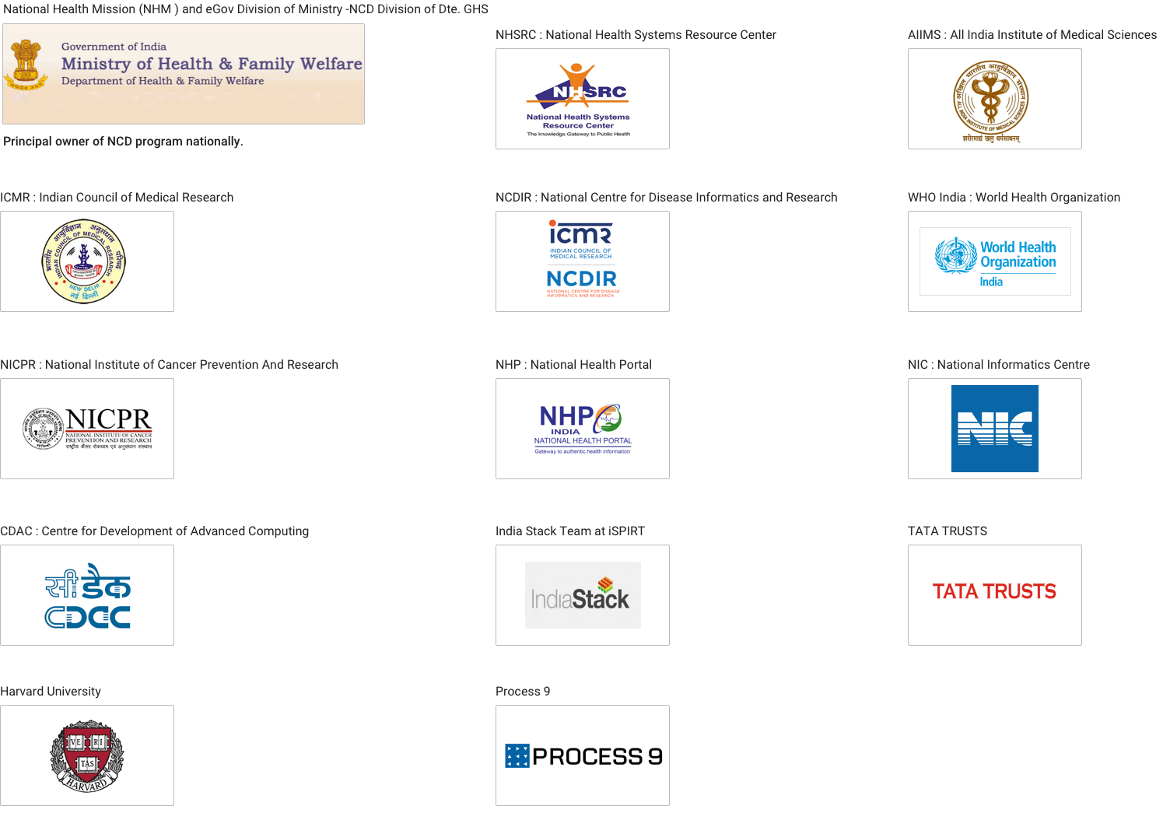





Thank You
Digital Lifecare Platform powered by
Karuna Trust

