Slide 1


Free Drugs Services Initiative
Tamil Nadu
Dr.Senthil Raj.,IAS,
Project Director, TNHSRP

Slide 2
Average per Child birth total expenditure (Rs.) in health centres, public and private hospital in TN and All India
(NSSO 71st Rounds, 2014)

Slide 3
Observation of 11th Common Review Mission 2018-19
Very minimal OOPE due to drugs/diagnostics (direct expenses) in Tamil Nadu’.

Slide 4
Free Drugs Services Initiative – Tamil Nadu
Free Drugs to patients ; Policy of the Tamil Nadu State Government ALL TIME
Free Drugs in the State through;
Medical Teaching Institutions District Head Quarters Hospitals Taluk Head Quarters Hospitals Primary Health Centers Health Sub Centers ESI Hospitals and Dispensaries Panchayat Union Dispensaries Local Body Medical Facilities (Corporation and Municipalities) | 9. TNEB Medical Facilities 10. Police Medical Facilities 11. Prison and Rehabilitation Homes 12. Juvenile Homes 13. Co-operative Sugar Factories 14. Transport Corporation Dispensaries

Slide 5
NHM Drug Budget
(Rs. in Lakhs)
Year | HOD |  |  |  | Total
 | DPH | GCC | DMS | Apex
2011-12 | 1104.86 |  | 0 | 0 | 1104.86
2012-13 | 7127.94 |  | 93.64 | 0 | 7221.58
2013-14 | 5159.57 |  | 99.84 | 0 | 5259.41
2014-15 | 7698.78 |  | 99.84 | 712 | 8510.62
2015-16 | 4690.55 |  | 4022.3 | 7004 | 15716.85
2016-17 | 7572.88 |  | 3915.84 | 5033.75 | 16522.47
2017-18 | 11381.40 | 1400.00 | 4641.50 | 4705.23 | 22128.13
2018-19 | 10868.42* (General drug includes JSSK, NCD, PHC & Urban) | 850.00 | 5007.26 | 5684.00 | 22647.18
Scheme drugs like GDM, NDD, Vit A,WIFS,RBSK,VBDC,KIT A,KIT B, MMU,Polyclinic,Oral health consumables etc., | 4135.06
2019-20 | 15409.41 | 875.00 | 8155.81 | 6060.57 | 30500.79

Slide 6
Free Drugs Services Initiative – Tamil Nadu
Procurement of Drugs for the Public Health Care Facilities is being done through Tamil Nadu Medical Services Corporation Limited.( TNMSC)
TNMSC ;
  established in 1994
  a system which is best described as an autonomous supply agency with direct delivery
  to provide medicines to “hospitals” quality drugs, diagnostic equipment and services at the most economical cost.
  assures quality of the drugs supplied through strict meticulous quality checks on the drugs by empaneled Laboratories.
  Essential Drug Lists; 315 drugs
  Specialty Drug Lists; 591 drugs

Slide 7
Supply Process of Free Drugs to Public Health Facilities
Finalization of (EDL)
Scientific Forecasting
Calling for tenders
Evaluation and Finalization of rates and suppliers
Placement of purchase orders
Receipt and storage at warehouses
Quality tests
Issue to Institutions
Payments to suppliers

Slide 8
Finalization of EDL ; Year wise
Managing Director, TNMSC Ltd
Director of Medical Education
Director of Medical and Rural Health Service
Director of Public Health & Preventive Medicine
Director of Family Welfare
Director of Drug Control
Professors of Medicines and Surgery.
Feedback from Pharmacist TNMSC
Request from Doctors / Surgeons
Feedback / Request
Drug Committee
Request from District Drug Committee
Inclusion
Deletion
Essential Drug List

Slide 9
Forecasting of Requirements
Indenting based on systemic consumption plans from PHC level onwards
Forecasting
Warehouse wise Requirement
Item wise overall Consumption
Item wise overall Requirement
Forecasting Standards and Techniques
Previous Year’s Consumption
The current year requirements will be ascertained from previous years consumption details
Information are processed by a proven Mathematical models
Values are worked out from the day to day transactions.
All inputs relevant to consumption are taken to decide requirements
Prevent excess stocking Minimize wastage due to expiry

Slide 10
Logistics
Upon purchase orders, manufacturer supplies the drugs directly to district warehouses
Automated Handling System for Receipt and Storage in Warehouses
Care taken to transport drugs which are temperature sensitive in temperature controlled containers
Quality Check
Meticulous quality checks by strict checks on the randomly picked up samples by 12 NABL empaneled laboratories.
11/12 empaneled laboratories are NABL accredited

Slide 11
Issue to Institutions & Utilization
Through Pass book system on value basis.
Indent (Online) by the concerned Medical Stores officers.( Upto PHC level)
Two pass books maintained per institution, one with the Institution and another with warehouse
Values debited on drawls on the values allocated by the heads of the Departments
Additional allocation required for additional drawls.
Monitored by Inward Indent/Issue form, Outward Goods Register.
Drugs expiry first will be exhausted first.
Procurement of drugs by all medical institutions from their Warehouses at specified, predetermined frequency.

Slide 12
Drug and Vaccine Distribution Management System (DVDMS)
TNMSC
  Developed Oracle based software to monitor the drug utilisation and stock up to District TNMSC Warehouse level
Medical / Hospitals in Tamil Nadu
  Existing HMIS 1.0
  Revamping of HMIS 2.0 in process and will be done before December 2019
Linkage with DVDMS
  In process to link it through API
  With this API, GOI can monitor the drug utilisation and stock up to District TNMSC Warehouse level……..
Drug Indenting Support under UHC IT Platform:
  For 3 months drug requirement of the UHC HSCs.

Slide 13
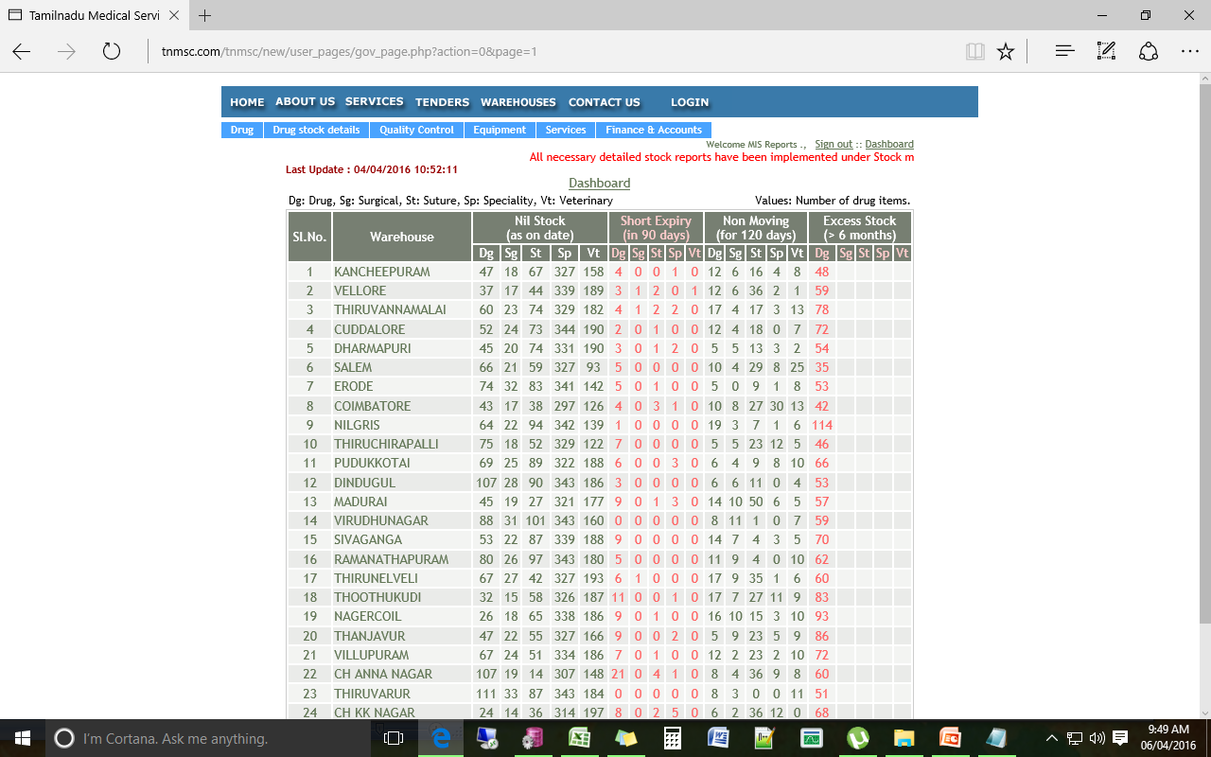
DVDMS / State owned Software; Dashboard (1)
Dashboard; Nil Stock / Short Expiry / Non Moving / Excess Stock ; At Warehouse level

Slide 14
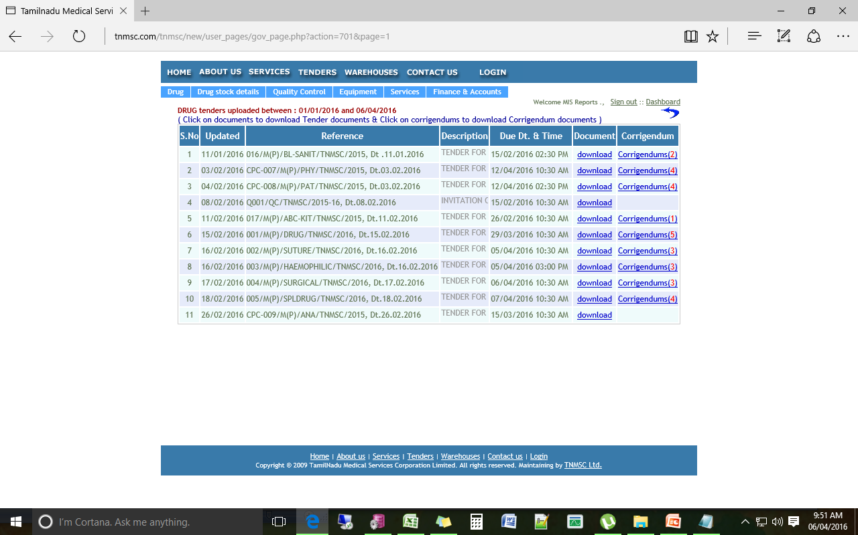
DVDMS / State owned Software; Dashboard (2)
Dashboard; Tender Details at TNMSC

Slide 15
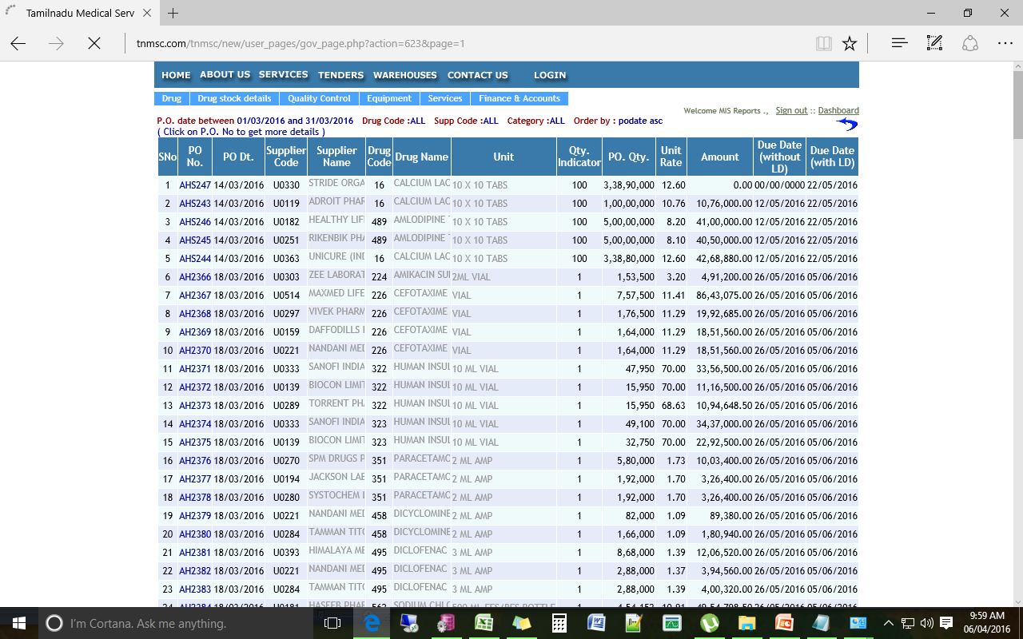
DVDMS / State owned Software; Dashboard (3)
Dashboard; Purchase Orders

Slide 16
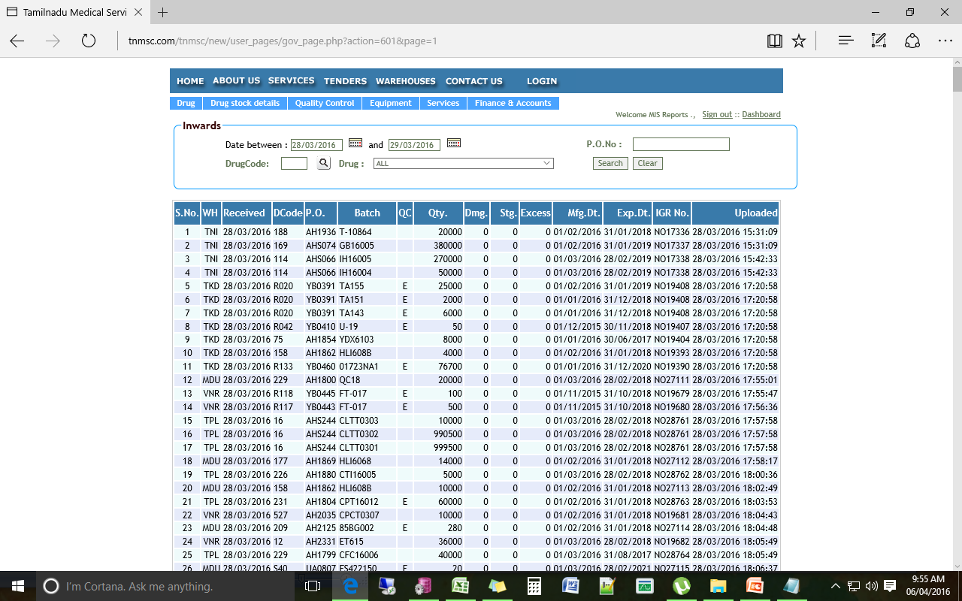
DVDMS / State owned Software; Dashboard (4)
Dashboard; Stock Receipt Details

Slide 17
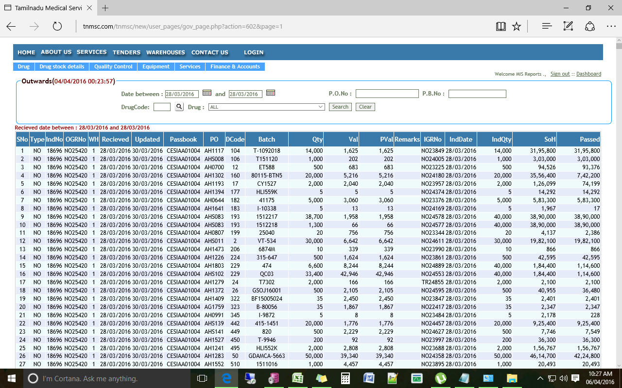
DVDMS / State owned Software; Dashboard (5)
Dashboard; Distribution Details to Hospitals

Slide 18
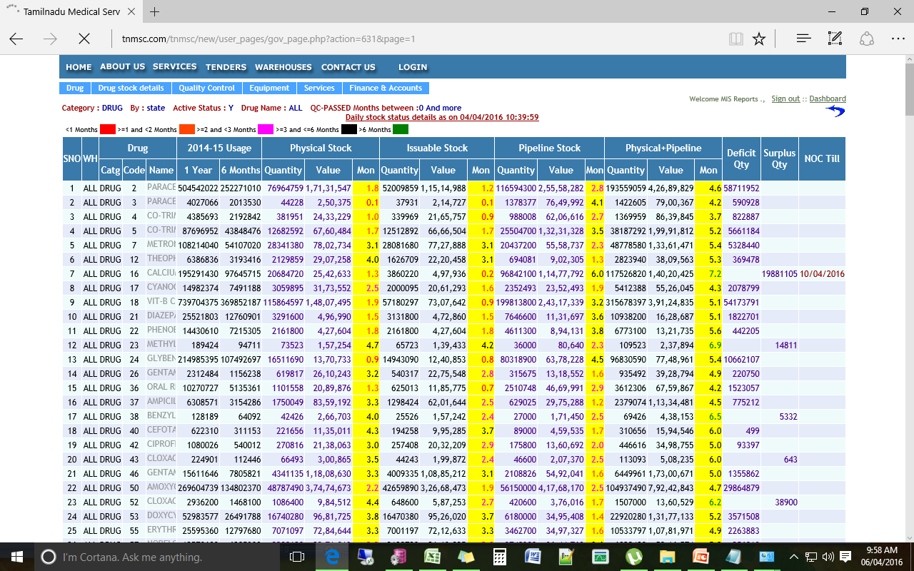
DVDMS / State owned Software; Dashboard (6)
Dashboard; State Level Stock Position

Slide 19
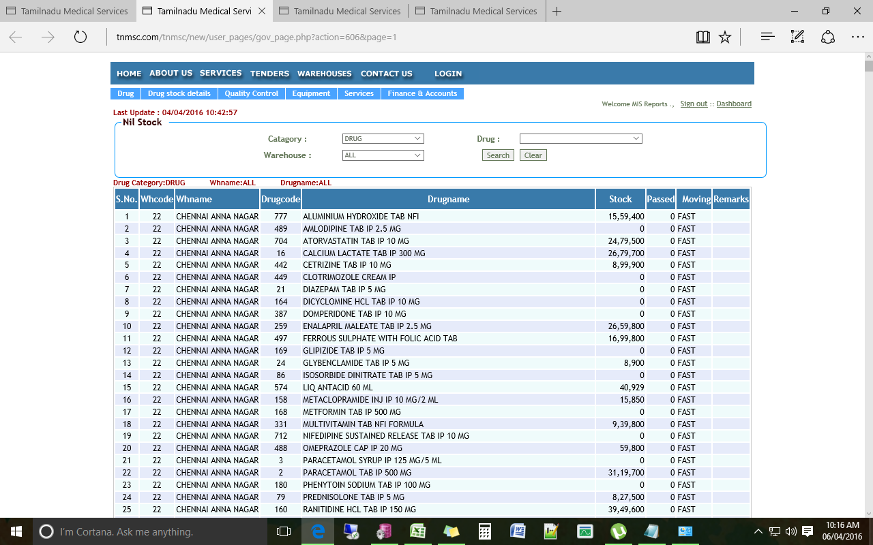
DVDMS / State owned Software; Dashboard (7)
Dashboard; Nil Stock details

Slide 20
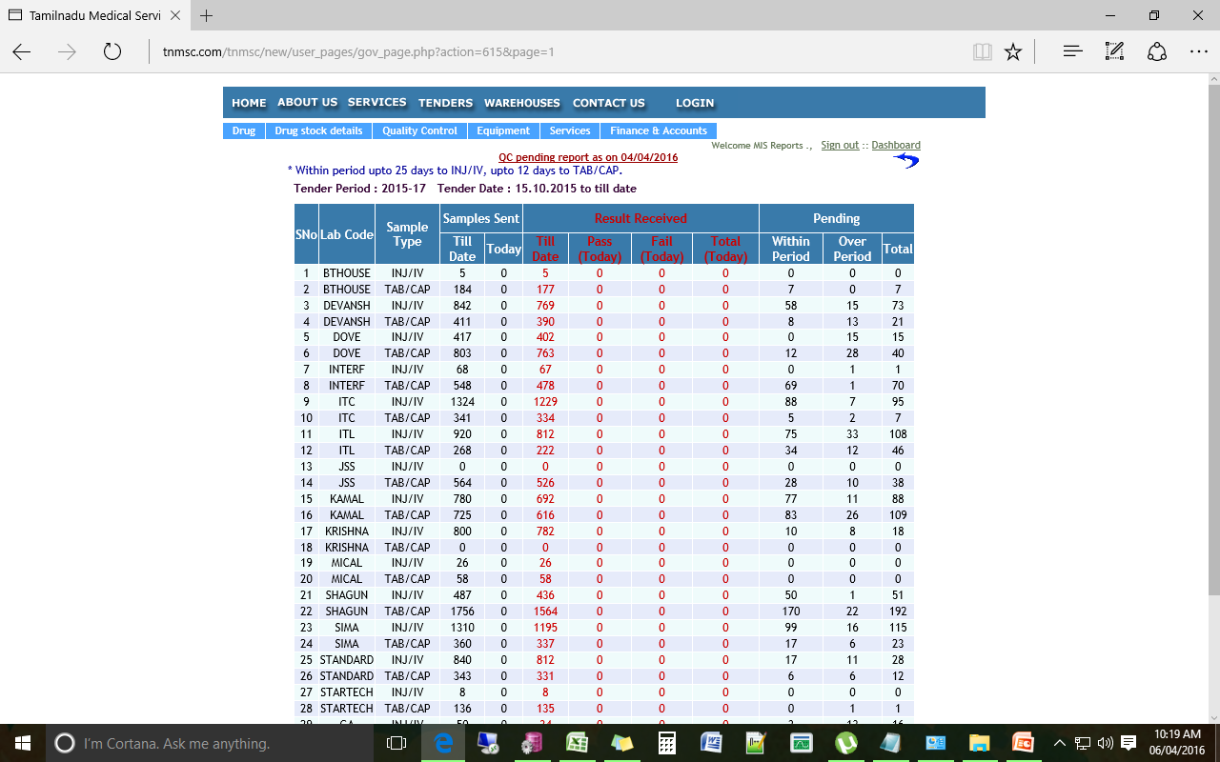
DVDMS / State owned Software; Dashboard (8)
Dashboard; Samples Status for Quality Checks

Slide 21
THANK YOU

