Slide 1
QUARTERLY REVIEW MEETING
THEMES | PRESENTER
Ayushman Bharat - HWCs & Health Systems Strengthening | JS (Policy) | Dr. Manohar Agnani
National Urban Health Mission | JS (NUHM) | Ms. Preeti Pant
NHM Finance | EA (Finance) | Ms. Preeti Nath
19th – 20th September 2019
Dr. Ambedkar International Centre
Janpath, New Delhi

Slide 2


Ayushman Bharat –
Health and Wellness Centres a Platform to integrate service delivery – provide comprehensive care
Preventive and Promotive
Comprehensive Primary Health Care – Oral, Mental, Geriatric etc.
Moving towards Universal Health Coverage
RMNCHA+N
Communicable Diseases
Non Communicable Diseases
Notes:
RMNCHA +N

Slide 3






CHC / SDH / District Hospitals / Medical Colleges, PMJAY empanelled Pvt. facilities
TERTIARY
SECONDARY
CPHC through HWCs
Referral/Return
Gatekeeping
PRIMARY
Preventive, Promotive, Curative, Rehabilitative & Palliative Care
Unmet need: NCDs/other Chronic Diseases
Existing services: RMNCH+A
AYUSHMAN BHARAT – HEALTH AND WELLNESS CENTRES

Slide 4
AB-HWCs- Field visits conducted
States covered (20) | Andhra Pradesh, Karnataka, Kerala, Odisha, Tamil Nadu, Telangana, Bihar, Goa, Jharkhand, Maharashtra, Uttar Pradesh, Punjab, Haryana, Rajasthan, Himachal Pradesh, Jammu & Kashmir, Gujarat, Uttarakhand, Chhattisgarh, Madhya Pradesh
UTs covered (6) | Chandigarh, Puducherry, Lakshadweep, A&N Islands, Dadra & Nagar Haveli, Daman & Diu

Slide 5
AB-HWCs - What has changed?
Up to an extent only!!!
Improved infrastructure including branding
Human Resources at AB-HWCs
Strengthening of existing services – RMNCHA+N
Availability of essential medicines
Availability of essential diagnostic services
Population Based Screening for 30+ (NCD – diabetes/hypertension, 3 Common Cancers)
Emergence of IT – AB-HWC portal and NCD Application
Wellness activity – YOGA and others

Slide 6

AB-HWCs- Good practices observed
Andhra Pradesh:
  Safe Delivery Calendar
Karnataka:
  Streamlined recruitment process and Performance Linked Payments of CHOs
Kerala:
  PRI Involvement in Palliative Care
  SN designated for NCD screening, also working as Ophthalmic Assistant, ECG technician- UPHC-HWC
  Arogya Sena / Health Ambassadors
Odisha:
  Population Based Screening – Campaign mode
  Yoga and Meditation – for pregnant women
  Mahila Aarogya Samitis (SHG) actively involved for in house profiling, IEC and health promotional activities – urban areas
  Weekly Specialist services in UPHCs
  Mental Health Services provided by trained MO and SN through NIMHANS (R/U)

Slide 7

AB-HWCs- Good practices observed
Tamil Nadu:
  3 months of buffer stock of medicines at SHC, PHC
  Population being served is defined with SHC – PHC linkages
  96 Poly clinics providing Specialist services in UPHCs
  SN designated for NCD screening- UPHC-HWC
Telangana:
  Basti Dawa Khanas in Urban Areas
  State run diagnostic hub
  Streamlined collection of samples and reporting
Maharashtra:
  Model AB-HWCs – SHC layout-3 Designs
  Certificate Course in Community Health through MUHS (6300 candidates/batch)
  Netradan trust – NGO collaboration for diagnosis and treatment for cataract etc.
  Jharkhand:
  ATAL Clinic (Community Clinic) to cater to health care needs of urban marginalised population by Nagar Nigam

Slide 8
AB-HWCs- Good practices observed
Gujarat:
  Arogya Samanwaya – Integration of Ayurvedic and Yogic practices with Allopathy
  Yoga at SHC/PHCs - daily by trained CHO/MPW-M/ANM, twice weekly by trained ANMs at UPHCs
  Meditation and Saptdhara
Uttar Pradesh:
  Community Health Officer – Virtual Classrooms
  Curriculum for CHOs improvised.
Himachal Pradesh:
  Expansion of Population based NCD screening to 18-30 yrs age group
  Alcohol Cess
  Goa:
  Linkages with School Health Programs - Identified Health & Wellness Ambassadors
  Expanded Wellness Activities – laughter clubs etc.

Slide 9
AB-HWCs- Good practices observed
  Dadra & Nagar Haveli:
  Upgradation of Infrastructure using MPLAD / CSR funds
Daman & Diu:
  e-Arogya (Cloud based health ecosystem) at all public health facilities
  Haryana:
  VIA screening started at PHCs by trained staff nurses.
  CSR leveraging – TATA Steel and Indian Oil
  Eye Camps in Urban Areas for Drivers to reduce accident cases
Chhattisgarh:
  NCD Suraksha Maah
  Attractive & Informative Internal branding for AB-HWCs
  Collaboration with Govt. Medical Colleges for community outreach and service delivery in urban areas.
  Mental Health Services provided by trained MO and SN through NIMHANS (R/U)

Slide 10
AB-HWCs- Functional Status as on 17.09.2019
STATE/UT | Total facilities (NUHM + RHS 2018) | Approvals Accorded Till date | FUNCTIONAL HWC as on 17.09.19 |  |  | 25% of Total facilities | TOTAL AB-HWC FUNCTIONAL as on 17.09.19
 |  |  | SHC | PHC | UPHC
Andhra Pradesh | 7680 | 3616 | 789 | 1145 | 243 | 1920 | 2177
Bihar | 10048 | 2856 | 82 | 433 | 95 | 2512 | 610
Chhattisgarh | 5236 | 1900 | 594 | 197 | 21 | 1309 | 812
Dadra & Nagar Haveli | 73 | 60 | 24 | 7 | 0 | 18 | 31
Delhi | 256 | 0 | 0 | 0 | 0 | 64 | 0
Goa | 218 | 58 | 4 | 20 | 4 | 55 | 28
Himachal Pradesh | 2092 | 785 | 0 | 37 | 2 | 523 | 39
Jammu & Kashmir | 3016 | 1185 | 113 | 115 | 4 | 754 | 232
Jharkhand | 3907 | 1797 | 244 | 108 | 53 | 977 | 405
Kerala | 5463 | 1308 | 0 | 641 | 30 | 1366 | 671
Lakshadweep | 14 | 3 | 0 | 0 | 0 | 4 | 0
Meghalaya | 462 | 113 | 29 | 9 | 1 | 116 | 39
Nagaland | 401 | 327 | 49 | 2 | 3 | 100 | 54
Odisha | 6781 | 2057 | 96 | 824 | 82 | 1695 | 1002
Puducherry | 59 | 121 | 2 | 22 | 0 | 15 | 24
Sikkim | 153 | 20 | 22 | 8 | 0 | 38 | 30
Tamil Nadu | 9132 | 2866 | 418 | 1200 | 312 | 2283 | 1930
Telangana | 4991 | 1705 | 332 | 613 | 238 | 1248 | 1183
Tripura | 1027 | 485 | 40 | 26 | 5 | 257 | 71
West Bengal | 10816 | 3230 | 143 | 256 | 0 | 2704 | 399

Slide 11
AB-HWCs- Functional Status as on 17.09.2019
STATE/UT | Total facilities (NUHM + RHS 2018) | Approvals Accorded Till date | FUNCTIONAL HWC as on 17.09.19 |  |  | 25% of Total facilities | TOTAL AB-HWC FUNCTIONAL as on 17.09.19
 |  |  | SHC | PHC | UPHC
Andaman & Nicobar Islands | 128 | 85 | 27 | 0 | 2 | 32 | 29
Arunachal Pradesh | 316 | 222 | 34 | 34 | 4 | 79 | 72
Chandigarh | 20 | 34 | 0 | 0 | 10 | 5 | 10
Daman & Diu | 27 | 28 | 19 | 4 | 0 | 7 | 23
Manipur | 438 | 352 | 57 | 6 | 1 | 109 | 64
Mizoram | 378 | 198 | 0 | 2 | 2 | 95 | 4
Uttarakhand | 1847 | 996 | 87 | 88 | 34 | 462 | 209

Slide 12
AB-HWCs- Functional Status as on 17.09.2019
STATE/UT | Total facilities (NUHM + RHS 2018) | Approvals Accorded Till date | FUNCTIONAL HWC as on 17.09.19 |  |  | 25% of Total facilities | TOTAL AB-HWC FUNCTIONAL as on 17.09.19
 |  |  | SHC | PHC | UPHC
Assam | 4683 | 1720 | 628 | 252 | 49 | 1171 | 929
Gujarat | 9471 | 3480 | 767 | 778 | 72 | 2368 | 1617
Haryana | 2685 | 1504 | 168 | 212 | 85 | 671 | 465
Karnataka | 9807 | 2740 | 464 | 146 | 119 | 2452 | 729
Madhya Pradesh | 11333 | 2871 | 0 | 764 | 108 | 2833 | 872
Maharashtra | 11151 | 9035 | 1111 | 1325 | 416 | 2788 | 2852
Punjab | 3043 | 1833 | 428 | 348 | 91 | 761 | 867
Rajasthan | 14650 | 4806 | 130 | 423 | 57 | 3663 | 610
Uttar Pradesh | 21113 | 7570 | 780 | 945 | 392 | 5278 | 2117

Slide 13
Field findings suggest
We need to move away from Adhocism to
Comprehensive thinking & planning…
Request to have a Vision Document on it…

Slide 14

AB-HWCs- Vision Document
Financial planning – NHP 2017 (2/3rd allocation to Primary Care)
Infrastructure strengthening
Strengthening of Drug Distribution and Management Systems and Expansion of essential Diagnostic services
Expanded package of services
Capacity building of the existing staff
Bidirectional referral and return
CHOs retention and motivation

Slide 15


National Health Policy 2017
Increase Govt. Health Expenditure as % of GDP from existing 1.15% to 2.5% by 2025
Increase State sector health spending to >8% of their budget by 2020
Increase in State Health Budget by 10% every year

Slide 16
Year-wise health expenditure to achieve 2.5% of GDP
 | (Rs. in Lakh Crore)
Year | Expenditure on Health as a % of GDP | GDP ( assuming growth@7.5% at current prices over baseline of 2017-18) | GDP with Rate of Inflation @4%only | Expenditure on Health | 35% of Expend. for Centre | 65% of Expend. for State
1 | 2 | 3 | 4 | 5=4*2 | 7 | 8
2018-19* | 1.40% | 178.75 | 185.90 | 2.60 | 0.91 | 1.69
2019-20* | 1.40% | 199.83 | 207.84 | 2.91 | 1.02 | 1.89
2020-21 | 1.58% | 223.42 | 232.36 | 3.67 | 1.28 | 2.39
2021-22 | 1.76% | 249.79 | 259.78 | 4.57 | 1.60 | 2.97
2022-23 | 1.98% | 279.26 | 290.43 | 5.75 | 2.01 | 3.74
2023-24 | 2.22% | 312.22 | 324.70 | 7.21 | 2.52 | 4.68
2024-25 | 2.50% | 349.06 | 363.02 | 9.07 | 3.17 | 5.90
* Assuming that Govt. health expenditure is 1.4% of GDP, as in 2017-18, as per Economic Survey, 2017-18

Slide 17
State Health Budget Status for FY 2019-20
Category | No. of State/UTs | States/UTs
State increased by 10% and above over last yr. | 7 | Andhra Pradesh (35%), Delhi (18%), Nagaland (77%), Tamil Nadu (11%), Haryana (12%), Uttarakhand (24%) and Gujarat (11%)
SHB not reported for the FY 2019-20 over last yr. | 13 | Bihar, Chhattisgarh, Jammu and Kashmir, Jharkhand, Meghalaya, Puducherry, Telangana, Arunachal Pradesh, Madhya Pradesh, Manipur, Punjab, Rajasthan and Uttar Pradesh
State increased less than 10% | 7 | Himachal Pradesh (8%), Kerala (0%), Odisha (3%), West Bengal (9%), Assam (2%), Maharashtra (8%) and Karnataka (0%)
State Health Budget decreased from last year | 4 | Goa (-22%) and Sikkim (-10%), Tripura (-9%) and Mizoram (-14%)

Slide 18
AB-HWCs- Financial Resources required for..
Infrastructure
Human Resource
Training and Capacity Building
Medicines (0.5% of the GDP)
Diagnostics
IT – tablets / laptops
Telemedicine- Hubs and Spokes
Enhanced Untied funds for AB-HWCs

Slide 19

AB-HWCs- Infrastructure
As per RHS 2018, a number of facilities (PHCs and SHCs) are without regular electricity and water supply. The number exceeds 50% in Bihar, J&K, Jharkhand, Manipur, Meghalaya, Mizoram and Nagaland.
Additional space for lab services, drug dispensation & drugs storage cabinets, patient waiting area, etc.
Space for YOGA / other wellness activities
Rooms for MPW / CHO etc.

Slide 20

AB-HWCs-SHC- Status of CHOs
Sr. No. | States | Number of SHCs approved for 2018-20 | CHO recruited (as per portal as on 29.08.2019) (a) | Estimated Number of CHOs available for July 2019 and Jan 2020* (b) | Total CHO available (a+b) | DEFICIT CHO based on Total SHCs approvals
1 | A & N Islands | 58 | 28 | 24 | 52 | 6
2 | Andhra Pradesh | 2250 | 780 | 342 | 1122 | 1128
3 | Arunachal Pradesh | 130 | 62 | 73 | 135 | NIL
4 | Assam | 1233 | 635 | 412 | 1047 | 186
5 | Bihar | 726 | 85 | 526 | 611 | 115
6 | Chandigarh | 0 | 2 | 0 | 2 | NIL
7 | Chhattisgarh | 1500 | 729 | 1154 | 1883 | NIL
8 | D & N Haveli | 52 | 24 | 22 | 46 | 6
9 | Daman & Diu | 26 | 20 | 48 | 68 | NIL
10 | Delhi | 0 | 0 | 0 | 0 | NA
11 | Goa | 9 | 14 | 0 | 14 | NIL
12 | Gujarat | 2303 | 786 | 1571 | 2357 | NIL
13 | Haryana | 562 | 178 | 344 | 522 | 40
14 | Himachal Pradesh | 354 | 0 | 384 | 384 | NIL
15 | Jammu & Kashmir | 574 | 131 | 298 | 429 | 145
16 | Jharkhand | 1452 | 245 | 915 | 1160 | 292
17 | Karnataka | 1705 | 537 | 902 | 1439 | 266
18 | Kerala | 728 | 0 | 728 | 728 | 0
19 | Lakshadweep | 0 | 0 | 0 | 0 | 0
20 | Madhya Pradesh | 1015 | 5 | 862 | 867 | 148
*Based on estimated admissions reported by States and assuming 80% pass rate

Slide 21
AB-HWCs-SHC- Status of CHOs
Sr. No. | States | Number of SHCs approved for 2018-20 | CHO recruited (as per portal as on 29.08.2019) (a) | Estimated Number of CHOs available for July 2019 and Jan 2020 (b) | Total CHO available (a+b) | DEFICIT CHO based on Total SHCs approvals
21 | Maharashtra | 6791 | 1135 | 6300 | 6175 | 0
22 | Manipur | 220 | 81 | 96 | 177 | 43
23 | Meghalaya | 132 | 42 | 130 | 172 | NIL
24 | Mizoram | 120 | 1 | 56 | 57 | 63
25 | Nagaland | 152 | 49 | 96 | 145 | 7
26 | Odisha | 1321 | 123 | 921 | 1044 | 277
27 | Puducherry | 1 | 1 | 0 | 1 | 0
28 | Punjab | 1640 | 481 | 1136 | 1617 | 23
29 | Rajasthan | 2909 | 138 | 2736 | 2874 | 35
30 | Sikkim | 60 | 53 | 48 | 101 | NIL
31 | Tamil Nadu* | 985 | 605 | 664 | 1269 | NIL
32 | Telangana | 987 | 336 | 465 | 801 | 186
33 | Tripura | 332 | 40 | 251 | 291 | 41
34 | Uttar Pradesh | 5050 | 900 | 3186 | 4086 | 964
35 | Uttarakhand | 739 | 140 | 474 | 614 | 125
36 | West Bengal | 1660 | 145 | 1368 | 1513 | 147
Total |  | 37776 | 8531 | 26,532 | 33,803
*Based on estimated admissions reported by States and assuming 80% pass rate

Slide 22
AB-HWC-SHC- Community Health Officers:
Retention and Motivation
  Defined career pathways
  Streamlined recruitment procedures – preference postings
  Performance linked payments
  Training at District level – National Health Programmes
  Constant Supportive Monitoring and Mentoring
  Timely provision of tablets
Delay in admission process of CHOs for July 2019 session-
Rajasthan, Bihar, Uttar Pradesh, Haryana, Telangana, Jammu & Kashmir and Uttarakhand.

Slide 23
AB-HWCs- Basket of Wellness activities
YOGA – the only activity being focused on – can CHOs be trained as Yoga instructors?
Different options:
  Open Gyms – in collaboration with the local panchayats
  Sahi Bhojan, Behtar Jeevan – Eat Right Campaign
  Nutrition Counselling – expanded to adolescents, patients suffering with chronic conditions, awareness building (BMI), lifestyle modifications – less salt, less sugar
  Food adulteration kits
  Medicinal Plants and their use
  Health Talks / Discussions / Counselling / Laughter Clubs
  Health Calendar / Planning of Events
  Cycling / Zumba/ Cyclathons Activities

Slide 24

Free Drugs Service Initiative
  Strengthening of Drugs and Vaccine management systems till AB-HWC-SHC level
  Field visits suggest that all States/UTs need to expand their Essential Medicine List (EML).
Status:
32 States/UTs have centralized procurement:
  Andaman & Nicobar, Chandigarh, Dada & Nagar Haveli & Lakshadweep yet to implement.
29 States/UTs have operationalized IT enabled logistics & supply chain system/DVDMS:
  Mizoram, Nagaland, Sikkim, A&N Island, Chandigarh, Lakshadweep & Puducherry yet to implement.
28 States/UTs have NABL accredited labs to ensure quality of drugs provided.
  Uttar Pradesh, Himachal Pradesh, Manipur, Meghalaya, Goa, A&N Islands, Chandigarh & Daman & Diu yet to implement.

Slide 25
Free Drugs Service Initiative
31 States/UTs have facility wise EDL:
  Manipur, Sikkim, A&N Island, Chandigarh & Lakshadweep do not have facility wise EDL.
14 States/UTs have prescription audit mechanism:
  Assam, Bihar, D&N Haveli, Delhi, Himachal Pradesh, Jammu & Kashmir, Lakshadweep, Mizoram, Odisha, Rajasthan, Telangana, Tripura (under process), Uttarakhand, West Bengal
20 States/UTs have established call centre based grievance redressal mechanism with dedicated toll-free number:
  Andhra Pradesh, Assam, Bihar, Chhattisgarh, D&N Haveli, Daman & Diu, Delhi, Himachal Pradesh, Jharkhand, Karnataka, Kerala, Lakshadweep, Madhya Pradesh, Maharashtra, Punjab, Rajasthan, Tamil Nadu, Telangana, Tripura (under process), Uttarakhand

Slide 26
Free Diagnostics Service Initiative
Enhanced range of free diagnostics: 14 tests at AB-HWC-SC and 63 tests at AB-HWC-PHC.
FDI Pathology- laboratory services implemented in 33 States /UTs
  Yet to be implemented in Mizoram, Nagaland, Uttarakhand
FDI- Tele-radiology implemented in 10 States only
  Andhra Pradesh, Assam, HP, Meghalaya, Odisha, Rajasthan, Tripura, Uttar Pradesh, Uttarakhand, West Bengal
FDI CT scan implemented in 23 States/UTs
  Yet to be implemented in Arunachal Pradesh, Chandigarh, Chhattisgarh, D&NH, Jammu & Kashmir, Maharashtra, Manipur, Meghalaya, Mizoram, Nagaland, Sikkim and Uttarakhand

Slide 27
State Performance on Free Diagnostics at SHC
Telangana: 54 tests

Slide 28
State Performance on Free Diagnostics at PHC

Slide 29
State Performance on Free Diagnostics at DH
Delhi: 200 Tests

Slide 30
Bi-directional Referral and Return Linkages
Facility mapping for secondary and tertiary care– CHC/SDH/DH/MC/PMJAY
Referral to be prioritized (non-financial incentives) – referral slips / cards / point person at the referred facility
Return linkages – information to be provided to the linked CPHC team for follow up

Slide 31
AB-HWCs- IEC
Uniform IEC display at facilities – local language
State / District specific media plan / IEC strategy
Use of Social Media platform for wider dissemination of services
IEC on prevention, promotion (Eat Right), early diagnosis and improved treatment outcomes (with regular treatment) – need to be emphasized

Slide 32
AB-HWCs- Strengthening the IT systems
Daily reporting and Monthly reporting at AB-HWC portal to be ensured
IT Systems – to be standardized and integrated with GoI applications
  In the mean-time, manual records – allowed for Performance Linked Payments till December 2019.

Slide 33
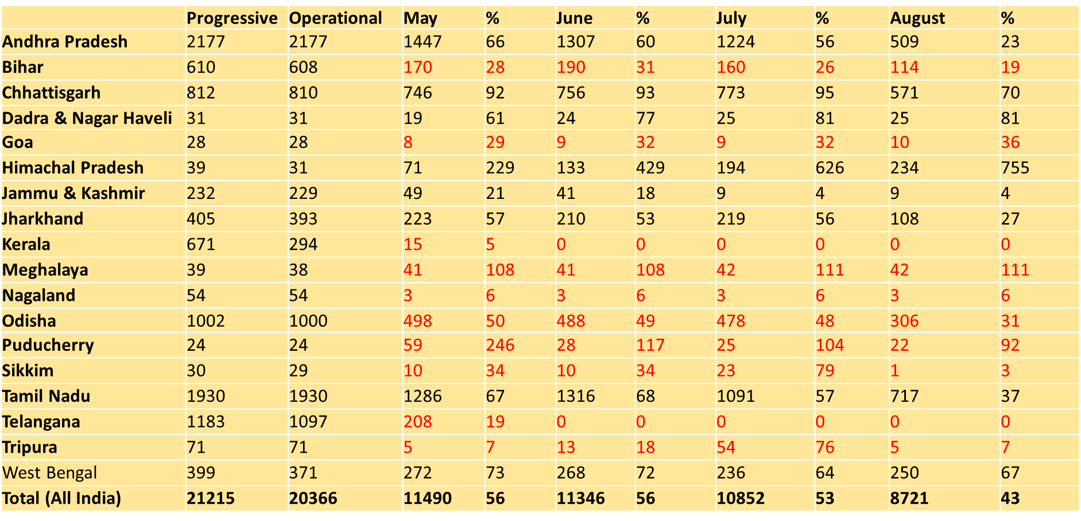
Monthly Reporting Status on AB-HWC Portal

Slide 34
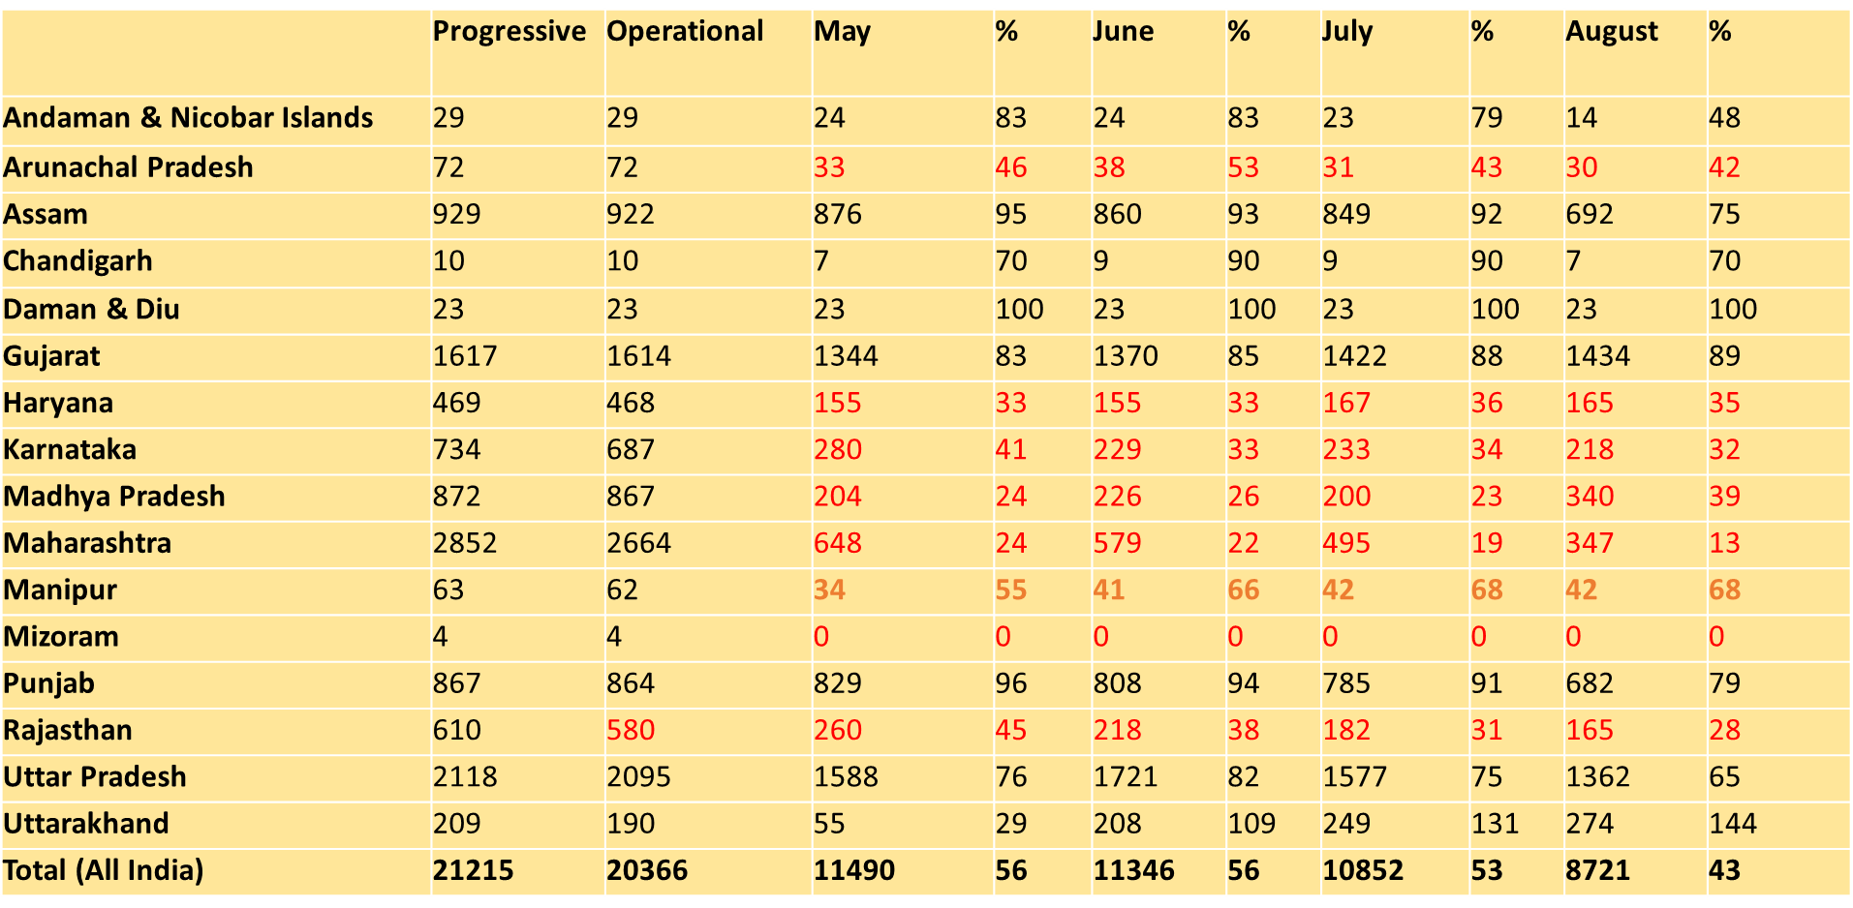
Monthly Reporting Status on AB-HWC Portal

Slide 35
Daily Reporting Status on AB-HWC Portal
(1st- 17th September, 2019)

Slide 36
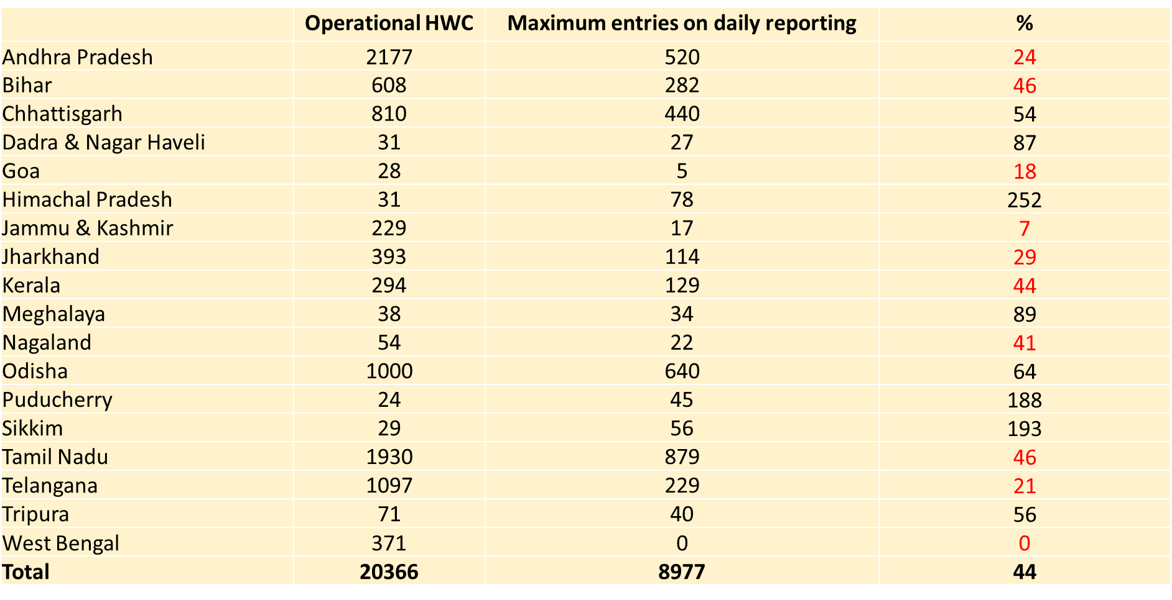
Daily Reporting Status on AB-HWC Portal
(1st- 17th September, 2019)

Slide 37
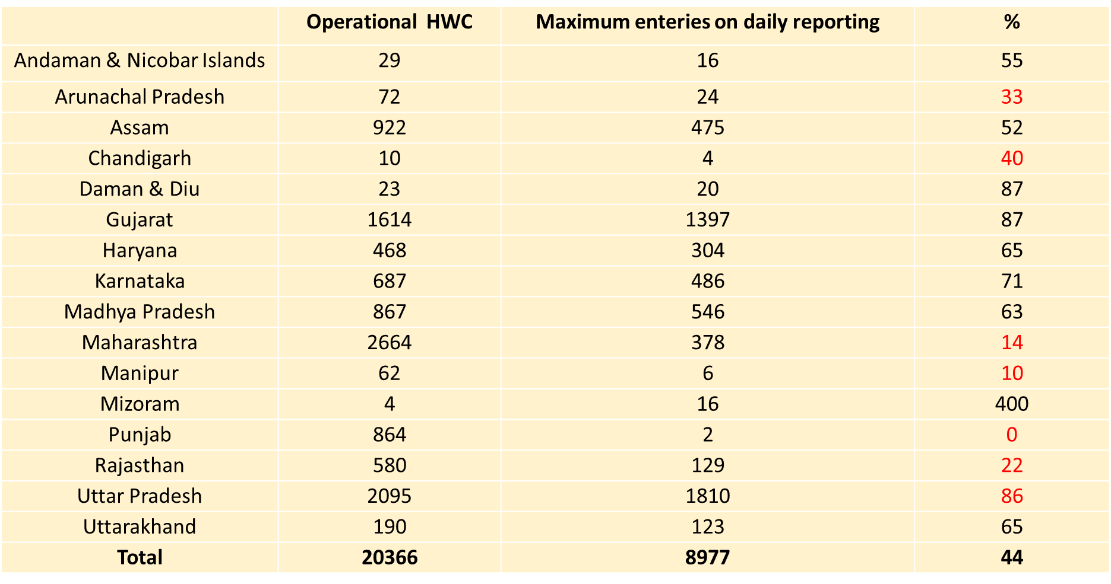
Daily Reporting Status on AB-HWC Portal
(1st- 17th September, 2019)

Slide 38
Monitoring of AB-HWCs
Facility based Monitoring:
Medicines, Diagnostics, Swachhta related activities, Counselling, Wellness, Patient records, Tele-consultation Utilization of untied funds
Social Audits:
PBS, CBAC,
Immunization, ANC, Other outreach activities, Health Promotion and Wellness Activities
Constitution of RKS (facility based)
VHSNCs / SHGs (community based)

Slide 39
Health Systems Strengthening

Slide 40

Human Resources for Health
No Specialist Cadre: UP, MP, Chhattisgarh, HP, Rajasthan, Uttarakhand, Punjab, Haryana, Assam, Nagaland, Meghalaya, Mizoram, Tripura
High Vacancy reported in many States (Source: PIP 2019-20)
  States Not using NHM flexibility especially for specialists entirely
Vacancy | Specialists | MO-MBBS | Staff Nurse | Lab Technician
Regular | Chhattisgarh (91%) Jharkhand (80%) Bihar (71%) MP (68%) Gujarat (64%) | Sikkim (74%) Gujarat (47%) Manipur (45%) Chhattisgarh (44%) | Sikkim (80%) Gujarat (70%) Odisha (63%) Jharkhand (55%) | Bihar (81%) HP (67%) Jharkhand (62%) Haryana (50%)
Contractual | Rajasthan (90%) Meghalaya (85%) MP (81%) J&K (77%) Ar. Pradesh (77%) | HP (97%) Rajasthan (78%) Odisha (77%) Bihar (74%) Maharashtra (63%) | Rajasthan (81%) HP (74%) Bihar (77%) Jharkhand (70%) Maharashtra (61%) | Ar. Pradesh (76%) Rajasthan (69%) Jharkhand (63%)

Slide 41
Human Resources for Health
Number of sanctioned regular position of Staff Nurse is much less than the requirement as per IPHS in most of the states:
  Jharkhand (13%)*, Assam (19%), Uttar Pradesh (20%), Nagaland (24%), Karnataka (30%), Uttarakhand (34%), MP (40%), Maharashtra (48%)
Assessment of all staff on Minimum Performance Benchmarks to be conducted on quarterly basis:
  Report to be shared with MoHFW twice a year (October and March)
  First round of report card expected in first week of October from all states
Human Resource Management Information System (HRMIS):
  Implemented in Chhattisgarh, Kerala, Punjab, Haryana and Assam
  Partial in Tripura, UP, AP and Odisha
  Not yet functional in other states
*Figures in Brackets are IPHS required vs sanctioned positions e.g. Jharkhand has only 13% of the required IPHS staff nurses posts sanctioned

Slide 42


Quality Assurance
NQAS:
  A total of 441 Public Health facilities certified under NQAS at national level; 66 more under process in 28 States/UTs.
  8 States/UTs yet to submit applications (A&N Islands, Arunachal, Chandigarh, Daman&Diu, Goa, Puducherry, Sikkim, Lakshadweep)
Kayakalp: 12% of facilities scored >70% scored in External Assessment in 2018-19

Slide 43

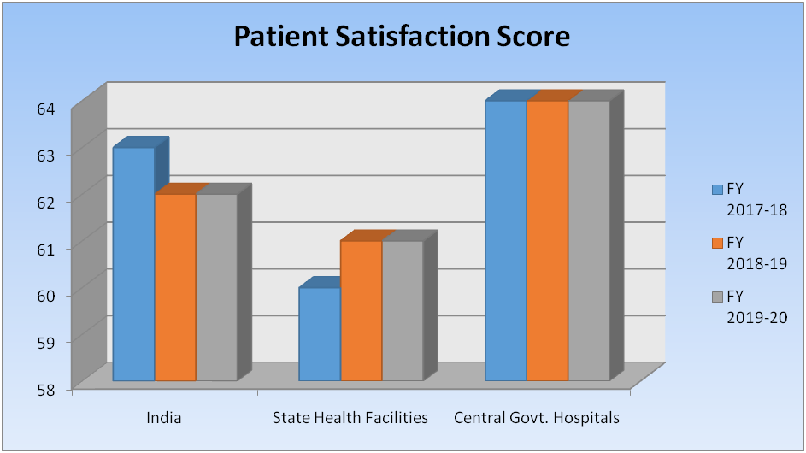
Mera Aspataal
Currently functioning in 25 States and 5 UTs (3106 Facilities)
  Arunachal Pradesh, Nagaland, Sikkim, Kerala, A&N Islands, Lakshadweep yet to implement
Sub-district facilities are covered in 10 States (Gujarat, AP, Rajasthan, Karnataka, Mizoram, Jharkhand, Telangana, HP, Goa and Delhi). Gujarat & Himachal covered PHCs too.
National level Patient Satisfaction Score remained stagnant from 2018-19. PSS of States/UTs except Tamil Nadu remained constant or shown downward trend.
Reasons of Dis-Satisfaction | India 5.91 Lakh Responses | State health Facilities (3.41 lakh Responses)
Staff Behavior | 39 | 40
Cleanliness | 12 | 13
Cost of Treatment | 18 | 19
Quality of Treatment | 0 | 0
Other Reasons (Long waiting time, lack of amenities, inadequate information etc.) | 31 | 28

Slide 44

Blood Services
  24 Districts [Arunachal (2), Bihar (5), Jharkhand (5), HP (1), Manipur (3), UP (3), Maharashtra (1), Karnataka (3), J&K (1)] do not have Govt. Blood Banks.
  Gap between supply & demand – States are collecting blood units of <1% as against the requirement of 2% of the population
    Jharkhand, UP, Chhattisgarh, Punjab, Rajasthan, Andhra Pradesh, Telangana, MP, Orissa, Uttarakhand, J&K, Bihar, Assam, Nagaland)
  Voluntary blood donation is 40-55% in these states.
  Transfusion transmitted infections are high in UP, MP, Jharkhand, Meghalaya, Chhattisgarh, Bihar, Maharashtra, Haryana, Punjab, West Bengal, Assam, Manipur & Nagaland.

Slide 45


National Ambulance Service
National Average Response Time (Emergency referral services)
 | Rural | Urban
ALS | 21 Min 14 Sec | 14 Min 11 Sec
BLS | 20 Min 14 Sec | 14 Min 56 Sec
7 States/UTs do not have Emergency Referral Services under NHM.
  A&N Islands, Lakshadweep, Manipur, Mizoram, Nagaland, Tripura & West Bengal
Manipur, Mizoram, Nagaland & West Bengal (BLS) has Dial 102 services only.
Arunachal Pradesh does not maintain average response time (call to scene) currently at the centralised call centre.
Haryana is yet to operationalise centralised call centre.

Slide 46

Biomedical Equipment Management
& Maintenance Programme (BMMP)
BMMP - Uptime of equipment (95% in District Hospital, 90% in Community Health Centres and 80% in Primary Health Centres).
Implemented in 28 States/UTs:
  22 States/UTs in PPP mode:
    Andhra Pradesh, Arunachal Pradesh, Assam, Chhattisgarh, Goa, Himachal Pradesh, Jharkhand, Kerala, Madhya Pradesh, Maharashtra, Meghalaya, Mizoram, Nagaland, Puducherry, Punjab, Telangana, Tripura, Rajasthan, Uttar Pradesh, West Bengal, Jammu & Kashmir, and Manipur.
  6 States/ UTs in In-House mode:
    Gujarat, D&N Haveli, Daman & Diu, Delhi, Lakshadweep, and Tamil Nadu.
Tender for outsourcing in progress in 4 States/UTs:
  Haryana – Tender pending for approval by State.
  Karnataka – Tender complete but yet to be implemented
  Uttarakhand – Tender failed.
  Sikkim – Tender pending with the state for approval.
Not implemented in 4 States/UTs - A&N Islands, Bihar, Chandigarh, Odisha

Slide 47
National Urban Health Mission (NUHM)

Slide 48
Infrastructure- AB-HWCs/ UPHCs
Gap of 2711
U-PHCs as per urban population
Gap of 1286
HWCs
Maximum gaps of UPHCs in 5 States- Maharashtra (398), U.P- (298), T.N (278), Kerala (236), Gujarat (201)
States with maximum U-PHCs running in rented building- U.P, Bihar, Delhi, Jharkhand, Madhya Pradesh, Meghalaya etc.
States with maximum U-PHCs running in Govt. building- Tamil Nadu, Odisha, Gujarat, Karnataka, Chhattisgarh, Kerala, West Bengal, Telangana
Maximum gaps of HWCs approval in 4 States- W.B (373), Delhi (242), Gujarat (209), Maharashtra (205)

Slide 49
Human Resource - UPHCs
More than 40% Positions of Medical Officers vacant – Bihar, Jharkhand, Madhya Pradesh, Maharashtra and Punjab
More than 60% of SN vacant- West Bengal, M.P, Rajasthan and Jharkhand
More than 35% MPW (F) vacant- Rajasthan, Karnataka, Tripura. Bihar- None of LT is in place
More than 50% LTs vacant- Jharkhand, Maharashtra, Madhya Pradesh, Rajasthan, Bihar- None of LT is in place
Source: QPR / MIS Report ending March, 2019

Slide 50


State wise Performance
(In respect of Physical Progress)
Source: QPR Report ending March, 2019

Slide 51


Cumulative Financial Progress of NUHM
Fund utilization of 70%- 75%
Fund utilization of 40%-60%

Slide 52

UPHC - Public Private Partnerships
e-UPHC management on PPP mode by e-Vaidya & Apollo agencies -Andhra Pradesh
  HR, Tele-consultation, IT, Diagnostic services: Supported by Agency
  Building, Drugs: Provided by State Health Department
Partnership between State and TATA Trust in developing 26 U-PHCs as Model centres in Nagpur corporation- Maharashtra
  Infrastructure, IT, investigations through Hub & Spoke model : Supported by Agency.
  Building, Drugs: Provided by State Health Department
Provision of Eye care at U-PHC- Partnership with Susrut Eye Foundation - Kolkata Municipal Corporation, West Bengal

Slide 53

AB-HWC-UPHC- Health Service Delivery Models
96 Polyclinics providing Specialist services as per weekly roster in each UPHC - Tamil Nadu
104 Basti Dawakhana functional in urban areas for covering 5000 to 10000 population with focus on slum population- Telangana
Atal Mohalla Clinic is being initiated for urban slum dwellers to impart health services including NCD screening with support from ULBS- Jharkhand
Specialist services Schedule - Tamil Nadu
  Monday – General Medicine & Dermatology
  Tuesday – Obs/ Gynae & Dental
  Wednesday – Pediatrics and Ophthalmology
  Thursday – Ortho and Physiotherapy
  Friday – ENT and Dental
  Saturday - Psychiatry

Slide 54
AB-HWCs - Vision document for urban areas
Criteria for establishing AB-HWCs -
  Population based / Ward based ?
  Infrastructure (Buildings) - Community Halls of Urban Local Bodies / Corporation
  Assigning the Population to the AB-HWC
  Defining referral linkages – Secondary and Tertiary
Facility based services - Specialty Services - Model ? (Facility based / Tele-consultation)
Outreach – Can we have a different Model ?
  Basti Dawa Khana , Telangana – thinking for performance linked payments for outreach activities ?
  In areas where there are no ASHAs - Can existing community volunteers, SHGs, NGOs, Nursing students etc. be utilized ?

Slide 55
AB-HWCs - Vision document for urban areas
Human Resources
  Norms for ASHAs (1 ASHA for 1000 - 2500 population)?
  MPWs (Introduction of MPW-Male) If yes – at what population?
  Specialist services – Odisha / Rajasthan model – part-time weekly services
Wellness – Linkages with open spaces or gyms

Slide 56
NHM Finance

Slide 57
Status of State Share pendency up to 31-03-2019
(Withheld 1st Tranche Release)
S. No. | States/UTs | Outstanding after consideration of G.O. (Rs. in Crore) | % of Outstanding Amount
1 | Nagaland | 13.80 | 10%
2 | Puducherry | 8.65 | 36%
3 | Delhi | 12.33 | 12%
4 | Uttar Pradesh | 614.39 | 5%

Slide 58
Status of State Share pendency up to 31-08-2019
(for 2nd Tranche release)
Category | No of State/UTs | States/UTs
No pendency under State Share | 6 | Chhattisgarh, Himachal Pradesh, Tripura, Sikkim, Manipur and Karnataka
Up to 2 % | 4 | Meghalaya (2%), Odisha (2%), Arunachal Pradesh (2%) and Mizoram(2%)
From 3% to 5% | 5 | Andhra Pradesh (4%), Tamil Nadu (5%), Gujarat (4%), Haryana (3%) and Uttarakhand (3%)
From 6% to 10% | 8 | Bihar (8%), Goa (9%), Jammu & Kashmir (10%), Jharkhand (8%), Madhya Pradesh (8%), Maharashtra (10%), Punjab (8%) and Rajasthan (6%)
Above 10% | 4 | Kerala (16%), West Bengal (11%), Telangana (21%) and Assam (23%)

Slide 59
Delay in Transfer of Funds from State Treasury to
SHS for the FY 2018-19
Category | No of State/UTs | States with Days
0 to 15 days | - | -
Above 15 to 100 days | 22 | Odisha (18), Puducherry (20), Andhra Pradesh (25), West Bengal (25), Kerala (31), Chhattisgarh (32), Tamil Nadu (36), Meghalaya (37), Delhi (45), Sikkim (61), Jammu & Kashmir (63), Tripura (92), Bihar (99), Madhya Pradesh (20),Gujarat (24), Assam (27), Uttarakhand (46), Mizoram (70), Punjab (72), Haryana (88), Maharashtra (89), Rajasthan (96)
100-200 days | 8 | Telangana (115), Jharkhand (121), Nagaland (128), Himachal Pradesh (186), Goa (190), Karnataka (104), Arunachal Pradesh (106), Uttar Pradesh (124)
200-300 days | - | -
More than 300 days | 1 | Manipur (313)

Slide 60
Status of Statutory Audit for the FY 2018-19
Only 7 States have submitted their Statutory Audit Report for the FY 2018-19:
      Andhra Pradesh
      Tamil Nadu
      Goa
      Jharkhand
      Gujarat
      Haryana
      Maharashtra
      (Due date for submission was 31/7/2019)

Slide 61
1st Tranche Release of Funds for the FY 2019-20
(No fund Release)
Category | No of State/UTs | States/UTs
(1)NRHM RCH Flexible Pool
(i) RCH | 8 | Lakshadweep, Delhi, Puducherry, Nagaland, Rajasthan, Uttar Pradesh, A & N Islands, Arunachal Pradesh
(ii) HSS | 4 | Puducherry, Nagaland, Delhi, Uttar Pradesh
(iii) Ayushman Bharat (HWC) | 4 | Puducherry, Nagaland, Delhi, Uttar Pradesh
(iv) ABP | 28 | Chhattisgarh, Jharkhand, Odisha, Jammu & Kashmir, Andhra Pradesh, Telangana, Goa, Kerala, Tamil Nadu, West Bengal, Nagaland, Sikkim , D & N Haveli, Delhi, Puducherry, Lakshadweep, Madhya Pradesh, Rajasthan, Uttar Pradesh, Uttarakhand, Gujarat, Haryana, Karnataka, Punjab, Mizoram, A & N Islands, Chandigarh, Daman & Diu
(2) NUHM Flexible Pool
(i) Other NUHM | 10 | Goa, Delhi, Puducherry, Meghalaya, Tripura, Nagaland, Uttar Pradesh, A&N Islands, Daman & Diu, Arunachal Pradesh
(ii) Ayushman Bharat (HWC) | 8 | Goa, Delhi, Puducherry, Nagaland, Uttar Pradesh, A&N Islands, Daman & Diu, Arunachal Pradesh

Slide 62
1st Tranche Release of Funds for the FY 2019-20
(No fund Release)
Category | No of State/UTs | States/UTs
(3) NDCP Flexible Pool
(i) NLEP | 18 | Bihar, Chhattisgarh, Jharkhand, Odisha, Himachal Pradesh, Jammu & Kashmir, Goa, Kerala, Lakshadweep, Delhi, Meghalaya, Nagaland, MP, Rajasthan, Uttar Pradesh, Karnataka, Maharashtra, Arunachal Pradesh
(ii) RNTCP | 11 | Bihar, Jharkhand, Goa, Lakshadweep, Delhi, Meghalaya, Nagaland, Rajasthan, Uttar Pradesh, Arunachal Pradesh, Manipur
(iii) NVBDCP | 26 | Bihar, Chhattisgarh, Jharkhand, Odisha, Himachal Pradesh, Jammu & Kashmir, Andhra Pradesh, Goa, Telangana, Kerala, Lakshadweep, Delhi, Meghalaya, Sikkim, Nagaland, Tripura, MP, Rajasthan, Uttar Pradesh, Haryana, Karnataka, Maharashtra, Punjab, Arunachal Pradesh, Assam, Manipur

Slide 63
1st Tranche Release of Funds for the FY 2019-20
(No fund Release)
Category | No of State/UTs | States/UTs
(3) NDCP Flexible Pool
(iv) IDSP | 16 | Chhattisgarh, Jharkhand, Odisha, Goa, Kerala, Lakshadweep, Delhi, Meghalaya, Sikkim, Nagaland, Tripura, MP, Rajasthan, Uttar Pradesh, Maharashtra, Arunachal Pradesh
(v) NVHCP | 36 | All states/UTs have been released
(4) NCD Flexible Pool | 20 | Bihar, Chhattisgarh, Jharkhand, Odisha, Himachal, Jammu & Kashmir, Andhra Pradesh, Goa, Lakshadweep, Delhi, Puducherry, Meghalaya, Nagaland, Tripura, Rajasthan, Uttar Pradesh, Uttarakhand, Haryana, A & N Islands, Arunachal Pradesh
(5) IM Pool | 7 | Bihar, Jharkhand, Odisha, Delhi, Meghalaya, Uttarakhand, Maharashtra

Slide 64
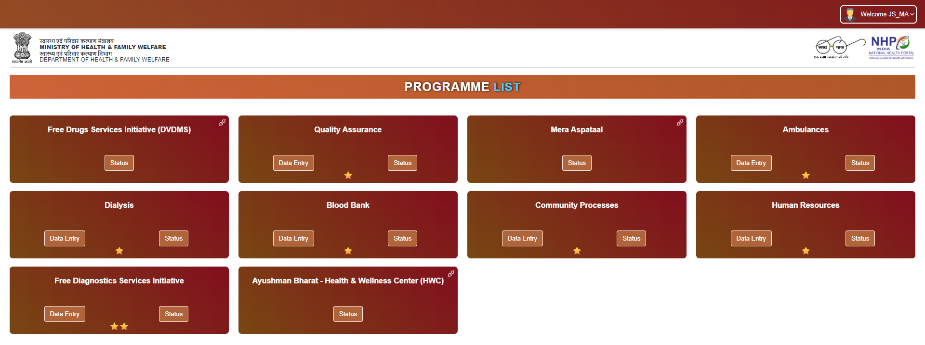
Central Health Dashboard
States to provide and update data for the following thematic areas on a regular basis:

Slide 65
Upcoming Events!!
13th Common Review Mission (16th – 23rd October, 2019)
  District 1: District with maximum no. of functional HWCs
  District 2: Aspirational District
6th Best Practices & Innovations Summit (16th – 18th November, 2019)
  Venue: Statue of Unity, Gujarat
  Best Practices to be uploaded on innovations portal latest by 23rd September, 2019.

Slide 66
