Slide 1
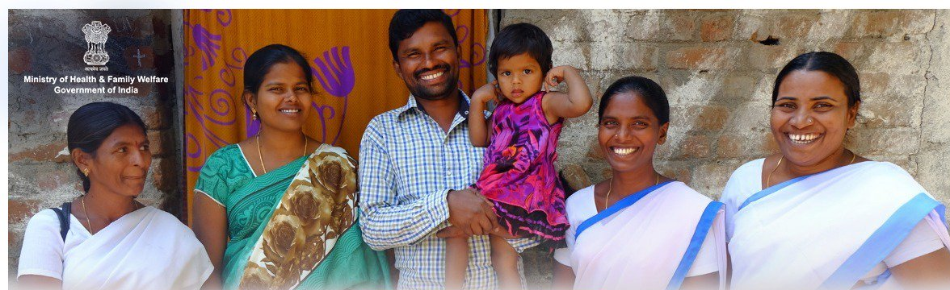

RMNCAH+N Quarterly Review
By:
Ms. Vandana Gurnani
JS (RCH), MoHFW, GoI

Slide 2
Outline of Presentation
Reproductive Health
Maternal Health
Child Health
Immunization
Adolescent Health
DBT & JSY
PCPNDT
MMP Cell

Slide 3





Demographic Scenario
Understanding our population
131 Crore +
People
2.7 Crore+
Deliveries/year
25.3 Crore+
Adolescents
Women (20-49 years), Child and Adolescent popul.
62%
Source: Census 2011
Notes:
Adolescents??

Slide 4
Key Achievements: RMNCAH Indicators
Infant Mortality Rate
States with IMR more than National Average | Madhya Pradesh, Assam, Arunachal P, Odisha, Uttar P, Meghalaya, Rajasthan, Chhattisgarh, Bihar
Other States with Slow decline in IMR as compared to National Average (2014-17)- 15.4% | Maharashtra, Karnataka, West Bengal, Gujarat, Jharkhand, Punjab, Uttarakhand, Goa, Tripura, Manipur, Lakshadweep, Daman & Diu
Target – 28 by 2019
Data Source: SRS

Slide 5
Key Achievements: RMNCAH Indicators
MATERNAL MORTALITY RATIO
MMR India – 130/ lakh live births
NHP Goal – 100 by 2020
MMR 100 or less | KL (46), MH (61), TN (66), AP (74), TG (81), GJ (91),
MMR 100-130 | WB (101), HR (101), KN (108), PB (122)
MMR 130-200 | Bihar (165), Jharkhand (165), Chhattisgarh (173), Madhya P (173), Odisha (180), Rajasthan (199)
MMR 200 above | Uttar Pradesh (201), Uttarakhand (201), Assam (237)
Assam, Bihar, Jharkhand, Madhya Pradesh, Chhattisgarh, Orissa, Rajasthan, Uttar P, Uttarakhand are expected to miss the NHP target of 100 by 2020

Slide 6
PPIUCD
Injectable Contrace-ptive MPA
FP-LMIS
Mission Parivar Vikas
REPRODUCTIVE HEALTH

Slide 7
Impact of Family Planning
In 2018, we estimate that with the use of contraceptives:
13.9+ Crores
5.44+ Crores
18.2+ Lakhs
23,000
Unintended pregnancies were
prevented
Unsafe Abortions were
averted
Women were using a
Modern Method of Contraception
Maternal deaths were
averted
1.10 crore total births averted
Notes:
139,620,000
54,421,000
10,884,000

Slide 8
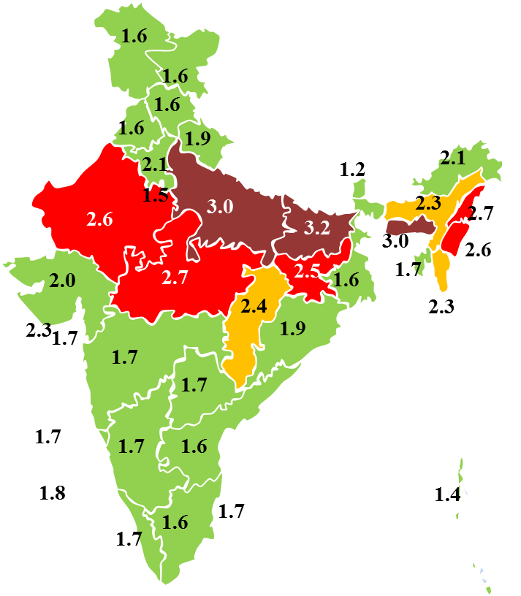
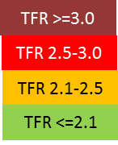
Total Fertility Rate
We have been able to achieve fertility decline
24 out of 36 States/ UTs have achieved replacement fertility level.
Bihar, Uttar P, Madhya P, Rajasthan, Jharkhand, Nagaland, Manipur, Meghalaya-will not reach 2.1 by 2025
Decline of 0.1 points reported in 16 states (from 2016 to 2017 (SRS)
AP, BH, CG, DL, HR, HP, JK, JH, KN, KL, MP, MH, OD, PB, RJ, UP
Source: SRS, NFHS
Notes:
22 states/UTs have unmet need for contraception higher than the national average:
Assam, Bihar, Chhatitsgarh, DNH, Daman Diu, Delhi, Goa, Gujarat, HP, JK, Jharkhand, Lakshadweep, Manipur, Meghalaya, Mizoram, Nagaland, Odisha, Sikkim, Tripura, UP, Uttrakhand, West Bengal
25 states/ UTs has shown an increase in Unmet need
Andaman and Nicobar, Arunachal P, Assam, Chhattisgarh, DNH, Daman Diu, Chandigarh, Delhi, Goa, Gujarat, Haryana, HP, Karnataka, Kerala, Lakshadweep, MP, Maharashtra, Manipur, Mizoram, Puducherry, Sikkim, Telangana, Tamil Nadu, Tripura, Uttrakhand

Slide 9
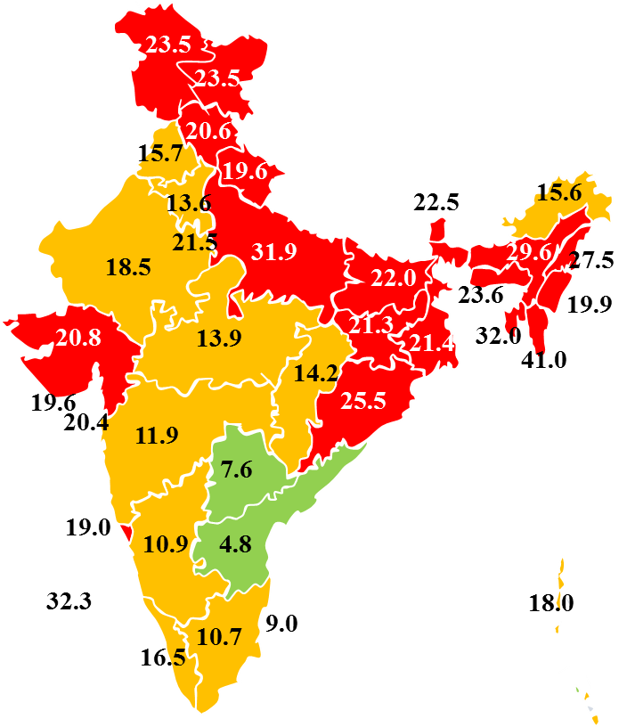
Improving Family Planning Services… Need of the hour
Still many challenges to address…
India: 18.6% unmet need-modern contraception.
25 states/ UTs shown an increase in Unmet need (NFHS 3 to NFHS 4)
AN, AR, AS, CG, DNH, DD, CD, DL, GO, GJ, HR, HP, KN, KL, LM, MP, MH, MN, MZ, PD, SK, TG, TN, TR, UK
UN Modern Contraception
>18.6
10.0-18.6
<10.0
Source: NFHS
Notes:
22 states/UTs have unmet need for contraception higher than the national average:
Assam, Bihar, Chhatitsgarh, DNH, Daman Diu, Delhi, Goa, Gujarat, HP, JK, Jharkhand, Lakshadweep, Manipur, Meghalaya, Mizoram, Nagaland, Odisha, Sikkim, Tripura, UP, Uttrakhand, West Bengal
25 states/ UTs has shown an increase in Unmet need
Andaman and Nicobar, Arunachal P, Assam, Chhattisgarh, DNH, Daman Diu, Chandigarh, Delhi, Goa, Gujarat, Haryana, HP, Karnataka, Kerala, Lakshadweep, MP, Maharashtra, Manipur, Mizoram, Puducherry, Sikkim, Telangana, Tamil Nadu, Tripura, Uttrakhand

Slide 10
Birth interval >36 months
50.3% births are adequately spaced (>36 months) in India (SRS 2017)
8 States
(HR, KN, CG, RJ, AP MP, TG, BH)
9 States
(MH, PB, HP, JK, GJ, TN, UP, JH, UK)
5 States
(AS, OR, WB, KL, DL)
<50.3% births are adequately spaced (>36 months)
50.3%-60% births are adequately spaced (>36 months)
>60% births are adequately spaced (>36 months)
Only 5 States have shown improvement in birth spacing in 2017 as compared to 2015 (MH,PJ,DL,KL,HP)
Source: SRS

Slide 11
PPIUCD Acceptance Rate
17 States
(LM, TR, MZ, GO, MG, NG, AP, DNH, TG, KL, JK, AR, MN, PD, HP, DD)
11 States
(SK, CD, AN, BH, UP, UK, KN, AS, MH, JH, GJ, CG)
5 States
(RJ, PB, MP, DL, OD)
3 States
(TN, WB, HR)
<10%
10%-15%
15%-25%
>25%
Source: HMIS
33 states and UTs are still below the National benchmark of 25%

Slide 12
Injectable MPA users per 1000 MWRA (Eligible Couples)-2018
21 States
(AP, MN, TR, DD, KL, TG, UK, MH, NG, PB, CG, MZ, OD, LM, GO, HR, HP, JH, KN, TN, PD, )
9 States
(AR, AS, GJ, UP, MG, MP, WB, AN, DL)
6 States
(JK, CD, RJ, BH, SK, DNH)
<0.5
0.5-1
>1
Source: HMIS
Family Planning Logistics Management Information System
Launched in 2017 to streamline the FP supply chain management system.
4 states/ UTs are yet to roll out trainings (AP, LM, DNH and AN)
Some yet to initiate even district level trainings (NG, MZ).

Slide 13
Mission Parivar Vikas- Program Performance
Mission Parivar Vikas
SN | State | % Facilities with condom boxes | Average Saas Bahu Sammelan per district | % Nayi Pahel Kits distributed
1 | Assam | 100 | 1668 | 96.1
2 | Bihar | 71 | 1204 | 82.1
3 | Chhattisgarh | 64 | 183 | 50.0
4 | Jharkhand | 97 | 694 | 22.7
5 | Madhya Pradesh | 71 | 1369 | 94.3
6 | Rajasthan | 91 | 1127 | NA
7 | Uttar Pradesh | 51 | 1447 | 88.1
 |  | < 60 | < 500 | < 50
 |  | 60 - 80 | 500 - 1000 | 50 - 80
 |  | > 80 | > 1000 | > 80

Slide 14
Contd… Mission Parivar Vikas- Program Performance
Name of the State | PPIUCD Percentage increase | PAIUCD Percentage increase | Injectable Percentage increase
Assam | 51.7 | 494.4 | 3598.7
Bihar | 4.6 | 43.9 | 1443.7
Chhattisgarh | 25.2 | 361.2 | 203.6
Jharkhand | -10.6 | 14.6 | 435.8
Madhya Pradesh | 1.6 | 88.0 | 683.1
Rajasthan | 36.1 | 169.9 | 480.3
Uttar Pradesh | -0.5 | -15.7 | 832
Declined
Stagnant
Improved
Focus on quality of IUCD and Injectable services and minimize discontinuation/ drop out rates
Ensure availability of IUCD and MPA cards

Slide 15
PMSMA
MIDWIFERY
LAQSHYA
MATERNAL HEALTH

Slide 16
LaQshya
Total facilities identified: 2441
Medical colleges: 193 , District Hospitals: 606 , SDH: 450, CHC:753, Others: 439 (including 339 PHCs)
Certification status | LR | OT
State | 16.5% | 15.2%
National | 4.2% | 3.4%
States with Less than 25% Facilities included in LaQshya (out of total facilities *)
West Bengal
Odisha
Jammu & Kashmir
Delhi
Madhya Pradesh
Nagaland
Punjab
Kerala
Rajasthan
Himachal Pradesh
Meghalaya
Arunachal Pradesh
Sikkim
Lakshadweep
Notes:
Smaller states: States/UTs with total facilities >=15
Larger states: State with total facilities >15
* Total facilities : Medical college + District hospitals+ Sub District hospitals+ CHCs

Slide 17
LaQshya Certification Status
No state/national certification
Andaman Nicobar Islands
Lakshdweep Meghalaya
Sikkim
West Bengal
Only State certification but no National Certification
Arunachal Pradesh Chandigarh
Daman & Diu
Delhi
Goa
Jammu & Kashmir Karnataka
Manipur
Mizoram
Nagaland
Puducherry
Tripura
Less than 25% facilities state or nationally certified
Andhra P
Bihar Himachal P Jharkhand Kerala Odisha Rajasthan Uttar Pradesh Uttarakhand
More than 25% facilities state or nationally certified
Assam Chhattisgarh
Dadra N Haveli Gujarat
Haryana Madhya P
Maharashtra Punjab Tamil Nadu
Telangana
Notes:
The teams in the Labour rooms and Maternity OT’s at Medical Colleges, District Hospitals and SDH/CHCs will get incentives of Rs. 6 Lakhs, 3 Lakhs and 2 Lakhs (for each department) respectively on achievement of following criteria:
Quality Certification of Labour Room and/or OT as per protocol under the NQAS.
Attainment of at least of 75% of commensurate facility level targets and its verification by the SQAC. List of such verifiable indicators the facility, its source and means of verification is given in Annexure ‘C’ in LaQshya guidelines.
80% of the beneficiaries are either satisfied or highly satisfied (or Equivalent score > 4 on Likert scale).
This incentive is recognition of the good work done by the quality circles and facility’s quality team. This amount can be used as cash incentive to the staff and also for the welfare activities

Slide 18
Pradhan Mantri Surakshit Matritva Abhiyan
% of PW received PMSMA- 2018-19 | Mizoram (17%) Jharkhand (12%) Sikkim (10%) Manipur (10%) Meghalaya (9%) Assam (8%) | Uttar Pradesh (8%) Uttarakhand (7%) Arunachal Pradesh (6%) Tripura (5%) Nagaland (2%)
% of HRP Detected during PMSMA- 2018-19 | Arunachal Pradesh (9%) Jharkhand (8%) Chhattisgarh (7%) Meghalaya (7%) Madhya Pradesh (7%) Uttarakhand (6%) | Odisha (6%) Assam (5%) Bihar (4%) Manipur (3%) Sikkim (3%) Mizoram (2%)

Slide 19
PMSMA & LaQshya
LaQshya:
Expedite the process of LaQshya National Certification
Facilities that have achieved National Certification must focus on claiming incentives
Plan for roll out of LaQshya at all Medical Colleges, District Hospitals, SDH and CHCs
Medical Colleges trained by National Mentors to act as State Mentoring Resource Centre
Strengthen state and district level LaQshya mentoring
PMSMA:
Focus on ensuring comprehensive and quality ANC on PMSMA sites
Self-assessment of all PMSMA Facilities to be completed by Sep’19

Slide 20
Roll out of Midwifery Initiative
Expedite Selection of Midwifery Educators for 1st Batch of Midwifery Educator Training
Assam
Haryana
Jammu & Kashmir
Jharkhand
Karnataka
Maharashtra
Uttarakhand
Meghalaya
Mizoram
10. Andhra Pradesh
11. Himachal Pradesh
12. Manipur
13. Odisha
14. Sikkim
15. Uttar Pradesh
16. West Bengal
All States must ensure selection by 1st October 2019

Slide 21
Newborn Health
Nutrition
New Initiatives – Anaemia Mukt Bharat
RBSK
CHILD HEALTH

Slide 22
Newborn Health
Facility Based Newborn Care
  9 Aspirational Districts without SNCU (JH-5, TG-2, UP-1, UK-1)
  Higher proportion of reported adverse outcome (mortality, LAMA and Referral) - >30% in the States of UP, UK, MN, BH and JH.
  State of PB, KL, DL, LM, A & N need to ensure regular reporting in SNCU Online Portal
Community Based Newborn Care
  HBNC- <50% Coverage - KN(49%), MH (45%), NG(38%) and AR(19%)
  HBYC- State/UT level ToTs pending in AP, CG, TG, DNH, DD
  Only 9 States have started HBYC trainings–J&K, MH, MP, MN, MG, MZ, NG, PB and SK.
Consider MNCU at better performing and high case load units in order to ensure Zero Separation

Slide 23
Nutrition: MAA, NRC, Diarrhoea, Pneumonia
  Capacity building of Health Care Providers at Delivery points to be done on priority as early breastfeeding rate (42%) are lower than institutional delivery (78.9%) at National level
  Coverage during IDCF in July 2019 was <50% in Maharashtra (42%), Kerala (48%) and Lakshadweep (30%)
  Most of the NRCs are under-utilized, consider converting/merging these into Paediatric units
  New VHSND guidelines released with focussed attention on group counselling with specific themes identified for every month
  New ARI guidelines with introduction of Amoxicillin in place of Cotrimoxazole are under finalization

Slide 24
Rashtriya Bal Swasthya Karyakram (RBSK)
  Screening at AWC (0-3 Years):
    17% reported average at National level (Expected: 50%)
    <10% coverage in States of HP, JH, JK, RJ, MN, NG and PB
  Comprehensive newborn screening to be initiated in CG, RJ, DL, A&N, LM
  District Early Intervention Centres (DEICs)- Most have shortage of Critical trained HR and Equipment
  Printing of Revised MCP card and establishment of ECD Call Centre to be prioritized
  Screening for TB and Leprosy included under RBSK screening protocol

Slide 25
Anemia Mukt Bharat (AMB)
  Rolled out in 9 states- BH, CG, JH, MP, RJ, UP, MG, MH and PB
  Reporting on dashboard-
    National coverage for children 6-59 months: <10%
    Reporting errors - Coverage >100% across all age groups in Andhra Pradesh, Odisha and Dadra & Nagar Haveli
  Low coverage of NDD round held in February, 2019 in the State of Arunachal P(61%), Andhra P (52%), Maharashtra (61%), Chandigarh (52%), Delhi (51%) and Daman & Diu(48%)
  Anemia Test, Treat and Talk (T3) camps to be organized in schools and colleges for Adolescents and also during POSHAN Maah

Slide 26
Routine Immunization
IMI 2.0
Diphtheria
Rotavirus Vaccination
IMMUNIZATION

Slide 27
Intensified Mission Indradhanush(IMI) 2.0
OBJECTIVE
Achieving & Sustaining 90% FIC through Immunization system strengthening
IMI 2.0 is being planned as per road-map for achieving 90% FIC across the country.
4 rounds of IMI being planned - December 2019 to March 2020 in:
  271 districts across 27 States /UTs
  652 Blocks in 109 districts of 2 states (UP & Bihar)
Selection of districts/ blocks based on:
  Coverage data from HMIS, Surveys, and Concurrent monitoring
  Vaccine Preventable Diseases (VPDs) Surveillance data
  Aspirational districts

Slide 28
Activities in Four Phases
INTENSIFIED MISSION INDRADHANUSH (IMI 2.0)
1
Evidence generation & Planning Phase- Sep – Nov 2019
2
MI Campaign Phase to cover left outs and drop outs through IMI days - Dec 2019 to March 2020
3
System Strengthening Phase for Routine Immunization – April 2020
4
Evaluation Phase – May-Jun 2020

Slide 29
Strengthening of Routine Immunization (RI)
Development of quality microplans to ensure that all areas are covered.
  Ensure Mother & Child Protection (MCP) card retention with the beneficiaries and regular updation
  Regular updation of RCH portal
Strengthening the capacity of HR :
  BRIDGE (Boosting Routine Immunization Demand Generation & Expansion) training
    Initiative to equip the front line workers (ANMS, AWW & ASHA) to conduct effective IPC (Inter-personal communication) and address vaccine hesitancy
  Delays in training in:
    KL, KA, J & K
    DL, HR, PB, UK, HP, RJ, SK, JH and AS (ToTs completed but no information on FLW trainings)

Slide 30
Measles/ MR-1 & Measles/MR-2 Coverage
Goal: To eliminate measles and rubella / CRS by 2023
Strategy: to achieve and maintain at least 95% MCV-1 & MCV-2 coverage under RI
States with < 85% MCV-1 coverage: | AR, BH, D&D, HP, MP, MG, MZ, NG, OD, PB, PD, RJ & SK
States with < 85% MCV-2 coverage: | A&N, AS, AR, CH, CG, DNH, HP, KL, MZ, HP, PB, MH, GJ, OD, BH, HR, SK, TR, RJ, UP, TN, MG, MP, PD, MN, JH, D&D
States with > 30% drop out from MCV-1 to MCV-2 | A&N, J&K, GJ, JH, LM, MN, TN, TR, TL, & UP
(Source HMIS 2018-19)
After successful MR campaign, if coverage is not maintained at > 95% for both the doses , we will miss the target

Slide 31
Rotavirus Vaccine (RVV) Expansion
The target of achieving country wide roll out of RVV within the first 100 days of the new Govt. achieved successfully
Rotavirus vaccine was introduced in India in March 2016, and currently all the states have introduced RVV under their immunization programme.
However, the states are required to ensure full coverage in each block upto the last mile, of the newly introduced vaccine and ensure that not even a single child remains unvaccinated.

Slide 32
Strengthening Td vaccine operationalization
Increase in immunization coverage in children led to shift in age-group of diphtheria cases to school going children and adults.
Tetanus and adult Diphtheria (Td) vaccine to replace 2 doses of TT or single booster dose of TT given to pregnant woman and booster doses at 10 and 16 years of age.
Available TT stock should be used first before using Td under UIP schedule. TT should not be recalled or discarded.
The states need to ensure that all districts switch to Td vaccine in RI sessions.

Slide 33
Management of Diphtheria
States to ensure:
  Strengthening routine immunization in all areas specially areas which reported outbreaks
  Availability of Anti Diphtheria serum at health facilities
  Assured referral linkages for management of Diphtheria cases
  Capacity building of the concerned personnel for effective management of outbreak and cases.

Slide 34
WIFS
Peer Educator
School Health Programme
AFHCs
ADOLESCENT HEALTH

Slide 35
Performance - Adolescent Friendly Health Clinics (AFHCs)
7736 AFHCs are functional
States/UT wise performance is as below
(Figures in lakh)
States with > 150 Clients per month | UP, MH, WB, HR, UK, Goa , DNH and SK
States with < 150 Clients (Sub Optimal Utilization) | BH, OD, RJ, TN, TG AS, CG, PB, GJ, KN, MP, TR, KL, HP, JK, JH, AR, MN, MG, MZ, DL NG, CD, DD, PD and A&N.
Suboptimal utilization is due to low demand generation and inadequate AH Counselors.

Slide 36
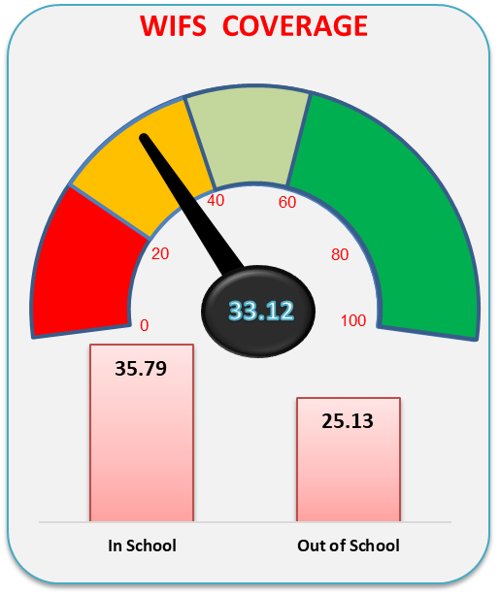
WIFS coverage
National average of WIFS is 37.4%. The performance of the States/UTs is as below:
% WIFS COVERAGE FY 19-20 (Q1)
States with > 80% Coverage | AP, TG, PD, Goa & SK
States with 40 to 80% Coverage | UP, MP, TN, MH, GJ, JH, AS, HR, PB, DL, UK, MN DNH and A&N
States with < 40% Coverage | BH, WB, OD, RJ, KN, KL, TR, MZ, MG, NG, CD, and DD
37.4
38.6
32.5
IFA Stock outs reported in KN, UK, AR, MN in FY 2018-19
The coverage may be improved through better convergence and ensuring availability of IFA and intensified demand generation.

Slide 37
School Health Programme to be launched shortly
Growing Up Healthy
Emotional Well-being and Mental Health
Gender Equality
Interpersonal Relationships
Nutrition, Health and Sanitation
Prevention and Management of Substance Misuse
Promotion of Healthy Life Style
Reproductive Health and HIV Prevention
Safety and Security Against Violence and Injuries
Values and Responsible Citizenship
Promotion of Safe Use of Internet and Social Media Behaviors
Two teachers in every school designated as “Health & Wellness Ambassadors” will be trained in a 24-hour curriculum (24 sessions – 1 hr/ session) to transact age appropriate, culturally sensitive activity based weekly sessions
Existing infrastructure of School Education Department will be used for capacity building of Health and Wellness Ambassadors

Slide 38
PCPNDT
Performance Indicators for PNDT

Slide 39
PCPNDT
Highlights of SRS 2017
Sex ratio at Birth declined in 14 states and improved in 8 states (from 2016 to 2017)
Haryana and Chhattisgarh recorded the lowest and highest SRB of 833 and 961 respectively.
Tracking of SRB as per Civil Registration System: 14 states have not started data entry (AR, JH, MP, MH, MN, MZ, NG, SK, TN, UK, UP, A&N, LM, PD)
Capacity building of appropriate authorities: 13 states have not started training program (AR, AS, J&K, JH, MP, MN, MG, PB, SK, TN, WB, LM, PD)
Online maintenance of records (form F): only 18 states have developed the mechanism (AP, CG, Goa, GJ, HR, HP, J & K, JH, KR, MP, MH, OD, RJ, TG, TR, UP, D. & NH and Delhi)
Max. decline
Kerala- by 11 points
Odisha- by 10 points
Uttarakhand- By 9 points
Max. improvement:
Assam- by 19 points
J&K- by 11 points

Slide 40
ANMOL
Kilkari & Mobile Academy
MCTFC
RCH Portal
MMP Cell

Slide 41
RCH Portal - Implementation Status (FY 2019-20)
State Performance (% on pro rata Basis) | Pregnant Women Registration | Child Registration
>70% | DL, HP, KN, KL, MH, MZ, PD, PB, TR | DL, KN, KL, MZ
70%-40% | AR, AS, CD, CG, DNH, DD, GO, HR, JK, MP, MN, MG, OD,SK,UK,WB | AR,CH,CG,DNH,GO,HR,HP,JK,MH,PB,TR,WB
<40% | AP, AN, BH, GJ, JH, LM, NG, TG, UP | AP, AN, AS, BH, DD, GJ, JH, LM, MP, MN, MG, NG, OR, PD, SK, TG, UP, UK
RCH register should be implemented at field level
Ensure Health sub-facilities and User are reporting in RCH portal
Data as on 17th September, 2019

Slide 42
Kilkari/ Mobile Academy/ MCTFC
Kilkari and Mobile Academy:-
Trainings at districts/blocks to be conducted
Timely distribution of Mobile Academy course completion certificate
Ensure Mobile Number data accuracy in MCTS/RCH Portal.
MCTFC
States to ensure that correct mobile numbers of PW/ASHAs and ANMs are provided

Slide 43
JSY and PMMVY
Updation of JSY Beneficiary details into PMMVY – CAS software

Slide 44
PMMVY & JSY Beneficiaries updation into PMMVY-CAS software
Total pendency = 65 lakhs
In 16 states where data backlog > 1 Lakh. (UP, RJ, MH, MP, WB, BH, KR, KE, AP, GJ, HR AS, JH, CH, TN and PB)
16 states - Constitute 95% of the total pendency at National level
Data of JSY beneficiaries not being adequately entered.
States/UTs to take up ‘One time Special Drive’ to update the backlog as per the SoP issued.
All States/UTs to complete the backlog latest by 20th Oct, 2019.
27 lakhs (i.e. 42%) is the pendency of 10 Health States/UTs - [UP, MH, WB, AP, TN, MG, D&NH, D&D, TG and Chandigarh]

Slide 45
Direct Benefit Transfer (DBT)
Reporting on DBT Health portal

Slide 46
STATUS OF DBT REPORTING INTO DBT HEALTH PORTAL
DBT Health Portal used by the States/UTs which allows direct reporting of DBT data for JSY, ASHAs, Family Planning, JSSK and Contractual staff payments.
States DBT Nodal officers to report DBT progress latest by 5th day of every month.
Lakshadweep to start DBT reporting [No reporting in FY 18-19 & FY 19-20].
NOTE: NATIONAL ABSTRACT
100% Reporting till August by 12 States. | 12 | Arunachal Pradesh; Bihar; Chandigarh; Daman Diu; Jharkhand; Karnataka; Maharashtra; Puducherry; Punjab; Tamil Nadu; Uttarakhand; West Bengal.
Not reported for August only by 14 states. | 14 | Andaman Nicobar Islands; Chhattisgarh; Dadra Nagar Haveli; Goa; Gujarat; Haryana; Himachal Pradesh; Jammu and Kashmir; Kerala; Madhya Pradesh; Meghalaya; Odisha; Telangana; Tripura.
Not reported for more than 2 months including August by 09 states. | 9 | Andhra Pradesh; Assam; Delhi; Manipur; Mizoram; Nagaland; Rajasthan; Sikkim; Uttar Pradesh.

Slide 47
Implementation of RMNCH+A Priorities in Medical Colleges
Medical Colleges – A Critical Platform for delivery of RMNCH+A services
Departments of Medical Education and Departments of Health to:
  Plan for Orientation of Medical Colleges on RMNCH+A programmes
  Plan for implementation of programmes in Medical Colleges – LaQshya, JSSK, SNCUs etc
  Prepare State level Plan for Mentoring of DH through Medical Colleges
  Medical Colleges to support Maternal , Perinatal and Child Death Reviews as well as Referral Audits
  Community Medicine, Obs/ Gynae and Pediatric Departments of MCs to focus on research on National Health Programmes.

Slide 48
“Health of mothers will determine the health of our children. Health of children will determine the health of our tomorrow”
- Shri Narendra Modi
PM Modi during Partners’ Forum 2018

