Slide 1


Effective HR Initiatives:
Odisha Experience
Presented by:
Secretary,
Health & FW Deptt., Odisha

Slide 2
HRH Initiatives
New Medical Colleges
4 no. of new Medical Colleges have been established.
Another 6 Medical Colleges are in pipeline.
Provision of incentives to Faculties of Medical Colleges
  Assistant Professor- Rs.35,000/- to Rs.50,000/-
  Associate Professor- Rs.25,000/- to Rs.1,00,000/-
  Professor- Rs.15,000/- to Rs.1,25,000/-
  In addition to the above incentives, Pre and Para Clinical Faculty get additional Incentives of Rs. 20,000/-
  Post Graduation Diploma
  MoU signed with College of Physicians and Surgeons of Mumbai
  During 2018-2019, 47 MBBS Doctors have been enrolled in various specialties (09 disciplines) in 11 DHHs
  Counselling for 2019-20 is under process

Slide 3
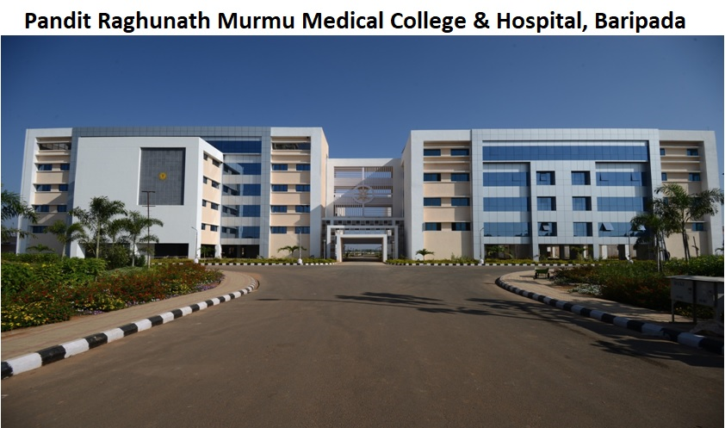
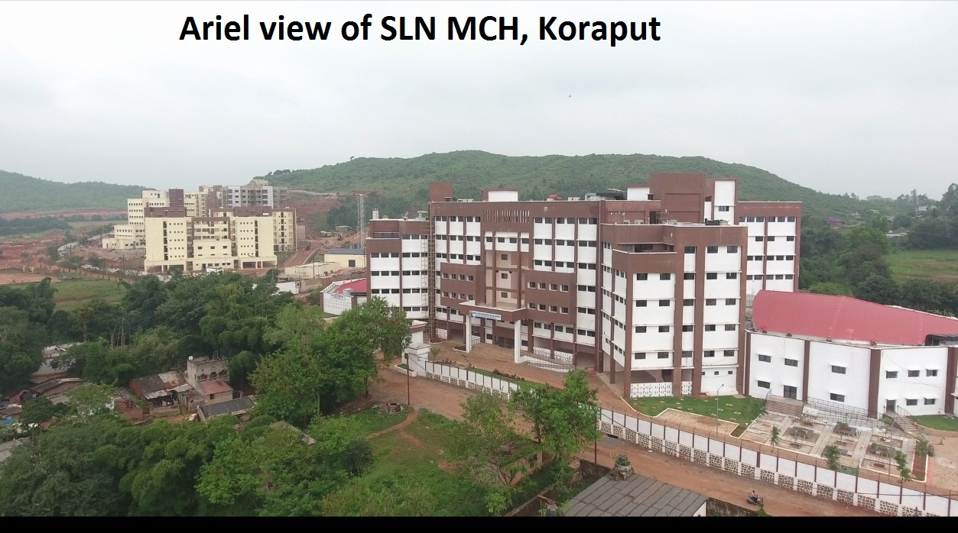
New Medical Colleges
SLN MCH Koraput

Slide 4
Incentive & Allowances
Specialists Incentives
Doctors with Super Specialization from Medical Colleges (MCI Recognised) : Rs.30,000/-
Doctors with Post-graduation from Medical Colleges (MCI Recognised) : Rs.20,000/-
Incentive for Doctors with Post- graduate Diploma recognized by GoO: Rs.10,000 /-
Place Based Incentive (Doctors in Difficult Institutions) - General (MBBS) doctors
working in V4 CHCs and PHCs get Rs 40,000/- as incentive whereas a specialist working in
V4 CHC gets Rs 80000/- as incentive.
Dynamic Assured Career Progression (DACP) Scheme introduced (Three (03) assured
promotions i.e., after 07 years, 14 years and 21 years of service counted from the direct entry
level has been implemented)
Counselling process for posting and Exit Policy in place
Additional weight-age for PG entrance for working in difficult Institutions (V1 to V4)

Slide 5
Creation of Positions
Doctor Positions
OMHS Cadre restructured with creation of 1330 new posts as per IPHS norms
578 posts have been identified as Public Health posts
2000 posts of LTRMO have been created to take care of the vacancies
Each CHC has 4 posts of specialists, one each in O&G, Paediatrics, Medicine and Surgery.
Paramedic Positions
Regularisation of services of Nurses and other Paramedics engaged on contractual basis under different schemes.
Creation of 26000 posts of Paramedics (Pharmacist, Multi Purpose Health Workers, Radiographers and Laboratory Technicians )as per IPHS norms are under process
Corpus fund (For KBK+ Districts)& DMF Fund used for engagement of Doctors as per
need

Slide 6
Availability of Medical Officers in KBK/KBK+ districts
26%

Slide 7
Thank you

