Slide 1
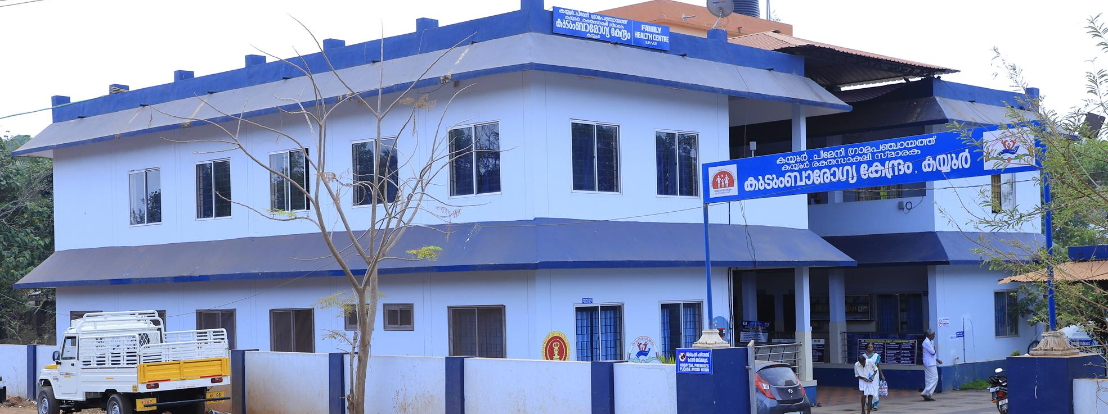
Family Health Centres kerala

Slide 2
Family Health Centres
Caters to a population of 20000 to 30000
Provides curative care, preventive and promotive care, rehabilitative and palliative care to its beneficiaries
Hub for coordination of all public health activities in an LSG area
Reinvigoration of “Family Doctor” concept
Supervision & support of spokes (Sub centres)
Continuity of care established through e- health mechanism

Slide 3
Pregnancy & Child CARE
Pre-conceptional Folic Acid supplementation to married couple
Early antenatal registration at Sub Centres
Diagnosis of high risk pregnancies at FHC level
NST at Family Health Centres using portable USGs
Screening for 4Ds by trained RBSK nurses & mobile health teams in all LSG areas through Anganwadis, play schools, immunisation points, etc
Referral to DEIC for diagnosis and initial management
Follow-up & management of complications

Slide 4

Management of NCDs
Workplace NCD screening through PHCs & Sub Centres
Universal population based NCD screening through Sub Centres & PHCs
  Risk assessment by ASHA using Customised forms & e-Health NCD application.
  Neighbourhood NCD camps by ANM & Male HW once per month. ASHA to support.
  Diagnosis & Management through PHCs/CHCs.
Tracking of diagnosed patients through patient cards & patient books
  Tickler box system as part of India Hypertension Management Initiative
Screening for Diabetic Retinopathy (Nayanamritham)
  Teleconsultation with Regional Institute of Ophthalmology using non-mydriatic fundus camera

Slide 5
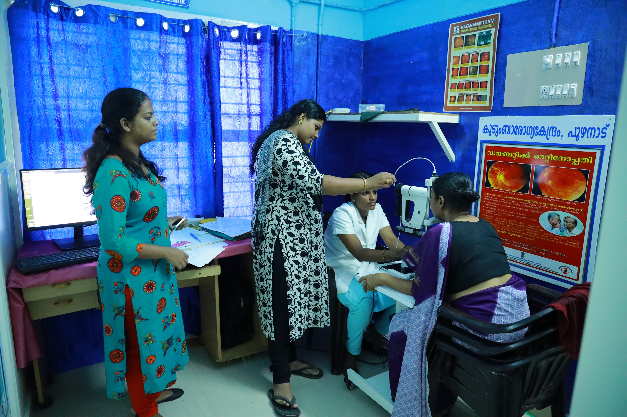
Nayanamritam: Screening for Diabetic Retinopathy

Slide 6

Mental Health
Sampoorna Manasikarogyam - Population survey using PHQ9 questionnnaire to identify those in high risk of depression
  Conducted by ASHA (using Malayalam questionnaire)
  Confirmation of diagnosis through fixed day mental health clinics at FHCs (DMHP teams)
  Follow up care through FHCs, Subcentres
Aswaas clinics - fixed day depression clinics at FHCs
  Manned by trained MPW
Amma Manass - Identification of post-partum depression & maternal mental health issues through trained ANMs
School Mental Health Program - Identification of children in need of support

Slide 7
Community based management of communicable diseases
Arogya Jagratha Campaign
Community mobilisation for mosquito source reduction
Water source chlorination
Waste management & Environment management
Promoting environment consciousness
Cadre of non-remunerated community health volunteers: Arogya Sena

Slide 8
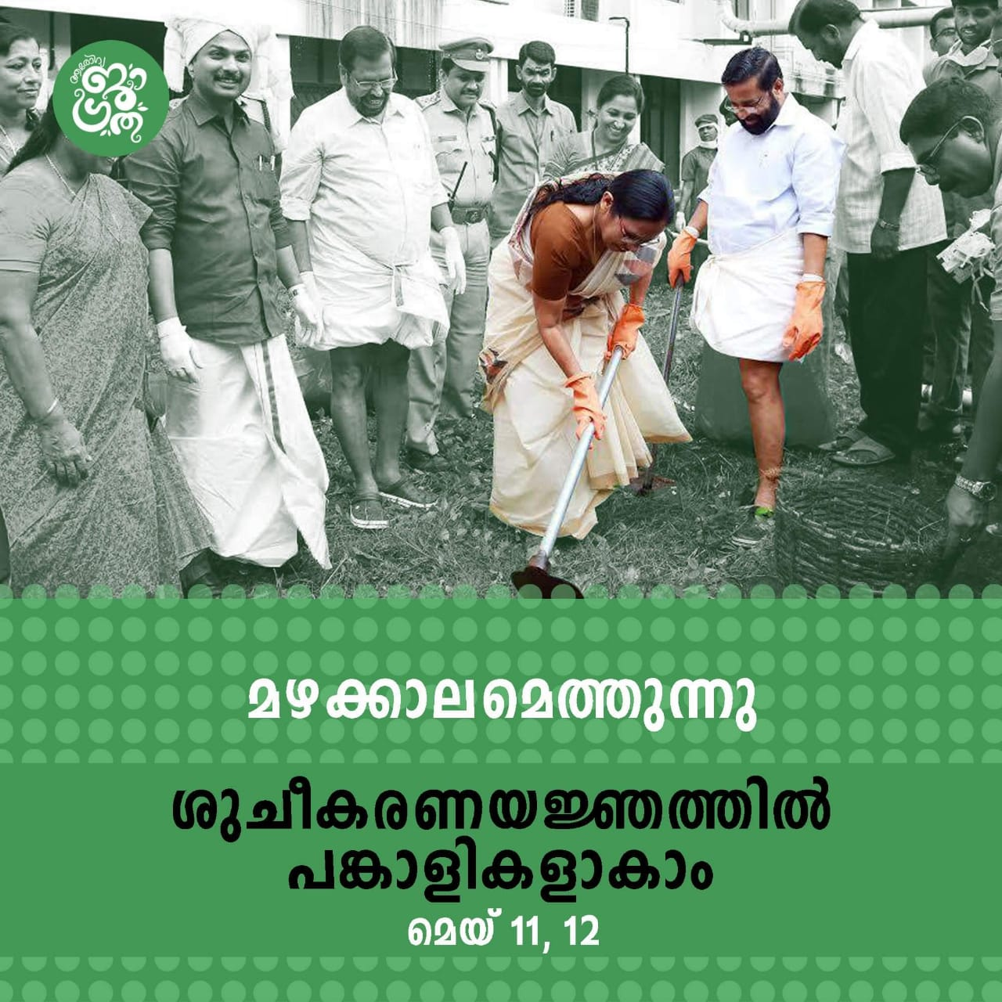
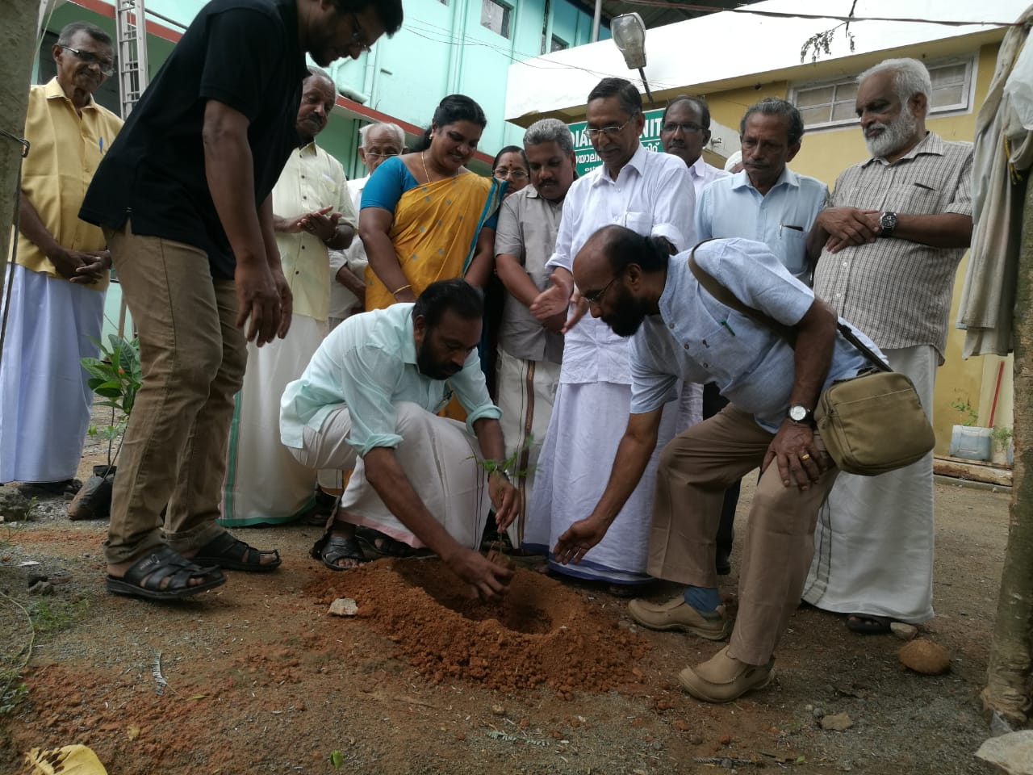
Rainy season coming
We can participate in the cleaning drive

Slide 9

Wellness
Play areas at workplaces
Yoga training
Cycling tracks & walkways around FHCs
Junk food Junglee campaign in association with Food Safety Department to promote healthy eating habits

Slide 10
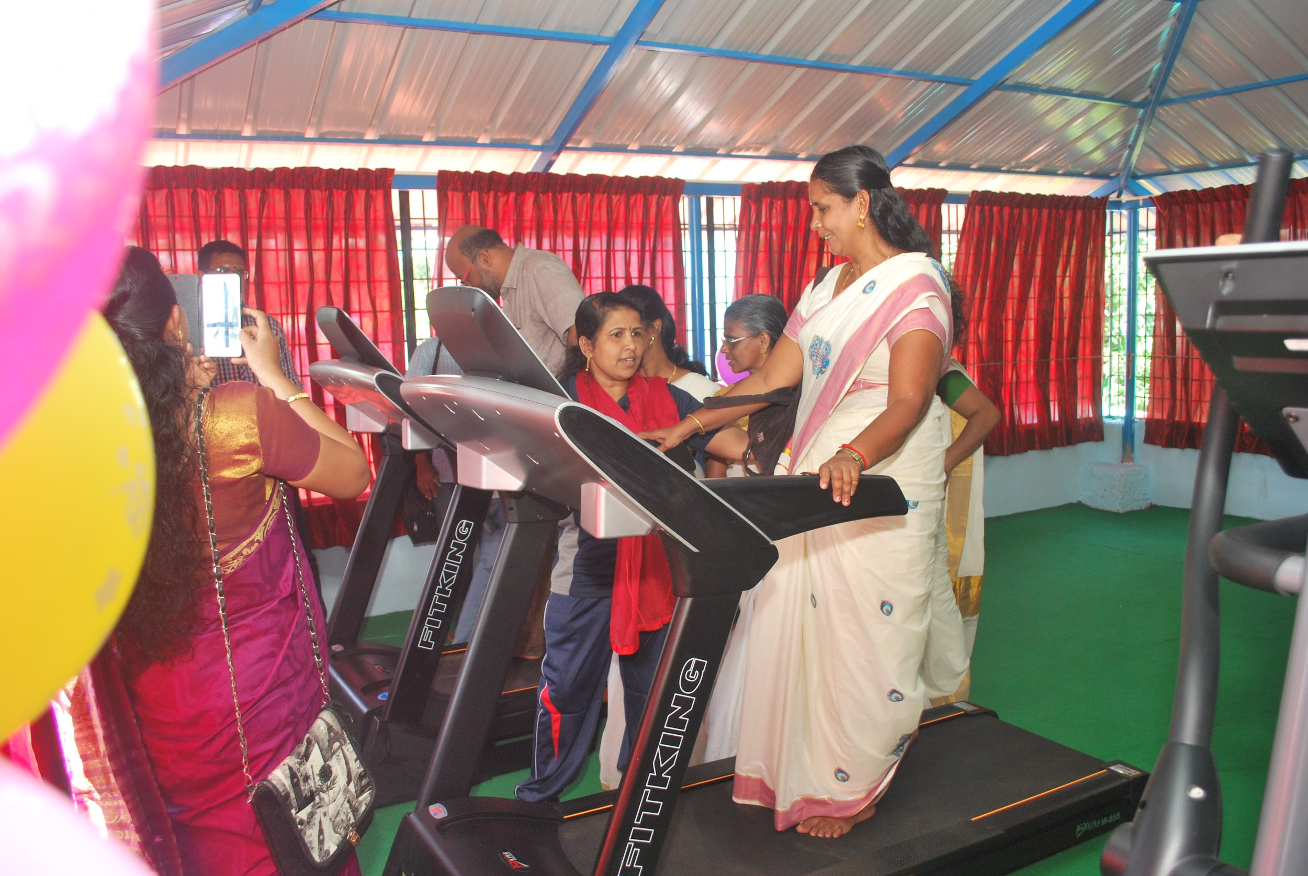
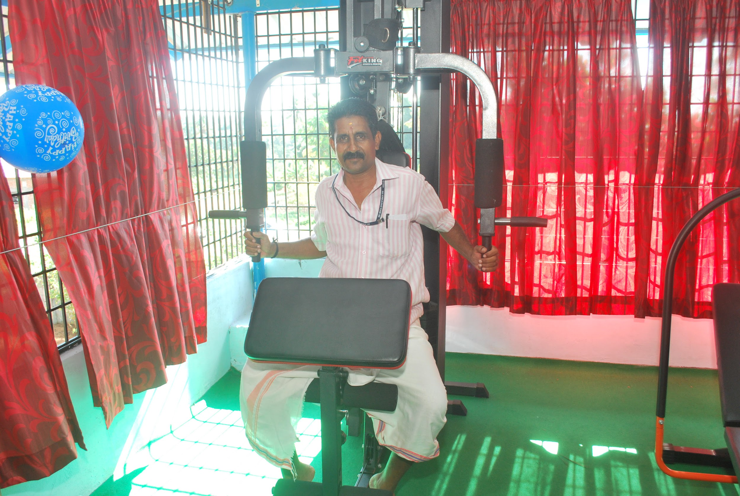
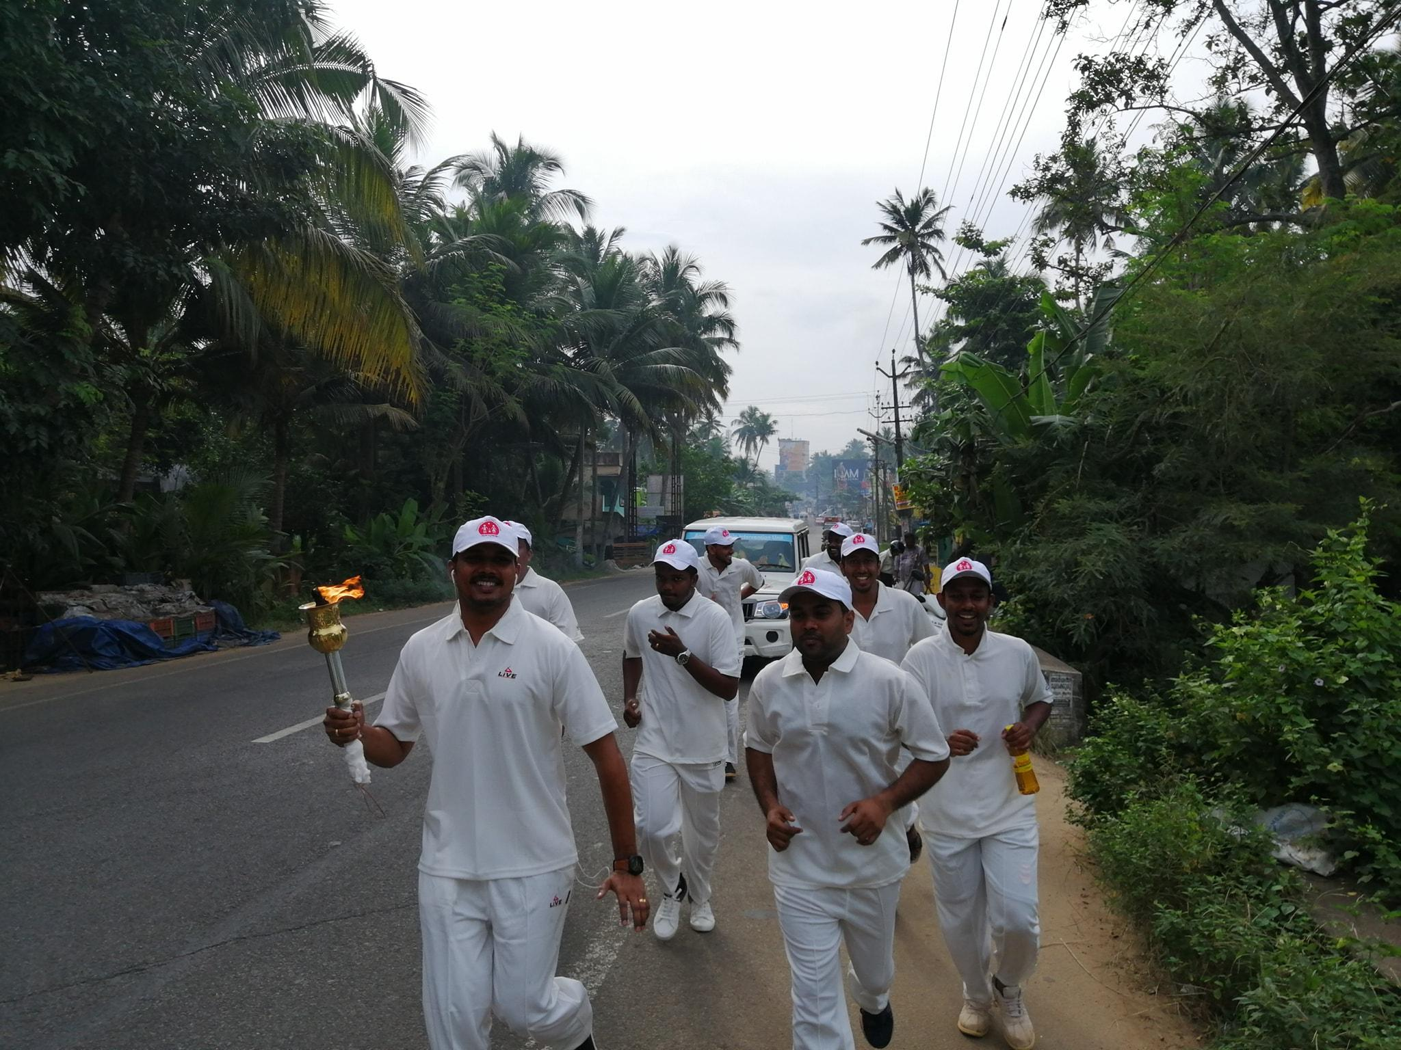
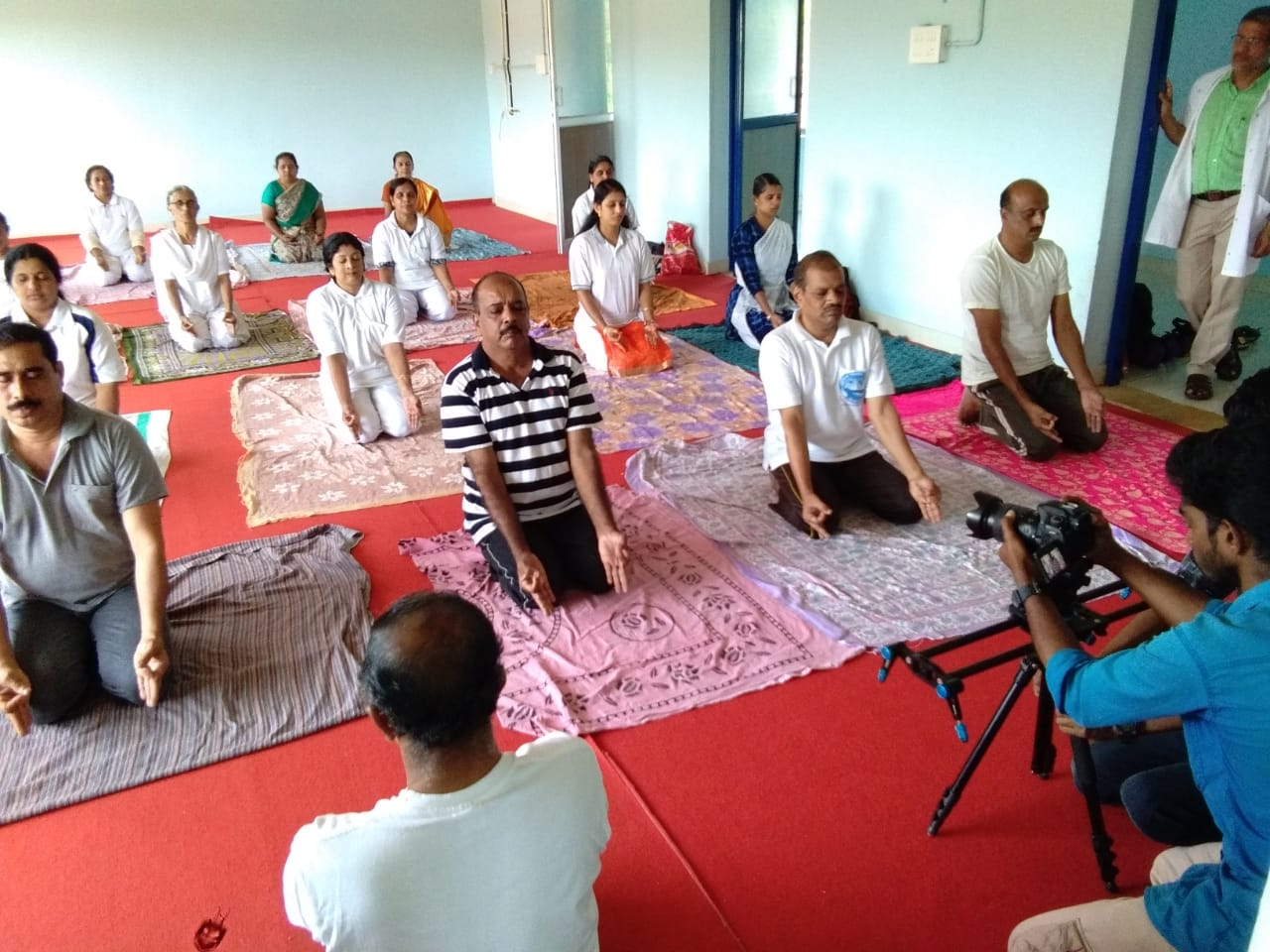
Wellness activities in various FHCs

Slide 11
Palliative Care
Project owned by LSG
Implemented through MO in charge of health institution
Trained ANMs (3 months training) in every PHC/panchayat
Home based palliative care for 16 days in a month
Remaining are OP days
Provision for consumables (incl catheters, colostomy bags, ryles tube etc), drugs, mobility support & honorarium
Training of Arogya Sena volunteers & self help groups for community assistance in palliative care
Community patient support for non-medical needs

Slide 12
e-Health in Kerala
Public Health Module
Operational across the state
Population enumeration - Unique Health ID for each person
Virtual family folders
Tracking of communicable diseases with geolocation
e-Health NCD module for population based screening (data sharing with national app)
Hospital Module
Currently in Pilot phase
Patient registration
Online appointments
Queue management
Paper-less prescription and drug dispensation
Facilitates referral & back-referral

Slide 13
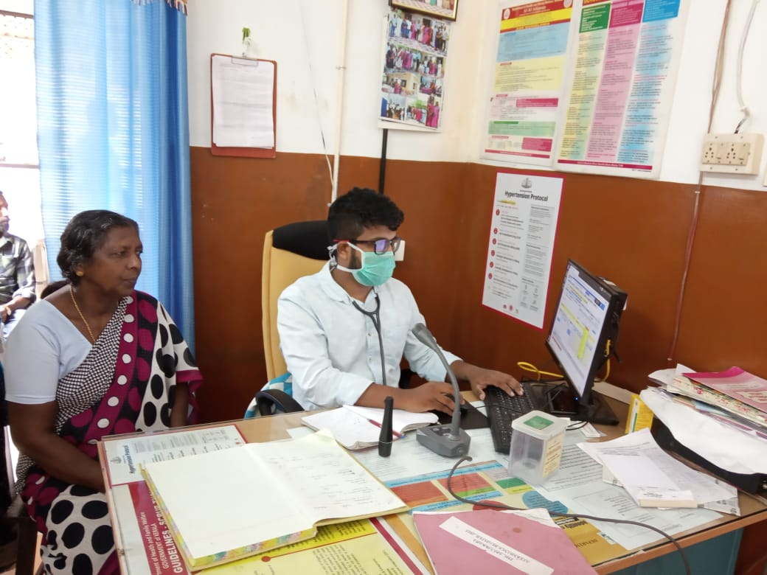
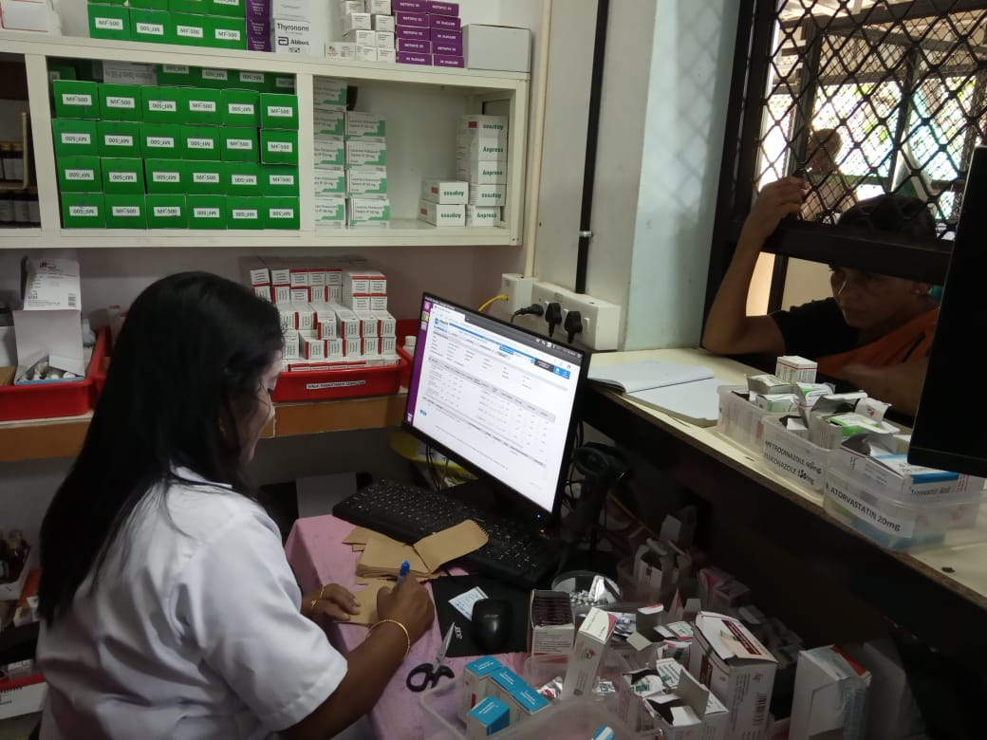
e-Health Implementation in Kerala - OPD and pharmacy

Slide 14
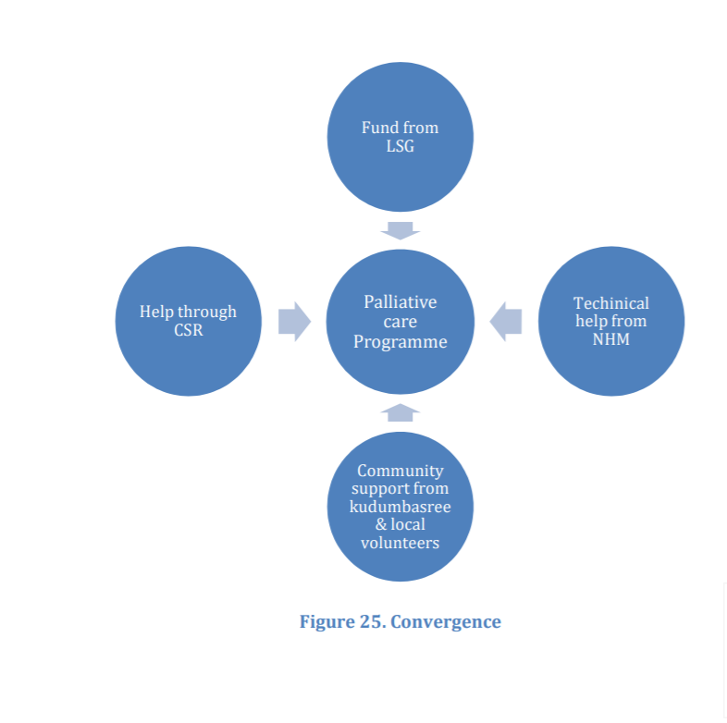
Demand generation with PRI involvement
PRIs actively involve in the functioning of FHCs
Service delivery & Infrastructure augmented with PRI support
Ward Health Review
  Ward level health review by PRI member, ANM, ASHA and ArogyaSena Volunteers
  Monthly meeting
Panchayat Health Review
  Institutional mechanism for interdepartmental coordination
  Once per month
  ASHAs, PRI members, Medical Officers of all cadres
  Other allied departments

Slide 15
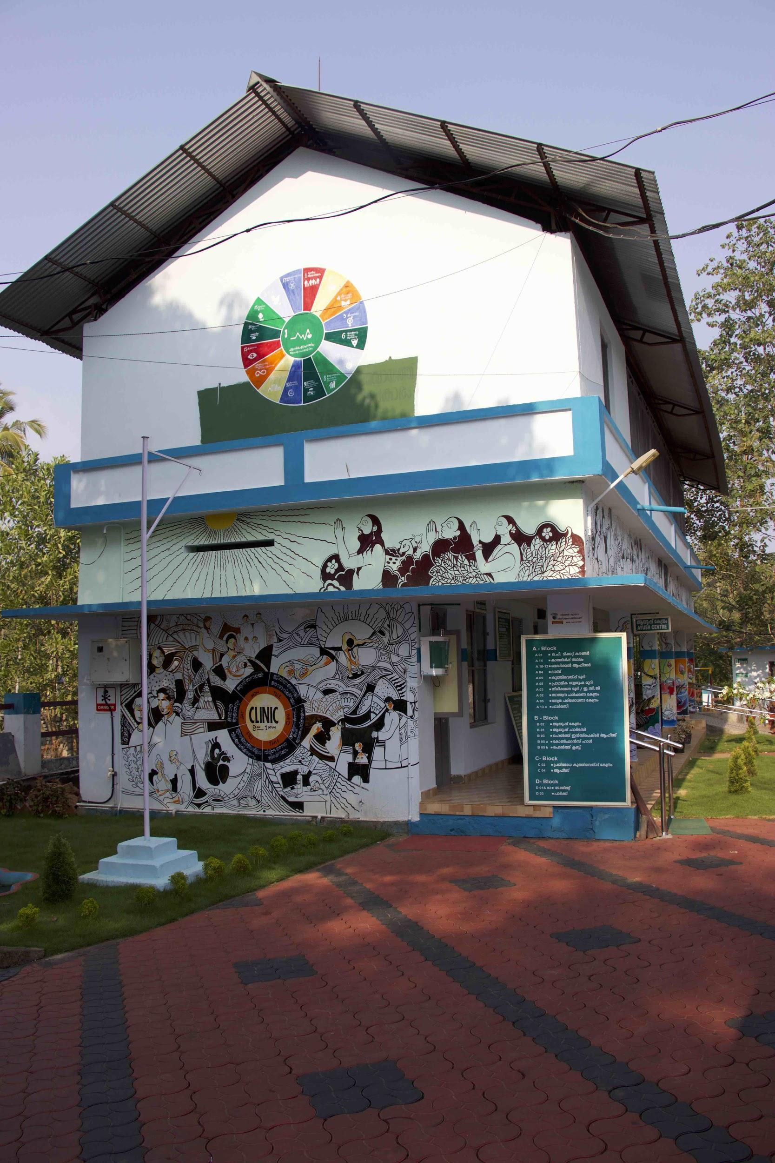
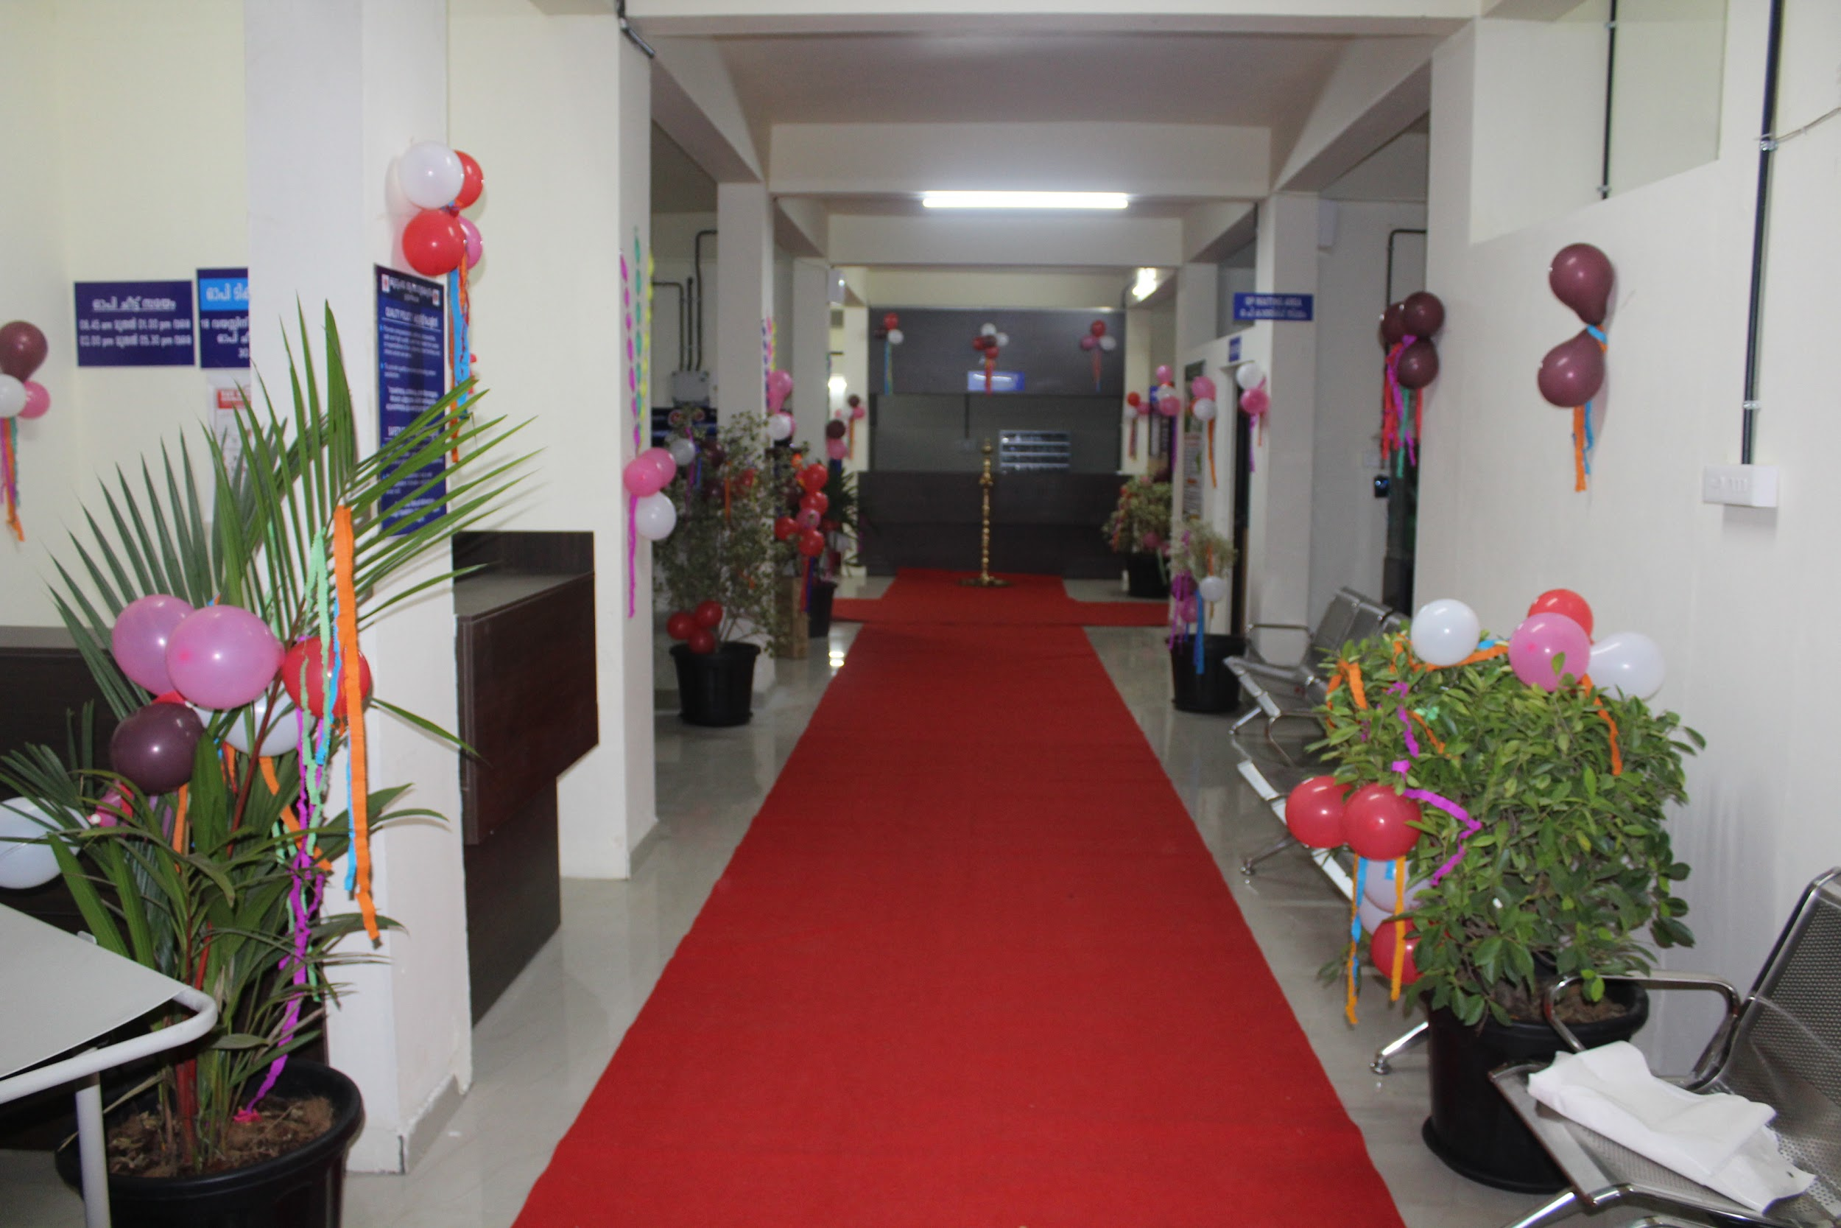
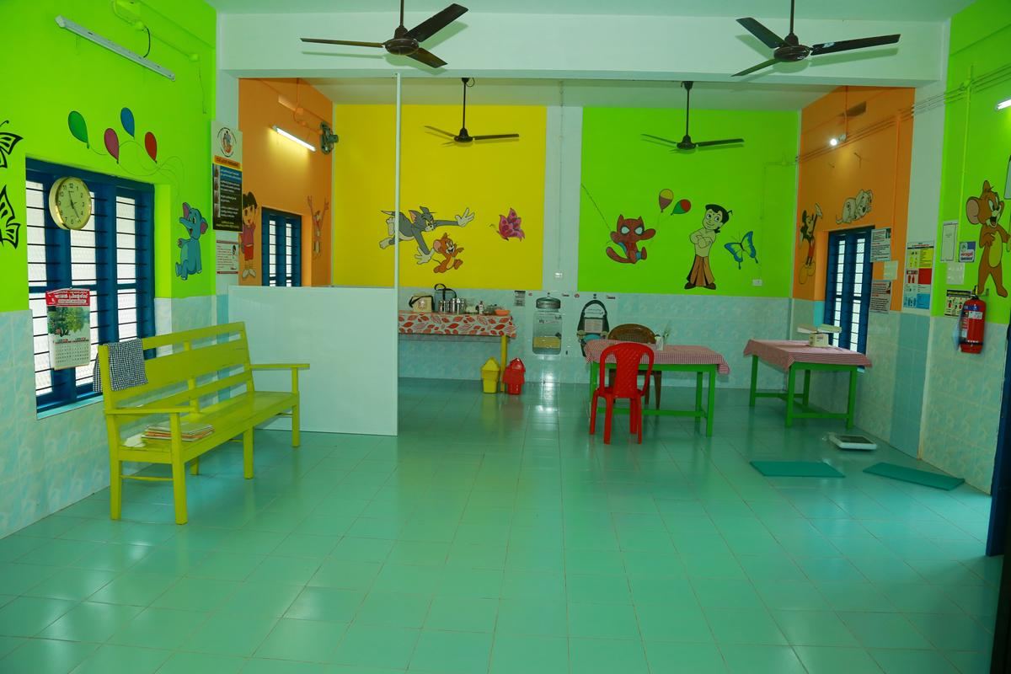
FHCs of Kerala

Slide 16
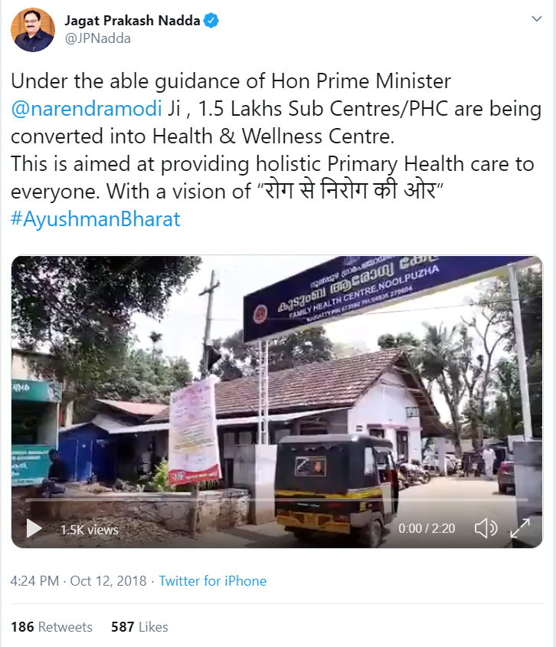
Former Union Minister of Health & Family Welfare tweeting about FHCs in Kerala

Slide 17
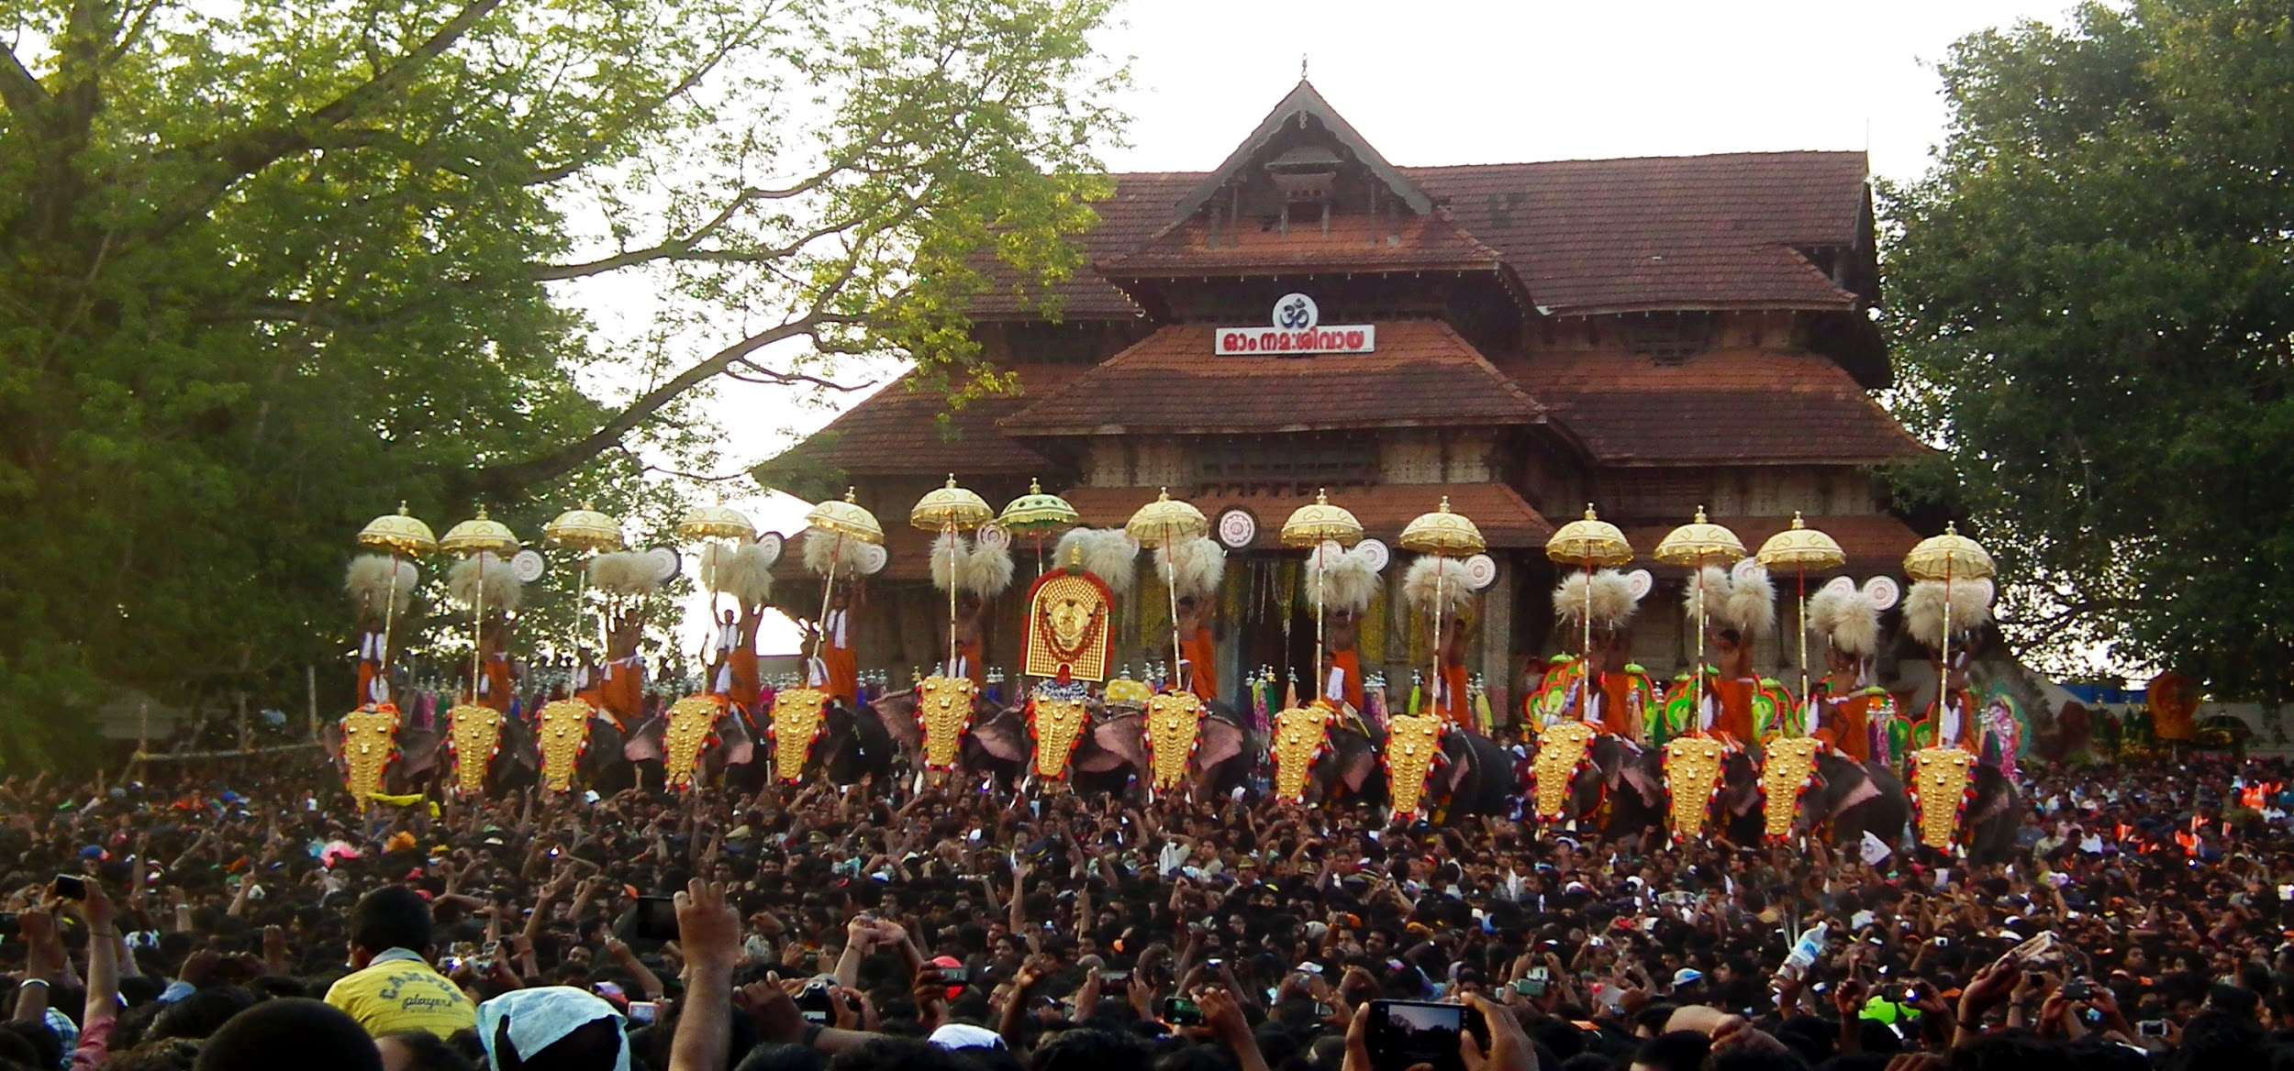
Thank You
THANK YOU

