Slide 1
Family Planning PROGRAM IN BIHAR
September 2019

Slide 2
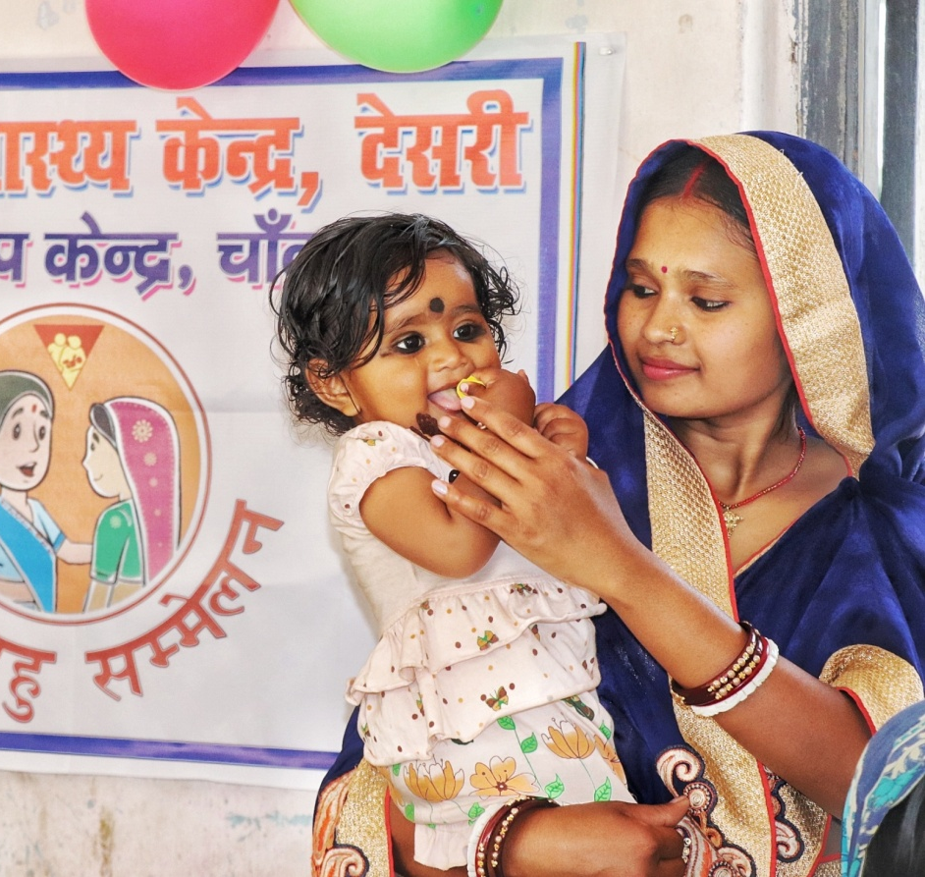
Bihar has highest fertility rates in the country
TFR | NFHS 3 (2005-06) | NFHS 4 (2015-16)
India | 2.7 | 2.2
Bihar | 4.0 | 3.4
mCPR | NFHS 3 (2005-06) | NFHS 4 (2015-16)
India | 47.8 | 48.5
Bihar | 28.9 | 23.3
Sterilization continues to be the dominant mode of family planning in the state, accounting for over 75% of all modern methods according to National Family Health Survey (NFHS) 4.

Slide 3

A woman in Bihar, on an average, has 3 children by the time she uses the first modern contraceptive method at an age of ~25
Age
16
17
18
19
20
21
22
23
24
25
16.2
16.8
19.2
3
24.6
Marriage
First Sex
First Child Birth
Number of living children by 1st modern contraceptive use
First Use of Modern Contraceptive
Legal Age of Marriage
Healthy Age of 1st Pregnancy
3 children born in less than 5 ½ years
Early Marriage
Early Pregnancy
90% sterilization
Source: CARE INDIA CMWRA 2 Data (December 2018)

Slide 4
While sterilization has been preferred method of contraception, the uptake has plateaued over the past few years
*Source: Health Management Information System (HMIS)

Slide 5
Hence, reducing TFR further poses a tough challenge in Bihar and requires a shift in approach
Need for spacing methods
(1st contraceptive uptake is after having 3-4 children. Increase in Modern Contraceptive Prevalence Rate (MCPR) hence would not reduce Total Fertility Rate (TFR) unless spacing methods are introduced)
Uptake of sterilization services plateauing
BUT myths and misconception around available spacing methods is impacting their usage

Slide 6
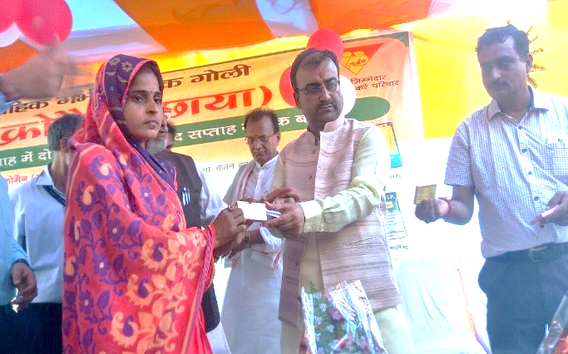
The launch of Injectables & Chhaya under the Mission Parivar Vikas was an opportunity to meet the unmet need for spacing and introduce newer methods

Slide 7
Antara was rolled out in 4 phases in Bihar
PHASE - I
October 2017
Launch of Antara
PHASE – II
December 2017
Antara available at all Medical Colleges, District Hospital, Sub-Divisional Hospital & Referral Hospital.
PHASE – III
March 2018
Antara available at Community Health Centers, Primary Health Centers & Additional Primary Health Centers across the State
Roll out in Medical Colleges
PHASE – IV
June 2019
Antara available at Urban Primary Health Centers and Health Sub Centers across the State

Slide 8
A number of key steps were taken parallelly for effective rollout of Antara
Training of medical officers, AYUSH and Staff Nurse/ANM
Estimation of stock and distribution
Pre- conditioning of facilities and outreach
Development adaptation of customized IEC* materials
Dissemination of necessary protocol for side effect management
Timely printing and availability of record keeping materials
Parallel launch of Family Planning Logistics Management Information System
Injectable promotional schemes
ASHA – fixed incentive (promotion of spacing method)
*Information Education Communication

Slide 9
Antara uptake at the end of phase 4 has reached substantial numbers
Total Uptake so far (Oct ‘17 to Aug’19 )*
 | TOTAL | 1st dose | 2nd dose | 3rd dose | 4th dose
Antara Clients | 4,24,427 | 2,62,228 | 99,746 | 41,838 | 20,615
Facility wise uptake (Apr’19 to June ‘19)*
 | Medical College | District Hospital | Sub-Divisional Hospital | Primary Health Center | Urban Primary Health Center | Additional Primary Health Center | Health Sub Center
Total Numbers | 8 | 36 | 33 | 533 | 85 | 1,387 | 10,252
Providing Antara services | 6 | 36 | 32 | 451 | 65 | 573 | 5,239
% of facilities | 75 | 100 | 97 | 85 | 76 | 41 | 51
Antara injections Apr-Jun’19 | 542 | 3,432 | 2,222 | 22,195 | 890 | 6,478 | 43,344
Average # Antara injections per facility per month | 30.1 | 31.7 | 22.4 | 16.4 | 4.5 | 3.7 | 2.8
Source: *HMIS

Slide 10
48.8%* potential clients received second dosage of Antara
MONTH | Oct'17 | Nov'17 | Dec'17 | Jan'18 | Feb'18 | Mar'18 | Apr'18 | May'18 | Jun'18 | Jul'18 | Aug'18 | Sep'18 | Oct'18 | Nov'18 | Dec'18 | Jan'19 | Feb'19 | Mar'19 | Apr'19 | May'19 | Jun'19 | Jul'19 | Aug'19
1st dose | 256 | 512 | 1048 | 1982 | 3848 | 5888 | 9233 | 10571 | 10371 | 27588 | 13161 | 11784 | 12436 | 12371 | 11573 | 13467 | 15555 | 15526 | 14906 | 14185 | 13257 | 27986 | 14724
2nd dose | 9 | 40 | 32 | 61 | 154 | 513 | 840 | 1529 | 1872 | 3996 | 3742 | 3993 | 6740 | 6342 | 5368 | 6167 | 6848 | 7779 | 7313 | 8022 | 8040 | 11992 | 8354
3rd dose | 7 | 13 | 11 | 21 | 3 | 47 | 109 | 91 | 271 | 496 | 655 | 1033 | 1738 | 1910 | 1805 | 3081 | 3679 | 3848 | 4028 | 4046 | 4208 | 6099 | 4639
4th dose | 44 | 26 | 21 | 226 | 41 | 50 | 138 | 114 | 165 | 189 | 167 | 246 | 385 | 559 | 866 | 1194 | 1470 | 1557 | 2267 | 2439 | 2615 | 3340 | 2496
Total | 316 | 591 | 1112 | 2290 | 4046 | 6498 | 10320 | 12305 | 12679 | 32269 | 17725 | 17056 | 21299 | 21182 | 19612 | 23909 | 27552 | 28710 | 28514 | 28692 | 28120 | 49417 | 30213
% 2nd Dose |  |  |  | 23.8 | 30.1 | 49.0 | 42.4 | 39.7 | 31.8 | 43.3 | 35.4 | 38.5 | 24.4 | 48.2 | 45.6 | 49.6 | 55.4 | 67.2 | 54.3 | 51.6 | 51.8 | 80.5 | 58.9
2nd dose calculated based on consumption of 2nd dose for the month in proportion to 1st dose consumption 3 months prior to 2nd dose
YEAR | 1st dose | 2nd dose | 3rd dose | 4th dose | Total
2017-18 | 13,534 | 809 | 102 | 408 | 14,853
2018-19 | 163,636 | 55,216 | 18,716 | 7,050 | 244,618
2019-20 (Till Aug) | 85,058 | 43,721 | 23,020 | 13,157 | 164,956
Total | 262,228 | 99,746 | 41,838 | 20,615 | 424,427
Source: *HMIS

Slide 11
Uptake of Antara is steadily improving with prominent peaks during FP fortnight
July Month Peaks due to World Population Day FP Fortnight
Overall Second dose – 48.8%
Source: HMIS

Slide 12
Bihar has the highest Antara coverage across the country
424,427 doses of Antara administered
HIGHEST IN INDIA
262,228 clients (dose1) have availed Antara since roll out
Highest client coverage in the country
No major Adverse event reported
Confidentiality helped uptake by women
Expanded basket of Choice
Improved access
Achievements

Slide 13
But, this high demand will lead to stockouts of injectable…
Details (as on 18th September) | Quantity
Total | 561,081
Distributed to Districts | 539,180
Available in State WH | 21,901
Utilized till August 2019 | 424,427
Total available in districts | 136,654
Date of receipt | Quantity received
12-08-17 | 107,288
28-02-18 | 124,467
11-08-18 | 99,828
25-08-18 | 99,498
02-11-19 | 50,000
06-05-19 | 50,000
10-08-19 | 30,000
TOTAL | 561,081
Note:
Total available “Inter district/ facility transferable” stock of Antara is estimated around 30000.
1 lakh Antara are available below Primary Health Center (PHC) level (Additional PHC, Health Sub-Center (HSC)) which are non transferable under Family Planning Logistics Management Information System (FPLMIS) as FPLMIS is non functional at APHC and HSC.
Currently FPLMIS training below PHC level has been completed in 13 districts

Slide 14
As an alternate spacing method, Post Partum IUCD has also shown increased uptake over the past few years and is expected to continue doing so in Bihar
Along with increase in absolute number of PPIUCD cases, % of PPIUCD cases out of all institutional deliveries have also steadily increased
State has also promoted PPIUCD services by increasing accessibility by increasing service points (`700) and service providers (~5000 trained Auxiliary Nurse Midwives (ANMs))
Source: *HMIS

Slide 15
Hence, a trend towards increased uptake of spacing methods is visible in Bihar over the past 2 years
PERMANENT & LONG ACTING SPACING METHODS
Services | 2017-18* | 2018-19* | Difference
Total Female Sterilization | 4,74,071 | 3,90,572 | -83,499
Male Sterilization | 2,576 | 4,988 | 2,412
PPIUCD | 1,69,196 | 1,76,427 | 7,231
Antara | 15,465 | 2,41,032 | 2,25,567
Total | 9,53,088 | 10,45,344 | 92,256
SHORT ACTING CONTRACEPTIVES DISTRIBUTION
Services | 2017-18* | 2018-19* | Difference
Centchroman-Chhaya | 33,650 | 1,84,948 | 1,51,298
ECP-Ezy Pill | 2,01,939 | 2,22,185 | 20,246
OCP-Mala N | 9,09,942 | 10,06,288 | 96,346
Condom-Nirodh | 60,06,920 | 88,12,802 | 28,05,882
ECP: Emergency Contraceptive Pills; OCP: Oral Contraceptive Pills
Source: *HMIS

Slide 16
Uptake of Minilap Sterilizations and Antara is highest in Bihar
Methos | All India Rank (in Absolute number) | All India Rank (in % Achievement against ELA)
Non – Scalpel Vasectomy | 3 | 8
Minilap Sterilization | 1 | 1
Post Partum Sterilization | 8 | 30
Post Partum IUCD | 6 | 12
IUCD | 5 | 12
Antara 1st Dose | 1 | 2
Total MPA | 1
ELA: Expected Level of Achievement

Slide 17
However, there still are a challenges which needs to be taken care of
Client tracking and follow up – Individual client tracking for Antara and Post Partum IUCD is in primitive stage. A Memorandum of Understanding (MoU) was recently signed with a Development Partner to provide Careline to clients .
Supply requirement for ANTARA – With average monthly consumption of close to 20000 doses, state will soon run out of stock for Antara
Multiple E System for supply chain – Electronic Vaccine Intelligence Network (EVIN), E-Aushadhi, Family planning Logistics Management Information System (FPLMIS) are all similar software for tracking supply chain, while entry person is the same at each level

Slide 18
The way forward!
Specific strategy to curb seasonality trends and migration – State is going to implement specific activities to curb seasonal trends for sterilization and also migration affecting sexual and behavioral practices through increased sensitization during specific festival e.g Holi and Chhath Pooja
New Information Education Communication (IEC) strategy – State is shifting its focus from method centric communication to behavior specific communication and also from facility based communication to community based communication
Demand generation at community level through FLWs – State is re focusing on community mobilization through sensitization of the ASHA Facilitator cadre and also increasing FP focus at Village Health Sanitation and Nutrition Day to increase demand generation for FP services

Slide 19
THANKS
Status of Family Planning Program in Bihar
September 2019

