Slide 1
Home Based Care for Young Child (HBYC)
Rollout in Maharashtra
Dr. Pradeep Vyas
Principal Secretary, Public Health Dept

Slide 2

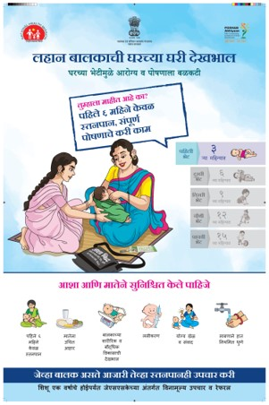
Scheme of Presentation
Rationale
Salient Features
Domain specific actions
Role of ASHA and AWW
HBYC in Maharashtra
State Roll out
Trainings - State, District
Printing and IEC
Home Visits and Poshan Maah
Way Forward

Slide 3

Early childhood is the most rapid period of development in human life.
The years from conception through birth to first few years of age are critical to the complete and healthy cognitive, emotional and physical growth of children.
This in turn ensures optimum health and wellbeing in adult life.
Global evidence shows that community-based intervention packages can reduce 27 percent of the child mortality
Rationale for HBYC

Slide 4
Slow Progress in Child Feeding Practices countrywide
Nationally, percentage of children receiving adequate diet continues to be less than 10%
Exclusive Breastfeeding Faltering from 2-3 months of age
First 2 years are critical for improving nutrition, promoting development and reduction of diarrhoea and pneumonia
No contact with health system during critical window period of 6 months to 2 years
Rationale for HBYC

Slide 5
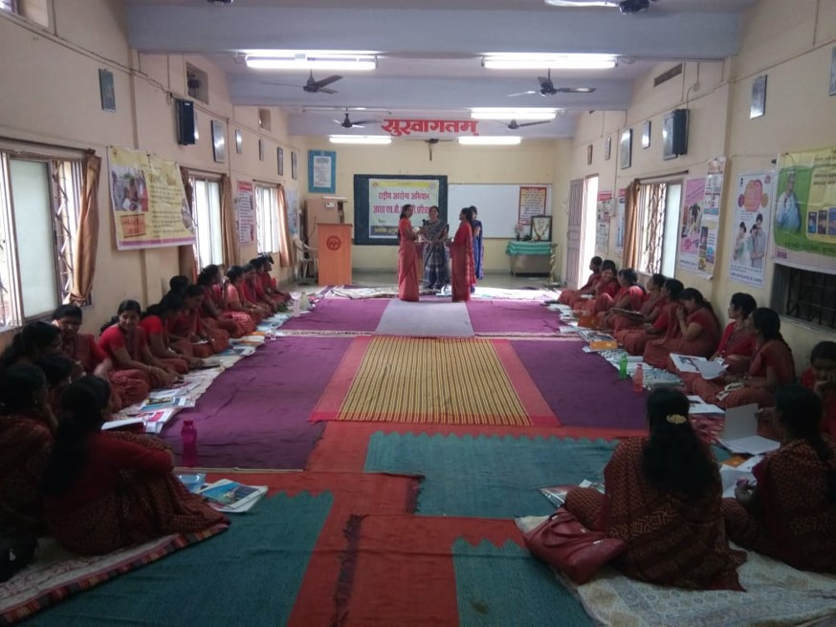
Salient Features
Convergent action by MWCD & MOHFW, leveraging existing community level platforms.
Evidence based interventions for child health & nutrition, bundled as a service package
Convergence and integration across interdependent domains of Health, Nutrition, WASH & Early Childhood Development.
Five additional home visits by ASHA in coordination with AWW starting from 3rd months and extending into 2nd year of life (in 3rd, 6th, 9th, 12th and 15th months).
Additional incentive of INR 250/- for five visits to be provisioned for ASHA under NHM and disbursed using existing ASHA payment mechanisms
SBCC (Social Behaviour Change Communication) plan to focus on addressing adverse social norms in health care seeking especially for the girl child

Slide 6
Domain specific actions under HBYC
KEY DOMAINS | SPECIFIC ACTIONS
NUTRITION | Exclusive breastfeeding for six months Adequate complementary feeding from six months and continued breast feeding up to two years of age Iron and Folic acid (IFA) supplementation Promote use of fortified food
HEALTH | Full immunization for children Regular growth monitoring Appropriate use of Oral Rehydration Solution (ORS) during diarrhoea episodes Early care seeking during sickness
CHILD DEVELOPMENT | Age appropriate play and communication for children
WASH | Appropriate hand washing practices

Slide 7
Role of ASHA and AWW
HOME VISITS | ASHA | AWW
At 3rd Month | Support for exclusive breastfeeding Counsel on hand washing practices Appropriate play and communication Check immunization status Check weight recording in MCP card; identify growth faltering | Monthly weighing of infants Weight recording and plotting on growth chart Detect underweight children & take further action Counsel mother for exclusive breast feeding

Slide 8
Role of ASHA and AWW
Home Visits | ASHA | AWW
At 6th, 9th, 12th and 15th Months | All above activities PLUS Counsel on initiation of complementary feeding & continued breastfeeding Age appropriate & adequate complementary feeding for children Age appropriate play and communication Ensure full immunization Distribution of prophylactic IFA and ORS and counselling for their appropriate usage Depot holder for ORS & Zinc | ‘Take Home Ration’ and nutrition- specific counselling to mothers Monthly weighing and supplementary food from AWC Counselling regarding complementary feeding Weight recording on growth chart; detect underweight children & take further action Record length/height Counsel for deworming of children above 1 year of age

Slide 9
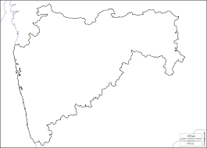
State has already initiated Intensified HBNC program in 78 tribal blocks since January 2016 under which every alternate day visit for first 6 months and fortnightly visit between 6 months to 1 year infant is given by ASHAs and children identified with high risk signs are referred for treatment.
In view of this and the launch of HBYC by GOI, State has embarked upon this opportunity to cover nutrition, sanitation and ECD components also.
State has prioritized 16 tribal districts and aspirational districts i.e. 18 districts for HBYC implementation.
HBYC in Maharashtra

Slide 10
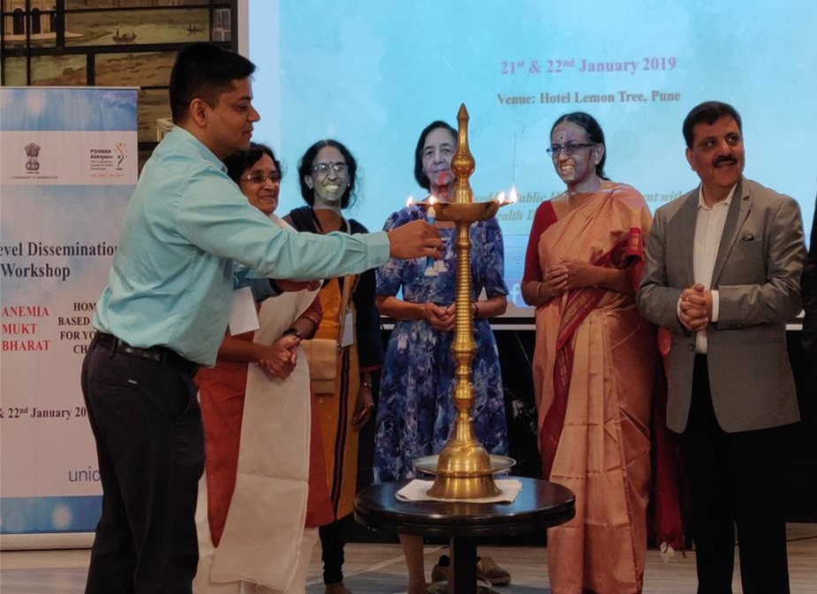
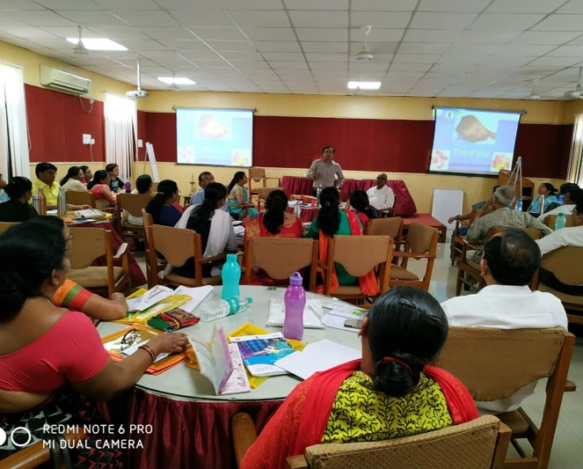
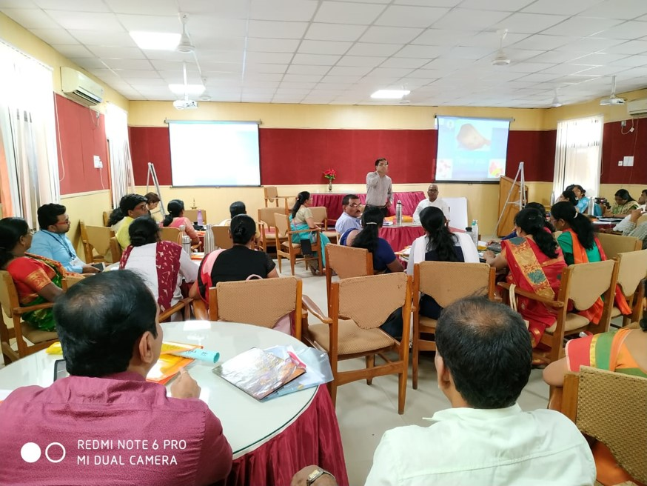
Rollout process
+Third
State Level Workshop: State conducted workshop for HBYC on 21st Jan 2019 at Pune under the guidance of GoI Officials, NHSRC Team, Family Welfare Training and Research Center Mumbai (FWTRC) with support from UNICEF Maharashtra.
Workshop was attended by State ICDS Officers, District and Corporation level Officers, Officials from Regional and District Training Teams.
,
117 Officials participated in this workshop

Slide 11
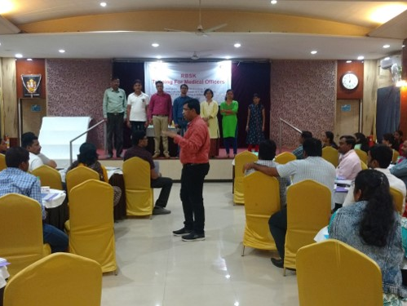
Training at State
+Second
State TOT: 2 State level batches of ToT were conducted at Nagpur and Pune
Participants- MO DTT, HBNC trainers from districts, DCM, faculty from HFWTC
Trainers- National Trainers
Total 90 trainers were trained in 2 batches
RBSK MO Training: All RBSK MOs were oriented at State level about HBYC and ECD and trained in early identification of developmental delays.
+Third
,

Slide 12
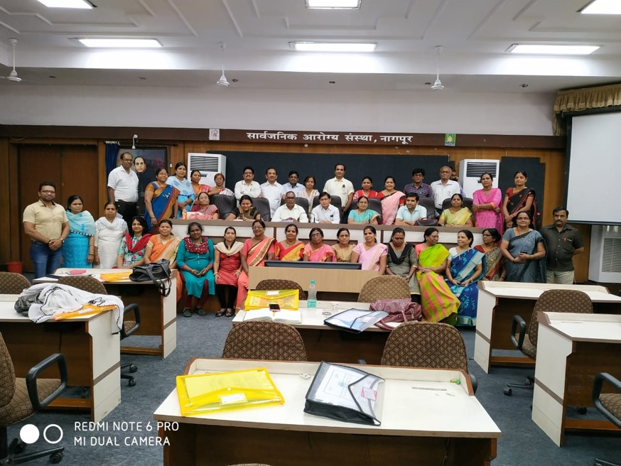
State-level ToTs: Pune and Nagpur
+Second
+Third
,

Slide 13
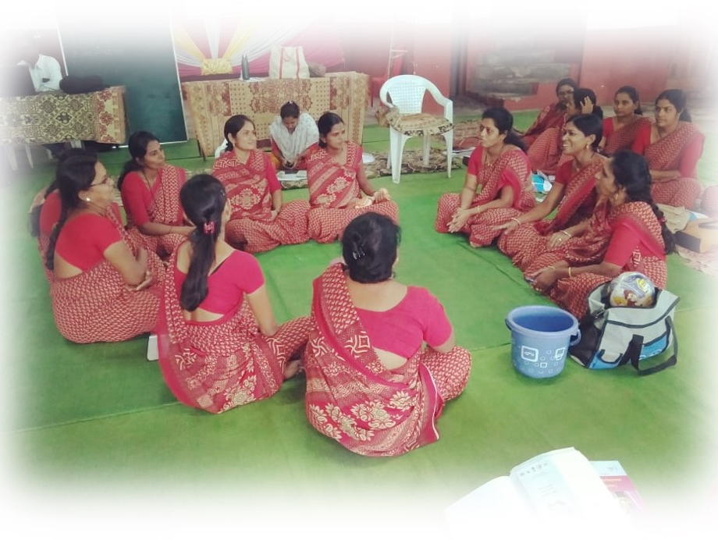
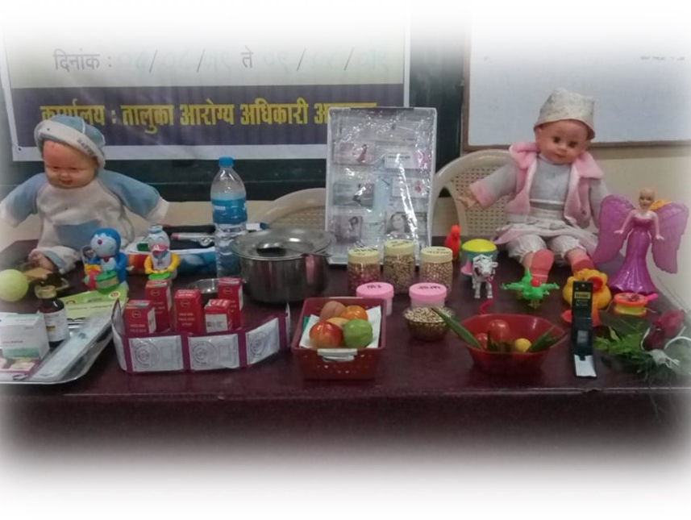
District Level ToT and Block Trainings
District Level ToT: 37 batches were conducted at District Training Centers for identified ASHA trainers ( ANM, LHV )
Block Trainings: To speed up ASHA trainings, block level batches for ASHAs, ASHA Facilitators and ANM are planned
+Second
+Third
Status till August
District ToT: 37 ToTs conducted, 900 trainers trained in 18 districts
ASHA/ANM Trainings: 11153 ASHAs against target of 33973 trained
,

Slide 14
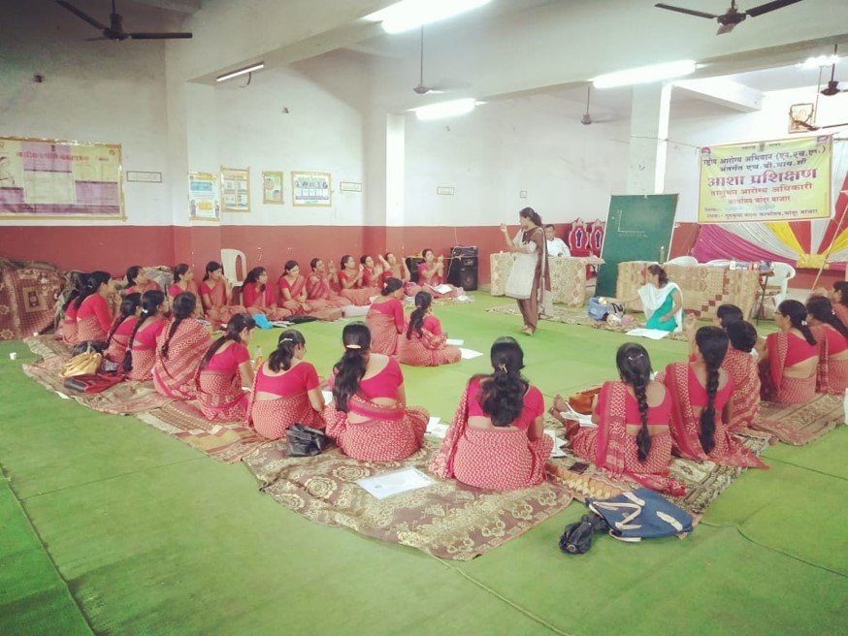
ASHA Trainings
+Third
,
ASHA Training at Katol Block, Nagpur
ASHA Training at Tiwasa Block, Amravati

Slide 15
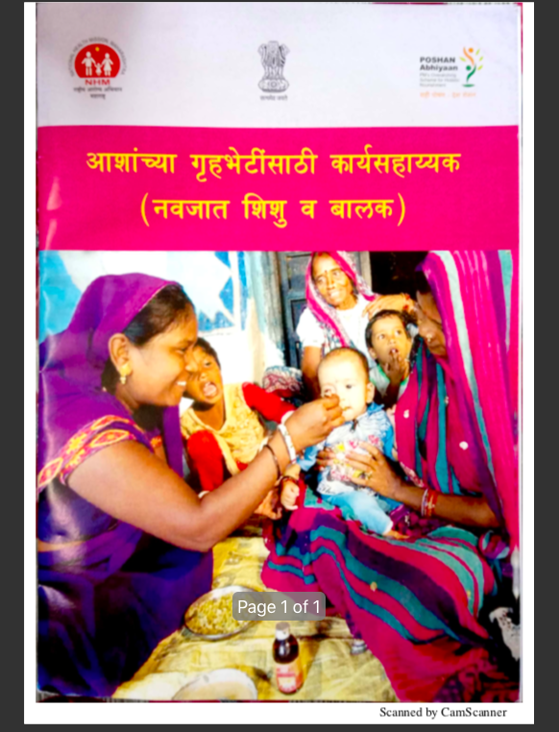
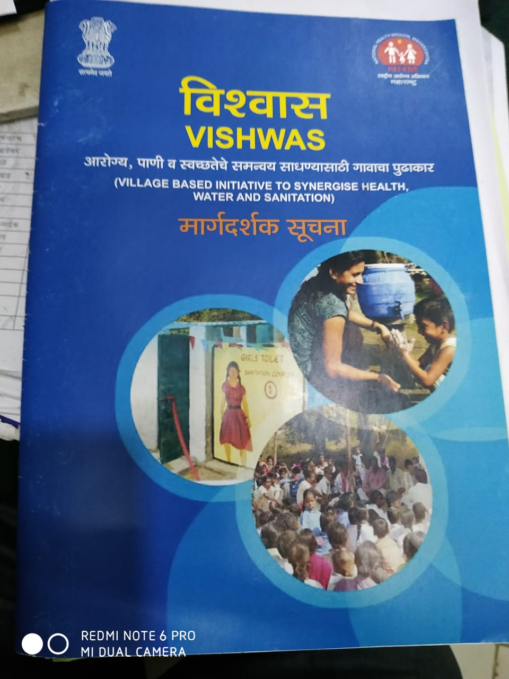

Printing and IEC
Training modules and IEC material translated in Marathi
01
MCP Card- Revised MCP Card translated, printed and initially provided to 4 aspirational districts on priority with support from UNICEF
02
ECD Call Center operationalized through existing 104 HACC where in parents are being called and counselled regarding early childhood development. Till date more than 8000 parents have been counselled.
03

Slide 16
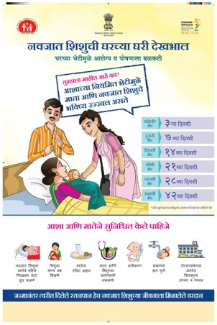
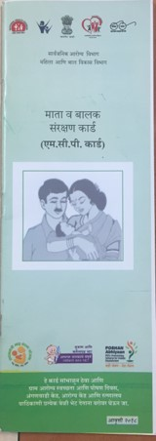
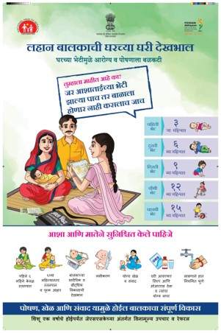
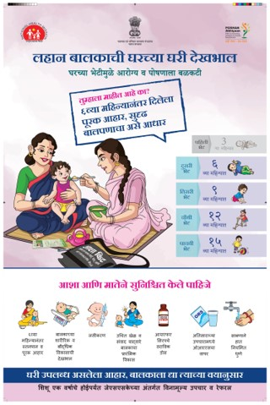
IEC material translated in Marathi &
Revised MCP card 2018
+Third

Slide 17
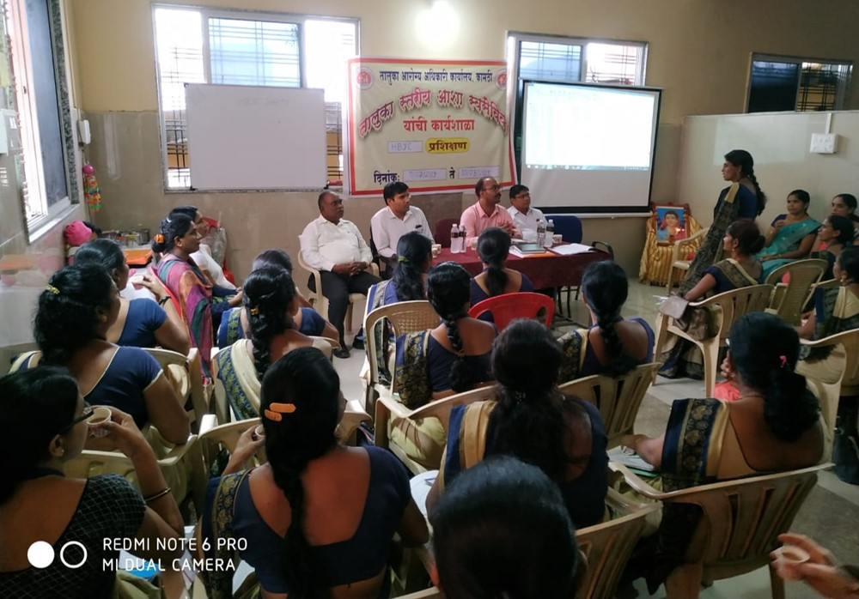
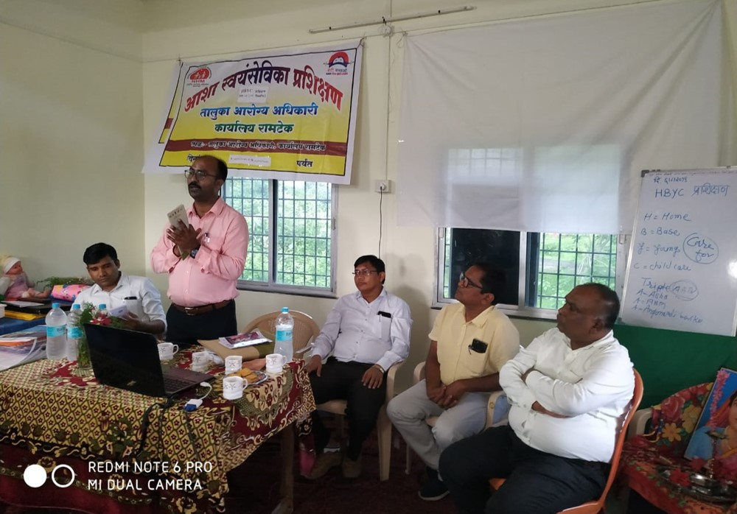
Visit by GoI officials
GoI Lead Consultant visited training sessions in Amravati and Nagpur districts.
+Third
,

Slide 18
HBYC Visits and Activities under Poshan Maah
HBYC Visits:
Visits already started in 4 districts where 832 children were visited by ASHAs.
Activities under Poshan Maah:
Home Visits under HBNC and HBYC: 223210 visits by ASHAs till 17th September.
Demonstration regarding Water and Sanitataion at schools and AWC– 18236
VHNSD- 27130
Anaemia camps - 37087

Slide 19
Way forward
Remaining ASHA trainings will be completed by October 2019
Home visits by ASHAs in remaining districts will start as training is completed
Regular Monitoring at various levels from state to block level
Remaining 16 districts will be proposed in 2020-21
Assessment of HBYC implementation in districts will be carried out in Dec 2019 and March 2020
Interdepartmental joint review meetings for effective implementation
Linkage with DEIC for treatment of developmental delays will be strengthened
ECD Call Center – Activities will be scaled up in all 34 districts as per GoI guidelines

Slide 20
THANK YOU

