Slide 1
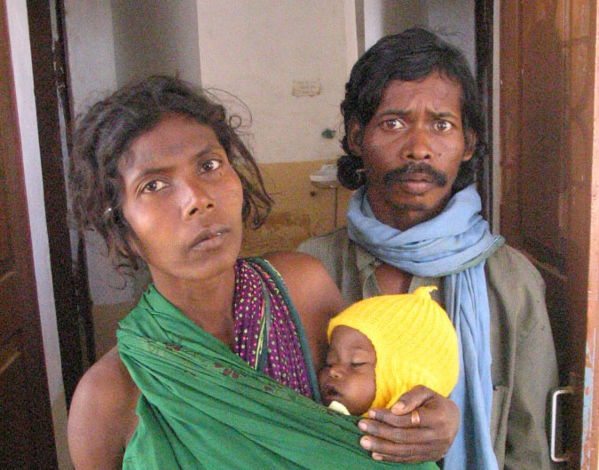
Sustaining Coverage of Home Based Newborn and Young Child Care in Chhattisgarh
September 2019

Slide 2
Home Based Newborn Care
Training: All Mitanins (ASHAs) trained on HBNC in 2008 followed by 5 refreshers since then. Mitanins use a picture book for home visits. Mitanin Trainers (ASHA facilitators) provide handholding support
Performance 2018-19:
No of newborn visited for HBNC- 495862 (Rural-456258 / Urban – 39604)
No. of sick new-borns referred- 31291 and 28066 sick newborn treated by ASHA where referral was infeasible
No. of LBW/preterm (high risk) babies reported out of those visited- 43996
SNCU discharges followed up- 8276
Gap: HBNC kits need partial replacements for around 30000 ASHAs. Procurement initiated.

Slide 3
Home Based Young Child Care
The first training of Mitanins in 2002 was on HBYC
7 refreshers of HBYC including with use of picture books for home visits
Films to train ASHAs on counseling skill
Psycho-social development added to curriculum of Mitanins in 2013
Refresher on lines of HBYC suggested by Government of India planned for 2019. Key difference – use of MCP cards. First level ToTs completed.
State to train all 70,000 ASHAs and not limit it to aspirational districts
Challenge: Small font of print on MCP cards

Slide 4
Performance on HBYC
Increase in home visits from 24 lakh in 2014-15 to 57.8 lakh home visits by rural Mitanins in 2018-19
4.9 lakh home visits by Urban Mitanins
Greater intensity of visits now focused on children around 6 months of age – to ensure required changes in complementary feeding

Slide 5
Evaluation of Mitanins Knowledge , Skills & Practice on HBNC and HBYC by UNICEF
The external survey covered a total of 582 Mitanins randomly selected across 6 districts in 2016-17– Surguja, Jashpur, Raipur, Durg, Bijapur, and Dantewada.
HBNC and HBYC assessment key findings:
  89% of newborns visited 7 or more times within 42 days of birth.
  90.5% Mitanins had adequate knowledge of key newborn care messages.
  97.2% Mitanins asked question during the conversation
  95% of Mitanins appreciated mother for positive action
  77.8% of Mitanins had repeated important messages at end of counseling session
Messages provided by Mitanins during visit of 6-24 months child- Breastfeeding (100%), feeding (97%), prevention from diseases (79%), hand washing (88%).
92% demonstrated baby-wrapping skill adequately
83% Mitanins had adequate knowledge about major symptoms of pneumonia

Slide 6
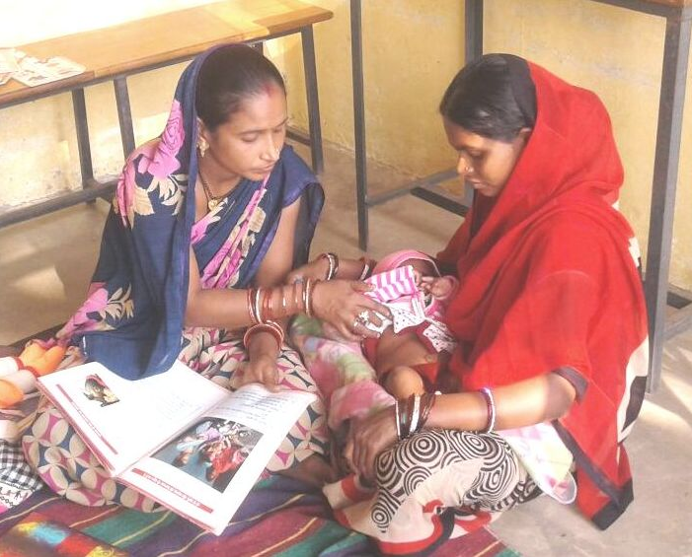
Home Visit

Slide 7
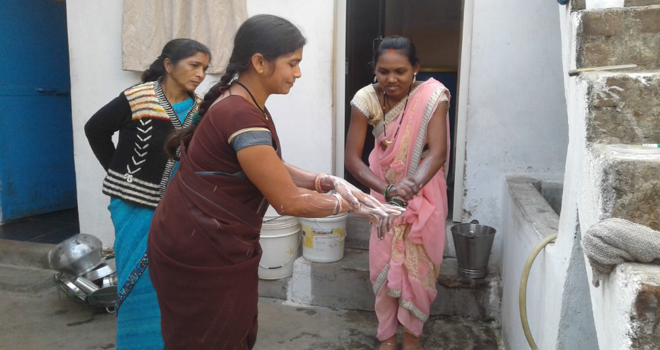
Demonstration of Hand washing

Slide 8
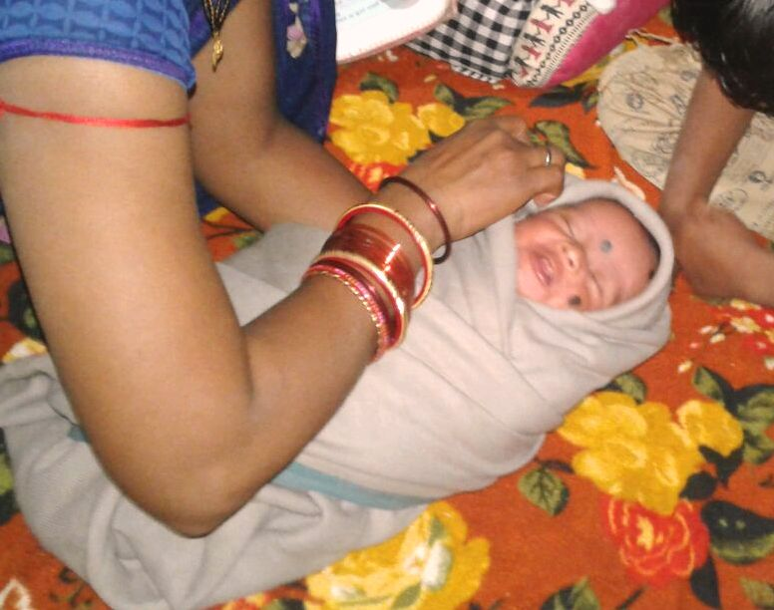
Demonstration of Baby Wrapping

Slide 9
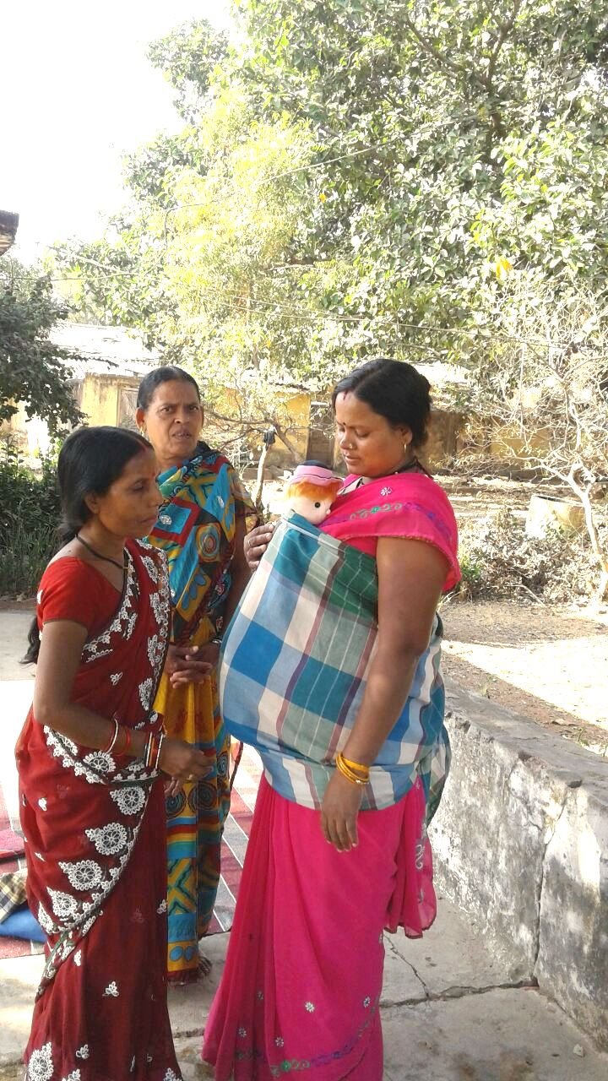
Demonstration of skin to skin contact care

Slide 11
Thank You

Slide 12
Thanks

