Slide 1

TELANGANA e-FAMILY HEALTH RECORD
Government of Telangana

Slide 2
3. Kanti Velugu (Eye screening programme)
1. Aarogyasri (Insurance scheme)
2. KCR KIT (Maternal benefit scheme)
4. e-Birth & Notifiable Diseases
5. PHC Out Patient Module
6. Sub-Center Module
7. Telangana e-Family Health Record

Slide 3
1. Aarogyasri (Health Insurance Scheme)
IT ARCHITECTURE:
  URL: www.aarogyasri.telangana.gov.in
  Web based end to end software, that supports implementation, monitoring and payments
  Primary data entry at the hospital (Govt & Pvt)
  97 Government Hospitals & 234 Private hospitals are on board.
  The number of records: 24.49 lakhs
  Web based MIS developed to monitor treatment, surgeries, transfer of funds etc
  Ayushman Bharat has adopted the Software for NATION WIDE implementation.

Slide 4
2. KCR KIT – Maternal Benefit Scheme
Objective: To provide safe delivery & to compensate wage loss of pregnant women.
Launched on 2.6.2017
IT ARCHITECTURE:
URL: www.kcrkit.telangana.gov.in
Web based end to end – work flow based software application to support implementation & monitoring
Primary data entry by ANMs at Sub-Centre & PHC level using Tabs.
Number of records: 40.61 lakhs
Web based MIS developed to monitor Registration, ANC Care, High Risk cases, birth planning, delivery and immunization of new born & DBT.
Daily SMS on Key Performance Indicators

Slide 5
Coverage (02.06.2019 to 14.11.2019)
Sl. No | Year | No. of PW Registered | Number of ANCs done | HR Cases Identified | No. of Kits Distributed | DBT (Rs Crs)
1 | 2017-18 | 7,97,804 | 12,51,740 | 1,89,869 | 2,02,283 | 201.36
2 | 2018-19 | 6,13,292 | 16,74,375 | 1,78,416 | 2,42,444 | 219.93
3 | 2019-20 (till Oct -2019) | 4,11,980 | 11,73,374 | 1,47,237 | 1,38,504 | 199.19
TOTAL |  | 18,23,076 | 40,99,489 | 5,15,522 | 5,83,231 | 620.49

Slide 6
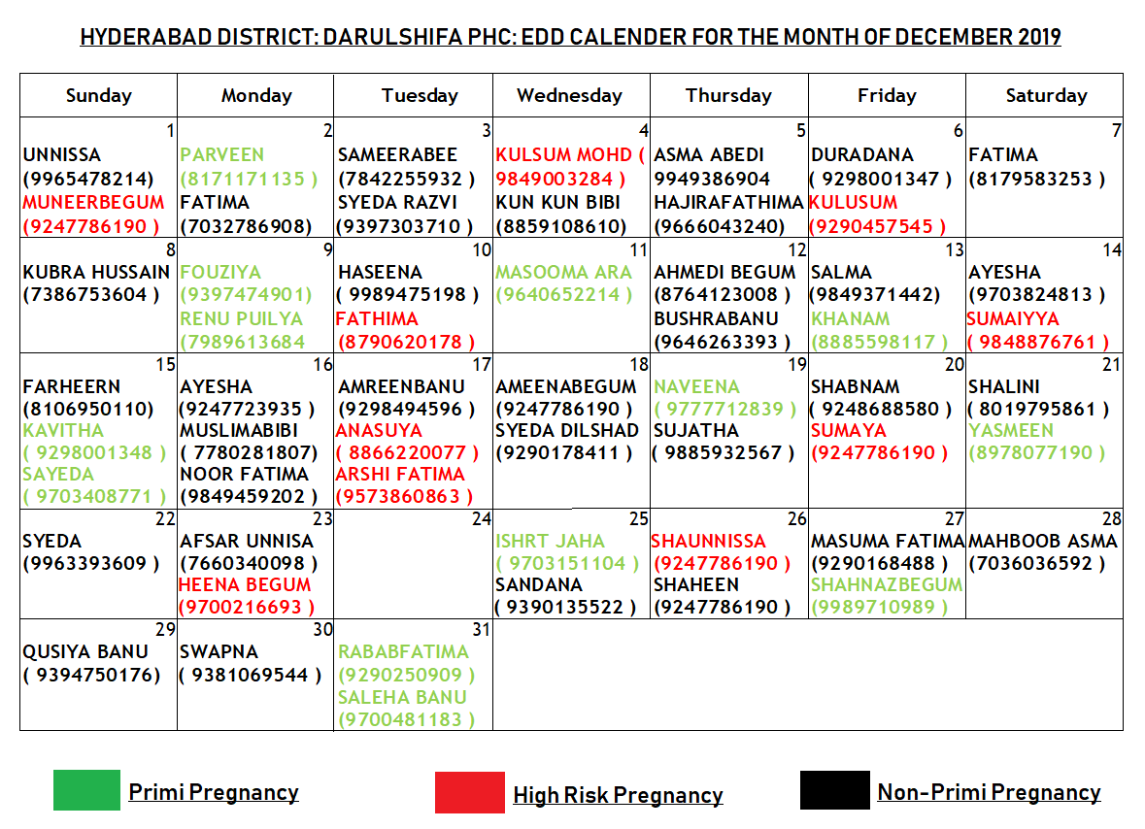

Slide 7
3. Kanti Velugu – Universal Eye Screening
Objective: To provide holistic, hassle free eye screening at door steps of citizens. Launched on 15.08.2019
IT ARCHITECTURE:
URL: www.kantivelugu.telangana.gov.in
Data captured using end to end – Work flow based Android APP (offline / online modes)
Tabs are used to capture data by ANMs (1650 nos)
Number of records: 1.54 Crores.
It supports implementation as well as monitoring of the program
Daily SMS on Key Performance Indicators

Slide 8
Daily Output & Coverage
Sl No | Particulars | Daily Output | Total Coverage
1 | No. of people screened | 1,50,000 | 1.54 crores
2 | No. of reading glasses distributed | 28,000 | 23 lakhs
3 | No. of prescription glasses | 10,000 | 18 lakhs
4 | No. of referrals | 12,000 | 9 lakhs

Slide 9
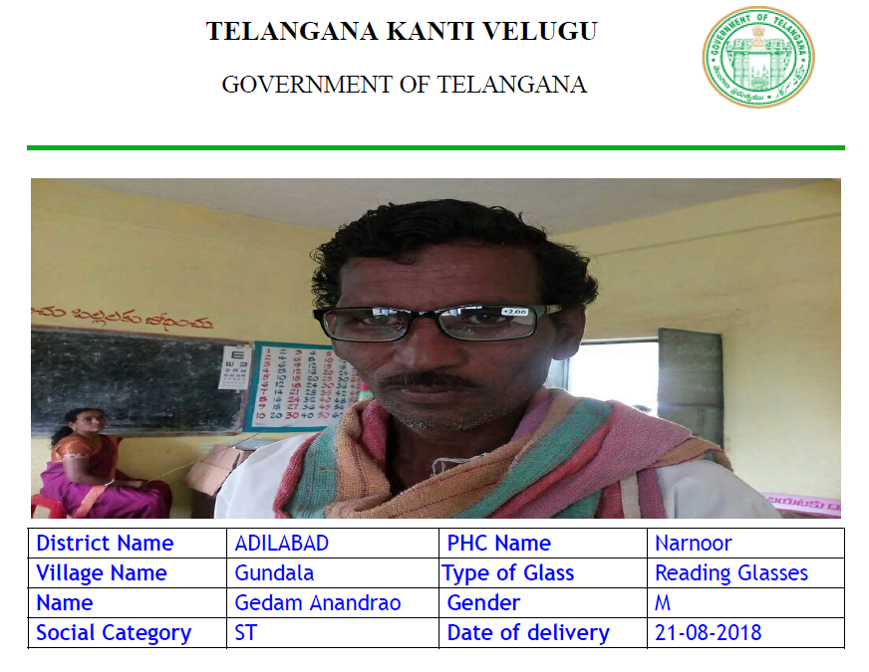

Slide 10
4. e-Birth & Notifiable Diseases
  Objective: To capture births & notifiable diseases.
  Launched on 01.01.2019
  IT ARCHITECTURE:
  URL: www.ebirth.telangana.gov.in
  Web based software that supports follow up by the concerned field level functionaries
  Primary data entry at the hospital level (Govt & Pvt)
  893 Government Hospitals & 2247 Private hospitals on board
  Number of records: 4.24 lakhs (equals 85% of all births in the state)
  Web based MIS developed to monitor deliveries in govt. facilities, sex ratio, C-Section Rate, 24 notifiable diseases.

Slide 11
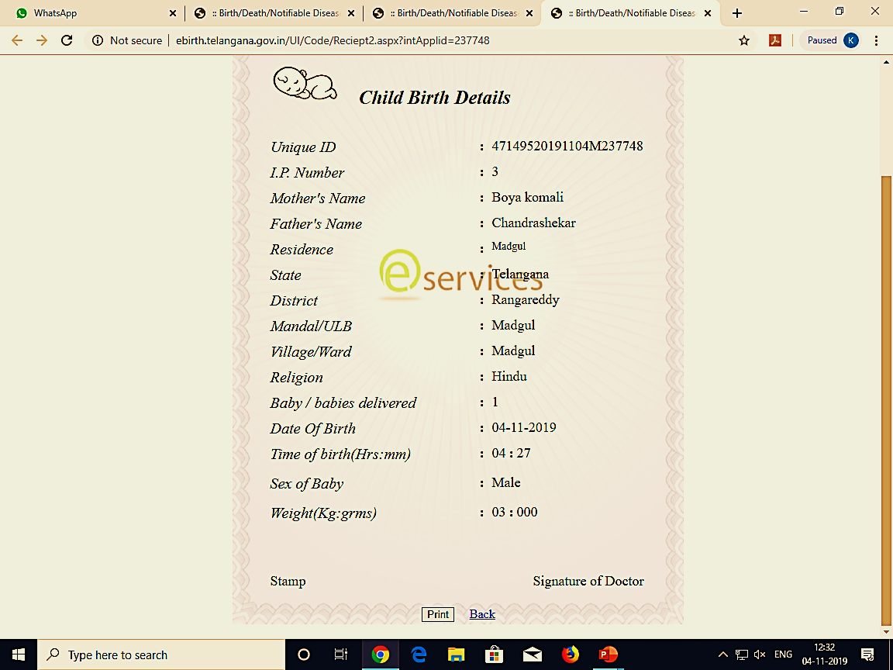

Slide 12
5. Out Patient Module for PHCs
  Objective: To track ailment and treatment detail, so as to understand primary health needs of people at any given point.
  Launched on 1.4.2019
IT ARCHITECTURE:
  Android APP
  Primary data entry at PHCs / Basthi Dawakhanas by Medical Officers
  798 PHCs and 115 Basthi Dawakhanas are on board.
  Number of records: 75 lakhs
  On an average 50,000 OPD gets updated daily.

Slide 13
6. Sub-Center Module
  Goal: To capture deaths and causes of death.
  Launched on 01.04.2019
IT ARCHITECTURE:
  URL: www.healthprofile.jhs.telangana.gov.in
  Android APP, using TABs by ANMs at Sub Center level
  4797 Sub Centers update data once in a month
  Web based MIS developed

Slide 14
7. Telangana e-Family Health Record
Objectives -
  Creating a single health record at household level.
  Developing evidence based understanding of health requirements .
  Optimize service delivery by developing linkages across initiatives and services
Strategy :
  Leverage the existing software application data, hardware and create big picture.

Slide 15
How it is created ?
Govt had conducted “Samagra Kutumba Survey (SKS)” of all households in the state. The survey is digitized. This data is taken as the base data.
Each household is has an SKS ID.
Each individual has Aadhar ID.
The data from 6 different software applications developed for different programs at different points of time are integrated, to form a e-family health record.

Slide 16
e-Family Health Record
Sub-Center Module
Aarogyasri
PHC Out Patient Module
Kanti Velugu
KCT KIT
e-Birth and Notifiable Diseases
Data from Private Hospitals

Slide 17
Key Strengths
Integrated data from primary, secondary and tertiary level institutions
Integrated data from Government as well as Private institutions
MIS Report / Dashboards are created for key functionaries on real time basis so that they can use for effective management
Number of Records: 3.09 Crores
Number of villages: 11,567
Number of Government health facilities: 5690 (incl. sub-centers)
Number of Private health facilities: 2247

Slide 18
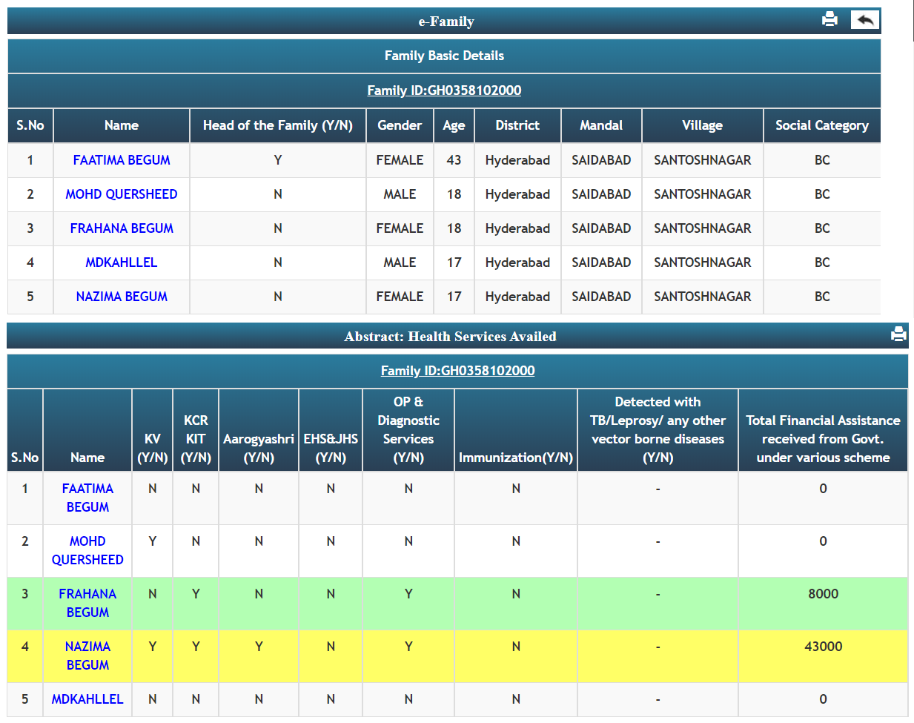

Slide 19
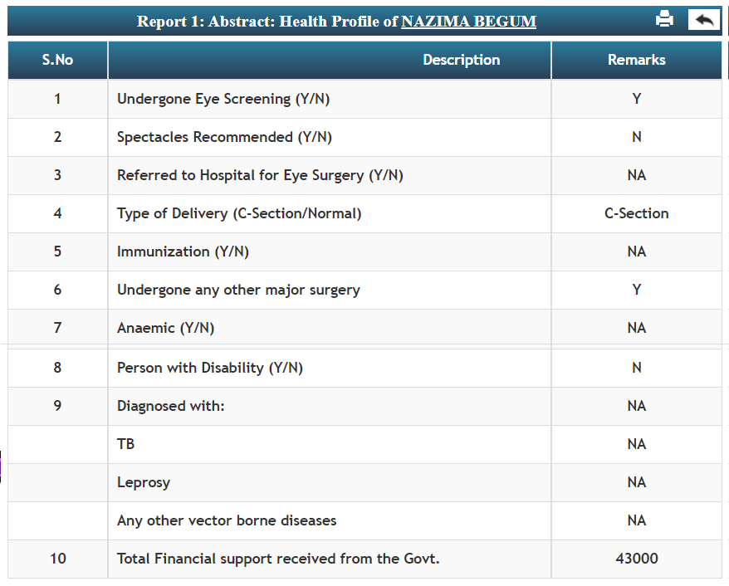

Slide 20
ANALYTICS
Telangana e-Family Health Record

Slide 22
Total Records: 4.24 lakhs

Slide 23
Total Records: 4.24 lakhs

Slide 24
Total Records: 1.08 lakhs

Slide 25
Total Records: 75 lakhs

Slide 26
Constraints:
Integration of GoI applications like NCD, NIKSHAY etc

Slide 27
Way forward….
Integrate all existing and new health applications to eHR through family ID / Aadhar
Integrate basic diagnostic services availed by individuals to eHR
Integrate drug dispensation to patients (e-aushadi) to eHR
Integrate NCD and track management of Hypertension and Diabetes

Slide 28
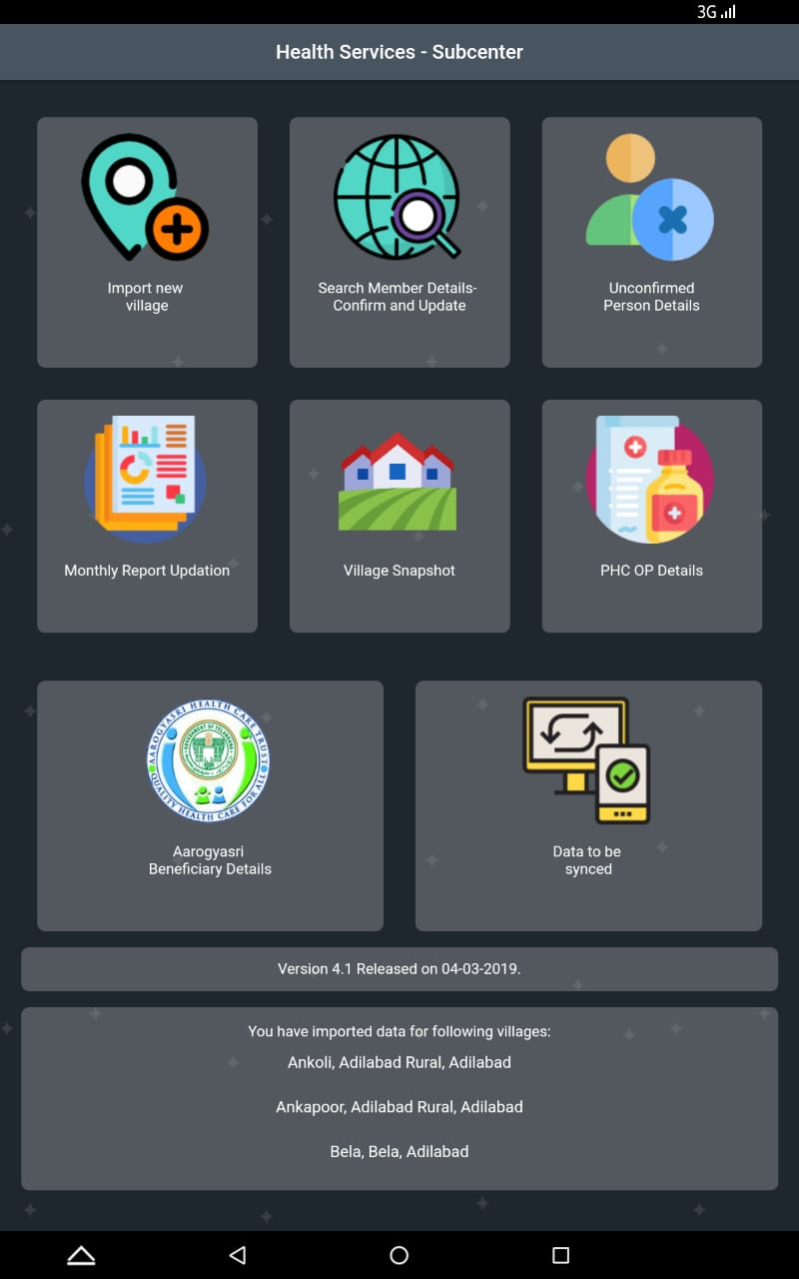

Slide 29
Thank you

