Slide 1
6TH NATIONAL SUMMIT ON “GOOD & REPLICABLE PRACTICES AND INNOVATIONS IN PUBLIC HEALTHCARE SYSTEMS”
DR. R. LYNGDOH,
DEPUTY DIRECTOR OF HEALTH SERVICES (M),
SPO, NVBDCP, NHM
MEGHALAYA

Slide 2
Achievements of the Programme: 2016-2018(2019 Upto Sep)
Decrease in malaria cases : 2016 by 27.94 % (in comparison to 2015)
          2017 by 53.08 % (in comparison to 2016)
          2018 by 61.09 % (in comparison to 2017)
          2019 by 69.08 % (in comparison upto Sep,2018)
Decrease in Pf cases : 2016 by 28.27% (in comparison to 2015)
          2017 by 52.87 % (in comparison to 2016)
          2018 by 59.42 % (in comparison to 2017)
          2019 by 71.03 % (in comparison upto Sep,2018)
Decrease in deaths : 45 (2016) from 79(2015)
12 (2017) from 45 (2016)
        6 (2018) from 12 (2017)
        3 upto Sep, 2019

Slide 4

BEST PRACTICES
Constant in-depth analysis of data at all levels.
Early warning signals are flagged and necessary actions are carried out.
EDPCT
The initiation of DOTS for positive cases at a few districts have yielded successful results

Slide 5
Monitoring & Evaluation
Priority on Focal outbreak management which includes hands on training of the Medical Officers & Field Staff for any corrective measures.
Every case is line listed with follow ups.
Close Co-ordination with and guidance to the grass root workers and districts – State Review Meeting held outside State HQ.

Slide 6
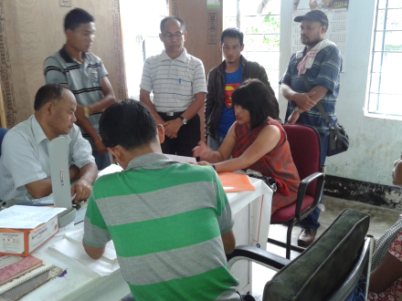
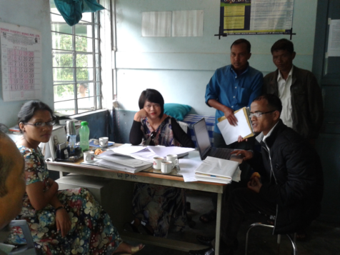
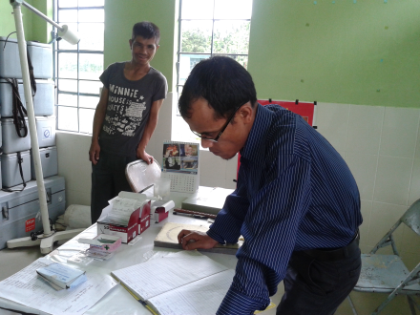
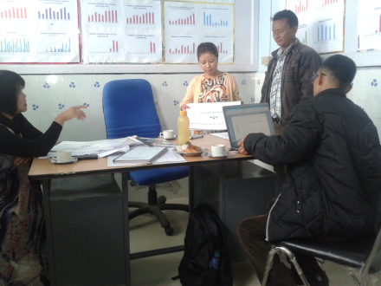
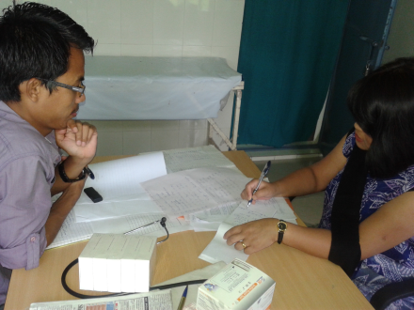
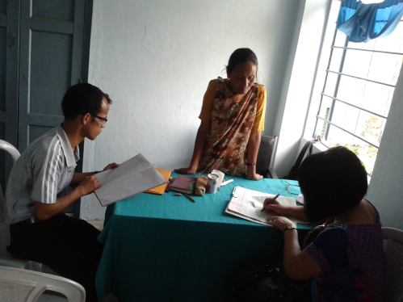
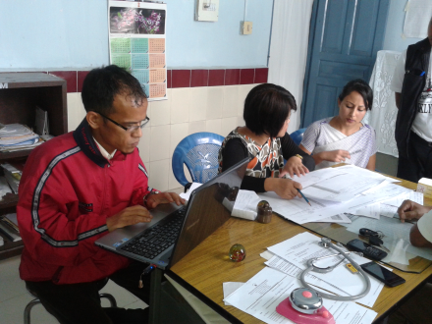
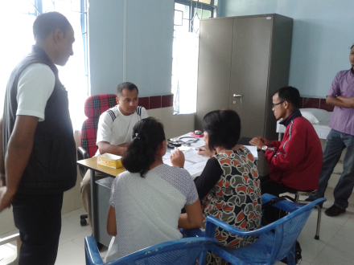

Slide 7
IEC / BCC
Through sustained IEC/BCC activities – communities are being made aware
School Activities are being prioritized.
Miking is being carried out regularly.

Slide 8
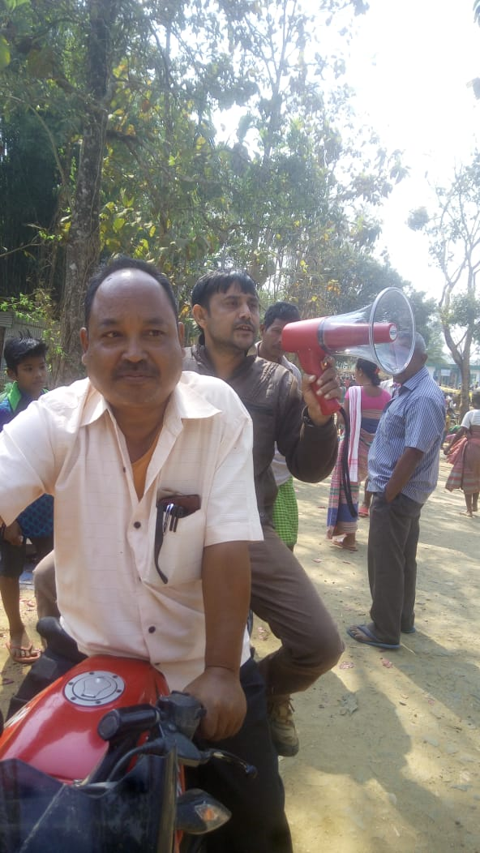

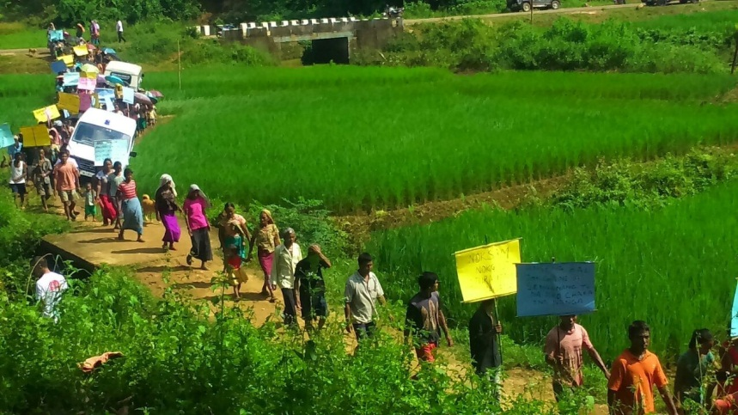
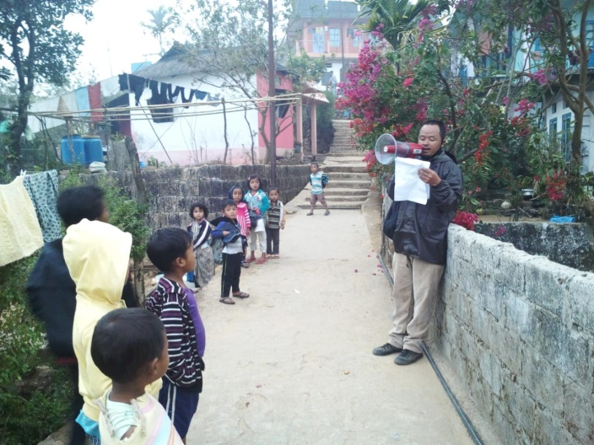
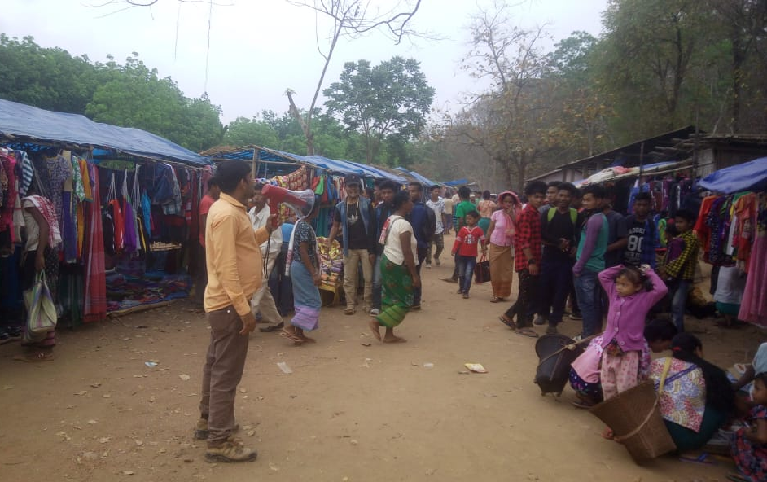
Miking – West Garo Hills
Miking – East Khasi Hills

Slide 9
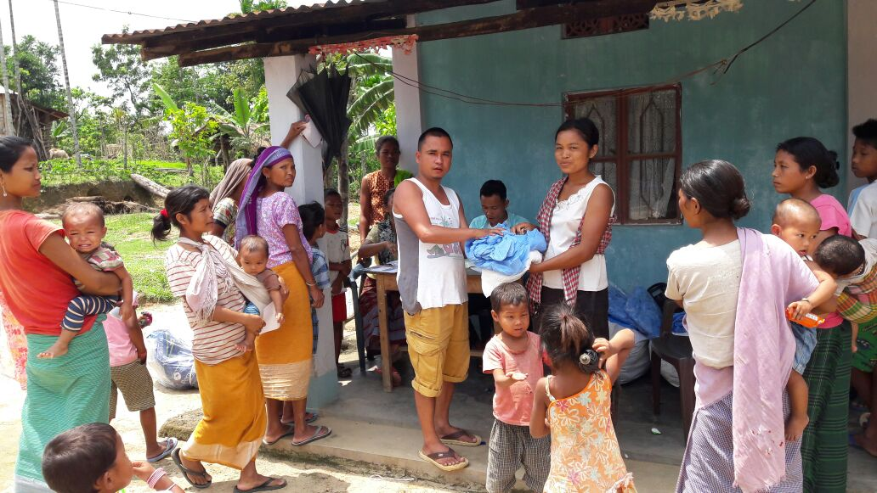
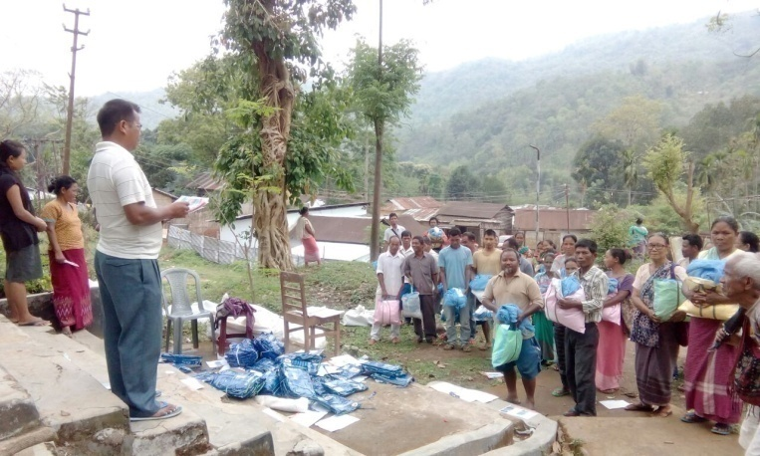
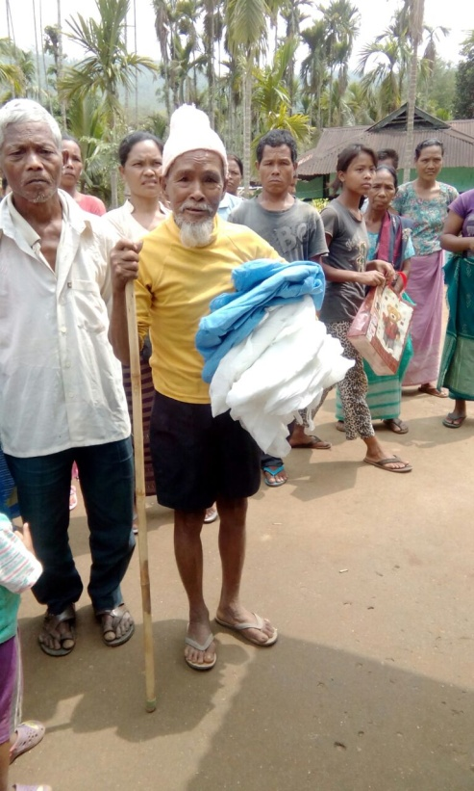

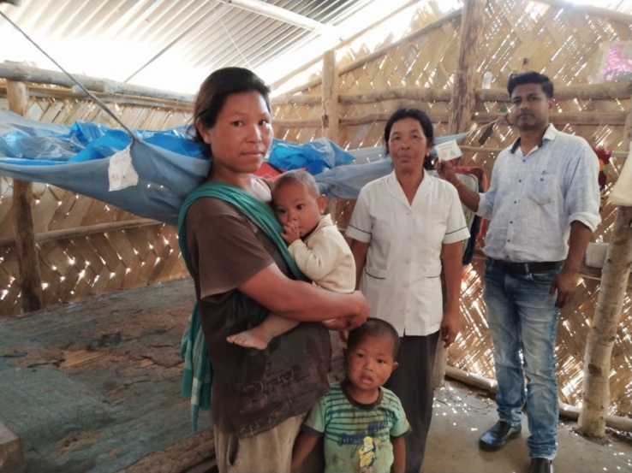
LLIN usage has brought about the most significant reduction in Malaria cases in the State
Checking on breeding sites

Slide 10
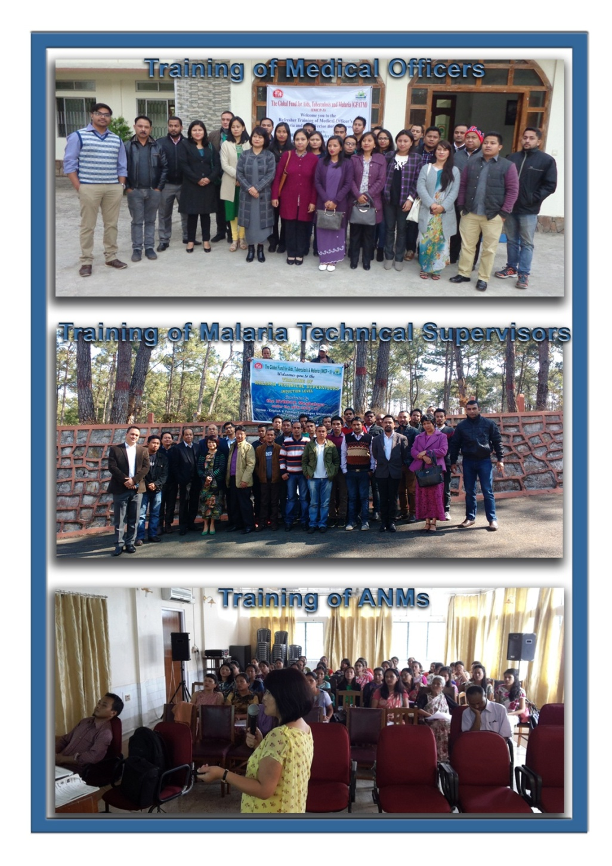
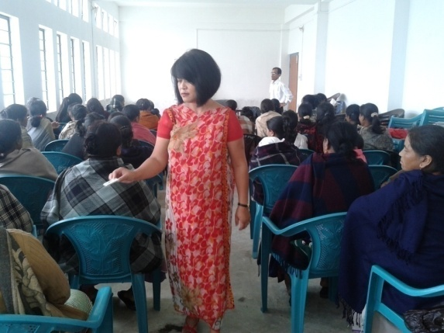
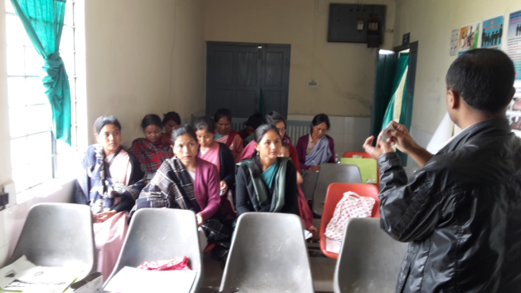
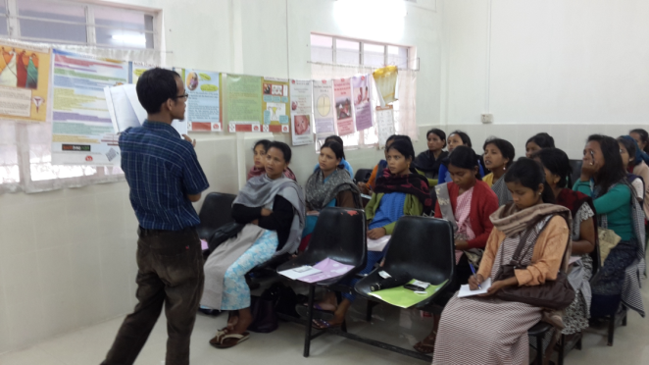
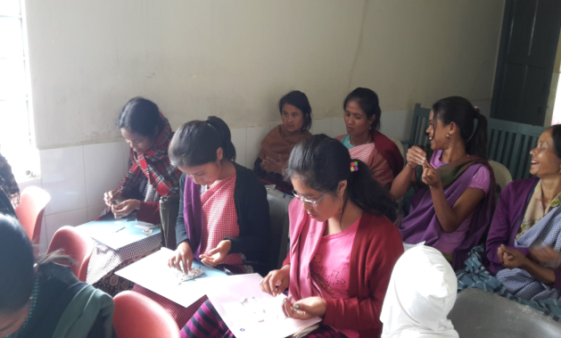
Trainings conducted
ASHAS’ TRAININGS IN PHCs/CHCs

Slide 11

Innovations
District Death Review Committee
Portable IEC/BCC / Drug Chart for ASHA
Release of booklet for Intersectoral Convergence
ASHA – IEC / Drug Chart

Slide 12


Slide 13

THANK YOU

